Slide 1

Perspective and outlook for MeV Ultrafast Electron Diffraction
P. Musumeci
UCLA Department of Physics and Astronomy
The main focus of the talk is to discuss development of the UED science and technology, starting from where the field is now and then moving on to what could be the next steps
Notes:
Show how adoption of conventional and advanced accelerator concepts has tremendously increased the scientific reach of this technique, with many opportunities for further improvements still available

Slide 2
Outline
Development of MeV UED
Spatial and reciprocal space resolution
Sub-10 fs temporal resolution
Advanced modalities
Conclusions
Review of Modern Physics, 94, 045004 (2022)

Slide 3
Ultrafast Electron Diffraction
Some possible variations on the theme:
Electron beam energy
Excitation and probe pulse parameters
Sample phase
Repetition rate
Notes:
The technique involves firing a beam of ultrafast electrons at a sample and then measuring the pattern of electrons that are scattered by the sample.
In UED, the ultrafast electron beam is typically generated by a laser-based system that produces femtosecond pulses of electrons. The electron beam is then focused onto the sample, and the scattered electrons are detected and the pattern of scattered electrons provides information about the structural properties of the sample, such as the spacing of atoms and the arrangement of molecules. The same laser pulse is used to deposit energy into a sample so that by using a series of carefully delayed synchronized femtosecond electron pulses, UED can also capture snapshots the dynamics of materials on ultrafast timescales, such as the motions of atoms and molecules during a phase transition or a chemical reaction.

Slide 4
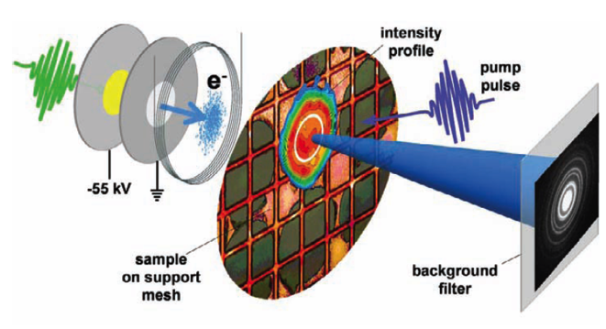
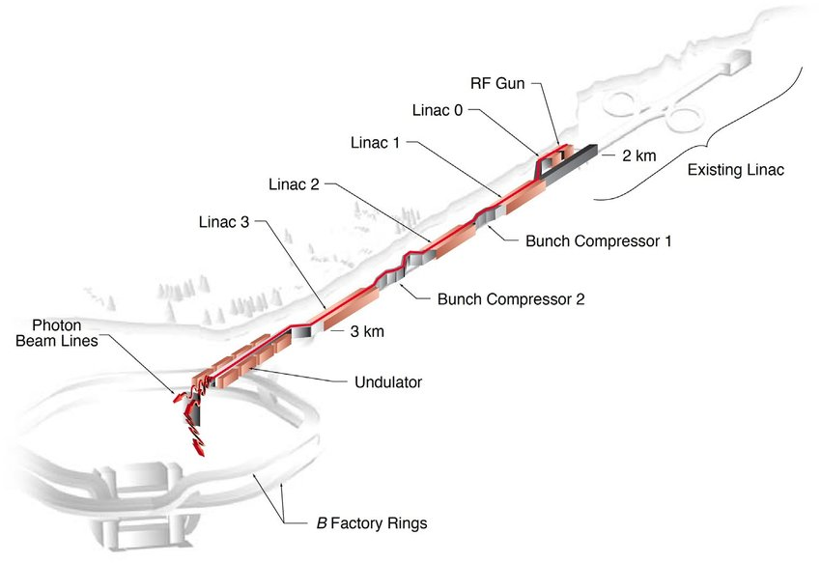


Probing matter at its fundamental time and spatial scales photons vs. electrons
UED
X-FEL
Km size
m size
Rutherford
Thomson
Electrons provide direct access to structural information with compact tools
Probing with electrons can be better for surfaces, thin films, gas phase
Less damage to biological samples (400-1000 times)
Notes:
Now if you want to probe matter at its fundamental scale, you don’ thave to do this with electrons and in fact this pump and probe technique is very well developed in xsray as well. So it is useful to understand the differences between using x-rays and electrons. Parallel but smaller scale cousin of XFEL

Slide 5
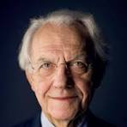


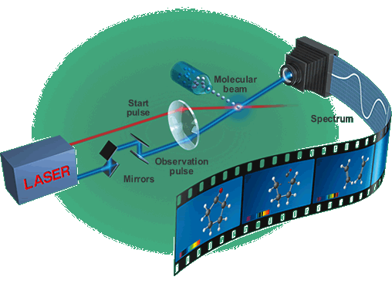
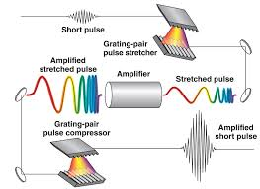
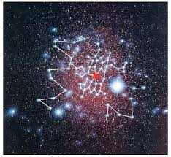
Early days of UED: non relativistic electrons
G. Mourou
A. Zewail
D. Miller
Developed CPA for ultrafast lasers
Pioneered use of electrons generated by short laser pulses for time-resolved material study
Nobel prize for femtochemistry
Realized that short wavelength probes like electrons are needed for structural dynamics
Developed concept of molecular movie
Investigated space charge effects and limits in temporal resolution for keV UED
Mourou, Gerard, and Steve Williamson. "Picosecond electron diffraction." Applied Physics Letters 41.1 (1982): 44-45.
Zewail, Ahmed H. "4D ultrafast electron diffraction, crystallography, and microscopy." Annu. Rev. Phys. Chem. 57.1 (2006): 65-103.
Siwick, Bradley J., et al. "An atomic-level view of melting using femtosecond electron diffraction." Science 302.5649 (2003): 1382-1385.
Siwick, Bradley J., et al. "An atomic-level view of melting using femtosecond electron diffraction." Science 302.5649 (2003): 1382-1385.
Notes:
Recognize important early contributions from giants in the field. Remember that XFELs have actually been around in the last 15 years or so. Fs X-ray pulses before then were hard to come by, not intense at few femtoslicing synchrotrons. While electrons much easier to come around as many people recognize.

Slide 6
High energy ultrafast electron scattering
Unique advantages for MeV electrons
Single shot diffraction patterns capability
  Irreversible processes
  Low repetition rate processes
Near speed-of-light probe
  No velocity mismatch (gas, plasma)
High penetration depth.
  Kinematic diffraction
  Thick samples, liquid phases.
RF compression. Bunch lengths can be shorter than 10 fs !
 | UED | MeV ED
Energy | 20-100 KeV | 3-5 MeV
Accelerating field | 10 MV/m | 100 MV/m
# particles | 10⁴ | 10⁷ – 10⁸
Pulse length | ~200 fs | 50 fs
Bragg angle | 10 mrad | 0.5 mrad
Elastic mean free path (Al) | 20 nm | 200 nm
Normalized emittance | 50 nm | 50 nm
Energy spread | <0.01 % | < 0.1 %

Slide 7
Highlight two important differences for MeV electrons
Sensitivity to higher order Bragg reflections
Energy dependence of cross-section
Notes:
One obviously the momemntum is higher and so the wavelength shorter. Well below a pm.

Slide 8

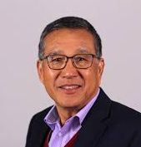
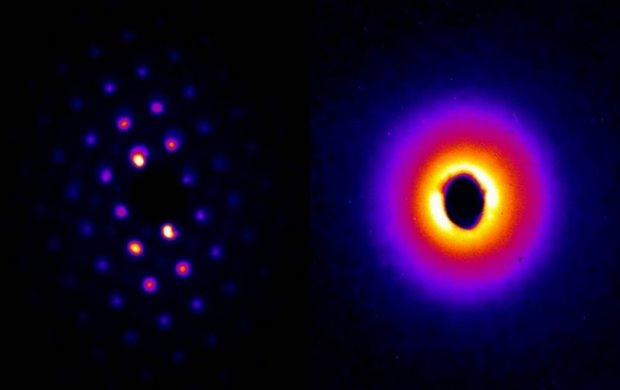
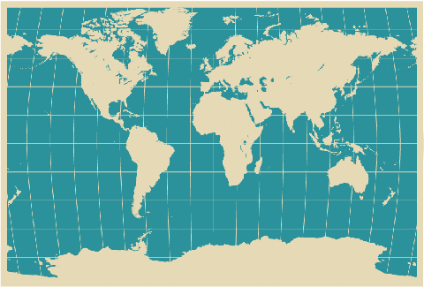
RF photoinjector based ultrafast MeV electron diffraction
MeV electron diffraction is a very active and growing field with activities in many national laboratories and universities.
Efforts at SLAC, BNL, UCLA, LBNL
DESY, Shanghai Jiao Tong, Tsinghua, Japan, Korea, UK, Berlin, etc.
J. Hastings et al. Appl. Phys. Lett. 89, 184109 (2006).
P. Musumeci et al., Applied Physics Letters 97, 063502 (2010).
R. Li et al., Rev. Sci. Instrum. 81, 036110 (2010).
Y. Murooka et al., Appl. Phys. Lett. 98, 251903 (2011).
P. Zhu et al., New J. Phys. 17, 063004 (2015).
S. Weathersby et al., Rev. Sci. Instrum. 86, 073702 (2015).
S. Manz et al., Faraday Discuss. 177, 467 (2015)
D.Filippetto and H. Qian, J. Atom. and Mol. And Opt. Phys. 49, (2016)
F. Qi et al, Phys. Rev. Lett. 124, 134803 (2020).
H. W. Kim et al., Nature photonics 14, 245 (2020)
Ultrafast electron diffraction patterns of single-crystal gold (left) and nitrogen gas (right) obtained with SLAC’s new experimental setup. From Weathersby et al. RSI 2015
Notes:
Spend lot of time here. dOE recognized this opportunity few years back. We have heard recently of significant efforts in the UK. Really the beginning of use of MeV electrons should be traced back to this paper from Xijie where he observed a fundamental properties of RF photoinjector and was pressed by referees to discuss applications. Early efforst here at SLAC by Jerry Hastings at the gun test facility (just before LCLS was born).

Slide 9
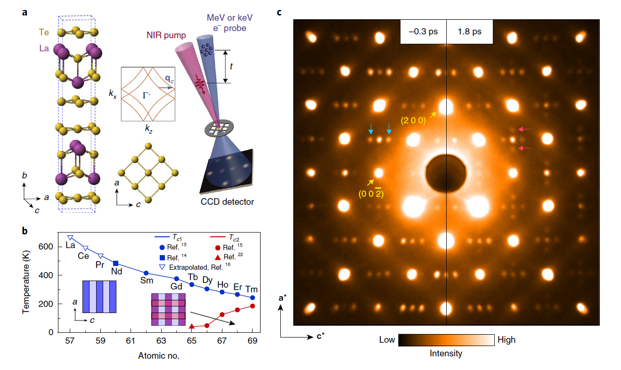
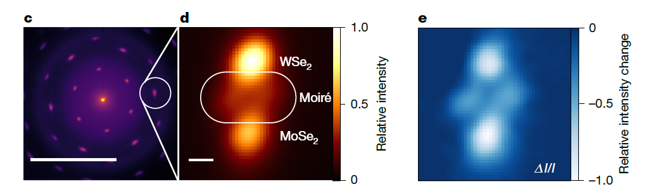
Photoinduced ordering phenomena in quantum materials
UED can reveal transient states induced by light which do not exist in equilibrium conditions
These might or might not have spectroscopic signatures. Interplay between lattice and electronic degrees of freedom
C. Duncan et al. Nature, 647, 8090 (2025)
A. Kogar et al. Nature Physics, 16, 159 (2020)
Typically revealed as small intensity changes of superlattice diffraction signatures (Moire’, CDW)
Evolution characteristic time scales can be below < 1 ps
Notes:
WSe₂/MoSe₂ heterobilayers Photoinduced twist and untwist of moiré superlattices
Light-induced charge density wave in LaTe₃

Slide 10
Diffuse scattering
Scattering intensity in-between Bragg peaks carries information on phonon distribution
A view on dynamic disorder
“Heat” dissipation at the fundamental scale
Extreme sensitivity for very small diffraction intensities required ( high rep-rate, detectors, signal-to-noise)
MeV energy advantage to ensure kinematic scattering condition in ‘thin’ samples.
L. P. Rene de Cotret et al., Phys. Rev. B 100, 214115 (2019). Time- and momentum-resolved phonon population dynamics with ultrafast electron diffuse scattering
Y. Cheng, et al. , Nature Physics 20, 54 (2024). Ultrafast formation of topological defects in a two-dimensional charge density wave

Slide 11
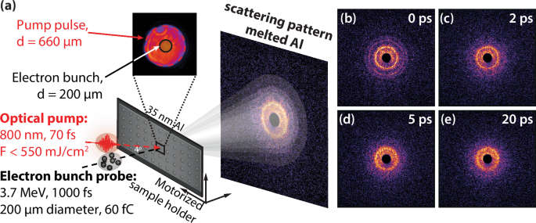
High energy density
Leverage single-shot capabilities of MeV-UED
“Diffract and destroy” modality
Irreversible processes
Ultrafast phase transitions
High pump laser intensities to explore HEDP: warm dense matter, high pressure shock physics
Mo, Mianzhen, et al. "Ultrafast visualization of incipient plasticity in dynamically compressed matter." Nature communications 13.1 (2022): 1055.
Ofori-Okai, Benjamin K., et al. "Unveiling structural effects on the DC conductivity of warm dense matter via terahertz spectroscopy and ultrafast electron diffraction." Nature Communications 16.1 (2025): 10541.

Slide 12
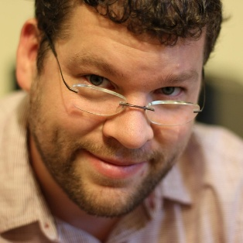
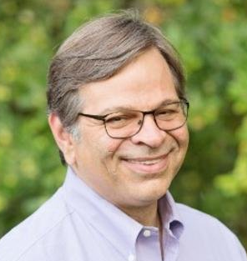
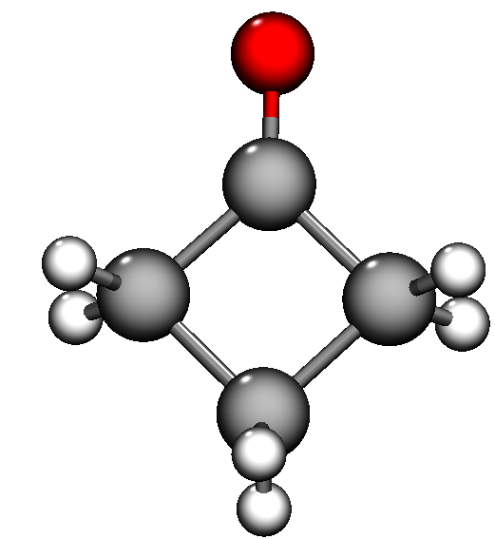
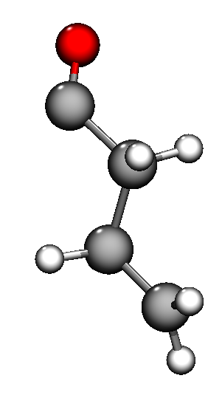

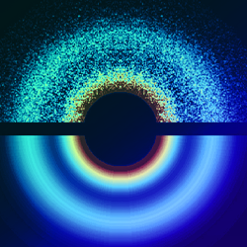
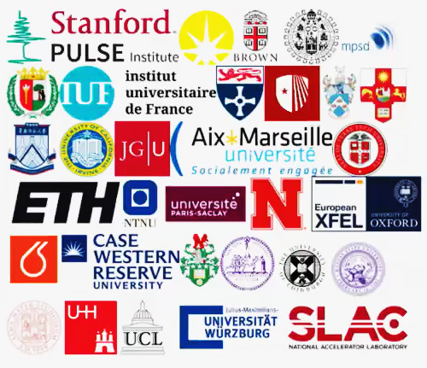
Prediction Challenge: Cyclobutanone Photochemistry
Special issue in Journal of Chemical Physics
Goal: Benchmark predictive power of state-of-the-art nonadiabatic dynamics
Simulations exploit the ease of access to the UED observable
Target: Norrish type-I reaction in cyclobutanone
Independent publication in the same issue:
  Experimental results on the photochemical dynamics of cyclobutanone from MeV-UED
  15 Independent Simulations of the photochemical dynamics of cyclobutanone including the UED observable (submitted by deadline 02/15/2024)
  2 Experimental Studies, one from SLAC MeV-UED and one from Shanghai SHINE MeV-UED
h𝜈

Slide 13
What is next for MeV UED? A wish-list for the next 5 years
Instrument characteristic | State-of-the-art | Need to improve | Why
Spatial resolution | 5 um | Smaller spot sizes at sample plane | Heterogeneous materials
Absolute and Relative coherence length | 10 nm / 100 um < 1e-4 | Higher transverse brightness | Larger unit cells, proteins
Temporal resolution | <50 fs | Shorter bunch length, jitter | Hard phonons, faster processes
Signal-to-noise ratio | 1 A / 10 nA | Peak and average electron current (repetition rate) | Weaker signals for reversible/irreversible processes
Stability | 50 ppm 0.02⁰ of RF | Low level and high power RF. Laser system | Repeatability
Pump | IR, NIR, THz, X-rays | Synchronized pumps | Different excitation mechanisms
Notes:
Believe it or not, I have been updating this slide. Which means we are doing a good job.

Slide 14
High brightness electron sources
Better understanding of photocathode physics (condensed matter and material science advances)
Improved gun technology
  higher injection fields
Better computation tools
  Multiobjective optimization
  3D electromagnetic solvers
  Point-to-point space charge algorithms
Relative coherence length
https://science.energy.gov/bes/community-resources/reports/
Great potential for breakthrough advances as time resolved electron scattering requires operation in “very low charge” regime

Slide 15

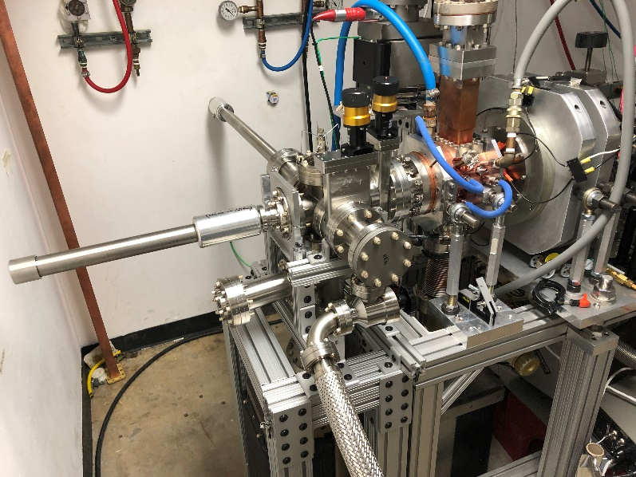
Advanced photocathode research
Typical operation of Cu cathodes yields Mean Transverse Energies of few 100 meV
6 meV measured from cooled single crystal Cu…very low QE ~ 10-8. Laser heating when trying to extract more power
Semiconductor photocathodes show much promise with potentially more than one order of magnitude increase in coherence length of beam at sample.
Need loadlock system and excellent operating vacuum < 1e-9 (@ 10 Hz)
Notes:
I’ll give you an example of what I am taking about with respect to advanced photocathode research.

Slide 16
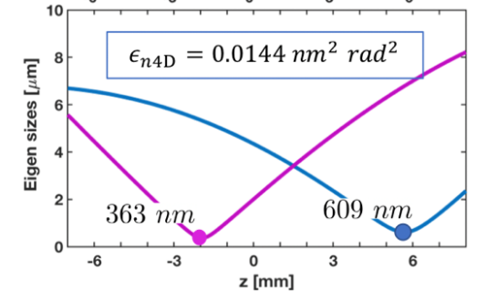
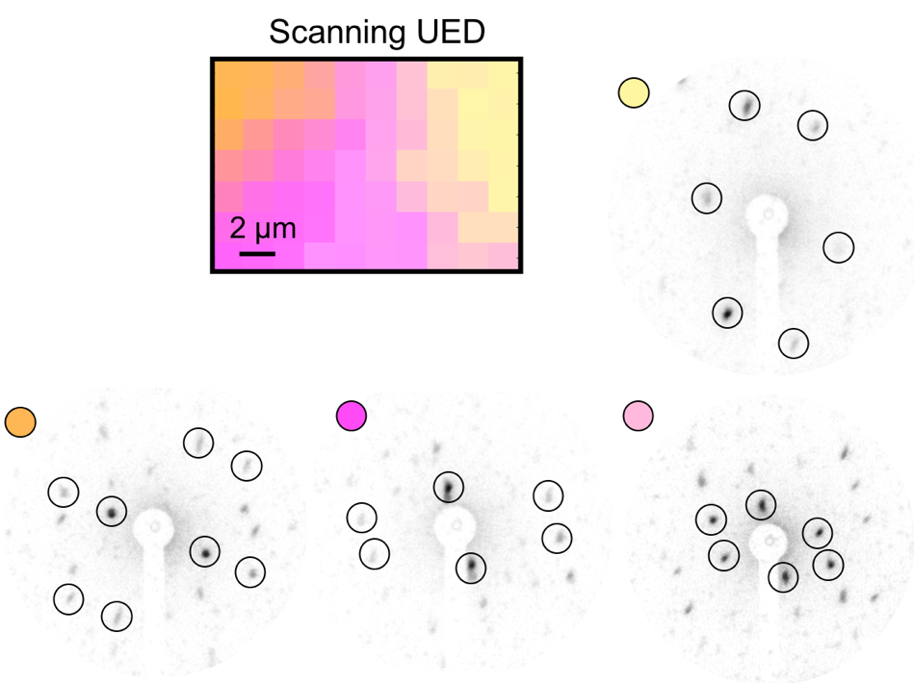
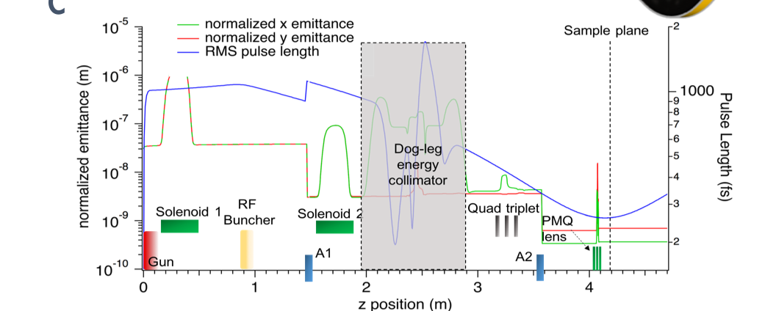
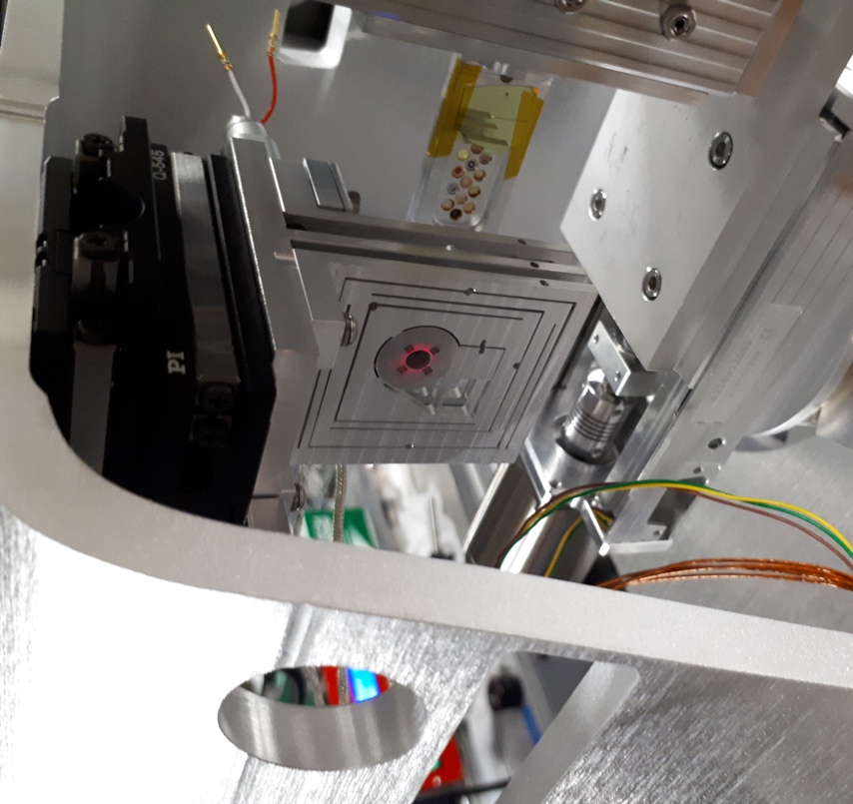
Transverse collimation
F. Ji, D. Filippetto et al. Communications Physics 2.1 (2019)
Li, W. H., et al. PRAB 27:084401 (2024)
Very small spot sizes and low emittances possible by sacrificing number of electrons per pulse
Compensated by high repetition rate to keep number of electrons per second
Sub-nm scale emittance in combination strong electron lenses for tight focusing
at sample plane
With collimation:
Generally brightness stays constant !
  Charge decreases with the square of the collimation radius
  Emittance decreases linearly with the collimation radius
  It may get slightly better when collimation is used to select core emittance

Slide 17
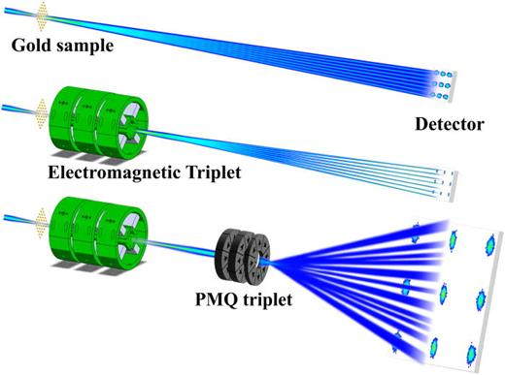

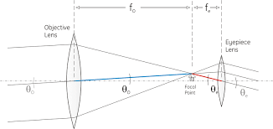
Improving reciprocal space resolution
“Zoom in” on diffraction features adding magnetic lenses after the sample
Telescope configuration for angular magnification ( m = f₀/f_{e} )
Could tune for variable diffraction camera length
Enables high energy MeV UED
Angular magnification telescope
Xu, Tianzhe, et al. PRAB 28.8 (2025): 082401.
Denham, P., et al. , Structural Dynamics 11.2 (2024).

Slide 18
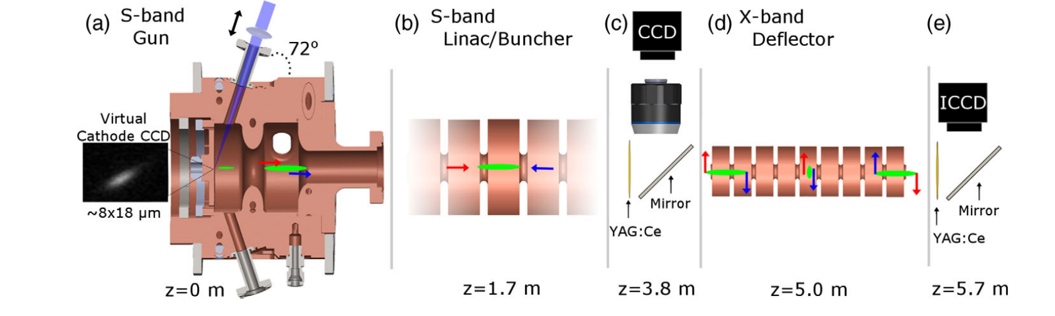
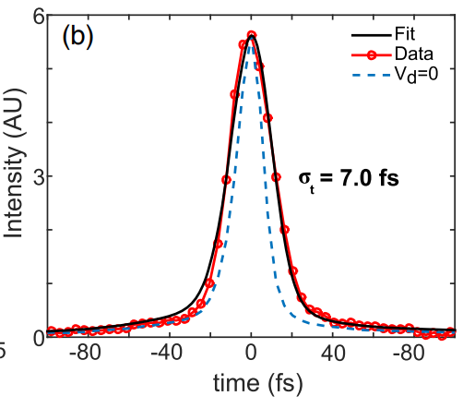
RF compression
Standard technique in accelerator and beam physics
Introduced to compensate longitudinal expansion first in keV sources
Clearly can also be applied to MeV beams
High harmonic linearization for even shorter bunches
Suffers from timing jitter
Laser-based THz compression to synchronize
Maxson et al., PRL 118, 154802 (2017)
L. Zhao. Phys. Rev. X 8, 021061 (2018)
T. van Oudheusden, E. F. de Jong, S.B. van der Geer, W.P.E.M. Op ’t Root, B. J. Siwick, O. J. Luiten, J. Appl. Phys. 102, 093501 (2007).
T. van Oudheusden, P. L. E. M. Pasmans, S. B. van der Geer, M. J. de Loos, M. J. van der Wiel, and O. J. Luiten Phys. Rev. Lett. 105, 264801 (2010)
Notes:
Example of perfect Ph.D. come up with idea and then demonstrate it few years later.

Slide 19
Temporal resolution
For a typical pump and probe experiment the temporal resolution is given by
Pump pulse length
≈ 10s fs
Timing jitter
Synchronization and time of arrival fluctuations
Duration of probe
relativistic electrons ≈ 10 fs
Velocity mismatch
Depends on the geometry of interaction.
Spot sizes and angles of pump and probe beams.
For 5⁰ and 50 μm spot size Δt_{vm}≈ 10 fs
In early days the probe length was the limiting factor.
But will we able to take really advantage of shorter probes?
Notes:
Stability, much improved thanks to digital RF and fast electronics feedback.

Slide 20
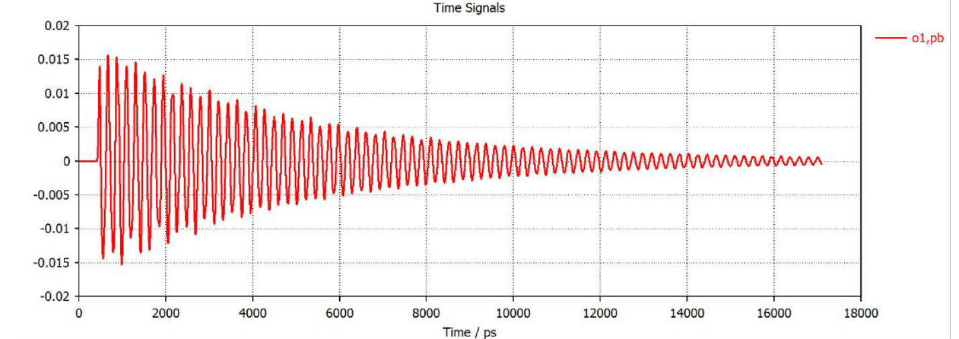
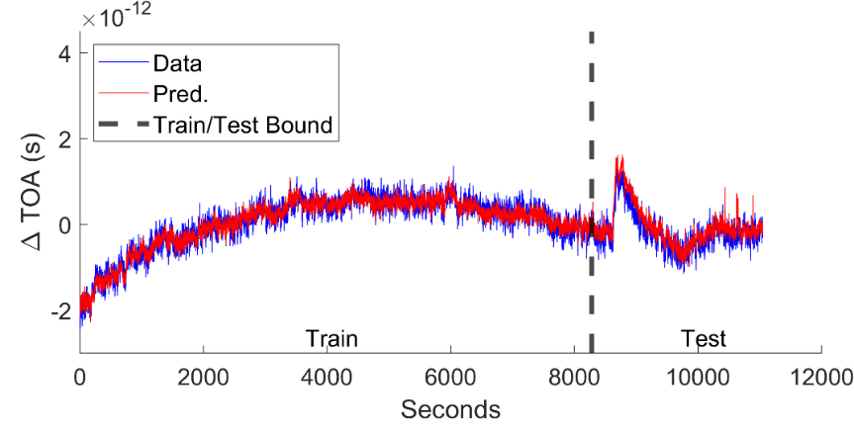
Time stamping
Electronics based
Laser based
Software based
Exceptional signal to noise is exceptional (< 0.5 fC. Non destructive)
Timing potentially < 50 fs
Advanced digital signal processing methods to enhance the measurement resolution and enable fast feedback
EOS or e-beam induced index of refraction changes
Laser-generated THz can be used to measured time-of-arrival (and bunch length at the same time)
Measure all accelerator parameters
Tag each shot with reconstructed time-of-arrival information
Train neural network to predict time of arrival using data from independent diagnostics
Demonstrated at LBNL to perform at 150 fs level, better than conventional feedback systems on similar time-scales.
F. Cropp et al., PRAB, 26, 052801(2023)
J. Fabiańska et al., Scientific Reports, 4 5645 (2014)
C. Kealhofer et al., Science 352, 429 (2016).
L. Zhao. Phys. Rev. X 8, 021061 (2018)
R. K. Li, Phys. Rev. Accel. Beams 22, 012803 (2019)
X. Shen et al., AIP Advances 9, 085209 (2019)

Slide 21
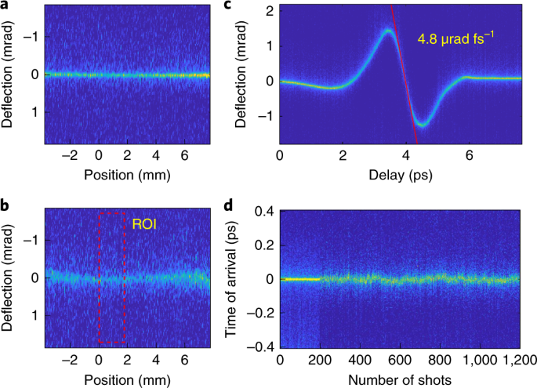
Magnetic compression
Fully passive system
Relies on space charge and gun induced chirp
Multi bend achromat or alpha magnets
Non linearities can be managed
Record temporal resolution demonstrated
H. W. Kim et al., Nat. Phot., 14, 245 (2020)
F. Qi et al., Phys. Rev. Lett. 124, 134803 (2020).
Y. Yang et al. https://arxiv.org/abs/2508.03946 (2025)
THz streaking

Slide 22
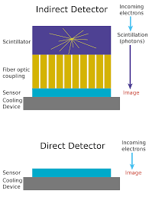
Detectors
Free-space or fiber-coupled screen + intensified camera
  Sensitivity vs. resolution
Direct electron detection
  > 80 % DQE, large dynamic range, electron counting mode
Central hole for direct beam diagnostics (charge, time-stamping, energy, pointing)
High repetition rate readout for laser on/off contrast improvement.
  Need high rep-rate source

Slide 23
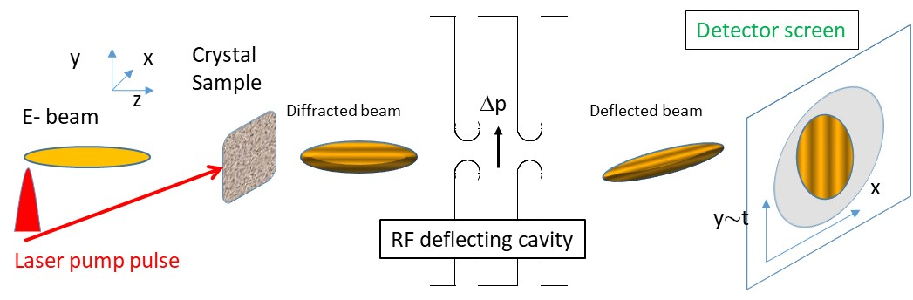
Streaked MeV UED
Capture entire history of ultrafast process in one shot (full movie in single exposure)
RF streak camera based electron diffraction (from Mourou-Williamson original paper on UED)
Use RF deflecting cavity as a streak camera to time-resolve a relatively long (10s of ps) electron beam after its interaction with the diffraction sample.
Three significant advantages
  Free UED by the limitation due to the length of the electron beam.
  Improve significantly the temporal resolution of the technique.
  Yield true single-shot structural change studies revolutionizing the approach of the conventional pump-probe experimental procedure.
C. M. Scoby et al., APL, 102, 023506 (2013)
P. Musumeci et al. JAP, 108, 114513 (2010)
Smart (ML/AI) image processing algorithms and masks can greatly help 2d reconstruction. See D. Qi et al. Phys. Rev. Applied 10, 054061 (2018)

Slide 24
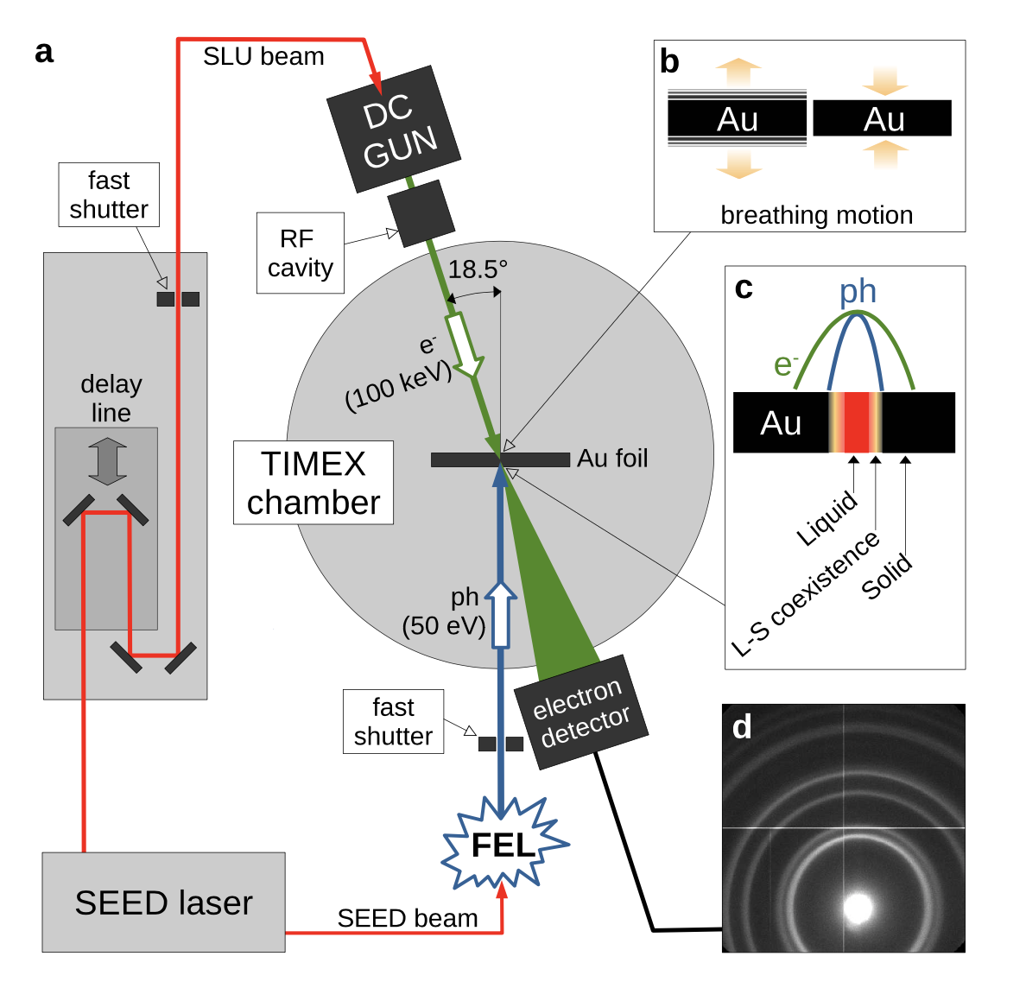
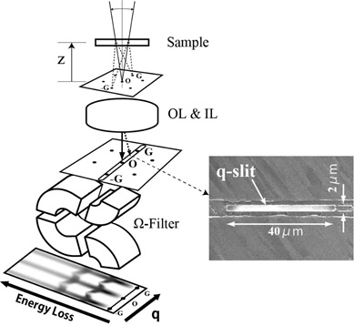
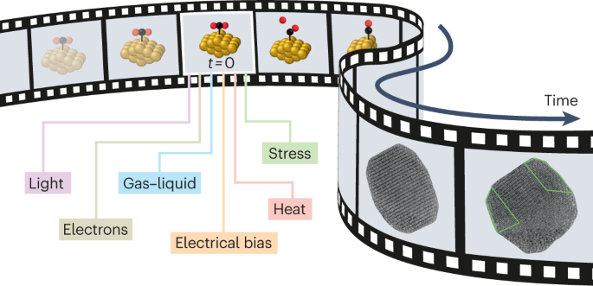
Combining UED with other capabilities/modalities
FEL pump / UED probe experiments at FERMI FEL
THz pump / UED probe
Electron beam pumping ?
Use postsample optics for real space imaging of grain boundaries (microscopy)
Energy analyze diffraction patterns for momentum resolved EELS.
Courtesy of E. Principi and L. Giannessi
from JEOL website

Slide 25
Conclusions and outlook
Ultrafast electron sources (MeV and keV) are pushing the boundary of spatial and temporal resolution in structural dynamics
Advanced photocathodes and high gradient RF can improve beam brightness
  Longer coherence lengths, nanodiffraction, diffuse scattering
Towards sub-10 fs temporal resolution
  Magnetic compression, phase space linearization, high frequency compression, time stamping
Streaked electron diffraction
  Highest temporal resolution, no jitter problems, truly single shot, image reconstruction algorithms
Multimodal UED
  Imaging, Spectroscopy, X-rays, THz.

