Slide 1
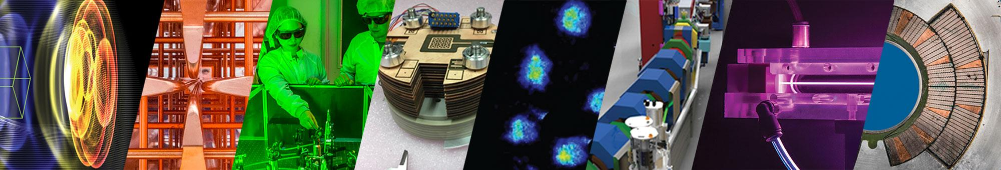
State of the Art Performance and Applications of Plasma Accelerators
Sam Barber
Lawrence Berkeley National Lab
AFOSR+NSF Workshop: Scientific Opportunities with Compact, High Intensity Accelerators
February 24, 2026
1

Slide 2
Outline
Brief intro to plasma accelerators
Some useful metrics for state of the art particle accelerators; discuss progress of plasma accelerators wrt to these metrics
Applications: Light sources, muon beams, nuclear photonics, cancer therapy, UED

Slide 3
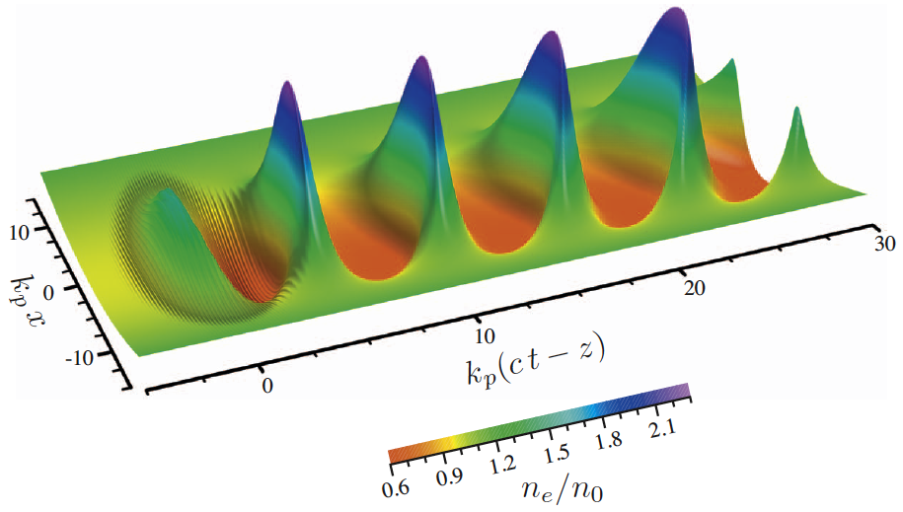
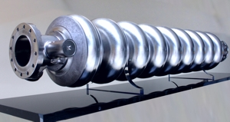
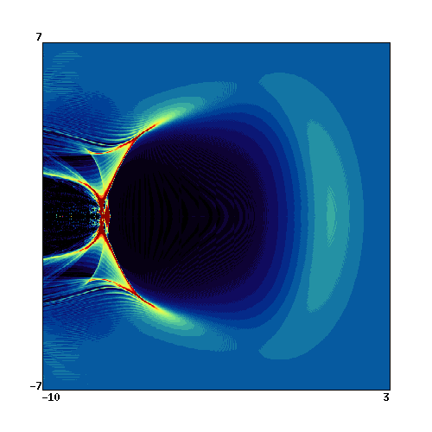
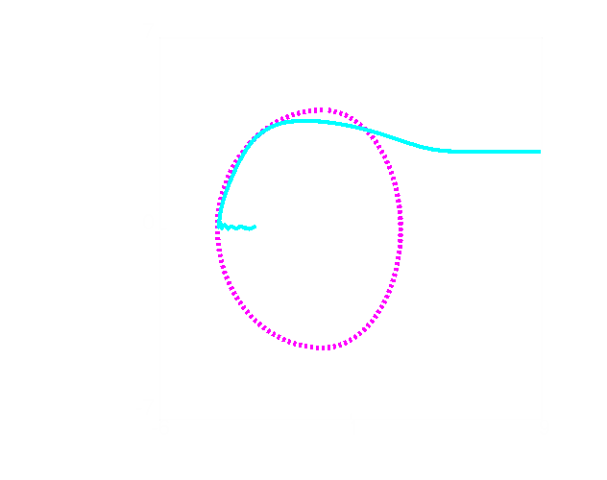
Plasma Accelerators offer path towards extreme acceleration gradients, compactification
Ponderomotive force keeps pushing electrons away → charge separation
Ions pull back electrons (time scale ~ 10-100 fs)
Ultra-high axial electric fields co-propagate with laser at c
T. Tajima and J.Dawson, PRL, 43, 267 (1979)
Esarey et al., RMP 81, 1229 (2009)
30μm
30μm
Laser/particle beam
B.A. Shadwick et al., IEEE PS. 2002
Conventional structure:
~< 100 MV/m
(Laser -driven) plasma structure:
~< 100 GV/m
1000x

Slide 4
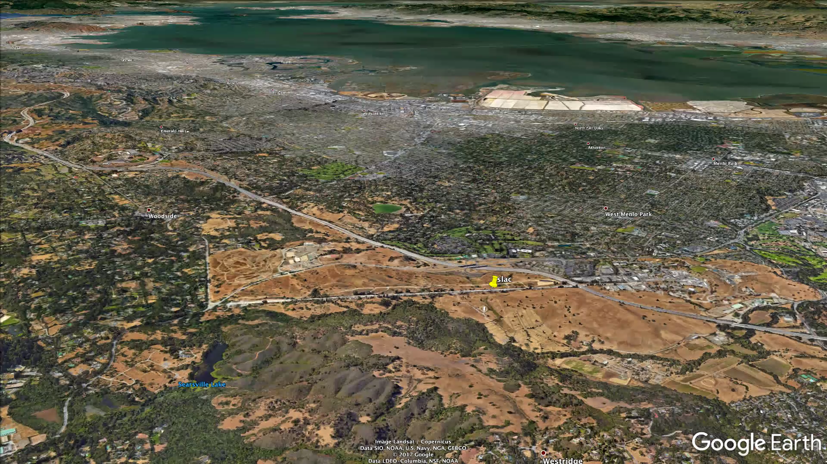
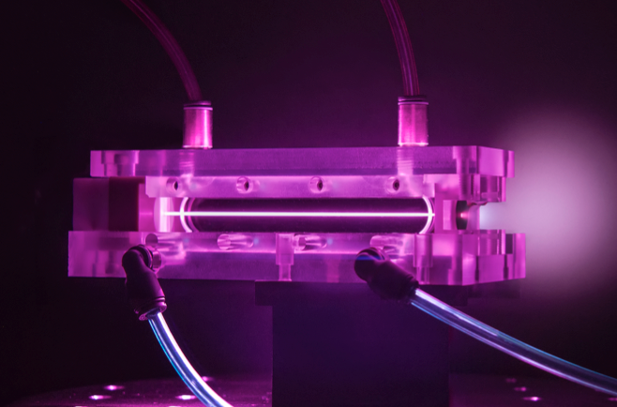
~10 GeV electrons in 1 km
~10 GeV electrons in 30 cm

Slide 5
Defining some metrics for particle accelerators to benchmark plasma accelerators
Scale: gradient and total energy gain
Quality: emittance, energy spread, brightness
Control: stability, reliability, tunability, jitter
Throughput: total charge, repetition rate

Slide 6
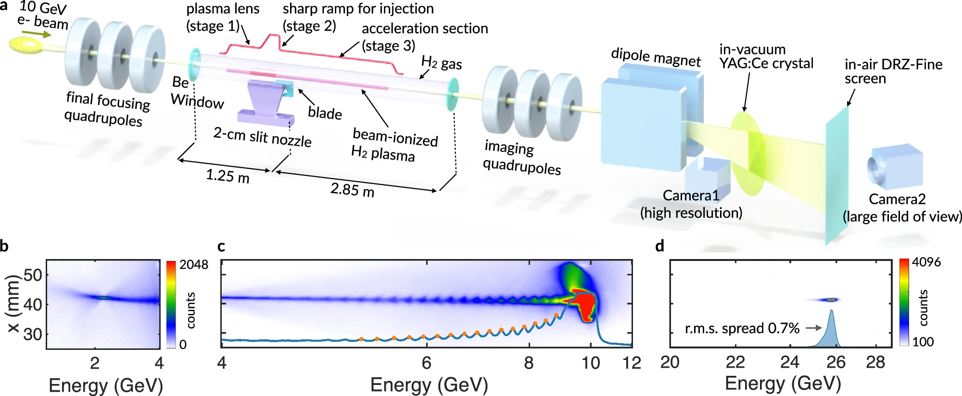
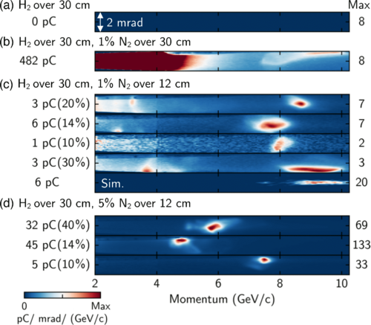
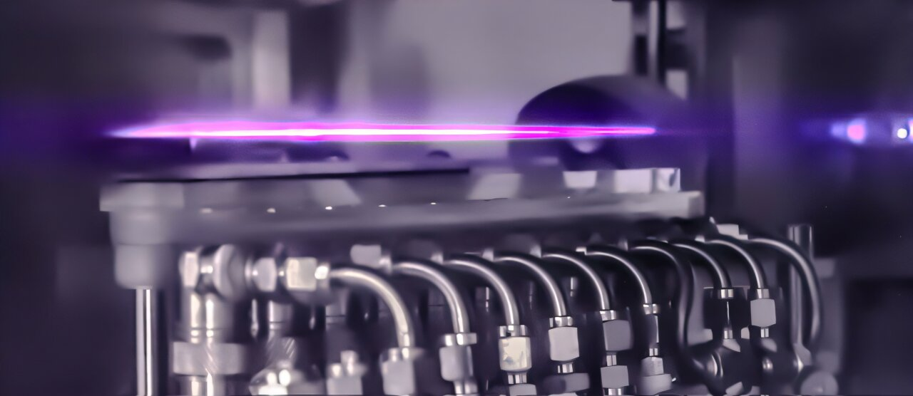
Scale: >100 GeV/m gradients well established, total energy gain greater than 10 GeV recently demonstrated
Acceleration of 10 GeV electron beam in LPA
Acceleration of ~25 GeV electron beam in PWFA
Numerous experiments demonstrate over the years demonstrate peak acceleration >100 GeV/m, but with limited total energy gain
Used dual-laser, channel-guided plasma to sustain ultrahigh accelerating gradient.
Achieved ~10 GeV e-beams in ~30 cm acceleration length at BELLA (~30-35 GeV/m) using only 20J laser energy
Injected and accelerated electrons to 25 GeV+ in 2.5 meters using a 10 GeV drive beam
Demonstrated energy transformer ratio >2, boosting acceleration efficiency
Picksley et al. Phys. Rev. Lett. (2024)
Zhang et al. Nat. Comm. (2025)

Slide 7
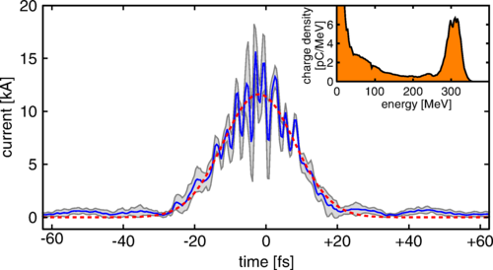
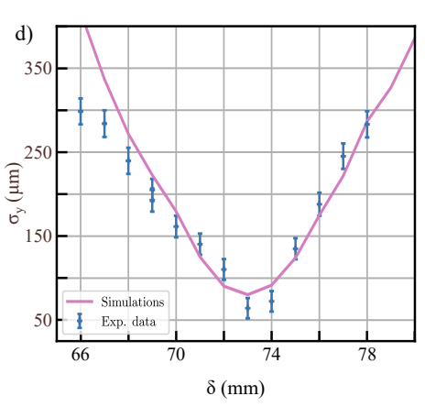
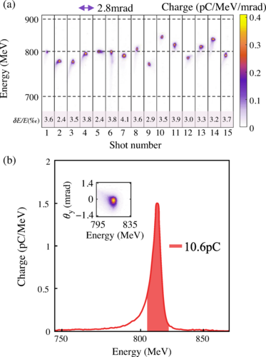
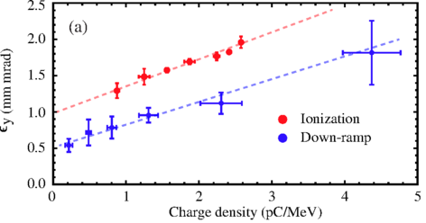
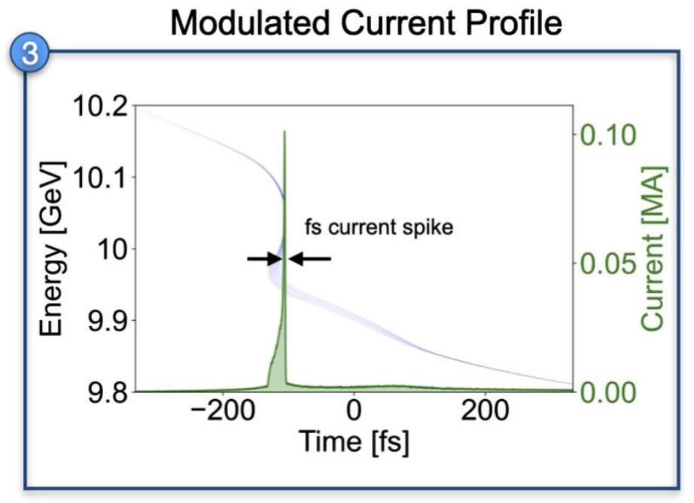
Quality: Sub micron normalized emittances, sub percent energy spread and greater than 10 kA currents measured
Low emittance
Low energy spread
High current
In early experiments, 100% energy spread was common.
Percent and sub-percent energy spread is the new frontier with many groups reliable achieving it
Physical size of plasma accelerating structures naturally produces ultra-short, high current bunches >10 kA⁴
Also produce phase space characteristics ripe for manipulation even higher current (mega amp)
Sub-micron normalized emittance measured by numerous groups
Emittance characterized for beams with few MeV to multi-GeV energies
3
4
1
2
5
Weingartner, Phys. Rev. ST Accel. Beams. (2012)
Plateau, Phys. Rev. Lett. (2012)
¹Barber, Phys. Rev. Lett. (2017)
Jiang, HPL. (2023)
²Monzac, arXiv (2026)
And many more…
⁴Zarini, Phys. Rev. Accel. Beams. (2022)
⁵Emma, Phys. Rev. Lett. (2025)
³Ke, Phys. Rev. Lett. (2021)

Slide 8
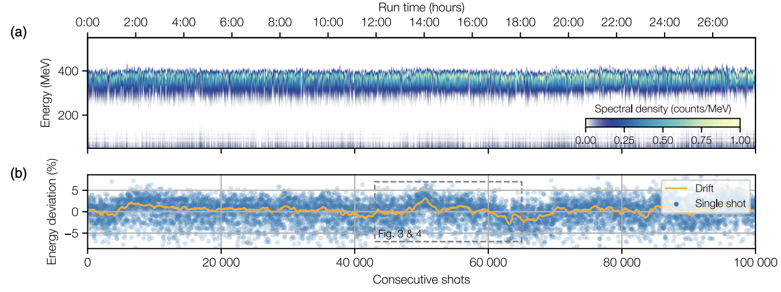
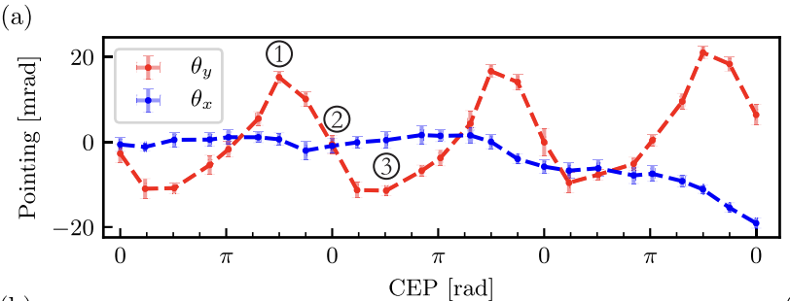
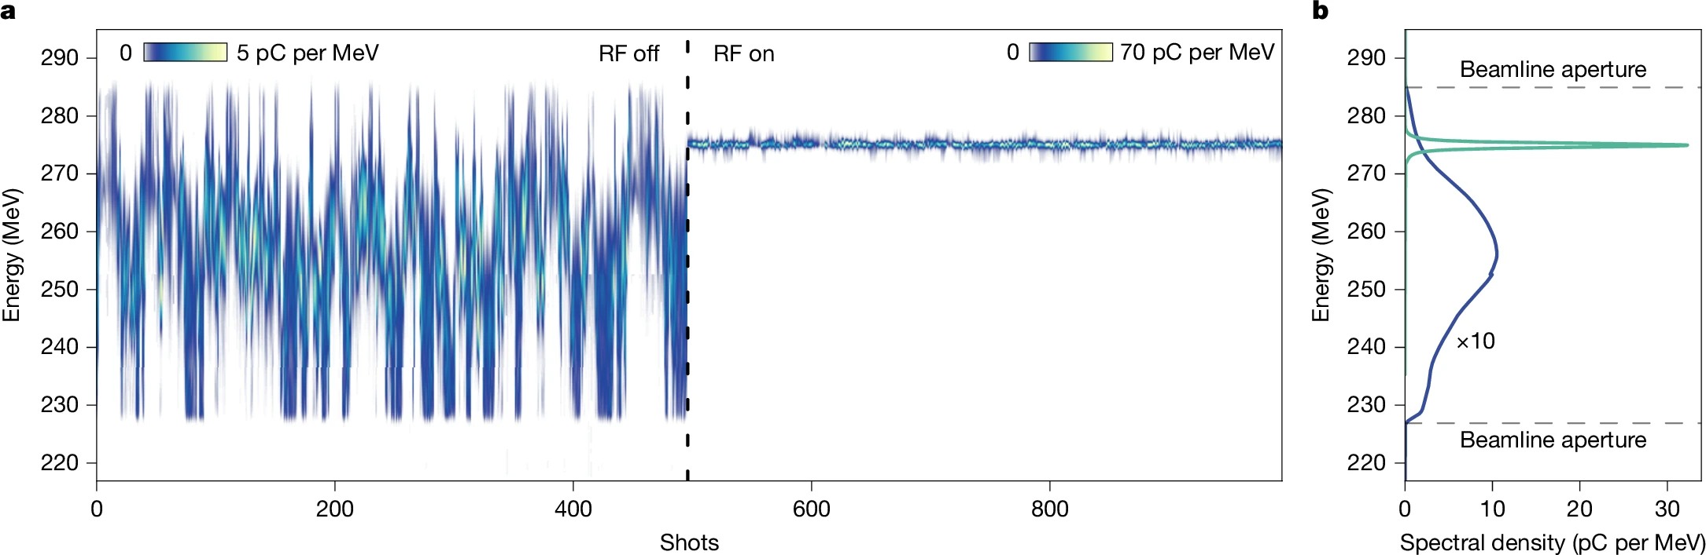
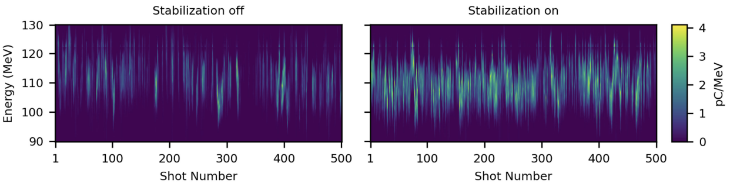
Control: Shot to shot parameter jitter still a challenge for plasma accelerators, but major advances are being made
Active energy compression
Laser stabilization for improved LPA performance
Long term stability of LPA performance now well established (e.g. 24 hour continuous running)¹
Many sources of instability/jitter can be traceable to intrinsic variations in the drive laser. For example:
For single cycle laser drivers, carrier envelope phase has been tied to pointing variations and has been successfully stabilized to improve performance³
Has enabled development of novel techniques like active energy compression which was used to reduce central energy jitter and rms energy spread to below 0.1%²
Longitudinal focal stabilization can reduce e-beam jitter⁴
¹Maier, Phys. Rev. X (2020)
²Winkler, Nature (2025)
³Huijts, Phys. Rev. X (2022)
⁴Jensen, Phys. Rev. Accel. Beam. (2025)

Slide 9
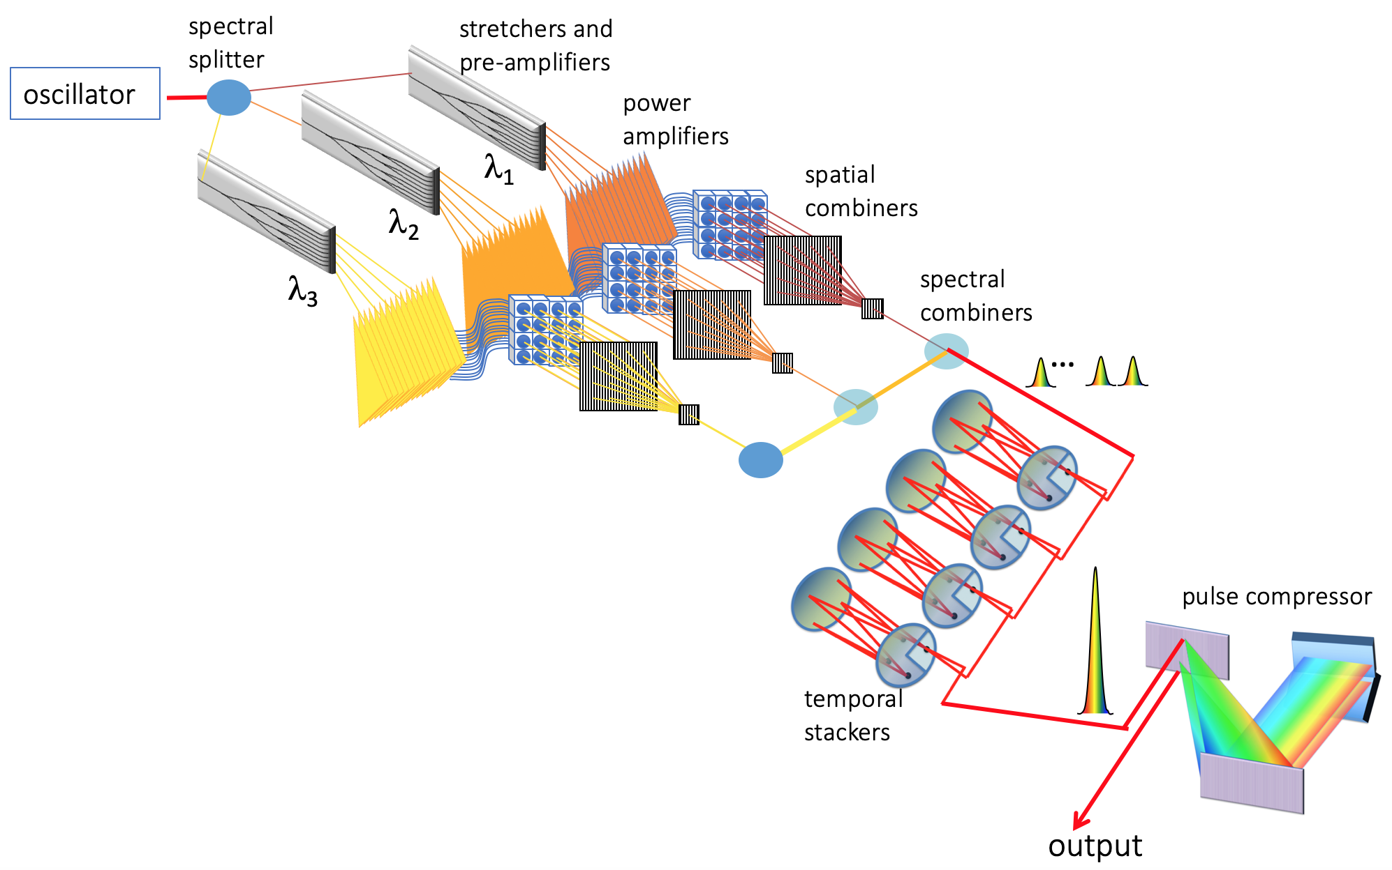
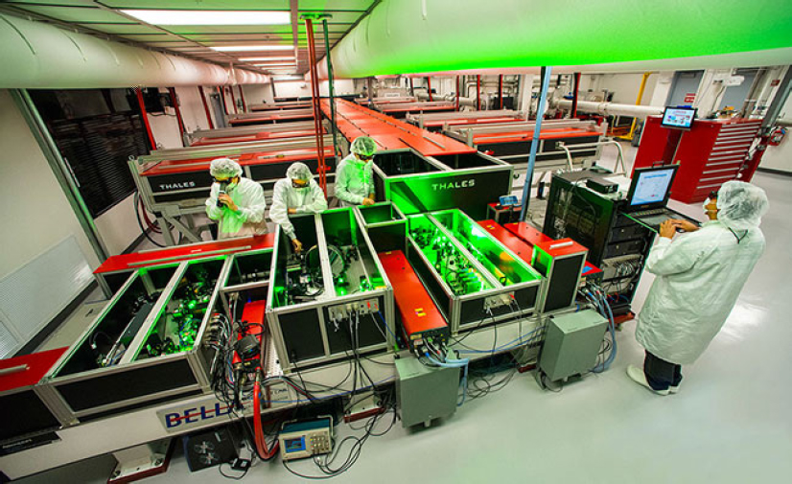
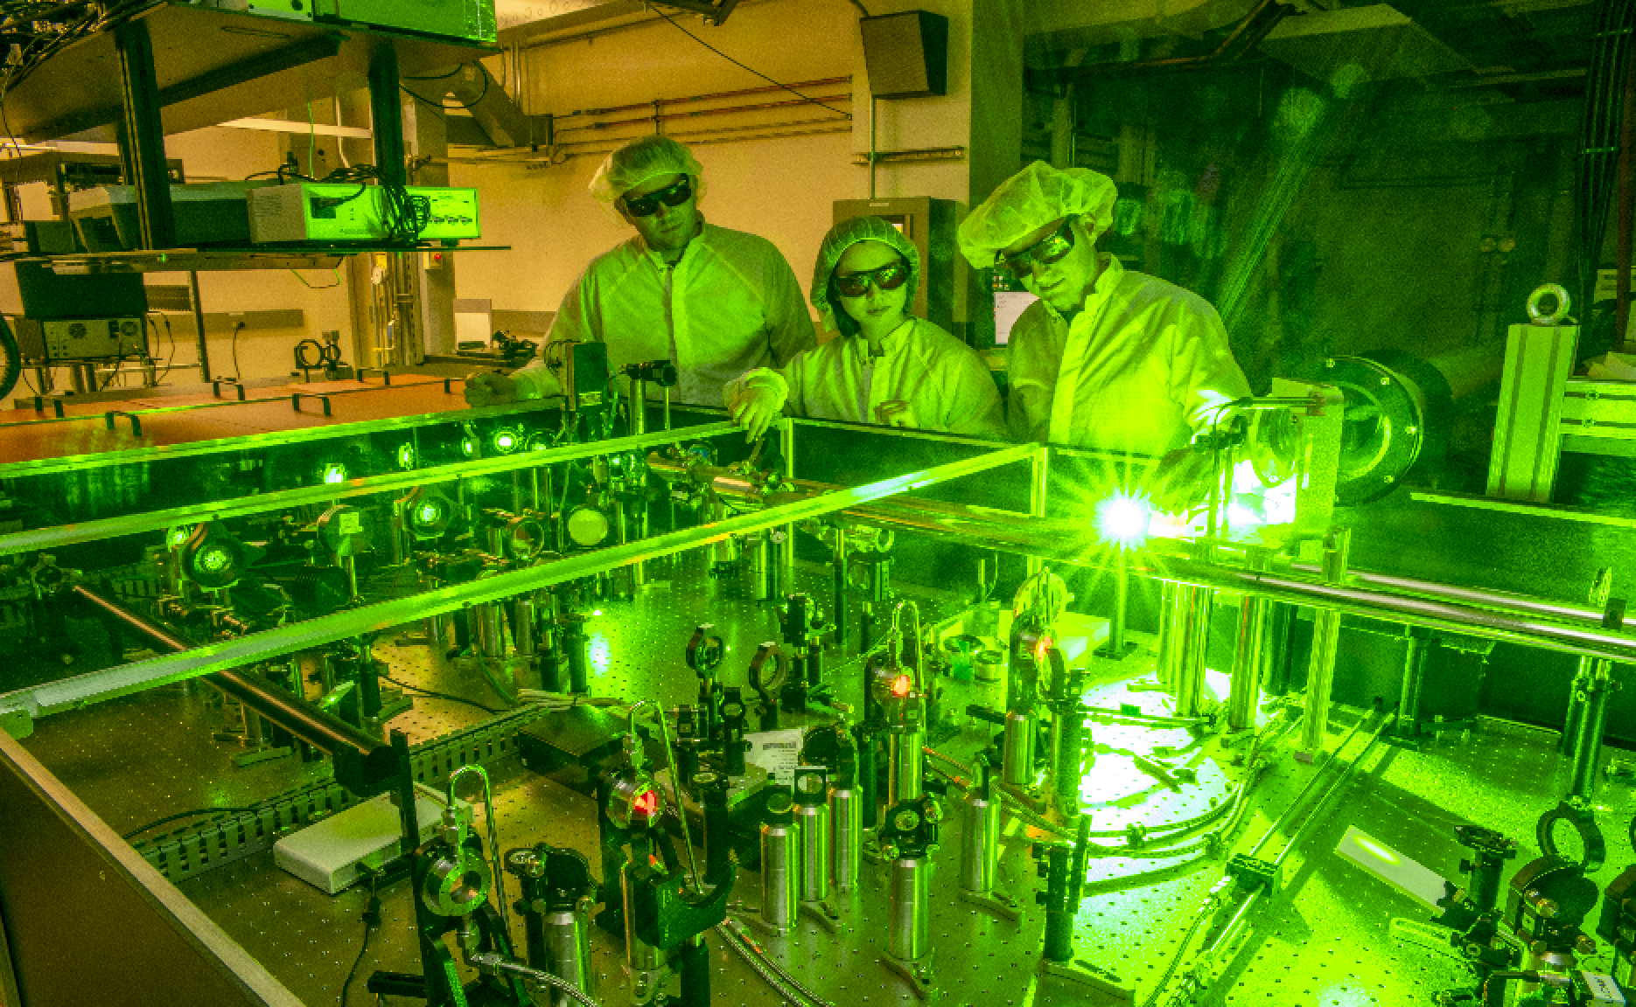
Throughput: different repetition rates for different regimes; new technologies to enable higher throughput under active development
Laser plasma accelerators limited by laser technology
Scalable laser technologies in development
Use high efficiency, high average power fiber lasers, and add them coherently for high pulse energy
Use spatial¹, spectral², and temporal³ combining to achieve J-class pulse energy, sub 100 fs pulse duration at up to 100kW average power
Ti:Sapph is the dominate format
~10 GeV class, requires ~ 1 PW (~ 1-10Hz)
1 GeV class, requires ~0.1 PW (~1-100Hz)
Few MeV class, requires ~0.01 PW (~1kHz)
Ti:Sapph is nearing its ultimate limits because of energy efficiency
1 PW, 1Hz laser
100 TW, 5Hz laser
¹Zhou, Optics Letters (2017)
²Chen, Optics Express (2023)
³Zhou Optics Express (2015)
*Beam driven plasma accelerators limited by rf technology

Slide 10
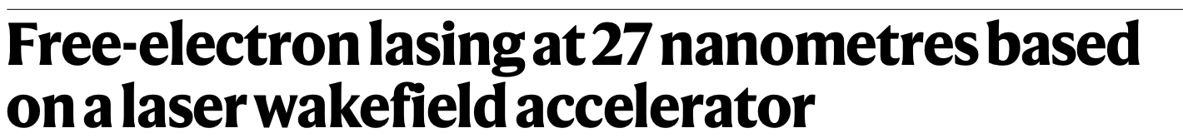

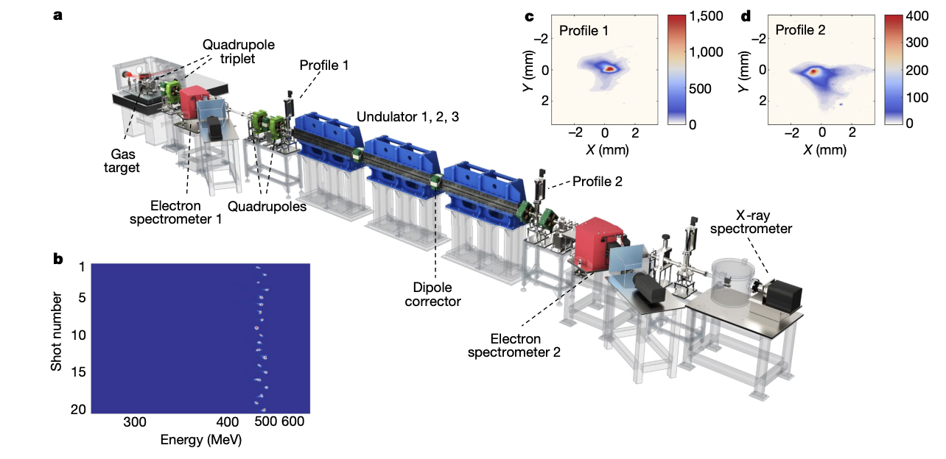
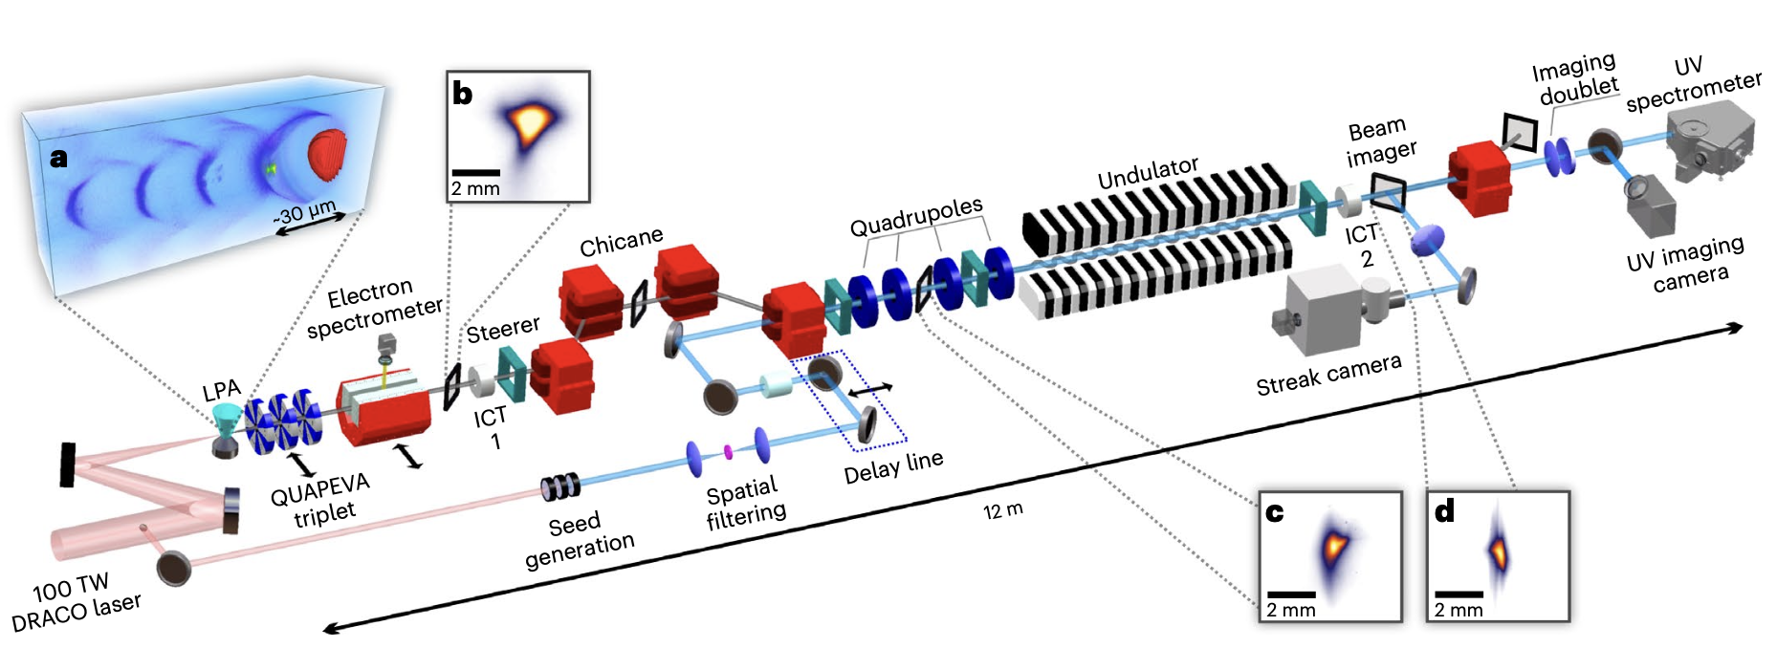
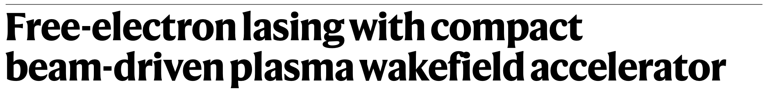
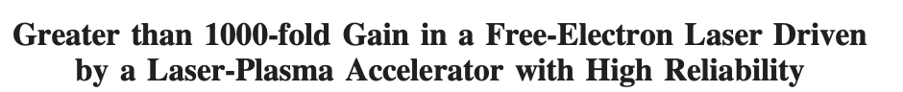
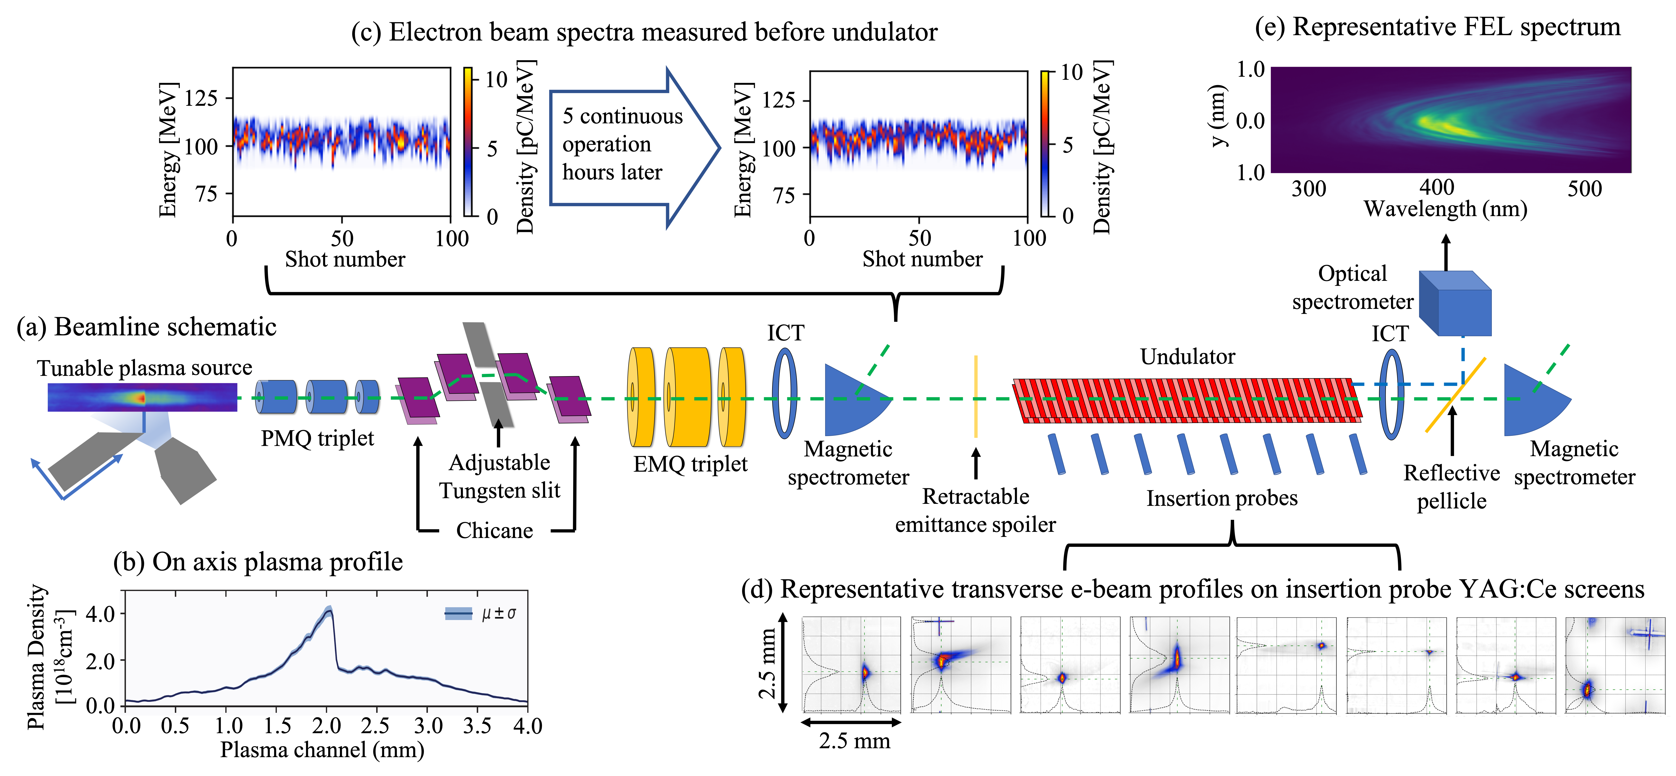
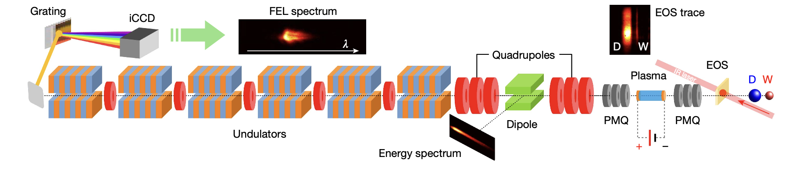
Applications: plasma accelerators as drivers of compact free electron lasers
High brightness, high energy beams from compact plasma accelerators offer the potential to extend the reach of XFEL
4 results from international community demonstrating FEL lasing using plasma accelerators
Wang et al., Nature (2021)
Labat et al., Nature Photonics (2023)
Pompili et al., Nature (2022)
Barber et al., Phys. Rev. Lett. (2025)

Slide 11

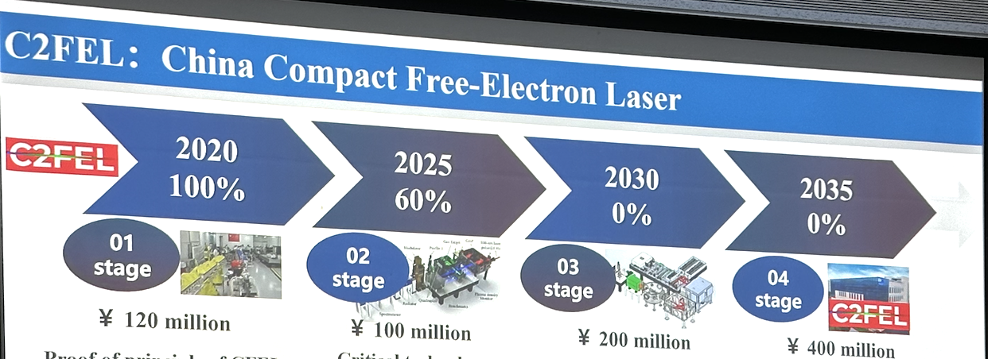
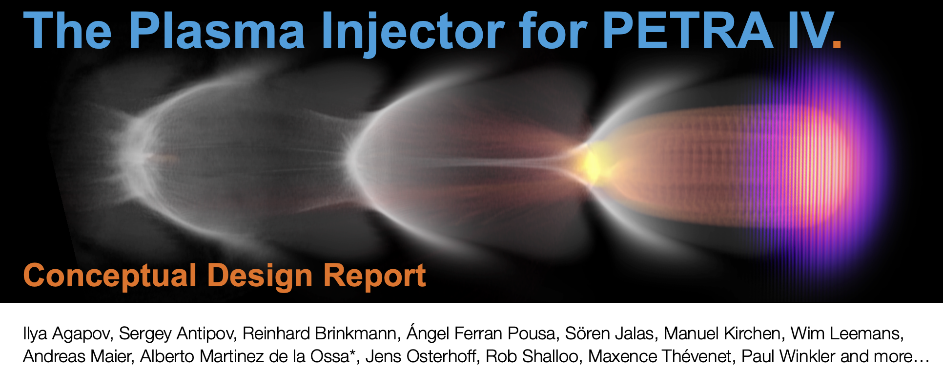
Applications: several large scale ambitious projects in development
China Compact Free-Electron laser
Develop a compact, plasma-based accelerator for scientific and industrial applications.
Enable versatile research opportunities in free-electron lasers
300 million euro project
~700 million yuan project
See A. Maier talk tomorrow

Slide 12
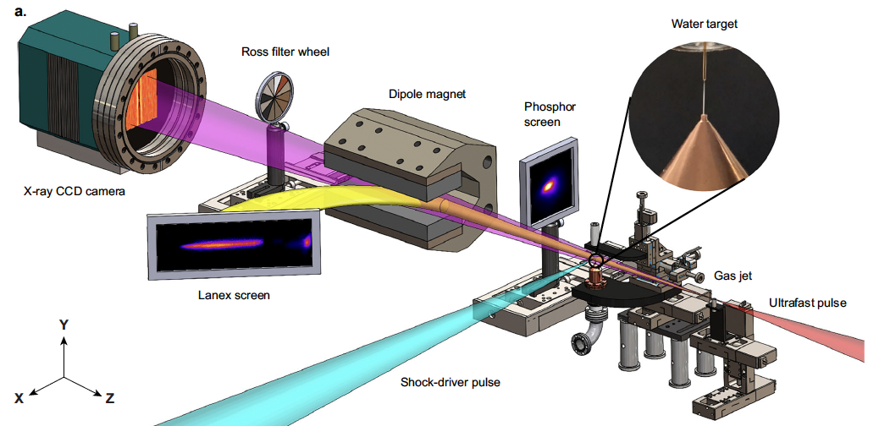
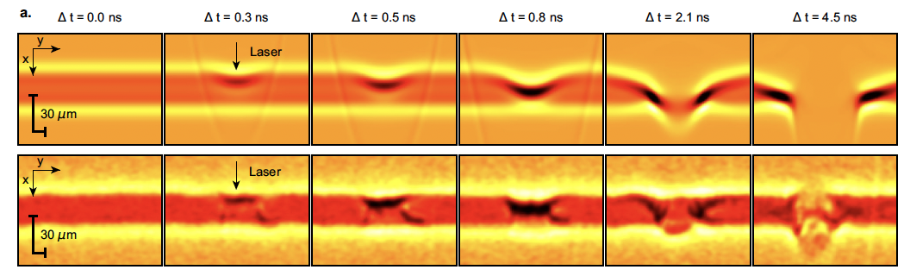
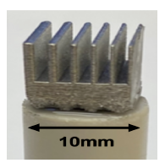

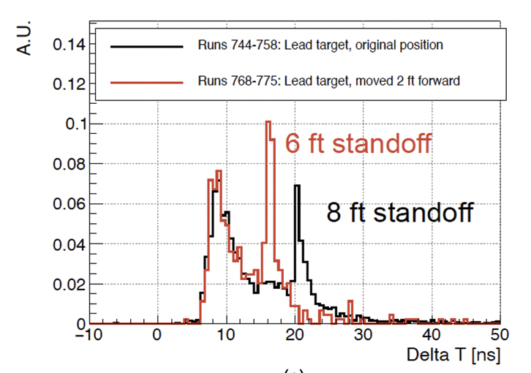
Applications: Betatron radiation and inverse Compton scattering
Betatron x-rays generated during plasma acceleration are ultrafast, with small source size
Recently used to probe dense matter hydrodynamics of laser induce shock in water jet
Balcazar et al., Nat. Comm. (2025)
Tunable, mono-energetic gammas through laser-LPA Thomson scattering enabling applications like tomographic imagingª and gamma ray lidar^{b}
a
b

Slide 13
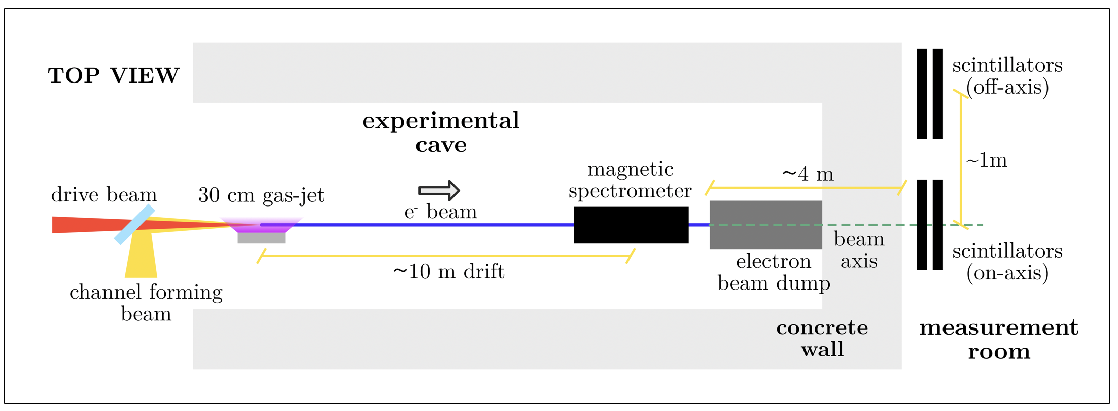
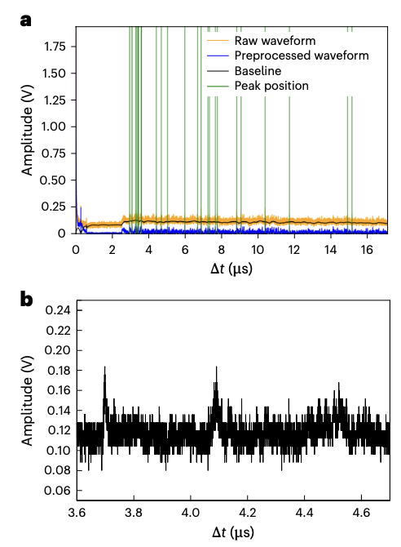
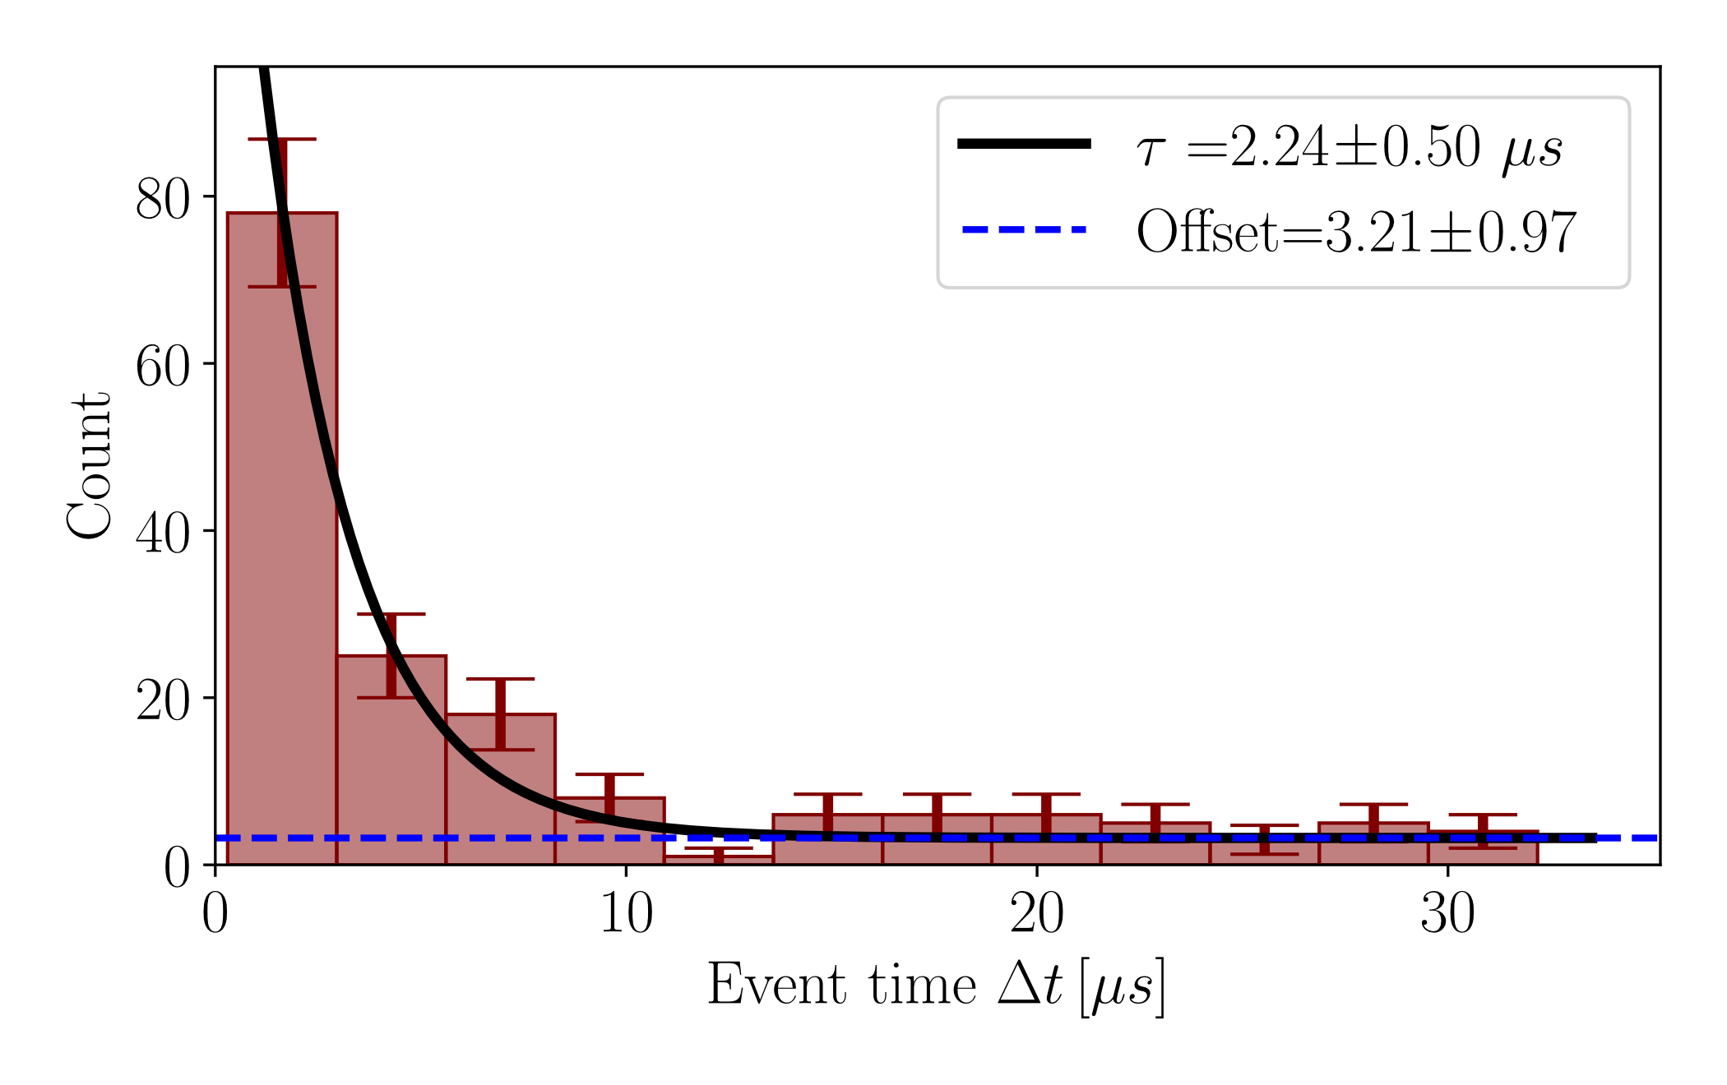

Applications: compact source of high energy directed muon beams
Laser–plasma accelerators can generate electron beams capable of producing GeV-scale muons with advantages over cosmic-ray backgrounds.
These compact, directional, high-yield muon sources could dramatically enhance muon imaging by reducing exposure times by orders of magnitude.
Fitting all the data collected by the scintillators with an exponential distribution + a constant background
Data consistent with muon decay ($τ≃2.2 μs$)
Terzani et al., Phys. Rev. Accel. Beams (2025).
Zhang et al., Nat. Phys. (2025).

Slide 14
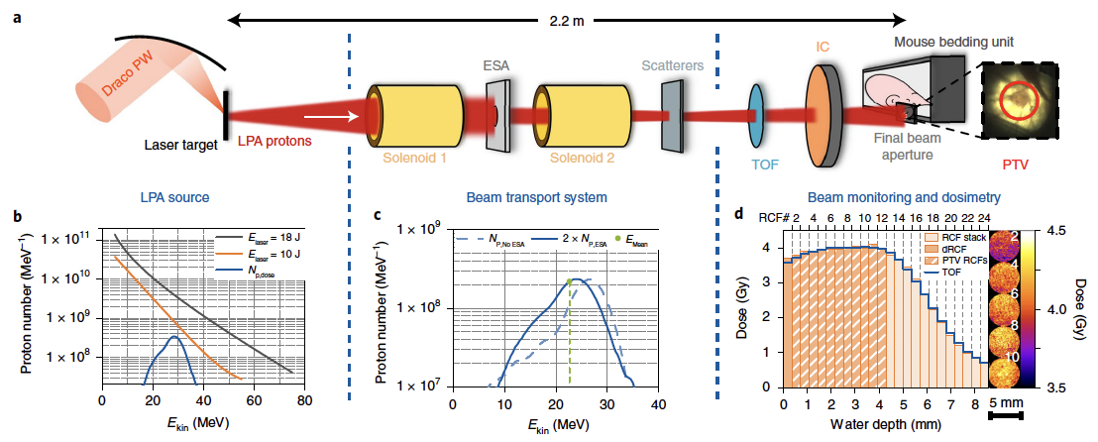
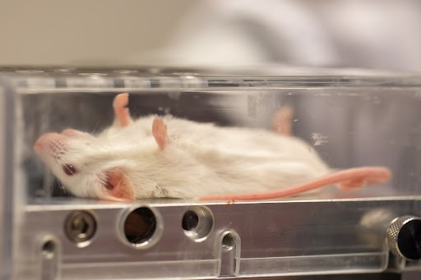
Applications: cancer therapy using laser plasma accelerated proton beams
Laser-accelerated proton beams are ultra short compared to conventional sources; gives access to FLASH effect*
Multiple experiments performed at several labs have demonstrated beneficial effects (delayed tumor growth, preferential sparing of healthy tissue) on in vivo samples (e.g. mice)
Kroll et al., Nat. Phys. (2022).
*FLASH effect: the differential sparing of healthy tissue under irradiation at ultra-high dose rates

Slide 15
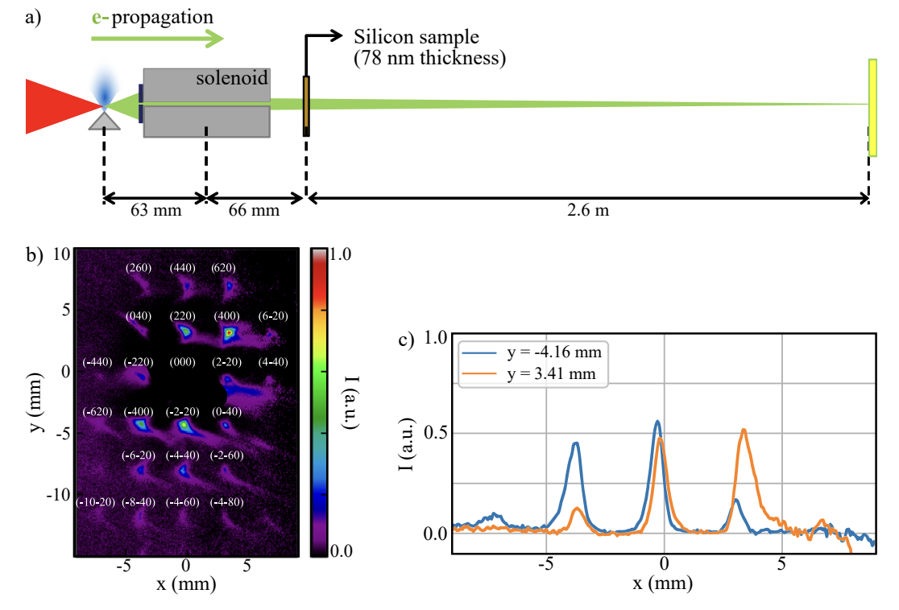
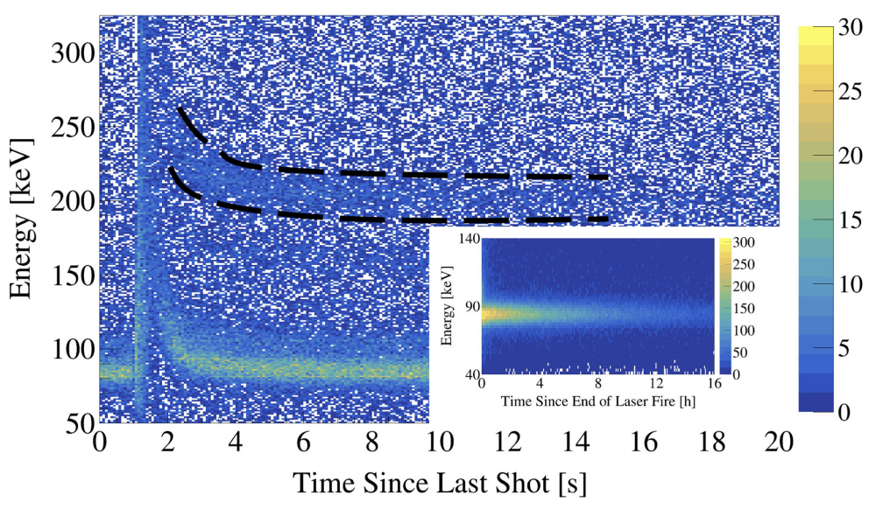
Applications: the list is growing; ultrafast electron diffraction, nuclear photonics etc.
First (?) electron diffraction experiments with LPA beams
‘Decay on Demand’
Leveraging low normalized emittance (100 nm), high repetition rate (kHz) LPA, encouraging UED results achieved
Useful radioisotopes locked up in long actinide decay chains
Ability to directly alter long lived nuclear states with short pulse LPA beams demonstrated
Monzac et al., arXiv (2026)
Jacob et al., Phys. Rev. Lett. (2025)
Commercialization efforts for plasma accelerators underway in US (e.g. Tau Systems, Inversion Semiconductor) and collaborating with National Labs, Universities etc.

Slide 16
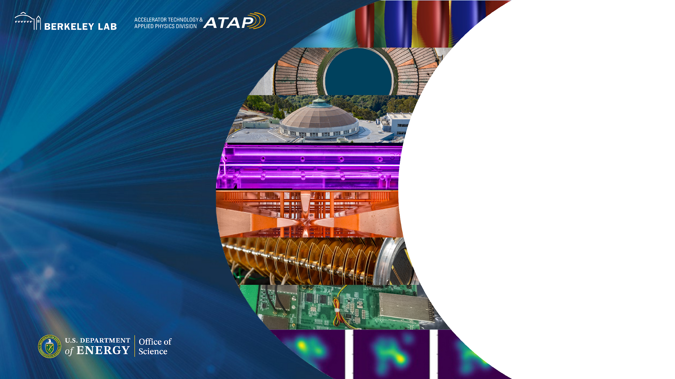
Thank You!

Slide 17
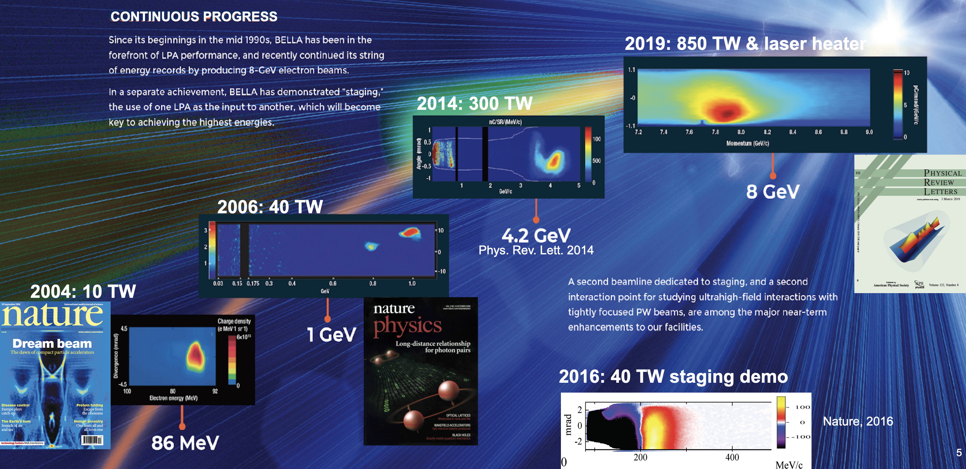

Scale: GV/cm gradients well established, total energy gain greater than 10 GeV
10 GeV

