Slide 1
New Applications Enabled by High Gradient RF Accelerators
Emilio Nanni
AFOSR + NSF Scientific Opportunities with Compact, High Intensity Accelerators
2/24/2026

Slide 2
Acknowledgments
SLAC
Brandon Weatherford
Zenghai Li
Chris Nantista
Emma Snively
Mohamed Othman
Muhammad Shumail
Annika Gabriel
Valery Dolgashev
Mamdouh Nasr
Ankur Dhar
Caterina Vernieri
Andy Haase
Mitchell Schneider
Valery Borzenets
Galen Aymar
Martin Breidenbach
Cornell
Jared Maxson
Nigel Lockyer
Matt Andorf
ASU
Sami Tantawi
Radiabeam
Alex Murokh
Ron Agustsson
Argonne
Ali Nassiri
Stanford University
Billy W. Loo Jr.
Indiana University
Peter Maxim
Loma Linda University
Reinhard Schulte
UCSF
Bruce Faddegon
Jose Mendez
NIU
Xueying Lu
NIKEF Harry Van Der Graaf
ESRF
Simone Liuzzo
+COLD Project Team
Recent Survey of RF Accelerator R&D Neds and Opportunities:
DOE GARD RF Roadmap Update
References and Presentations:
https://web.slac.stanford.edu/c3/

Slide 3
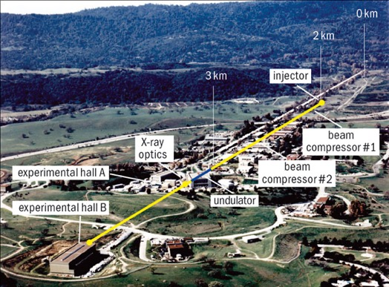
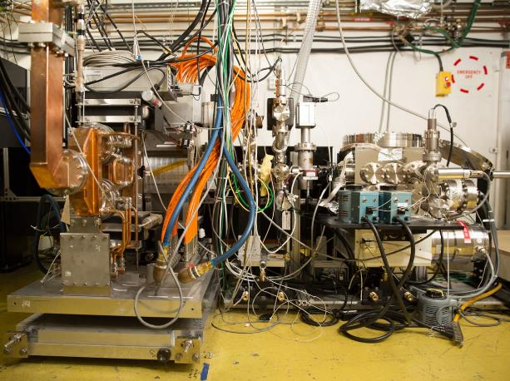
Particle Accelerators Drive Scientific Discovery
Coherent X-rays from LCLS (2009)
Ultrafast Electron Diffraction (2015)
What new science is enabled by the next generation of accelerator technology?

Slide 4

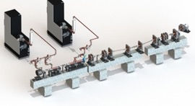
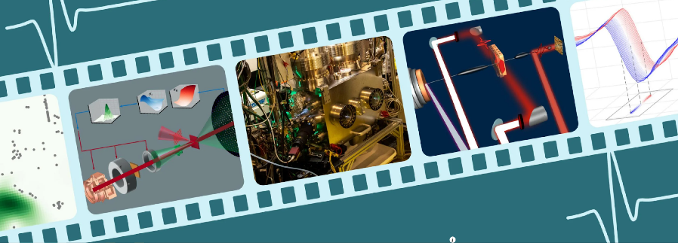
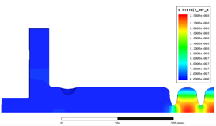


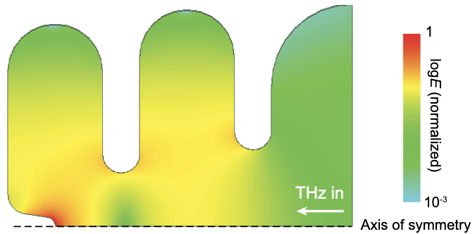
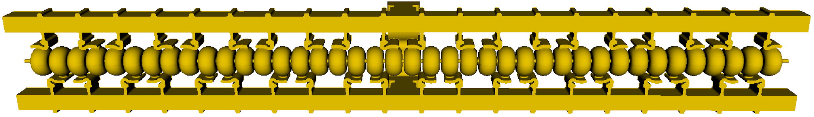

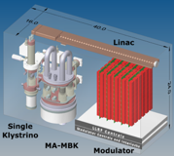
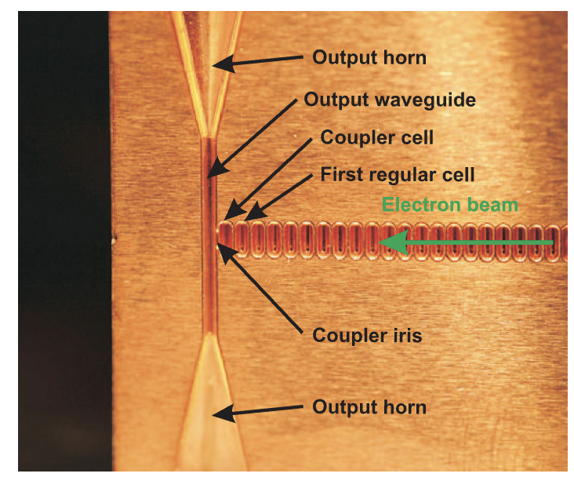

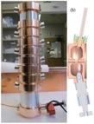

Broad Impact and Reach of Accelerator Physics
High-Brightness Injectors
(NSF,DOE)
Compact Light Sources
(NSF)
 | ``
Advanced Concepts in Accelerator Physics (DOE)
Novel linac designs for improved gradient and efficiency
Material and physics studies
Beam manipulation
RF Compression
High potential impact of ultra-high gradient (0.1-1 GV/m) acceleration to increase electron beam brightness
Exploring new beam manipulation techniques to enable compact and coherent x-ray sources
Enormous impact both x-ray and electron scattering instruments
J. B. Rosenzweig, et al. ARXIV, 2016
PRAB 25, 121301 (2022)
Compact and Efficient High-Avg. Power X-Ray and VHEE Source
(Stanford Medical/DHS/DOE/NIH)
Accelerators Deployed on Satellites (NSF/DOE)
Accelerator Based RF Power (DOE)
Requires extremely efficient and compact accelerator to produce MeV beams
Ultra-high peak power rf pulses
Microwave + mm-Wave sources
MWs to GWs
X-ray sources with advanced cost-capabilities for nuclear interdiction, cargo scanning and medical therapy
Daily Mail, 2015

Slide 5
State-of-the-Art and Potential Impact

Slide 6
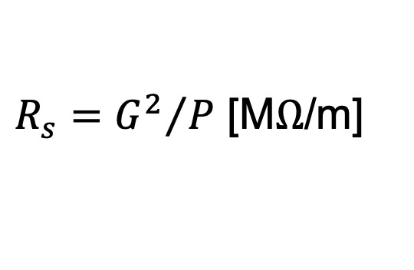

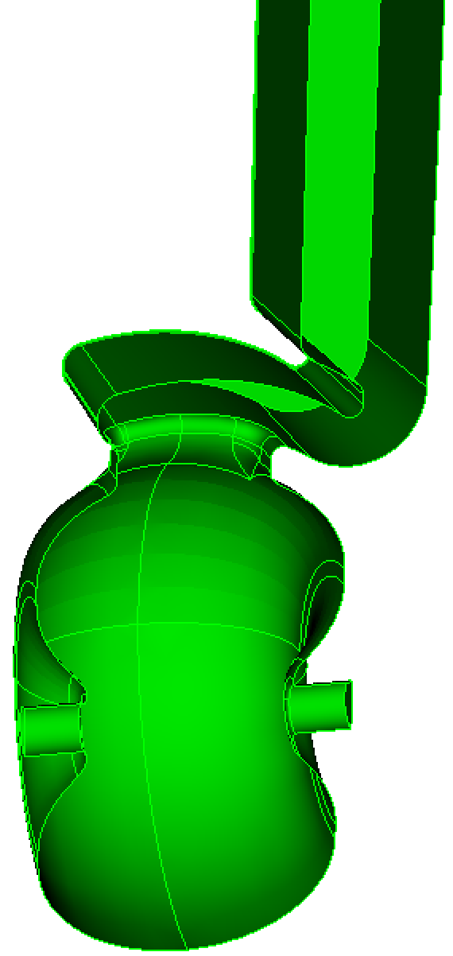
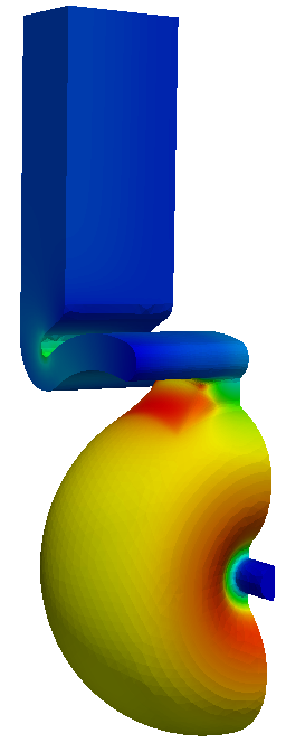
Breakthrough in the Performance of RF Accelerators
RF power coupled to each cell – no on-axis coupling – with distributed coupling
Full system design requires modern virtual prototyping
Vacuum space for rf cavities and manifold
Optimization of cell for efficiency (shunt impedance)
Control peak surface electric and magnetic fields
Key to high gradient operation
arXiv:1807.10195 (2018)
PRAB 23.9 (2020): 092001

Slide 7
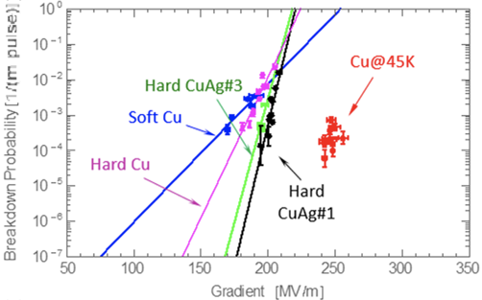
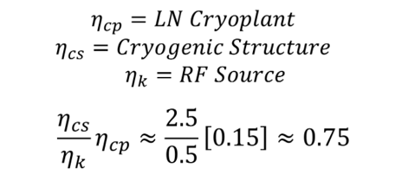
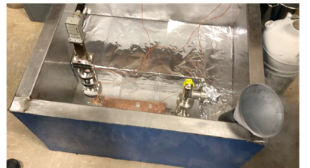
Cryo-Copper: Enabling Efficient High-Gradient Operation
Cryogenic temperature elevates performance in gradient
Material strength is key factor
Impact of high fields for a high brightness injector may eliminate need for one damping ring
Operation at 77 K with liquid nitrogen is simple and practical
Large-scale production, large heat capacity, simple handling
Small impact on electrical efficiency
Cryogenic temperature elevates performance in gradient
Material strength is key factor
Impact of high fields for a high brightness injector may eliminate need for one damping ring
Cahill, A. D., et al. PRAB 21.10 (2018): 102002.

Slide 8
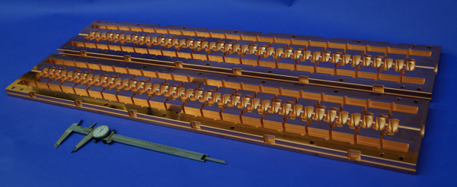
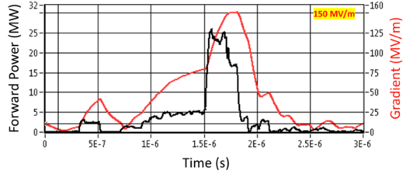
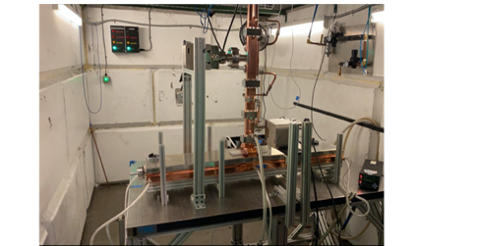
High Gradient Performance of D.C. and Cold-Copper
Prototype One Meter Structure
Dramatically improving efficiency and breakdown rate
Distributed power to each cavity from a common RF manifold
Provides protection to structure during breakdown
Operation at cryogenic temperatures (LN₂ ~80-K)
Robust operations at high gradient: 120 MeV/m
Scalable to extremely high energy
High Gradient Operation at 150 MV/m
High power Test at Radiabeam
Cryogenic Operation at X-band
PRAB 24.9 (2021): 093201

Slide 9
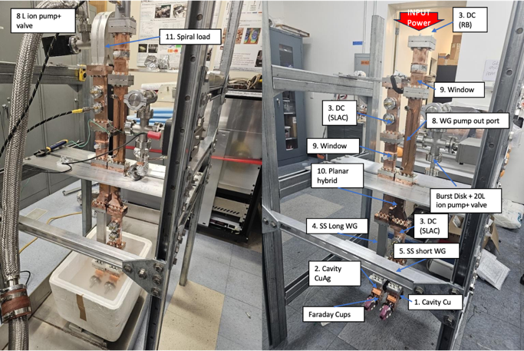
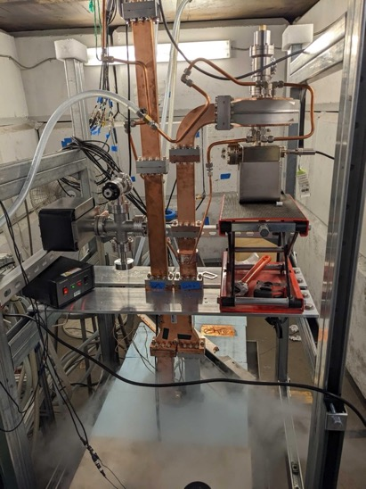
Understanding Limits at 77K: Two Cell Assembly
SLAC
Radiabeam

Slide 10
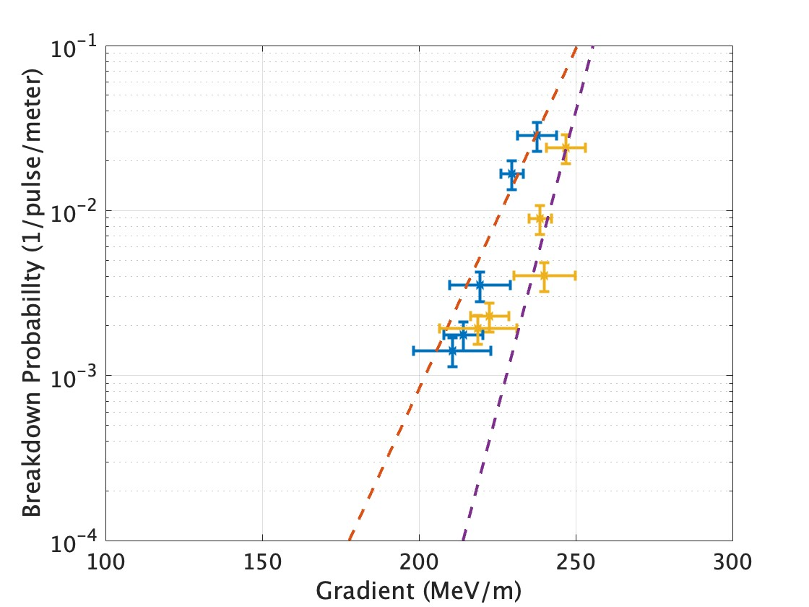
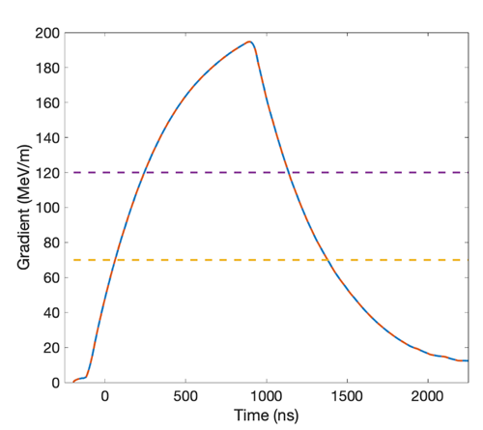

Breakdown Rates and Pulse Lengths for 200+ MeV/m
Long flat top allows for multi-bunch operation
1 $μs$
Cu
155 MeV/m
500 ns
120 MeV/m
1000 ns
70 MeV/m
CuAg
1250 ns
A. Diego, M. Schneider, M. Boyce and A. Dhar

Slide 11
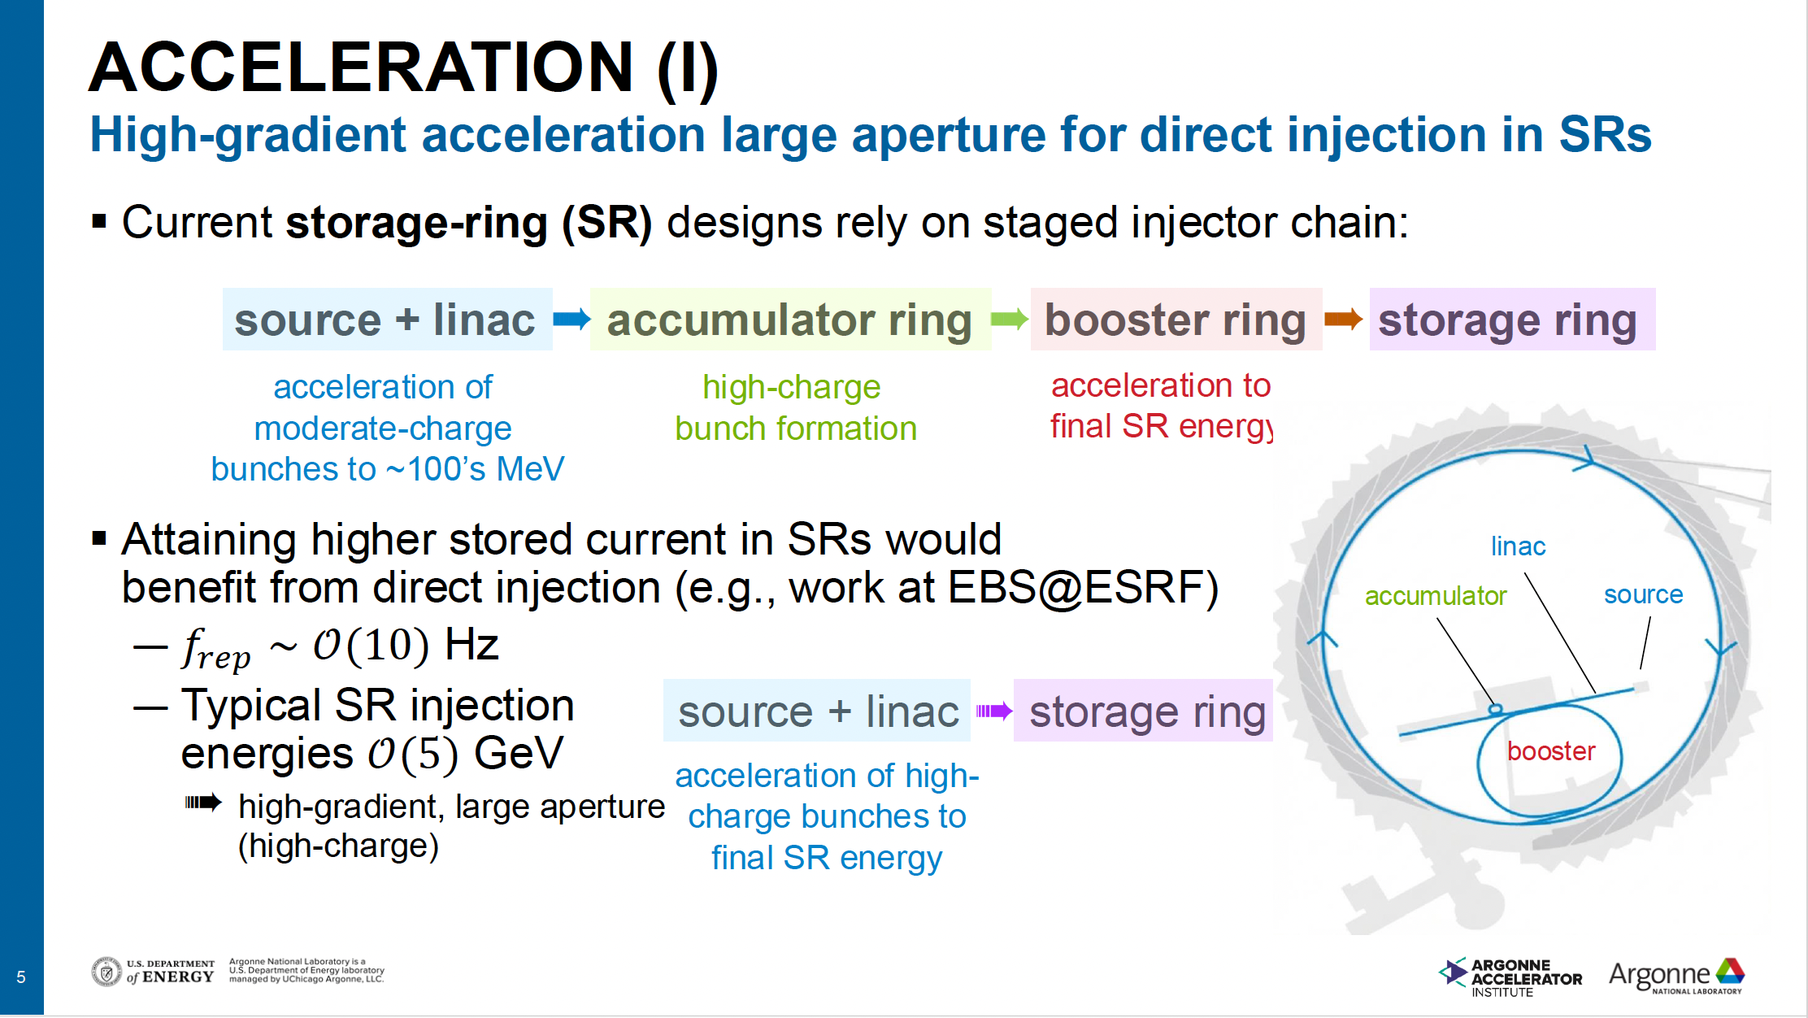
Slide: Philippe Piot https://indico.slac.stanford.edu/event/10356/contributions/14184/attachments/6201/15842/NCRF_needs_ForBES_20260120.pdf

Slide 12
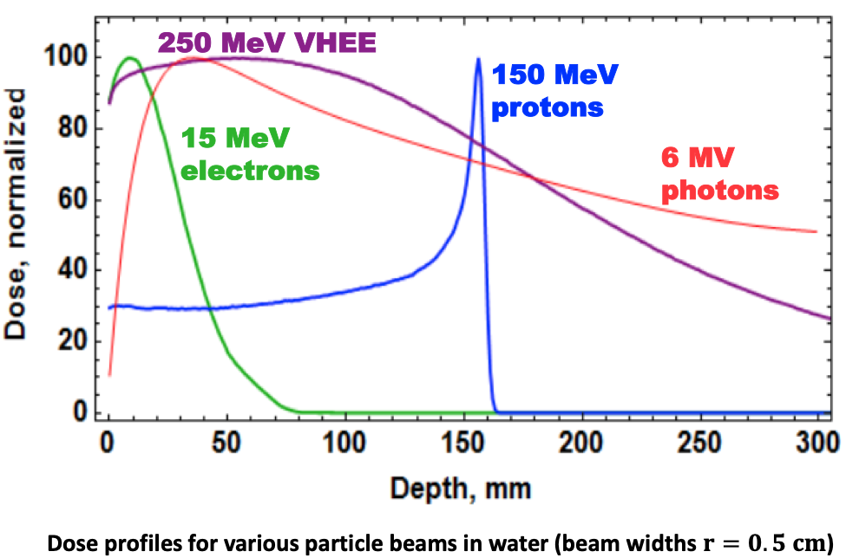
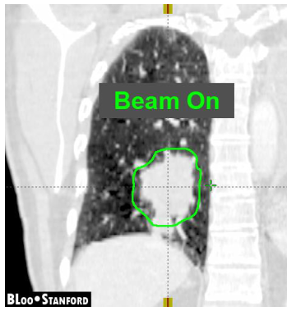
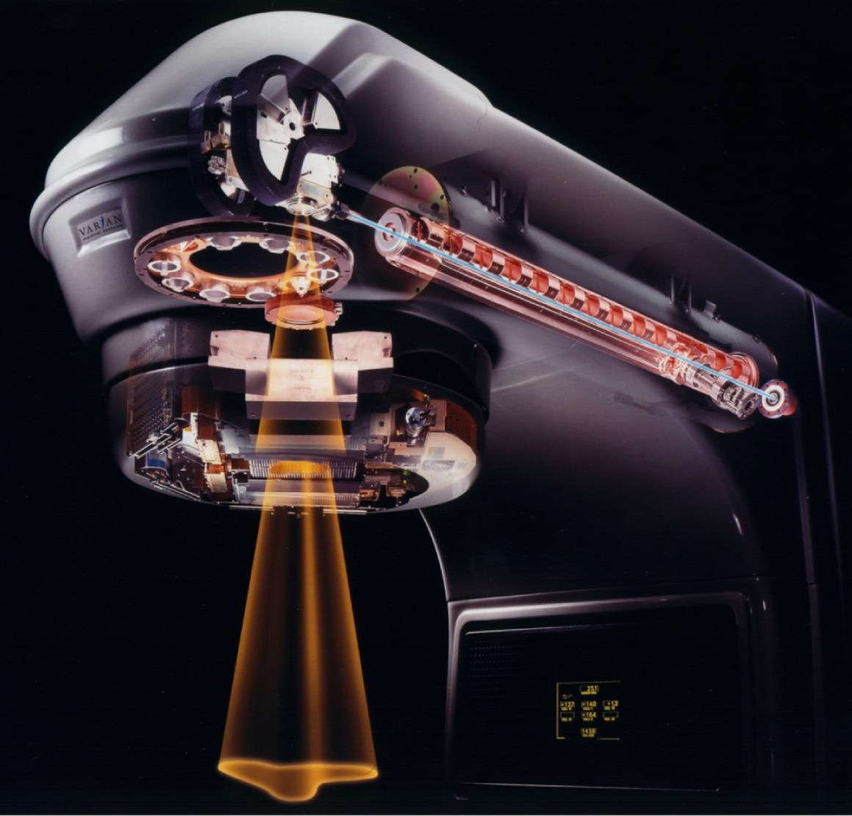
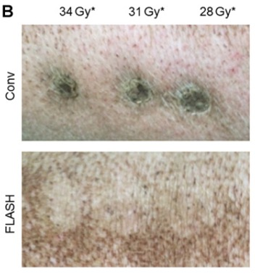
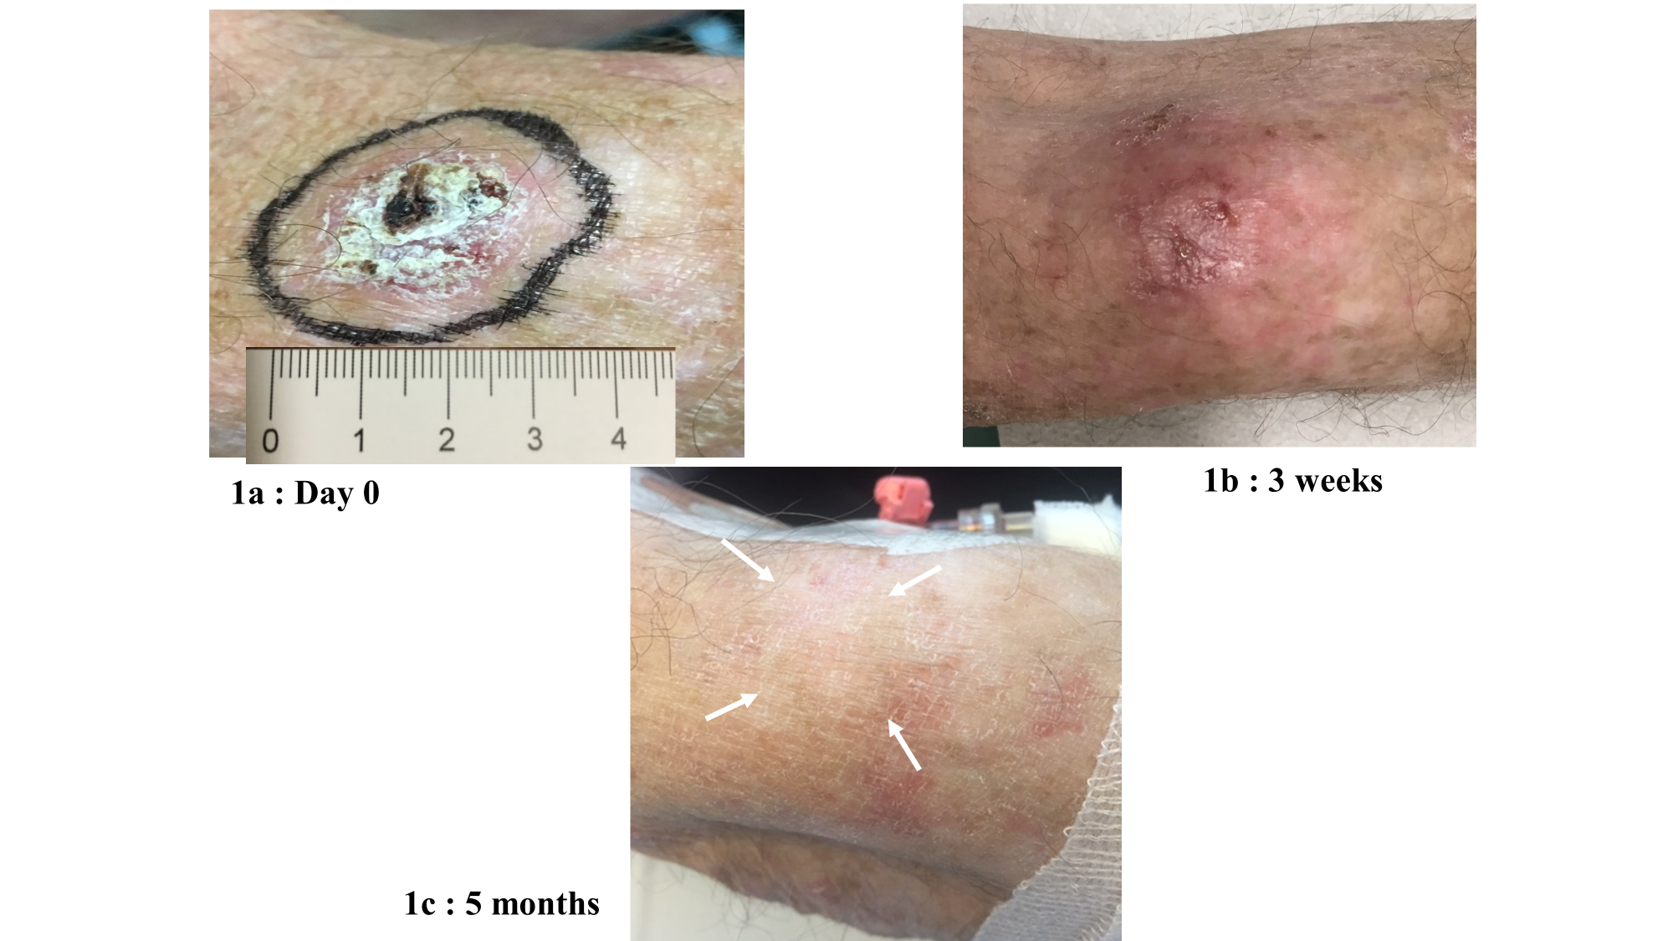
Medical Accelerators
Present systems limited by achievable beam energy dose
Workhorse accelerators in the commercial sector with stringent requirements on precision and reliability
Cutting edge research in high dose rate radiation therapy
Lawrence, et al., in Princ Pract Oncol, DeVita, et al., ed. 2008
FLASH Therapy
Sub-second treatment time appears to improve healthy tissue sparing with comparable tumor control
Demonstrated in preclinical setting with photons, electrons, and protons
Requires high dose rate >40 Gy/L/s
Respiratory gating
Image courtesy of Varian Medical Systems, Inc. All rights reserved.
Motion Management
Vozenin, M.C., et al. "The advantage of FLASH radiotherapy confirmed in mini-pig and cat-cancer patients." Clinical Cancer Research 25.1 (2019): 35-42.
5 months
Bourhis, Jean, et al. "Treatment of a first patient with FLASH-radiotherapy." Radiotherapy and oncology 139 (2019).
E. Snively
Notes:
Effects of 167 GY/s (15-Gy in 90-ms) electron beam treatment of a 3.5-cm skin tumor in the first FLASH-RT of a human subject. Top: Day 0, bottom: ~ Day 150

Slide 13
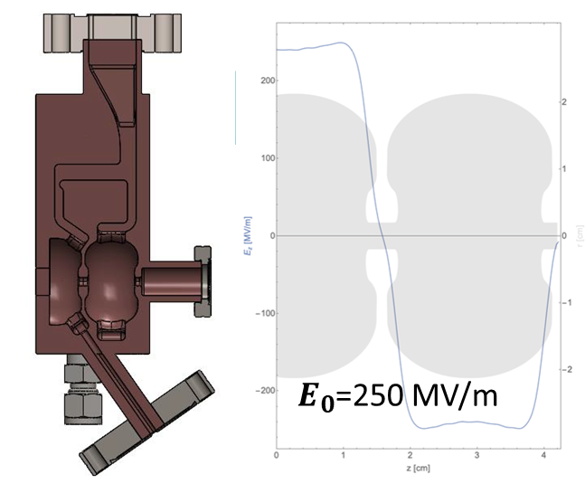
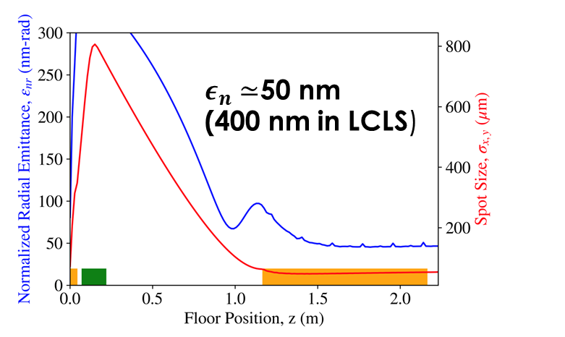
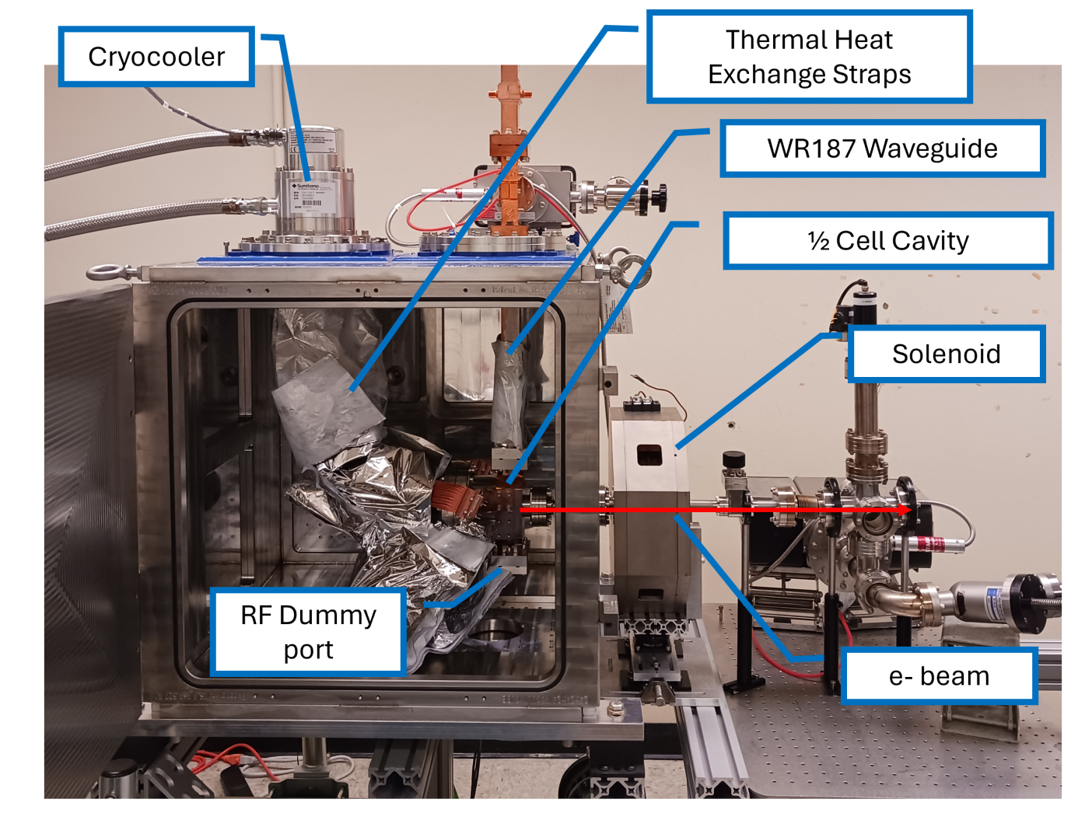
Ongoing Development for Cryogenic RF Photo-Injectors
Ongoing work at UCLA is looking to achieve higher photo-injector gradients for brighter beams
C-band gun uses a mechanical chiller instead of liquid nitrogen to achieve this
Higher gradient would allow for lower emittance beams, benefiting current and future light sources
Rosenzweig et al., PRAB 22, 2019
Robles, et al., PRAB 24, 2021
Cahill et al., PRAB 21, 2018.
Lawler et al., Proc. IPAC’24
HEP GARD RF Roadmap Update

Slide 14
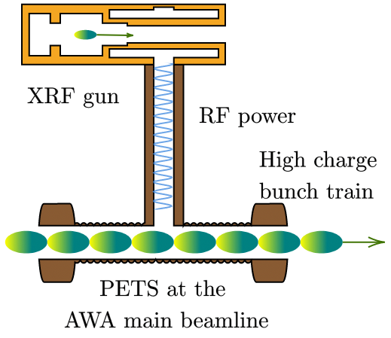
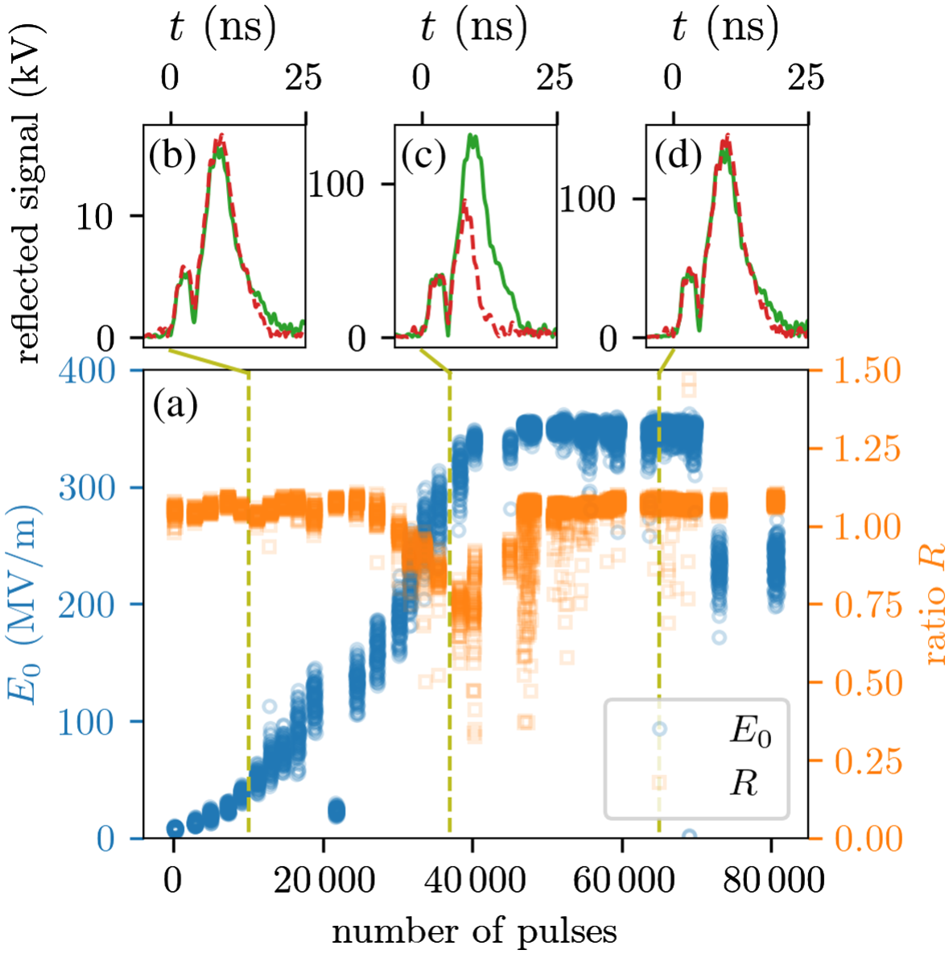
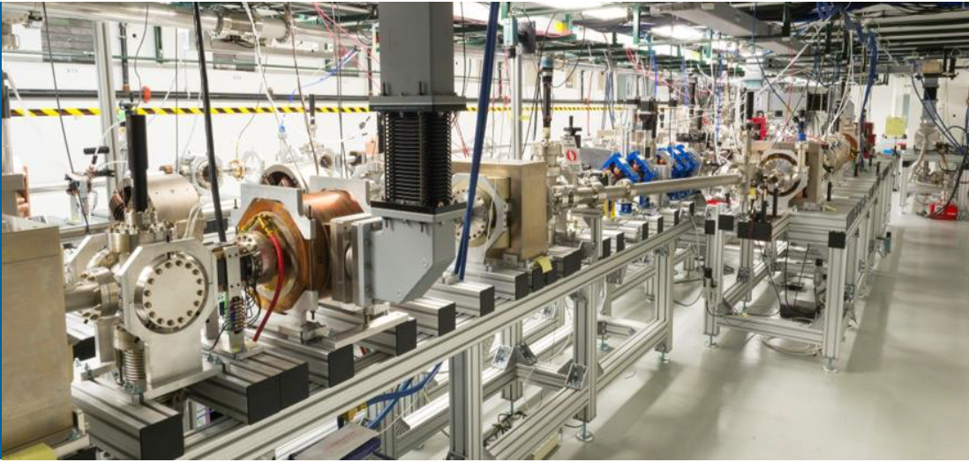
Higher Brightness through High Gradient
Previous work at Argonne Wakefield Accelerator (AWA) used ultrashort (<20 ns) RF pulses to achieve surface fields <400 MV/m for a 10X improvement in beam brightness and very low dark current.
Ultrashort RF Pulses
AWA Approach: Requires Stand Alone High-Charge Linac and Power Extraction Transfer Structure (PETS)
Increased Surface Fields
Tan et al., PRAB 25, 2022.

Slide 15
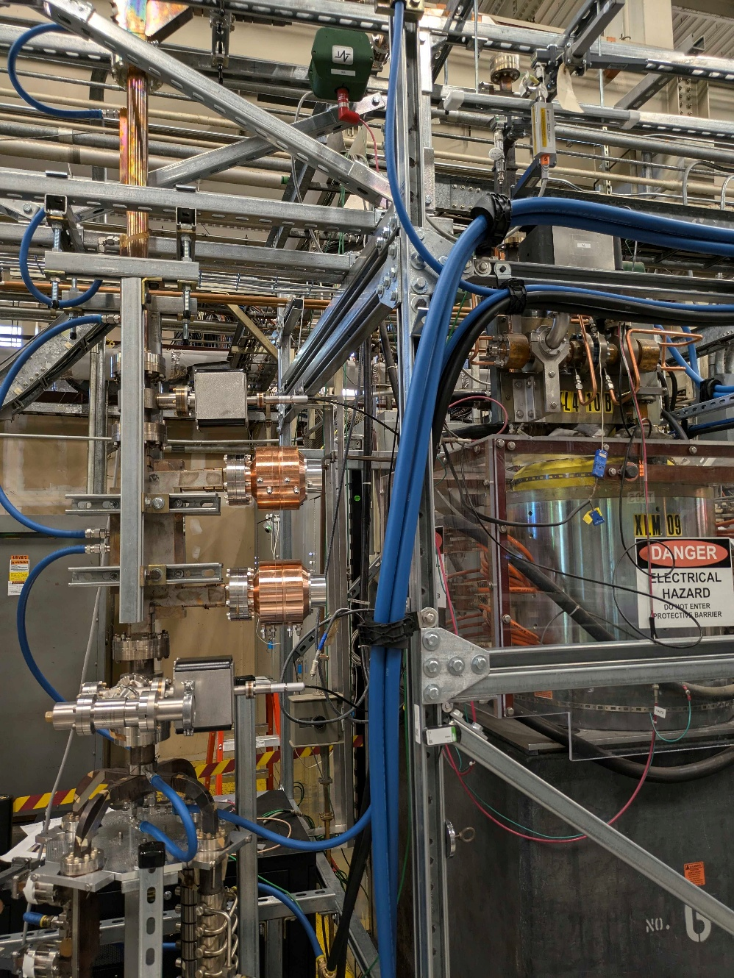
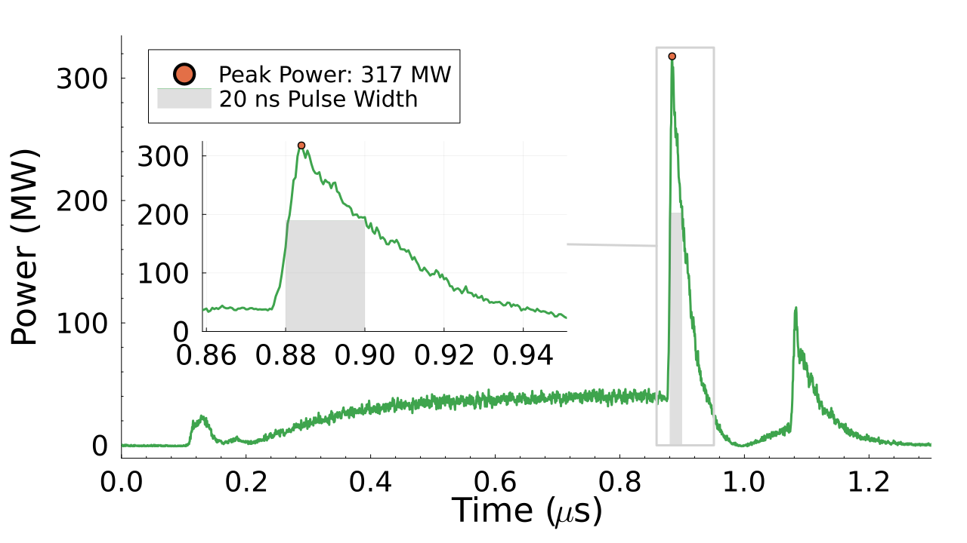
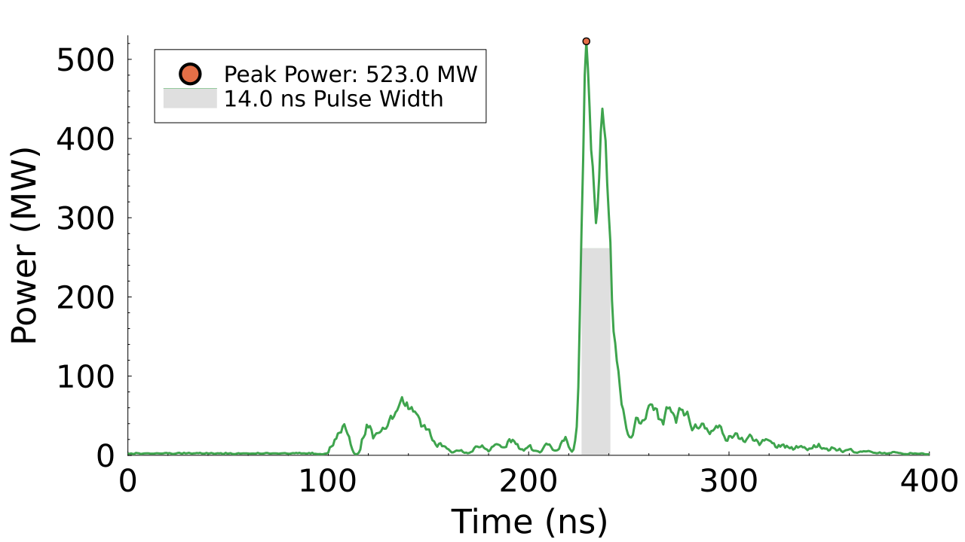
RF Pulse Compression Network at SLAC
50 MW
XL-4 klystron
50 MW
XL-4 Klystron
Directional Coupler
High Power Hybrid
RF Load
High Power hybrid
SLED
Spherical cavities
RF Load
Klystron
SLAC-built RF pulse compression system recently used to compress pulses from 50 megawatts over 1 µs to 317 megawatts over 2 ns.
Further development power combining two 50 MW klystrons has produced up to 510 MW.
System currently high power testing CUPID cavities
Load
Examples of compressed RF pulses
A. Dhar

Slide 16
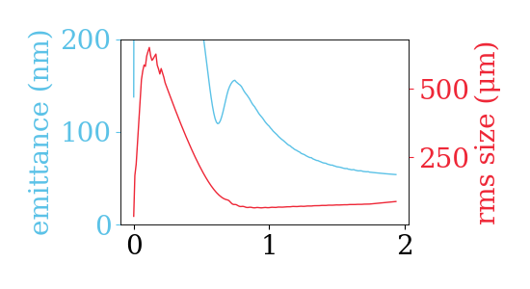
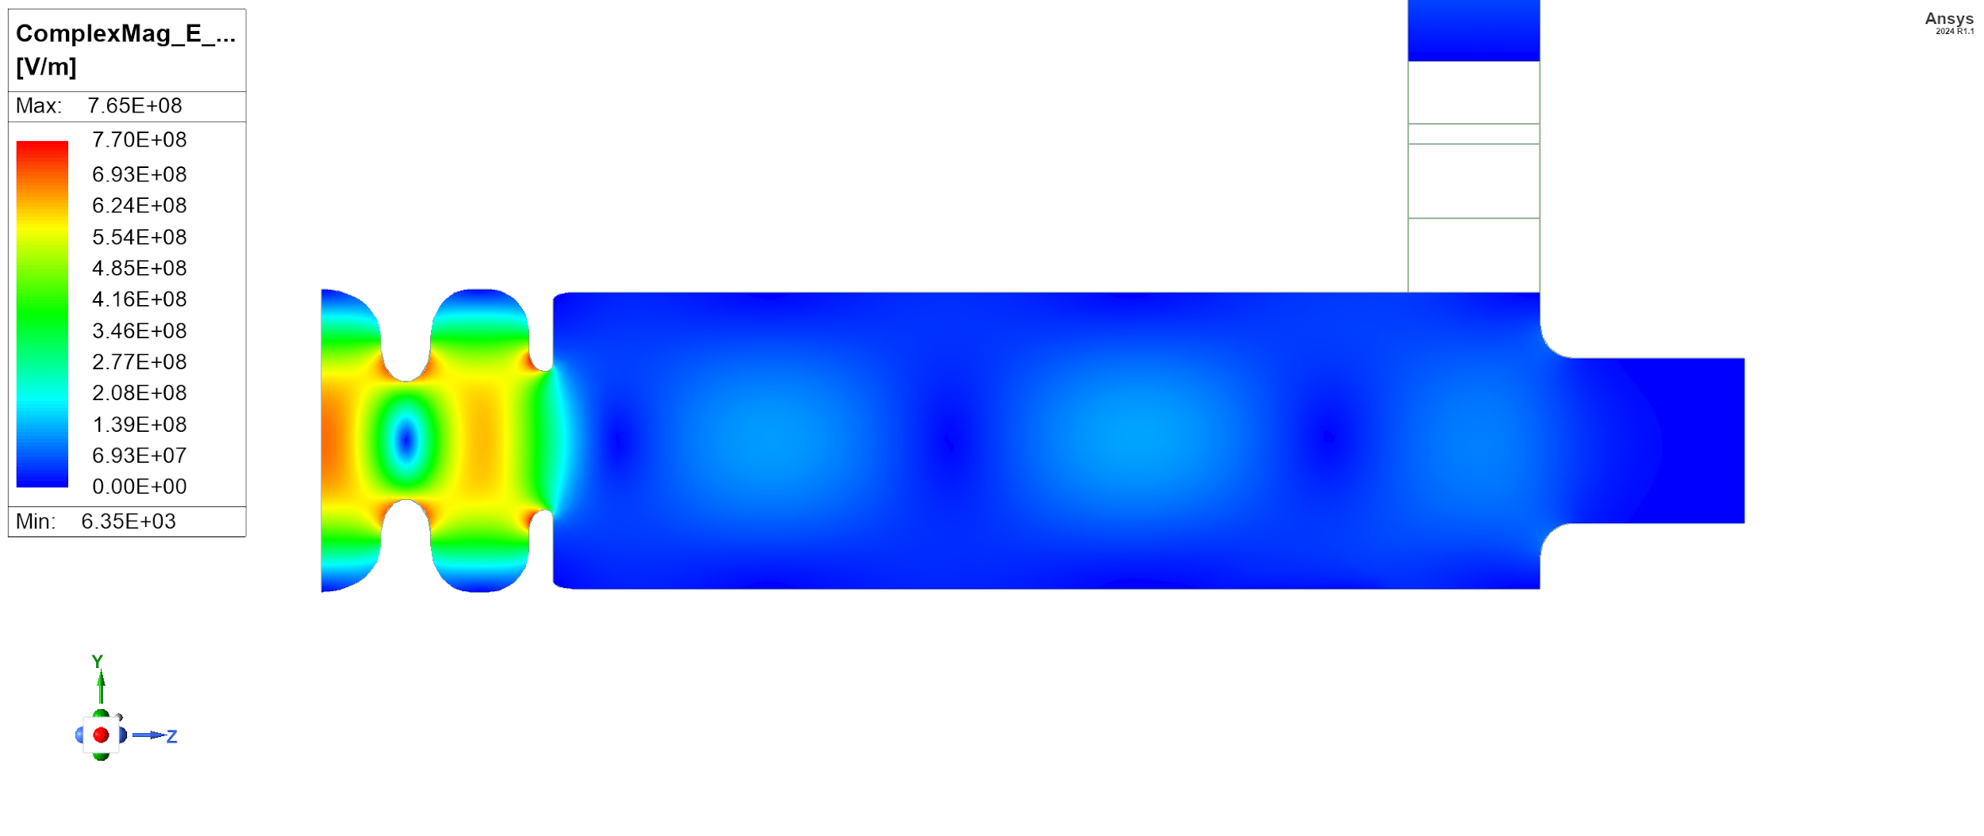
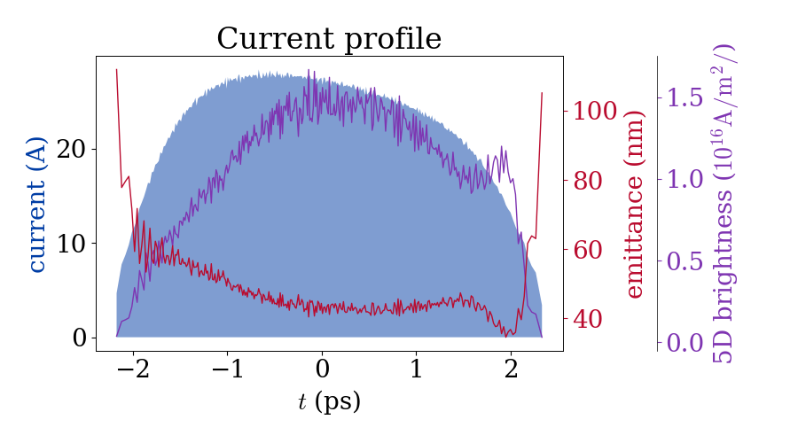
Design of Photo-Injector based on CUPID
Cathode thermal emittance
0.9 μm/mm
Solenoid
1 meter S-band (2.856 GHz) linac
Research Details
Simulations with realistic beamline components shows promising results, with final emittance down to 60 nm.
5D brightness reaches 10¹⁶ A/m²
This meets the requirements for enabling higher X-ray pulse and photon energies at LCLS
Ongoing work includes designing specific beamline components required to reach these brighter electron beams.
arXiv:2511.07592 (2025)

Slide 17
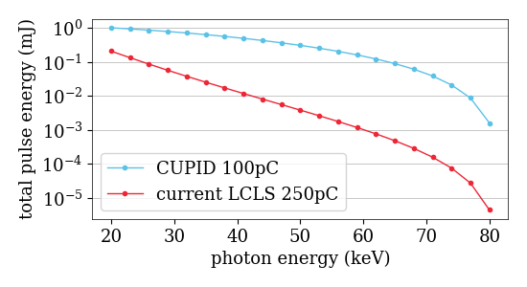
LCLS FEL performance Studies
Drop-in FEL performance gain for LCLS with CUPID injector based on beam dynamics studies using ELEGANT and Ming-Xie analysis
current LCLS-I injector: 50% of 250pC beam core at 400 nm emittance
CUPID: 84% of 100pC beam core at 75nm emittance
Further performance gain can be achieved with newer beam manipulation techniques
CUPID
injector
LCLS
accelerator
arXiv:2511.07592 (2025)

Slide 18
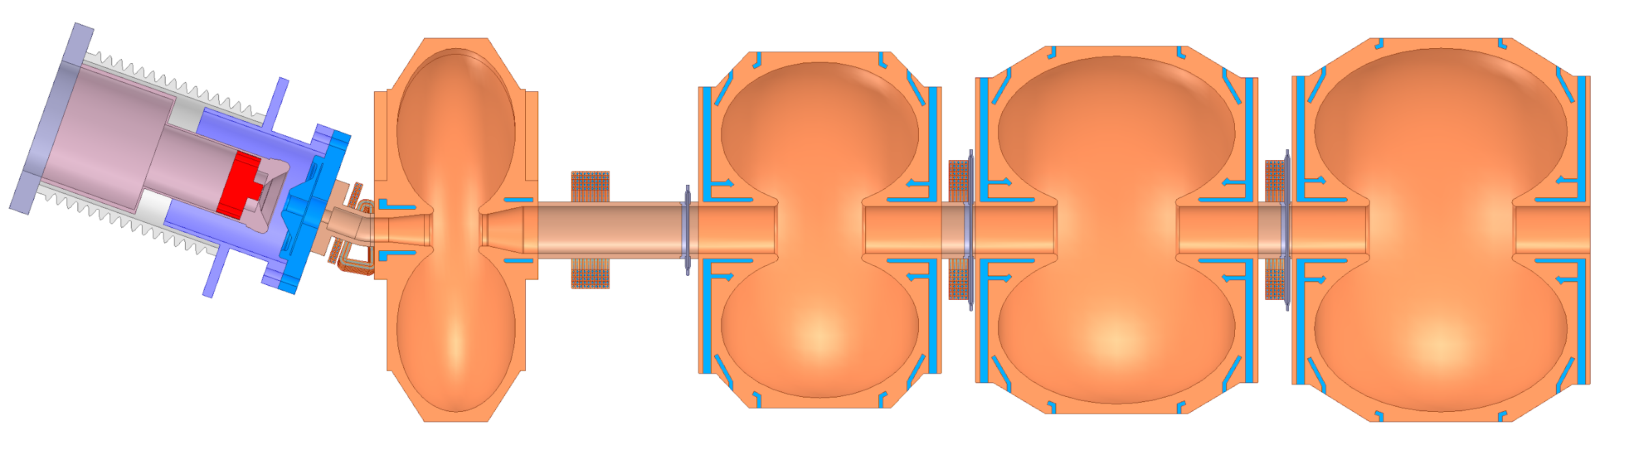
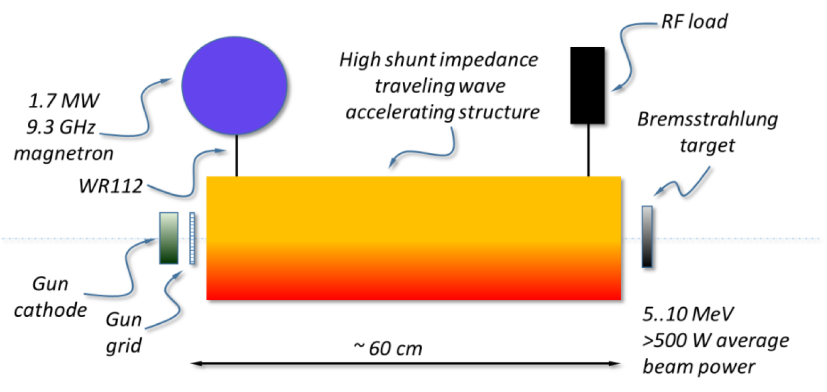
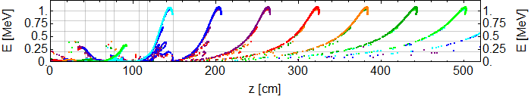
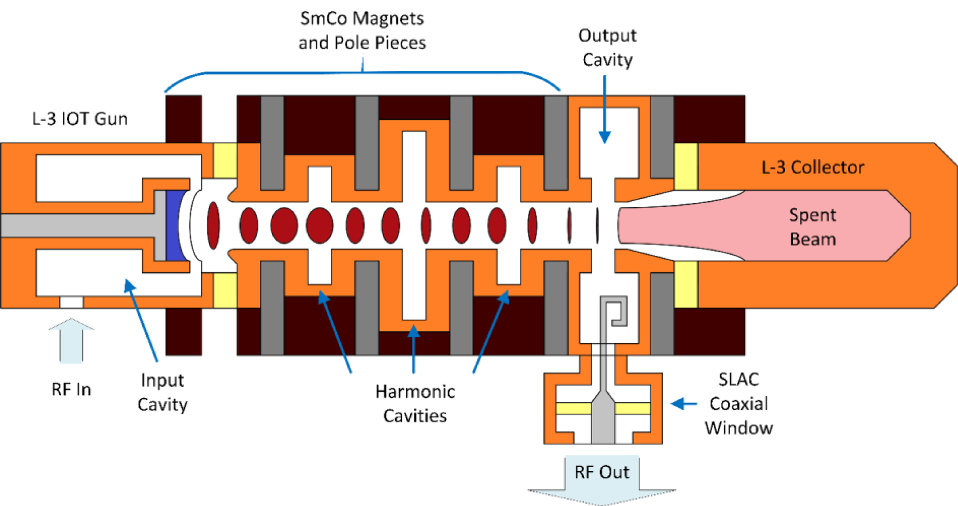
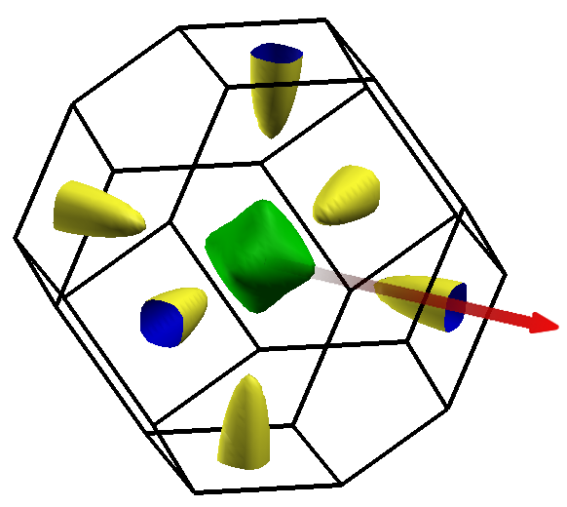

Highlighting Use-Inspired Basic Research
Energy & Environment | Medicine | Industry | Security & Defense | Discovery Science
Normal Conducting RF Linac with Optimal Phase Advance to Generate CW, 1 MeV, 1 MW, Electron Beams for Industrial Applications
High Efficiency Tunable Energy Traveling Wave Linac for Medical and Security Applications
Development of a Scalable 1.3 GHz High Efficiency IOT for High Average Power Accelerators
From Theory to Practical High Brightness Photocathodes
Accelerator
Stewardship
Fermi surface of cubic DyP
preferred (001) emission direction

Slide 19
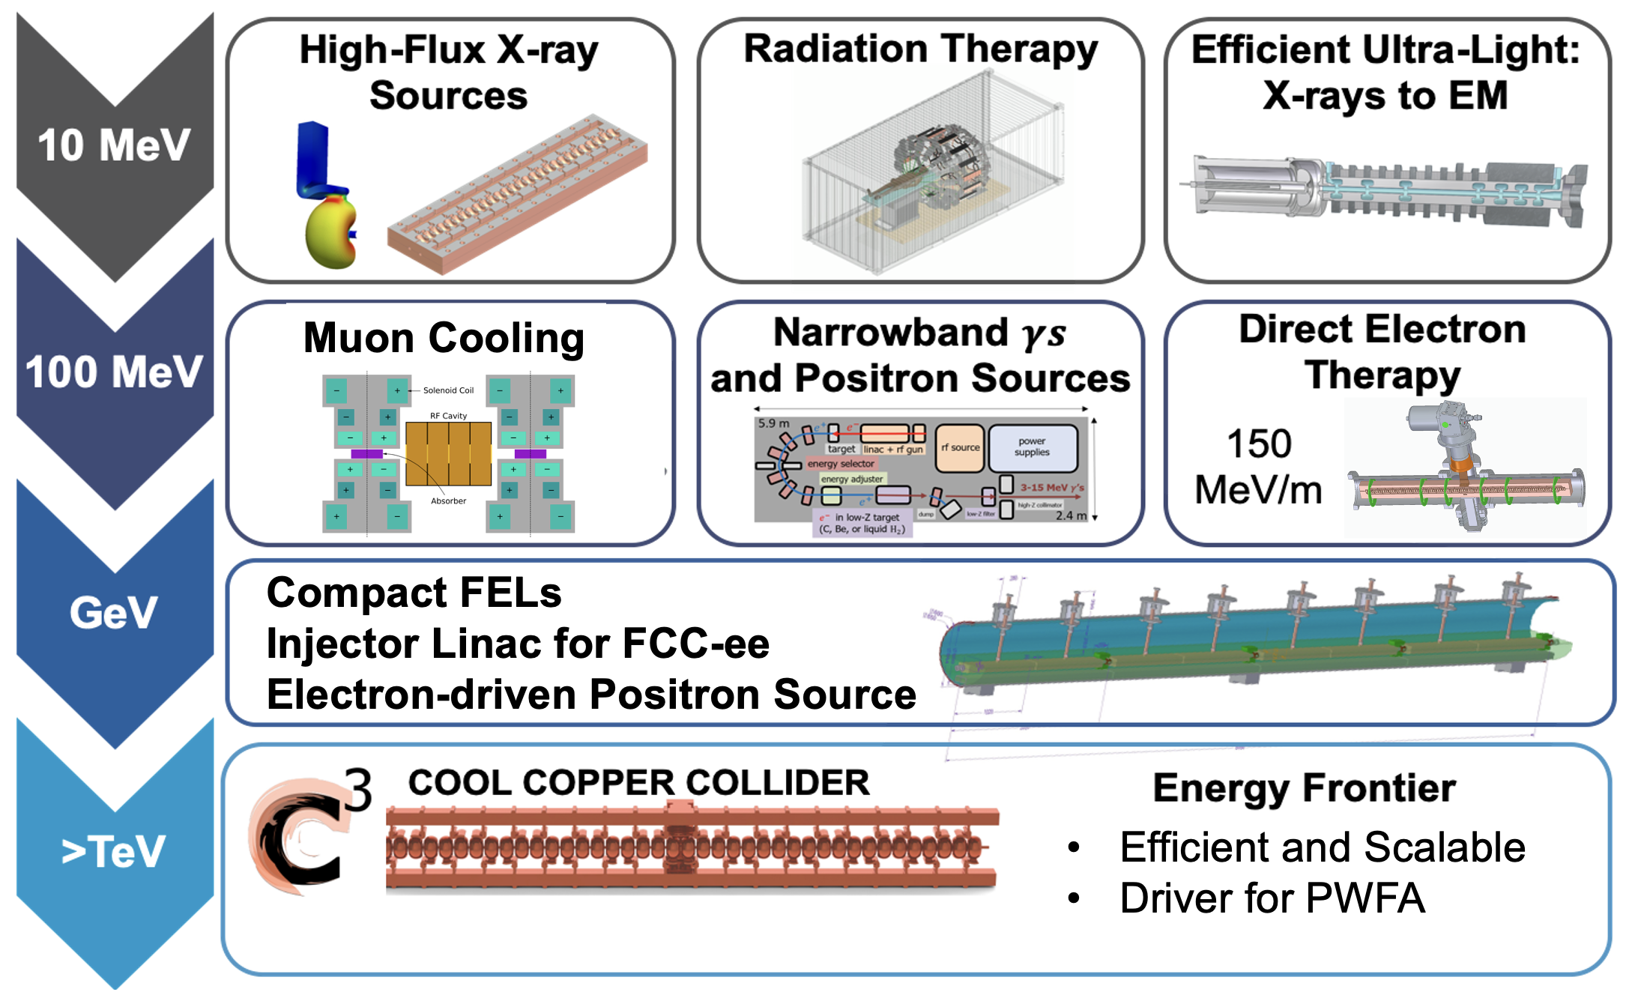
Realizing the Full Impact of High Gradient RF
Potential:
Increase beam brightness 10-100X
Increase gradients over conventional >10X
Increase rf to gradient efficiency 10X
Increase beam loading to 50-90+%
Need:
Technology development that transitions smoothly in energy
Broad base of scientific and non-scientific applications

Slide 20
Development of Distributed Coupling and Cold-Copper as a Platform for Compact, Hight Intensity Accelerators

Slide 21
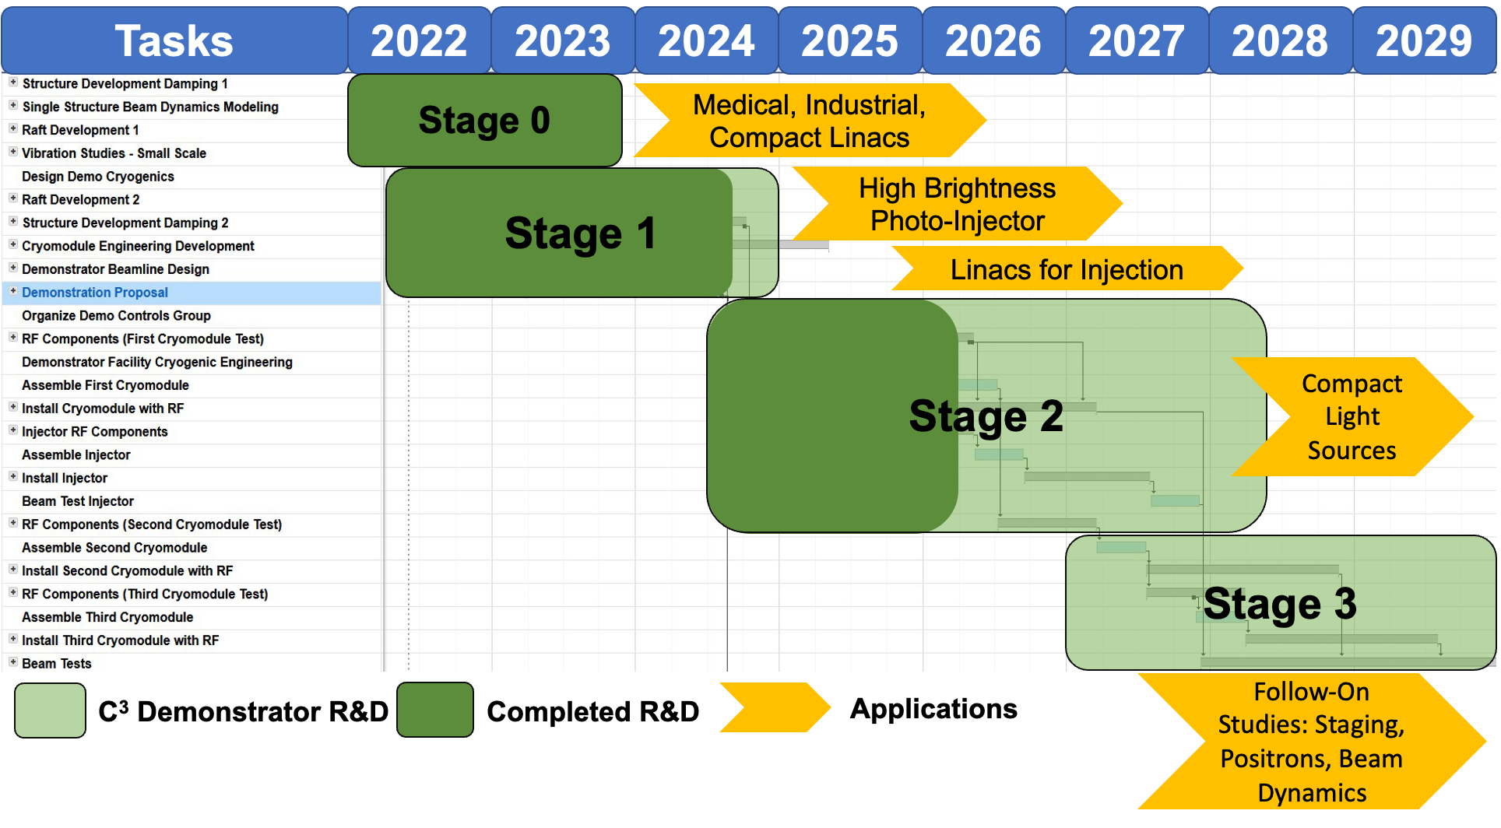
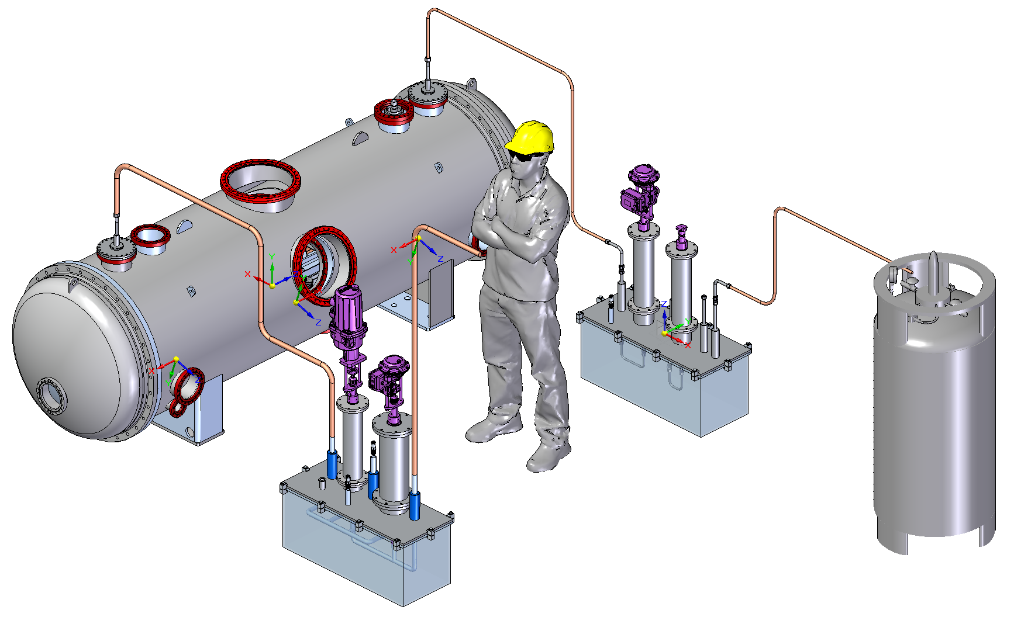
Distributed Coupling and Cold-Copper Development Plan
Staged approach opening new applications scaling in energy
Multi-institutional collaboration to address technical challenges
Common platform with customizable features and flexibility to handle diverse beam formats

Slide 22




C-Band RF Geometry
Incorporates latest designs for minimizing fields, maximizing efficiency, extremely high quality beams
40 cells with pair wise side to side distributed coupling
Cell Balancing features
4 damping slots extending to the beam center line (4 part open cells and iris)
1-m structure: 40-cell with damping slots
0.3mm
0.1mm
R2mm
21.010 mm
0.25 mm rounding
42.020 mm
Damping slot
Waveguide corner rounding

Slide 23



Braze Steps and Features for <10 micron Precision
3 critical “perimeter” joints (2 vacuum, 1 mechanical)
During braze, the braze joints are held by external clamps and compression bolts.
At assembly, alignment is achieved with a pin and slot arrangement, using stainless steel inserts to prevent deformation of the hole and slot (Exterior flat surfaces may also be used)
Production of 4 structures planned – first units to ESRF and Cornell

Slide 24

Mechanical Features – Alignment and Fiducials
Very high precision structures, piezo 5 DOF stage, raft with 5 DOF stepper adjustment, Rasnik alignment feedback, beam position monitor.
Option 1:
CMM alignment of accelerators to laser nests on the raft
Laser alignment of laser nests on the raft to laser nests on the QCM external face
Survey QCM external lasers nests for alignment
Option 2:
CMM alignment of beam tunnel to laser nests on the structure (visible through view ports)
Calibration of laser nests on structure through windows and LN2
Survey laser nests on structure to do alignment

Slide 25








Auxiliary Systems: LLRF and Alignment
NG-LLRF in development based on RFSoC
Demonstrated high-precision LLRF requirements in high power test
Initial thoughts to system implementation
Rasnik alignment system
H. Van Der Graaf
AIR
LN
Liu, C., et al., Review of Scientific Instruments 96.4 (2025).
Notes:
Sustainability lcws talk and paper

Slide 26
COOL COPPER OPERATION LINAC DEMONSTRATOR (COLD) AT ESRF
INFN: could be S-band
OBJECTIVES:
Test C-band 77K high gradient technology:
Acc. Gradient
Breakdowns
Dark currents
Reliability
Maintainability
Gain experience:
C-band structures / modulators
Laser
Cryogenics
Evaluate potential to extend to 6GeV
35 MW
4-6μs
4Hz
S-band (--> C-band)
50 MW
0.5-10 μs
4-10Hz
C-band
load
load
pen
Independent test of modulators
pen
valve
WG switch
valve
WG switch
pen
WALL
valve
load
pen
Directional Coupler
Directional Coupler
IP
Window
Isolator (critical in C-band)
pen
valve
Directional Coupler
load
pulse compressor?
pen
Window
IP
valve
Window
50MW
Directional Coupler
valve
pen
pen
Window
25MW
Planar hybrid
Collaborators:
SLAC
CORNELL
INFN
CERN
GUN
valve
Phase shifter
attenuator
valve
pen
attenuator
valve
C3 1m struct
C3 1m struct
C3 1m struct
LCWS 2025

Slide 27

COLD Project Phases and Scope
2025 S-band RF-unit for photo-gun (usable for present linac)
2026 2x C-band RF-unit for Cryomodules
diagnostics for Linac refurbishment
2027 RF test of 77K C-band acc.struc. +dark currents +laser
2028 photogun, diagnostics
2029 beam measurements
2030 + 2xC-band accelerating structures for: pulse compression, phasing studies, EU cryomodule development and/or: install undulators
2031 COLD as ~300-350MeV alternate operation injector for ESRF. (Two injector linacs will be operational)
2032: new 12x100 m tunnel construction
2033: install and commission 6GeV Linac
2034: decommission booster, installation of transfer line 6GeV linac to SR (~2 months dark time)
Phase 1
6GeV Linac
Phase 2
Beyond
S. Liuzzo, et al.,Proc. IPAC'25,TUPM107

Slide 28

Synergies with Future Colliders
NCRF Accelerator Technology Required for all Near-Term Collider Concepts
Cold copper technology is positioned to contribute synergistically or directly to all near-term collider concepts
FCC-ee - common electron and positron High Energy linac from 6 to 20 GeV
Muon Collider - high gradient cryogenic copper cavities in muon cooling channel
AAC - SLAC Beam Test facility proposal utilized for staging, multi-TeV energy upgrade reutilizing tunnel, 𝛾𝛾 colliders
Single Cavity
Design Study: FCC HE-Linac
HE-Linac Requirements
Charge (nC) | 0-5.5 nC
Number Bunches | min. 4
Bunch Spacing | 25 ns spacing
Initial Energy | 6 GeV
Final Energy | 20 GeV
Goal is high RF efficiency for a set gradient
Shunt impedance at 300 K: 58.5 MΩ/m
At 77 K: 152 MΩ/m
Gradient: 22.5 MeV/m
Baseline design: 3.5 MW/m, 3 μs
Pulse compressed version should be even more efficient in terms of RF power

Slide 29
Conclusion
Distributed coupling provides a versatile platform for optimizing rf accelerators
Cold-copper provides distinct advantages for applications requiring compactness and high gradient
Short-pulse operation opening new possibilities for extreme gradients
Major challenges: scaling of this technology to higher energy; generating and preserving high brightness beams
Future work:
Structure design could improve efficiency or relax alignment tolerances
Opportunities to consider more exotic – hybrid NCRF/SRF – could further improve the performance of linacs
Technology industrialization proceeding in parallel through applications

Slide 30
Questions?

Slide 31
Backup

Slide 32










Alignment and Vibrations for Bright Beams
Two-Phase Fluid Simulations
System level optimization essential for achieving performance
RF Structure Optimization
Vibration Measurements and Analysis
3.55 mm iris radius
2.0=E_{max}/E_{acc}
1.23=H_{coup}/H_{wall}
K. Shoele
Electric Field
Precision Short and Long Range Alignment
Magnetic Field
Z. George, V. Borzenets, A. Dhar, D. Palmer
H. Van Der Graaf
M. Shumail, Z. Li
Main Linac Beam Dynamics
Alignment Parameters | Units | Value
Raft Components | μm | 5
Short Range (~10m) | μm | 30
Long Range (>200m) | μm | 1000
Structure Vert. Vibration | μm | 9
Quad Vert. Vibration | nm | 15
BPM Resolution | μm | 0.1
BPM-Quad Alignment | μm | 2
100 nm resolution
Approved effort to test cold
White (C³), Schulte (CLIC)
https://arxiv.org/pdf/2307.07981.pdf

Slide 33


RF Power Requirements
70 MeV/m 250 ns Flattop (extendible to >100 ns)
~1 microsecond rf pulse, ~30 MW/m
Conservative 2.3X enhancement from cryo
No pulse compression
Ramp power to reduce reflected power
Flip phase at output to reduce thermals
RF Power
One 65 MW klystron every two meters -> Matches CLIC-k rf module power
Gradient
Thermals

Slide 34



RF Sources Available vs. Near Term Industrial Efforts
RF sources and modulators capable of powering CCC-250 commercially available
Plan to leverage significant developments in performance (HEIKA) of high power rf sources – requires industrialization

Slide 35

High Efficiency Klystrons
Please See I. Syratchev’s Talk for Many Great Examples from Designs to Prototypes
https://indico.cern.ch/event/1101548/contributions/4635964/attachments/2363439/4034986/CLIC_PM_13_12_2021.pdf

Slide 36

QCM Accelerator Installation Fixture
Entire structure (raft with two accelerator structures) is installed into the QCM from one end riding on vertically adjustable shafts.

Slide 37


Synergies with NCRF Developments
Cold Copper technology benefits from collaboration with several other NCRF Developments
Distributed Coupling: Directly benefits and motivated further development in high gradient RF design for NCRF structures
ACE3P: Allows for rapid iteration on new designs and accurate benchmarking of fabricated structures
Future BES accelerators: Cold copper can provide high energy electron beams for hard X-ray FELs or synchrotrons which operate at 6 GeV
Industrial linacs: Cryo-cooled medical accelerators can provide high energy beams with a compact form factor
Short pulse: Both cold copper and short pulse RF can reach higher gradients, combining the two could provide even better peak power handling
6GeV Linac
HEP GARD RF Roadmap Update

Slide 38




Distributed-Coupling based Large Aperture Injector Linac
S-Band linac developed for efficient acceleration of high charge bunches
Prototype structure tuning utilized iterative measurements and simulation in ACE3P
Current design would preserve emittance for up to 14 nC bunches with 18 MV/m gradient
Power draw would only be 5 MW for a meter-long 20 cavity linac
Large aperture design (14.12 mm) for reduced wakefields
Designed based on requirements for Electron Ion Collider (EIC)
Operating cold enables even higher gradients/RF efficiency
Up to 80 MV/m with 35 MW per structure
Alternatively, 1.8 MW/m for the EIC target gradient
Emittance Comparison
Simulated tuning in ACE3P
Prototype Linac
IPAC2024 p. TUPR14
Distributed coupling and cold copper technology can be applied to injector linacs and other high beam power applications
HEP GARD RF Roadmap Update

Slide 39
Future R&D Directions

Slide 40



Max Shunt Impedance with 135 deg Phase Advance
Achieve Same Efficiency with a Larger Aperture (compared with 180 deg cell) (Muhammad Shumail)
Quality factor, aperture size, and gap distance for $R_{s}=114 MΩ/m$ and $Es/Ea=2$

Slide 41




Cavity (with two different coupler implementations) Parameters
Parameters@ 77 K | Cavity Left | Cavity Right
Resonant Frequency, $f_{0}$ (GHz) | 5.712 | 5.712
Coupling Coefficient, $β$ | 1.8625 | 1.8634
Reflection Coefficient, $Γ$ | 0.3013 | 0.3015
Shunt Impedance, $r_{s}$ (MΩ/m) | 317.22 | 317.22
$$\frac{η_{0}H_{surf_{peak}}}{Gradient}$$ | 1.14 | 1.14
Quality Factor, $Q_{0}$ | 30124 | 30122
$φ$ 7.1 mm
(Muhammad Shumail)
135/deg vs 180/deg Design
3π/4 phase Design
Aperture radius of 3.55 mm, same shunt impedance (300 MΩ/m (77K) and the peak E field
With 35% larger aperture, rf structure is much more resilient to both short-range and long-range wakefield effects.
PI phase design
Aperture radius of 2.624 mm, shunt impedance 300 MΩ/m (77K)

Slide 42




















Distributed coupling for 135 deg Design
Equivalent phases and Feeding Scheme:
Beam Direction
0° 180$°$ 0° 180$°$
0$°$
-135$°$
+0$°$
90$°$
-135$°$
+90$°$
180$°$
-135$°$
+180$°$
-90$°$
-135$°$
-90
0$°$
-135$°$
+0$°$
90$°$
-135$°$
+90$°$
180$°$
-135$°$
+180$°$
-90$°$
-135$°$
-90
0° 180$°$ 0° 180$°$
There has to be a phase difference of 135$°$ between the upper and lower rf feeding manifold.
T-junction
with power splitter
1-period of 135 deg distributed coupling structure

Slide 43


Response of Cavities Through the Manifold for Tuning
Port 1
Port 2
When all cavities in the manifold are detuned except, possibly, those connected to port 3 and/or 4 of one of the four-port unit networks then the reflection coefficient at Port 2 of that network is 1.
The graphs below show the response of the cavities as seen through Port 1 when one or none of them are detuned for various values of $φ$.
Port 3
Port 4
-- Blue: Response of cavity at port 3 when cavity at port 4 is detuned
-- Orange: Response of cavity at port 4 when cavity at port 3 is detuned
-- Green: Response of both cavities at port 3 and port 4

Slide 44


Example of Manifold -> Right Going 7x2
-41 dB

Slide 45


135 deg Standing Wave Structure with 2 Feed Waveguide
Two waveguides need to be 135 deg difference in phase
Hybrid power splitter to isolate the two feed waveguides
56 cell, one meter

Slide 46


High Temperature Superconductors with RF
The main material of choice is Yttrium Barium Copper Oxide (YBCO) though other Rare Earths (REBCO) may be used to similar effect.
The most mature form of this technology are tapes optimized for high conductivity along one axis, though experiments are ongoing with film growth on other substrates.
Primarily used for low power high Q applications like axion cavities.
S. Ahyoune et al., JHEP, vol. 2025, Apr. 2025, doi: 10.1007/JHEP04(2025)113
46

Slide 47




Applying HTS to RF design
As a first potential application, a pulse compressor cavity utilizing the TM010 mode has been built. It will be tested in a second cryostat designed for testing accelerator cavities.
This cavity is built from 8 facets with soldered YBCO tapes, allowing surface current to run along the axis of maximum conductivity.
HTS Cavity
Surface current density
Cryostat for testing cavity
47

Slide 48



Cryogenic Measurements
Initial measurements of HTS cavity at cryogenic temperatures have been performed
Q_{e} remains roughly around 60000, with Q₀ rising to over 120k at 80 K
At this temperature, a copper cavity would have a Q₀ of 40k
4.5 K
80 K
48

Slide 49



Future Plans
The next stage of our research program will be to understand the transitional dynamics of these HTS materials at MW-scale power.
Both cryostats will in turn be connected to an XL-4 klystron to be driven with up to 2 MW of power.
These measurements should provide foundational knowledge for designing future high power RF cavities.
Cavity testing cryostat
Expected electric fields at 2 MW
49

Slide 50


Future Designs at Lower Frequencies
Another crucial area of study is how the behavior of these materials scales with frequency
To this end, an S-band (2.856 GHz) cavity of similar shape is being designed
Q0 >380,000 at 80 K, fill time of 3 microseconds
These facets would require 34 mm wide tapes, which should be available in the near future
S-band Preliminary Design
Expected electric fields
50

