Slide 1
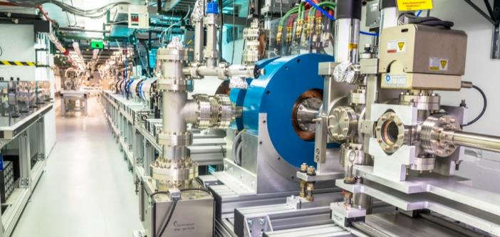
From Limits to Breakthroughs: Short-Pulse RF Acceleration at GV/m level gradient
Afosr+nsf scientific opportunities with compact, high intensity accelerators
erhtjhtyhy
Chunguang Jing
Euclid Techlabs LLC,
Argonne National Laboratory
2/24/2026

Slide 2
outline
Dependence of Gradient on RF pulse length
  Scaling law?
  Observation from CLIC 30GHz era
  Discovery of BIAR (breakdown insensitive accelerator regime) at AWA
Make a short RF pulse case for >500MeV/m gradient
Challenges and R&D work

Slide 3
Dependence of Gradient on RF pulse length

Slide 4
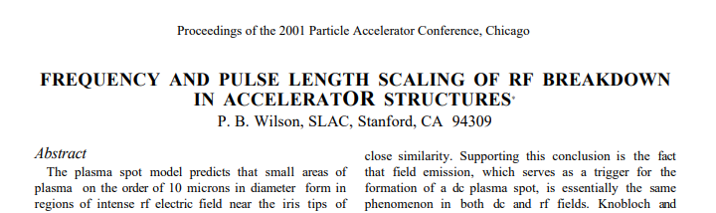
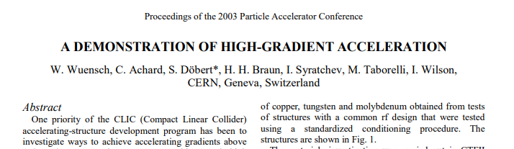
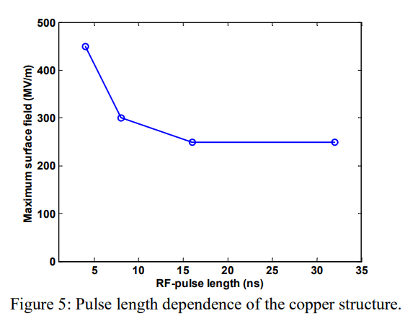
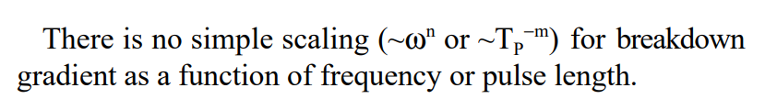
Relevant history of studying RF breakdowns dependences on rf pulse length
Theoretical model
Experimental efforts

Slide 5
Empirical scaling law
SLAC Breakdown and pulse heating study 2010 (from F. Wang, AAC10 presentation)
Empirical formula summarized from decade of high gradient accelerator research (x+k_{a} bands)
Shorter pulse length
BDR∝E³⁰τ⁵
A. Grudiev et al., Phys. Rev. ST-AB, 12, 102001 (2009).
110 MV/m
Freq. | Pulse length (ns) | Max. Grad. (MV/m)
S-band at FERMI 2.0 | 700 | 28
C-band in Japan | 300 | 50
X-band at CERN | 180 | 120
SLAC Breakdown study 2008 (from V.A. Dolgashev, AAC10 presentation)
Shorter pulse length

Slide 6
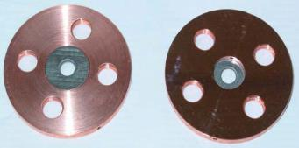
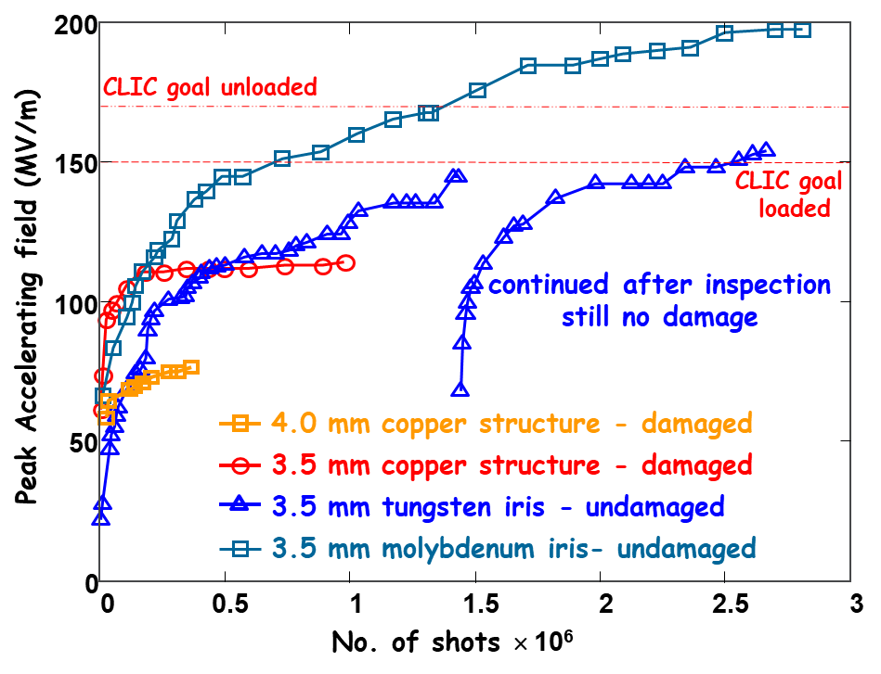
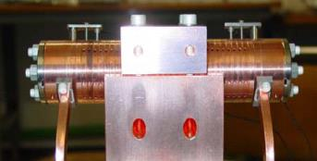
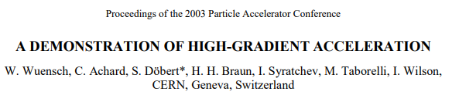
Observation from CLIC 30GHz era
A 30-cell structure with Mo irises and low E_{S}/E_{A} largely exceeded the CLIC accelerating field requirements without any damage
190 MV/m accelerating gradient in first cell - tested with beam ! (but only 16 ns pulse length)
30-cell clamped tungsten-iris structure

Slide 7
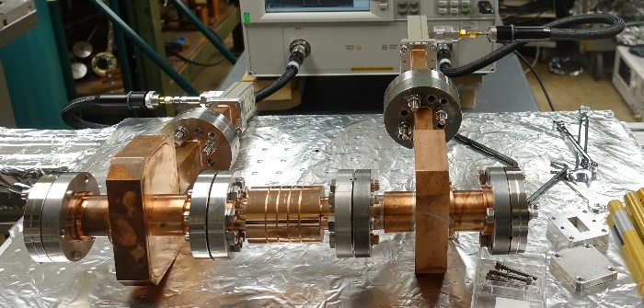
Discovery of BIAR (breakdown insensitive accelerator regime) at AWA-I
Single-cell structure
- Optimized for maximum transient gradient
Normal cell properties (11.7 GHz)
Iris diameter | 6.1 mm
Iris thickness | 2.9 mm
Phase advance | 120 degree
Quality factor | 6070
Shunt impedance r/Q | 1.4x10⁴ Ω/m
Group velocity | 0.0114c
92%
80%
100%
93%
- The input matching cell has higher gradient and surface field than the normal cell

Slide 8
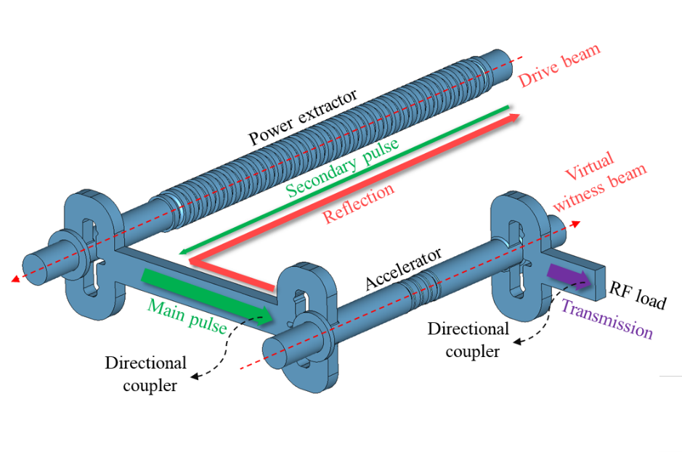
Discovery of BIAR at AWA-II
Experimental setup
RF conditioning
Main pulse
Input
pulse
- 7.7x10⁴ pulses accumulated at 2 Hz repetition
Secondary pulse
Conditioning
Testing
Normal transmitted pulse
Main pulse
Secondary pulse

Slide 9
Discovery of BIAR at AWA-III
BD type I
BD type II
- Distorted main pulse
- Disappeared after conditioning
- Likely to be caused by multipacting
- Blocked secondary pulse and normal main pulse
- Probability decreases after conditioning
- Likely to be caused by RF breakdown
H. Xu et al., PRAB 22, 021002 (2019)
Main pulse
Main pulse
Secondary pulse
Secondary pulse

Slide 10
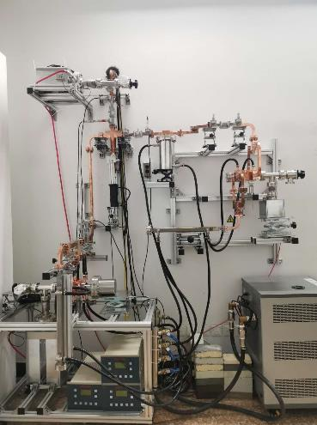
Long-pulse high-power test at Tsinghua
Experimental setup
RF conditioning
- Driven by klystron with pulse compressor
- 2.3x10⁷ pulses accumulated at 40 Hz repetition
Courtesy of Hao Zha
Y. Jiang et al., IEEE Trans. Microw. Theory Tech., 69, 1586-1593, (2021)

Slide 11

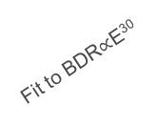
Results discussion (I)
E_{a}τ_{p}^{1/6} =Const.
Comparison of short and long pulse results
Accelerating gradient of the normal cell and the input matching cell reaches 270 MV/m and 310 MV/m
Surface field of the input matching cell reaches 500 MV/m
Gradient improved at least twofold using short pulse (limited conditioning period, only secondary pulse taken into consideration)
BDR vs. pulse length doesn’t follow the empirical scaling law in short-pulse regime
$${(\frac{54 ns}{6 ns})}^{1/6}$$
Fit to BDR$∝$E³⁰
New physics of RF breakdown in short-pulse regime

Slide 12
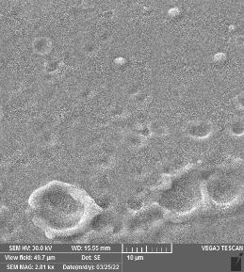
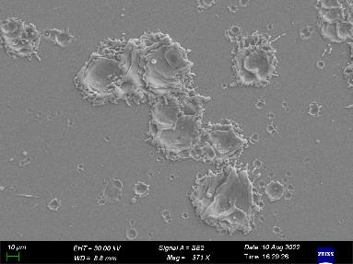
Results discussion (II)
Breakdown Insensitive Acceleration Regime (BIAR)
0 ns
RF causes BD and plasma generation
RF pulse
after ~10 ns
Plasma expansion to block RF transmission
ANL: ϕ10-20 μm
Tsinghua: ϕ30-100 μm
Transmitted RF pulse and accelerated beam not influenced by RF breakdown
Reduced structure damage due to limited energy available for breakdown avalanche

Slide 13
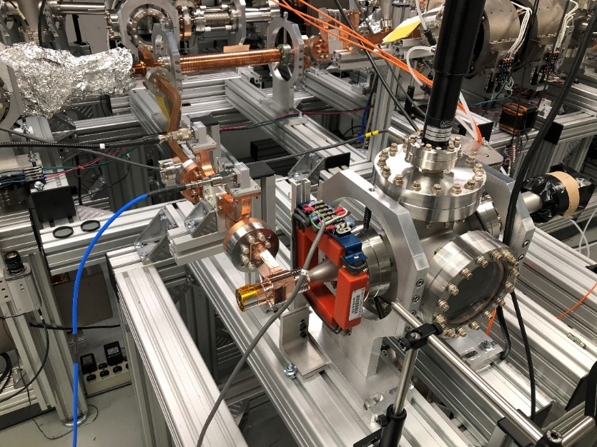
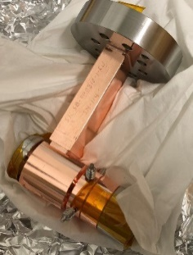
Another example: short pulse RF photogun
Achieved 350MV/m on cathode
Observed strong dark current loading regime but quickly conditioned away
It only took 70k pulses for a full condition
Back to 200MV/m to 250MV/m region, no breakdown, no measurable dark current
Dark current loading
Conditioning & dark current reduction
Quick ramp-up
d
a
beam
b
c
PETS
RF
a
b
c
d
Prototype TW-gun
Reflection signal from bi-directional coupler
Euclid, SBIR Grant #DE-SC0018709, 2020

Slide 14
Make a short RF pulse case
for
>500MeV/m gradient

Slide 15
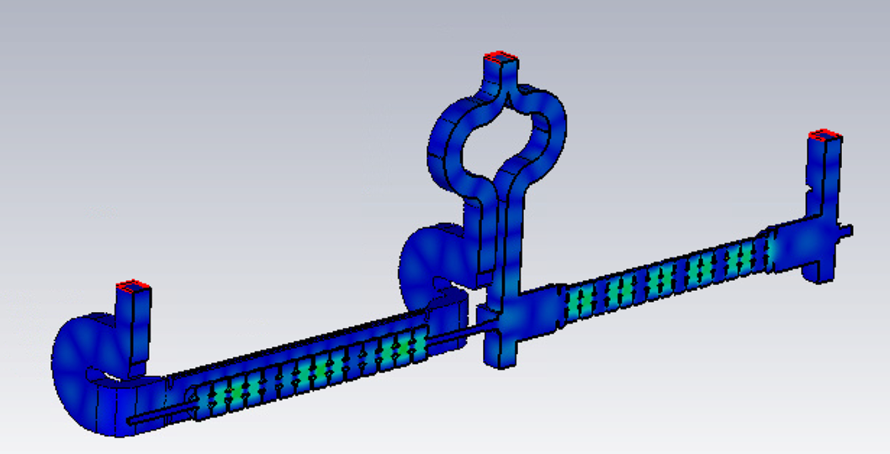


Short Pulse Acceleration to achieve 500MeV/m of geographical gradient
Hybrid FW-BW-accelerator
BW
We are currently developing an X-band accelerator operating in the short pulse regime.
FW
Parameters | Designed Values
Freq. | 11.7 GHz
Filling time | 6 ns
Structure length | 25 cm
Input Power | 320 MW
Gradient | 170 MV/m
$$\frac{R}{Q}=\frac{{\left(E_{a}L_{cell}\right)}^{2}}{ωU}$$
$$U=\frac{P}{V_{g}}$$
Simply scale this structure to 11.7*3=35.1GHz, then R/Q is the same, Vg is the same, then 300MW will build up ~500 MV/m. If double the power from PETS to 600MW, the gradient will be ~700 MV/m. If the fill factor is 0.7, the geographical gradient will be ~500MeV/m.
But, the beam aperture will be <1.5mm. (ref. CLIC 30GHz has aperture 2.4mm~3.2mm.)

Slide 16
On the power source side
 | AWA X-band PETS in operation | Scale 3 X frequency
PETS basics | Metallic ID=17.6 mm | L=30 cm | Metallic ID=5.9 mm | L=30 cm
PETS freq. | 11.7 GHz | 35.1 GHz
Power | ~400 MW | ~600 MW
Pulse length | ~9 ns (full) | ~15 ns (full)
σ_{z} | F(ω) | 1 mm | 0.94 | 0.5 mm | 0.93
Qb | 50 nC | 9 nC | 3 nC | 1 nC
Bunch spacing | 796 ps | 256 ps | 85 ps | 28 ps

Slide 17
Challenges and R&D work

Slide 18
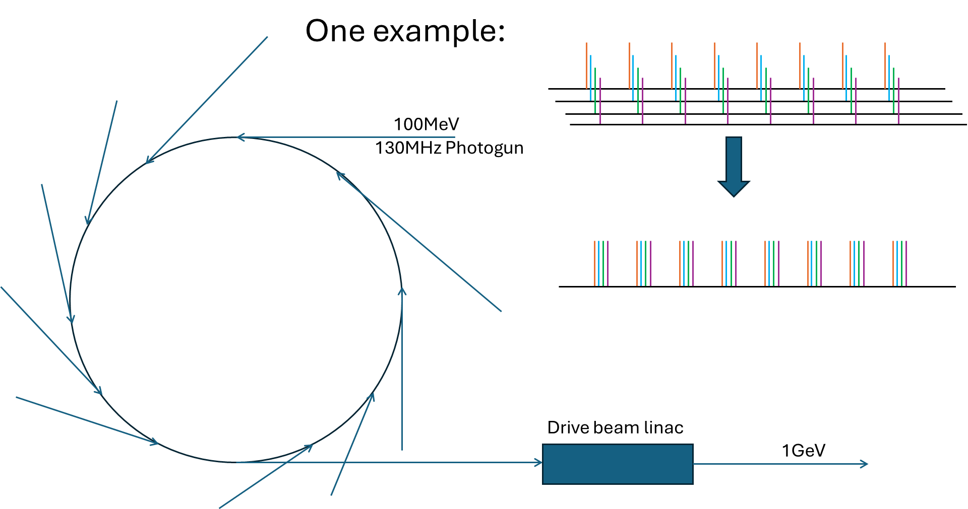
Accelerators Subject to study tailed to short pulse regime
  Main accelerating structure (WF, BD)
  Power extractor (WF)
  Drive beam production

Slide 19
single bunch applications
If we use this as a Figure of Merit for an accelerating structure,
Def: RF usage rate
 | Klystron power | Energy gain | MeV/(MW*Trf[us]) per Str.
S-band standard | 50MW, 3us | 50MeV in 3m (16.7MeV/m) | 0.33
NLC Xband | 75MW x 2=150MW, 1.6us, compress to 450MW, 400ns | 270MeV in 6.5m ( 6 structures, total 5.4m structures,83% fill factor, 50MeV/m) | 1.5
CLIC-Kly Xband | 53MW x 2=106MW, 2us, compress to 170MW x 2=340MW, 334ns | 276MeV in 4.6m (80% fill factor, 8 structures, 0.46m ea., 75MeV/m) | 2.43
CLIC-TBA Xband | 132MW from ea. PETS, 176.5ns | 46MeV in 57.5cm (80% fill factor, 2 structures, 23cm ea. , 100MeV/m) | 2
Short Pulse X-band-TBA | 537MW from ea. DPETS, 22ns | 36MeV in 37.5cm (80% fill factor, one structure, 30cm, 120MeV/m) | 3
Short pulse X-band Kly | 20MW, 1us, compress to 250MW, 10ns | 40MeV in 25cm (80% fill factor, one structure, 20cm, 200MeV/m) | 16*
Notes:
One drive beam to rule them all (simple), drive beam gives the accelerator designer frequency freedom
Could energy jitter get translated to timing jitter in the kickers?

Slide 20
Remarks
  CLIC 30GHz era left abundant data and many unanswered questions, which is worth revisiting them.
  Experiments in short pulse regime exhibits some unique performance which is worth exploring.
  Challenges on wakefield damping are tremendous, but it may work perfectly for the single bunch or light beam loading applications.
Notes:
One drive beam to rule them all (simple), drive beam gives the accelerator designer frequency freedom
Could energy jitter get translated to timing jitter in the kickers?

Slide 21
Thanks for your attention!

