Slide 1

“Scientific Opportunities with Compact, Intense Accelerators”
Welcome and Introduction
Nigel Lockyer and Jared Maxson
Cornell University Laboratory For Accelerator-Based Sciences and Education (CLASSE)
Cornell High Energy Synchrotron Source (CHESS)

Slide 2
Organizational Details
Thank you for coming! We have an exciting 2.5 day workshop planned.
We are extremely grateful to our hosts, Dr. Joel Bixler, AFOSR HERMES program officer, and the BRICC facility.
BRICC Details, WIFI, presenter options: our laptop or yours
Snacks: available for purchase
Lunch/Dinners: on your own. A Lunch recommendation: Ballston Quarter Food Court (10 min walk).
Live agenda: https://indico.classe.cornell.edu/event/2576/

Slide 3
Why are we here?
“Conventional” particle accelerator technology is undergoing rapid change.
For example: energy gain per unit length (“gradient”) used to be measured in 10s of MeV/meter. Experimental structures are now reaching >100 MeV/m, or even hundreds of MeV/m.
Gains in compactness, cost, and peak intensity
You don’t have to take my word for it, our speakers will do a better job.
NSF+AF Memorandum of Understanding—this workshop an opportunity to connect!

Slide 4



AFOSR+NSF+DOE: Fundamental Accelerator R+D
DOE has been a major supporter of this fundamental R+D: across HEP, ARDAP, BES, NP, and NNSA.
NSF has provided significant support to fundamental accelerator R+D, recent example the Center For Bright Beams
AFRL supports a variety of novel particle acceleration and radiation generation techniques
We hope our workshop might help increase interactions among these programs and their researchers.

Slide 5
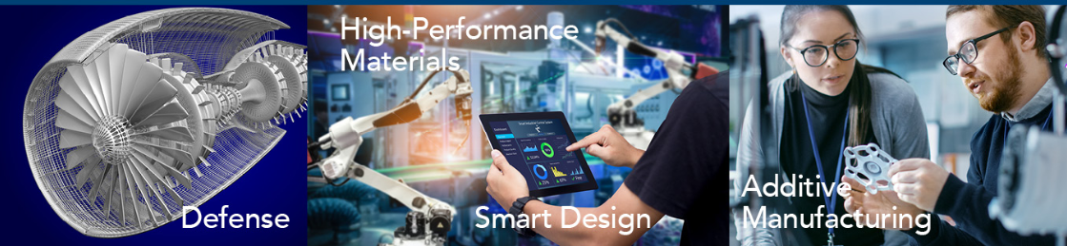
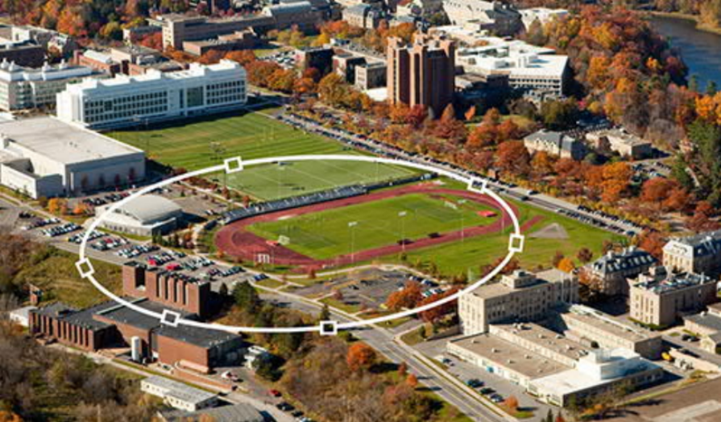
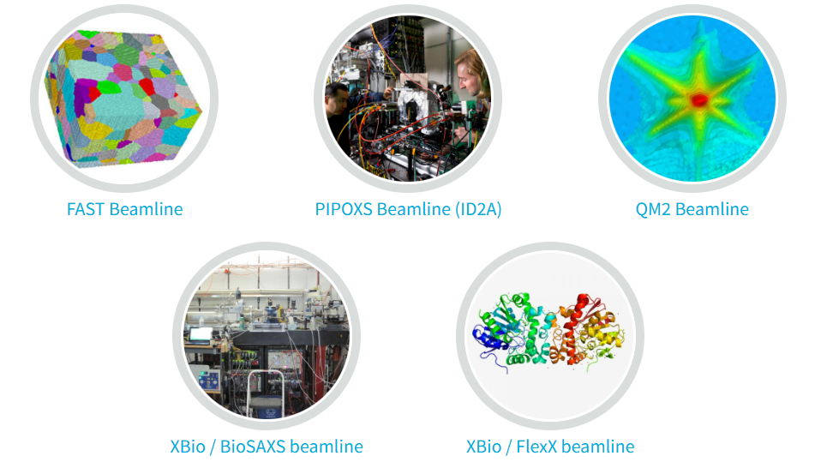
Using Accelerator Technology
DOE operates large accelerator facilities around the US, obviously!
NIH also funds beamlines at Cornell CHESS, and in DOE-based synchrotrons.
NSF and AFRL also fund the operation of particle accelerators.
Examples: CHESS at Cornell is supported by NSF [the CHEXS facility] and AFRL [the MSN-C facility]
MSN-C
CHESS
CHEXS
Supported by: NSF, AFRL, NIH, NYS, Cornell

Slide 6
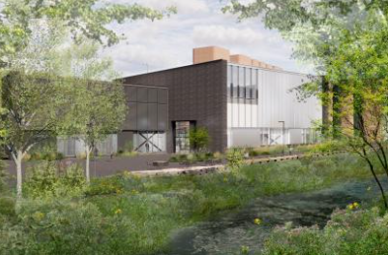
Using Accelerator Technology
DOE operates large accelerator facilities around the US, obviously!
NIH also funds beamlines at Cornell CHESS, and in DOE-based synchrotrons.
NSF and AFRL also fund the operation of particle accelerators.
Examples: CHESS at Cornell is supported by NSF [the CHEXS facility] and AFRL [the MSN-C facility]
MSN-C
New NSF projects:
CHESS
High Magnetic Field
Beamline
XLEAP: Agriculture and Plant Sciences Beamline
Supported by: NSF, AFRL, NIH, NYS, Cornell

Slide 7
Using Accelerator Technology
DOE operates large accelerator facilities around the US, obviously!
NIH also funds beamlines at Cornell CHESS, and in DOE-based synchrotrons.
NSF and AFRL also fund the operation of particle accelerators.
Examples: CHESS at Cornell is supported by NSF [the CHEXS facility] and AFRL [the MSN-C facility]
MSN-C
CHESS
New AFRL accelerator Projects:
High power, high gradient test beamline (DURIP-selected for funding)
Collaboration with Kirtland AFB via AFRL Regional Network
Supported by: NSF, AFRL, NIH, NYS, Cornell

Slide 8
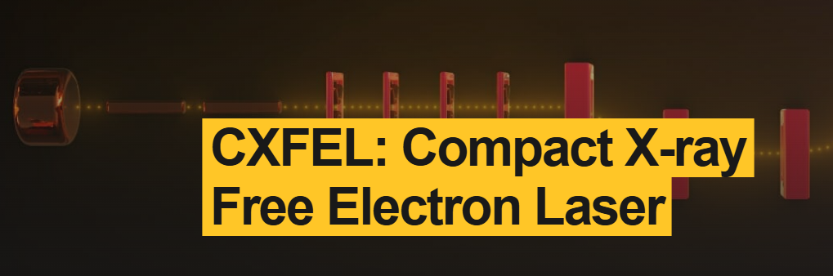
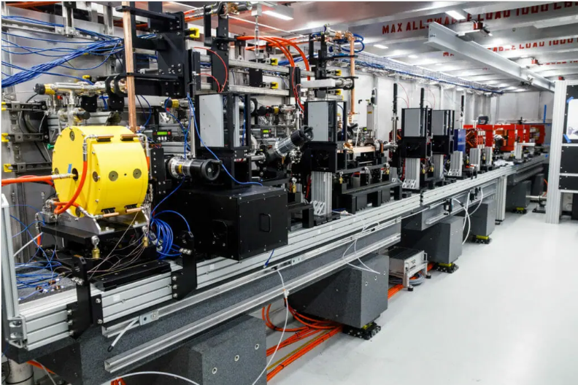
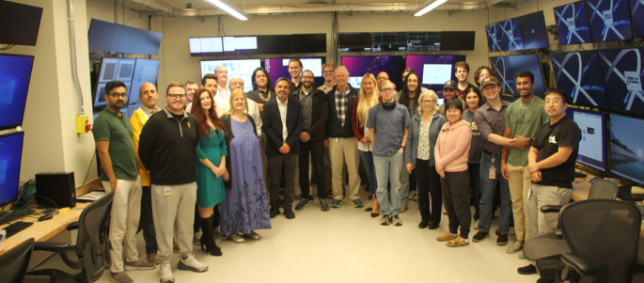
Using Accelerator Technology
DOE operates large accelerator facilities around the US, obviously!
NIH also funds beamlines at Cornell CHESS, and in DOE-based synchrotrons.
NSF and AFRL also fund the operation of particle accelerators.
Examples: CXFEL at Arizona State University funded by NSF (MSRI 2)
CXLS

Slide 9
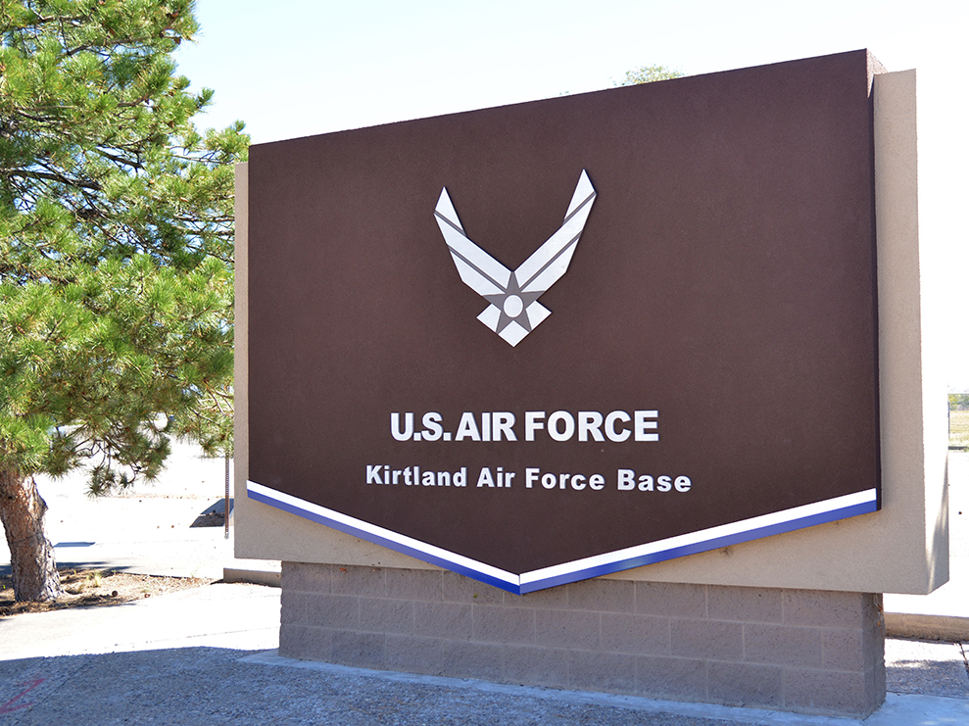
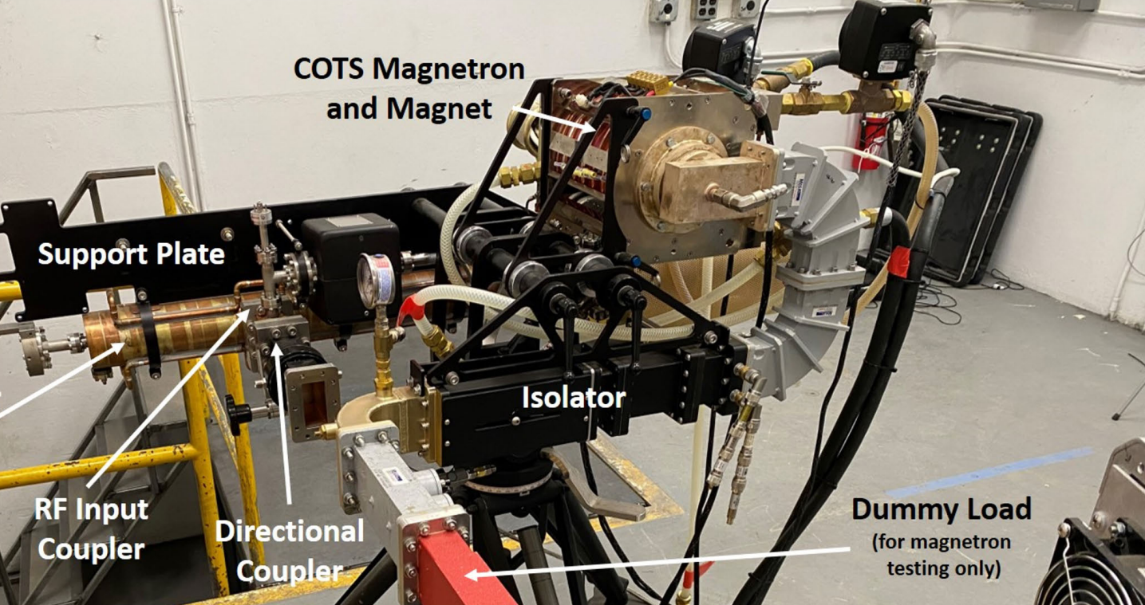
Using Accelerator Technology
DOE operates large accelerator facilities around the US, obviously!
NIH also funds beamlines at Cornell CHESS, and in DOE-based synchrotrons.
NSF and AFRL also fund the operation of particle accelerators.
Examples: Scientists at Kirtland AFB are developing compact particle accelerators for defense, security, and basic research applications.
The SPEBS Accelerator, R. Bruce Miller et al.
DOI: 10.1109/TPS.2023.3255004 (2023)

Slide 10
Workshop Mission
Accelerators are everywhere, including chip fabrication, health and cancer therapy, electron microscopes….
How can we leverage upcoming compact accelerators for new science at AFRL and NSF?
We will explore:
X-ray materials research: focus on quantum and functional materials
New x-ray production modalities (particularly compact x-ray free electron lasers)
Upgrading existing storage rings (CHESS and several around the world)
Directed energy opportunities
High energy density science
Crossover topics: ultrafast electron microscopy, quanta control, chips
Also wish to make connections to other high impact areas:
Health applications/cancer therapy—connections to NIH?
Connections to NNSA and other DOE applications

Slide 11
Disclaimer
This coverage is clearly incomplete! We have limited time.
Accelerator technology covered here will focus on normal conducting RF, with several nods to plasma acceleration.
Many advances in superconducting RF recently also, but not covered here. Perhaps covered in a future workshop!

Slide 12
Thank you to all those who have helped us craft the workshop
Thanks to our co-organizers: Emilio Nanni, John Luginsland, Joel Bixler
Charles Ying, Debassis Majumdar of NSF, and Germano Iannacchione (WPI, formerly NSF)
Rich Vaia, Paul Shade, Hilmar Koerner of AFRL
Our entire team of speakers has helped advise us on the scientific program, suggested additional speakers, honed message, and more. Thank you!

