Slide 1


Facilitating Industry Access to MSN-C
Arthur Woll

Slide 2
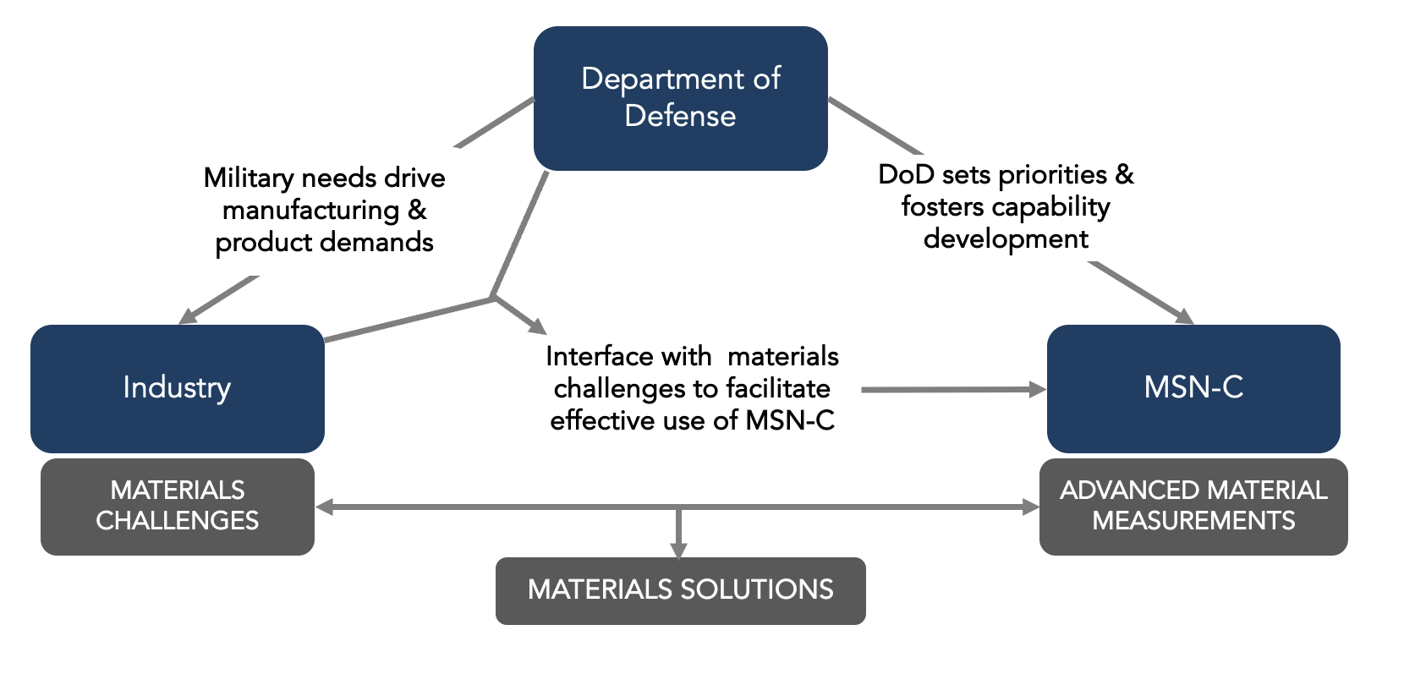
The MSN-C Mission & Model
MSN-C Access
MSN-C Mission: Develop, mature & leverage world-class synchrotron x-ray tools and research to solve critical DoW-relevant challenges faced by DoW and its industry partners.
Notes:
Clarify

Slide 3
MSN-C as a Sponsored Program
MSN-C Access
MSN-C Mission: Develop, mature & leverage world-class synchrotron x-ray tools and research to solve critical DoW-relevant challenges faced by DoW and its industry partners.
Sponsored Beamtime directly serves this mission:
Is governed by the MSN-C / AFRL cooperative agreement.
Is free of charge, including scientific and technical support.
Always includes AFRL/DoW as an implicit collaborating partner.
AFRL retains rights to raw & processed data generated by MSN-C.
Can include handling of proprietary, EAR, and/or ITAR components and data.
Vision: Facilitate access to MSN-C tools for broader use by DoW industry partners, i.e. beyond DoW-critical projects.
Unsponsored Beamtime:
Is governed by a contract between Cornell and company.
Requires AFRL approval, but need not include AFRL as a collaborating partner
AFRL may waive rights to data generated by MSN-C.
Is not free: fees based on beamtime and level of scientific and technical support.
(Currently): Can include handling of proprietary and/or EAR components and data.
Notes:
Clarify

Slide 4
MSN-C Access, Revisited
MSN-C Access
Review,
DoW (AFRL)
Inquiry
Discussion
Beamtime Proposal Submission
Allocation, Scheduling
Safety
Notes:
Clarify

Slide 5
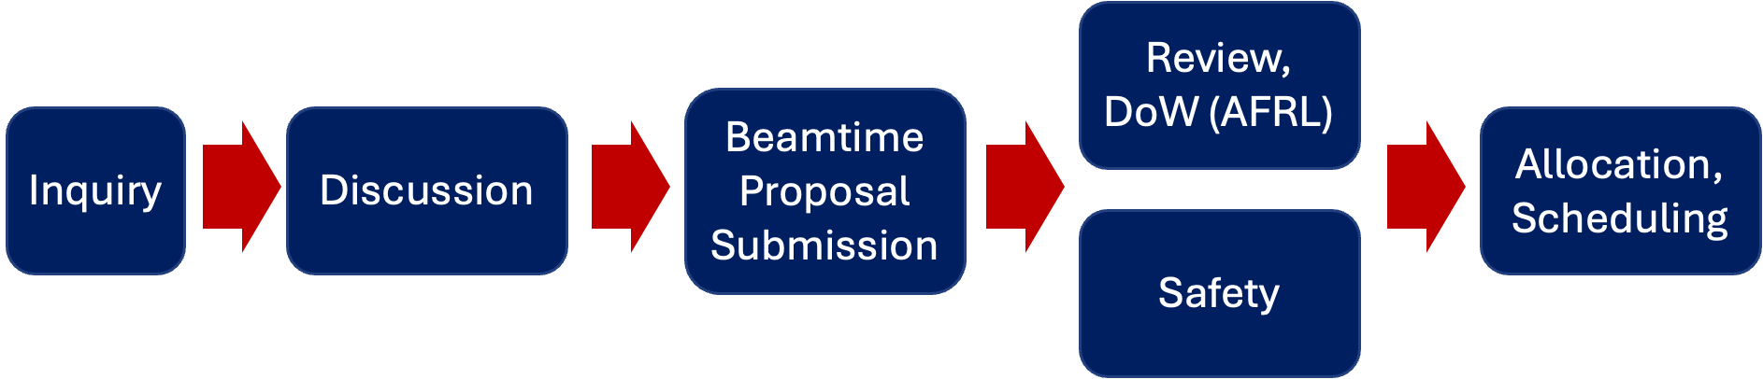
MSN-C Access, Revisited
MSN-C Access
Discussion:
Usually involves all three of AFRL/DoW, Company, and MSN-C
Topics:
Information Restriction Needs:
- Is an NDA between MSN-C and the Company needed before substantive discussion? (if so, discussions may begin strictly with AFRL, not MSN-C).
- Will Export Controlled data or samples be involved?
for discussions?
for the experiments?
Scientific Challenges, Desired Outcomes
Experimental Design
Duration: Weeks to months
Notes:
Clarify

Slide 6
Envisioning an MSN-C Industry Consortium
MSN-C Access
Goals:
Facilitate both sponsored and unsponsored industry access to MSN-C, esp. discussion related to NDAs, IP, etc.
Provide dedicated resources (personnel, documentation, logistics) for industry engagement.
Provide systematic opportunities and means for industry to influence capability development, e.g. through more frequent workshops like this.
Facilitate links & access to network resources such as the Mid-Atlantic Regional Network and nMat
Bolster public support of MSN-C and related resources by demonstrating broad impact to decision makers.
Notes:
Clarify

Slide 7
END

