Slide 1


FMB Overview at the Materials Solutions Network at CHESS (MSN-C)
Arthur Woll (Director, MSN-C), Christopher Budrow, J.Y. Peter Ko, Hilmar Koerner, Matthew Miller, Kelly E. Nygren, Kirt Page, and Paul Shade
Symposium: Additive Manufacturing: Advanced Characterization with Synchrotron, Neutron, and In Situ Laboratory-Scale Techniques IV
Notes:
Monday 3/16 – 9:00 AM.

Slide 2
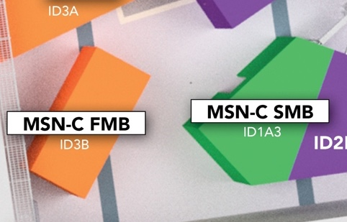
MSN-C Beamlines
What is MSN-C?
MSN-C SMB: Structural Materials Beamline
Monochromatic mode: 40-90 keV
White Beam: (50-200 keV)
Focus: In-situ and Ex situ characterization of processing and performance or metals and alloys.
MSN-C FMB: Functional Materials Beamline
Energies: 9-30 keV
Focus: In-situ & Ex situ characterization of polymers, composites, thin film structure and processing.

Slide 3
FMB Team Core Competencies
Polymer Structure and Dynamics (Hilmar/Kirt)
Materials Science (Mia)
Mechanical Engineering (Mathew/Joe)
Data Science and Analytics (Jacob/Devin)
Additive Manufacturing (Arthur/Mia/Kirt)
X-ray/Neutron Scattering (Arthur/Peter/Kirt/Hilmar)
Measurement/Methods Development
FMB/SMB Functional Goal
Provide broad expertise in service of finding solutions to materials processing and manufacturing challenges

Slide 4
CHESS Partner Model : FMB Access
MSN-C Access
Review,
AFRL and MSN-C
Review,
AFRL and MSN-C
AFRL Sub-facility
AFRL Sub-facility
Submission
Allocation, Scheduling
Submission
Allocation, Scheduling
Safety
Safety
Before submission contact one of the following people for assistance in determining feasibility and proposal development.
ion
AFRL: Hilmar Koerner
(hilmar.koerner.1@us.af.mil)
MSN-C/CHESS: Arthur Woll (arthurwoll@cornell.edu)
Peter Ko (peter.ko@cornell.edu)
AV Inc.: Kirt Page (kirt.page.ctr@afrl.af.mil)
Notes:
Today’s talk is two stories that highlight the effect of this change in access: industry and DoD need - including manufacturing challenges rather than publication – has driven innovation and ease of use of instrumentation and software. But that development, in turn, feeds back to fundamental research by enabling greater sophistication and accessibility of otherwise challenging data.

Slide 5
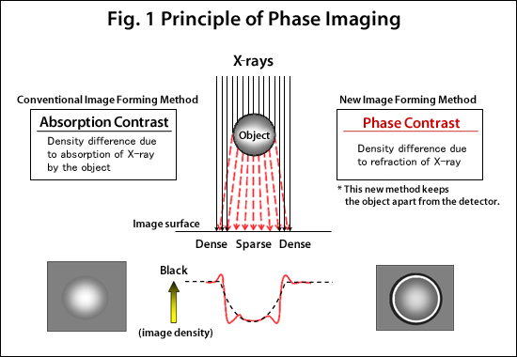
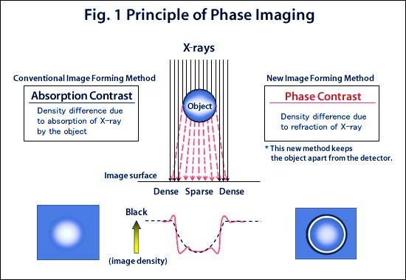
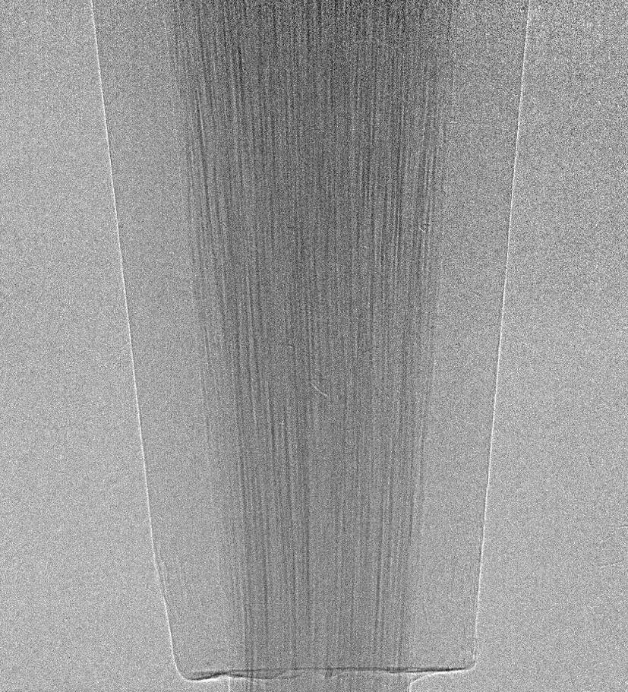
FMB Core Capabilities
FMB Core Capabilities
SAXS/WAXS microbeam Mapping
Full field Imaging & CT
Length & Time scales
image rate: hours / image
field of view: ~1 cm²
resolution: 1.3 x 13 µm² (beamsize)
image rate: 50 Hz (per radiograph)
field of view: ~3 x 3 mm²
resolution: ~2 µm abs. contrast
5-6 µm phase contrast
SAXS/WAXS mapping
(hours/
image)
Full-Field Imaging
(50 Hz)
Typical SAXS/WAXS beamsize
SAXS
WAXS

Slide 6
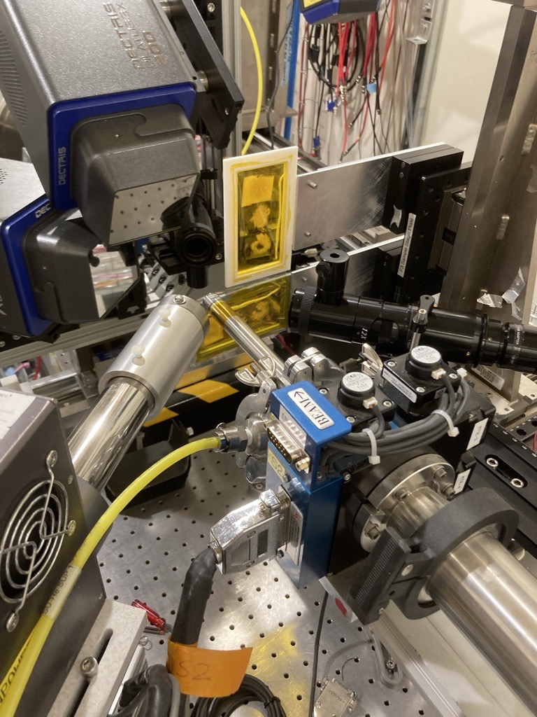
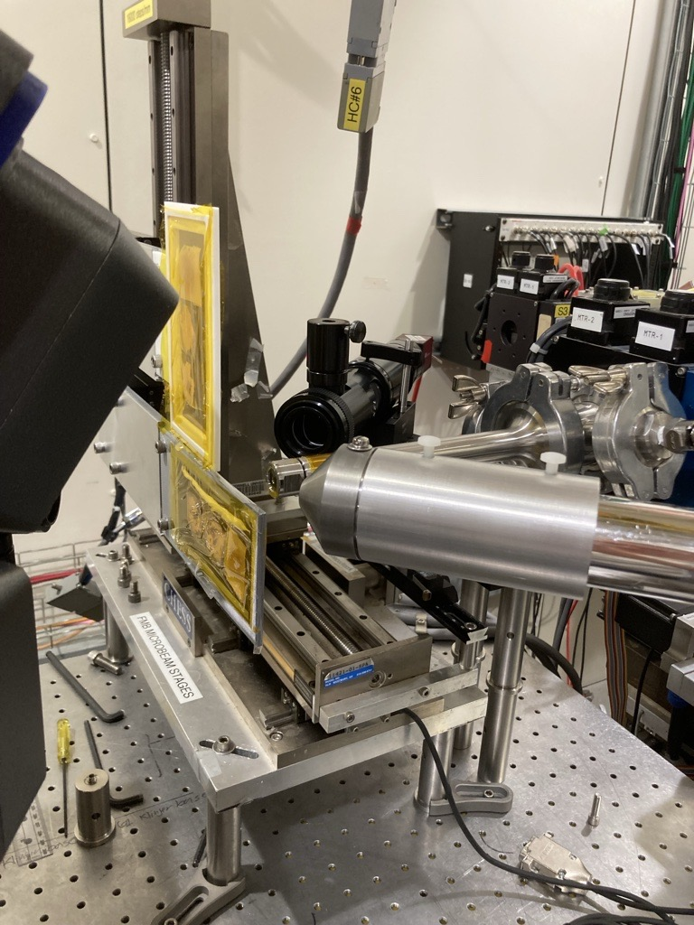
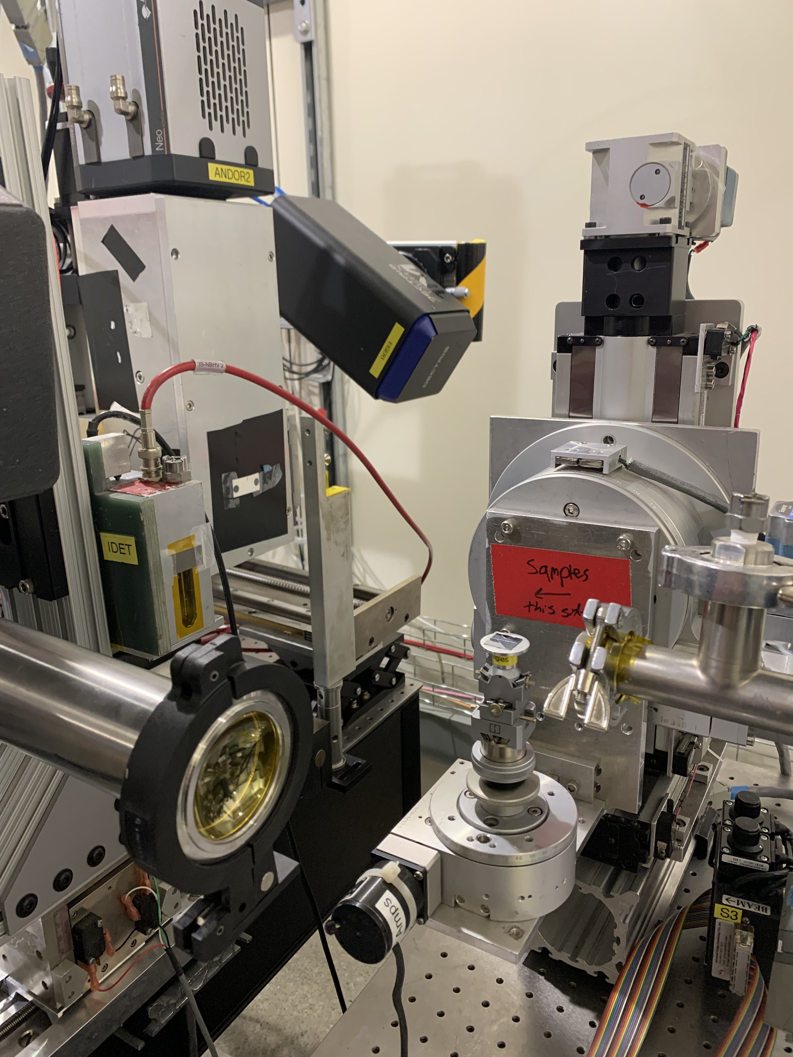
FMB Core Capabilities
XRF microbeam Mapping
Grazing-Incidence
Length & Time scales
SAXS/WAXS mapping
(hours/
image)
Full-Field Imaging
(50 Hz)
SAXS
WAXS
Notes:
The beamline is also capable of doing microbeam chemical mapping using X-ray fluorescence spectroscopy while simultaneous doing SAXS/WAXS. Mention Mia’s structural batteries work. During my time as a post-doc at CHESS, I helped to build out the GI scattering capabilities which is currently being leveraged by AFRL and researchers at Cornell other DoD partners to explored the processing-structure relationships in thin-film COFs.

Slide 7
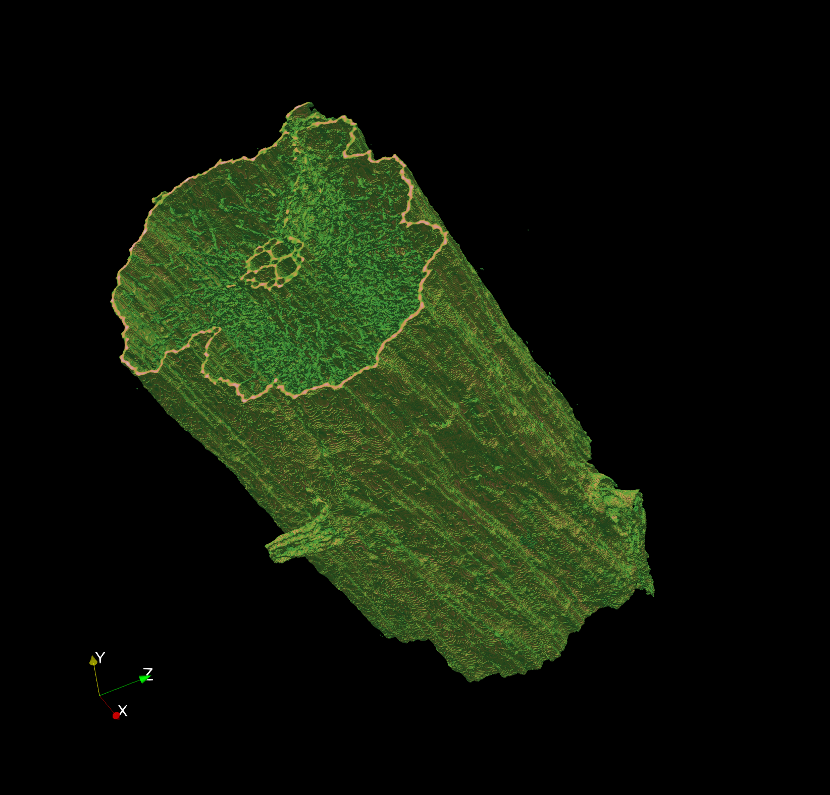
FMB Core Capabilities
Full Field: Absorption or Phase Contrast Imaging and Tomography
We have effectively demonstrated tomographic reconstruction and can do so under mechanical load.
Freeze-dried wheat stem 15.8 keV

Slide 8
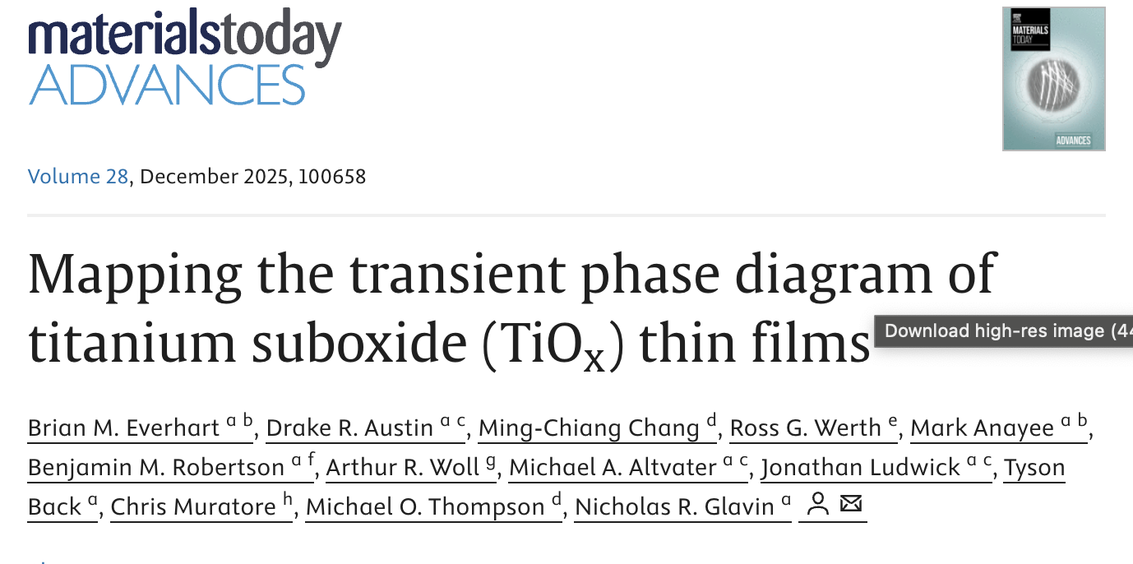
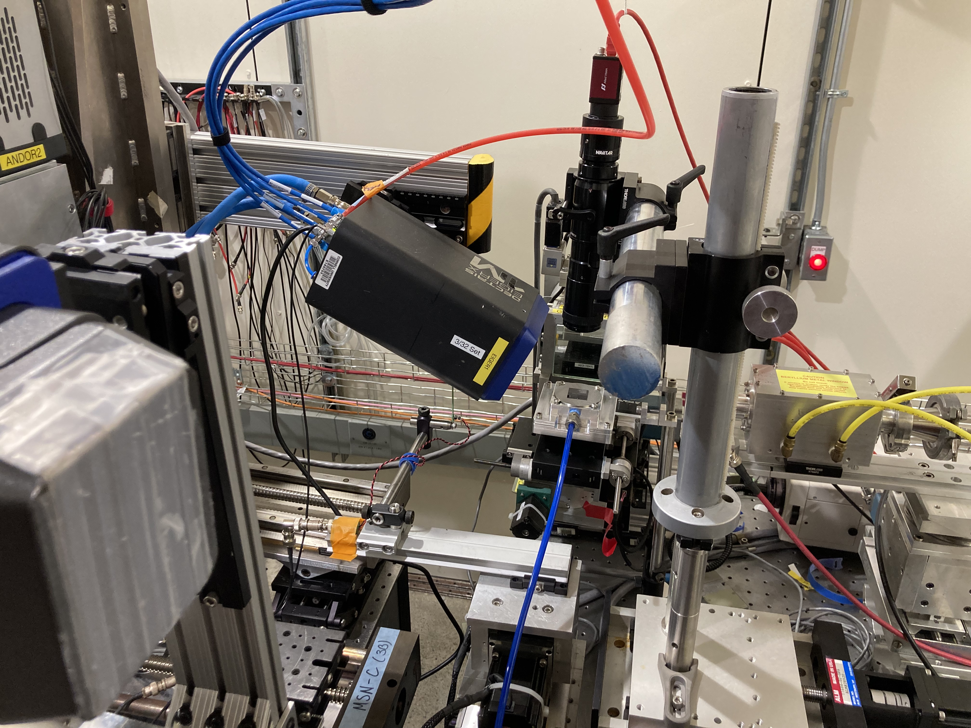
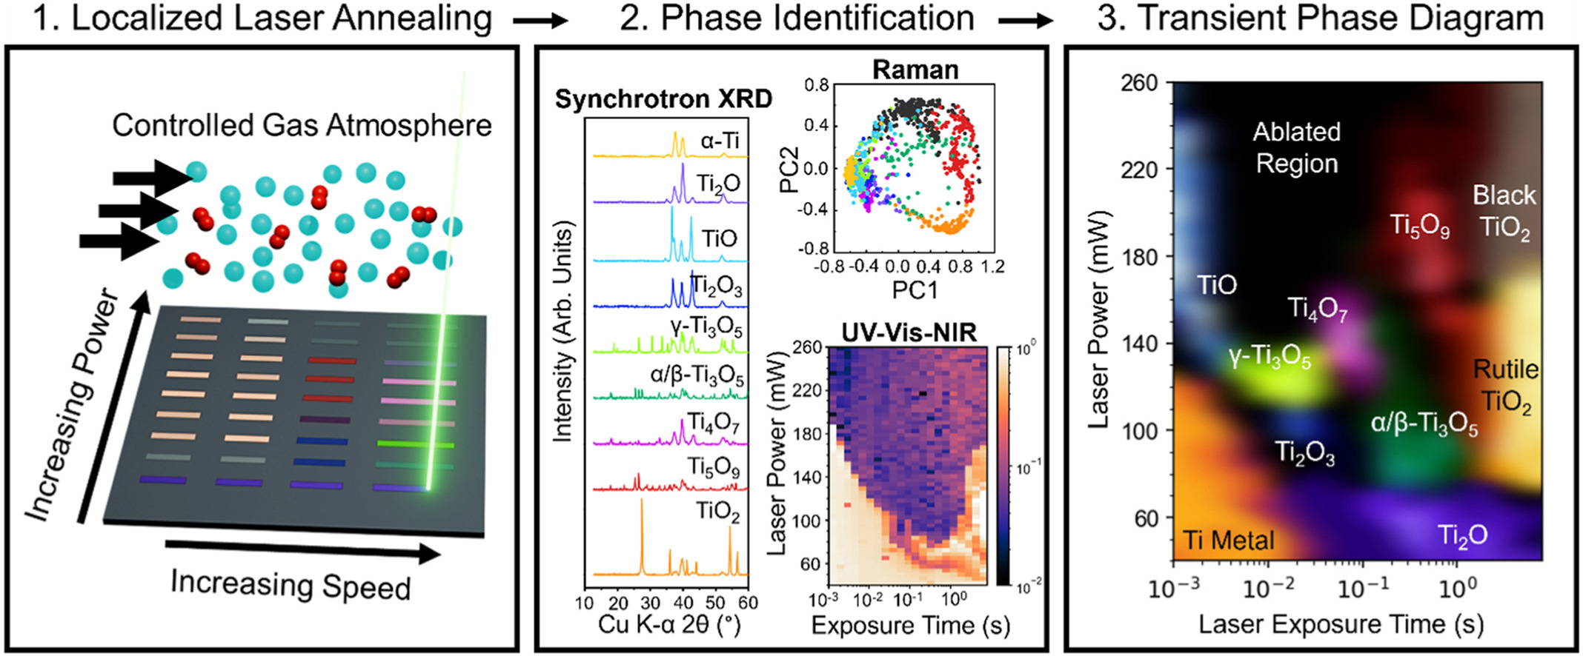
High-throughput Phase Diagram Characterization

Slide 9
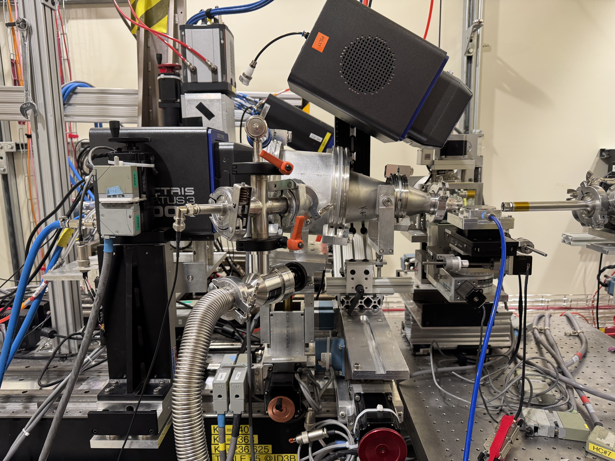
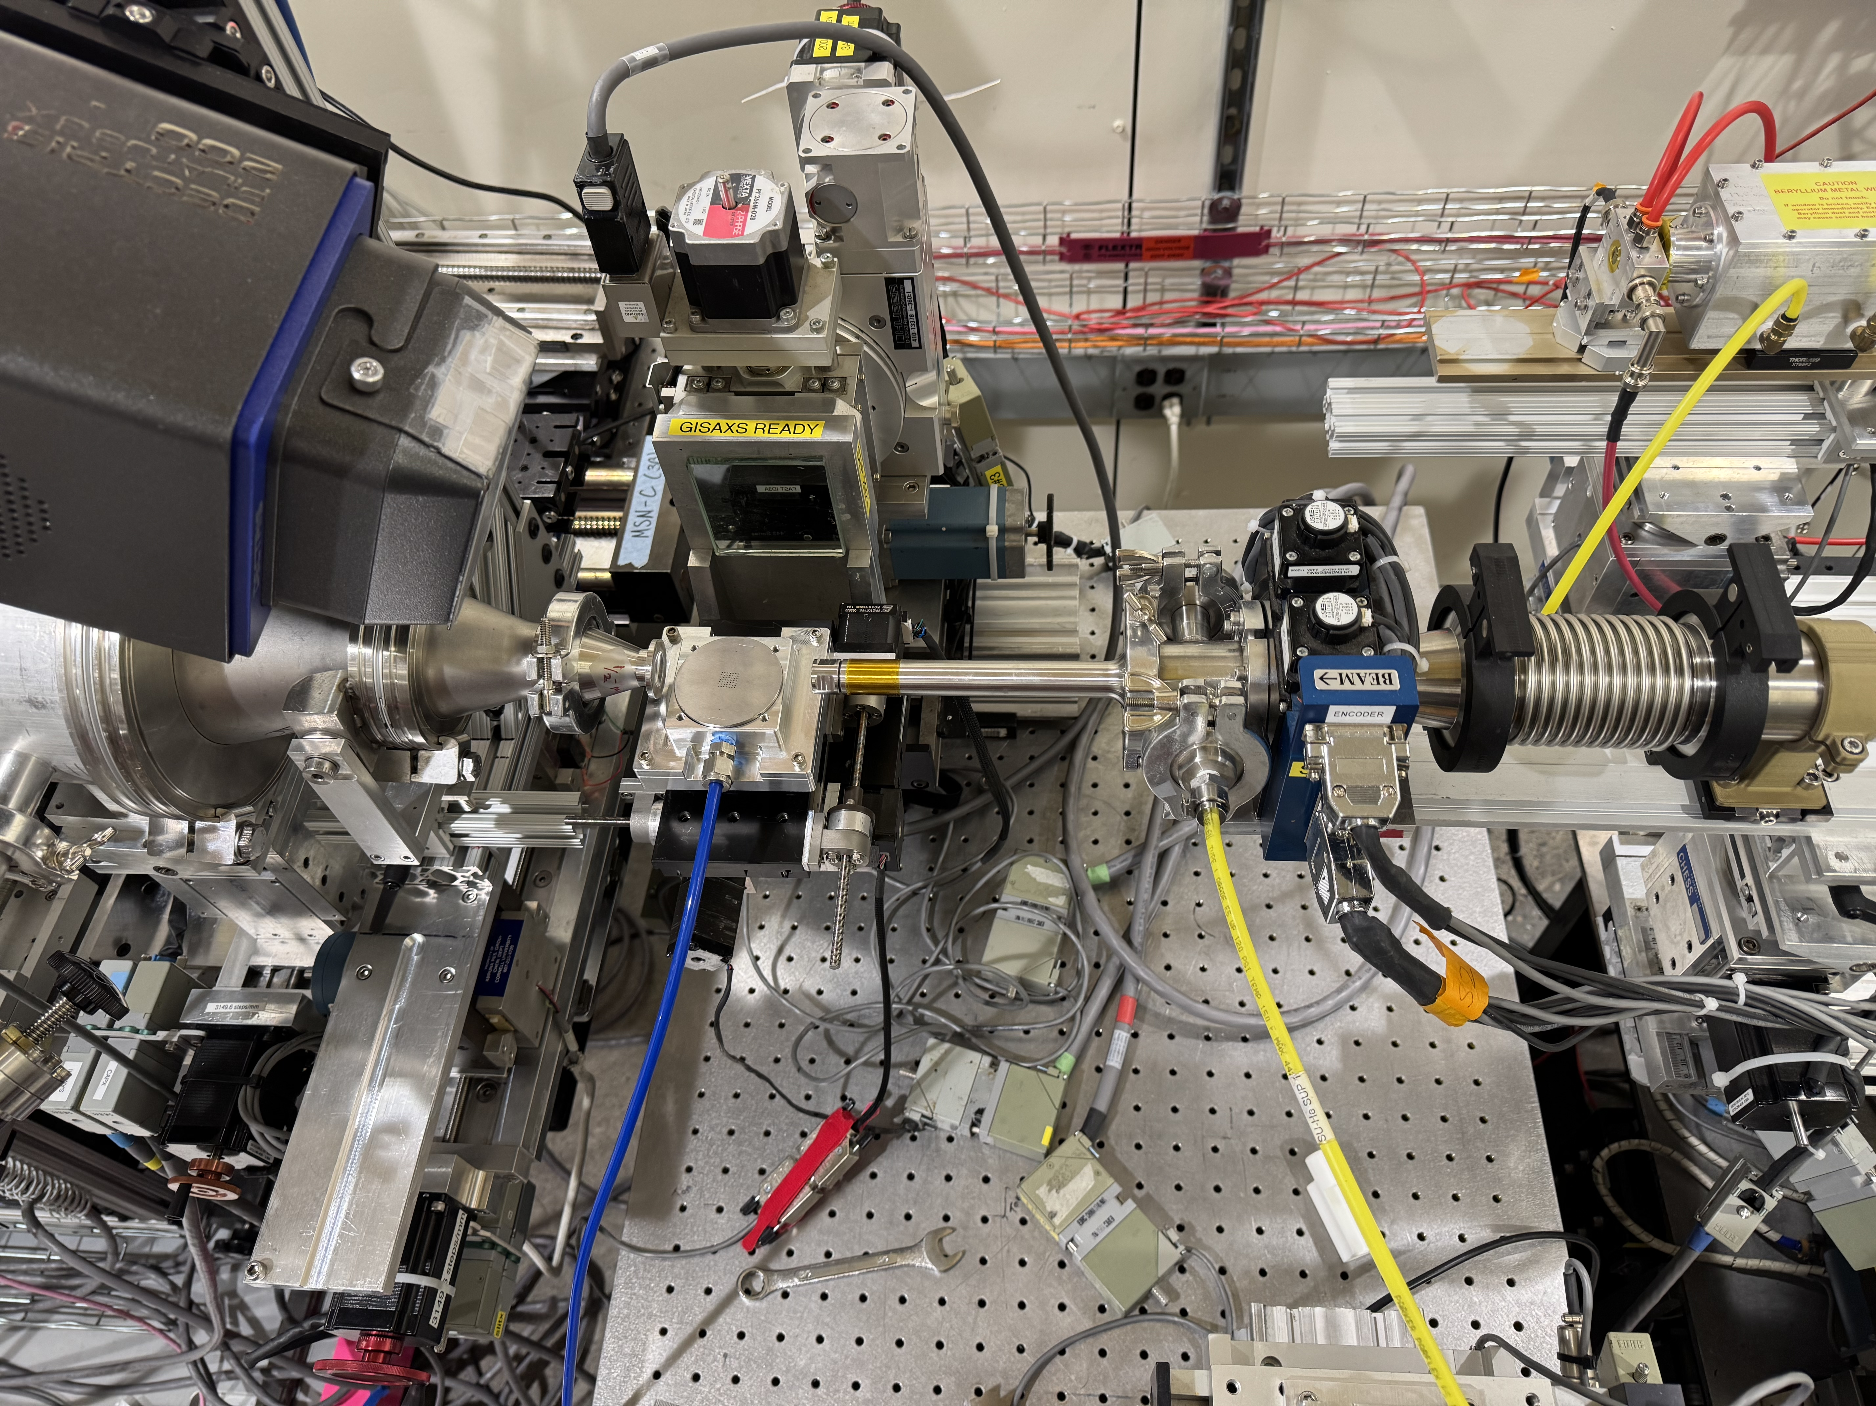
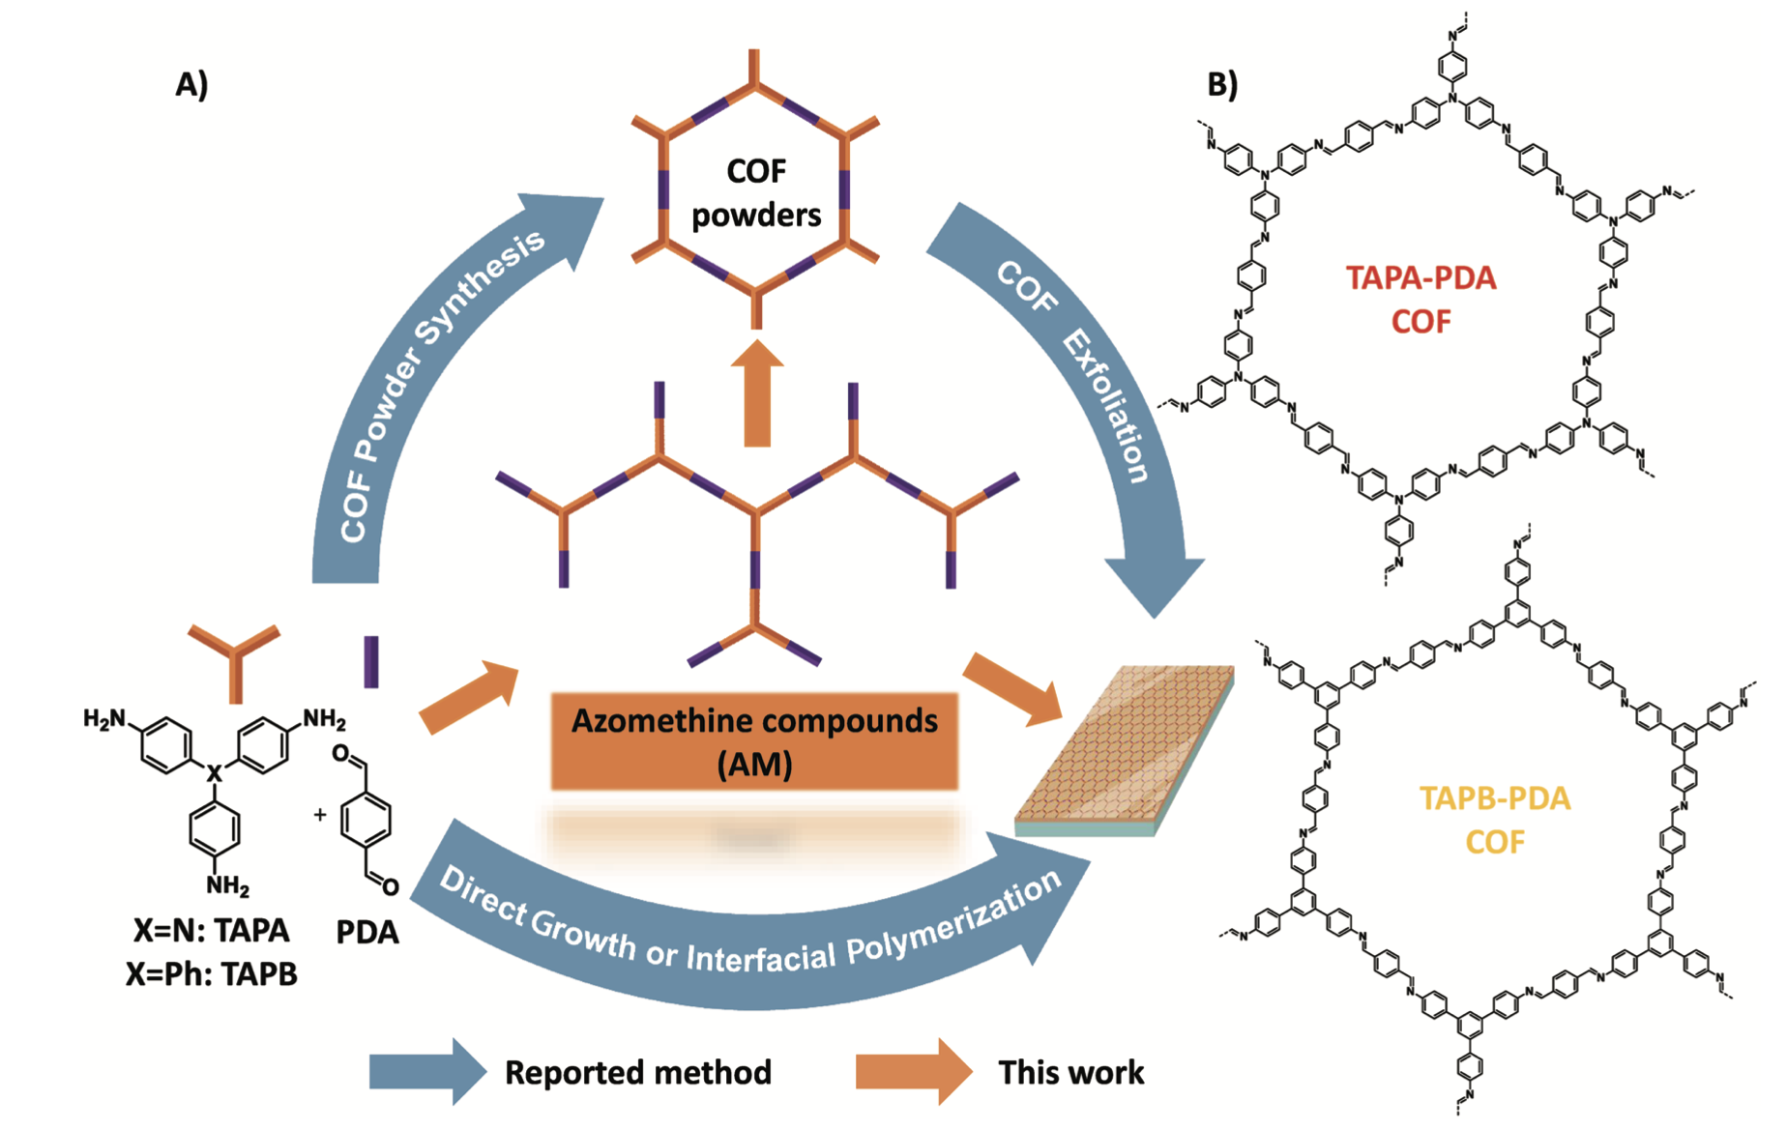
Covalent Organic Frameworks

Slide 10
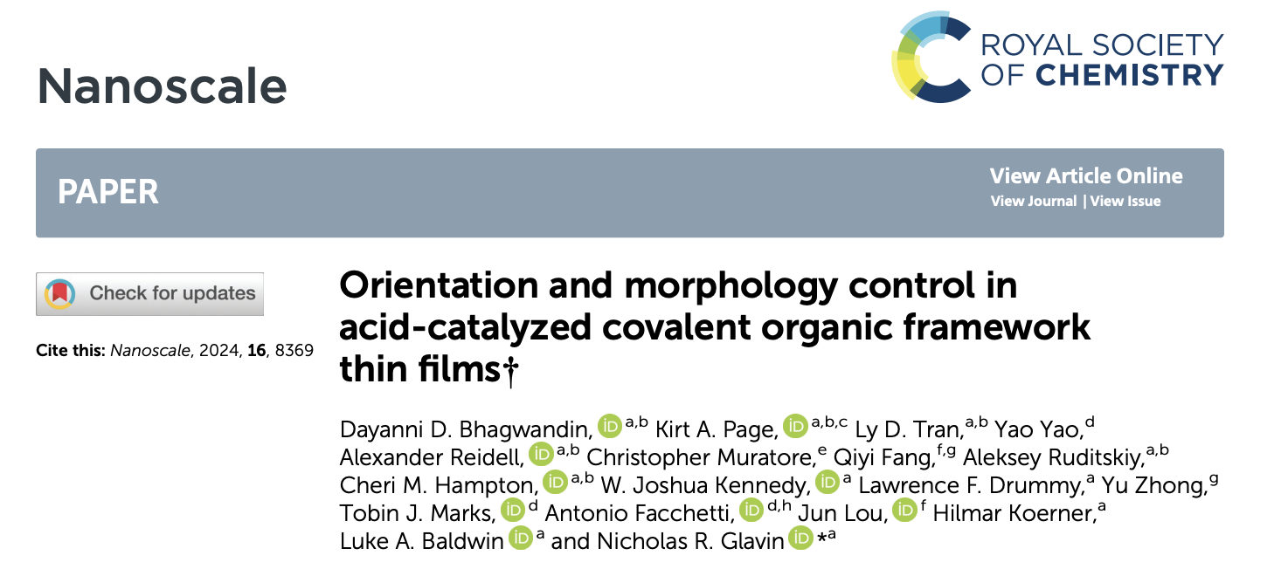
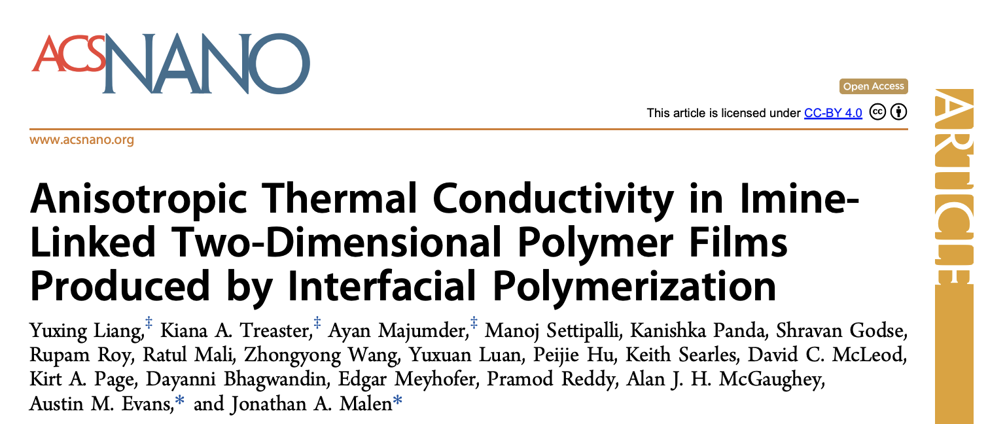
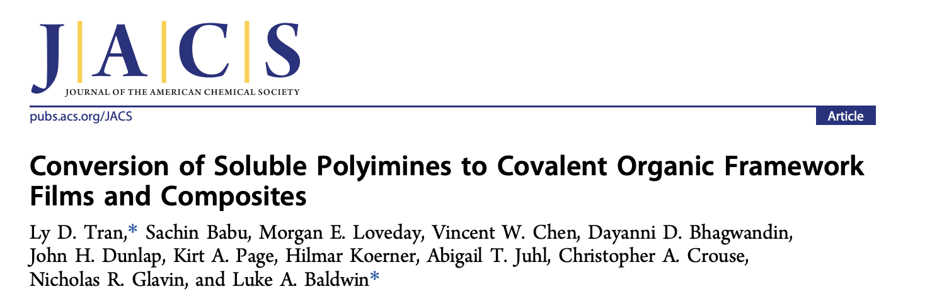
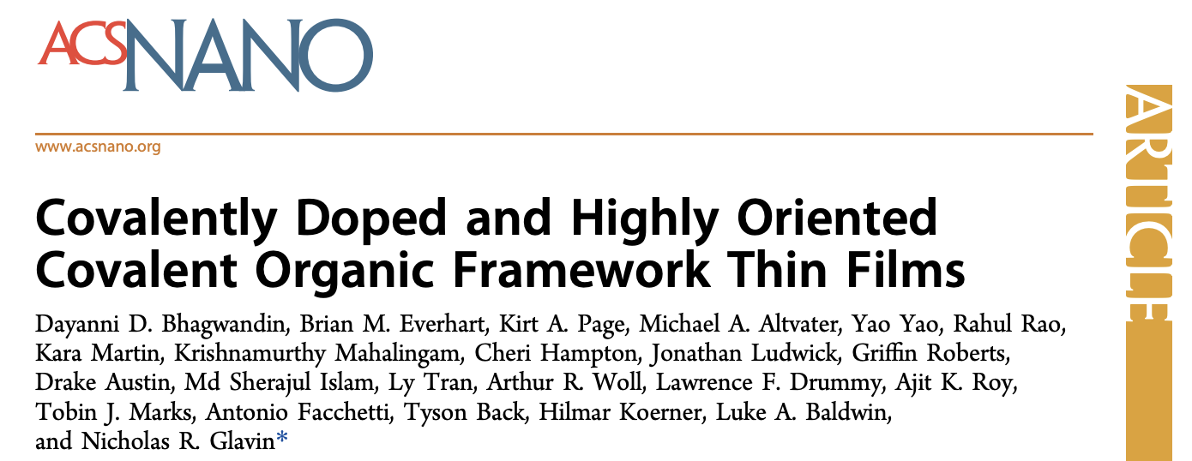
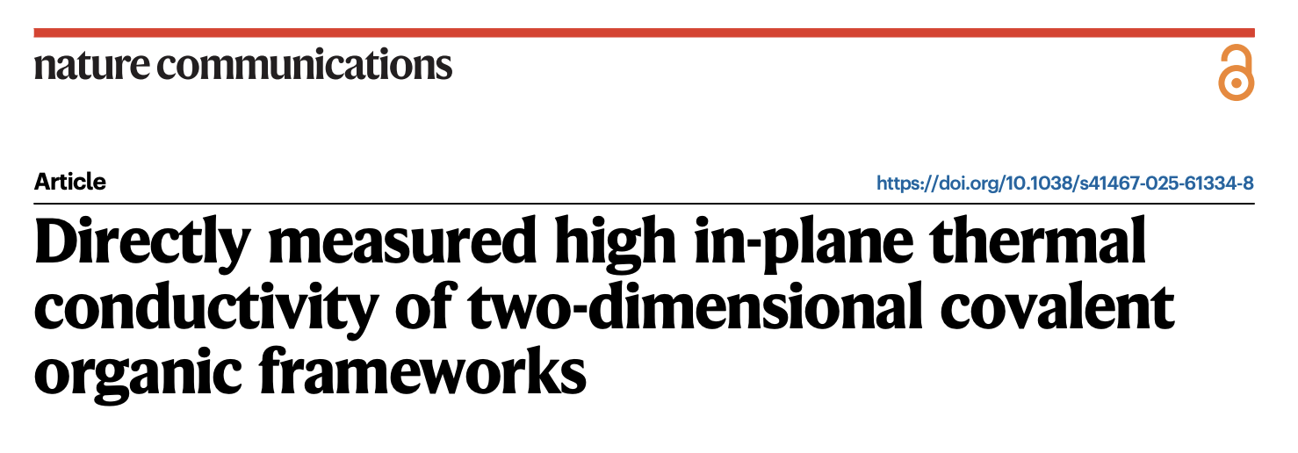
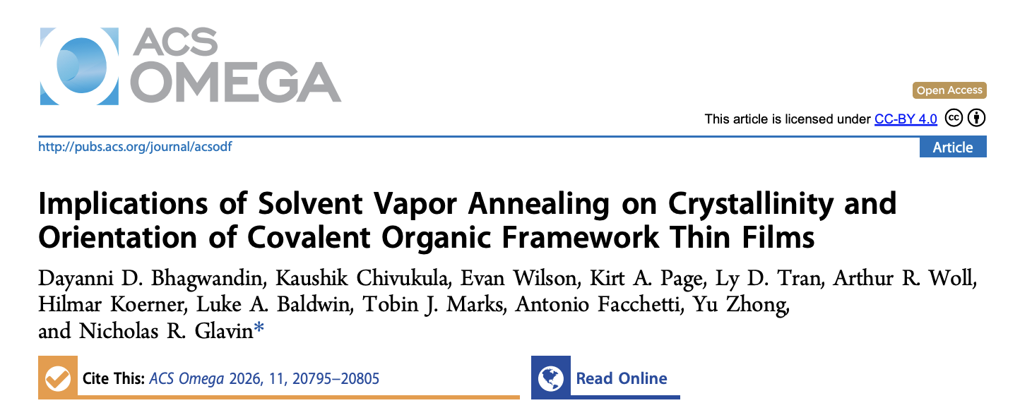
Covalent Organic Frameworks
Notes:
To date, the instrument has led to impactful publications for researchers at AFRL/AV Inc and for other users in the field.

Slide 11
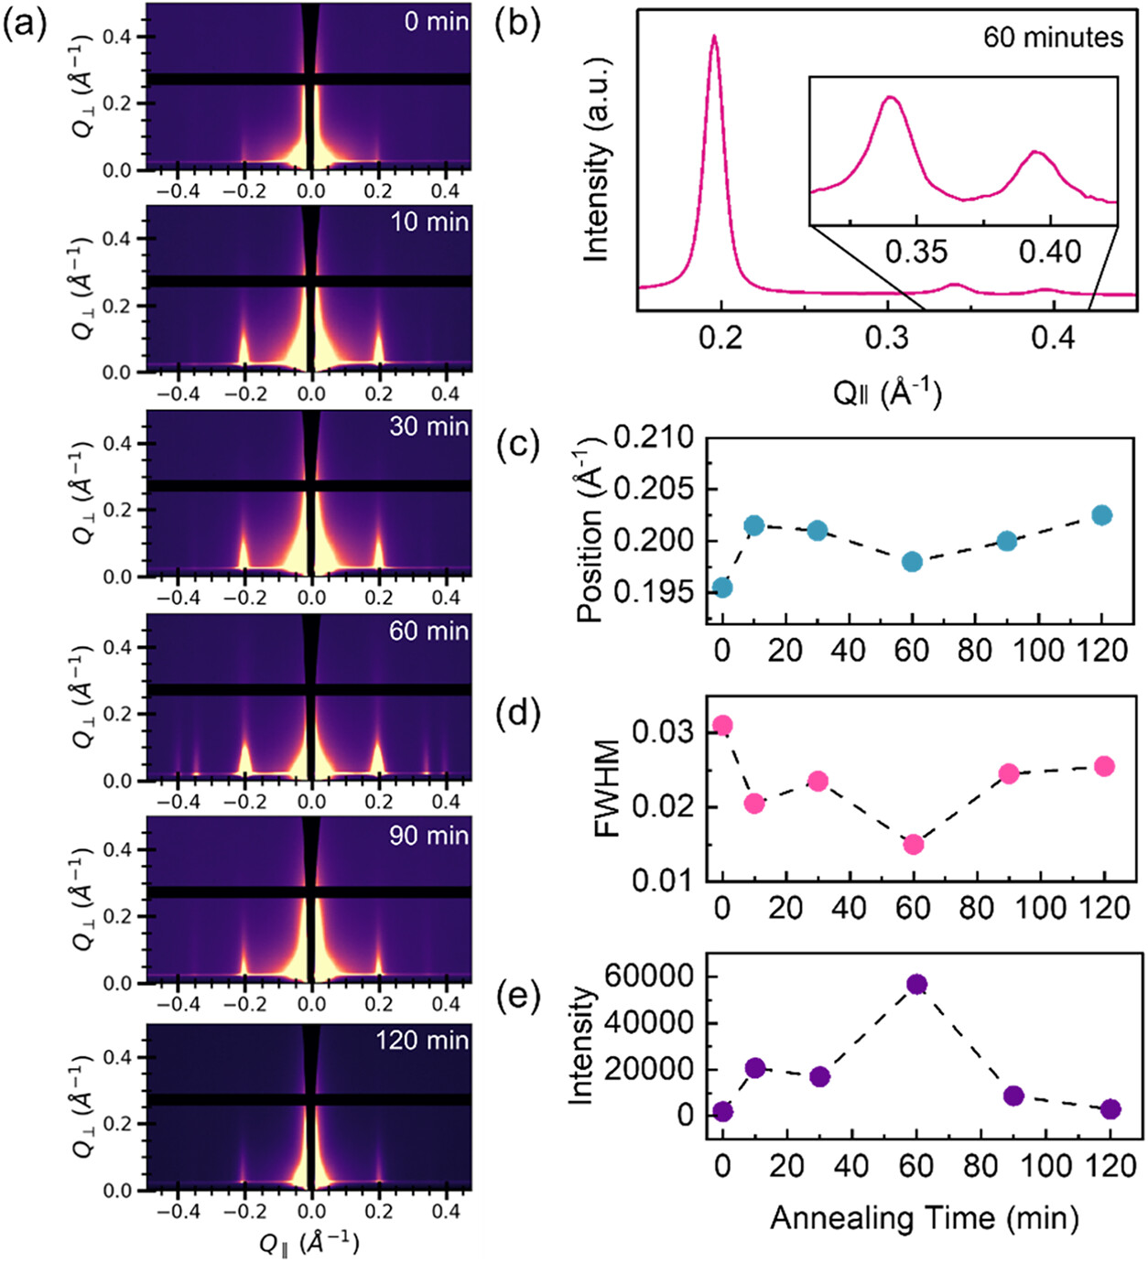
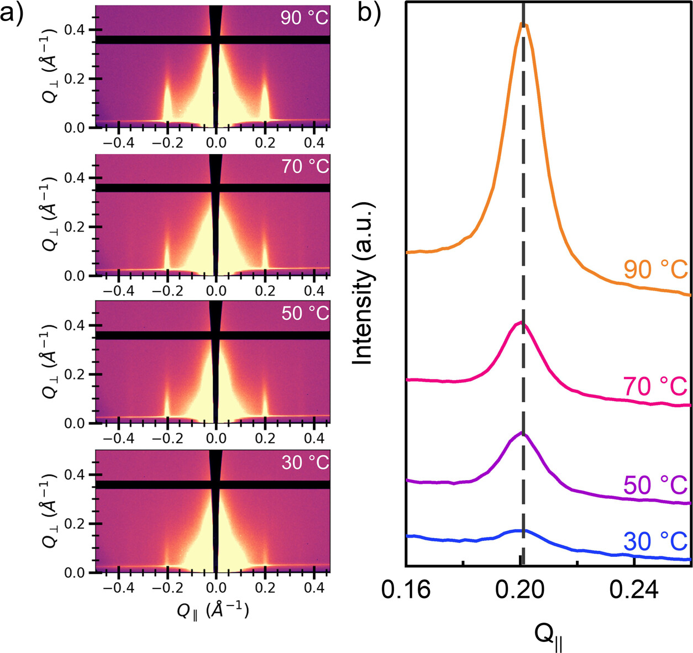
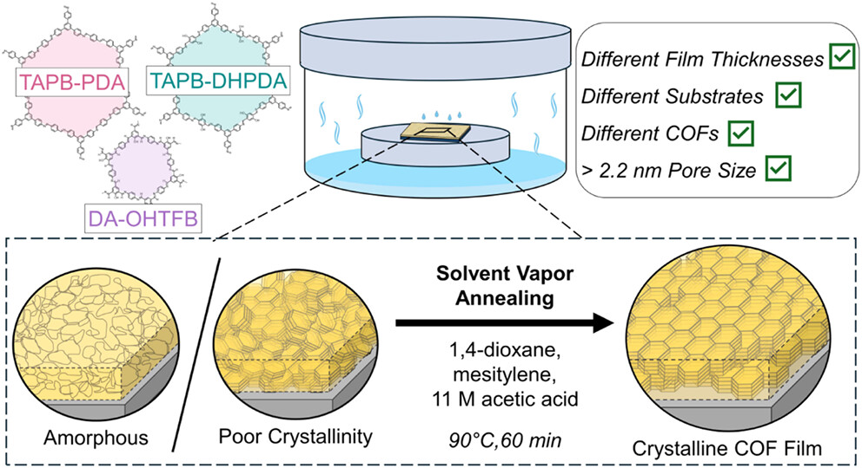
Covalent Organic Frameworks

Slide 12


Flow-Induced Crystallization
12 s Shear Pulse at 140 °C
No Shear
$\dot{γ}$ = 1 s⁻¹
$\dot{γ}$ = 31.6 s⁻¹
Investigate the effect of shear rate on crystalline lamellae structure via in situ SAXS/WAXS
Partial melting approach used to probe minority phase iPP lamellar structure
Flow-induced orientation observed at lower shear rates for PE matrix versus iPP droplets, attributed to higher viscosity of PE
Shish-kebab structure found in both PE and iPP at higher shear rates
T = 128 °C
PE scattering dominates
Isotropic
Oriented
Shish-Kebab
T = 150 °C
iPP scattering
via partial melt
Two-phase shish-kebab formation
Higher shear rate to increase PP lamellar orientation
shear rate (1/s)

Slide 13
In-situ Tensile Testing

Slide 14
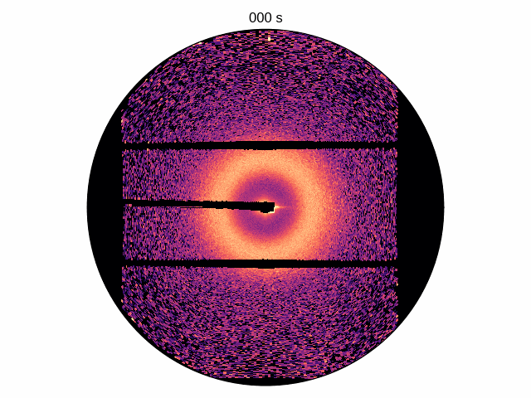
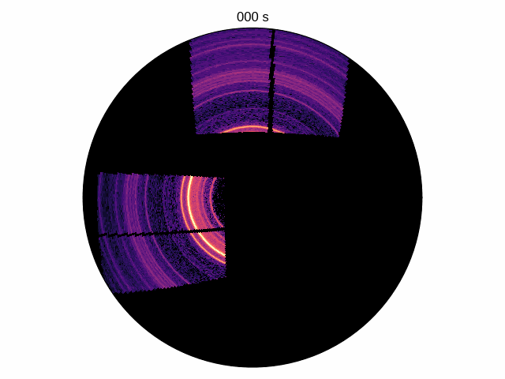
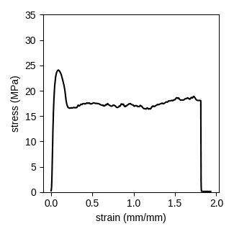
In-situ Tensile Testing
Tensile testing in situ with SAXS/WAXS shows crystal structure changes in polyolefin blends McKenzie Coughlin, Aaron Burkey
Investigate the effect of cooling rate on tensile properties and structure
Faster cooling gives ductile blends
SAXS shows formation of fibrils
Orientation occurs in both PE and PP
Fast cooled via water quench
Fibrils form after yielding
Crystal alignment occurs
Notes:
Objective: Investigate effect of flow on crystallization kinetics in polyethylene (PE) / polypropylene (PP) blends for recycling

Slide 15
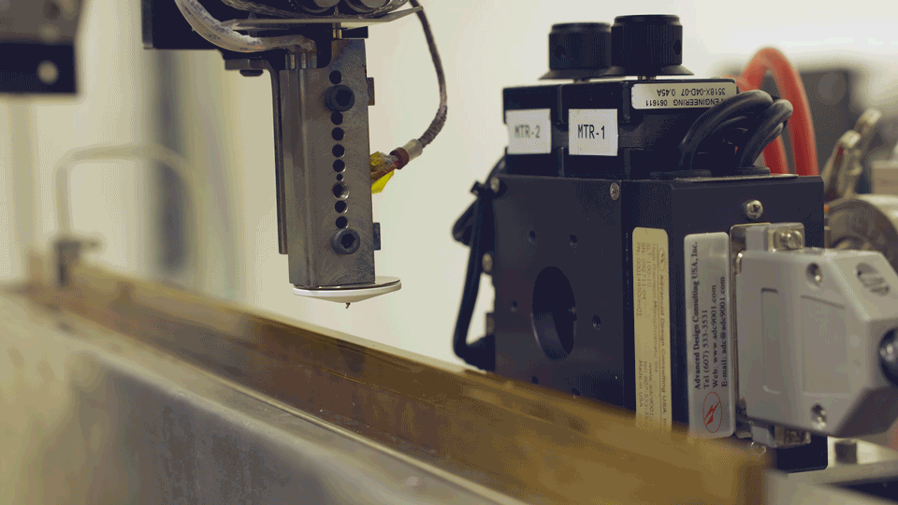
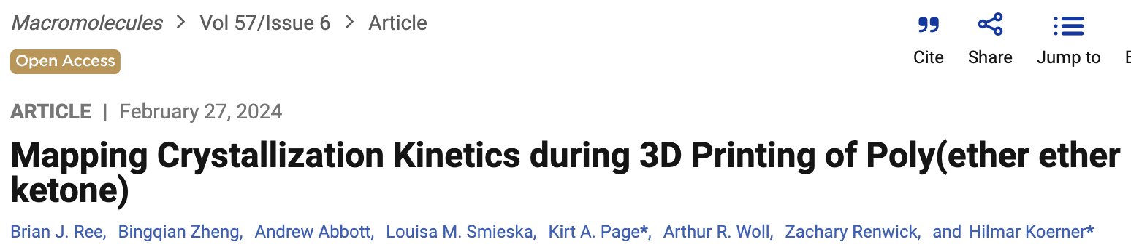
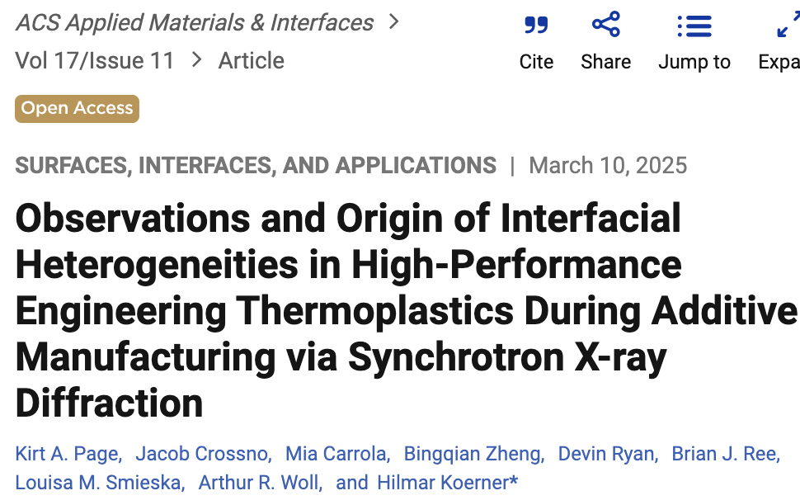
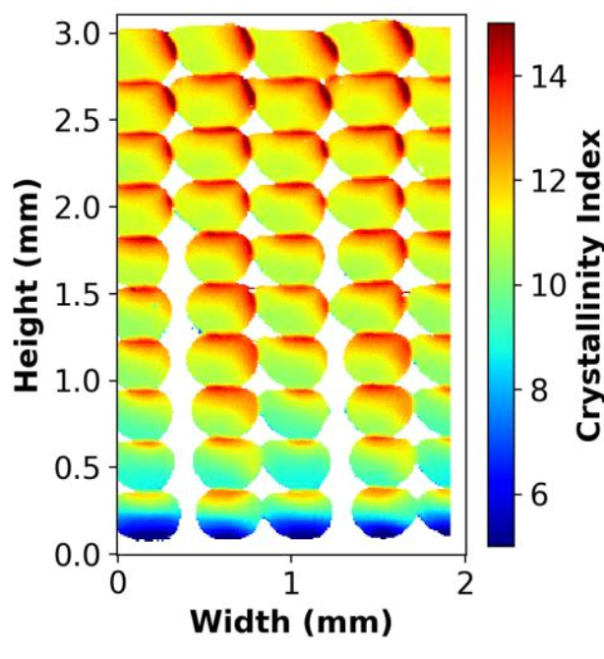
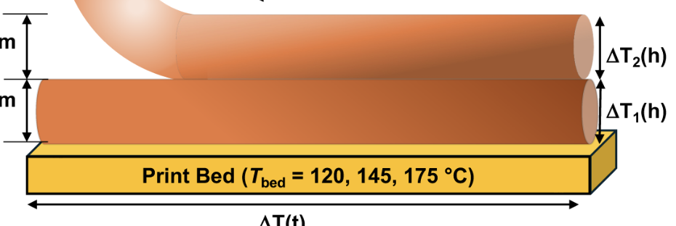
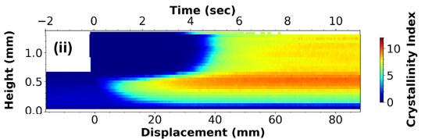
FMB Program – 3D printing of high strength polymers & composites
February 2024
March 2025

Slide 16
Thank You

