Slide 1
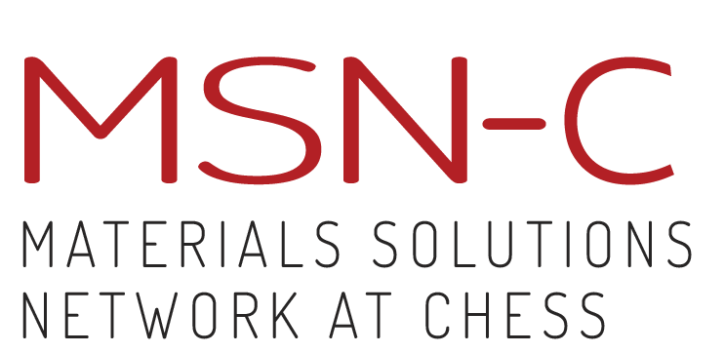

The Materials Solutions Network at CHESS:
an AFRL-sponsored sub-facility of the
Cornell High Energy Synchrotron Source
Arthur Woll, Director, MSN-C

Slide 2
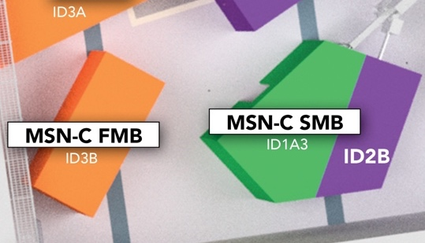
MSN-C Mission & Key Features
What is MSN-C?
Beamtime allocation is controlled by AFRL, permitting balance between applied materials problems and fundamental research.
MSN-C serves non-X-ray specialists by providing interpretable information, not x-ray data.
MSN-C has established protocols to handle ITAR components and data.

Slide 3
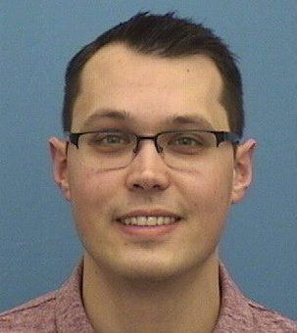
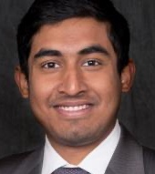
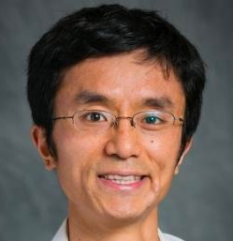
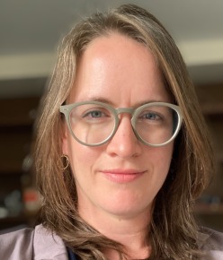
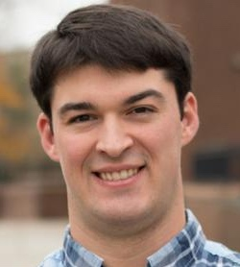
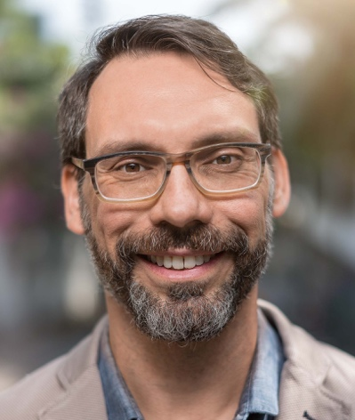
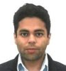
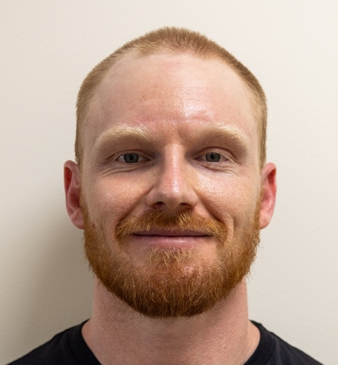
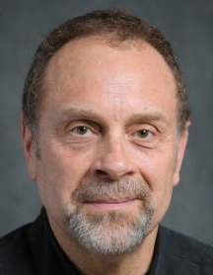
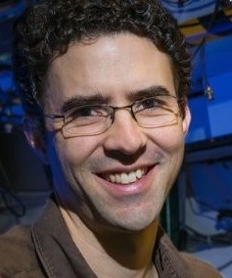
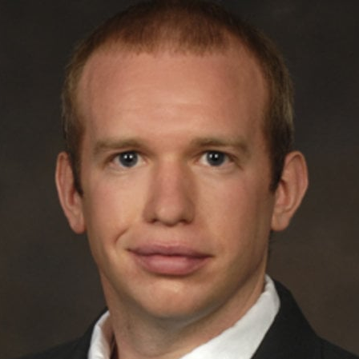
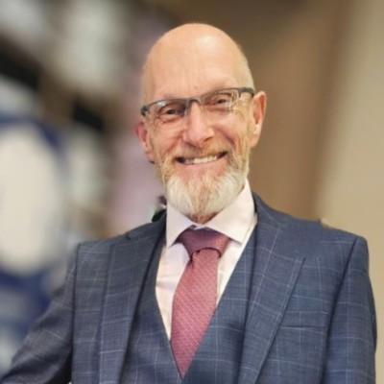
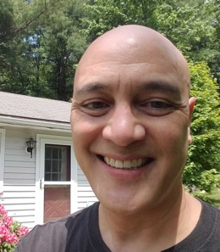
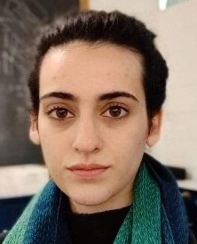
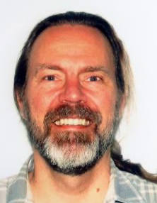
MSN-C Personnel
Staff Scientists
Visiting Scientists
Grad
Kelly Nygren
Metals, HEDM, Diffraction
(SMB)
Sven Gustafson
Metals (SMB)
Amlan Das
Metals
(SMB / FAST)
Peter Ko
Instrumentation,
Electrochemistry (FMB)
Louisa Smieska
Scan-probe, XRF, (XLEAP, FMB)
Chris Budrow
Metals (Budrow
Consulting)
Kirt Page
Soft Matter
(UES, AFRL)
Diwakar Naragani
Metals
Wiley Kirks
Metals (SMB)
Matt Miller
PI
Arthur Woll
Director
Paul Shade, AFRL
Program Manager
Hilmar Koerner,
AFRL, FMB Lead
Mark Obstalecki (AFRL)
Joe Crum
Mech. Eng.
Keara Soloway
Programmer
Rolf Verberg
Programmer
Notes:
Adjust Louisa’s affiliation somehow? Think about organization? MSN-C, FMB, SMB.

Slide 4
MSN-C Access
MSN-C Access
External Review
Submission
Allocation, Scheduling
Safety
Paul Shade, AFRL
Program Manager
Hilmar Koerner,
AFRL, FMB Lead
Review,
DoD (AFRL)
Submission
Allocation, Scheduling
Safety
Notes:
Clarify

Slide 5
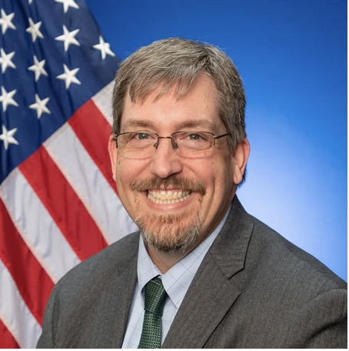


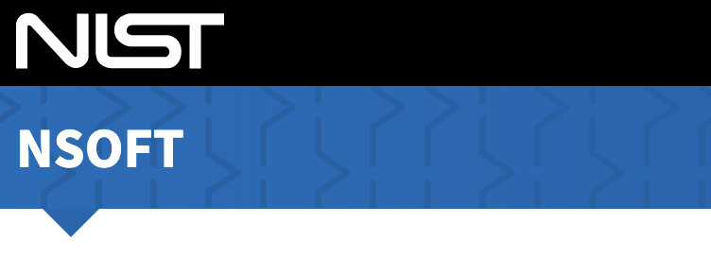
Materials Solutions Network (at CHESS)
MSN-C Access
John Luginsland, AFRL
John Seppala, NIST; Director, nSoft
https://www.midatlantichub.afresearchlab.com/
https://www.nist.gov/nsoft/about
Notes:
Clarify

Slide 6
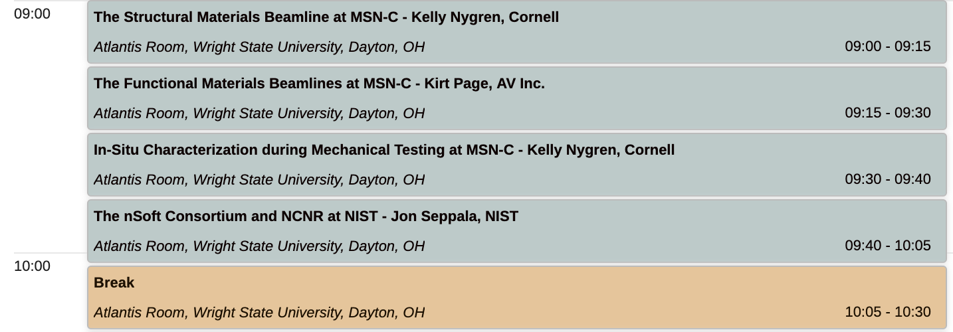
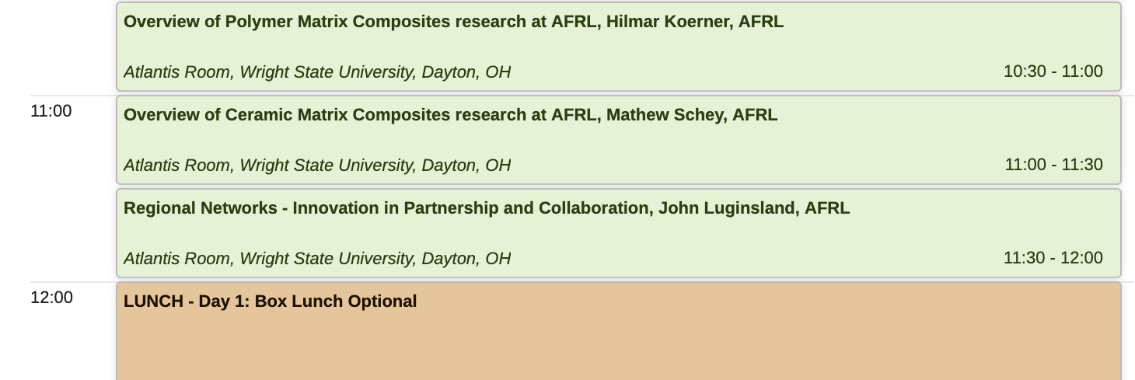
Workshop Schedule – Day 1
MSN-C Access
Notes:
Clarify

Slide 7
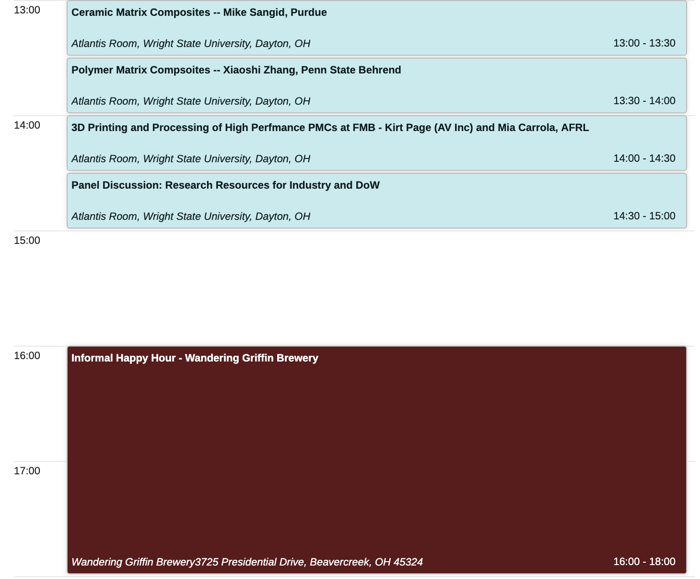
Workshop Schedule – Day 1
MSN-C Access
Notes:
Clarify

Slide 8
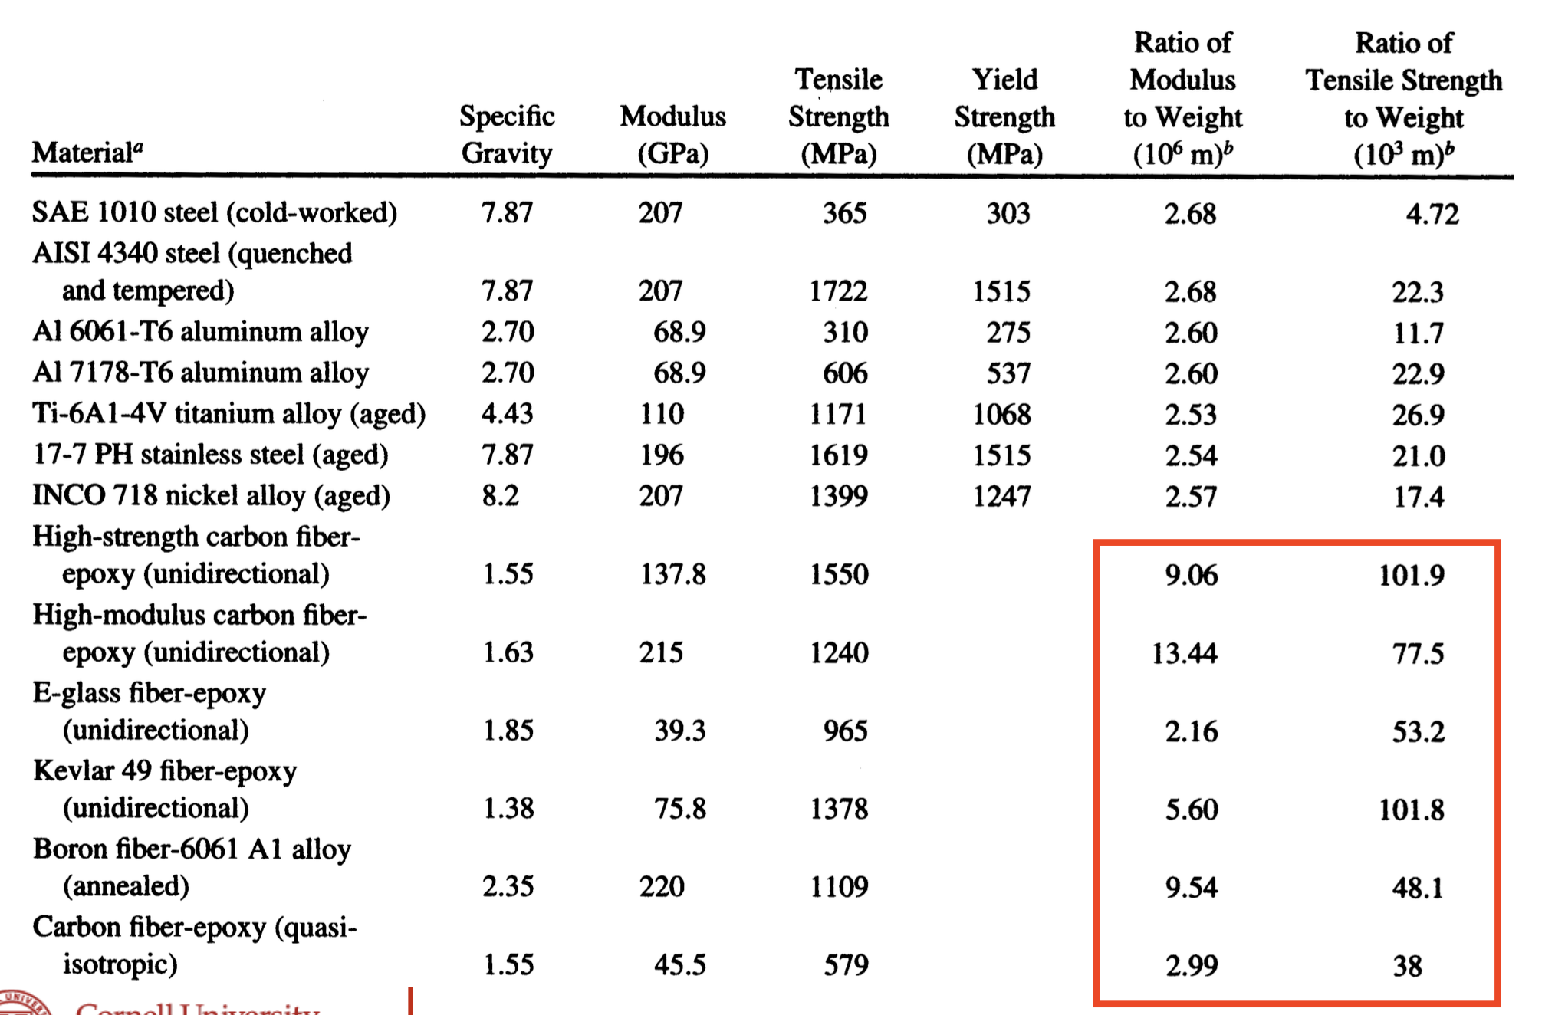
Why Composites & Synchrotron Radiation?
MSN-C Access
Synchrotron Radiation provides:
Composites are:
Heterogeneous
Hierarchical
Often processed and/or used in challenging environments
Imaging
Access to atomic-to-macroscopic scales
Comparatively easy to measure in challenging environments.
Notes:
Clarify

Slide 9
Summary and Charge
MSN-C exists to serve both fundamental research and practical challenges related to manufacture and processing.
Its value is built on its access model, expertise, and transforming state-of-the-art techniques into routine tools.
MSN-C’s future relies on thriving R&D and collaboration with DoW and its industry partners.
The purpose of this workshop is to help boost such collaboration by finding new opportunities to contribute to composites R&D.
Welcome and Thank You for Attending!

Slide 10
END

