Slide 1
Welcome and Introduction to CHESS
Joel D. Brock
Director, Cornell High Energy Synchrotron Source
Given Foundation Professor of Engineering
School of Applied & Engineering Physics
Cornell University

Slide 2
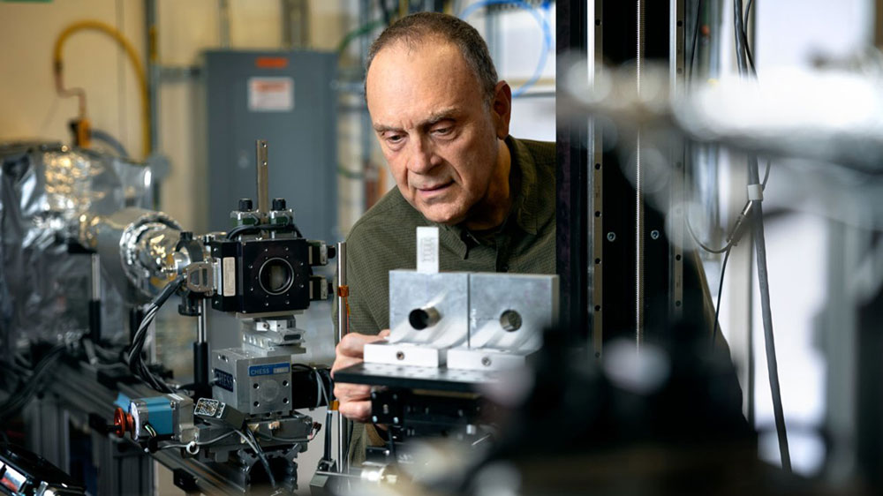
Matt Miller: PI MSN-C

Slide 3
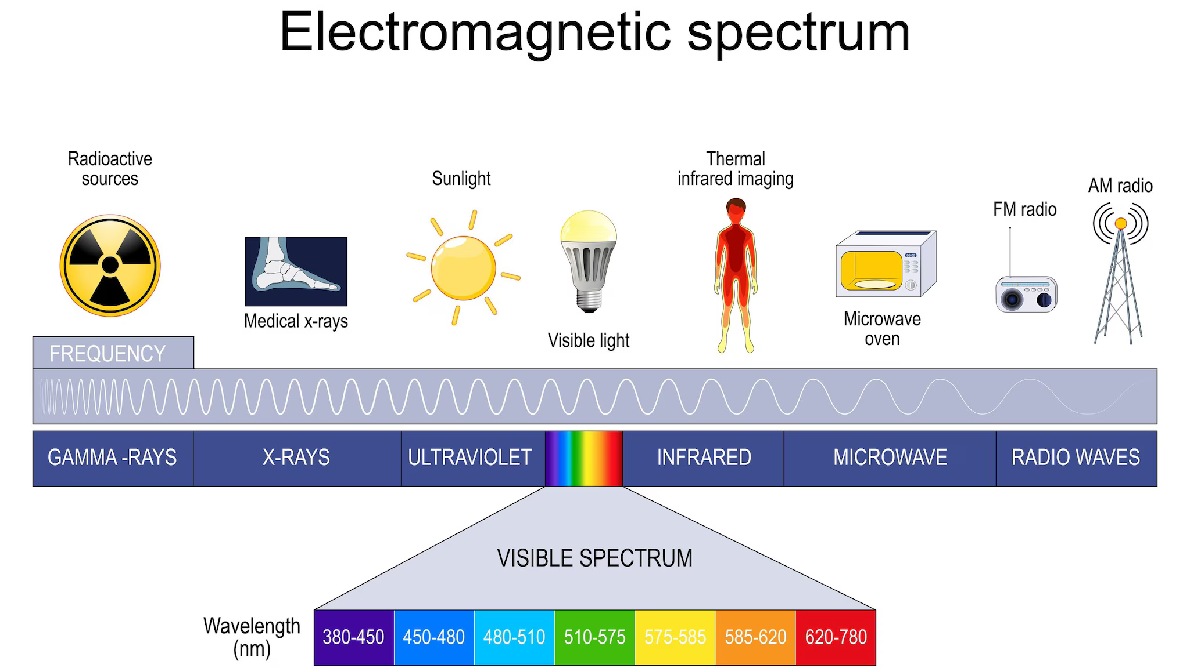

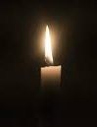
Introduction to X Rays, Synchrotrons, and X-Ray Techniques
X-rays are short wavelengths of energetic light.
X-rays are uniquely suited to penetrate opaque material and non-destructively probe the structure of matter on length scales ranging from shipping containers to medical X-rays to the atomic scale.
Synchrotrons are exceptionally bright sources of X-rays. If a medical x-ray unit is a candle, a synchrotron corresponds to the lights at a football stadium.
X-Ray Techniques
Absorption
Radiography
Scattering/Diffraction
Crystallography, powder diffraction
(where are the atoms?)
Spectroscopy
Absorption and Emission Spectroscopy
(electronic energy levels)
Imaging
These techniques are now used to create spatial maps and time sequences.
Scanning, Full Field, and Tomography
https://www.cdc.gov/radiation-health/about/electromagnetic-spectrum.html
https://depositphotos.com/photos/football-stadium-lights.html

Slide 4
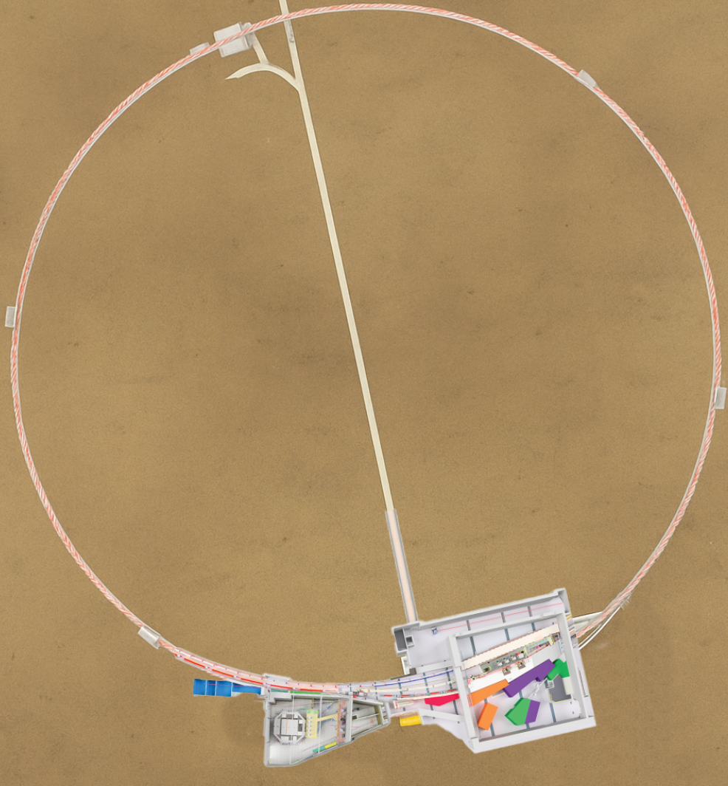
What is CHESS?
The Cornell High Energy Synchrotron Source (CHESS) is a 3rd generation, high-energy, synchrotron X-ray facility operated by Cornell University for the US National Science Foundation (NSF), the National Institutes of Health (NIH), and the Air Force Research Laboratory (AFRL).
3rd generation means that the storage ring is optimized for undulators, a periodic array of magnets that produce the X rays.
High-energy means that the storage ring operates at 6 GeV.
The result is an extraordinarily bright source of X rays in the range from 5KeV to several hundred KeV.
CHESS

Slide 5
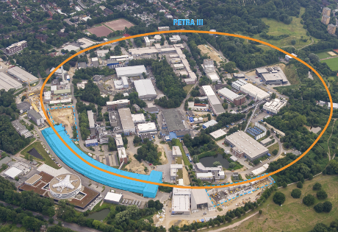
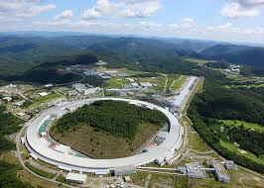
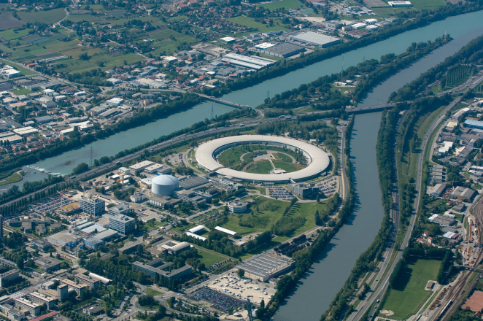
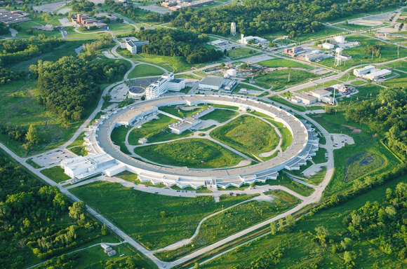
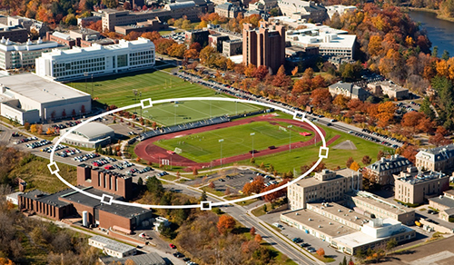
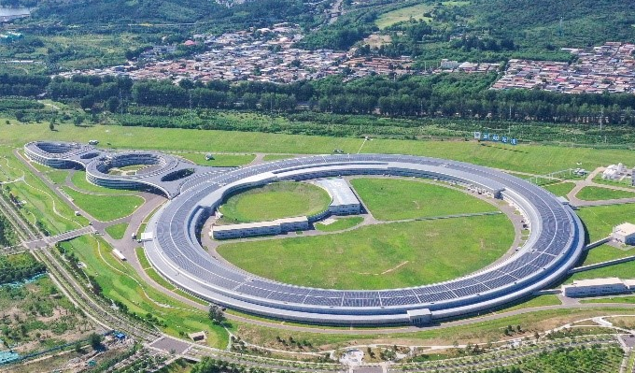
6 High-Energy, 3rd Generation X-ray Facilities in World
Petra-III: Germany
SPring-8: Japan
ESRF: France
http://http://photon-science.desy.de
http://www.riken.jp
http://www.esrf.eu
APS: Illinois
CHESS: New York
IHEP: Beijing
http://www.anl.gov
https://english.ihep.cas.cn/heps/nae/
Notes:
CHESS is one of only two high-energy synchrotron sources in the U.S. (and only five in the world) that can produce intense beams of high-energy X-rays. High-energy X-rays (20-100 keV) have a wavelength short enough that diffraction can determine the distance between atoms and energy well above electron binding energies, minimizing photoelectric absorption and enhancing penetration. These characteristics are key requirements for in situ and operando structural studies of materials. Already, the performance delivered by some CHESS beamlines is indistinguishable from that of an APS beamline due to CHESS’s unique x-ray optics, innovative techniques, and specialty detectors [3].

Slide 6
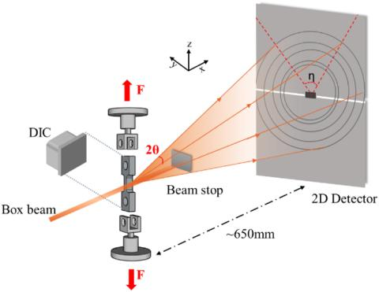
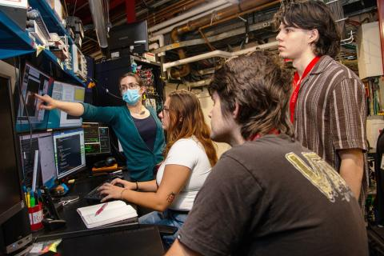
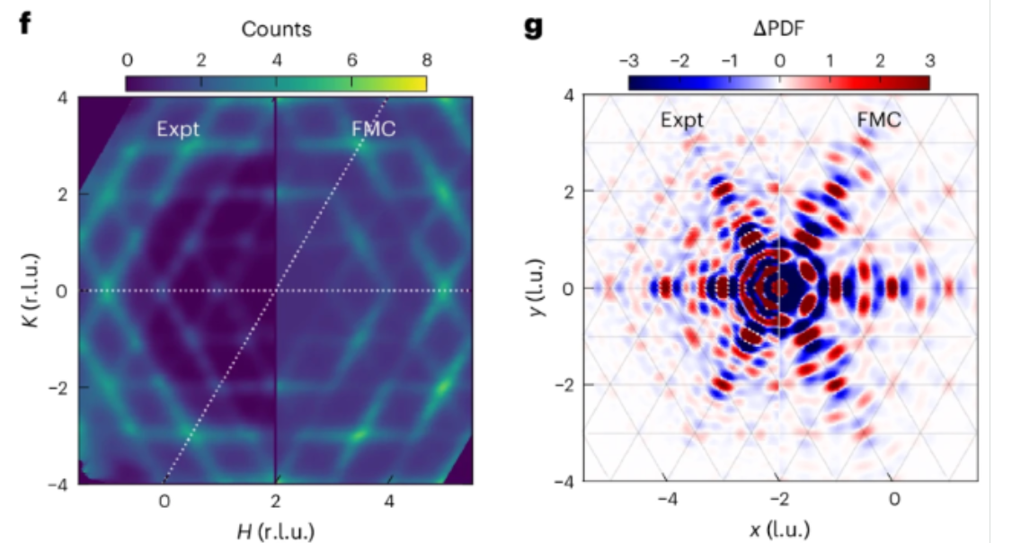
Mission of CHESS
Provide unique synchrotron x-ray infrastructure and “end-to-end” expertise to support the (inter)national research community to solve the most important scientific, engineering, and scholarly challenges.
Train the next generation of diverse synchrotron x-ray users, practitioners, and developers.
Develop new synchrotron x-ray technology and techniques.
In situ tensile loading SXRD setup at FAST
High Energy X-Ray Techniques (HEXT) School
Magnetic and structural frustration coexist in LnCd₃P₃

Slide 7
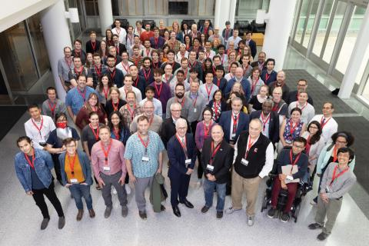
CHESS Numbers
1980-2019: National User Facility
2019-present: Partner Model
Currently 7 operating beamlines (more under construction)
Operations and upgrades funded by multiple partners (NSF, NIH, DoD, NY State)
~200 Staff Members
$54M in 2023
24/7 operations
Accelerator runs
~5000hr/year, ~3500hr/yr delivered as user time.
Remainder for R&D and commissioning.
6.0GeV, 145mA
~1500 user visits/year

Slide 8
Unique Characteristic: The Partner Funding Model
Multiple organizations (partners) support x-ray beamlines and the core facility on a proportional basis.
Partners develop beamtime allocation policies for their beamlines.
Operations funded by partner programs.
Upgrades and expansions funded by capital/construction sponsored awards.
Cornell University makes strategic investments (e.g., the NEH), provides annual support for costs covered by F&A, and makes infrastructure improvements.
Recent: Lake Source Cooling, Fire Sprinklers, Fire Stopping, Building Code upgrades, ADA upgrades.
Planned: replacing transformers and electrical infrastructure
Notes:
DOE synchrotrons “operate” for ~5000 hours per year
~4000 hours per year is delivered as user time.
CHESS delivered ~3800 hours of user time / year.

Slide 9
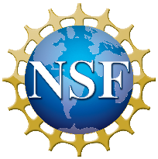
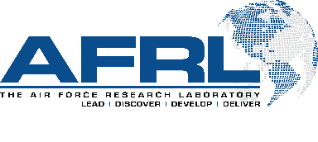

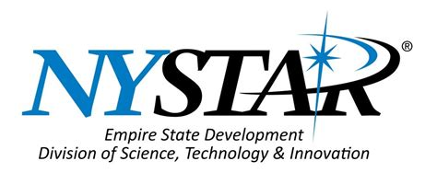
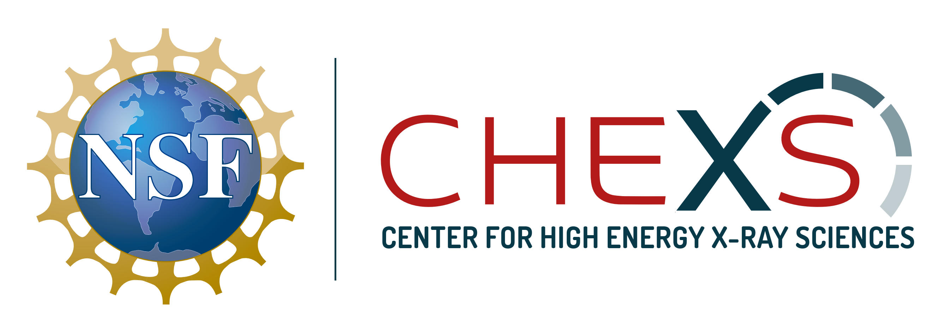
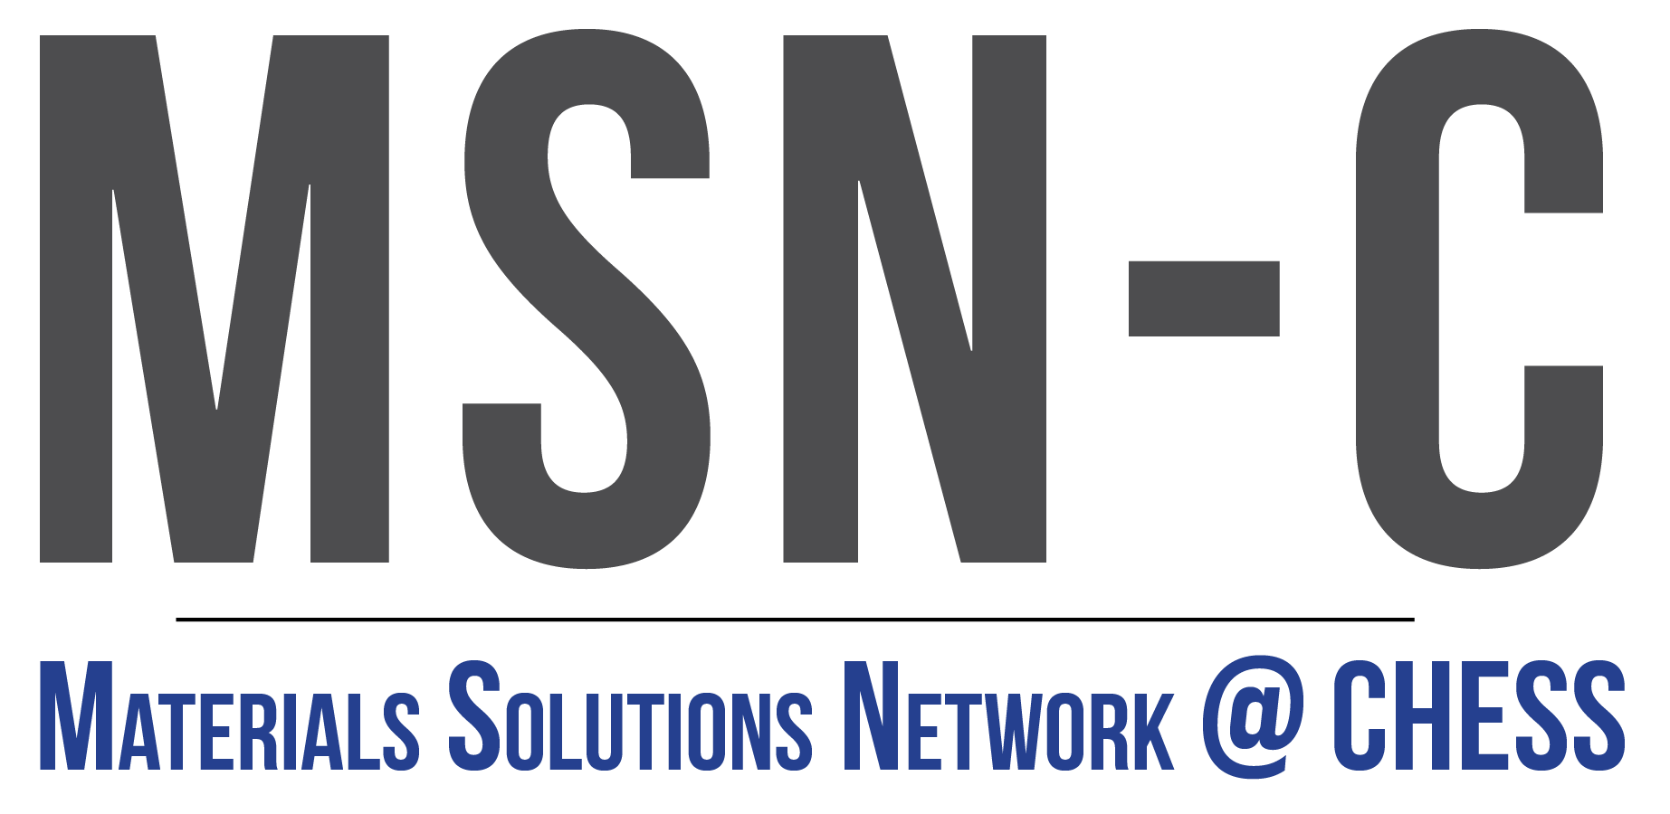
Current Partners
NSF: Center for High Energy X-ray Science (CHEXS) at CHESS National User Facility
4 Beamlines (spectroscopy, quantum materials, materials processing, high-pressure biology)
Technical R&D
Education and Outreach
AFRL: Materials Solutions Network at CHESS (MSN-C) DOD Research Facility
2 Beamlines (structural materials and functional materials)
Outreach to OEMs in Aerospace Sector (ITAR)
NIH: MacCHESS 1 Beamline (2 x ½ in collaboration with NSF)
Service beamlines for the MX and Bio-SAXS communities
Outreach to pharmaceutical and biomedical industry
NYSTAR: Matching award for MacCHESS

Slide 10
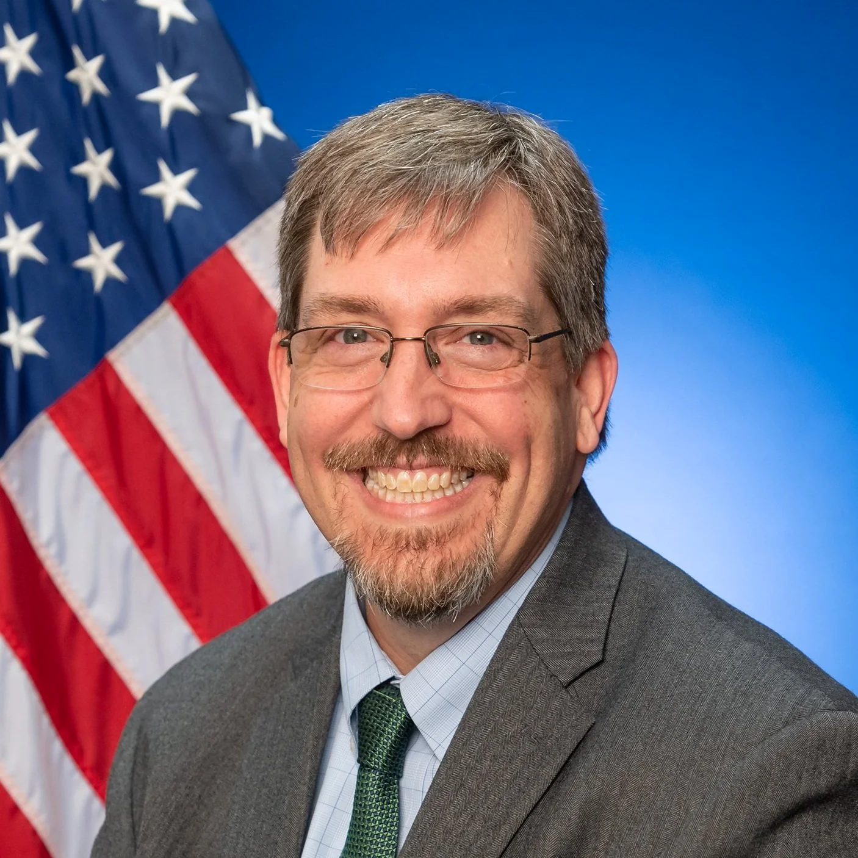
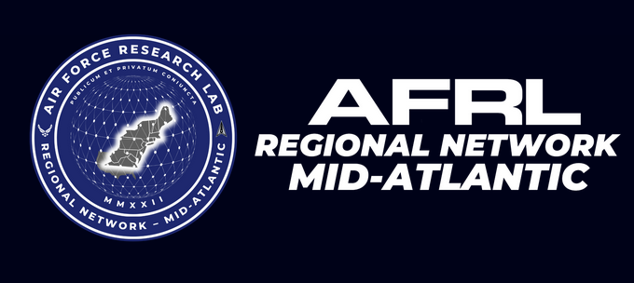
CHESS, NSF, and AFRL
CHESS
Operations
Users
Academic
National Labs
Industry
New facilities
New technology
Training
The interactions and relationships between the partners are deep.
John Luginsland
Collaboration Director for the Air Force Research Laboratory (AFRL) Regional Network – Mid-Atlantic
AFRL
MSN-C
NE Regional Hub
Accelerator Physics R&D
NSF
CHEXS
HMF
X-LEAP
Cyber/AI
MOU
https://www.midatlantichub.afresearchlab.com/

