Slide 1
FAIR Data
X-CITE Training @ CHESS Users Group 2025

Slide 2
What we'll talk about
We're drowning in data, but finding and using what we need is (still!) tough.
Describing our data so we can find it again – Metadata.
A pilot project at CHESS named FOXDEN.

Slide 3
The problem(s)
"I wonder if someone has done this before?"
"Assuming they have, can I see, use, and cite their data?"
"Am I going to need a Computer Scientist and an Archaeologist to even open the files?"
"Has this data been modified, corrupted or even forged?"

Slide 4
FAIR Data
To be fair, various disciplines and funding agencies have been wrestling with this for many years (1980s!)
2014 workshop led to a minimal set of guidelines that can span, in principle, all domains.
Mark D. Wilkinson et al in Nature Scientific Data DOI: 10.1038/sdata.2016.18
because you knew I was going to use a DOI, right?

Slide 5
Enforcement?
FAIR is a set of guidelines, not a prescription for how to solve the problem.
We're free to build solutions that fit into this framework, and there are countless ways to do it.
Nice in that it's flexible, frustrating when you just want a list of standards to implement so you can check off one more box.

Slide 6
FAIR writ large
Findable
Accessible
Interoperable
Reusable

Slide 7
"Google Exists" doesn't cut it
Search engines only index the Findable data
Only index what they can access, and they don't preserve it
Limited set of formats they can handle sensibly
Very limited concept of metadata

Slide 8
Findable
There are four elements that make up the “Findable” principle. Let's take a look at each of them (in bold) and their implications.
F1. (meta)data are assigned a globally unique and persistent identifier
If you can't uniquely name something, how do you know you're looking at what you think you are?
How many URLs are still valid after 5, 10, 20 years?

Slide 9
F2
F2. data are described with rich metadata (see R1)
Rich metadata, not just the filename and date. Who, what, where, when, why, was it raining, for how long? Which beamline?

Slide 10
F3
F3. metadata clearly and explicitly include the identifier of the data it describes
Metadata and data can get separated (oops). Must be able to associate them.

Slide 11
F4
F4. (meta)data are registered or indexed in a searchable resource
Your secret stash of data does no one else any good. Publish it, and make it searchable.

Slide 12
Accessible

Slide 13
Accessible
A1. (meta)data are retrievable by their identifier using a standardized communications protocol
A1.1 the protocol is open, free, and universally implementable
HTTP(S) is strongly implied, isn't it?

Slide 14
Accessible
A1.2. the protocol allows for an authentication and authorization procedure, where necessary
Identity and Access Management (IAM).
Internet 2's InCommon is quite common.
CILogon makes InCommon almost easy.
Hey! Wait a second! What do we need with IAM when we're putting our data our for everyone, for free? (stay tuned)

Slide 15
Accessible
A2. metadata are accessible, even when the data are no longer available
Publication embargoes
Healthcare! HIPPA. Illegal to release patient data, severe penalties. The metadata should be available, but not the sensitive part of the data and perhaps not the data at all.
It is really hard to anonymize data in a way that it's still useful. See "Differential Privacy" for more.

Slide 16
Accessible, A2 continued
"A2. metadata are accessible, even when the data are no longer available"
Some data collections just aren't feasible to store long term. The metadata should nonetheless live forever. Some breadcrumbs for other researchers is better than nothing, especially if the metadata is rich enough.

Slide 17
Interoperable
Here's the hard part: hidden in some simple little statements are some very hard problems.

Slide 18
Interoperable
I1. (meta)data use a formal, accessible, shared, and broadly applicable language for knowledge representation.
"Knowledge Representation" is incredibly broad.
File formats, for instance.
Libraries: MARC vs. Z39.50 (version 1, anyone?)
Proprietary formats

Slide 19
Interoperable
I2. (meta)data use vocabularies that follow FAIR principles
Controlled Vocabularies, Classification Hierarchies, Ontologies.

Slide 20
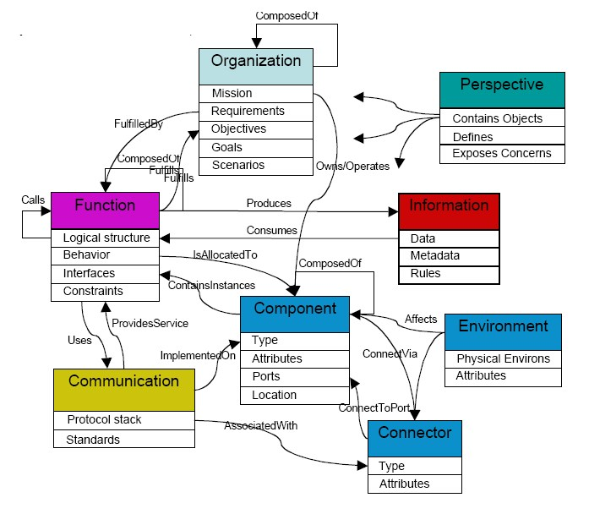
(Part of) an ontology
Peter Shames & Joseph Skipper. NASA, JPL. - "Toward a Framework for Modeling Space Systems Architectures".
I copied this straight from Wikipedia.

Slide 21
Interoperable
I3. (meta)data include qualified references to other (meta)data
I heard you like metadata, so I put some metadata in your metadata.
If your metadata has a CAS number, it should have a way to link that back to Chemical Abstracts

Slide 22
Reusable
R1. meta(data) are richly described with a plurality of accurate and relevant attributes
Ever see someone use a 200 character filename to hold their metadata? How did that work out for them? 10 years later?
Was that "someone" you?
Attributes you think are irrelevant may be useful to someone else (ex: meta-analysis)

Slide 23
Reusable
R1.1. (meta)data are released with a clear and accessible data usage license
Many licenses are available (public domain, Creative Commons, publication date embargoes)
It does matter – can someone legally add your data to some other data and claim "compilation copyright", and is that bad?

Slide 24
Reusable
R1.2. (meta)data are associated with detailed provenance
Provenance (Chain of Custody) – not just malfeasance
Is this a subset of a subset of a subset?
Did errors creep in?
Compressed, decompressed, compressed again (lossy compression)
Was data removed?
Outliers?
Cleaning – ex: broken instruments
Only "interesting" events were stored

Slide 25
Reusable
R1.3. (meta)data meet domain-relevant community standards
Are their metadata requirements specific to your field?
Disclosures/Conflict of Interest?
Controlled Vocabulary?
Ontology?
Hierarchy? Ex: "11.63(a)2"

Slide 26
Metadata Representations
Switching Gears Completely, how do we represent, store, and transmit metadata in response to queries and between repositories?

Slide 27
Metadata representations
Two most common (modern) methods:
JSON – Javascript Object Notation
RDF – Resource Data Framework

Slide 28
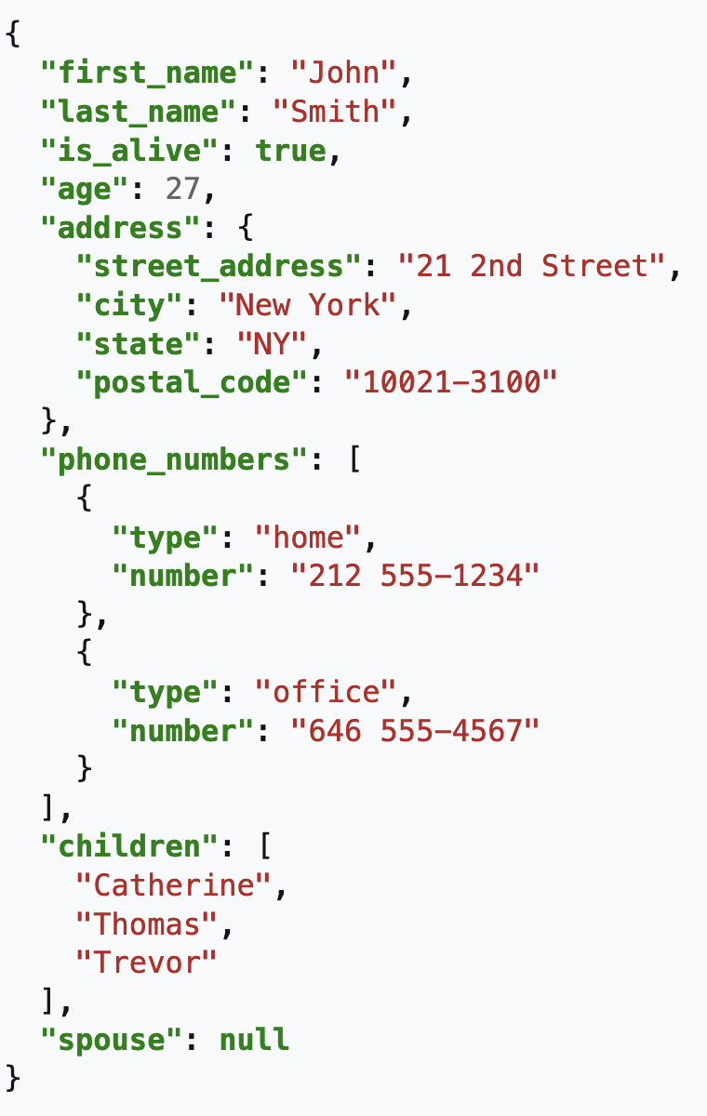
JSON
Ignore the "JS" part – practically every language has support for it.
Even FORTRAN
Represents data as nested lists, objects, and primitives.
Enough data types to build any representation (numbers, strings, lists, booleans, objects, and a null value)

Slide 29
JSON – the good part
Simple.
I described it in one minute.
Nice for debugging.
Built-in support in many languages (python: "import json")

Slide 30
JSON – the bad part
The JSON specification is "fast and loose".
Is that number an integer or a float? JSON floats are defined as IEEE doubles. How do we truncate down for lower precision (it matters in AI!)
"De-normalized": tons of redundancy, possibility of insert, update, or delete anomalies
That same human readability that is so nice for debugging means it needs lots more storage and bandwidth (but, see "BSON")

Slide 31
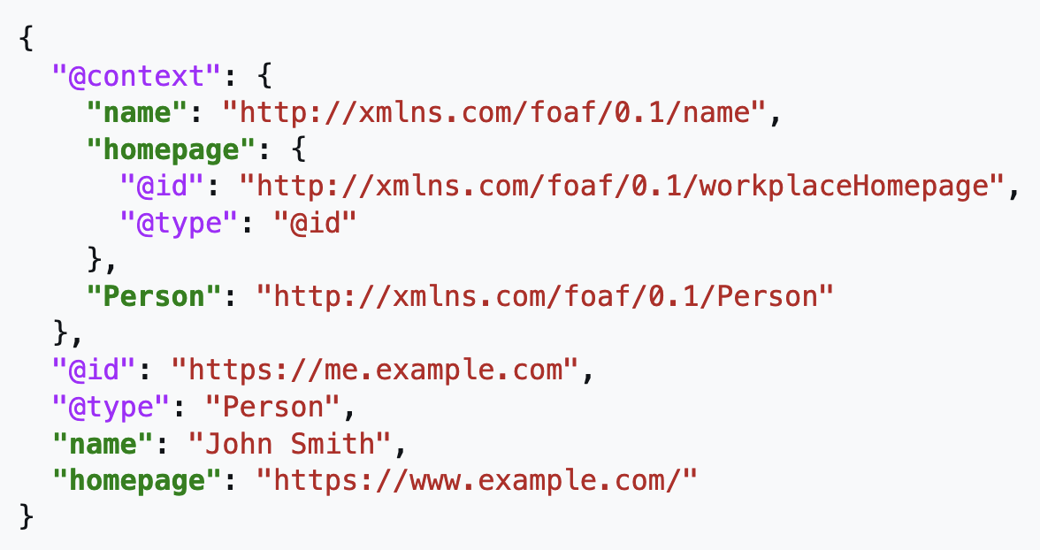
JSON-LD
JSON for Linked Data
A standard set of tags added to JSON allowing us to specify "contexts", external resources that describe data fields

Slide 32
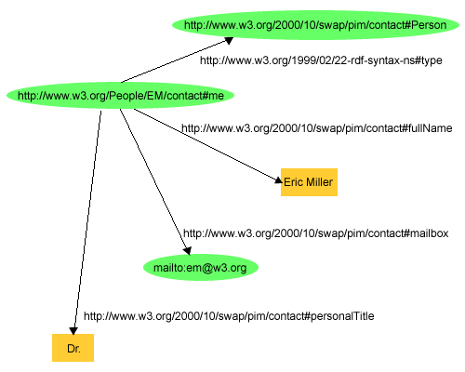
Resource Description Framework (RDF)
A "Knowledge Graph", in the Graph Theory sense of the term
The scheme: triples of the form subject-predicate-object.
Green: subjects
Loose text: predicates
Yellow: objects
From W3C "RDF Primer", and following explanation

Slide 33
FOXDEN
FOXDEN is a Pilot project at CHESS
A web- and web-services based system of independent tools that facilitate implementing FAIR principles

Slide 34
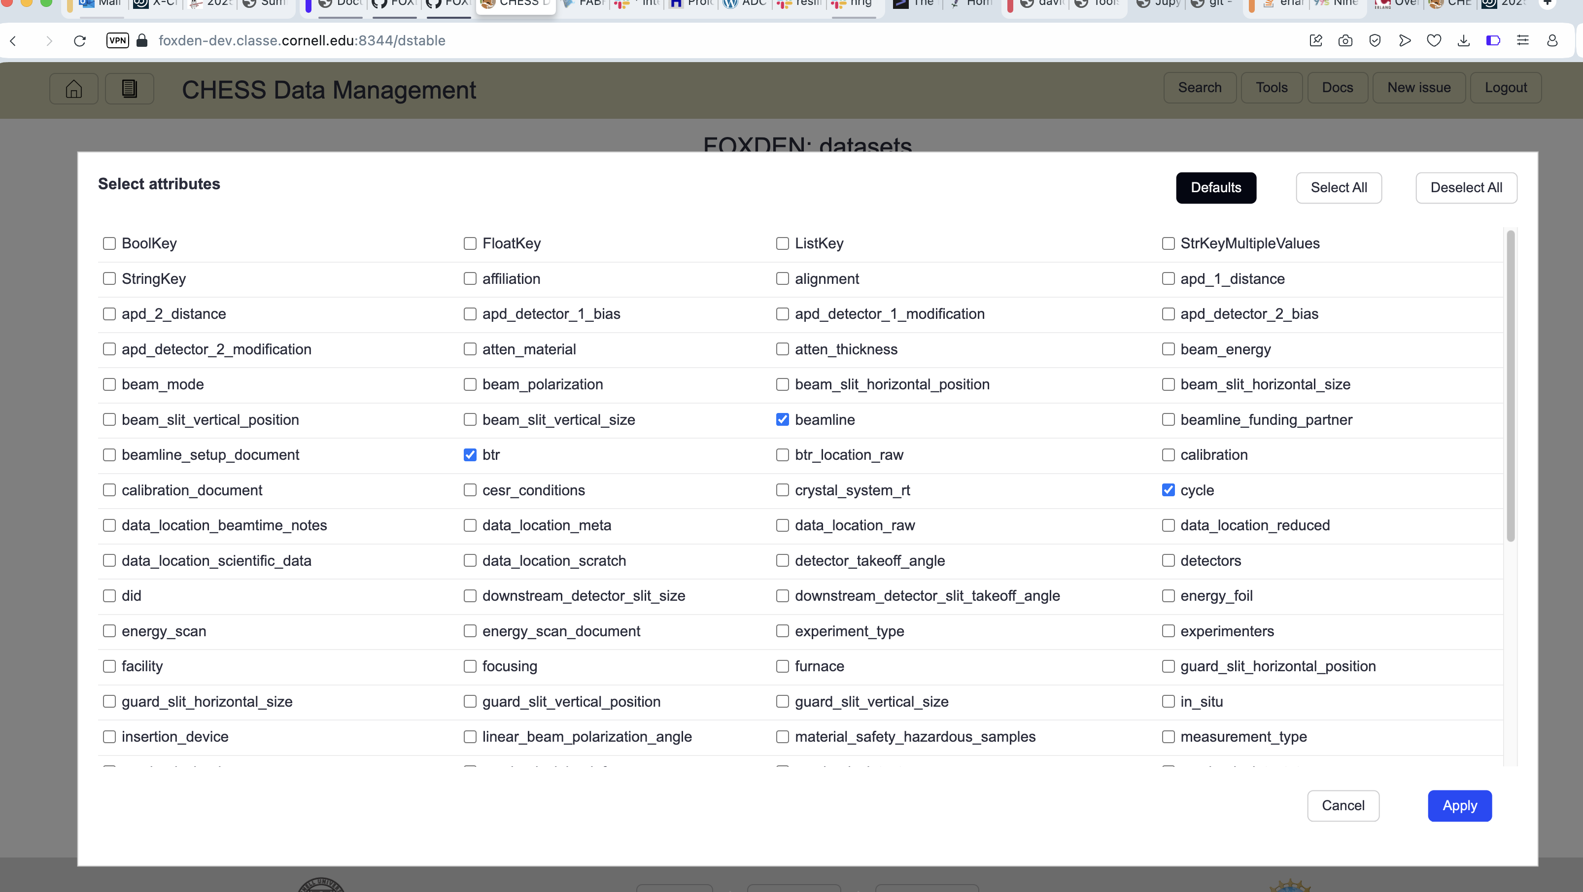
Web Front End
Web-based GUI as the human-facing user interface.
Access to underlying tools in a "pleasant" way

Slide 35
Web Services?
"Web Services" is pretty much just a means for two programs to communicate and it just happens to use HTTP or HTTPS protocol.
Makes use of some HTTP verbs rarely or never implemented in web browsers, but that's not a problem – we have curl! Can use on the command line or from inside your own programs.
curl -X POST
-H "Authorization: bearer $token" \
-H "Content-type: application/json" \
-d '{"client":"frontend","service_query":{"query":"{}","spec":null,"sql":"","idx":0,"limit":2}}' \ http://localhost:8300/search

Slide 36
FOXDEN Components
Frontend service: web interface
generates the web pages through which users can easily interact with the system.
Command line (CLI) tool
"foxden" command is both an alternative way users can access the system as well as a means to interface shell scripts to the system.
Authentication and authorization service
Web user interface can use OAuth or local passwords - easy to support collaborators.

Slide 37
FOXDEN Components 2
Data Discovery service
Provides a way to query the underlying “management database” that tracks movement of files and the metadata associated with them.
MetaData service
Can not only query metadata but also create new schemas and manipulate existing ones.
Provenance service
Queries database to learn the steps the data took to get to here.

Slide 38
FOXDEN Components 3
Data Management service
Abstracts data movement in and out of the underlying Object Store.
Publication service
Creation and assignment of DOIs and the association of that identifier with metadata and data. Also provides a means to interact with Zenodo in a manner consistent with the rest of FOXDEN.
SpecScan service
Create and manipulate records for spec scans.

Slide 39
FOXDEN 4
MLHub
Run various Machine Learning (ML) algorithms directly in the FOXDEN environment.
CHESS Analysis Pipeline (CHAP)
Runs the CHESS-developed CHAP algorithms on data stored in FOXDEN.
CHAP Notebook
Jupyter-like interface for writing code modules that are inserted into pre-defined workflows.

Slide 40
Questions?

