Slide 1
CyberInfrastructure Training and Education for Synchrotron X-Ray Science (X-CITE)
Overview of CHESS Research Workflow & CI
Anirban Mandal, Erik Scott, Sajith Sasidharan (RENCI, UNC Chapel Hill)
Ewa Deelman, Karan Vahi, Mats Rynge (ISI, USC)
Matthew Miller, Werner Sun, Peter Ko, Kelly Nygren, Keara Soloway, Rolf Verberg (CHESS, Cornell)
Brandon Sorge (IUPUI)
NSF OAC Award Numbers: 2320373, 2320375, 2320374

Slide 2
CHESS Experiment Timeline
For MOST projects, experiments begin BEFORE the beamtime.
Detailed experimental plans should be generated and agreed upon with your beamline scientist
Input Arrays for data collection campaigns may be generated ahead of the beamtime for some experiments
(may require python + pandas, numpy package)
Material/Sample Fabrication
Experiment Planning
Beamtime
Data Reduction
Analysis
Dissemination
You may need to perform calculations or SIMULATIONS prior to your beamtime to prepare for your data collection strategy
(may require using domain-specific software prior to beamtime)
Work with your staff scientist to know what to expect at different times in your experiment life-cycle which trainings are relevant at which times
Provenance should be included in metadata collected during beamtime

Slide 3
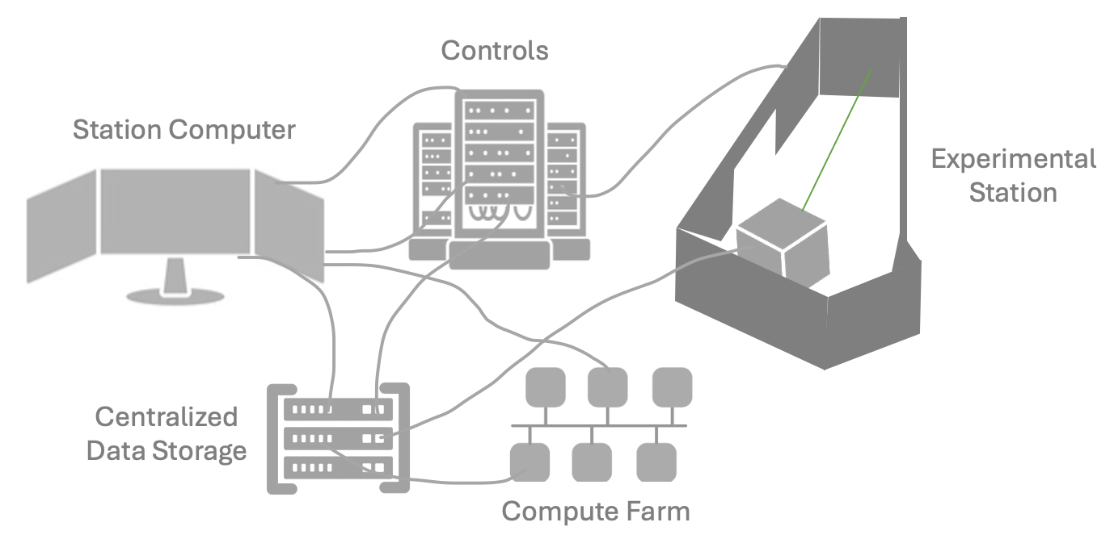
Data Collection at CHESS
The beamtime/data collection part of the research workflow is often overwhelming in terms of CI/computing for many users - we will focus on this part of the research workflow in this session.

Slide 4

Large Burden of Expertise For Users
Users need to become proficient (often experts) across multiple fields
DOMAIN SCIENCE
X-RAY SCIENCE
COMPUTING & CYBER INFRASTRUCTURE
OTHER
(e.g. MODELING, SIMUALTIONS etc.)
Historically users were on their own to learn this - learned on-the-fly AT the beamline
Increasing user cyber and computing literacy before the time of data collection will allow users to focus on science decisions at the beamline, rather than being overwhelmed by learning these skills in real time
When they start their synchrotron journey: most users - regardless of discipline
do not have a sufficiently strong background in scientific computing or cyber infrastructure to perform synchrotron measurements and subsequent analysis

Slide 5
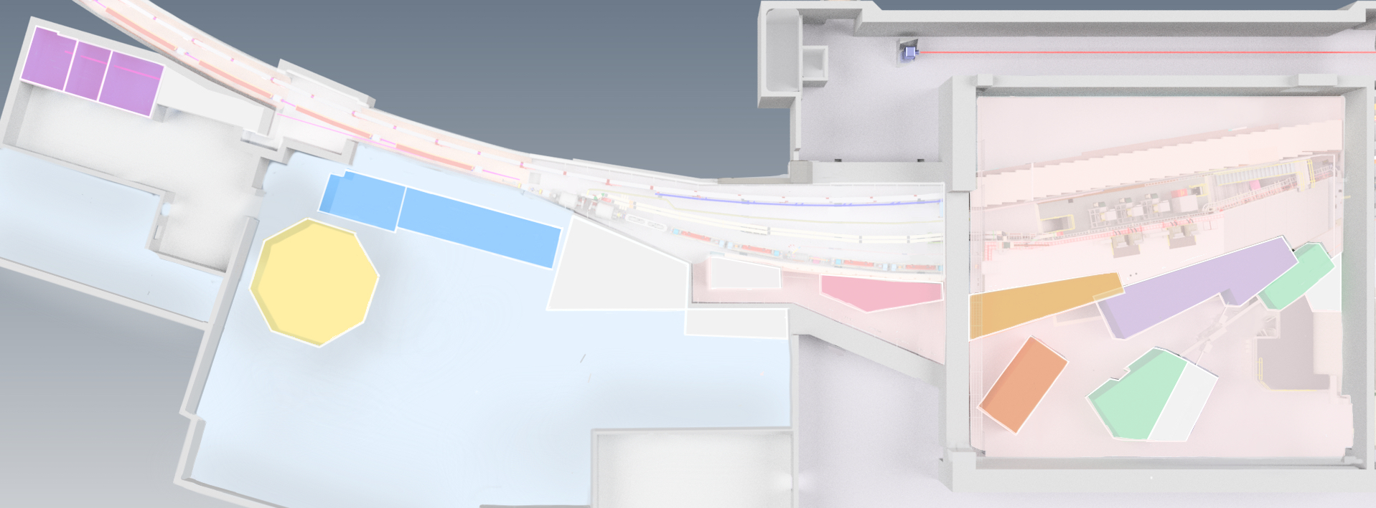
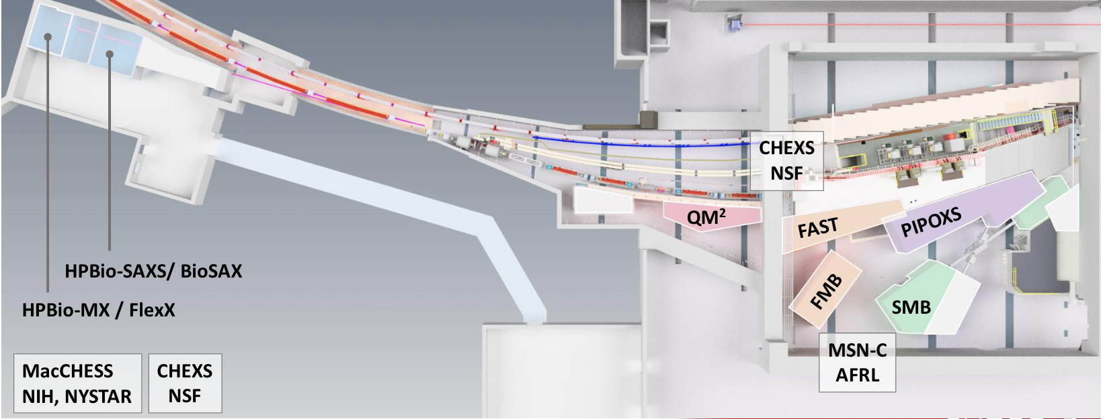




Diverse Science Drivers & Communities at CHESS
7 Beamlines – each specializing in a specific scientific domain & set of techniques
Partner model - 3 subfacilities – each with their own missions, deliverables, structure, and allocation policies
NEW CONSTRUCTION
X-LEAP
HMF
QM²
PIPOXS
HP BioSAXS
& BioSAXS
FAST
HPBio MX & FlexX
FMB
SMB
SUB-FACILITIES
MacCHESS
CHEXS
MSN-C

Slide 6


Data Collection: Computing & CI
Computing and CI literacy needs vary across beamlines and even for different techniques within a beamline.
All programs
Most Programs/Techniques
Program/Technique Specific
Experimental station | XS100
CHESS Networks | XS100
CHESS Filesystem | XS100
CHESS Compute Farm | DC200
CHESS BYOD Policies | XS100
Python | PE100-2
SPEC
Git | PE103
Program-Specific Software Packages (e.g. GSASII, DIALS, HEXRD, PyMCA, NEXUS, etc.)
Pandas
Matlab
Many of these categories have XCITE courses associated with them.
Users should work with their beamline scientists to understand what is required for their experiment.

Slide 7

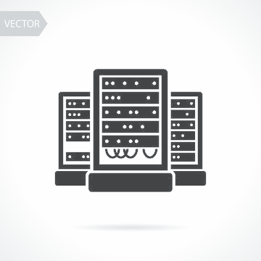


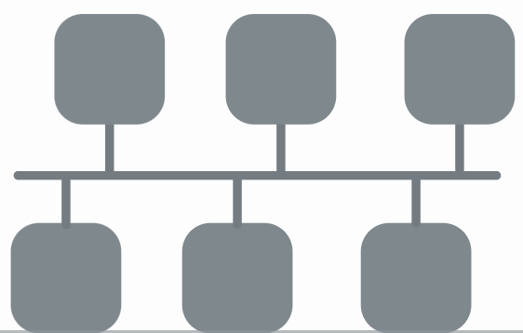
Anatomy of an Experimental Station: Station Computer
All experimental stations are controlled by a special computer , the station computer that communicates to all the hardware and software needed for data collection.
The station computer typically runs a number of processes and is responsible for orchestrating data collection, motor motions, synchronized triggers, metadata logging, and more.
Controls
Stewardship Warning
The station computer has special permissions that allows it to communicate with protected devices and filesystems.
Only interact with processes that your staff scientist has approved or trained you on
Do not launch additional terminals from the station computer without consulting your staff scientist (some programs will overload and crash the computer if run locally and disrupt data collection)
Station Computer
Centralized
Data Storage
Experimental Station
Compute Farm

Slide 8


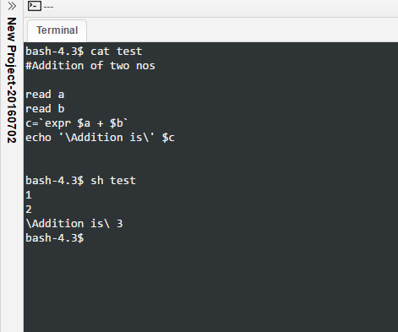
Station Computer: Linux and CLI
hands-on
tutorial
The station computers run on Linux - currently AlmaLinux 9
Most users will need to become familiar with the:
Linux OS
Terminal and using a Command Line Interface (CLI)

Slide 9


Station Computer: Remoting in via NoMachine
To access your beamline station remotely, use NoMachine
(both desktop and web client options)
Your CLASSE ID must be added to a trusted access list by your staff scientist.
This access is only enabled for users associated with scheduled beamtimes so make sure all users who need access are associated with the beamtime.
Stewardship Warning
You are being given direct access to the beamline controls desktop – as though you are there
Be cautious of where you mouse and what you type when remote
Keep pets away from the keyboard
Instructions at: https://wiki.classe.cornell.edu/Computing/NoMachine

Slide 10
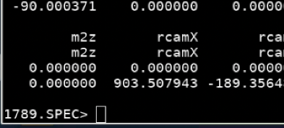
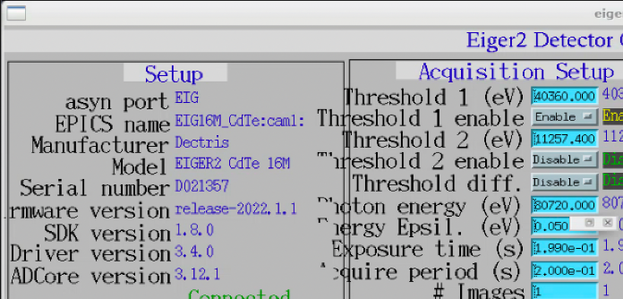
Anatomy of an Experimental Station: Station Computer
Many stations use SPEC as the data acquisition software and EPICS for instrument control
SPEC is a language, loosely based on C, used for instrument control and data acquisition at many synchrotrons.
When using spec, you will interact with a SPEC terminal and run a combination of “standard” SPEC commands and/or a series of compiled programs for your technique
EPICS is a set of software tools and applications which provide a software infrastructure for use in building distributed control systems to operate devices
Many of the devices at CHESS leverage EPICS drivers for operation EPICS PVs (process variables) are commonly used for signal monitoring and metadata/data logging.
Your staff scientist will tell you which commands are appropriate at your station

Slide 11
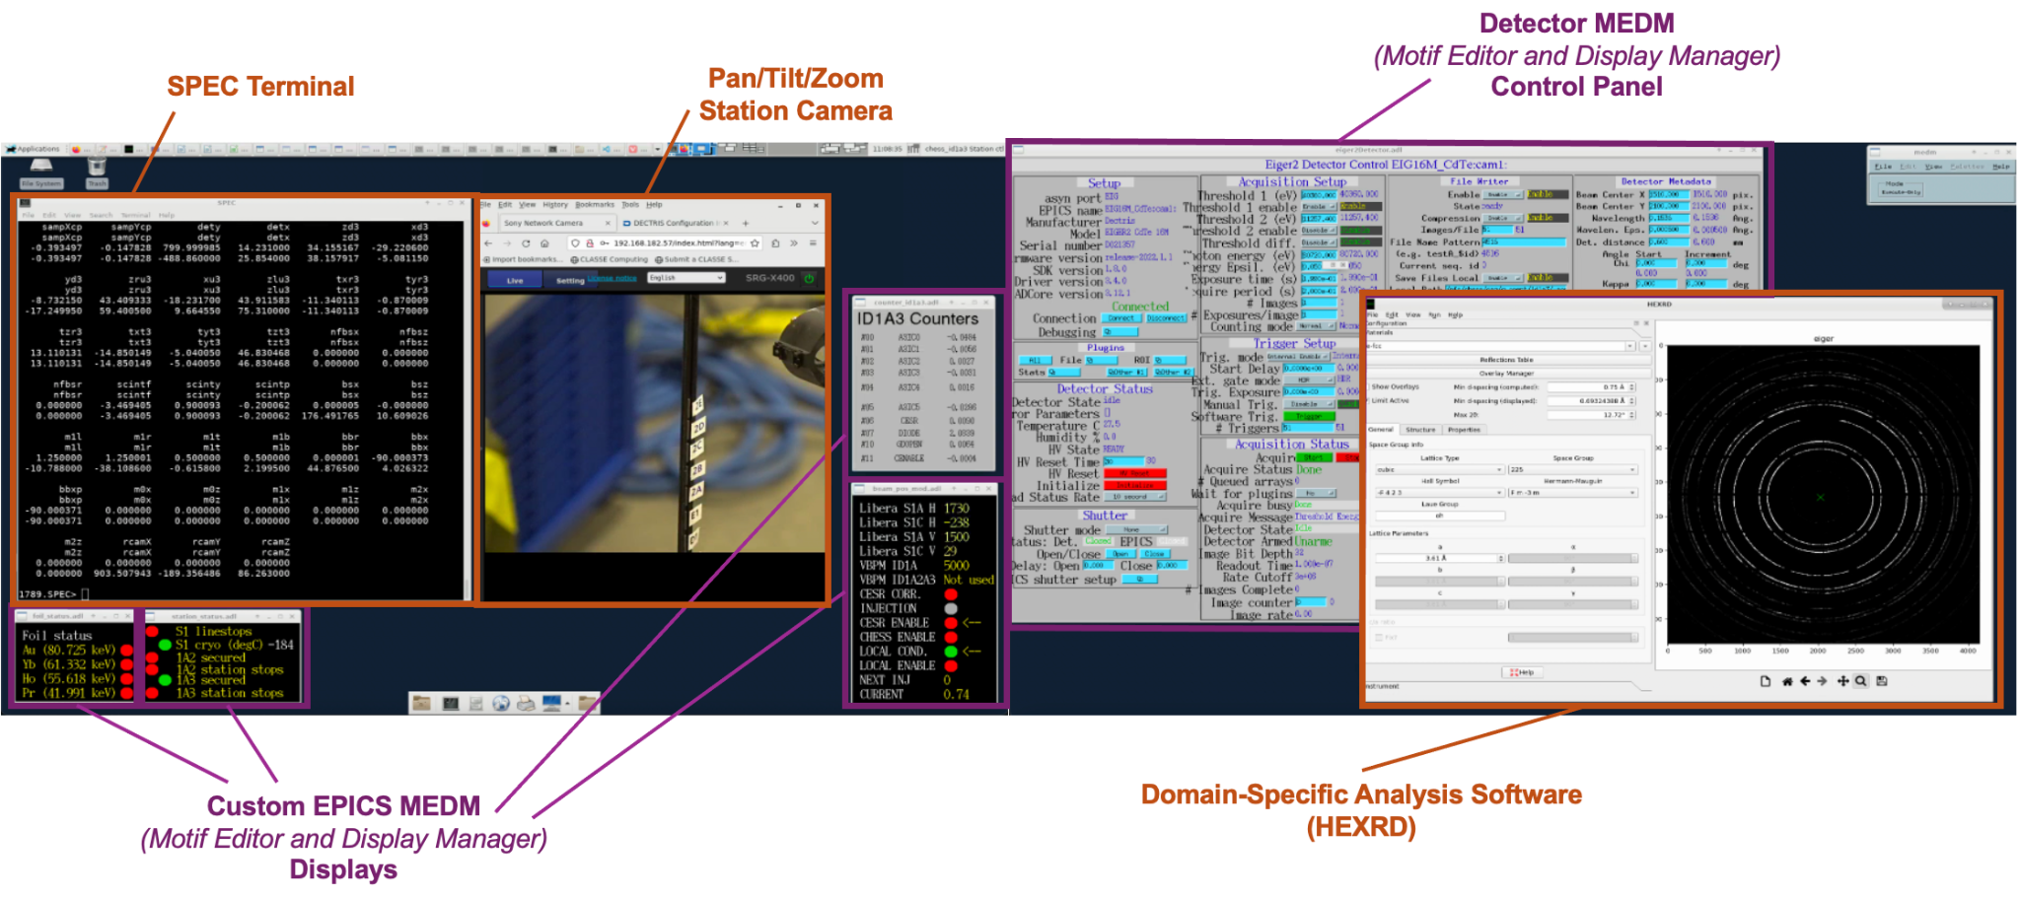
Station Computer: ID1A3 Example

Slide 12

Station Computer: ID1A3 Example

Slide 13
Station Controls Stewardship
Perform Only Trained Tasks Only engage in processes you have been trained on or explicitly approved for by your staff scientist. For tasks within your training, feel confident and empowered to carry them out!
Stay Engaged During Training Take thorough notes and ask questions while being trained. This not only helps you learn but also shows initiative and supports smooth operations.
Know the Training Policy Training policies can vary by beamline. In some cases, users may train one another; in others, only staff scientists are authorized to provide training. Always confirm the expectations at your station.
Exercise Caution With the Unknown Do not proceed with tasks you have not been trained on. Even if the system doesn’t prevent you from doing something, that doesn’t mean it’s safe. When in doubt, stop and ask—the consequences of untrained actions can be significant.
.

Slide 14
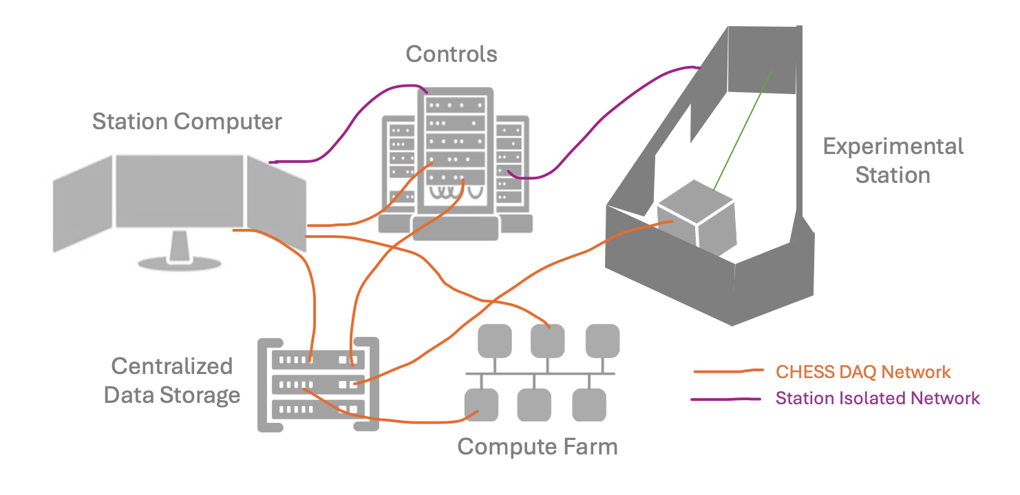
Station Networking
Data is traveling rapidly between devices, computers, and storage locations
Ethernet/Fiber
CHESS Public Network
CHESS DAQ
Station Isolated Network (10Gb)
Direct Network Lines between equipment (sometimes >100Gb lines)
WiFi
Eduroam
RedRover
Cornell Visitor
LNS Protected (requires registration with CLASSE-IT)
Specialized, fast pathways to move data between equipment are protected and/or isolated. Only approved instruments/devices can be connected to these networks.
Ethernet cables are color coded:
CHESS Public Network = White
DAQ = orange
Station isolated network = pink

Slide 15

Bring Your Own Device (BYOD)
Users may need to bring their own devices to be beamline - either physically in the lab or remotely connected to the CHESS networks
Examples include:
Controls computer for equipment they have integrated for an experiment
Analysis computer for on-the-fly analysis
All devices must be approved at least two weeks in advance. It may not be possible to consider integration on a shorter time period.
If you are bringing a computer that needs to read the DAQ (raw data directory), computer must be registered to be added to the LNS Protected WiFi network:
https://wiki.classe.cornell.edu/Computing/LaptopRegistration

Slide 16
CHESS-DAQ Filesystems
Data Tier | Description | Total size | Nightly Incremental | Full Backup | Paths
DAQ/RAW | Raw data | 1587 TB (4/23) | ✓ | Per cycle | Linux: /nfs/chess/daq, /nfs/chess/raw Win: \\chessdaq\daq, \\chesssamba\raw
METADATA | Metadata | 150 TB (AUX) | ✓ | Per cycle | Linux: /nfs/chess/aux/metadata Win: \\chesssamba\aux\metadata
REDUCED DATA | Reduced non-BTR |  |  | Per cycle | Linux: /nfs/chess/aux/reduced_data/user Win: \\chesssamba\aux\reduced_data\user
 | Reduced BTR |  |  | Per cycle | Linux: /nfs/chess/aux/reduced_data/cycles Win: \\chesssamba\aux\reduced_data\cycles
USER | Project space | 40 TB | ✓ | Monthly | Linux: /nfs/chess/user Win: \\chesssamba\user
SCRATCH | Temp files non-BTR | 30 TB |  | — | Linux: /nfs/chess/scratch/user Win: \\chesssamba\scratch\user
 | Temp files BTR |  |  | — | Linux: /nfs/chess/scratch/cycles Win: \\chesssamba\scratch\cycles
hands-on
tutorial
Where you’re asked to save your data or perform analysis matters!

Slide 17
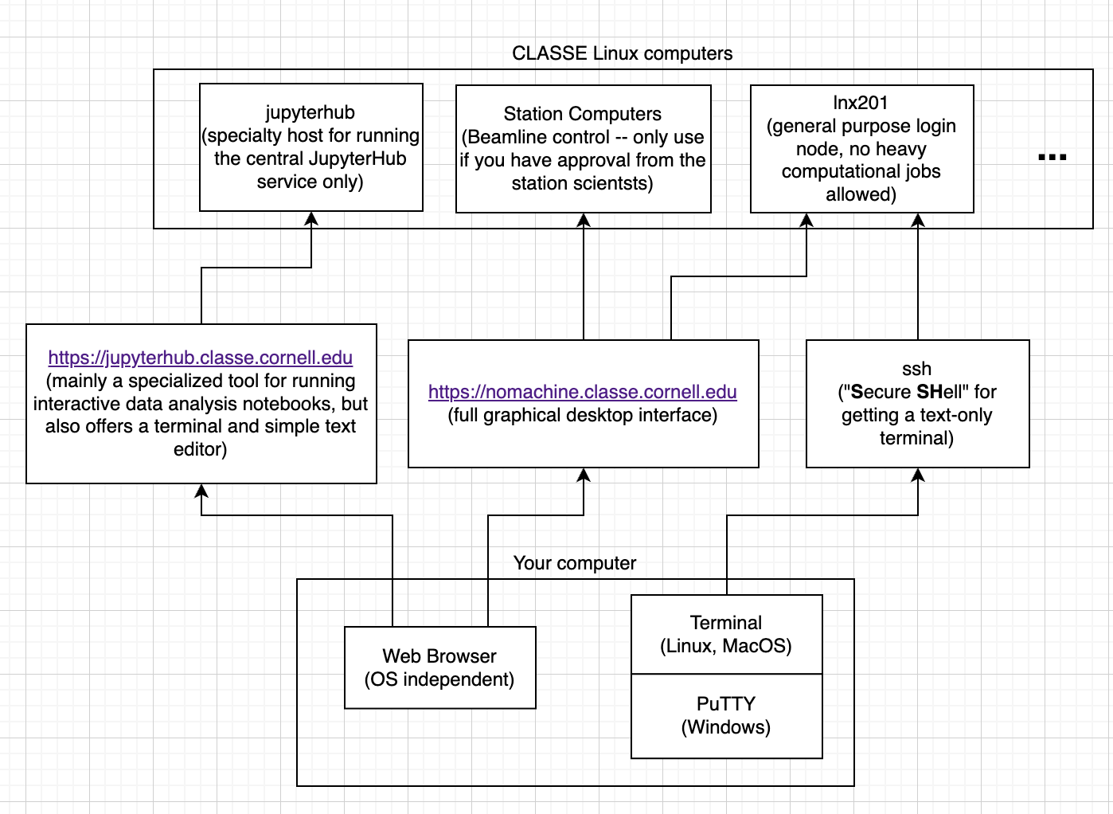
CHESS-Computer Access
hands-on
tutorial

Slide 18
CHESS-Computer Access
Stewardship Warning
Don’t save data on your “home” space!
It will fill up fast and automatically lock you out
hands-on
tutorial
Don’t do processing on lnx201!
IT will kill your process and you’ll need to go to an appropriate computer!

Slide 19

Protected Data: Intellectual Property (IP) and Export Control
Some data needs to be protected:
e.g. data covered under Intellectual Property or Export Control agreements
All such data must be declared and all agreements signed before ANY data is on CHESS/Cornell computing systems (including preparatory material that falls under IP or Export Control categories).
Data Collection, Storage, and Analysis can be customized to comply with data agreements, including:
Modifying isolated networks
Mounting encrypted drives
Configuring encrypted computers
Modifying permissions on filesystem locations
Securing the experimental station with an entry password
Disconnecting streaming video to the experimental station

Slide 20
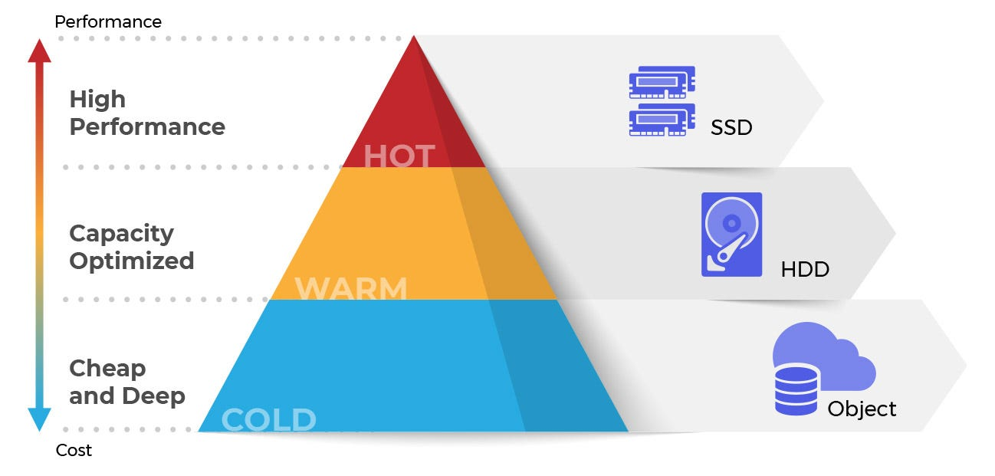
Large Data Volumes and File Transfers
The preferred method for file transfer is using Globus: https://wiki.classe.cornell.edu/Computing/GlobusDataTransfer
Data may be too large to easily transfer to user’s home institution / not enough requisite compute resources home institution.
Hot/Cold Data Storage
When data is initially written to the “raw” data drive, it is available for direct access for data transfer or analysis.
Due to the volumes of data produced at each beamline, your raw data may be moved to “cold” storage (aka tape) after approx. 6 months.
The data is still saved, but to transfer or perform analysis on the files you will need to arrange to have it rolled back into “hot storage” - AKA take out an IT ticket: https://wiki.classe.cornell.edu/Computing/ServiceRequestTips

Slide 21
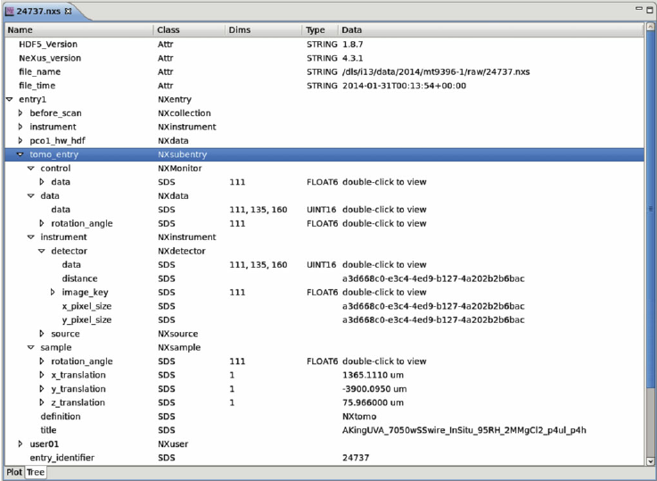
DataTypes: HDF5 & NEXUS
hands-on
tutorial
Large, multi-stream datasets benefit from specialized, efficient storage files
HDF5: A hierarchical format for storing and organizing large amounts of scientific data.
NeXus: A standardized HDF5-based format for scientific instrument data, particularly in neutron, X-ray, and muon sciences.
HDF5/NeXus provides a hierarchical structure that efficiently organizes complex data relationships while offering self-description for interoperability and long-term preservation.
This also allows readers to efficiently access and analyze specific parts of the massive dataset without needing to load the entire file.

Slide 22
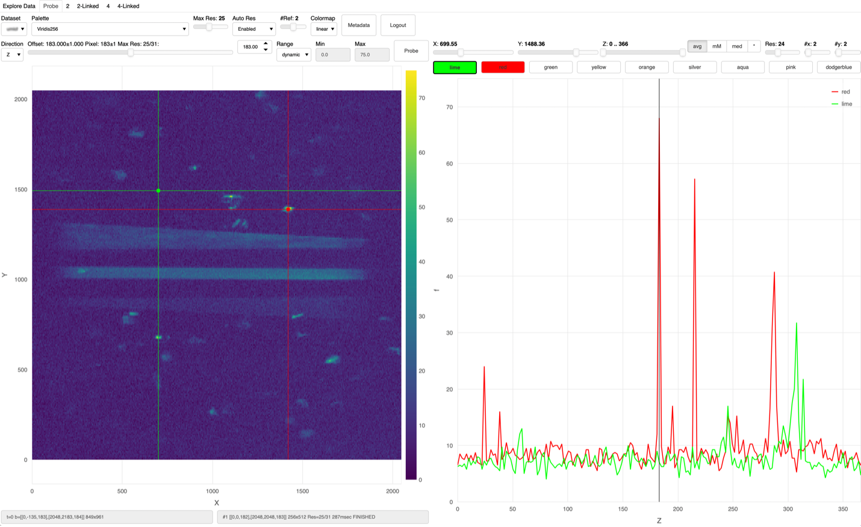
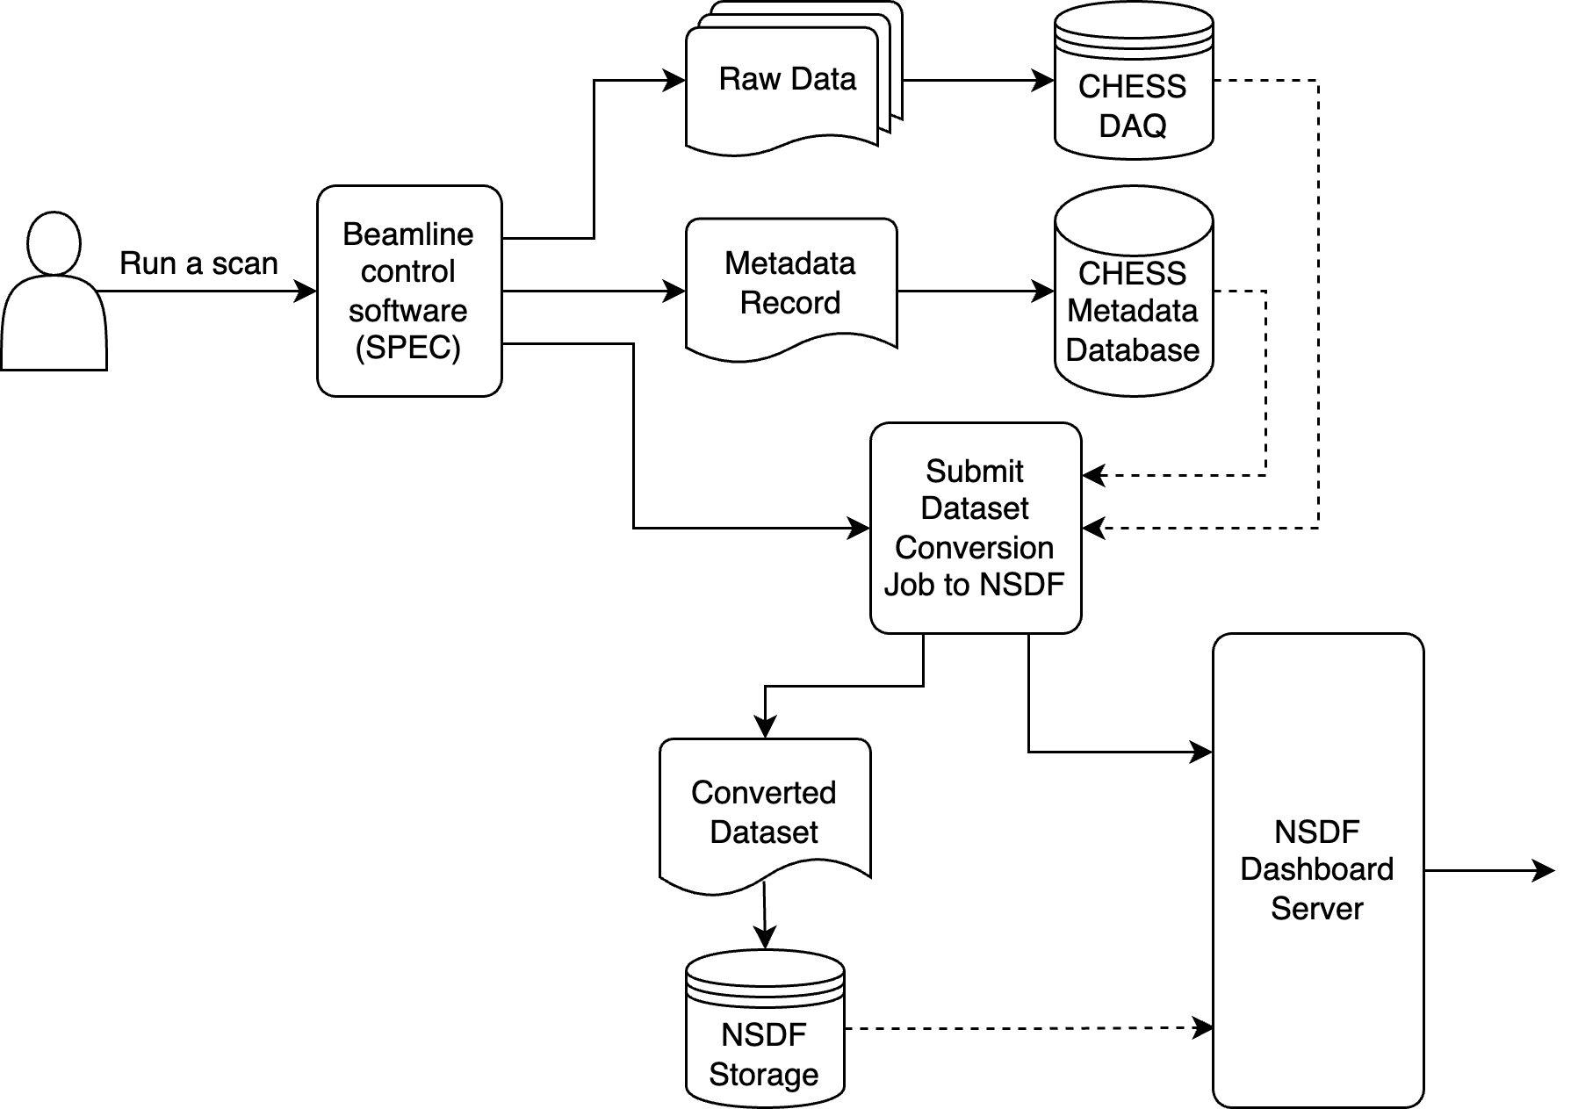
Real Time Visualizing, Computing, Data Reduction
National Science Data Fabric (NSDF) Dashboard
Large data sizes and volumes are historically hard to visualize
Dashboard built on OpenViSUS to enable real time visualization
https://services.nationalsciencedatafabric.org/chess/
Inline Data Processing/Computing
Many beamlines have an initial “data reduction” procedure that reduces the size of the data through compression or on-the-fly analysis to have smaller file sizes that are more manageable to analyze at your home institution.
Some of these processes are software procedures performed on the data after it is written to the raw directory, while other beamlines utilize inline data processing/compression prior to writing their files to the raw directory.

Slide 23

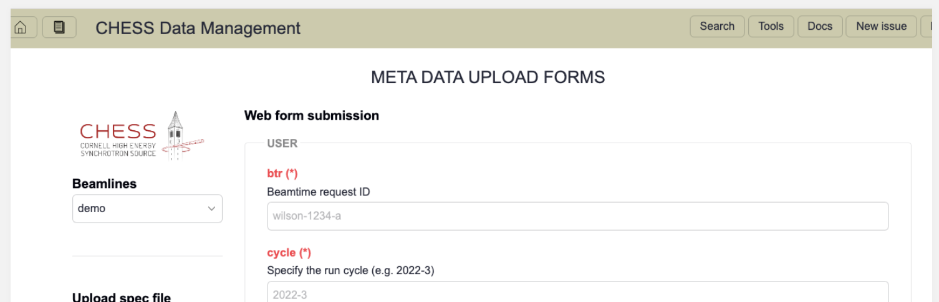
Metadata Services
Ideally, all the data necessary to fully reproduce your results are recorded and disseminated in a manner that others can interpret after your experiment. Ideally the provenance remains unbroken from experiment planning.
Metadata and parallel data streams are generated at every stage of your experiment.
CHESS is continuing to develop and implement services to help with this creation. From programs like Galaxy, to our Metadata service (see right).
FOXDEN Metadata Service
Providing tools to record and automatically ingest machine-readable metadata in a systematic way.
Includes variables that historically were not recorded via a second data stream (e.g. the material processing parameters)
Tutorial In Hands-on Exercises: https://chesscomputing.github.io/FOXDEN/docs/web_tutorial.html
hands-on
tutorial

Slide 24

Taking Good Beamtime Notes
Friendly Reminder:
No spaces in file names. Use _underscores_ or CamelCase.
File names should start with a letter, not a number.
Ultimately, some of the most important metadata comes from your experimental logbook.
Your beamtime notes must supplement metadata provided during data collection in such a way that your experiment could be entirely reproduced. It is important to record any scientist decisions and the reasons for making those decisions in your beamtime notes.
Your beamline scientist may not remember every detail of your beamtime - it is not their responsibility - it’s yours.
Good experimentalists take notes. Full Stop.

Slide 25
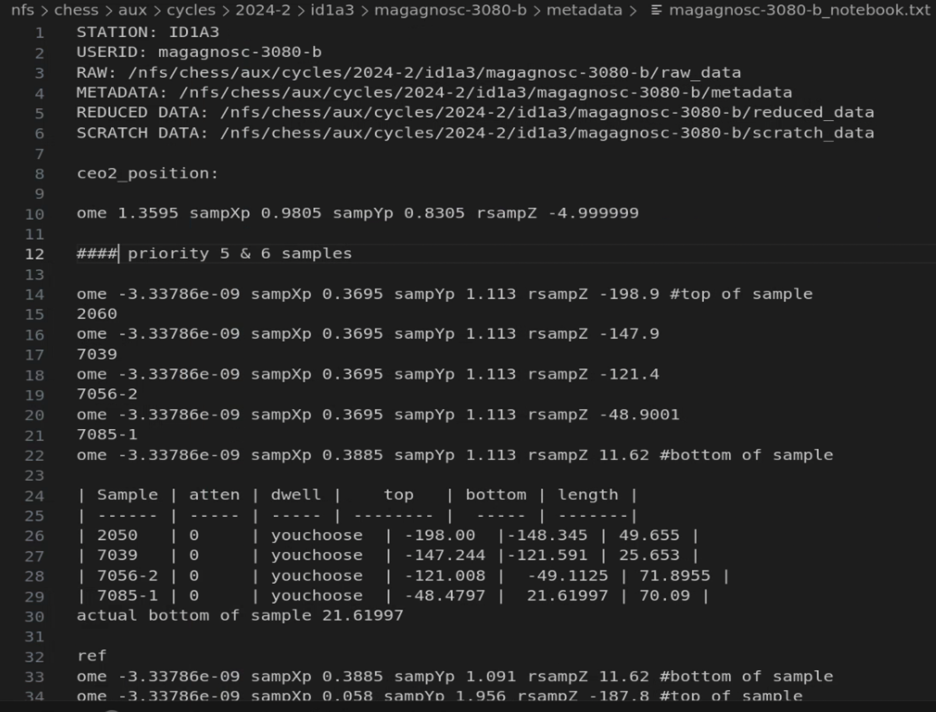
Taking Good Beamtime Notes
Friendly Reminder:
No spaces in file names. Use _underscores_ or CamelCase.
File names should start with a letter, not a number.
Beamtime Notes / Supplementary Documentation Best Practices
Beamline scientists often have examples of good beamtime notes
For recording notes during the beamtime, many beamlines suggest plain text or Markdown language (formatted text file) because it is easy to read in many systems, rather than a Microsoft Word Document which has a proprietary format. Images can be rendered in markdown formats.
Save your beamtime notes or a copy of your beamtime notes or (link to your google doc / equivalent) on the CHESS filesystem with your data (your beamline scientist will tell you where the best place is)
Commenting Software
Comment any code produced at the beamtime. If this code was used to make decisions about the experiment, it should be saved and referred to in your experimental log.

Slide 26
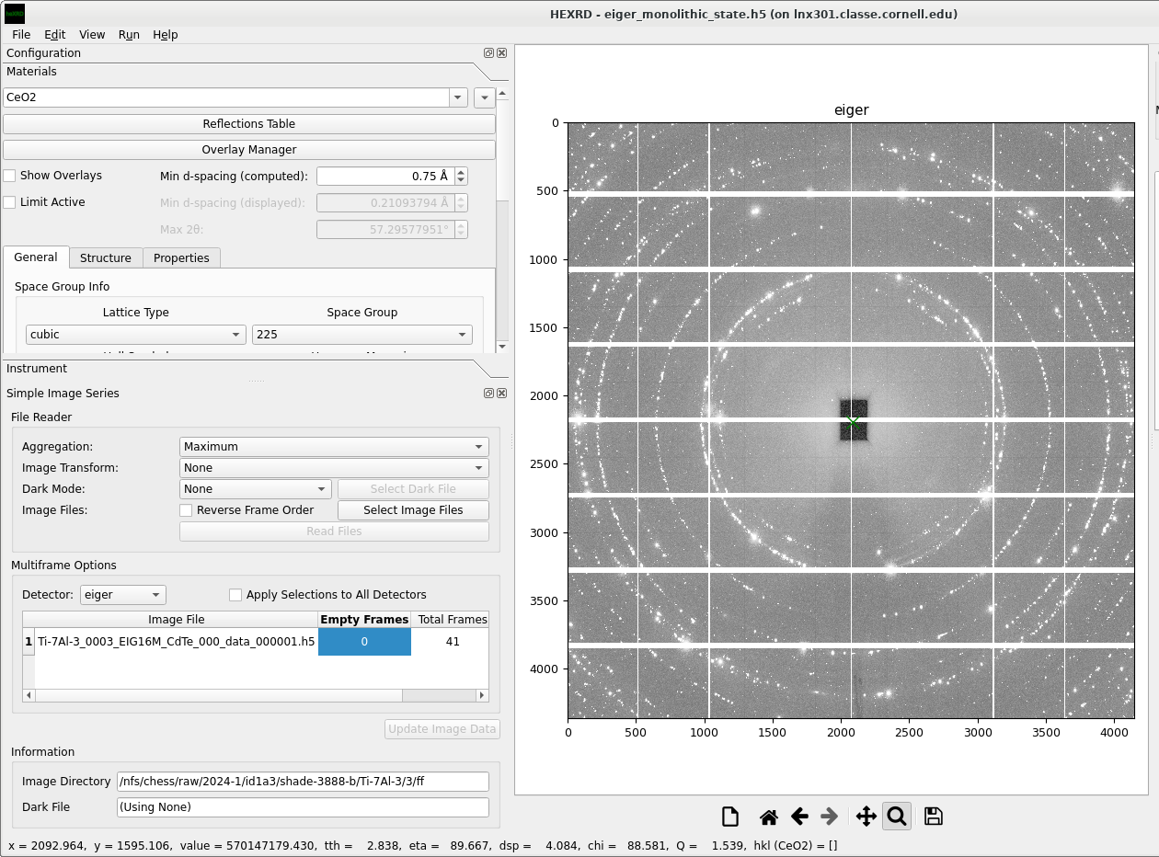
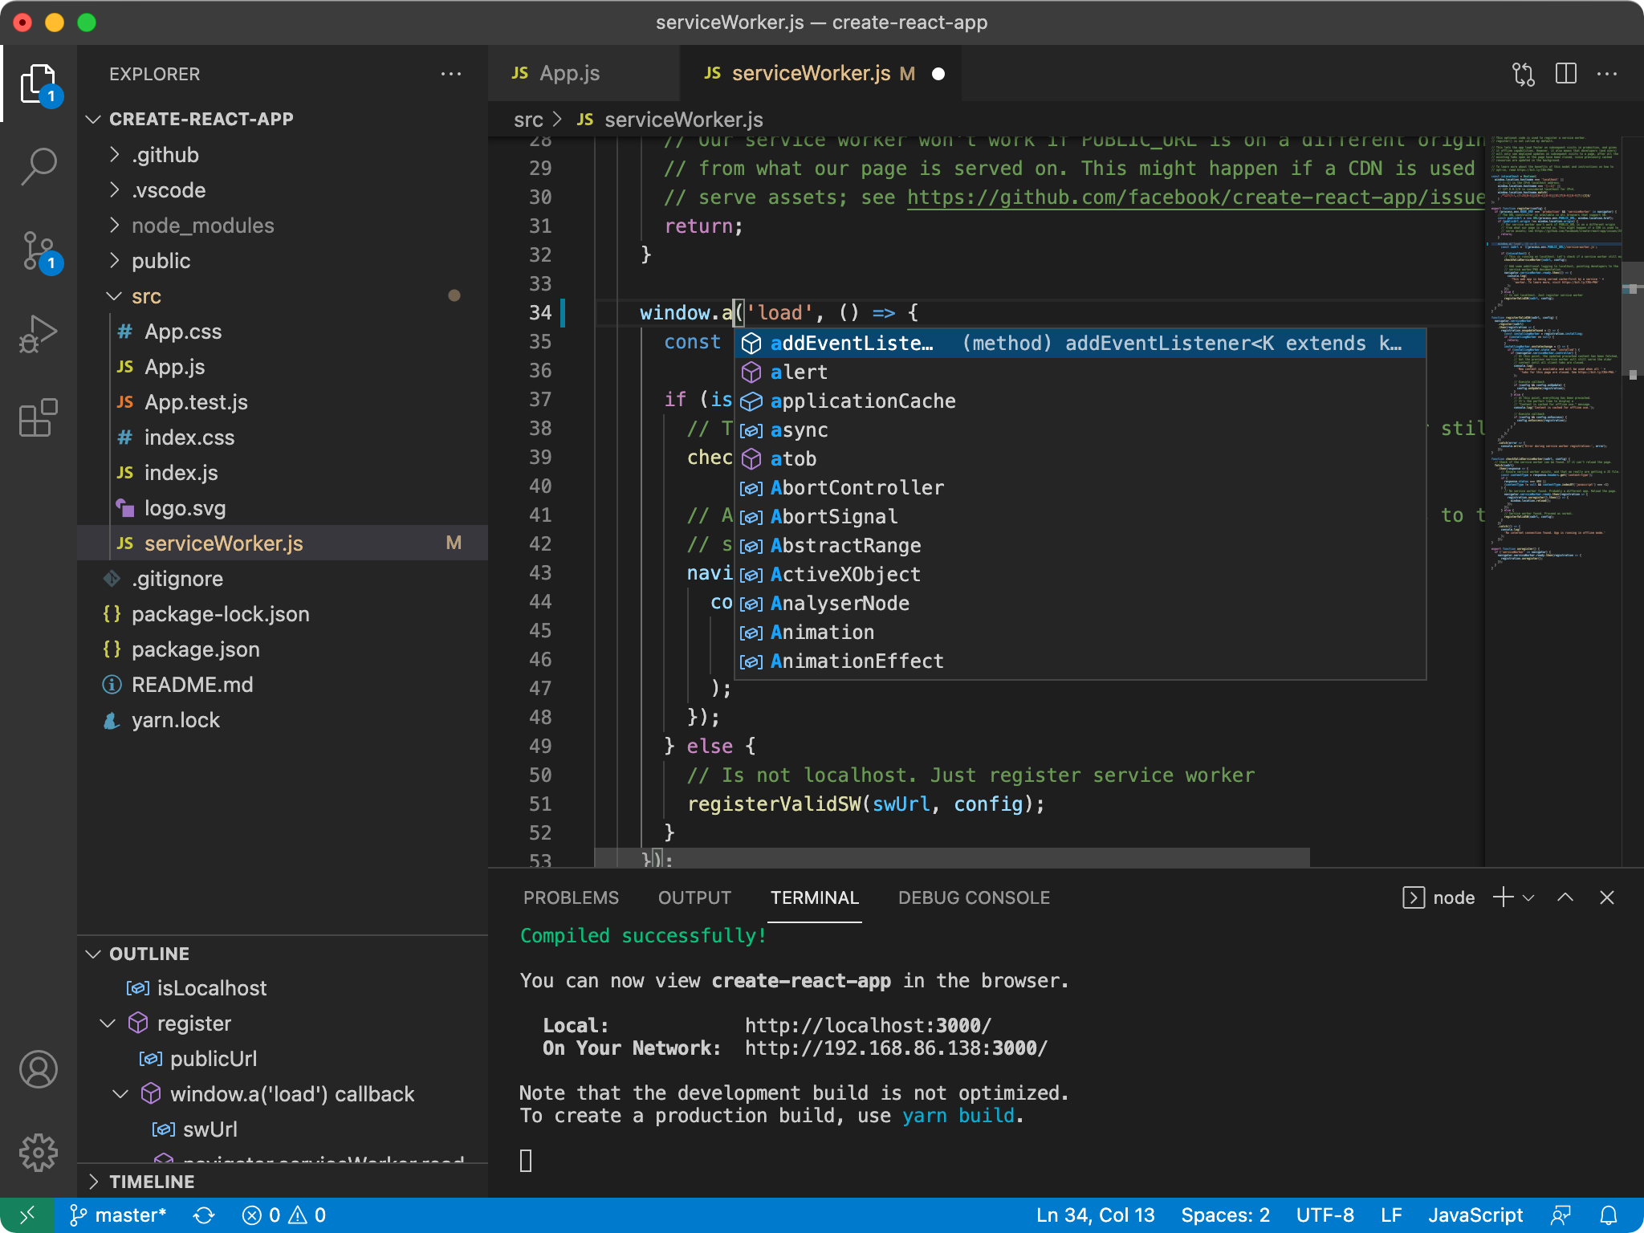
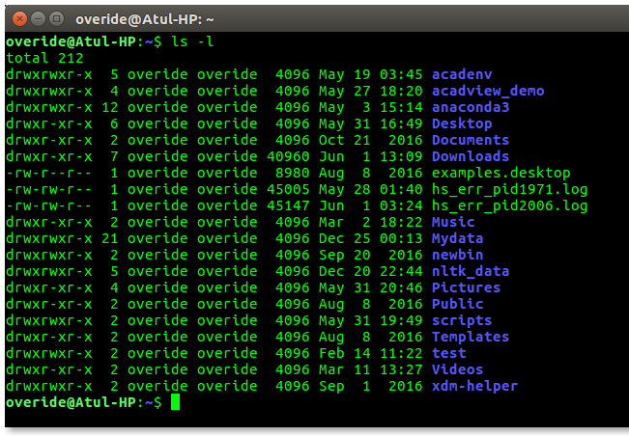
Executing and interacting with software
Graphical User Interfaces (GUIs)
Integrated Development Environments (IDEs)
Command Line Interface
(CLI)
A visual interface where users interact with software using graphical elements like icons, windows, and menus, making applications intuitive and accessible to a wide range of users.
A comprehensive software application providing a unified interface with tools like a code editor, debugger, and build automation to streamline software development.
A text-based interface where users type commands to interact directly with the operating system or software, offering powerful automation and remote management capabilities.
True computing literacy means respecting each has valid and optimal use cases

Slide 27

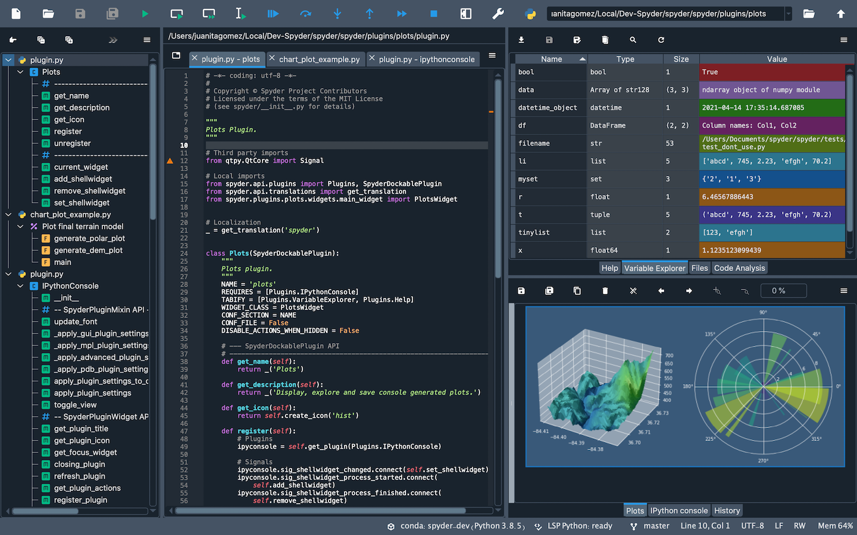

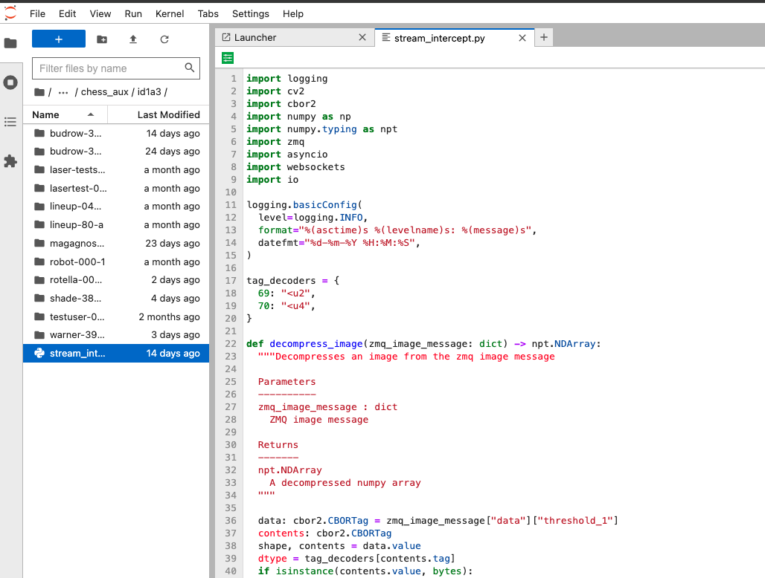

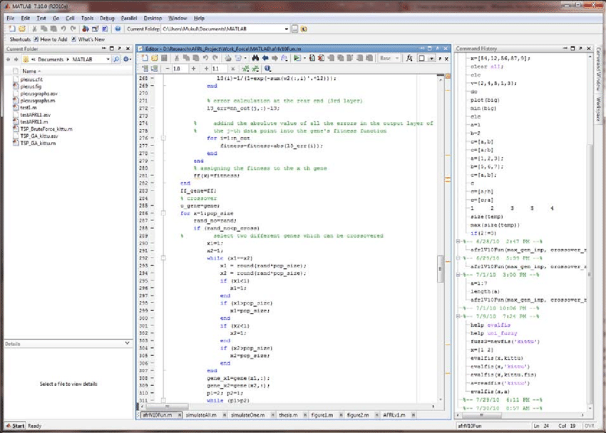

Integrated Development Environment (IDEs)
IDEs are popular for at-beamline code development & analysis codes – here are some examples
CLASSE JupyterHub :
https://wiki.classe.cornell.edu/Computing/JupyterHub
https://jupyter01.classe.cornell.edu/
hands-on
tutorial

Slide 28
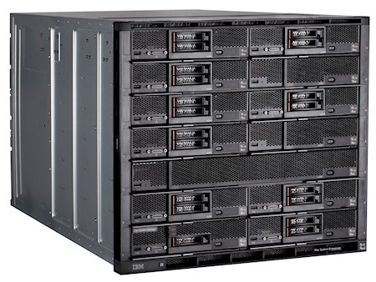
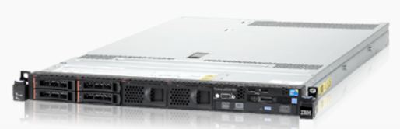
Command Line Interface (CLI)
Powerful tool for batch processing and automation
Convenient when a UI is unnecessary
Especially valuable at CHESS when leveraging Compute Farm resources
hands-on
tutorial
CLASSE Compute Farm
A compute farm is a large cluster of networked computers that collectively provide immense processing power for computationally intensive tasks by distributing workloads
See “CI Resources at CHESS and Beyond”
More information available at
https://wiki.classe.cornell.edu/Computing/ComputeFarmIntro

Slide 29
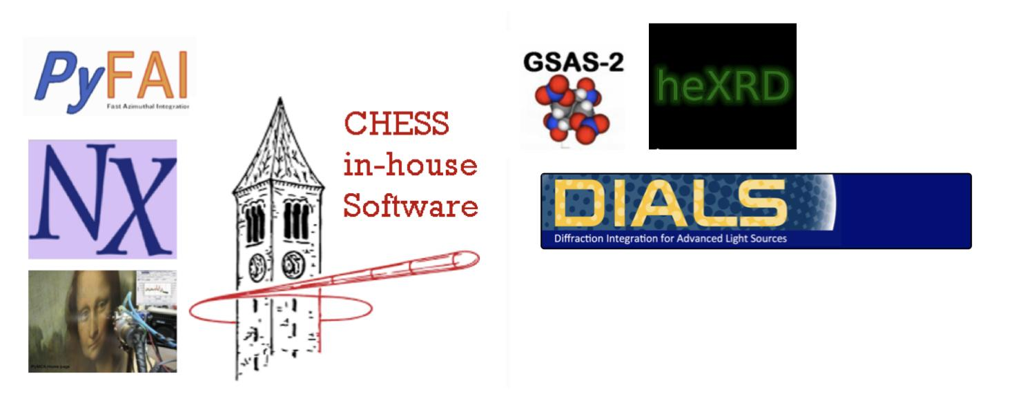
Data Analysis Science Specific Software Packages
Most software will be domain and technique specific. CHESS has many common X-ray software packages available on the system. Speak with your beamline scientist for the preferred software package for your experiment.
hands-on
tutorial
…and so many more!!!
If YOU are interested in creating a tutorial or linking us to one for an XCITE module, we’re interested!

Slide 30
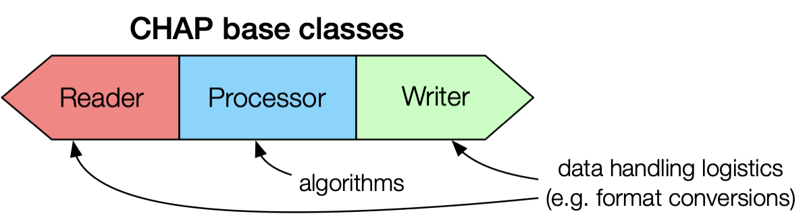
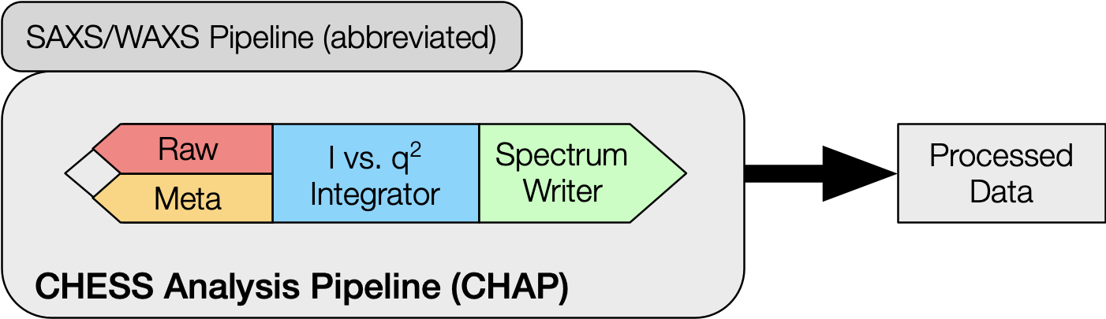
CHESS Analysis Pipeline (CHAP) & Building Blocks of Good Software
ChessAnalysisPipeline (CHAP) is a framework of modular building blocks that can be used to construct data processing workflows for different kinds of X-ray experiments
hands-on
tutorial
Data analysis code organized into reusable modules
Reader
Processor
Writer
Multiple inputs
User interface
Command line (expert)
Galaxy (non-expert)
CHAPBook (coding interface)

Slide 31
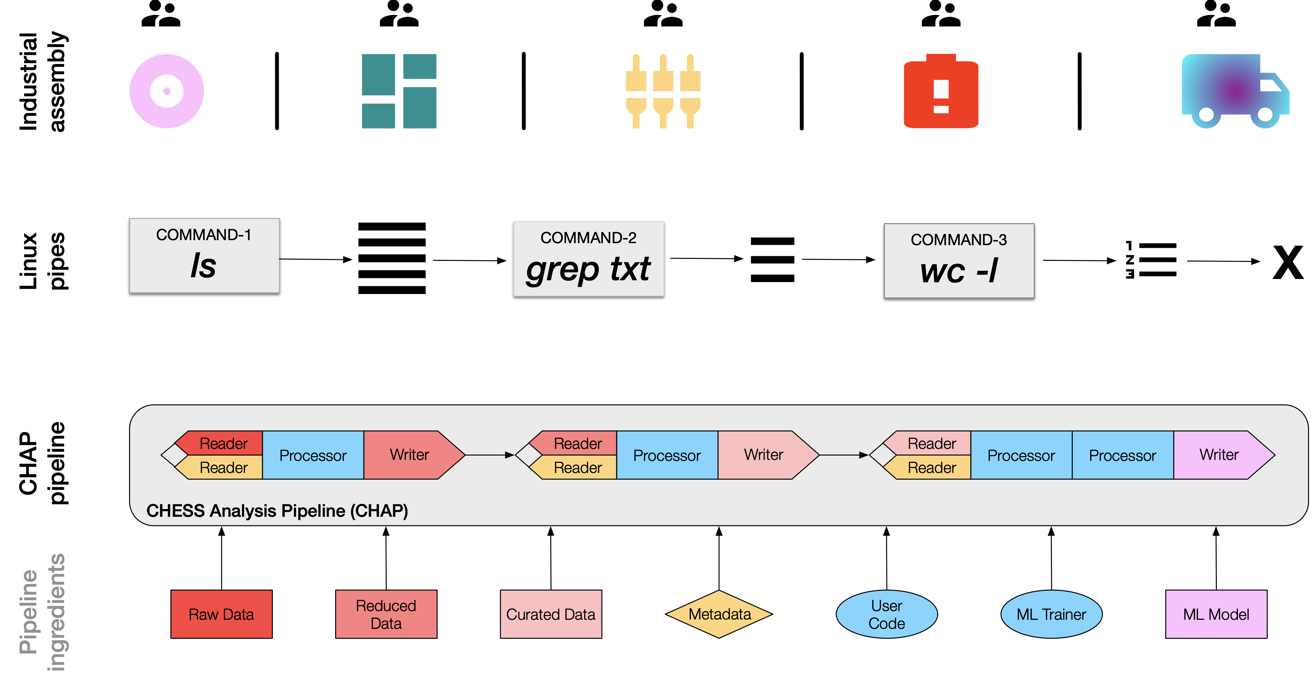
CHAP Follows Logical Process!

Slide 32
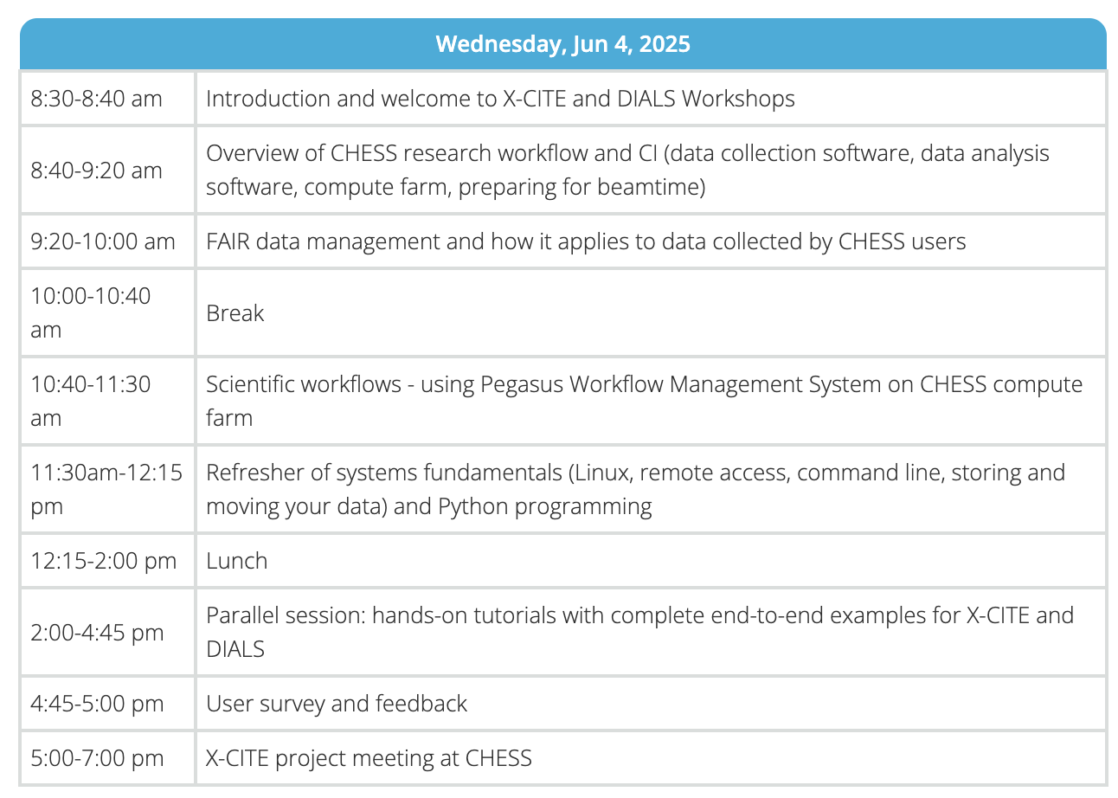
X-CITE Workshop Agenda

Slide 33

Thanks
Project website: https://sites.google.com/view/x-cite-nsf/home
Training materials: https://xcitecourse.org
NSF Cybertraining Award # 2320373

