Slide 1
CyberInfrastructure Training and Education for Synchrotron X-Ray Science (X-CITE) and Diffraction Integration for Advanced Light Sources (DIALS) - Joint Workshop
X-CITE Team
Anirban Mandal, Erik Scott (RENCI, UNC Chapel Hill)
Ewa Deelman, Karan Vahi, Mats Rynge (ISI, USC)
Matthew Miller, Werner Sun, Peter Ko, Kelly Nygren, Keara Soloway, Rolf Verberg, Valentin Kuznetsov (CHESS, Cornell)
DIALS Team
Aaron Brewster, Daniel Paley (LBL)
Jeney Wierman (CHESS, Cornell)
NSF OAC Award Numbers: 2320373, 2320375, 2320374
Notes:
I wanted to extend a warm welcome to everyone for coming to the second edition of the X-CITE workshop. We are hosting this workshop with our DIALS colleagues this time. X-CITE stands for Cyberinfrastructure training and education for synchrotron X-ray science. In short, this training program is geared toward CHESS users, you, to help you make better use of computing, data and systems - Cyberinfrastructure, to accelerate your scientific endeavors.
I am Anirban Mandal, the lead PI for X-CITE, and I serve as the Director for Network Research and Infrastructure at RENCI, UNC Chapel Hill.

Slide 2
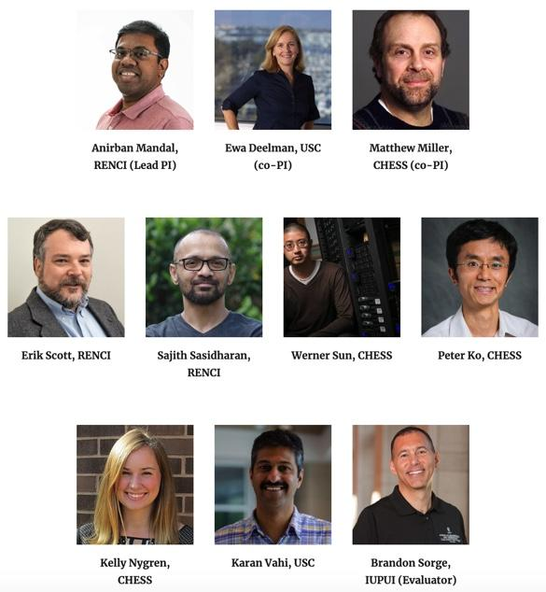
What is X-CITE and who are we ?
X-CITE is an NSF funded project with the goal of developing a training program targeted to CHESS users that
reduces barriers to the use of CHESS Cyberinfrastructure (CI) - instruments, computing, data, and tools;
democratizes access to NSF CI resources and services; and
accelerates X-ray science for a broad user community.
We are a group with expertise in CI as well as X-ray and related domain sciences
Keara Soloway, Rolf Verberg, Valentin Kuznetsov

Slide 3
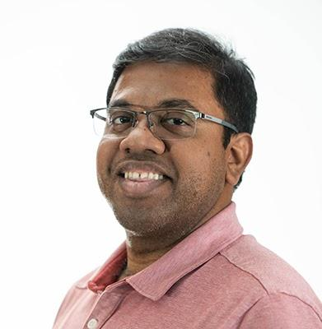
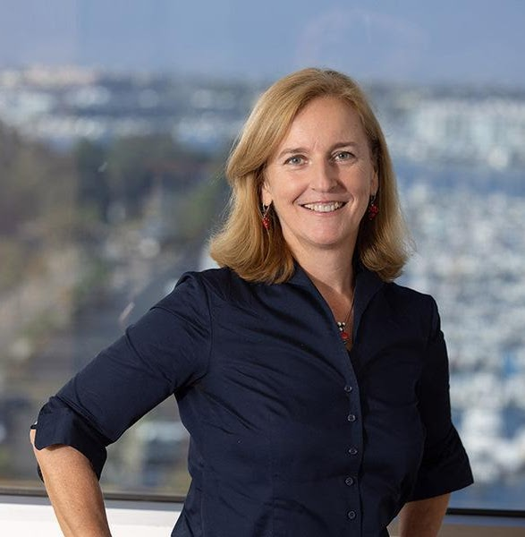
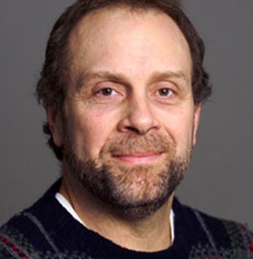
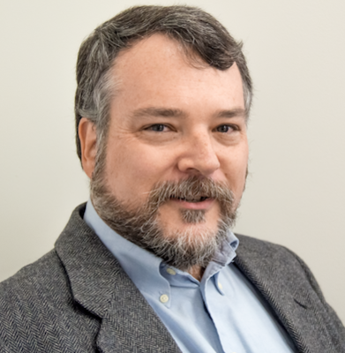
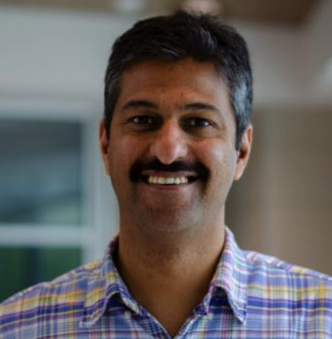
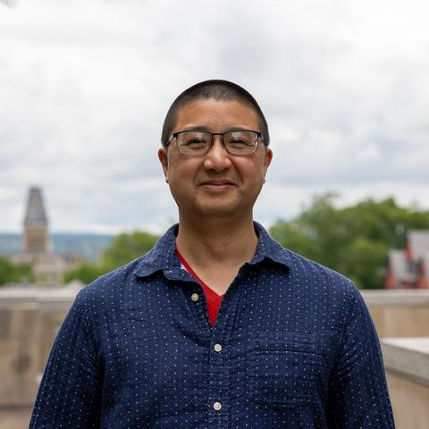
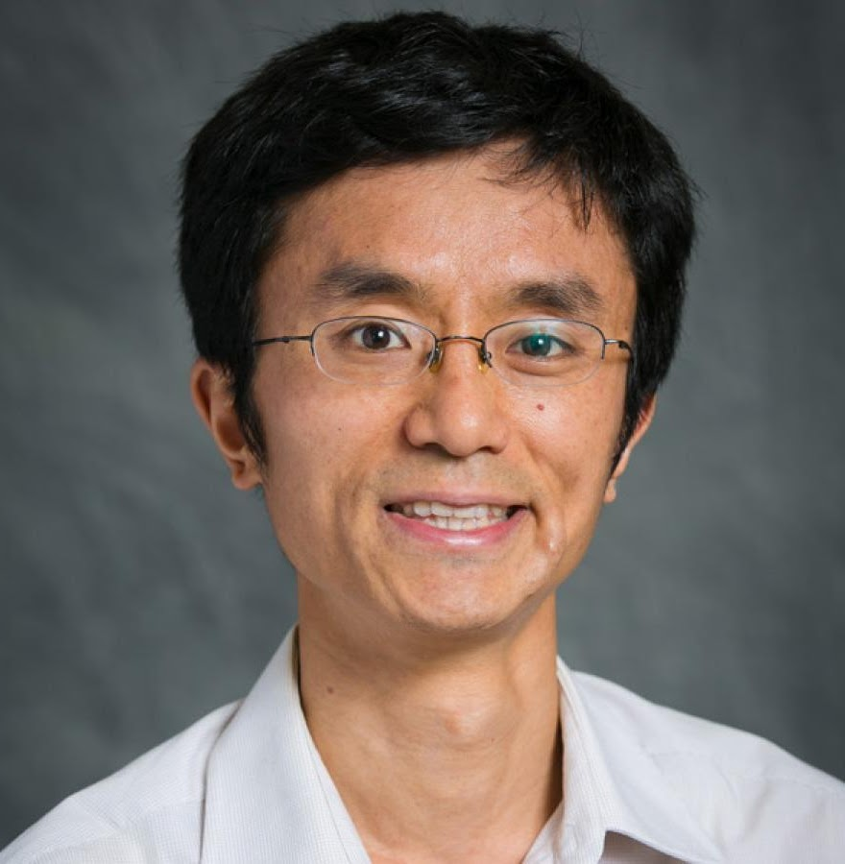
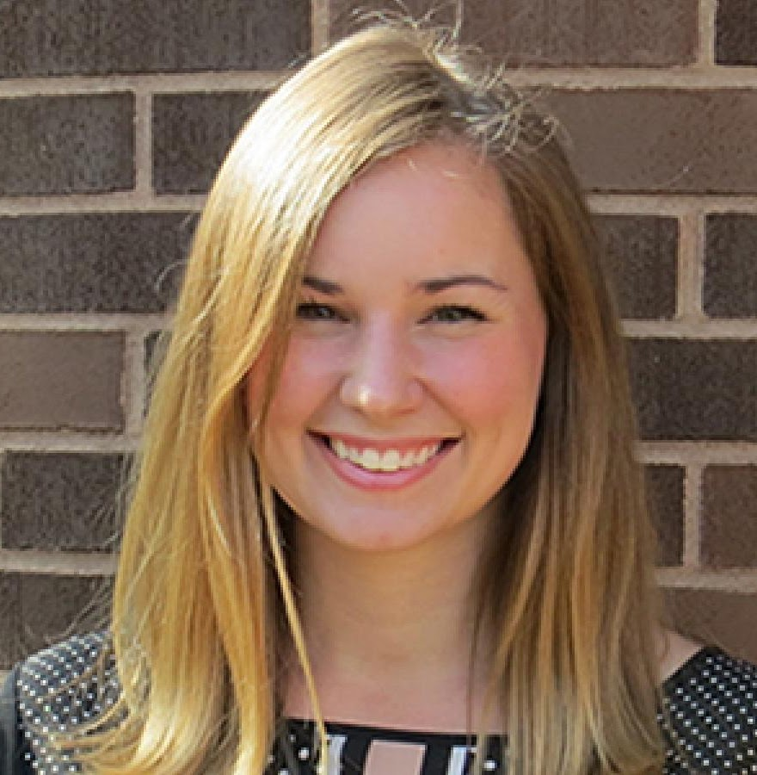
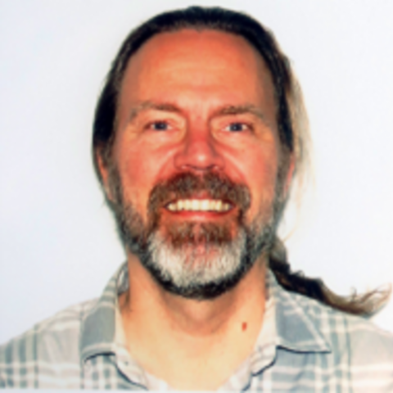
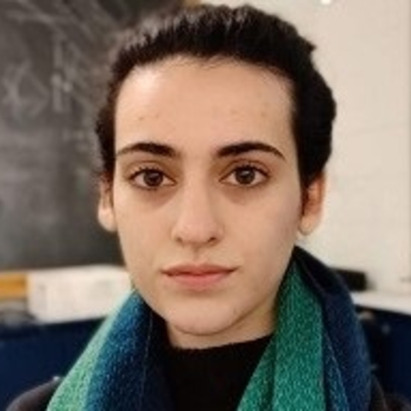
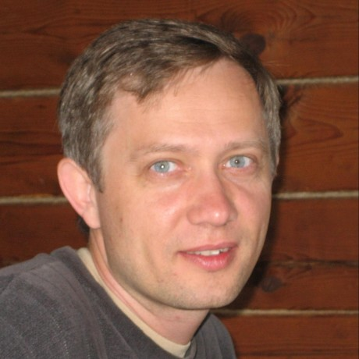
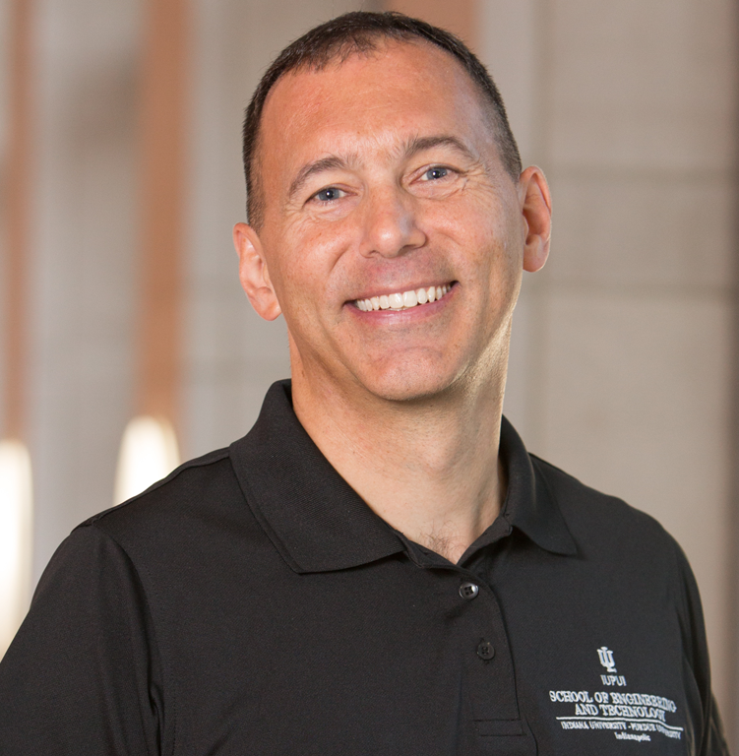
What is X-CITE and who are we ?
X-CITE is an NSF funded project with the goal of developing a training program targeted to CHESS users that
reduces barriers to the use of CHESS Cyberinfrastructure (CI) - instruments, computing, data, and tools;
democratizes access to NSF CI resources and services; and
accelerates X-ray science for a broad user community.
We are a group with expertise in CI as well as X-ray and related domain sciences

Slide 4
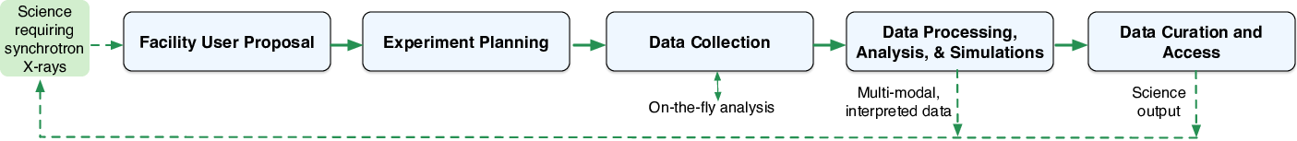
CI Training for CHESS: Motivation
Proposal and planning stage
Proposal plans for processing and analyzing synchrotron X-ray data need some prior CI knowledge in all areas above.
Data collection stage
Need for basic computer systems knowledge (command line) and (on-the-fly) data analysis; Best practices for collecting data
Data processing stage
Processing data (reduction, analysis, simulation, interpretation), handling large data sets, leveraging existing software and CI.
Data curation stage
Metadata management, Open Science/FAIR and data curation.

Slide 5
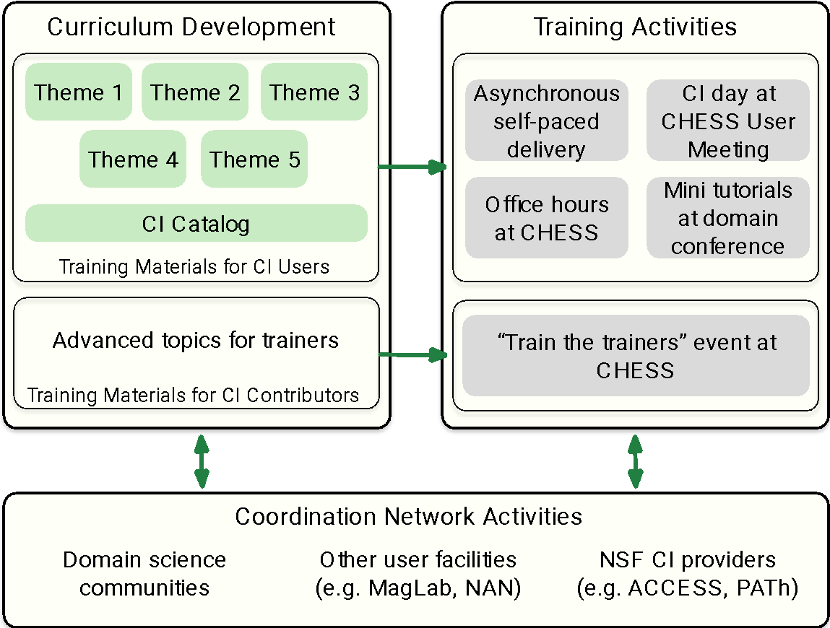
X-CITE Training Program Overview
Curriculum development
Targeted to the Users
Programming Essentials
Systems fundamentals
Distributed computing
X-ray science software
Data curation and FAIR
CI Catalog
Targeted to trainers
Advanced CI uses and topics
Training activities
Asynchronous materials
Training events
CHESS User meeting
Tutorials at domain conferences
Coordination network activities
Domain sciences, other facilities, NSF CI providers (ACCESS, etc.)

Slide 6
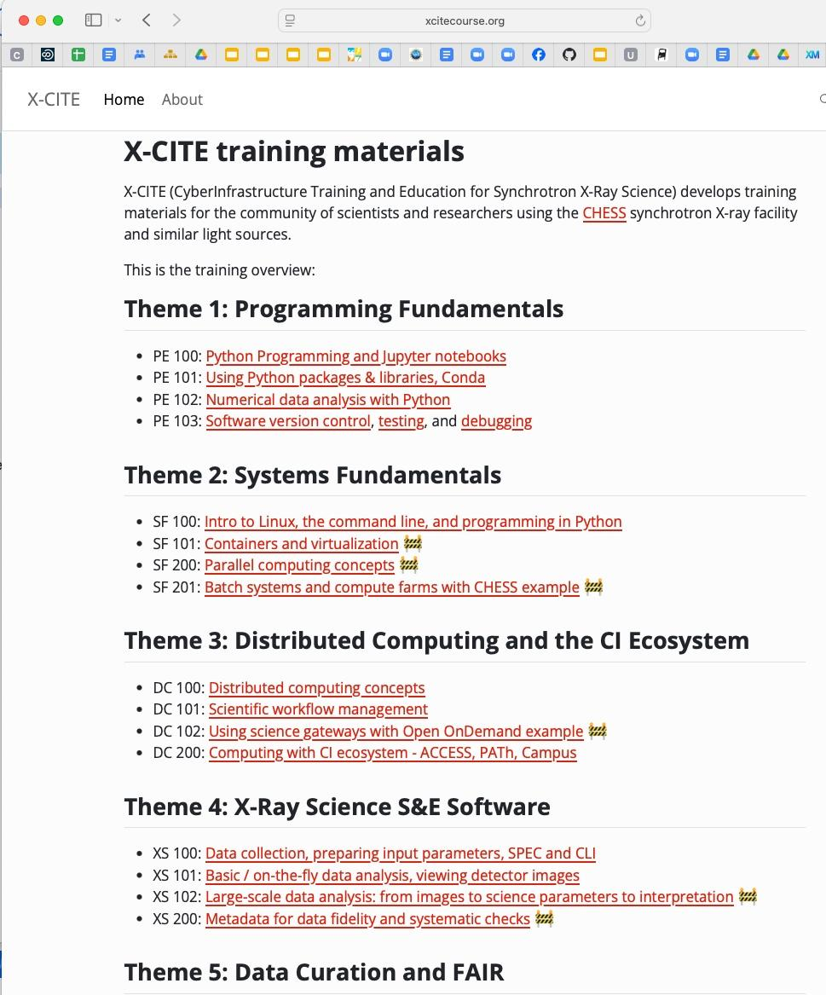
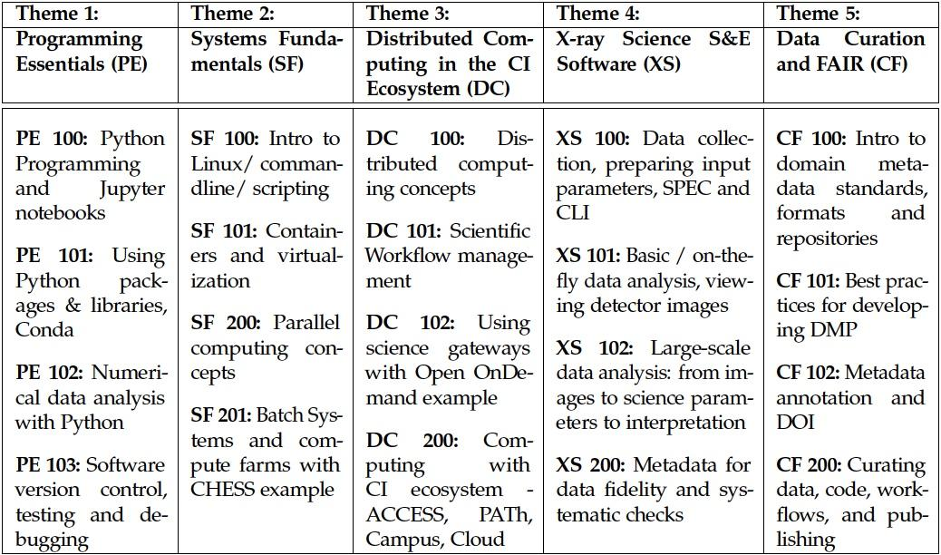
X-CITE Training Materials
https://xcitecourse.org

Slide 7
Workshop Agenda
Time | Content
8:30 - 8:40 am | Introduction and Welcome to X-CITE and DIALS Workshops
8:40 - 9:20 am | Overview of CHESS Research Workflow and CI (data collection software, data analysis software, compute farm, preparing for beamtime)
9:20 - 10:00 am | FAIR Data Management and How it Applies to Data Collected by CHESS Users
10:00 - 10:40 am | Coffee Break [Coffee and Lunch Options]
10:40 - 11:30 am | Scientific Workflows - Using Pegasus Workflow Management System on CHESS Compute Farm
11:30 - 12:15 pm | Refresher of Systems Fundamentals (Linux, remote access, command line, storing and moving your data) and Python Programming
12:15 - 12:25 pm | Group Photo
12:25 - 2:00 pm | Lunch [Coffee and Lunch Options]
2:00 - 5:00 pm | X-CITE Hands-on tutorial
2:00 - 4:45 pm | DIALS Hands-on tutorial
Notes:
Common plenary session followed by hands on sessions

Slide 8


Thanks and Acknowledgements
Local Organization and Help:
Mike Gilpin, Chris Mobley, Katerina Malysheva, Rick Ryan, Aia Ferreira Barboza, CLASSE-IT, CHESS User Office
Suchismita Sarker, Lead Scientist, QM2 beamline, CHESS
Workshop attendees
X-CITE and DIALS team members
X-CITE training materials: https://xcitecourse.org
NSF Cybertraining Award # 2320373

Slide 9
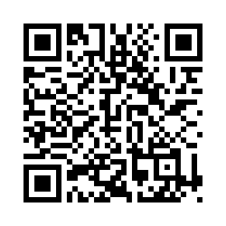
X-CITE Post Workshop Survey
Please take this
short survey to help us improve the X-CITE training program
https://iu.co1.qualtrics.com/jfe/form/SV_eqUCLvzPOeJwKIm
NSF Cybertraining Award # 2320373

