Slide 1
Perspectives from HEP GARD
Materials for Bright Beams Workshop 2025
Cornell University
July 16, 2025
Derun Li
DOE HEP GARD Program Manager

Slide 2
Introduction: DOE-HEP GARD
General Accelerator R&D (GARD) Program is a unique DOE-SC resource that supports a long-term R&D program of Accelerator Science and Technology for broad, cross-office accelerator-based sciences (HEP, BES, NP and FES) : national labs and universities.
As the steward of GARD program, OHEP is well positioned to identify and address the fundamental materials science challenges that limit the performance of current and future accelerators, including topics of materials for producing bright beams at this workshop.
The interconnection of the SC offices within GARD is demonstrated by the HEP-commissioned community roadmaps for five GARD thrusts. To emphasize the cross-office nature of GARD, HEP includes participants from all relevant SC laboratories and universities in the planning and authorship of the roadmaps. The roadmaps comprise a broad, expositive understanding between the research community and DOE-SC on the appropriate and realizable outcomes and timelines of R&D programs in each thrust area:
  Particle Sources and Targets (PST) – roadmap updated in 2025
  Accelerator and Beam Physics (ABP) – 2023 roadmap
  RF Acceleration Technology (RF) – 2017 roadmap
  Superconducting Magnets and Materials (SCM) – 2020 roadmap
  Advanced Accelerator Concept (AAC) – 2016 roadmap
These roadmap reports are either currently
being updated or have already been updated.

Slide 3
Current OHEP Organization – New AT Division
New AT Division
Updated April 2025

Slide 4
HEP GARD Scope and Topics
Develops the next generation of particle accelerator science and related technologies that are essential for discoveries primarily in High Energy Physics but also benefits broad accelerator-based sciences and applications. GARD supports world-leading research in the physics of particle beams, and long-range, early-stage exploratory research aimed at developing new concepts. GARD also provides graduate and postdoctoral research training, equipment for experiments and related computational efforts.
Topics studied include but not limited to:
  Accelerator and beam physics (ABP), including analytic and computational techniques for modeling particle beams and simulation of accelerator systems, and beam instrumentation (diagnostics & controls).
  Advanced Accelerator Concepts (AAC), laser- and beam- driven wakefield accelerations.
  RF technology (RF), the science of high gradients in accelerating cavities and structures (SRF and NCRF), high-power radio-frequency sources.
  High-power targets and high-brightness beam sources (electrons and ions) (PST).
  Superconducting materials and conductor (SCM) development, innovative magnet design and development of high-field superconducting magnets and cables, and as well as associated testing and cryogenic systems.

Slide 5
High Bright Beams for HEP Accelerator/Colliders
The drive for higher luminosities in future HEP colliders, a key GARD objective, directly translates into the demand for unprecedented high brightness beams (electrons, ions and muons)
  High performance requirements for future accelerators/colliders demand
      Photocathodes: High QE, low emittance, long lifetime/robustness, high average current, fast response time.
      SRF Cavities: High accelerating gradient (MV/m), high Q₀ (low RF losses), stability, manufacturability, cost reduction. High accelerating gradient for pulse operation (resonant controls) and tunable cavities.
    NCRF Cavities: High shunt impedance, high field breakdown limit, precision manufacturing, thermal management, wakefield suppression. NCRF for muon ionization cooling channels.
  Current Material Challenges (HEP Perspective):
    Photocathodes: Degradation in vacuum, ion back-bombardment, inherent trade-offs between QE/emittance/lifetime.
    SRF: Niobium's fundamental limits (superheating field), surface defects, cost of large-scale fabrication, quench behavior.
    NCRF: Breakdown limits (surface heating, field emission), thermal management at high average power (CW operations), precise machining. RF breakdown in the presence of a strong magnetic field (muon ionization cooling) etc.
    Materials for RF absorbers (in-vacuum and air).

Slide 6
Materials Research for Accelerators/Colliders
New Material Research Directions (some of them already supported by GARD):
  Photocathodes: Advanced alkali antimonides (e.g., K2CsSb), NEA GaAs variants, novel semiconductors, 2D materials, plasmonic structures, protective coatings, in-situ regeneration. Exploring materials with engineered electronic structures that allow for more efficient photoemission from states near the Fermi level, which typically results in lower emittance. This includes optimizing band alignment and surface terminations.
  SRF: Nb3Sn (coatings for higher gradients/Q), novel superconductors (MgB2, thin films), surface engineering (N doping/infusion), advanced fabrication (e.g., additive manufacturing for complex geometries, atomic layer depositions).
  NCRF: Refractory metals (e.g., tungsten, molybdenum) for higher breakdown thresholds, advanced copper alloys for thermal management, diamond/other high-thermal-conductivity materials, advanced surface treatments (coatings, passivation) and metamaterials.
  Radiation Hardness: Increasingly important for all components in high-intensity beam environments.
  Thermal Management: Critical for high-power operation
  Surface Science: Understanding and precisely controlling surfaces/interfaces is paramount for all.
  Computational Materials Science & AI/ML: How these tools accelerate material discovery and optimization for all components. Mention inverse design, property prediction, simulation acceleration.
  Manufacturing and Cost: The need for scalable, cost-effective manufacturing techniques for new materials.

Slide 7
Materials for Accelerators and Info Update
Particle Sources and Targets (PST)
  High power target materials and windows, essential for the US high intensity frontier program at Fermilab.
LTS and HTS Materials for high field magnets
  Essential for future colliders, such as muon collider and FCChh at CERN
Release of 2024 HEP GARD Laboratory Comparative Review Report
  Assessment of five GARD-supported national labs programs and test facilities (BNL, ANL, Fermilab, Berkeley Lab and SLAC), findings, comments and recommendations.
  Importance of workforce development and encourage collaboration between national labs and universities, AAC and traditional accelerator community.
  Recommendations of five GARD thrusts
    Balanced GARD profile to support near-, mid- and long-term R&D.
    Emphasis the importance of technology development and support on HPT, SRF at Fermilab and NCRF at SLAC if budget allows.
SC-wide roundtable meeting on Accelerator workforce development and HEP Accelerator Traineeship PI meeting (Jan. 2025)
Generating high brightness beams require (1) Particle sources, (2) acceleration (SRF and NCRF), (3) beam focusing
and transportation (SCM) and (4) beam physics and controls and more … → GARD thrusts & objectives

Slide 8
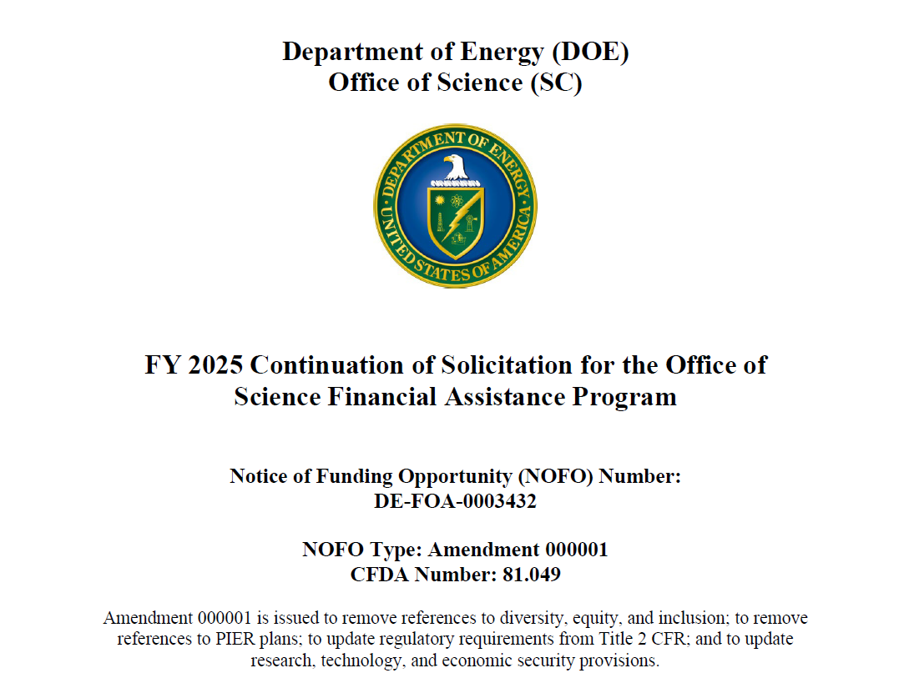
Accelerator Science and Opportunities
Accelerator Science is science
  R&D for accelerators isn't just a means to an end, but also it is science.
  Studying materials for bright beams, we are advancing understanding
  about superconductivity, quantum mechanics, and materials science.
GARD University Grants - FY25 NOFO:
  GRANTS FY 2025 Continuation of S... | U.S. DOE Office of Science(SC)
HEP Accelerator Traineeship program (five active awards now), HEP ECRP and USPAS (twice a year) support these endeavors or education and training.
Continuing investment in materials research, guided by HEP's strategic vision, including input/feedback from this workshop, through the GARD program, ensures the long-term viability and advancement of accelerator-based science for HEP and beyond.
Sustained GARD investment, including materials for accelerators, is the lifeblood of HEP's future; without it, our capabilities risk stagnation, profoundly and negatively impacting our ability to pursue the fundamental missions of accelerator-based High Energy Physics and beyond and losing US’s world leadership role in accelerator science and technology.

