Slide 1

Materials for Bright Beams Workshop 2025
July 17, 2025

Slide 2
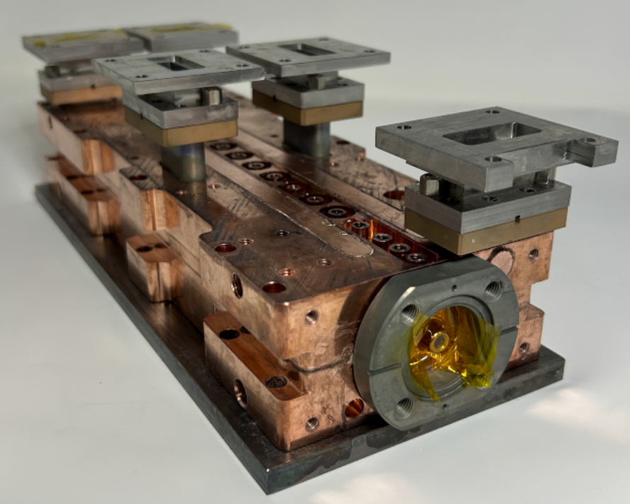
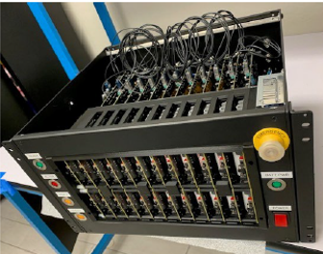
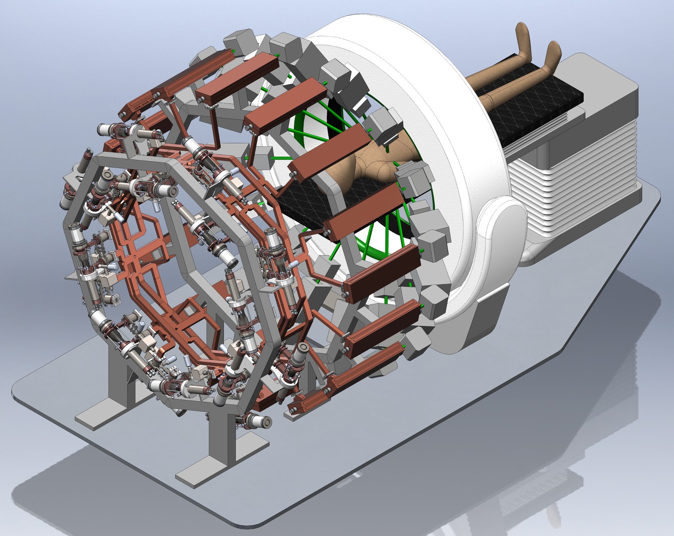
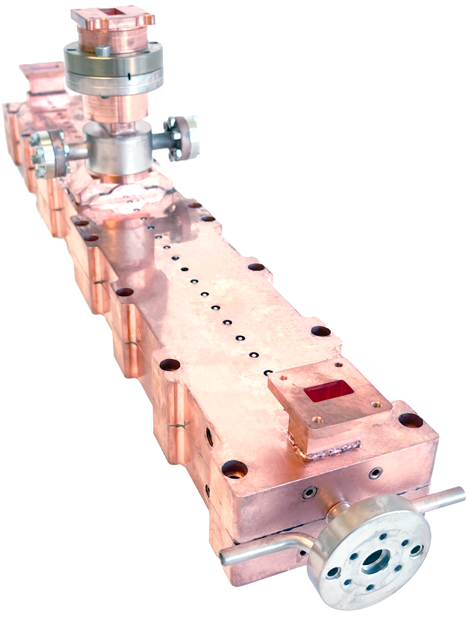
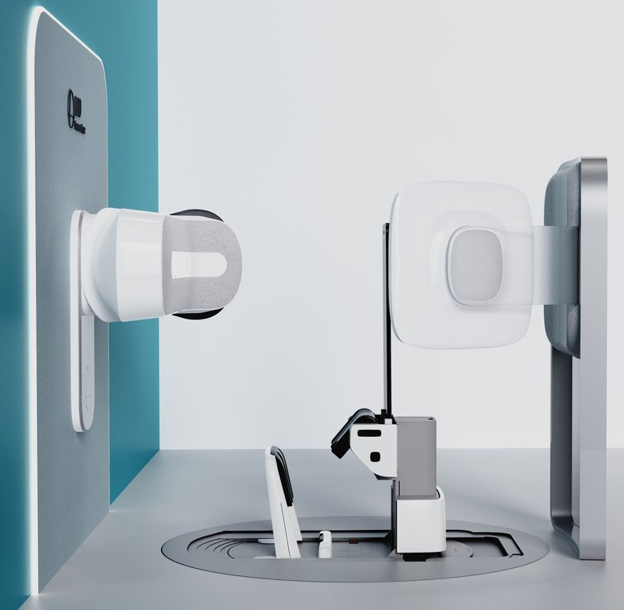
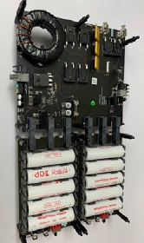
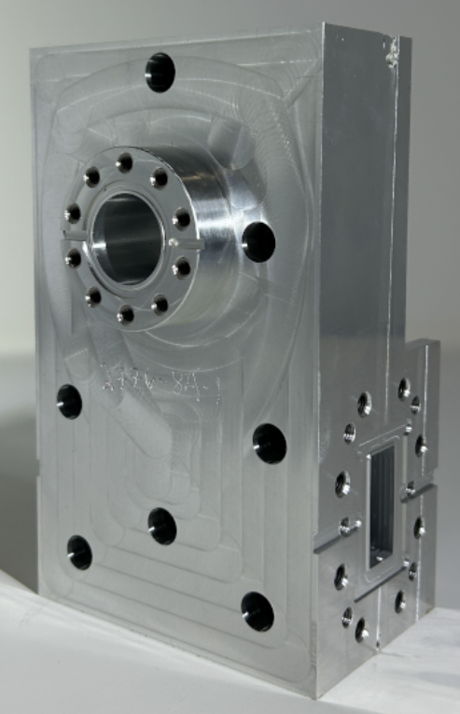
Radiation Oncology Roadmap
1. TibaRay Inside
2. Falcon
3. PHASER
Efficient accelerator systems
30x faster (<5 seconds)
12MeV Radiation Therapy
400x faster (<1 second)
FLASH Therapy
Battery-operated compact modulators
DRAGON Linear accelerators
Broadband compact isolator
Commercial Today
Commercial in 2 Years
Funding Dependent

Slide 3
TibaRay Product Development Pipelines
1. LINACS
2. Enabling Technologies
Radiation Oncology Linacs
Sources for non-destructive imaging in security and inspection applications
Portable, Batter Operated, Variable Energy X-ray sources
Battery Powered EGun Modulator (30A/30kV)
Battery Powered RF-Source Modulators
Compact High Bandwidth Isolators
Very low losses RF Windows

Slide 4
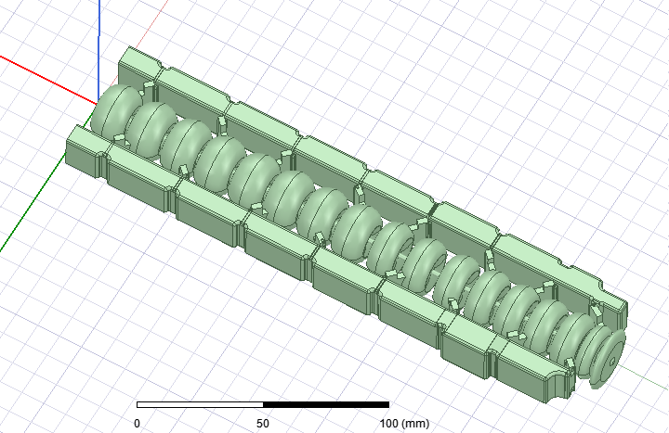
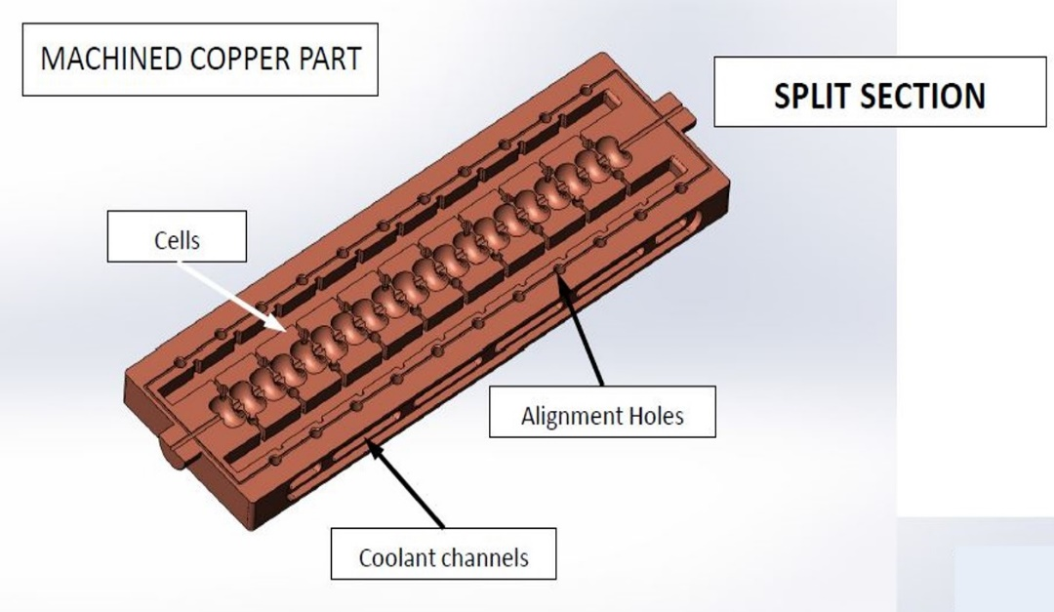
Review of Concept: Novel electron linac design
Accelerating cells are NOT coupled, can be optimized individually.
Greater control of RF phase & power going into any particular accelerating cell
TibaRay implementation:
Low-cost manufacturing designed-in at the outset
All the cells of a structure are machined in two halves that are brazed instead of brazing cell by cell
Cooling and alignment integrated into the two halves and machined at the same time as the cells
Generalized design algorithm developed to allow optimization of linacs of different energy and power levels

Slide 5
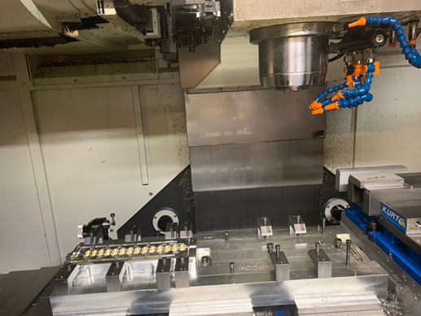
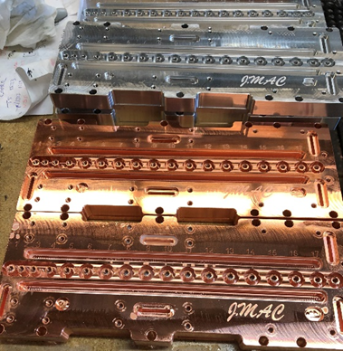
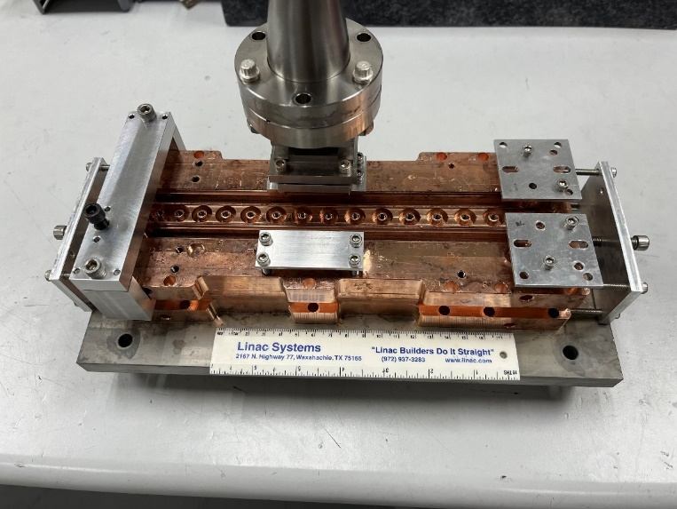
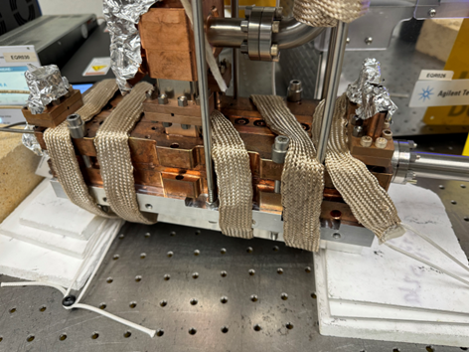
Linac construction
Initial Aluminum prototype to check in-house CNC programing
Construction of copper plates with tunning pins machined directly into the plates.
Checking for vacuum leaks after diffusion bonding.
Backing the linac for vacuum after full construction.
CAD model of final 15inch 2.5MeV linac product

Slide 6
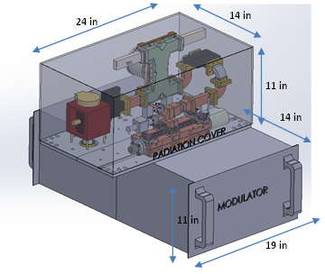
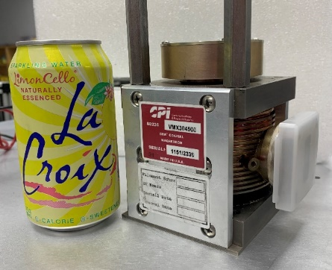
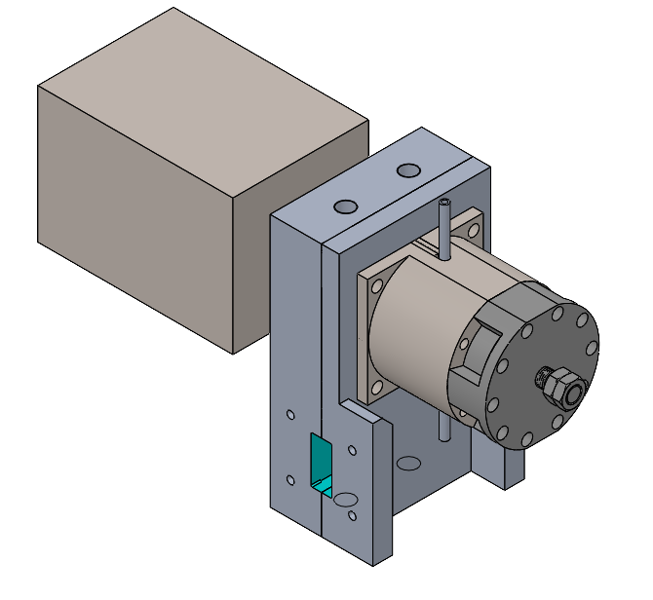
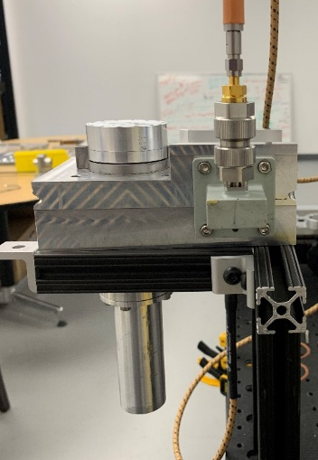
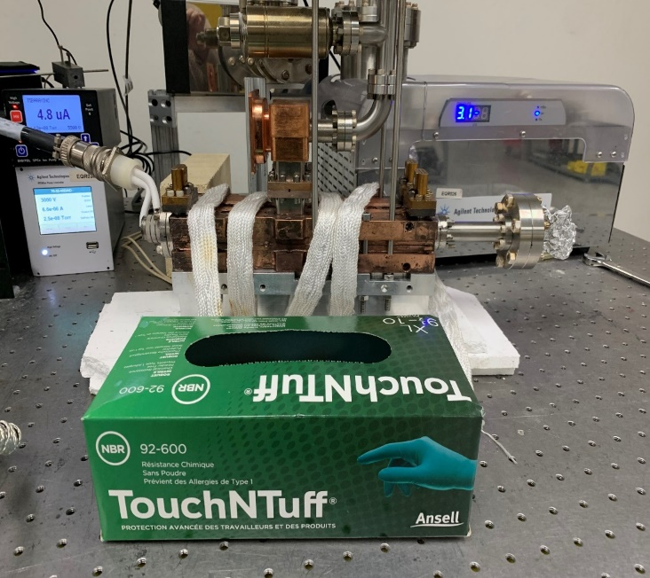
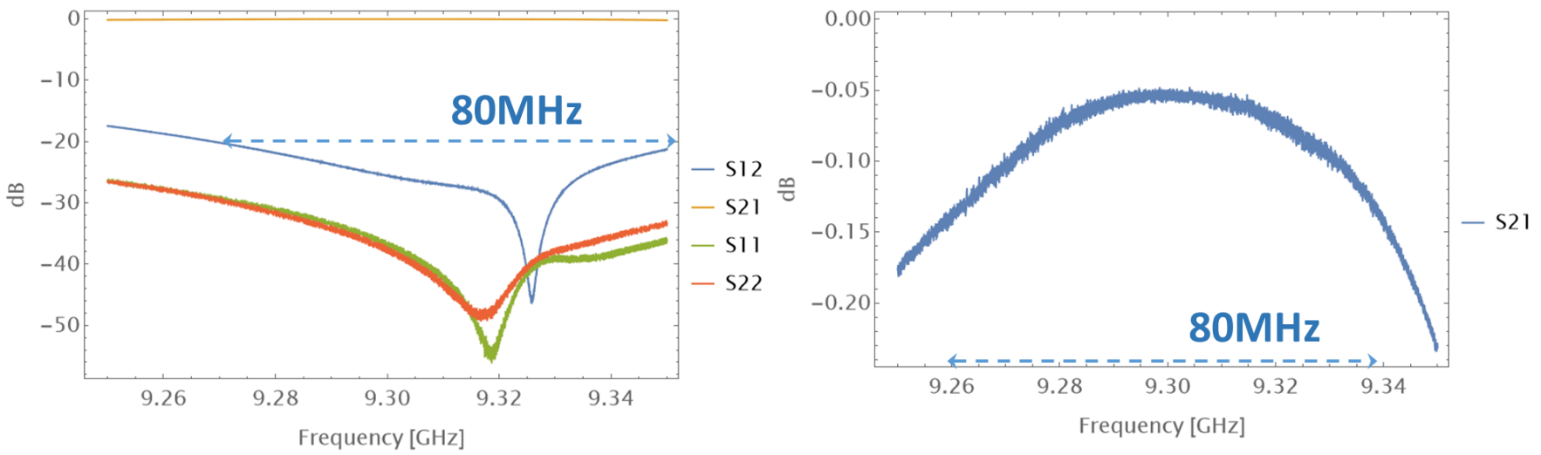
2.5MeV Portable Linac
Two Box System
Source (Linac + magnetron + isolator): 37 lbs
Modulator: 26.6 lbs, 45.6 lbs total with battery
Plan to test all components with our battery powered modulators.
Magnetron
We designed isolator from the ground up:
Higher power handling capability than anything on the market
Much higher bandwidth than the state of the art, assuring stable magnetron operation.
Linac Pump-Down
TIbaRay proprietary and confidential

Slide 7
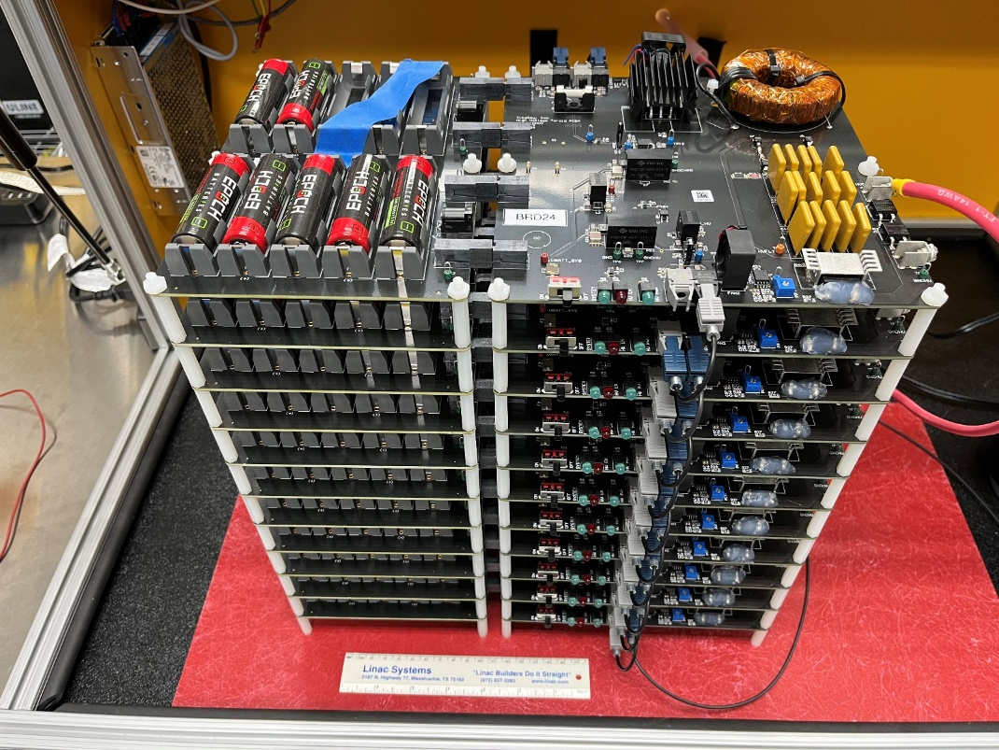
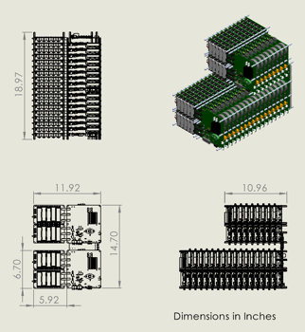
Battery Powered Modulator

Slide 8
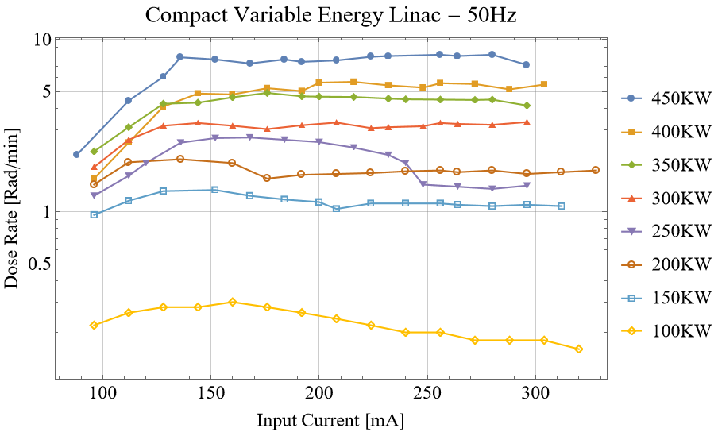
50Hz, Operation – Xray Target, Dose-rate @ 1 meter
Compact Multi-Energy Accelerator for Imaging
The initial testing at 50Hz is complete; even at 50Hz the linac exceeds the design specifications.
Once we combine with the compact magnetron, we can go up to 400Hz to produce a dose rate greater than 20 Rad/min.

