Slide 1
Air stable III-Nitride photocathodes
Luca Cultrera
Instrumentation Department - Brookhaven National Lab
Materials for Bright Beams Workshop 2025

Slide 2
What we want from a photocathode?
High QE, operation with Visible or Infrared laser, short response time, compatible with high electric field and poor vacuum levels, with a long lifetime and a small MTE
Material | QE | Laser | Response time | Electric field | Vacuum | Lifetime | MTE
Copper | 1e-5 | UV | Sub-ps | 120 MV/m | 1e-9 Torr | months | 500 meV
Cs₂Te | 1e-1 | UV | Sub-ps | 80 MV/m | 1e-9 Torr | months | 500 meV
GaAs | 1e-2 | IR | 10s of ps | 5 MV/m | 1e-12 Torr | days | 50 meV
Cs₂KSb | 1e-1 | VIS | ps | 20 MV/m | 1e-10 Torr | months | 100 meV
The perfect photocathode does not exist yet!

Slide 3
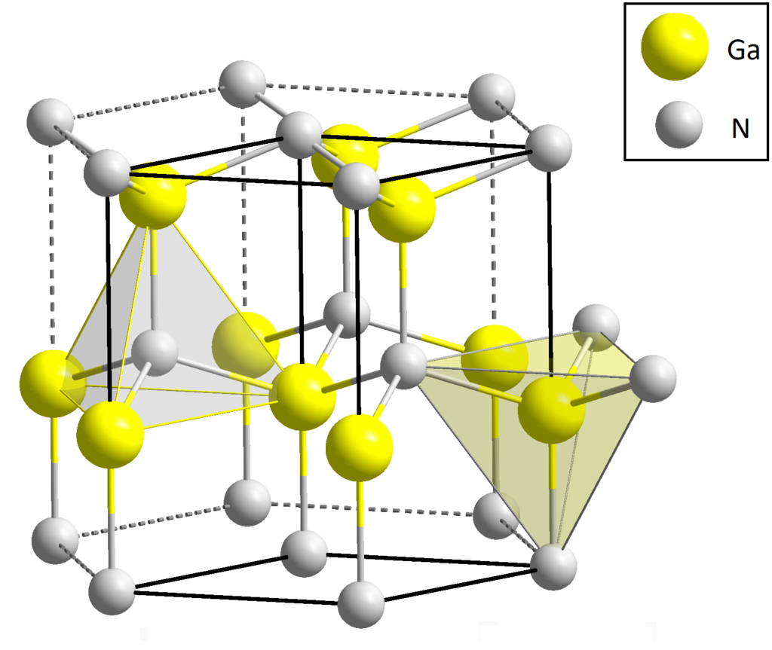
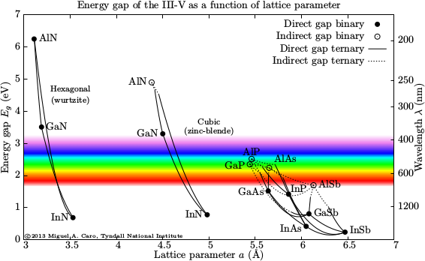
Why the III-nitrides?
(0001)
Established industrial technology;
LEDs;
High power electronics;
Photocathode R&D;
Solar blind detectors;
Band gap tunability:
Matching to laser wavelength;
Engineering perspectives:
Multi Quantum Well;
Distributed Bragg Reflectors;
Resonant tunneling Barriers;
Polar bonds non-symmetric
1-10 MV/m internal fields
Strong polarization fields
P_{sp}
P_{sp}
(0001)
(000-1)
Wavelength tunability

Slide 4
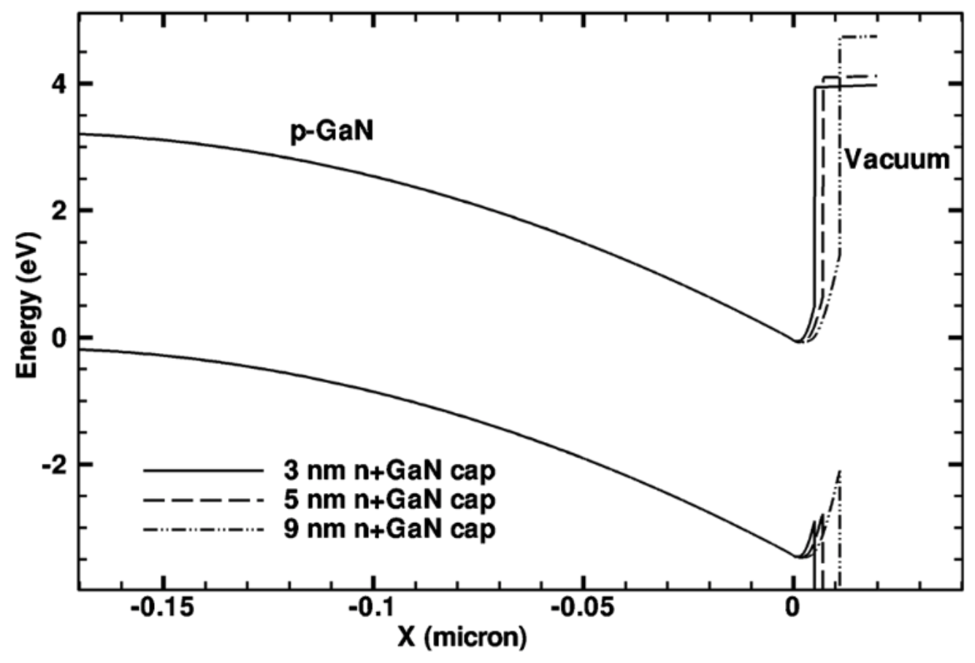
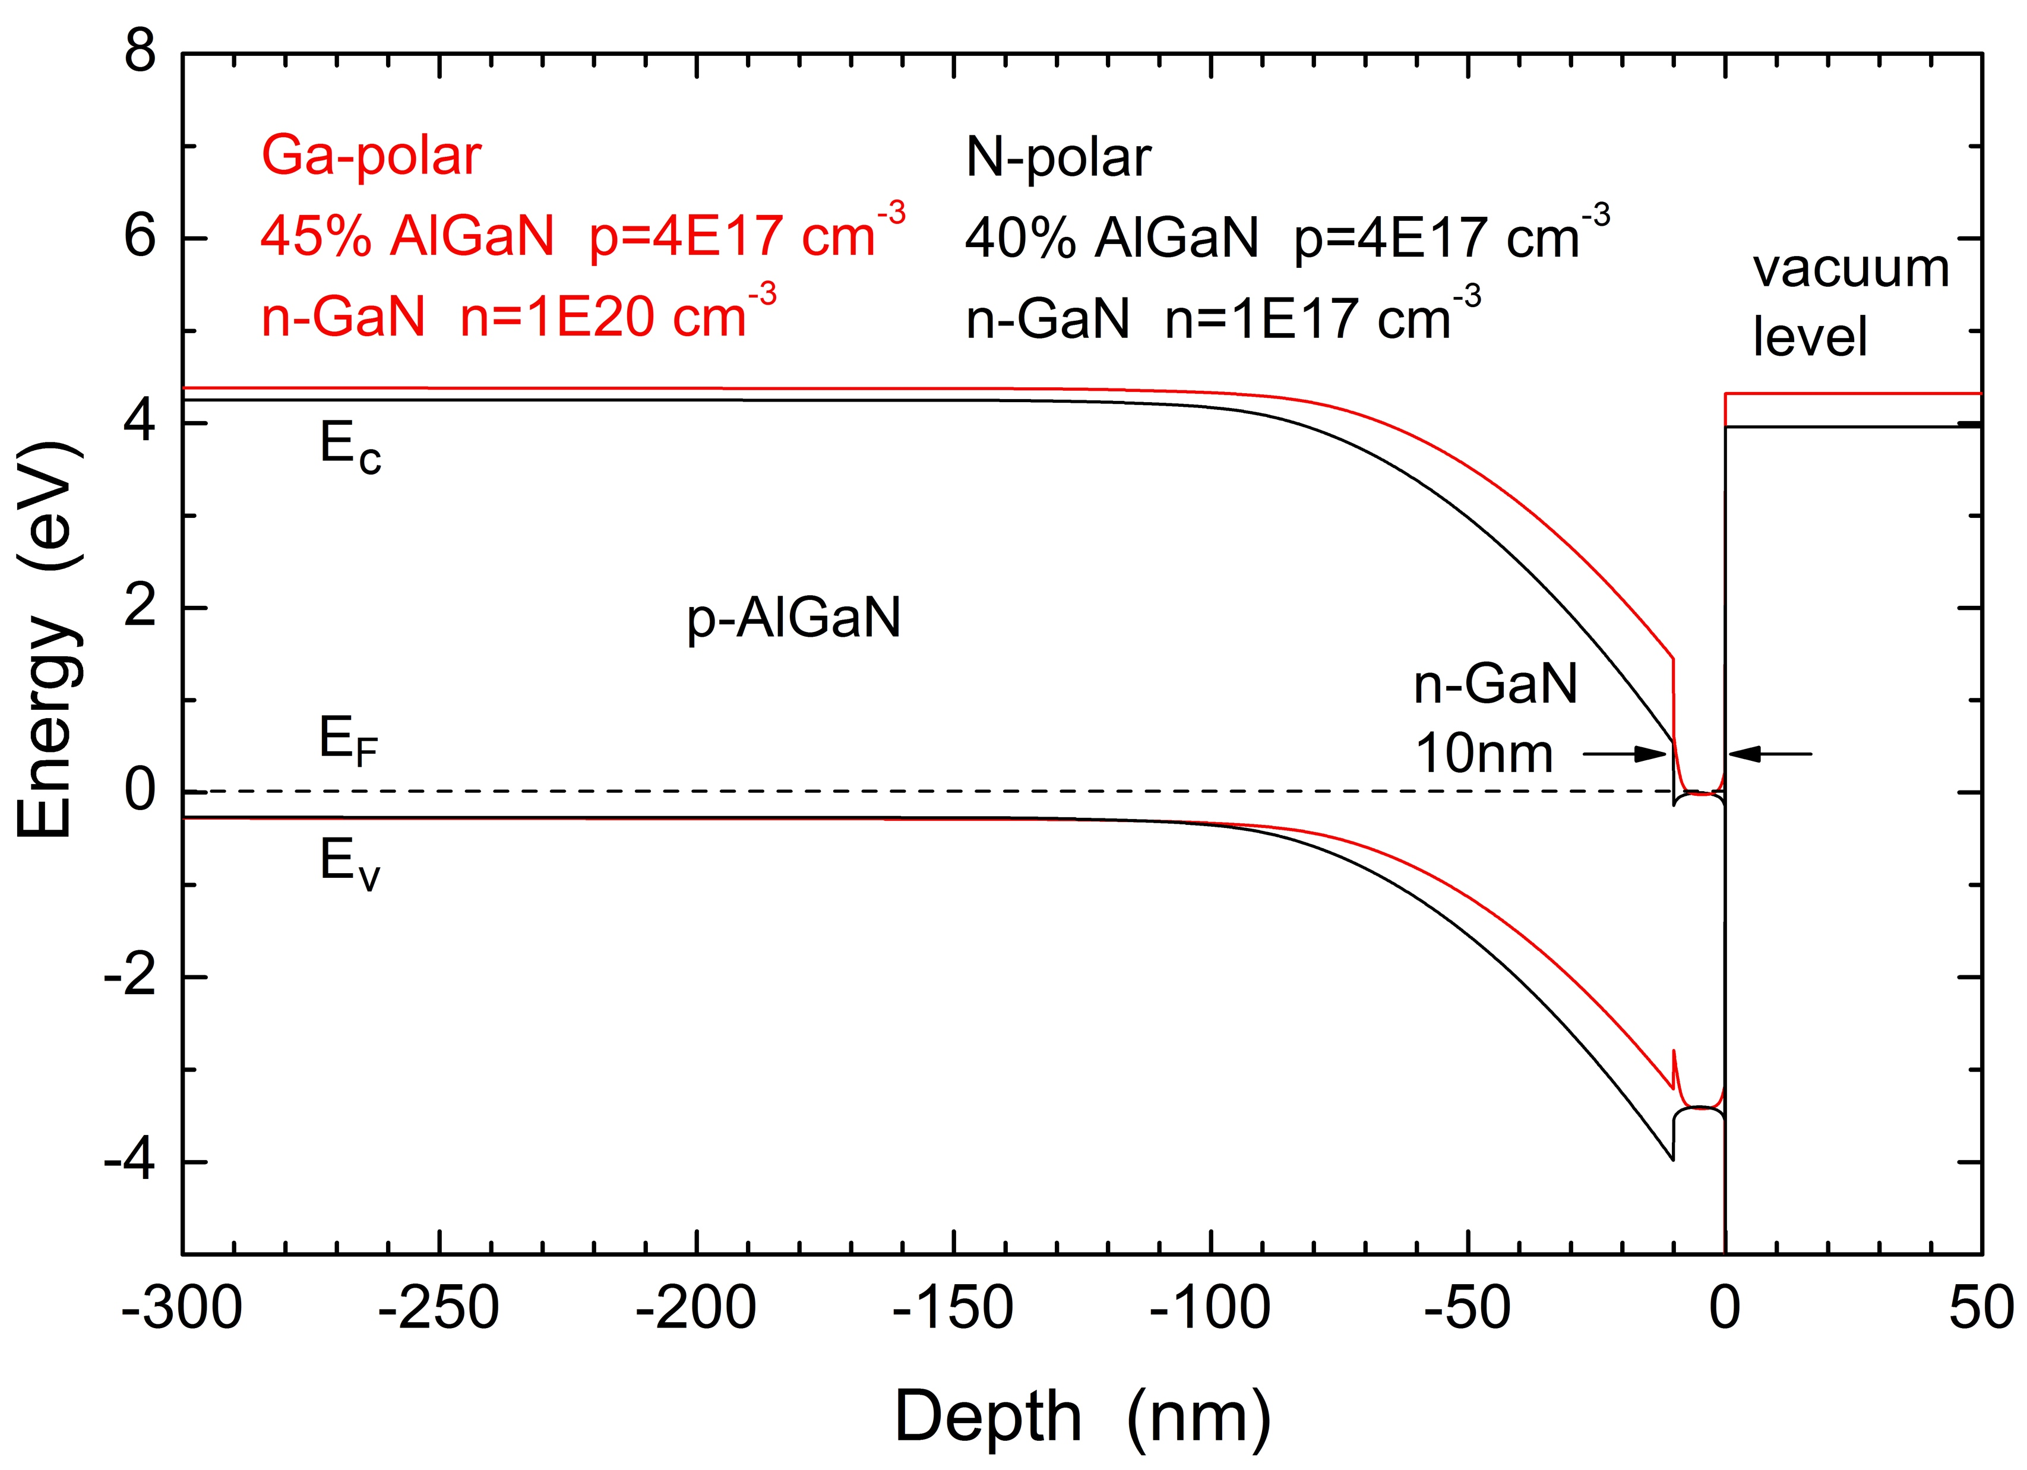
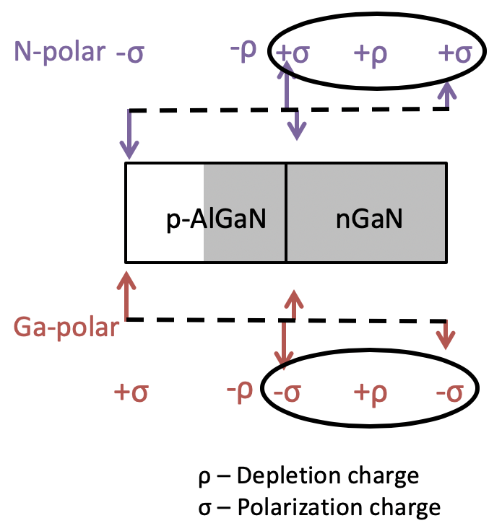
Surface engineering to achieve NEA
Activation by Cs:O surface treatment
Utilizing p-type bulk and Cs/Cs-O surface layer
Cs/Cs-O creates tunneling barrier at surface
Reactive to air and water
Cs-O
p-GaN
Delta-doped cap layer
Growth of thin, highly doped n⁺GaN cap layer
Increased downward band bending at surface, NEA
n⁺-GaN
p-GaN
Nitrogen polar photocathodes
Utilize direction of polarization and depletion charge
Removes need for highly doped cap structure or Cs
u-GaN
N-polar p-GaN
4
J. Fu et al., Optik 125, 1451 (2014).
N. Tripathi, et al., Appl. Phys. Lett. 97, 052107 (2010).
Marini, et al, J. Appl. Phy. 124, 113101 (2018).
Notes:
To get the effective negative electron affinity, a thin cap layer is used to modify the surface and induce downward band-bending. First with a Cs/Cs-O surface treatment on p-GaN which creates a dipole at the surface acting as a tunneling barrier for electrons, thus lowering the effective negative electron affinity. However, the Cs surface treatment is highly reactive to air and moisture, leading to the requirement to fabricate, package and test devices without breaking vacuum increasing the cost and complexity of device use. Our group has pioneered Cs-free III-nitride photocathode detectors. First using a highly doped n+GaN cap on Ga-polar p-GaN. The n+ cap layer increases the magnitude of downward surface band bending, lower the effective electron affinity at the surface. However the high doping concentration results in an increase in electron scattering at the surface. To eliminate the need for such high n-type doping in the cap layer. N-polar photocathodes were proposed. In the N-polar orientation the polarization and depletion charge are aligned and positive at the surface, increasing the magnitude of band bending and lowering the vacuum level with the use of an unintentionally doped cap layer.

Slide 5
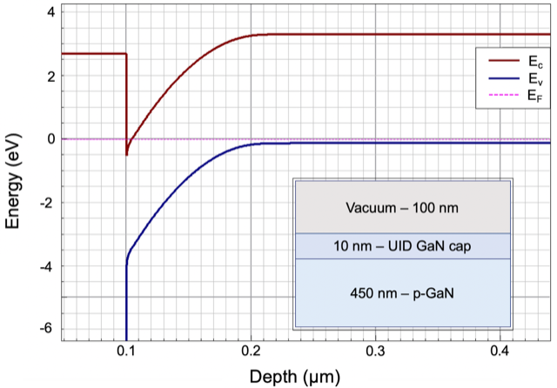
Leveraging the polarization field and get rid of Cs!!
Can we achieve air stable Negative Electron Affinity condition?
Compatible with “poor vacuum” conditions and operation in RF gun
Mild HCl chemical etch required to remove surface oxide after air exposure
Peak QE up to 12% at 6 eV
u-GaN cap
AlN
N-polar
p-GaN
N-polar
u-GaN
sapphire
Simulation with polarization
(000-1)
J. Marini et al., J. Appl. Phys. 124, 113101 (2018)

Slide 6
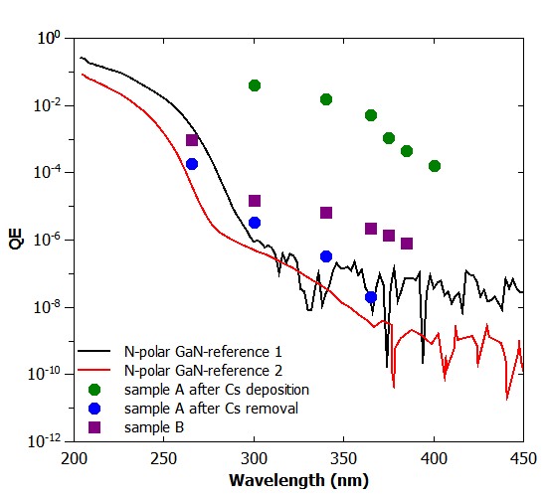
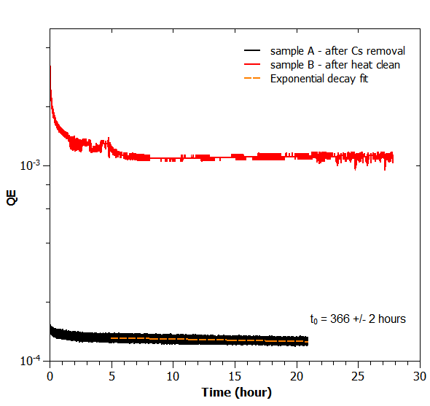
QE and lifetime
Two N-polar GaN samples from the same MOCVD growth run
Peak at 23%!!
25 uW @ 265 nm
Bias -18 V
10⁻¹⁰Torr
QE stable above 10⁻³ level !!
HCl and heat cleaning @500C
L. Cultrera et al., J. Appl. Phys. 131, 124902 (2022)

Slide 7
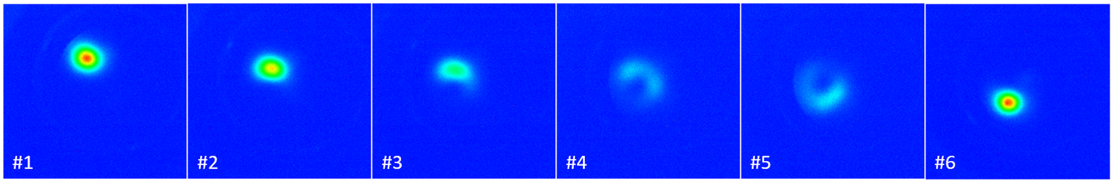
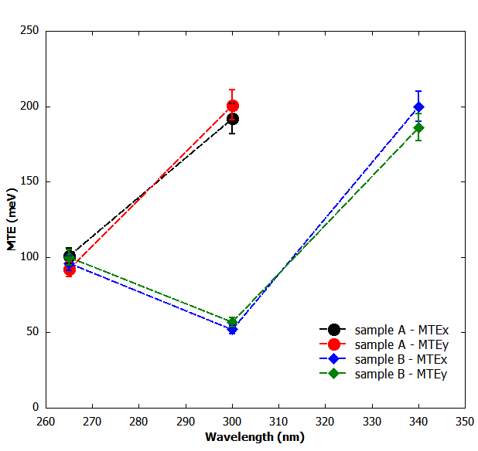
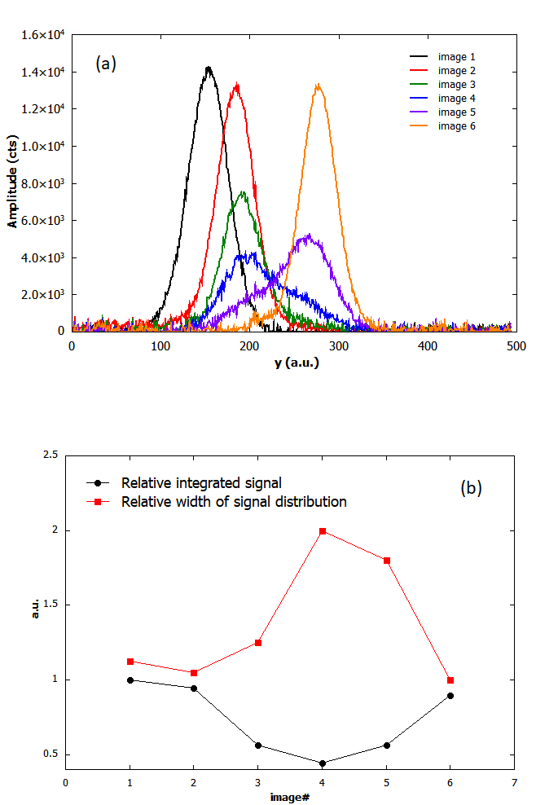

MTE as function of photon energy and location
Free space beam expansion as function of voltage
e- beam images as the laser spot (50um r.m.s. @265nm) moves vertically on the cathode
H. Lee, Rev. Sci. Instr. 86, 073309 (2015)
Compare with a typical Cu photocathode
QE~1e-4 and MTE ~500 meV @266 nm
QE~6x10⁻⁶
QE~3x10⁻⁶
Low QE sample
QE~1x10⁻⁴
High QE sample
QE~1x10⁻³
QE~1.5x10⁻⁵
Local MTE
Local QE
L. Cultrera et al., J. Appl. Phys. 131, 124902 (2022)

Slide 8
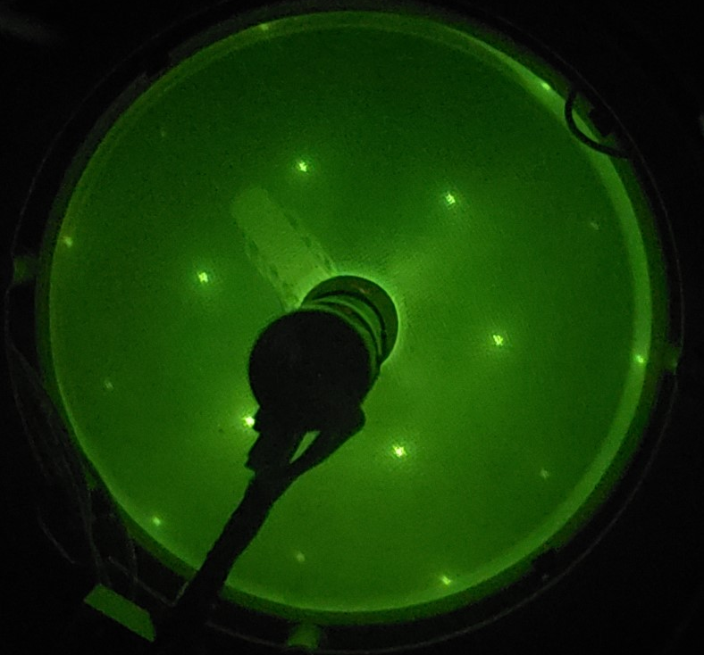
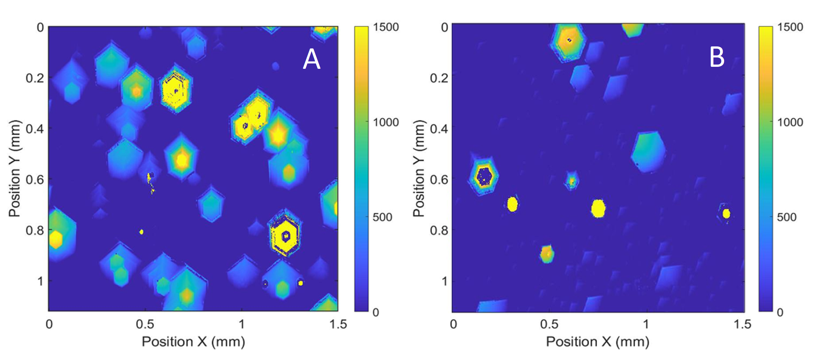
Surface morphology
Sharp LEED pattern
Confocal microscope imaging
L. Cultrera et al., J. Appl. Phys. 131, 124902 (2022)
nm
nm
Typical of N-polar growth: Hexagonal base pyramidal shaped hillocks – size comparable with laser spot
Additional studies required to mitigate their presence and study compatibility with high electric fields

Slide 9
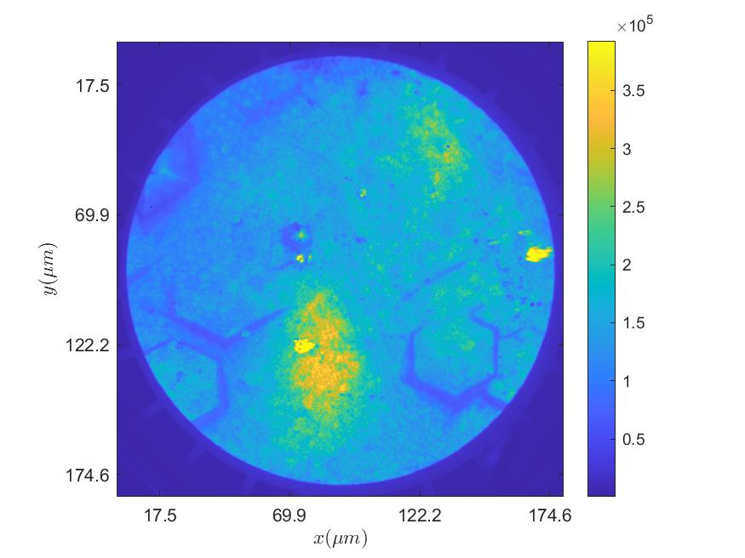
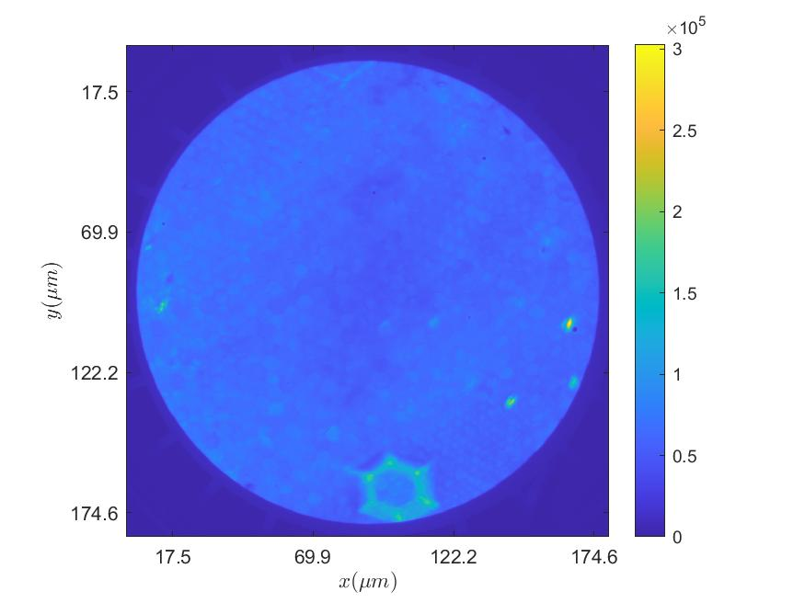
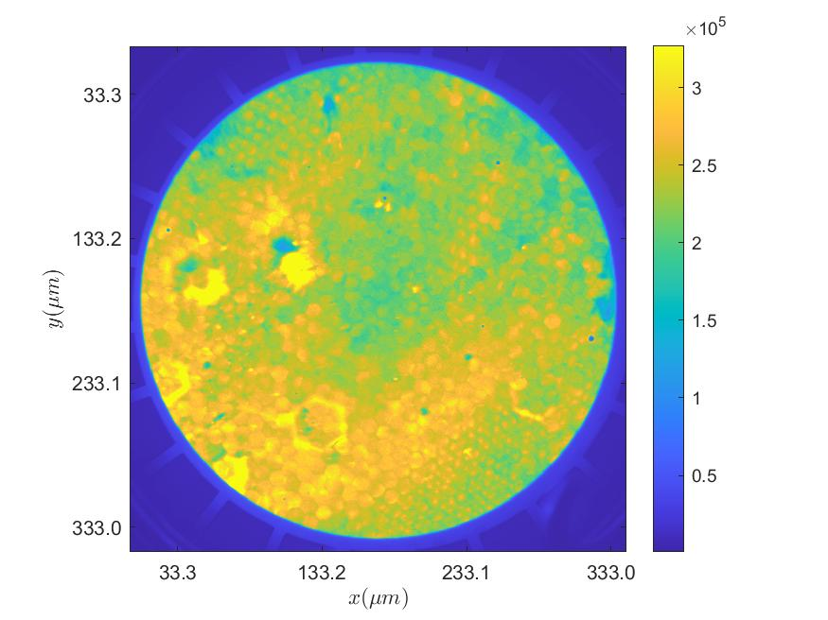
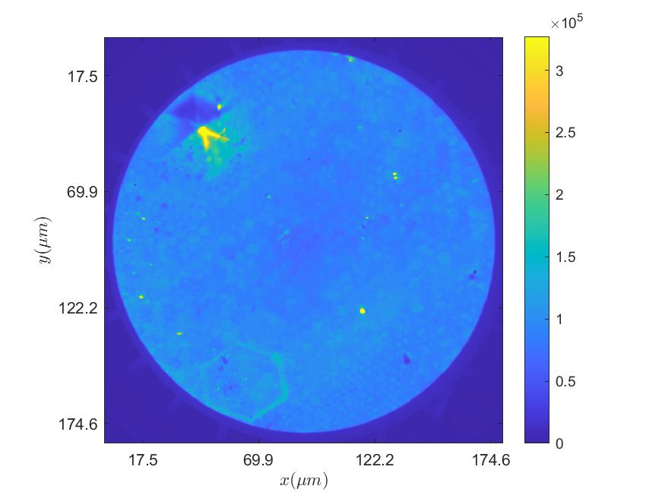
PEEM imaging uniformity of emission
HCl rinse followed by IPA rinse with N2 blow dry and annealing in UHV to 300C
fov=172 um
MCP=1430 V
C/s= 1.1920e+09
Hg lamp
PEEM allows to correlate QE and morphology
Large non-uniformity of emission across the surfaces
For photoinjector operation +/-10% is typically required to mitigate non uniformity in the charge distribution in the electron bunches
N-polar GaN s0583

Slide 10
What we learned so far?
N-polar III-Nitrides photocathodes shows promising performances in terms of QE, MTE, lifetime and handling between the production facility and their possible use in electron gun.
Morphology of the surface -hillocks- and non uniform photoemission may be detrimental to electron beam performances and requires more investigation.
III-Nitrides do not require UHV transportation or storage, and a simple chemical etch is sufficient to restore emission properties

Slide 11
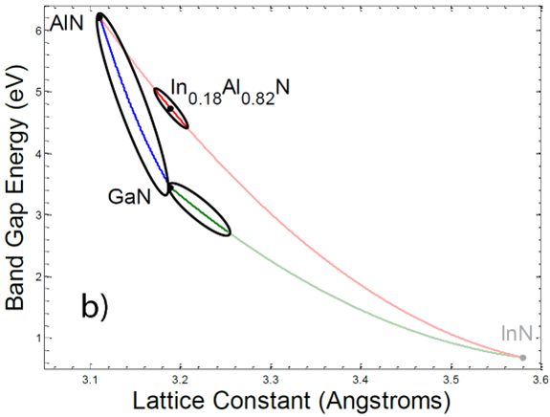
What next? Leverage Eg tunability
Operating photocathodes in electron guns with deep UV photon poses some challenges:
1 mA of photocurrent with QE of about 1x10⁻³ requires 4.6W @266nm –some applications require 100 mA-
spatial and temporal laser pulse shaping required for optimizing electron beam dynamics
Optical transport is challenging
III-Nitrides provide a versatile platform to engineer photocathode structures that can operate in the range 3.1-3.6 eV where optical transport and laser shape manipulation is less problematic even at high average power.

Slide 12
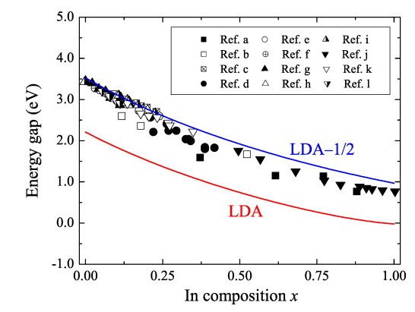
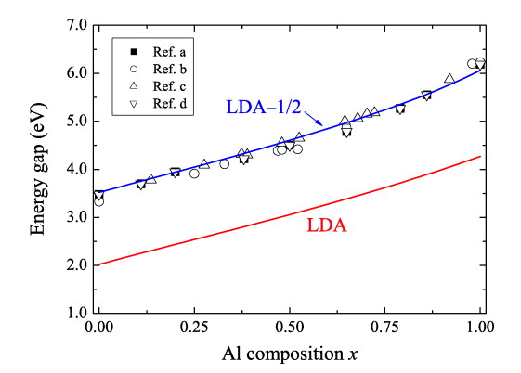
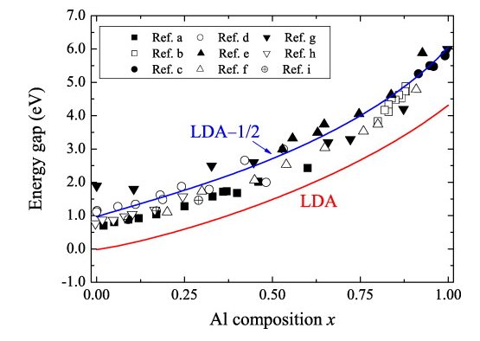
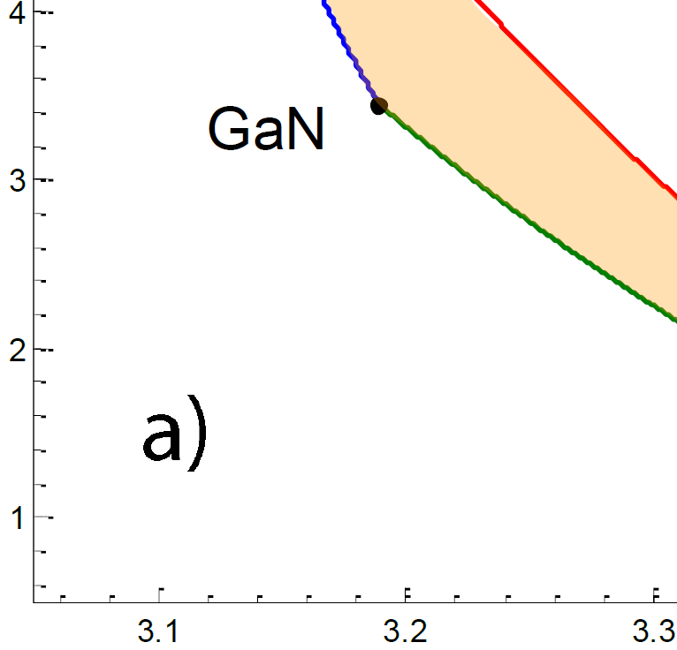
Alloy space for Eg target 3.1-3.6 eV
In_{x}Ga_{1-x}N
Al_{x}Ga_{1-x}N
Al_{x}In_{1-x}N
R.R. Pela et al, Appl. Phys. Lett. 98, 151907 (2011)
Target emission range requires p-In_{x}Al_{y}Ga_{1-x-y}N with E_{g} slightly larger than E_{C}-E_{F}=φ_{s}=3.1–3.6 eV
Effective negative electron affinity (NEA) must be achieved
InN has very high EA (~5.6–5.8 eV)
AlN has much lower EA (~0.6–1.9 eV)
By alloying InN with AlN, target E_{g} can be attained with EA lower than that of GaN (~4.1 eV)
Al_{0.1}Ga_{0.9}N
Al_{0.7}In_{0.3}N
In_{0.1}Ga_{0.9}N
Al_{0.6}In_{0.4}N
Sakalauskas, E., et al. J. Appl. Phys. 110.1 (2011).
Lin, S., et al Appl. Phys. Express 5 031003 (2012)
Bermudez, V., et al. J. Appl. Phys. 89, 1991 (2001)
Notes:
Based on the targeted operation at 3.1-3.6 eV we have identified boundaries

Slide 13
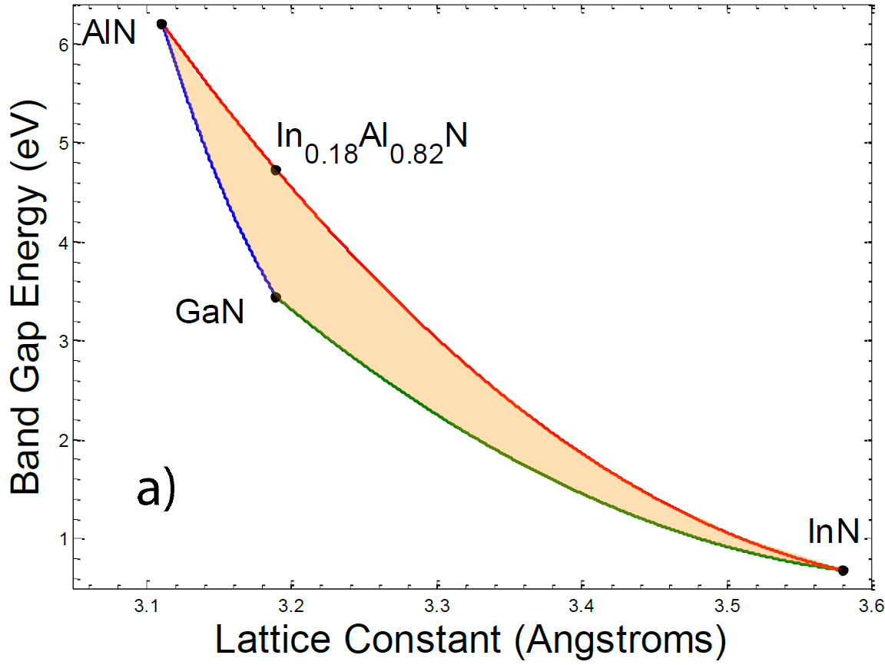
MOCVD growth conditions
Growth completed using Veeco D180 MOCVD in the Wide Band Gap Optronix Lab at SUNY Albany
TMGa, TMAl, and TMIn precursors for Ga, Al, and In, respectively
Before quaternary growth, ternary InAlN must be developed
Initial growths targeted In_{0.18}Al_{0.82}N to lattice-match GaN substrates
Growth temperatures kept ≤800 °C to promote In incorporation
N₂ used as precursor carrier gas to minimize parasitic reactions with H₂
Notes:
To grow the material, we used a Veeco D180 MOCVD. Our initial growths targeted InAlN with 18% In to lattice-match with GaN. This allowed us to use Ga- and N-polar GaN substrates to easily grow metal- and N-polar material. To promote In incorporation, growth temperature was kept at or below 800 C, and N2 was used as the carrier gas to minimize parasitic reactions with H2.

Slide 14


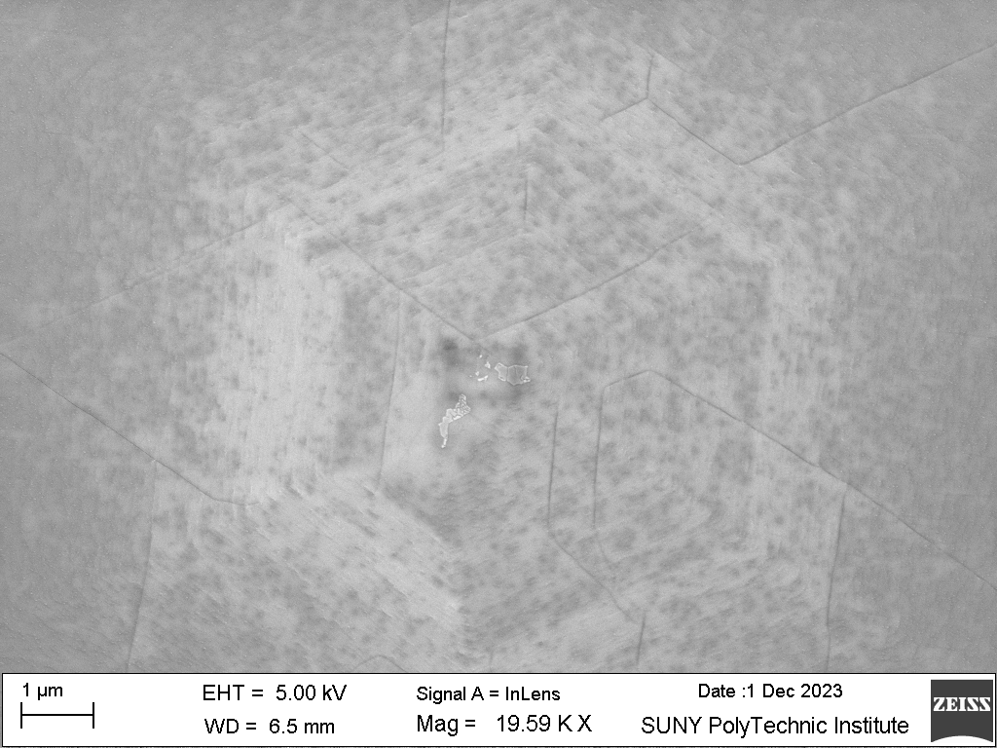
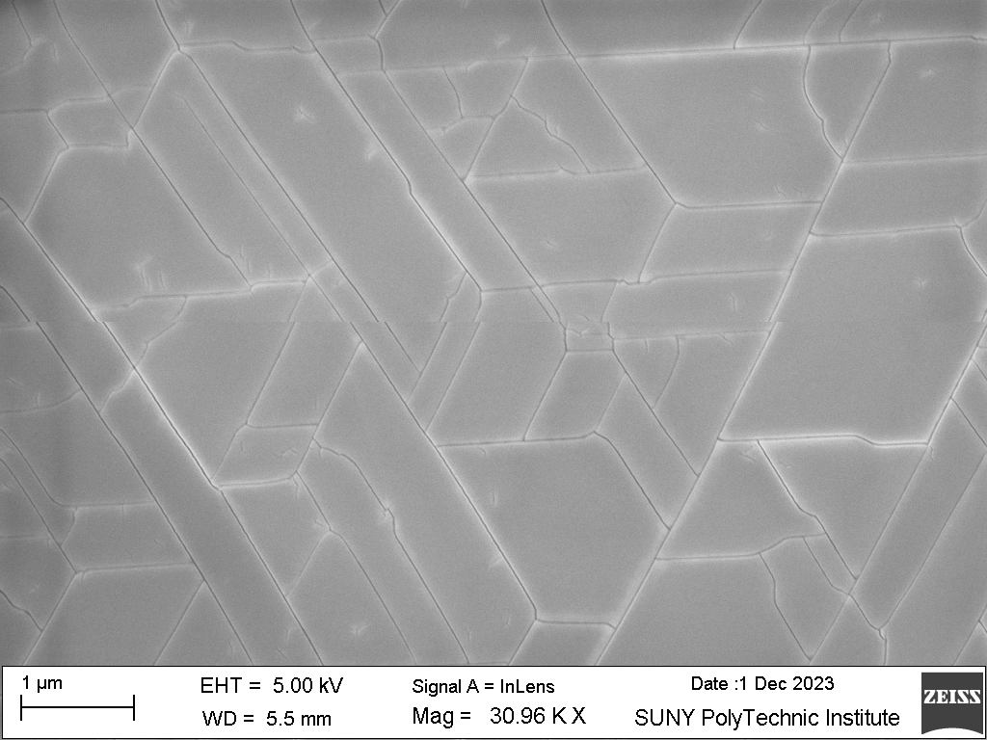
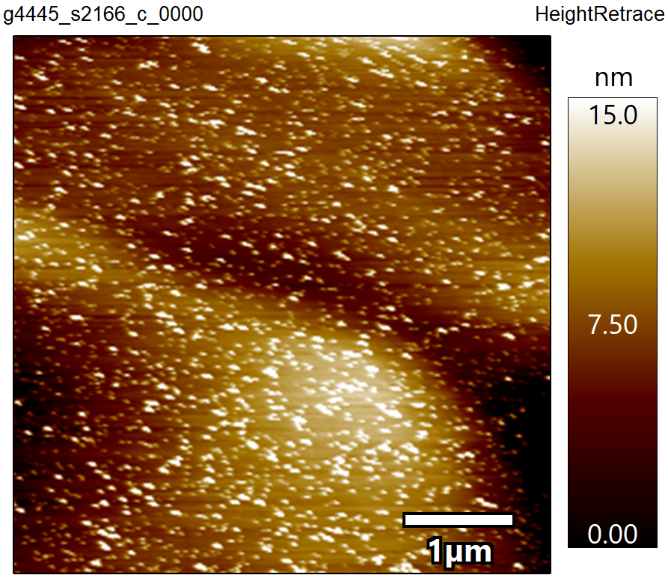
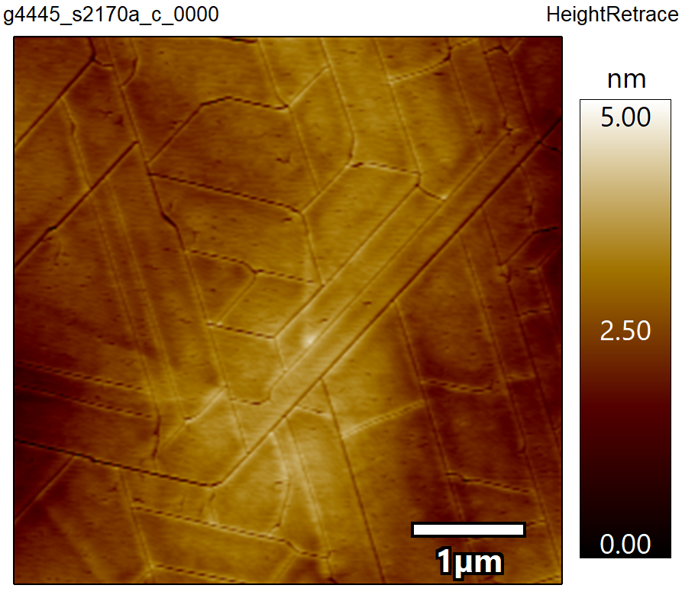
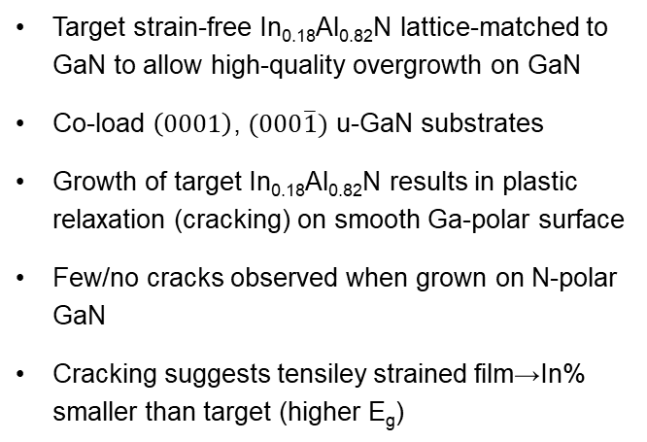
Lattice-Matched InAlN Overgrowth on GaN
Target strain-free In_{0.18}Al_{0.82}N lattice-matched to GaN to allow high-quality overgrowth on GaN
Co-load $\left(0001\right)$, $(000\overline{1})$ u-GaN substrates
Growth of target In_{0.18}Al_{0.82}N results in plastic relaxation (cracking) on smooth Ga-polar surface
Few/no cracks observed when grown on N-polar GaN
Cracking suggests tensiley strained film→In% smaller than target (higher E_{g})
RMS: 3.5 nm
RMS: 0.5 nm
Notes:
As I mentioned, we targeted 18 In% to allow for high quality overgrowth, and based on the surface morphology of the material (smooth on Ga-polar GaN and full of hexagonal hillock structures on N-polar GaN), the polarity of the overgrown material matched that of the substrate. However, the surface of the metal-polar material was covered in a dense network of cracks due to tensile strain, which implies that the overgrowth was not lattice-matched to GaN.

Slide 15
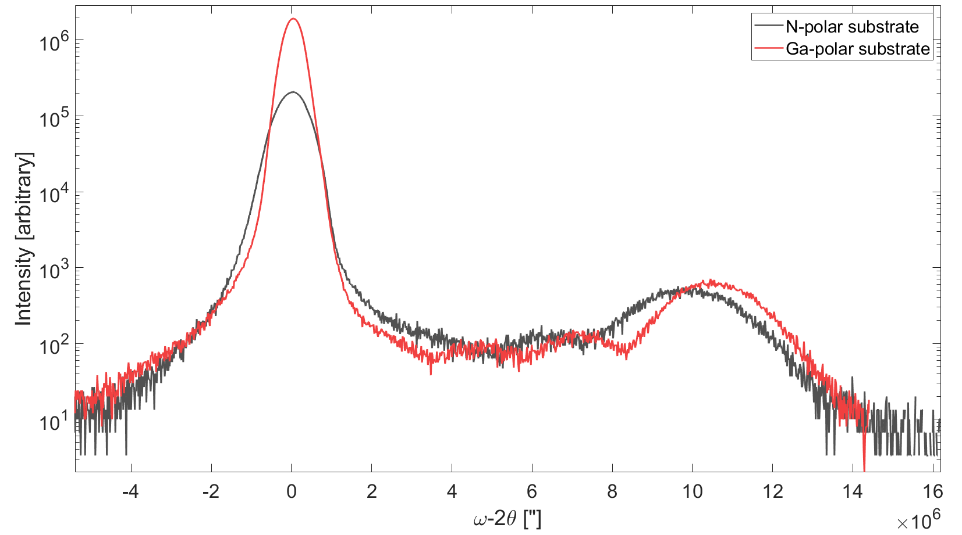
XRD analysis
XRD ω-2θ indicates slightly In% higher on N‐polar (~2.6%) GaN than on Ga-polar (~2%)
Growth rate very low→~20 nm/hr
InAlN overgrowth on GaN appears to match underlying polarity
In% always low, largely insensitive to metal precursor flow ratio
Al outcompetes In for Group-III sites
Decreasing growth temperature and increasing substrate lattice parameter may encourage In incorporation
GaN
Notes:
And in fact, XRD analysis indicates very low In%, below 5% for both metal- and N-polar materials. This result was also insensitive to variation in metal precursor flow ratio; the Al always outcompeted the In for group-III sites. This indicates then, that to increase In incorporation, the growth temperature must be reduced. Growth directly on sapphire (which has a larger lattice parameter) may also be useful, as the large lattice mismatch may reduce adatom mobility and increase the In sticking coefficient.

Slide 16
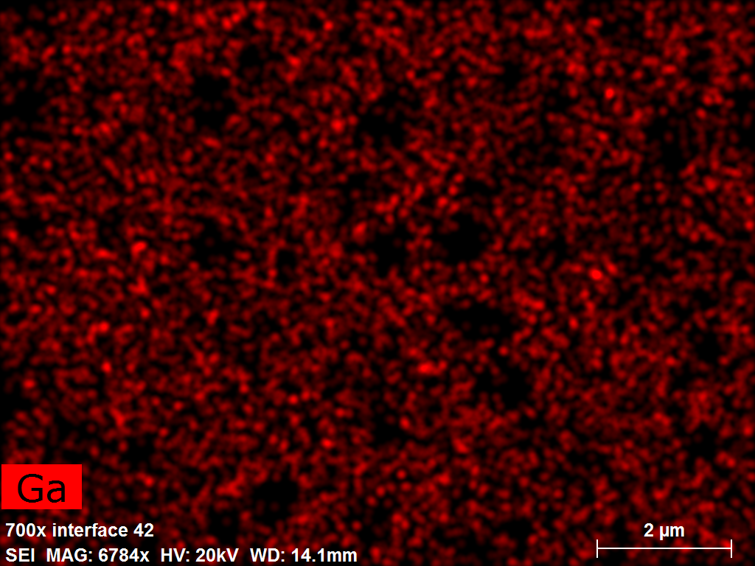
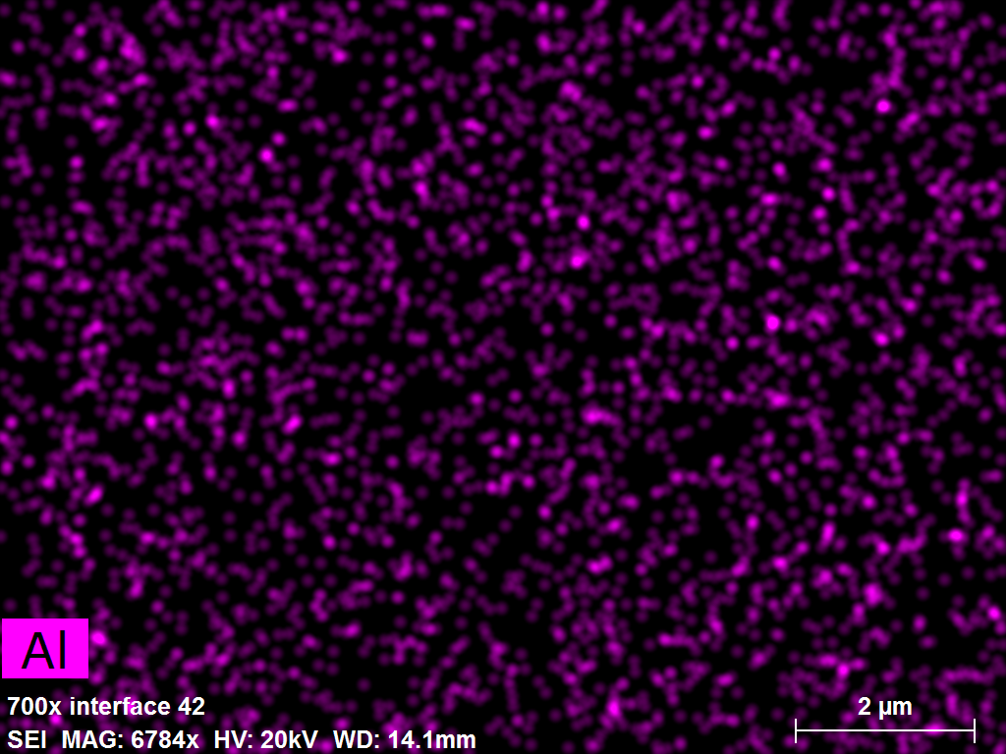
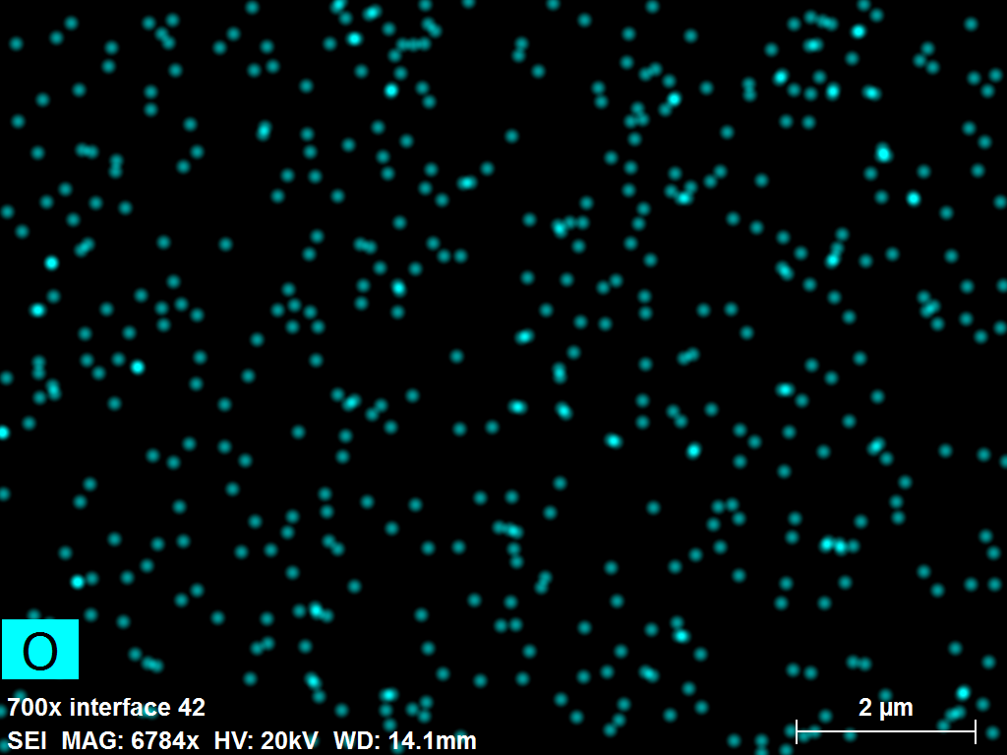
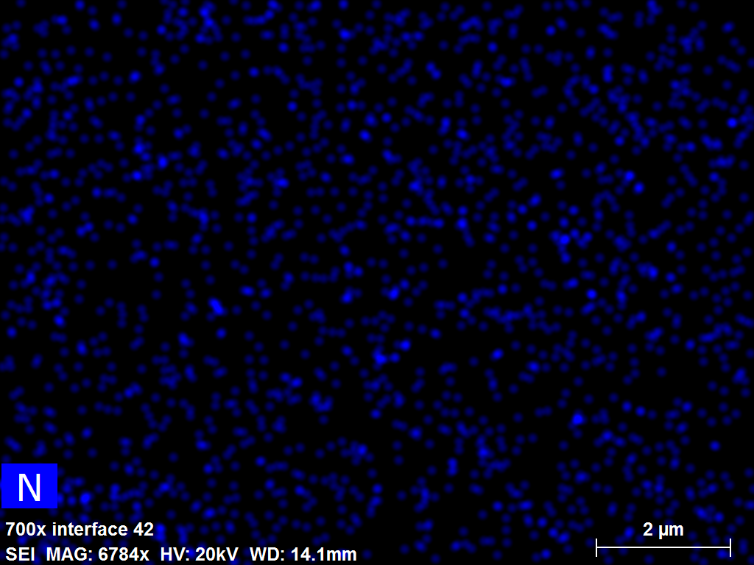
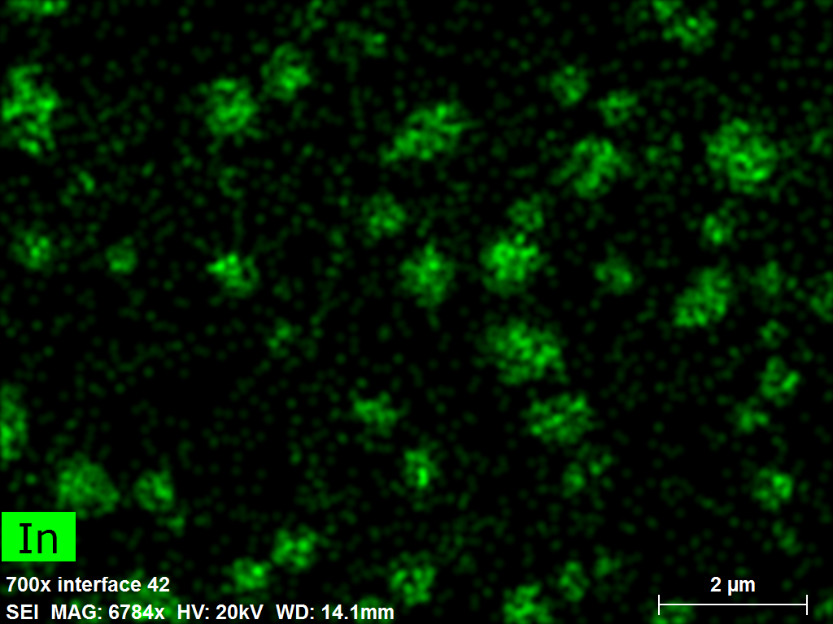
Uniform indium incorporation proven to be challenging

Slide 17
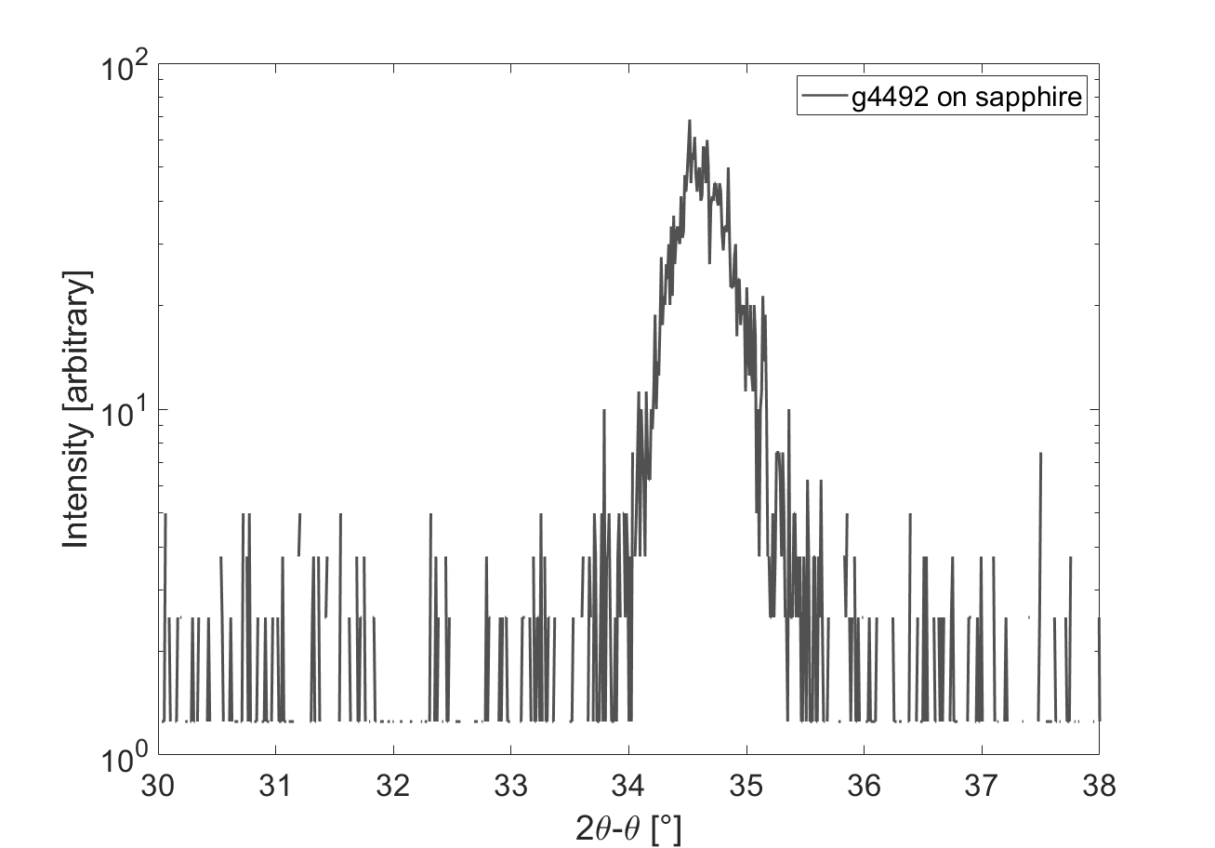
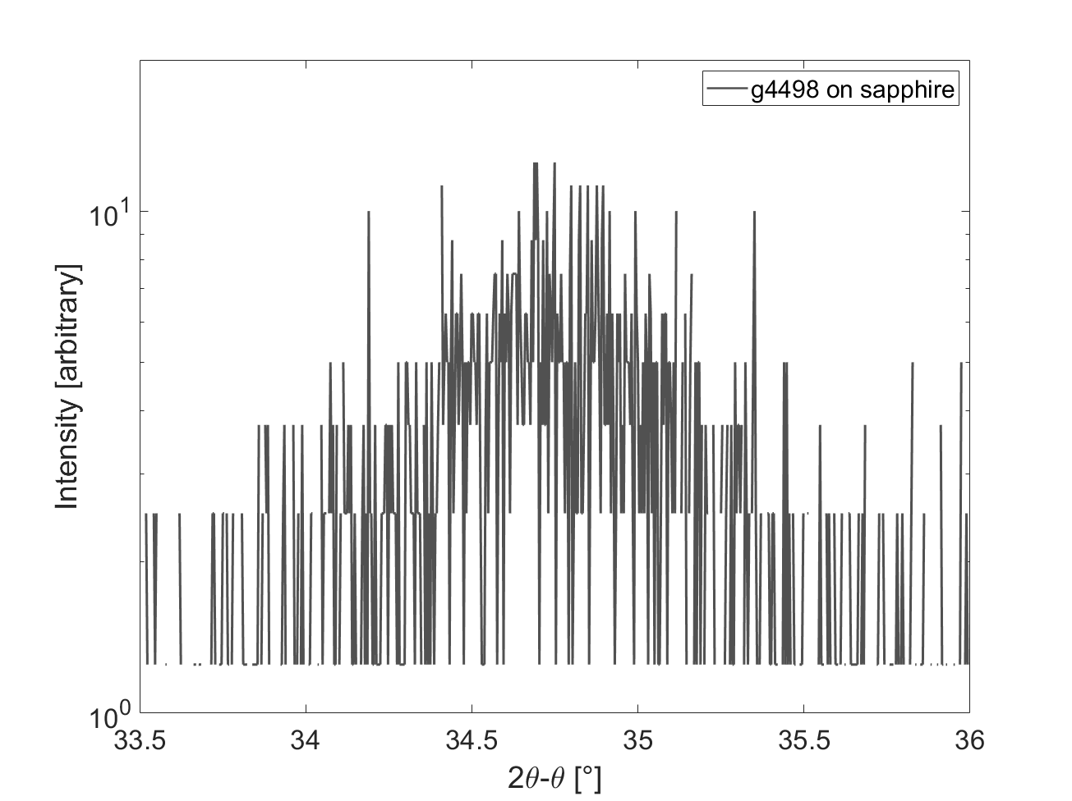
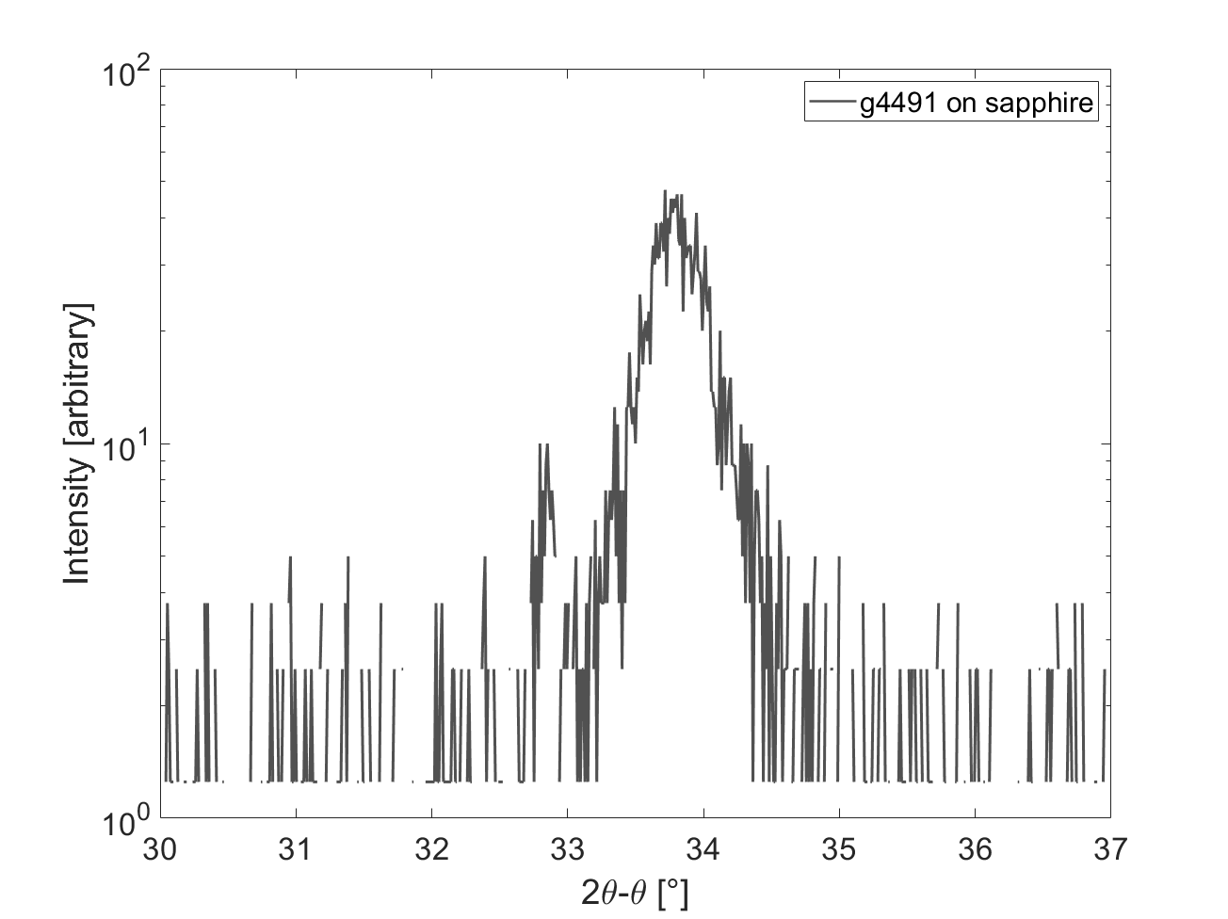
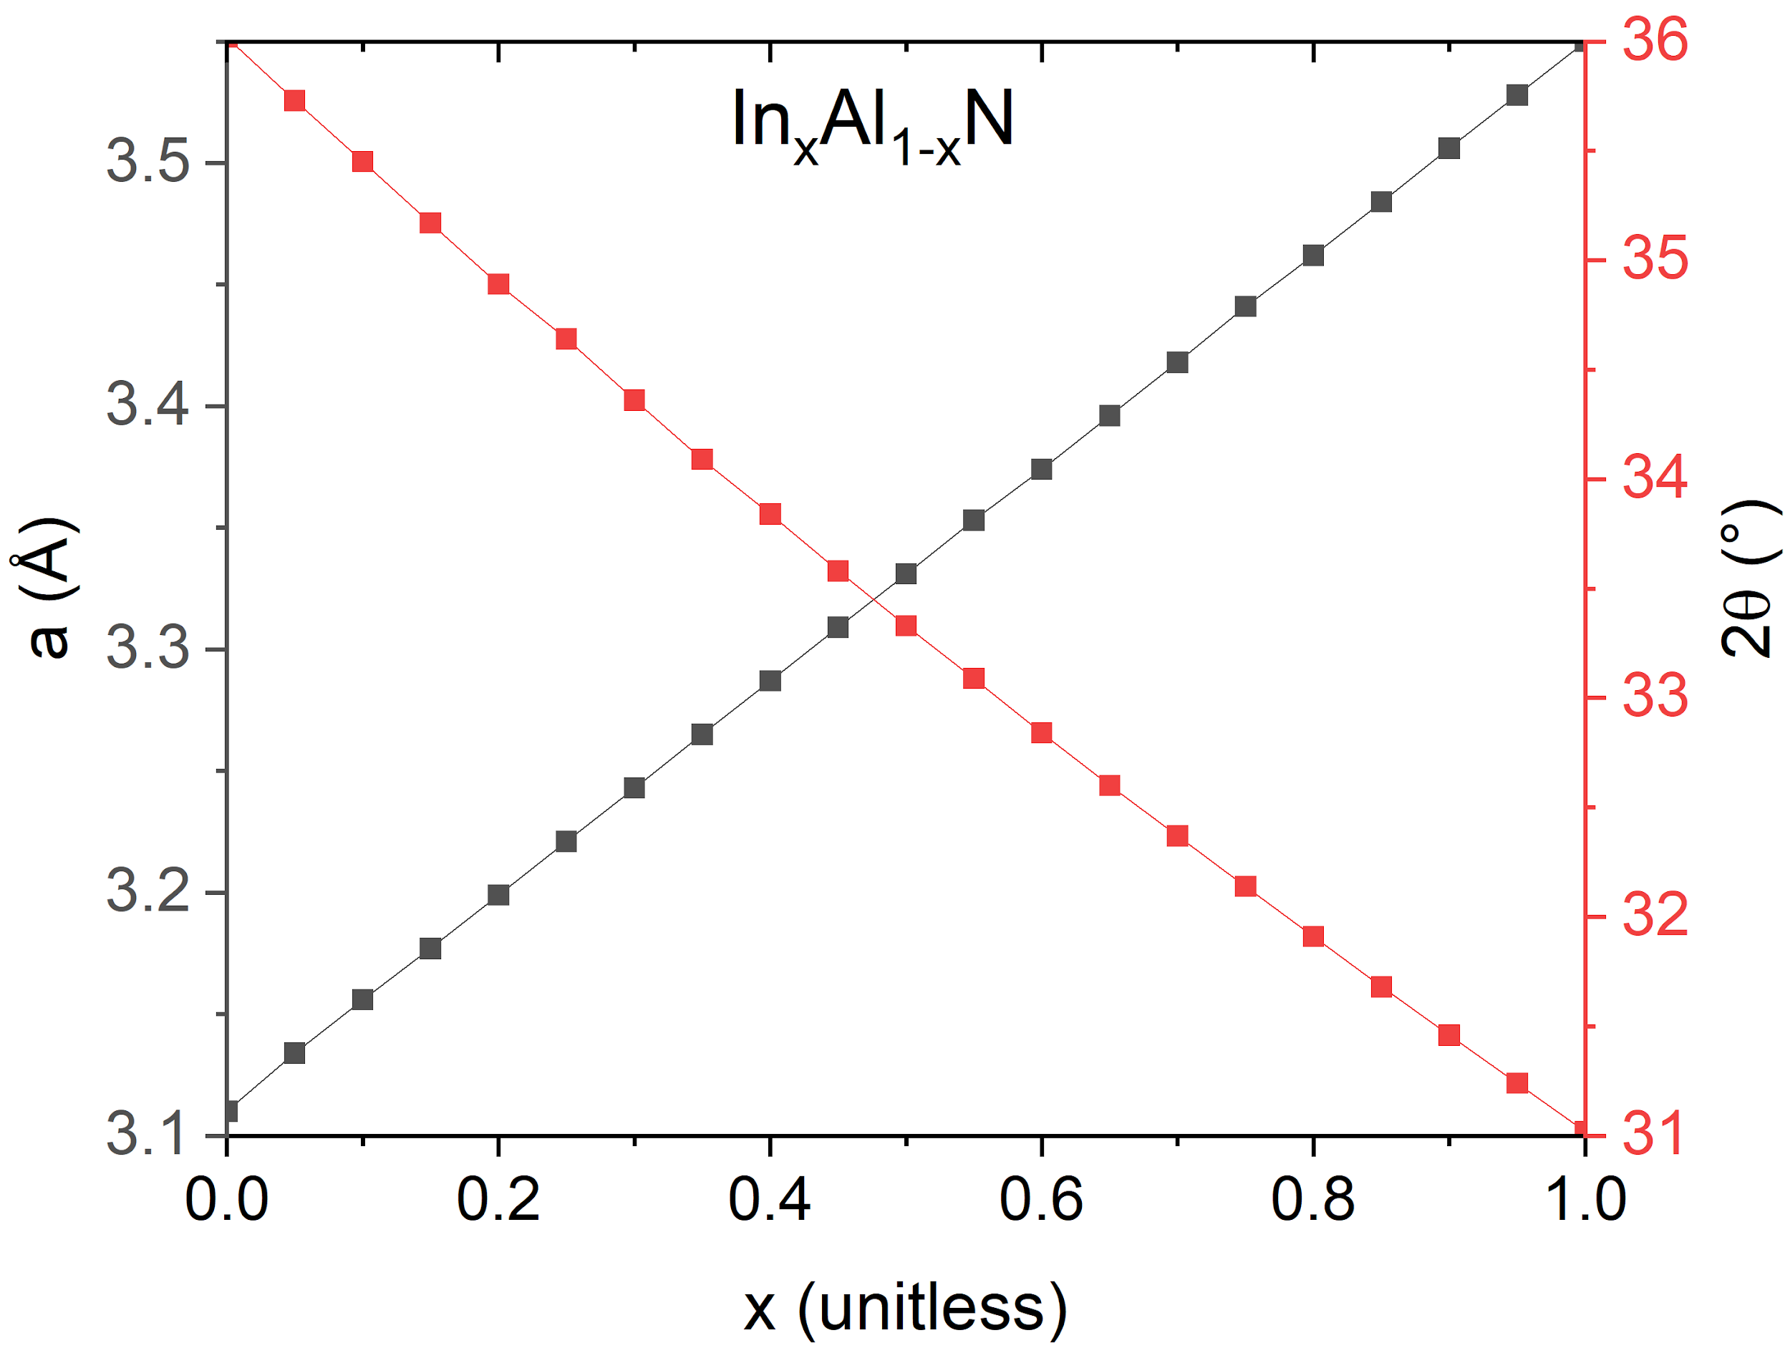
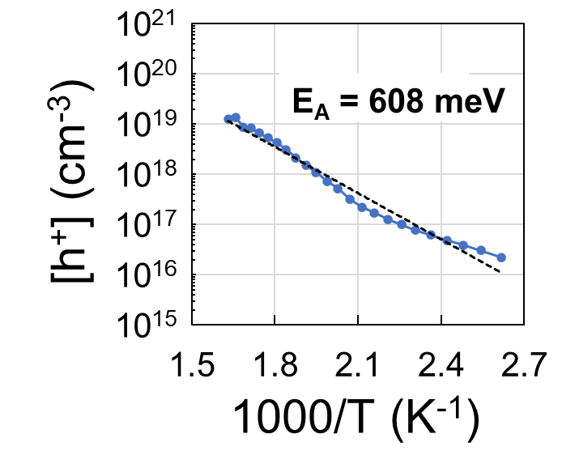
InAlN and InAlN:Mg on sapphire
2θ-θ XRD
T_{growth}=750 °C
w/o Mg
T_{growth}=750 °C
w/Mg
T_{growth}=700 °C
w/Mg
Higher In% growth possible on sapphire
2θ-θ XRD scans run between strain-free (002) reflection of InN and AlN to identify ternary Bragg condition
Assuming 0% strain, InAlN samples grown at 750 °C with and without Mg doping have In% of 22.5% and 25%, respectively.
InAlN:Mg grown at 700 °C has In% of 40%
Notes:
And indeed, we found that growth at lower temperatures increased the In%, with the highest In% and highest quality material grown directly on sapphire. I have shown here XRD scans showing the InAlN peaks of undoped material grown at 750C, Mg-doped material grown at 750C, and Mg-doped material grown at 700C. Assuming the films are fully relaxed, this gives In% of 25% for undoped InAlN, and slightly lower 22.5% for Mg-doped when grown at 750C. This may be due to the Mg competing with the In for group-III sites. However, at 700C, we successfully achieved 40 In% InAlN doped with Mg.

Slide 18
Photoemission measurement
Photoemission measurement performed at ASU and BNL
Retarding potential – total kinetic energy distribution
Photoluminescence – Electronic band gap
Photocurrent - Quantum Efficiency
Vacuum system operates at levels of 1x10⁻¹¹ Torr or better
Light sources used includes (UV LEDs, Lamps+mono, laser diodes, OPA)
Typical surface preparation includes HCl+IPA etch, N2 blow dry and annealing in UHV to 300C

Slide 19
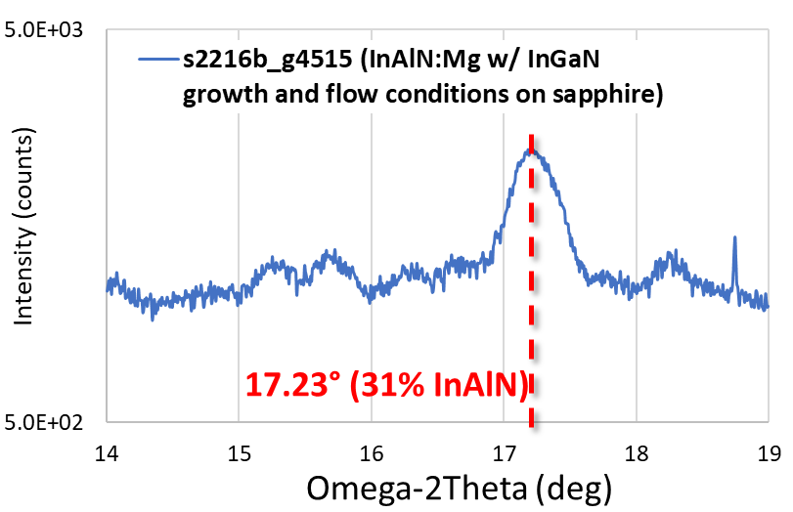
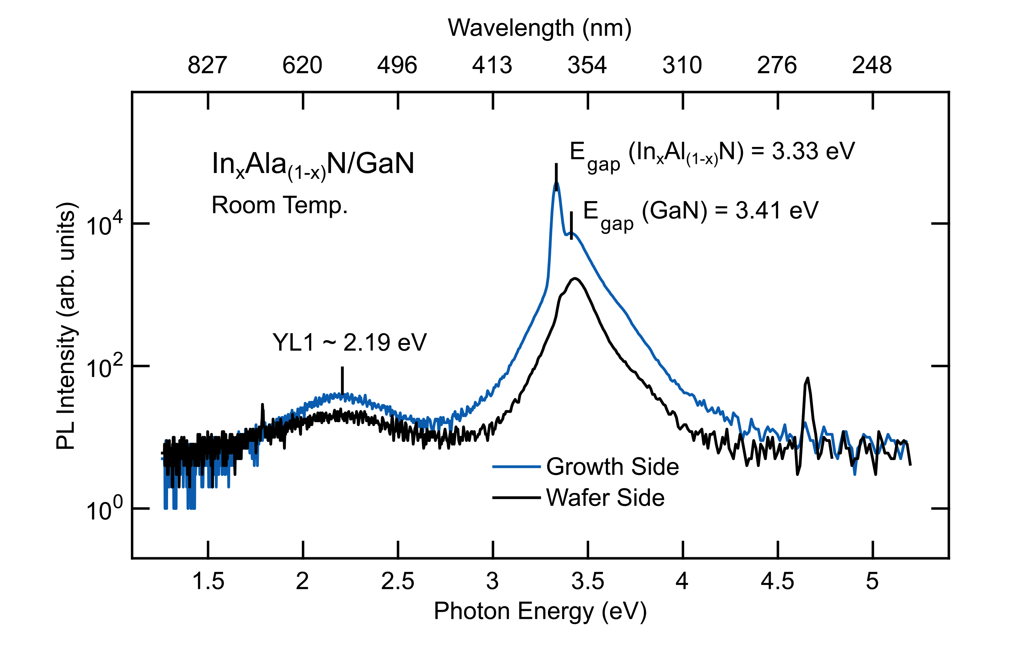
In_{x}Al_{1-x}N N-polar g4515_s2218f
Photoluminescence inferred band gap is consistent with a higher In% content than the one inferred by XRD (37% rather than 31%)
The PL structure at 2.19 eV could be due to a defect state or defect-related band -YL1 (Yellow Luminescence)-observed at room temperature. Reshchikov et al. [1] have also reported this feature for undoped GaN.
[1] Reshchikov et al. Sci. Rep. 7, 9297 (2017).

Slide 20
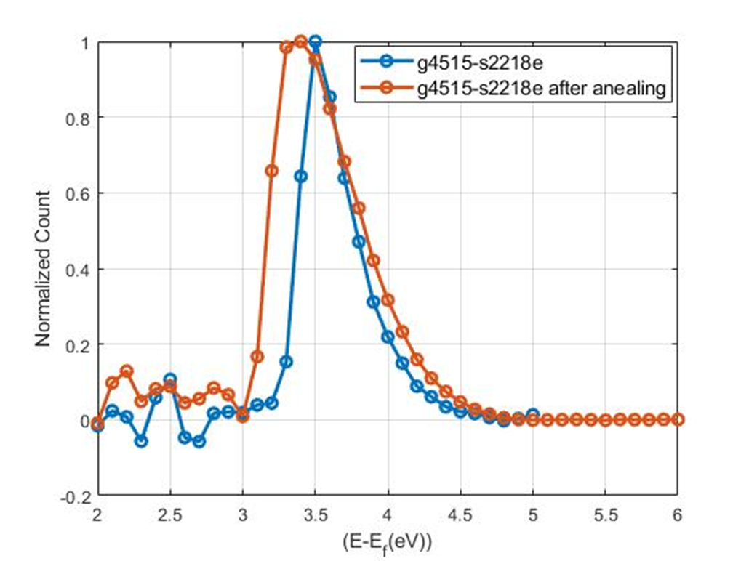
In_{x}Al_{1-x}N N-polar g4515_s2218f
Retarding potential – total kinetic energy distribution
The max of kinetic energy is derived as difference between the rise and fall of photocurrent generated from the sample at a defined wavelength (240 nm here) as function of the retarding potential.
𝜑 =5.16 eV -1.3 eV= 3.86eV before annealing
𝜑 =5.16 eV -1.5 eV= 3.66eV after annealing
E_{affinity}= (3.86-3.33) eV= 0.53 eV before annealing
E_{affinity}= (3.66-3.33) eV= 0.33 eV after annealing
Bandgap inferred from PL is 3.33 eV

Slide 21
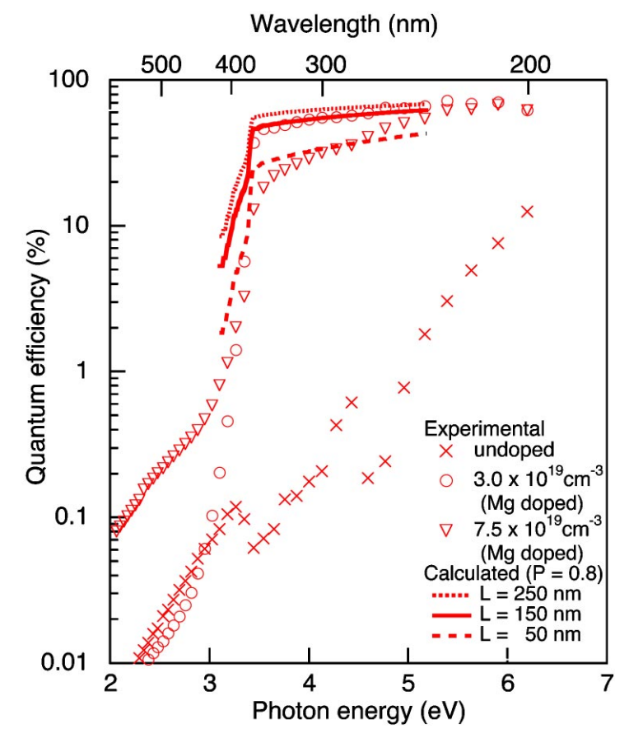
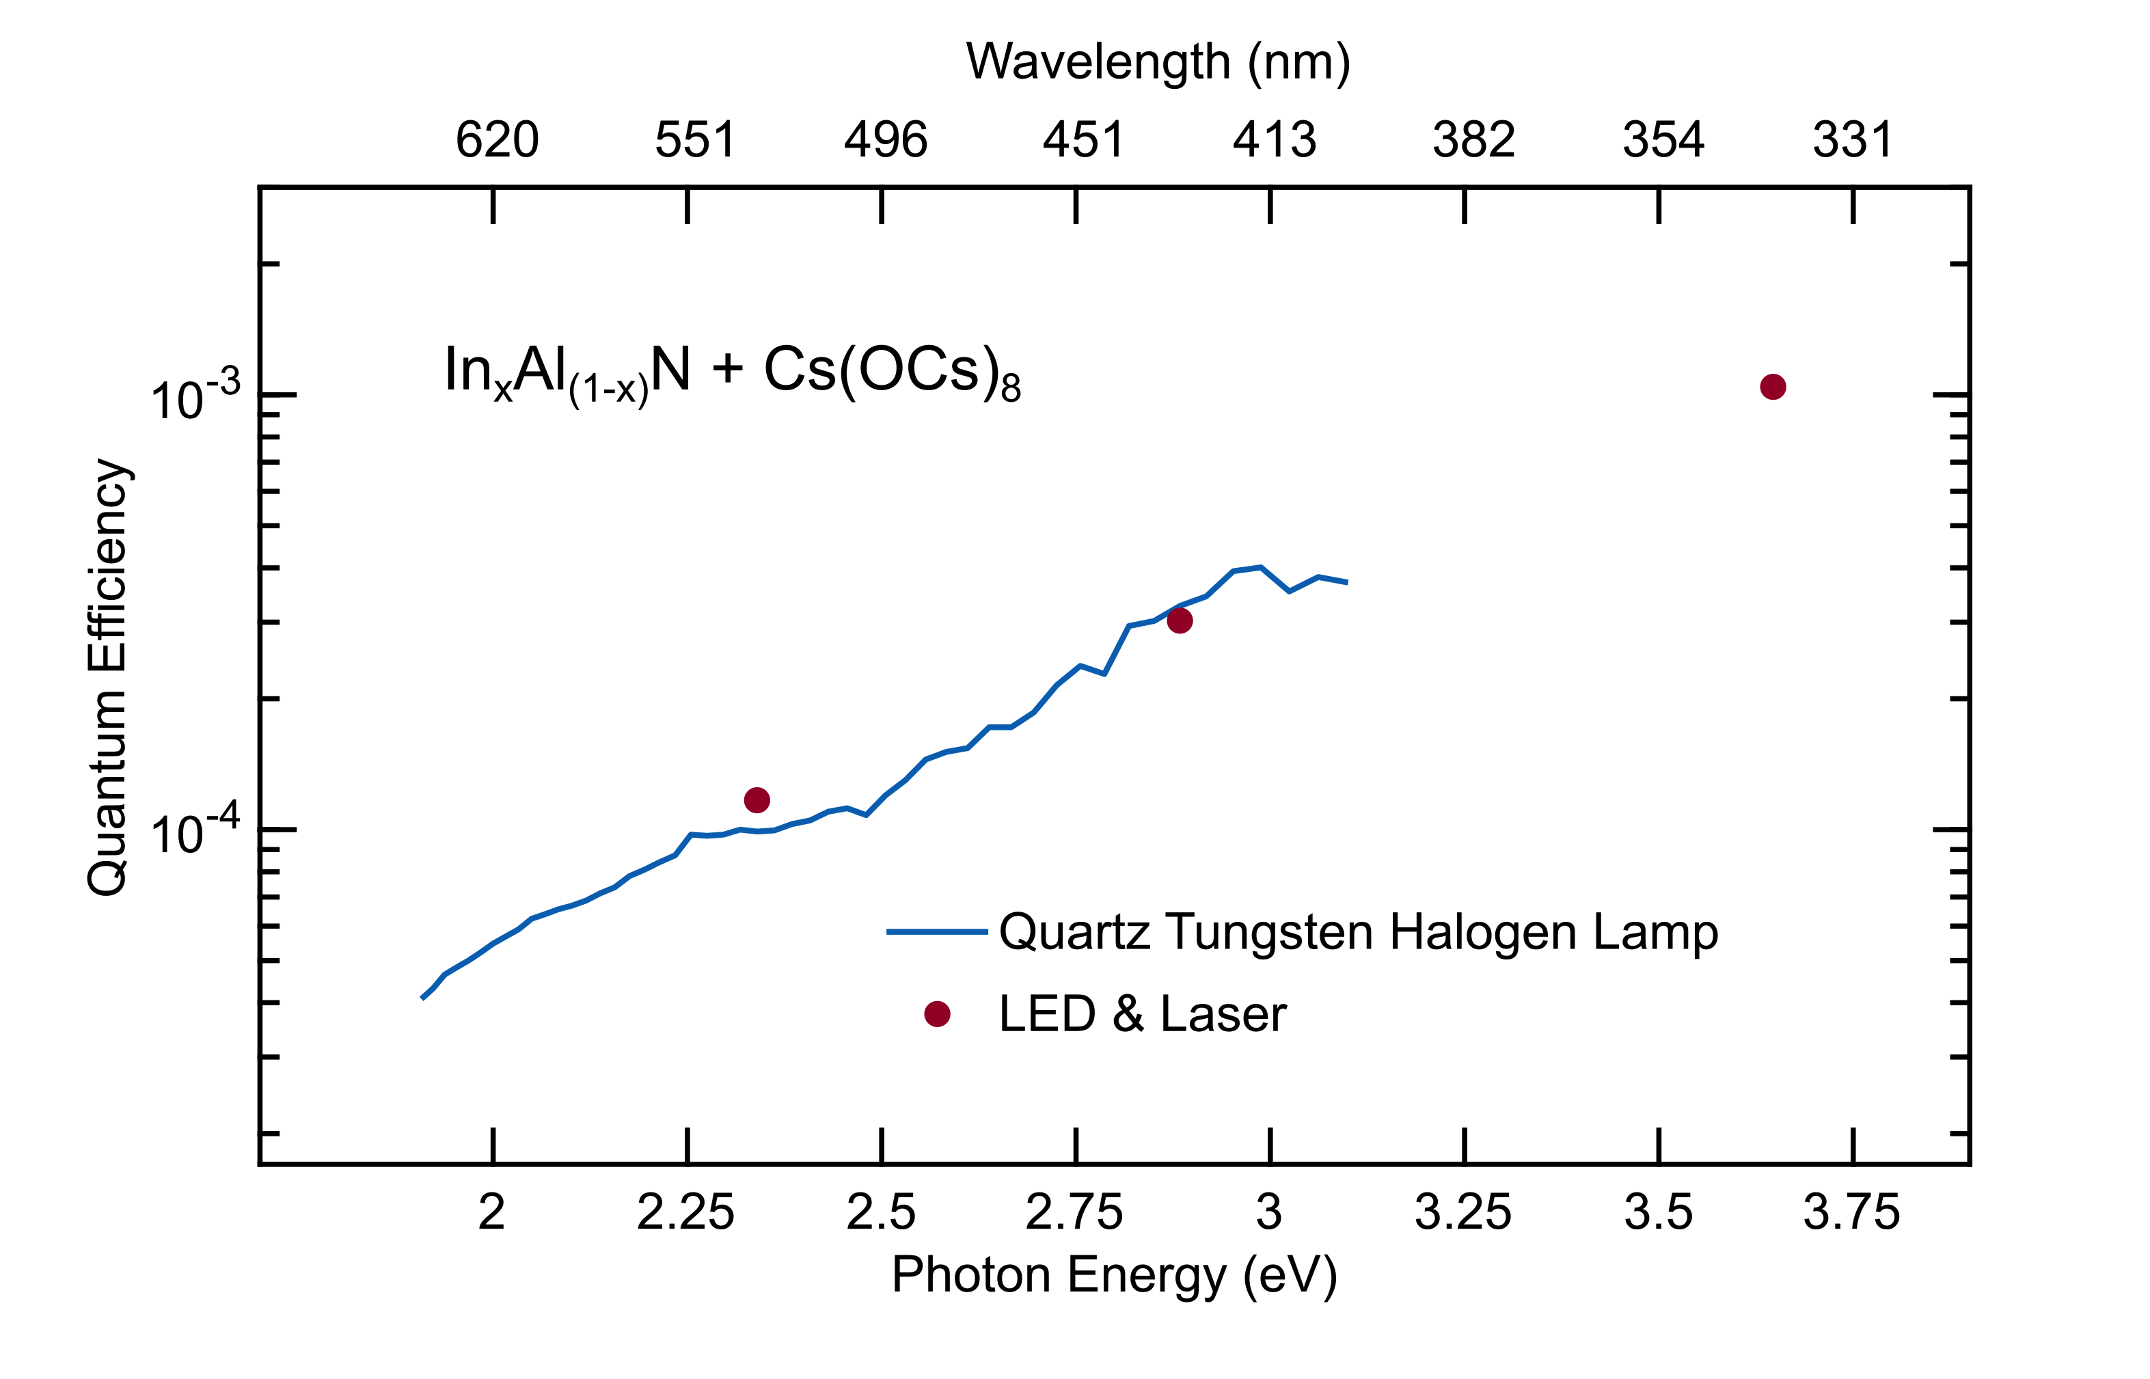
In_{x}Al_{1-x}N N-polar g4515_s2218f
Initial photoemission measurements carried out with a photon energy of 3.6 eV revealed very low QE value of about 1x10⁻⁷
Effective Ea =0.33 eV
Eb =??? eV
Ea =??? eV
Exposing the photocathode surface to alternating fluxes of Cs vapors and oxygen allow the formation of a strong surface dipole that lowers the effective Ea (typically used to achieve Negative Electron Affinity in III-V and III-nitrides)
Eg =3.33 eV
GaN
AlInN
No NEA evidence in QE
GaN NEA
10⁻³ QE @ 3.6eV
Notes:
What is the thickness of the AlInN? 50 nm?
What is the doping level if any…

Slide 22
Outlook
N-polar In_{x}Al_{y}Ga_{(1-x-y)}N are promising materials for photocathodes designed to produce high-brightness electron beams
Growth of high-quality In-rich III-N alloys difficult due to In coalescence and lattice strain associated with high In content
In_{x}Al_{(1-x)}N with up to 40% In successfully grown and doped with Mg
Ongoing studies continue to induce N-polar growth on sapphire by nitridating surface, and adding Ga to achieve quaternary InAlGaN growth
Photoemission studies revealed non uniform emission from photocathode surfaces
Negative Electron Affinity has not yet been achieved

Slide 23
Thank you!!
Acknowledgement to DOE HEP Office of Science for funding (DE-SC00024192)
F. S. Shahedipour-Sandvik, A. Lanjani, B. McEwen, S. Omranpour (State University of New York-Albany),
E. Rocco (Naval Research Lab),
V. Meyers (Sandia National Lab),
M. Moeini Rizi, L. Lathpandura, S. Karkare (Arizona State University)

Slide 24
Backup

Slide 25
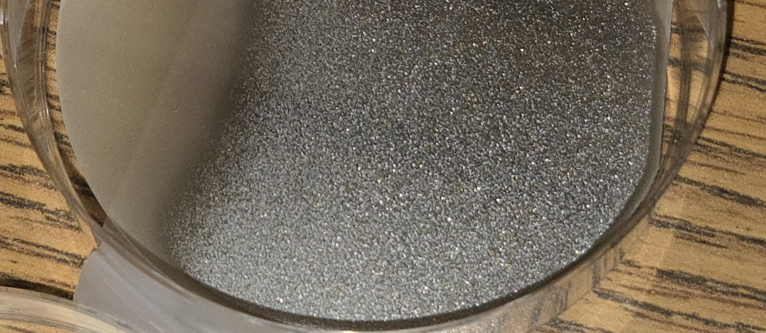
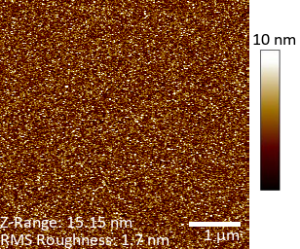

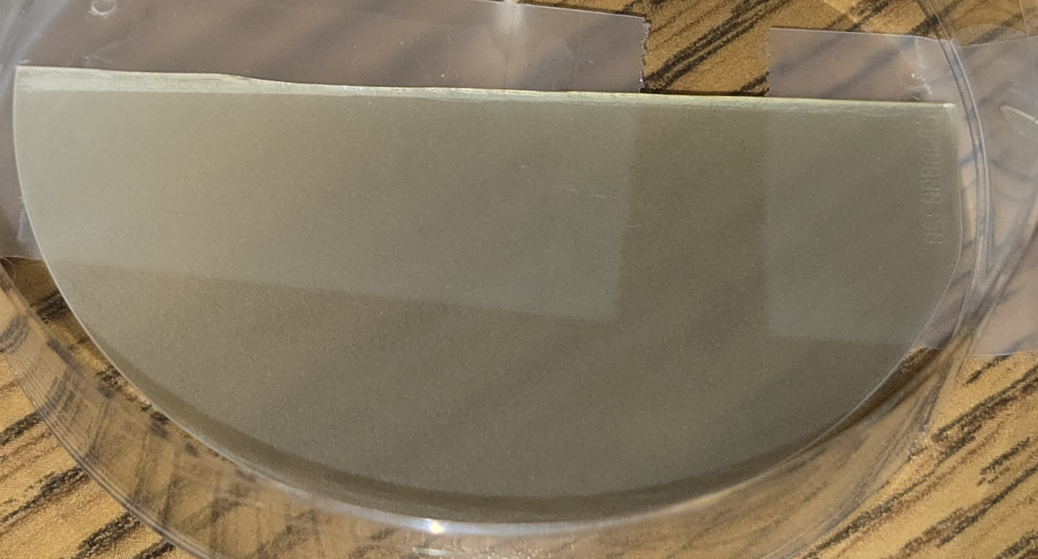
Optimization of the growth conditions
On sapphire
Growth performed at 70 torr, V/III=6,800, N₂ carrier gas
InAlN highly lattice mismatched to sapphire→ reliable ω-2θ challenging
2θ-θ XRD scans run between strain-free (002) reflection of InN and AlN to identify ternary Bragg condition
Assuming 0% strain, g4491, has In% of 40%.
Strain effects not yet accounted for in XRD→ In% contains uncertainty
T_{growth}=700 °C
w/Mg
RMS 2.45 nm
g4491
Reducing TMIn flow by 50%
On sapphire
Hall characteristics
[h⁺]_{sheet}: ~1∙10¹³ cm⁻²
μ: ~0.1 cm²/V∙s
ρ_{sheet}: 2.7∙10⁶ Ω/□
RMS 1.7 nm
g4511

Slide 26
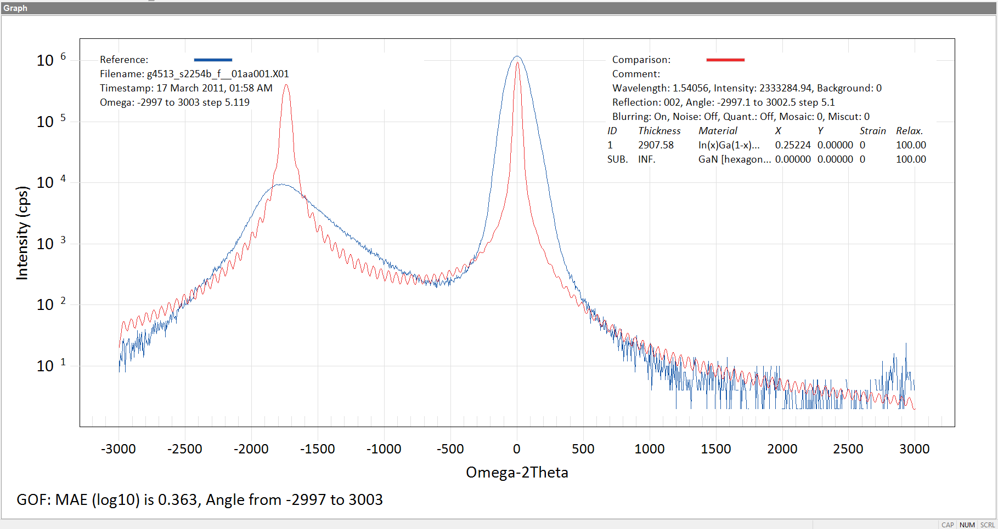
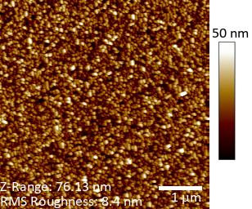
g4513_s2254 (InGaN Growth on uGaN template)
~25% In_{x}Ga_{1-x}N (Flat)
5 μm x 5 μm AFM scan of this growth with RMS roughness of ~8 nm
(002) Omega-2Theta XRD scan on this sample (blue line) and RADS fitted XRD simulation (red line) showing ~25% In_{x}Ga_{1-x}N assuming 100% relaxation
Note: Accurate thickness needs to be measured by cross-section SEM, but is estimated to be ~150-200 nm

Slide 27
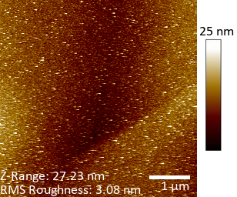
g4515_s2218 (InAlN:Mg Growth on N-polar GaN template)
Cross-section SEM shows <50 nm InAlN:Mg. Identifying an InAlN sharp peak (grown on N-polar GaN) was difficult in the Omega-2Theta XRD scan due to low intensity (thickness)
5 μm x 5 μm AFM scan of InAlN:Mg on N-polar GaN template with RMS roughness of ~3 nm
Omega XRD scan of InAlN:Mg on sapphire. A peak at ~17.2° corresponds to ~x = 30% in In_{x}Al_{1-x}N based on Bragg conditions of InN and AlN (assuming 100% relaxation)

Slide 28

Spin polarized emission from GaN
https://doi.org/10.1103/PhysRevB.81.155216
Spin relaxation times can be increased in GaN by cryocooling the samples
At LN2 temperature spin relaxation is larger than 200 ps
Timing is compatible with operation in photoguns
https://doi.org/10.1063/5.0215746
Net spin polarized electron photoemission from GaN activated to NEA has been recently measured by Mott polarimetry
Polarization is lower than strained GaAs (up to 92%) and likely affected by reduced HH-LH separation and reduced spin relaxation times
Notes:
Pol= (up – down)/(up+down)

Slide 29


Spin polarized electron emission
Achieving electron photoemission with net spin polarization requires removal of energy degeneracy in valence bands
III-Nitrides can leverage spitting from crystal field and spin orbit coupling to increase HH-LH energy separation
https://doi.org/10.1063/1.3603015
LH
HH
CH
https://doi.org/10.3390/app10010232
Upgrading the UHV system for spin polarization
with a sample holder capable of cryo-temperatures
Notes:
In a degenerate HH-LH bands
The maximal pol is (3-1)/(3+1)=0.5 (50%)

