Slide 1
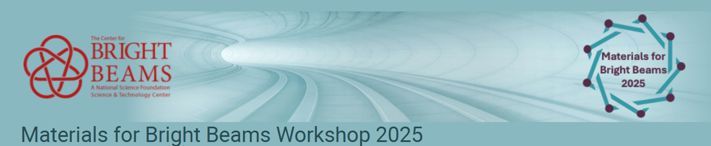
Spin polarized photocathode studies at Cornell
Matthew Andorf

Slide 2
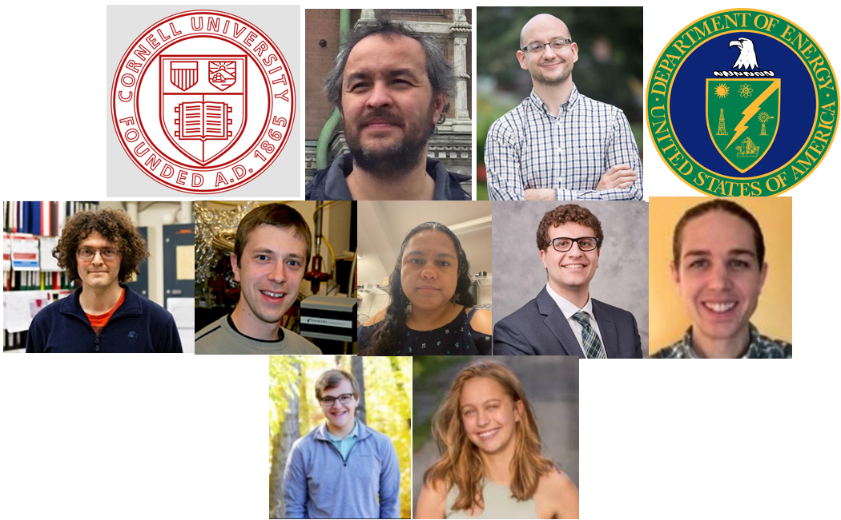


Ivan Bazarov
Jared Maxson
Adam Bartnik
Elena Echevarria
Sam Levenson,
Ben Dickensheets
Mark Reamon
Abbigail Flint
SC0025663
SC0025663
SC0025663
Works supported by:
DOE-HEP DE-SC0025356
DOE-NP DE-SC0025663
NSF-PHY-1549132 (CBB)

Slide 3
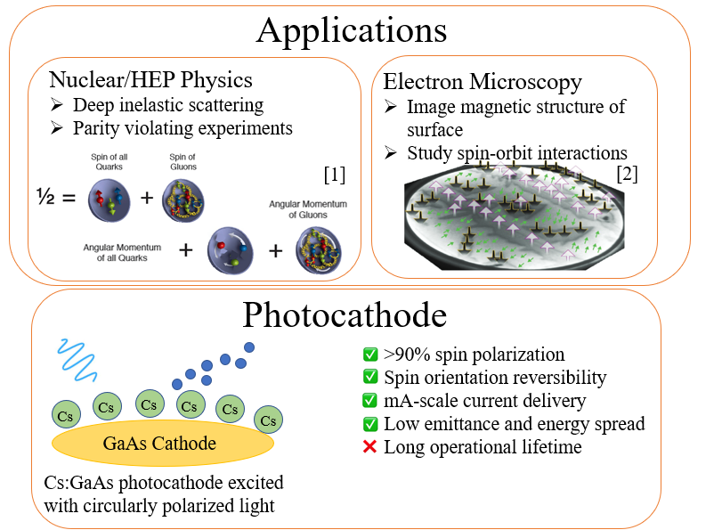
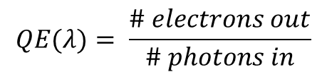
Spin Polarized Electron Beams
$$QE(λ)= \frac{\# electrons out}{\# photons in}$$

Slide 4
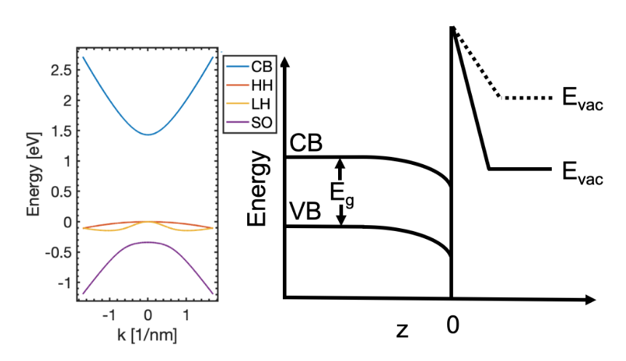
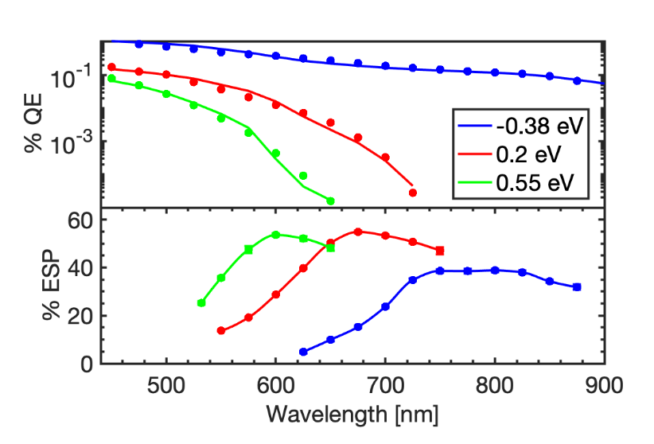
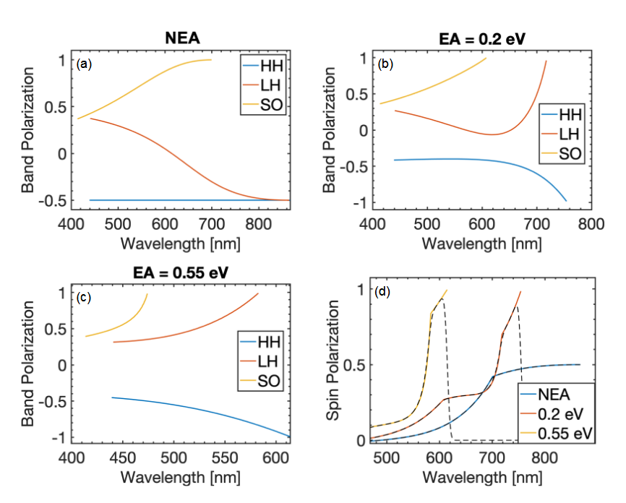
GaAs Affinity state and ESP
Cs-O forms a strong dipole layer which lowers the vacuum energy
  Negative Electron Affinity state (NEA) occurs when conduction band minimum is larger than vacuum energy
At NEA, bandgap energy photons (circularly polarized) excite from HH/LH bands resulting in 50% ESP
Higher ESP achieavable by:
  Straining the lattice, lifting degeneracy allowing theoretically 100% ESP
  Operating in slight PEA (at the expense of QE)

Slide 5
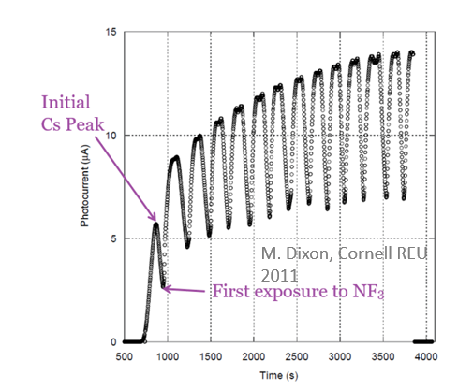
Traditional NEA activation
NEA is typically achieved by depositing a monolayer of Cs-Oxidant onto the GaAs surface can be done by:
  Co-deposition: Cs is deposited until QE peaks, at which point an oxidant is leaked while Cs source remains on
  Yo-yo method: the cathode is over cesiated at which point the cesium source turns off. It is then exposed to an oxidant until the QE peaks, the oxidant is then turned off and cesium source back on. The cycle is repeated numerous times

Slide 6



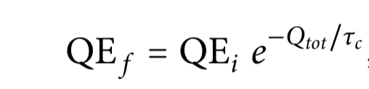
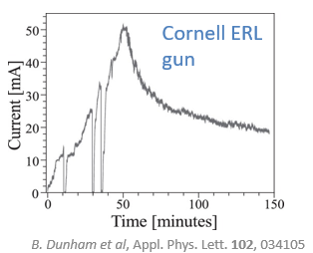
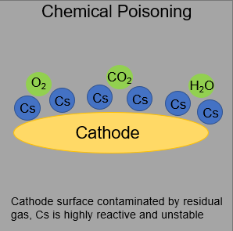
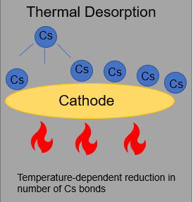
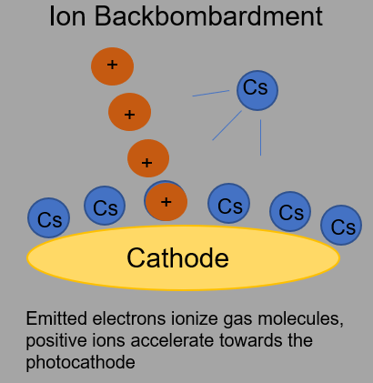
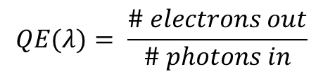
High current spin polarization
Charge lifetime: The amount of current extracted before the QE degrades by 1/e
  1000 C is state of the art→6 hours at 50 ma!
$$QE(λ)= \frac{\# electrons out}{\# photons in}$$

Slide 7
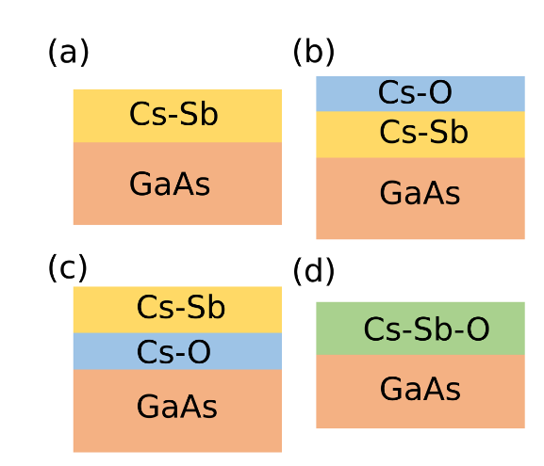
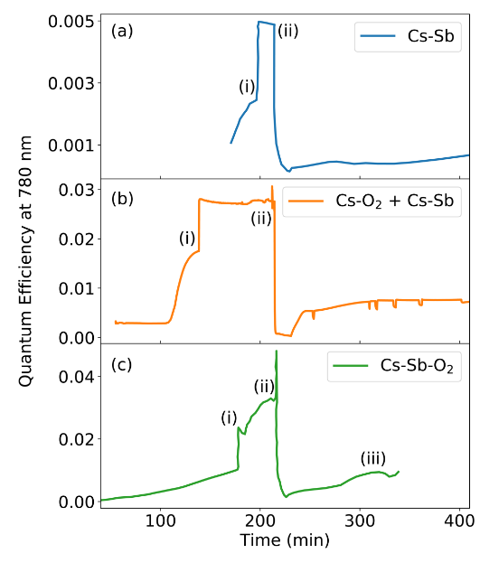
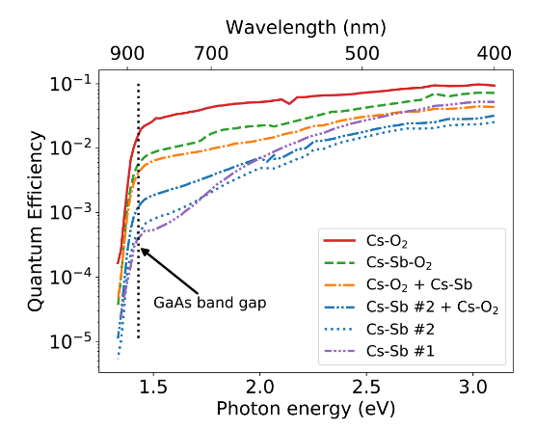
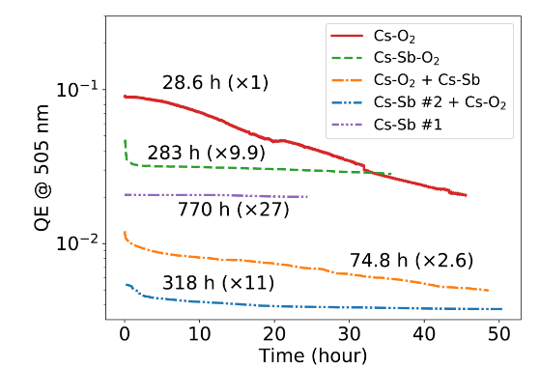

Sb based activation recipes
Various activation recipes were tried and compared with Cs-O₂ activation:
All methods achieved NEA
  Overall, Cs-O₂ produced the highest QE while Cs-Sb had the worse
  Including O₂ in the activation improved QE of Sb containing recipes
The QE was monitored over time to determine robustness
  All Sb activations outperformed pure Cs-O₂ and pure Cs-Sb had the longest lifetime.
Co-deposition of Cs-Sb-O finds a happy middle ground
  10x Improved lifetime over Cs-O activation.
  10x improved QE over Cs-Sb activation
Bae et al, “Improved lifetime of a high spin polarization
superlattice photocathode (2020)”

Slide 8

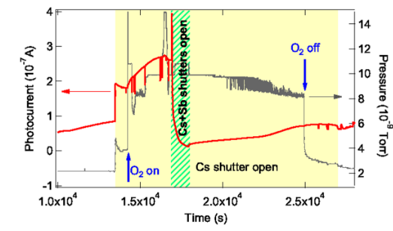
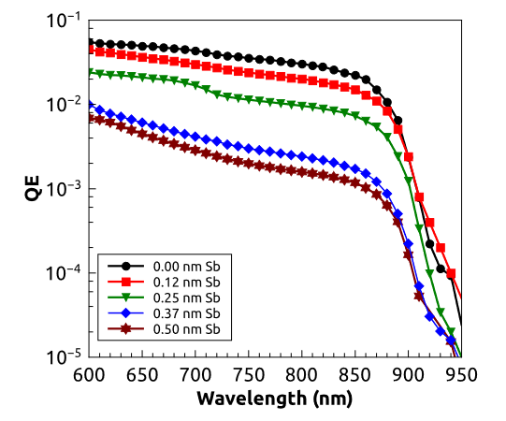
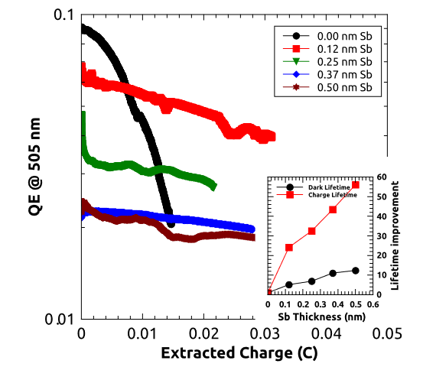
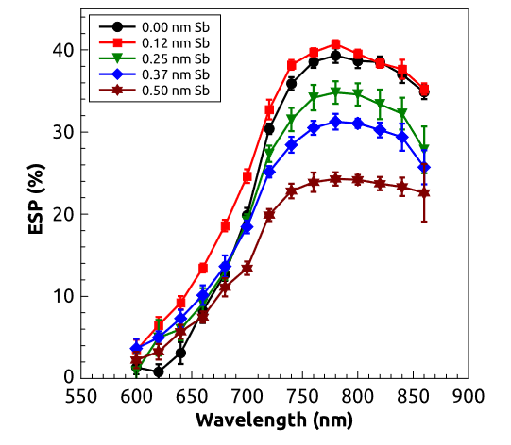
Cs-O-Sb activation tradeoffs
Cs-O-Sb co-deposition recipe was further refined through scanning the Sb layer thickness:
  QE and electron spin-polarization decrease with Sb layer thickness
  0.12 nm layer results in only a small QE decrease while preserving max spin-polarization!

Slide 9
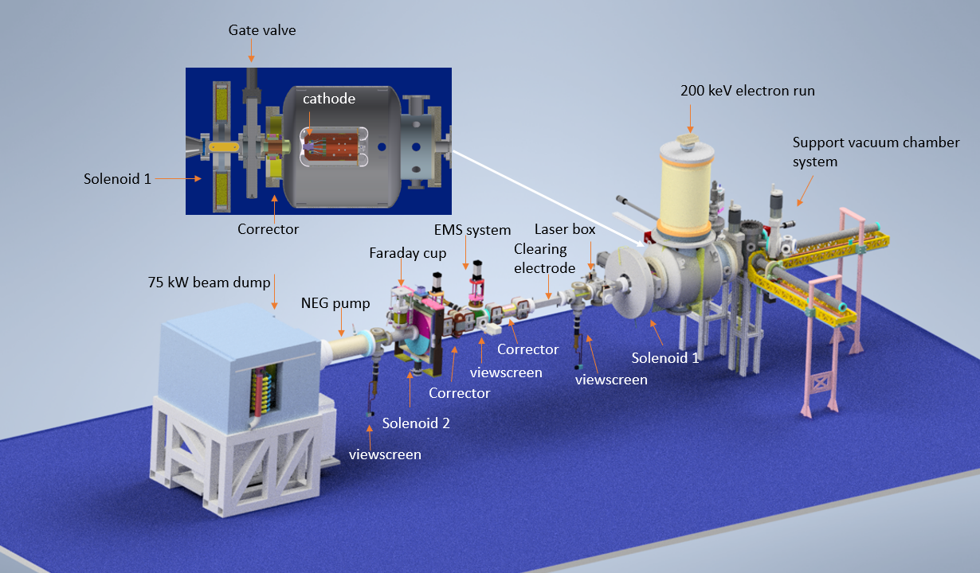
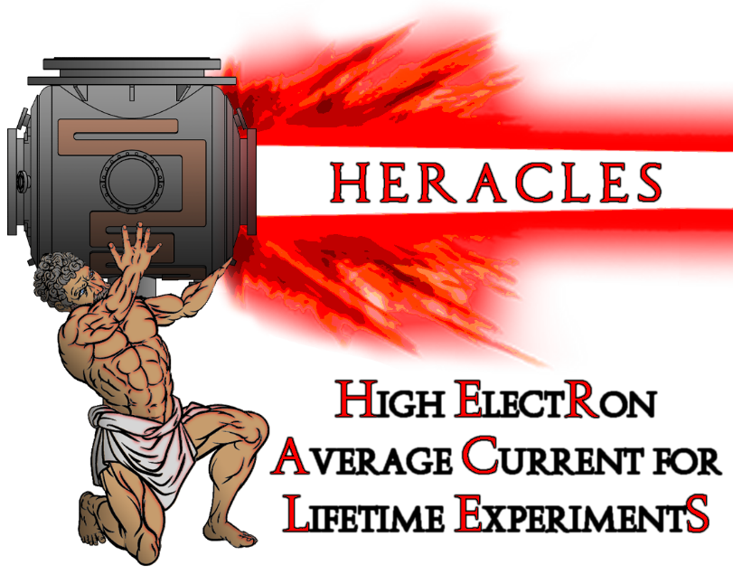
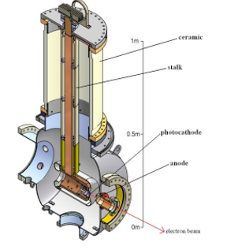
The HERACLES Beamline
A beamline dedicated to the study of high current beam running:
Former CU-ERL gun. Recommissioned to 10 mA @ 200 KeV
Ion clearing electrodes
75 kW beam dump
Unique facility for high current photocathode testing on a university campus!

Slide 10
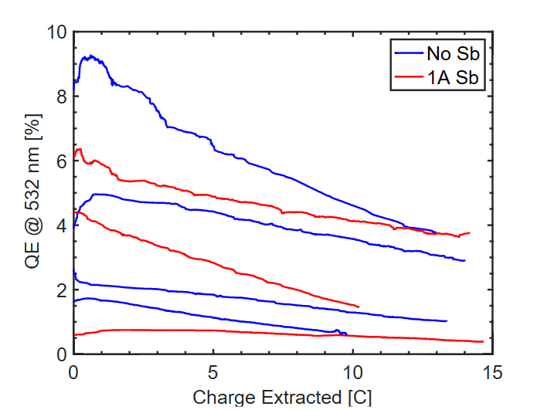
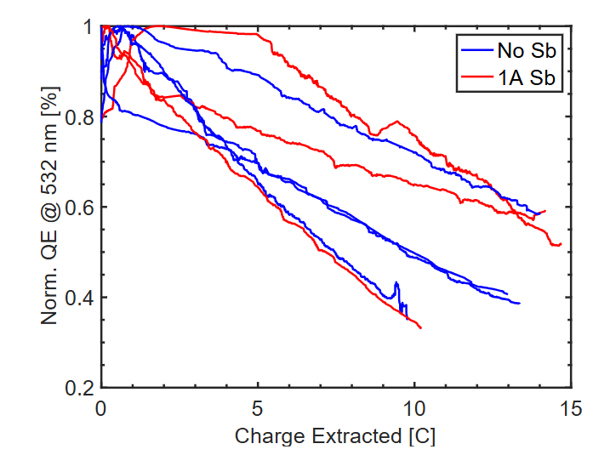
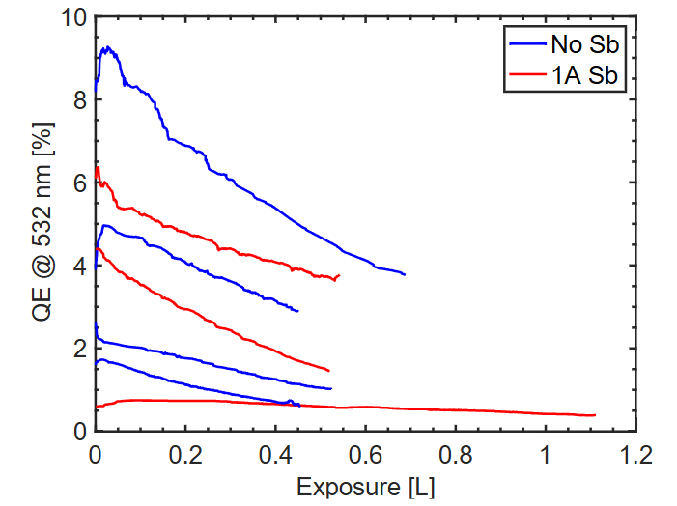
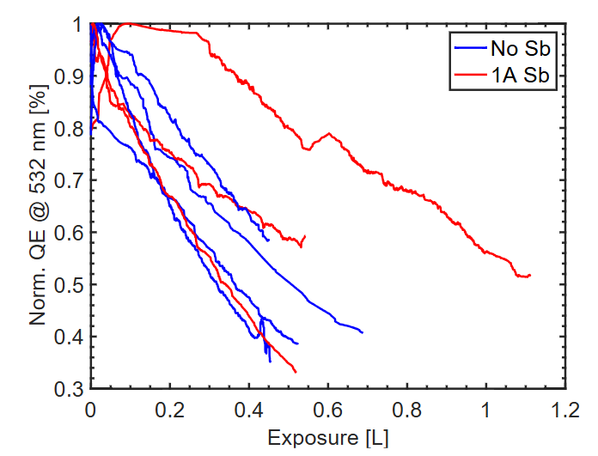
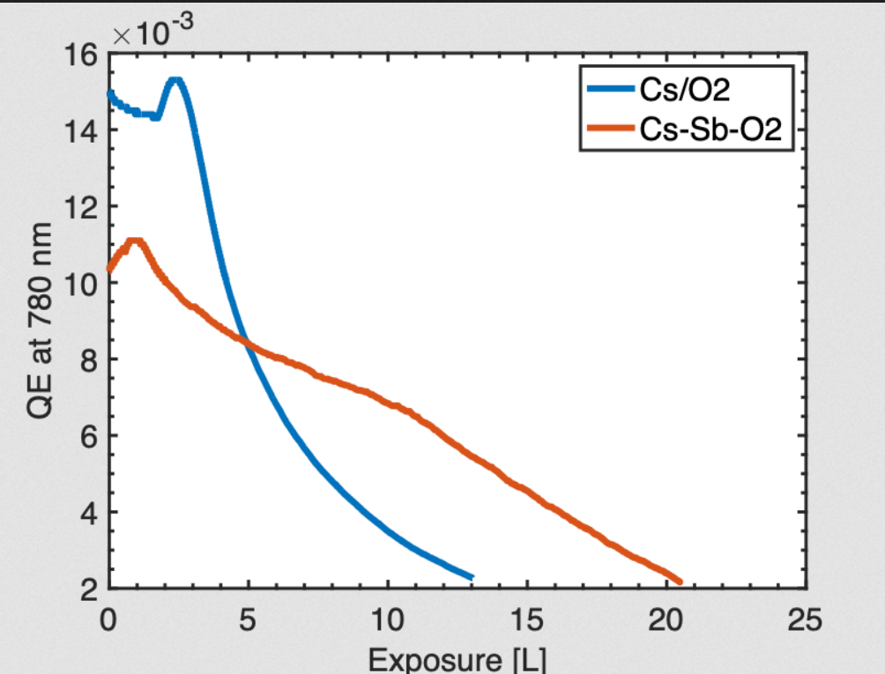
Cs-Sb-O operation at high current
Photocathode operated with 532 nm light
Operation at 1 mA, typical run extracted 10-15 C of charge
Lifetime compared using Cs-O activation and Cs-Sb-O activation
  No substantial change in operational lifetime observed
Lifetime in growth chamber

Slide 11
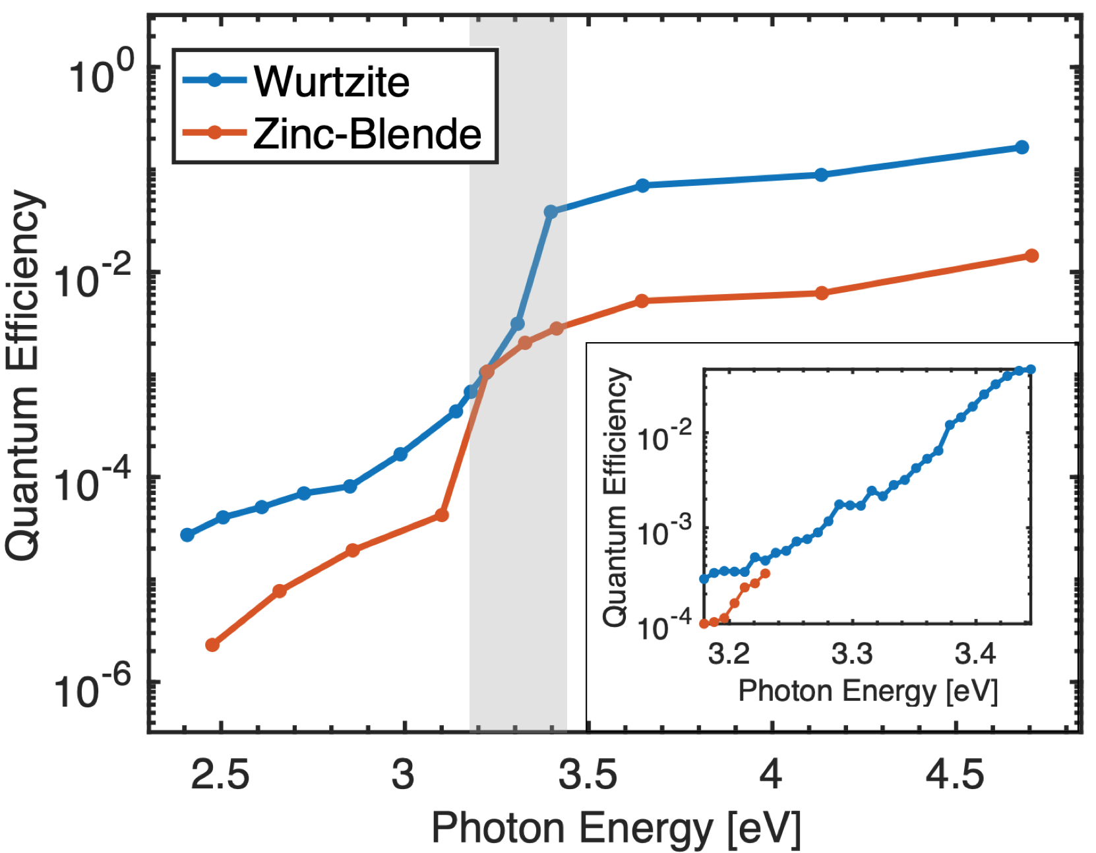
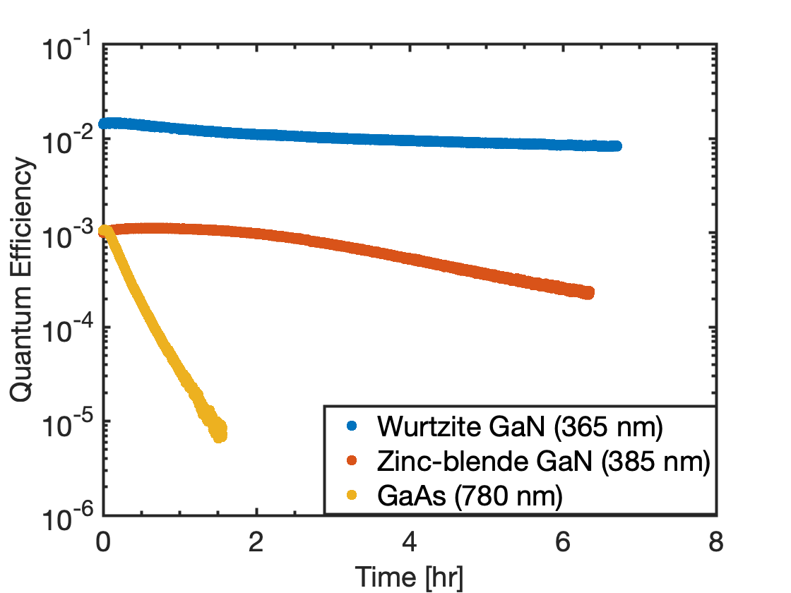
GaN as a novel spin polarized source
  Wurtzite or Zinc-Blende orientation
  >50% QE achievable with W-pGaN
  Comparable spin relaxation time to GaAs (~5 ns)
  Could be strained for high polarization
  3.2 eV band gap is conveniently at the second harmonic of Ti:Sapphire
  Less Cs to get to NEA→ stronger bond to Cs?
  NEA with Cs only
  Smaller SO splitting compared to GaAs (compare 340 meV to 17/5 meV for GaN)

Slide 12
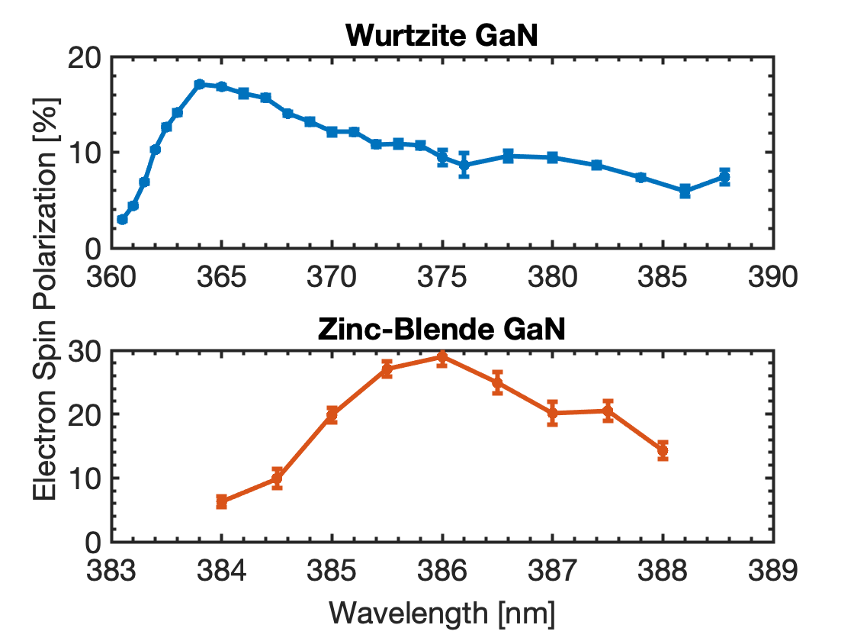
GaN ESP measurement
“First ever” demonstration of electron spin photoemission from a GaN photocathode!
Tunable (360—400 nm), narrowband (1.4 nm) UV source developed to resolve ESP curve in photon energy
ESP observed from both Wurzite (hexagonal) and Zinc-Blende (cubic) GaN.
  Unexpected long tail observed with Wurzite phase
  ESP observed in cubic phase comparable to bulk GaAS value!
  On going project to introduce strain to GaN for >50% ESP
SHG
BiBO crystal
Diffraction grating
1032 nm pulsed femtosecond laser
20 W
Optical Parametric Amplifier
Tunable 600-800 nm
2% efficiency
Linear polarizer and quarter-wave plate

Slide 13
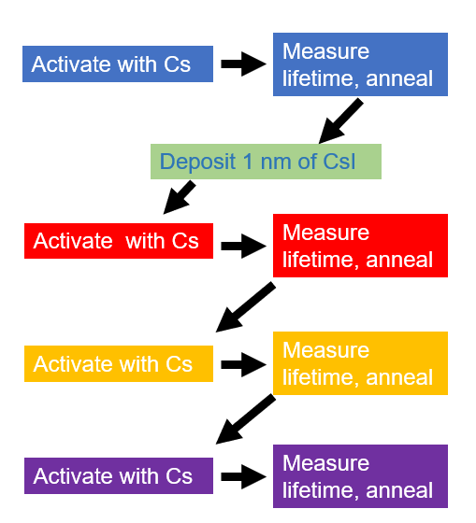
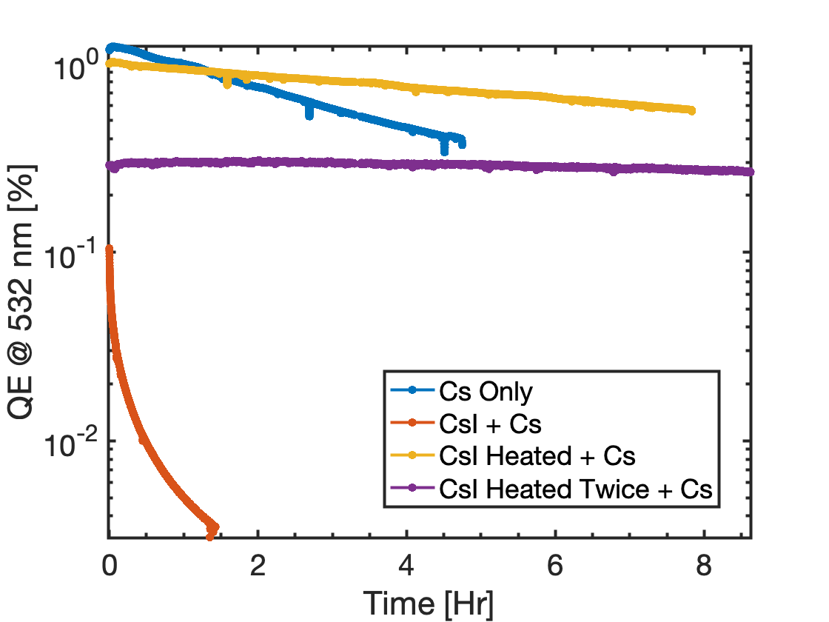
CsI surface treatment of GaAs/GaN
GaAs
Cesium Iodide has been used as the photoemitter material in Ring Imaging CHerenkov (RICH) detectors
We were investigating the possibility of using it for NEA activation (similar to Sb approach)
  Had been used in conjunction with laser activation to improve metal cathode QE (Chemical Physics Letters 621 (2015) 155–159)
cycle of deposition and heating resulted 20x better lifetime!

Slide 14
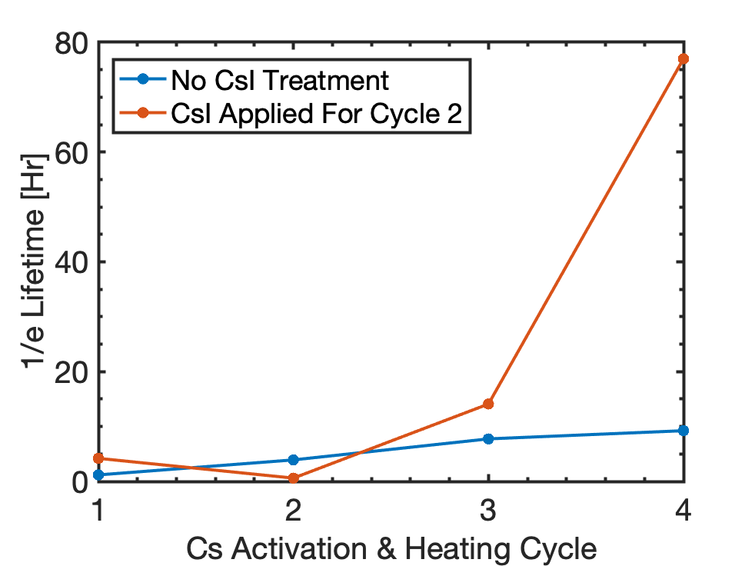
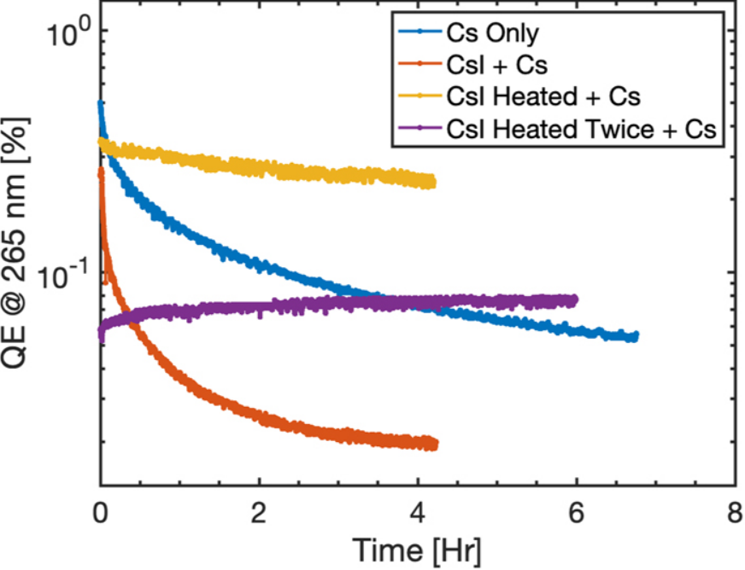
CsI surface treatment of GaAs/GaN
GaN
GaAs
Improvement in lifetime NOT the result of longer heating time
ESP is not degraded with improved lifetime
Similar improvements observed with GaN!

Slide 15
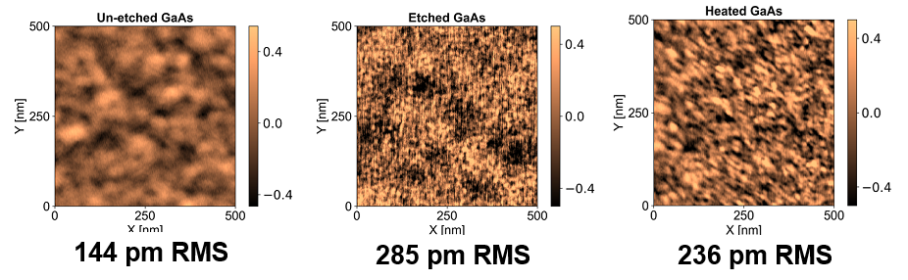
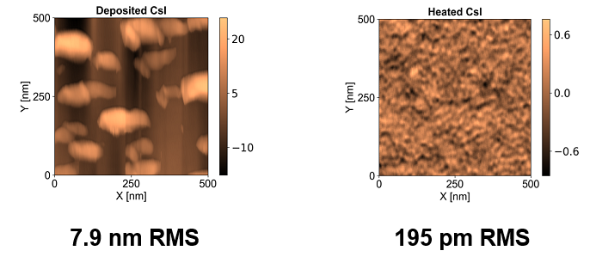

AFM analysis

Slide 16

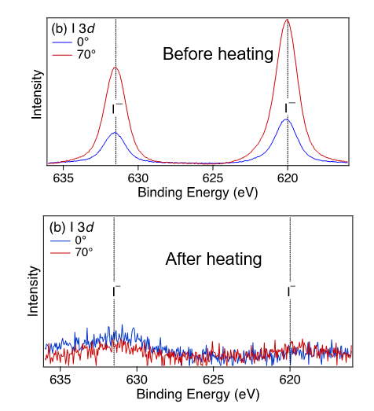
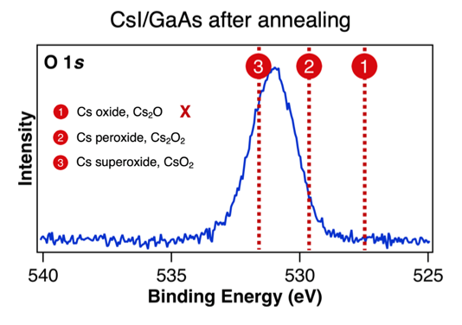
XPS analysis
Q. Zhu, M. Hines.
XPS analysis shows clear presence of Iodine before heating but none after!
Post heated surface shows suppression of Cs-oxide while Cs sub-oxide present
Cs-suboxide robust to exposure of water/oxygen up to 625 L

Slide 17
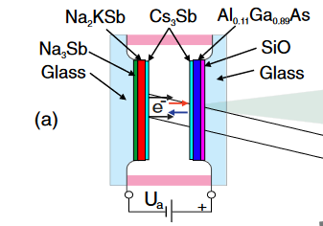
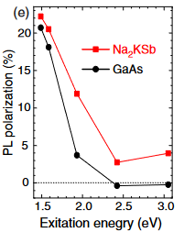
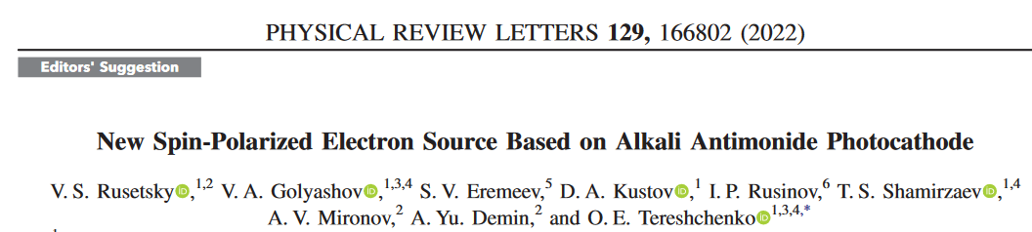
Spin polarized Alkali-Antimonide PC
Rusetsky et al. reported spin polarized photoemission alkali antimonide
  Cs₃Sb NEA layer on Na₂KSb
  Photoluminescence (PL) Al_{0.11}Ga_{0.89}As detector
  Circular PL degree correlated to ESP
  Calibrated with an NEA GaAs photocathode
Alkali-antimonides are robust, efficient emitters!
Active project at Cornell to confirm ESP measurements using Mott polarimetry

Slide 18
Conclusion
Summary
Antimony based NEA activation of GaAS
  Improved robustness to vacuum poisoning
  Trade-off between QE, ESP and lifetime
  No improvement at high current operation
GaN as a spin-polarized photoemitter
  Naturally more robust than GaAs
  ESP measured for both hexagonal and cubic phases
    Cubic GaN ESP comparable to bulk GaAs
  On going project to apply many techniques developed for GaAs on GaN
    Alternative activation layers
    Strained lattice for high ESP
    Bragg reflector for high QE
CsI surface treatment
  20x improvement in dark lifetime
  Works for both GaN and GaAs
  Testing if compatible with antimony based NEA activation

