Slide 1
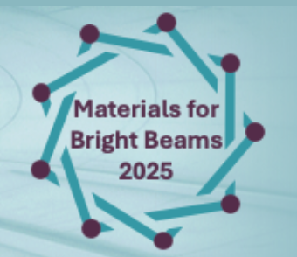
Additive Manufacturing of Normal-Conducting RF (NCRF) Structures: Overview & Possibilities
Nanda gopal Matavalam
RadiaBeam Technologies
Advanced Materials for Charged Particle Beams Workshop
July 16^{th-}18th, 2025
Cornell University, Ithaca, New York

Slide 2
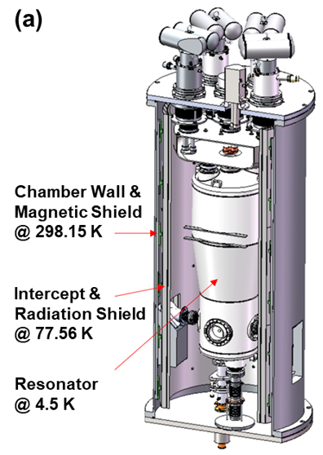
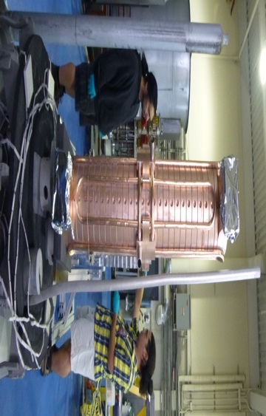
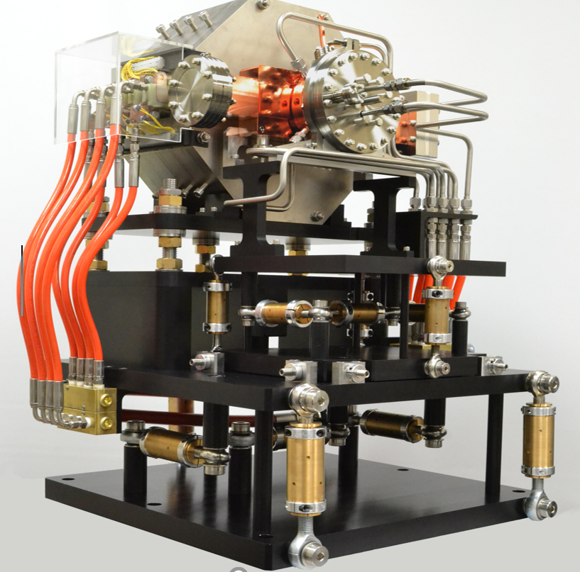
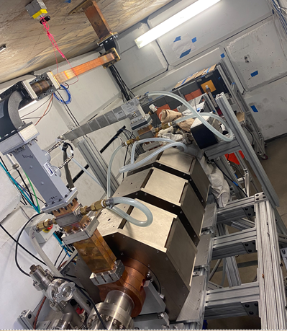
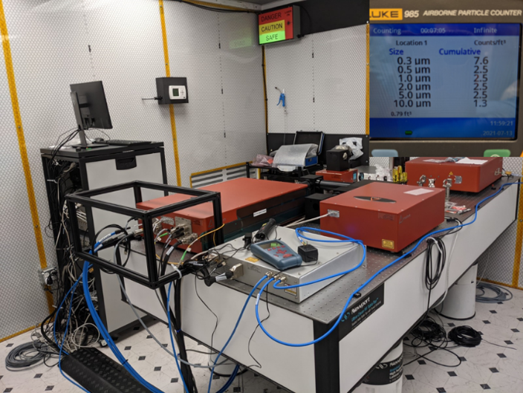
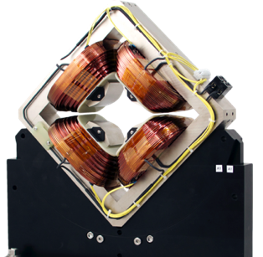
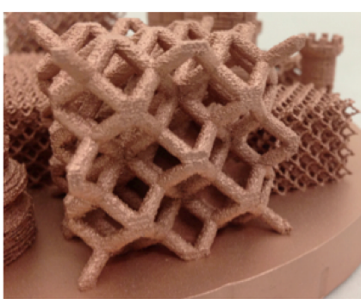
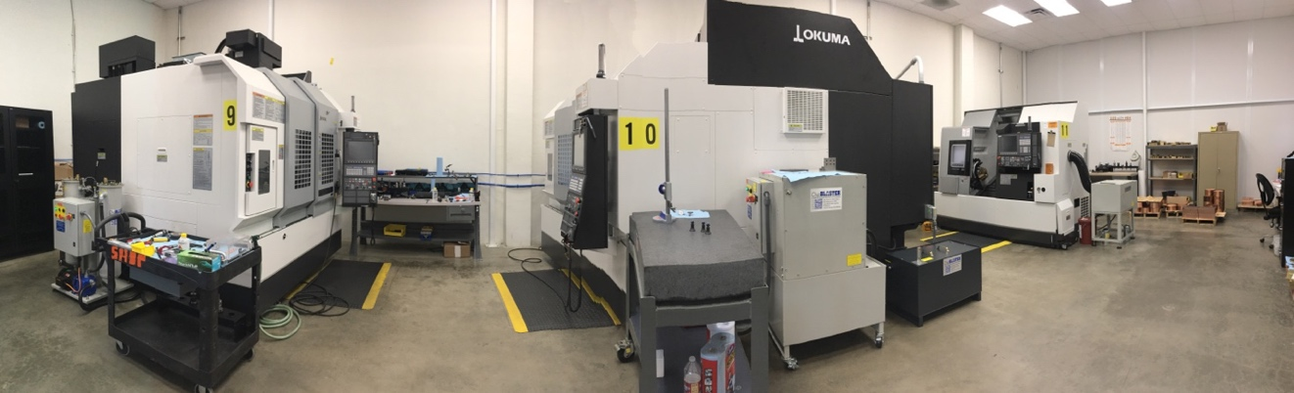
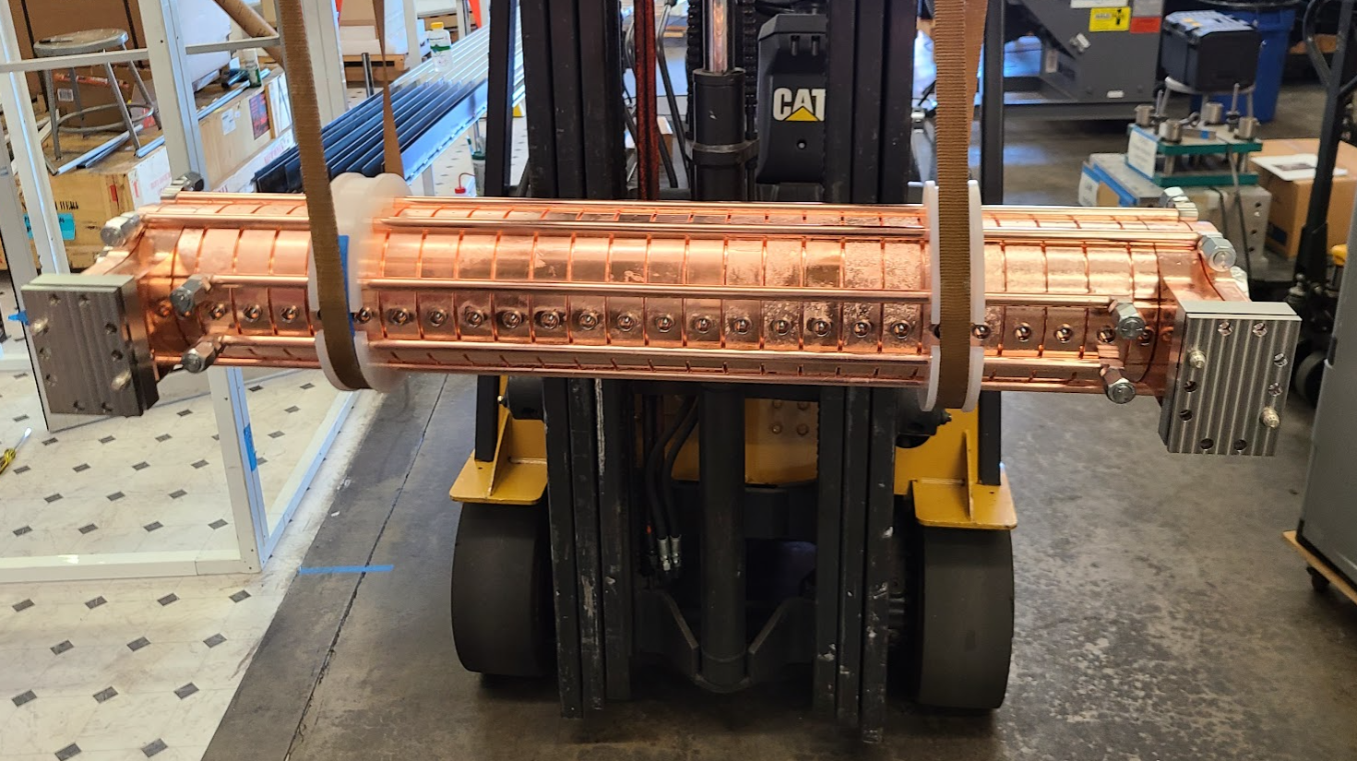
RadiaBeam: Brightness, Applied
Spin-out of UCLA Physics Department: 2004
Located in Santa Monica, California, 30,000sq.ft facility
Charge particle optics, custom magnets & >MeV X-ray systems
Sim, design, fab and testing of high-power RF structures
Custom instrumentation with vac-compatible manufacturing
Cryogenic engineering
9MeV Radiography/CT services
Brazed linac
‘Dry’ cryostat
High power pulsed lasers
9MeV CT Linac
Turn-key accelerator
High power magnets
Pure AM copper: ebeam
White room manufacturing of copper

Slide 3
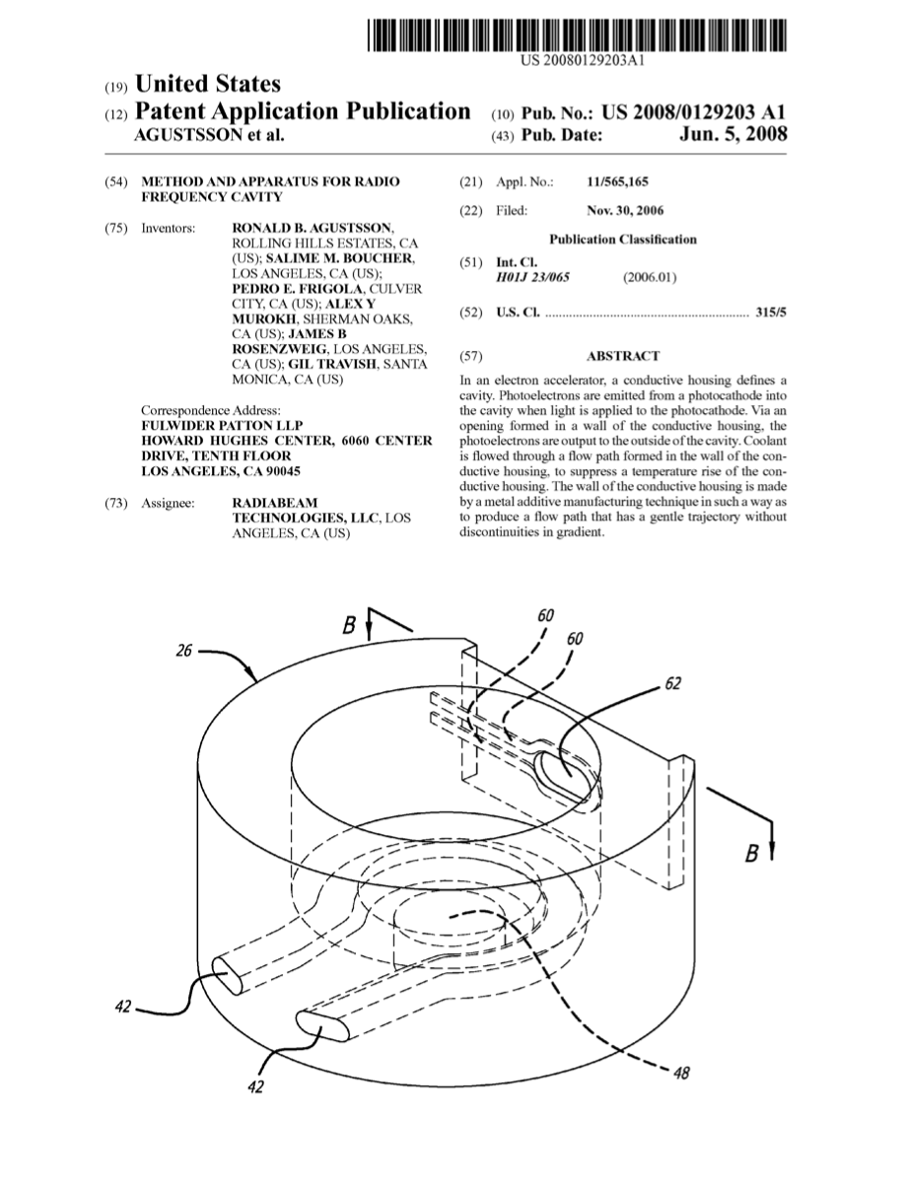
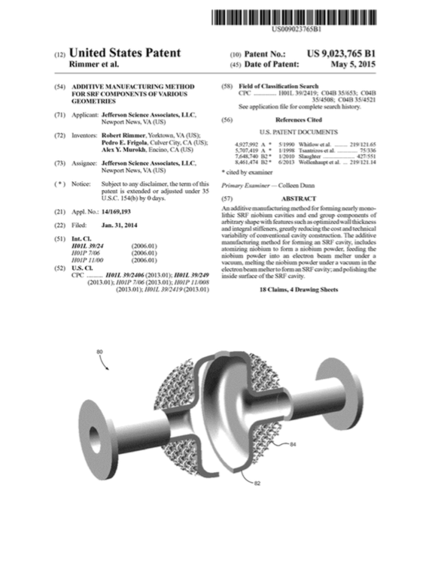
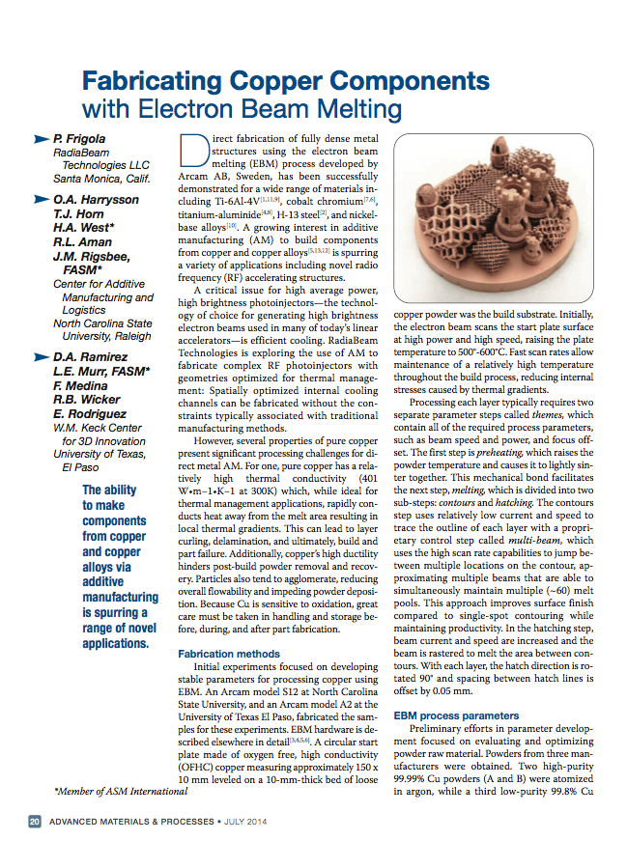
AM Specific Research at Radiabeam
Government funded directed research, as well as Internal R&D funded
NCRF accelerators using AM (2006 – present)
US Patent 7,411,361: “Method and Apparatus for Radio Frequency Cavity”
SRF accelerators using AM (2009 – present)
US Patent 9,023,765: “Additive Manufacturing Method for SRF Components of Various Geometries”
Collaborations with NCSU, UTEP, SLAC, JLab, LANL, ORNL, FNAL, ANL.
Developed accelerator designs exploiting AM
Developed Arcam EBM process parameters for pure copper and niobium
Developed hardware upgrades for EBAM platforms

Slide 4
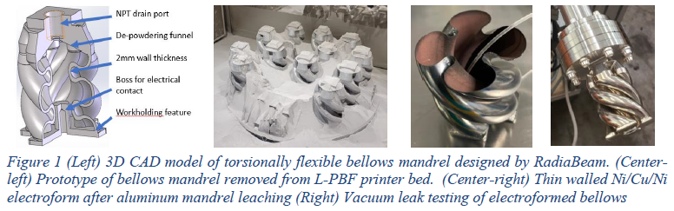
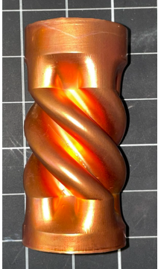
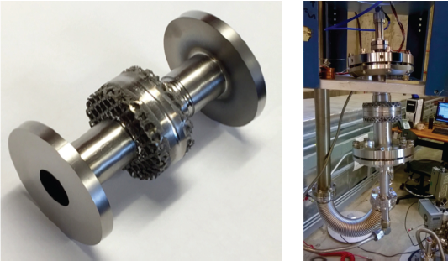
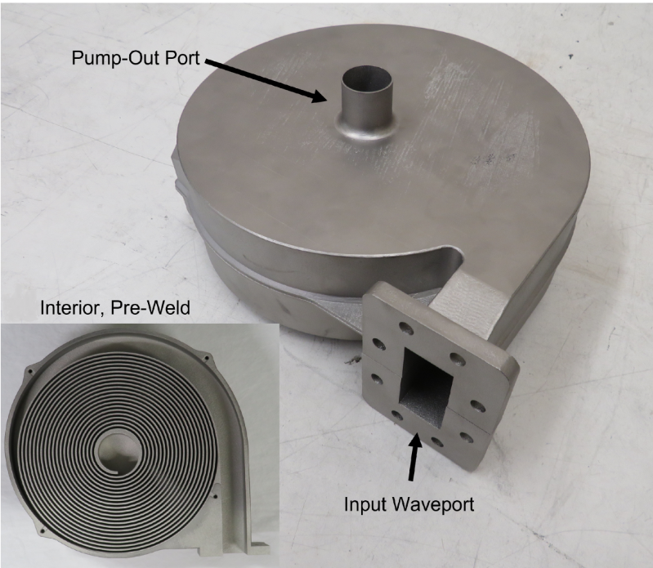
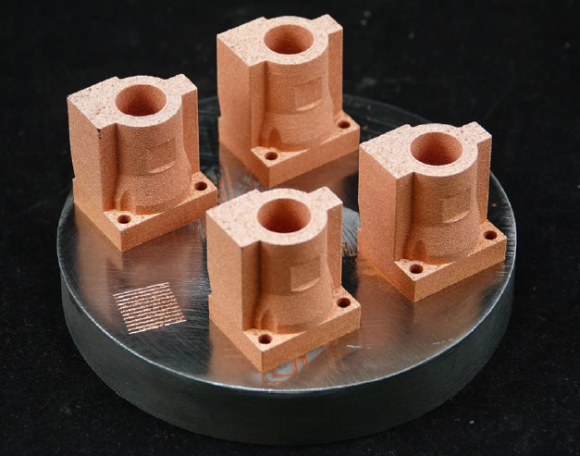
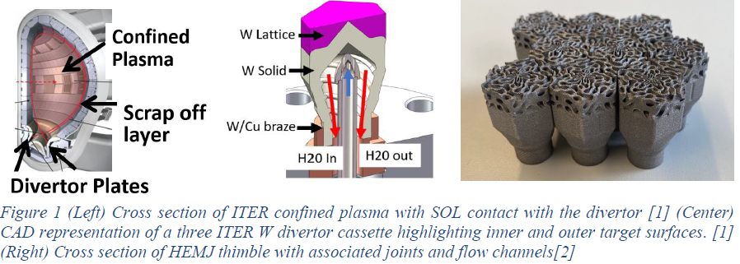
Past & Current Projects in AM (collaboration work University and Industry partners)
Advanced Manufacturing of Torsionally Flexible Vacuum Bellows (AlSi10Mg-L-PBF), (Pure Cu plated)
Collaborators: ANL, Wagner Machine Inc, Servometer
3.8GHz Nb Cavity (Pure Nb Eb-PBF) Jlab Collaborators: Jlab, NCSU
Nuclear Fusion HEMJ style thimbles (Pure Tungsten-L-PBF)
Collaborators: NCSU, UCSD
C-band spiral load (316L SS -L-PBF)
Collaborators: SLAC, Xometry
6GHz (Pure copper -L-PBF green laser)
Collaborators: TRUMPF

Slide 5
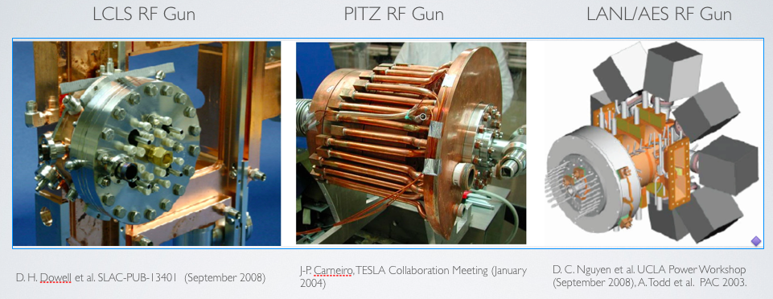
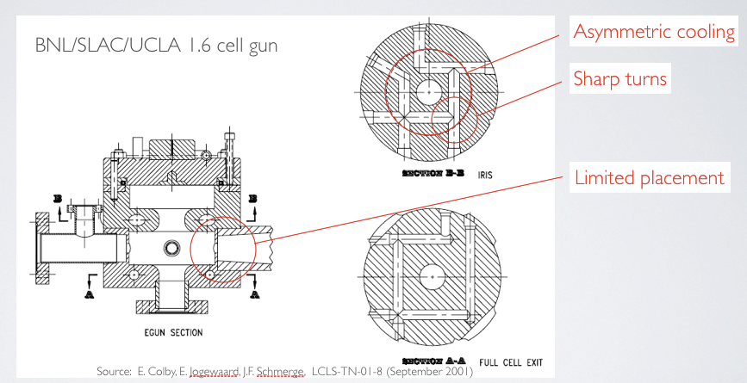
Challenges of Conventional NCRF Fabrication
Complex Assemblies: NCRF cavities today often built from ~20+ brazed parts → labor-intensive, alignment errors, vacuum-leak risk.
Limited Cooling Channels: Straight drilled channels restrict heat removal and design flexibility.
Thermal and Quality Issues: Machining constraints lead to poor surface quality; brazed joints cause leaks and distortion. Soft copper post braze leads to higher breakdowns
Long Lead Times & Cost: ~6-month development cycle; expensive tooling; few design iterations.

Slide 6
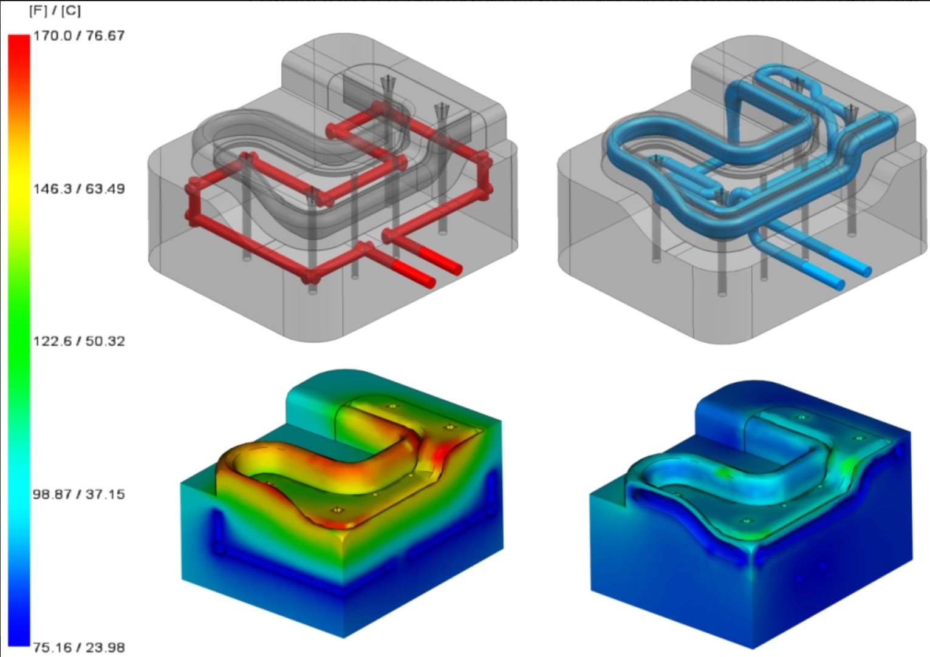
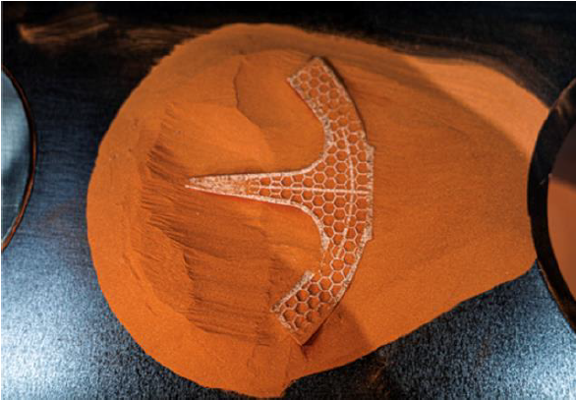
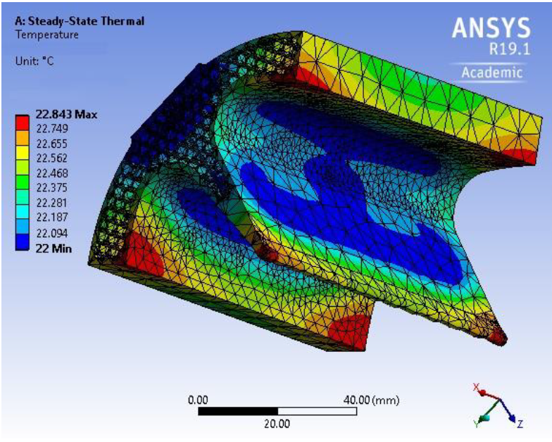
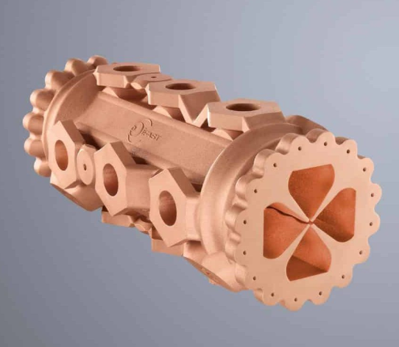
Why Additive Manufacturing? - Performance Advantages
Design Freedom: Integrate conformal cooling and complex internal geometries; leverage topology optimization.
Thermal Performance: Achieve ~20% lower peak operating temperature and 15–25% higher accelerating gradient (due to better cooling).
Rapid Development: Prototype in ~3 weeks (design+build) vs. ~6 months conventionally.
Part Consolidation: Reduce ~20+ separate parts into 1 monolithic structure – no brazing.
Economic Impact: faster development at reduced for complex RF components.
Ammendola, R., et al. “Thermal Losses in Couplers and Ports of a SPS Double‑Quarter‑Wave Cavity.” Proceedings of SRF2015, Whistler, BC, 2015, paper THPB052. Figures 4–5 illustrate the cooling-channel CAD design and temperature distribution .
CERN. 3D-Printed Copper Demonstrator for RF Applications — iFAST Project, European Union Horizon 2020 Framework, 2023. Image showing copper AM part in powder bed

Slide 7
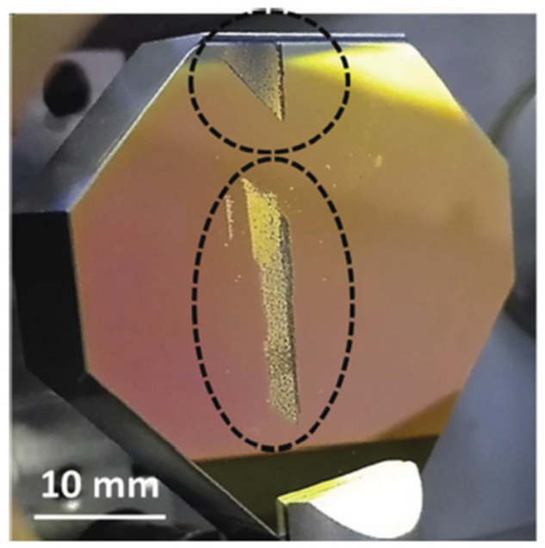
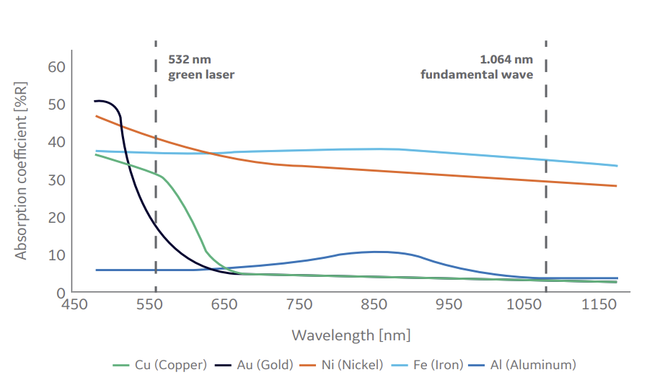
Material & Process Challenges (Copper)
High Reflectivity: Cu reflects ~95% of IR laser light; special lasers (green) or e-beams needed.
High Conductivity: 401 W/m·K – heat conducts away rapidly, leading to unstable melt pools and tight process windows.
Narrow Parameters: Must finely balance beam power, speed, layer thickness to avoid layer curling, delamination, keyholing.
Oxidation: Copper oxidizes easily at high T; requires vacuum or inert gas. Powder life is limited (~3–5 builds before oxygen pickup).
Cost/Equipment: Specialized machines ($0.5–2M for Cu-capable systems). Cu powder ~$50–100/kg (5–10× bulk copper). Fewer suppliers – quality control is critical.
Li, Xiaolong, et al. "A Review on Additive Manufacturing of Pure Copper." Materials, vol. 13, no. 1, 2020, p. 6. MDPI, https://doi.org/10.3390/ma13010006.

Slide 8
Technology Solutions - Three Pathways to Success
Electron Beam Melting (EB-PBF): 99.9% density, vacuum environment, high power (3kW+)
Green Laser Technology (515nm) (L-PBF): 7x higher absorption, 99.8% density, 97% IACS
Hybrid AM + Polishing + Electroplating: Cost-effective, superior surface finish, 102% IACS
Technology Maturity: EB-PBF (mature), Green Laser (emerging), Plating (production-ready)
EB-PBF (Electron beam-powder based fusion
L-PBF (Laser-powder based fusion)
Technology | Density | Conductivity (IACS) | Surface Finish | Strengths & Limits
EB-PBF | ~99.9% | Near bulk Cu | Rough (poor finish) | Vacuum needed; roughness & porosity need mitigation
Green‑Laser PBF (515 nm) | ~99.8% | ~97–100% | Moderate–Good | Solves IR absorption issues; new but promising
Hybrid AM + Electroplating | Base part density + coating | 100% | Excellent (mirror-like) | Best surface & conductivity; adds processing steps

Slide 9
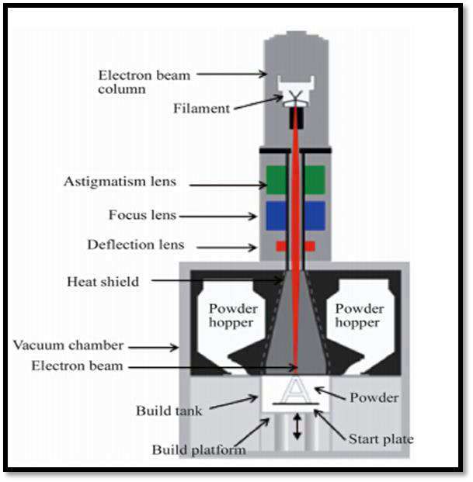
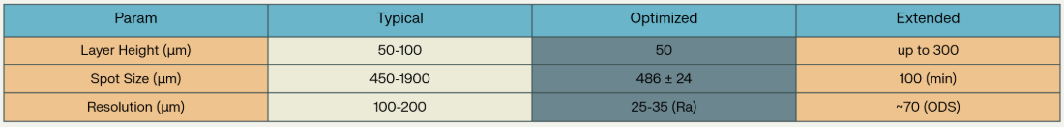
Electron-Beam AM of Copper (EB-PBF)
Mature Pathway: (achieves ~99.9% density).
Key Parameters:
~60 kV acceleration voltage
3–4 kW beam power
build chamber ~10⁻⁴ mbar.
Performance: Tensile ~250 MPa; electrical conductivity ≈102% IACS (with post-anneal).
Features: average resolution surface finish ~30 μm Ra. Columnar <110> grains (HIP can refine to equiaxed).
Commercial Systems: ARCAM, Freemelt AB

Slide 10
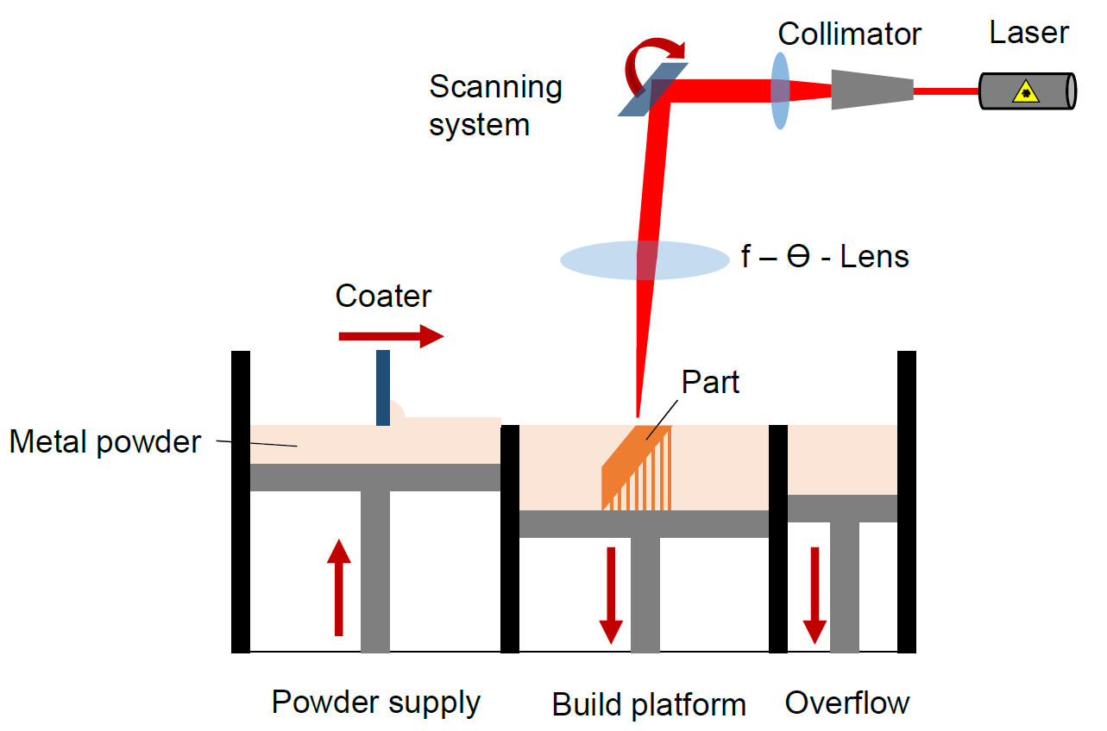
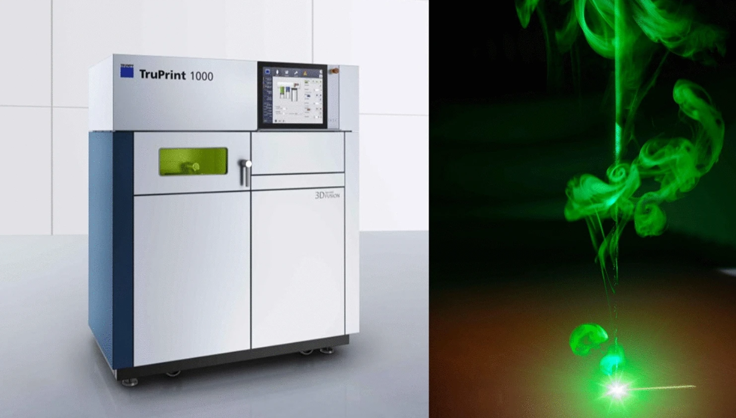
Green-Laser L-PBF
Green Laser Advantage: 515 nm wavelength – copper absorption ~35% (vs only 5% at 1064 nm).
Build Metrics (Green L-PBF): ~99.8% density; ~97% IACS conductivity; surface finish ~3–4 μm Ra.
Equipment: Emerging commercial systems (e.g. TRUMPF TruPrint 5000 Green, EOS M290 1kW).
Parameter | Typical Range | Optimized Range | Extended Range
Layer Height (μm) | 20 - 50 | 30 - 40 | Up to 100
Spot Size (μm) | 150 - 200 | 200 (TruPrint 1000) | 35 - 100 (adjustable)
Resolution (Ra, μm) | 20 - 35 | 10 - 20 | ~10

Slide 11
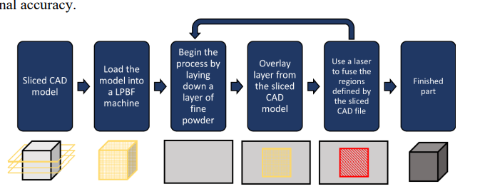
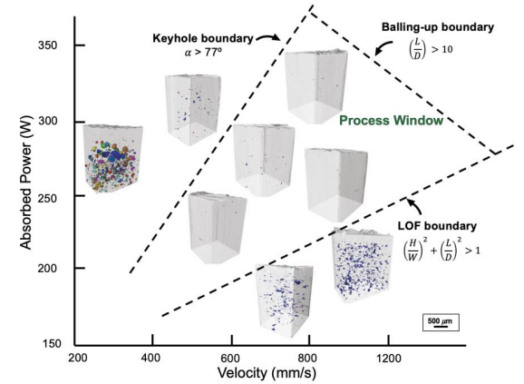
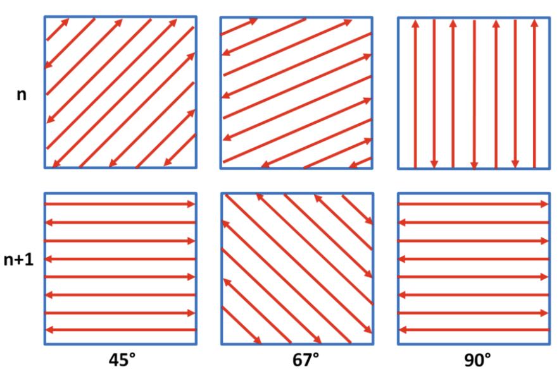
Powder bed based AM workflow
Key Parameters for printing
Particle Size (ex: 15-45um)
Layer height (20-150um)
Line-off set (half of spot size)
Scan speed
Process workflow
Process Mapping
Wang, Wenjia, Jinqiang Ning, and Steven Y. Liang. “Analytical Prediction of Balling, Lack‑of‑Fusion and Keyholing Thresholds in Powder Bed Fusion.” Applied Sciences, vol. 11, no. 24, 2021, article 12053. Figures illustrate exactly the LOF, keyhole, and balling boundaries in power‑speed space.
Layer specific process steps
Hatching & contouring

Slide 12
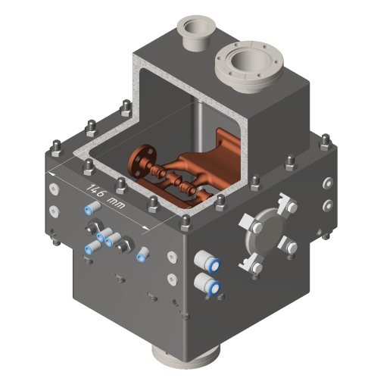
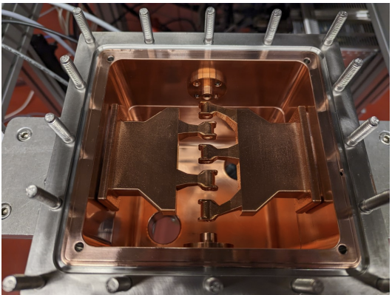
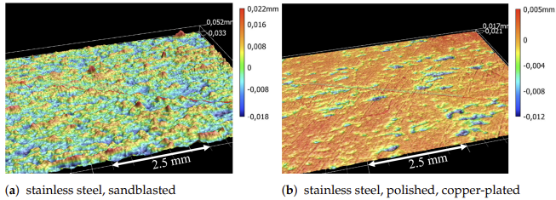

Hybrid AM + Plating
Hybrid AM+Plating: AM substrate (possibly printed in Al, SS, Nb base metal) then copper electroplated. Achieves 102% IACS (annealed copper), with <1 μm Ra finish.
Process Steps: Pre-treat surface (etch/activate), apply strike layer (1–2 μm Cu), then thick Cu plating (50–200 μm) via pulse-reverse electroplating or DC electroplating
IH-Type Linac Structure from Stainless Steel and Pure Copper
Hähnel, H., A. Ateş, B. Dedić, and U. Ratzinger. "Additive Manufacturing of an IH-Type Linac Structure from Stainless Steel and Pure Copper." Instruments, vol. 7, no. 3, 2023, p. 22. MDPI, https://doi.org/10.3390/instruments7030022.

Slide 13
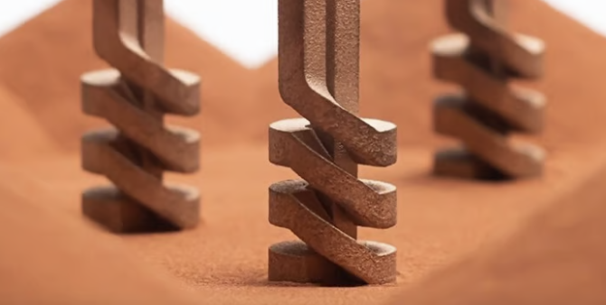
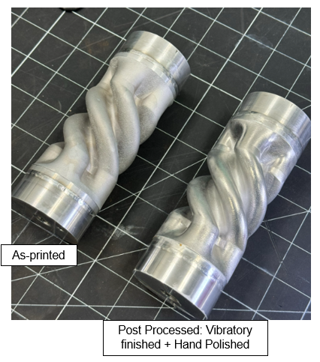
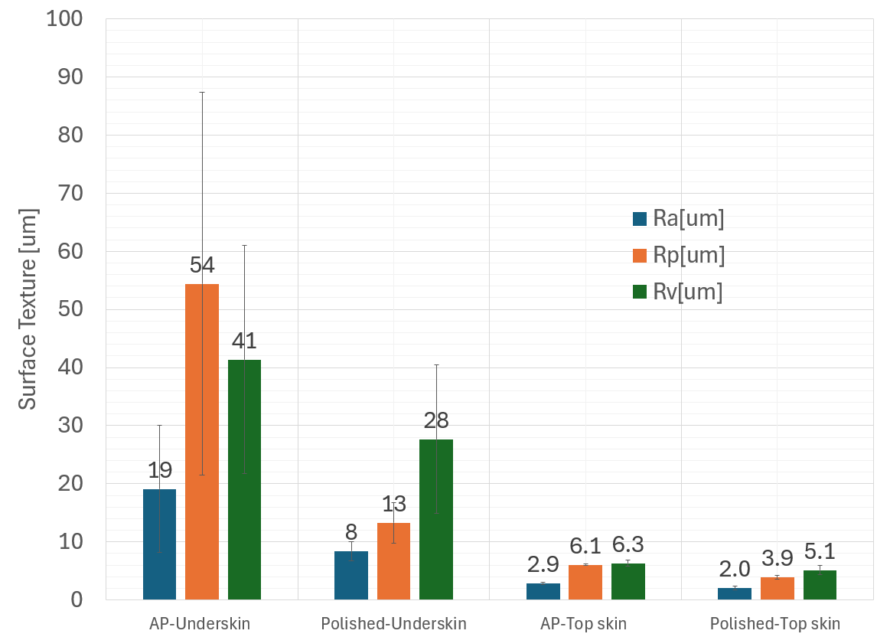
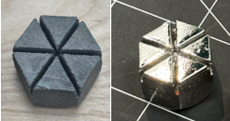
Post-Processing & Microstructure Engineering
Finishing:
Powder removal
Precision machining / abrasive flow to Ra ≤ 5 µm.
Electropolishing or chemical polishing to Ra ≤ 1 µm for RF surfaces; electropolishing at 18–20 A dm⁻² in H₃PO₄/n-butanol electrolyte gives < 60 nm RMS roughness.
If plating is required (e.g., Nb or Au overlay), pre-plate roughness should be < 0.8 µm to avoid field-emission hot-spots.
EP’d for 70um removal
(bright shinny appearance)
Radiabeam

Slide 14
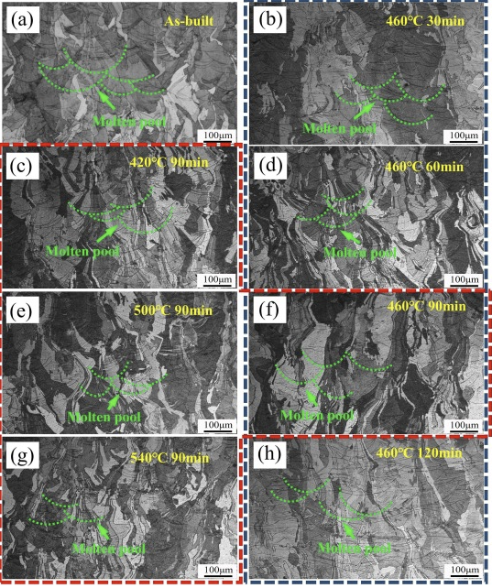
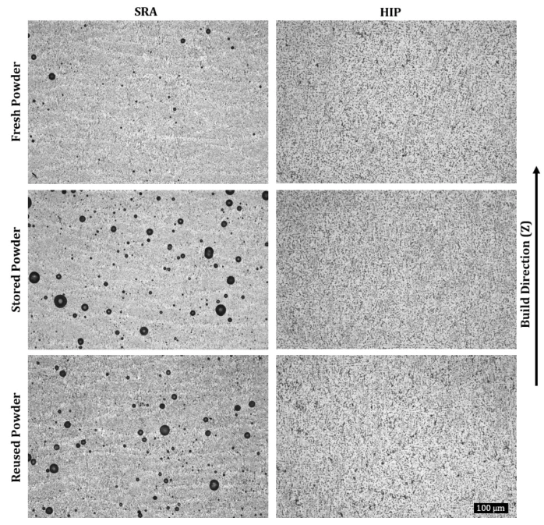
Post-Processing & Microstructure Engineering
Heat Treatments:
300–400°C stress-relief (reduce residual stress)
650°C anneal (recrystallize, refine grains)
950°C/100 MPa HIP (eliminate porosity).
Wu, Xiaoli, et al. "Effect of Heat Treatment on the Microstructure and Mechanical Properties of CuCrZr Alloy Fabricated by Selective Laser Melting." Journal of Alloys and Compounds, vol. 875, 2021, 159889. Elsevier, https://doi.org/10.1016/j.jallcom.2021.159889.
Wang, Ping, et al. "Additive Manufacturing of Copper and Copper Alloys: Processing Techniques and Material Properties." Metallurgical and Materials Transactions B, vol. 49, no. 6, 2018, pp. 3230–3250. Springer, https://doi.org/10.1007/s13632-018-0456-z.

Slide 15
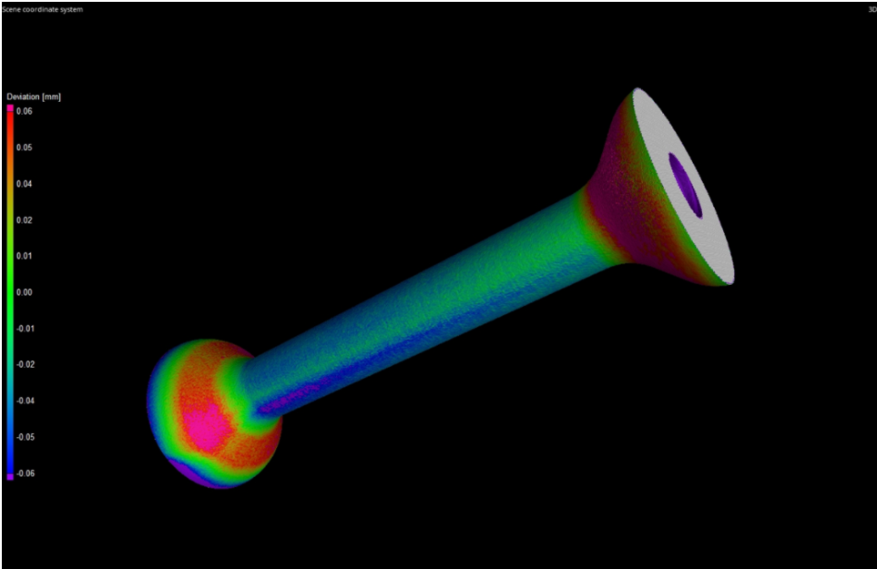
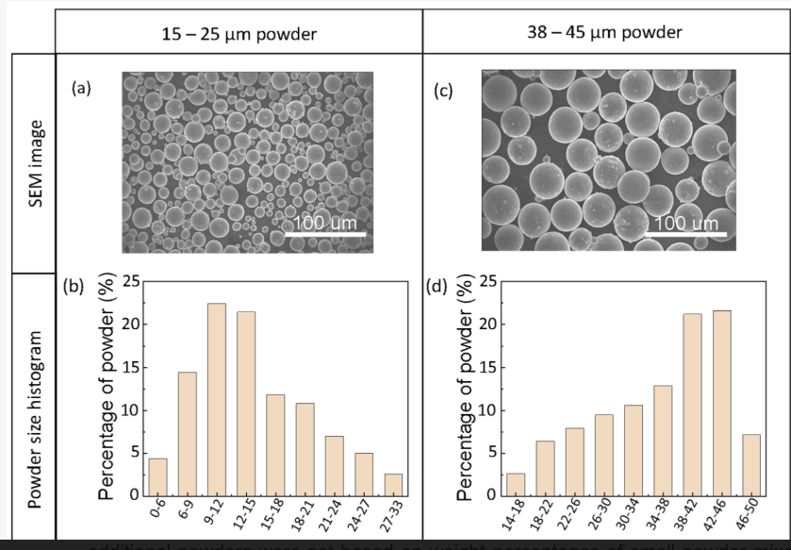
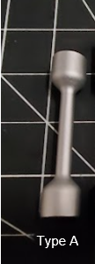
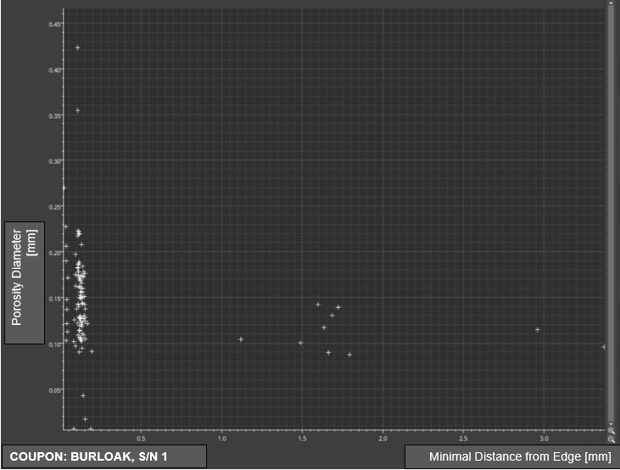
Quality Assurance
Feedstock Qualification:
Powder
Particle size
Particle morphology
Composition
Post Print
Metrology
Destructive testing
Mechanical testing
Shovkoplyas, Iryna Ya., et al. "A Review on Additive Manufacturing of Pure Copper." Materials, vol. 15, no. 3, 2022, p. 705. MDPI, https://doi.org/10.3390/ma15030705.

Slide 16
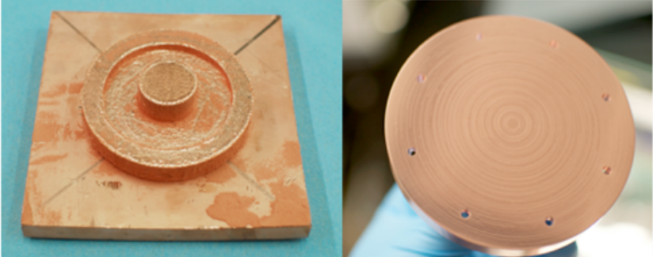
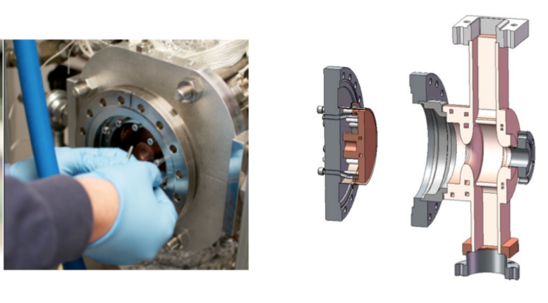
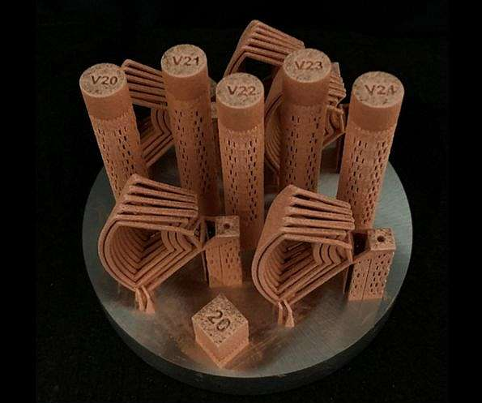



Industrial Adoption
Photo Injector cathode: S-band electron gun cathode with integrated cooling channels
(RadiaBeam prototype).
Synchrotron Absorbers & Magnets: Complex-shaped absorbers and quadrupole elements
(e.g: Diamond Light Source, CERN prototypes).
Space Accelerators: Compact, lightweight accel. modules
(ESA CubeSat and NASA deep-space projects are pursuing AM designs).
Heat Exchangers & Power Devices: High-power RF couplers, gyrotrons, and rocket engine cooling manifolds (conformal microchannels).
Emerging Fields: Electric propulsion, fusion RF structures – anywhere high thermal demands and rapid prototyping are needed.
"EBM Photocathode RF Test." AM Research at RadiaBeam - AM VED Workshop, 31 Jan. 2020.
Morrone, Marco, et al. Synchrotron Radiation Absorber Design. TE-VSC, CERN, Presentation
European Space Agency (ESA). "ESA Optimizes 3D Printing for Pure Copper Electromagnetic Coils." ESA Newsroom, General Support Technology Programme (GSTP)
CERN. "Additive Manufacturing of HOM Coupler Prototype Using Niobium." CERN Newsroom, Magnets, Superconductors and Cryogenics group (TE-MSC), 2023. Image Credit: CERN. Accessed 14 July 2025.

Slide 17

Economic Impact & Market
Cost & Time Savings: No tooling or brazing cost; complex parts ~50% cheaper. Development ~70% faster [1].
Performance Edge: Compact, lighter accelerators can reduce facility size & cost.
Market Opportunity: rapid growth in space, medical, defense sectors needing advanced RF components.
Competitive Advantage: With successful R&D of process parameters. Adopters gain ability to deliver novel designs for cost efficient accelerators.
ROI: Investment in AM is paid back via superior product performance and opening new applications.
1. "First 3D Printed IH-Type Linac Structure—Proof-of-Concept for High Gradient Applications." Instruments, vol. 4, no. 1, 2020, p. 7. MDPI.
“SpaceX Optimizes Raptor 3 with DFAM and 3D Printing.” 3Dnatives, 12 Aug. 2024, https://www.3dnatives.com/en/spacex-optimizes-raptor-3-dfam-3d-printing-120820244/amp/. Accessed 16 July 2025.

Slide 18





Case Study CERN-750MHz Radio frequency (RFQ)
Traditional
Iteration-1
Iteration-2
Optimization of the cooling channels
AM RFQ appears leak tight at 1∙10⁻¹⁰ mbar/l/s-1
Post-processing- (18um to 0.65um) Ra
CERN. 3D-Printed Copper Demonstrator for RF Applications — iFAST Project, European Union Horizon 2020 Framework, 2023. Image showing copper AM part in powder bed
Torims, T., et al. "Development of Additively Manufactured 750 MHz RFQ." 32nd Linear Accelerator Conference (LINAC2024), 2024, Chicago, IL, USA. JACoW Publishing, 2024. doi:10.18429/JACoW-LINAC2024-THAA003. https://inspirehep.net/files/ce28c0d1284c283028b07146d9c5a2b6.

Slide 19

Conclusion & Call to Action
Summary: Copper AM for NCRF can lead to big breakthroughs with focused effort on R&D
New Designs
Process parameter
New alloys
Post processing
Microstructural Engineering
Key Benefits: Unmatched design flexibility; higher gradients; superior cooling; much faster & cheaper prototyping.
RadiaBeam’s Role: We offer turnkey design-to-test capability. We invite you to collaborate on next-generation AM RF hardware development.
Ready for questions!

