Slide 1


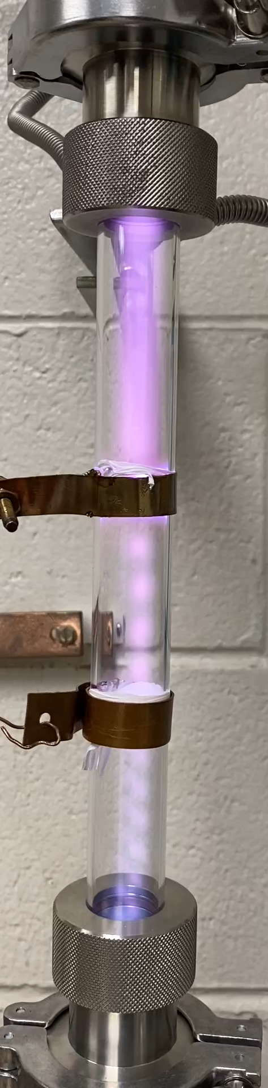
MICHIGAN STATE UNIVERSITY MAP LAB COLLEGE OF ENGINEERING
Surface effects in RF breakdown
Sergey V. Baryshev
Department of Electrical and Computer Engineering,
Chemical Engineering and Materials Science
Michigan State University, MI 48824, USA
Materials for Bright Beams Workshop 2025 – 7/17/2025

Slide 2
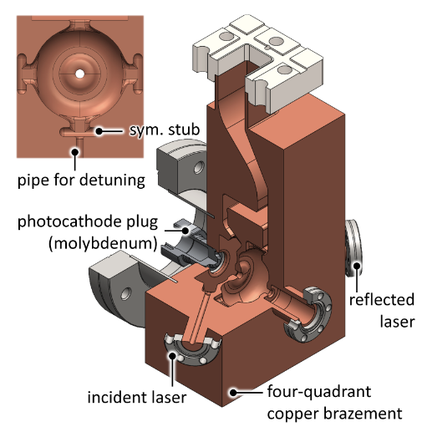

Surface effects in RF breakdown
Acknowledgments
CARIE Project (Cathodes and RF Interactions In Extremes)
Accelerator Science and Engineering Traineeship students:
Ryo Shinohara, Mitch Schneider, Ben Sims and Emily Jevarjian
AOT and T-1, LANL: Evgenia Simakov and Dany Perez
Taha Posos (now at FNAL), Oksana Chubenko (now at NIU), Stas Baturin (now at ITMO University)
High Energy Physics:
ASET – Cooperative Agreement DE-SC 0018362
Award No. DE-SC 0020429

Slide 3
Surface effects in RF breakdown
Outline
Part 1. Vacuum breakdown – it is nice to meet you
Part 2. Metals and semiconductors are different
Part 3. Current saturation: space charge time vs tunneling time vs transit time
Part 4. Semiconductor in high field
Part 5. Conclusions and outlook

Slide 4
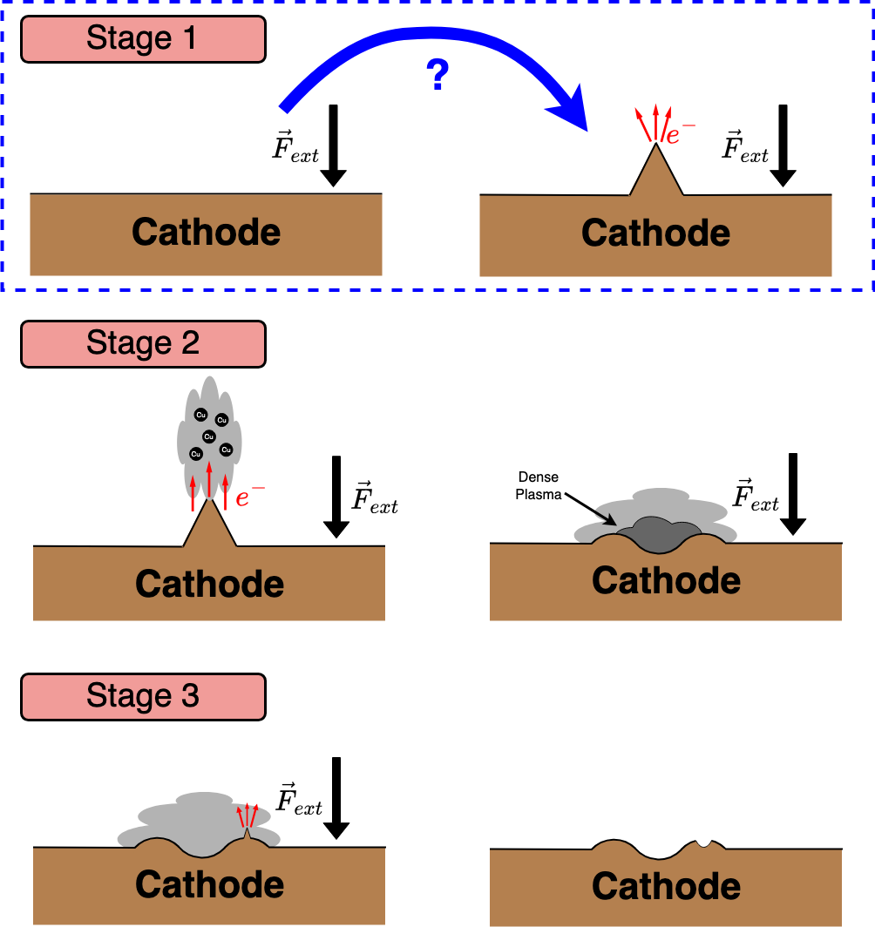
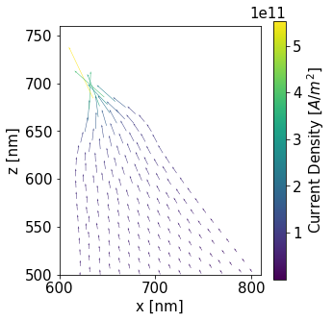
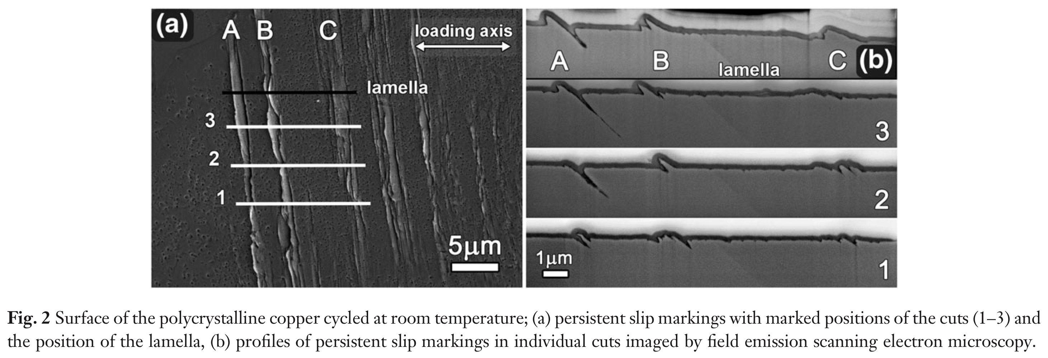
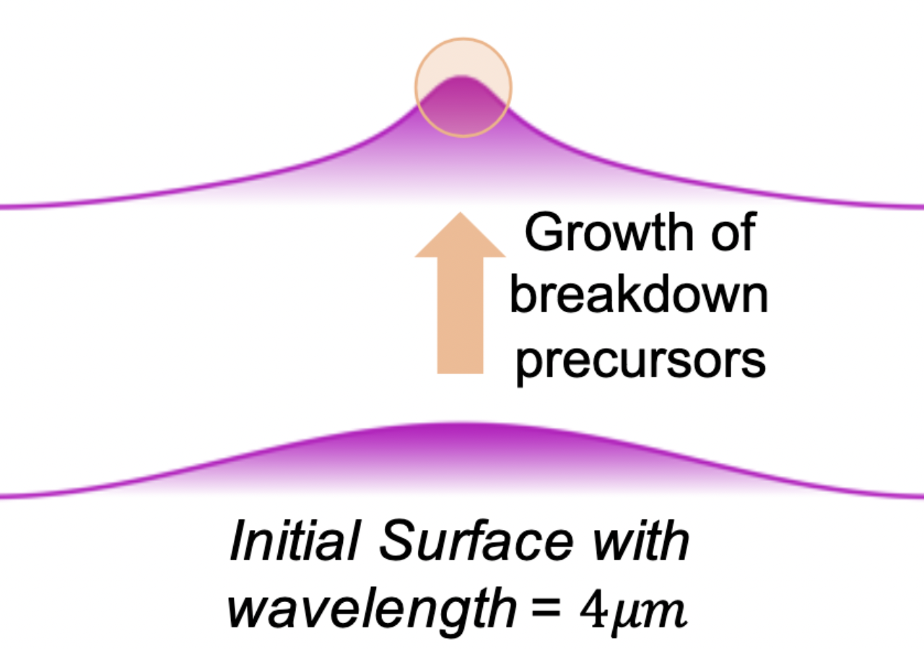
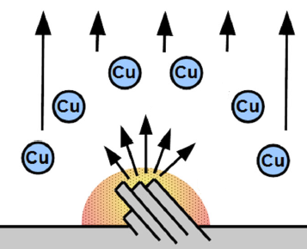
Part 1 -- Vacuum breakdown
RF Breakdown Mechanics
Step-wise view of breakdown
Sharp emitter formation scenarios

Slide 5
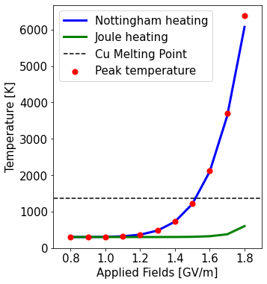
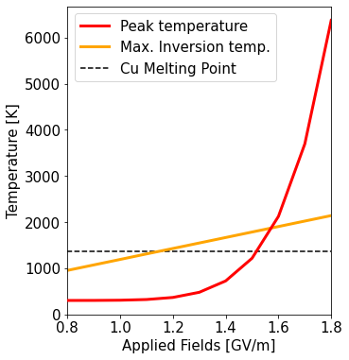
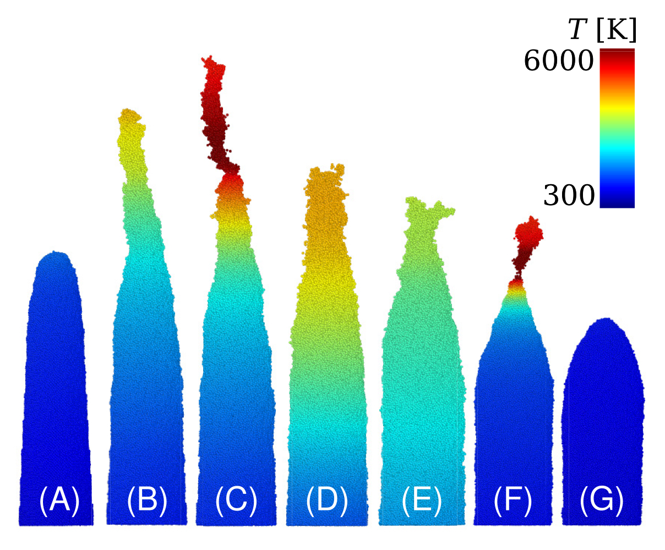
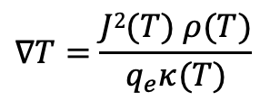
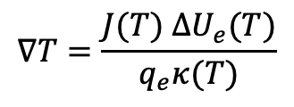
Part 1 -- Vacuum breakdown
Thermal Runaway
Major heating effects
Copper evaporation
$$∇T=\frac{J(T) ∆U_{e}(T)}{q_{e}κ(T)}$$
$$∇T=\frac{J2(T) ρ(T)}{q_{e}κ(T)}$$
J. Phys. D: Appl. Phys. 51 225203 (2018)

Slide 6
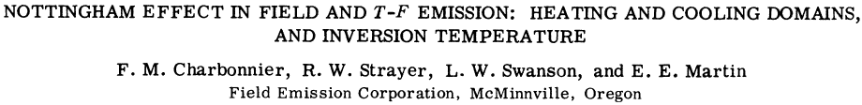

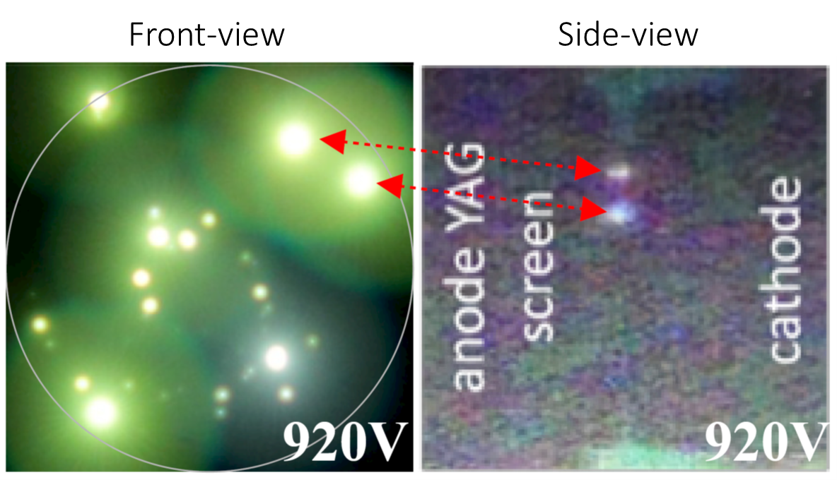
Part 1 -- Vacuum breakdown
Nottingham Heating
CNT: stable 2,000 K (m_{eff}~1/2m₀)
NCD: runaway 4,500 K (m_{eff}~1/18m₀)
Baturin et al, J. Phys. D: Appl. Phys. 52, 325301 (2019)

Slide 7
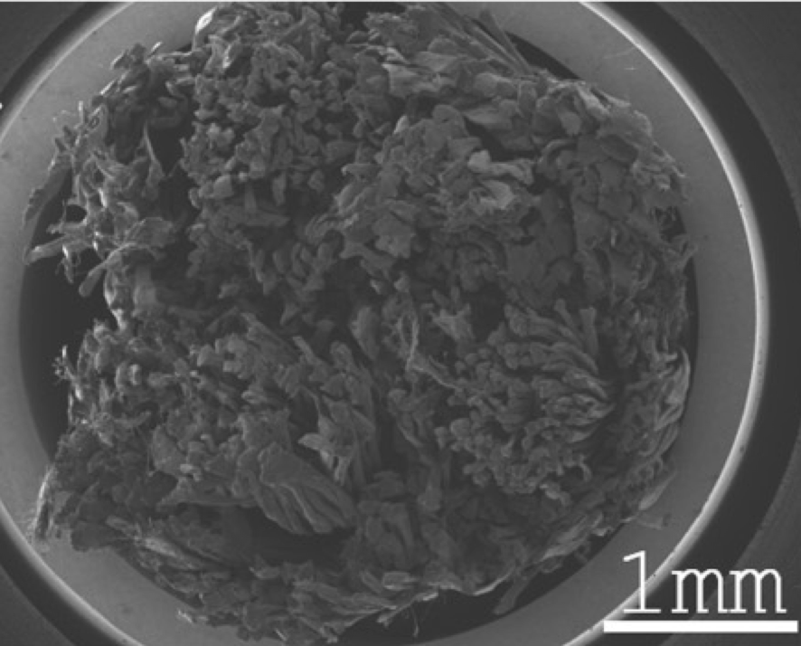
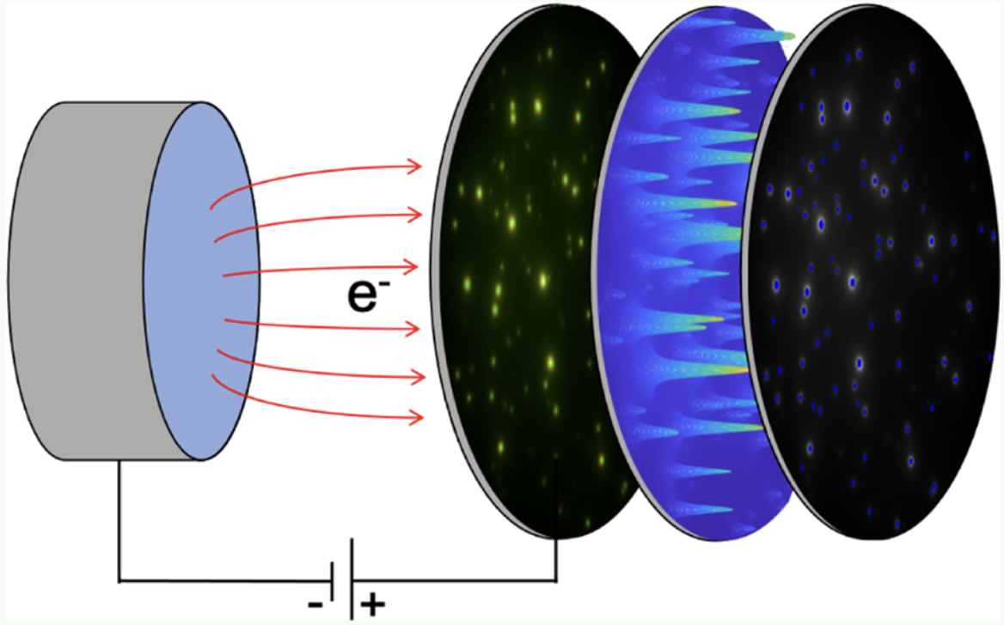
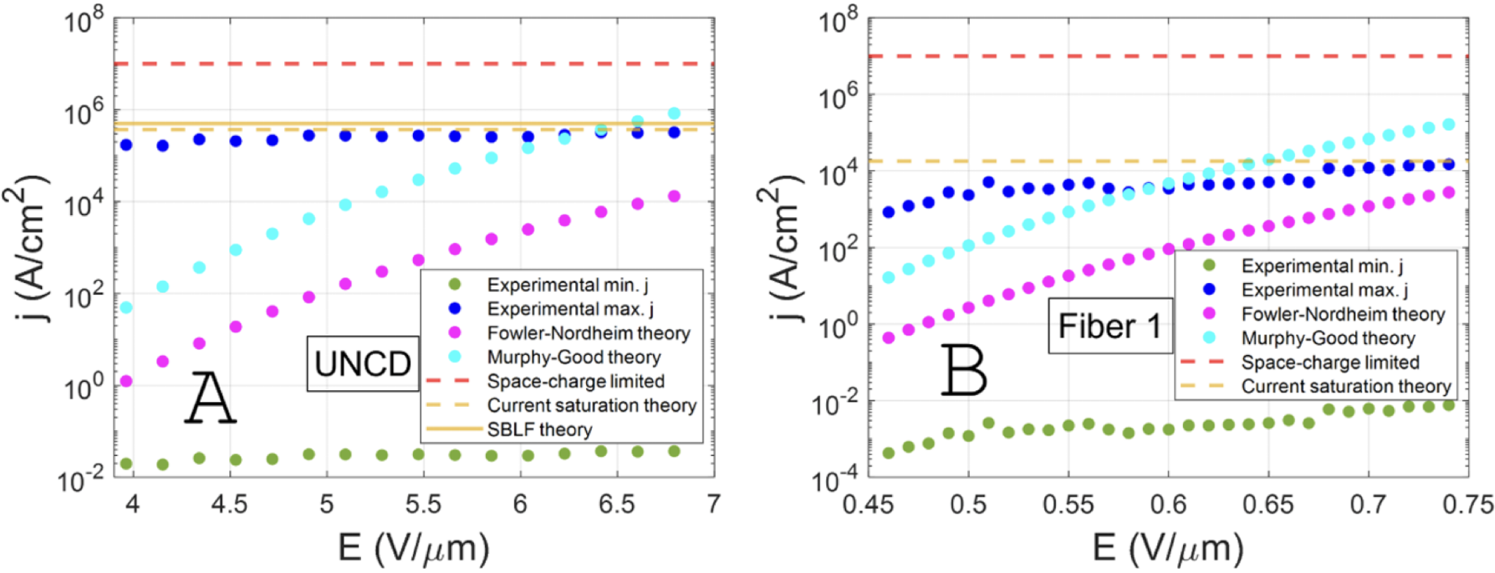
Part 2 -- Metals vs. semiconductors
More Insight from Nanodiamond and CNT
nanodiamond CNT fiber
Emission area measured
Posos et al, ACS Appl. Electron. Mater. 3, 4990 (2021)
j<<10⁷ A/cm²
j<<10⁷ A/cm²

Slide 8
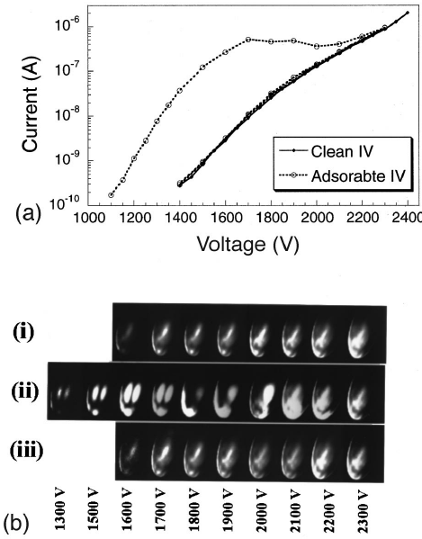
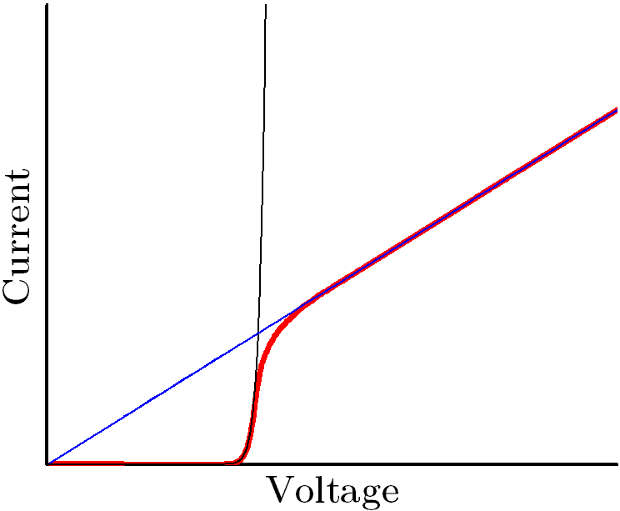
Part 2 -- Metals vs. semiconductors
Possible Saturation Effects
Limiting resistor
Vacuum space charge
Foreign molecules
work function 𝜙 effect
??? physical nature of
the limiting resistor ???
Barbour et al, Phys. Rev. 92, 45 (1953)
Dean and Chalamala, APL 76, 375 (2000)
Luginsland et al, APL 69, 2770 (1996)

Slide 9
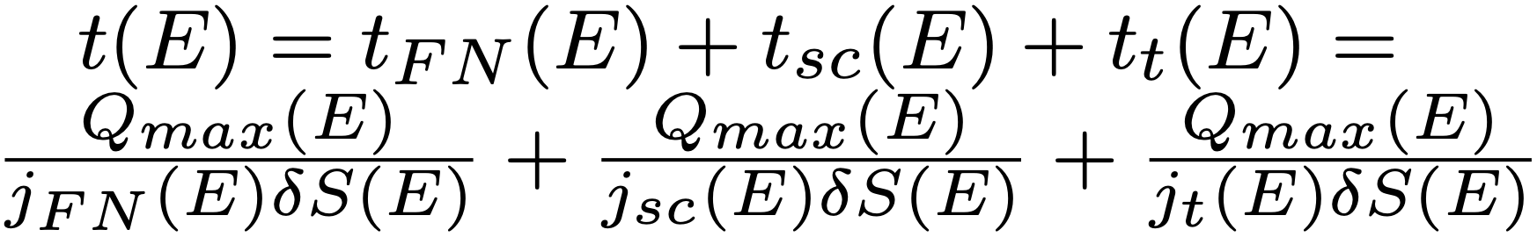
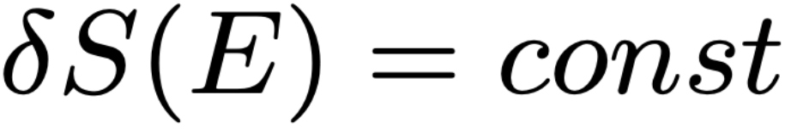
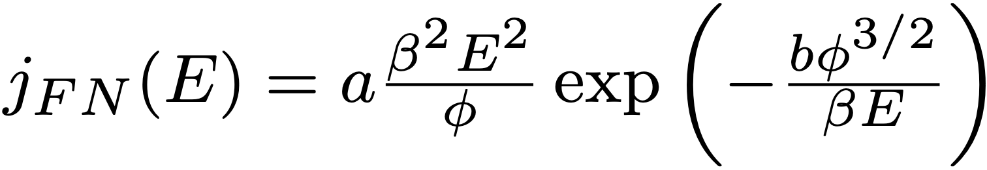
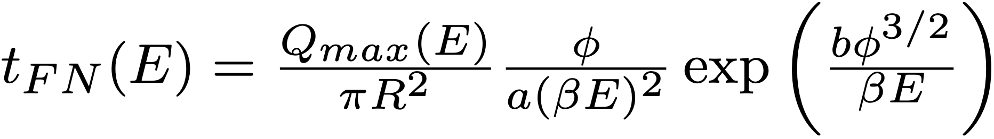
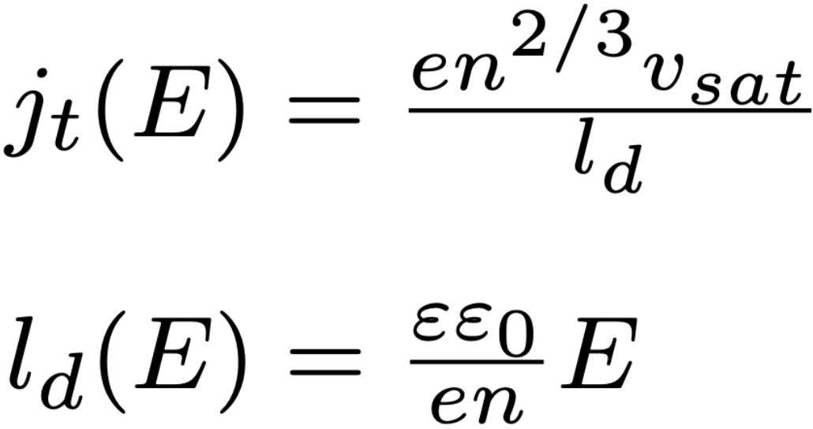
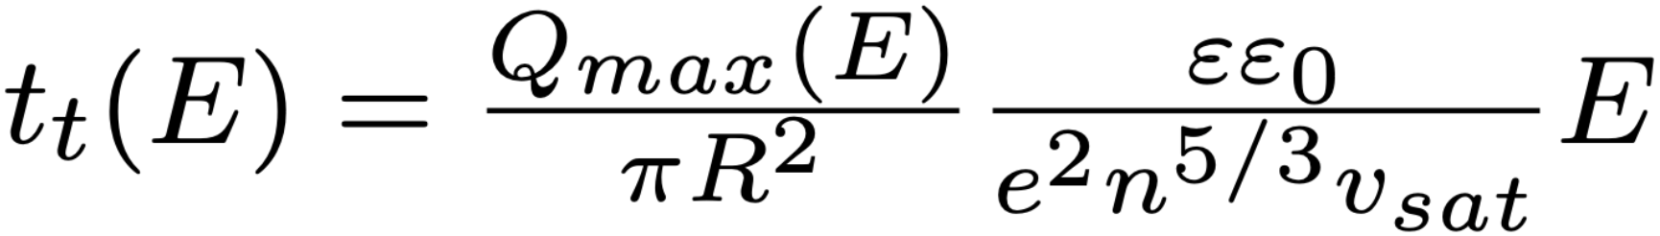
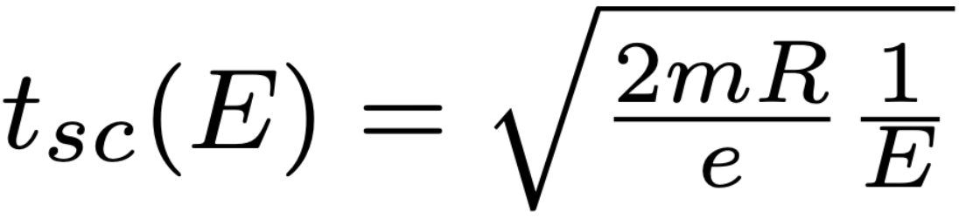
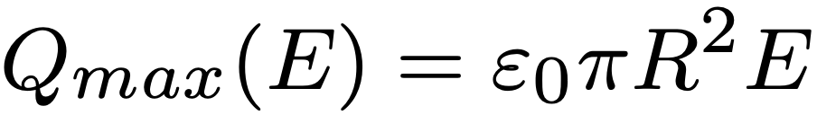
Part 3 -- Current saturation: space charge time vs tunneling time vs transit time
Model Formulation
Filippetto et al, Phys. Rev. Accel. Beams 17, 024201 (2014)

Slide 10
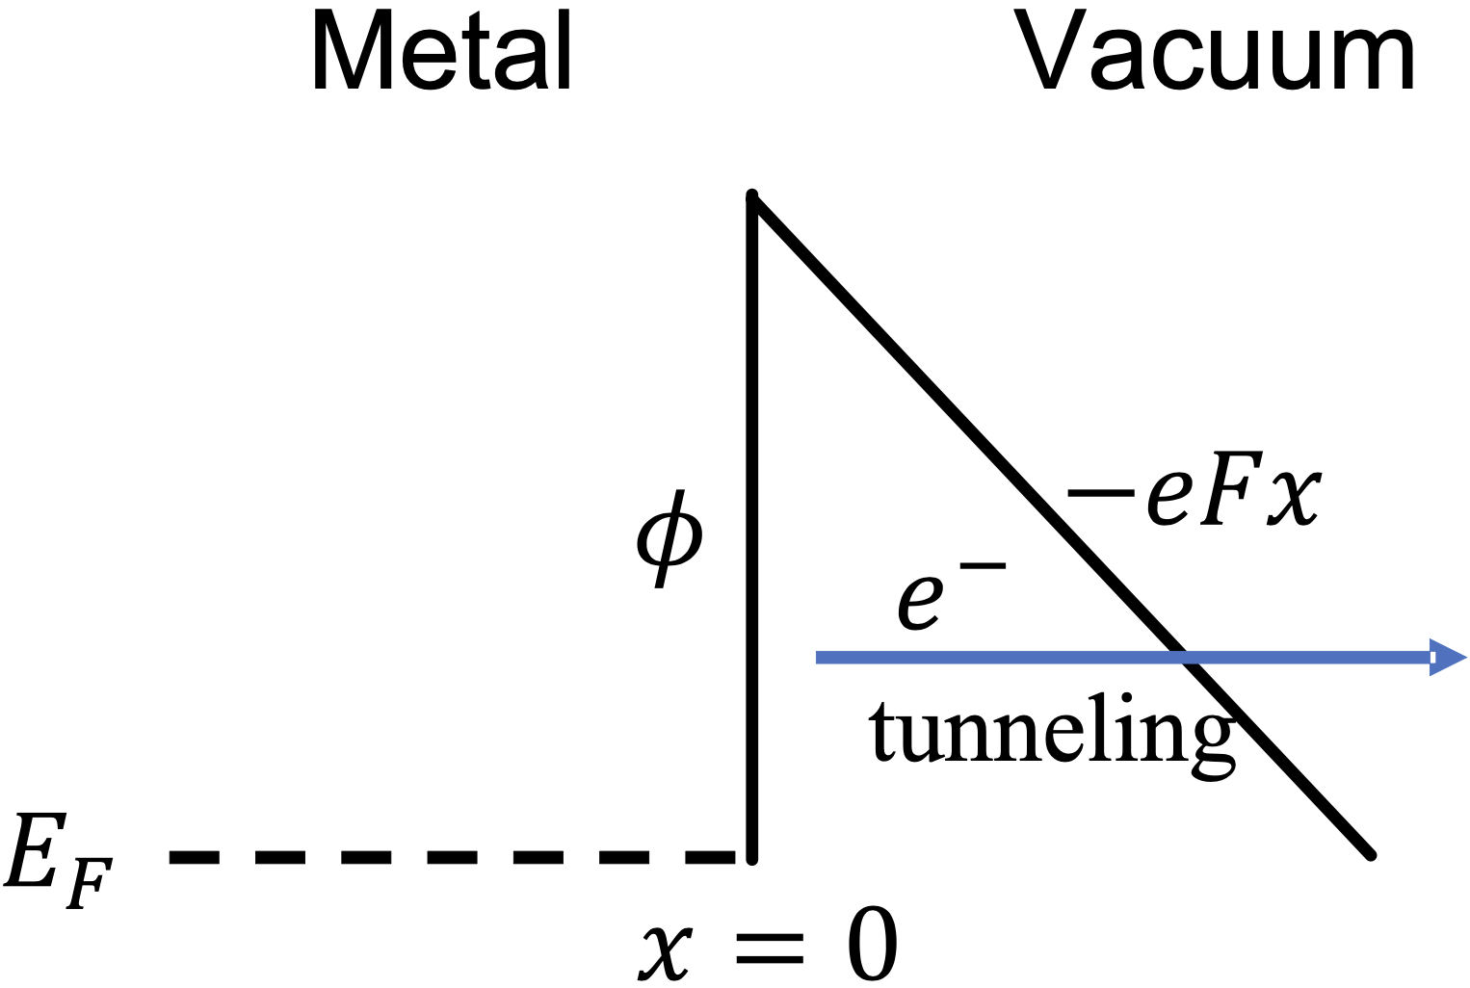
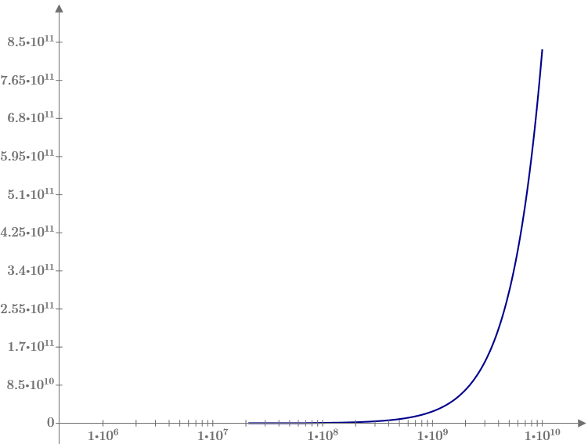
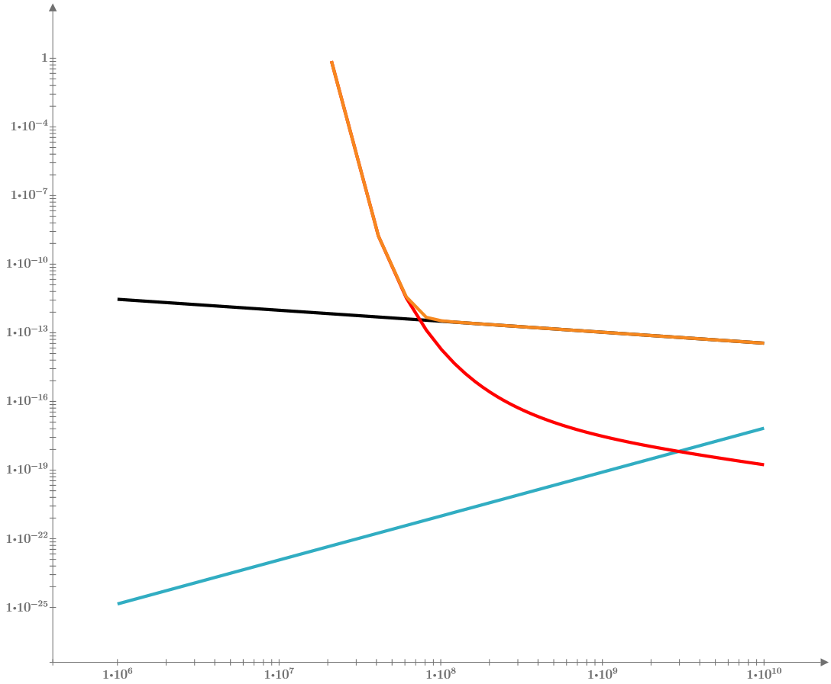
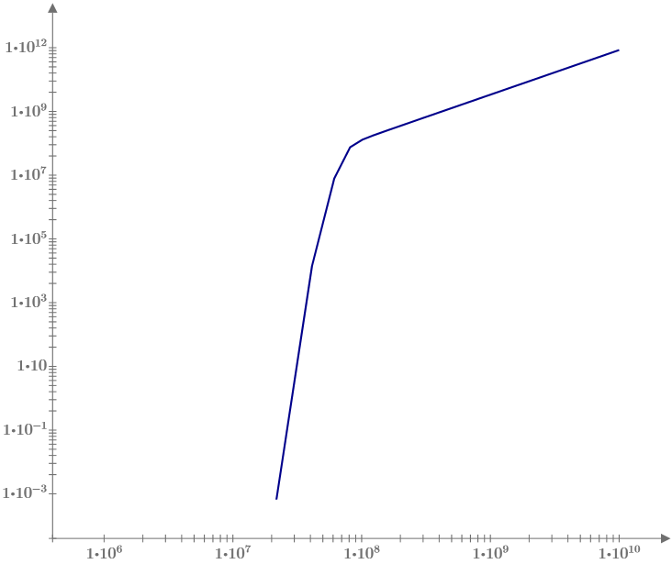
Part 3 -- Current saturation: space charge time vs tunneling time vs transit time
Metal Case Study: high 𝜙 (5 eV)
β=100
n=10²⁹ m⁻³
R=10 µm
j(E) (A/m²)
t_{sc}
t(E) (s)
t_{FN}
t_{t}
log(j(E))
E (V/m)
E (V/m)

Slide 11

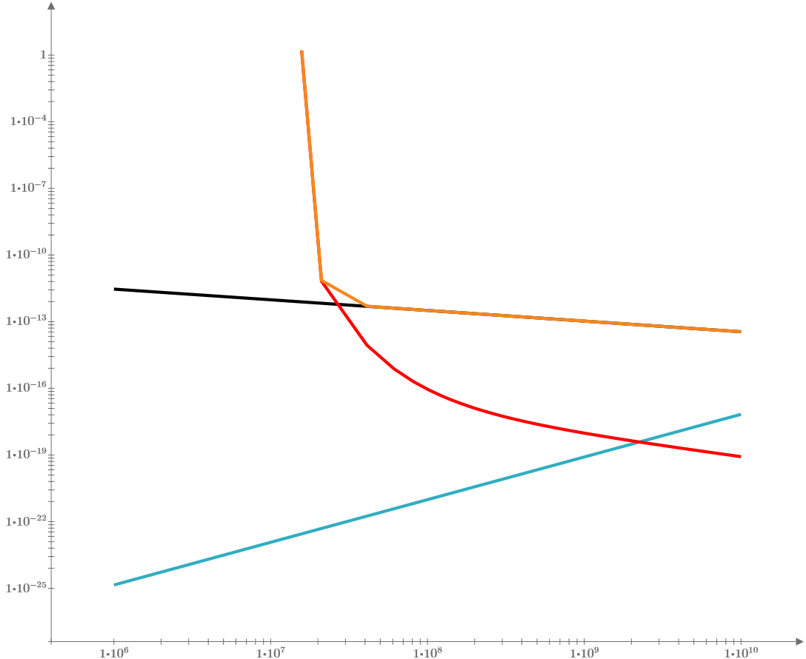
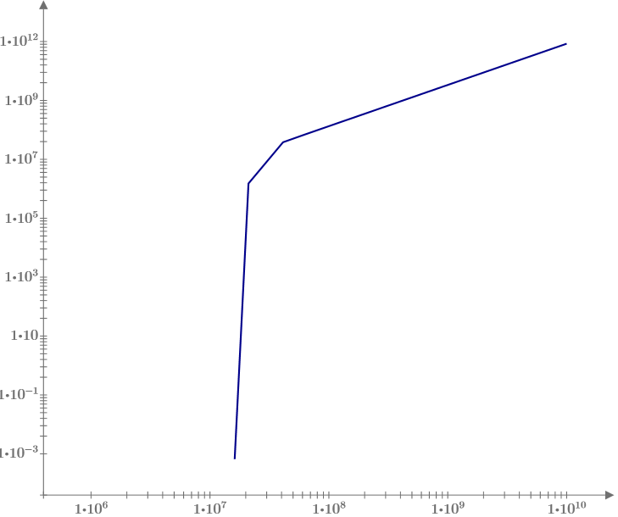
Part 3 -- Current saturation: space charge time vs tunneling time vs transit time
Metal Case Study: low 𝜙 (2.5 eV)
β=100
n=10²⁹ m⁻³
R=10 µm
j(E) (A/m²)
t_{sc}
t(E) (s)
t_{FN}
t_{t}
log(j(E))
E (V/m)
E (V/m)

Slide 12
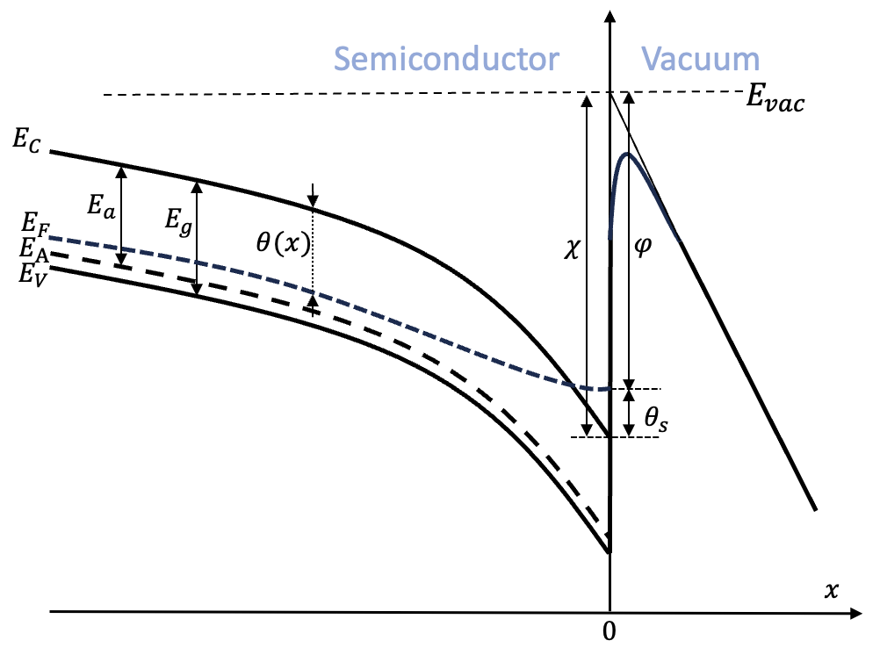
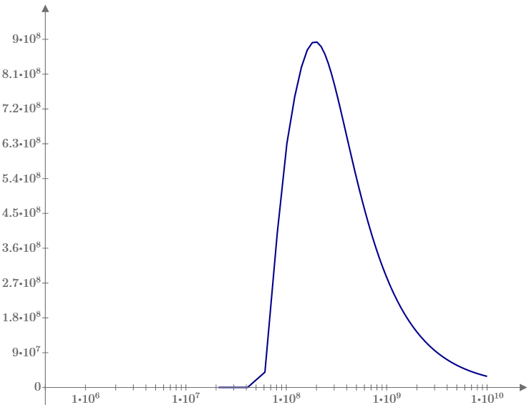
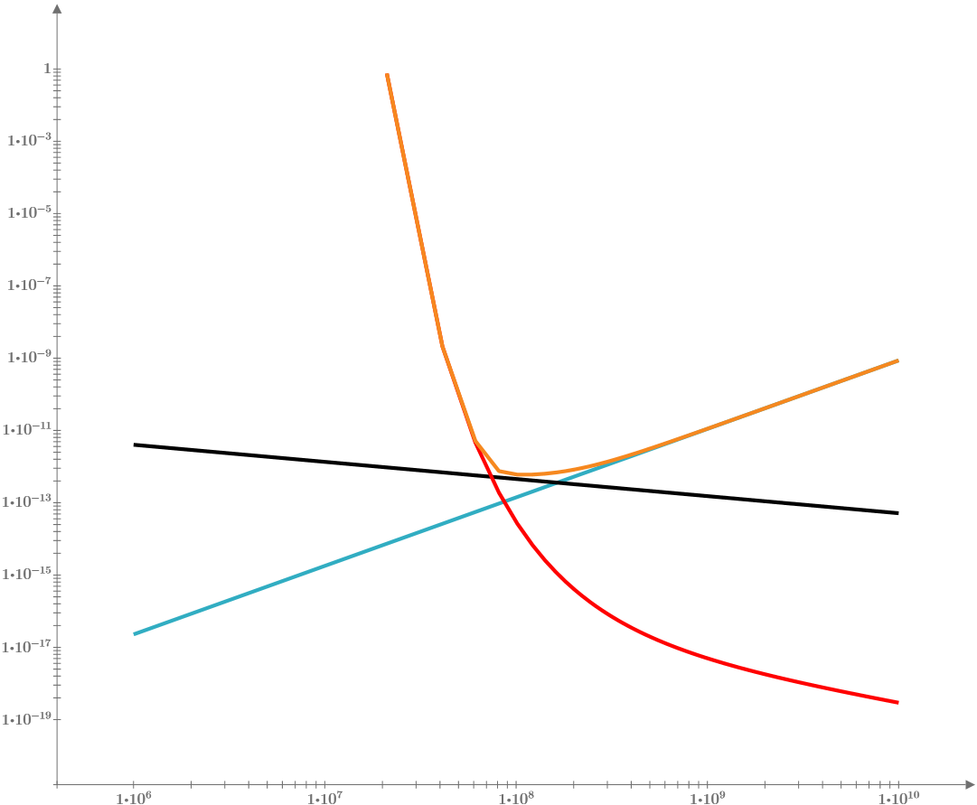
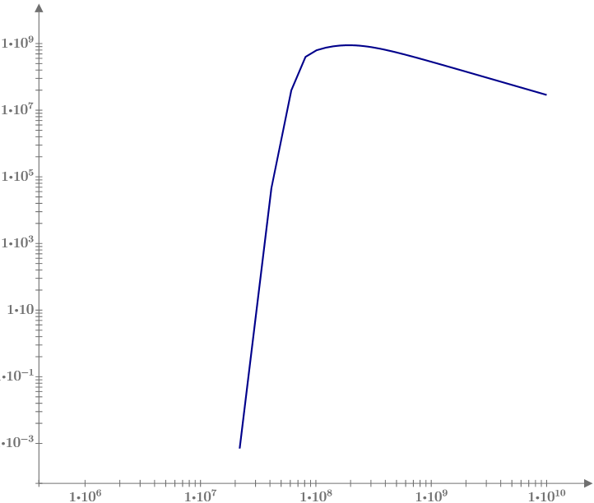
Part 3 -- Current saturation: space charge time vs tunneling time vs transit time
Semiconductor Case Study: high 𝜙 (5 eV)
β=100
n=10²⁴ m⁻³
R=10 µm
v_{sat}=10⁵ m/s
ε=10
j(E) (A/m²)
t(E) (s)
t_{sc}
t_{t}
t_{FN}
log(j(E))
E (V/m)
E (V/m)

Slide 13
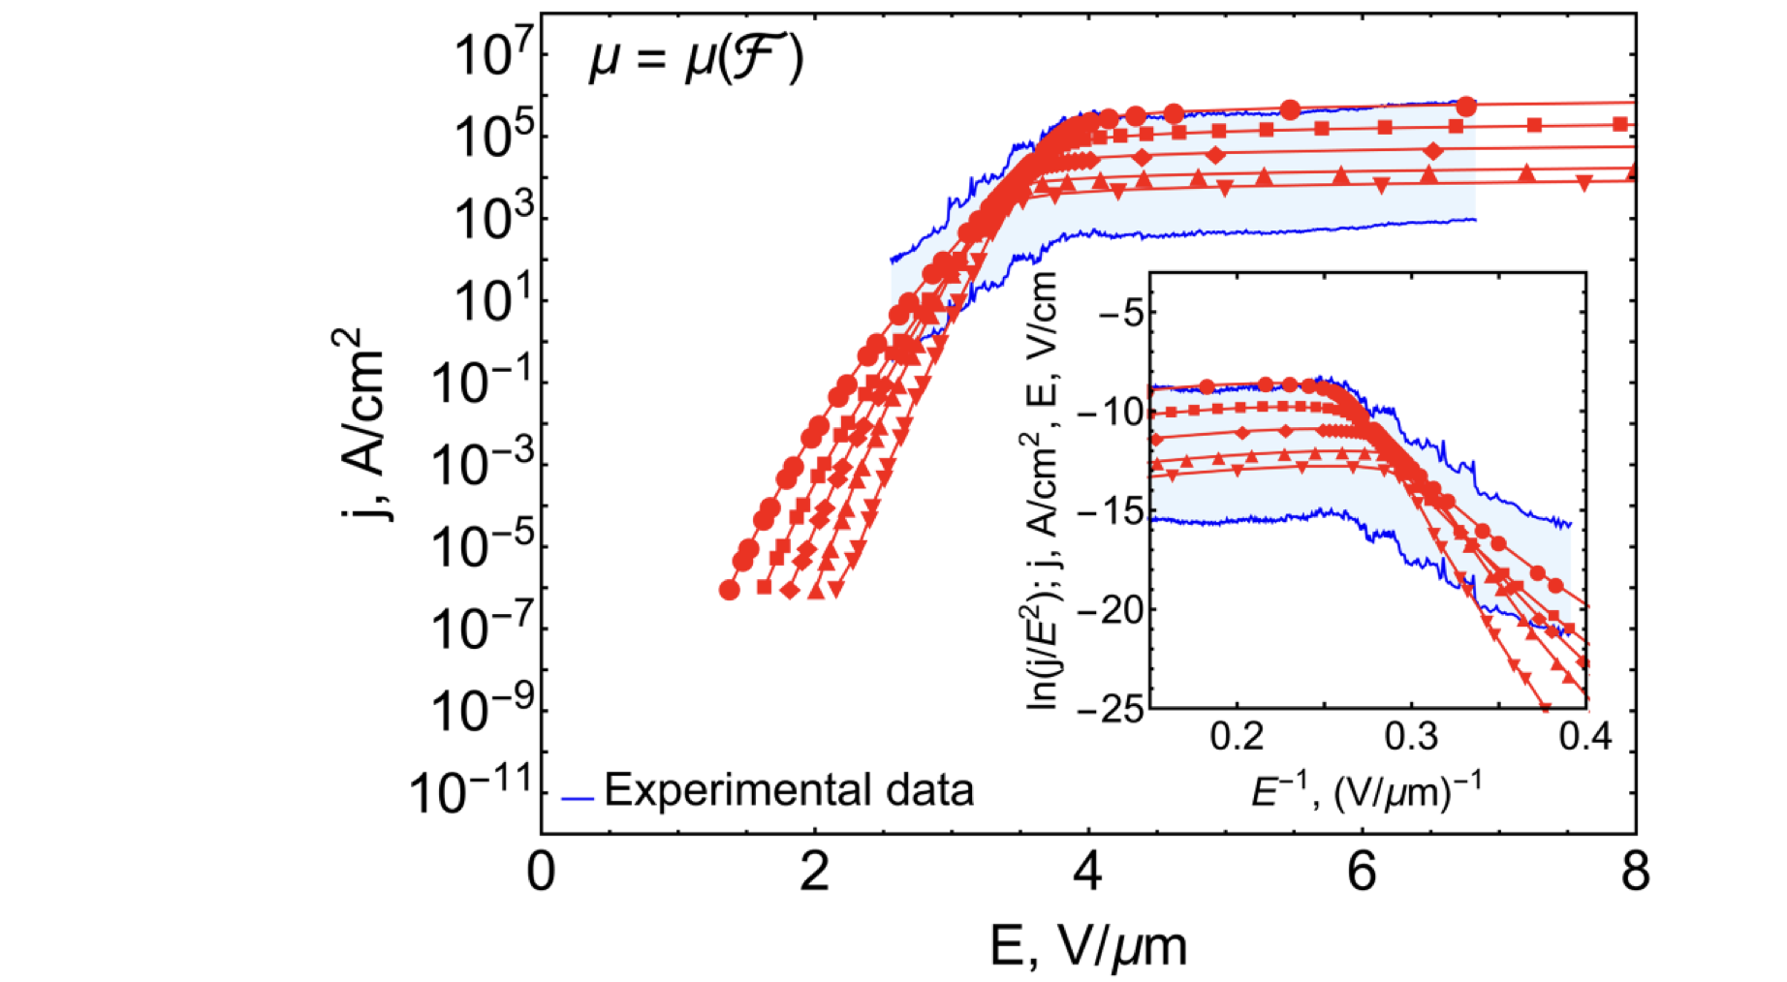
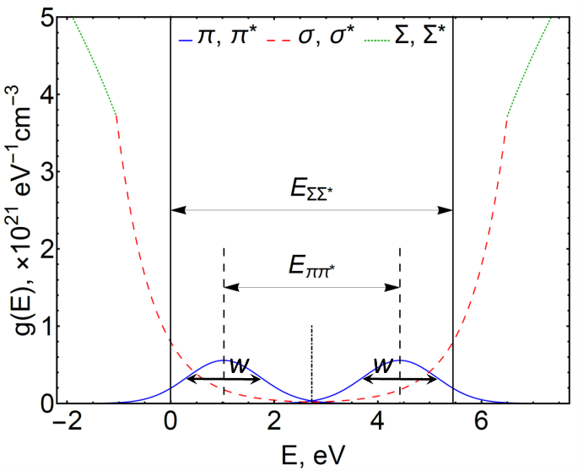
Part 4 -- Semiconductor in high field
Stratton–Baskin–Lvov–Fursey (SBLF) Formalism
Band structure
Poisson
Stratton
Chubenko et al,
JAP 125, 205303 (2019)

Slide 14
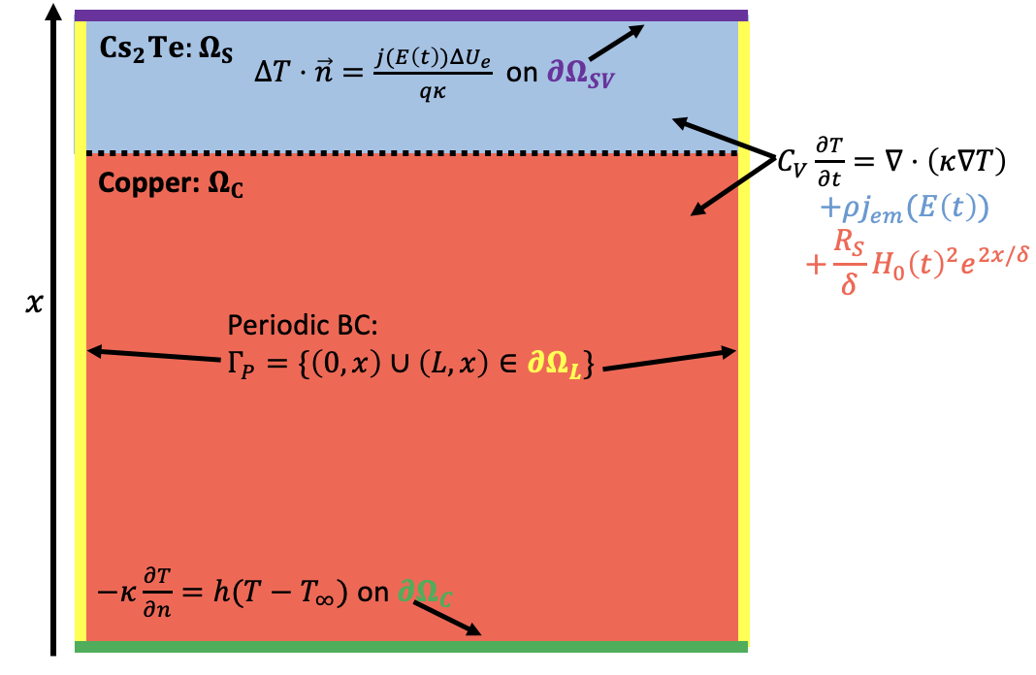
Part 4 -- Semiconductor in high field
How about Cs₂Te???
Band structure
\
Scientific Reports 15, 2780 (2025)
Computational domain
2

Slide 15
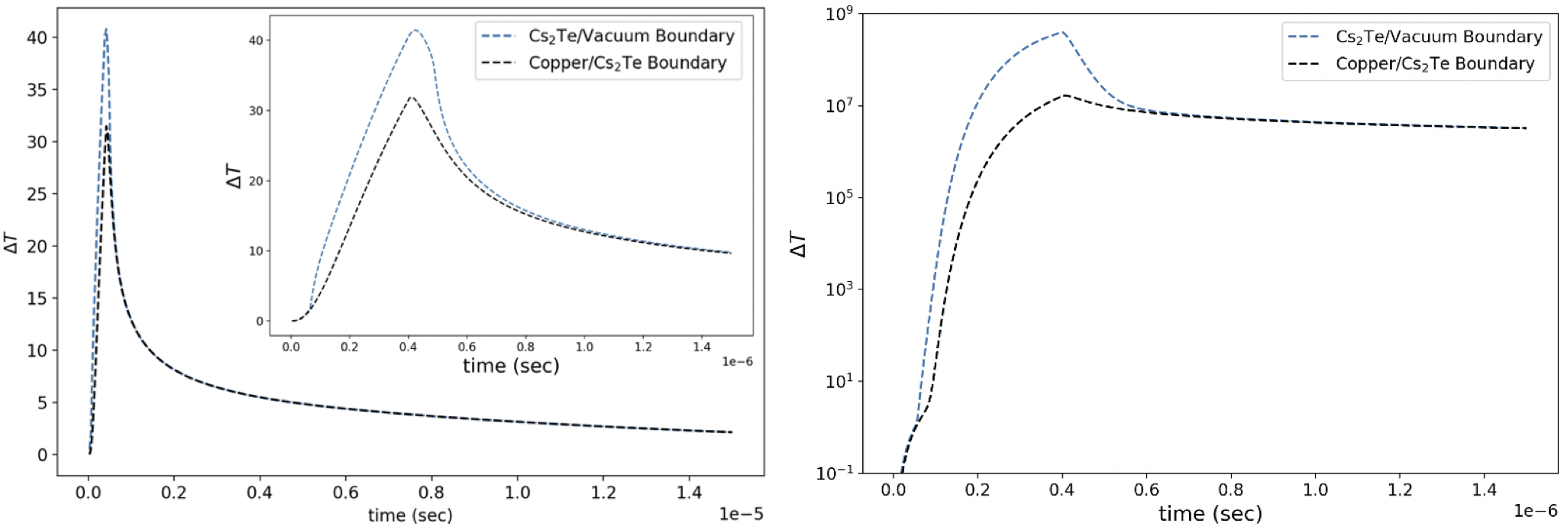
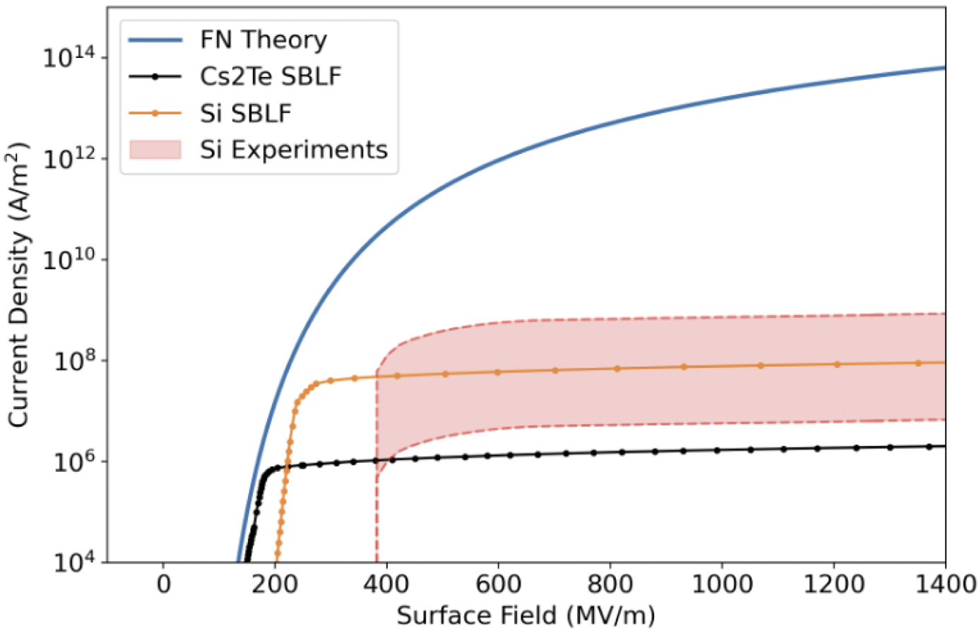
Part 4 -- Semiconductor in high field
Current and Temperature Single Pulse Transients
Shinohara et al, J. Vac. Sci. Technol. B 43, 034003 (2025)

Slide 16
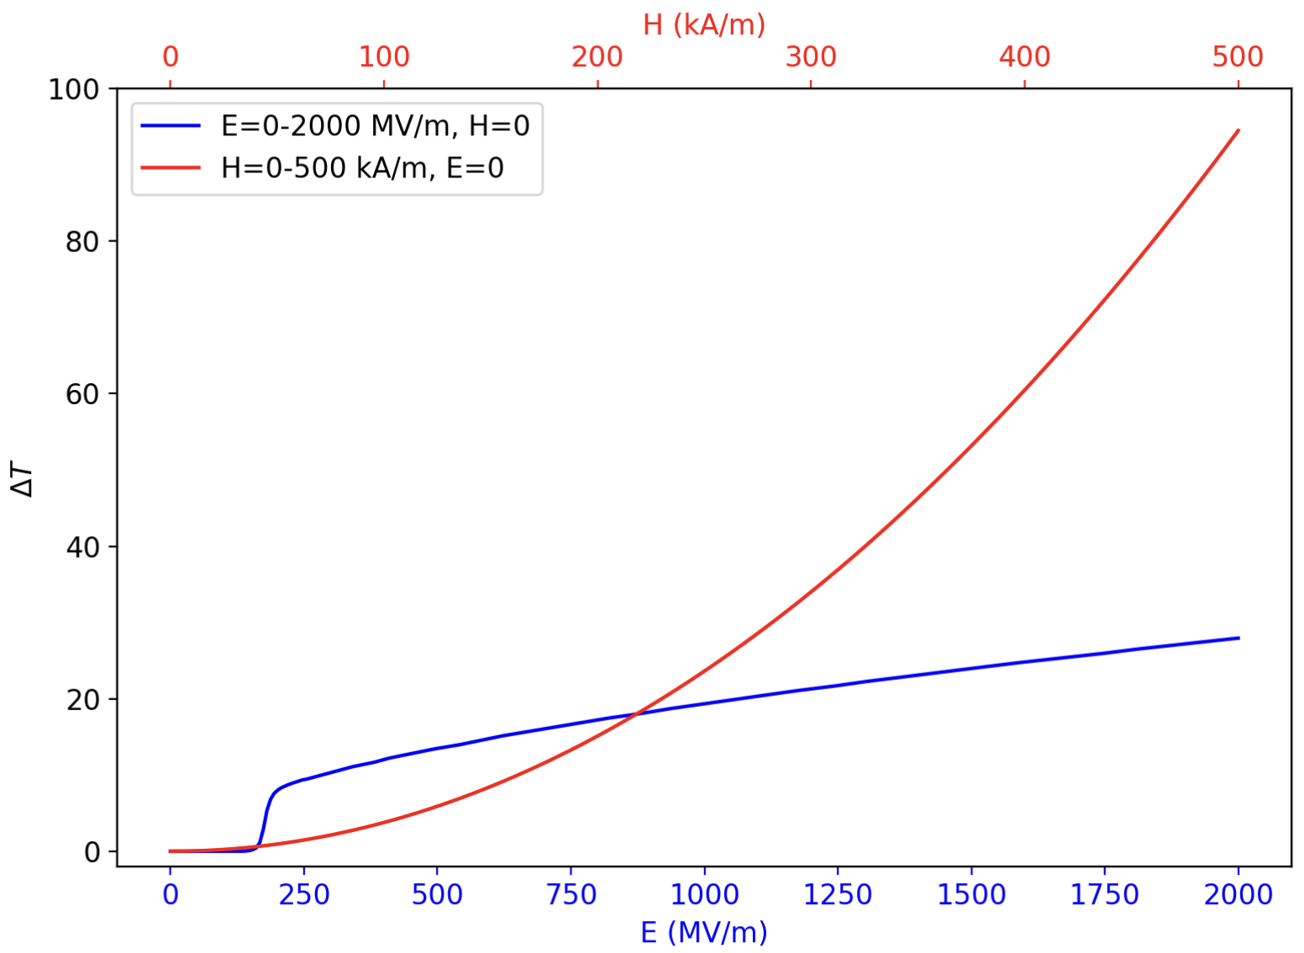
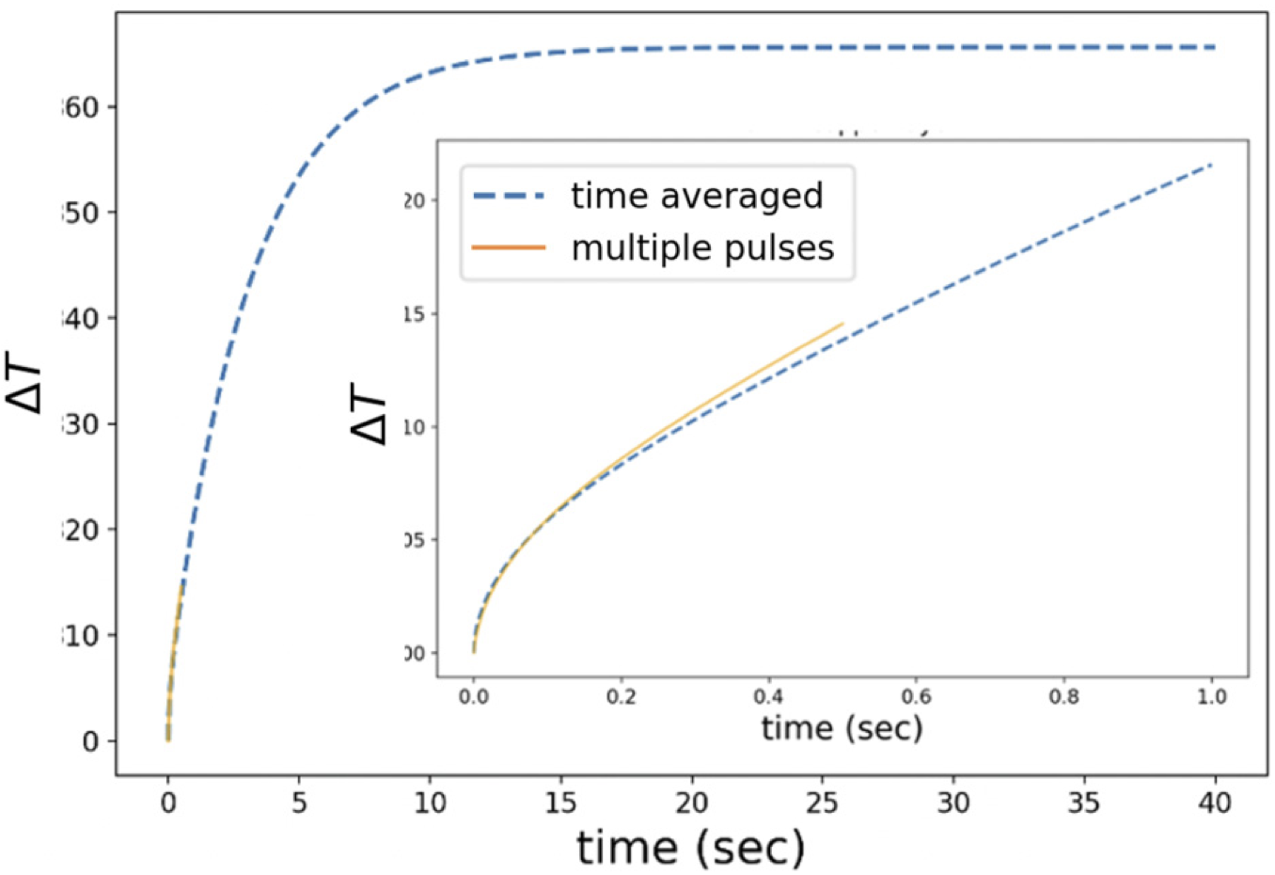
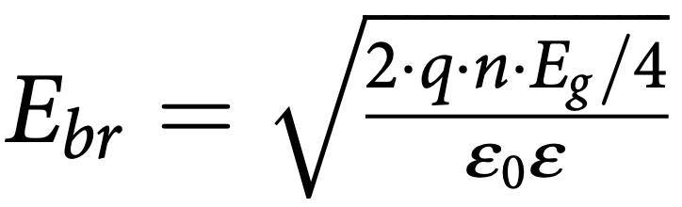
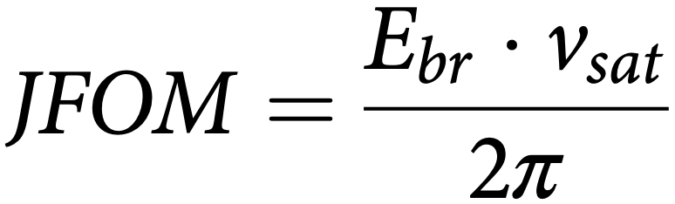
Part 4 -- Semiconductor in high field
1D Heating Summary for Cs₂Te
E vs H field effects
375 Hz reprate
+40 K
+60 K
enough heating to consider thermal stress induced surface evolution
see Shinohara et al, PRAB 27, 053101 (2024)
Beyond the saturation: dielectric/avalanche breakdown
≈10 MV/m
Shinohara et al, J. Vac. Sci. Technol. B 43, 034003 (2025)
≈10⁵ m/s
300 MV/m@5 GHz hits 50 nm Cs₂Te with 0.075 V/ps!!!
0.15 V/ps

Slide 17
Part 5 -- Conclusions and outlook
Final Thoughts
Surfaces in high gradient breakdown to due terminal runaway caused by Joule and/or Nottingham effects
Joule and Nottingham effects can curb due to current saturation
Saturation in metals is caused by space charge effect
Saturation in semiconductors is caused by charge supply (limiting resistor effect)
how many electrons available, term n^{5/3}
how fast/far they travel, term v_{sat}
how much emission surface available, term R²
In Cs₂Te (in its standard intrinsic form) dark current saturates: Cs₂Te is immune to thermal runaway!
Nevertheless, in the new era of high-f 200+ MV/m it is possible to observe new breakdown regimes

