Slide 1
Ab-initio Cu alloy design for high-gradient accelerators
Gaoxue Wang, Evgenya I. Simakov, Danny Perez
07/17/2025
LA-UR-22-20111

Slide 2
Outline
Introduction
- Figure of merit (FOM)
Computational details
- Ab-initio material properties modeling and validation
FOM of dilute Cu alloys
- What alloy is good? At what solute concentration?
Summary

Slide 3
RF breakdown
Breakdown probability is dependent on the material of the cavity
Cu-Ag alloys show improved breakdown resistance
Can we computationally screen the periodic table to identify the optimal solute and concentration?
Simakov, Dolgashev, Tantawi, 2018

Slide 4
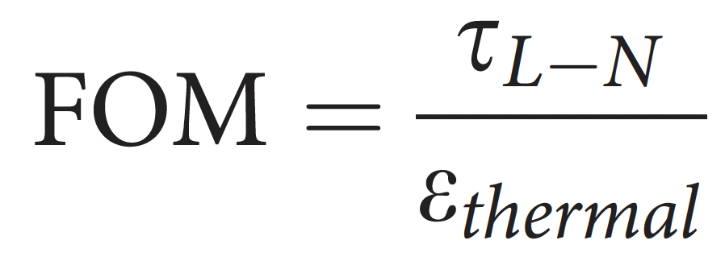
FOM overview
FOM:
Critical stress to move dislocations / Thermal stress created by RF dissipation
Tradeoffs:
Good: Adding solute atoms can improve strength: limit plastic deformation under thermal loading
Bad: Adding solute atoms can increase RF dissipation and thermal stresses: increase driving force for plastic deformation
Chemical space: Dilute binary Cu alloys

Slide 5
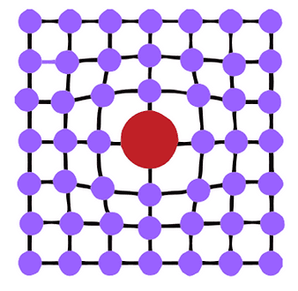

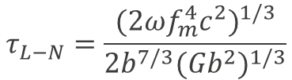


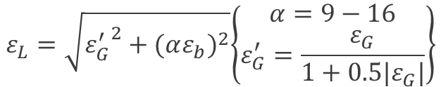
FOM #1: Critical stress to move dislocations
Labusch–Nabarro (LN) model: Critical resolved shear stress required for dislocation motion:
With:
Two key parameters:
Size misfit
Modulus misfit
$$τ_{L−N}=\frac{{(2ωf_{m}^{4}c^{2})}^{1/3}}{{2b}^{7/3}{(Gb^{2})}^{1/3}}$$
$$f_{m}=\frac{Gb^{2}}{120}ε_{L}$$
$$ε_{L}=\sqrt{{ε_{G}^{′}}^{2}+{(αε_{b})}^{2}}\left\{\begin{aligned}α=9−16 \\ ε_{G}^{′}=\frac{ε_{G}}{1+0.5|ε_{G}|}\end{aligned}\right\}$$
$$ε_{b}=\frac{db}{bdc}$$
$$ε_{G}=\frac{dG}{Gdc}$$
Johan Zander et al., Computational Materials Science 41 (2007) 86–95
M. Z. Butt, Journal of Materials Science 28 (1993) 2557-2576

Slide 6
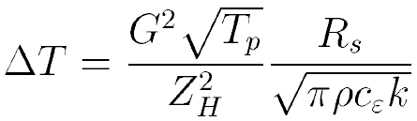
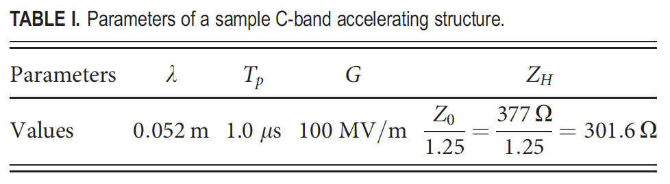
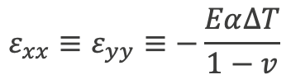
FOM #2: Thermal stress created by RF dissipation
Assuming that the surface is free to relax in z only, the corresponding in-plane thermal stress is
$$ε_{xx}≡ε_{yy}≡−\frac{Eα∆T}{1−v}$$
Heating due to RF losses can be estimated from the solution of the heat equation:
Accelerator parameters
Material properties
Perry B. Wilson. In ITP Conference on Future High Energy Colliders.
University of California, Santa Barbara, October 1996.

Slide 7
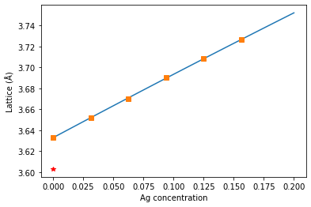
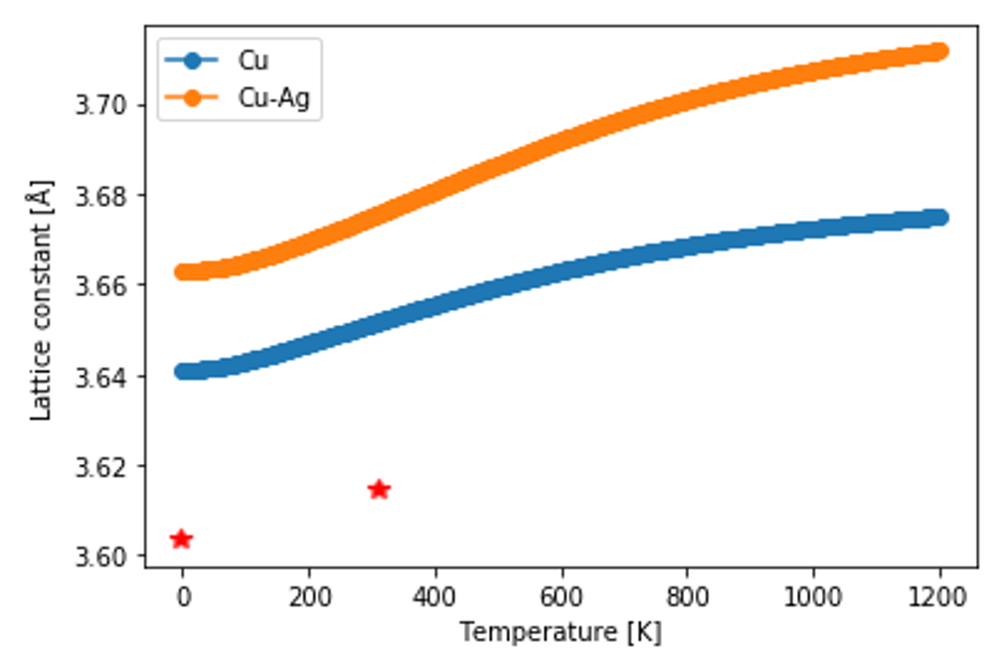
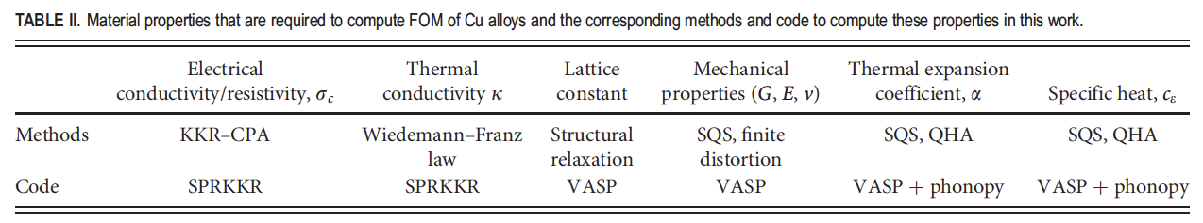
Calculating the FOM requires:
Electrical and thermal conductivity:
- SPRKKR
Lattice constant: direct structure relaxation
Mechanical properties: finite distortion
Thermal expansion coefficient: quasi-harmonic approximation
These quantities need to be computed vs solute concentration.
This requires tens of DFT calculations per solute per concentration (!)

Slide 8
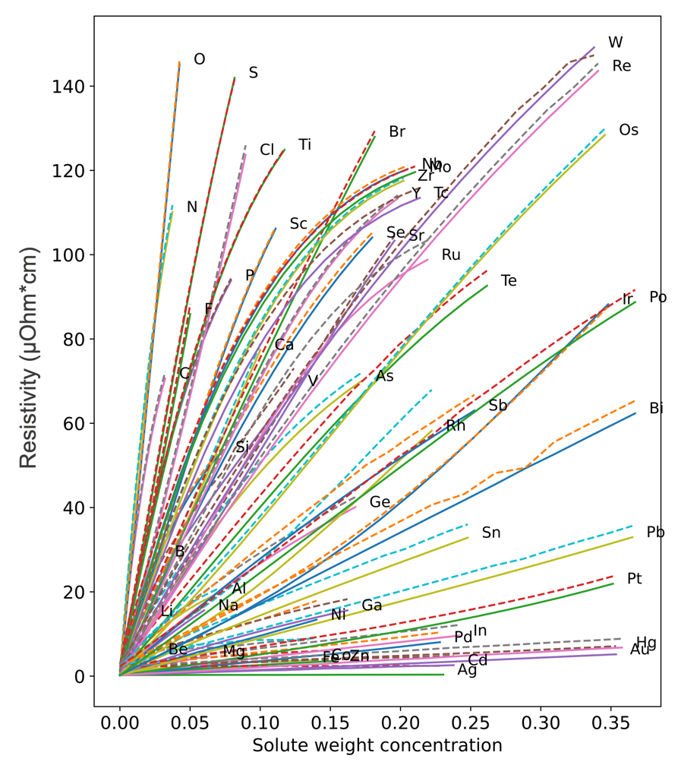
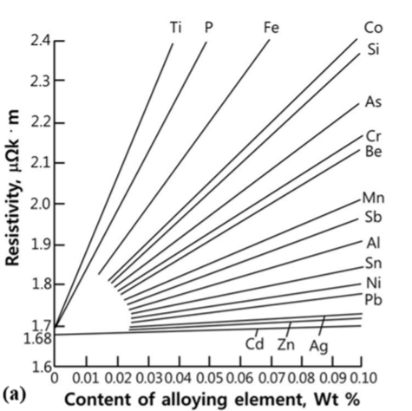
Electrical and thermal conductivity
SPRKKR
Experiments
Resistivity (µOhm*cm)
Experiments from: Han, Seung Zeon, Eun-Ae Choi, Sung Hwan Lim, Sangshik Kim, and Jehyun Lee. "Alloy design strategies to increase strength and its trade-offs together." Progress in Materials Science 117 (2021): 100720.

Slide 9
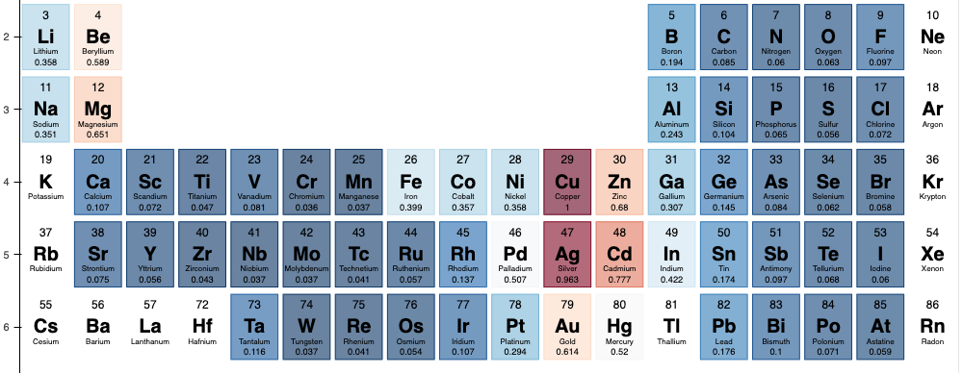
Electrical and thermal conductivity
SPRKKR 3% solute at 300K
(*Normalized by conductivity of pure Cu)

Slide 10


Thermal expansion coefficients
Calculated using the Quasi-harmonic approximation (QHA)

Slide 11
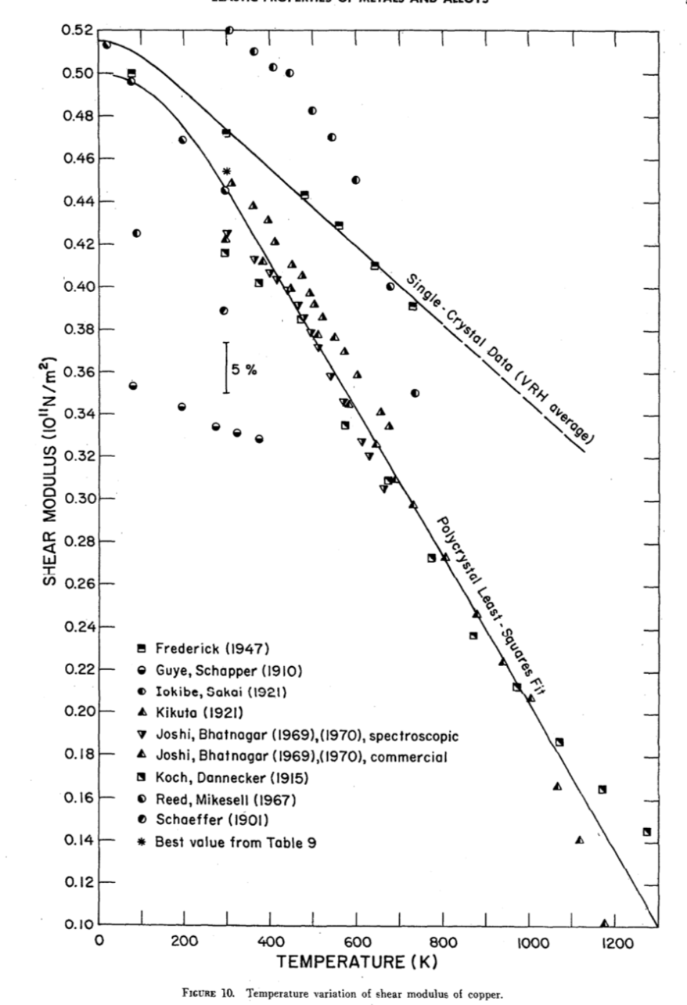
Bulk and shear modulus
Experimental data from: Ledbetter, H. M., and E. R. Naimon. "Elastic properties of metals and alloys. II. Copper." Journal of physical and chemical reference data 3, no. 4 (1974): 897-935.

Slide 12
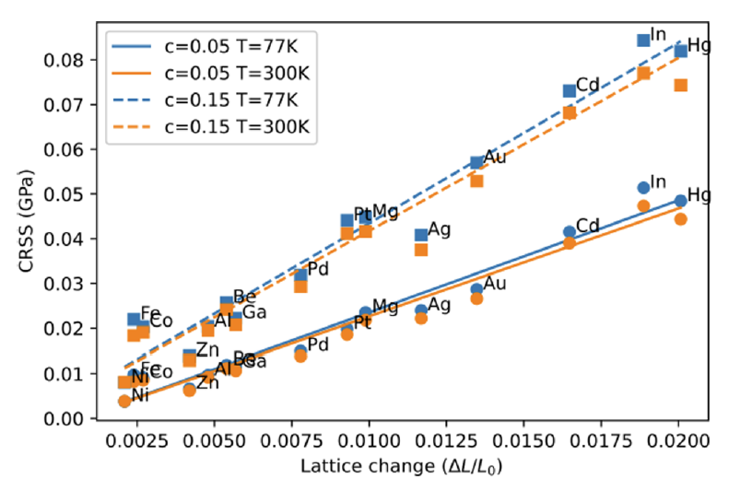
FOM #1: Critical stress to move dislocations
In, Hg, Cd, and Au show stronger strengthening effects.
CRSS is linearly correlated with lattice mismatch with Cu.

Slide 13
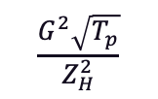
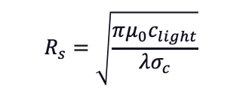
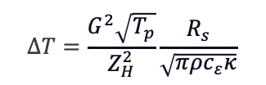



FOM #2: Thermal stress created by RF dissipation
Ag, Cd, Zn, Au and Mg induce relatively small thermal stress.
$$ε_{xx}≡ε_{yy}≡−\frac{EαT}{1−v}$$
$$∆T=\frac{G^{2}\sqrt{T_{p}}}{Z_{H}^{2}}\frac{R_{s}}{\sqrt{πρc_{ε}κ}}$$
Estimated from DFT
with SQS structures
$$α$$
$$c_{ε}$$
$$R_{s}=\sqrt{\frac{πμ_{0}c_{light}}{λσ_{c}}}$$
SPRKKR
$$\frac{G^{2}\sqrt{T_{p}}}{Z_{H}^{2}}$$
(unloaded gradient, RF pulse length, impedance)

Slide 14
Combined FOM
CuAg, CuCd, CuHg, CuAu, CuIn, and CuMg stand out.
Maximum solubility in copper:
Ag (5 at.% 1100K), Cd (2.07 at.% 820K), Hg (~5 at.% 930 K ),
Mg (7 at.% 1008K), In (11 at.% 850K)

Slide 15
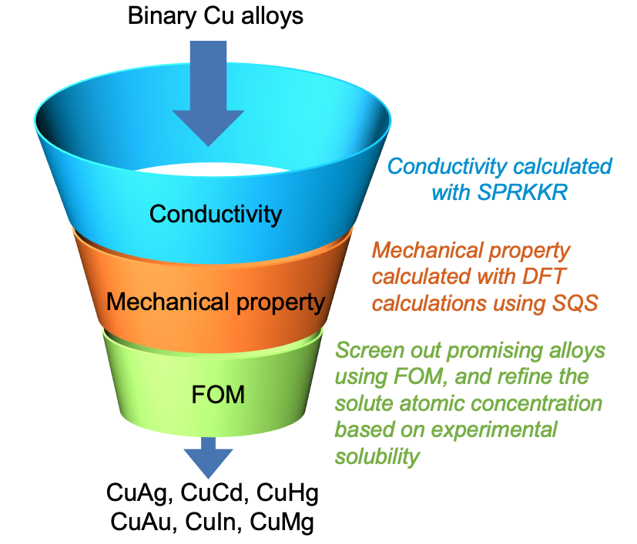
Summary
FOM: Tradeoff between solid solution strengthening and thermal stress
Identify binary Cu alloys that are promising for high gradient accelerator design
Future work:
Extend to multicomponent alloys
Validate predictions experimentally
Wang, Gaoxue, Evgenya I. Simakov, and Danny Perez. Applied Physics Letters 120, no. 13 (2022): 134101.
Wang, Gaoxue, Evgenya I. Simakov, and Danny Perez. Journal of Applied Physics 132, no. 17 (2022).

Slide 16
Acknowledgements
C-band and CARIE team
LANL LDRD: 20200057DR, 20190079DR, 20230011DR
Thanks for your attention.

