Slide 1

Experimental Demonstration of Particle Acceleration with Normal-Conducting High-Gradient Accelerating Structure at cryogenic temperature
Sami Tantawi, Mamdouh Nasr, and collaborators
Materials for Bright Beams Workshop 2025

Slide 2
Acknowledgment
My colleagues who were pivotal to this work:
Zenghai Li
Mamdouh Nasr
Mohammed Shumail
Christopher Nantista
Marco Oriunno
Martin Breidenbach
Cecile Limborg

Slide 3
Outline
Physics of breakdown
in high gradient normal conducting structures
The distributed-coupling technology
New geometric optimization capabilities
Cryogenic-copper structures
New accelerating frontiers for high-gradient operation
Next-Generation Distributed-Coupling Linacs
Making full benefit of the optimization capability of this novel technology

Slide 4
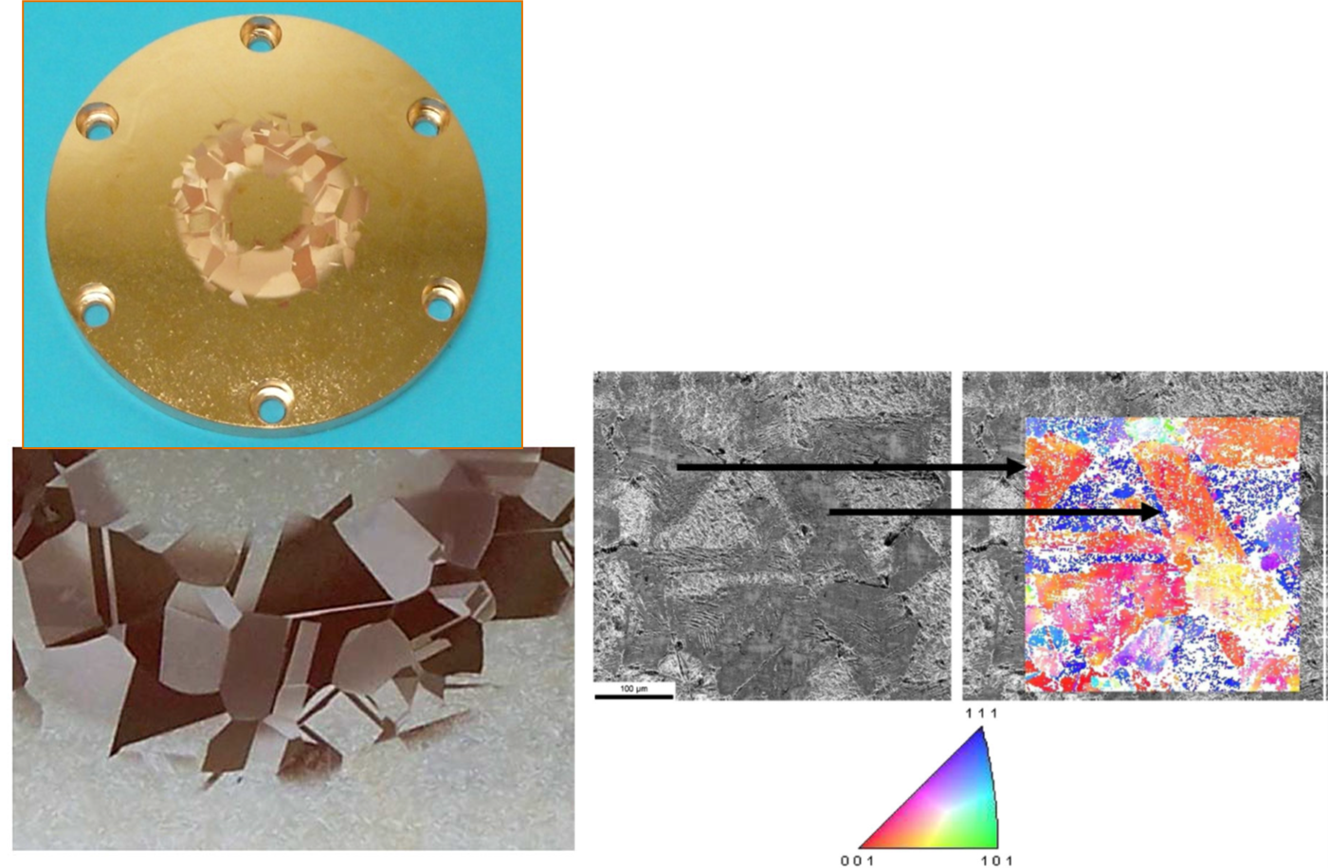
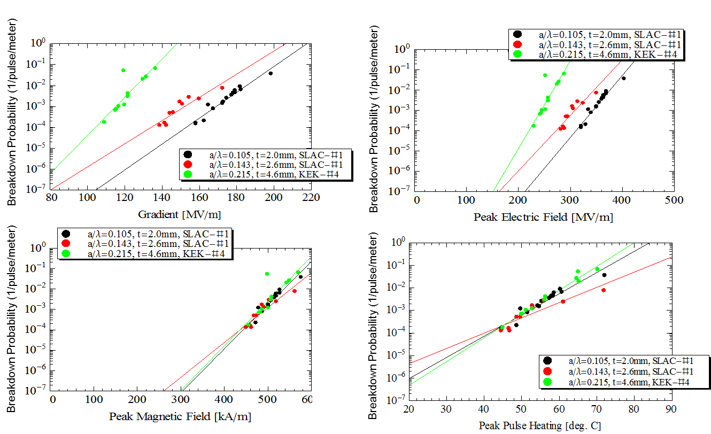
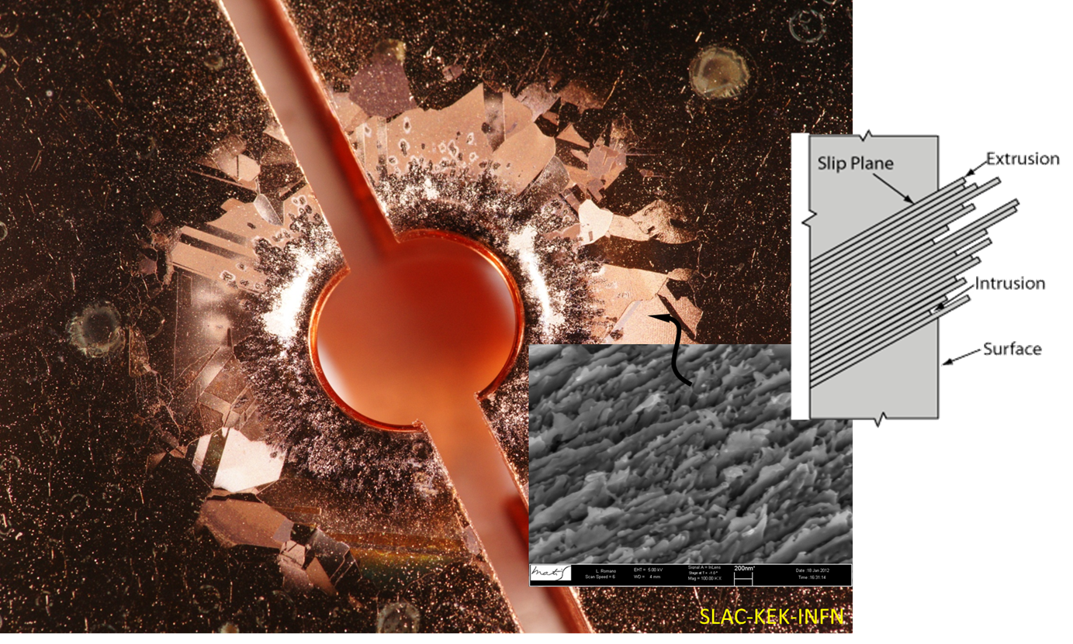
New Discovery of Magnetic Fields Role in Breakdown Triggered a Change in Research Direction
Geometrical Studies:
Standing-wave structures with different iris diameters and shapes
a/λ=0.215, a/λ=0.143, and a/λ=0.105
Pulsed heating and crystal orientation: Annealed Copper with large grain shows crystal pattern because damage is different for each crystal orientation
New research initiated
    Geometry optimizations for accelerator structures based on reduction of the magnetic surface field
    Studies of surface magnetic fields and materials
    Basic Physics studies with mixed E&H dual-mode cavities
    Low temperature experiments with very high gradient structures
Applications of new information
    A new methodology for designing Photonic Band Gap (PBG) structures
    New understanding of MUON cooling cavity results in operation under strong magnetic fields
    Improved design of high peak power rf sources
4
Valery Dolgashev et al., “Geometric dependence of radio-frequency breakdown in normal conducting accelerating structures,” Applied Physics Letters, Volume 97, Issue 17, pp 171501 - 171501-3, October 2010.
Alex Cahill et al., "High gradient experiments with X-band cryogenic copper accelerating cavities" Phys. Rev. Accel. Beams 21, 102002 – Published 23 October 2018.
Evidence of pulsed heating due to magnetic field triggers crystal plane slippage that caused breakdown due to electric filed

Slide 5
Understanding the physics of breakdowns triggered new research directions for high gradient linear accelerators
Novel
Manufacturing
Optimization Flexibility
Cryogenic Operation
Notes:
To relax the geometric and breakdown limitations in accelerator structures, we need to develop
-New Geometric optimization approaches for accelerating structures based on our understanding of the breakdown physics
-Novel Manufacturing Techniques that are Compatible with Superior Materials and Unique Geometries
-Also, we need to investigate Cryogenic operation of NC structures for increased efficiency and reduces breakdown rates

Slide 6
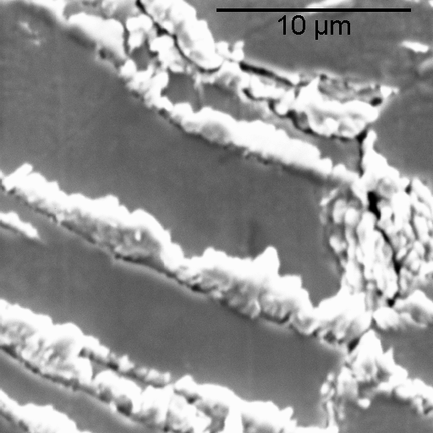
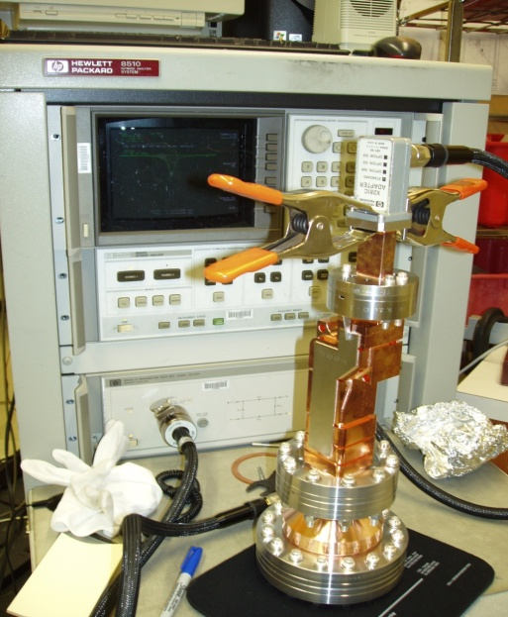
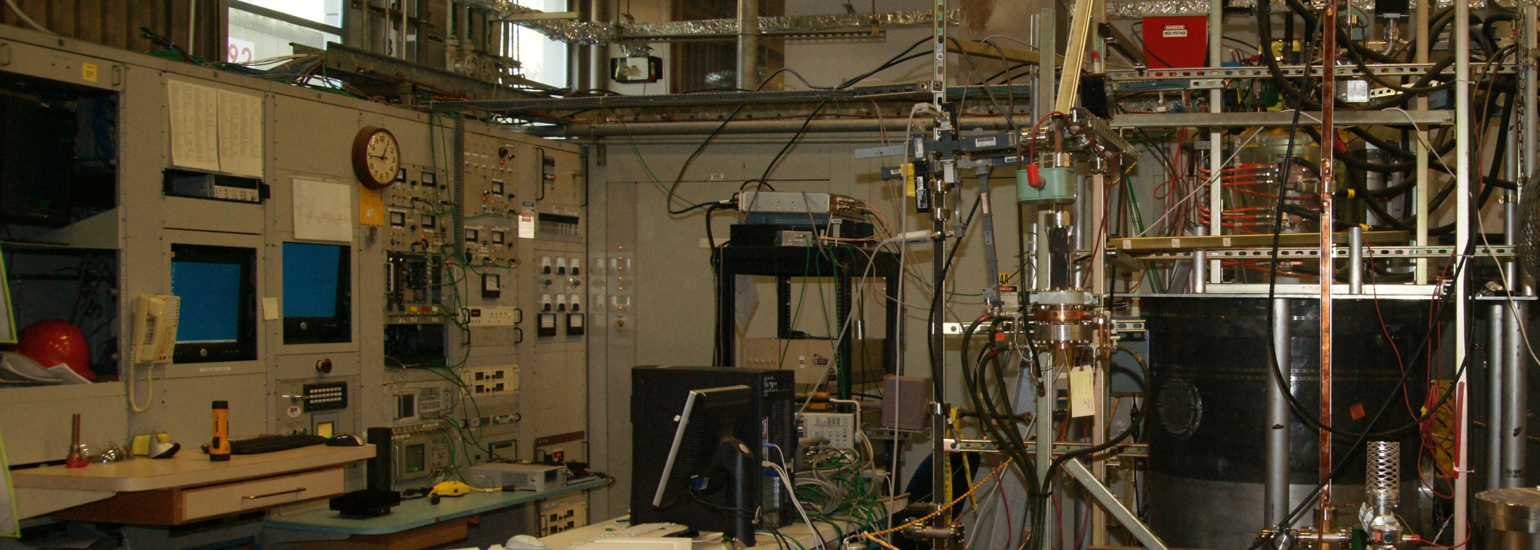
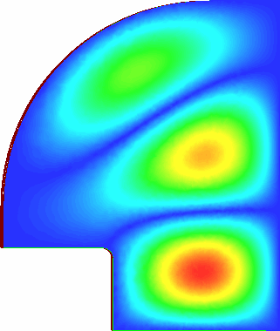
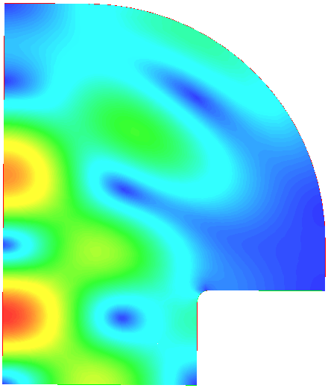
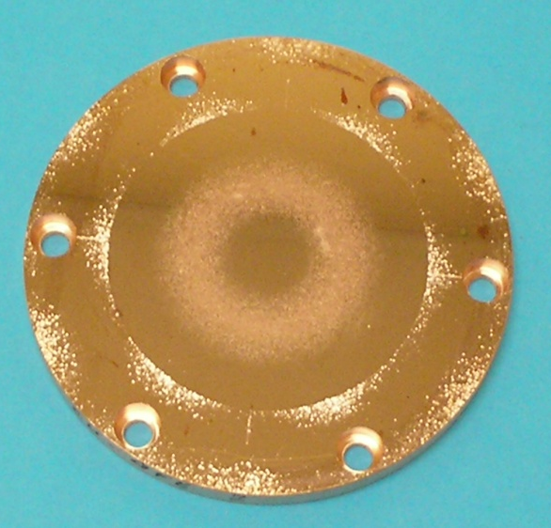
Material Testing ( Pulsed heating experiments)
Economical material testing method
Essential in terms of cavity structures for wakefield damping
Recent theoretical work also indicate that fatigue and pulsed heating might be also the root cause of the breakdown phenomenon
Special cavity has been designed to focus the magnetic field into a flat plate that can be replaced.
SEM Images Inside Copper Pulse Heating Region
TE₀₁₃-like mode
Metallography: Intergranular fractures 500X
|Ε|
|Η|
αξισ
Q₀ = ~44,000
(Cu, room temp.)
TE₀₁ Mode Pulse Heating Ring
material sample
r = 0.98”
Max Temp rise during pulse = 110ºC
The Conclusion of the HG collaboration and the future: Advanced Ultra-High Frequency Acceleration

Slide 7
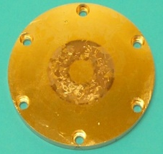
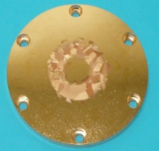
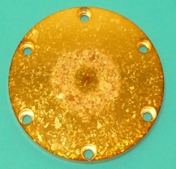
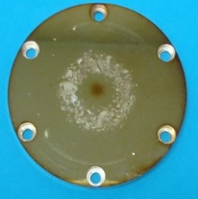
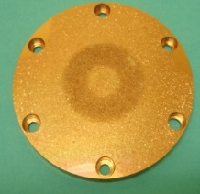
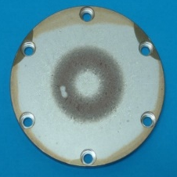
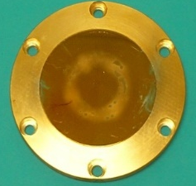
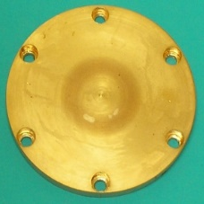
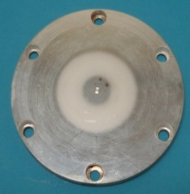
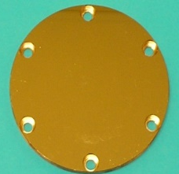
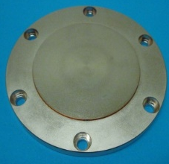
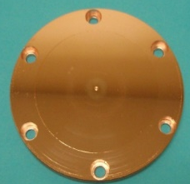
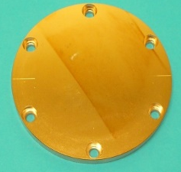
Pulse Heating Samples RF Tested
Hardness Test Value
10
19
33
36
45
Cu101 (SLAC)
KEK3 (KEK)
HIP2 (KEK)
HIP1 (KEK)
CuZr2-2 (CERN)
54
??
62
64
CuCr101 (SLAC)
Single Crys Cu (KEK)
E-Dep. Cu (KEK)
AgPCu (KEK)
77
78
80
83
CuZr3-2 (CERN)
CuAg5 (SLAC)
CuAg1 (KEK)
CuCr102 (SLAC)

Slide 8
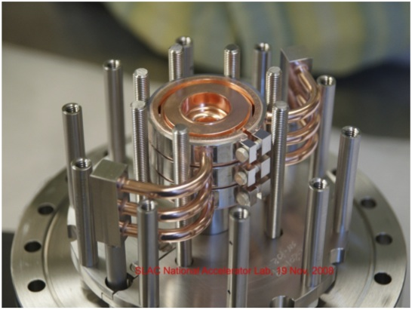
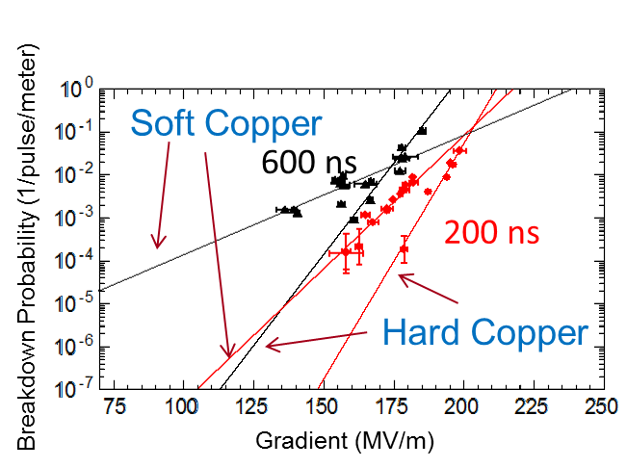
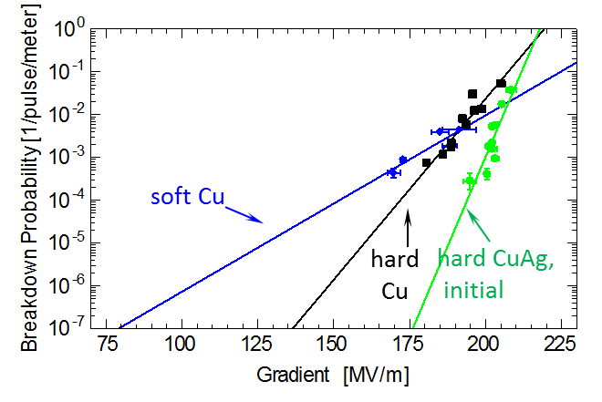
Hard copper and copper alloys resulted in ultra-high gradients
We developed an apparatus for testing accelerator structures without brazing
The results show a great improvement in gradient at very low breakdown rates, Lower than that required by a collider application
Demonstration of 175 MV/m, a major program milestone!

Slide 9
Novel Manufacturing Techniques

Slide 10
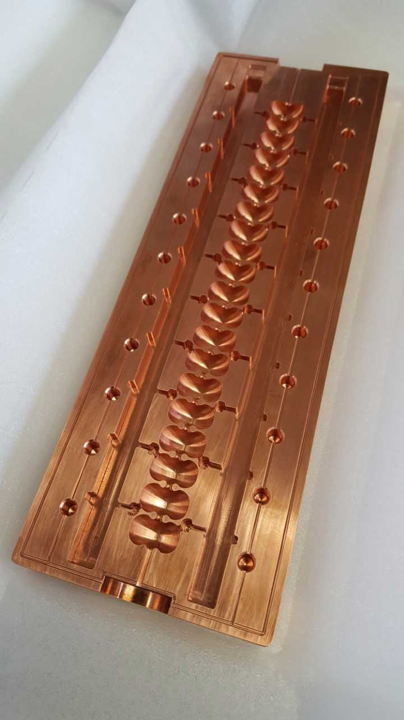
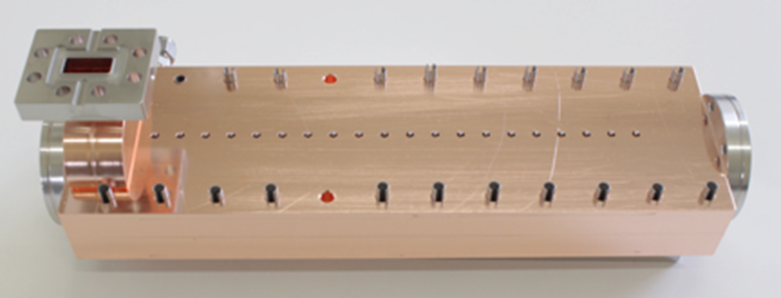
Novel fabrication methods are compatible with hard metals and reduced cost
Milling structure out of two halves instead of machining and then brazing single cells
No RF currents through the joint
Consistent with manufacturing structures out of hard copper alloys
Demonstrated with Standing and Traveling Wave Structure
S. Tantawi, P. Borchard, Z. Li
V. Dolgashev
Developing new manufacturing techniques to implement advanced materials in practical accelerating structures and reduce costs
Notes:
This technique have proved efficient operation in practical accelerators at high-gradient operation

Slide 11
Optimized Geometries
using
Distributed-Coupling Topology

Slide 12
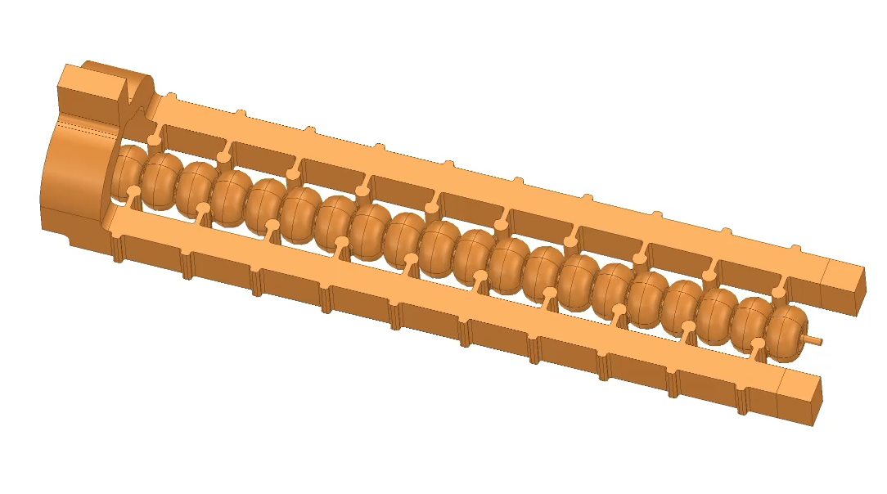
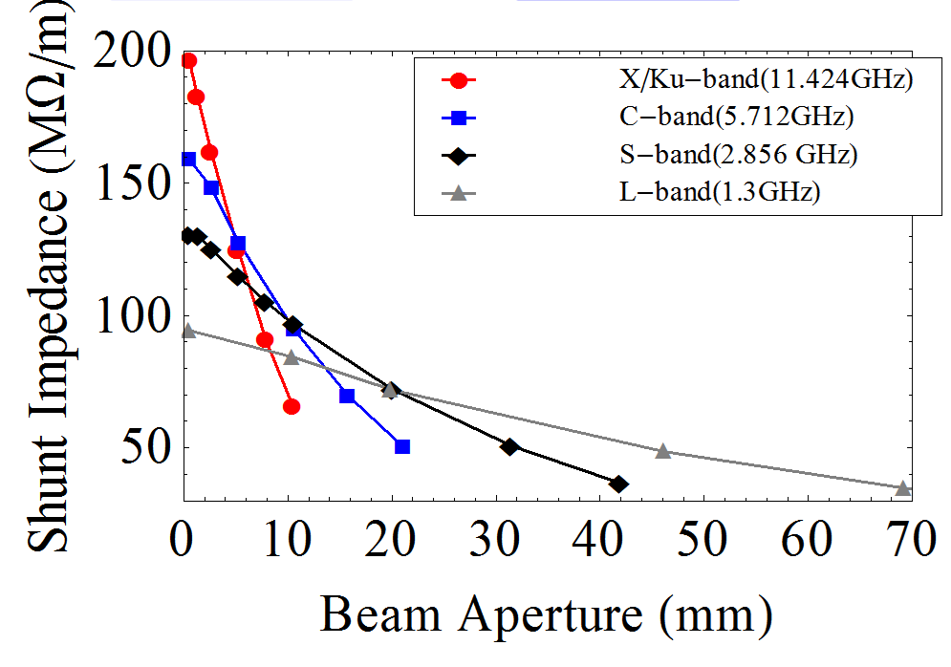
Distributed coupling Linacs provides a new technology that enables much flexible cell-design optimization
The existing linac designs requires careful consideration of the coupling between cells
which limits the ability of designers to optimize the cell shape.
The distributed coupling linac overcomes these limitations by providing a new topology
that allows feeding each accelerator cell independently using a periodic feeding network.
Distributed-coupling linac
New Scaling Laws Determine the Best Performance for Accelerating Structures
Tantawi et al. “Distributed coupling and multi-frequency microwave accelerators,” Jul. 5 2016, US Patent 9,386,682.
S. Tantawi, M. Nasr et. al. "Design and demonstration of a distributed-coupling linear accelerator structure." Physical Review Accelerators and Beams 23.9 (2020): 092001.

Slide 13
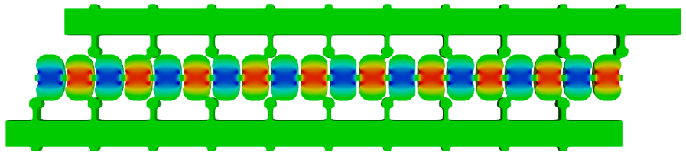
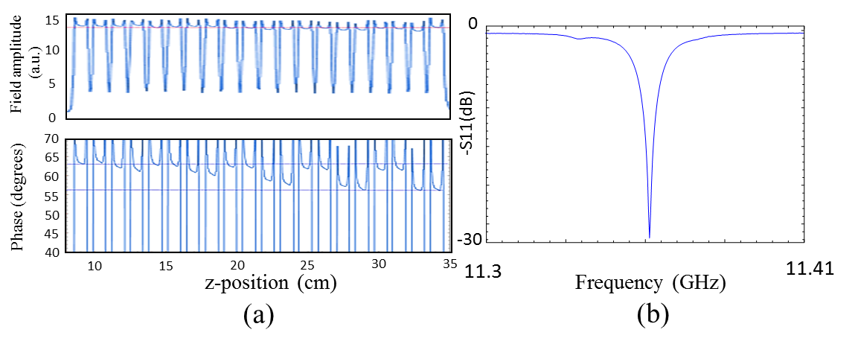
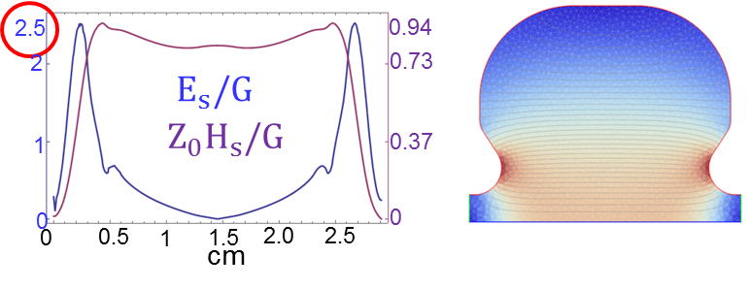



Distributed coupling Linacs provides a new technology that enables much flexible cell-design optimization
$$λ_{g}/2\sim λ$$
Designed to minimize surface magnetic field
Easy tuning and single frequency rather than 20
$π$-mode, X-band, 20 cells Linac
$$R_{shunt}=155 MΩ/m$$
Tantawi et al. “Distributed coupling and multi-frequency microwave accelerators,” Jul. 5 2016, US Patent 9,386,682.
S. Tantawi, M. Nasr et. al. "Design and demonstration of a distributed-coupling linear accelerator structure." Physical Review Accelerators and Beams 23.9 (2020): 092001.

Slide 14
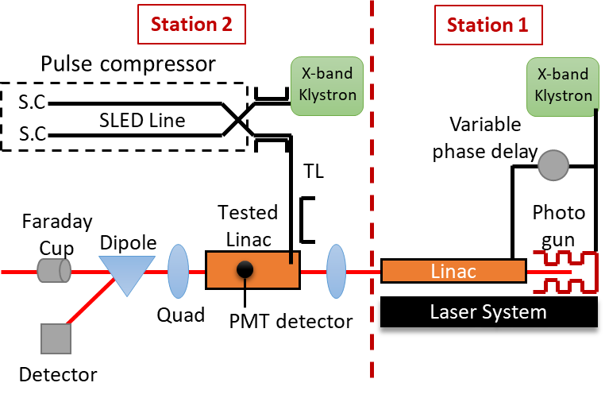
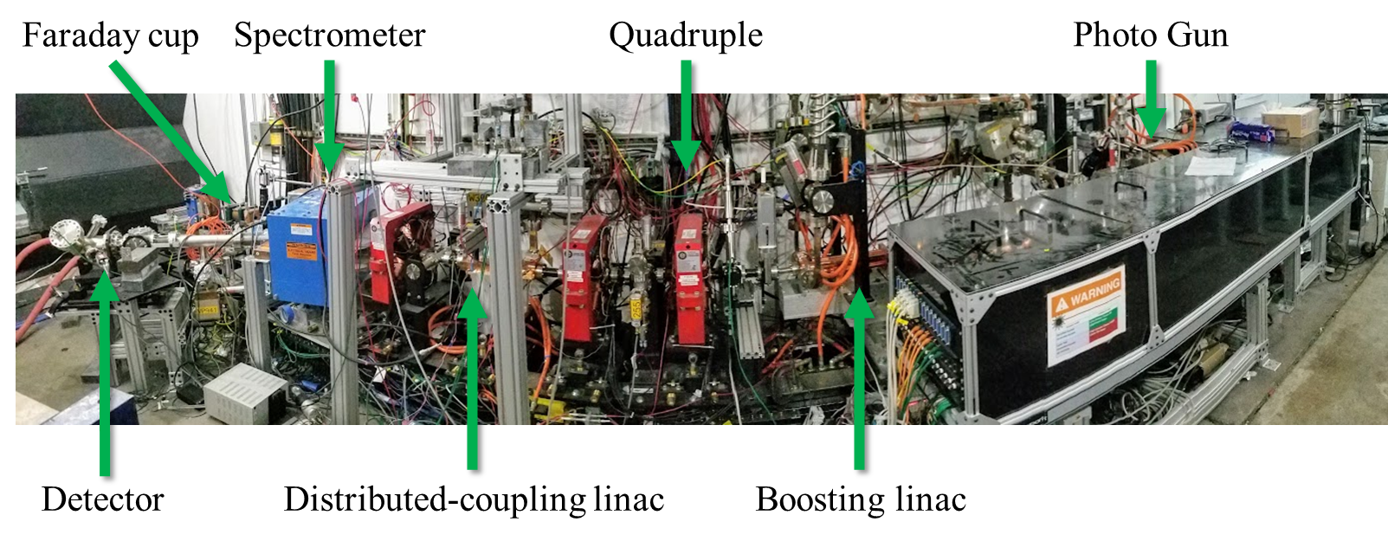
Verification of accelerating parameters and study of breakdown mechanism in the first distributed-coupling linac
M. Nasr, B. Weatherford, C. Limborg, S. Tantawi
Notes:
Beam charge calculations using the measured wakefields
And compared our calculation with the measured charge from the FC
We also verified the energy gain of an electron beam at a gradient of 100 MV/m
And finally we were able to push the structure to ultra high-gradient of 140 MV/m and verified the gradient using the peak dark-current energy
300 ns square pulse with no pulse shaping (step), we reached a peak gradient at the end of the pulse and put a single bunch at this point

Slide 15
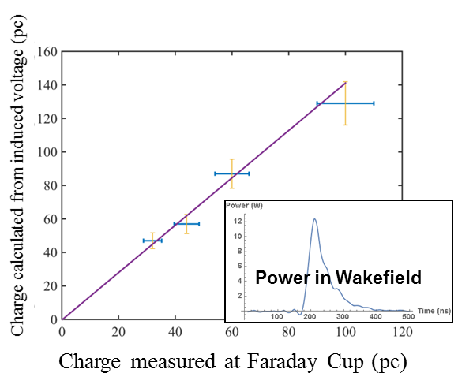
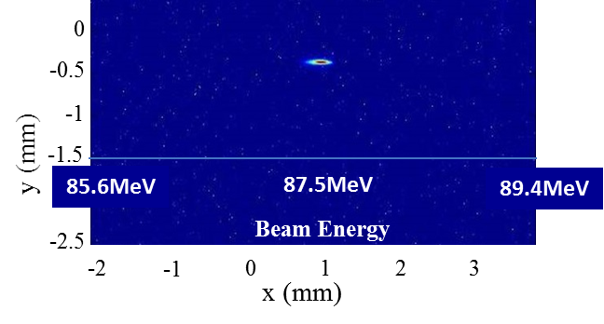
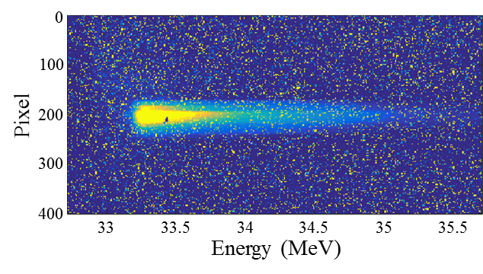
Verification of accelerating parameters and study of breakdown mechanism in the first distributed-coupling linac
Verification using beam energy, dark current, and charge measurements
Dark Current Energy
Gradient=100 MV/m
Gradient=140 MV/m
Results agree with the designed shunt impedance and predicted quality factor
M. Nasr, B. Weatherford, C. Limborg, S. Tantawi
Notes:
Beam charge calculations using the measured wakefields
And compared our calculation with the measured charge from the FC
We also verified the energy gain of an electron beam at a gradient of 100 MV/m
And finally we were able to push the structure to ultra high-gradient of 140 MV/m and verified the gradient using the peak dark-current energy
300 ns square pulse with no pulse shaping (step), we reached a peak gradient at the end of the pulse and put a single bunch at this point

Slide 16
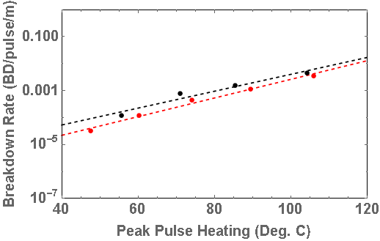
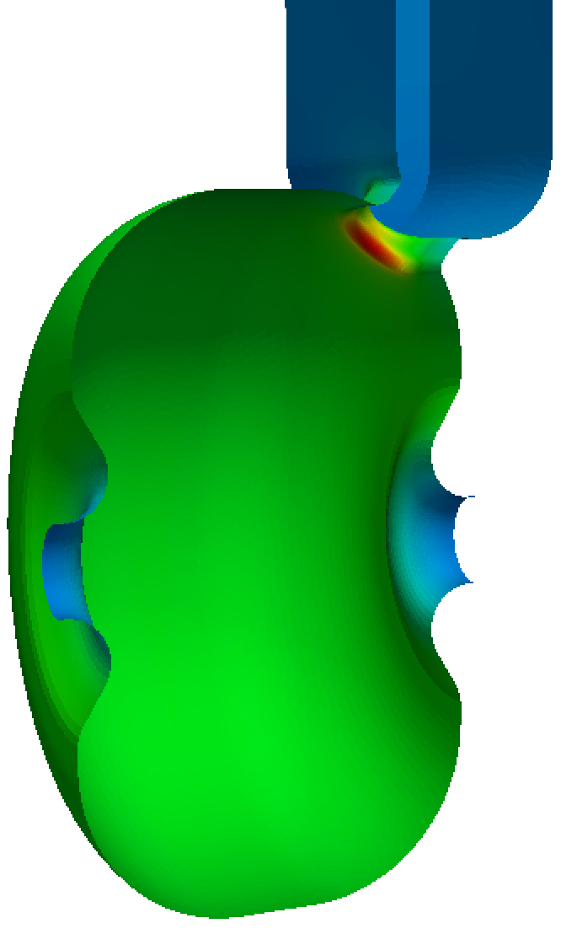
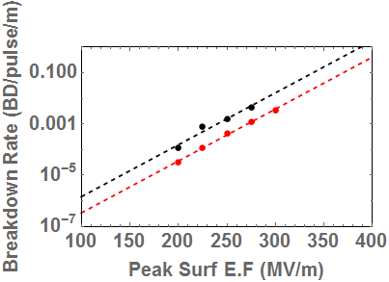
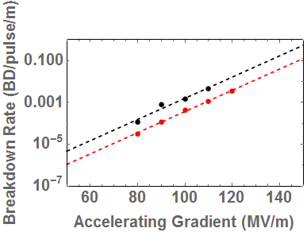

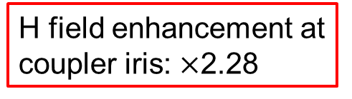
Verification of accelerating parameters and study of breakdown mechanism in the first distributed-coupling linac
Verification using beam energy, dark current, and charge measurements
Breakdown measurements at 100 ns and 200 ns flat gradient.
$$Peak E_{s}/Gradient=2.5$$
200 ns flat gradient
100 ns flat gradient
H field enhancement at coupler iris: $×$2.28
Pulse heating lines matches for both pulses
Dark Current Energy
H Field
Gradient=100 MV/m
Gradient=140 MV/m
Results agree with the designed shunt impedance and predicted quality factor
M. Nasr, B. Weatherford, C. Limborg, S. Tantawi
Notes:
300 ns square pulse with no pulse shaping (step), we reached a peak gradient at the end of the pulse and put a single bunch at this point

Slide 17
Cryogenic Operation
of
Normal Conducting Structures

Slide 18
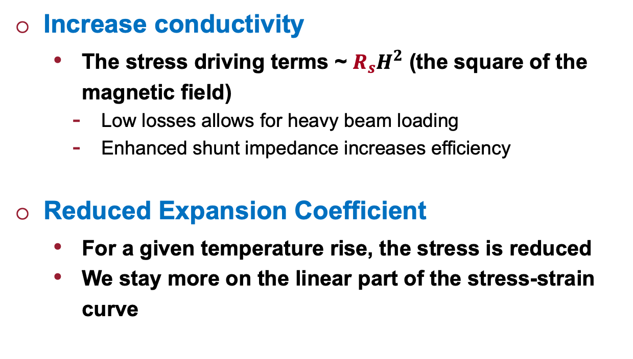
Cryogenic operation of NC accelerating structures
Increase conductivity
  The stress driving terms ~ $R_{s}H^{2}$ (the square of the magnetic field)
    Low losses allows for heavy beam loading
    Enhanced shunt impedance increases efficiency
Reduced Expansion Coefficient
  For a given temperature rise, the stress is reduced
  We stay more on the linear part of the stress-strain curve

Slide 19
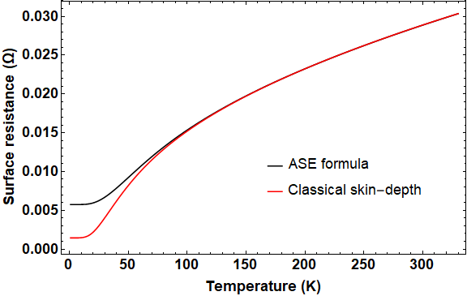




Cryogenic operation of normal conducting materials
The theory of Anomalous skin effect in metals
At low temperatures and high frequencies, the mean free path of the electrons in a good conductor becomes greater than the classical skin depth.
At high temperatures and low frequencies, the mean free path of the electrons in a good conductor is much smaller than the classical skin depth.
E
Comparison of the normal skin effect surface resistance and anomalous skin effect surface resistance at 11.424 GHz in RRR=400 copper
$$δ$$
$$δ$$
Conductor
$$σ$$
$$↑$$
Notes:
In order to understand the operation of the NC acc structures at cryo temp
We have to mention the theory of anomalous skin effect

Slide 20
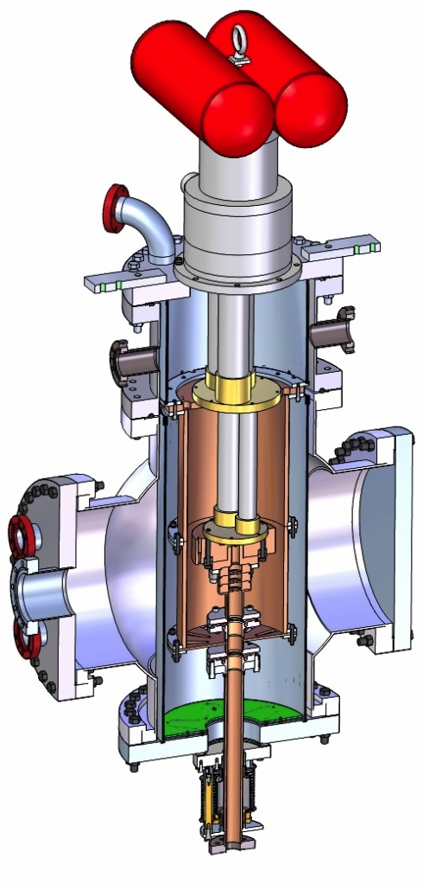
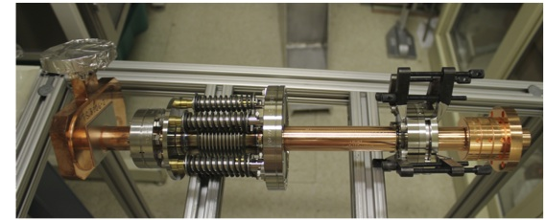
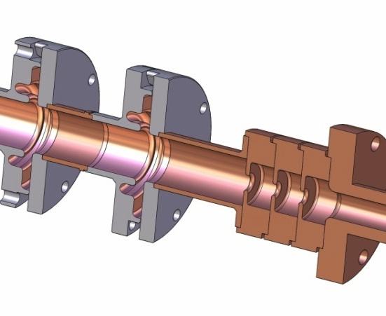
Accelerator Structures at Cryogenic Temperatures
We made detailed measurements for copper conductivity at 11.424 GHz. Because of the anomalous skin effect this data was not available.
Conductivity increases (by a factor of 17.6 at 25K), enough to reduce cyclic stresses.
The yield strength of copper improves.
The experiment is currently running
RF in

Slide 21
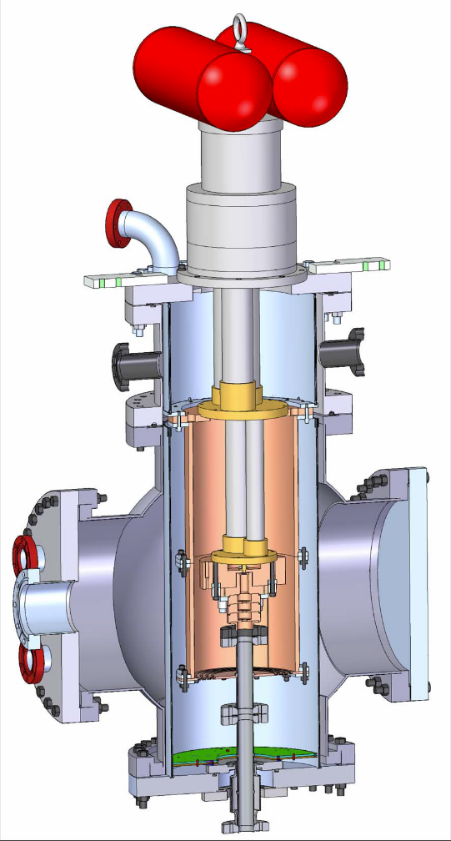
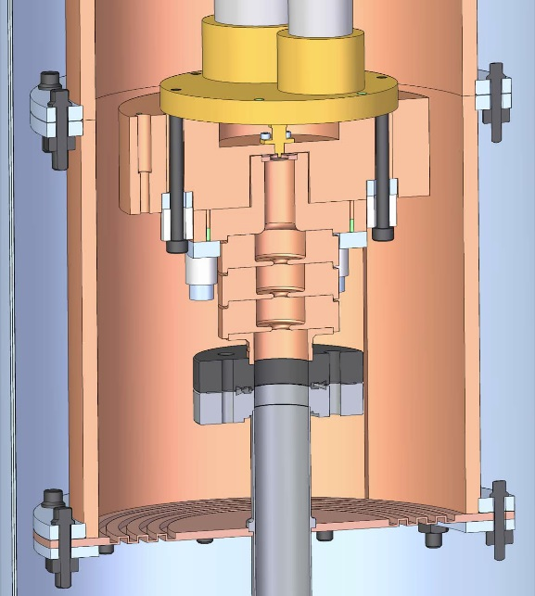
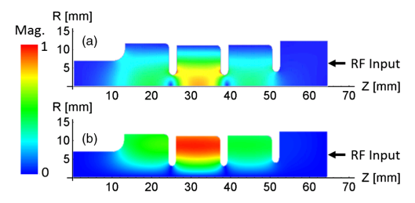
High-power testing of single-cell structure at cryogenic temperature of 45k
Breakdowns were detected above a gradient of 240 MV/m
1
E
2
Cu@45K
Hard CuAg#3
3
Soft Cu
H
Hard Cu
Hard
CuAg#1
The single-cell fields profile
1. dark-current monitor
2. accelerating structure
3. RF flange
Threshold
A. Cahill et al., “High gradient experiments with X-band cryogenic copper accelerating cavities,” PRAB, 21, 2018
Cryostat assembly
Notes:
A very enlightening experiment on the operation of NC acc
At cryogenic temperatures at high-gradient
Was performed at slac by…
Were they tested a single-cell inside a cryostat at cryogenic temp of 45k and high gradient operation

Slide 22
Full practical accelerator testing at cryogenic temperature
Distributed-coupling technology
with flexible optimization and exceptional Rs
Cryogenic operation
for increased Rs and reduced breakdown rates
Dramatic reduction in cost
using cryogenics at 77K

Slide 23
High-power test of the distributed-coupling structure (Xband, 20 cells) at LN cryogenic temperature (77k)
The high-power experiment was modified for LN cryogenic operation
Pulse compressor
X-band
Klystron
X-band
Klystron
SLED-II Line
NLCTA tunnel
NLCTA tunnel
Vent-out line
LN Feed line
Variable phase delay
Feed line
LN vent line
A
Solenoid
A
Faraday
Cup (FC)
Photo
gun
Cryostat
LN Dewar(s)
Dipole
Level detector
Boosting Linac
Stand
Laser System
Cryostat
Tested
Linac
Detector
M. Nasr, S. Tantawi, E. Nanni et. al.
Station 2
Station 1
Dramatic reduction in cost of system including cryogenics at 77K
Notes:
We modified the setup for the high-power testing of…

Slide 24

High-power test of the distributed-coupling structure (Xband, 20 cells) at LN cryogenic temperature (77k)
The high-power experiment was modified for LN cryogenic operation
M. Nasr, S. Tantawi, E. Nanni et. al.
Dramatic reduction in cost of system including cryogenics at 77K
Notes:
We modified the setup for the high-power testing of…

Slide 25



Cold cold-test of the distributed-coupling structure (Xband, 20 cells Linac) at LN cryogenic temperature (77k)
0
-8 dB
T decrease
-10
77k
|S11| dB
-20
-27.5 dB
300k
-30
11.402GHz
Frequency
11.438GHz
2.25X less RF power loss
Shunt impedance of 350 MΩ/m
M. Nasr et al. "Experimental demonstration of particle acceleration with normal conducting accelerating structure at cryogenic temperature." Physical Review Accelerators and Beams 24.9 (2021): 093201.

Slide 26




High-power test of the distributed-coupling structure (Xband, 20 cells) at LN cryogenic temperature (77k)
Modeled structure gradient confirmed with electron beam
Reduced breakdown rates compared to 300k operation
$$×100$$
Measured
Simulated
Room Temp (300k)
Cryogenic Temp (77k)
Stepped pulse with flat gradient of 200ns
Gradient=145 MV/m
Pixels
84MeV
Beam Energy
M. Nasr et al. "Experimental demonstration of particle acceleration with normal conducting accelerating structure at cryogenic temperature." Physical Review Accelerators and Beams 24.9 (2021): 093201.

Slide 27

High-power test of the distributed-coupling structure (Xband, 20 cells) at LN cryogenic temperature (77k)
Modeled structure gradient confirmed with electron beam
Reduced breakdown rates compared to 300k operation
$$×100$$
Measured
Simulated
Room Temp (300k)
Cryogenic Temp (77k)
Stepped pulse with flat gradient of 200ns
 | 300k | 77k
$$β=Q_{0}/Q_{e}$$ | 1 | 2.25
$$R_{s} (MΩ/m)$$ | 155 | 350
BDR | $$x_{0}$$ | $$x_{0}/100$$
Heavy beam loading
Reduced breakdown rates
High RF-to-beam efficiency
Cost-efficient solution with LN
M. Nasr et al. "Experimental demonstration of particle acceleration with normal conducting accelerating structure at cryogenic temperature." Physical Review Accelerators and Beams 24.9 (2021): 093201.

Slide 28

Distributed coupling structures are indestructible.
Old distributed coupling structure, Suface deformation happened at 300 MV/m
structure had a field enhancement factor of 2.6.

Slide 29
Next-Generation
Distributed-Coupling Linac

Slide 30




Next-generation distributed coupling linac:
New geometric-optimization approaches and optimized ports
New geometric-optimization approaches
The cavity curvature is defined with a set of control points with variable positions to control splines which describes the cavity shape.
$$r$$
The first design with circular shapes
$$R_{s}=155 MΩ/m→\frac{E_{peak}}{E_{acc}}=2.5$$
Can we do better?
$$z$$
Beam Axis
M. Nasr et al. New Geometrical-Optimization Approach using Splines for Enhanced Accelerator Cavities’ Performance, IPAC’18
M. Nasr, and S. Tantawi
Notes:
Successfully verifying the operation of the first distributed-coupling linac
We started developing the next generation of distributed-coupling linacs
Benifiting from the design flexibility of the distributed-coupling topology and overcoming the limitations of the first design

Slide 31







Next-generation distributed coupling linac:
New geometric-optimization approaches and optimized ports
New geometric-optimization approaches
Optimized coupling ports
X-band, 11.424 GHz, iris diameter $0.1λ$
Optimized shape
$E_{surf}$ (MV/m)
$H_{surf}$ (MA/m)
Starting shape
a.u.
Gradient=100MV/m
H Field
Distance along the surface (cm)
Target: Maximize shunt impedance with peak surface E-field to gradient ratio of 2
Peak surface E-field to gradient reduction from 2.5 to 2
with even higher shunt impedance
Reducing magnetic field enhancement to from $×$2.3 to $×$1.17
M. Nasr et al. New Geometrical-Optimization Approach using Splines for Enhanced Accelerator Cavities’ Performance, IPAC’18
M. Nasr, Z. Li, and S. Tantawi

Slide 32


Next-generation distributed coupling linac:
New geometric-optimization approaches and optimized ports
New geometric-optimization approaches
Optimized coupling ports
Peak surface E-field to gradient reduction from 2.5 to 2
with even higher shunt impedance
Reducing magnetic field enhancement to from $×$2.3 to $×$1.17
M. Nasr et al. New Geometrical-Optimization Approach using Splines for Enhanced Accelerator Cavities’ Performance, IPAC’18
M. Nasr, Z. Li, G. Bowden, and S. Tantawi
Notes:
We finalized the full structure design along with the mechanical design
, and we tested the manufacturing of our structure using a set of prototypes, and it is currently being built

Slide 33




135 degree phase advanced distributed coupling structure
If one includes the period as an optimization parameter then the optimal structure with the minimal surfac magnetic field, and consequently the highest shunt impedance occurs at ~$132°$ phase advance; a natural choice is$a 135°$ phase advance.
Every 4th cavity has a $π$phase shift, hence 4 manifolds are needed to feed the structure.
Every two manifolds need to be fed with a $\frac{π}{2}$ phase shift; naturally fed by a hybrid that isolates the forward signal from the reflected signal.
Marco Oriunno, J. Merrick, G. Bowden, Z. Li, C. Nantista, E. Snively, M Shumail, S. Tantawi

Slide 34
135 degree phase advanced distributed coupling structure
If one includes the period as an optimization parameter then the optimal structure with the minimal surfac magnetic field, and consequently the highest shunt impedance occurs at ~$132°$ phase advance; a natural choice is$a 135°$ phase advance.
Every 4th cavity has a $π$phase shift, hence 4 manifolds are needed to feed the structure.
Every two manifolds need to be fed with a $\frac{π}{2}$ phase shift; naturally fed by a hybrid that isolates the forward signal from the reflected signal.
Marco Oriunno, J. Merrick, G. Bowden, Z. Li, C. Nantista, E. Snively, M Shumail, S. Tantawi

Slide 35





Having every cell fed individually by a manifold naturally inspires the use of another manifold with another mode feeding the same cell
S-band
$$f_{res1}(GHz)$$ | 2.856
$$f_{res2}(GHz)$$ | 6.664
$$f_{comm}(MHz)$$ | 952
$$R_{shunt}(MΩ/m)$$ | 155
Power $∝$ (gradient)²
Performance of cavity improves when powered with two different RF modes
Efficiency: Linear superposition of fields by adding power in the two modes.
Gradient: doubling the accelerating gradient without doubling surface fields
C-band
M. Nasr, and S. Tantawi
Optimum designs require non-harmonic operation; instead, we design for frequencies that are not necessarily harmonically related, but rather have a common sub-harmonic.
Mode01
Mode02
Total
$E_{z}$ (a.u)
Energy gain(a.u)
M. Nasr et al. “A Novel Dual-Mode Dual-Frequency Linac Design”, IPAC’17
M. Nasr et al. “The Design and Construction of a Novel Dual-Mode Dual-Frequency Linac Design”, IPAC’18
Distance along the surface (cm)
Distance along the surface (cm)
Notes:
Increasing the gradient for single-mode operation comes at the cost of a larger increase in the input power with a square relation
On the other hand, dual-mode operation increases the system efficiency by boosting the accelerating gradient with a linear superposition of the power from the two modes; which increases the system efficiency
Also, Generally, the peak fields for the two modes doesn’t add up simultaneously on the surface
We found that our optimum designs require….
Thus, our designs still support multi-bunch operation separated by multiples of the common sub-harmonic period of the operating frequencies.
Our dual-mode design operating at S and C bands achieves a shunt impedance that is compatible with the one for our X-band design, but with double the iris diameter
And as we can see, an electron beam traveling on-axis experience the acceleration from both modes

Slide 36





Dual Moded Distributed Coupling 3$π/4$ Linac
Ultimate shunt impedance, bigger apertures without loss of efficiency.
The elimination of the spigot length compacted the structure horizontally. Hence, operation at low frequency would still yield a reasonably sized device, which would allow us to think about a superconducting implementation.
Electrically it is a standing wave accelerator. For the point view of the source it acts as travelling-wave accelerator.
The manifold provide damping for both dipole polarizations.

Slide 37
Conclusion
Understanding the physics of breakdowns
triggered new research directions for high-gradient operation
Distributed-coupling technology
enables much flexible cell-design optimization and pushes the limitation of Linacs performance.
Cryogenic-copper accelerating structures
have the promise for a new frontier for beam brightness, efficiency and cost-capability

Slide 38
Dual-Mode Dual-Frequency
Linac

Slide 39
Having every cell fed individually by a manifold naturally inspires the use of another manifold with another mode feeding the same cell
Power $∝$ (gradient)²
Performance of cavity improves when powered with two different RF modes
Efficiency: Linear superposition of fields by adding power in the two modes.
Gradient: doubling the accelerating gradient without doubling surface fields
Optimum designs require non-harmonic operation; instead, we design for frequencies that are not necessarily harmonically related, but rather have a common sub-harmonic.
M. Nasr et al. “A Novel Dual-Mode Dual-Frequency Linac Design”, IPAC’17
M. Nasr et al. “The Design and Construction of a Novel Dual-Mode Dual-Frequency Linac Design”, IPAC’18
M. Nasr, and S. Tantawi
Notes:
Increasing the gradient for single-mode operation comes at the cost of a larger increase in the input power with a square relation
On the other hand, dual-mode operation increases the system efficiency by boosting the accelerating gradient with a linear superposition of the power from the two modes; which increases the system efficiency
Also, Generally, the peak fields for the two modes doesn’t add up simultaneously on the surface
We found that our optimum designs require….
Thus, our designs still support multi-bunch operation separated by multiples of the common sub-harmonic period of the operating frequencies.
Our dual-mode design operating at S and C bands achieves a shunt impedance that is compatible with the one for our X-band design, but with double the iris diameter
And as we can see, an electron beam traveling on-axis experience the acceleration from both modes

Slide 40

Acknowledgement
PhD Advisor:
Sami Tantawi
Collaborators:
G. Bowden
M. Breidenbach
Z. Li
E. Nanni
B. Weatherford
S. Weathersby
NLCTA team:
Michael Dunning
Carsten Hast
Keith Jobe
Doug McCormick
Colleagues:
Karl Bane
Philipp Borchard
Craig Burkhart
Alex Cahill
Robert Conley
Valery Dolgashev
Alysson Gold
Mark Kemp
Cecile Limborg
Marco Oriunno
Tor Raubenheimer
Muhammed Shumail
Filippos Toufexis
Supported by:
Notes:
For all his support and continuous guidance
For their help with the work
For helping us on daily basis at NLCTA
For all their help and the useful discussions
Last but not least, the department of energy for supporting our program

Slide 41
Thanks!
Questions?
mamdouh@slac.stanford.edu

Slide 42
Supplementary material

Slide 43

Understanding the physics of breakdowns triggered new research directions for high gradient linear accelerators
Single-cell testing
Experimental studies for understanding the physics of breakdowns have led to many discoveries
Magnetic field’s role in breakdowns through pulsed heating
Reduced breakdown rates with increased material strength (hard materials and low temperature operation)
Full scale structures are long, complex, and expensive
Cu@45K
  Breakdown Rate Correlated with Magnetic Field
Hard CuAg#3
Soft Cu
Hard Cu
Hard
CuAg#1
Accelerating Gradient [MV/m]
Valery Dolgashev et al., “Geometric dependence of radio-frequency breakdown in normal conducting accelerating structures,” Applied Physics Letters, Volume 97, Issue 17, pp 171501 - 171501-3, October 2010.
Alex Cahill et al., "High gradient experiments with X-band cryogenic copper accelerating cavities" Phys. Rev. Accel. Beams 21, 102002 – Published 23 October 2018.
Notes:
Surface damage

Slide 44
Understanding the Physics of High Gradients has Established the Limits of Normal Conducting Copper Structures
Narrow error bar will be obtained after recalibration; work in progress
Hard CuAg#1
Cu@45K
Hard CuAg#1
Cu@45K
Soft Cu
Soft Cu
Hard Cu
Hard CuAg#2
Hard CuAg#2
Basic physics experiments move to testing normal & SC engineered materials
Cost effective implementation of accelerator structures capable of operating efficiently at these gradients.
Build RF sources that can power these structures to high gradients
New architectures for future facilities (colliders, light sources, etc.) will emerge when efficient RF systems to power linacs operating at these gradients become available
Immediately, this technology will lead to RF guns with unprecedented brightness.

Slide 45
High-power testing of single-cell structure at cryogenic temperature of 45k
Single-cell testing
1
E
2
3
H
The single-cell fields profile
1. dark-current monitor
2. accelerating structure
3. RF flange
A. Cahill et al., “High gradient experiments with X-band cryogenic copper accelerating cavities,” PRAB, 21, 2018
Cryostat assembly
Notes:
A very enlightening experiment on the operation of NC acc
At cryogenic temperatures at high-gradient
Was performed at slac by…
Were they tested a single-cell inside a cryostat at cryogenic temp of 45k and high gradient operation

Slide 46


Comparison with a side-coupled linac
The surface loss in the side coupling cavities is 2.6% of the surface loss of the accelerating cavities in a side coupled structure. This ratio is 1.14% in the parallel feed structure between the waveguide and the cavity losses, which is more a than factor of 2 lower.

Slide 47


Comparison with a side-coupled linac
The surface loss in the side coupling cavities is 2.6% of the surface loss of the accelerating cavities in a side coupled structure. This ratio is 1.14% in the parallel feed structure between the waveguide and the cavity losses, which is more a than factor of 2 lower.

Slide 48

Large-coupling distributed-coupling linac
The total bandwidth of this structure is 256 MHz, and the frequency spacing between the π and the N/N−1 π-mode is 2 MHz which is far outside of the bandwidth of the π-mode resonance.

Slide 49

Large-coupling distributed-coupling linac

Slide 50


Pulse-correction implemented at SLAC and KEK

Slide 51

High-power test of the distributed-coupling structure (Xband, 20 cells)
300k versus 77k operation forward and reflected waveforms
Notes:
The measured forward and reflected pulses at the input of the accelerator structure at a gradient of 95 and 120 MV/m for 300 and 77 K operation, respectively. The figure also shows the simulated gradient using the cavity model and the good agreement between measured and simulated reflected waveform.

Slide 52

High-power test of the distributed-coupling structure (Xband, 20 cells)
Processing history at 300k and 77k
In our calculations of the breakdown rates, we eliminated the periods of ramping up to the target gradient. As a result, the reported breakdown rate at a specific gradient level is calculated using the counted breakdowns and pulses while the structure is settling at this gradient level.

Slide 53


High-power test of the distributed-coupling structure (Xband, 20 cells)
A zoom-in of the collected breakdown statistics at 300 and 77 K
For both operating temperatures, the data were collected for a 400 ns stepped pulse with a flat gradient of 200 ns and 60 Hz repetition rate. The breakdown statistics at each gradient level were collected over more than $3×{10}^{6}$ pulses. The only exception is the collected statistics at 110 MV/m for 300 K where the data was collected over $4×{10}^{5}$ pulses.

