Slide 1
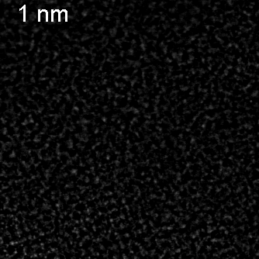
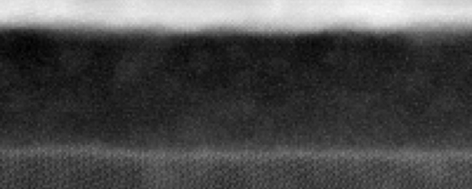
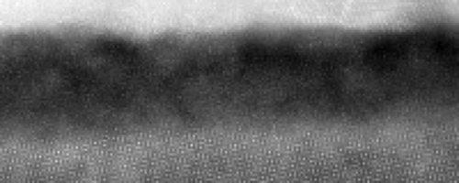
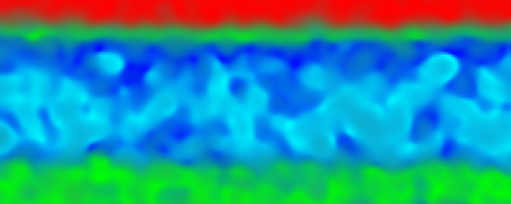

Surface characterization of Nb₃Sn surfaces with STEM
Electrochemical Synthesis (Electroplating) ‘wet’
Vapor Diffusion
(Wuppertal method) ‘dry’
ADF
EELS segmentation
10 Å
Electroplated samples have Sn/SnO/SnO2 on the surface which acts as a surface defect with Tc ~ 3.7K
Vapor diffused oxide contains admixture of Nb and Sn oxides, and higher oxygen vacancy
Revealing lattice distortions near metal-oxide interface
10 nm
Z. Baraissov, Z. Sun, M.Liepe, D. Muller

Slide 2
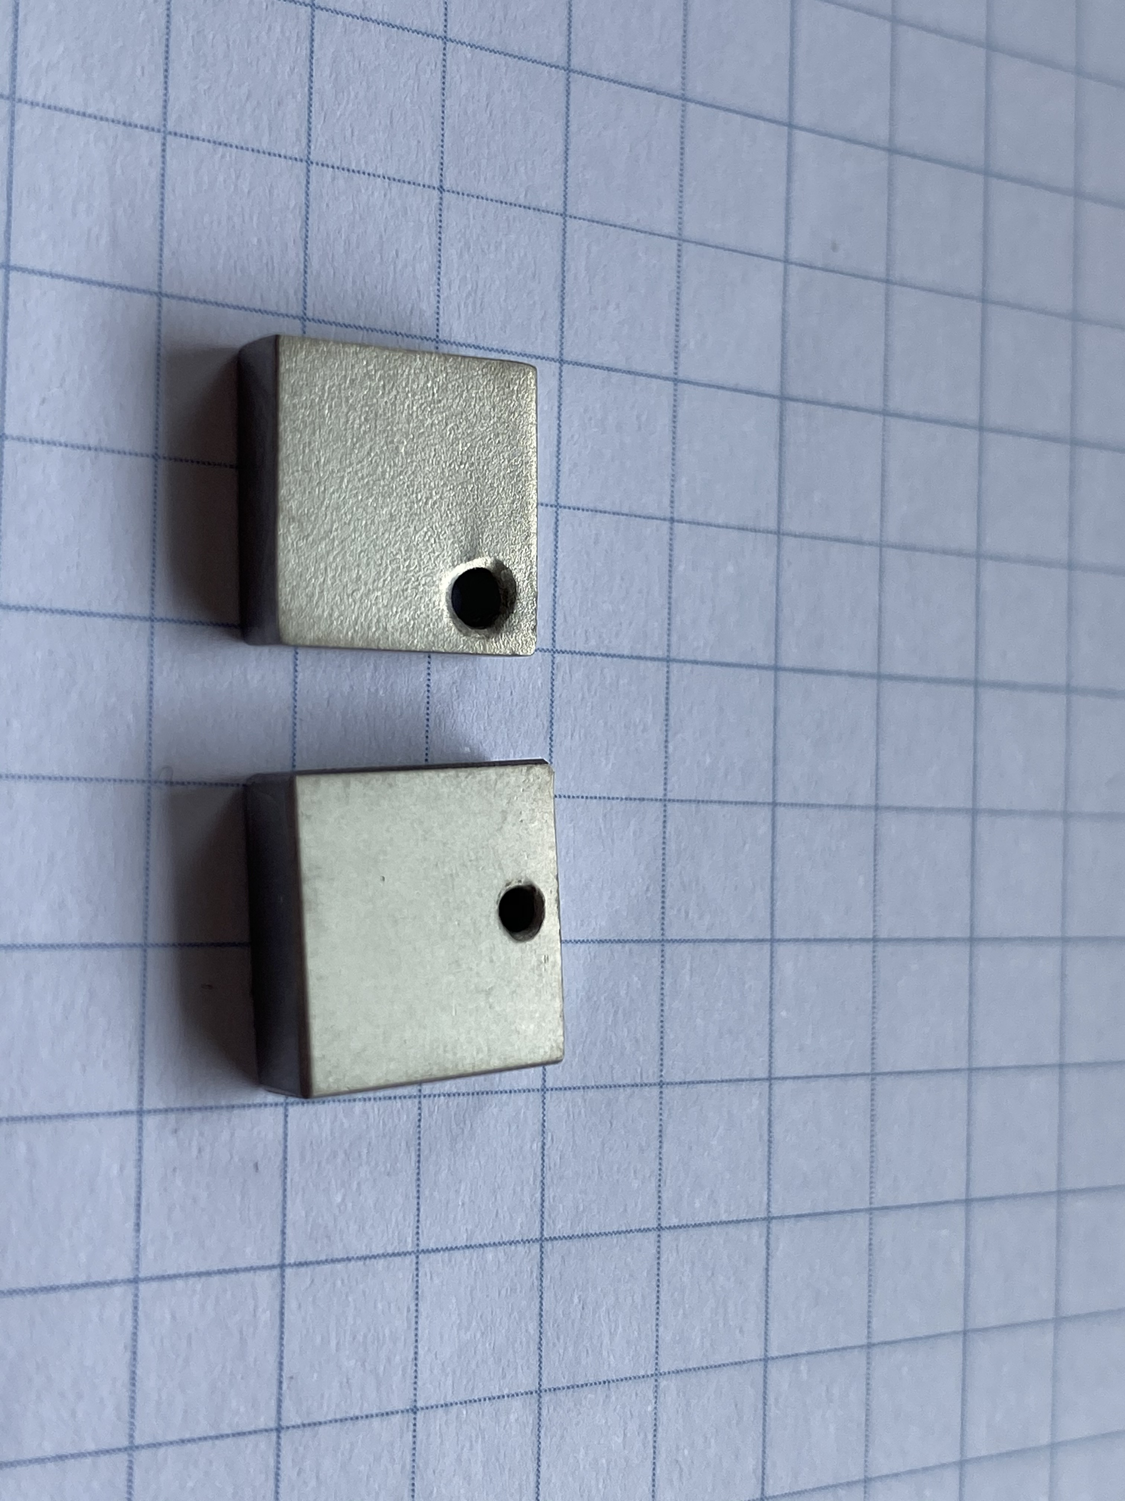
Material: Nb3Sn (vapor diffused vs electroplated)
Vapour diffusion using furnace
Electrochemical synthesis
Conventional method
Vacuum
( < 10⁻⁵ Torr )
Cavity/sample
Coating chamber
( 1100 °C )
Nucleation agent ( SnCl₂ )
Electroplating followed by annealing to obtain stochiometric Nb₃Sn
Developed by Z.Sun, M.Liepe ; cavity annealing L. Shpani.
Heaters
Tin crucible
Tin source (1250 °C )
Roughness reduced 4-5 times
Sun, Z., Baraissov, Z., et al (2023). Smooth, homogeneous, high-purity Nb3Sn superconducting RF resonant cavity by seed-free electrochemical synthesis. Superconductor Science and Technology, 36(11), 115003.

Slide 3
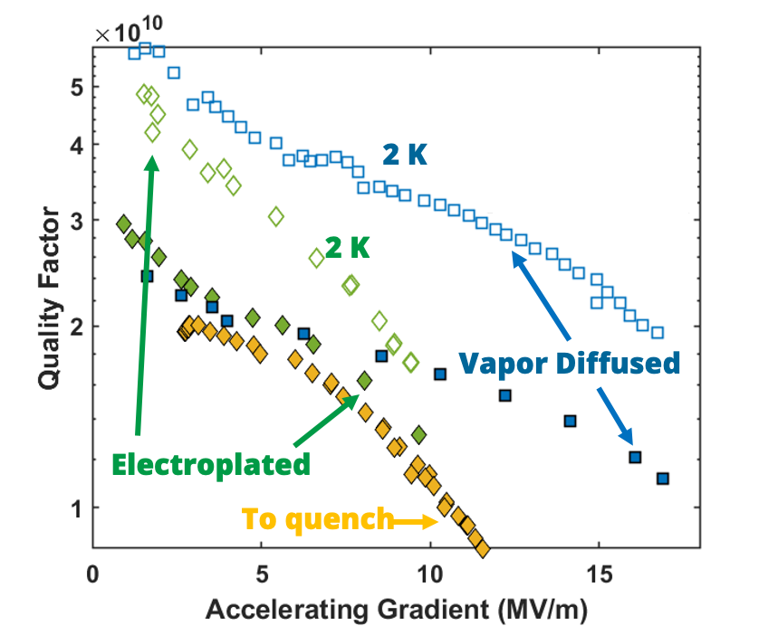
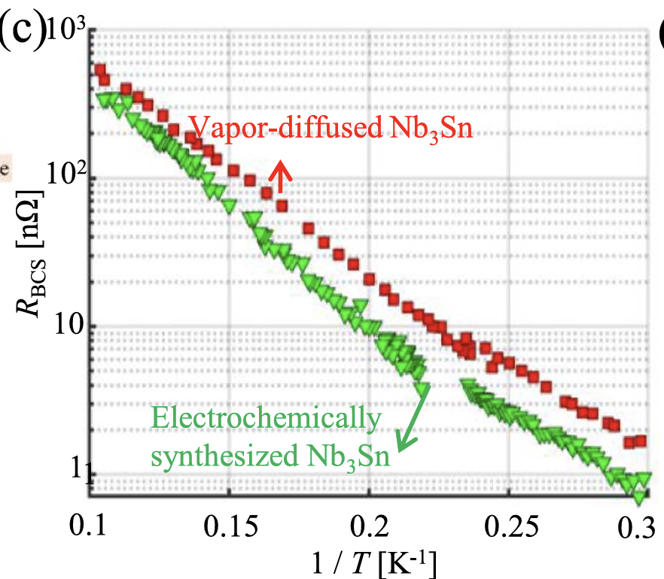
RF performance tests
Lower BCS resistance, higher residual
Measurements from Liana Shpani
Performance to structure correlation is critical : why quench early?
Which defects add to residual resistance?

Slide 4




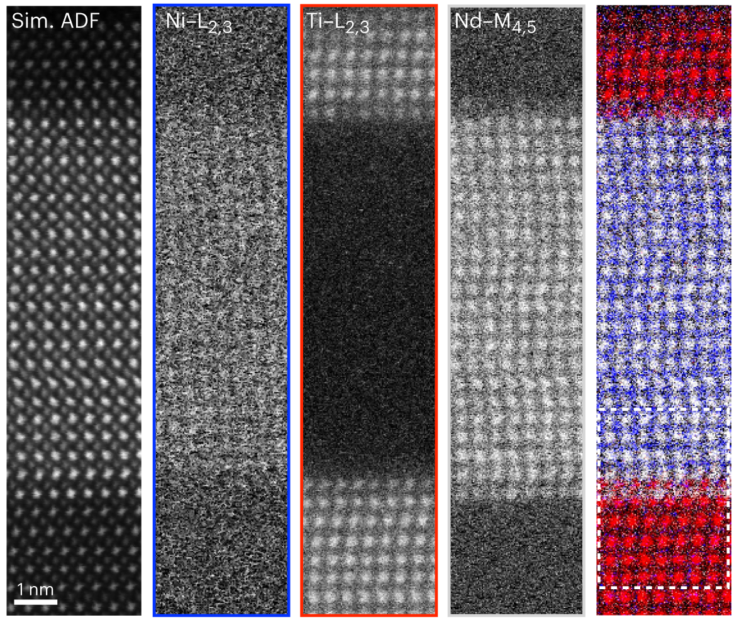
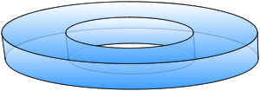
STEM and Electron Energy Loss Spectroscopy
record all energies at 1 spot in the sample
Electron beam
Ti 3d
O 2p
Nd 4f
Ni 3d
lenses
sample
Intensity
Energy loss (eV)
Increasing
energy loss
ADF
Detector
STEM-EELS provide access to:
atomic-scale elemental and chemical information
local electronic structure and unoccupied density of states
Electron Energy
Loss Spectrometer
Goodge, Berit H., et al. "Resolving the polar interface of infinite-layer nickelate thin films." Nature materials 22.4 (2023): 466-473.

Slide 5
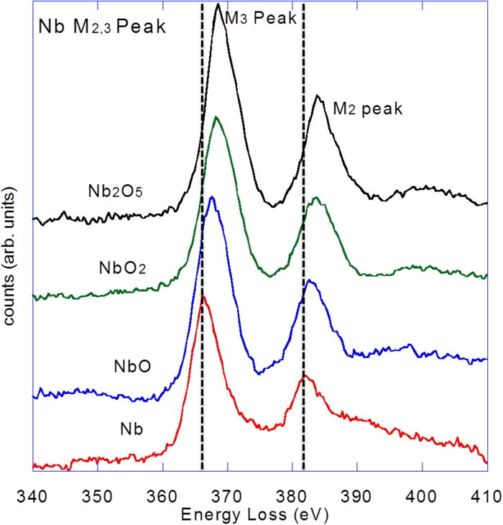
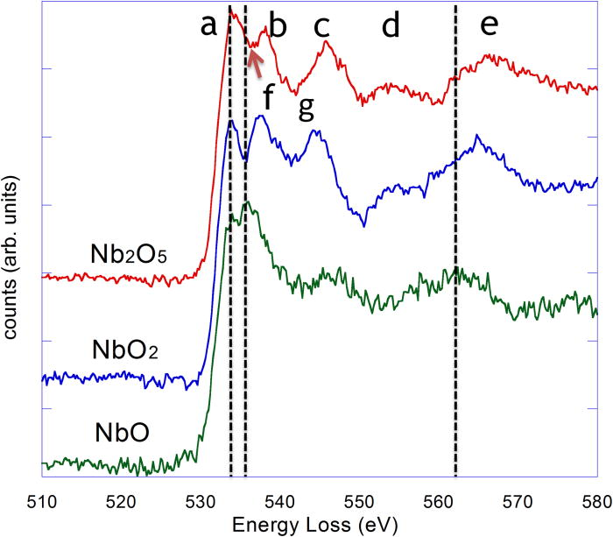
EELS of Nb oxides: Reference
Probe Nb valence state
Probe oxidation state
J. Appl. Phys.. 2011;110(12). doi:10.1063/1.3665193
Notes:
The electron is excited from the O 1s core level (binding energy ~ 530 eV, depending on chemical environment).
It is promoted into unoccupied conduction band states—these are primarily composed of O 2p orbitals hybridized with the metal cation orbitals (for example Nb 4d in Nb oxides or Si 3s/3p in SiO₂).
Because pure O 2p states alone don’t form the conduction band in oxides, the final states are actually mixed:
In transition metal oxides (like Nb₂O₅), the O 2p orbitals are strongly hybridized with Nb 4d orbitals.
The ratio of the two peaks reflects empty orbital populations ratio t₂_{g}/e_{g} , which is 6/4 for Nb₂O₅ and decreasing toward 3/4 for NbO. [3] In contrast, the vapor-diffused sample’s oxide shows a weaker first peak, suggesting a high density of oxygen vacancies or incomplete oxidation.

Slide 6
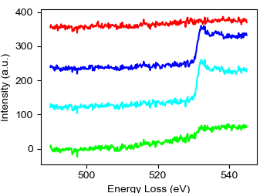
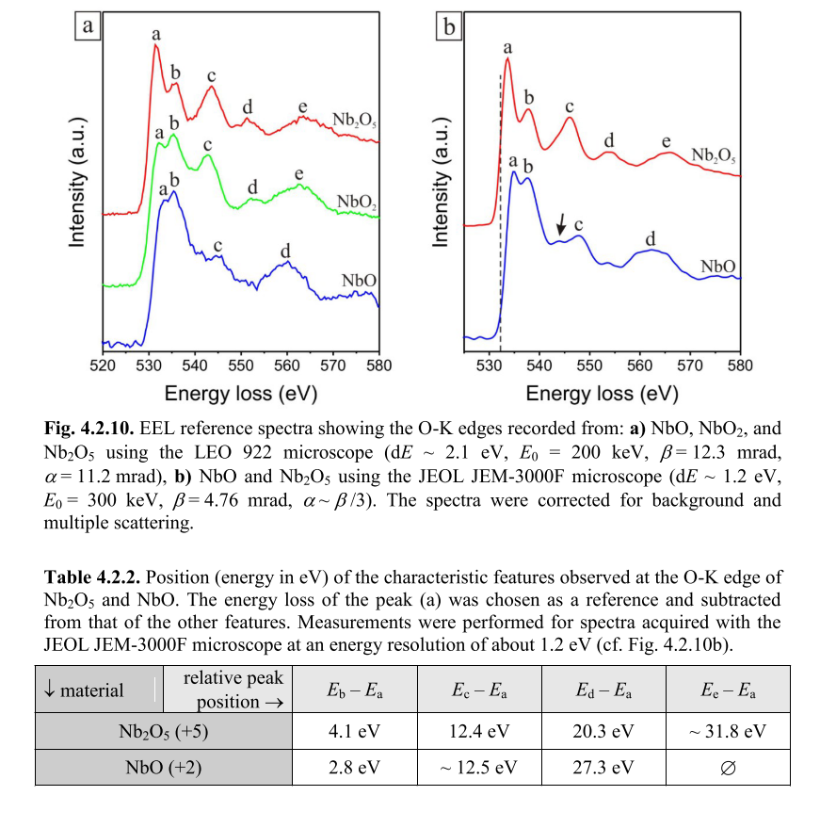
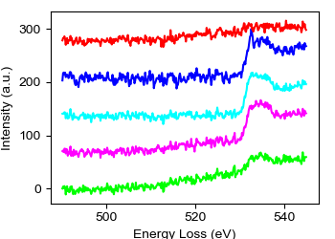
Sn-M edge and O-K edge
Electroplated
Vapor Diffused
Fine features present in electroplated oxide are washed out in the vapor diffused sample
( higher O vacancies)
10 nm
Bach, David, et al. "EELS of niobium and stoichiometric niobium-oxide phases—Part I: Plasmon and near-edges fine structure." Microscopy and Microanalysis 15.6 (2009): 505-523.

Slide 7
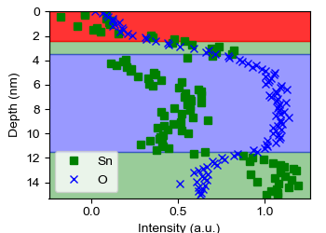
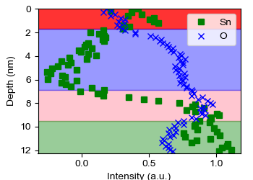
Phase separation of tin oxides
Does tin appear as metal or a part of an oxide?
The tin on the surface has lower oxygen content, i.e. metallic tin+ surface oxidation
Non-negligible tin concentration within the oxide (blue region)
10 nm
The tin rich region on the interface has the highest oxygen amount, suggesting that tin appears as part of the oxide
10 nm
Notes:
1) ADF images

Slide 8
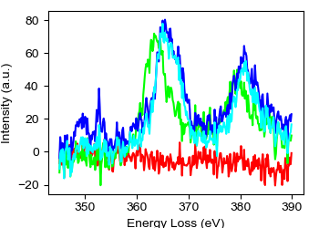
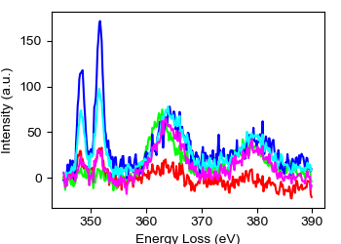
Nb-M edge and Ca-L edge
Ca-L
Nb-M3
Nb-M2
Significant Ca contamination in the vapor diffused sample
Different shift in Nb-M edge for two samples
Electroplated
Vapor Diffused
10 nm

Slide 9

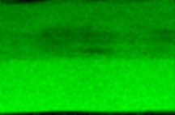
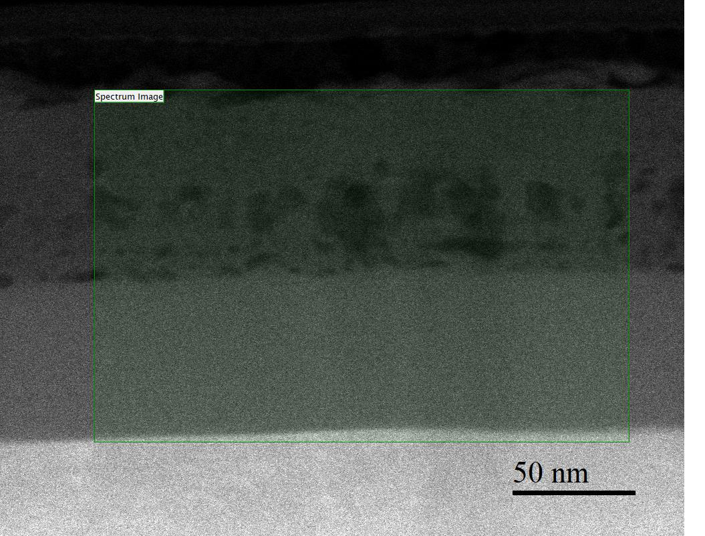


Anodized oxide can host contaminants
Nb-M edgemap
O-K edgemap
Protective
layer
Oxide after anodization
Nb + O + Ca
Ca-L edgemap
Nb
50 nm
The top layer is very porous and contains Ca, Nb, O, while the bottom layer is fully oxidized

Slide 10
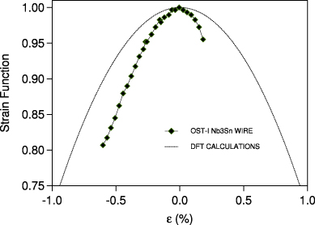
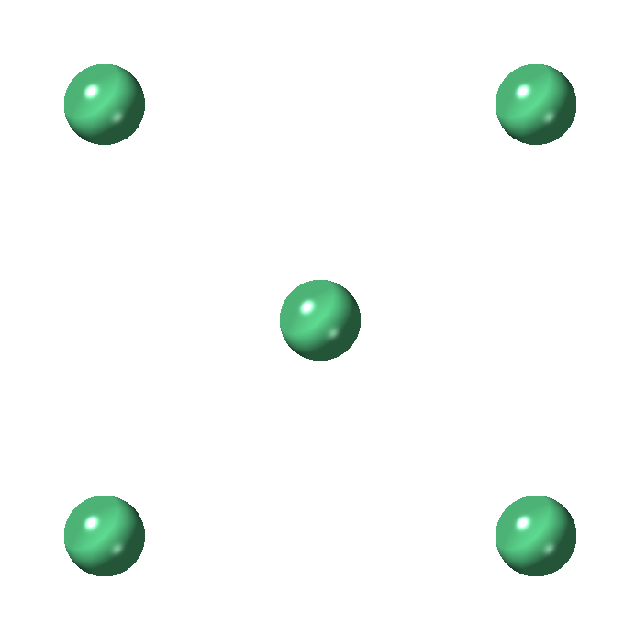
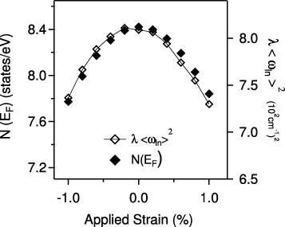

Nb-Nb distance impacts DOS and Tc
bcc Nb
Material | Shortest Nb-Nb bond (A)
Nb | 2.86
Nb₃Sn | 2.65
[111]
bcc Nb₃Sn
Parallel to [100]
How to measure the Nb-Nb distance in 3D?
De Marzi, Gianluca, et al. "Strain sensitivity and superconducting properties of Nb3Sn from first principles calculations." Journal of Physics: Condensed Matter 25.13 (2013): 135702.

Slide 11
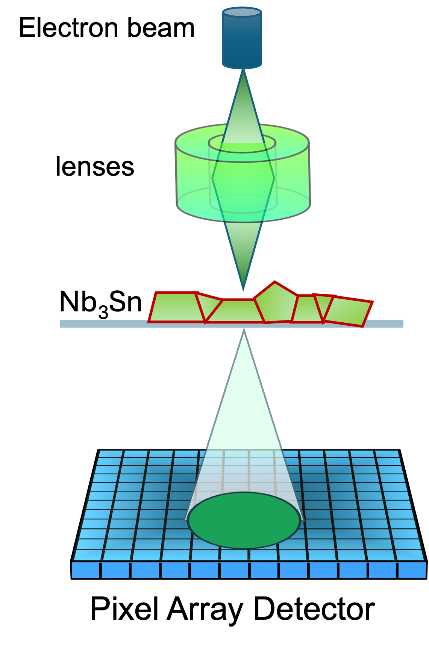
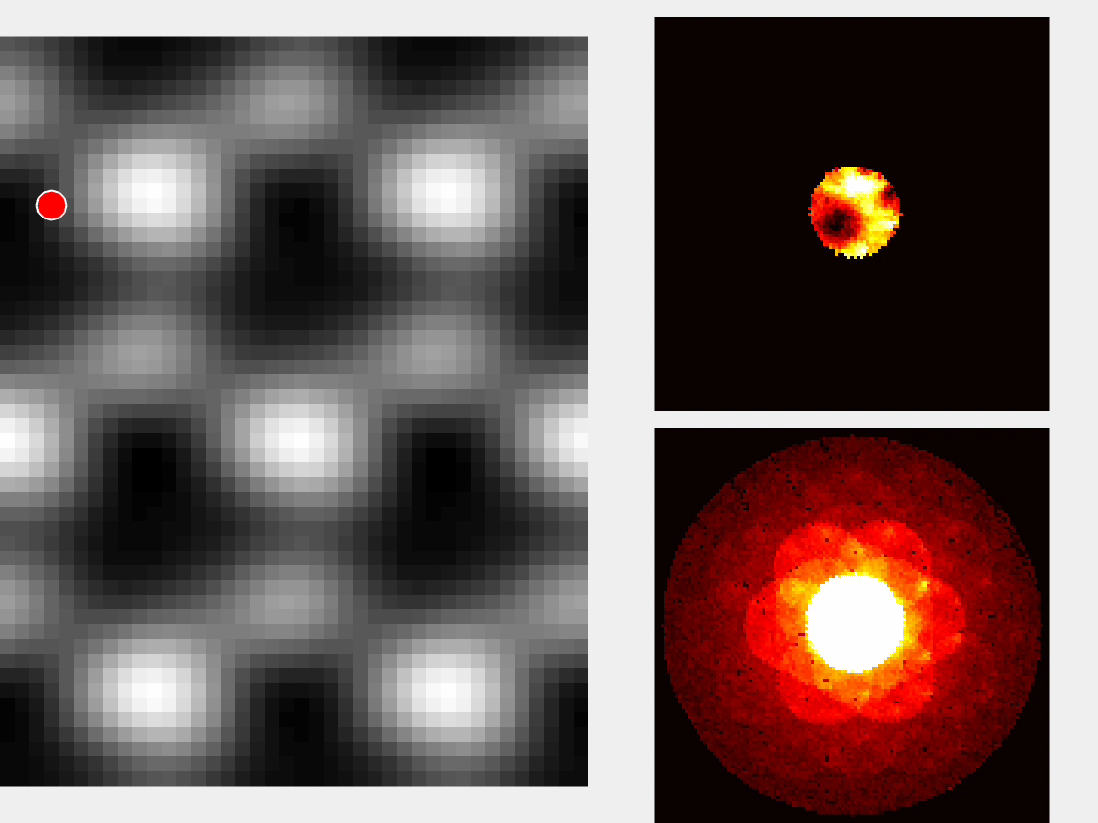
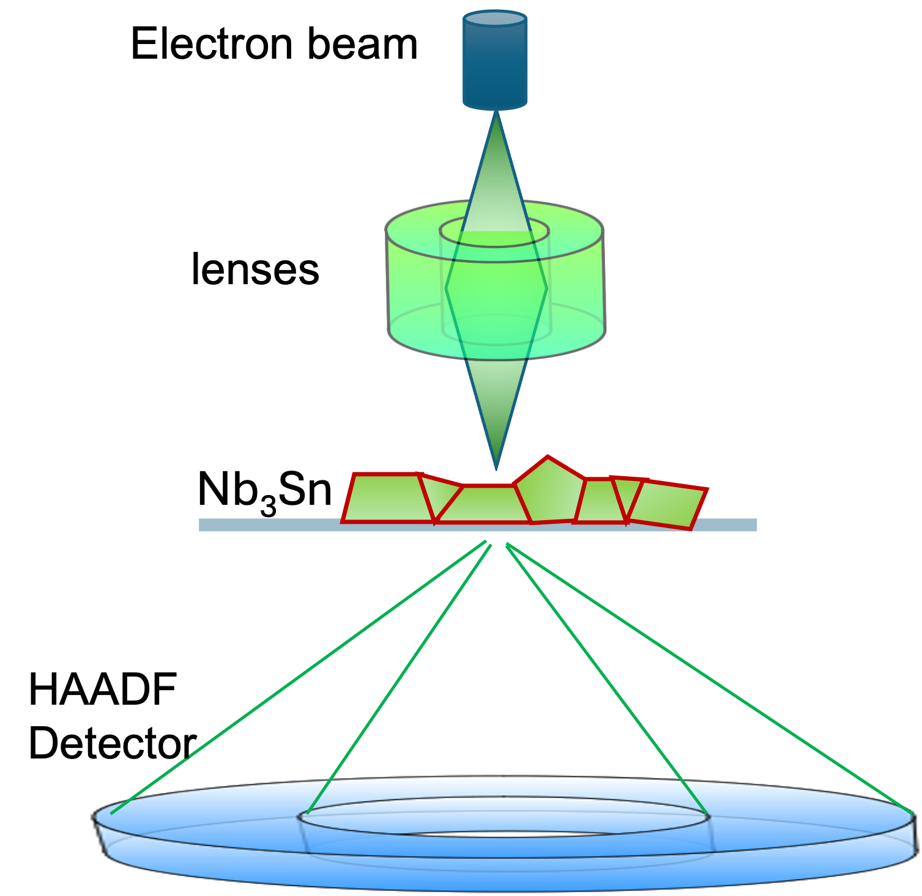








Multislice Electron Ptychography
$$ψ_{probe}$$
$$V1$$
$$Δz$$
$$ψ_{1e}=ψ_{probe}\exp\left(iσV1\right)$$
$$V2$$
$$ψ_{2e}=p\left(Δz\right)⨂ψ_{1e}\exp\left(iσV2\right)$$
$$V3$$
$$ψ_{exit}=p\left(Δz\right)⨂ψ_{2e}\exp\left(iσV3\right)$$
$${\left|ψ_{0}+ψ_{s}\right|}^{2}={\left|ψ_{0}\right|}^{2}+{\left|ψ_{s}\right|}^{2}+2\left|ψ_{0}\right|\left|ψ_{s}\right|\cos\left(φ_{0}−φ_{s}\right)$$
Jiang, Yi, et al. "Electron ptychography of 2D materials to deep sub-ångström resolution." Nature 559.7714 (2018): 343-349.

Slide 12
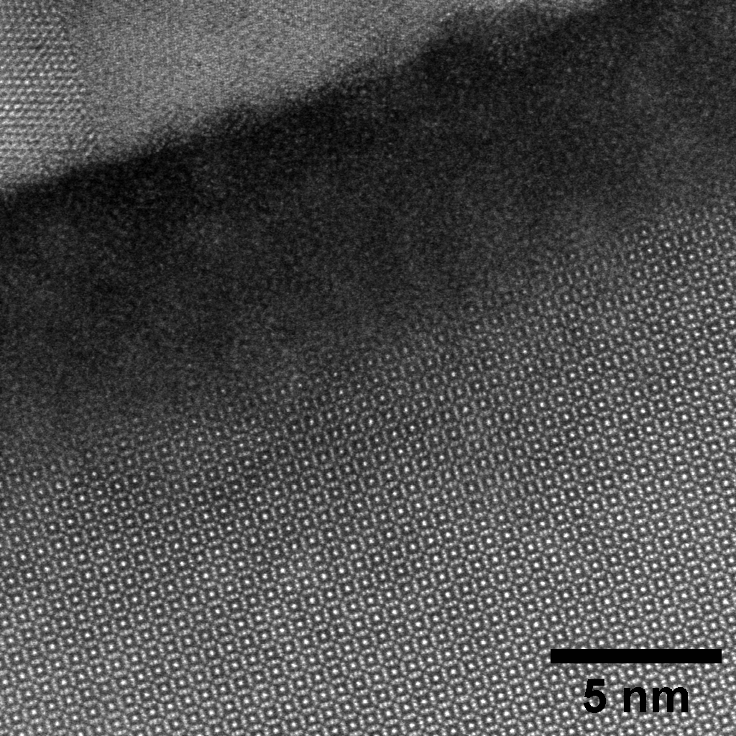
Conventional HAADF imaging
Amorphous oxide
Nb₃Sn
Protective layer
Nb₃Sn
Nb
HAADF imaging provides adequate lateral resolution, but lacks depth resolution

Slide 13
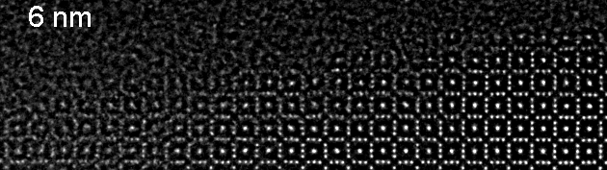
Results:Unit cell distortions at the interface
z
Amorphous oxide
Nb₃Sn
Distortions and rotations of unit cell are present near the interface
Possible sources of distortion – point defects and oxygen interstitials

Slide 14
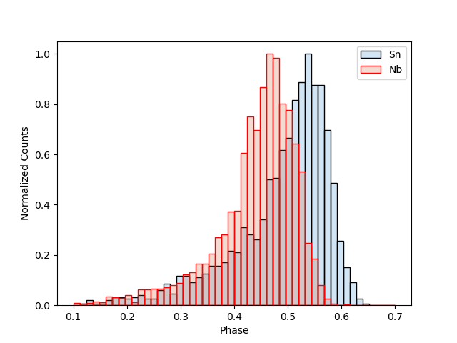
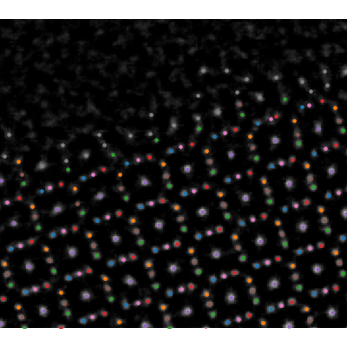
Phase difference in Nb and Sn
Atom classification
Distribution of phase for different atomic species
Possibility of measuring anti-site defects in 3D

Slide 15
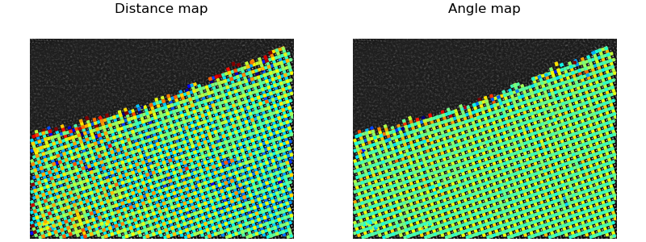
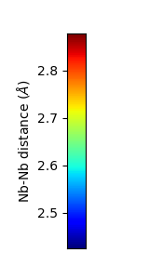
Disorder at the oxide/metal interface: out-of-plane
Z=7 nm
10 Å
Lattice distortions and rotations are prevalent at the oxide/metal interface
Lattice relaxes to the bulk value within two monolayers

Slide 16
Summary
EELS measurements show presence of tin/tin oxide on the surface of the EP sample, which acts as a surface defect with Tc ~ 3.7K
Higher oxygen vacancy concentration in vapor diffused oxide
Lower valence for vapor diffused oxide
Lattice distortions near metal-oxide interface and interstitials
EELS segmentation

Slide 17




Acknowledgments
Muller group @ Cornell
SRF group @ Cornell
Liana Shpani
Prof Matthias Liepe
CBB is supported by the NSF STC program, grant # PHY-1549132.
Facilities support from CCMR, an NSF MRSEC, grant DMR-1719875
Dr Zeming Sun
(Now at Bruker)

Slide 18
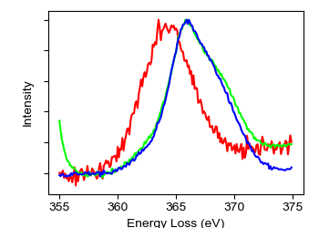
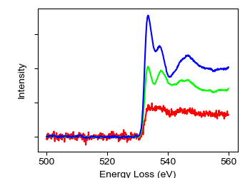
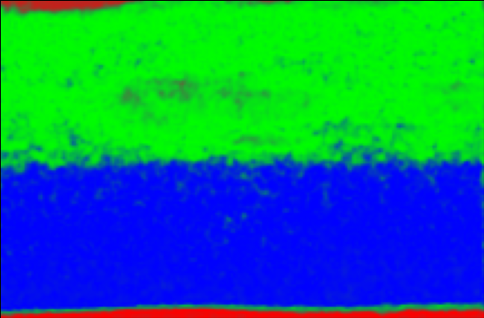
Spectral segmentation of the EELS dataset
EELS spectral map segmented
Nb-M₃
O-K
50 nm
Top oxide has similar Nb valence (no energy shift)
Blue: Fully oxidized Nb₂O₅
Green: Ca_{x}Nb₂O₄
Red: Nb + interstitial O

Slide 19
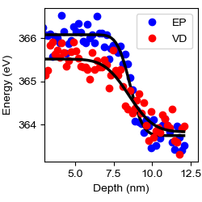
Nb valence tracking over the interface
Is there a bonding change for Nb at the interface?
10 nm
Surface oxide
Bulk Nb₃Sn
We observe a lower energy shift for VD (1.7 eV for VD vs 2.3 eV for EP) compared to bulk Nb3Sn.
Both measurements agree on the absolute value of Nb M3 peak for bulk Nb₃Sn within uncertainty
Separate bonding state for the interfacial layer
Nb 5+
Nb 4+

Slide 20
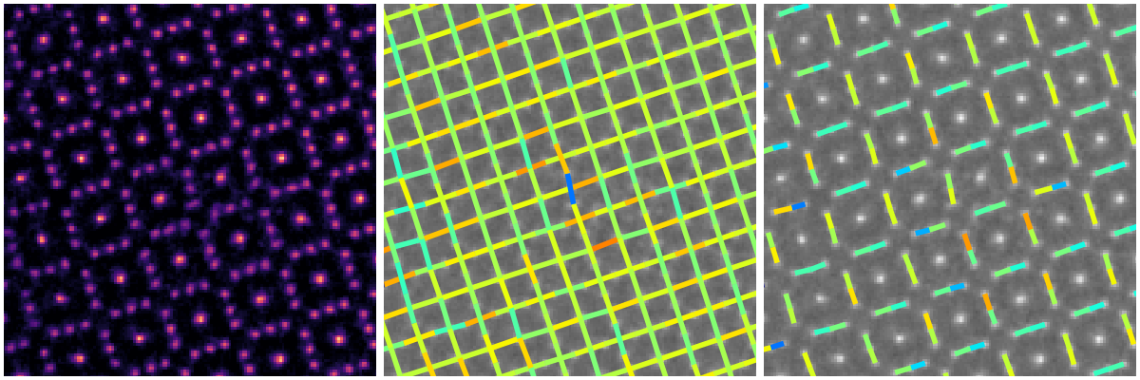
Oxygen interstitials
Object phase
Interatomic vector angle
Interatomic vector distance
5 Å

Slide 21
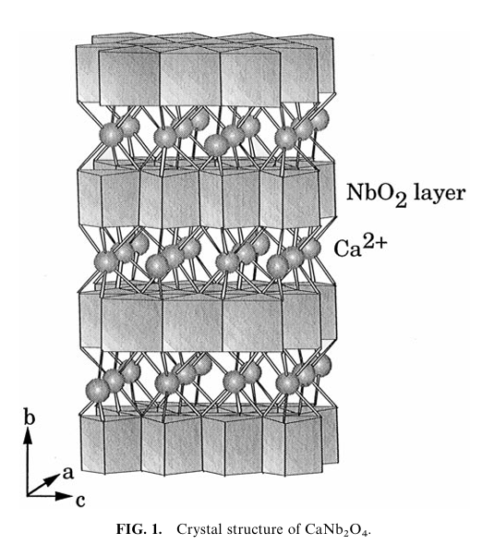
O-K fine feature comparison
50 nm
Bottom layer is a fully oxidized Nb₂O₅
Local bonding and coordination for the top layer is closer to NbO₂
17 possible phases of Ca_{x}Nb_{y}O
Bach, David, et al. "EELS of niobium and stoichiometric niobium-oxide phases—Part I: Plasmon and near-edges fine structure." Microscopy and Microanalysis 15.6 (2009): 505-523.
Kumada, N., and N. Kinomiura. "Preparation and crystal structure of a new reduced calcium niobium oxide: CaNb2O4." Journal of Solid State Chemistry 147.2 (1999): 671-675.
Notes:
The electron is excited from the O 1s core level (binding energy ~ 530 eV, depending on chemical environment).
It is promoted into unoccupied conduction band states—these are primarily composed of O 2p orbitals hybridized with the metal cation orbitals (for example Nb 4d in Nb oxides or Si 3s/3p in SiO₂).
Because pure O 2p states alone don’t form the conduction band in oxides, the final states are actually mixed:
In transition metal oxides (like Nb₂O₅), the O 2p orbitals are strongly hybridized with Nb 4d orbitals.
The ratio of the two peaks reflects empty orbital populations ratio t₂_{g}/e_{g} , which is 6/4 for Nb₂O₅ and decreasing toward 3/4 for NbO. [3] In contrast, the vapor-diffused sample’s oxide shows a weaker first peak, suggesting a high density of oxygen vacancies or incomplete oxidation.

Slide 22
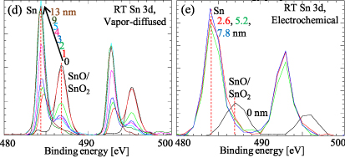
XPS comparison of VD and EC
Mixed Sn and Nb oxides in vapor-diffused and separate layer of SnO on the surface of the electroplated sample

Slide 23

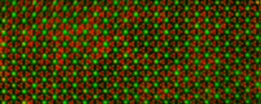
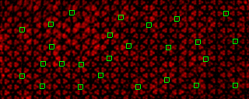

Previous work: Nb_{Sn} anti-site defects
Sn-L edgemap
Composite map of Nb and Sn
Nb-L edgemap
Nb atoms, that are 1Å apart, can be distinguished
Nb signal in the Sn atomic sites is detected
Drawbacks:
Very high dose (over 6000 times more than ptychography)
Defects are formed during imaging
Sum of the projection (no depth resolution)
10 Å

