Slide 1
A Surface Chemist’s Tools Applied to Study SRF Surfaces and Treatments
Materials for Bright Beams Workshop July 17th, 2025
Michael Van Duinen, University of Chicago
Van Do¹, Aiden Harbick², Michelle M. Kelley³, Helena Lew-Kiedrowska¹, Cristobal Méndez³, Liana Shpani³, Caleb Thompson¹, Sarah Willson¹, Matthias Liepe³, Mark Transtrum², Tomás Arias³, Steven J. Sibener¹
¹ = University of Chicago, ² = Brigham Young University, ³ = Cornell University

Slide 2
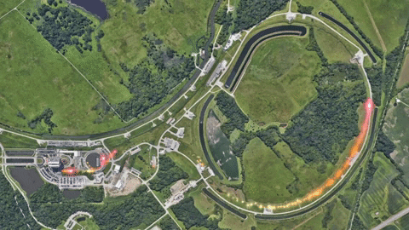
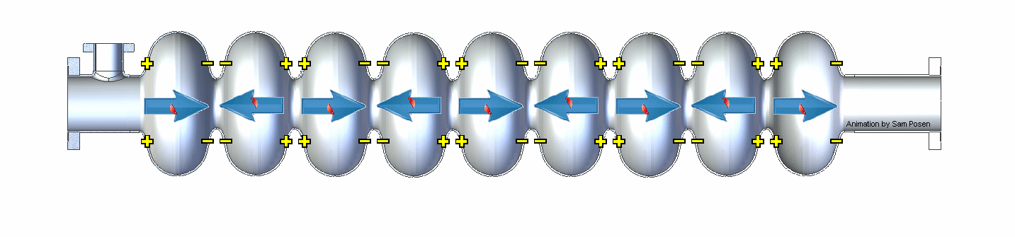
Niobium in SRF Cavities: Why? Why Not?
Superconducting Radio Frequency cavities accelerate particles in particle accelerators
High-energy, AC field
Superconductive materials prevent field losses
@FermiLab on GIPHY

Slide 3
Niobium in SRF Cavities: Why? Why Not?
Superconducting Radio Frequency cavities accelerate particles in particle accelerators
High-energy, AC field
Superconductive materials prevent field losses
Niobium is state-of-the-art for SRF cavities
@FermiLab on GIPHY

Slide 4
Niobium in SRF Cavities: Why? Why Not?
Superconducting Radio Frequency cavities accelerate particles in particle accelerators
High-energy, AC field
Superconductive materials prevent field losses
Niobium is state-of-the-art for SRF cavities
Nb has room for improvement
Cryocooling is very costly at 2 K (helium boiling point ~ 4 K)
@FermiLab on GIPHY

Slide 5
Niobium in SRF Cavities: Why? Why Not?
Superconducting Radio Frequency cavities accelerate particles in particle accelerators
High-energy, AC field
Superconductive materials prevent field losses
Niobium is state-of-the-art for SRF cavities
Nb has room for improvement
Cryocooling is very costly at 2 K (helium boiling point ~ 4 K)
@FermiLab on GIPHY
Current SRF cavity research is focused on developing new Nb-based materials at the Nb surface.

Slide 6
2-Pronged Approach to Improving Nb Superconducting Performance
Issue 1: Oxide is deleterious to superconducting performance
Niobium very readily oxidizes even in vacuum conditions
Incredibly high temperatures to remove
Solution 1: Suppress the oxide
Capping layers that don’t oxidize (i.e. Au)
“Sacrificial” layers with strong oxidation potential (i.e. Zr)
Issue 2: Niobium is nearing its fundamental material limits
Decades of research have pinned down excellent cleaning techniques
Solution 2: Develop material with stronger superconducting properties at surface
Nb₃Sn
Nb with trace N (discussed at the end)
Notes:
Needs slide before this
”higher performance”

Slide 7
Fundamental Chemical Questions Underlying the Approaches to Achieving Higher Performance
Oxide
”Oxide” is a catch-all term for many oxygen-containing Nb phases
Nb₂O₅ insulating
NbO₂ a semiconductor
NbO mild superconductor with many surface phases
Nb₃Sn
Chemical homogeneity
Narrow range of acceptable Sn proportions, ~23-26% Sn
Structural homogeneity
Generally shown that smoother surfaces allow for better superconducting performance
To what extent does the presence of NbO modify superconducting performance at the surface?
What specific chemical and structural surface features limit Nb₃Sn performance, and how do they arise?

Slide 8
Fundamental Chemical Questions Underlying the Approaches to Achieving Higher Performance
Oxide
”Oxide” is a catch-all term for many oxygen-containing Nb phases
Nb₂O₅ insulating
NbO₂ a semiconductor
NbO mild superconductor with many surface phases
Nb₃Sn
Chemical homogeneity
Narrow range of acceptable Sn proportions, ~23-26% Sn
Structural homogeneity
Generally expected that smoother surfaces allow for better superconducting performance
To what extent does the presence of NbO modify superconducting performance at the surface?
What specific chemical and structural surface features limit Nb₃Sn performance, and how do they arise?

Slide 9
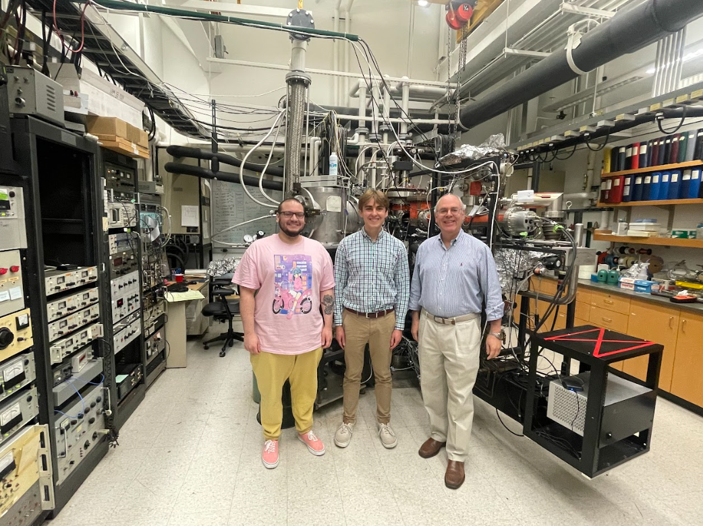

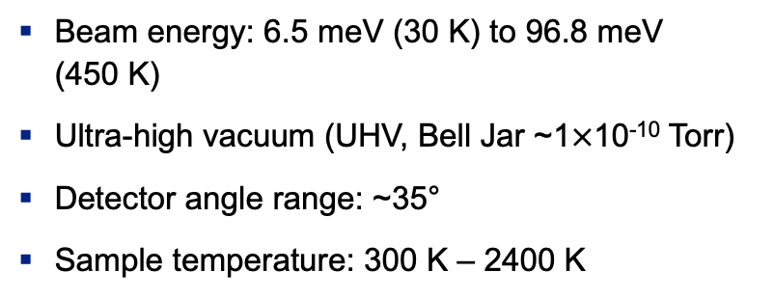
Helium Atom Scattering (HAS) Instrument
Bell Jar
Ion gun
Sample/Heater
Electron Energy Analyzer
LEED
AES
Beam QMS
Electron gun
Chopper wheel
Skimmer
Ionizer
Quadrupole Mass Spectrometer (QMS)
Beam energy: 6.5 meV (30 K) to 96.8 meV (450 K)
Ultra-high vacuum (UHV, Bell Jar ~1$×$10⁻¹⁰ Torr)
Detector angle range: ~35°
Sample temperature: 300 K – 2400 K
Nozzle
He
Beamline
Rotating Detector
Notes:
Be sure to brag; mention resolution

Slide 10
HAS is a Surface-Sensitive, Inert, In Situ Probe
Measures surface atomic properties through electronic corrugation
Good energy match with low-energy single phonons
Can capture ensemble dynamical properties like mean-squared displacement
Interacts with electron cloud ~3 Å above the surface
HAS uses the periodicity of surface electronic corrugation to capture ensemble surface atomic properties.
Notes:
Helium is chemically inert, and the beam is low energy
Reliably heat to 2400 K and measure up to 1750 K Have a good Eliashberg response

Slide 11
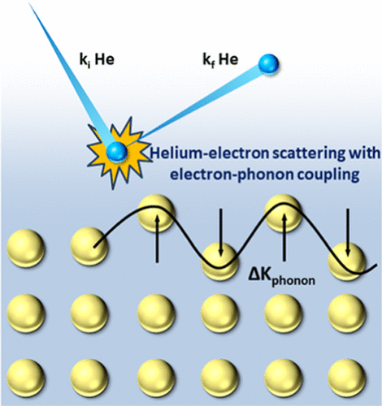
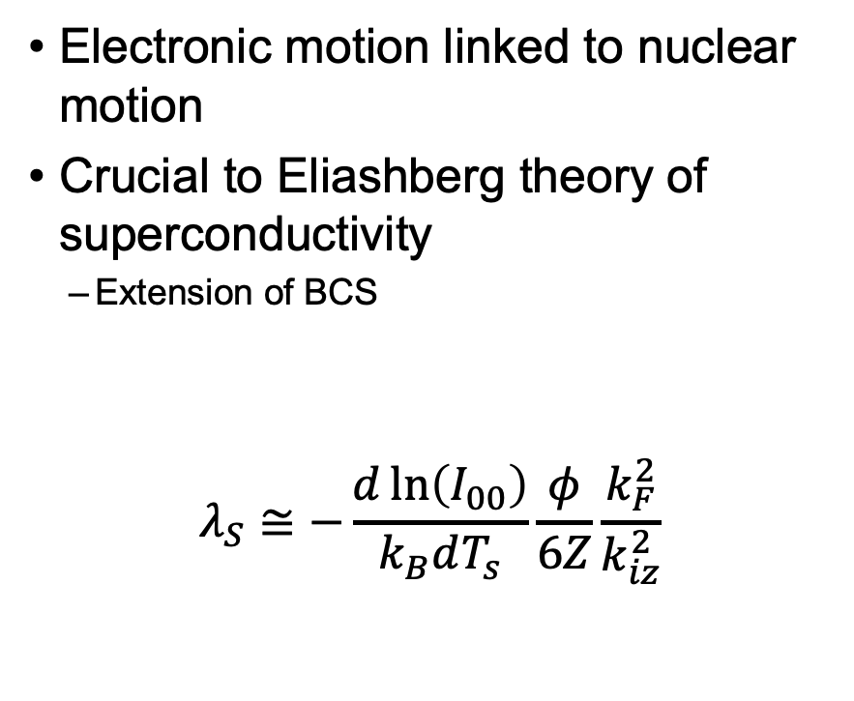
Surface Electron-Phonon Coupling (SEPC) Constant
Electronic motion linked to nuclear motion
Crucial to Eliashberg theory of superconductivity
Extension of BCS
jkfadskljfalkdjsflkajsdflkjasdkfljasdlkjflsdakjflkasdjfjffkjadslkfjaklsdjfalksdjflaksjdflkajfdlkasjdflksdjf
$$λ_{S}≅−\frac{d\ln\left(I_{00}\right)}{k_{B}dT_{s}}\frac{φ}{6Z}\frac{k_{F}^{2}}{k_{iz}^{2}}$$
Debye-Waller
Slope
Workfunction
Fermi
Wavevector
The surface EPC constant helps us better understand the relationship between electronic and nuclear motion at the surface.
Surface EPC
Constant
Number of
Free Electrons
Incident, Surface-Normal Beam Wavevector
C. J. Thompson, M. Van Duinen, C. Mendez, S. A. Willson, V. Do, T. A. Arias, S. J. Sibener. J. Phys. Chem. C 128 (25), 10714-10722 (2024).
11

Slide 12
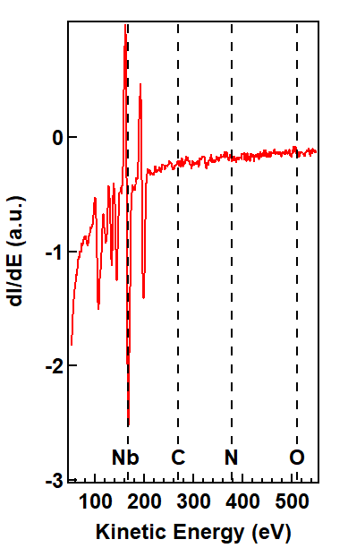
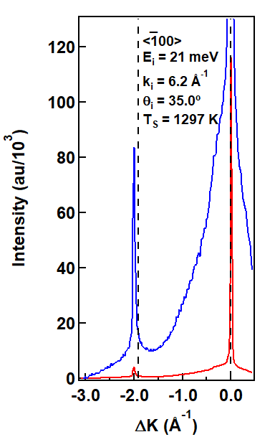


Foundational Studies on the Metallic Nb(100)
$$(\overline{1}0)$$
$$(00)$$
Surface modifies chemical and physical properties
Bulk Nb EPC known, but not surface
Finding metallic Nb(100) surface EPC is an important foundation towards understanding the SEPC on other materials.
C. J. Thompson, M. F. Van Duinen, M. M. Kelley, T. A. Arias, S. J. Sibener. J. Phys. Chem. C 128 (14), 6149-6157 (2024).
Notes:
Elements on Auger Label diffraction peaks

Slide 13
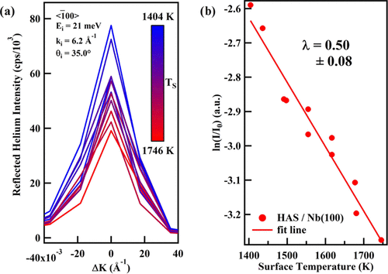
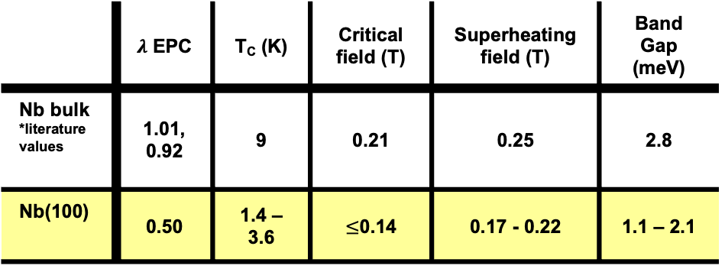
SEPC at the Metallic Nb(100) Surface
 | $λ$ EPC | T_{C} (K) | Critical field (T) | Superheating field (T) | Band Gap (meV)
Nb bulk *literature values | 1.01, 0.92 | 9 | 0.21 | 0.25 | 2.8
Nb(100) | 0.50 | 1.4 – 3.6 | $≤$0.14 | 0.17 - 0.22 | 1.1 – 2.1
This study represents the very first SEPC results on any niobium surface from HAS or any other method.
C. J. Thompson, M. F. Van Duinen, M. M. Kelley, T. A. Arias, S. J. Sibener. J. Phys. Chem. C 128 (14), 6149-6157 (2024).
13
Notes:
Same as earlier

Slide 14
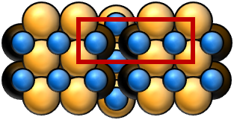
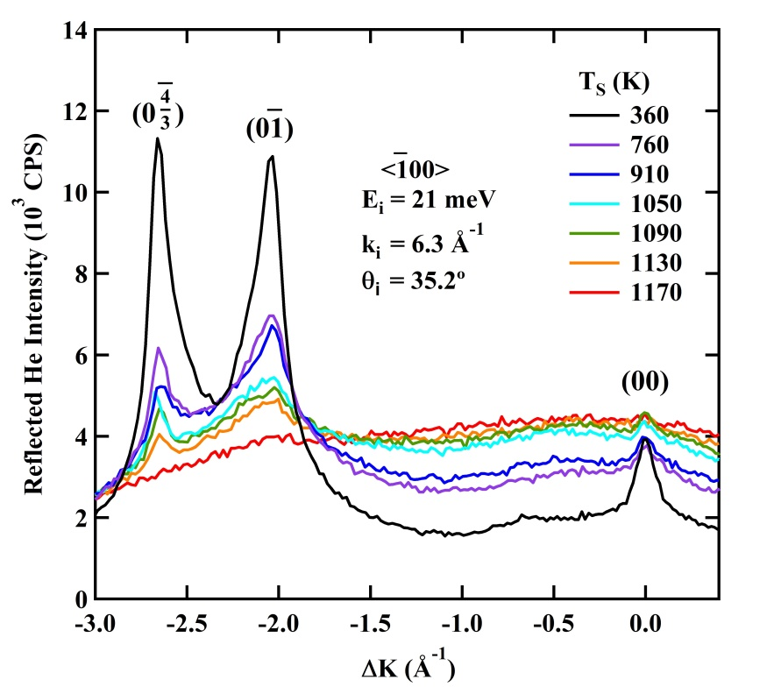
HAS Demonstrated In Situ That the (3x1)-O Nb Reconstruction Persists up to 1130 K
Other methods studied the surface after, not during, temperature treatments
(3x1)-O stable up to 1130 K without evolution of structural disorder
HAS reveals in situ the stability of the (3x1)-O reconstruction at temperatures relevant to doping and alloy formation processes.
A. A. McMillan, J. D. Graham, S. A. Willson, R. G. Farber, C. J. Thompson, S. J. Sibener. Superconduct. Sci. Technol. 33, 105012 (2020).
Notes:
Stable up to 1130 K, gesture at figure
At high temps, this is the system present at the (100) surface

Slide 15
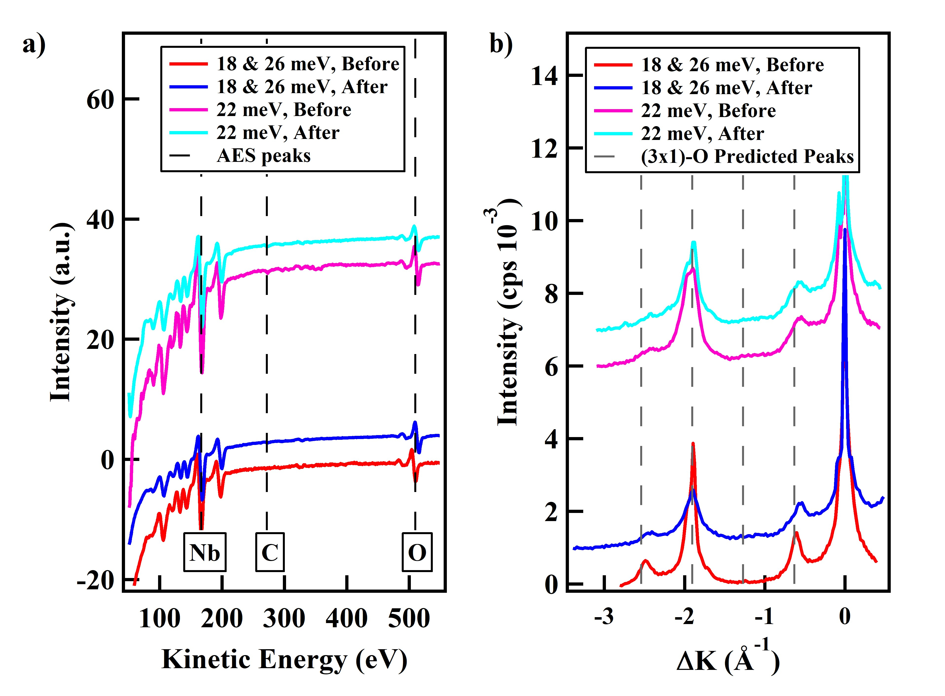
(3x1)-O Reconstruction EPC a Natural Next Step
Oxygen remains on Nb unless heated to ~2400 K
(3x1)-O reconstruction is thermally and kinetically stable
Many previous studies have worked with (3x1)-O
The (3x1)-O Nb(100) is a more thermally stable and chemically relevant model system for the Nb SRF surface than the metallic Nb(100).
C. J. Thompson, M. Van Duinen, C. Mendez, S. A. Willson, V. Do, T. A. Arias, S. J. Sibener. J. Phys. Chem. C 128 (25), 10714-10722 (2024).
15

Slide 16
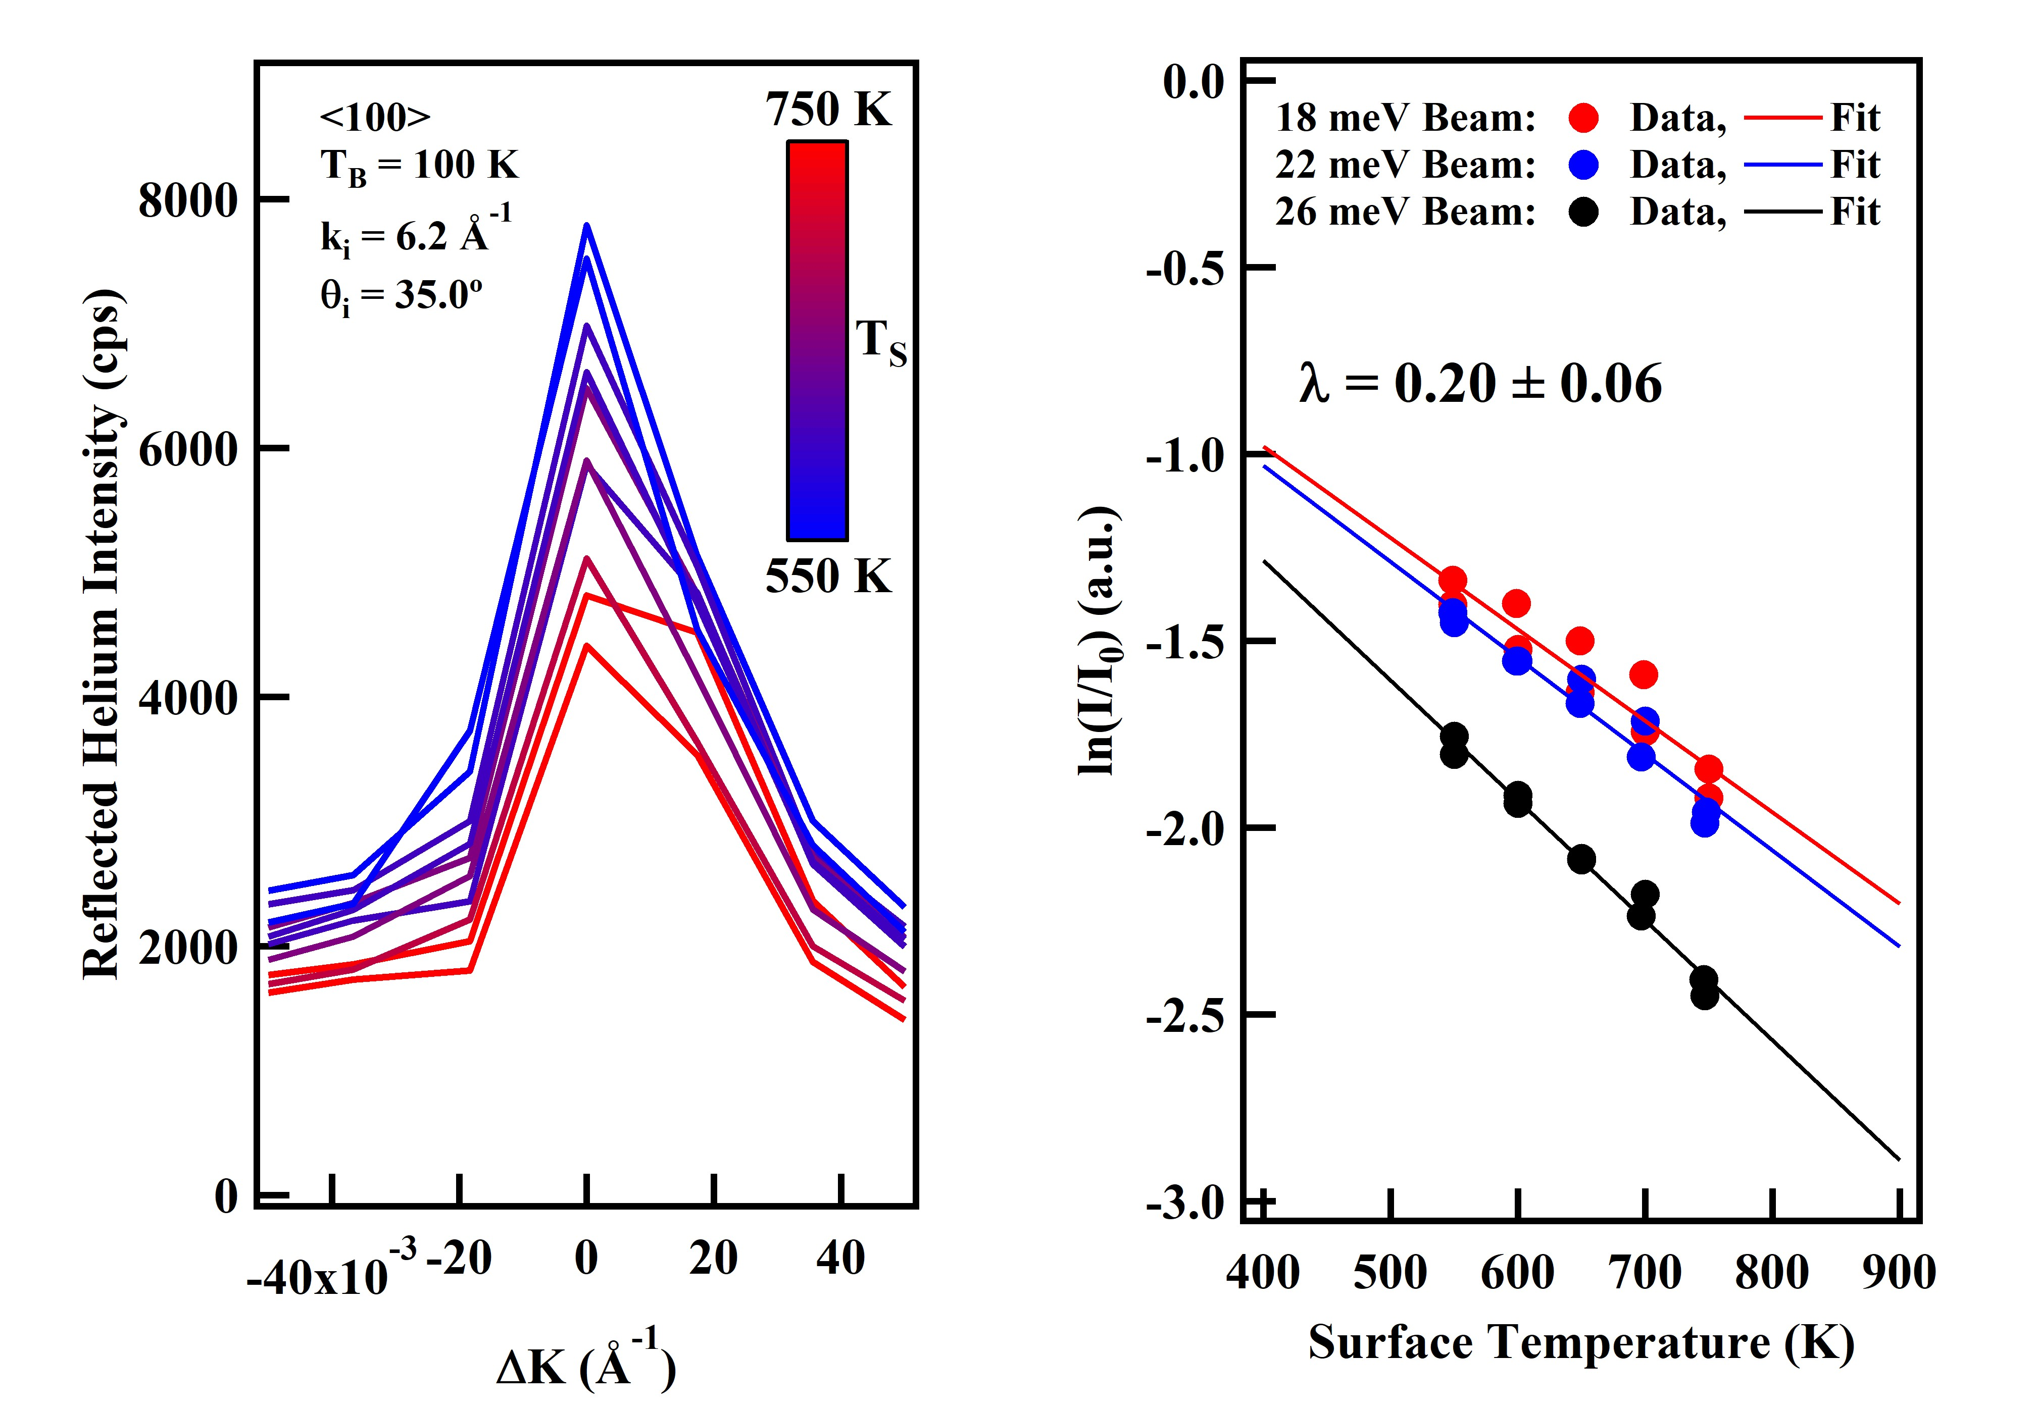
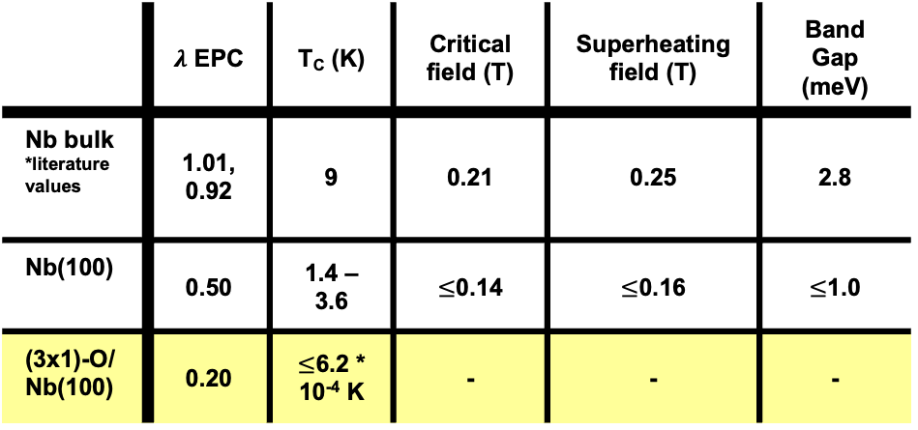
The Oxide Reduces Superconductivity Even Further
 | $λ$ EPC | T_{C} (K) | Critical field (T) | Superheating field (T) | Band Gap (meV)
Nb bulk *literature values | 1.01, 0.92 | 9 | 0.21 | 0.25 | 2.8
Nb(100) | 0.50 | 1.4 – 3.6 | $≤$0.14 | $≤$0.16 | $≤$1.0
(3x1)-O/ Nb(100) | 0.20 | $≤$6.2 * 10⁻⁴ K | - | - | -
HAS provides the first study that demonstrates and quantifies in situ the reduction in superconducting performance in Nb due to any NbO phase.
C. J. Thompson, M. Van Duinen, C. Mendez, S. A. Willson, V. Do, T. A. Arias, S. J. Sibener. J. Phys. Chem. C 128 (25), 10714-10722 (2024).
16
Notes:
First measurements of the surface EPC of the oxide/metal, both substantially reduced from bulk

Slide 17
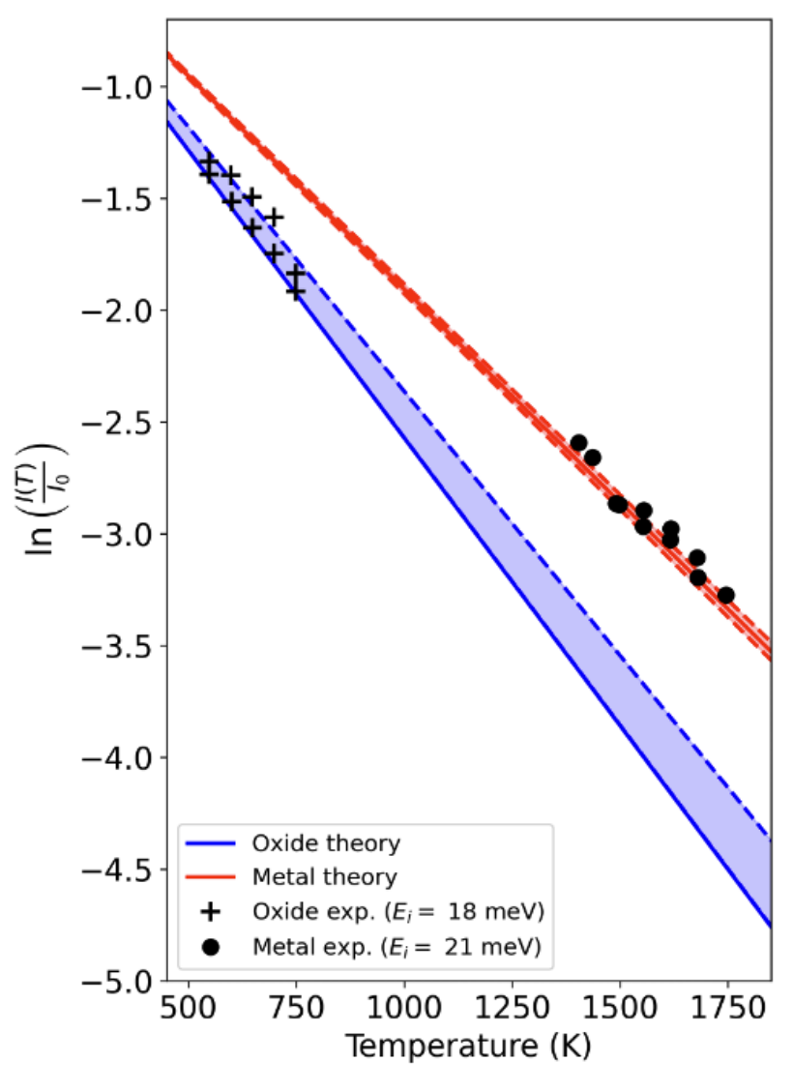
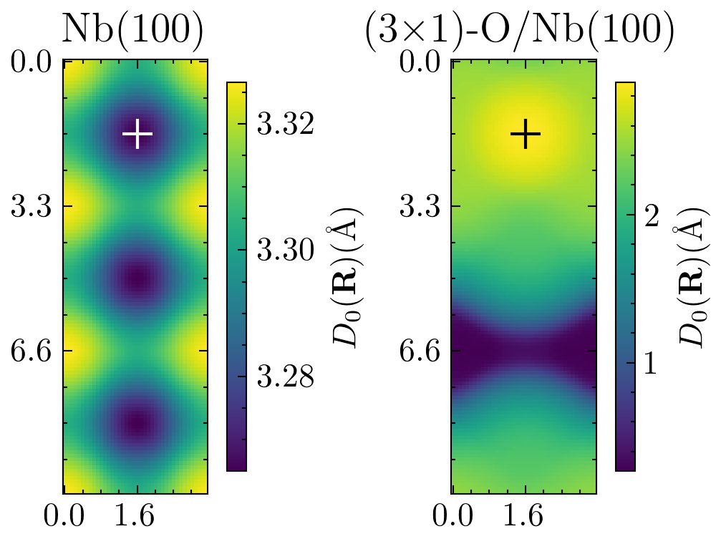

New Theory Matches Metallic and (3x1)-O Data
Electron Density of Surface Unit Cells
Cristobal
Mendez
Talk at 3:30!
The Arias group’s new calculations allow for a precise and physically realistic treatment of the helium-surface interaction.
Simulated Debye-Waller Slopes with HAS Data
C. Mendez, C. J. Thompson, M. Van Duinen, S. J. Sibener, T. A. Arias. J. Phys. Chem. C 128 (25), 10714-10722 (2024).
17
Notes:
Electron density is not immediately apparent/understandable

Slide 18
Fundamental Chemical Questions Underlying the Solutions to Achieving Higher Performance
Oxide
”Oxide” is a catch-all term for many oxygen-containing Nb phases
Nb₂O₅ insulating
NbO₂ a semiconductor
NbO mild superconductor with many surface phases
Nb₃Sn
Chemical homogeneity
Narrow range of acceptable Sn proportions, ~23-26% Sn
Structural homogeneity
Generally expected that smoother surfaces allow for better superconducting performance
To what extent does the presence of NbO modify superconducting performance at the surface?
What specific chemical and structural surface features limit Nb₃Sn performance, and how do they arise?

Slide 19





A Multidisciplinary Approach to Nb₃Sn Surface Chemistry
Liana Shpani
Liepe Group, Cornell University
Nb₃Sn thin film fabrication, large-scale RF testing
Talk at 9:18 AM today!
Van Do, Sarah Willson, Helena Lew-Kiedrowska
Sibener Group, University of Chicago
Ultra-high vacuum surface chemical thin film growth development and characterizations of Nb₃Sn on NbO
Aiden Harbick
Transtrum Group, BYU
Simulations of structural and chemical defects
Talk at 4:42 PM today!

Slide 20
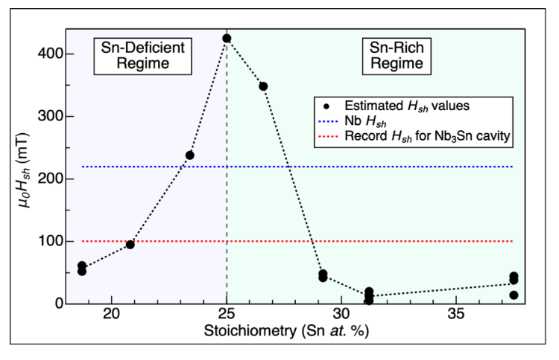
Superheating Field Calculations Show Stoichiometry Limits
Nb is a Type-II superconductor
First critical field: normal conducting vortices form
Second critical field: material becomes fully normally conducting
Superheating field (H_{sh}) is when SRF performance breaks down
Operationally defined
Sn composition in Nb₃Sn has an especially limited range for superconducting performance to outperform Nb.
S. A. Willson, A. V. Harbick, L. Shpani, V. Do, H. Lew-Kiedrowska, M. U. Liepe, M. K. Transtrum, S. J. Sibener. Phys. Rev. Res 6, 043133 (2024).

Slide 21
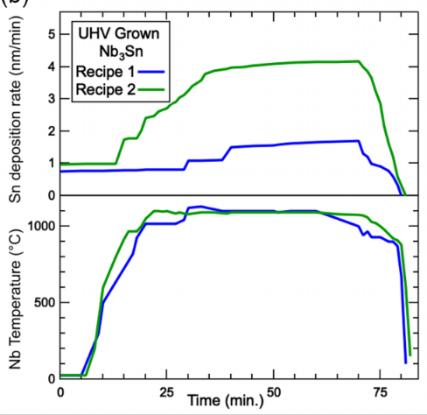
2 Recipes for UHV Replication of Nb₃Sn Development Procedures
Nb₃Sn thin film development well-known for creating Sn-rich and Sn-deficient regions
Recipe 1
Lower flux overall
Promote large, Sn-deficient grains
Recipe 2
Higher flux, more akin to large-scale Nb₃Sn development procedures
More Sn-rich regions

Slide 22
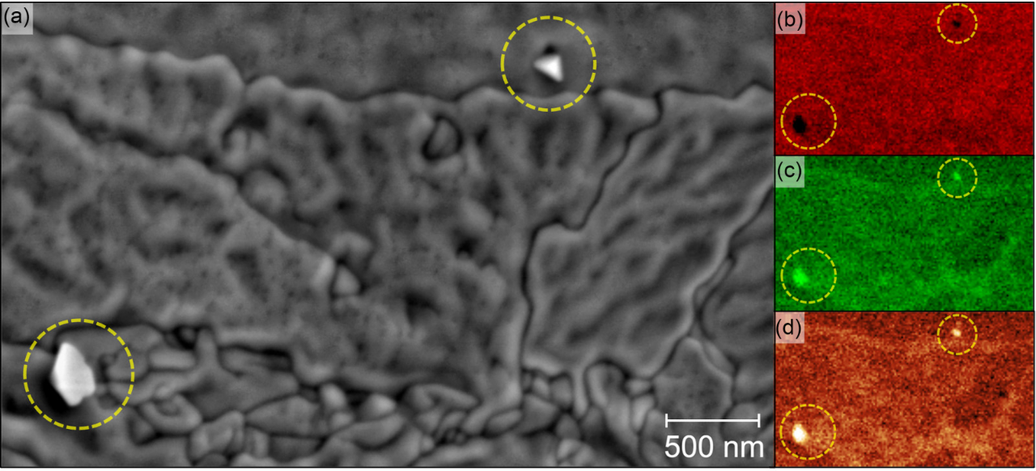
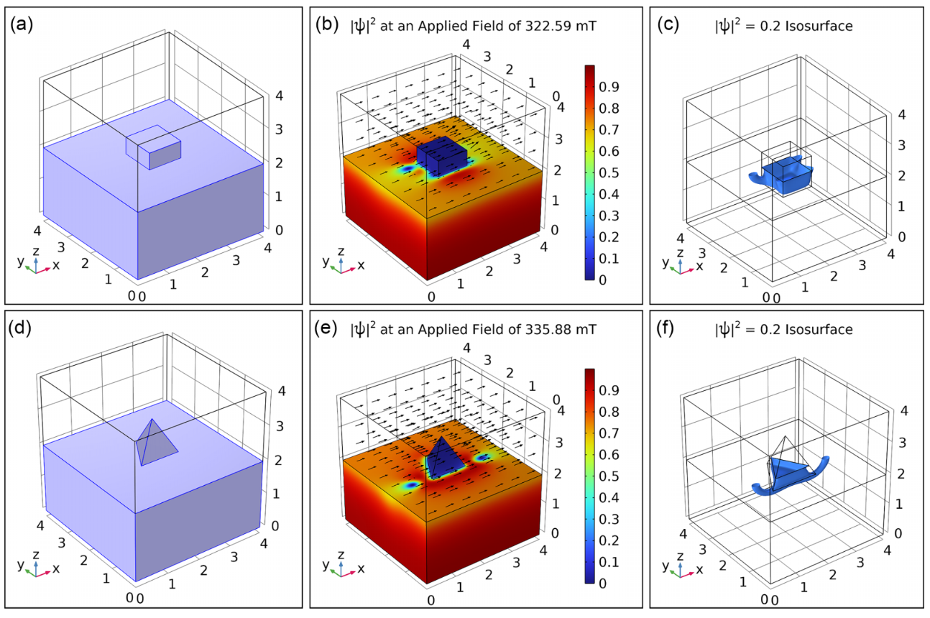
Sn Islands Are Both a Compositional and Structural Hindrance to SRF Performance
Sn islands are more detrimental to superconducting performance than their stoichiometry alone would suggest, and the larger and more embedded the island is, the larger its effect on superconducting performance.
S. A. Willson, A. V. Harbick, L. Shpani, V. Do, H. Lew-Kiedrowska, M. U. Liepe, M. K. Transtrum, S. J. Sibener. Phys. Rev. Res 6, 043133 (2024).
Notes:
Why an issue?

Slide 23
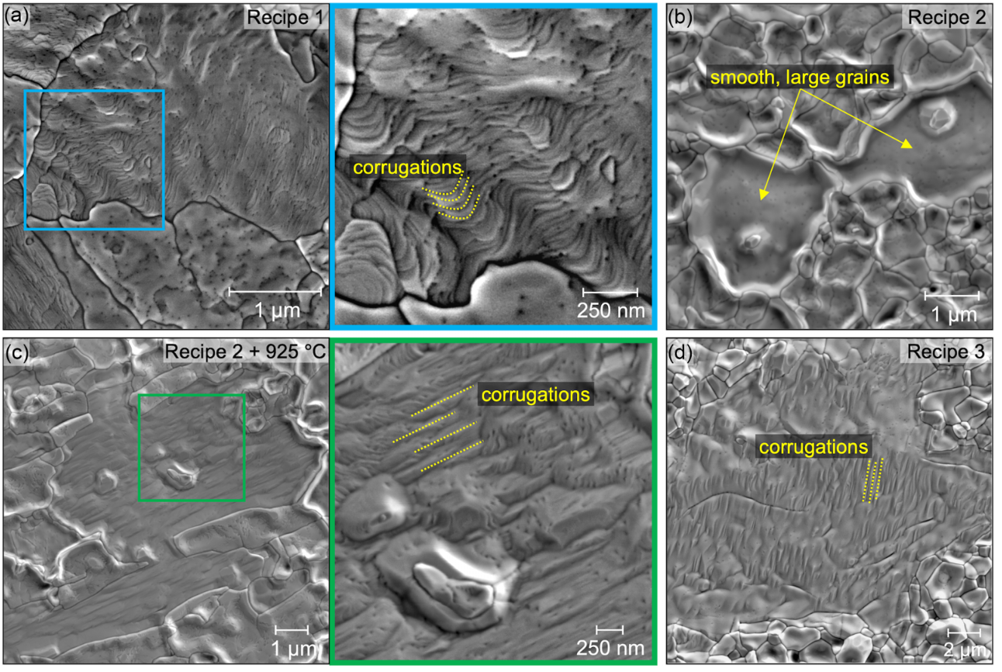
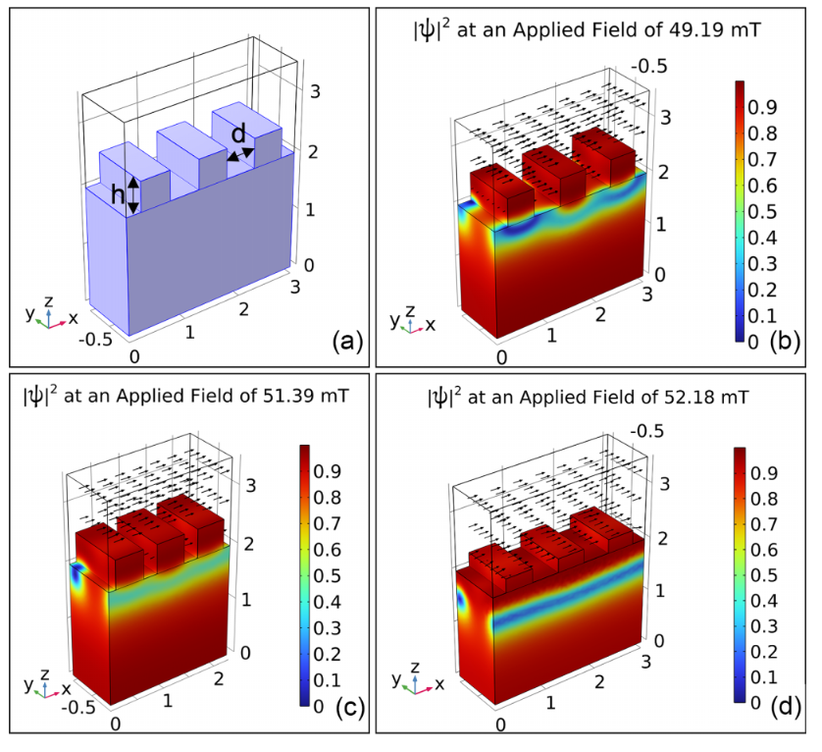
Corrugations Arise on Large, Sn-Deficient Grains
Sn-deficient regions also have a compounding geometric effect on superconducting performance, with worse superconducting performance the narrower and farther apart the corrugations are.
S. A. Willson, A. V. Harbick, L. Shpani, V. Do, H. Lew-Kiedrowska, M. U. Liepe, M. K. Transtrum, S. J. Sibener. Phys. Rev. Res 6, 043133 (2024).

Slide 24
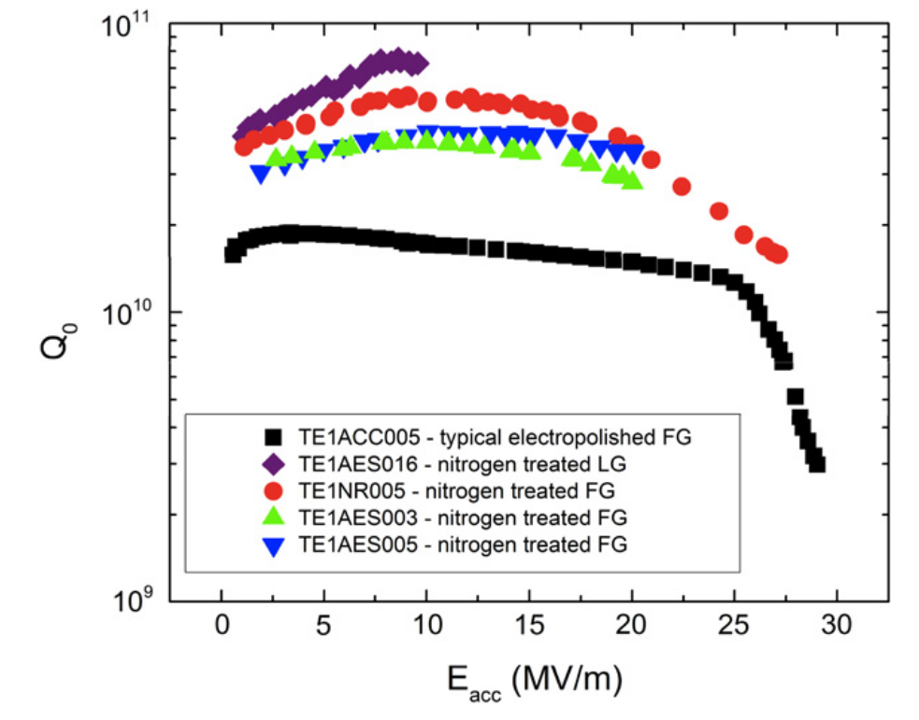
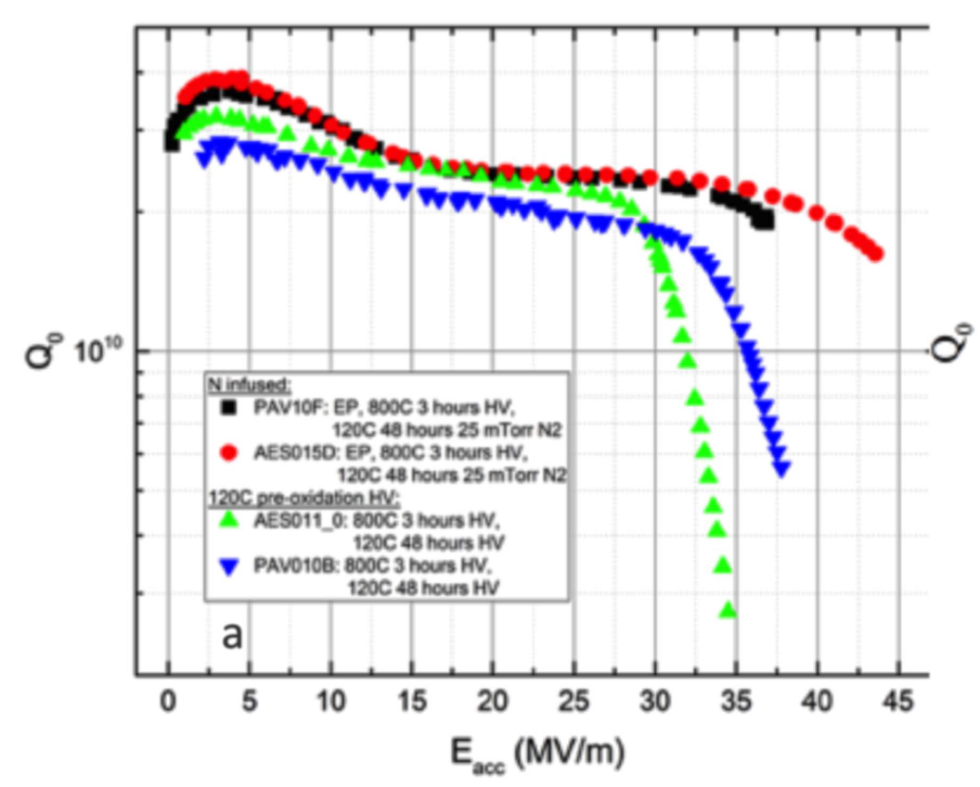
Next Steps: N-Doping and HAS
Nitrogen Doping
Nitrogen Infusion
Nitrogen Doping
Increases overall Q₀
Shorter exposure time, hotter surface
Nitrogen Infusion
Offsets high-field Q-slope
Longer exposure times, cooler surface
NbN has too low H_{sh}
Electropolished off
The relationship between N content and SEPC for a variety of different N reconstructions on both oxidized and metallic Nb(100) remains to be thoroughly and quantitatively explored.
A. Grassellino, A. Romanenko1, D. Sergatskov, O. Melnychuk, Y. Trenikhina, et al. Supercond. Sci. Technol. 26, 102001 (2013).
A. Grassellino, A. Romanenko, Y. Trenikhina, M. Checchin, M Martinello, et al. Supercond. Sci. Technol. 30, 094004 (2017).

Slide 25
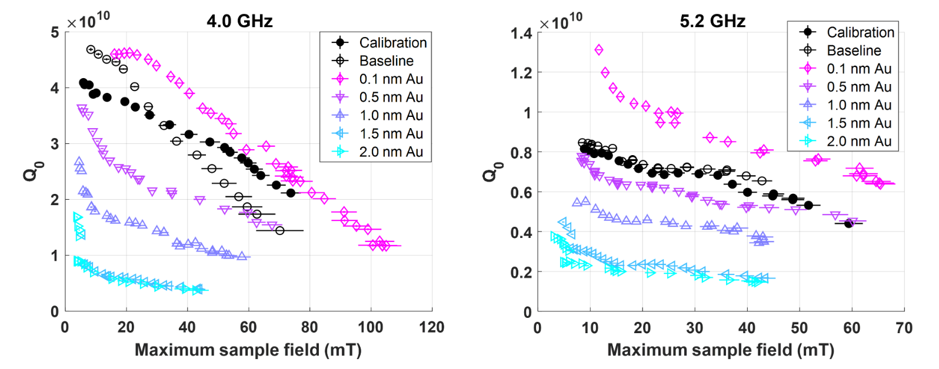
Next Steps: Au Capping Layers
Au has very low oxidation potential
Au only beneficial to SRF cavities at 0.1 nm thickness
Au diffusion and low Au-Nb affinity present challenges
While it is known that Au can be helpful for oxide suppression and improving SRF performance, how to develop and maintain a 0.1 nm layer and the chemical details of its challenges remain to be known.
T. Oseroff, M. U. Liepe, Z. Sun. 21st Int. Conf. RF Supercond. TUCBA01 369-373 (2023).

Slide 26
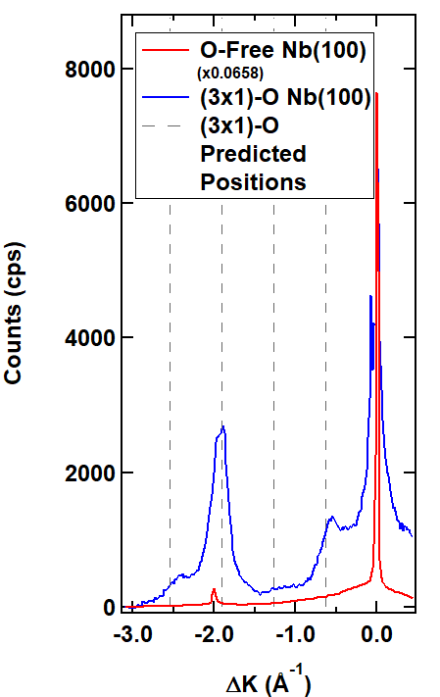
Summary
Taking SRF materials to the next level will require ongoing collaboration centered in the materials’ surface atomic chemistry.

Slide 27
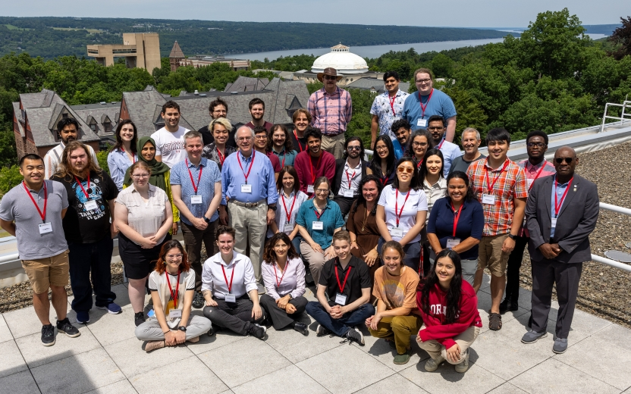

Acknowledgments
Sibener Lab (UChicago)
Van Do
Caleb Thompson
Sarah Willson
Helena Lew-Kiedrowska
Arias Group (Cornell)
Cristobal Mendez
Michelle M Kelley
Liepe Group (Cornell)
Liana Shpani
Transtrum Group (BYU)
Aiden Harbick

