Slide 1

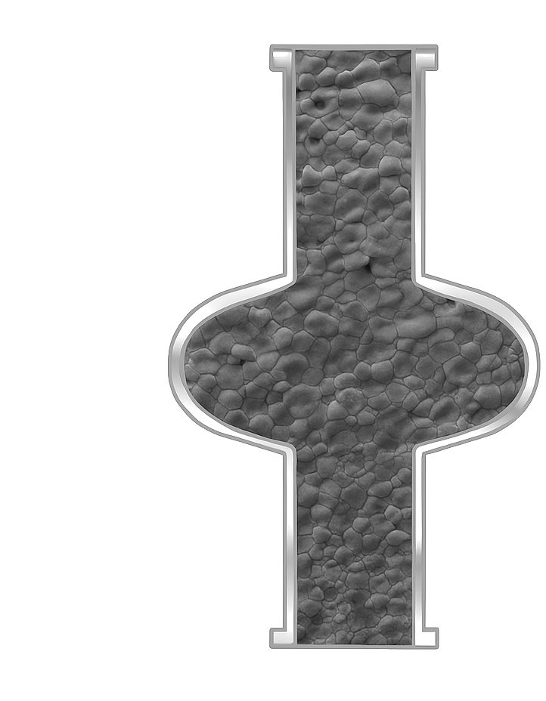

Nb₃Sn Growth Methods
&
Material Characterization
Uttar Pudasaini
July 17, 2025

Slide 2
Outline
Nb₃Sn for Accelerator Cavities
Overview of Growth Methods
Importance of Material Characterization
Characterization Insight into Vapor-diffused Nb₃Sn
Summary

Slide 3
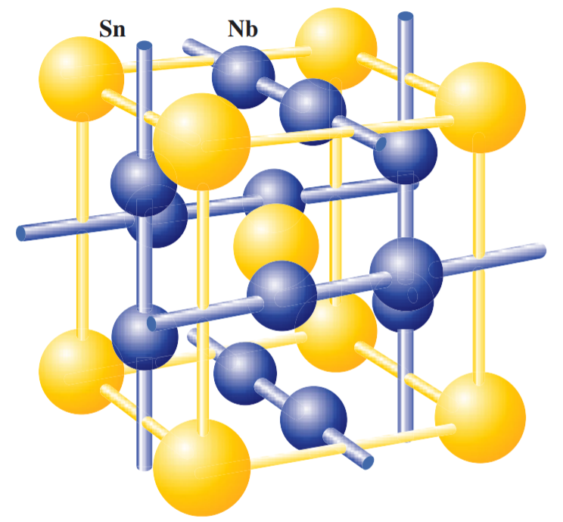
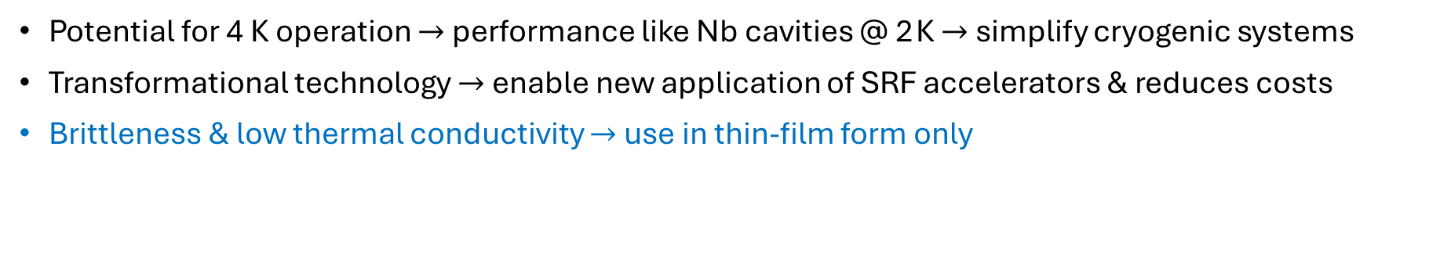
Nb₃Sn for SRF Accelerator Cavity Applications
*Approximate values
 | Nb | Nb₃Sn
T_{c} (K) | 9.25 | 18.3
H_{sh} (mT) | 220 | 425
Q^{BCS} at 2 K | 5×10¹⁰ | 5×10¹⁴
Q^{BCS} at 4 K | 5×10⁸ | 5×10¹⁰
E_{acc} (MV/m) | 50 | 100
Potential for 4 K operation $→$ performance like Nb cavities @ 2 K $→$ simplify cryogenic systems
Transformational technology $→$ enable new application of SRF accelerators & reduces costs
Brittleness & low thermal conductivity $→$ use in thin-film form only

Slide 4
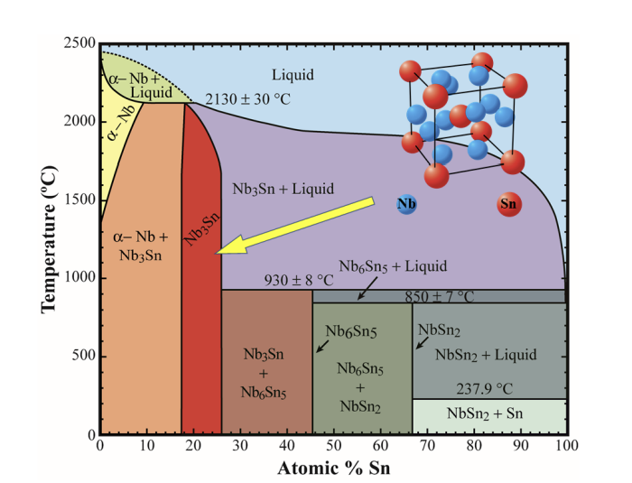
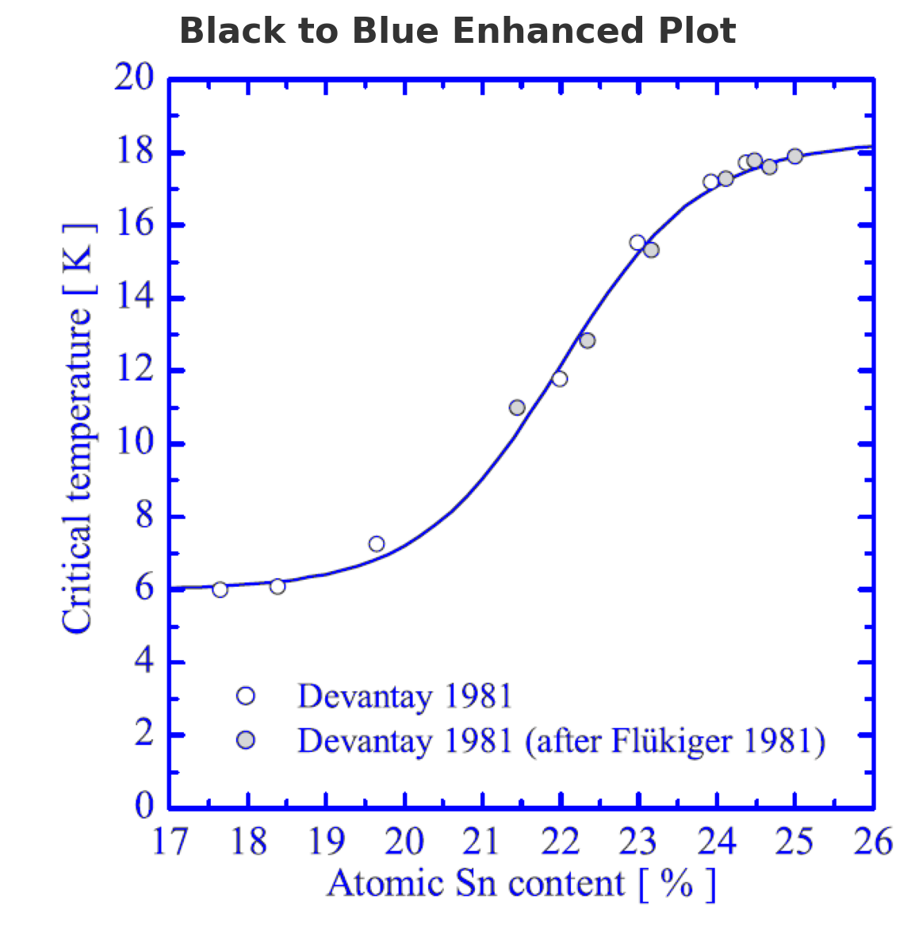
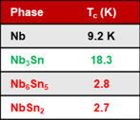
Growth Challenge
J. P. Charlesworth, I. Macphail and P. E. Madsen, "Experimental work on the Nb-tin constitution diagram and related studies," J. Mater. Sci., vol. 5, (7), pp. 580-603, 1970.
Godeke A 2006 A review of the properties of Nb₃Sn and their variation with A15 composition, morphology and strain state Supercond. Sci. Technol. 19 R68–80
Adequate phase and composition required
Thickness enough to screen RF currents from material below the Nb₃Sn layer
Uniform material growth on the entire cavity structure

Slide 5
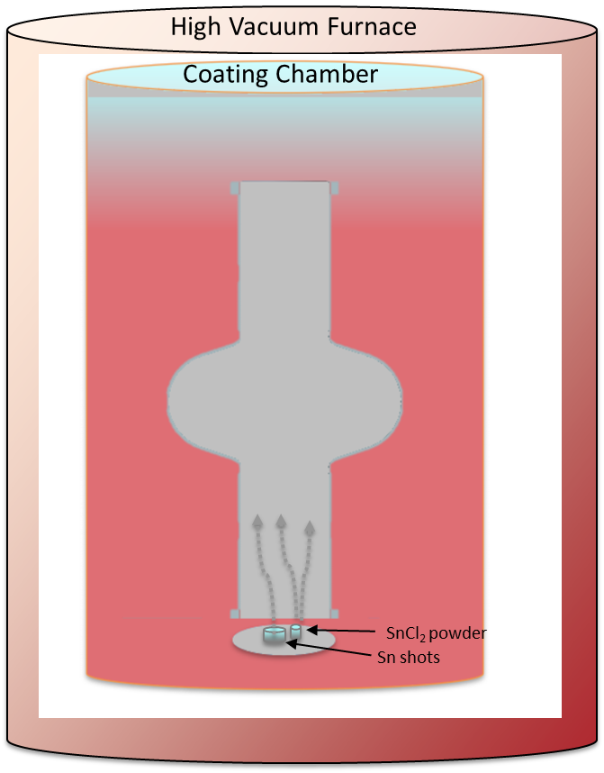
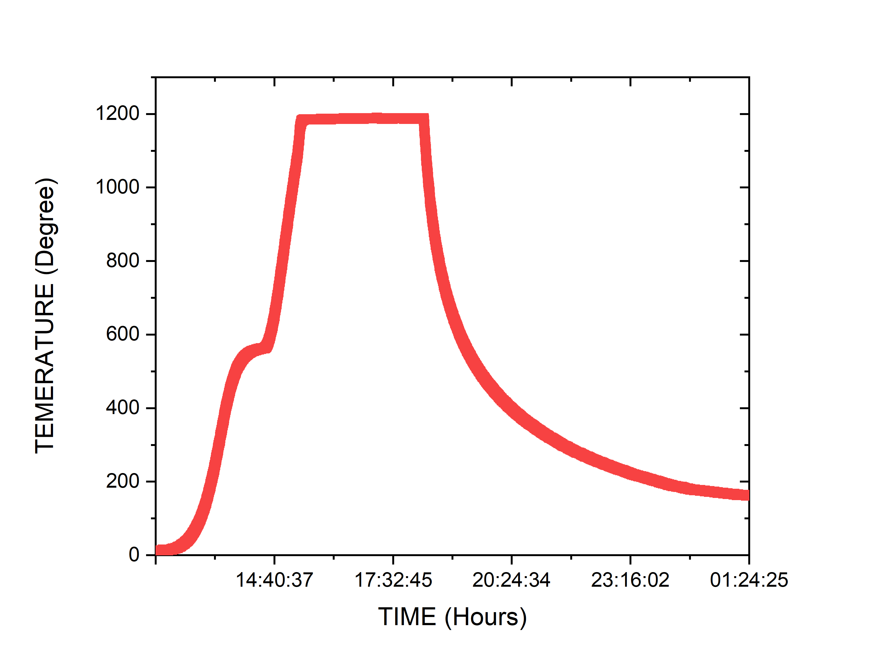
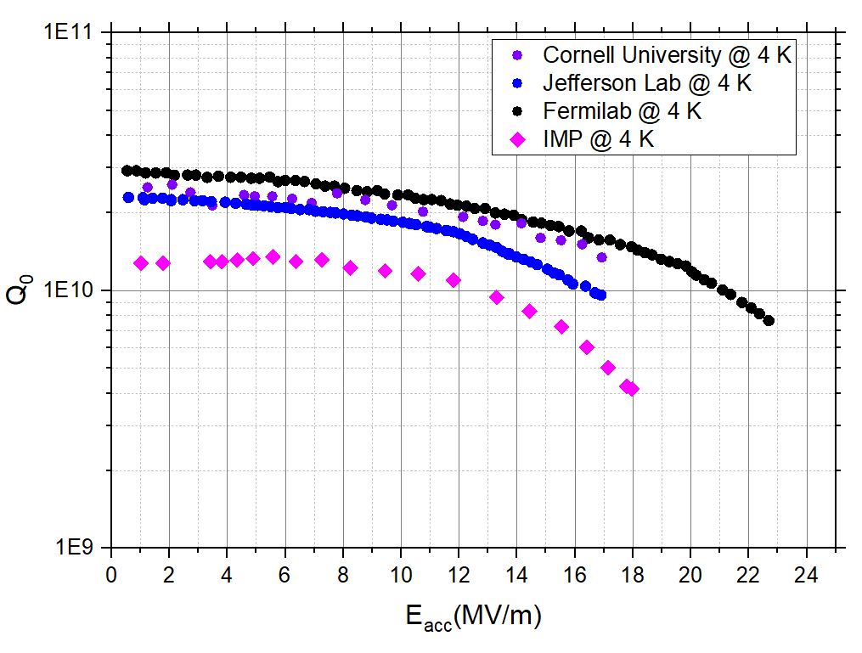

Nb₃Sn Growth Methods in Progress
High-temperature Nb-Sn Diffusion-based Methods for Nb₃Sn/Nb
  Sn Vapor diffusion (Cornell U., JLab, Fermilab, KEK, IMP, Peking U., SARI)
R&D 1.3 single-cell cavity performance
Temperature ($° C)$
>10¹⁰ @ >20 MV/m at 4 K
Since the 1970s
Create Sn-vapor and transfer to the interior surface of Nb cavity
So far ‘THE’ technique to produce practical Nb₃Sn cavities
“Wuppertal” or “Siemens” configuration
U.Pudasaini et al. “Managing Sn-Supply to Tune Surface Characteristics of Vapor-Diffusion Coating of Nb₃Sn”, SRF'21, East Lansing, MI, USA, Jun.-Jul. 2021,
S. Posen et al. “Advances in Nb₃Sn superconducting radiofrequency cavities towards first practical accelerator applications” Superconductor Science and Technology. 2021 Jan 11;34(2):025007.
D. Hall, “New Insights into the Limitations on the Efficiency and Achievable Gradients in Nb₃Sn SRF Cavities”, PhD thesis, Cornell University (2017).
G. Jiang et al.. Understanding and optimization of the coating process of the radio-frequency Nb3Sn thin film superconducting cavities using tin vapor diffusion method. Applied Surface Science. 2024 Jan 15;643:158708.
w/ Secondary heater for Sn source

Slide 6
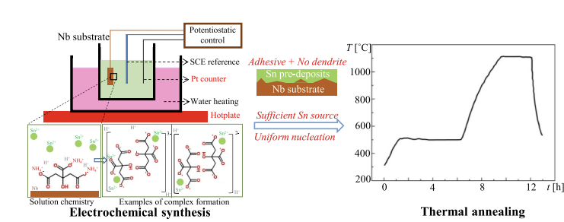
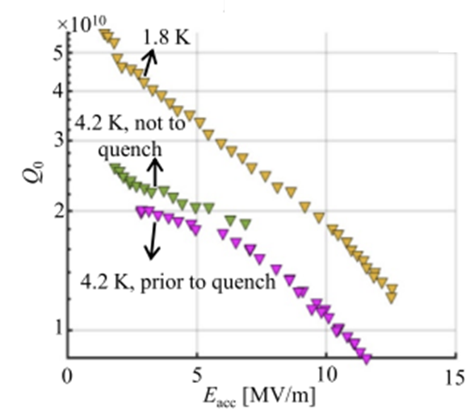
Nb₃Sn Growth Methods in Progress
High-temperature Nb-Sn Diffusion-based Methods for Nb₃Sn/Nb
  Sn Vapor diffusion (Cornell U., JLab, Fermilab, KEK, IMP, Peking U., SARI)
  Sn-electroplating on Nb followed by thermal diffusion (Cornell U.)
Q>10¹⁰ @ 12 MV/m @ 4.2 K
Deposit Sn on Nb
Converts into Nb₃Sn on Nb
Z. Sun, Zeming, et al. "Smooth, homogeneous, high-purity Nb3Sn superconducting RF resonant cavity by seed-free electrochemical synthesis." Superconductor Science and Technology 36.11 (2023): 115003.
Significantly smoother surfaces compared to vapor diffusion and lower BCS resistance
Performance comparable to vapor-diffused Nb₃Sn

Slide 7
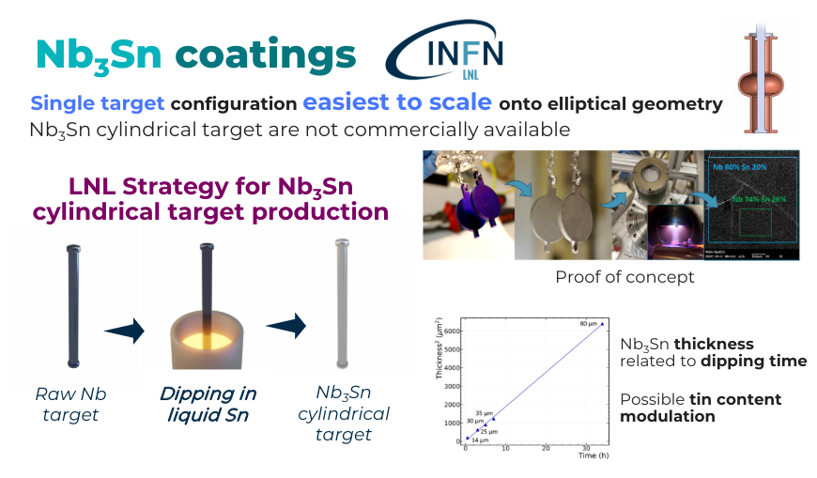
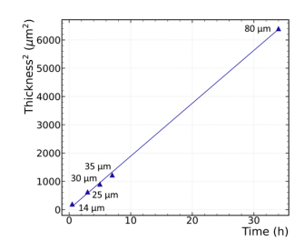
Nb₃Sn Growth Methods in Progress
High-temperature Nb-Sn Diffusion-based Methods for Nb₃Sn/Nb
  Sn Vapor diffusion (Cornell U., JLab, Fermilab, KEK, IMP, Peking U., SARI)
  Sn-electroplating on Nb followed by thermal diffusion (Cornell U.)
  Liquid Sn dipping (INFN) for Nb₃Sn targets for Nb₃Sn/Cu cavity
C. Pira et al., “Progress in European Thin Film Activities”, in Proc. 21th Int. Conf. RF Supercond. (SRF'23), Grand Rapids, MI, USA, Jun. 2023, pp. 607-614. doi:10.18429/JACoW-SRF2023-WECAA01

Slide 8
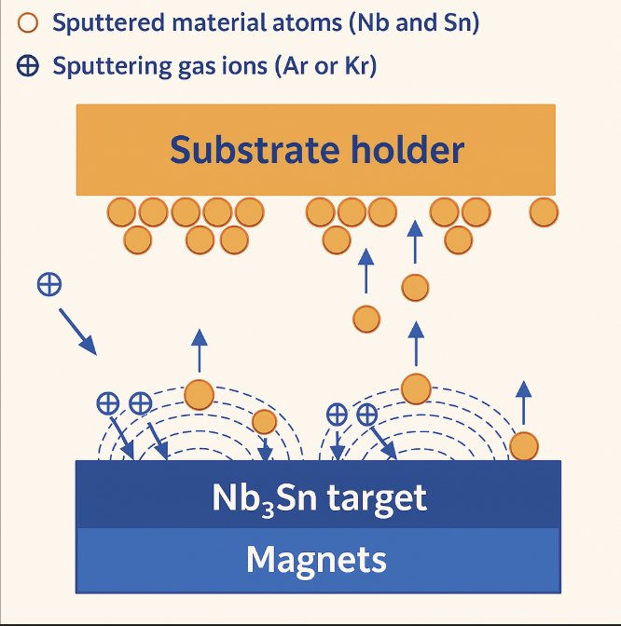
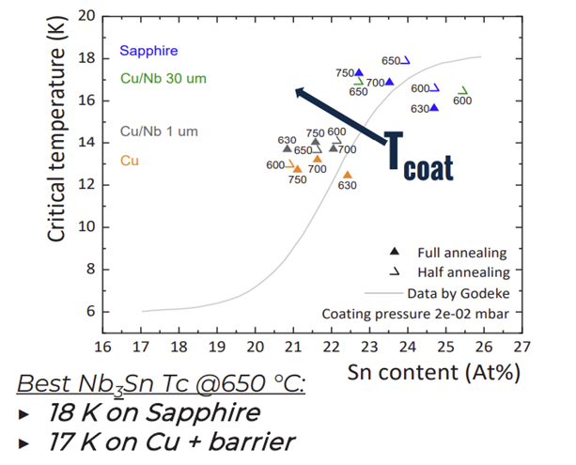
Nb₃Sn Growth Methods in Progress
Magnetron Sputtering for Nb₃Sn/Cu
  DC magnetron sputtering (ODU*, JLab, CERN, INFN, STFC, Cornell U., Peking U.)
  High Power Impulse Magnetron Sputtering - HiPIMS (CERN, JLab, STFC)
*for 2.6 GHz Nb cavity
C. Pira et al., “Progress in European Thin Film Activities”, in Proc. 21th Int. Conf. RF Supercond. (SRF'23), Grand Rapids, MI, USA, Jun. 2023, pp. 607-614. doi:10.18429/JACoW-SRF2023-WECAA01
Sputter Nb-Sn on Cu – low temperature suitable for Cu
T_{c} still lower than the theoretical value
Moving towards cavity coatings

Slide 9
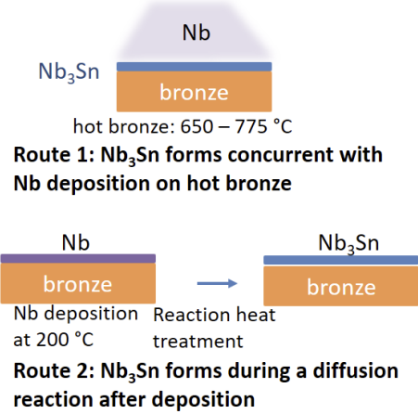
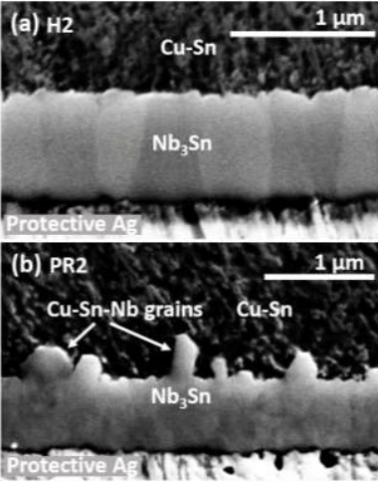
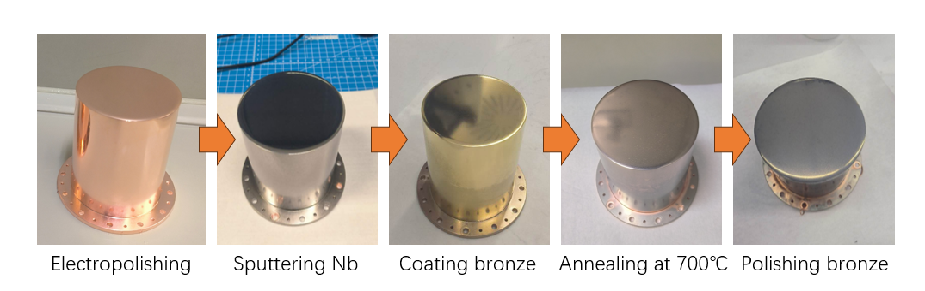

Nb₃Sn Growth Methods in Progress
Others for Nb₃Sn/Cu
  Chemical vapor deposition (Ultramet, Cornell U.)
  Nb-Bronze diffusion-based method (IMP, HZB, e2P, MagLab at FSU, and Peking U.)
Reaction between Nb and Cu-Sn solid solution
Avoid high temperatures ~700°C $→$works for Nb₃Sn/Cu
Follows ternary Cu-Sn-Nb system $→$Avoid the Nb₆ Sn₅ and NbSn₂
Withanage, W.K., Juliao, A. and Cooley, L.D., 2021. Rapid Nb₃Sn film growth by sputtering Nb on hot bronze. Superconductor Science and Technology, 34(6), p.06LT01.
Ming Lu et. al. The 11th Workshop on TFSRF2024, France
Electrodeposition
9

Slide 10
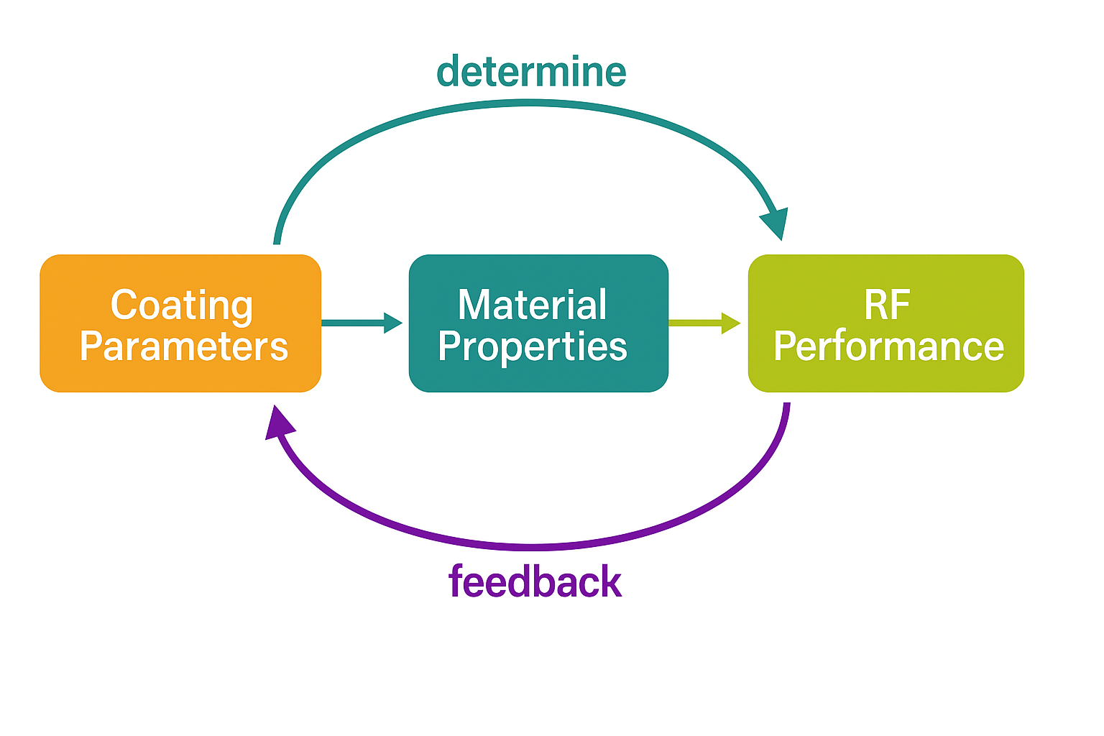
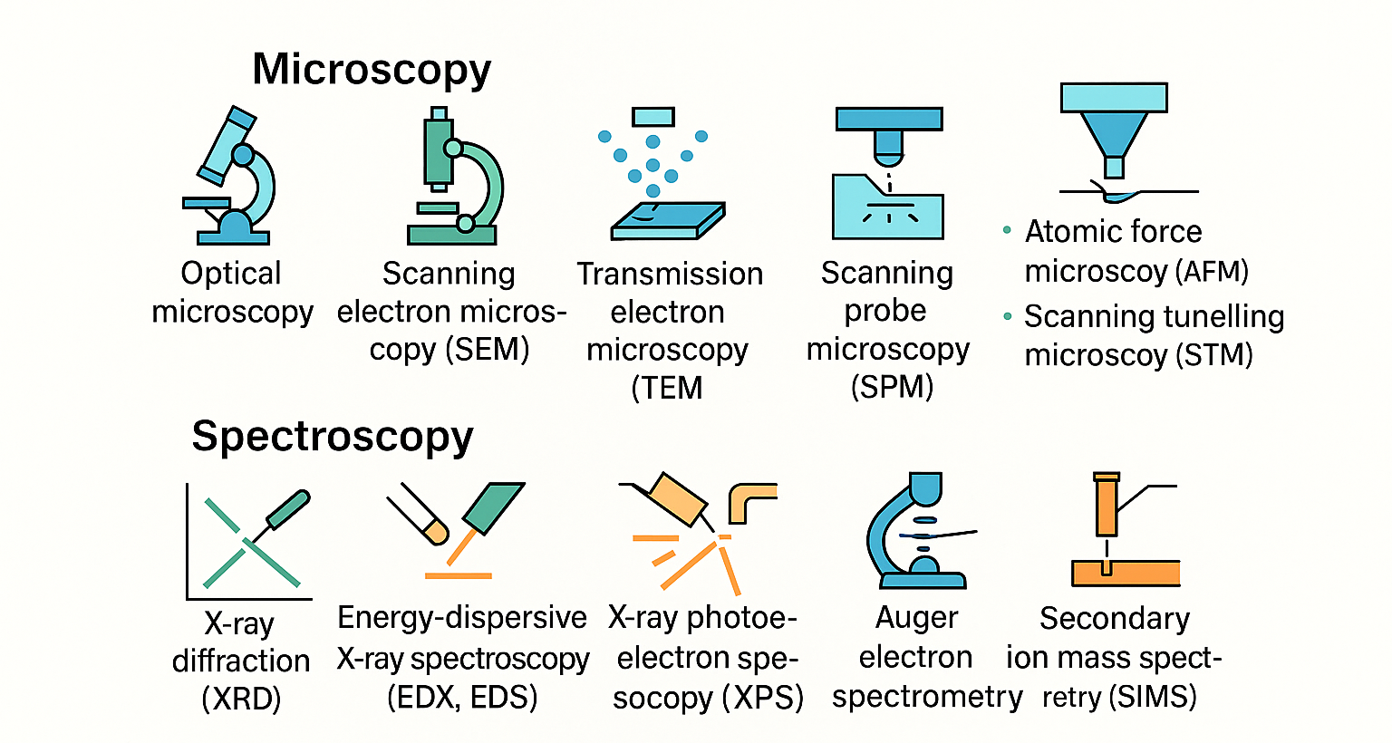
Need for Material Characterization
Assess the material quality
Provide feedback on the coating process
Correlate with RF performance
Identify defects
Guide to understand and optimize the growth methods
Structure
Composition
Morphology
Layer thickness
Uniformity

Slide 11
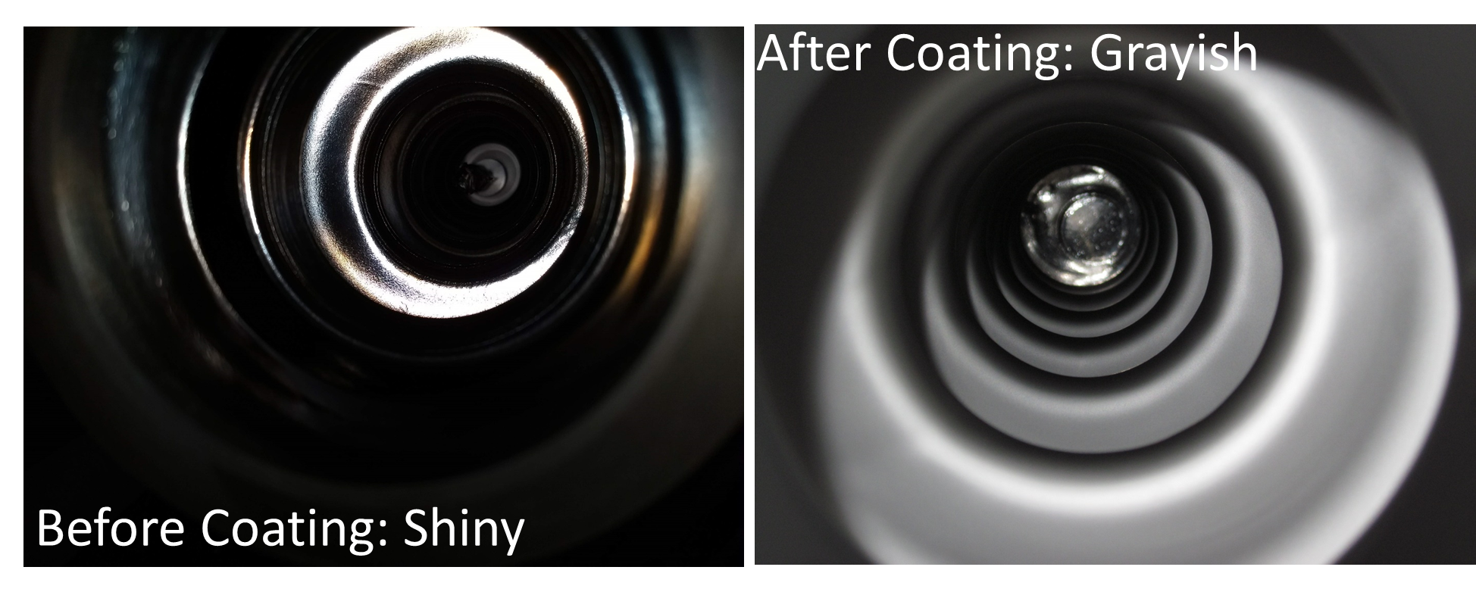
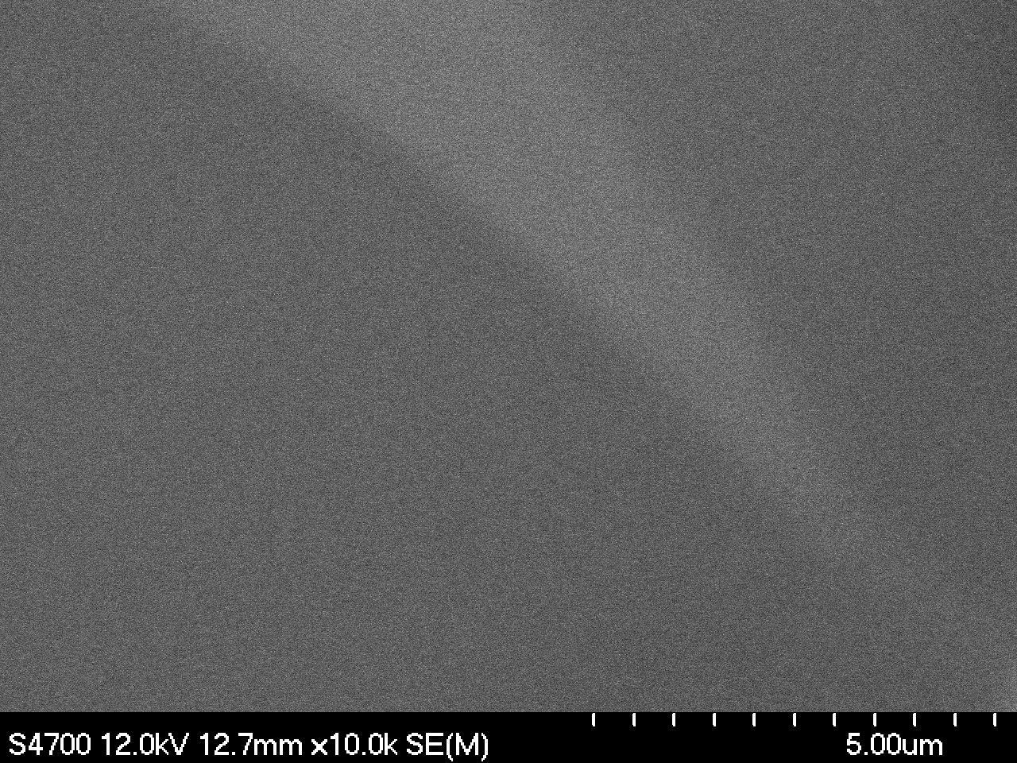
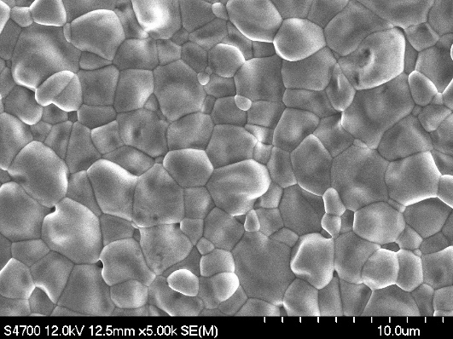
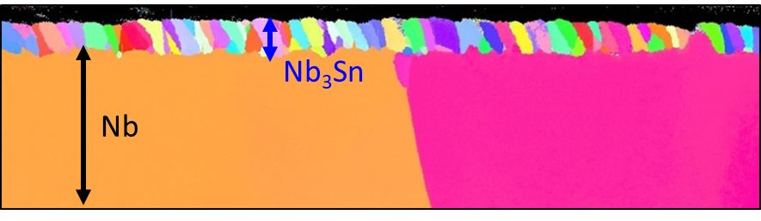

Vapor Diffusion – The Current Mainstream Technique
Temperature ($° C)$
U. Pudasaini, G.V. Eremeev, M.J. Kelley, C.E. Reece, and J. Tuggle, “Investigation of Structural Development of Nb₃Sn on Nb in the Two Step Diffusion Coating”, North American Particle Accelerator Conf. (NAPAC'16), Chicago, IL, USA, Sep. 2016, paper MOPLR023.
Average grain size: 1-2 microns
Composition: 24 -25 at.% Sn.
Micro-roughness
Columnar grains extending to Nb₃Sn-Nb interface.
Coating thickness: 1-2 µm
2 µm
EBSD

Slide 12
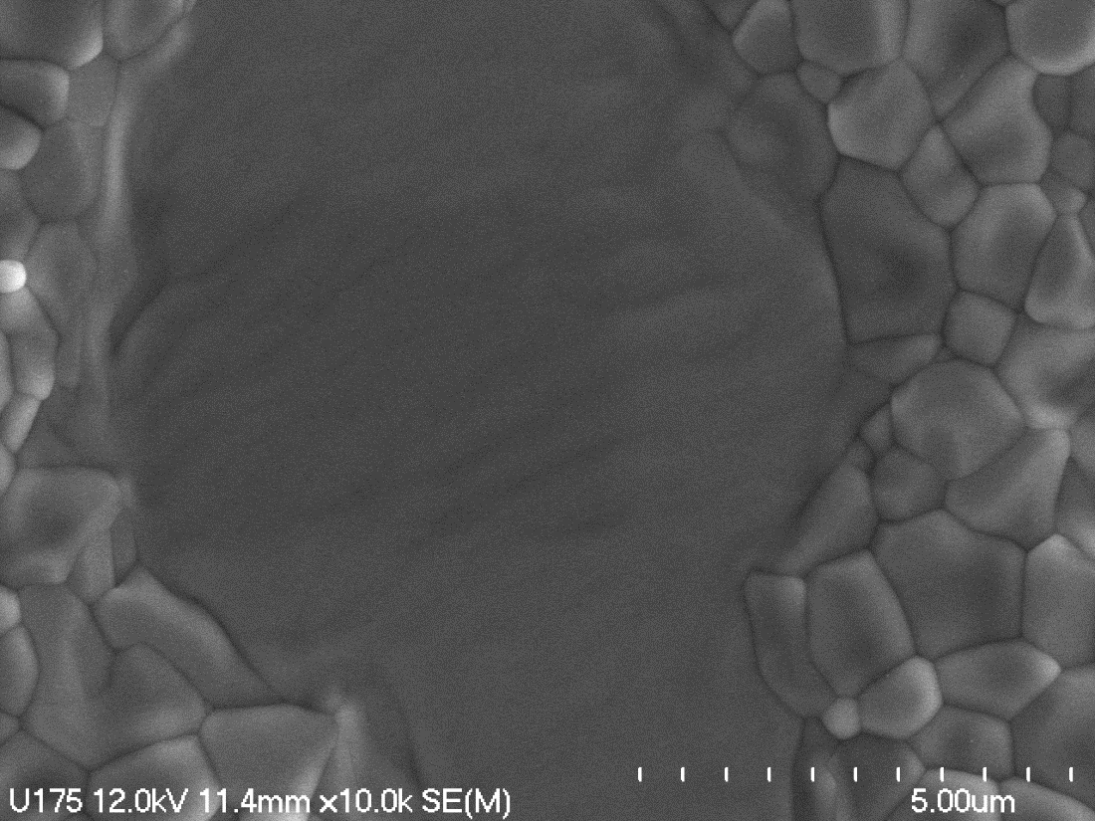
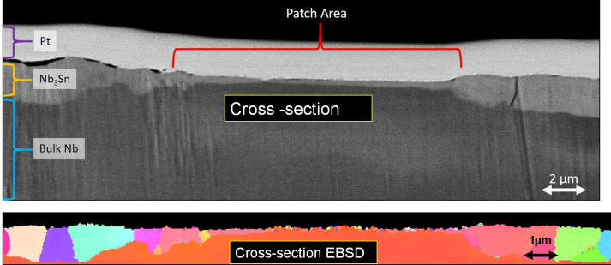
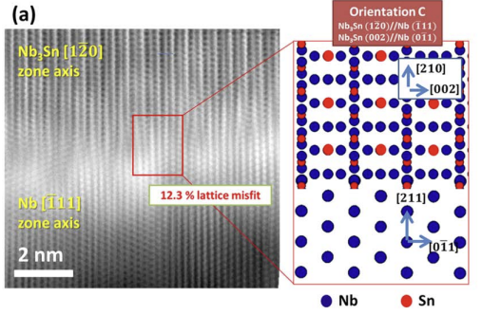
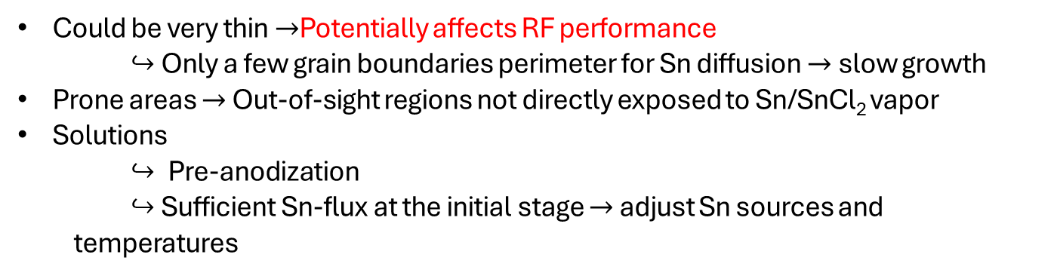
“Patchy” Region
~ 1.75 µm
~ 250 nm
U. Pudasaini, G.V. Eremeev, M.J. Kelley, C.E. Reece, and J. Tuggle, “Surface Studies of Nb₃Sn Coated Samples Prepared under Different Coating Conditions”, in Proc. 18th International Conference on RF Superconductivity, Lanzhau, China, July 2017, paper TUPB069.
Atomically-resolved HR-STEM image of the Nb₃Sn/Nb interface
Could be very thin $→$Potentially affects RF performance
$↪$Only a few grain boundaries perimeter for Sn diffusion $→$slow growth
Prone areas $→$ Out-of-sight regions not directly exposed to Sn/SnCl₂ vapor
Solutions
  $↪$ Pre-anodization
  $↪$Sufficient Sn-flux at the initial stage $→$ adjust Sn sources and temperatures
Low Sn flux → Epitaxial growth of Nb₃ Sn on Nb
J. Lee, et al. "Atomic-scale analyses of Nb₃Sn on Nb prepared by vapor diffusion for superconducting radiofrequency cavity applications: a correlative study." Superconductor Science and Technology 32.2 (2018): 024001.

Slide 13
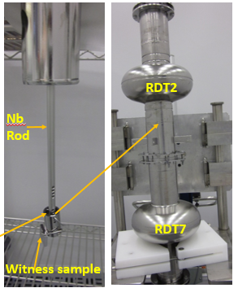
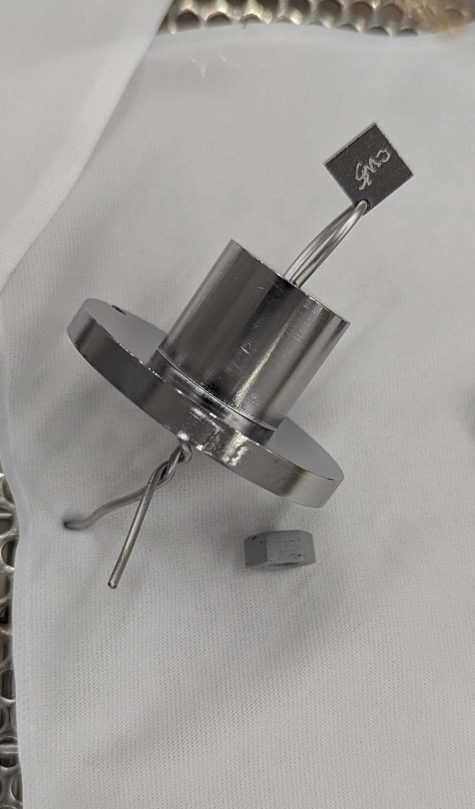
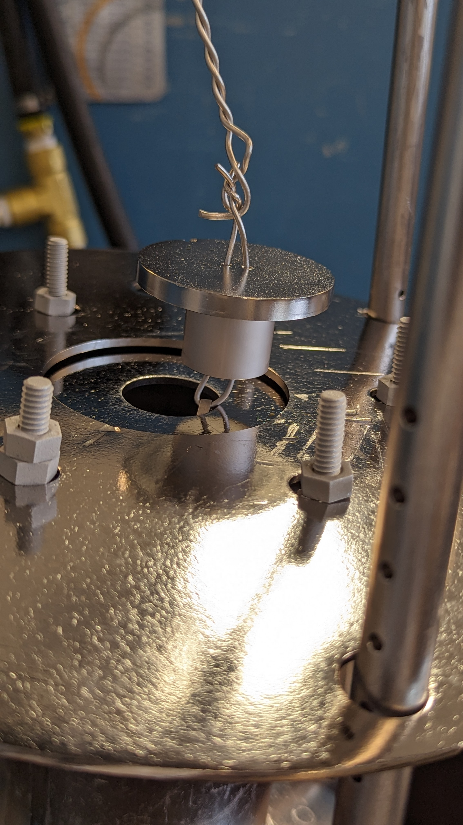
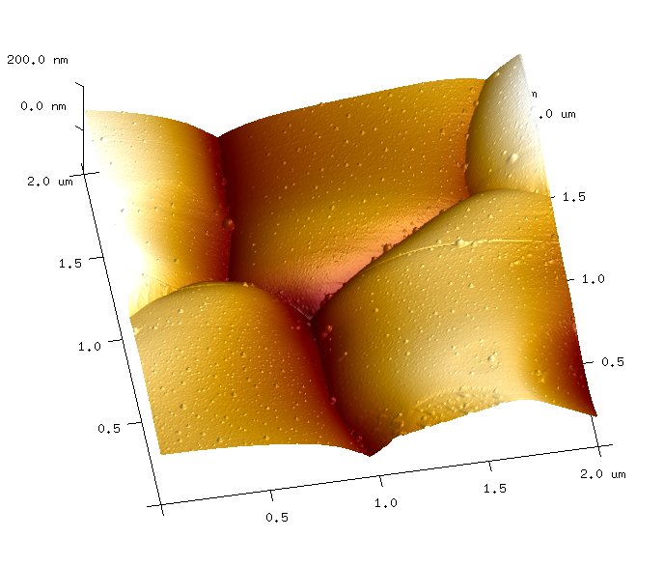
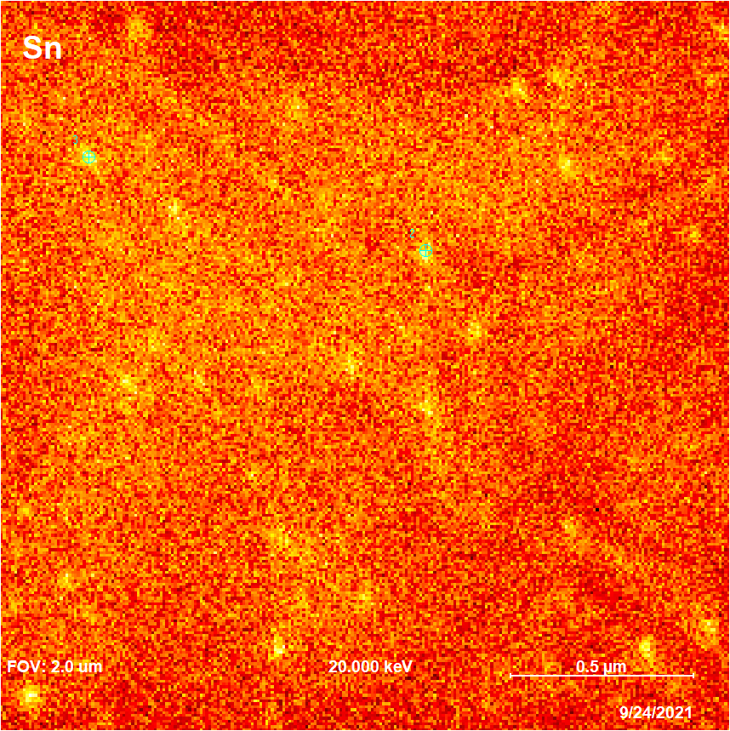
Sn Residues
Cavity covered with Nb plates during the coating
Sn-vapor condensation at the end of the process
Specific challenge for us
Mitigation approaches
AFM
Scanning Auger Microscopy (SAM)
SEM image
Elemental Mapping of Sn by Auger spectroscopy
3
2
Points 2 and 3: High Sn

Slide 14
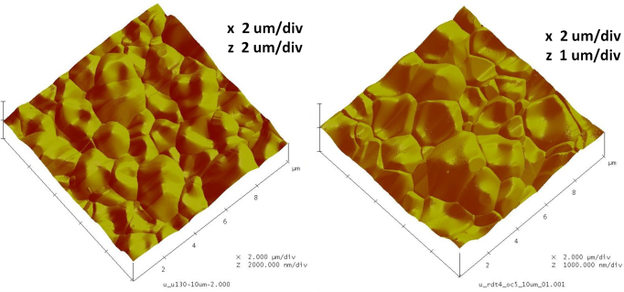
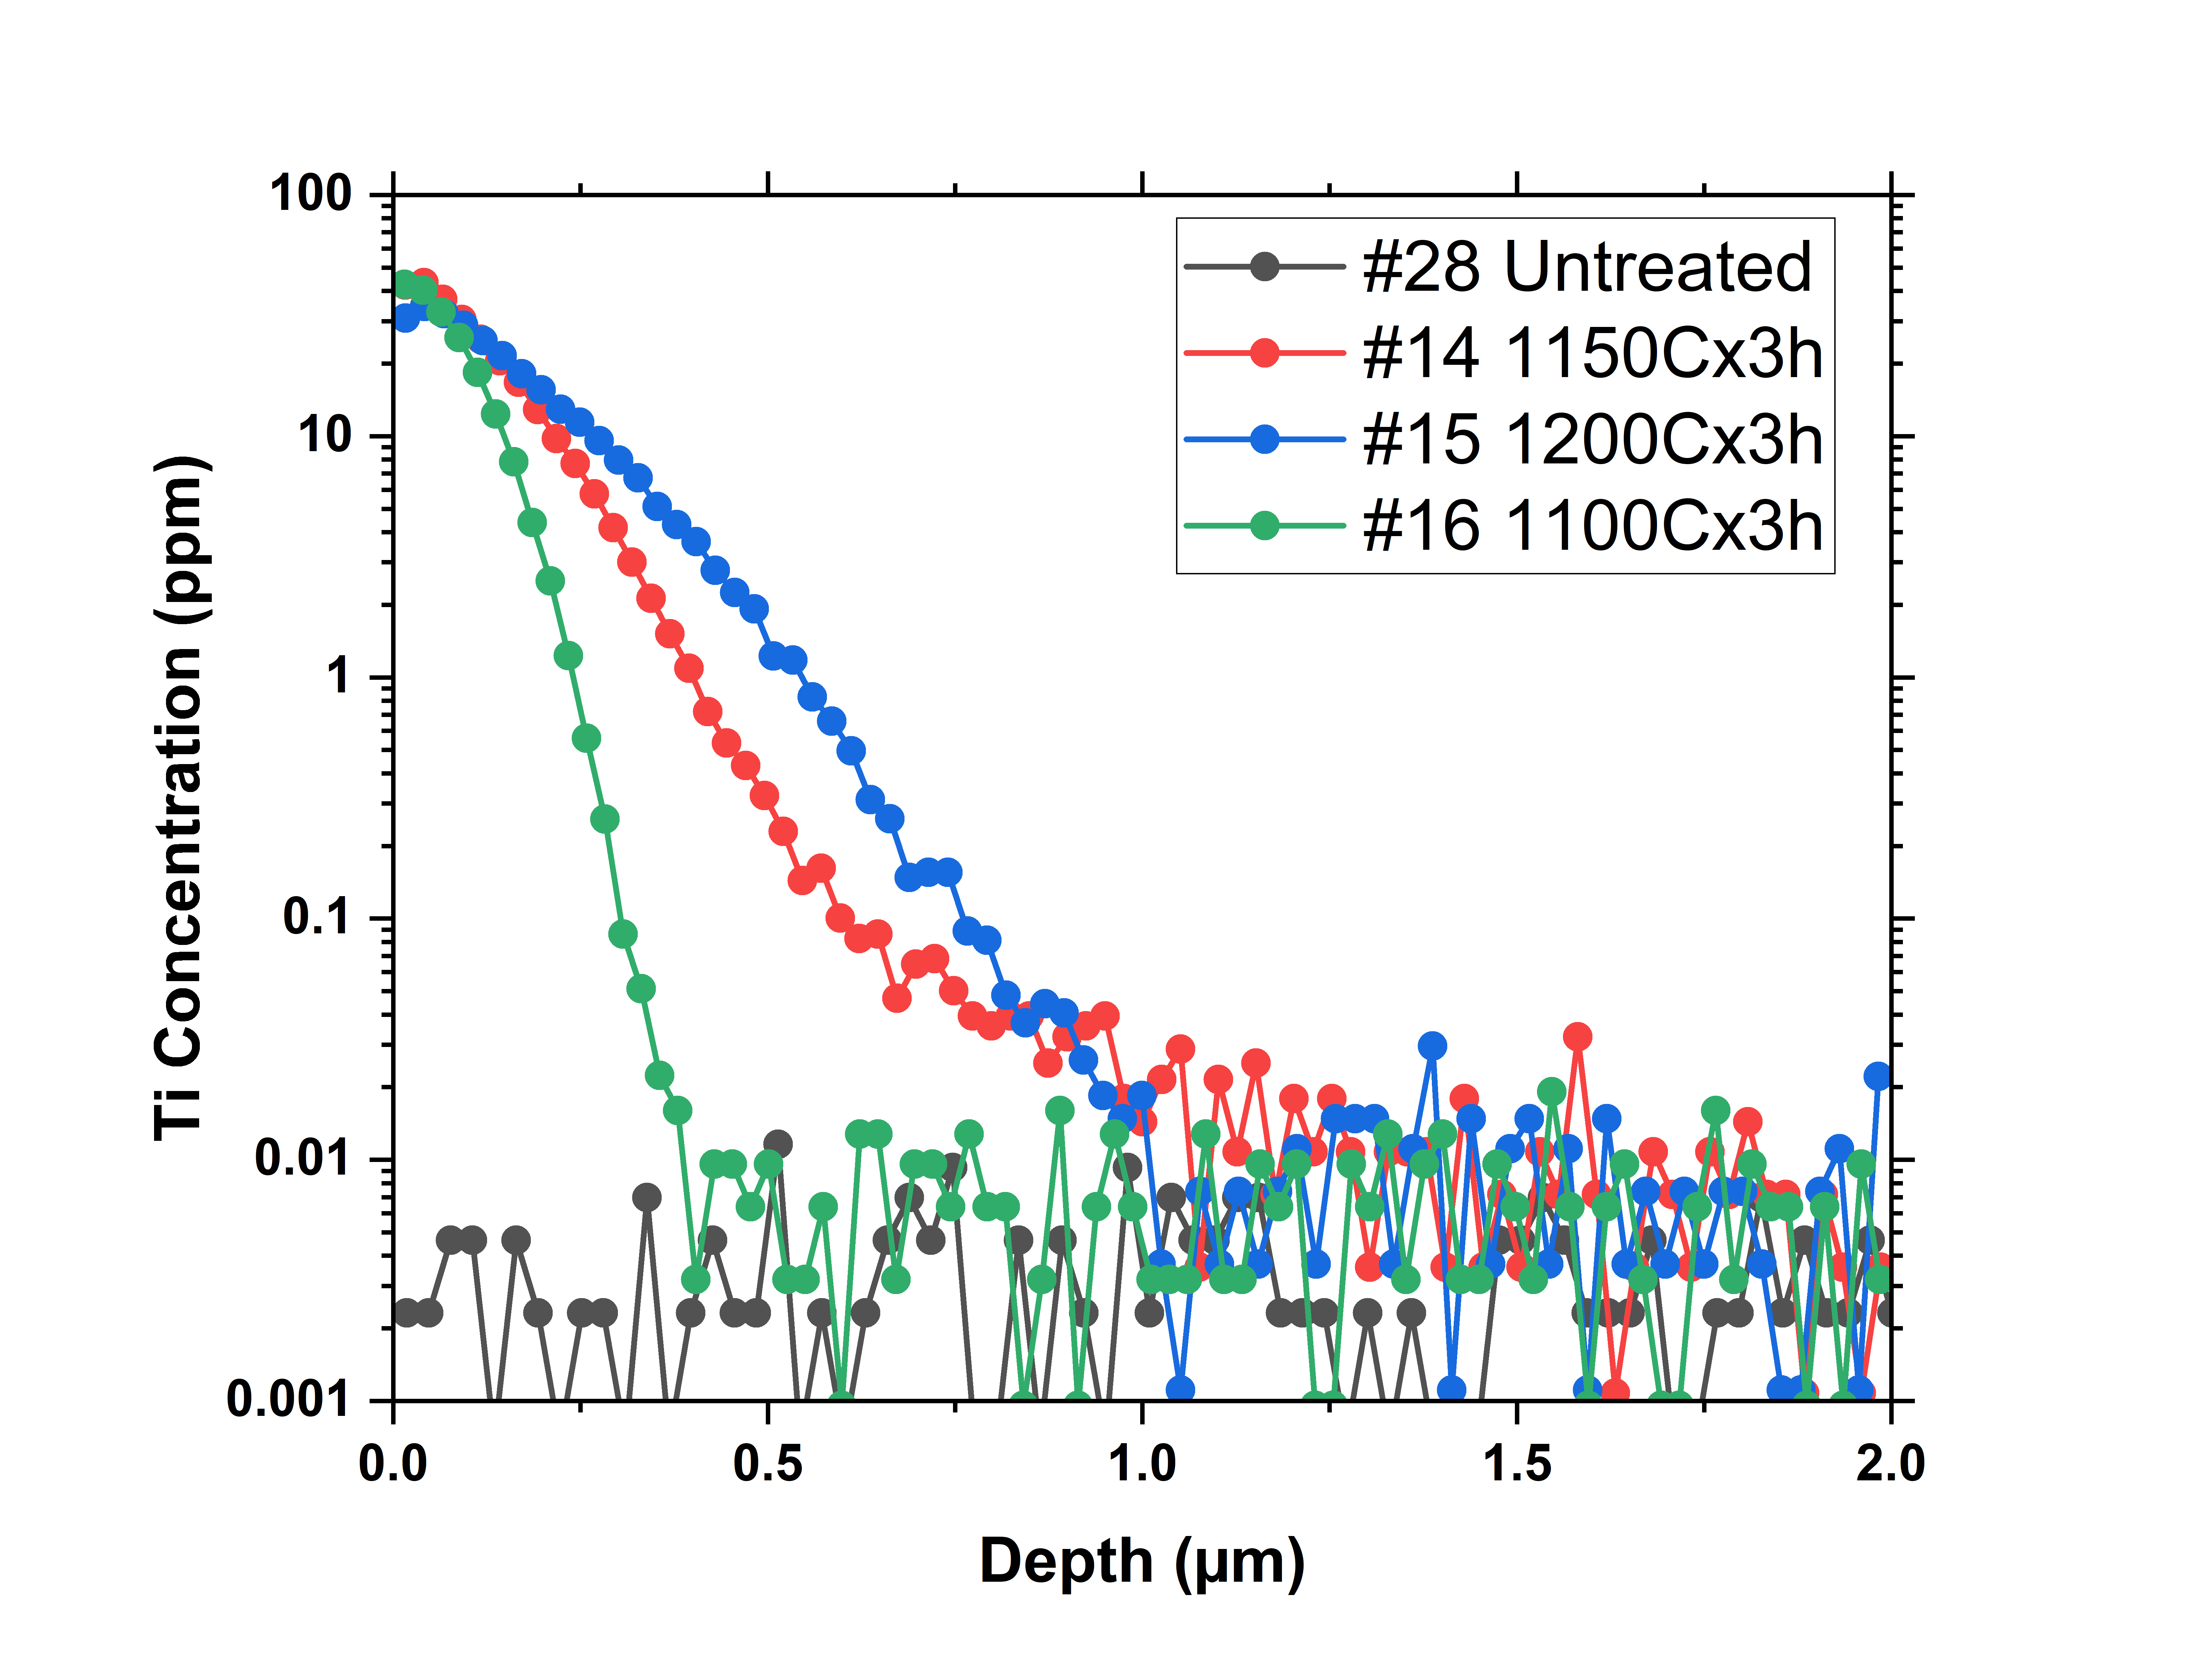
Titanium Contamination from NbTi Flange
Cornell (No Q-slope)
JLab (Q-slope)
At Wuppertal, the potential source of Ti could be Ti foils, used as getter material in the furnace.
M. Peiniger, PhD dissertation, Wuppertal University (1989)
Ti evaporation from NbTi flanges
Cause field dependence of Q₀ degradation in Nb cavities.
Dhakal, P., et al. "Effect of high temperature heat treatments on the quality factor of a large-grain superconducting radio-frequency niobium cavity." Physical Review Special Topics-Accelerators and Beams 16.4 (2013): 042001.
AFM
Ti-free Hygiene adopted after the furnace upgrade in 2017 resulted in the first cavity without “Wuppertal slope”.
Similar microstructure, composition, and topography.
SIMS depth profile from Nb samples with ceramic flange covers
SIMS Depth Profile
Risk of coating cavities with NbTi flanges?
J. Tuggle et al, 2018. Secondary ion mass spectrometry for superconducting radiofrequency cavity materials. Journal of Vacuum Science & Technology B, Nanotechnology and Microelectronics: Materials, Processing, Measurement, and Phenomena, 36(5), p.052907.
U. Pudasaini et al. "Surface Studies of Nb₃Sn Coated Samples Prepared under Different Coating Conditions." SRF 2017: THPB069.

Slide 15
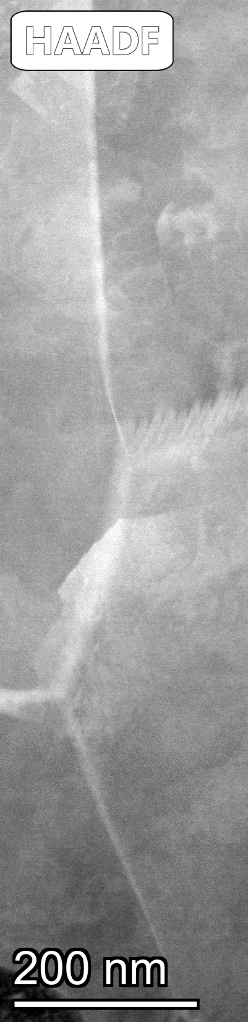
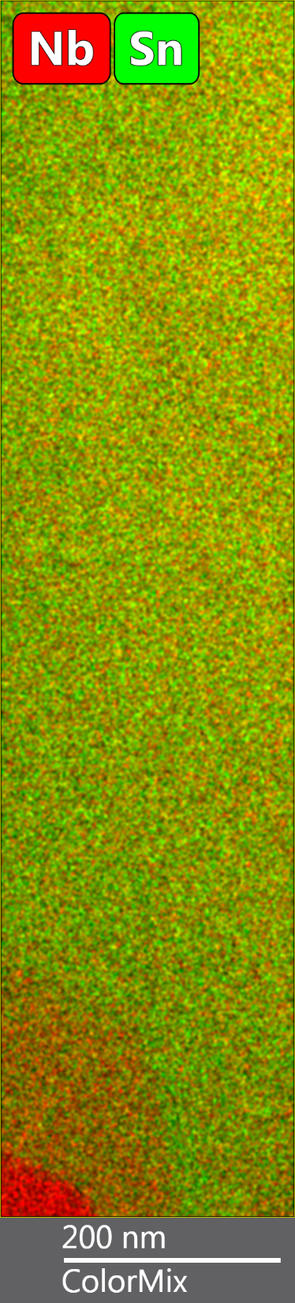
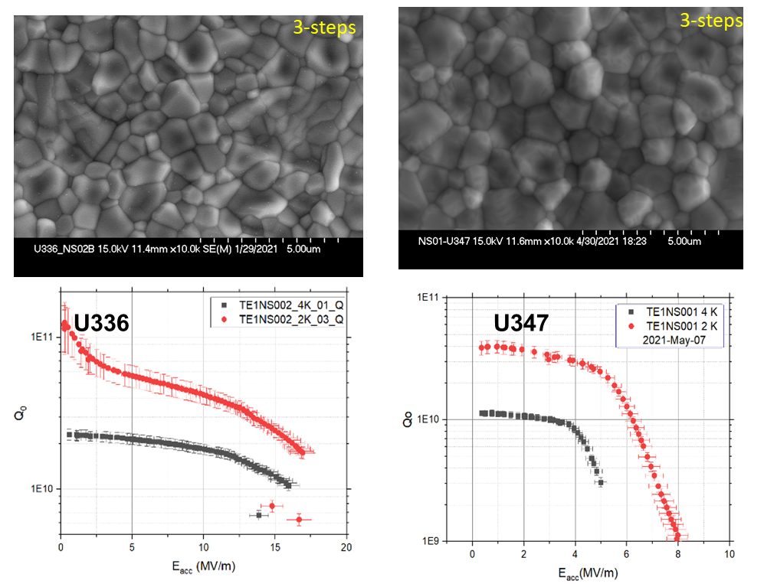
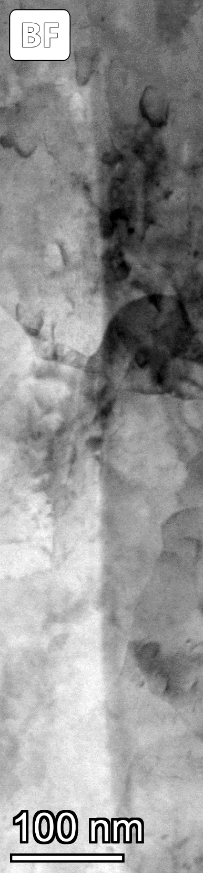
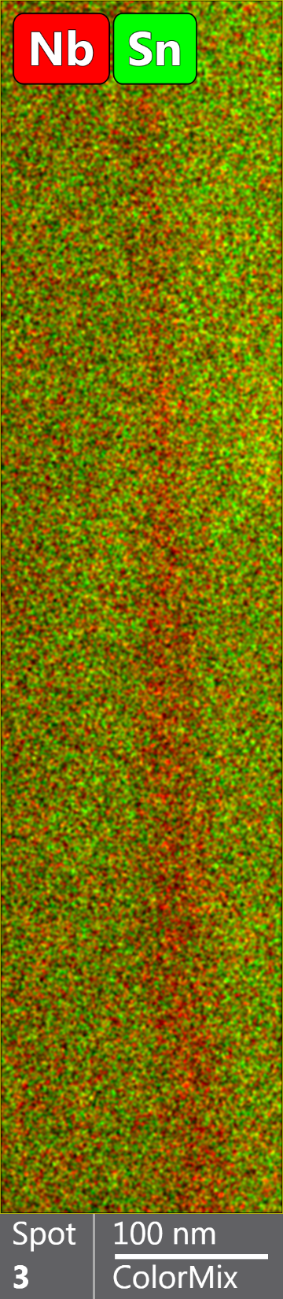
RF Performance vs. Material Characteristics
TEM Cross-Section with Elemental Mapping
Exhausted Sn
TEM Cross-Section with Elemental Mapping
Annealed
Q>10¹⁰ @ >17MV/m at 4 K
Q~10⁹ @ 5 MV/m at 4 K
No Sn-rich GBs but Sn-deficient regions close to the Nb₃Sn-Nb interface
Sample with annealing features – Sn-deficient GBs
Performance | “Good” | Annealed – “bad”
Average grain size (µm) | 0.96 ± 0.06 | 1.11 ± 0.08
Average roughness (nm), 50 µm scan | 73 ± 8 | 98 ± 5
Average thickness (µm) | 1.20 ± 0.12 | 1.75 ± 0.15
GB composition |  | Sn-deficient

Slide 16
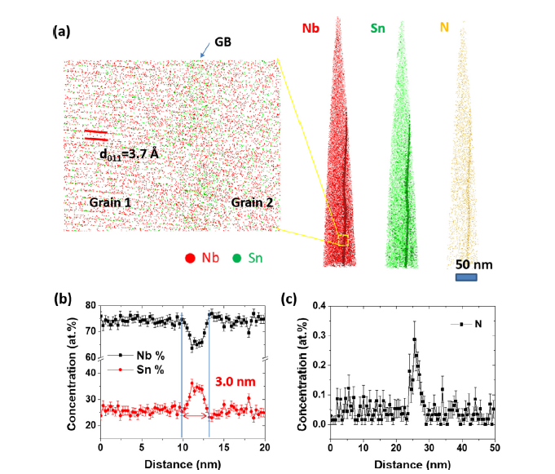
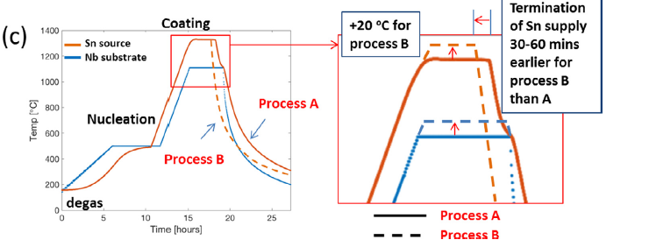
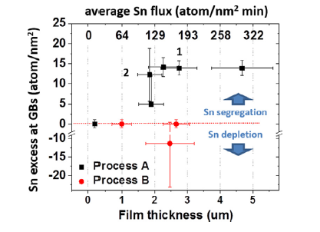
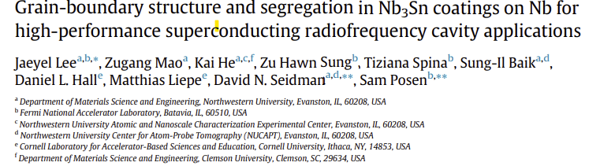
Grain-boundary Segregation
Atom-probe Tomography
Line profile across GB

Slide 17
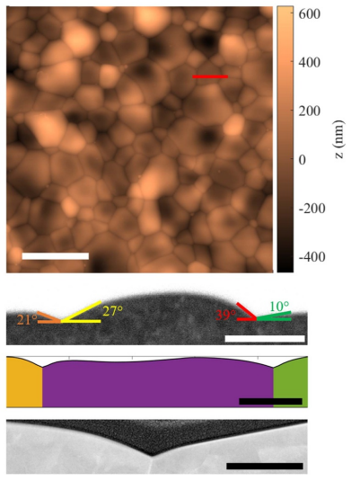
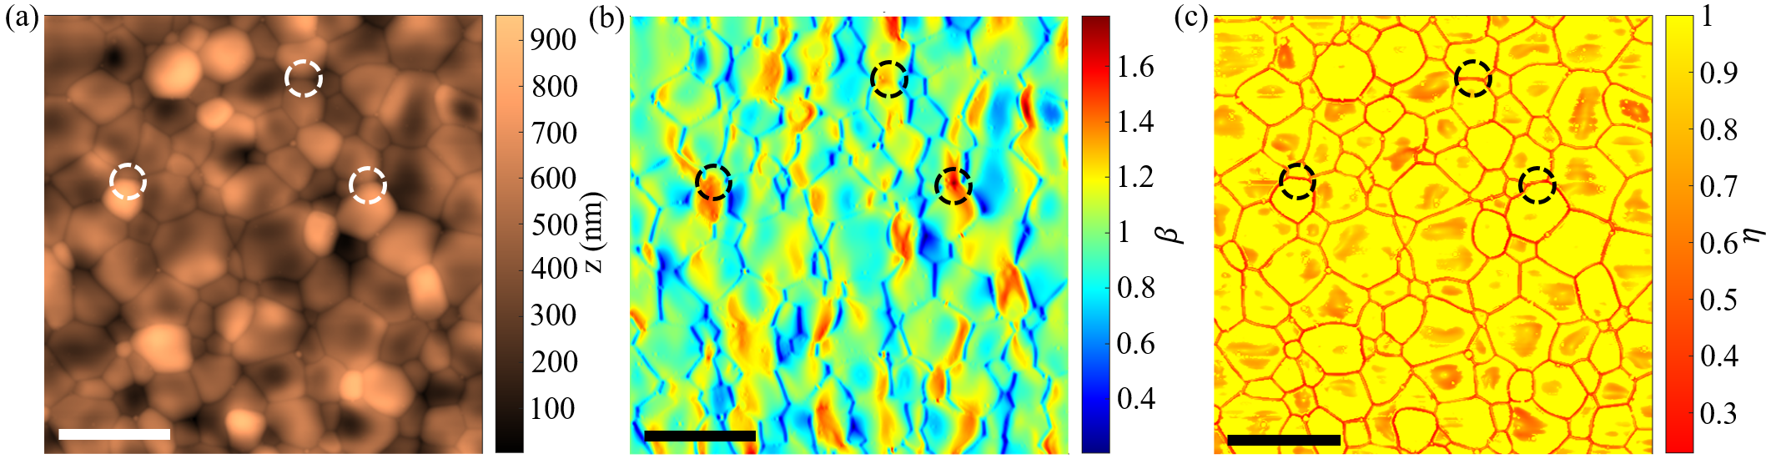
Surface Topography
5 µm
Grooved grain boundaries and substantial surface roughness.
Surface roughness poses threats to the stability of the Meissner state
Magnetic field enhancement and superheating field suppression
Improvement on process design and post-processing
SEM CS
1 µm
500 nm
200 nm
TEM
AFM
5 µm
5 μm
Eric Lechner et al 2025 Supercond. Sci. Technol. 38 01LT01

Slide 18
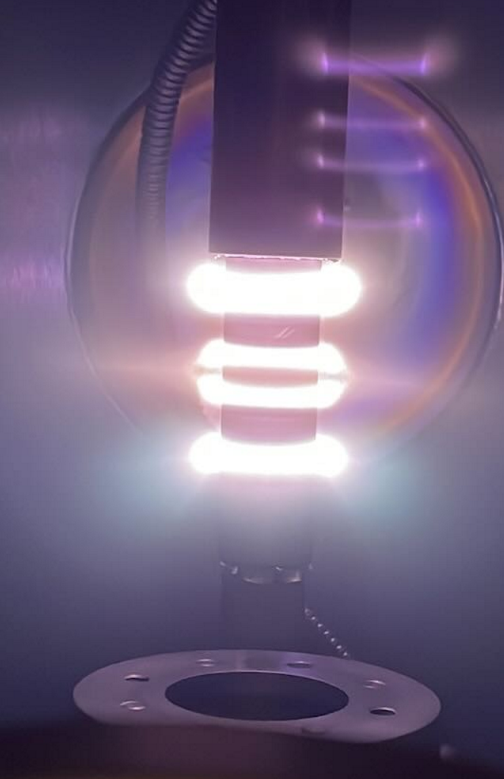
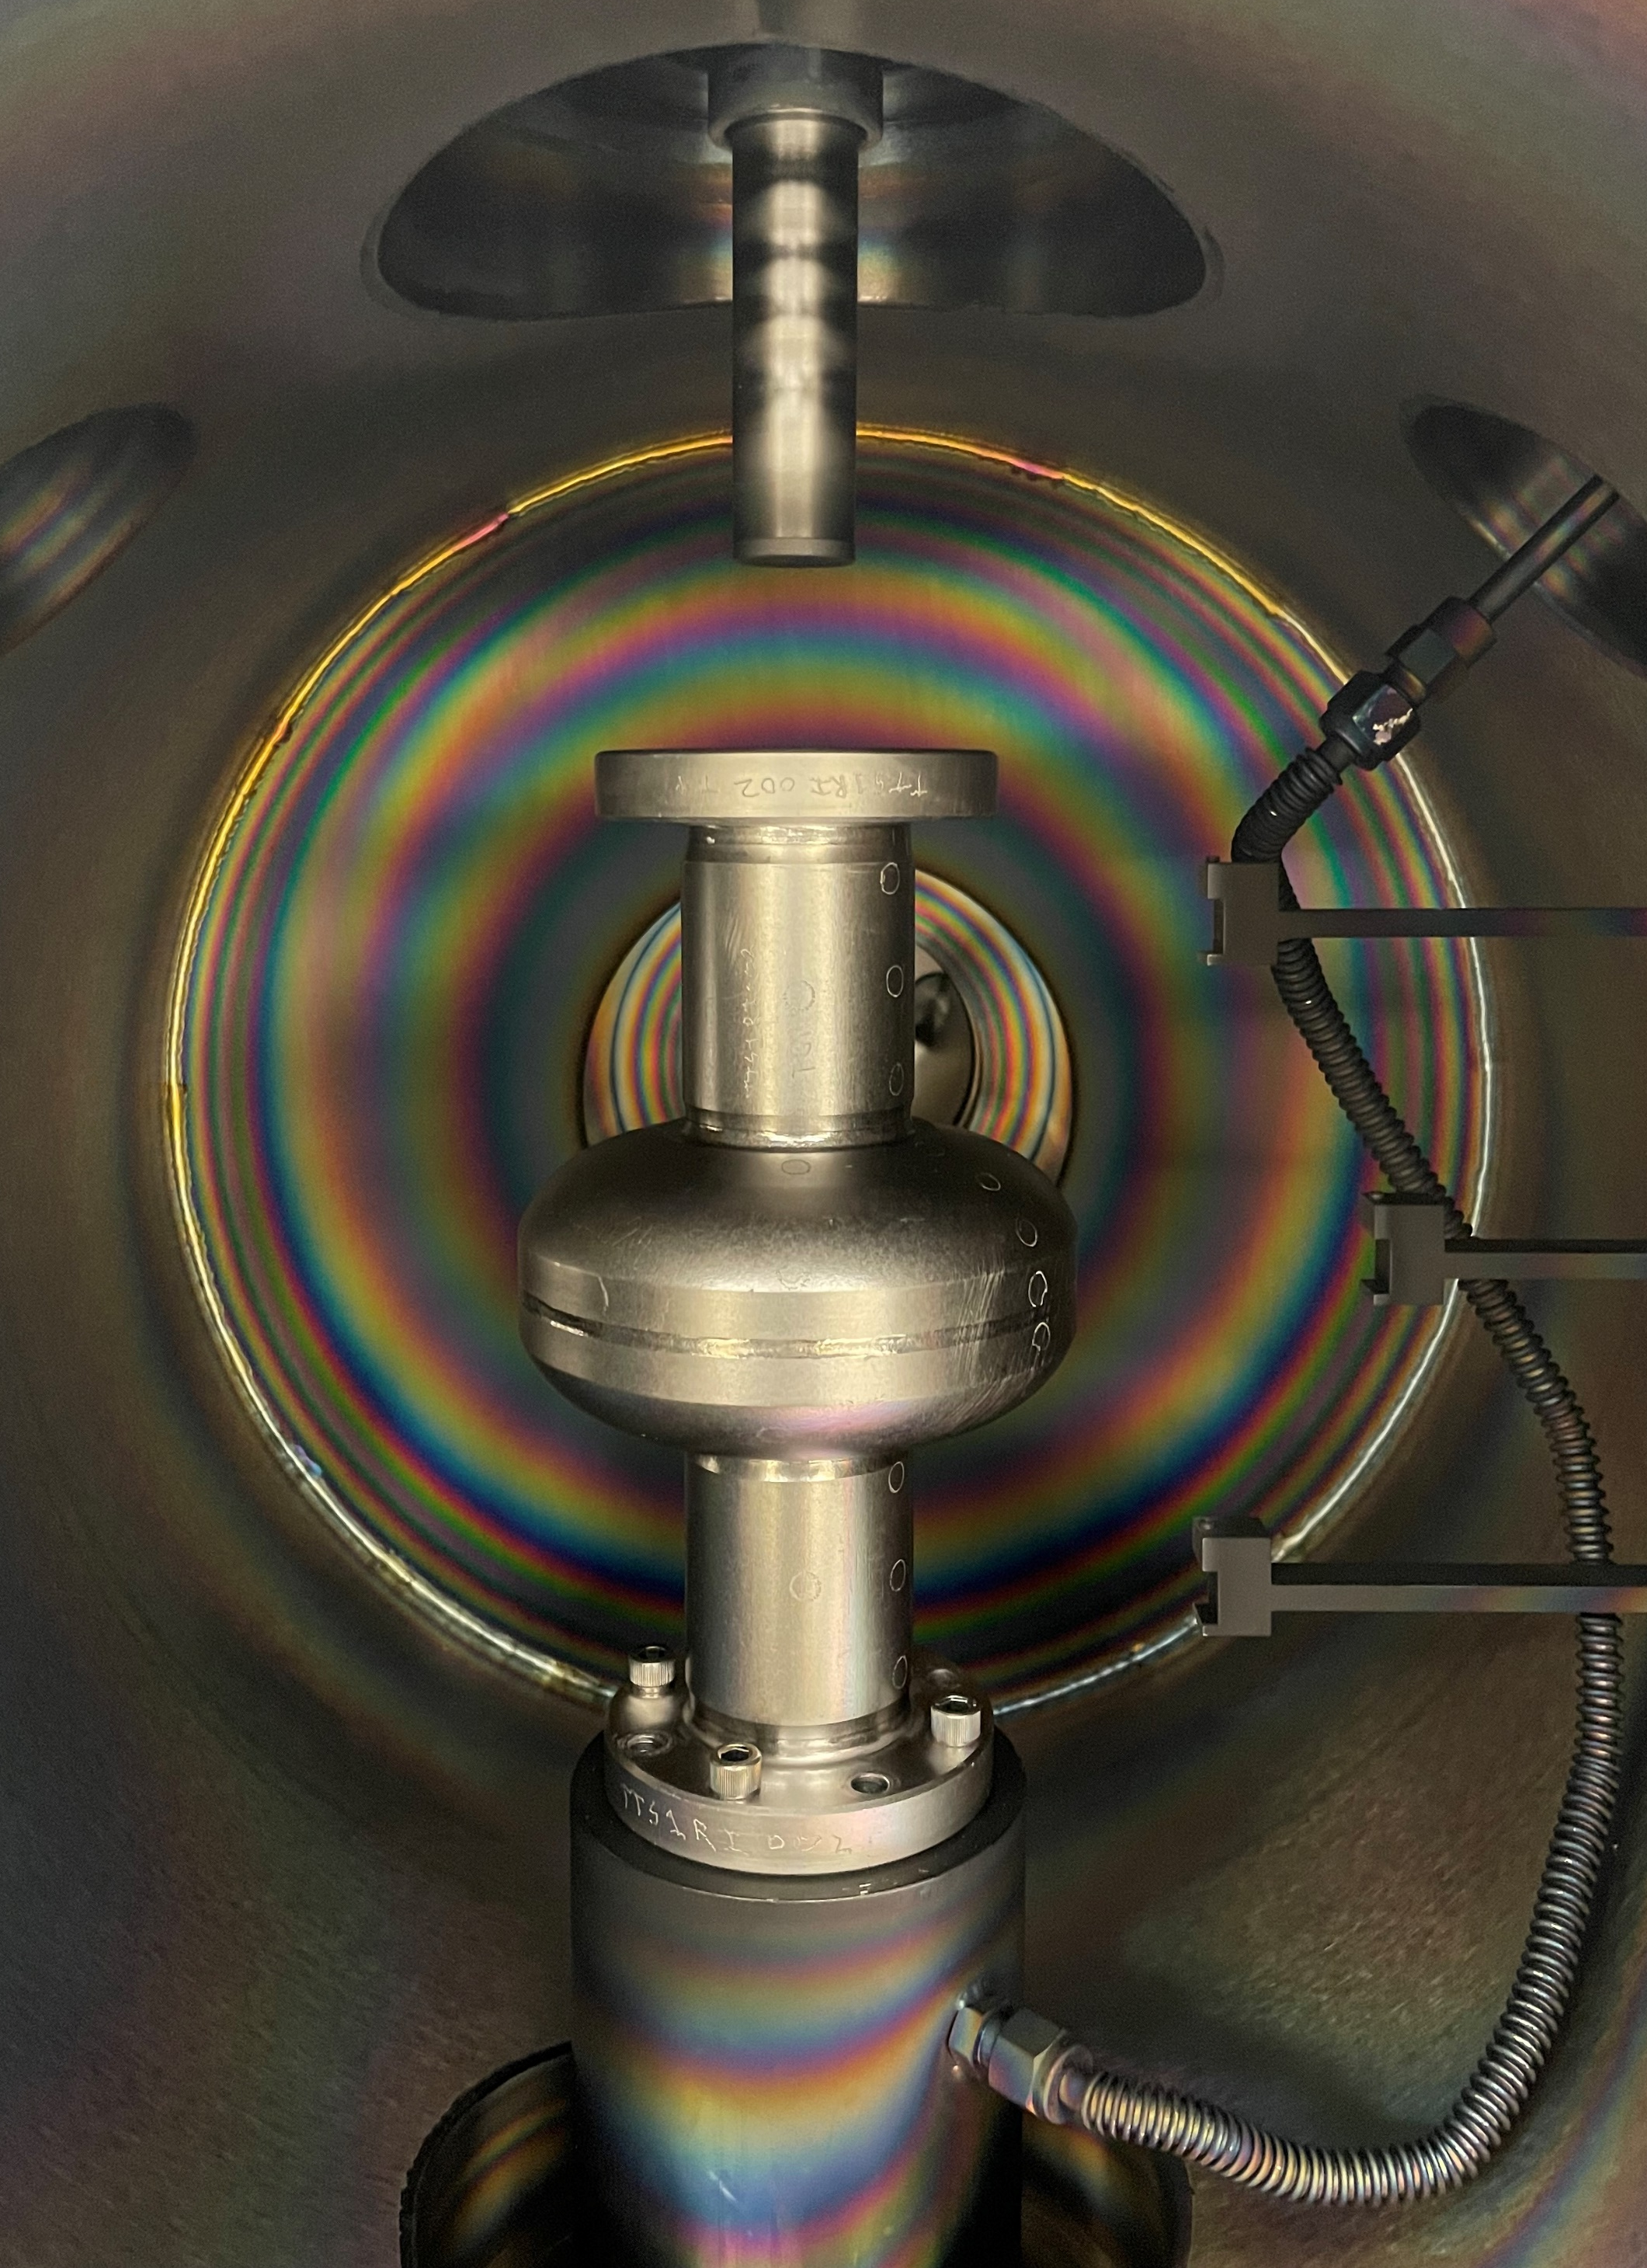



Coating onto 2.6 GHz Nb Cavity Using Cylindrical Sputter Coater
Slide courtesy: M.S. Shakel, ODU
Voids ~23% (area)
More details in the poster today!
2 µm
600 ⁰C – 3 h, 950 ⁰C – 1 h
600 ⁰C – 3 h , 950 ⁰C – 1 h
Co-sputtering from Nb-Sn targets
Equator region samples
Top beam region samples
Plasma interaction with the beam tube sample surface during deposition produces Nb₃Sn grains without voids.
Frank Batten College of
Engineering & Technology
Old Dominion University

Slide 19
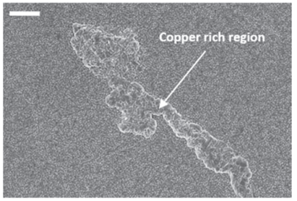


Cu Diffusion in Sputtered-Nb₃Sn
2 μm.
E A Ilyina et al 2019 Supercond. Sci. Technol. 32 035002
1 μm

Slide 20
Summary
Multiple growth methods are under pursuit for Nb₃Sn-coated Nb and Cu cavities.
Material characterization is vital for process feedback and performance optimization.
Process improvements targeting identified defects have improved vapor-diffused Nb₃Sn performance.
Could further performance gains hinge on addressing yet-to-be-revealed “defects”—calling for deeper, targeted material characterization?

Slide 21
Acknowledgements
A-M. Valente-Feliciano, E. Lechner, M. J. Kelley, O. Trofimova
G. Eremeev, S. Posen, M. Liepe
Work supported by the U.S. Department of Energy, Office of Science, Office of Nuclear Physics under contract DE-AC05-06OR23177.

Slide 22
Thank you for your attention!
Questions?

