Slide 1

Bright Beams Begin with Materials
Wrap up and looking forward
JOHN POWER
Argonne Wakefield Accelerator
Argonne National Laboratory
https://www.anl.gov/awa
July 18, 2025

Slide 2
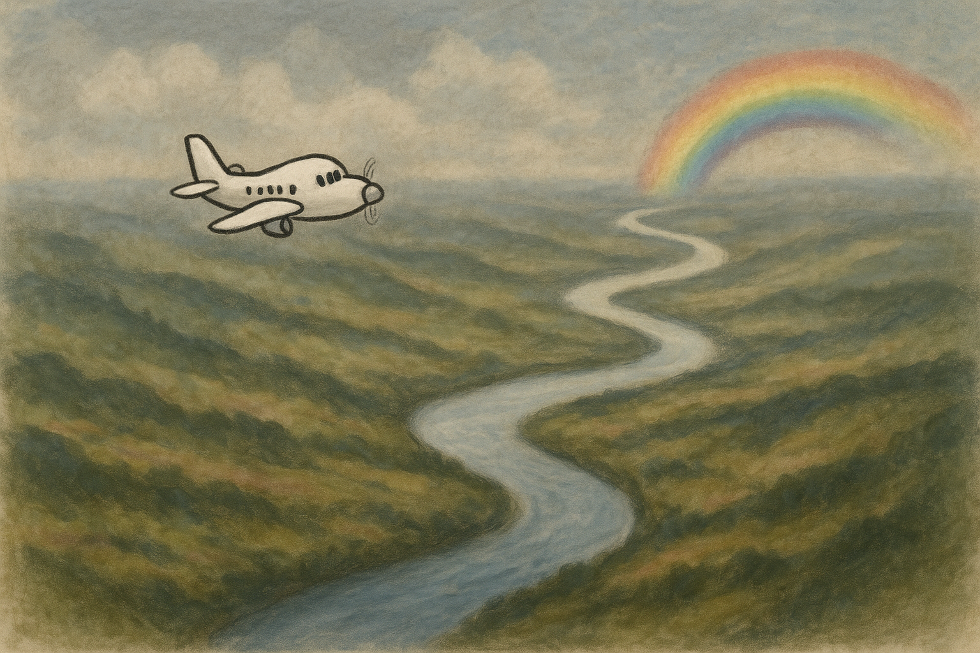
30,000-foot view
MBB
Tough waters ahead
-Workshop goals
  Define an MBB ecosystem
  Gain support for materials research
-Identify unifying themes
-Outcome of this workshop
-The future
High Brightness Beams
The materials river
PC
SRF
NCRF

Slide 3
Unifying themes
Materials matter for beams:
  Brightness
  Stability
  Operational lifetime
Performance hinges on materials:
  PC: QE, MTE, lifetime, max charge, response time, …
  SRF: Emax (~10s MV/m), Bmax (~100s mT), Tc, high Q₀ ,fabrication, …
  NCRF: Emax (~100s MV/m), RF losses (0.7e-8 (Ω⋅m) ), fabrication, …

Slide 4
Unifying themes
Emerging materials are important for each focus area:
  Novel alloys (Nb3Sn, CuAg, K2CsSb), thin films, engineered surfaces at the nanoscale …
Advance Characterization methods:
  ARPES, STM, Breakdown test stand, in situ studies,
Modeling and theory:
  DFT to many-body photoemission, Molecular dynamics, etc
Bridging the gap from lab results to real-world reliability. Need a pipeline between
  lab results → beam test facilities
  beam test facilities → User Facilities

Slide 5
Opportunities Ahead
MBB
PC, SRF, NCRF.
traditionally independent
High Brightness Beams
Cross-field collaboration? Find Common methods to SRF, NCRF, photocathodes
  Small overlap: theory
  Some overlap: Thin film deposition? engineered surfaces?
Early career development:
  Fresh perspectives and energy
Industry partnerships:
  Scaling and translating discoveries
The materials river
NCRF, SRF, PC

Slide 6
The Vision for Future Workshops
How often?
  What’s the right interval? One year? Two years? Three??
  Sister workshops
    High Gradient Workshop (https://indico.fnal.gov/event/65159/) annual, Mar 24-28)
    MeVArc (https://indico.cern.ch/event/1424597/) (annual, June 1-6, 2025)
Potential themes (TBD) for the next workshop
  Finding common themes
  Real-time, in-situ studies during operating conditions
  Machine learning for materials by design
Host for the next workshop?
  Let us know if you are interested in hosting the next workshop
  Select host by end of July 2025?
Summary notes ala Lance Cooley
  He will turn his notes into a draft of the summary report.
  He will share the summary report to get your comments
  He will release the internal report to us.

Slide 7
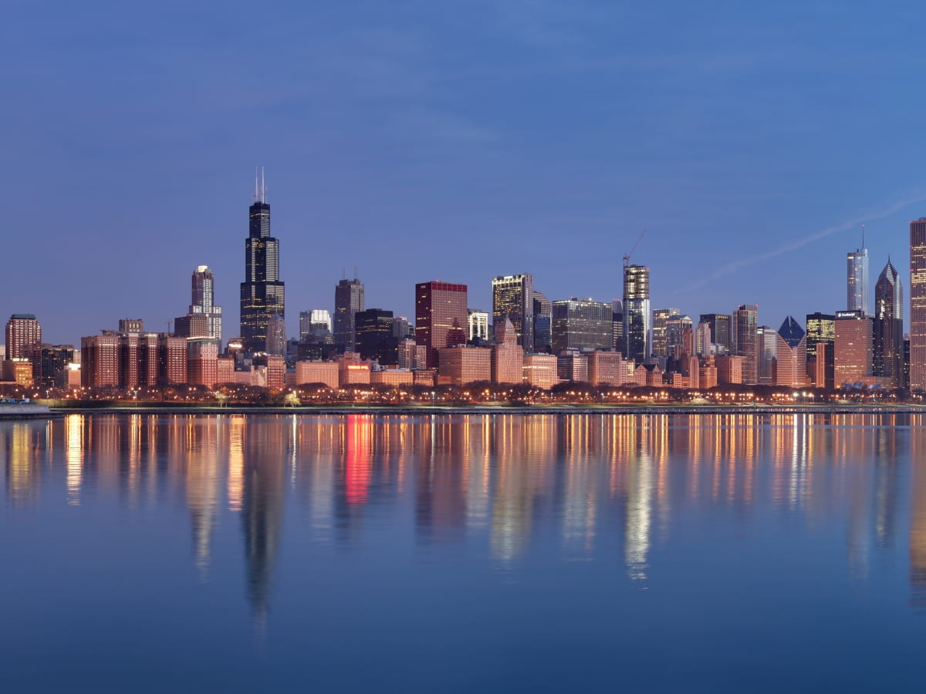
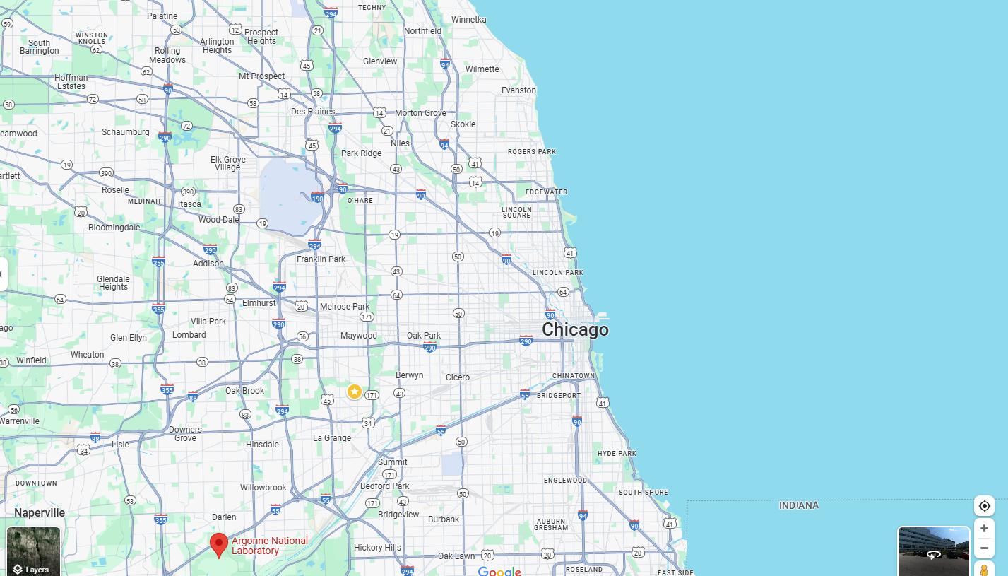


AAC 2024 Chicagoland
Join us for MBB27
(summer of 2027)
Hilton Orrington
Evanston, IL
Potential Venues
NIU conference center (close to FNAL)
Argonne National Lab

