Slide 1
Current status and gaps in our understanding of RF dissipation
Alex Gurevich
Old Dominion University, Norfolk VA
Supported by DOE under grant DE-SC0025560

Slide 2
Contributions to SRF losses
intrinsic (BCS)
extrinsic (residual)
Intrinsic:
Quasiparticle losses due to thermal-dissociation of Cooper pairs, field-dependent R_{s}(H) of a nonequilibrium superconductor driven by strong rf currents
Extrinsic:
Nonsuperconducting precipitates and surface layers (hydrides, suboxides)
Surface roughness, pits, groves, microcracks
Extended materials defects: grain boundaries, arrays of dislocations, impurity segregation on GBs and dislocations, nonstoichiometric regions
Vortices trapped in the cavity during its cooldown through Tc, hotspots on cavity surface
Materials-related subgap quasiparticle states: TLS in surface oxides, spatial correlation of impurities, strong e-p coupling, etc.
Interplay of intrinsic and extrinsic contributions

Slide 3
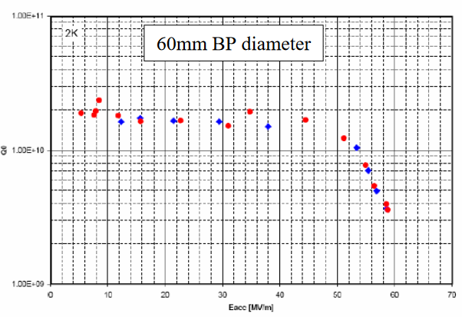
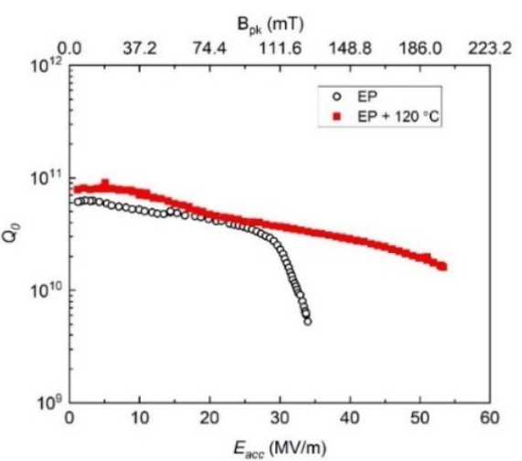
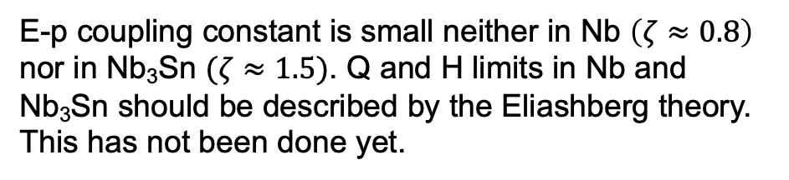
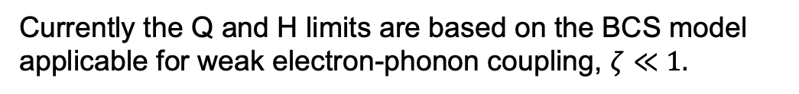
Do we really know the theoretical SRF performance limits?
?
How far can the breakdown fields and Q factors in Nb cavities be increased?
Surface field 220 mT is close to the dc superheating field at
which surface current density reaches the BCS depairing limit
Reentrant shape
?
Single-cell: 59 MV/m (223 mT) 1.3 GHz at 2 K
Currently the Q and H limits are based on the BCS model applicable for weak electron-phonon coupling, $ζ≪1.$
E-p coupling constant is small neither in Nb $\left(ζ≈0.8\right)$
nor in Nb₃Sn $(ζ≈1.5)$. Q and H limits in Nb and
Nb₃Sn should be described by the Eliashberg theory.
This has not been done yet.
?
?
Theoretical Q and H limits in Nb or Nb₃Sn at T << T_{c} and GHz frequencies are unknown.
53.3 MV/m in 650 MHz single-cell!

Slide 4
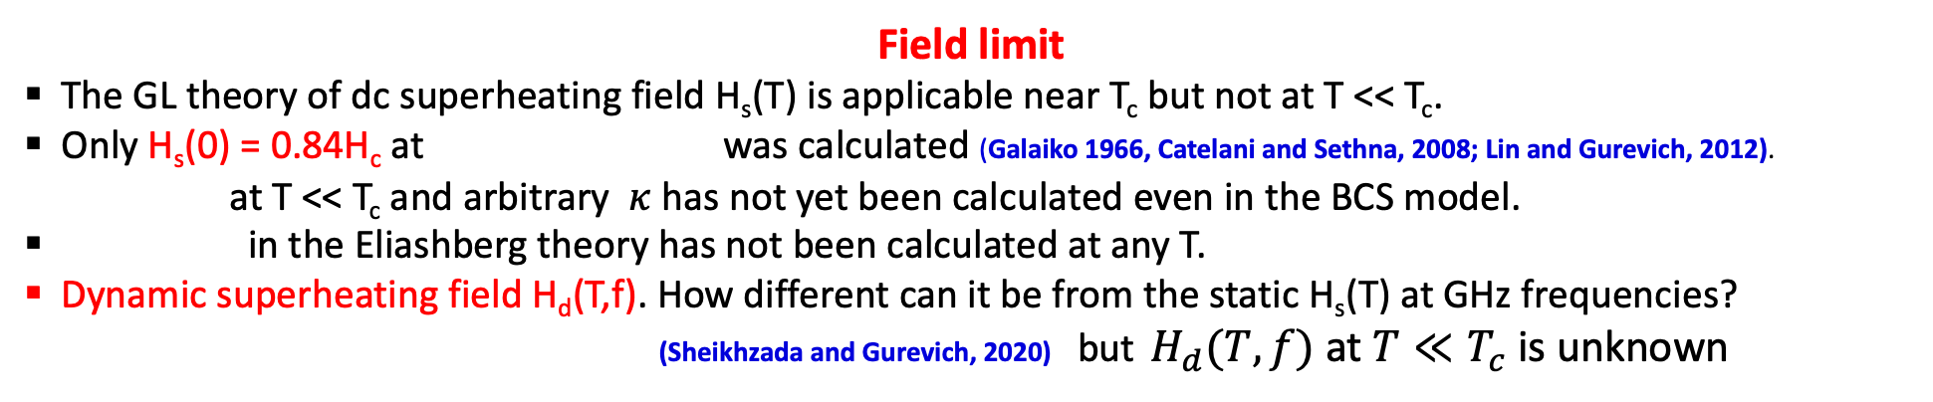
Gaps in theory
Field limit
The GL theory of dc superheating field H_{s}(T) is applicable near T_{c} but not at T << T_{c}.
Only H_{s}(0) = 0.84H_{c} at was calculated (Galaiko 1966, Catelani and Sethna, 2008; Lin and Gurevich, 2012).
at T << T_{c} and arbitrary $κ$ has not yet been calculated even in the BCS model.
in the Eliashberg theory has not been calculated at any T.
Dynamic superheating field H_{d}(T,f). How different can it be from the static H_{s}(T) at GHz frequencies?
(Sheikhzada and Gurevich, 2020) but $H_{d}(T,f)$ at $T≪T_{c}$ is unknown
Q limit
BCS surface resistance R_{s}(T) vanishes at T=0. How far can the residual resistance be decreased?
Multiple contributions to R_{i}: trapped vortices, subgap quasiparticles, two-level states, proximity-coupled
suboxide layers, …..
Nonequilibrium superconductivity
Problem of nonlinear BCS surface resistance in a nonequilibrium SC under strong rf current. Mechanisms of negative Q(H) slope.
Extreme dynamics and nonlinear losses of trapped vortices driven by strong rf current

Slide 5
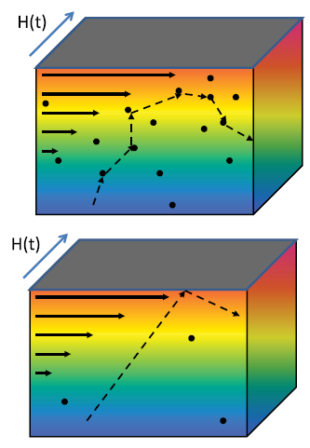
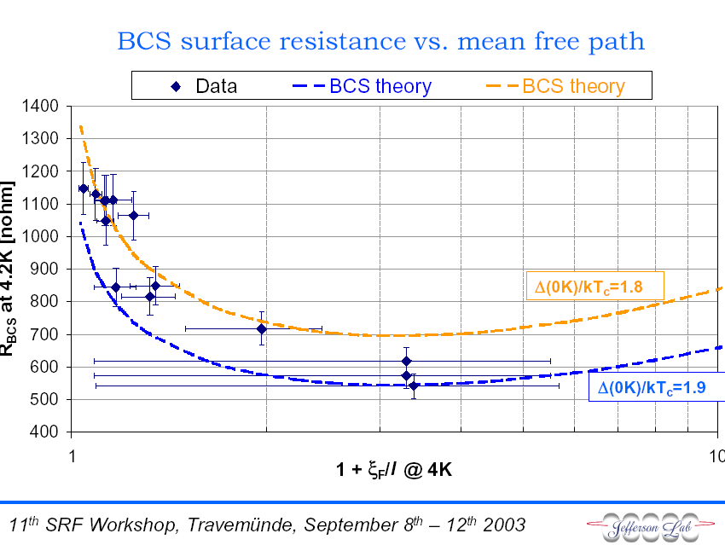
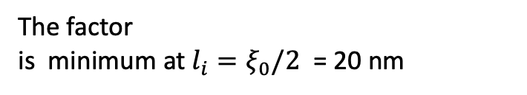
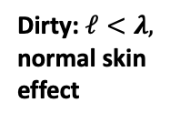
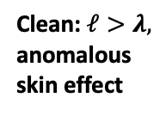
BCS surface resistance
D.C. Mattis and J. Bardeen, Phys. Rev. 111, 412 (1958)
Dirty: $ℓ<λ,$
normal skin
effect
λ
Vanishes at T→ 0.
The factor
is minimum at $l_{i}=ξ_{0}/2$ = 20 nm
Is the optimal Q at GHz
frequencies and low T
limited by the idealized
BCS surface resistance?
Clean: $ℓ>λ,$
anomalous
skin effect
λ
Nb cavities have R_{BCS} ≈ 10-20 nΩ
at 2 GHz and 2K

Slide 6
Mattis-Bardeen theory in the dirty limit
In the dirty limit of l < ξ, the relation between the current density J(r)
and the electric field E(r) is local:
Density of stares in the BCS model
The dissipative conductivity σ₁ results from thermal dissociation
of Cooper pairs
Mattis and Bardeen (1958), Abrikosov, Gor’kov, Khalatnikov (1958)
The singular DOS of BCS model results in logarithmically divergent
at

Slide 7
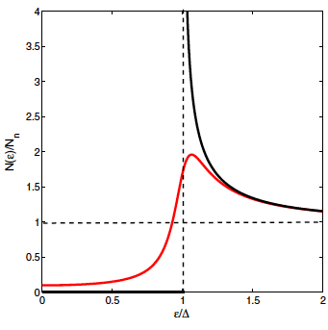
Broadening of gap peaks in N(ε) reduces R_{s}
Low-frequency surface resistance at 1-2 GHz, hf/kT ≈ 10⁻²
Broadened gap
peak and subgap
states in the
Dynes model
Idealized
BCS
Density of states with broadened gap peaks:
R_{s} can be reduced by:
electron-phonon inelastic
scattering
proximity-coupled
metallic suboxides
Dilute magnetic impurities
Optimal inhomogeneities
The BCS log singularity in R_{s} at $ω=0$ is removed by the DOS broadening:
Optimal broadening the gap peaks can reduce R_{s} by 4-5 times

Slide 8
Residual surface resistance from subgap states
Generalized M-B:
Gurevich, SUST 30, 034004 (2017)
Gurevich and Kubo, PRB 96, 184515 (2017)
Residual resistance is a part of BCS surface resistance which takes into account the broadening of gap peaks in
R_{i} increases with but R_{s}(T) at higher T is decreased by moderate DOS broadening
R_{i} = 10 nohm at 1.5 GHz and $λ=40$nm at

Slide 9
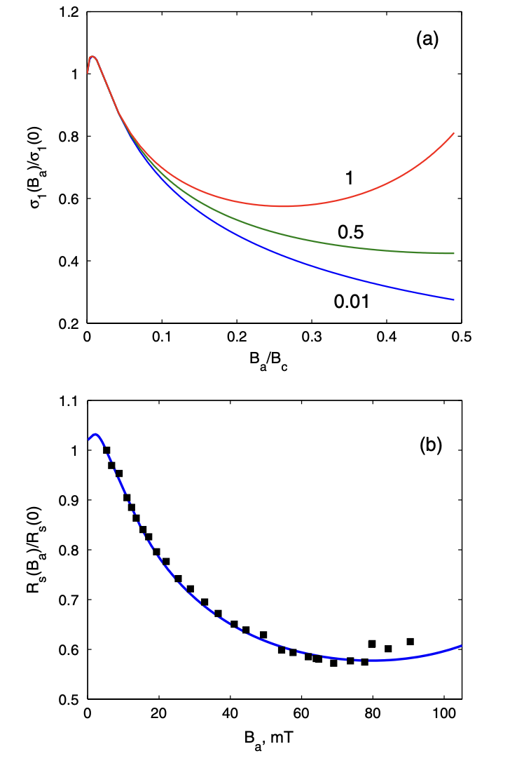
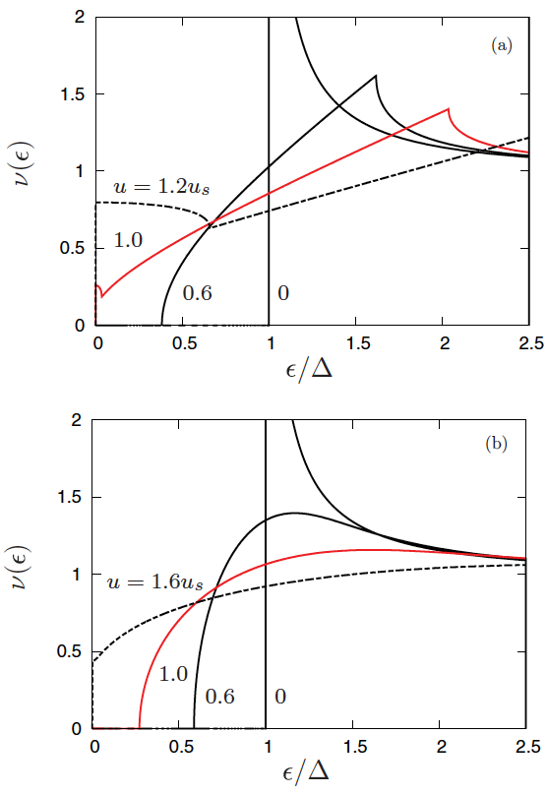
Broadening the DOS peaks by current produces the negative Q slope
Maki, Prog. Theor. Phys. 29, 10; 333 (1963);
Fulde, Phys Rev. 137, A783 (1965)
Lin and Gurevich, PRB 85, 054513 (2012)
The effect of current on the DOS:
Gap singularities are smeared out
The quasiparticle gap becomes
smaller than , both and
decrease with H
In the clean limit the gap vanishes at
H < H_{s}:
In the dirty limit the gap remains
finite at H_{s}:
clean
Ti-doped cavity,
Dhakal, Ciovati et al,
PR-AB 16, 042001 (2013)
dirty
Gurevich, PRL 113, 087001 (2014)

Slide 10
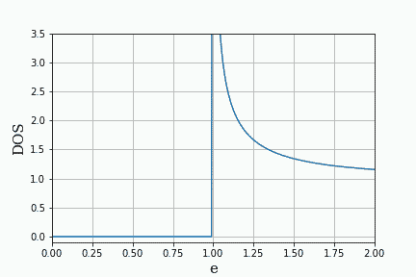
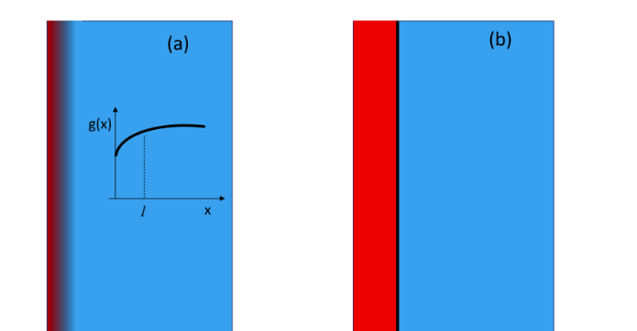
Optimizing surface resistance by pairbreaking mechanisms
Surface resistance can be reduced by RF current, surface nanostructuruing and magnetic impurities
Current-induced broadening of DOS peaks causes a negative Q(H) slope
Subgap states caused by finite quasiparticle lifetimes.
Surface layer of reduced BCS pairing constant (surface nonstoichiometry)
Proximity coupled thin normal (suboxide) layer on the surface
Small density of magnetic impurities
Gurevich, PRL 113, 087001 (2014)
Gurevich and Kubo, PRB 96, 184515 (2017)
Kubo and Gurevich, PRB 100, 064522 (2019)
Calculatioins of Rs in the dirty limit
based on the Usadel equations
DOS oscillating under RF currents
Reducing Rs by engineering an optimum DOS by surface nanostructuring and impurity management
magnetic
impurities
N
S
Current-induced DOS broadening

Slide 11
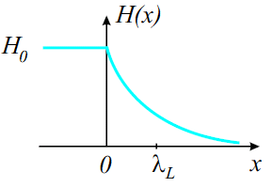
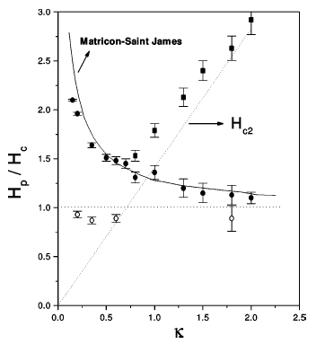
DC superheating field near T_{c}
Meissner state becomes unstable at H > H_{s} as the Cooper pairs reach the critical
pairbreaking velocity and the RF current density J_{s} = H/λ at the surface
approaches the depairing limit J_{d} = H_{s}/λ
GL region, T ≈ T_{c}: (Matricon and Saint-James, 1967, Chapman 1995)
λ
No microscopic theory of H_{s}(T) at low T and
At T << T_{c}, only H_{s}(0) = 0.84H_{c} at κ >> 1 has been
calculated in the clean limit (Galaiko 1966, Catelani and Sethna, PRB 2008)
and for arbitrary impurity concentration (Lin and Gurevich, PRB 2012)
Nb
No Eliashberg theory for H_{s}

Slide 12
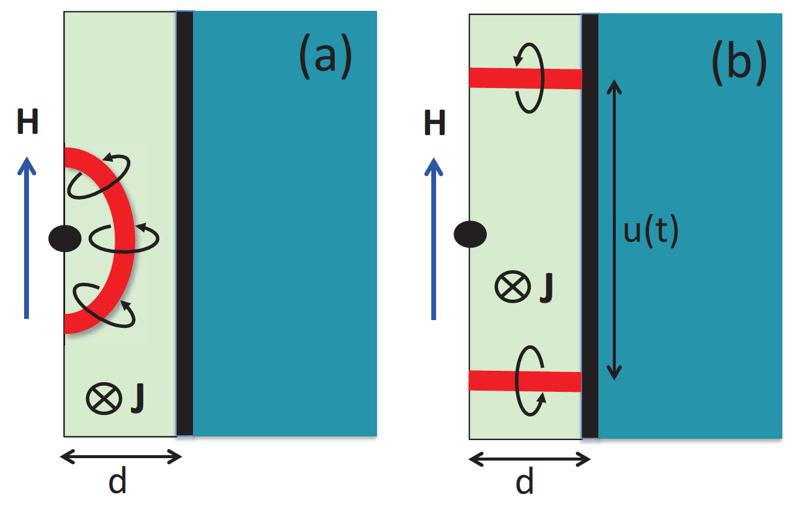
Surface nanostructuring to increase B_{s}
SIS multilayers (Gurevich, APL. 88, 012511 (2006))
higher-T_{c}SC: Nb₃Sn, etc, etc
Maximum breakdown
field at an optimum
layer thickness
Nb
AG, AIP Adv. 5, 017112 (2015
Thin I layer intercepts propagating vortex loops
and do not let them get in the bulk Strong
decrease of vortex dissipation
dielectric layers
Increased breakdown field H_{m} due to current counterflow
induced by the layers with
Experimental progress
NbN overlayer (Antoine et al, APL 102, 102603 (2013);
Roach, et al, IEEE Trans. Appl. Supercond. 23 (2013))
NbTiN/Al₂O₃/Nb thin film bilayers (Valente, SUST 29 (2016) )
Nb₃Sn multilayers (Sundahl et al.Sci. Rep. 11, 7770 (2021) )
MgB₂ coating of Nb (Tan et al, Sci. Rep. 5, 35879 (2016))
H_{m} at the optimum thickness exceeds H_{s} of both Nb and the layer material. mT (dirty Nb layer),
Kubo et al, APL, 104, 032603 (2014); SUST, 30, 023001 (2017); 34, 045006 (2021)
Posen, Transtrum, Catelani, Liepe, Sethna, Phys. Rev. Appl. 4, 044019 (2015)

Slide 13
Nonequilibrium SRF
Numerical simulations of time-dependent equations of nonequilibrium BCS
Kinetic equations for quasiparticles and dynamic equations for SC condensate
Time-dependent GL equations for a gapped dirty superconductor
Sheikhzada and Gurevich, PRB 102, 104507 (2020)
Kramer and Watts-Tobin, PRL, 40. 1041 (1978)
Watts-Tobin, Krahenbuhl and Kramer, JLTP 42, 459 (1980)
Relaxation time of SC condensate:
Relaxation time of quasiparticles due to
inelastic electron-phonon collisions:
Relaxation time constant of quasiparticles on phonons can be much larger
than the RF period at 1-2 GHz frequencies of SRF cavities,
For Nb at 7K: ,
Nearly instantaneous reaction of the SC condensate to the RF field
Much slower relaxation of quasiparticles, especially at lower T.

Slide 14
Dynamic superheating field
Breakdown H_{d} (T,f) increases with f up to:
SC pairbreaking caused by the time
averaged squared RF field

Slide 15
Trapped vortex driven by RF Meissner current
A trapped elastic vortex driven by the Lorentz force balanced by viscous drag and bending stress. At H_{a} = 100-200 mT,
J(0) at the surface approaches the depairing limit:
H(t)
Typical depinning J_{c} = 10-100 kA/cm² in Nb are some 4 orders of magnitude lower than J_{d} = 500 MA/cm²
Pinning is too weak to stop the vortex tip above H > 0.01H_{c} = 2 mT
•
•
λ
•
•
•
At H = H_{c}, the superflow velocity of Cooper pairs reaches the critical pairbreaking value v_{c} = Δ/p_{F} and the velocity of the vortex tip is
•
•
•
•
•
•
•
•
•
•
•
2ξ
•
•
•
l
•
•
•
•
•
Here v = 10 km/s exceeds the speed of sound (2-4 km/s) and v_{c} = Δ/p_{F} = 1 km/s. Vortex velocities 10-20 km/s were observed by SQUID scanning microscopy Embon et al, Nature Comm. 8, 85 (2017)
•
λ
•
•
•
•
Superfast vortex tip connected to the pinned part of the vortex.
How can a supersonic vortex tip remain connected to a subsonic elastic vortex line in the bulk?

Slide 16
What happens to the vortex drag at high velocities?
Slow vortex
Fast vortex
v
v
Velocity-dependent Larkin-Ovchinnikov vortex drag:
A nearly round vortex core
Cloud of dissipative quasiparticles is
locked onto the moving core
Bardeen-Stephen vortex drag
TDGL simulations show that the fast vortex core stretches along v
A cloud of nonequilibrium quasiparticles lagging behind the moving core
Decrease of the vortex drag with v causes a jumpwise LO instability as
the local force balance breaks down at

Slide 17
RF dissipation of a trapped vortex in a random pinning potential
Numerical simulation of nonlinear dynamics of a curvilinear elastic vortex driven by strong RF current
Mesoscopic effects in RF response for different pinning configurations
LO instability in the presence of surface, bulk and cluster pinning
Vortex losses as function of frequency and rf field have been calculated.
Pathirana and Gurevich, PRB 101, 064504 (2020);
PRB 103, 184518 (2021)

Slide 18
Quasiparticle R_{s}: challenges
Switch from MB model to Eliashberg theory which describes realistic superconductors with strong e-p pairing (Nb, Nb₃Sn, NbN etc)
Enigma of quasiparticle subgap states which define the ultimate Q limit at T<<Tc (SRF cavities and qubits). Many possible mechanisms (TLS, correlated impurities, strong e-p coupling, etc).
Field dependent Q(H) at high rf fields: the Pandora box of nonequilibrium superconductivity and complex kinetics of superconductors under strong RF fields. e-p and e-e relaxation times and their strong dependencies on T and rf field
Extended Q(H) rise, the effect of nonequilibrium kinetics of quasiparticles or putative two-level states
Ultimate breakdown of superconductivity- the physics of dynamic superheating field at GHz frequencies

Slide 19
Nonlinear dynamics of fast vortices: challenges
Nonlinear vortex drag, change of the vortex core with the velocity which determine field dependence of residual R_{s}
Nonequilibrium kinetics of quasiparticles in the vortex core; Larkin-Ovchinnikov and overheating instabilities.
Lack of theoretical tools to describe vortex dynamics at low T. Conventional TDGL for gapless superconductors or generalized TDGL for gapped superconductors are not adequate.
Interplay of BCS quasiparticle losses and losses due to trapped vortices

Slide 20
Conclusions
What we know: the well-established theory of BCS electrodynamics and trapped vortex losses at low rf fields. Effect of proximity coupled metallic precipitates or suboxide layers.
What we do not know or not fully understand:
Mechanisms of residual resistance, subgap states, TLS
Theoretical Q and H limits for key SRF players (Nb and Nb₃Sn)
Theory of nonequilibrium superconductivity which describes Q(H) at high rf fields
Extreme dynamics of trapped vortices driven by rf fields in SRF cavities
The exact SRF performance limits for Nb and Nb₃Sn are currently unknown, so we cannot say how much the H and Q limits of Nb cavities can be further improved.
Filling the knowledge gaps requires developing the Eliashberg + nonequilibrium SRF theories of SRF limits in conjunction with advanced computational modeling.

