Slide 1

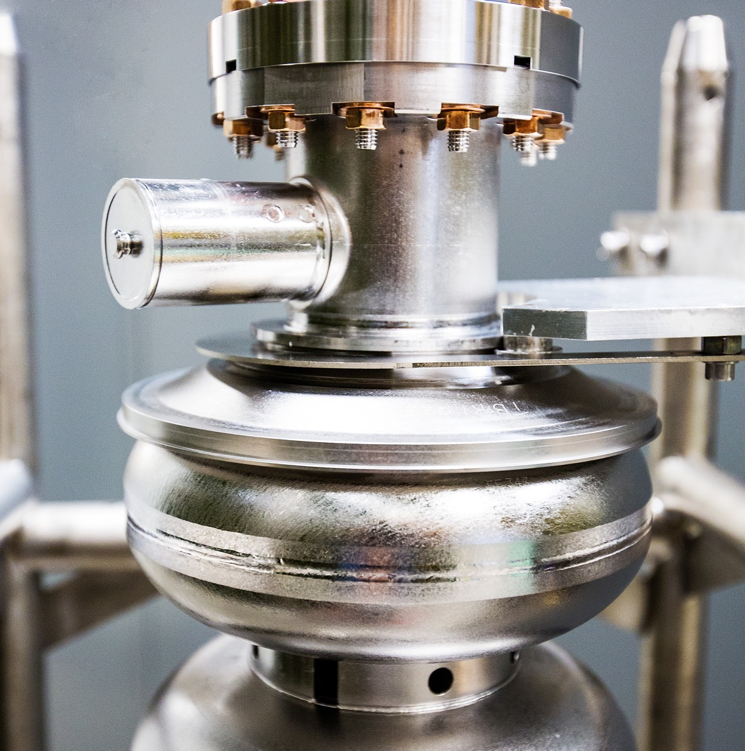
Correlations Between RF Performance and Surface Defects via STM
7/17/25
Eric M. Lechner
Work presented is based on: Lechner, Eric M., et al. "Characterization of dissipative regions of a N-doped superconducting radio-frequency cavity." Frontiers in Electronic Materials 3 (2023): 1235918.
https://doi.org/10.3389/femat.2023.1235918

Slide 2
Outline
RF Performance and Temperature Mapping of a N-doped Cavity
Scanning Tunneling Microscopy (STM)
STM Results
Tunneling Spectroscopy
Vortex Imaging
Local estimates of surface resistance

Slide 3

RF Performance of an N-doped Cavity
800 ºC/30 min N doping in 25 mTorr of N₂ followed by 800 ºC/30 min vacuum heat treatment +10 µm EP
Test 1 – 1.5K/min
Test 2 – 5K/min
Implied an exponential form of R_{s}: Decrease in R_{s}(B_{p}) is primarily due to the pre-exponential factor. Consistent with previous results [1].
Cool-down dependent surface resistance points to vortex losses.
No noticeable non-linearity in R_{i} due to vortex contribution in this range.
$$R_{s}\left(T,B_{p}\right)=A\left(B_{p}\right)\exp\left(−\frac{U}{k_{B}T}\right)+R_{i}$$
Test 1
[1] Ciovati, Gianluigi, Pashupati Dhakal, and A. Gurevich. Applied Physics Letters 104.9 (2014).

Slide 4
Temperature Mapping
Test 1 – 1.5K/min
Test 2 – 5K/min
Unfolded temperature maps show decrease in power dissipated with enhanced temperature gradient.
Eight samples were cut via CNC milling for further investigation (STM, XPS, SEM)
Empty symbols show the increase in power dissipated after quench.
Location A was the quench location

Slide 5
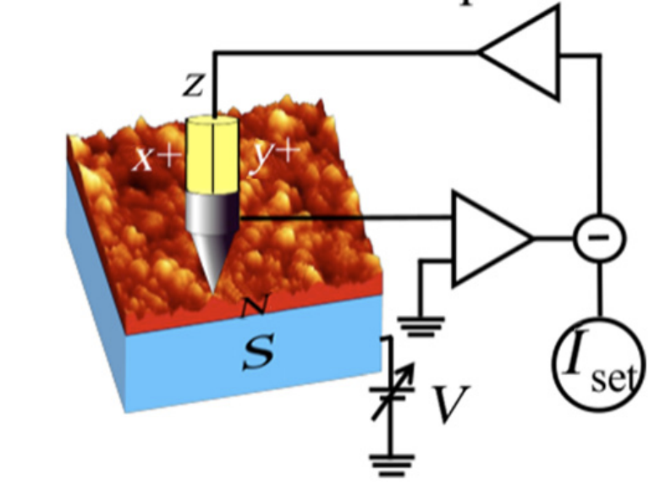


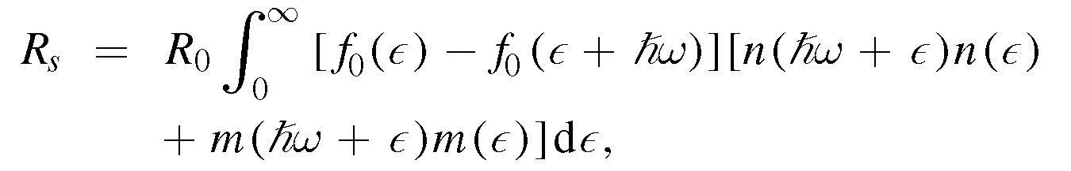




Scanning Tunneling Microscopy
Electron Tunneling
Probes directly the density of states
Local probe
$$I∝e^{−2kt}\int_{−∞}^{∞}{N_{S}\left(ε\right)N_{T}\left(ε−eV\right)[f\left(ε−eV\right)−f(ε)]dε}$$
e⁻
Energy
eV
$$\frac{dI}{dV}∝−\int_{−∞}^{∞}{\frac{∂f\left(ε−eV\right)}{∂V}N_{S}(ε)dε}$$
$$Zero Temperature Limit$$
$$\frac{dI}{dV}∝N_{S}(eV)$$
Density of states
N_{s} is a key ingredient determining R_{s}
The Nb oxide is too thick for vacuum tunneling. To remove this, the surface has been Ar ion milled.
[1]
[1] Gurevich, Alex. Superconductor Science and Technology 30.3 (2017): 034004.

Slide 6
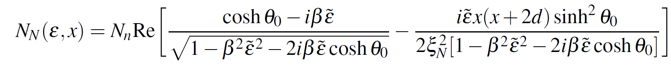
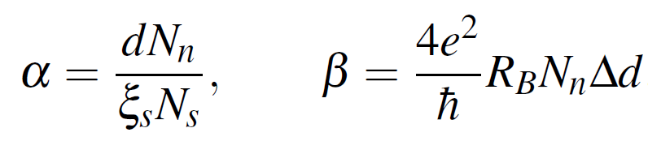
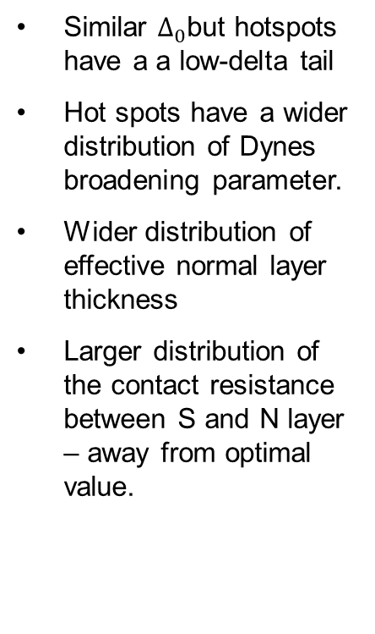
Scanning Tunneling Spectroscopy – Grid Spectroscopy
Similar $∆_{0}$but hotspots have a a low-delta tail
Hot spots have a wider distribution of Dynes broadening parameter.
Wider distribution of effective normal layer thickness
Larger distribution of the contact resistance between S and N layer – away from optimal value.
Model used:
A. Gurevich, T. Kubo PRB 96, 184515 (2017)
[1] Gurevich, Alex, and Takayuki Kubo. Physical Review B 96.18 (2017): 184515.

Slide 7
Scanning Tunneling Spectroscopy – Line Spectroscopy
Sample G – hot spot
Observation of in-gap states
May indicate the presence of magnetic impurities possibly originating from Nb suboxides
Exists on all sample, but higher density of such defects in hot-spots
Line spectra across region with in-gap states found in grid spectroscopy

Slide 8

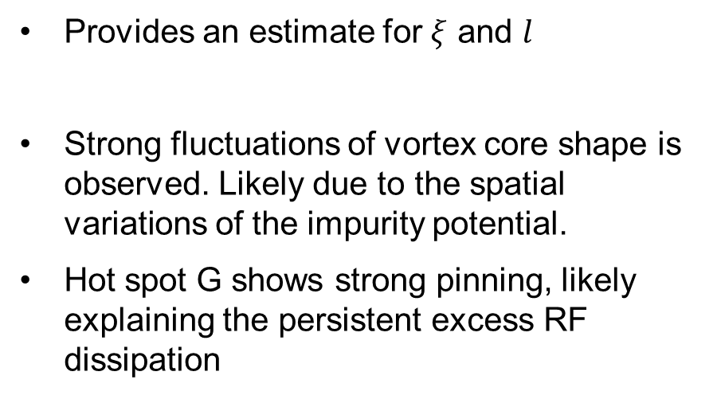
Scanning Tunneling Spectroscopy - Vortex Imaging
Provides an estimate for $ξ$ and $l$
Strong fluctuations of vortex core shape is observed. Likely due to the spatial variations of the impurity potential.
Hot spot G shows strong pinning, likely explaining the persistent excess RF dissipation
$ξ_{CS}≅22 nm,ξ_{HS}≅20 nm$, $l≅11 nm$

Slide 9
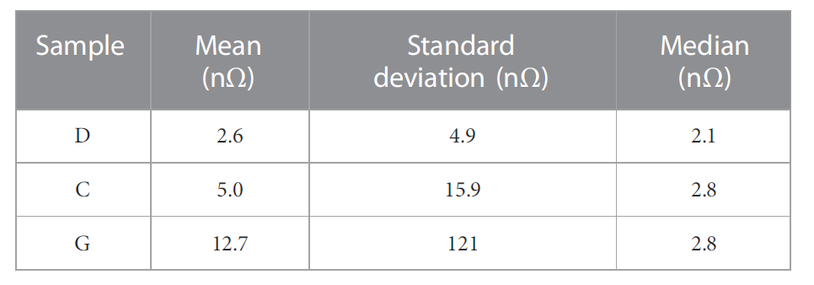
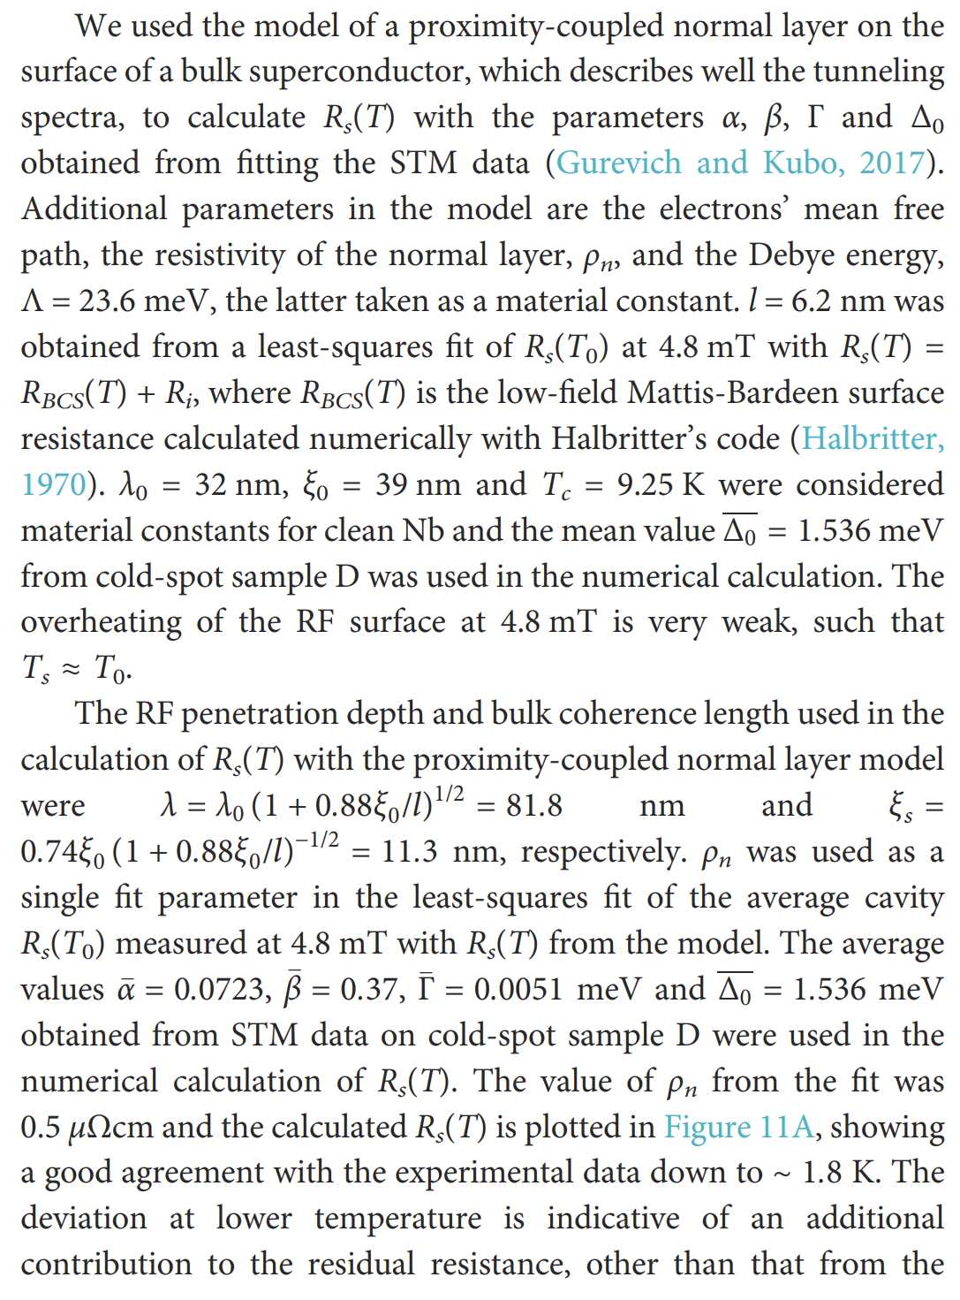

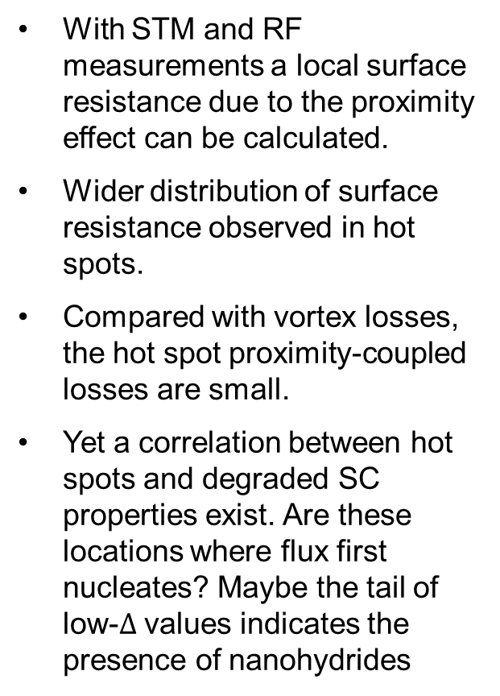
Calculating R_{s} of the Proximity-Coupled System
R_{BCS}
With STM and RF measurements a local surface resistance due to the proximity effect can be calculated.
Wider distribution of surface resistance observed in hot spots.
Compared with vortex losses, the hot spot proximity-coupled losses are small.
Yet a correlation between hot spots and degraded SC properties exist. Are these locations where flux first nucleates? Maybe the tail of low-$∆$ values indicates the presence of nanohydrides
R_{s}
Parameters used in calculation of Rs determined via RF measurement or STM
$ρ_{n}$- fitting parameter

Slide 10
Summary
Scanning tunneling microscopy is a powerful tool for studying spatial variations of key quantities that govern surface resistance.
We have quantified the effects of a thin normal metal on top of a superconductor and computed the surface resistance in the low-field thin proximity coupled normal layer limit.
The effect of the degraded superconducting and proximity coupled parameters account for a small contribution to the hot spot intensity, yet a correlation between hot spots and these degraded properties exists. This may point towards these defects assisting in nucleating vortices.

Slide 11





Acknowledgments
Basu Dev Oli
Junki Makita
Gigi Ciovati
Alex Gurevich
Maria Iavarone

Slide 12
QUESTIONS?

