Slide 1
How can DFT guide SRF materials development?
Materials for Bright Beams Workshop 2025
Speaker: Cristóbal Méndez, Cornell University

Slide 2
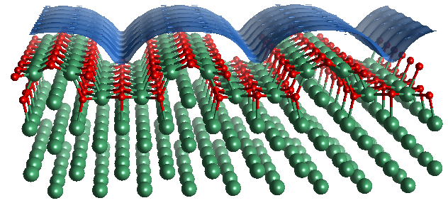
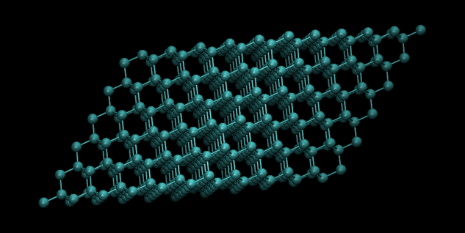




Outline
Why DFT in SRF?
Introduction to Density Functional Theory
Applications of DFT in SRF
Van Do
University of Chicago
Sadie Seddon-Stettler
Cornell University
Nathan Sitaraman
Cornell University
Michael Van Duinen
University of Chicago

Slide 3

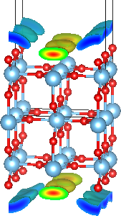

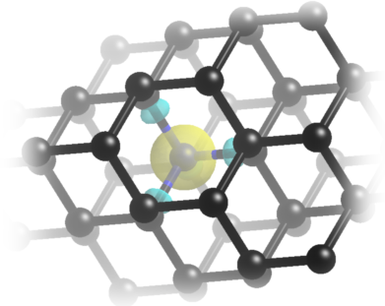
Research loop for better SRF materials
DFT Calculations
Flexible, Accurate
No experimental input needed!
Experiments
Screening of materials,
Predictions
- Formation energies of dopants, vacancies, etc
- Surface energies
- Grain boundaries
- Superconducting parameters
Results
- Minimize losses
- Reduce required cooling
- Etc

Slide 4
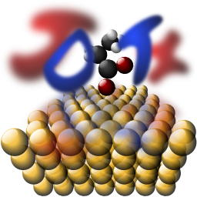
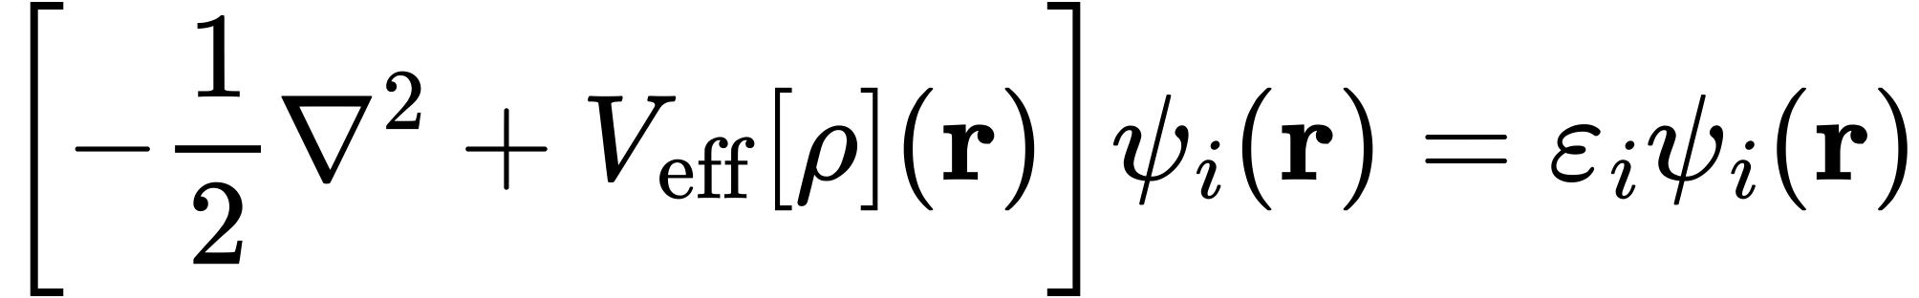
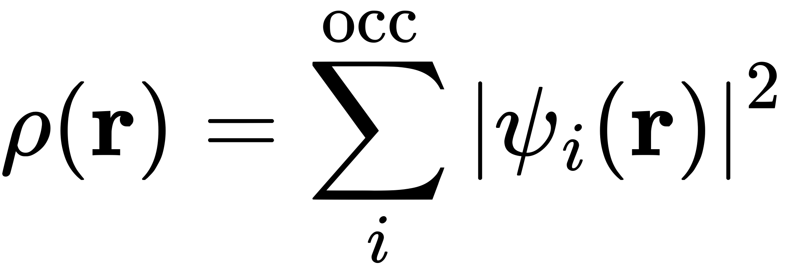
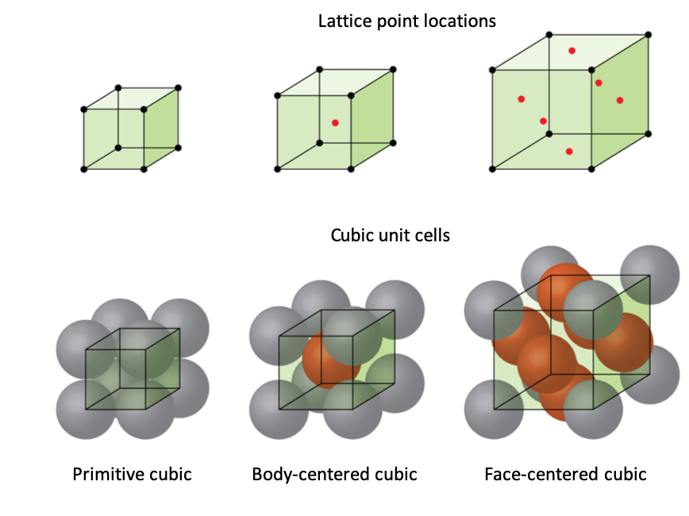

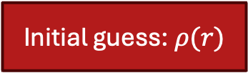
Brief introduction to DFT
What it is:
Solves Kohn–Sham equations for ground-state electron density ρ(r) → total energy E[ρ]
In a periodic crystal potential, we only need to solve for one small cell (unit cell) to recover the full, infinite crystal’s band structure. (Bloch theorem)
What we obtain:
Band structure & density of states (DOS)
Phonon spectrum
Surface/defect energies, diffusion barriers
Electron densities
Initial guess: $ρ(r)$
Solve Kohn-Sham equations
Calculate $ρ(r)$
Self-consistent?
Calculate Energy, Forces, etc

Slide 5
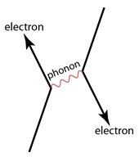
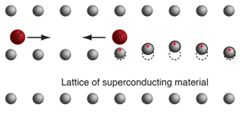
Case Study #1: Superconductivity
BCS theory and Cooper pairs
Electrons can attract each other if mediated by a phonon
The stronger the electron-phonon interaction, the stronger the effect

Slide 6
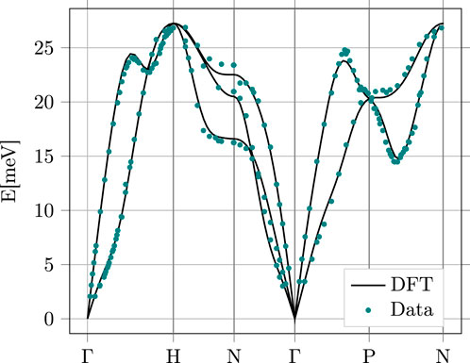
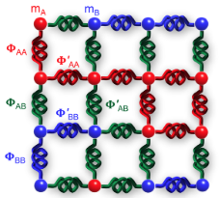
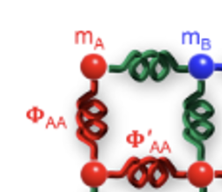
Case Study #1: Superconductivity
Modeling phonons is relatively easy using DFT
Calculate ‘spring constants’ between atoms in the lattice
Use force matrix to calculate phonon dispersion
Supercell
Zarea, M., Ueki, H., & Sauls, J. A. (2023). Effects of anisotropy and disorder on the superconducting properties of niobium. Frontiers in Physics, 11, 1269872.

Slide 7
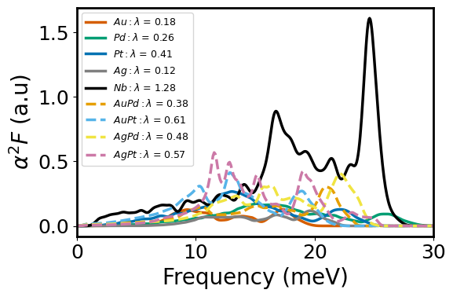

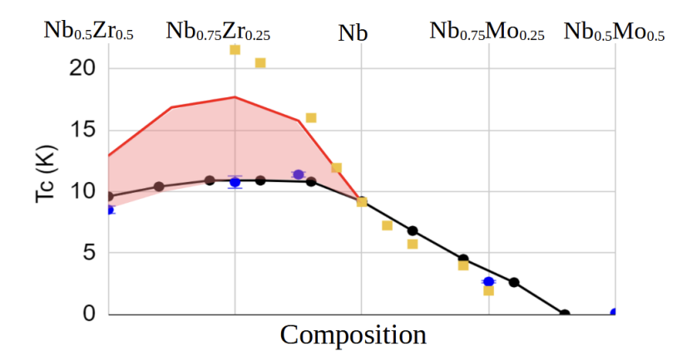



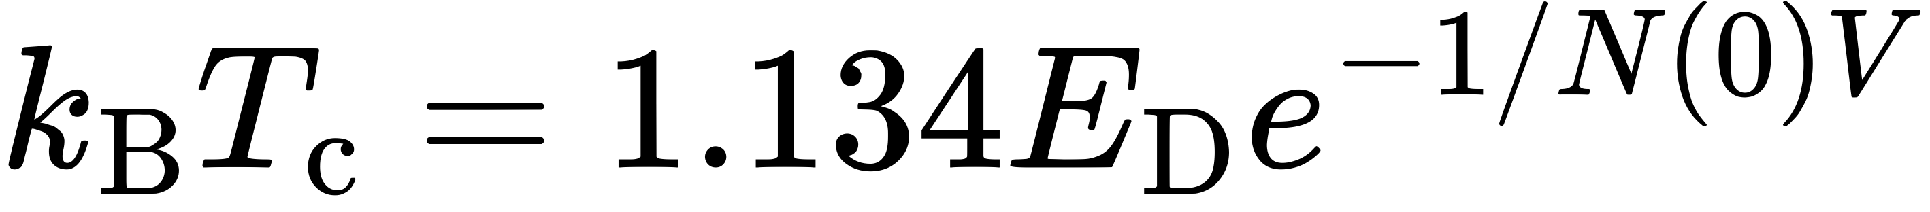
Case Study #1: Superconductivity
Eliashberg spectral function
El-ph coupling constant
Log-avg phonon frequency
McMillan formula
BCS formula
Sitaraman, N. S., Sun, Z., Francis, B., Hire, A. C., Oseroff, T., Baraissov, Z., ... & Transtrum, M. K. (2022). Theory of nb-zr alloy superconductivity and first experimental demonstration for superconducting radio-frequency cavity applications. arXiv preprint arXiv:2208.10678.

Slide 8
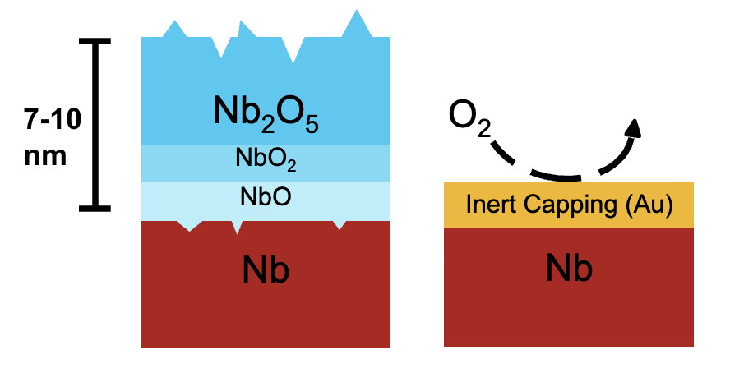


Case Study #2: Layered structures
Motivation:
Nb reacts with oxygen and forms native oxides
Lowers the quality factor of Nb cavities
Our approach at CBB: using metallic capping layers to prevent oxide formation
Challenge: To find the best capping material (as inert as possible)
Before: 😔
After: 😁
$$H_{2}$$
?
$$N_{2}$$
Figure by Van Do (University of Chicago)

Slide 9
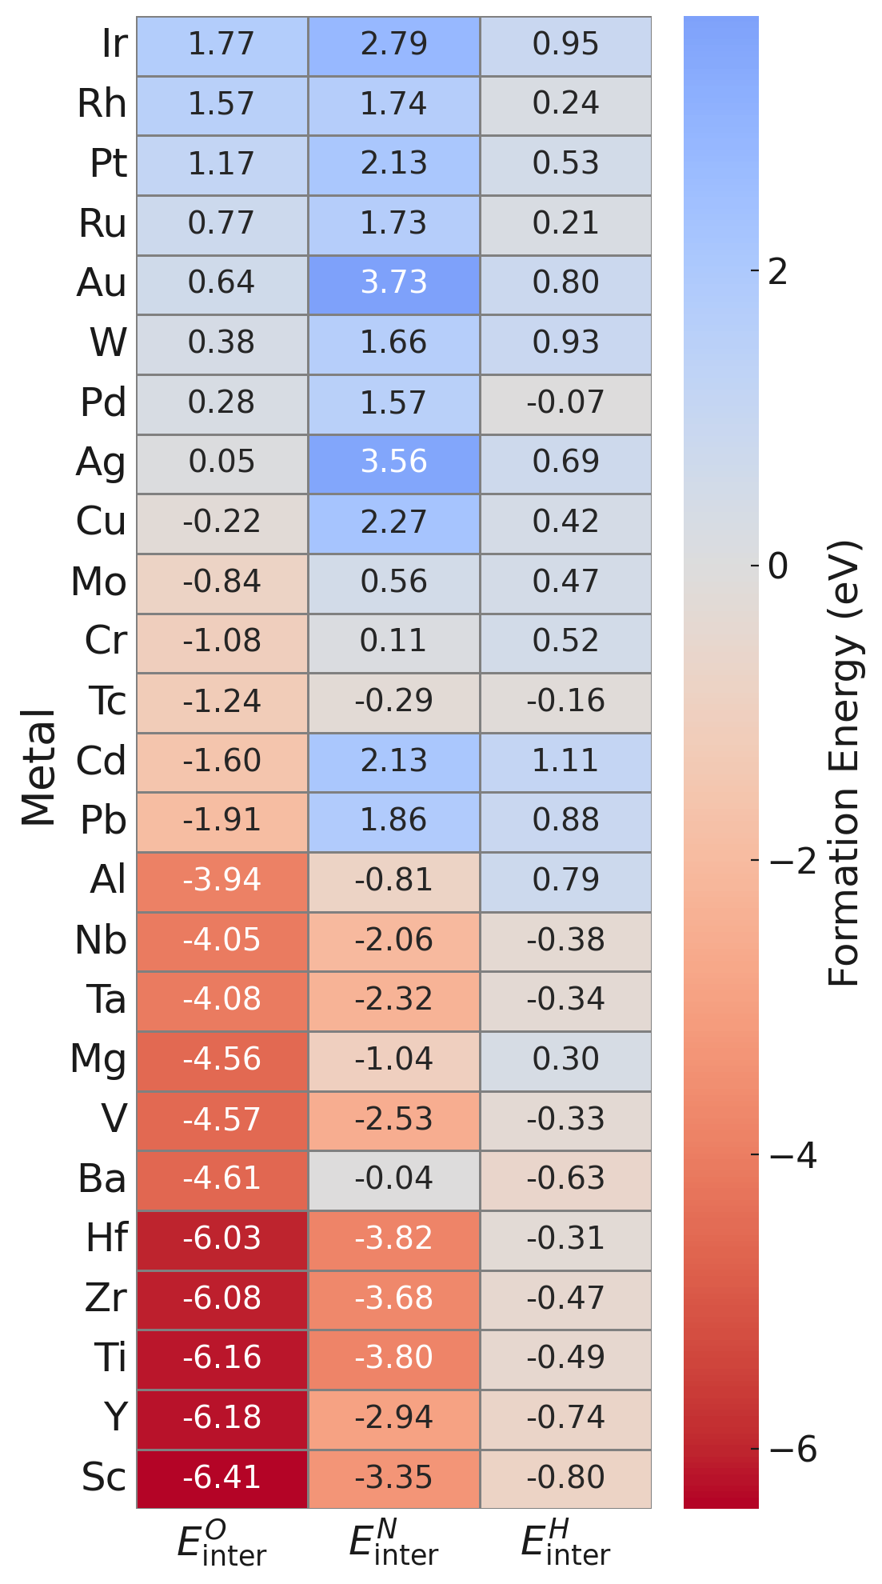
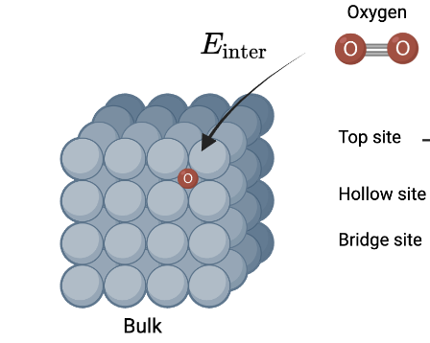

Case Study #2: Layered structures
O N H
Estimate oxygen affinity with interstitial energy
Interstitial Formation Energy:
Quantifies how likely is that a contaminant (O, N, H) will form in the bulk of different materials
$E_{inter}=E_{bulk+atom}−E_{bulk}−E_{atom}$

Slide 10
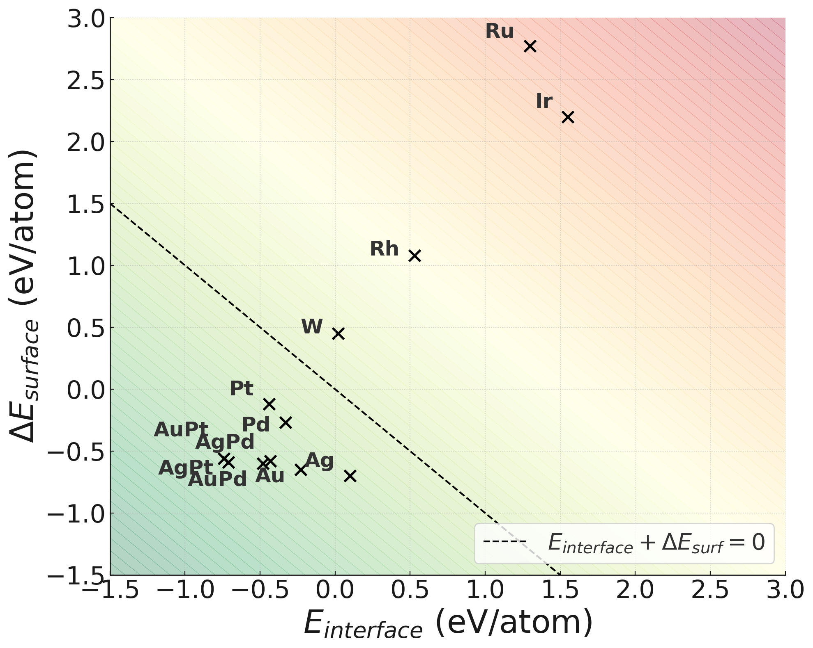
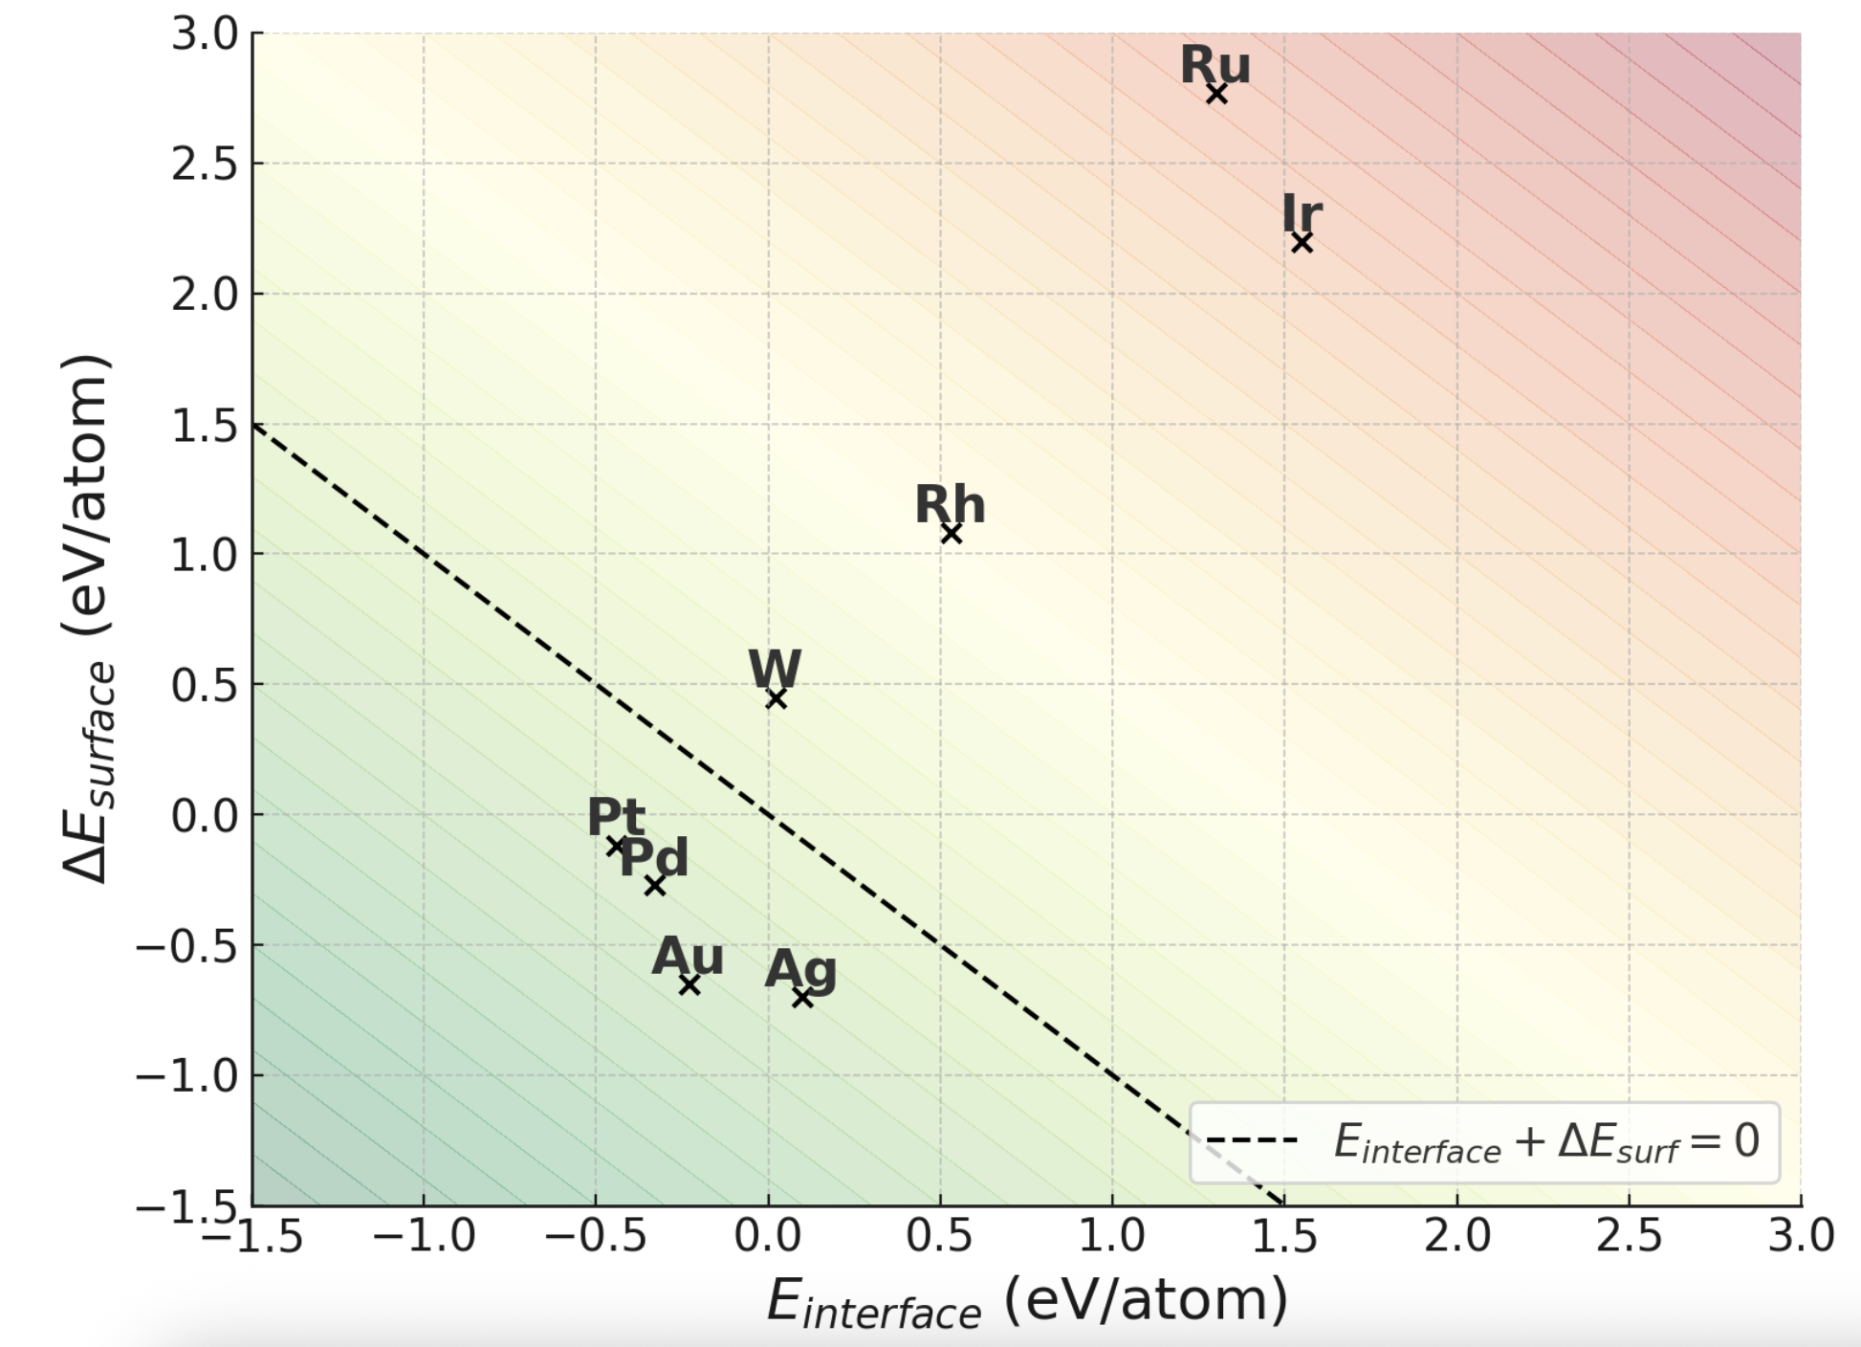
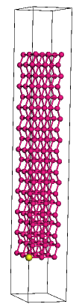
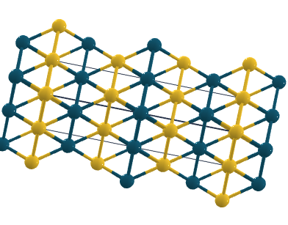
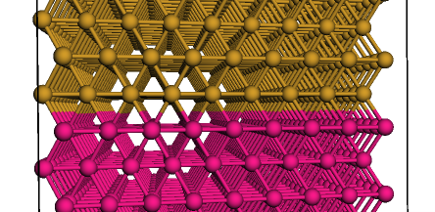
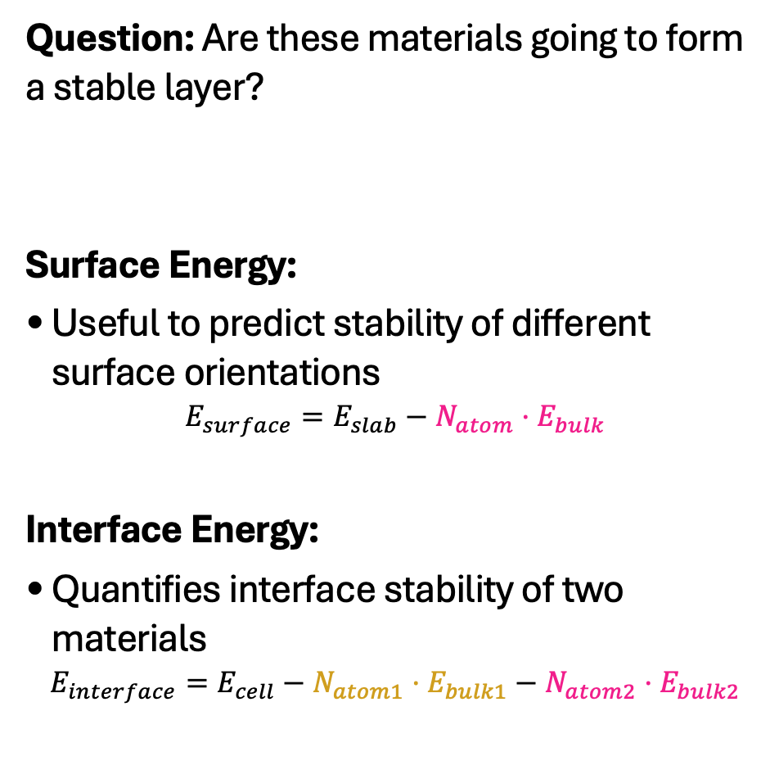
Case Study #2: Layered structures
Question: Are these materials going to form a stable layer?
Surface Energy:
Useful to predict stability of different surface orientations
$$E_{surface}=E_{slab}−N_{atom}⋅E_{bulk}$$
Interface Energy:
Quantifies interface stability of two materials
$$E_{interface}=E_{cell}−N_{atom1}⋅E_{bulk1}−N_{atom2}⋅E_{bulk2}$$
New surface
Metal
New interface
Nb
First to suggest alloys for protective layers in SRF!

Slide 11
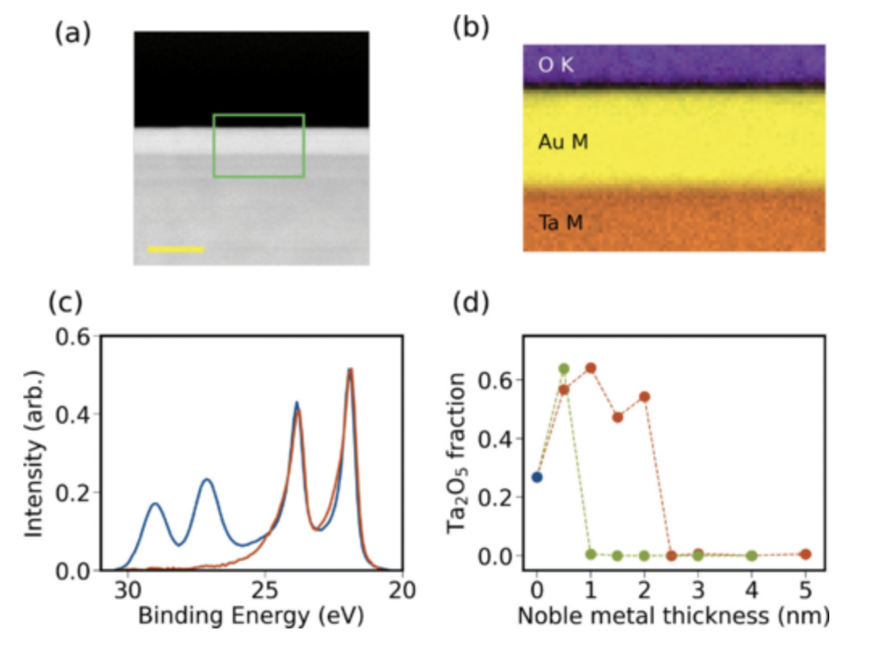
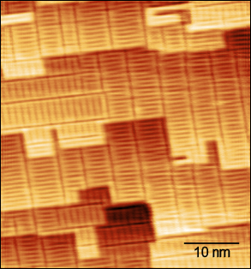
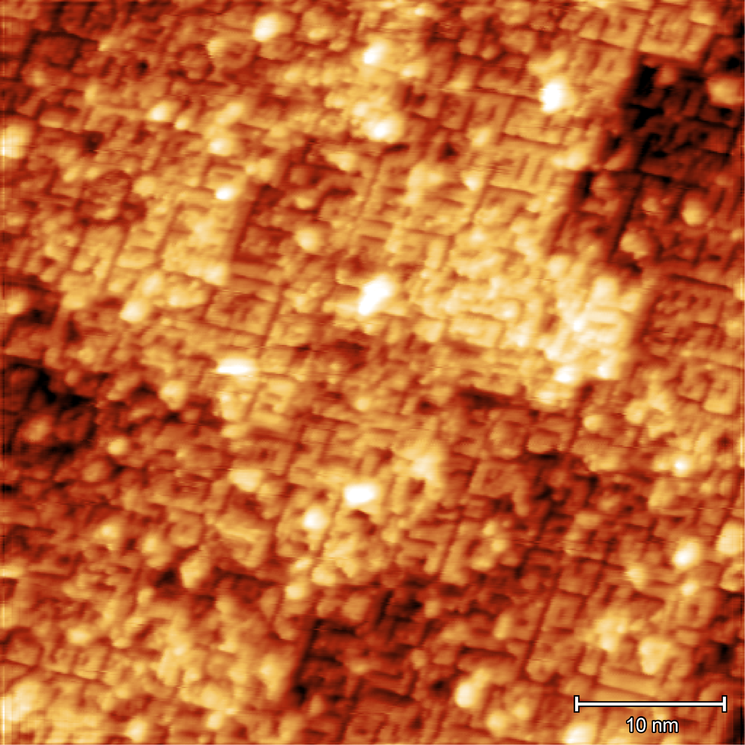
Case Study #2: Layered structures
Capping layers in practice: Using Au
(3x1)-O/Nb(100)
1 ML Au
Au island formation
Au
AuPd
STM images from Van Do, University of Chicago
Chang, R. D., Shumiya, N., McLellan, R. A., Zhang, Y., Bland, M. P., Bahrami, F., ... & De Leon, N. P. (2025). Eliminating surface oxides of superconducting circuits with noble metal encapsulation. Physical review letters, 134(9), 097001.

Slide 12
Case Study #2: Layered structures
Thick layer of Au
Bad for superconductivity 😔
Nb
Oxygen
Au
Nb
Thin layer of Au
Thin layer of adhesive metal
Better superconductivity😁
Nb

Slide 13
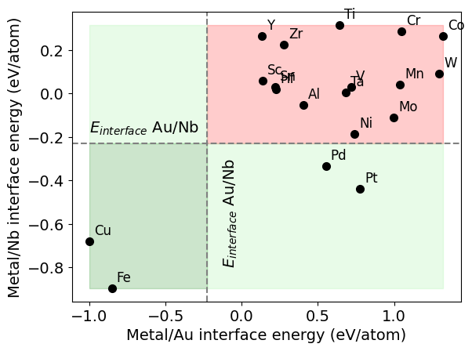
Case Study #2: Layered structures
Au
Metal/Au interface
Metal
Metal/Nb interface
Nb
Poster: Oxide mitigation with protective layers on Nb (today)

Slide 14
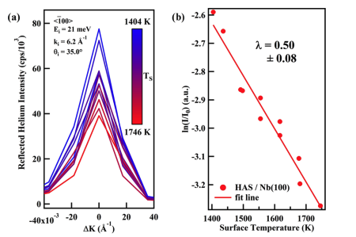
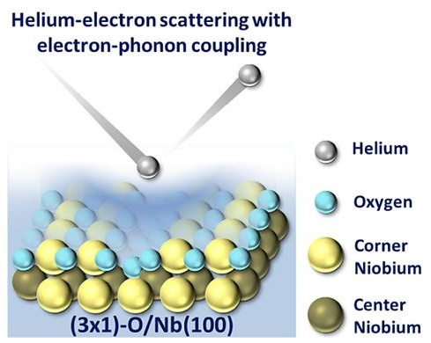
Case Study #3: Helium Atom Scattering
Motivation:
Surface superconductivity is critical for SRF
Electron-phonon coupling constant can be inferred from Helium Atom Scattering (HAS) measurements
Attenuation of specular peak (elastic scattering), known as the Debye-Waller (DW) factor
Figures from Sibener group

Slide 15
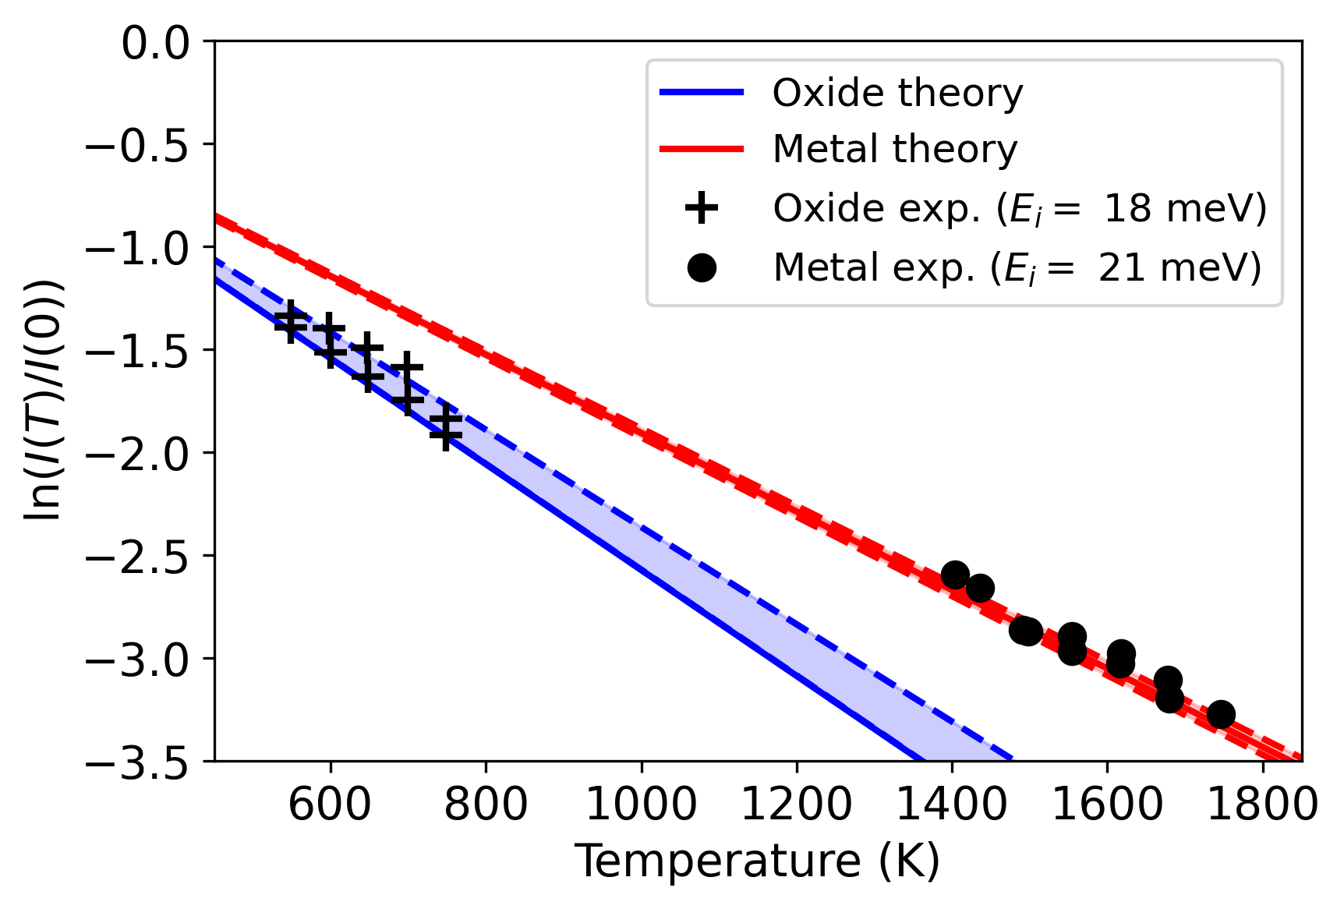
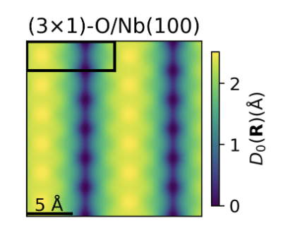
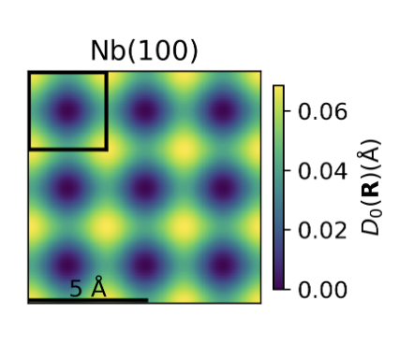
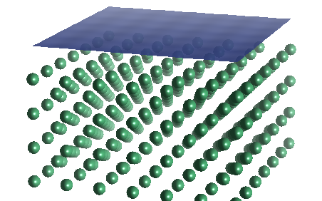
Case Study #3: Helium Atom Scattering
DFT beyond energies and forces: electron density
We calculated the scattering surface and its thermal vibrations
Used that to calculate DW factor fully ab-initio (for the first time)!
Now can understand how different surface phonons contribute to surface superconductivity
(3x1)-O/Nb(100) surface: Highly corrugated
Nb(100) surface: Low corrugation

Slide 16
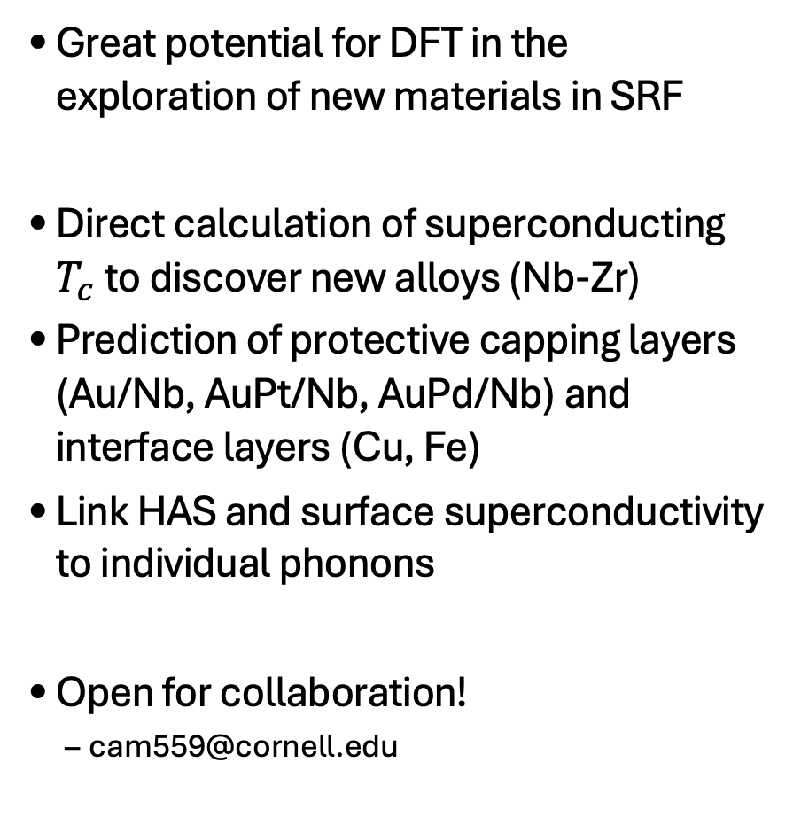
Summary
Great potential for DFT in the exploration of new materials in SRF
Direct calculation of superconducting $T_{c}$to discover new alloys (Nb-Zr)
Prediction of protective capping layers (Au/Nb, AuPt/Nb, AuPd/Nb) and interface layers (Cu, Fe)
Link HAS and surface superconductivity to individual phonons
Open for collaboration!
  cam559@cornell.edu

