Slide 1
Modeling insights into the evolution of NCRF materials in accelerator conditions
Danny Perez, with Soumendu Bagchi, Ryo Shinohara, Gaoxue Wang, Sergey Barishev, Evgenya Simakov
Theoretical Division T-1
Acknowledgements: LANL LDRD program
Materials for Bright Beams Workshop 2025

Slide 2
Motivation
High-gradient technology is in high demand:
Compact accelerators: medical, industrial, space, defense
Future colliders
Free electron lasers
…
But higher gradients = more breakdown! Breakdown rate imposes gradient ceiling
Fundamentals of breakdown physics only partially understood
Limits our ability to systematically design and optimize materials for HG
What can modeling contribute to this problem?

Slide 3
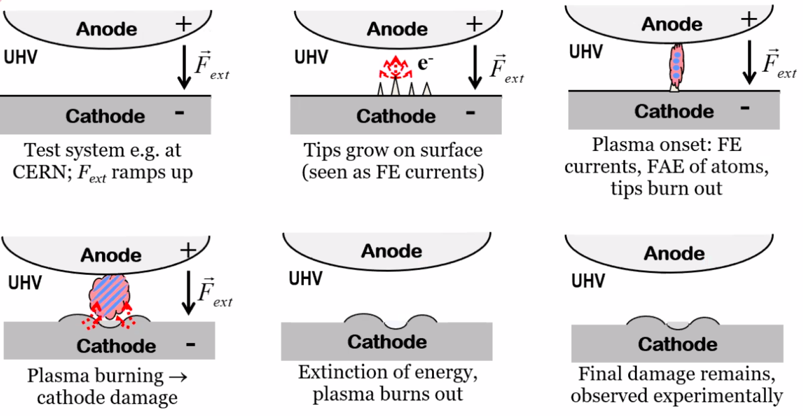
Breakdown: what do we know?
?
[Djurabekova et al. (2010)]

Slide 4
What do we know: Electric fields
Can occur for peak fields on the order of 100 MV/m and above
Extremely steep rate dependence (BDR ~ E²⁰⁻⁴⁰)
Possible relevant physics:
Plastic deformation
Biased mass transport
Field emission
…
[Cahill et al. (2018)]

Slide 5
What do we know: Electric fields
Can occur for peak fields on the order of 100 MV/m and above
Extremely steep rate dependence (BDR ~ E²⁰⁻⁴⁰)
Possible relevant physics:
Plastic deformation
Biased mass transport
Field emission
…
[Driesel (1994)]
[Gill, Goduru, Sheldon (2008)]

Slide 6
What do we know: Resistive Heating
Strong correlation between BDR and peak pulse heating
BDR significantly decreases in cryo conditions
Possible relevant physics:
Thermo-elastic stresses
Cyclic fatigue
Field emission
Thermally-activated kinetics
…
[Laurent, Tantawi, Dolgashev et al. (2011)]

Slide 7
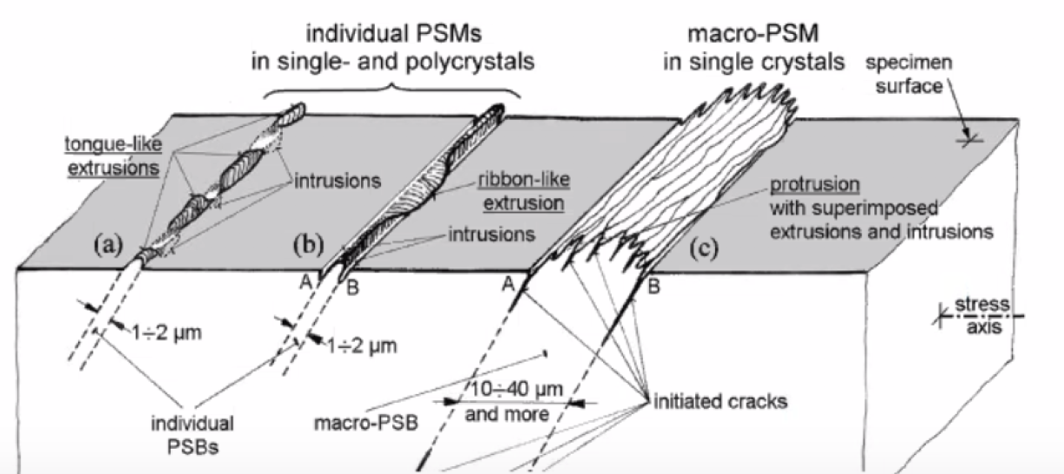
What do we know: Resistive Heating
Strong correlation between BDR and peak pulse heating
BDR significantly decreases in cryo conditions
Possible relevant physics:
Thermo-elastic stresses
Cyclic fatigue
Field emission
Thermally-activated kinetics
…
[Laurent, Tantawi, Dolgashev et al. (2011)]
[Man et al. (2009)]

Slide 8
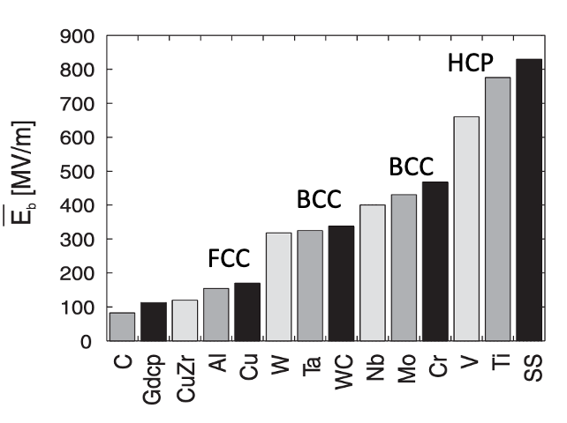
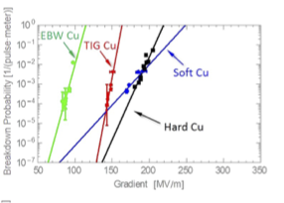
What do we know: Materials
Correlation between BD field and crystal structure
Harder materials = lower BDR
Processing matters (welding, …)
Possible relevant physics:
Plastic deformation
Dislocation motion/multiplication
Surface defects
Microstructure
…
[Descoeudres et al (2009)]
[Dolgashev et al (2021)]

Slide 9
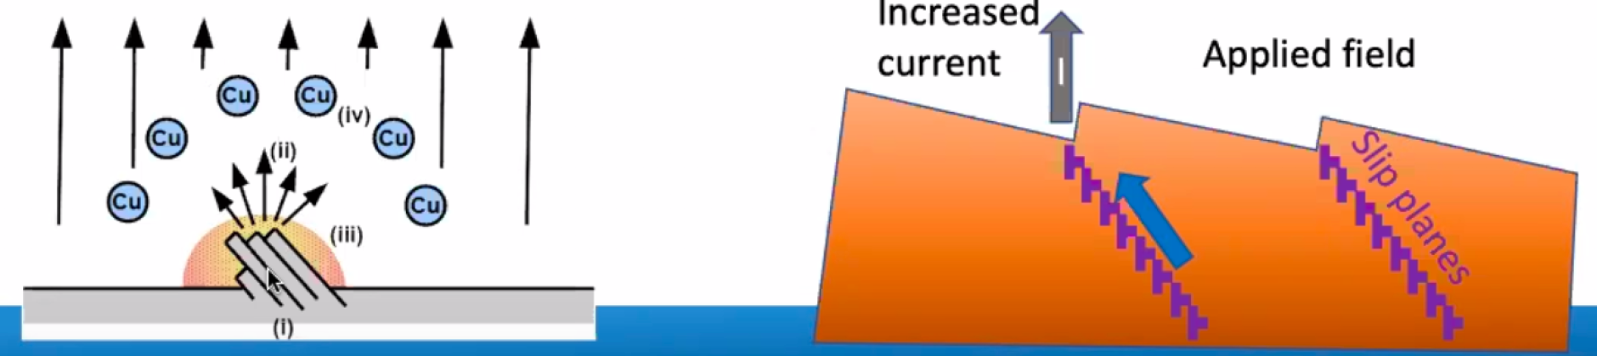
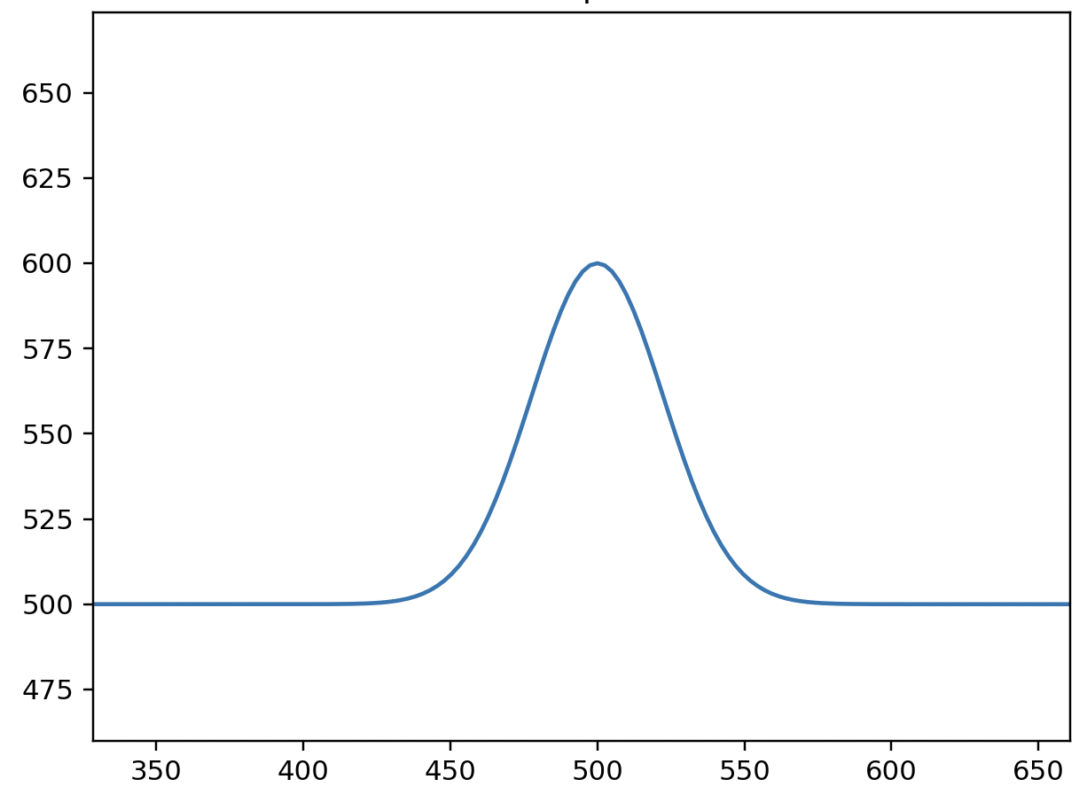
Breakdown precursor modeling
Plastic deformation (Djurabekova, Nordlund, Ashkenazy, LANL):
Key idea: runaway dislocation multiplication can lead to formation of breakdown precursors
Driven by Maxwell stresses, thermo-elastic stresses
[Review: Wuensch et al, arXiv:2502.03967]
Diffusive mass transport (Djurabekova, LANL):
Key idea: diffusive mass transport can lead to formation of breakdown precursors
Driven by Maxwell stresses, thermo-elastic stresses, surface tension

Slide 10
Breakdown precursor modeling
Plastic deformation (Djurabekova, Nordlund, Ashkenazy, LANL):
Key idea: runaway dislocation multiplication can lead to formation of breakdown precursors
Driven by Maxwell stresses, thermo-elastic stresses
[Review: Wuensch et al, arXiv:2502.03967]
Diffusive mass transport (Djurabekova, LANL):
Key idea: diffusive mass transport can lead to formation of breakdown precursors
Driven by Maxwell stresses, thermo-elastic stresses, surface tension

Slide 11
Surface instabilities
Flat surfaces are usually stable. However, small perturbations can spontaneously grow under the right conditions:
Dendrite formation during solidification
Capillary instability in thin films
Pitting, cracking in stressed solids
Taylor cone formation under electric fields
…
Extremely robust physics: no special assumptions or microstructural features required!
Could such instabilities lead to breakdown precursors formation?

Slide 12
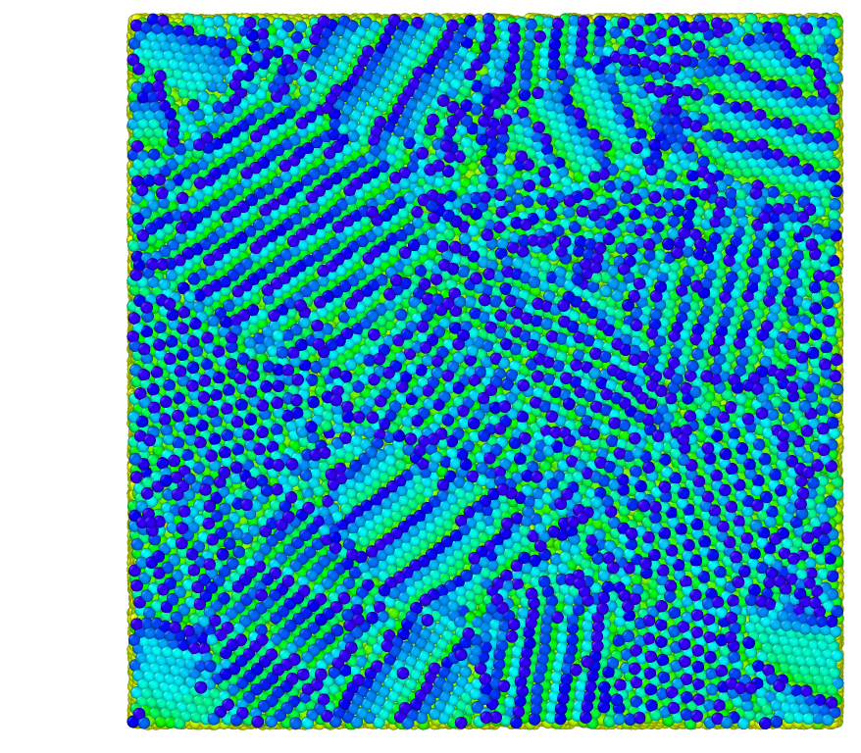
Atomistic simulation of surface evolution under E
At LANL:
Molecular dynamics
Classical interactions + charge equilibration
Captures:
Charge induction
Maxwell stresses
Field-induced evaporation
Thermo-elastic stresses
Similar approaches used by other groups
[Djurabekova et al. (2011); Jansson et al. (2015, 2016, 2020) ]

Slide 13
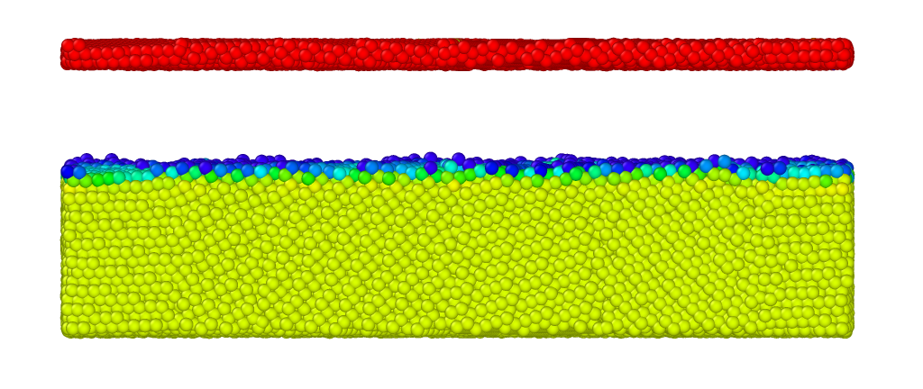
E

Slide 14
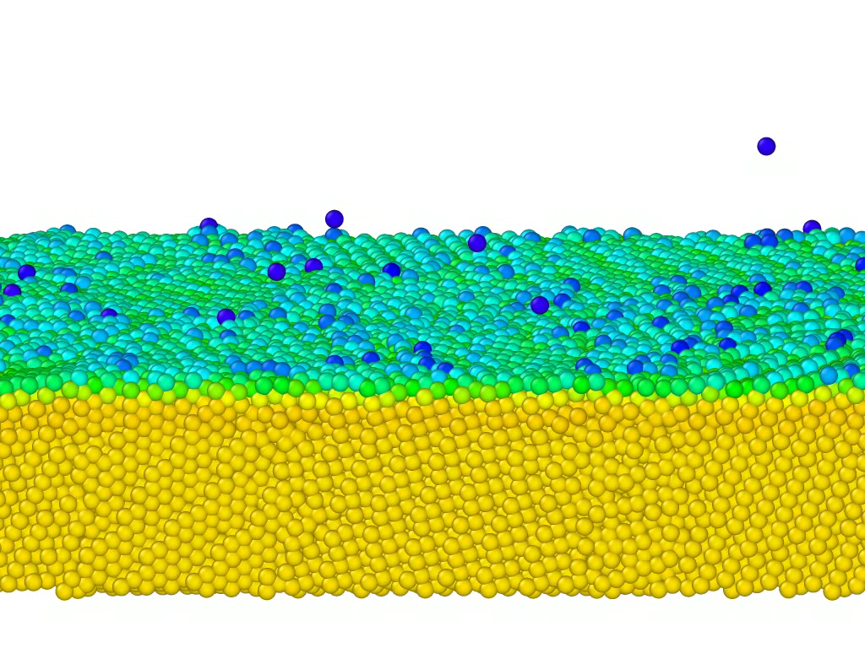

Slide 15
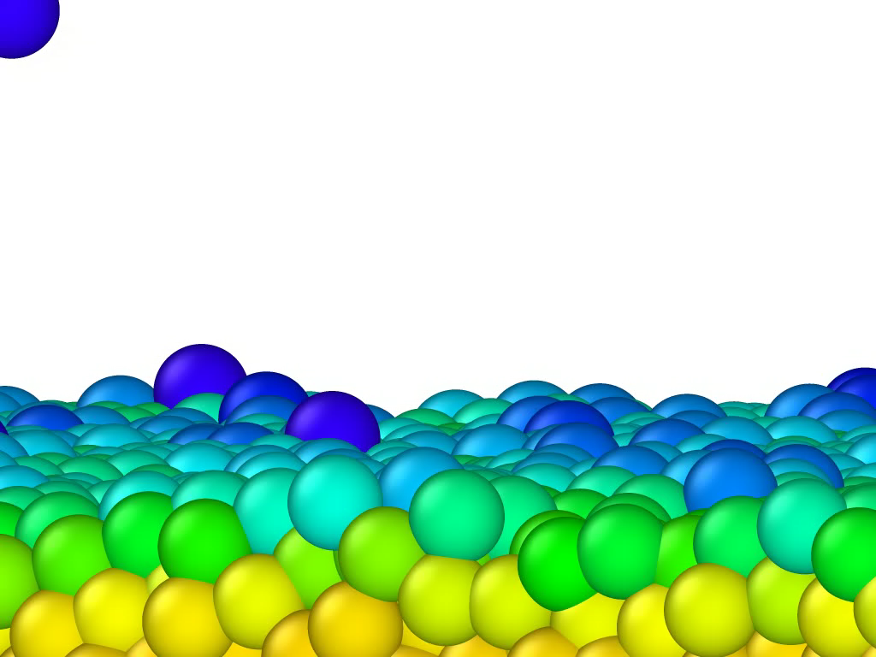

Slide 16
Atomistic modeling
Spontaneous nano-tip formation under electric fields can be simulated at the atomic scale
Time and length-scale limitations restrict applicability to very high fields (>GV/m)
Provides limited insights into the slow precursor formation process at application-relevant fields, but can inform breakdown models near the runaway regime
Similar observations by other groups. See [Wuensch et al, arXiv:2502.0396] for a recent review

Slide 17
Continuum description of surfaces under E
Under an applied field E and a stress caused by a temperature rise ΔT, the amplitude of a mode of wavenumber k on a metallic surface grows as:
Small k grows, large k decays
Can lead to runaway growth!
As amplitude grows, non-linear couplings become important. Numerical solutions needed.
$h\left(t,k\right)=$ $h_{0}(k)exp⁡(C\left(2k^{3}α^{2}ΔT^{2}+k^{3}ε_{0}E^{2}−γk^{4}\right)t)$
Thermoelastic stresses
Surface tension
E-field
[Shinohara, Bagchi, Simakov, Baryshev, Perez (2024);
Song, Yang (2006); Du, Srolovitz (2004)]

Slide 18
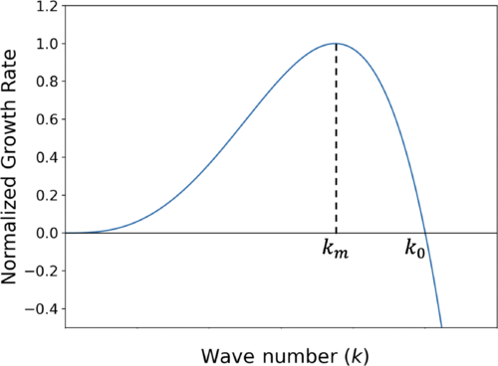
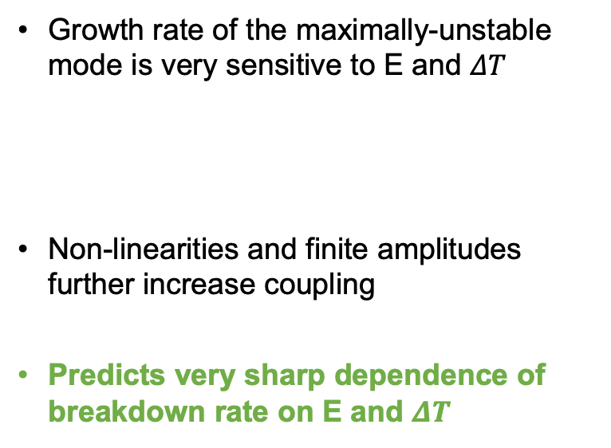
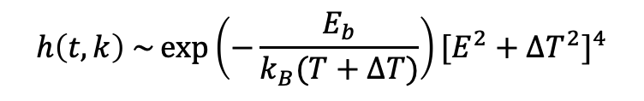
Linear perturbation theory
Growth rate of the maximally-unstable mode is very sensitive to E and $ΔT$
Non-linearities and finite amplitudes further increase coupling
Predicts very sharp dependence of breakdown rate on E and $ΔT$
$$h\left(t,k\right) \sim \exp\left(−\frac{E_{b}}{k_{B}(T+ΔT)}\right){[E^{2}+{ΔT}^{2}]}^{4}$$
[Shinohara, Bagchi, Simakov, Baryshev, Perez (2024)]

Slide 19
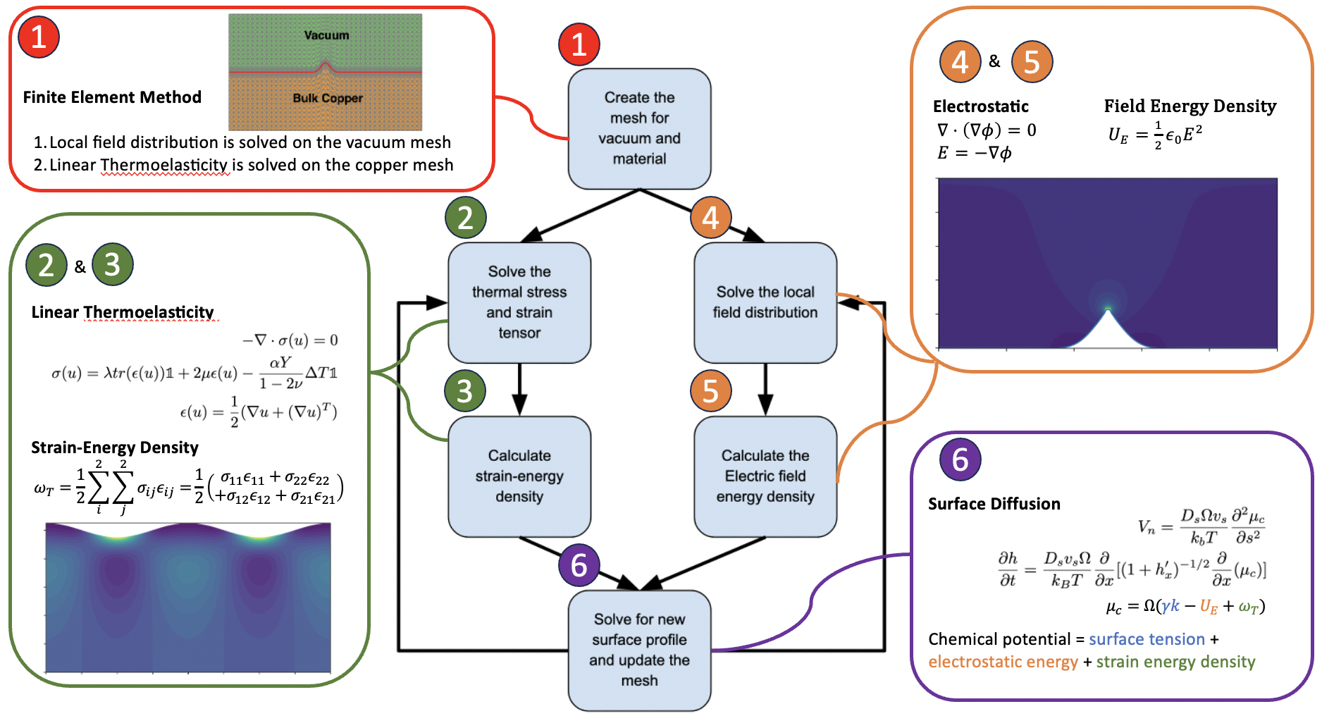
Method: 2D finite elements
Driving force #1: Electrostatics of field-induced charges
Driving force #2: Thermo-elasticity induced by resistive heating
Surface diffusion along chemical potential gradient

Slide 21
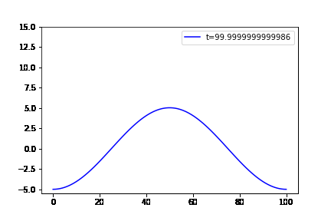
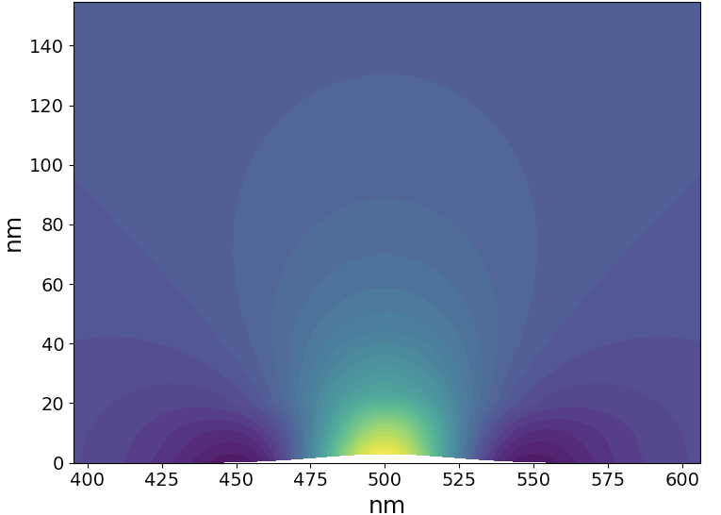
Surface evolution under electric fields
Induced surface charges cancel the field in the conductor
Electric chemical potential drives mass diffusion towards protrusions
Can lead to runaway tip growth
Can forms breakdown precursors (sharp tips)!
[Bagchi, Perez (2024)]

Slide 22
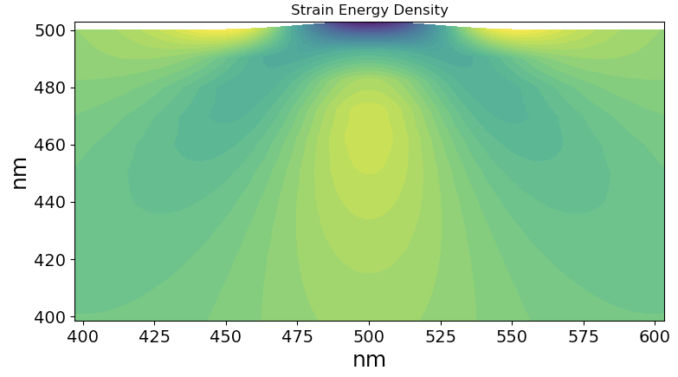
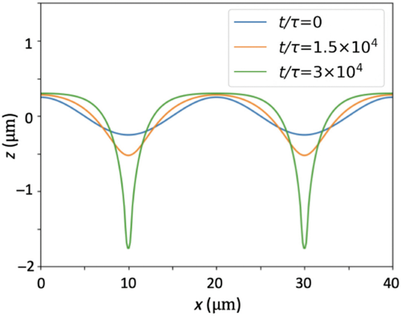
Surface evolution under thermoelastic stresses
Heating due to resistive losses leads to thermo-elastic stresses
Elastic chemical potential drives mass diffusion away from throughs
Can lead to runaway pitting instability
Does not form breakdown precursors (sharp pits, but blunt tips)!
[Shinohara, Bagchi, Simakov, Baryshev, Perez (2024)]

Slide 23
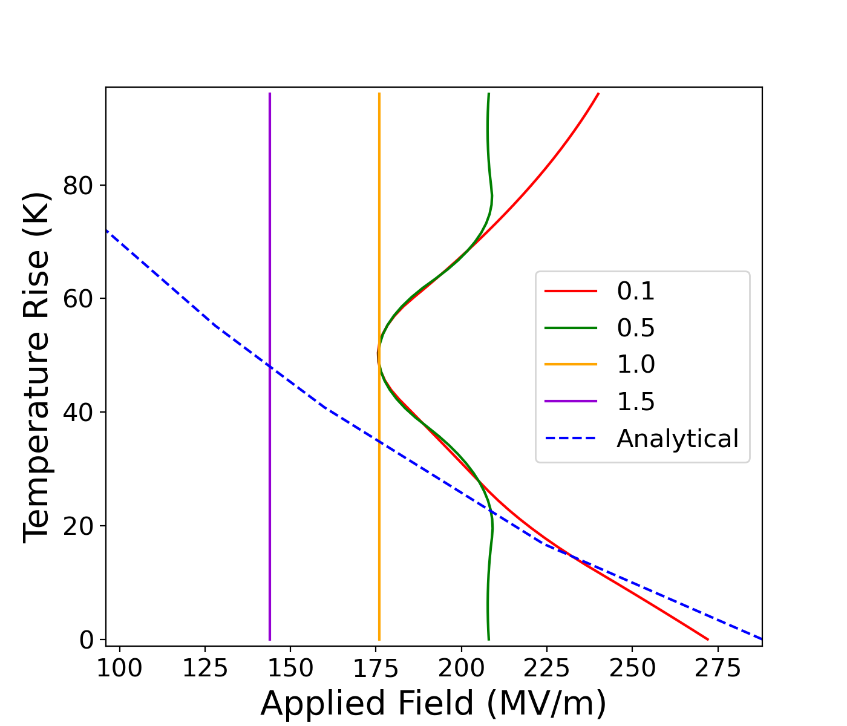
Surface evolution under combined E + ΔT
Nominal surface features:
Thermo-elastic stresses can dramatically lower critical E
Too much heating leads to pitting and blunt tips
Sharp preexisting features:
E-field dominates
Runaway tip growth at lower E
Consistent with
precursor formation around O(100-200) MV/m
increased breakdown with cyclic heating
secondary breakdowns
Initial aspect ratio
Stable
Runaway
[Shinohara, Bagchi, Simakov, Baryshev, Perez (2024)]

Slide 24
What is missing from the model?
Creep-like bulk transport (couple with thermoelastic and Maxwell stresses)
Stochasticity
Dislocation-mediated plastic deformation
Surface mediated transport is a robust mechanism that can lead to precursor formation, but it is not expected to be the whole story

Slide 25
Breakdown precursor modeling
Plastic deformation (Djurabekova, Nordlund, Ashkenazy, LANL):
Key idea: runaway dislocation multiplication can lead to formation of protrusions
Driven by Maxwell stresses, thermo-elastic stresses
[Review: Wuensch et al, arXiv:2502.03967]
Diffusive mass transport(Djurabekova, LANL):
Key idea: diffusive mass transport can lead to formation of protrusions
Driven by Maxwell stresses, thermo-elastic stresses, surface tension

Slide 26
The role of plastic deformation in breakdown
Plastic deformation plays a clear role in breakdown initiation
Body of work suggests that runaway dislocation multiplication can lead to breakdown (Djurabekova, Wuensch, Ashkenazy)
Plausible heuristic models. Specific microscopic mechanisms remain unobserved experimentally
Hard Cu
Soft Cu
[Korsback (2020)]
[Review: Wuensch et al, arXiv:2502.03967]

Slide 27
Maxwell stresses are (really) small!
Electric field | Maxwell stress on a flat surface (MPa) | Critical Frank-Read source length
10 MV/m | 400 Pa | 50 mm
100 MV/m | 40 KPa | 0.5 mm
1 GV/m | 4 MPa | 5 μm
10 GV/m | 400 MPa | 50 nm
?
!
Yield strength of annealed Cu: ~50 MPa
Peierls stress of Cu: ~0.3 MPa

Slide 28
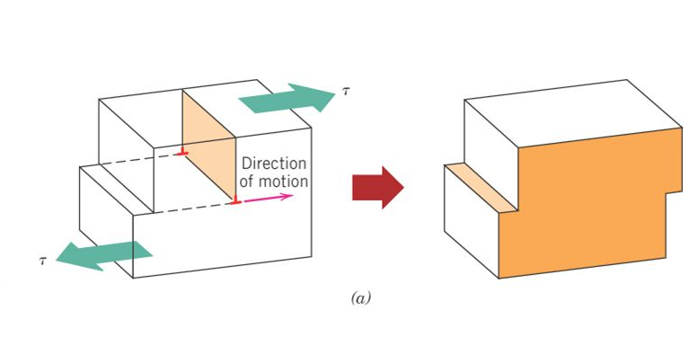
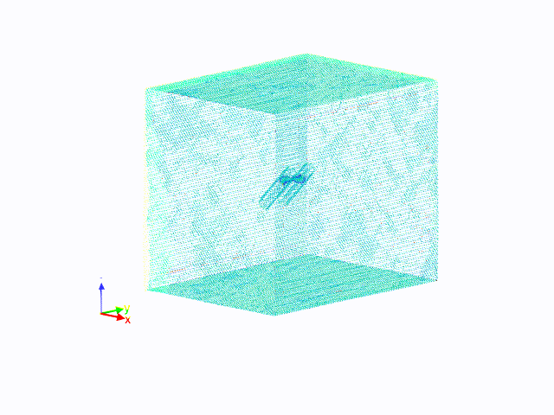
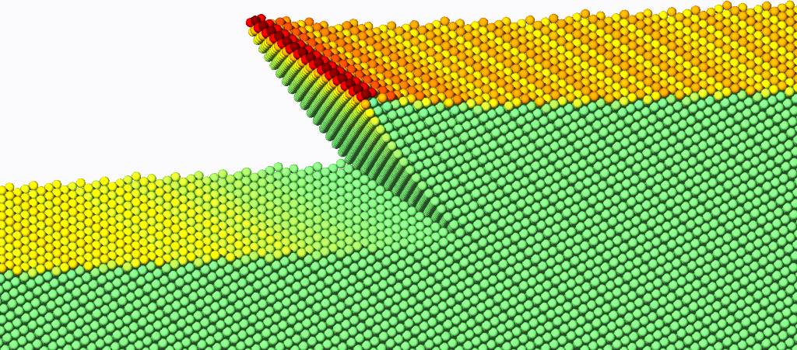
Dislocation multiplication via Frank-Read Sources
Surface features
Plastic deformation
Charge/stress concentration due to E
[Bagchi, Perez (2022)]

Slide 29
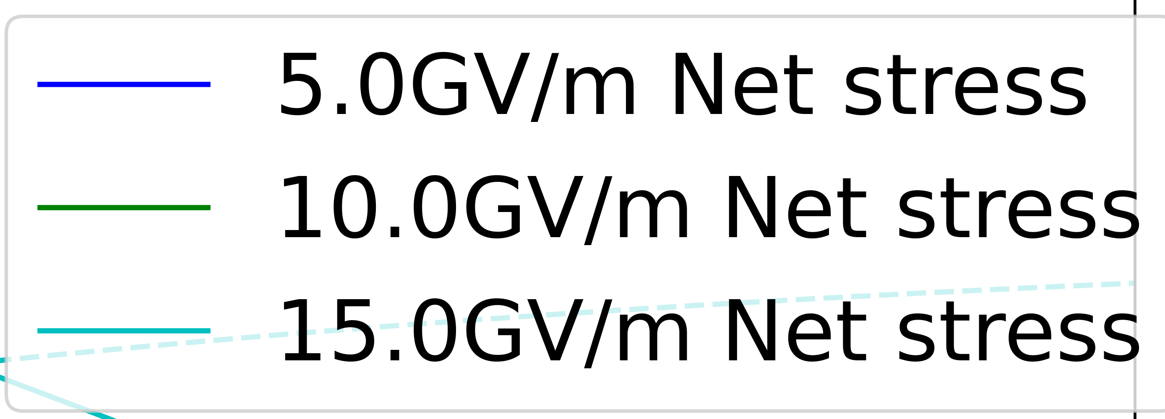
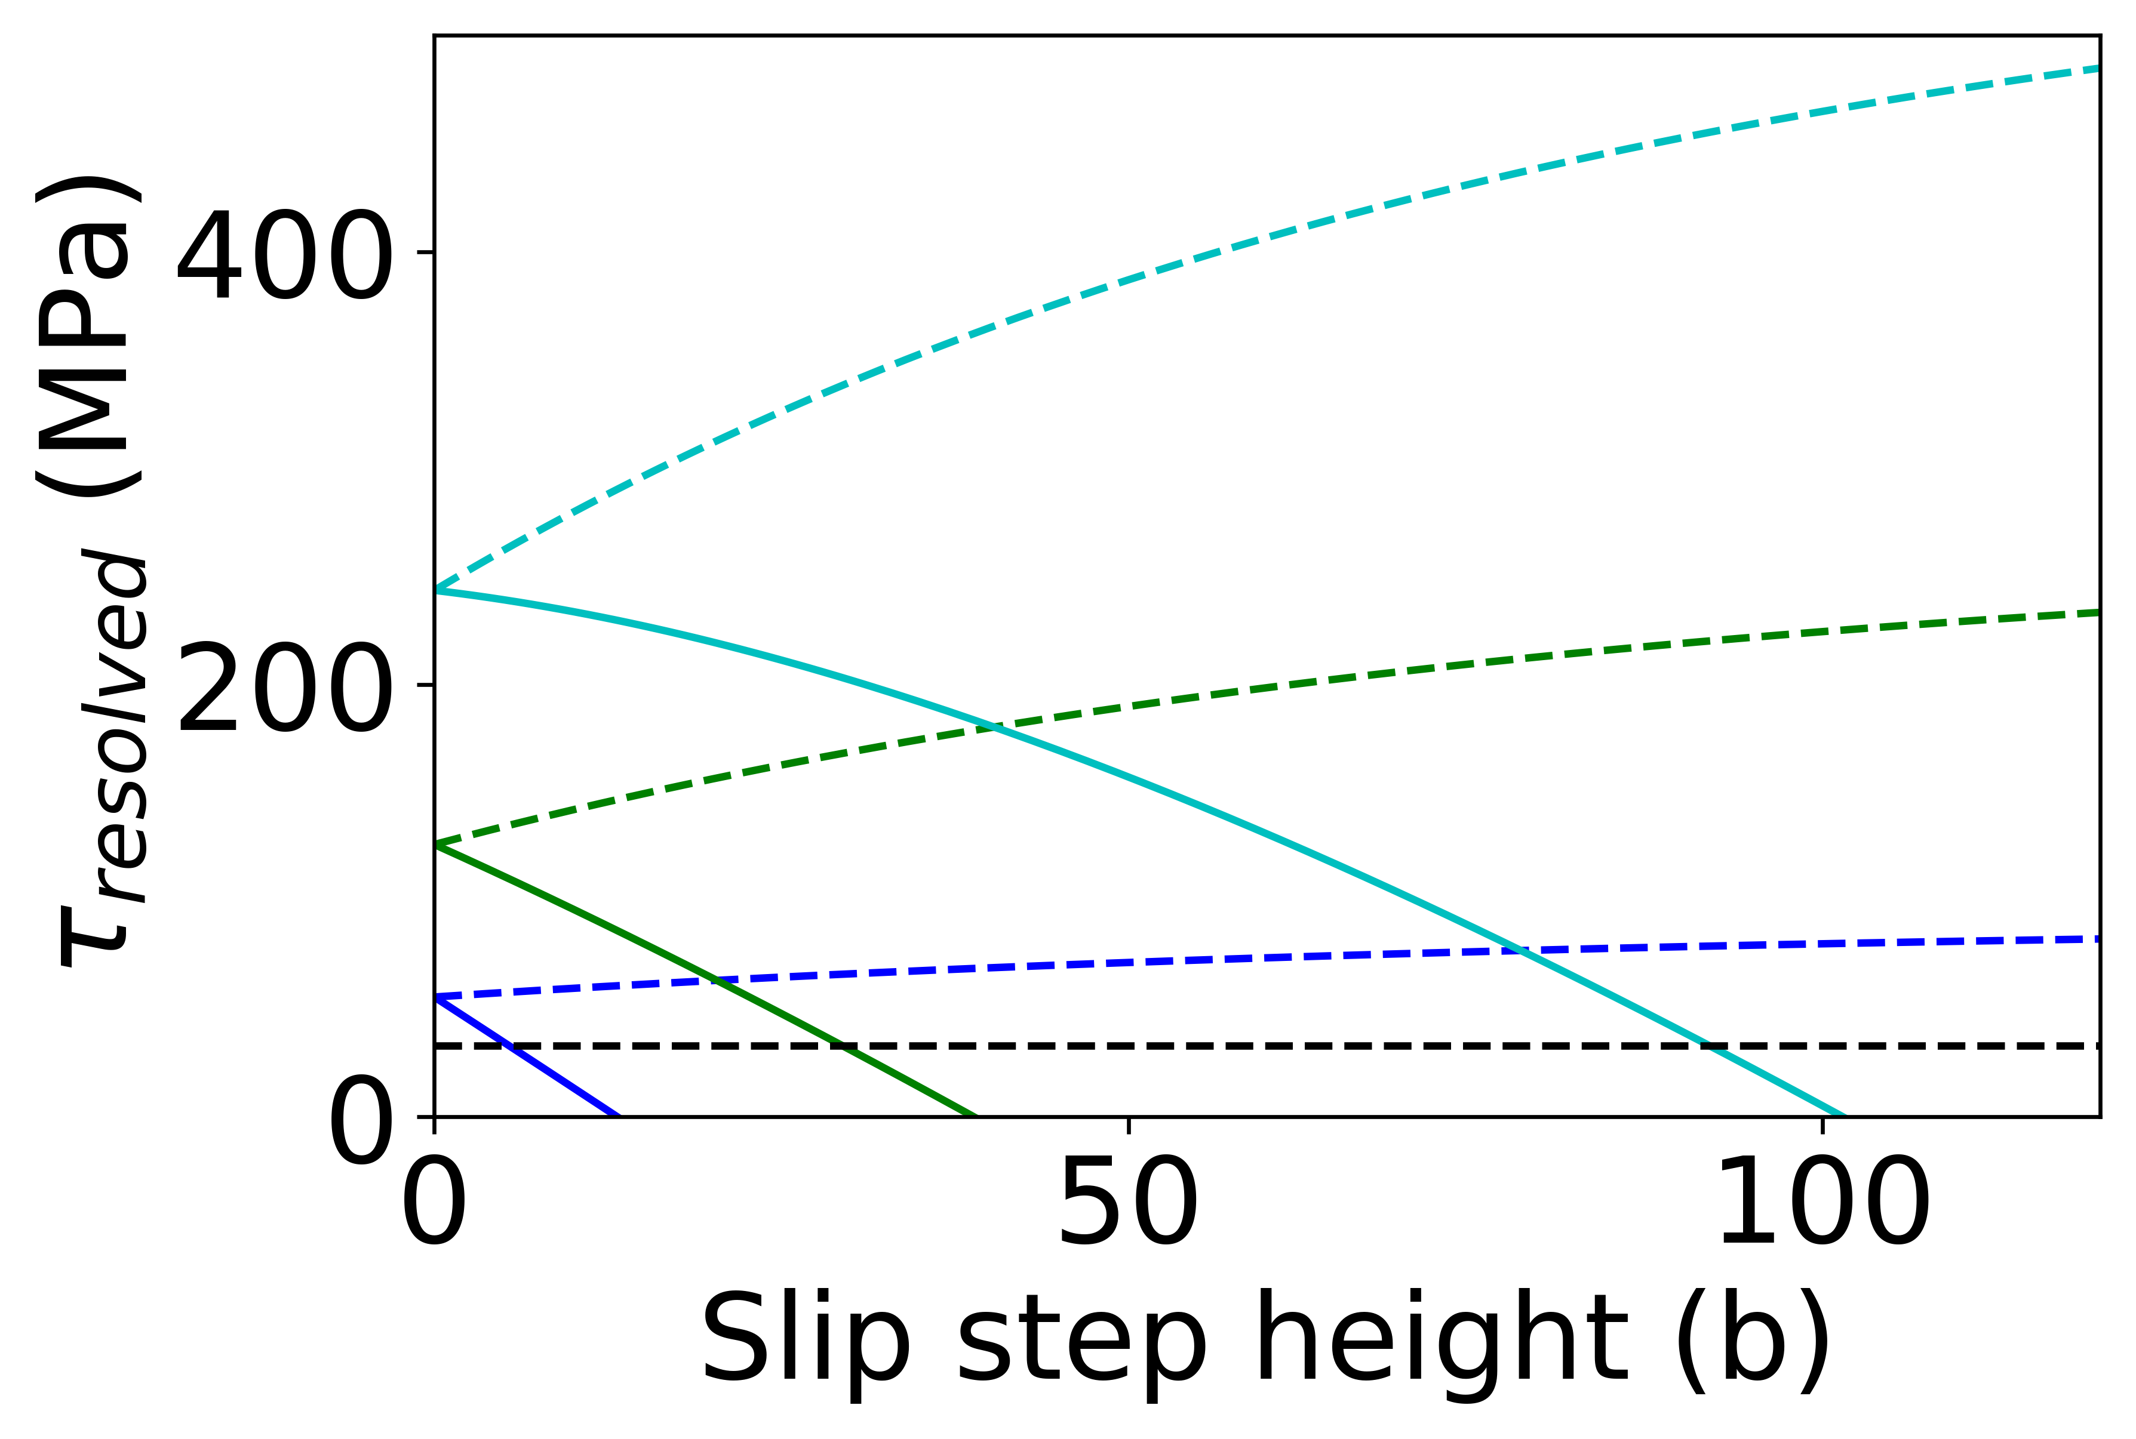
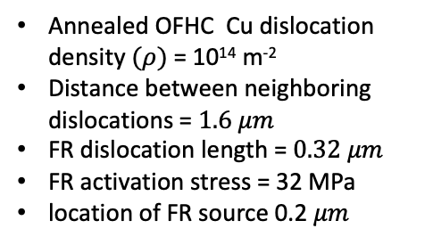
Continuous loop emission: $∆T$ = $20℃$
Annealed OFHC Cu dislocation density $(ρ)$ = 10¹⁴ m⁻²
Distance between neighboring dislocations = $1.6 μm$
FR dislocation length = $0.32 μm$
FR activation stress = 32 MPa
location of FR source 0.2 $μm$
Constant thermal stress
Step enhancement
Constant volume
Critical stress for FR emission
Final step height
Notes:
maximum possible step height.

Slide 30

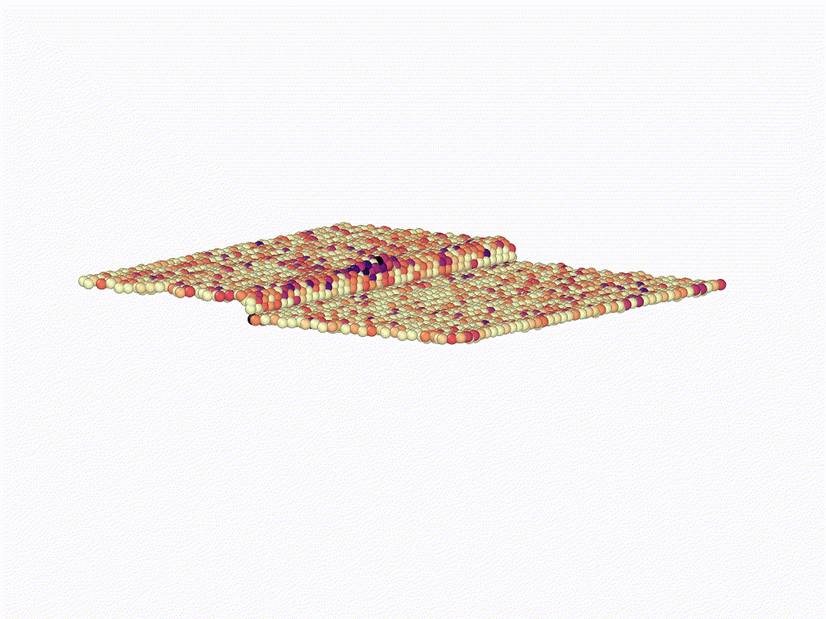
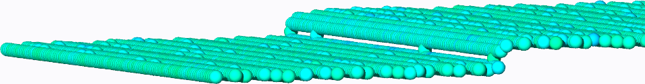
Surface dislocation multiplication
Stress concentration due to E
Surface step
Dislocation emission
[Bagchi, Perez (2022), Bagchi, Perez (2025)]

Slide 31
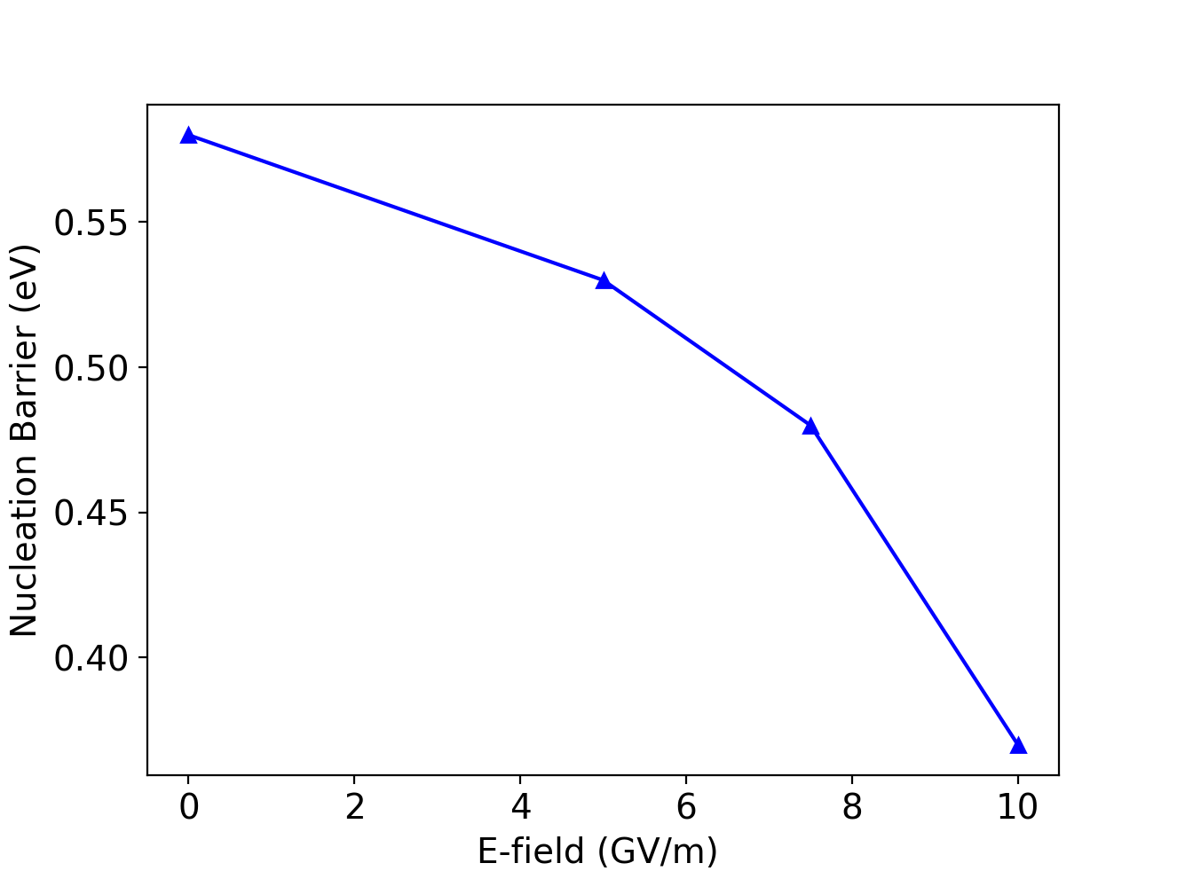
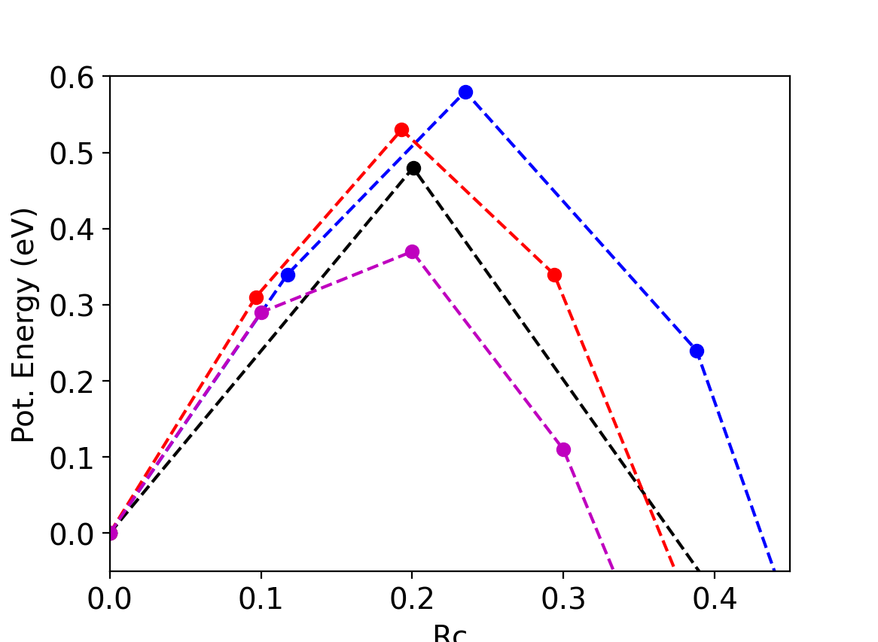
Surface dislocation multiplication
with 4% Compression
NEB
0 GV/m
10 GV/m
5 GV/m
7.5 GV/m
Modest impact of E on kinetics, even at very high fields
Need significant thermo-elastic strains to activate
Although, extreme entropic effects have been observed [Bagchi, Perez (2022, 2025)]

Slide 32
Plastic activity: the mystery remains..
Flat surfaces under typical fields (~100 MV/m)
Very low driving force for dislocation multiplication or motion
Very large FR sources required for multiplication (~mm)
Coupling of E with surface steps can enhance multiplications, but:
Bulk FR: very large sources (mm), very close to the surface (~100 nm)
Surfaces: high fields (>GV/m) and/or large thermo-elastic stresses (~3-4% strain) required
Similar conclusion reached by other groups [Wuensch et al, arXiv:2502.03967]
Plastic deformation is clearly an important ingredient, but the details remain poorly understood due to the very small driving forces involved under E alone. Other sources of stress needed to activate deformation.
[Bagchi, Perez (2022)]

Slide 33
Take home message
Probably “all-of-the-above” scenario where many different driving forces contribute
Modeling can easily explain BD for E ~GV/m either by plastic or diffusive mass transport
Transport is a plausible mechanism for E ~100-200 MV/m
Dislocation multiplication also proposed, but microscopic validation needed
Appears likely that pre-existing roughness and/or additional driving forces are needed to activate plastic deformation (e.g., formed through diffusive transport, thermal cycling/fatigue, secondary breakdowns, …)
Microscopically rare but macroscopically abundant microstructural features could also play an important role

Slide 34
What do we need to make progress
Help from our experimental colleagues!
“Single shot” in situ experiments to resolve breakdown precursor formation before BD occurs (e.g., scanning probe, in situ experiments in TEM)
Very well characterized materials (likely means small volumes)
Systematic, one factor at the time, approach

Slide 39
Hard Cu
Soft Cu
[Askhenazy et al. (2021)]
[Korsback (2020)]

