Slide 1

Nb₃Sn: State-of-the-art performance, challenges and opportunities for materials science
July 16, 2025
Grigory Eremeev
Materials for Bright Beams Workshop 2025
FERMILAB-SLIDES-25-0158-TD

Slide 2
State-of-the-art performance
01

Slide 3
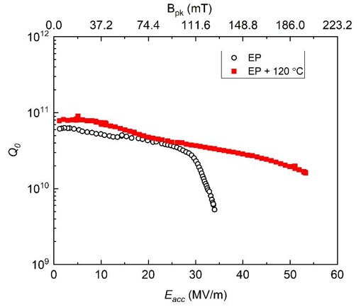
Nb₃Sn Cavities: Higher superheating field
Nb cavities reach high accelerating gradients
Many limiting mechanisms in Nb SRF cavities have been understood and mitigated
State-of-the-art Nb cavities are reaching very close to the superheating field H_{sh} of niobium
Nb₃Sn, an s-wave superconductor with large energy gap and twice as high H_{sh} as niobium, offers the potential for even high accelerating gradients
Material | Nb | Nb₃Sn
T_{c} [K] | 9.25 | 18.3
ρ_{n} [μΩcm] | 0.1 | ~ 5
H_{sh}(0) [T] | 0.24 | ~ 0.45
Δ [meV] | 1.45 | ~ 3.1
Q^{BCS} @ 2K | ~ 5·10¹⁰ | ~ 5·10¹⁴
Q^{BCS} @ 4K | ~ 5·10⁸ | ~ 5·10¹⁰
E_{acc} [MV/m] | ~ 50 | ~ 100
H_{c} ~ 540 mT ⇒ H_{sh} ~ 0.84·H_{c} = 450 mT ⇒
E_{acc} ~ H_{pk}/4 ⇒ E_{acc} ~ 100 MV/m

Slide 4
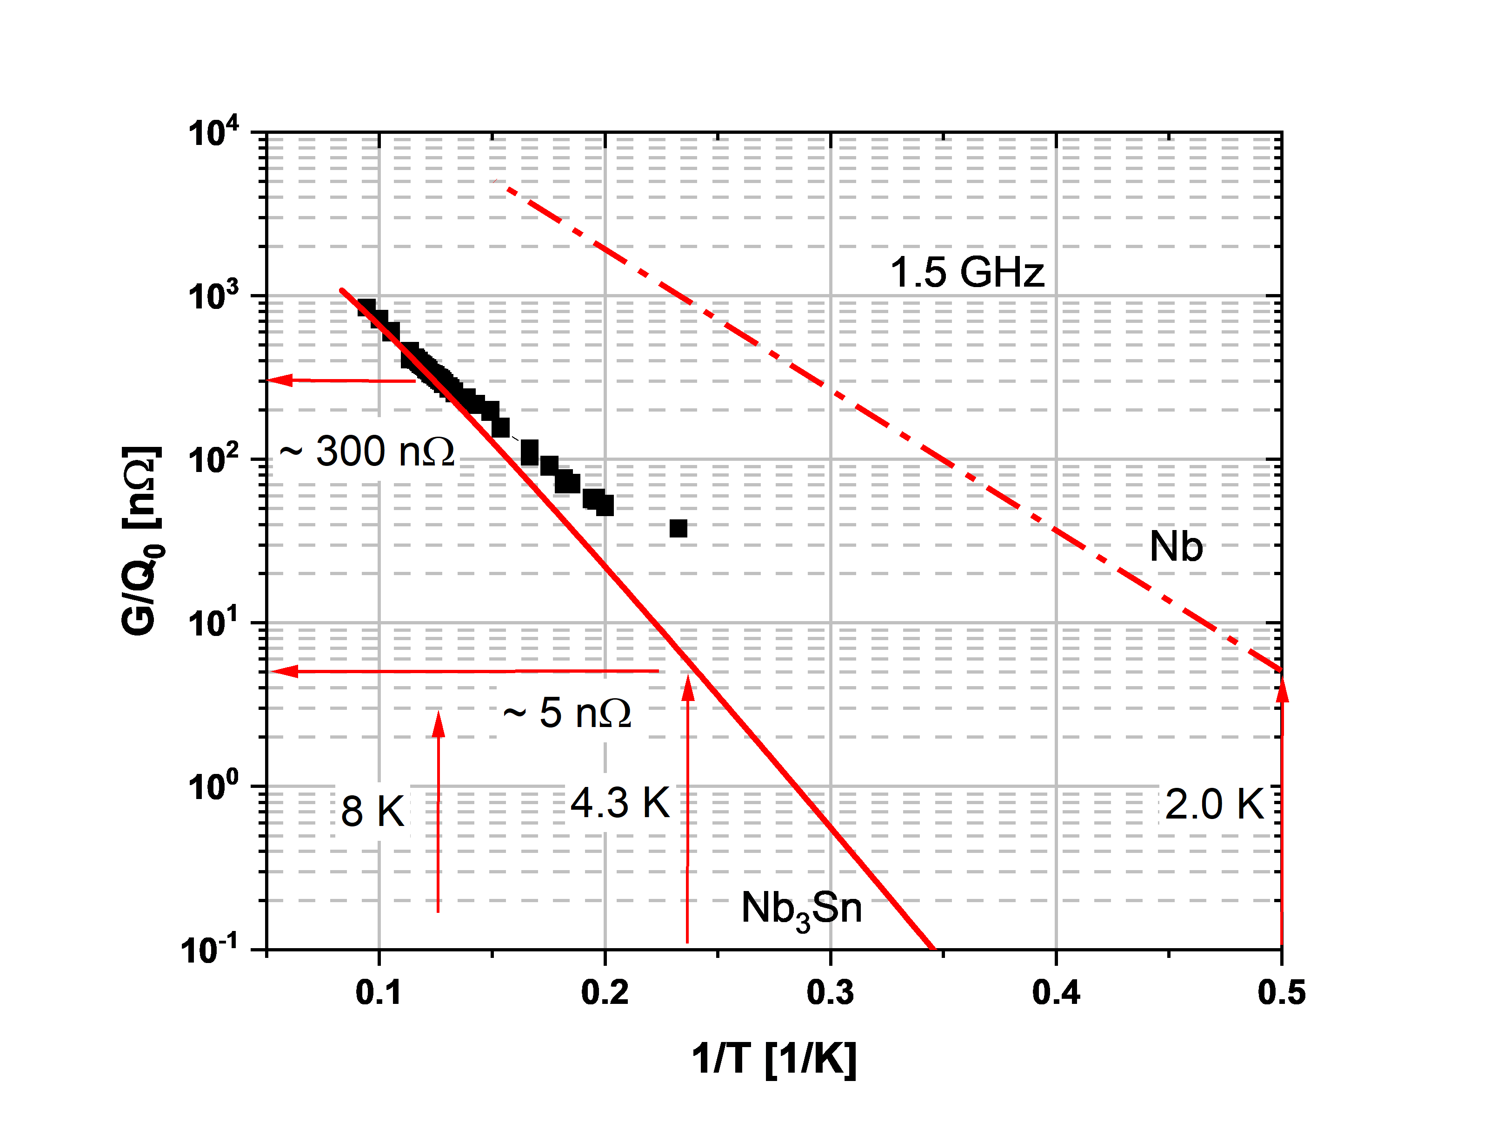
Nb₃Sn Cavities: High Q₀ at higher temperature
Nb₃Sn has larger energy gap than niobium and (relatively) low normal conducting resistivity
Higher Q₀ at higher temperatures
Q₀ > 10¹⁰ at 4 K
Can use cryocoolers instead of liquefier cryoplant
Reduce the capital and operating cost for high duty factor small and medium-size accelerators
Δ ~ 3.1 meV ⇒ Rs ≥ 5 nΩ @ 4.3K @ ~ 1 GHz

Slide 5
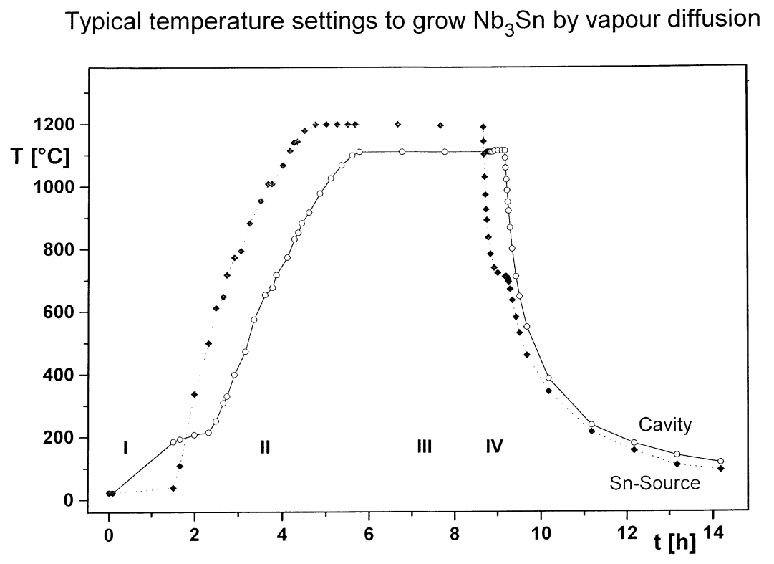
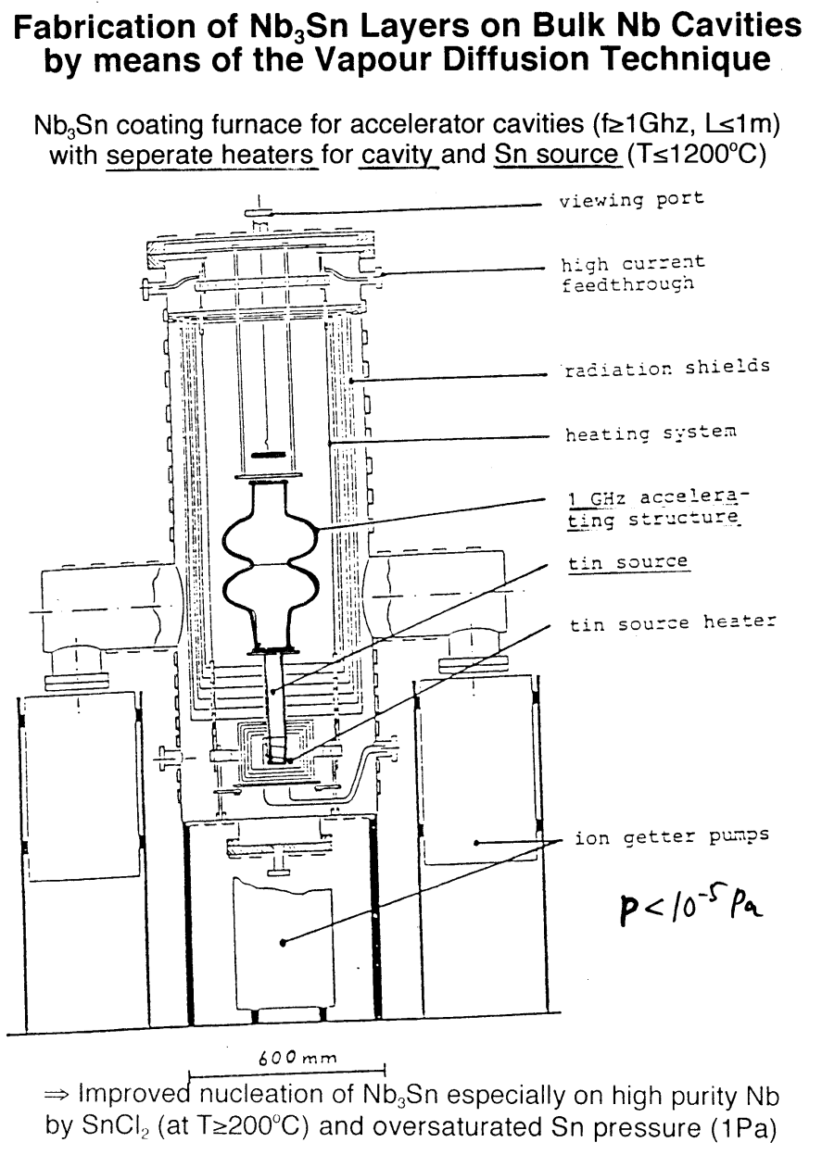
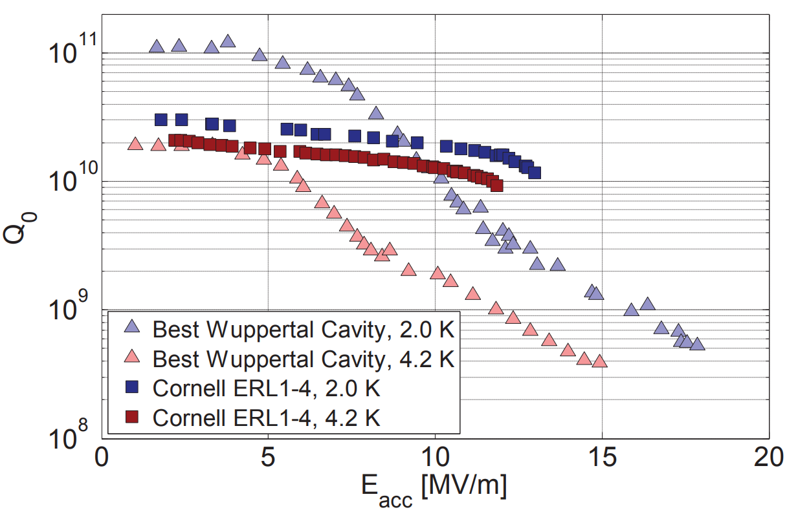
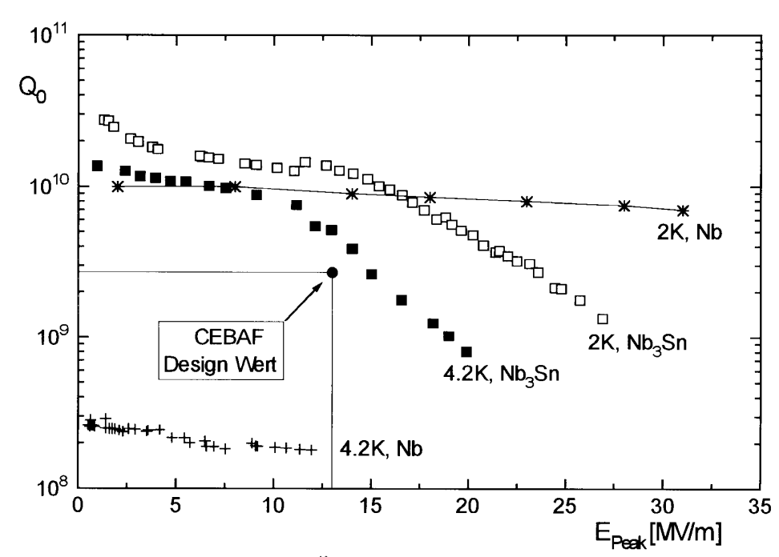
Short overview of past work
Nb₃Sn was discovered in 1953 by B. Matthias et al.
Material development in 70-80s by Siemens AG, Karlsruhe, Cornell University, University of Wuppertal and CERN
Development at Wuppertal led to high Q and E_{acc} ~ 15 MV/m, limited by strong Q-slope
“Wuppertal”
configuration
Q vs E without strong Q-slope at Cornell in 2013
G. Müller, P. Kneisel, D. Mansen, H.Piel, J. Pouryamout, R. W. Röth, EPAC’96
S. Posen et al., SRF’13

Slide 6
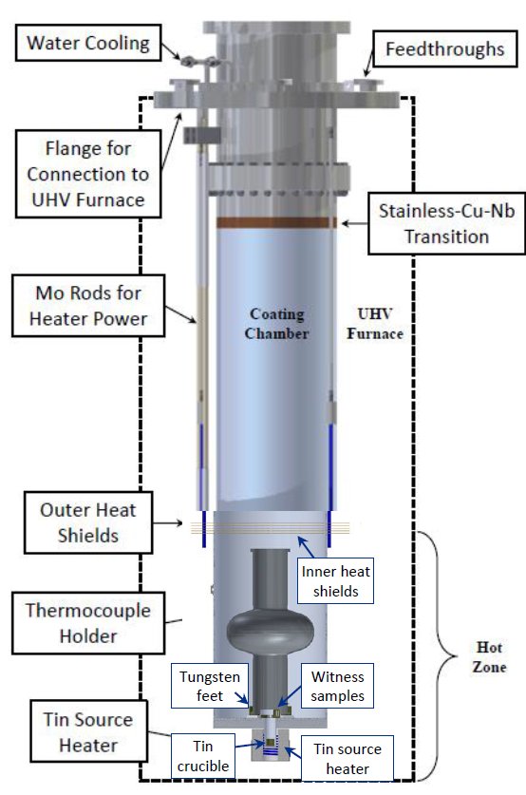
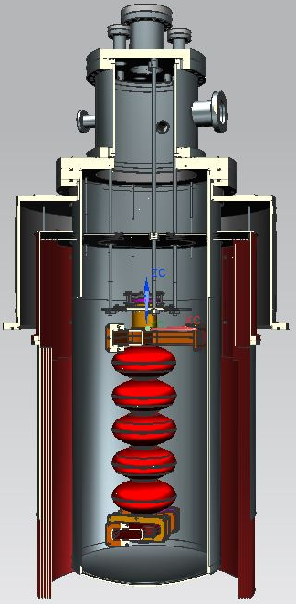
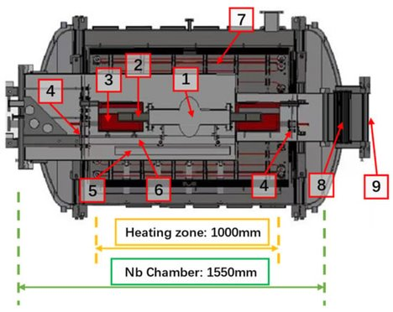
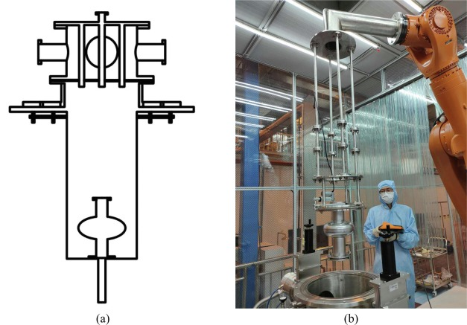



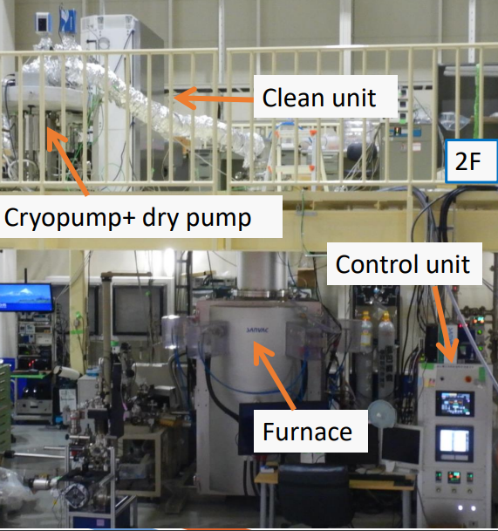
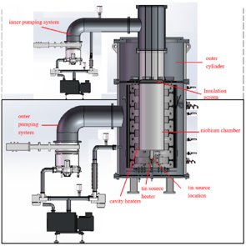

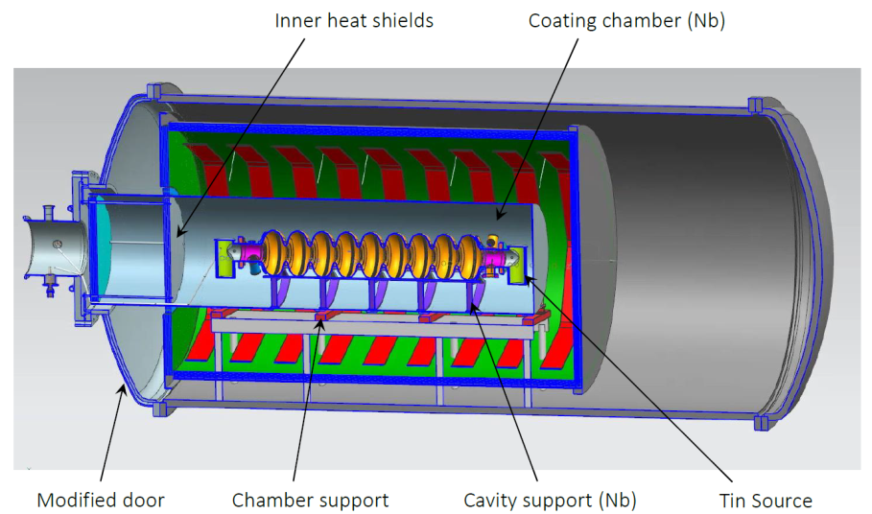


Nb₃Sn development world-wide
2018 - 2023
2012
2009
2015

Slide 7
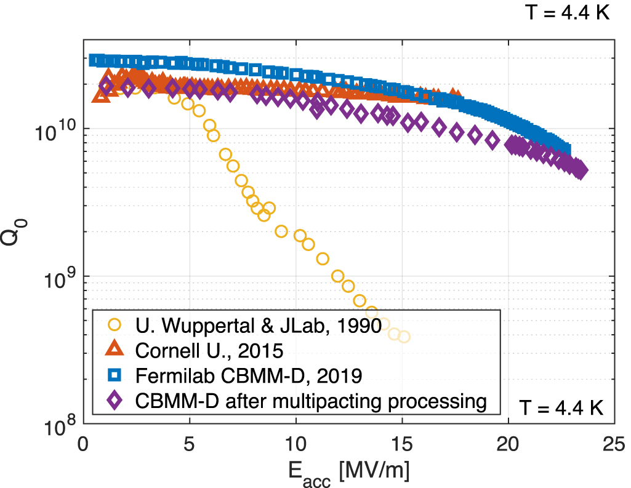
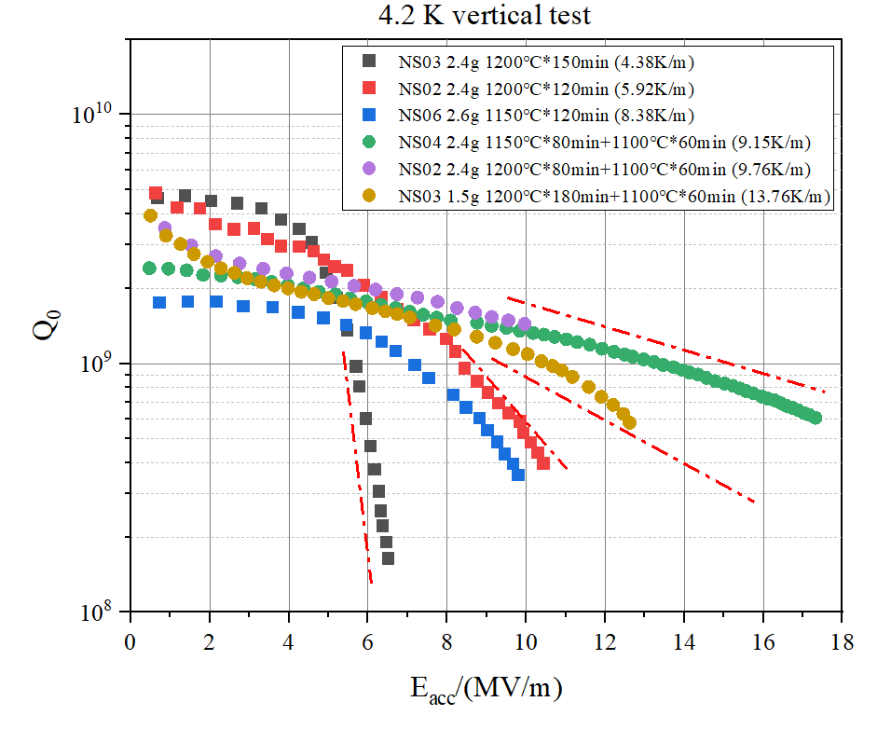
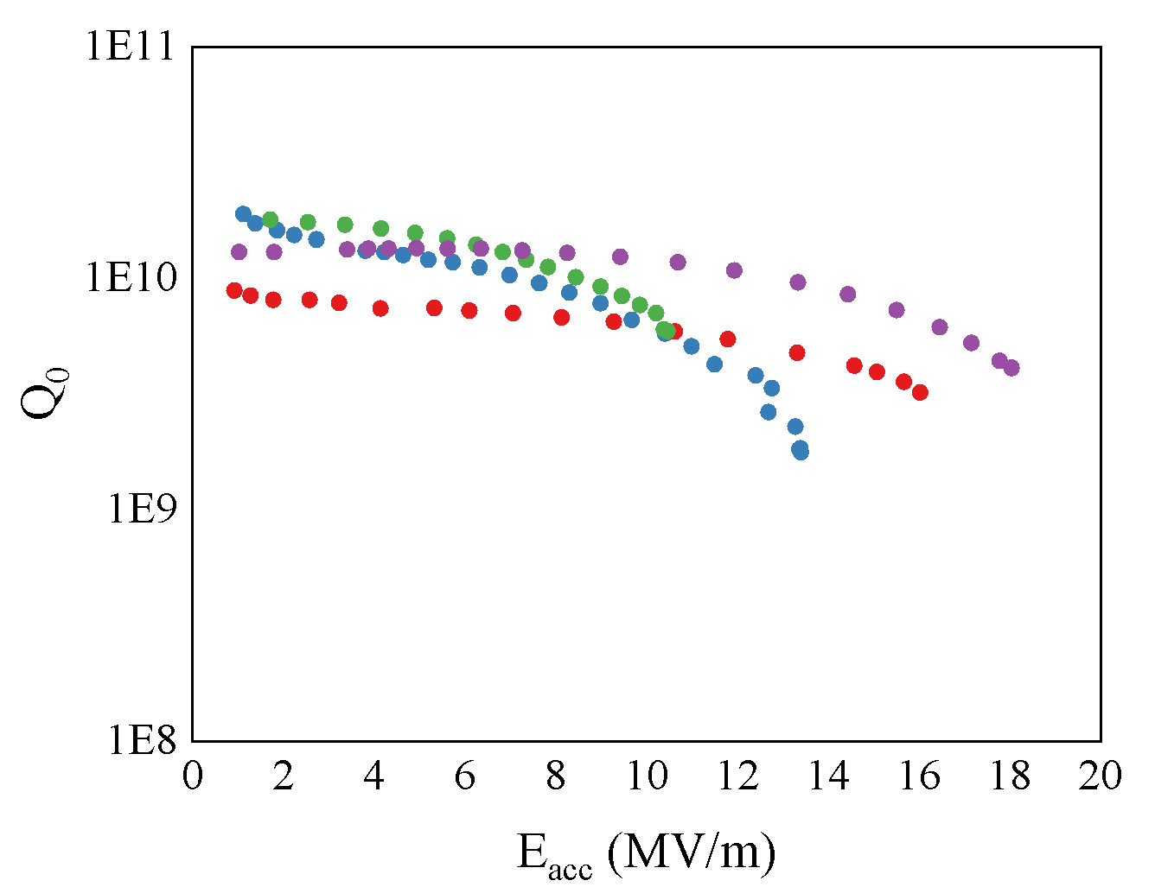
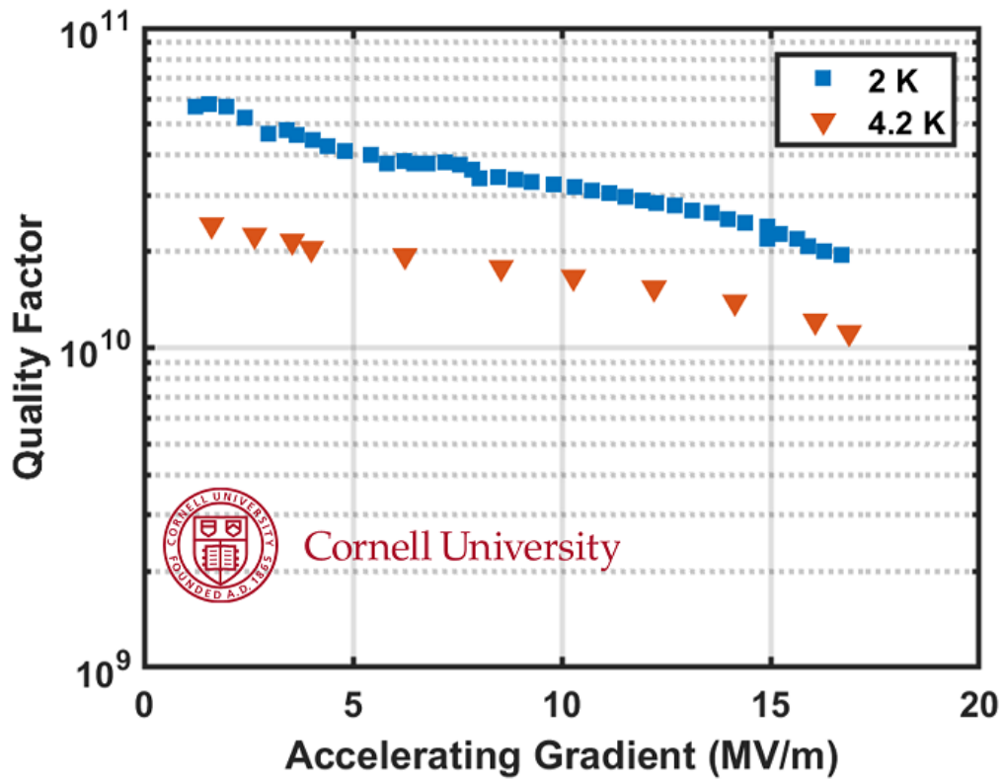
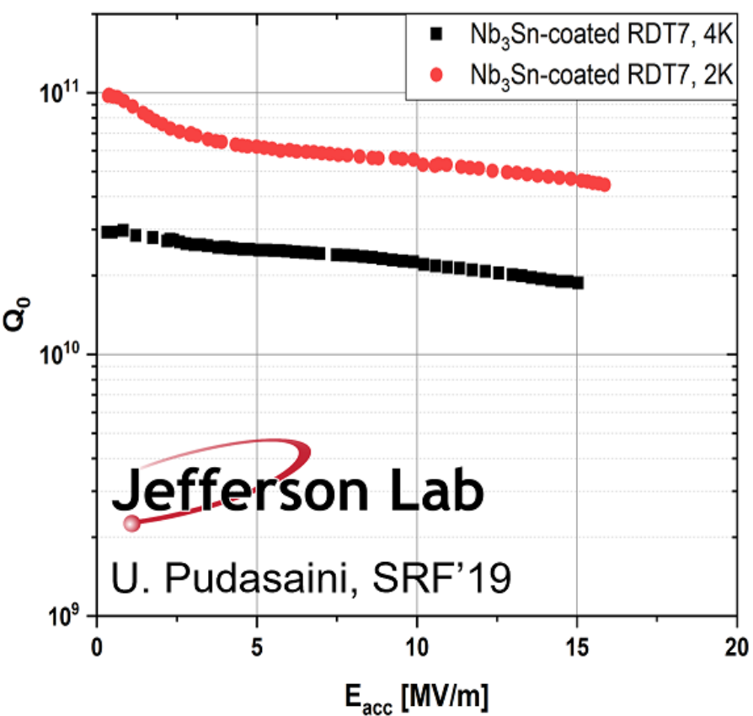
State-of-the-art R&D cavities
The highest accelerating gradient is above E_{acc} = 20 MV/m
The cavity was coated and measured at Fermilab
The record performance is attributed to thinner “shiny” coating
Coatings world-wide reached practical accelerating gradients above E_{acc} = 10 MV/m
N. Stilin, Ph.D. dissertation, 2024; J.Hao et al., TTC’25; Z.Yang et al, TTC’23

Slide 8
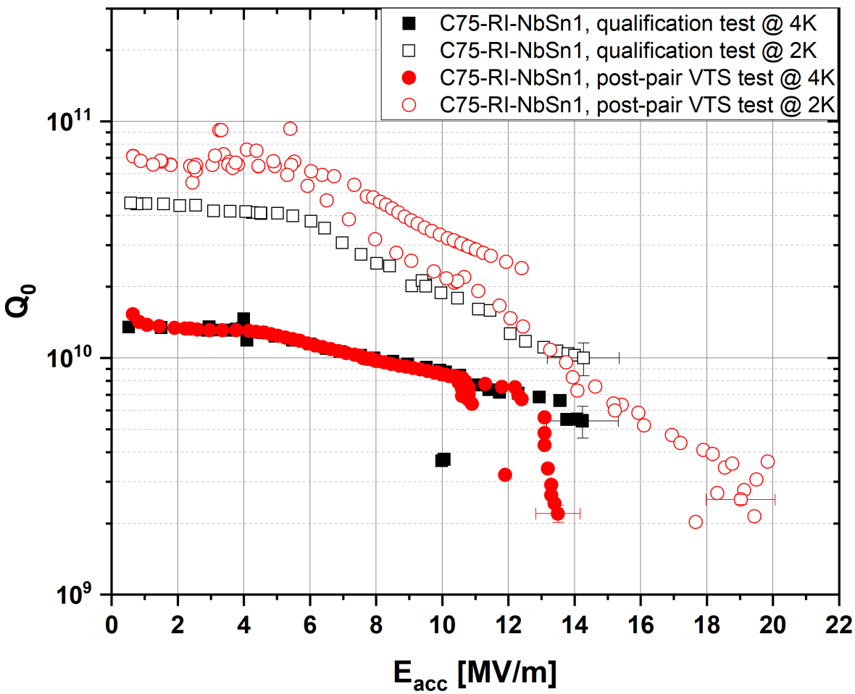
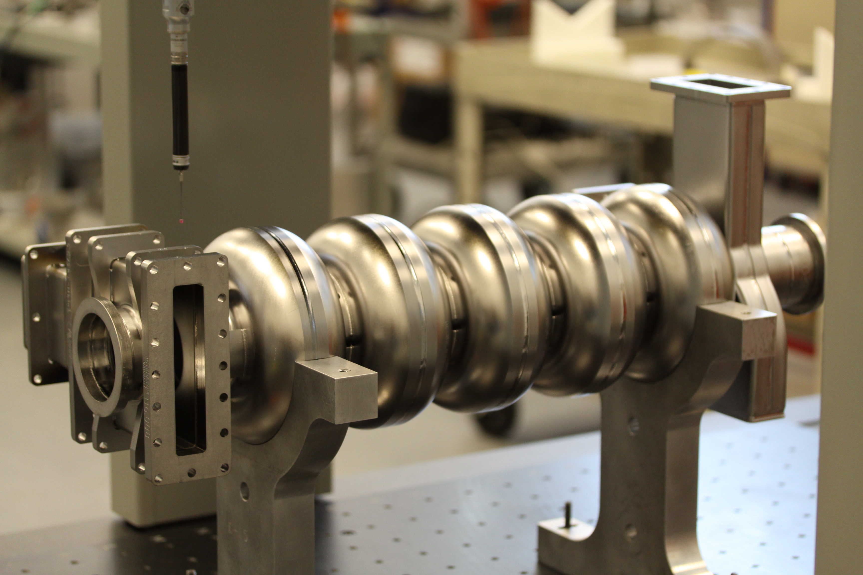
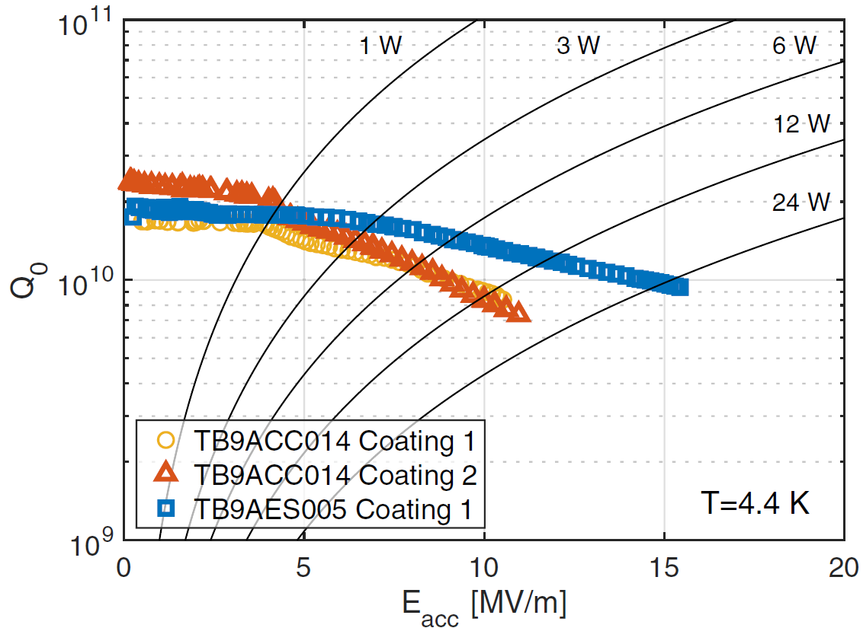
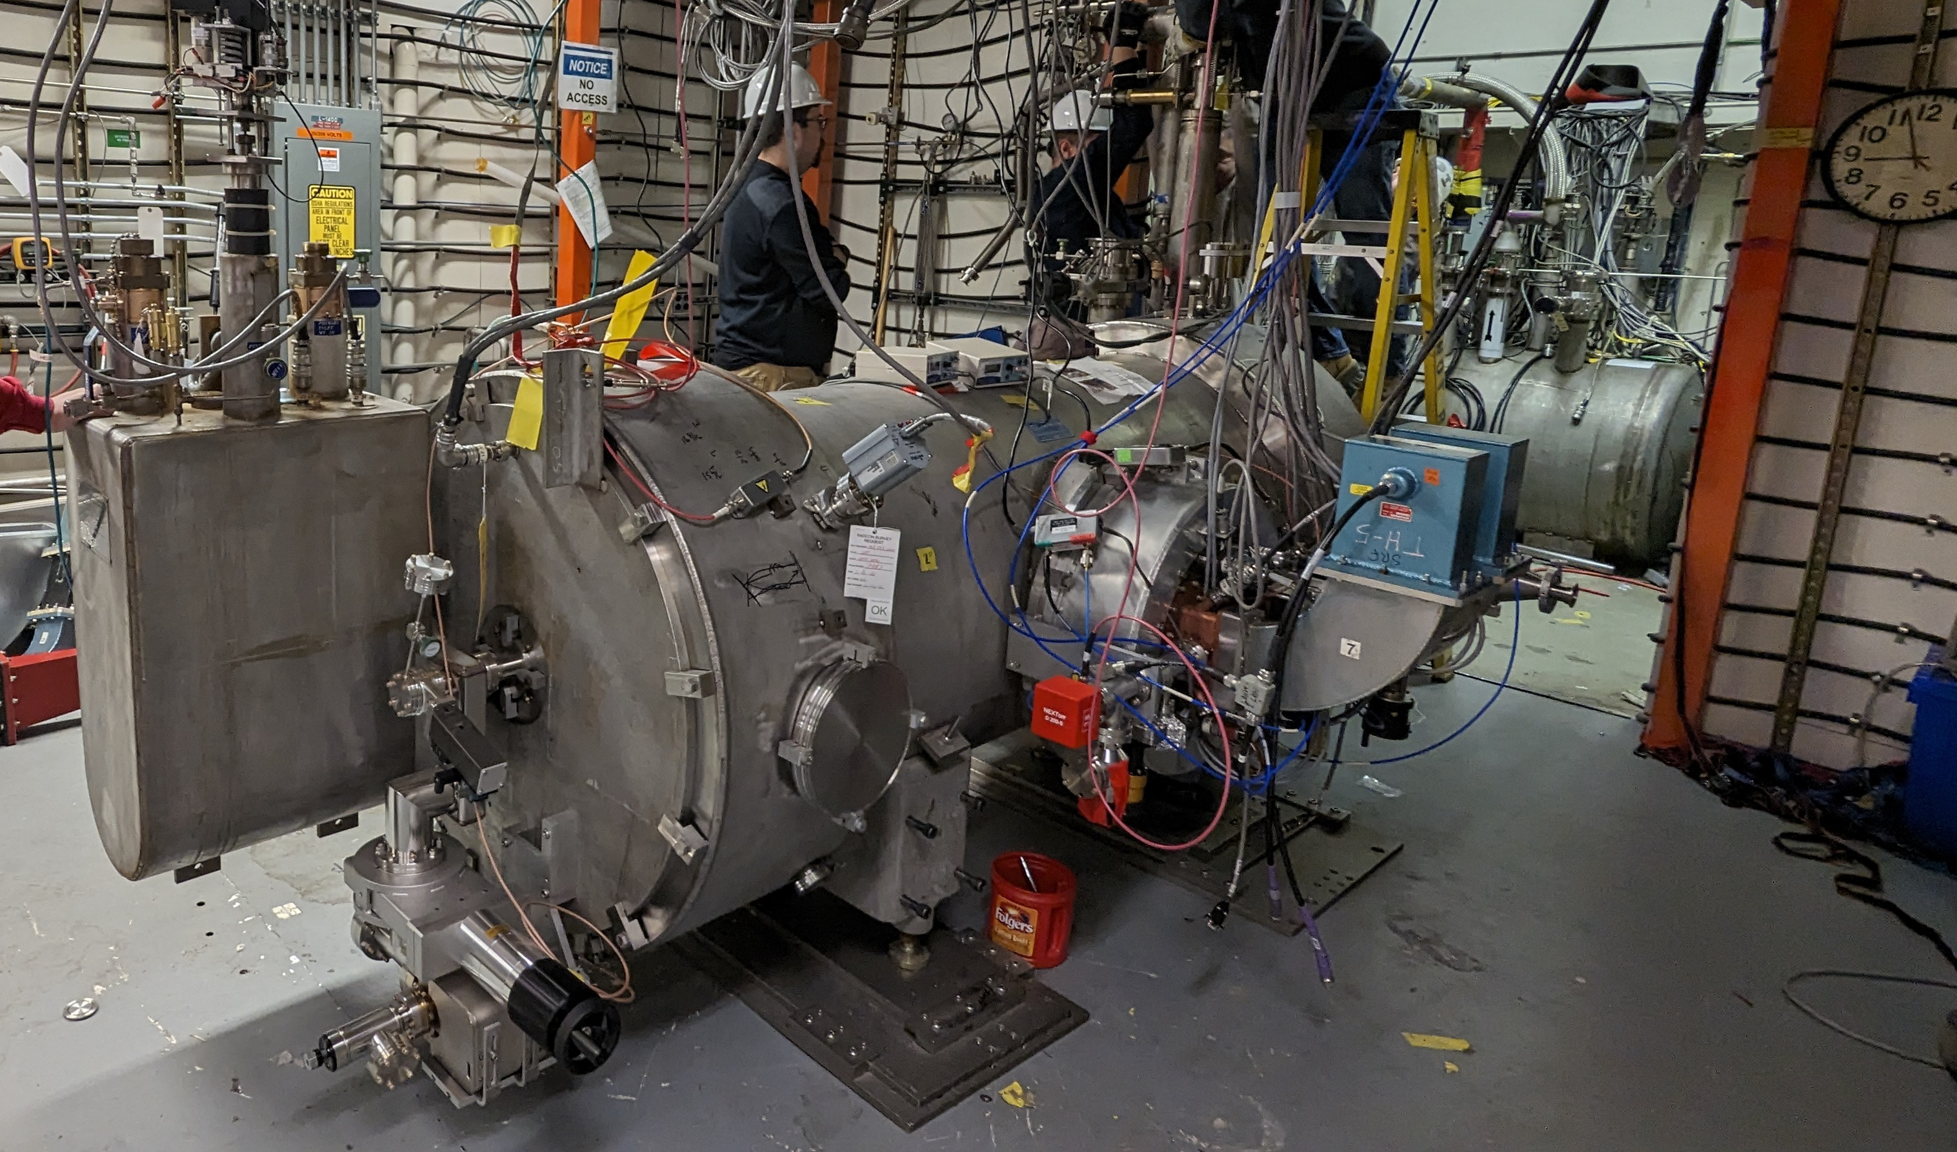
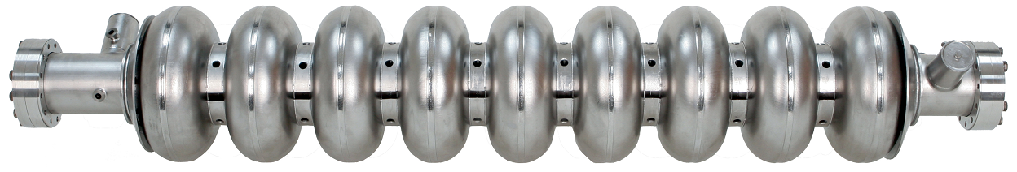
Best accelerator cavities
Multicell accelerator cavities reach E_{acc} above 10 MV/m
Several projects are underway to integrate cavities into operational cryomodules
CEBAF cryomodule with two Nb₃Sn-coated cavities has been recently measured with total voltage gain > 10 MV
Posen et al., Supercond. Sci. Technol. 34 (2021) 025007
Eremeev et al., SRF’23 & LINAC’24

Slide 9
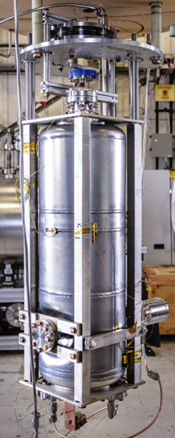
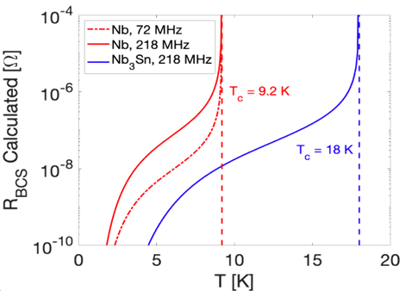
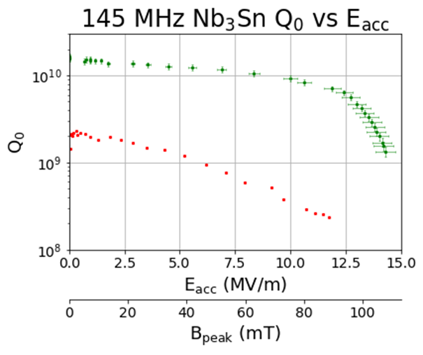
Best accelerator cavities
Nb₃Sn films offer advantages at lower frequencies at 4 K compared to Nb
QWR cavities were coated within ANL-FNAL collaboration
The best 145 MHz QWR cavity reached unprecedented B_{pk} = 108 mT
Such B_{pk} corresponds to E_{acc} > 25 MV/m in elliptical SRF cavity
T. Petersen et al., HIAT’25

Slide 10
Challenges and Opportunities (or how did we get here and how do we move beyond)
02

Slide 11
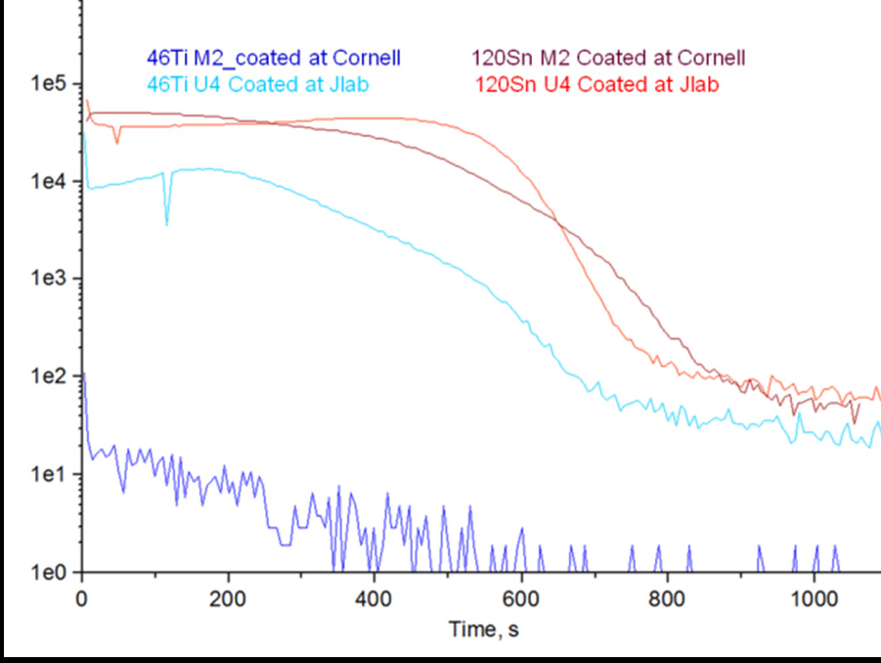
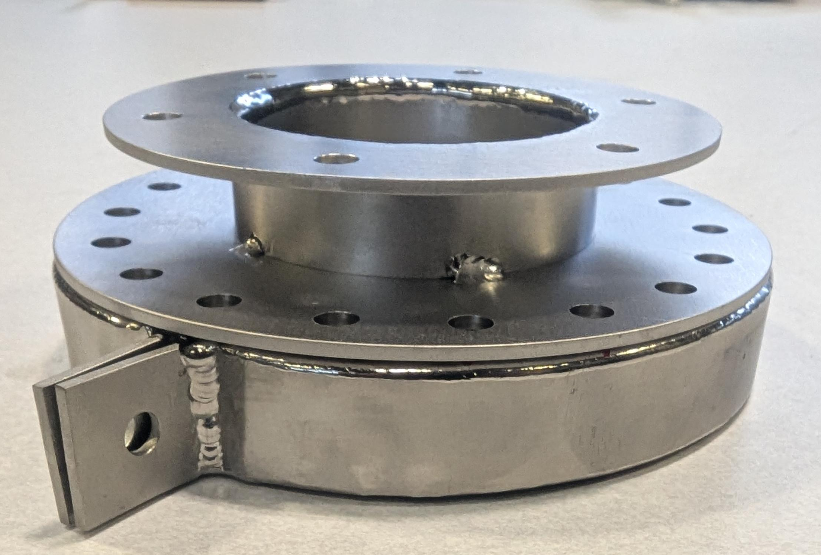
What causes Q-slope?
Cornell’s cavity did not have Q-slope, while Wuppertal’s and, later, Jlab’s did…why?
Titanium from NbTi flanges was one of the differences noted in the coating between Cornell and Jlab coated samples
The finding prompted coating facilities to use Nb cover to restrict uptake of Ti during Nb₃Sn coating
SIMS to identify Titanium contamination (myself) -> Ti covers.
Message: data prompted everyone to use covers to protect for Ti.
Also talk about Sn in GB and about more impurities in Nb3Sn
May be split into two slides: talk about Ti and covers, then in the next slide about Sn rich and Sn deficient GB
Eremeev, SRF’15

Slide 12
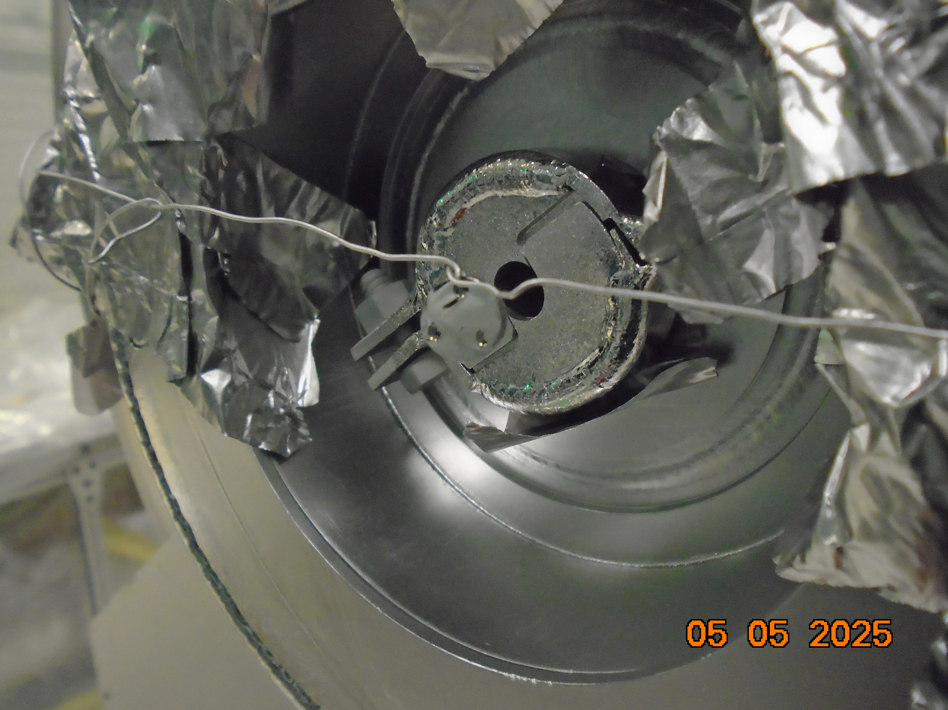
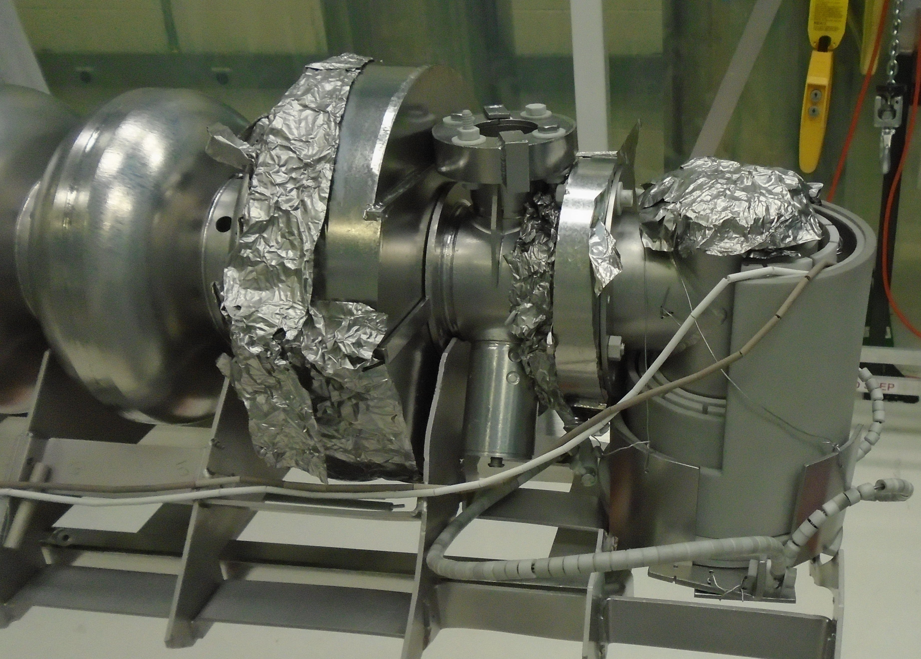
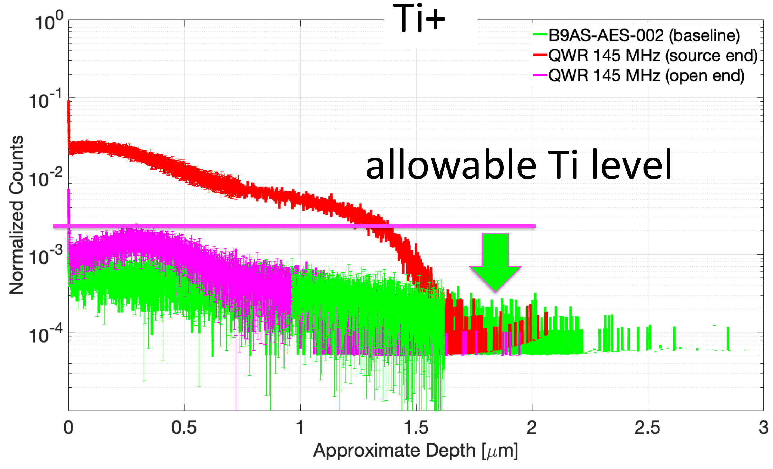
Titanium in Nb₃Sn
All coatings of cavities with NbTi flanges use Nb covers
Several other approaches to protect the coatings (and the furnace) from titanium contamination are explored
Ti uptake is studied and needs to be quantified to link it to Q₀ field dependence
See N. Tagdulang’s poster
SIMS to identify Titanium contamination (myself) -> Ti covers.
Message: data prompted everyone to use covers to protect for Ti.
Also talk about Sn in GB and about more impurities in Nb3Sn
May be split into two slides: talk about Ti and covers, then in the next slide about Sn rich and Sn deficient GB

Slide 13
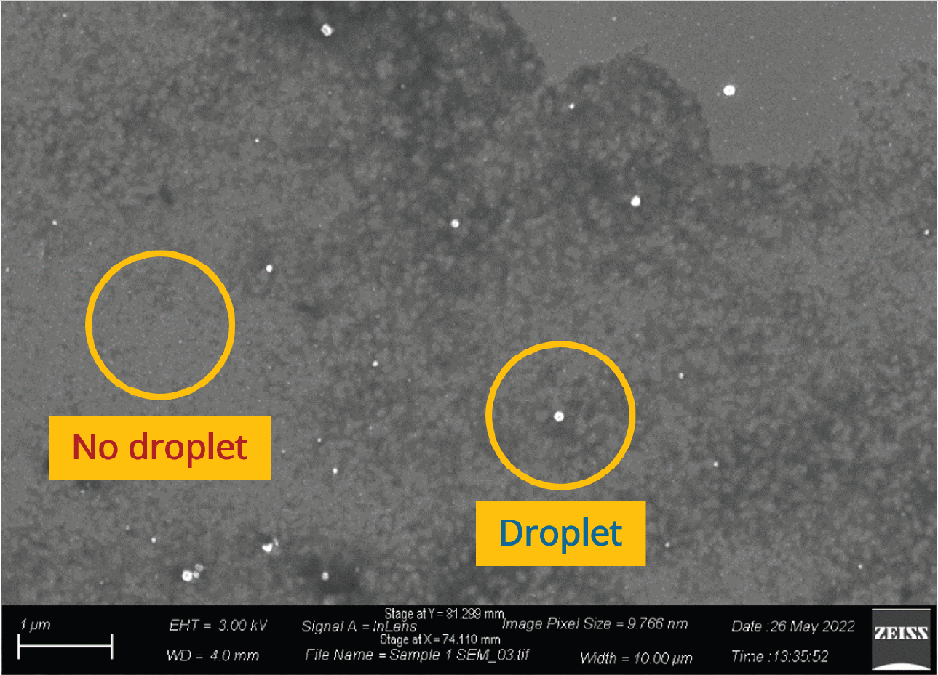
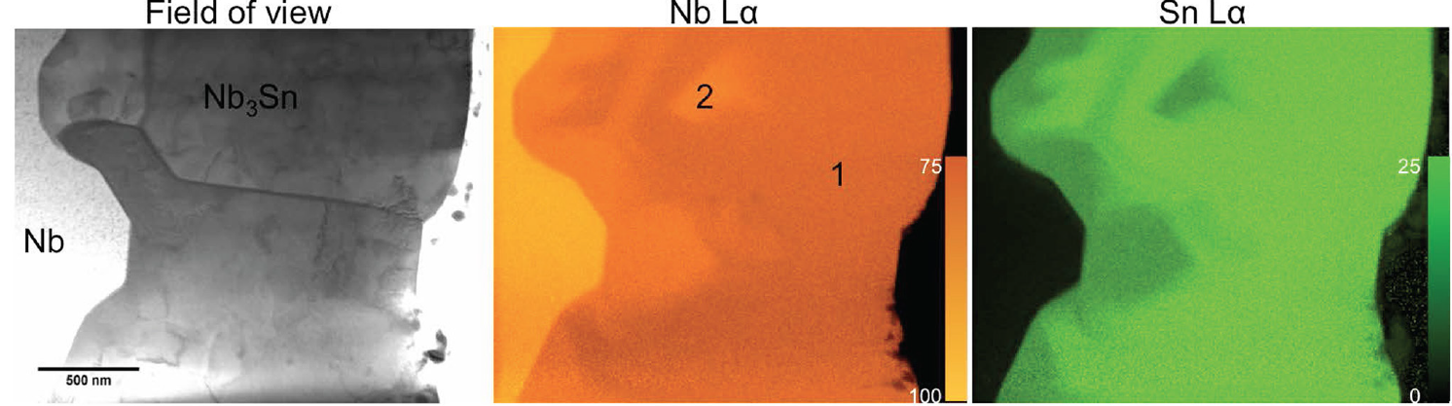
Sn flux and Nb₃Sn nucleation
Sn flux early in the coating process strongly impacts Nb₃Sn coating
Sn deficiency early in the coating is linked to patchy regions, voids, and Sn-deficient regions
Niobium anodization before the coating has been the approach to improve Sn seeding
Becker et al., Appl. Phys. Lett. 106, 082602 (2015)
L. Shpani et al., SRF’23

Slide 14
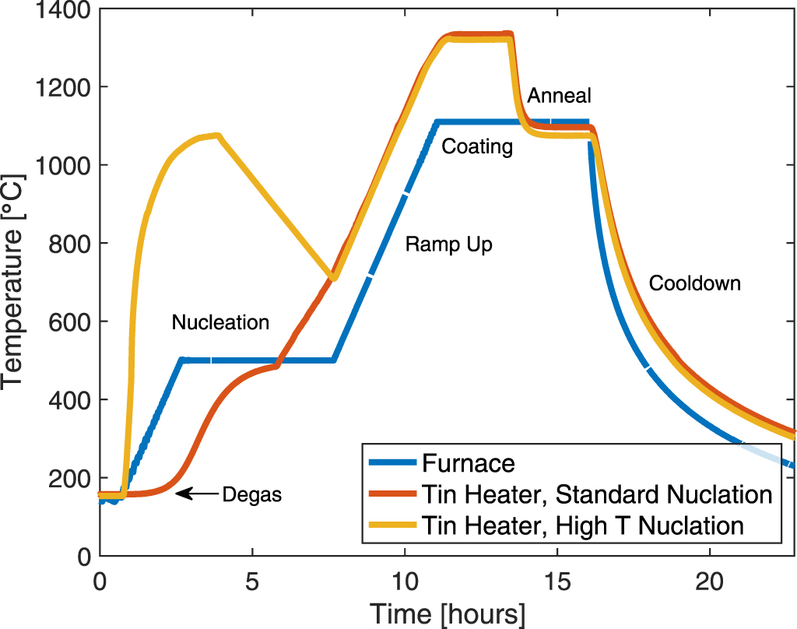
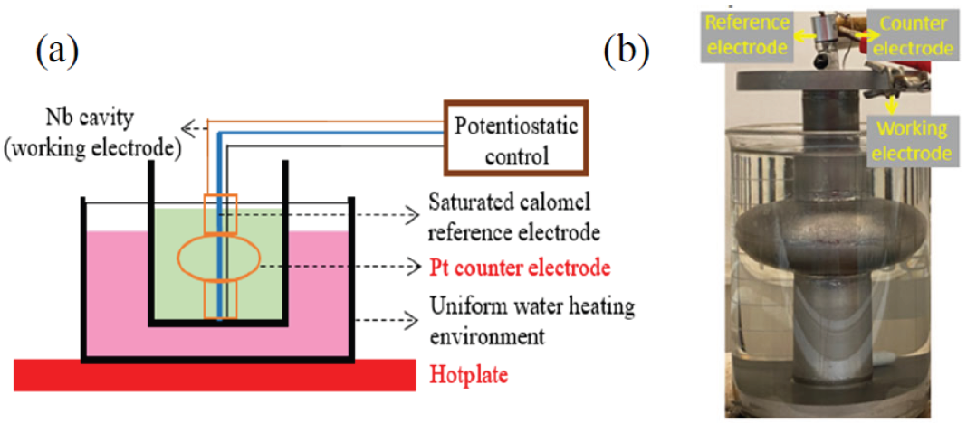
Source temperature spike to promote nucleation
In addition to anodization, Sn nucleation has been improved by increasing the temperature of Sn source during the nucleation stage
Alternative approaches such as Sn electroplating improves Sn distribution over the surface and may be more suitable for hard-to-reach areas
PlaceholdL. Shpani et al., SRF’23
S Posen et al 2021 Supercond. Sci. Technol. 34 025007

Slide 15
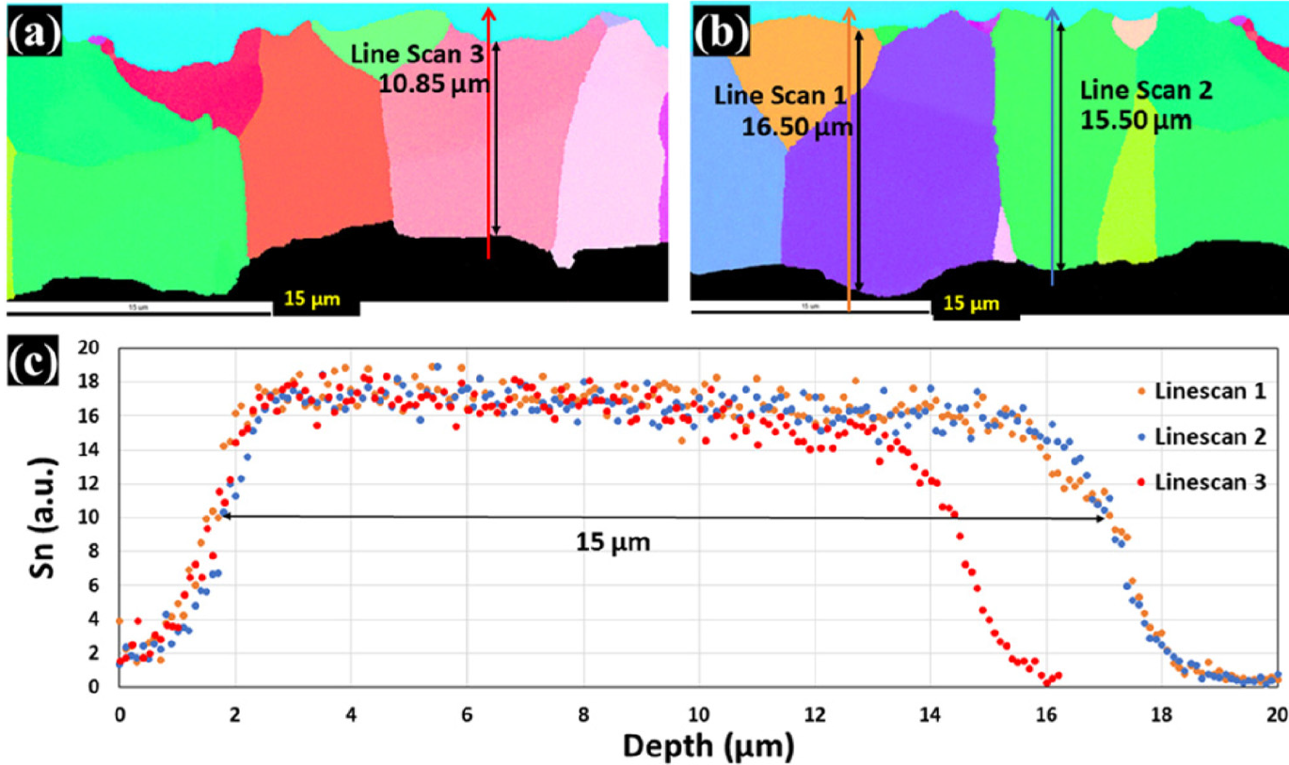
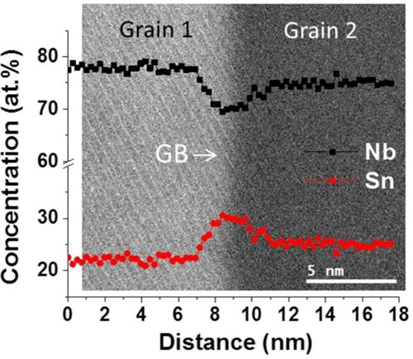
GB driven growth of Nb₃Sn
Nb₃Sn film grows in columnar grains driven by Sn diffusion through the grain boundaries
Nb₃Sn grain orientation is uncorrelated to underlying Nb, which explains excellent results achieved with both fine-grain and large-grain niobium
Sn diffusion via grain boundaries leads to the potential of Sn enrichment at the grain boundaries
Sn-rich GB will lead to T_{c} reduction and early vortex nucleation
U. Pudasaini, J. Vac. Sci. Technol. A 37, 051509 (2019)
Carlson J et al 2021 cavities Phys. Rev. B 103 024516

Slide 16
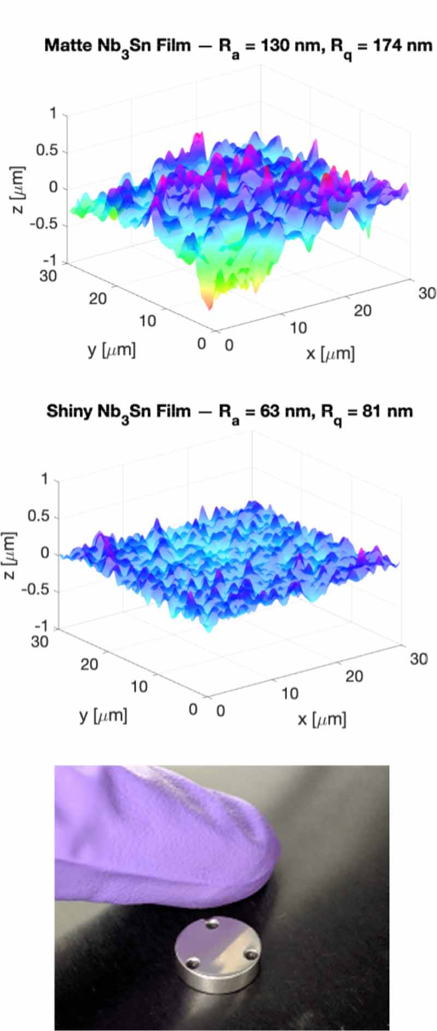
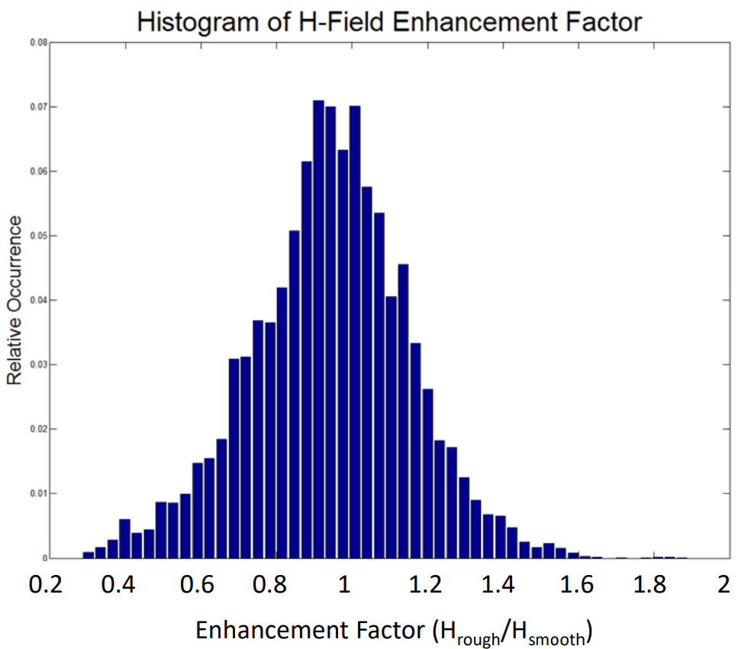
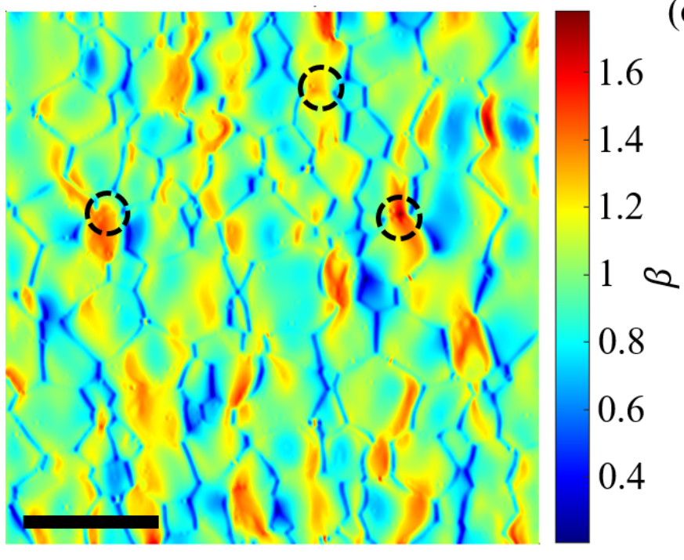
Roughness of Nb₃Sn
Surface roughness of Nb₃Sn films has been linked to performance degradation due to field enhancement
The highest E_{acc} has been achieved with thin Nb₃Sn coating that had lower surface roughness
R. Porter et al, SRF’19
Eric M Lechner et al 2025 Supercond. Sci. Technol. 38 01LT01

Slide 17
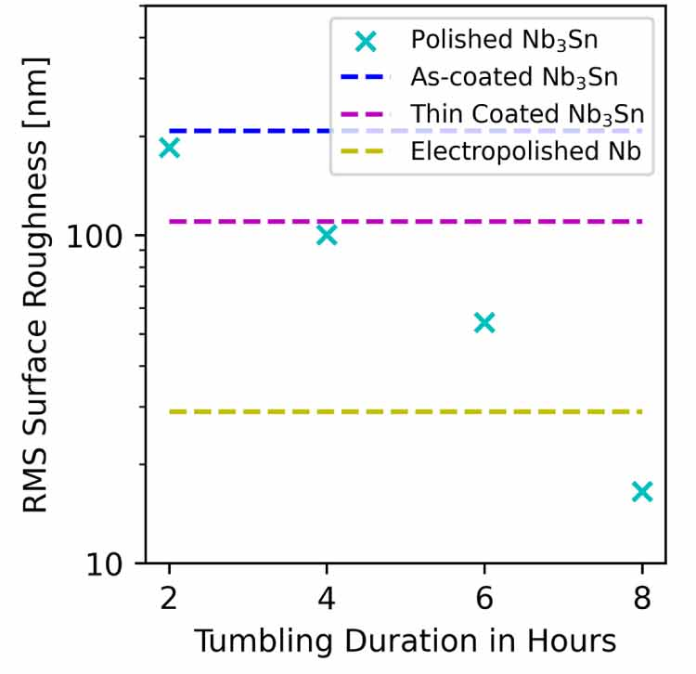
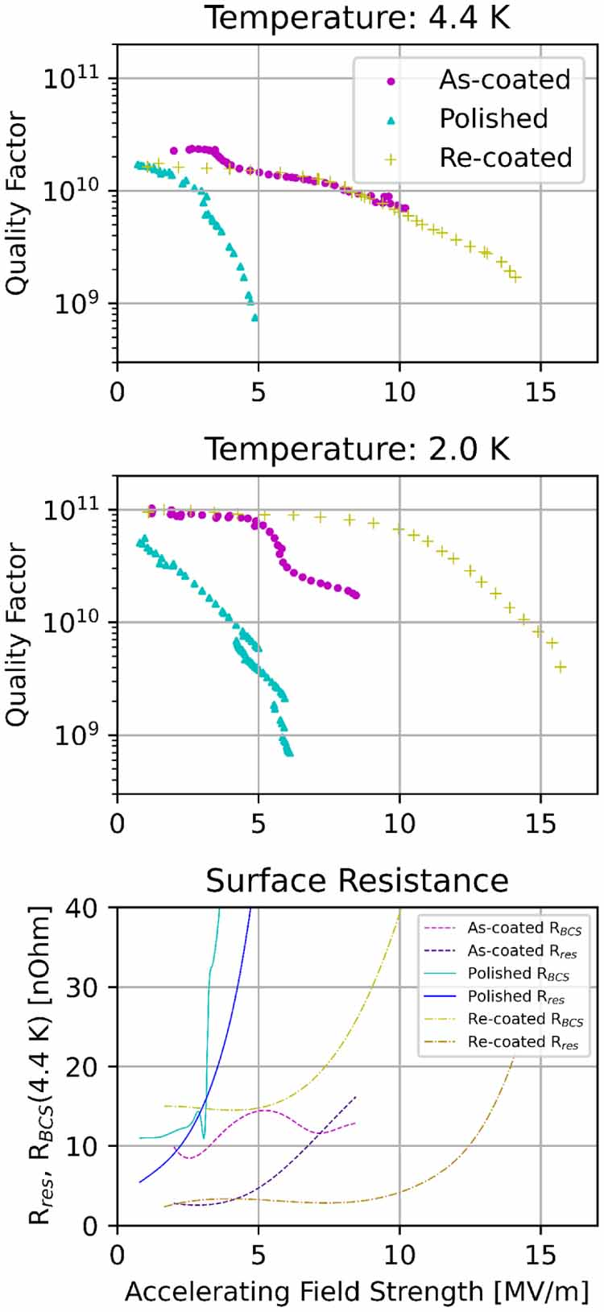
Mechanical polishing to reduce roughness
Centrifugal barrel polishing is an effective way to reduce surface roughness of Nb₃Sn films
Polished Nb₃Sn films have surface roughness better than that of electropolished niobium
The light re-coating process is used to heal film damage and close cracks in the film
The light re-coating process has been shown to be effective to improve degraded cavities
E. Viklund et al 2024 Supercond. Sci. Technol. 37 025009

Slide 18
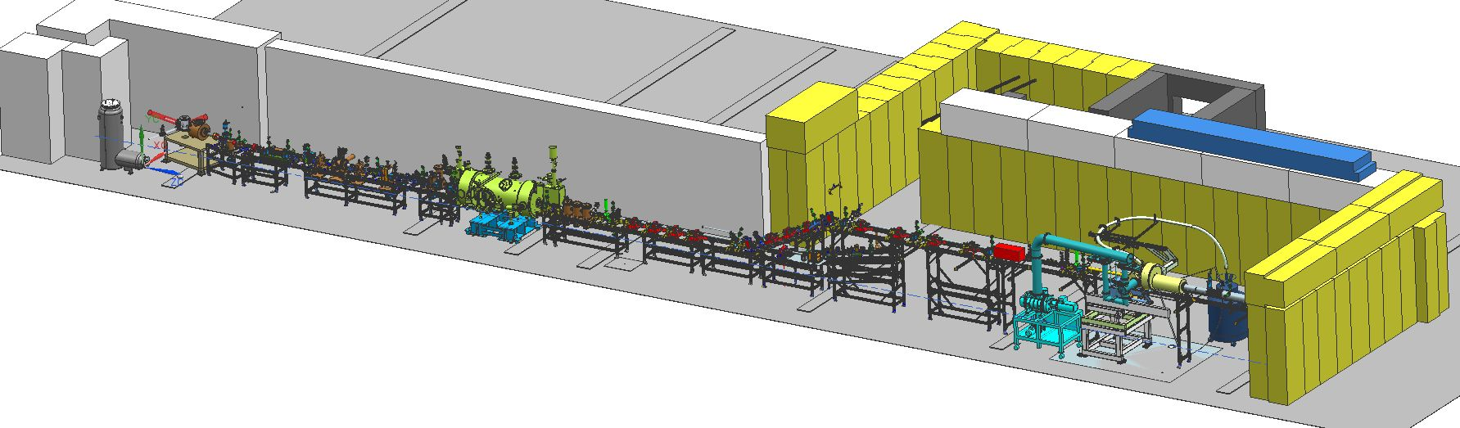
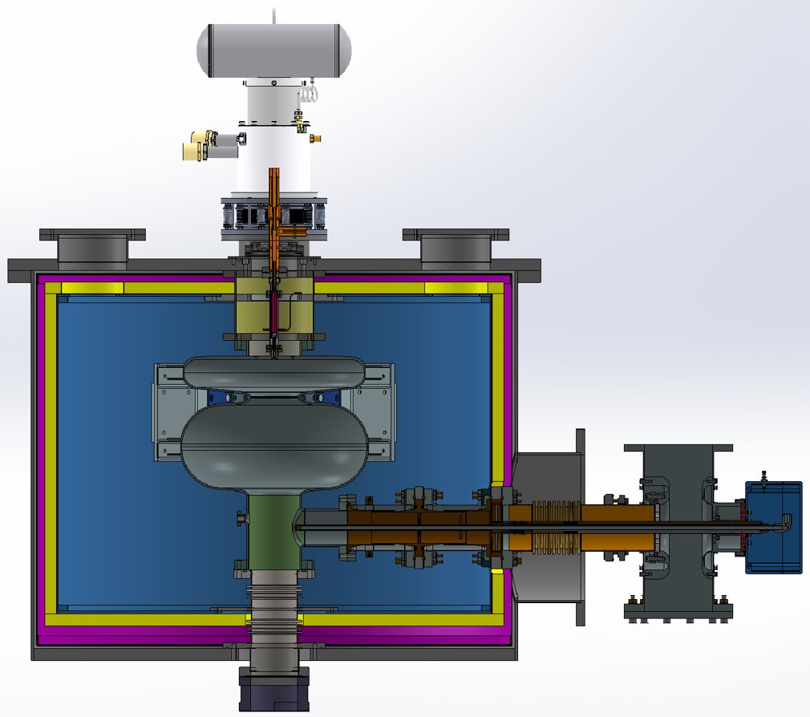
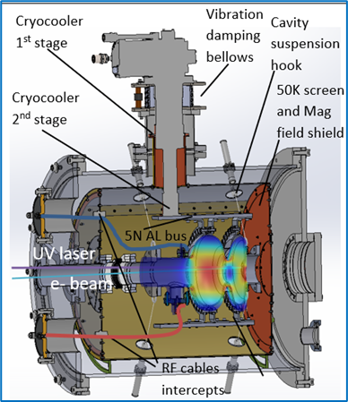
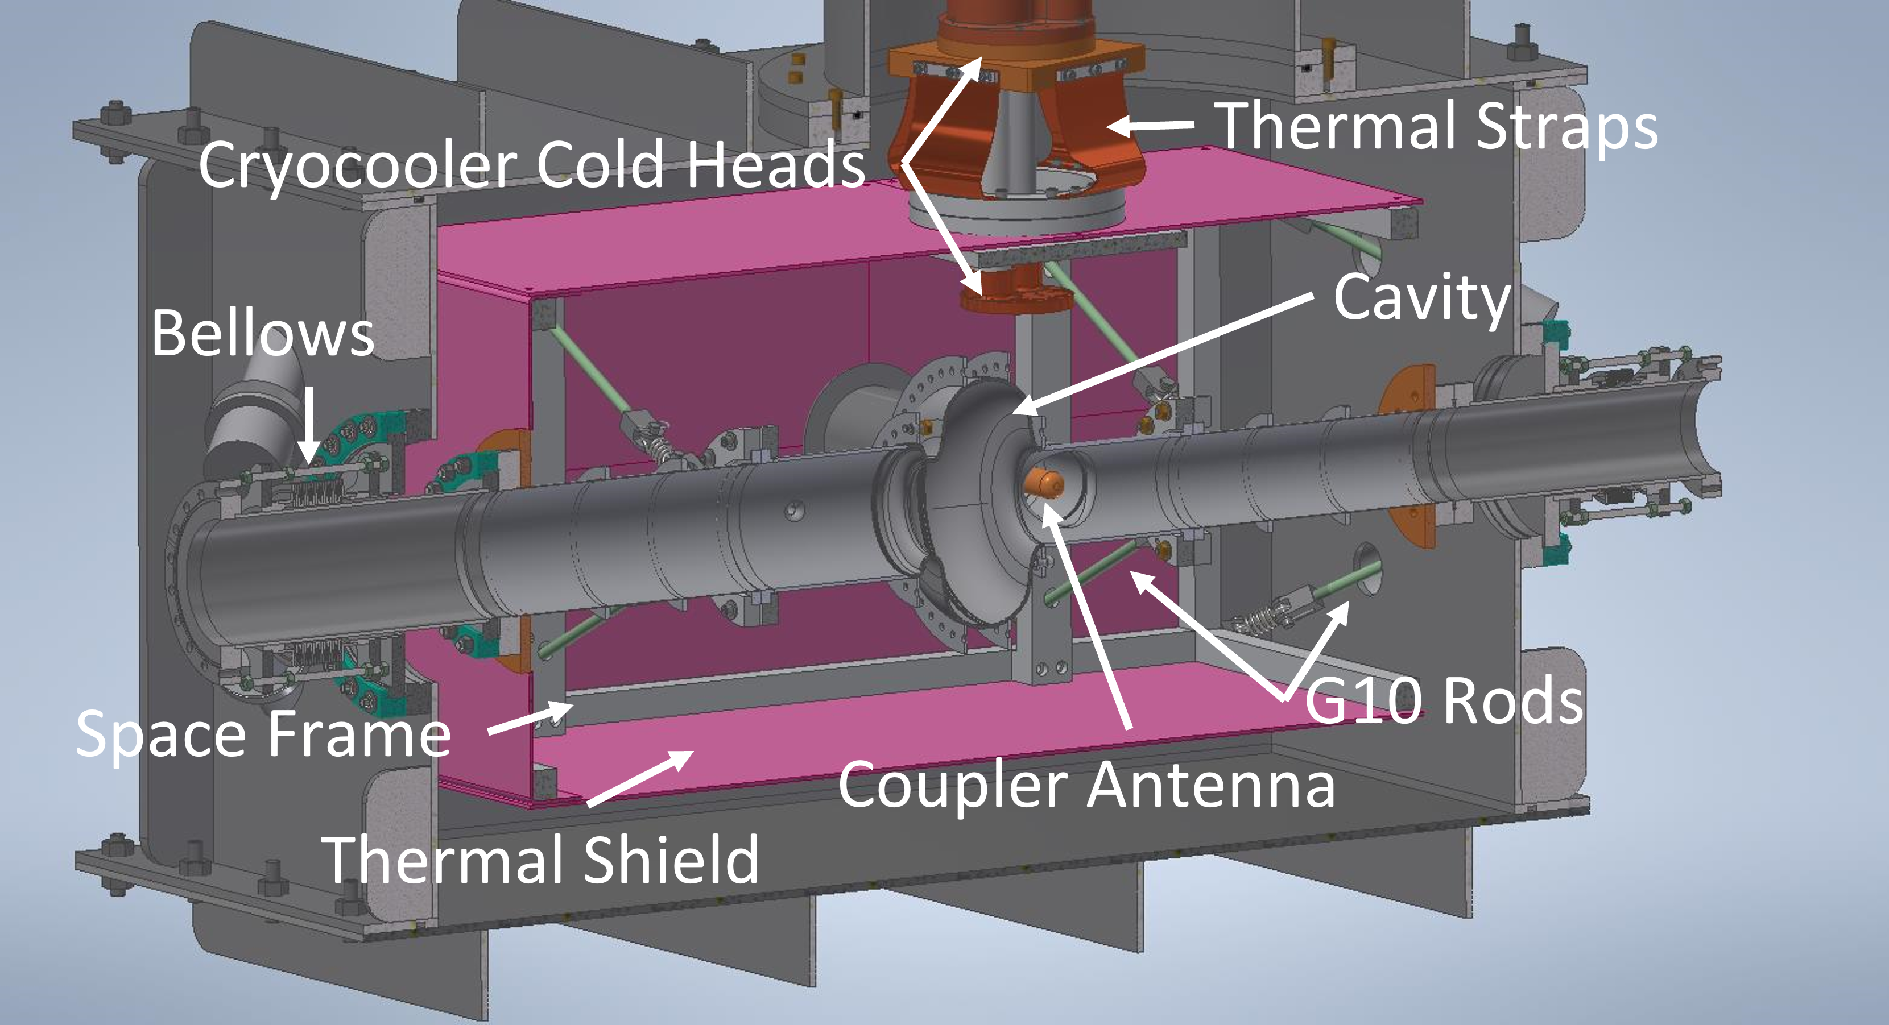


Material science enables applications
Material science studies improved the understanding of Nb₃Sn film growth and their RF properties
Several improvement in deposition process were developed based on the insights from material science
Understanding the composition coupled with improved theoretical understanding will lead to further improvement in material properties

Slide 19
Conclusion
B_{pk} above 100 mT have been achieved
Further understanding via careful designs of experiment and use of analytical tools is the key to realizing Nb₃Sn high field potential
Nb₃Sn cavities at several coating facilities world-wide demonstrate performance suitable for accelerator applications

