Slide 1
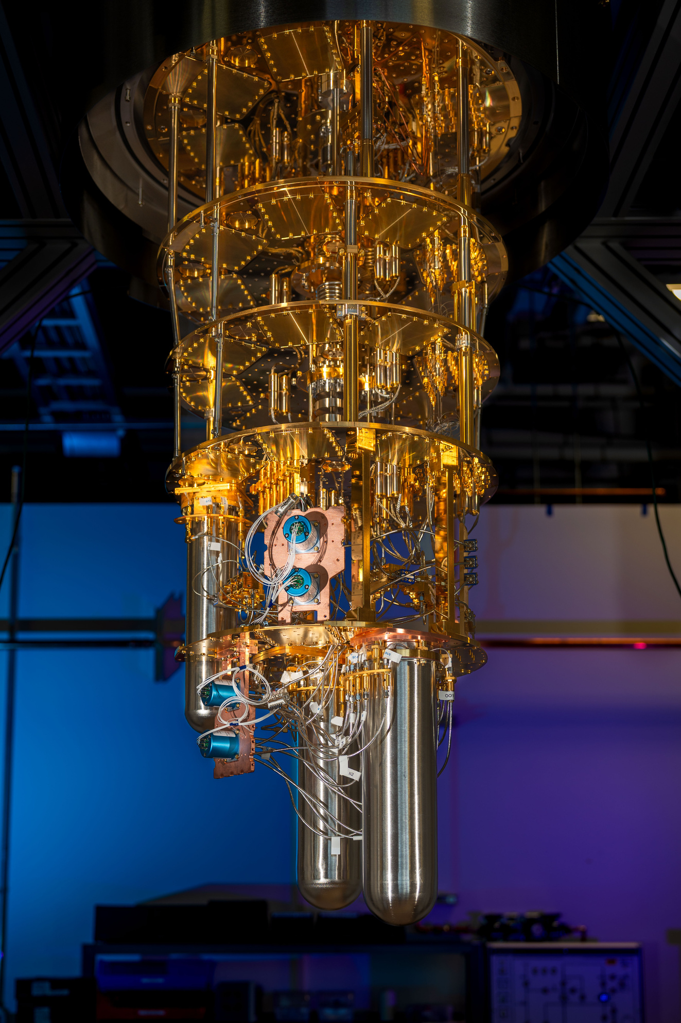




Nb: State of the art performance (both for accelerators and quantum), challenges, and opportunities for material science
Materials for Bright Beams Workshop
July 16, 2025
Daniel Bafia, on behalf of APS-TD and SQMS Directorates
FERMILAB-SLIDES-25-0149-SQMS-TD

Slide 2
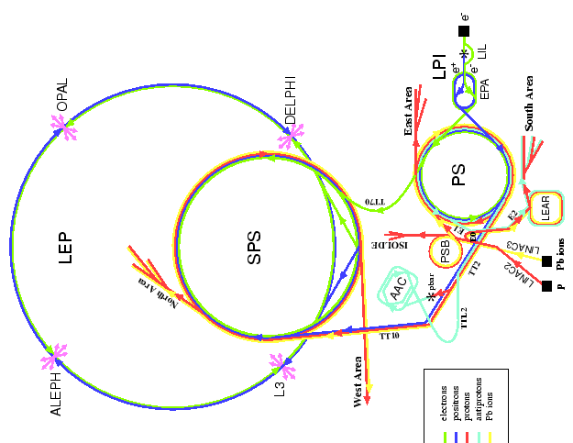
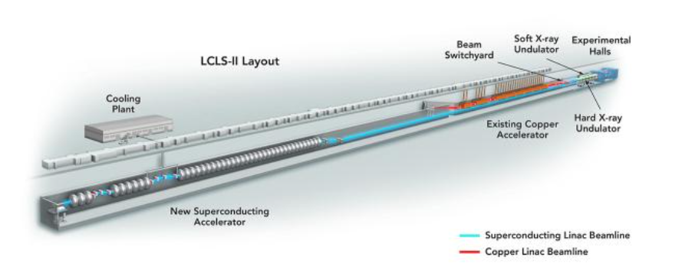
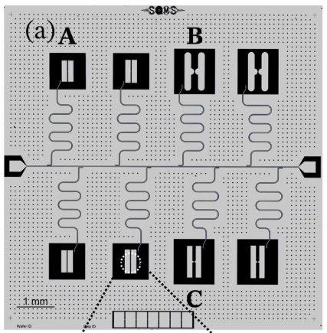
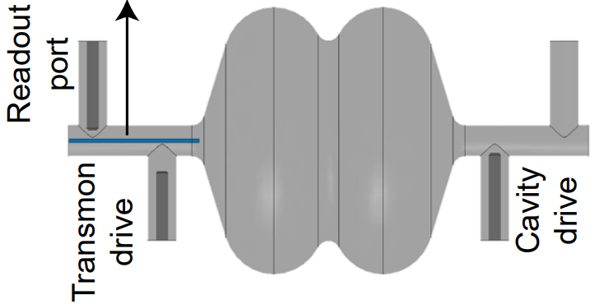
Niobium for Particle Accelerators and Quantum Computers
Accelerators
(SQMS) Quantum Computers
Bulk Nb
Nb film
3-D
2-D
T. Kim et al arXiv:2506.03286
M. Bal et al npj Quant Inf. 10, 43 (2025)
https://lcls.slac.stanford.edu/lcls-ii/ldesign-and-performance
https://www.hep.ucl.ac.uk/~jpc/all/ulthesis/node15.html
Increasing performance → materials issues
Goals of presentation:
Showcase state-of-the-art Nb performance for accelerators and quantum
Highlight key material challenges and targeted research efforts
Explore complementary materials issues relevant for both fields

Slide 3
Outline
Niobium for Accelerators
Current state-of-the-art and challenges for improved performance
Recent R&D to address challenges
Niobium for Quantum Computing
Current state-of-the-art challenges for improved performance
Recent R&D to address challenges
Open Questions and Opportunities for Complementary Materials Studies for Quantum and Accelerators
Conclusion

Slide 4
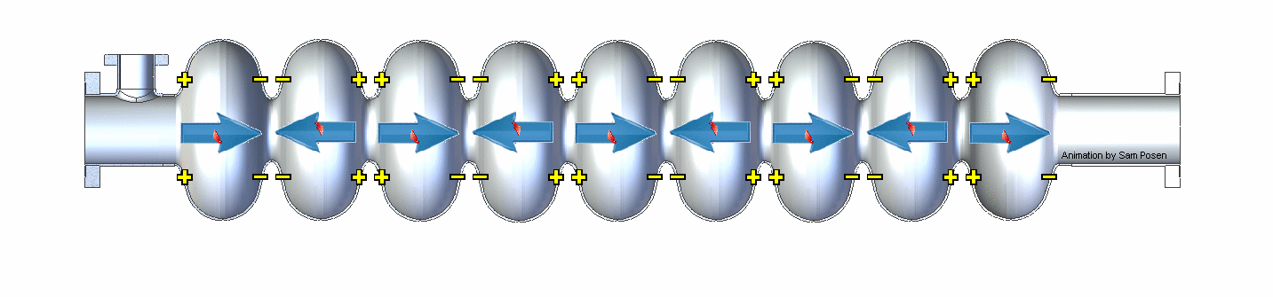
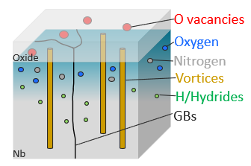
State-of-the-Art Nb SRF Cavity Performance for Accelerators
State-of-the-Art FNAL Cavities Post Various Treatments
Larger Q₀/higher gradient → lower $$
6e10
50 MV/m
RF field

Slide 5
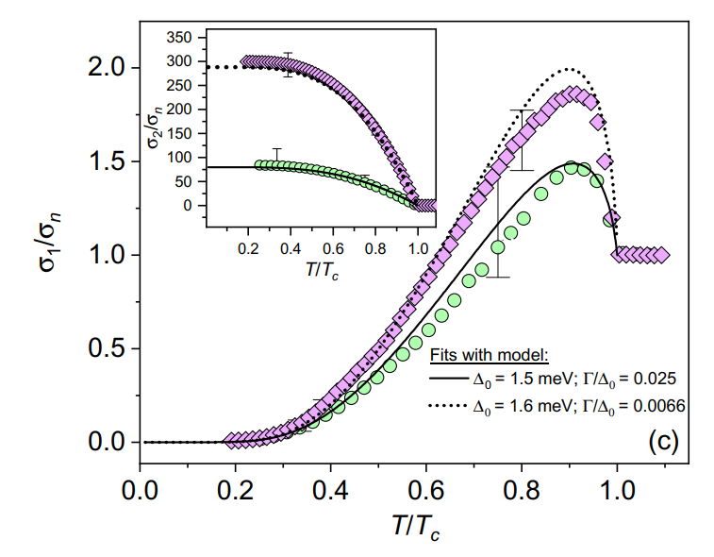
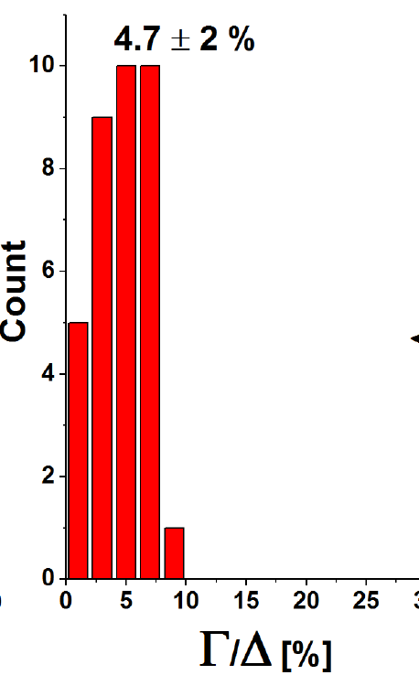
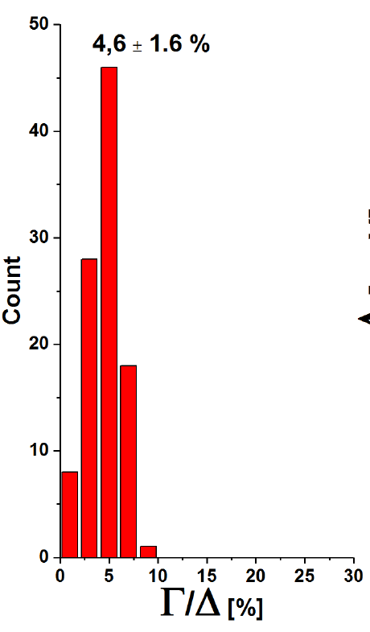
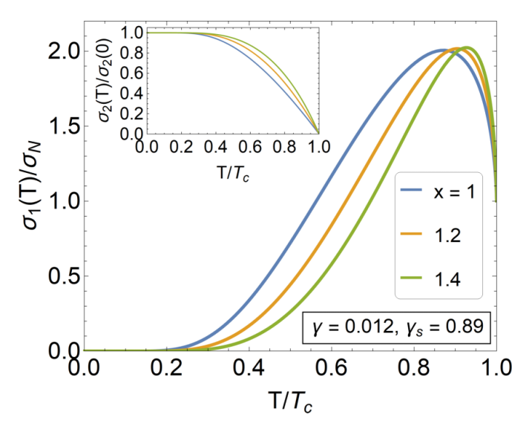
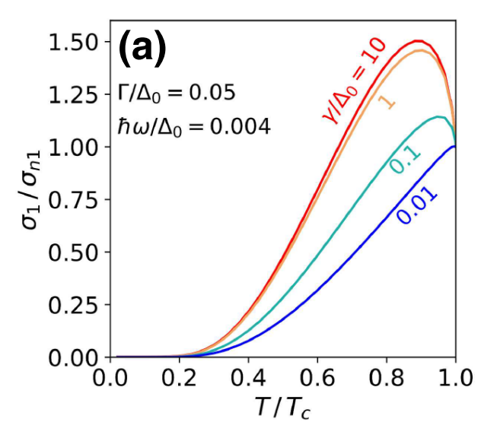
Exploring the Role of Impurities in Nb: Nitrogen
Nb SRF Cavity Conductivity Measurement
SRF Cavity Studies
PCTS Studies on Cutouts
N-Doped
EP
N-Doped
EP
Why does dilute N enhance Q₀?
N. Groll et al. arXiv:1805.06359
D. Bafia et al. PRAppl 23, 054052 (2025)
New Theoretical Models
Studies highlight the importance of N in optimal inelastic scattering
Less NbH? Anti Q-slope?
F. Herman and R. Hlubina PRB 104, 094519 (2021)
T. Kubo PRAppl 17, 014018 (2022)

Slide 6
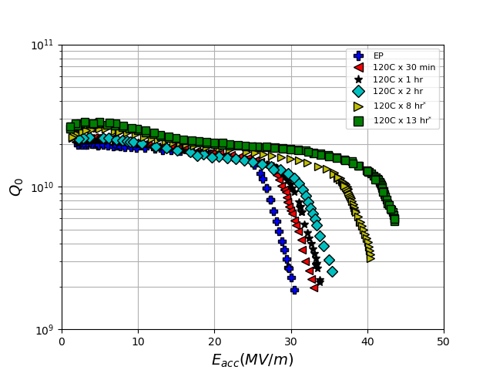
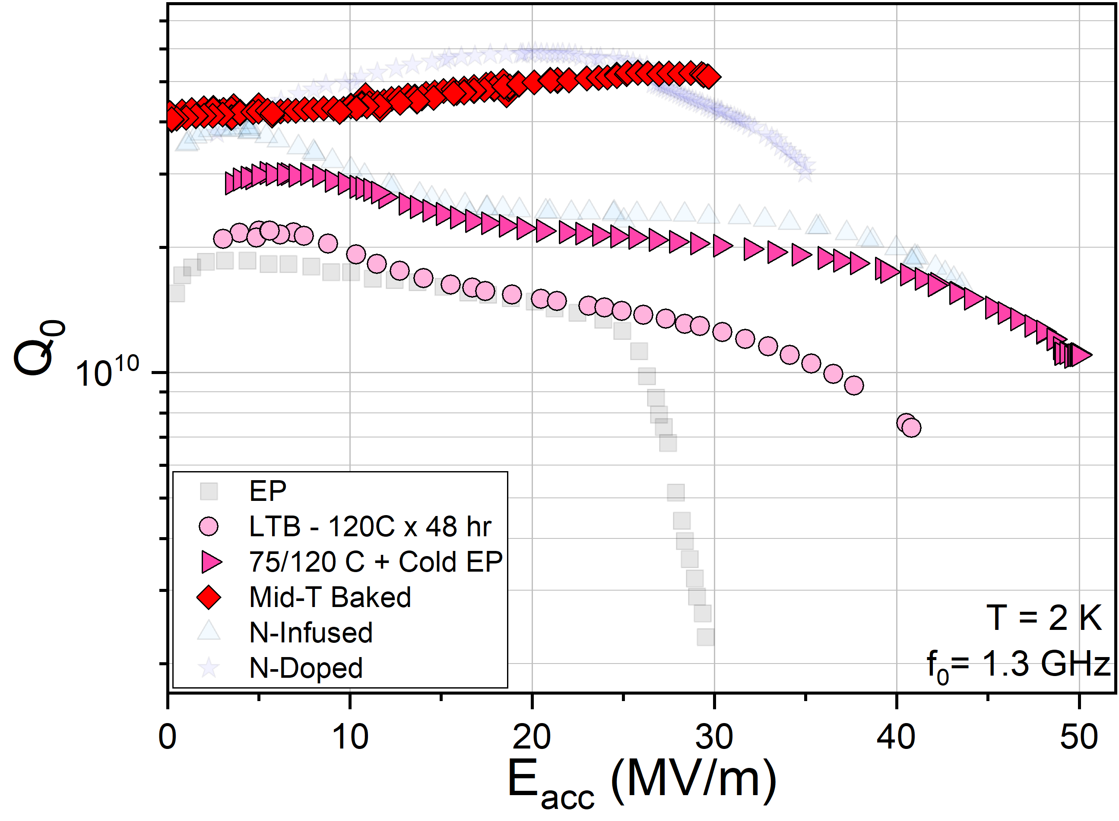
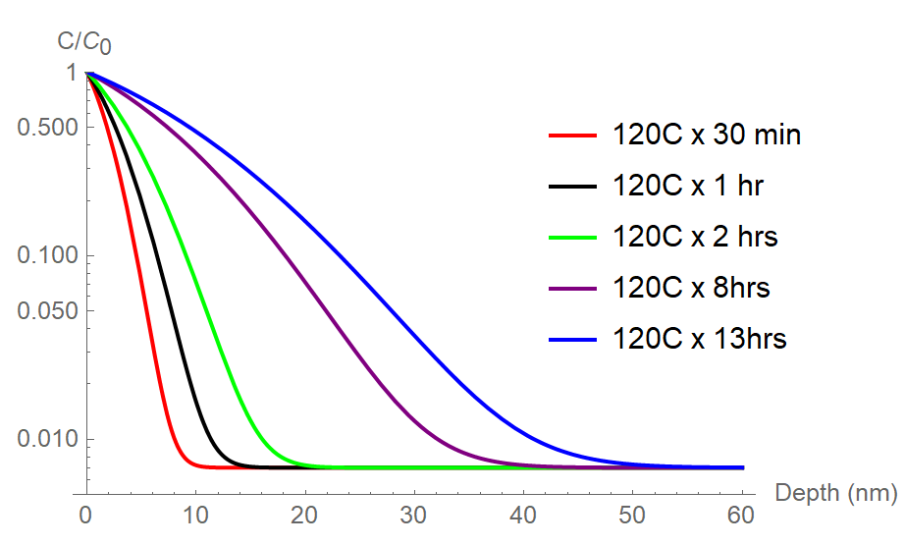
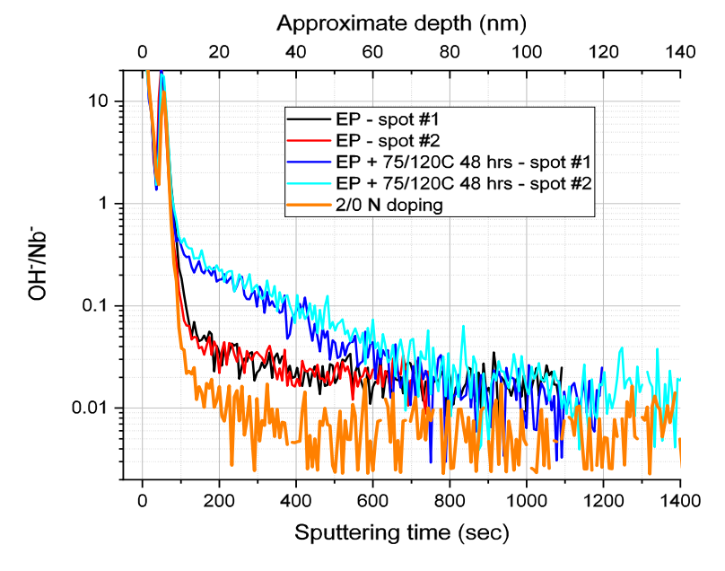
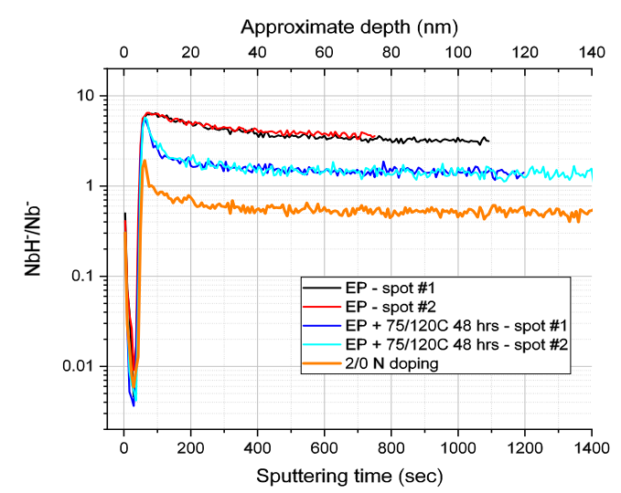
Exploring the Role of Impurities in Nb: Oxygen
Cavity Performance Post Various in situ Baking
Tracking Quench Field of 1.3 GHz Cavities with O Diffusion Depth
TE1RI003 Post Sequential 120C Baking
Mid-T Bake
D. Bafia et al. Proc. of SRF’21
75/120 C
Why does baking enable performance tuning?
120 C
Calculated O Depth Profile
T = 2K
f₀ = 1.3 GHz
D. Bafia et al. Proc. of SRF’21
Diffusion Depth
ToF SIMS Studies on Cutouts
Able to tune performance by diffusing O via baking
Due to reduction of NbH
Do O and N perform the same function in Nb? Which is better?
Baking drives the inward diffusion of O → reduces H!
See H. Hu’s talk Tomorrow at 8 AM
A. Romanenko et al. Proc. of SRF’19

Slide 7
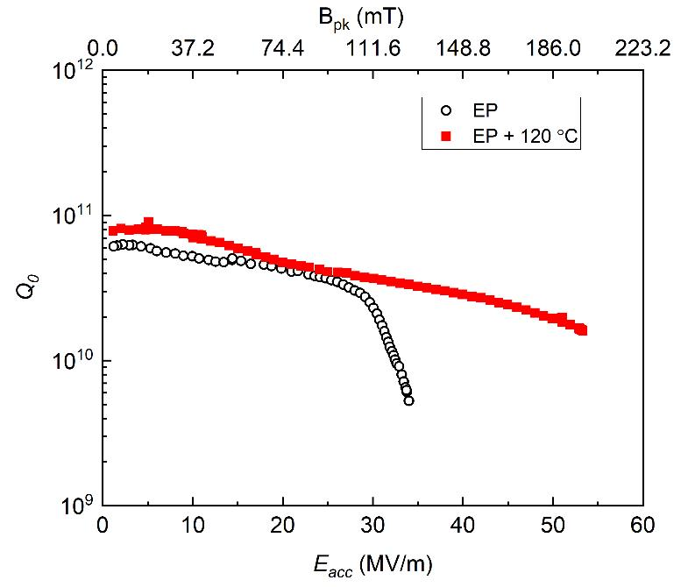
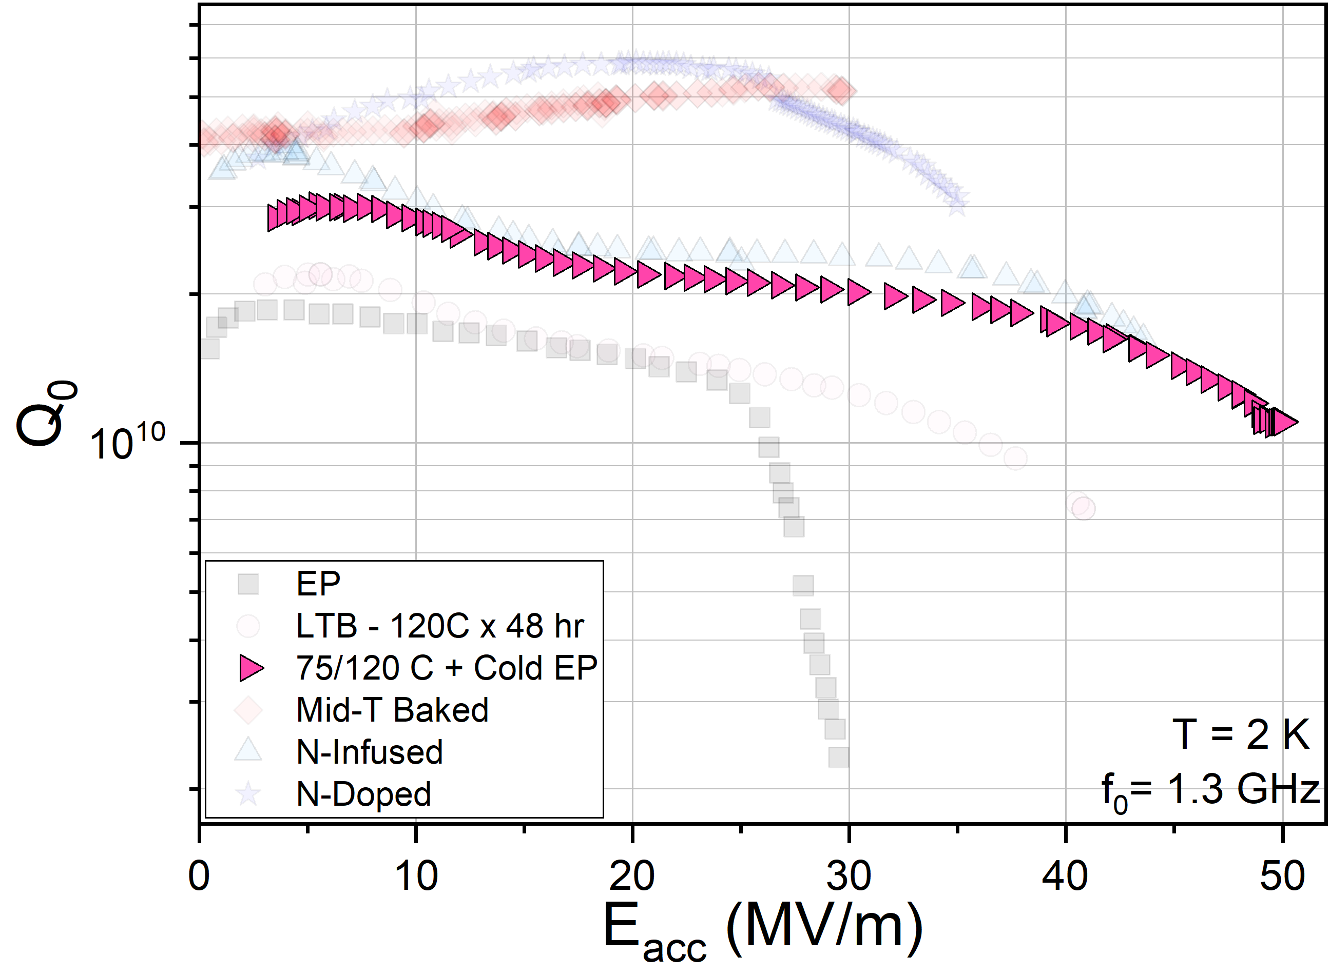
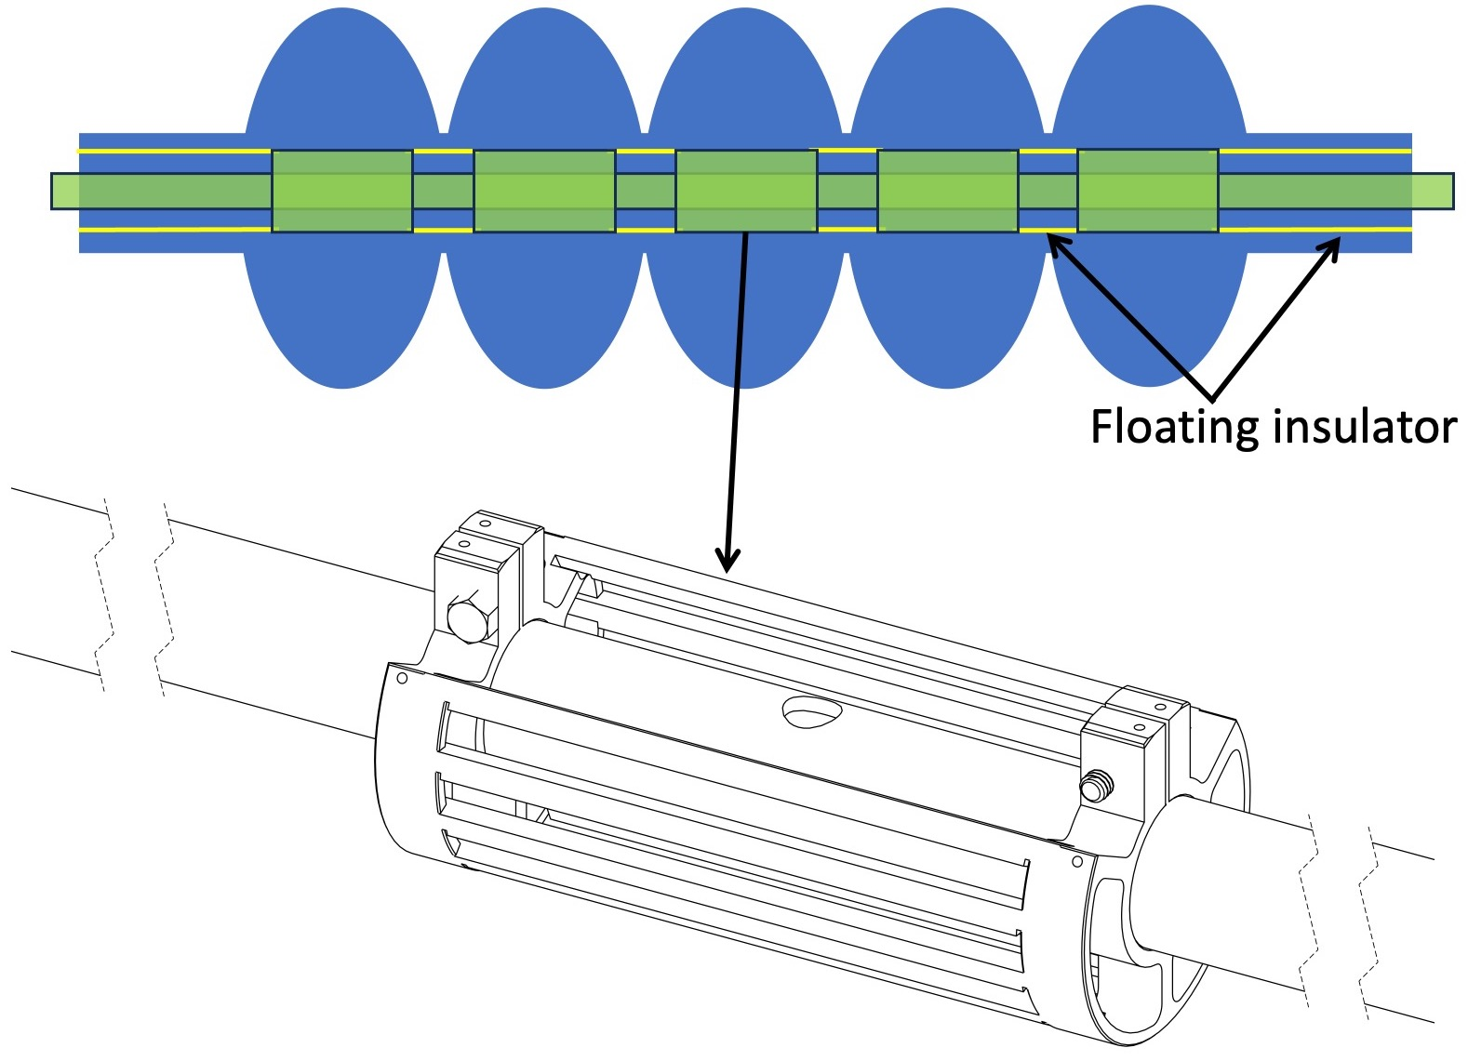
O Impurity Tailoring + Optimized Electropolishing: the Key to Unlocking Record-Breaking Performance
Cold EP + 75/120C Baking on 1.3 GHz Cavity
Optimized EP + 120C baking on HB 650 MHz
V. Chouhan et al., NIMPRA 1051, 168234 (2023)
75/120 C
+50 MV/m!
+50 MV/m!
Cathode-N
Require optimized EP parameters/design to reduce H uptake and surface roughness
Materials problem: Which is more important? What other parameters influence?

Slide 8
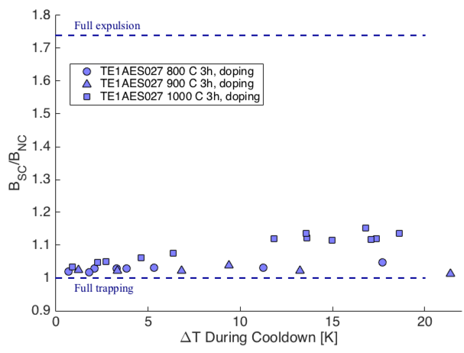
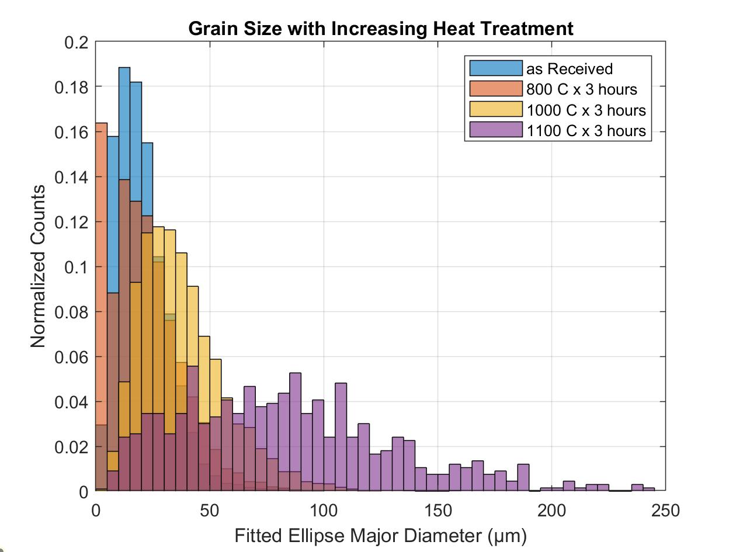
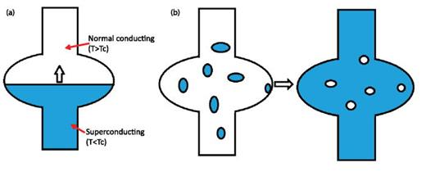
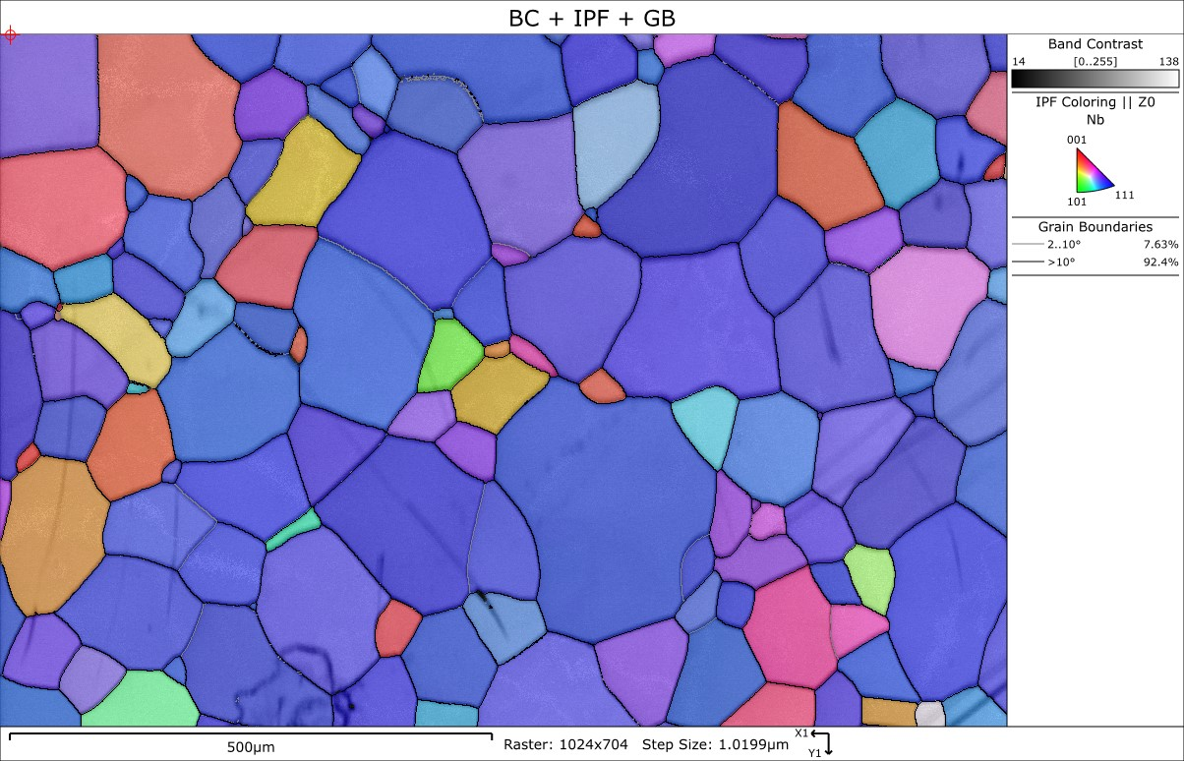
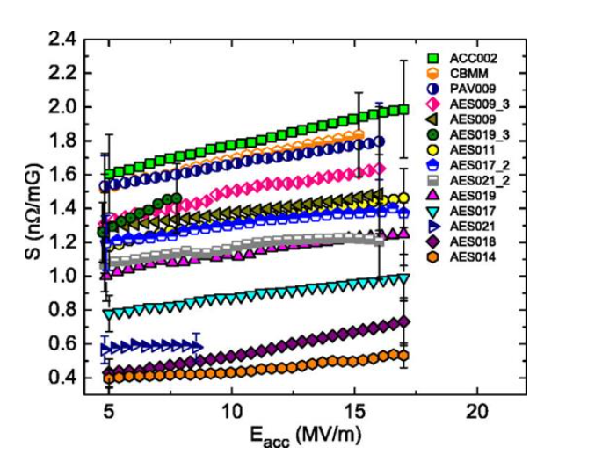
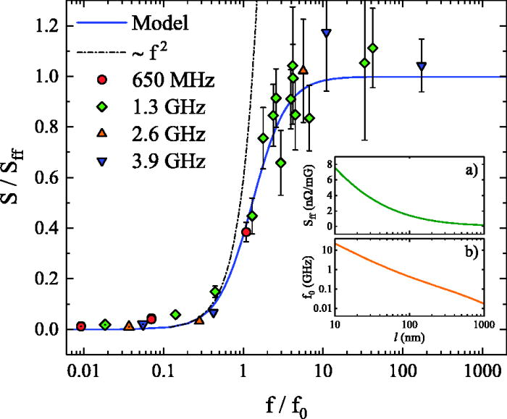
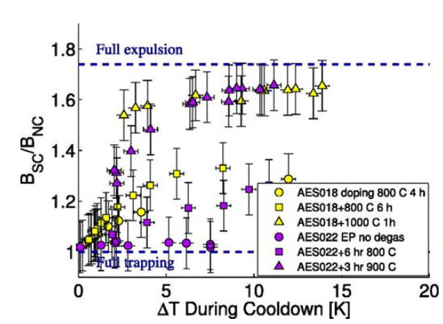
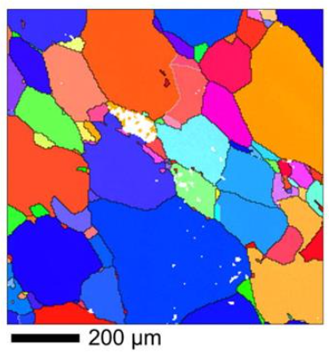
Understanding Flux Pinning and Vortex Driven Dissipation
Flux may be trapped at strong pinning centers
Using poorly expelling low RRR cavities to further study
See K. Howard’s poster Thurs. evening
Courtesy of S. Posen
K. Howard et al. APS GPS 2025
A. Romanenko et al JAP 115, 184903 (2014)
Mat. problem: What are these pinning centers?
Grain boundaries? NbH? Dislocations?
Characterizing vortex dissipation (Sensitivity)
S. Posen et al. JAP 119. 213903 (2016)
M. Martinello et al. 109, 062601 (2016)
M. Checchin et al. APL 112, 072601 (2018)

Slide 9
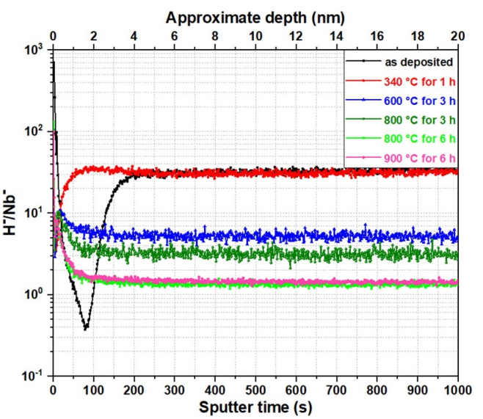
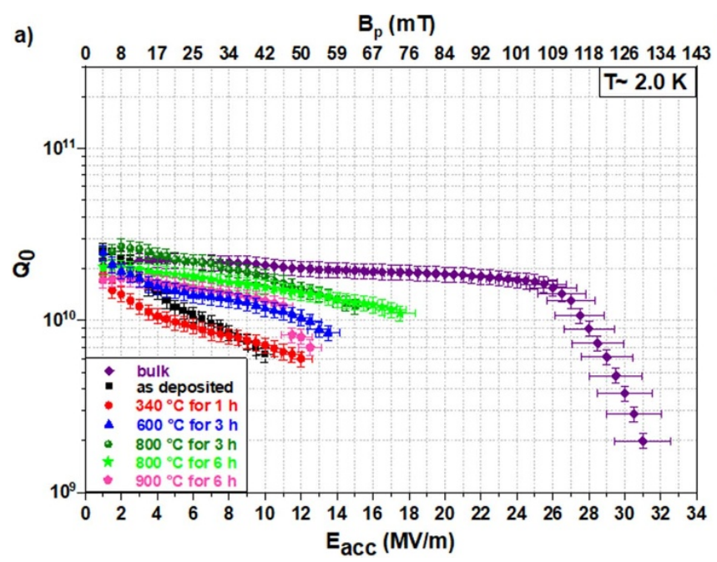
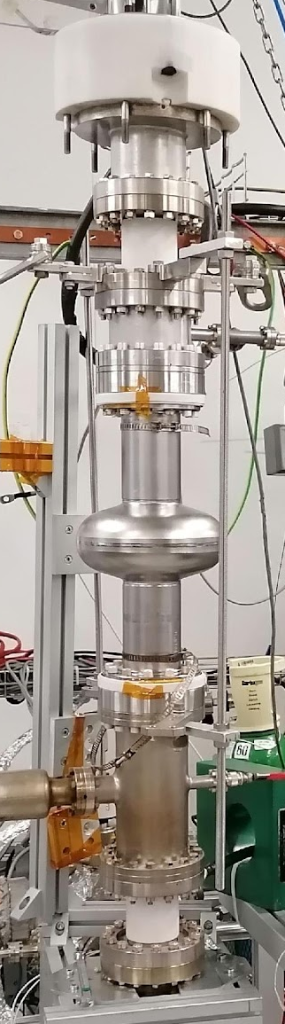
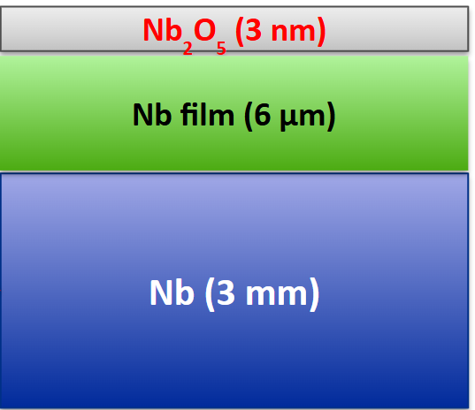
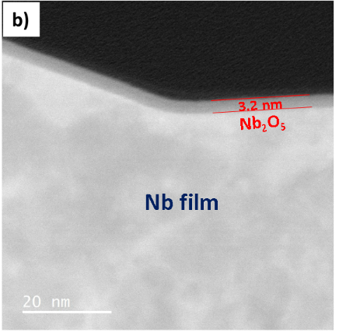
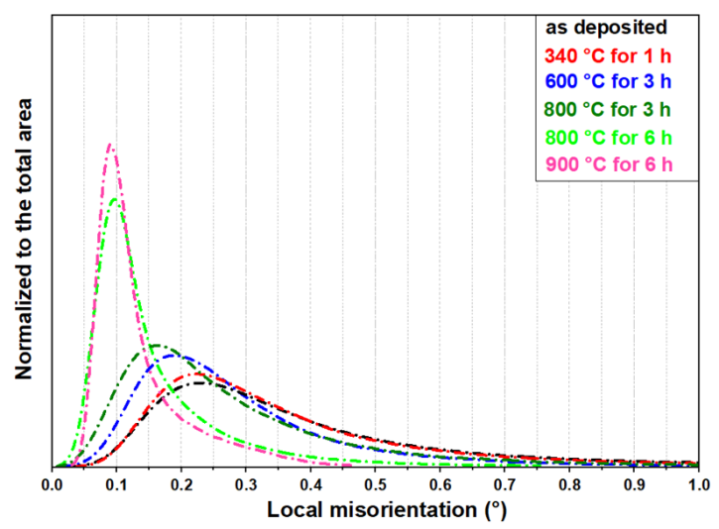
Beyond Bulk Niobium: Improving Nb Film Performance
Nb film on copper cavities exhibit “medium-field Q-slope” → why?
DC HiPIMS Deposition System @ CERN
Materials Studies on Nb Film on Nb Samples Post Baking
Performance of Nb Film on Nb Cavity Post Subsequent Annealing
ToF-SIMS studies reveal reduction in H upon annealing
→ Less NbH
B. Abdisatarov et al SUST 38, 075006 (2025)
EBSD reveals reduction in LMAD upon annealing
→ Heals defects
Subsequent annealing reduces MFQS!

Slide 10
Outline
Niobium for Accelerators
Current state-of-the-art and challenges for improved performance
Recent R&D to address challenges
Niobium for Quantum Computing
Current state-of-the-art challenges for improved performance
Recent R&D to address challenges
Open Questions and Opportunities for Complementary Materials Studies for Quantum and Accelerators
Conclusion

Slide 11
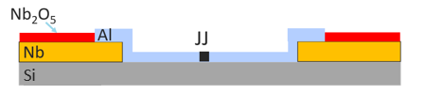
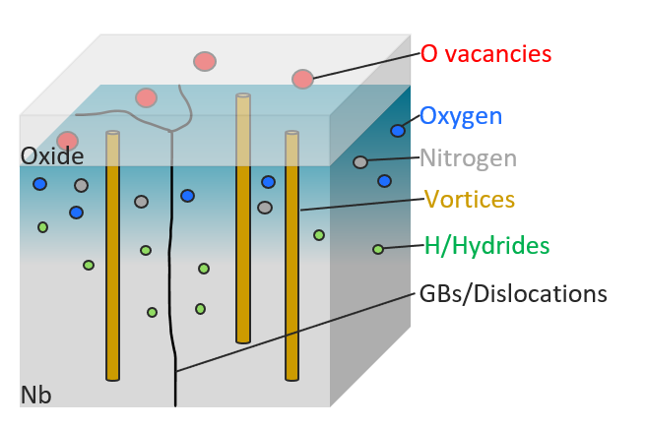
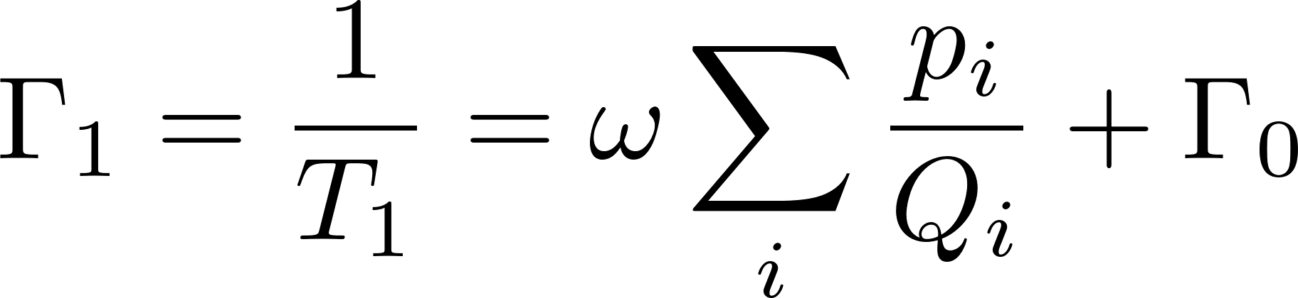
Superconducting Quantum Technology and the Necessity for Materials Science
SQMS Quantum Architectures
2-D
3-D
M. Bal et al npj Quantum Information 10, 43 (2024)
T. Kim et al arXiv:2506.03286
Longer T₁ → better quantum computer

Slide 12
State-of-the-Art T₁ for Superconducting Quantum Architectures
Question: What T₁ do we need to make a quantum computer?
Answer: TBD, but T₁ >> 1 ms
T₁ Performance Benchmarks by Architecture
Architecture | “OK” T₁ [ms] | "Good” T₁ [ms] | State-of-the-Art T₁ [ms]
2-D | > 0.05 | 0.1 – 0.3 | 1.68¹
3-D | > 0.05 | 0.3 - 1 | 1 mode² 25.6 | 2 modes³ 20.6,15.6
[1] M. Bland et al. arXiv:2503.14798, [2] O. Milul et al. PRX Quantum 4, 030336 (2023), [3] T. Kim et al arXiv:2506.03286
How can we push these values further?

Slide 13
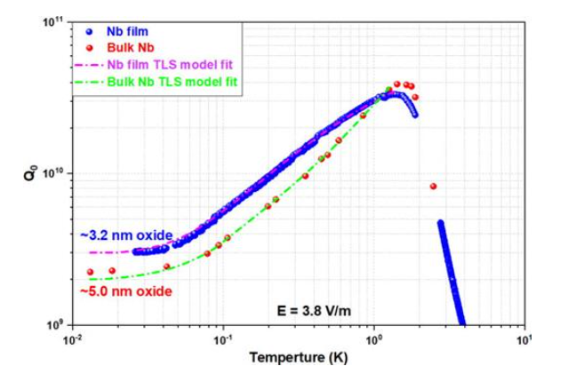
Exploring the Role of Defects in Niobium Films
Do defects in Nb (impurities, grains boundaries, etc.) presently limit our T₁?
No
DC HiPIMS Deposition System @ CERN
Comparing Material Properties of Nb Film Cavity vs Bulk Nb Cavity
Comparing RF Performance of Nb Film Cavity vs Bulk Nb at mK
Parameter | Nb Film | Bulk Nb
RRR | 20 | 300
Grain Size [μm] | ~0.5 | 50
Impurity conc. | high | Moderately high
Oxide Thickness [nm] | 3.2 | 5.0
B. Abdisatarov et al. APL 125, 124002 (2024)
Different Nb material yields nearly identical performance!

Slide 14
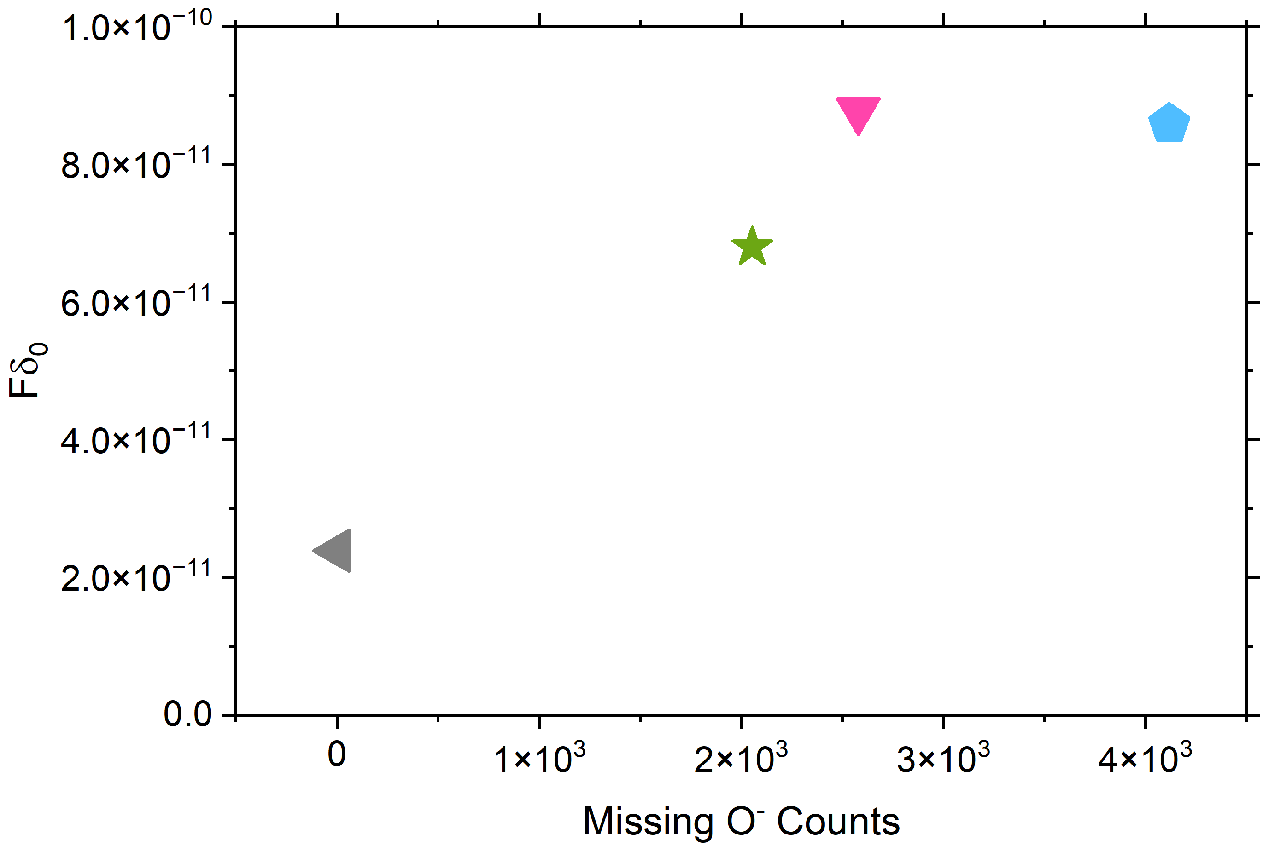
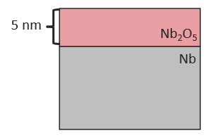
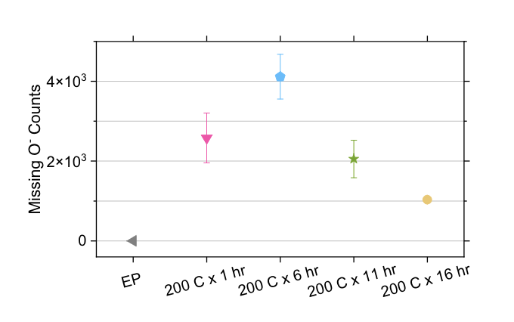
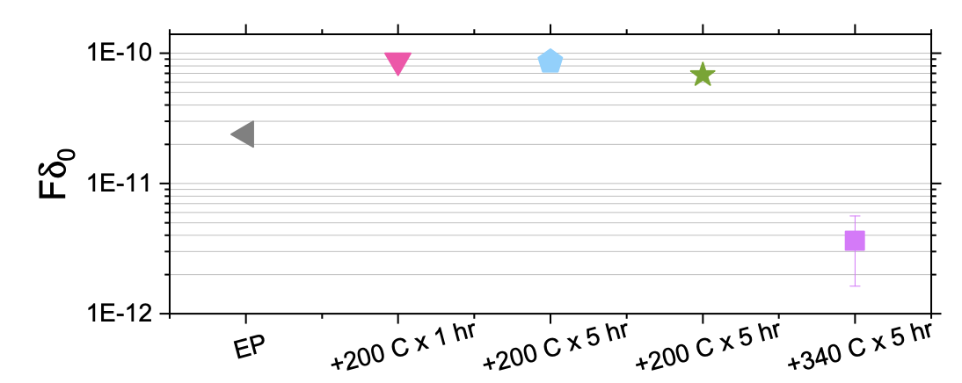
Identifying O-Vacancies in Nb₂O₅ as a Major Source of TLS
in situ 200℃/1h
Correlating TLS Loss and Missing O⁻ Counts
in situ 200℃/5h
in situ 200℃/5h
in situ 340℃/5h
O vacancies in Nb₂O₅ drive TLS
TLS-Driven RF Loss of Nb Cavity Post Baking
Missing O⁻ Counts in Nb₂O₅ Post Baking in ToF-SIMS
How to minimize O vac in Nb₂O₅?
More crystalline oxides?
Encapsulation
Y. Kalboussi et al. PRApplied 23, 044023 (2025)
D. Bafia et al. PRApplied 22, 024035 (2024)
M. Bal et al npj Quantum Information 10, 43 (2024)

Slide 15
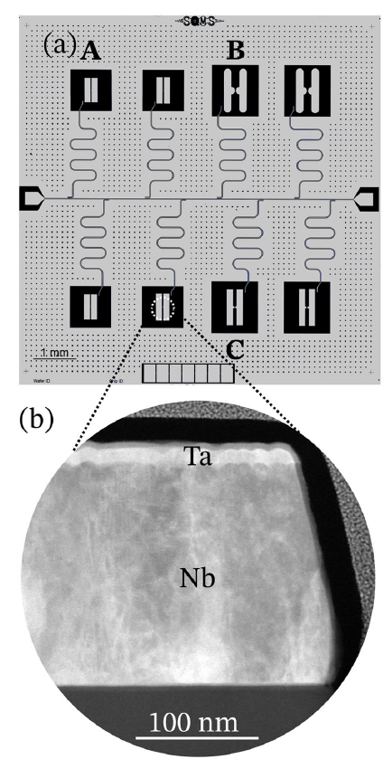
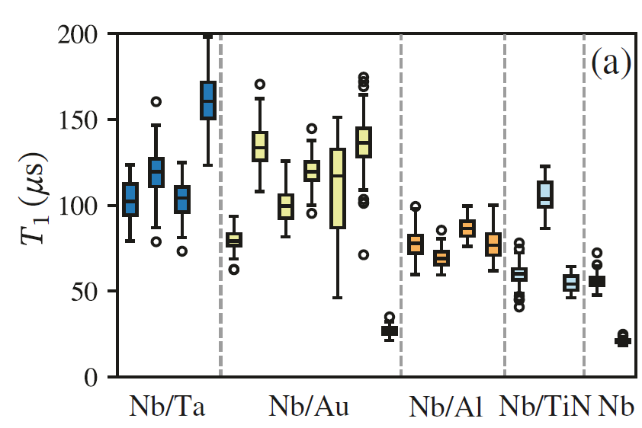
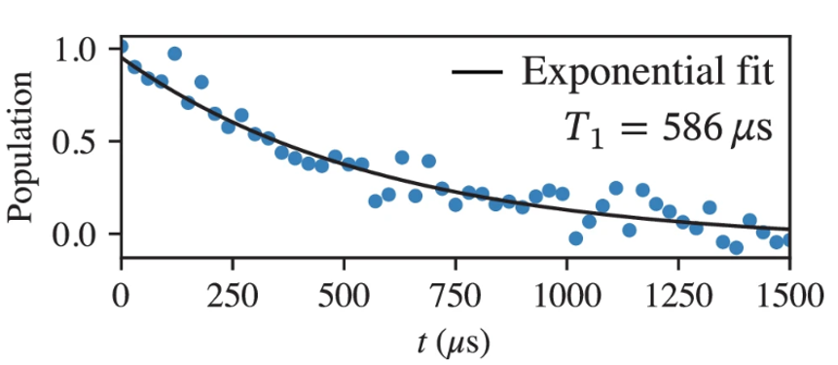
Using Findings to Enhance T₁: Encapsulation
M. Bal et al npj Quantum Information 10, 43 (2024)
T₁ of 2-D Transmon Qubits with Various Encapsulation Schemes
Capped Nb qubits with various materials to prevent Nb₂O₅ formation
Resulted in dramatic improvement in T₁
25 μs → 600 μs
Outstanding ?’s
Optimal capping?
Minimization of other losses?
Demonstration of Very Long T₁

Slide 16
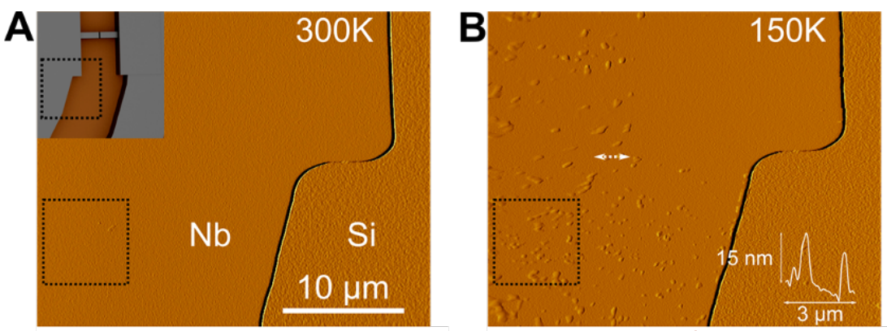
Other Potentially Limiting Mechanisms: Niobium Hydrides
J. Lee et al. arXiv:2108.10385
NbH found on niobium thin films in qubits
Some studies show that increased H content increases RF loss
Outstanding ?’s: How lossy are NbH? How do we reduce NbH?
May explain “aging” in qubits?
C. G. Torres-Castanedo et al Adv. Funct. Mater 34, 2401365 (2024)

Slide 17
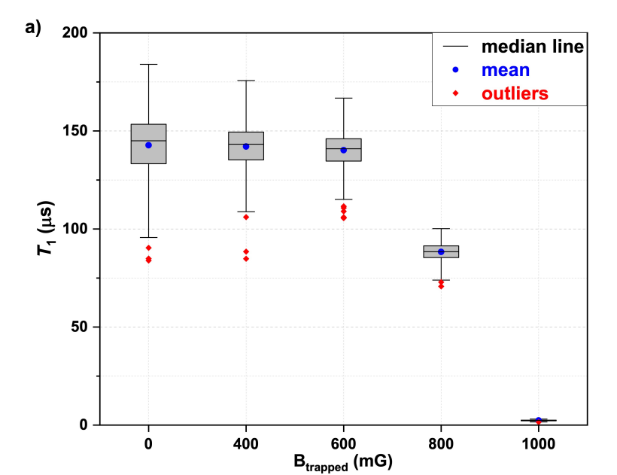
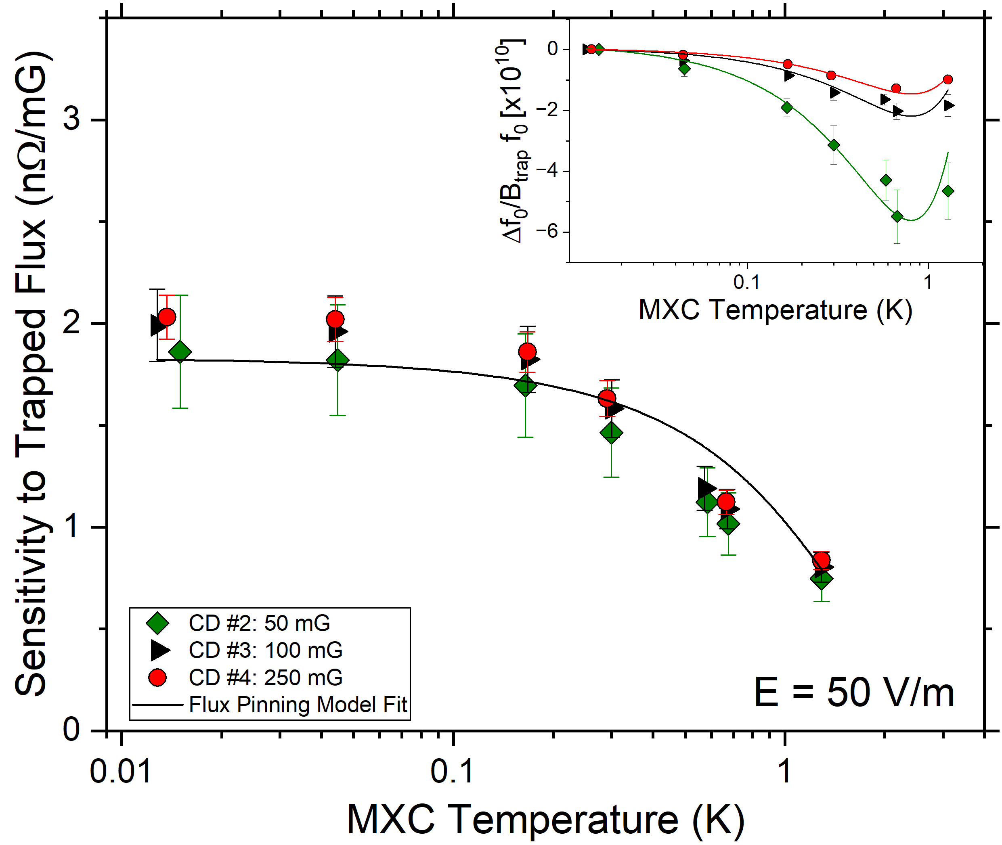
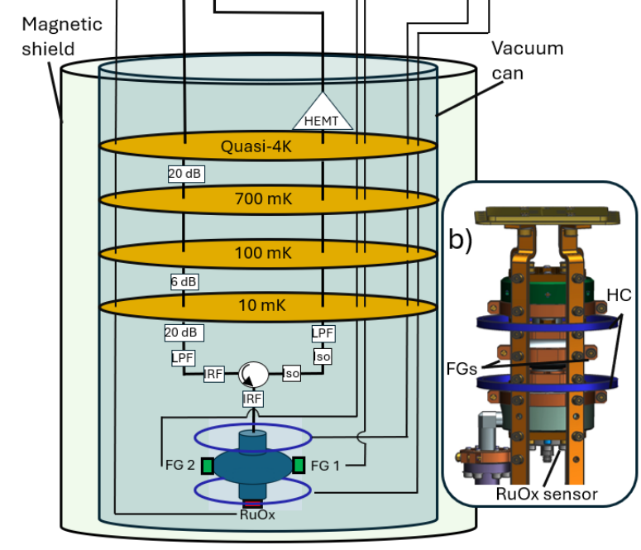
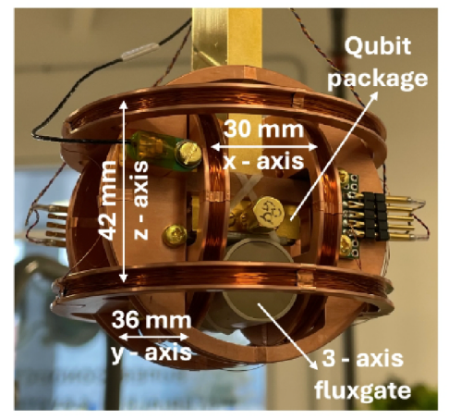
Quantifying the Role of Magnetic Field in Quantum Devices
Does trapped flux significantly impact T₁?
Depends
3-D Cavities
2-D Qubits
Sensitivity vs Temperature
T₁ Post Cooling in Various B_{trap}
D. Bafia et al. arXiv:2503.14616, under review at APL
B. Abdisatarov et al. arXiv:2506.02187
S = 2 nΩ/mG @ 10 mK, decreases with temperature → Well modeled by theory
T₁ significantly impacted post trapping large B_{trap}; also decreases stdev
Outstanding ?’s: how/where are vortices trapped in qubits? What about other materials like aluminum?

Slide 18
Outline
Niobium for Accelerators
Current state-of-the-art and challenges for improved performance
Recent R&D to address challenges
Niobium for Quantum Computing
Current state-of-the-art challenges for improved performance
Recent R&D to address challenges
Open Questions and Opportunities for Complementary Materials Studies for Quantum and Accelerators
Conclusion

Slide 19
Comparing Loss Mechanisms for Accelerators and Quantum
Accelerators
Loss Mechanism | Nb for Accelerators | Nb for Quantum Computing
Trapped Magnetic Flux | ✓✓ | ✓
Vortex Dissipation | ✓✓ | ✓
Surface Oxide (Nb₂O₅) TLS | ✓✓ | ✓✓
Hydrogen Contamination | ✓ | ✓
Dislocations / Cold Work | ✓ | ✓
Grain Boundaries | ✓ | ✓
Non-uniform Impurity Doping | ✓✓ | ?
Dielectric Loss (substrate) | N/A | ✓✓✓
Two-Level Systems (TLS) | ✓ | ✓✓
Chemical Etching | ✓ | ✓
Quantum Architectures
2-D
3-D
M. Bal et al npj Quantum Information 10, 43 (2025)
T. Kim et al arXiv:2506.03286
Complementary Materials Problems

Slide 20
Research Needs to Address Complementary Materials Issues and Talks @ This Workshop Which Might Help With These Issues
New growth techniques
Electro-deposition, zone refining, additive manufacturing—any potential for better control over impurities?
Characterization needs
Nanoscale mapping of oxides, dislocation networks, impurity segregation.
Vivek Anil (ARPES and low energy photoemission), Matthew Gordon: (photocathodes for Quantum Micro), Eric Lechner (Correlation between surface defects and RF performance using STM)
Cross-section TEM, atom probe tomography, synchrotron techniques.
Zhaslan Baraissov (Surface characterization of SRF surfaces)
Studying Vortices in Nb films and bulk
Steven Anlage (Investigation of local microwaves properties and pinned vortex response in SRF materials), Aiden Harbick (Impact of surface structure and vortex entry on RF dissipation)
Interface engineering
Passivation strategies to reduce TLS (e.g., ALD, HF dip + vacuum venting)
Impurity management
Controlled interstitial doping (e.g., N, O, C) to tailor mean free path.
Hannah Hu (Nb Treatments)
Theory
Cristobal Mendez (How can DFT guide SRF materials development), Alexander Gurevich gap in understanding of RF dissipation

Slide 21
Conclusion:
State-of-the-art performance achieved in both SRF accelerators and quantum devices using Nb
Key limitations remain: hydrogen, oxide defects, vortices, dielectrics losses, grain boundaries, etc
Materials-driven strategies (optimized EP, impurity tailoring, encapsulation) have realized performance gains
Unifying theme: Progress hinges on atomic-scale control and advanced characterization techniques
Rich opportunities for opportunities for complementarity and synergistic collaborations between accelerator and quantum communities

Slide 22

THANK YOU
This work was produced by FermiForward Discovery Group, LLC under Contract No. 89243024CSC000002 with the U.S. Department of Energy, Office of Science, Office of High Energy Physics.This material is based upon work supported by the U.S. Department of Energy, Office of Science, National Quantum Information Science Research Centers, Superconducting Quantum Materials and Systems Center (SQMS) under contract number DE-AC02-07CH11359.

