Slide 1
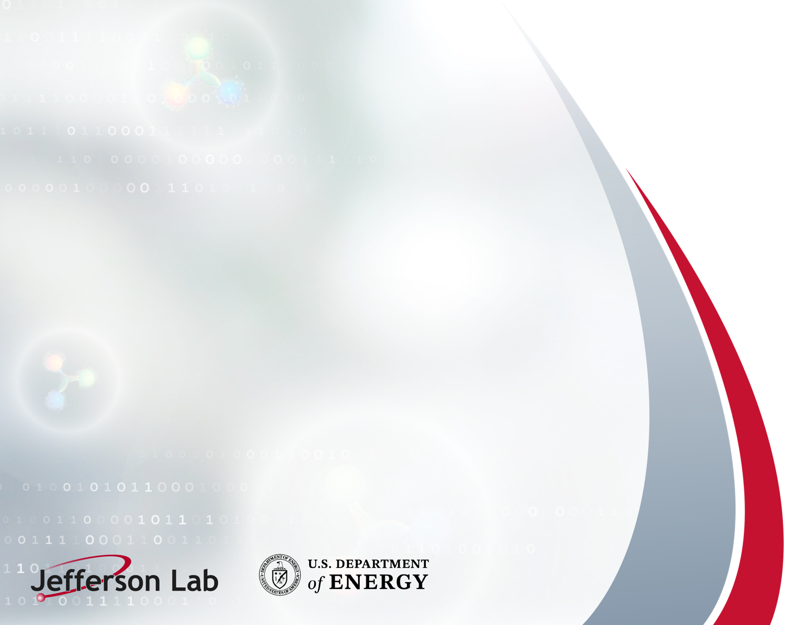
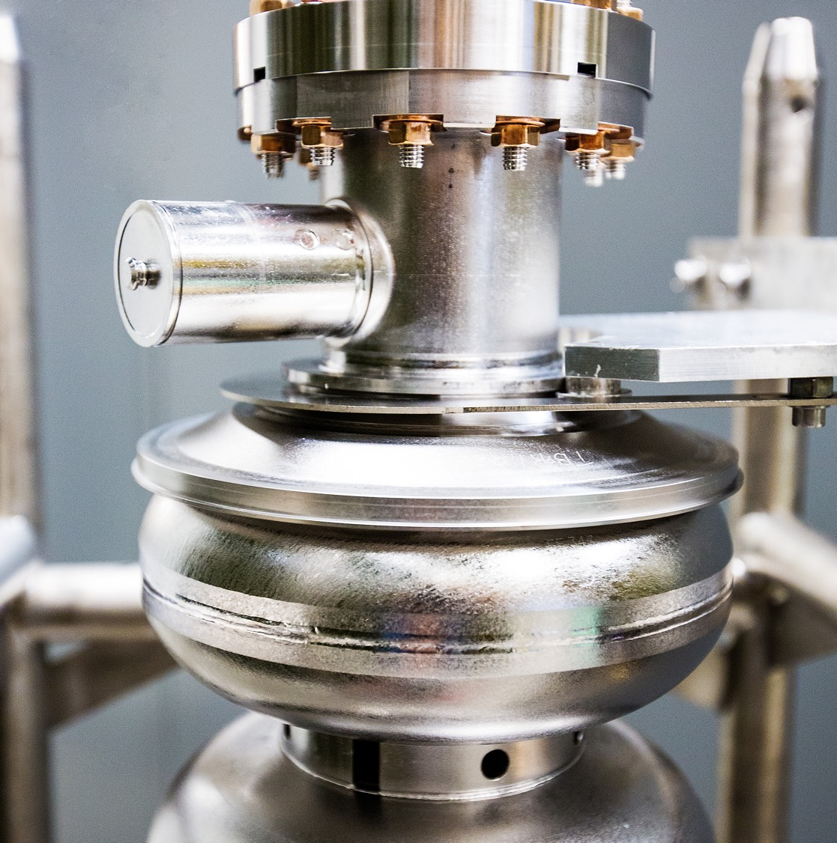
SRF for future accelerators: What performance do we need?
Materials for Bright Beams Workshop
July 16, 2025
Gianluigi Ciovati

Slide 2
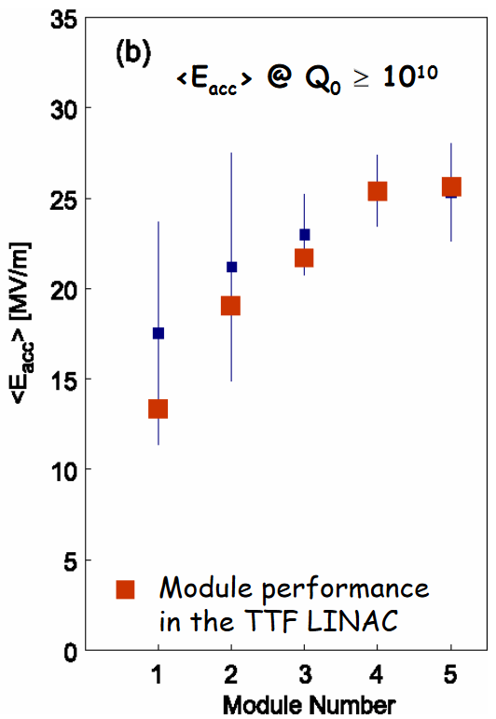
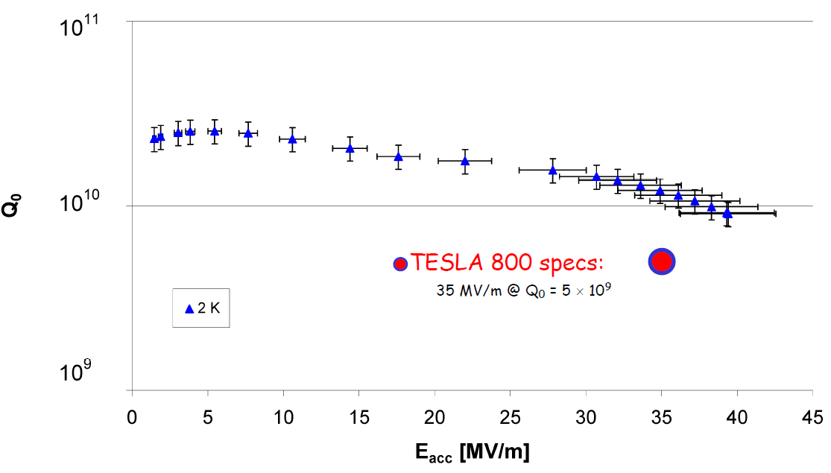
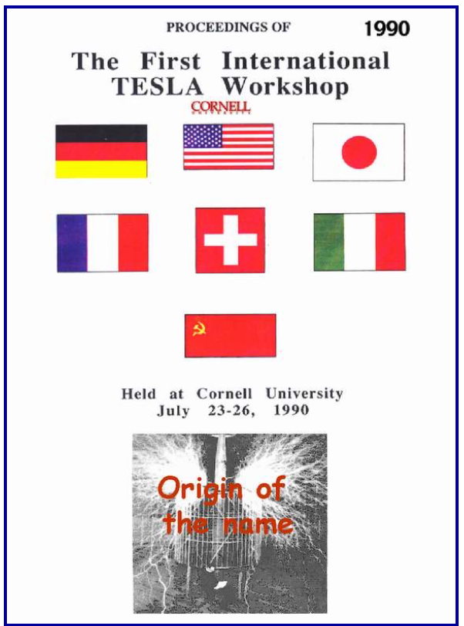
DO PROJECTS DRIVE R&D ON SRF PERFORMANCE?
The TESLA Technology Collaboration (1992): Develop SRF for the future TeV Linear Collider
Increase the accelerating gradient by a factor of 5
Reduce cost per MV by a factor 20
Make possible pulsed operation
C. Pagani, “European Overview of TESLA Technology Related Activities”, TESLA TTC Meeting, DESY, 30 March - 1 April 2004
Notes:
From 5 to 25 MV/m
New cryomodule concept and Industrialization
3 cavity productions from 4 European industries: Accel, Cerca, Dornier, Zanon
The 800 GeV upgrade (from 500 GeV) requires an accelerating field gradient of 35 MV/m

Slide 3
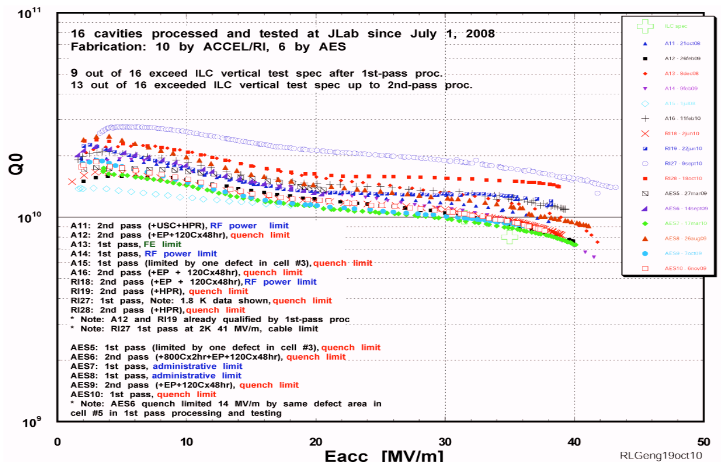
ILC: HIGH-GRADIENT R&D
2011: 16 cavities meeting the ILC specification of E_{acc} = 35 MV/m with Q₀>8×10⁹ at 2 K with 90% yield in a vertical test setup
2013: The ILC Technical Design Report is released. Cavities operating in a cryomodule at E_{acc} = 31.5 MV/m with Q₀>1×10¹⁰ at 2 K
2018: ILC-type CM achieves <E_{acc}> = 32.2 MV/m with <Q₀>9×10⁹ at 2 K
R. Geng et al., “Progress of ILC high gradient SRF cavity R&D at Jefferson Lab”, Proc. IPAC2011, San Sebastian, Spain, p. 334.
D Broemmelsiek et al., “Record high-gradient SRF beam acceleration at Fermilab”, New J. Phys. 20, 113018 (2018).
Notes:
500 GeV CM
Cavities built by AES and RI
Global effort DESY, JLab, FNAL, KEK and Cornell

Slide 4
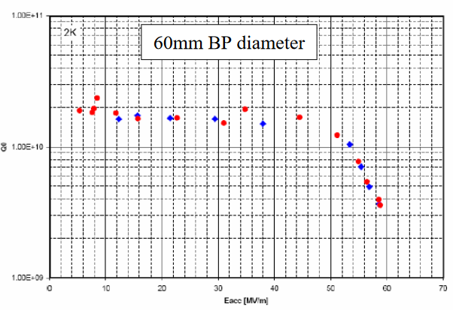
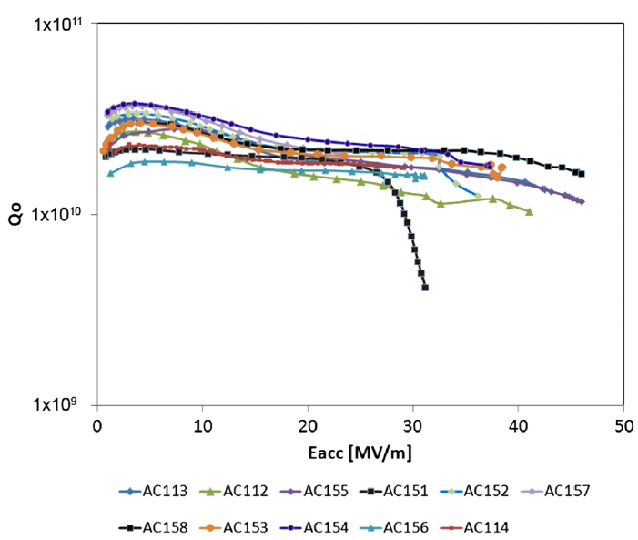
HIGH-GRADIENT: STATE OF THE ART
Single-cell: 59 MV/m (223 mT) at 2 K
9-cell: 45.5 MV/m (194 mT) at 2 K
Reentrant shape
Large-grain Nb
K. Saito, “Gradient Yield Improvement Efforts for Single and Multi-Cells and Progress for Very High Gradient Cavities”, Proc. SRF2007, Beijing, China, p. 82.
W. Singer et al., “Development of large grain cavities”, Phys. Rev. ST Accel. Beams 16, 012003 (2013).
Notes:
2007. Collab. Between KEK/Cornell. Not reproduced
2013. Large-grain Q0 close to 2e10

Slide 5
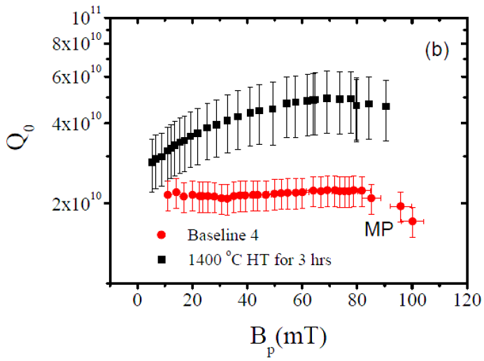
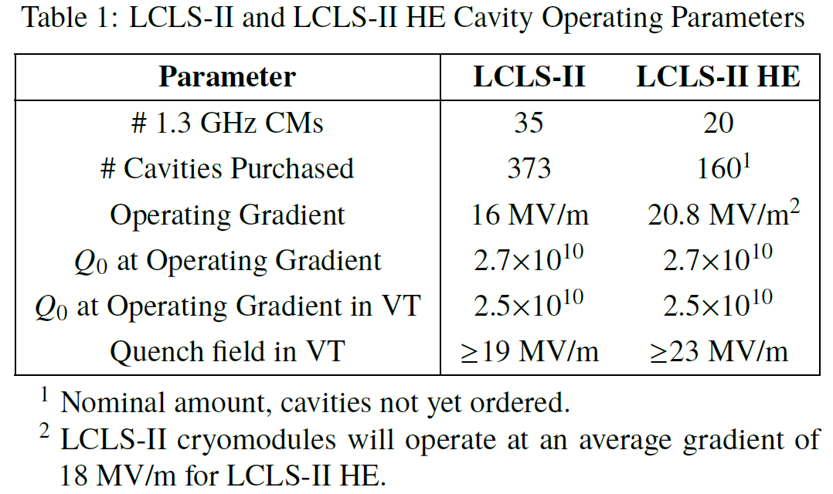
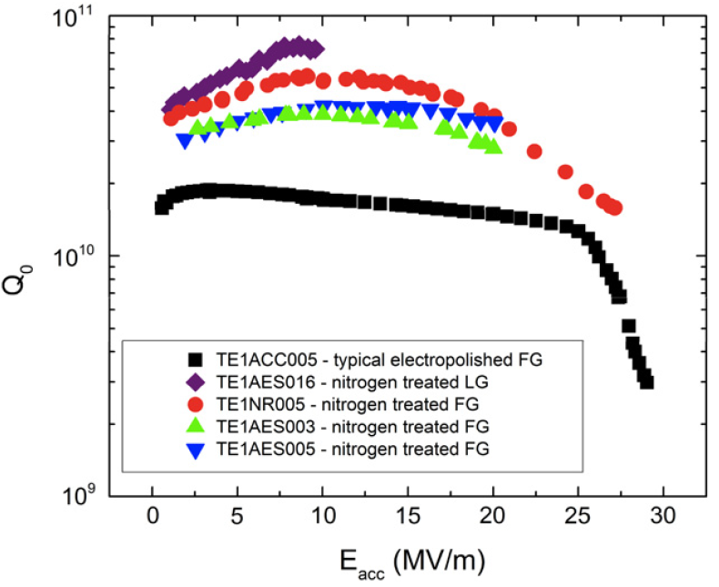
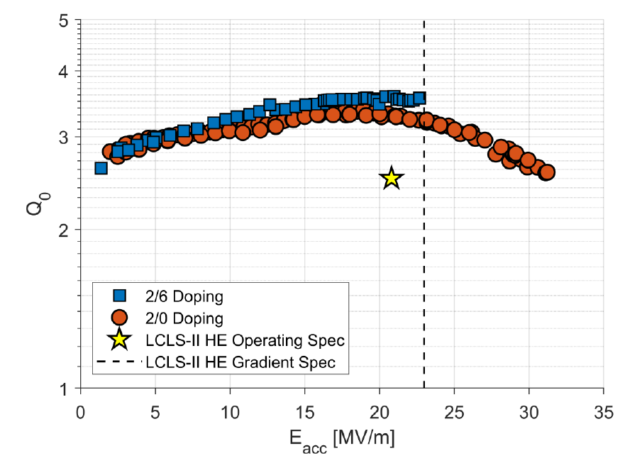
DO RESULTS FROM R&D ENABLE NEW PROJECTS?
LCLS-II
P. Dhakal, G. Ciovati and G. R. Myneni, “A path to higher Q₀ with large-grain Nb cavities”, Proc. IPAC2012, New Orleans, LA, May 20-25, 2012, p. 2426.
A. Grassellino et al., “Nitrogen and argon doping of niobium for superconducting radio frequency cavities: a pathway to highly efficient accelerating structures”, Supercond. Sci. Technol. 26, 102001 (2013).
D. Gonnella et al., “Industrial cavity production: lessons learned to push the boundaries of nitrogen doping”, Proc. SRF2019, Dresden, Germany, May 19-24, 2019, p. 1199.

Slide 6

THE SRF TREE
Industrial Machines
Discovery Machines
ADS
ICS
ERL
SRF R&D

Slide 7
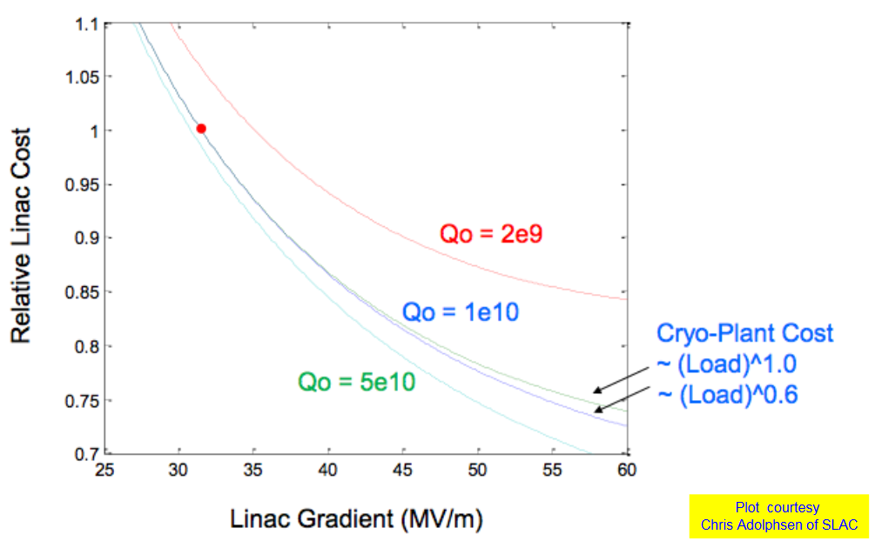
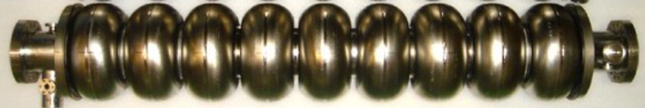
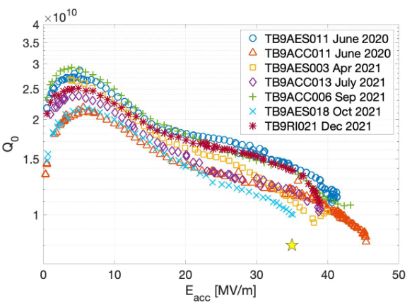
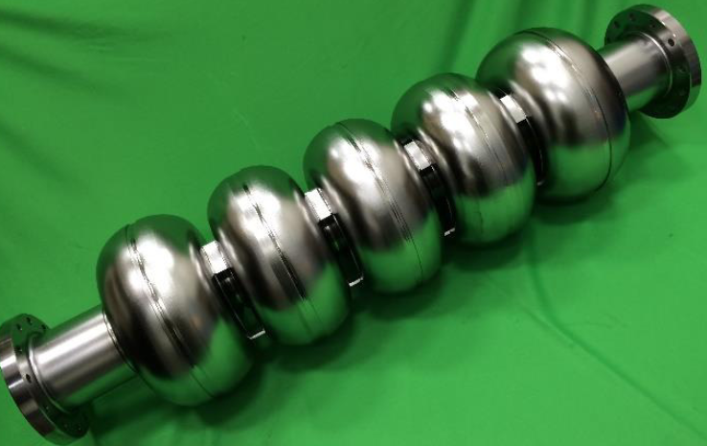
DISCOVERY MACHINES: LINEAR COLLIDER
“The International Linear Collider Machine Staging Report 2017”: considered options for higher E_{acc} = 35 MV/m
“Ichiro” cavity: 40 MV/m (2010)
<E_{acc}> = 40 MV/m in standard ILC cavities
“LSF” cavity: 32 MV/m (2019)
F. Furuta et al., “High Gradient Results of ICHIRO 9-Cell Cavity in Collaboration With KEK and Jlab”, Proc. SRF’11, Chicago, IL, USA, p. 386.
R. Geng et al., “Performance of First Prototype Multi-Cell Low-Surface-Field Shape Cavity”, Proc. SRF'19, Dresden, Germany, Jun.-Jul. 2019, p. 222.
S. Posen, “Review of Thermal Treatments: Effects, Reliability, and Open Questions”, SRF’23, Grand Rapids, MI, USA, June 25-30, 2023.
Notes:
Cold EP + 2-step baking

Slide 8
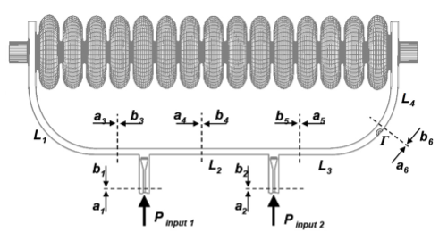
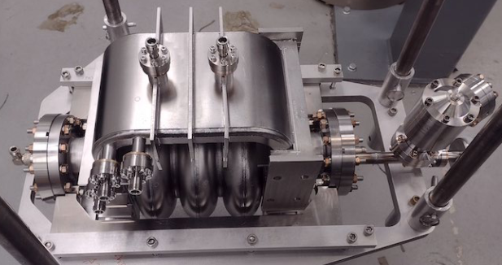
DISCOVERY MACHINES: LINEAR COLLIDER
Proposal for a 250 GeV linear collider based on TW SRF:
π/2 mode, B_{p}/E_{acc}~2.88 mT/(MV/m)
Challenges:
Cavity fabrication
Tuning of the feedback waveguide
High-power feedback waveguide
S. Belomestnykh et al., “HELEN: traveling wave SRF linear collider Higgs factory”, Proc. IPAC’23, Venice, Italy, May 2023, p. 788.
F. Furuta et al., "Progress and challenges in traveling-wave (TW) SRF cavity", in Proc. LINAC2024, Chicago, IL, USA, Aug. 2024, p. 621.
Notes:
Bp/Eacc ~30% less than ILC
Constant acceleration through the cavity

Slide 9
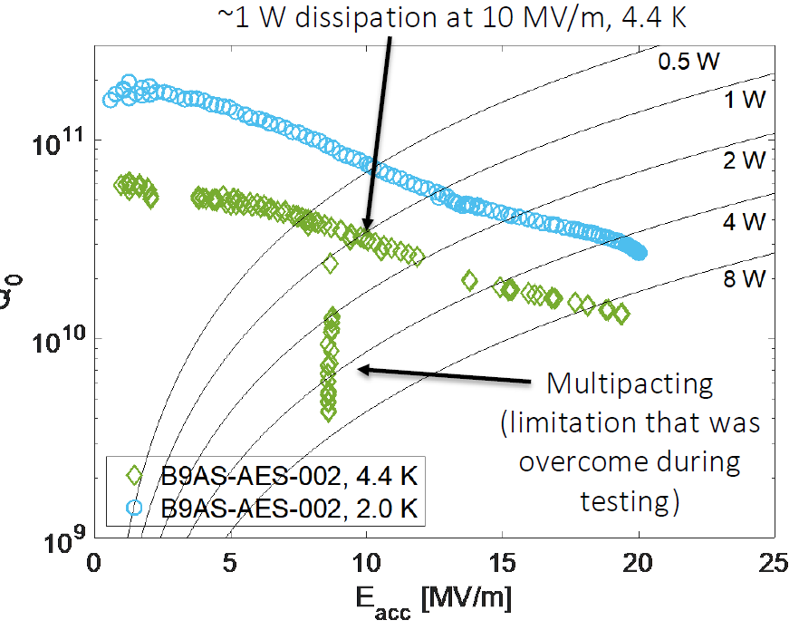
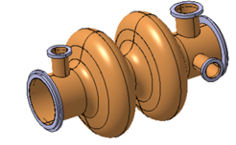
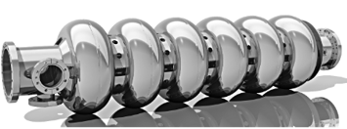
DISCOVERY MACHINES: FCC-ee
A lepton collider with CoM collision energies between 90 and 350 GeV
High beam current → strong HOM damping
400 MHz 2-cell
Q₀=2.7×10⁹ at E_{acc}=10.6 MV/m, 4.5 K
800 MHz 6-cell
Q₀=3×10¹⁰ at E_{acc}=20 MV/m, 2 K
650 MHz single-cell, Nb₃Sn
Nb/Cu
F. Peauger et al., “FCC-ee SRF Cavity Design and RF Powering Scheme”, FCC Week 2024, San Francisco, CA, USA, June 11, 2024.
S. Posen et al., “Advances in Nb₃Sn superconducting radiofrequency cavities towards first practical accelerator applications”, Supercond. Sci. Technol. 34 025007 (2021).
Notes:
CoM of 350 GeV to study ttbar (top quark and its antiparticle) production
800 MHz Nb: 30 W at 2 K, Nb3Sn: 50 W at 4 K

Slide 10
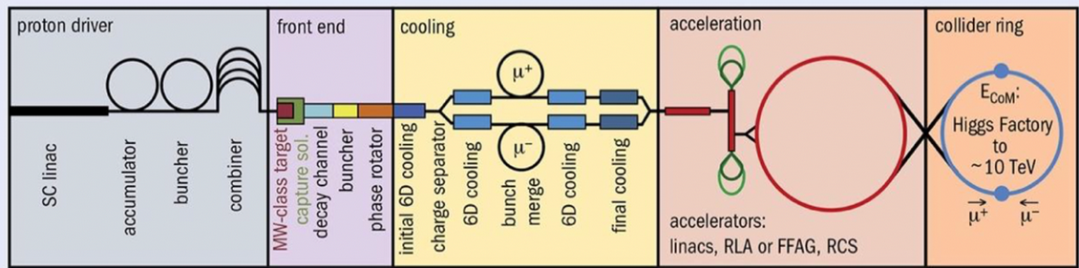
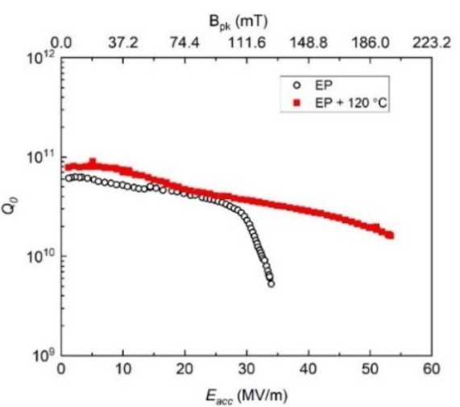
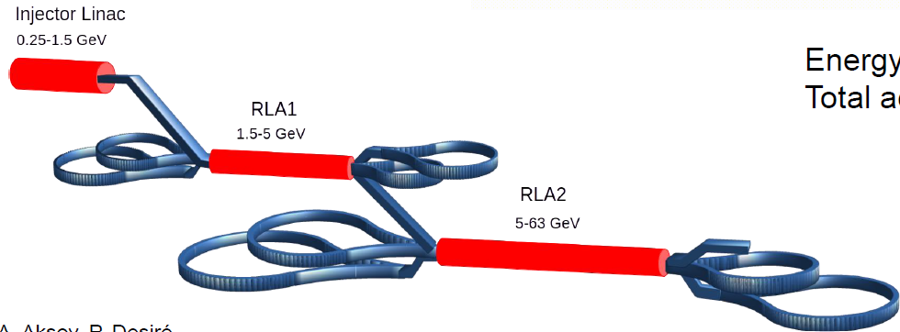
DISCOVERY MACHINES: MUON COLLIDER
Possible range of RF frequency: 325 MHz, 650 MHz/800 MHz, 1300 MHz
Challenges:
Achieving 20 MV/m at 4 K in 325 MHz cavities (Nb/Cu)
Achieving 38 MV/m at 2 K in 650 MHz Nb cavities
“PIP-II like”
53.3 MV/m in 650 MHz single-cell!
https://www.muoncollider.us/posts/accelerator/#super-conducting-rf
V. Chouhan et al., “"Excellent performance of 650 MHz single-cell niobium cavity after electropolishing", Proc. LINAC2024, Chicago, IL, USA, Aug. 2024, p. 692.
Notes:
SRF cavities will be used in the muon acceleration chain from the SRF linac (0.255 – 1.25 GeV) through dog-bone RLAs (1.25 – 63 GeV) to RCSs (up to the final energy). Along this chain of accelerators, the RF frequency would change from 325 MHz to 1300 Hz and accelerating gradients from 20 MV/m to 38 MV/m.
Synergies with FCC-ee

Slide 11
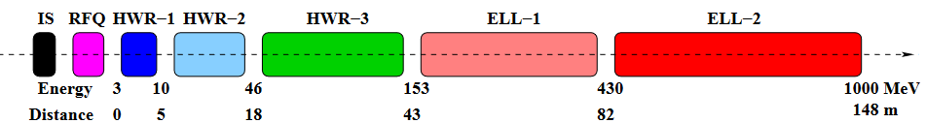
ACCELERATOR DRIVEN SYSTEMS (ADS)
~1 GeV, ~25 mA, CW proton linac
Cost
Reliability
162.5 MHz
650 MHz
325 MHz
SRF cavities operating at B_{p} ~ 70 mT
Cryoplant with cooling power of ~2.4 kW at 2.1 K
Reduce power consumption by a factor ~3.5
Reduce capital cost by a factor ~3
Nb₃Sn cavities: ~2.4 kW at 4 K
B. Mustapha et al., “A compact Linac design for an accelerator driven system”, Proc. LINAC2014, Geneva, Switzerland, Aug. 31-Sept. 5, 2014, p. 52.
Notes:
JAEA-ADS, China ADS
x Optimized superconducting cavity design for high voltage and low cryogenic losses.
x Superconducting solenoid focusing inside cryomodules to minimize warm transitions and consequently the number of required cryomodules.
x Cold BPMs attached to SC cavities inside the cryomodule to reduce the number of diagnostics required between cryomodules
x Horizontal and vertical steering correctors are built into the solenoids requiring no additional space for correctors along the beam-line.

Slide 12
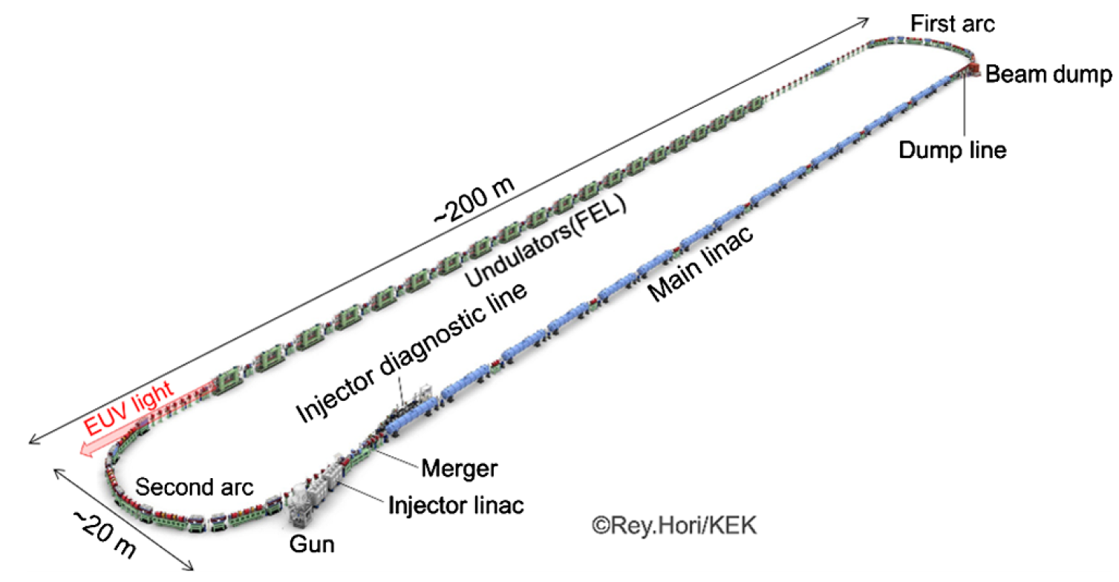
ENERGY RECOVERY LINACS (ERL)
ERL-based Free Electron Laser for EUV lithography
800 MeV, 9.75 mA SRF Linac:
64× 9-cell, 1.3 GHz cavities
E_{acc}=12.5 MV/m, Q₀=1×10¹⁰ → ~1000 W at 2 K
10 kW @ 13.5 nm
Nb₃Sn cavities: ~1000 W at 4 K
Reduce power consumption by a factor ~3.5
Reduce capital cost by a factor ~3
T. Konomi et al., “Damped superconducting structure for EUV light source based on energy recovery linac”, Phys. Rev. Accel. Beams 26, 121601 (2023).

Slide 13
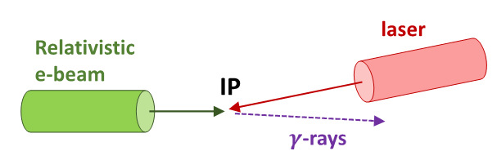
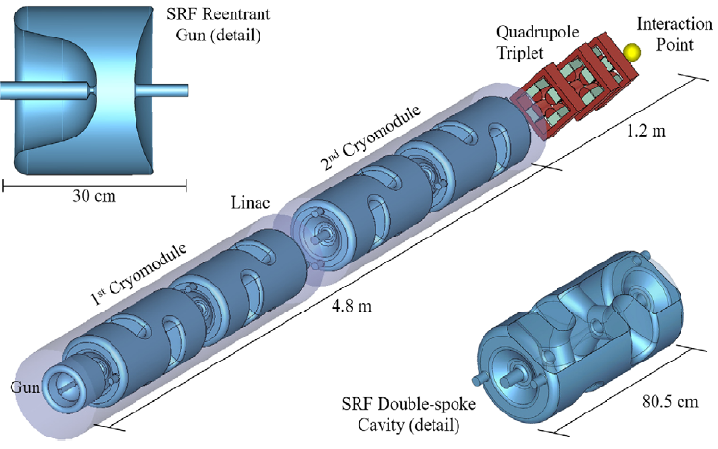
INVERSE COMPTON SCATTERING (ICS) SOURCES
High x-rays flux:
Low emittance
High repetition rate
SRF Linac
x-rays
Four 500 MHz double-spoke Nb cavities, B_{p}~50 mT, ~150 W at 4 K
Nb₃Sn, Q₀~2×10¹⁰ → ~10 W at 4 K
25 MeV, 100 MHz rep. rate, 1 mA
K. E. Deitrick et al.,, “High-brilliance, high-flux compact inverse Compton light source”, Phys. Rev. Accel. Beams 21, 080703 (2018).
Notes:
Directional and quasi-monochromatic laboratory scale X-ray source
X-ray energies in the range of 10 keV to 180 keV are of significant interest, as these energies are suitable for various applications including medical imaging and materials science.
10-35 keV:
This range is particularly useful for applications like K-edge subtraction (KES) and phase contrast imaging in medical imaging

Slide 14
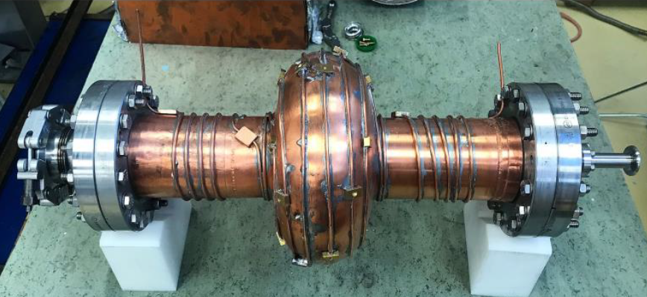
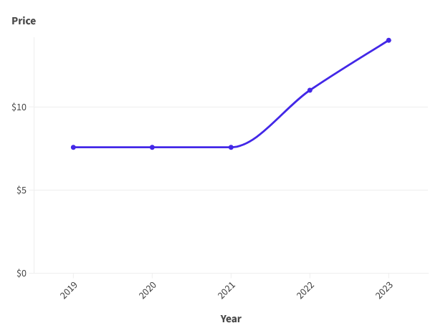
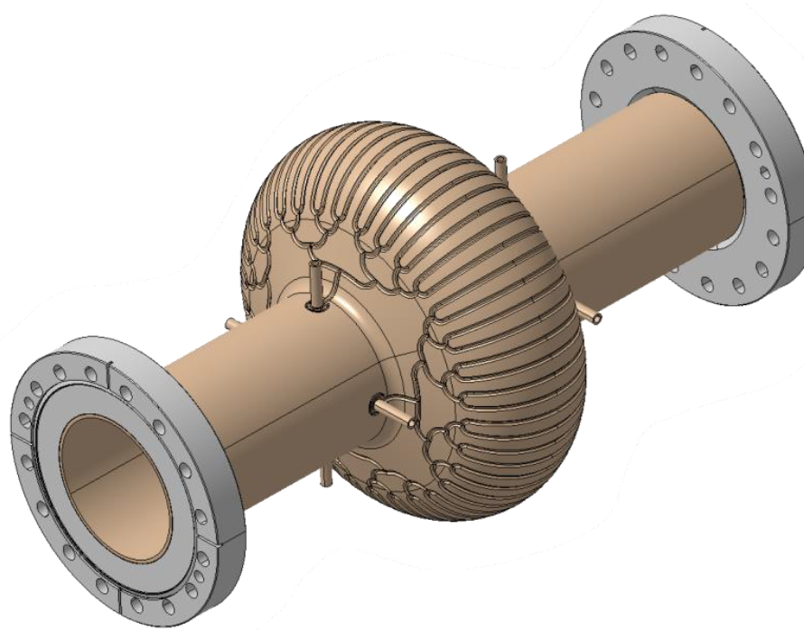
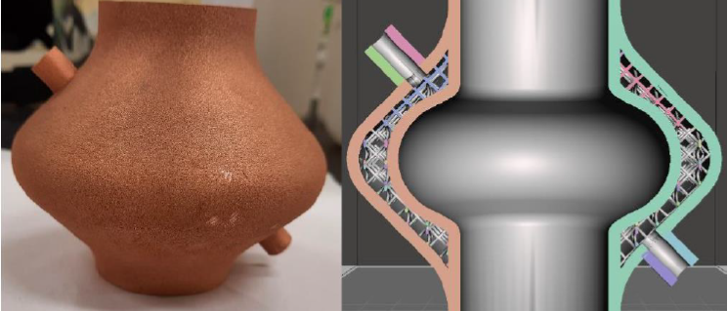
REDUCE HELIUM CONSUMPTION
Helium price, per cubic meter
A. Nordrum, “The era of cheap helium is over—and that’s already causing problems”, MIT Technology Review, February 25, 2024.
T. Koettig et al, “Semi-Dry Cavity Cooling of SRF Cavities at Temperatures above 4.5 K”, FCC Week 2025, Vienna, Austria, May 19-23, 2025.
T. Proslier et al., “3D additive fabrication of Cu cavity with cooling channeling at CEA”, TFSRF2024, Saclay, France, Sep. 16-20, 2024.
Notes:
Prices listed are estimates for Grade-A helium sold by private industry.

Slide 15
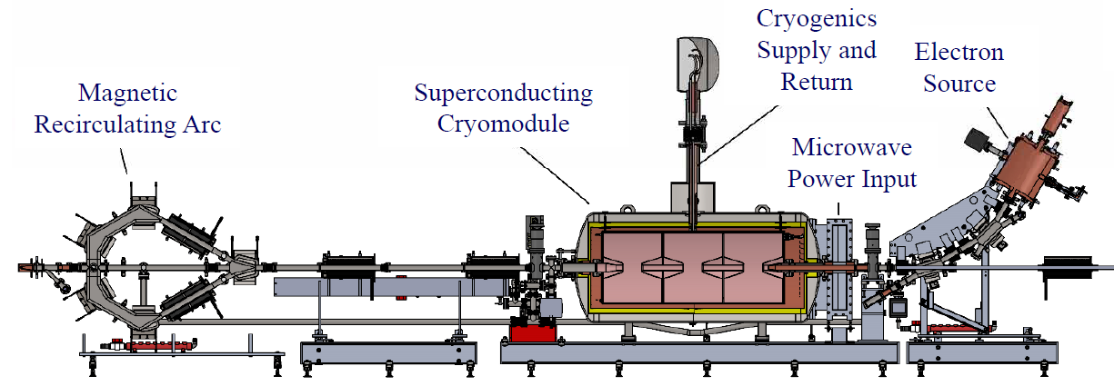
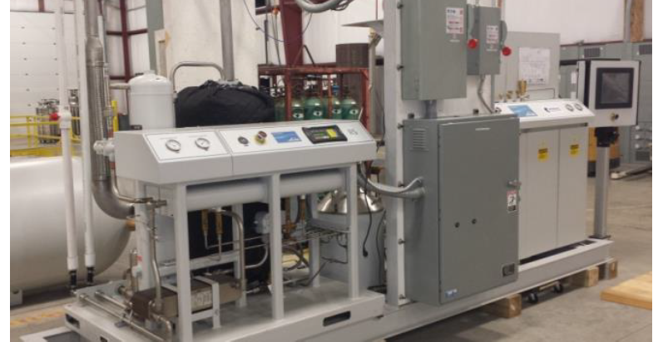
INDUSTRIAL SRF LINACS
Niowave has built and is operating a 20 MeV SRF linac for the production of medical isotopes Ac-225 and Mo-99
2-pass, 10-40% duty cycle, up to 40 MeV
3-gap reentrant cell, 350 MHz cavity
B_{p} = 58 mT, P_{c} = 29 W at 10 MeV
110 W at 4 K LHe refrigerator
Nb₃Sn, Q₀~2×10¹⁰ → ~4.5 W at 4 K
C. Boulware et al., ” High-power Two-pass Superconducting Electron Linac for Medical Radioisotope Production”, SRF’23 Grand Rapids, MI, USA, June 25-30, 2023.
Notes:
In use for more than 10 years.
Refrigerator: 100 kW wall-plug power

Slide 16
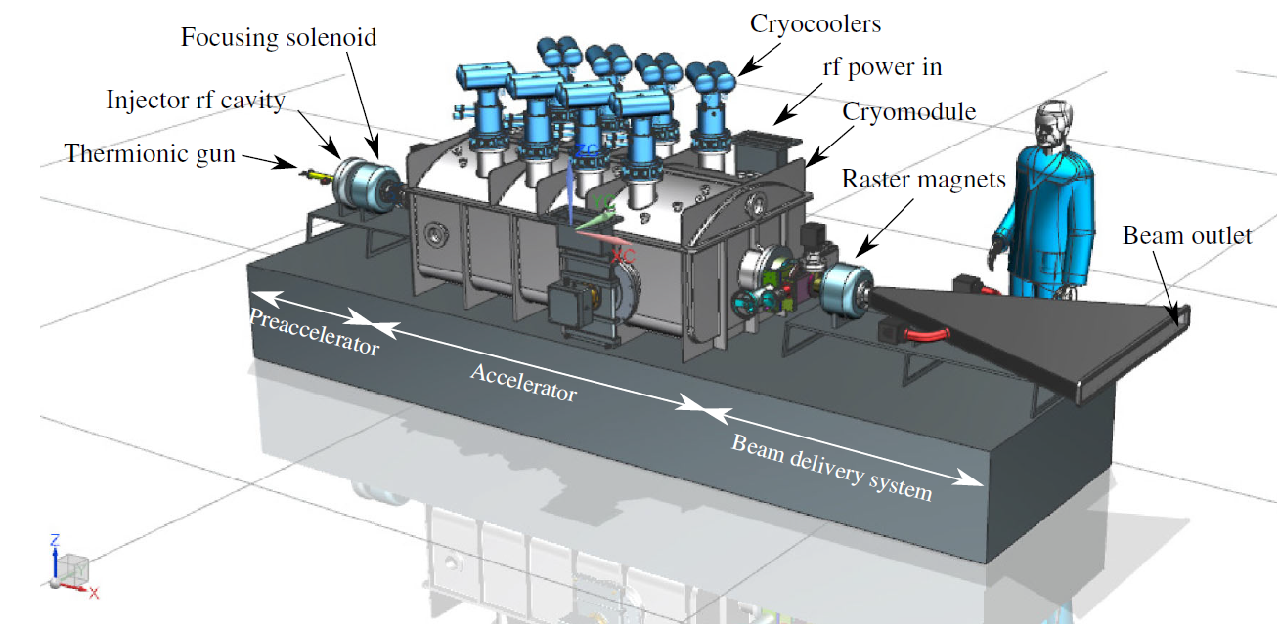
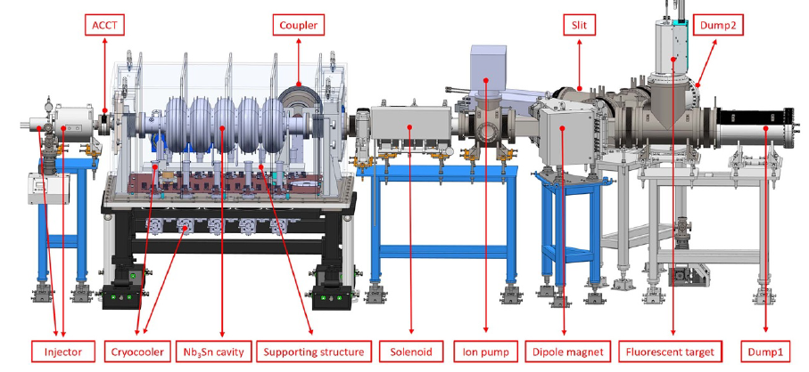
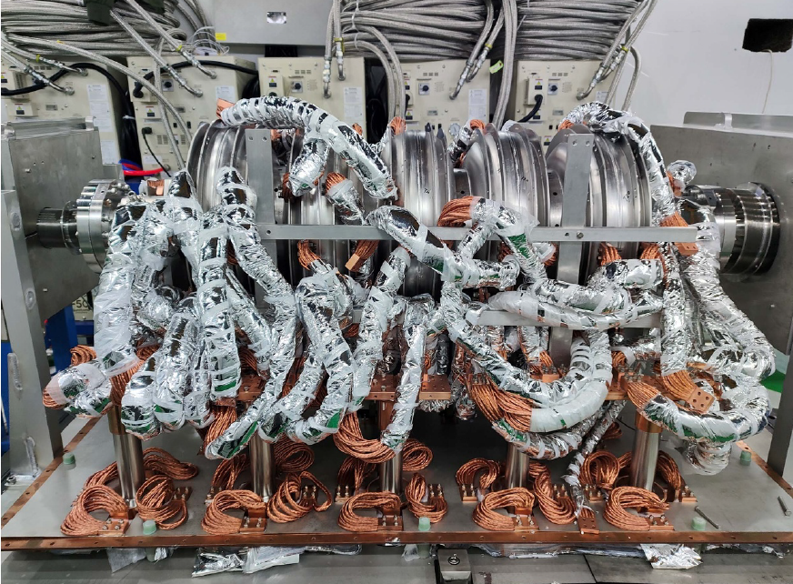
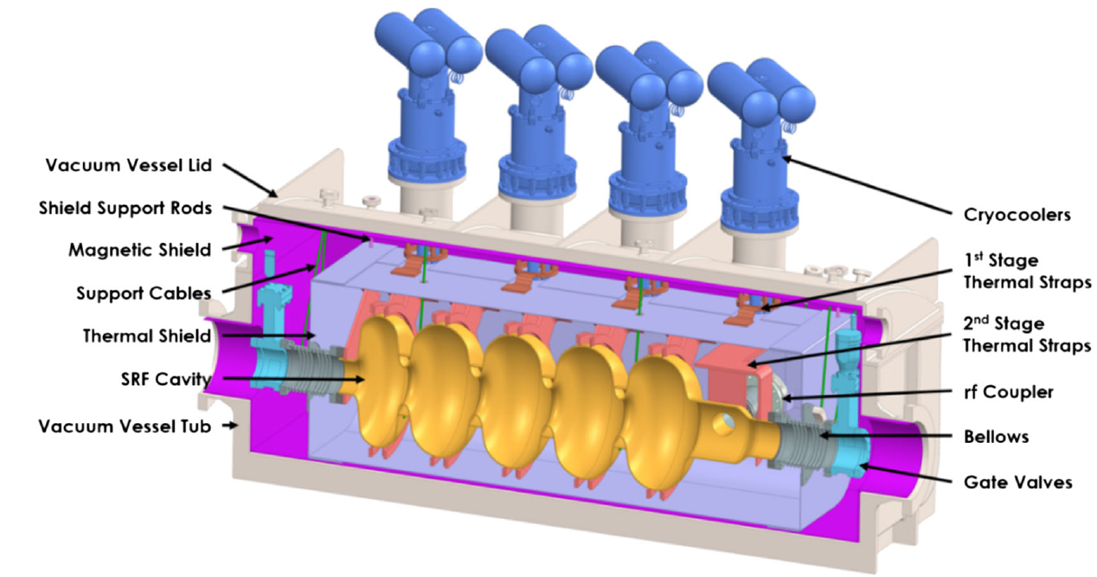
INDUSTRIAL SRF LINACS
Growing demand for compact & efficient high-power (>100 kW) CW electron linacs, <10 MeV:
Environmental remediation
Phytosanitary treatment
Medical device sterilization
Nb₃Sn
&
Cryocoolers
Accelerated a pulsed beam to 1.9 MeV
R.C. Dhuley et al., ”Design of a 10 MeV, 1000 kW average power electron-beam accelerator for wastewater treatment applications”, Phys. Rev. Accel. Beams 25, 041601 (2022).
Z. Yang et al., ” Stable acceleration of a LHe-Free Nb₃Sn demo SRF e-linac”, Supercond. Sci. Technol. 38 015009 (2025).

Slide 17
CONDUCTION COOLED SRF
The highest B_{p} achieved so far in a conduction cooled Nb₃Sn SRF cavity is 50 mT (E_{acc}~13 MV/m)
Cryooolers: 9 W at 4.2 K (fixed temperature) or 5 W at 4 K
Need to
Improve the reproducibility in the Nb₃Sn coating process
Deal with the brittleness of the material
Deal with thermoelectric currents
G. Ciovati et al., ” Development of a prototype superconducting radio-frequency cavity for conduction-cooled accelerators”, Phys. Rev. Accel. Beams 26, 044701 (2023).

Slide 18
CONCLUSIONS
Cost will be an important parameter determining the fate of future large-scale discovery machines
High-Q and high gradient in low-frequency (650 – 800 MHz) cavities
High-Q with higher-T_{c} SC for 4 K operation
Cryocoolers for industrial linacs
The performance we need will have to be demonstrated, reliably, by cavity vendors
The history of SRF R&D is full of surprises: keep experimenting!
QUESTIONS?
Notes:
Structures for high-current operation

