Slide 1


Modeling Photoemission in Alkali Antimonides from Ab Initio Many-body Theory Richard Schier & Caterina Cocchi Carl von Ossietzky Universität Oldenburg , Germany Friedrich-Schiller-Universität Jena, Germany July 16, 2025

Slide 2
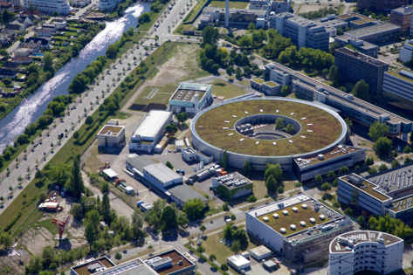
Motivation
Understand photocathode materials, especially alkali-antimonides, with ab initio many-body methods
Previous works:
© HZB / Dirk Laubner
Surface properties:
R. Schier et al., Phys. Rev. Mat. 6, 125001 (2022)
High-throughput
screening:
R. Schier et al., Adv. Theory Simul. 7, 2400680 (2024)
Electronic band structure
& optical spectrum:
R. Schier & C. Cocchi, Phys. Rev. Mat. 9, 053804 (2025)
C. Xu et al., Electron. Struct. 7, 015001 (2025)

Slide 3

Three Step Model
ħω
Recent implementations based on DFT:
E. R. Antoniuk et al.,
Phys. Rev. B 101, 235447 (2020)
P. Saha et al.,
J. Appl. Phys. 133, 053102 (2023)
Emission (III)
Surface
Scattering (II)
DFT is a ground-state theory and does not cover electron-electron / electron-hole correlations!
e⁻
Excitation (I)
We present an implementation of the three step model with results from many-body theory.
Bulk
W. E. Spicer, Phys. Rev. 112, 1 (1958)
C. N. Berglund & W. E. Spicer, Phys. Rev. 136, A1030 (1964)

Slide 4
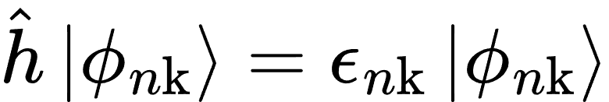


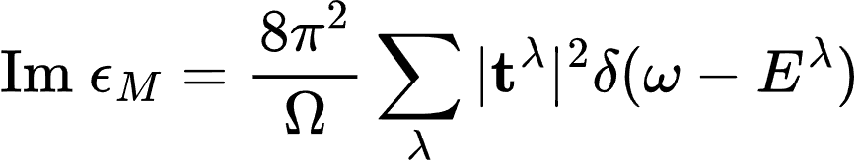

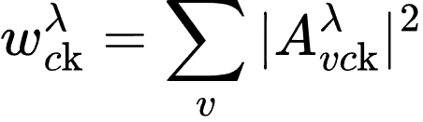
Theory Workflow
Ground state: Kohn-Sham equations
DFT
W. Kohn and L. J. Sham, Phys. Rev. 140, A1133 (1965)
Electron-electron correlation: Self-energy correction
Accurate band gap
G₀W₀
L. Hedin, Phys. Rev. 139, A796 (1965)
Electron-hole correlation: Bethe-Salpeter equation (BSE)
Optical spectrum
BSE
Excitonic weights
E. E. Salpeter and H. A. Bethe, Phys. Rev. 84, 1232 (1951)

Slide 5
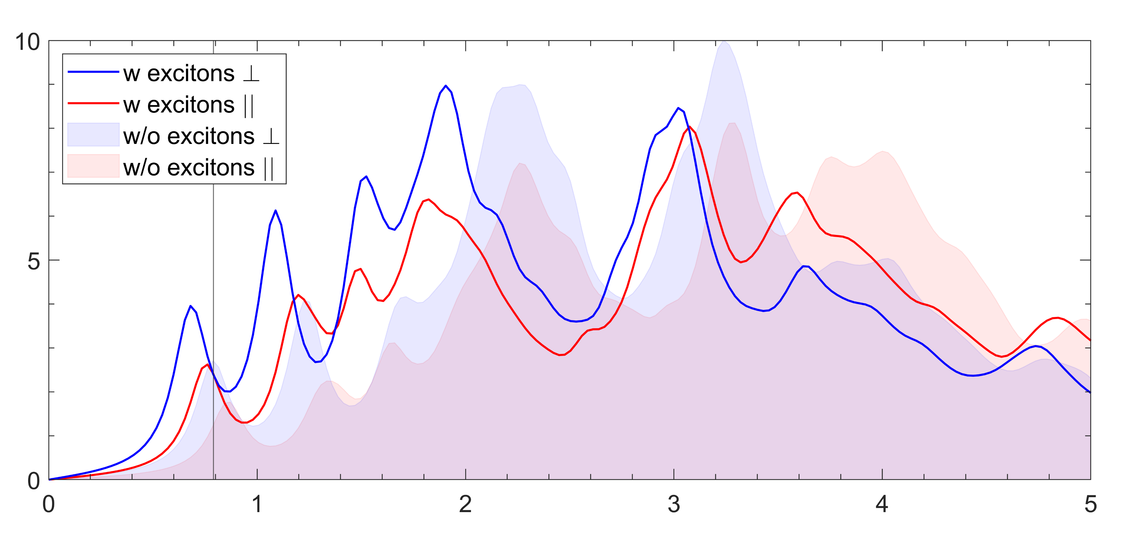
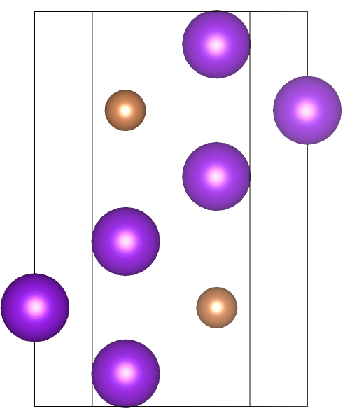
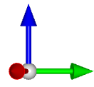
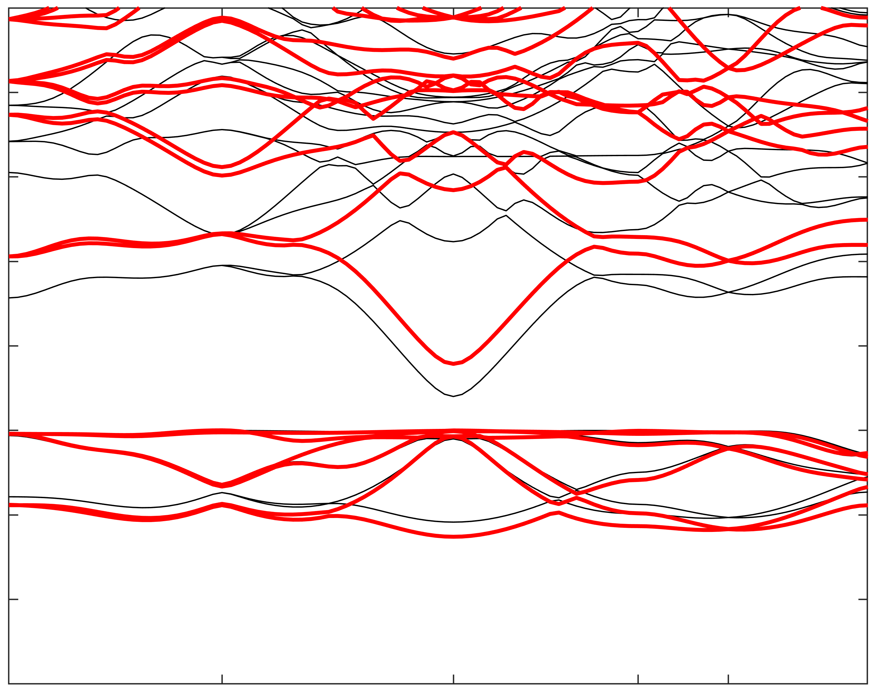
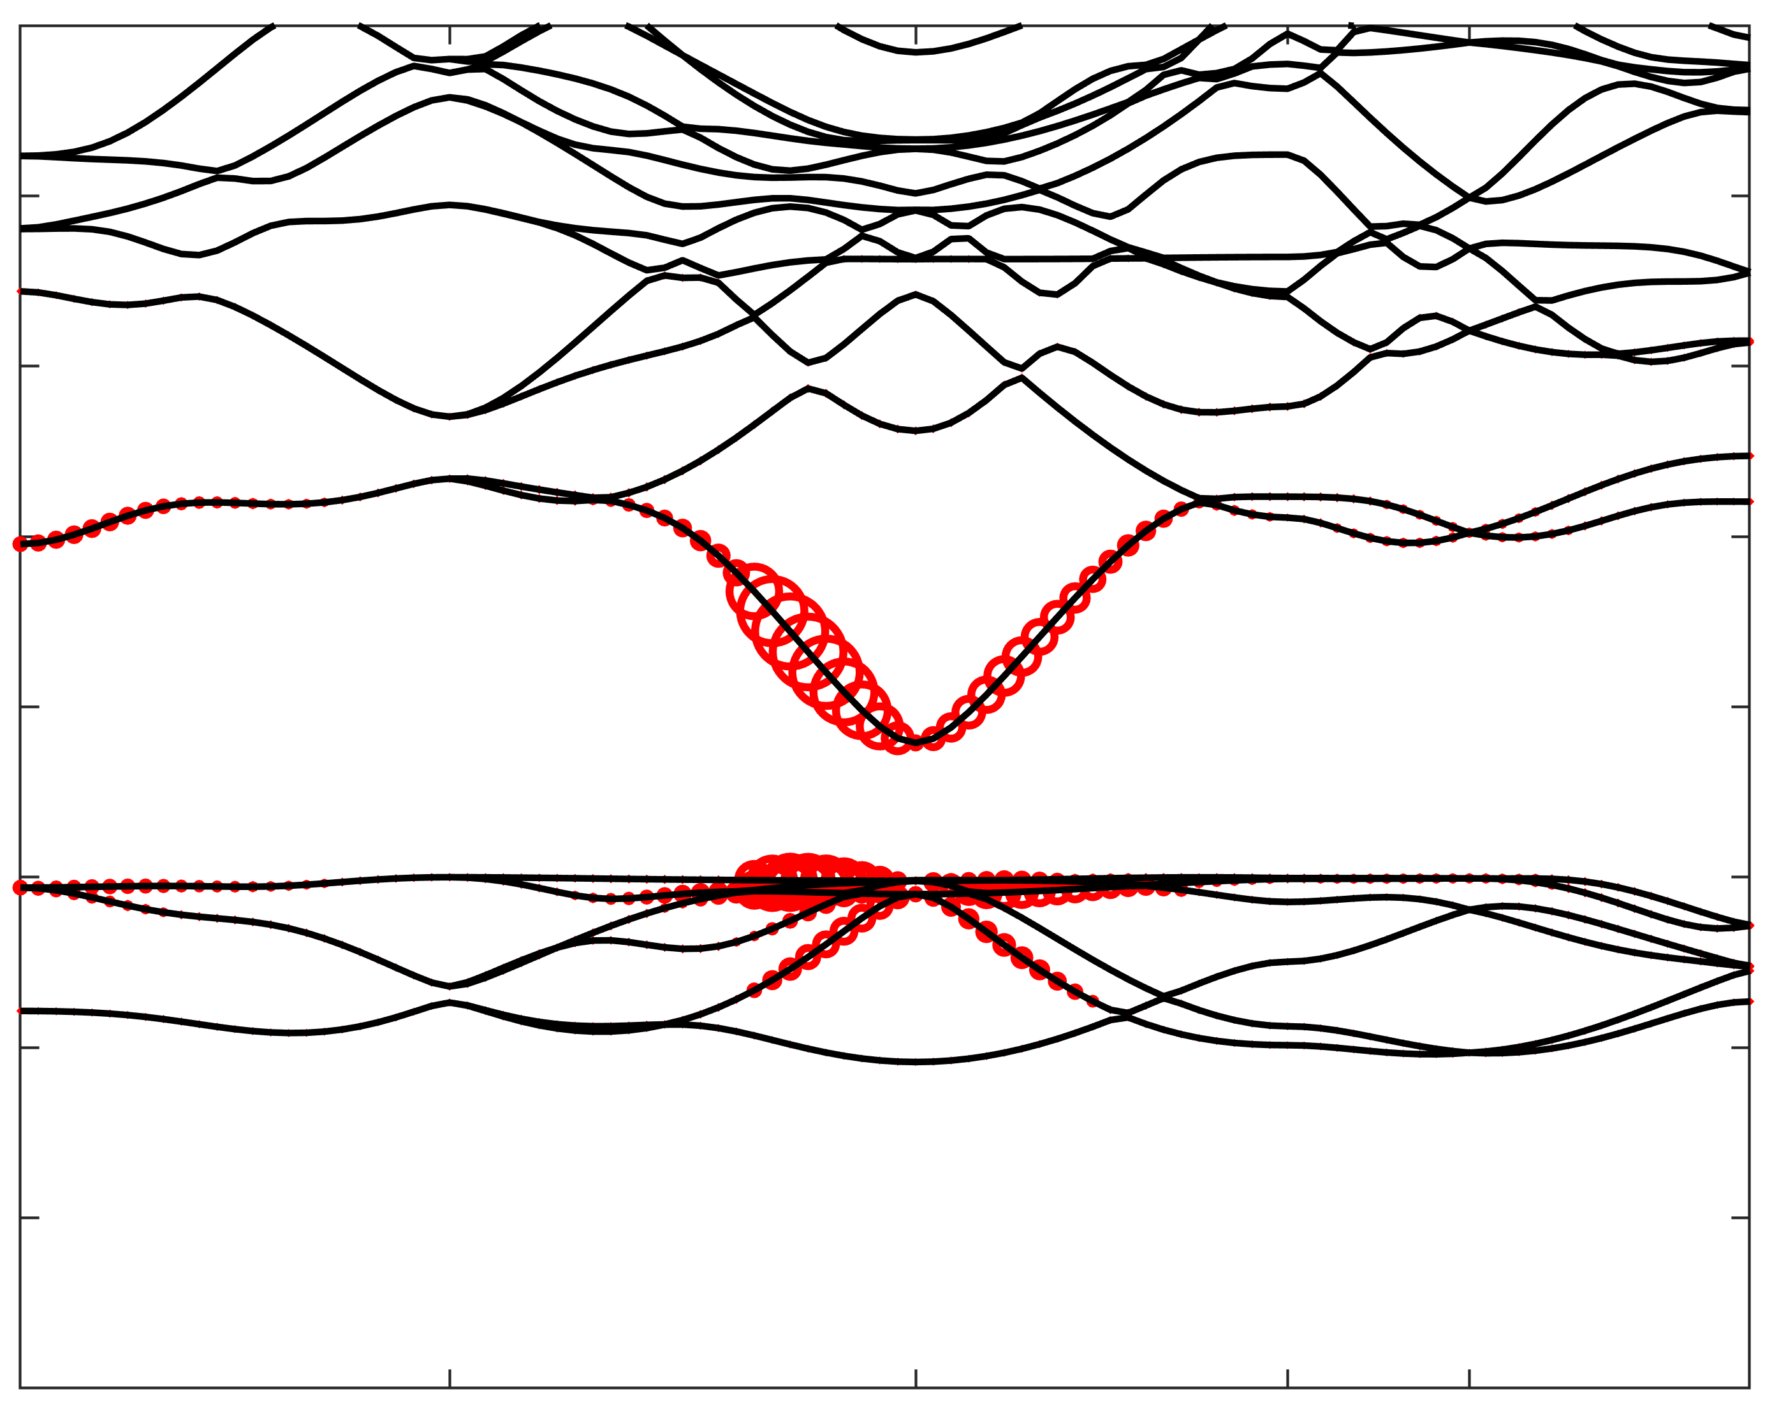

Electronic & Optical Properties of K₃Sb
Ⱶ
Im ε_{M}
Optical Spectrum
=
Hexagonal K₃Sb
G₀W₀ DFT
Band Structure
5
Energy [eV]
4
3
Energy [eV]
2
Excitonic Weights
1
0
Energy [eV]
-1
-2
-3
A
H
Γ
M
L
K
R. Schier & C. Cocchi,
Phys. Rev. Materials 9, 053804 (2025)
A
H
Γ
M
L
K

Slide 6
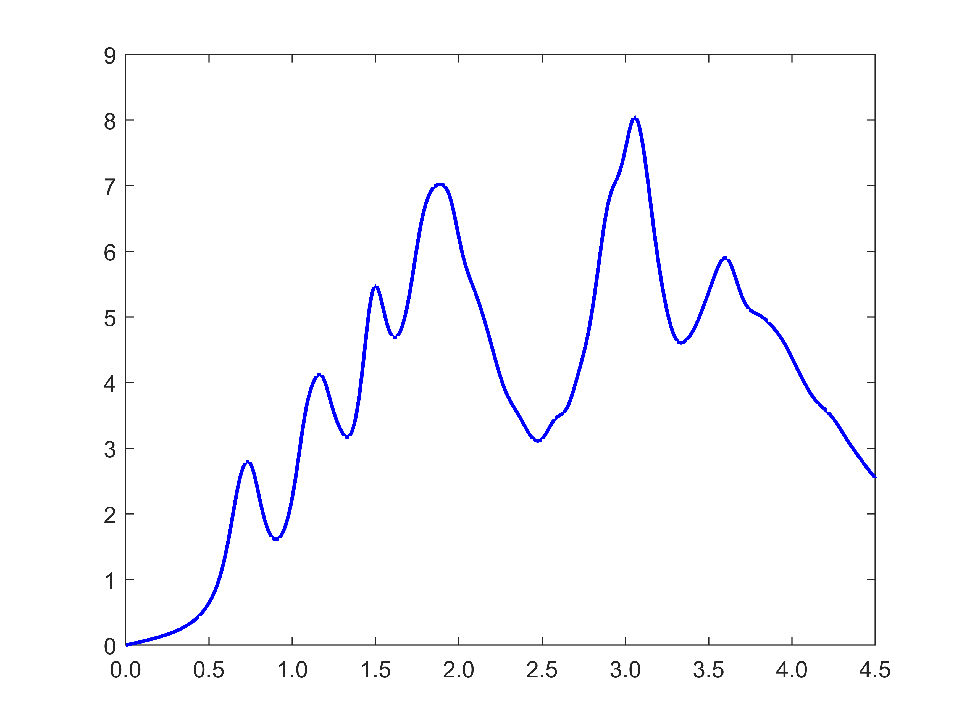
Step I: Excitation
Excitation
Im ε_{M} averaged over all components
Scattering
Im ε_{M}
Emission
Energy [eV]

Slide 7
Step II: Transport / Scattering
Excitation
Scattering can be covered through Monte Carlo simulations.
[P. Gupta et al., J. Appl. Phys. 121, 215702 (2017)]
Scattering is negligible in semiconducting thin films.
No scattering in this model.
Scattering
Emission

Slide 8
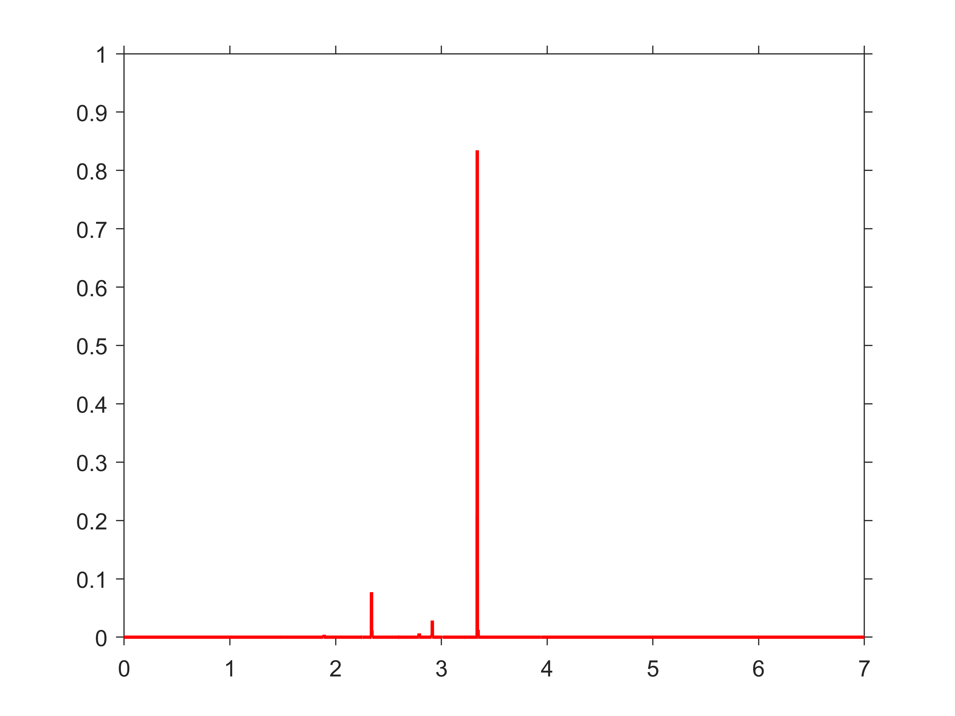
Step III: Emission
Excitation
Optical Spectrum
Energy distribution of excited electrons
Scattering
Im ε_{M}
P(E)
Emission
Energy Photon [eV]
Energy Electron [eV]

Slide 9
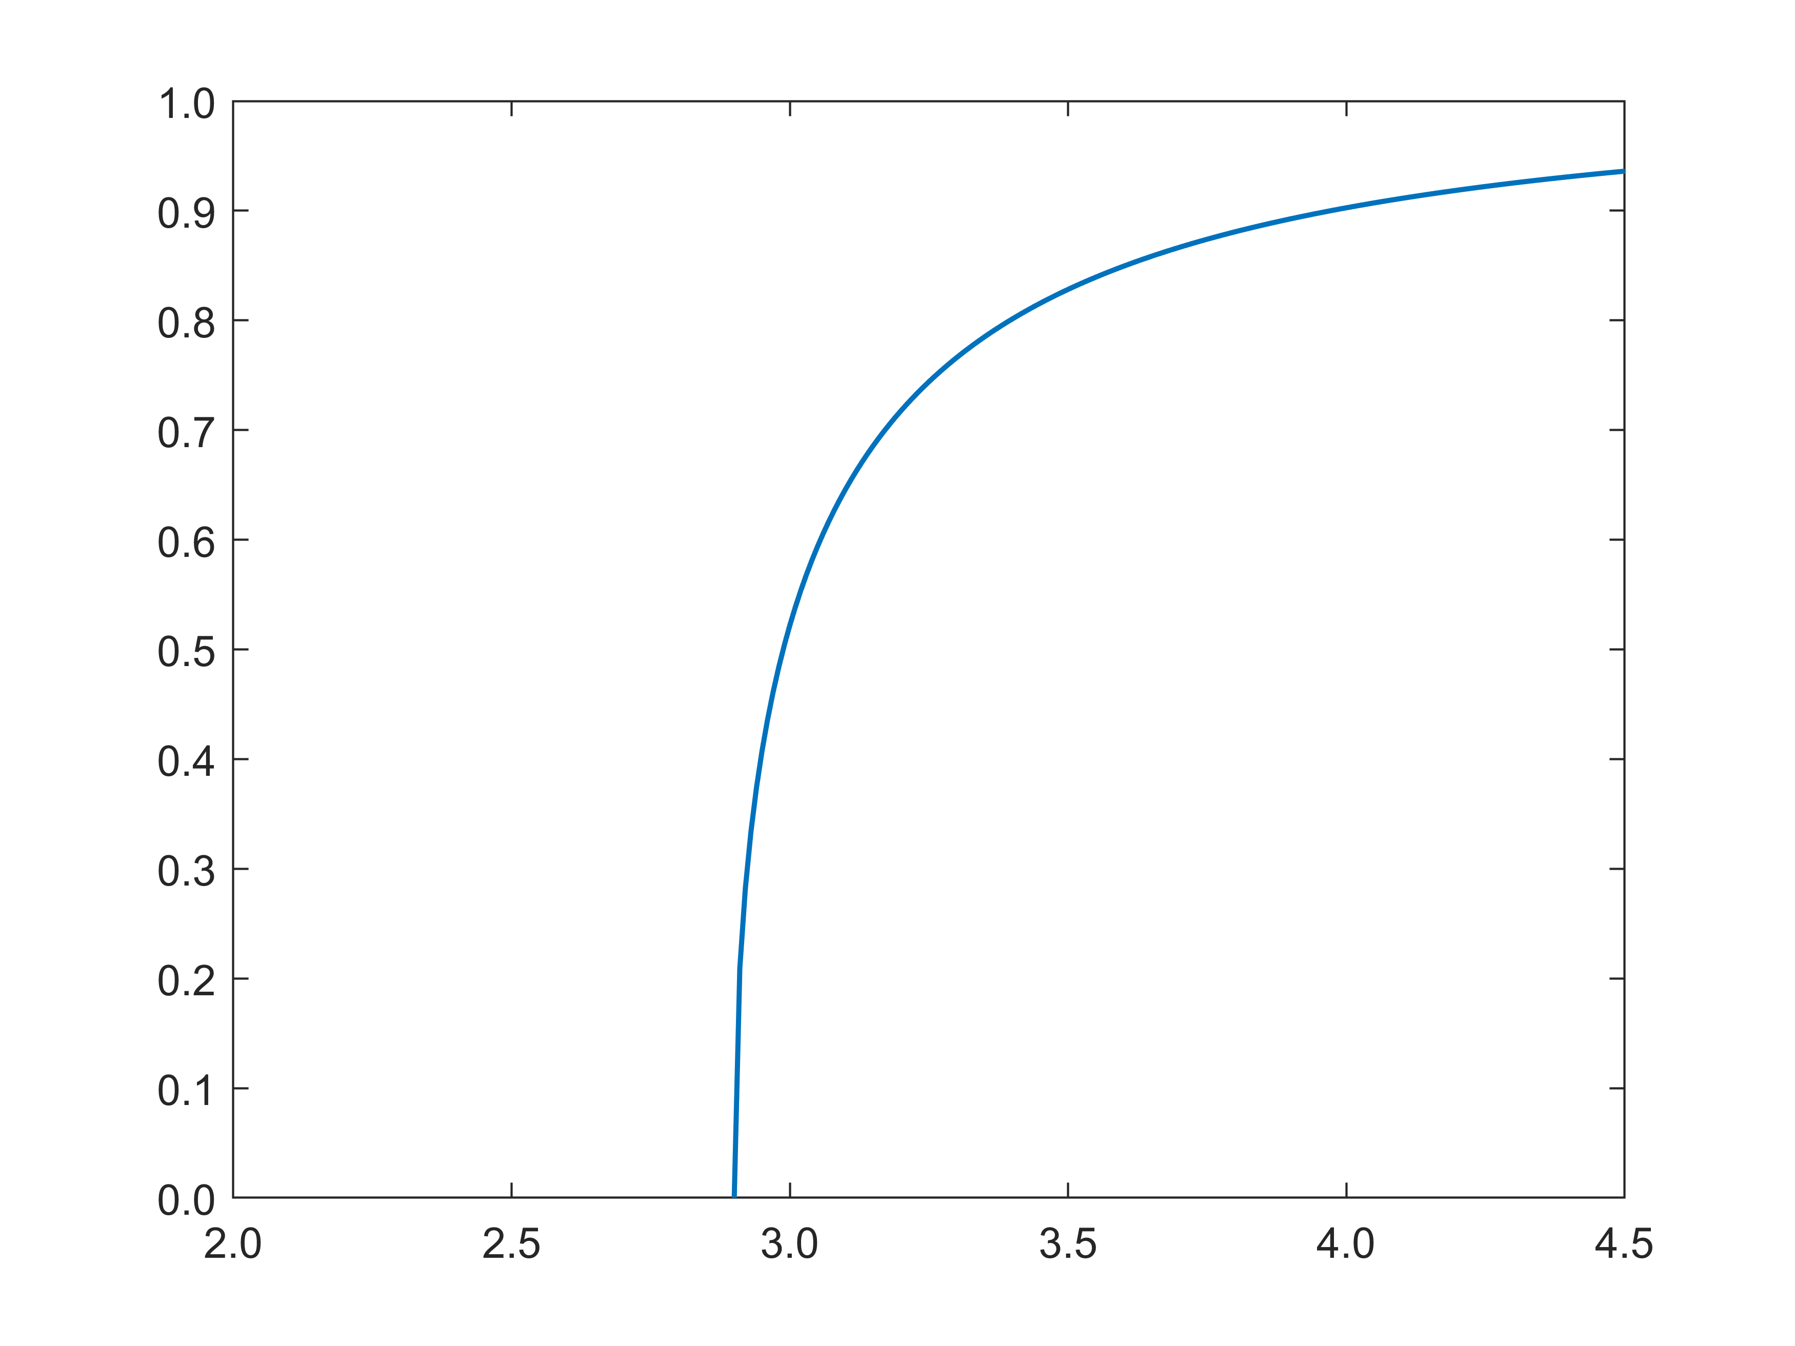
Emission Probability
Simple approximation for P_{Emission} (E): potential step
ħω
e⁻
P_{Emission}
V₀
Energy electron [eV]
Here: V₀ from experiment
[W. E. Spicer, Phys. Rev. 112, 1 (1958)]
Alternative: surface slab calculation:
R. Schier et al., Phys. Rev. Mat. 6, 125001 (2022)

Slide 10
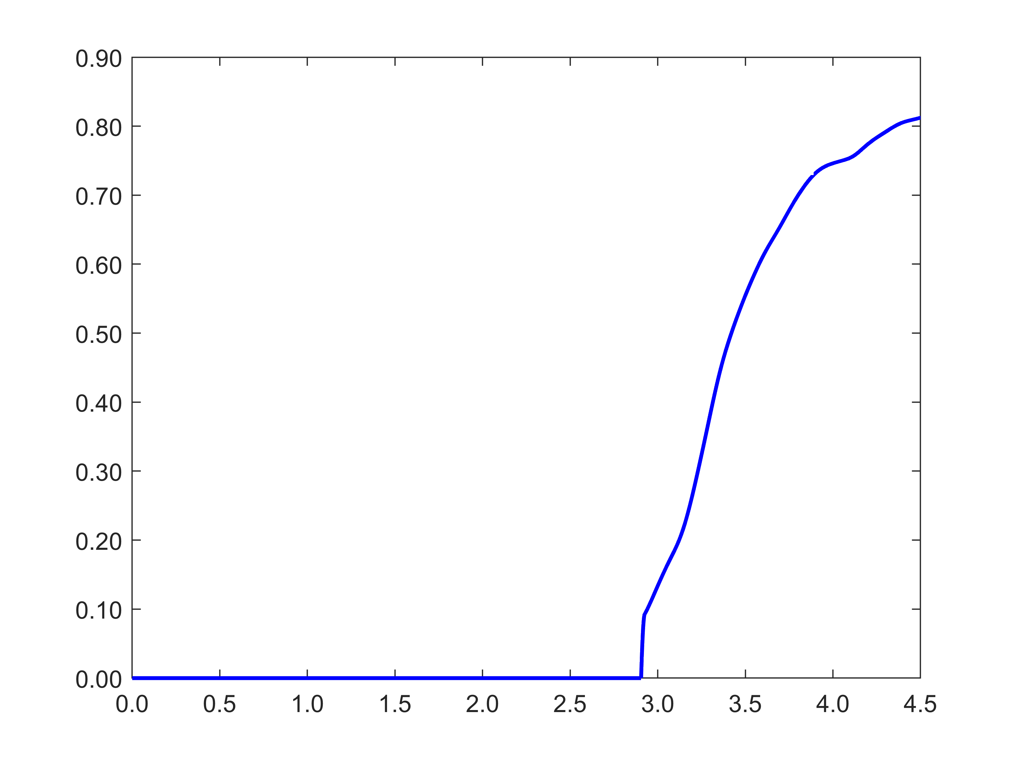
Emission by Photon Energy
P_{Emission}
Photon Energy [eV]

Slide 11
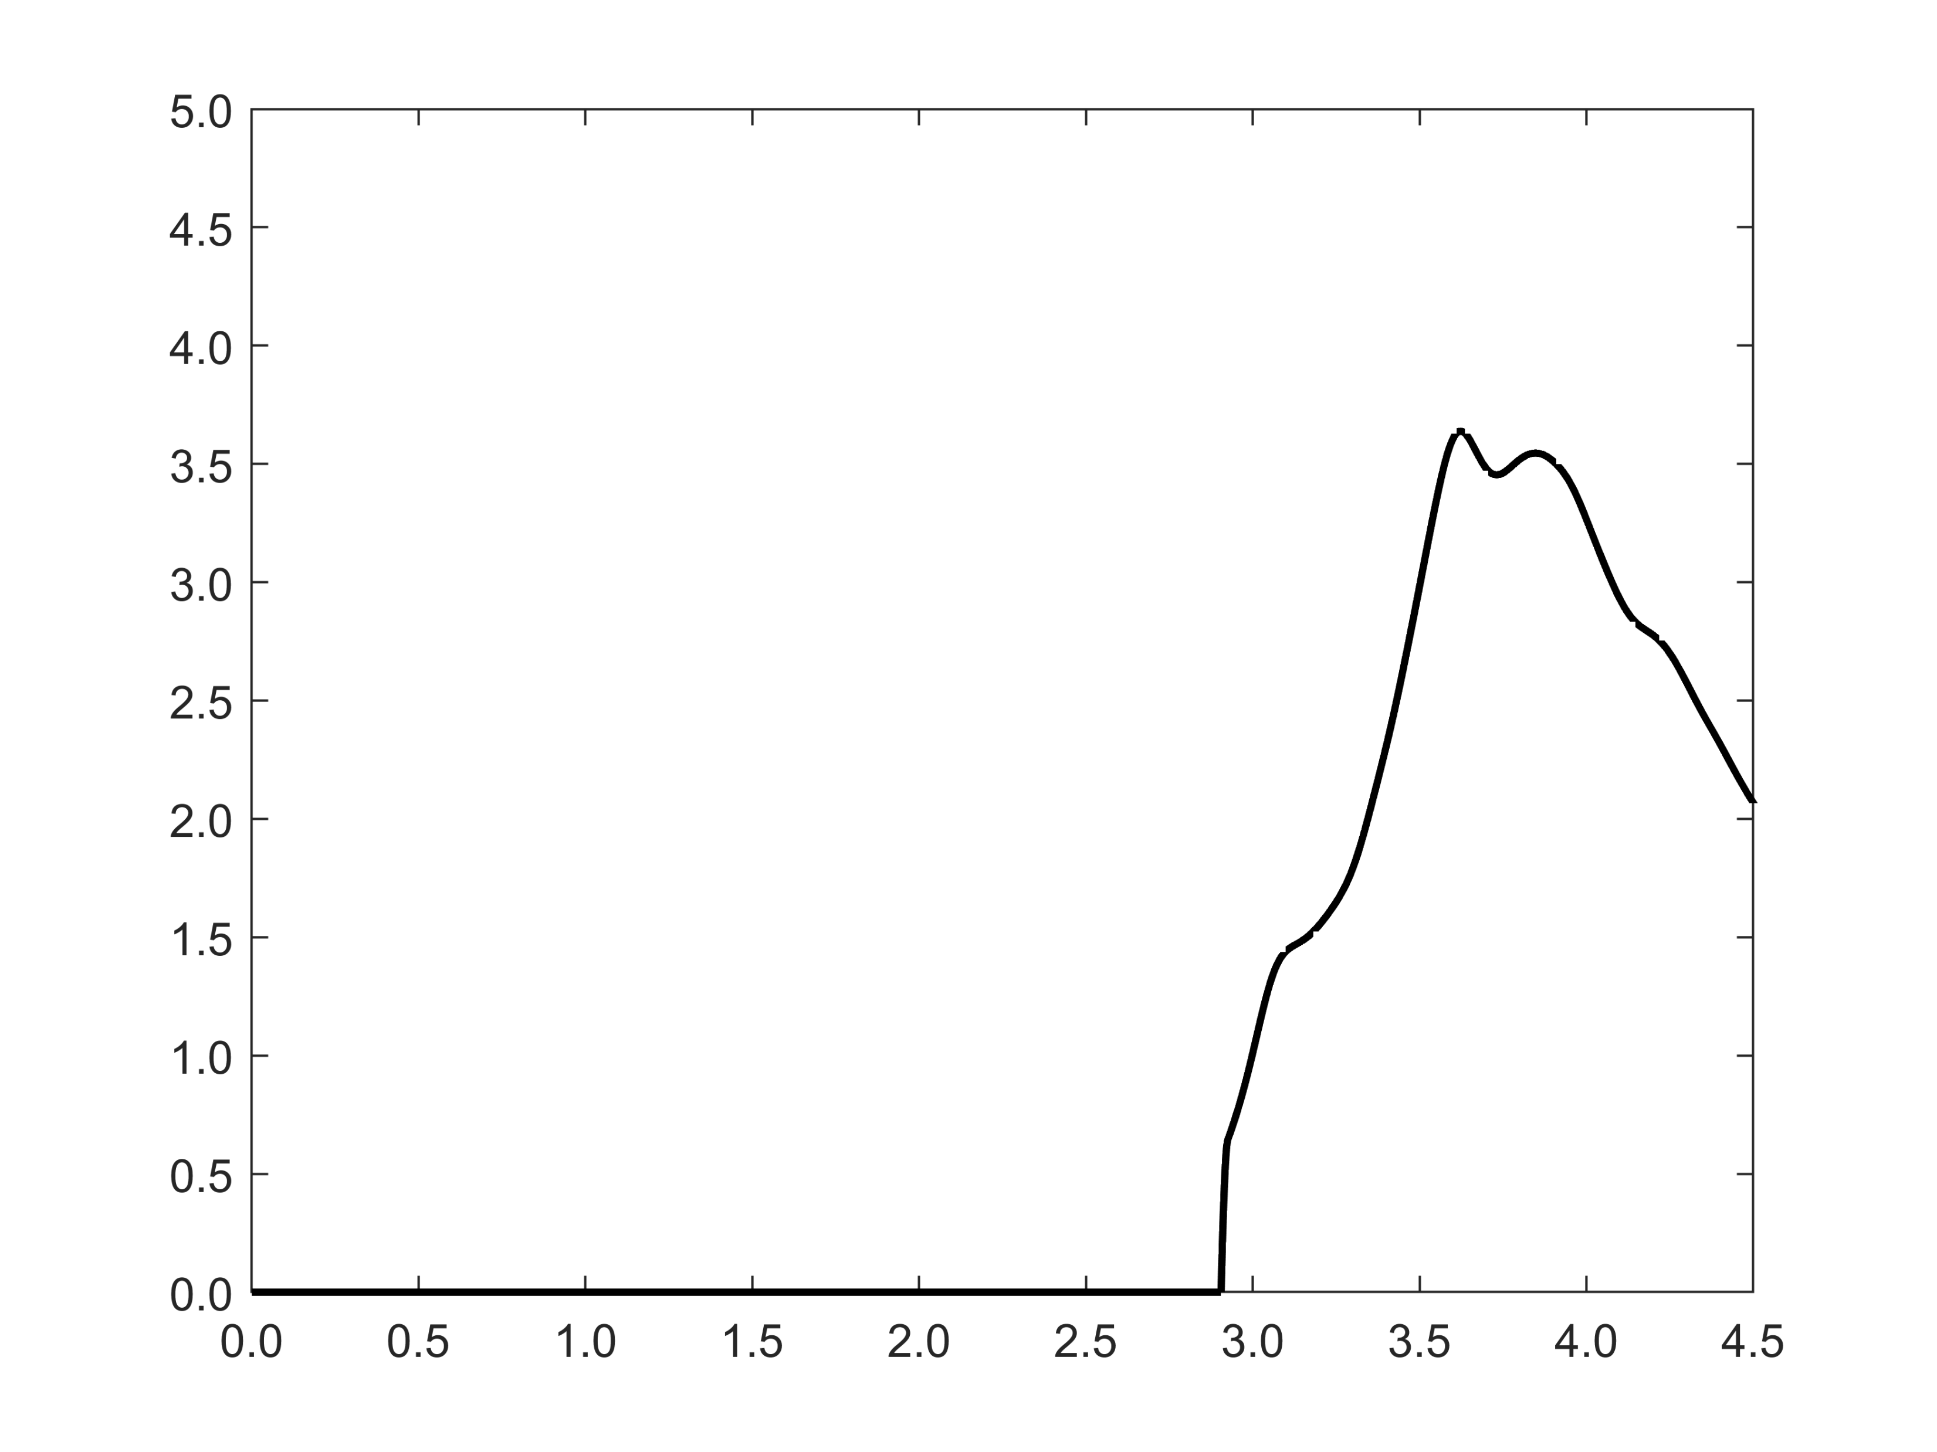
Final Result
Im ε_{M}
Hexagonal K₃Sb
Im ε_{M} * P_{Emission}
Photon Energy [eV]
P_{Emission}
Photon Energy [eV]
Photon Energy [eV]

Slide 12
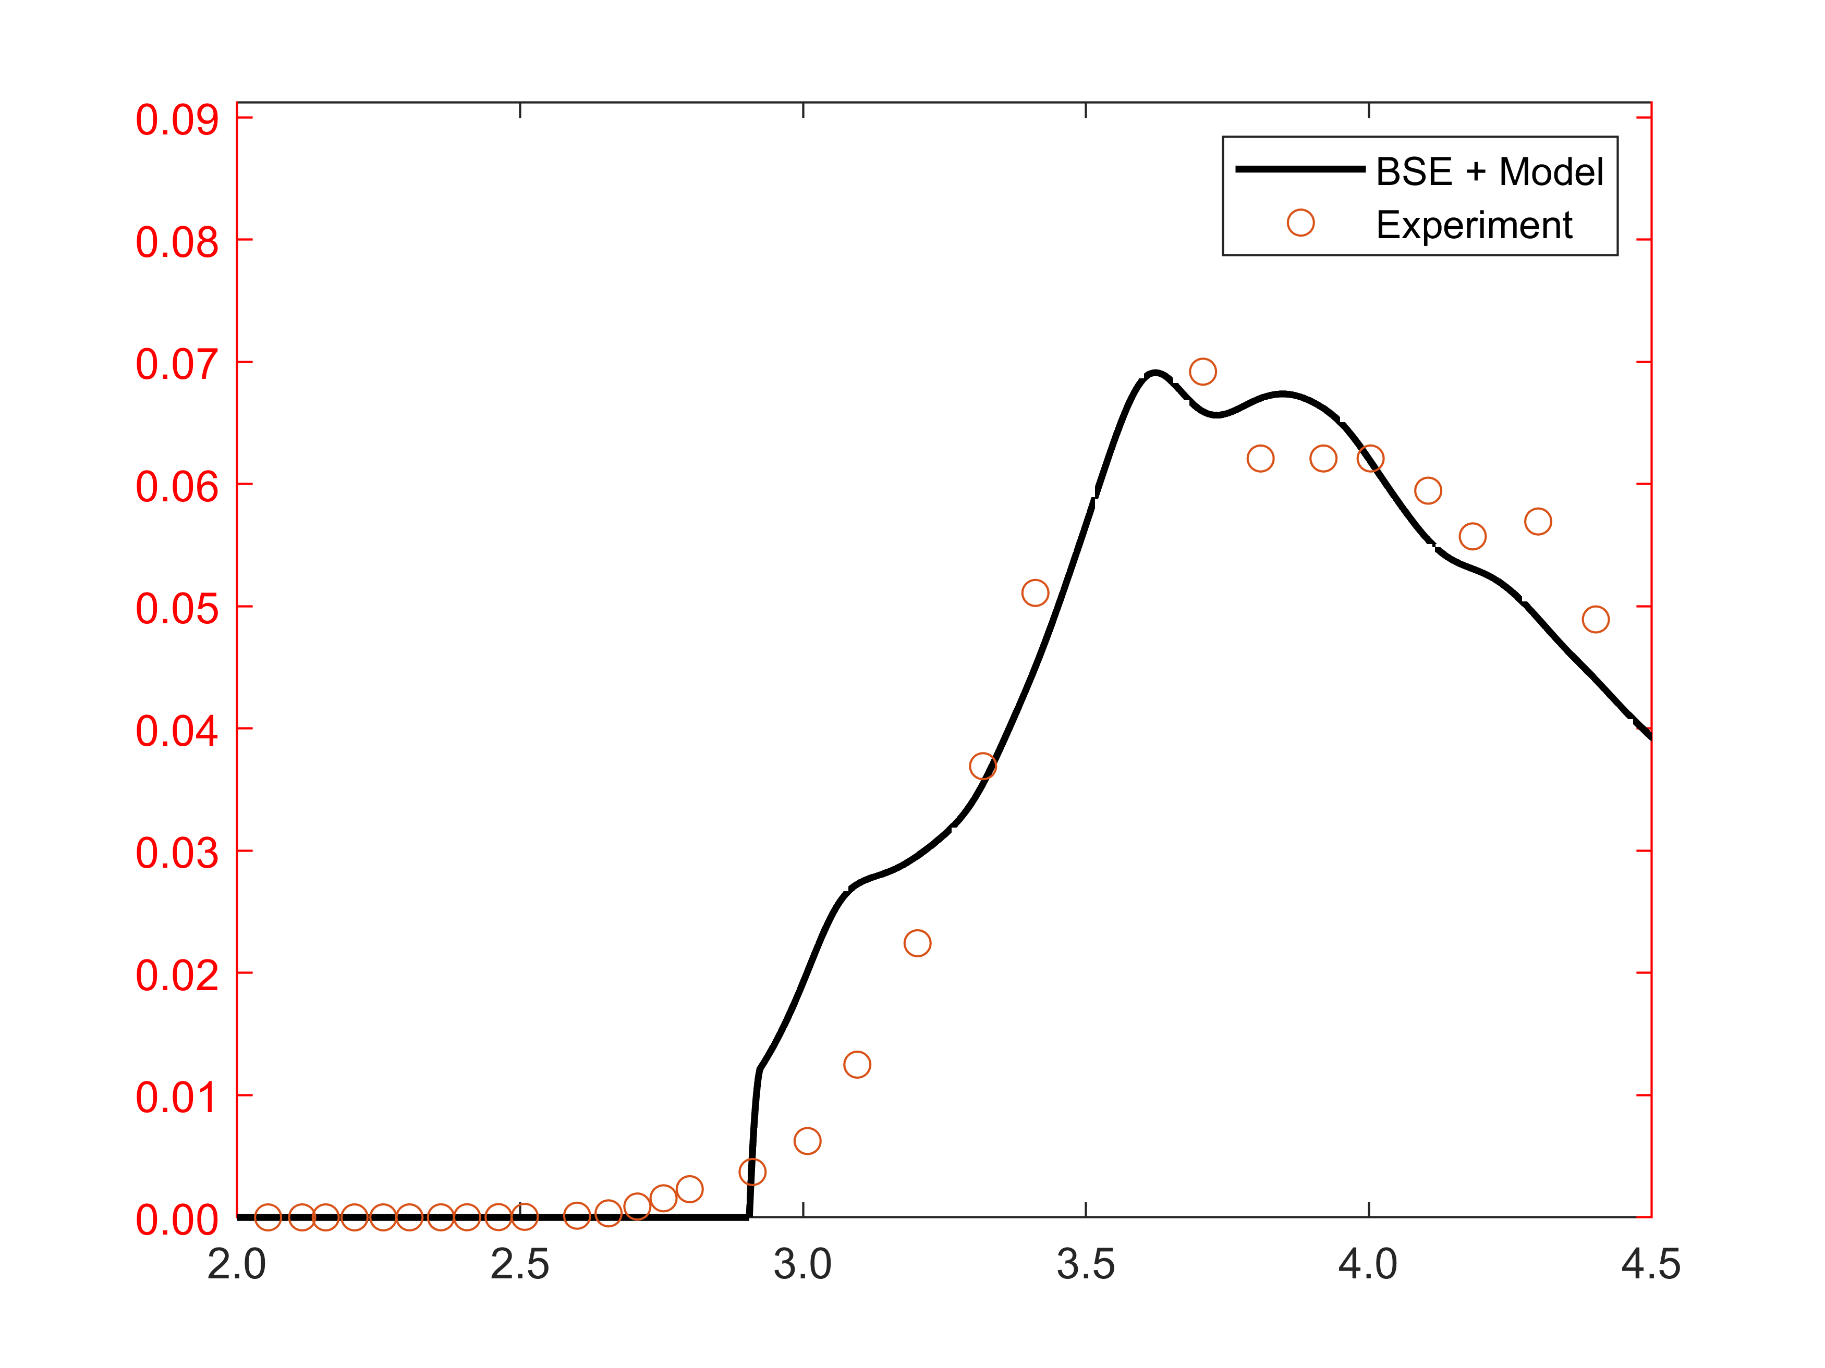
Comparison with Exp. Spectral Response
Hexagonal K₃Sb
QE
Photon Energy [eV]
Experimental data from W. E. Spicer, Phys. Rev. 112, 1 (1958)

Slide 13
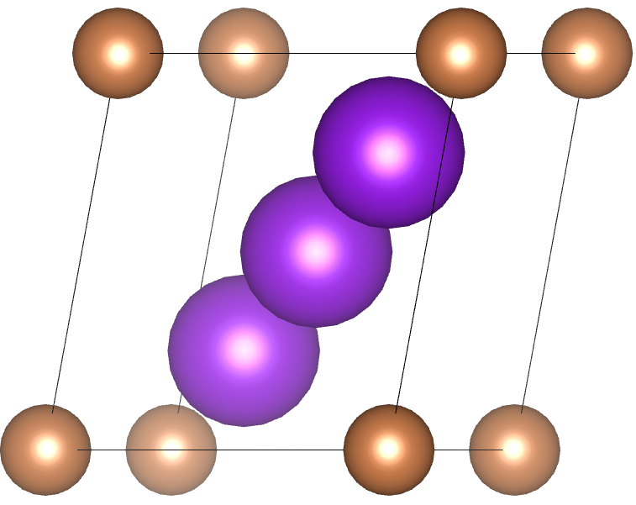
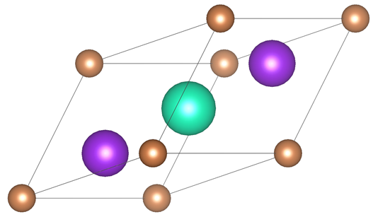
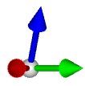
Results for other Alkali Antimonides
Cs₃Sb
cubic
Na₃Sb
hexagonal
CsK₂Sb
cubic

Slide 14
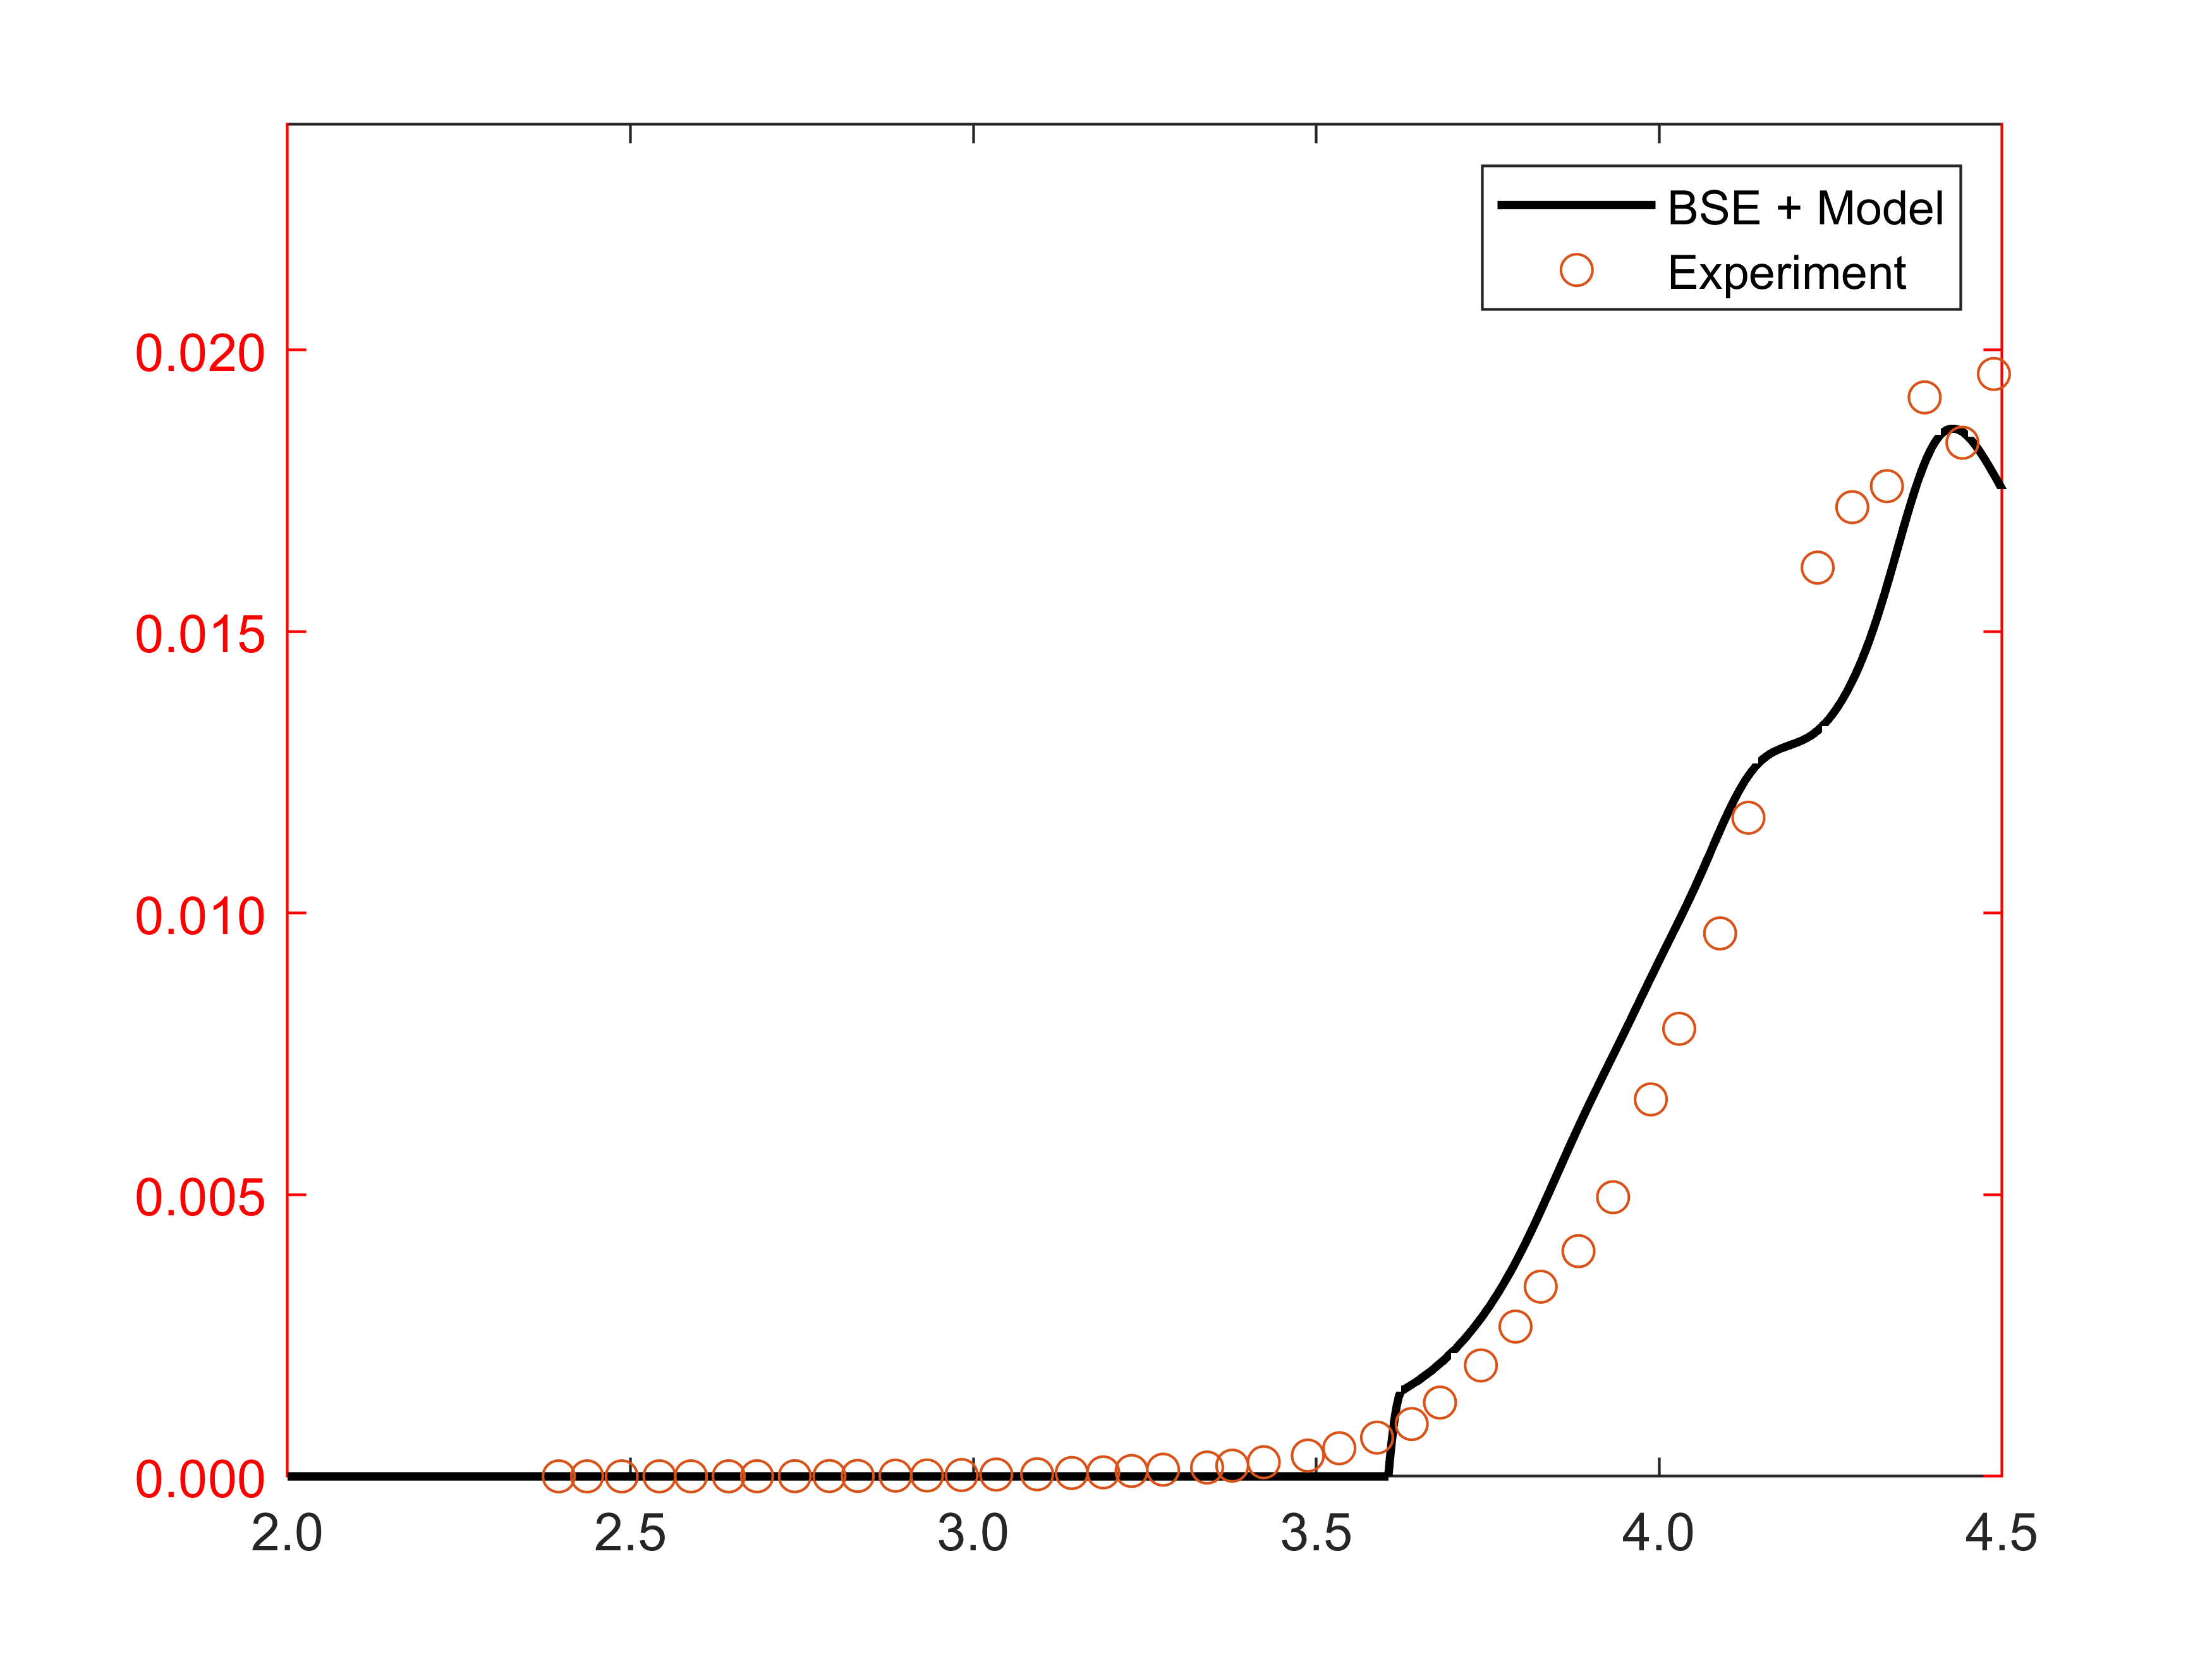
Example 2: Na₃Sb
Hexagonal Na₃Sb
QE
Photon Energy [eV]
Experimental data from W. E. Spicer, Phys. Rev. 112, 1 (1958)

Slide 15
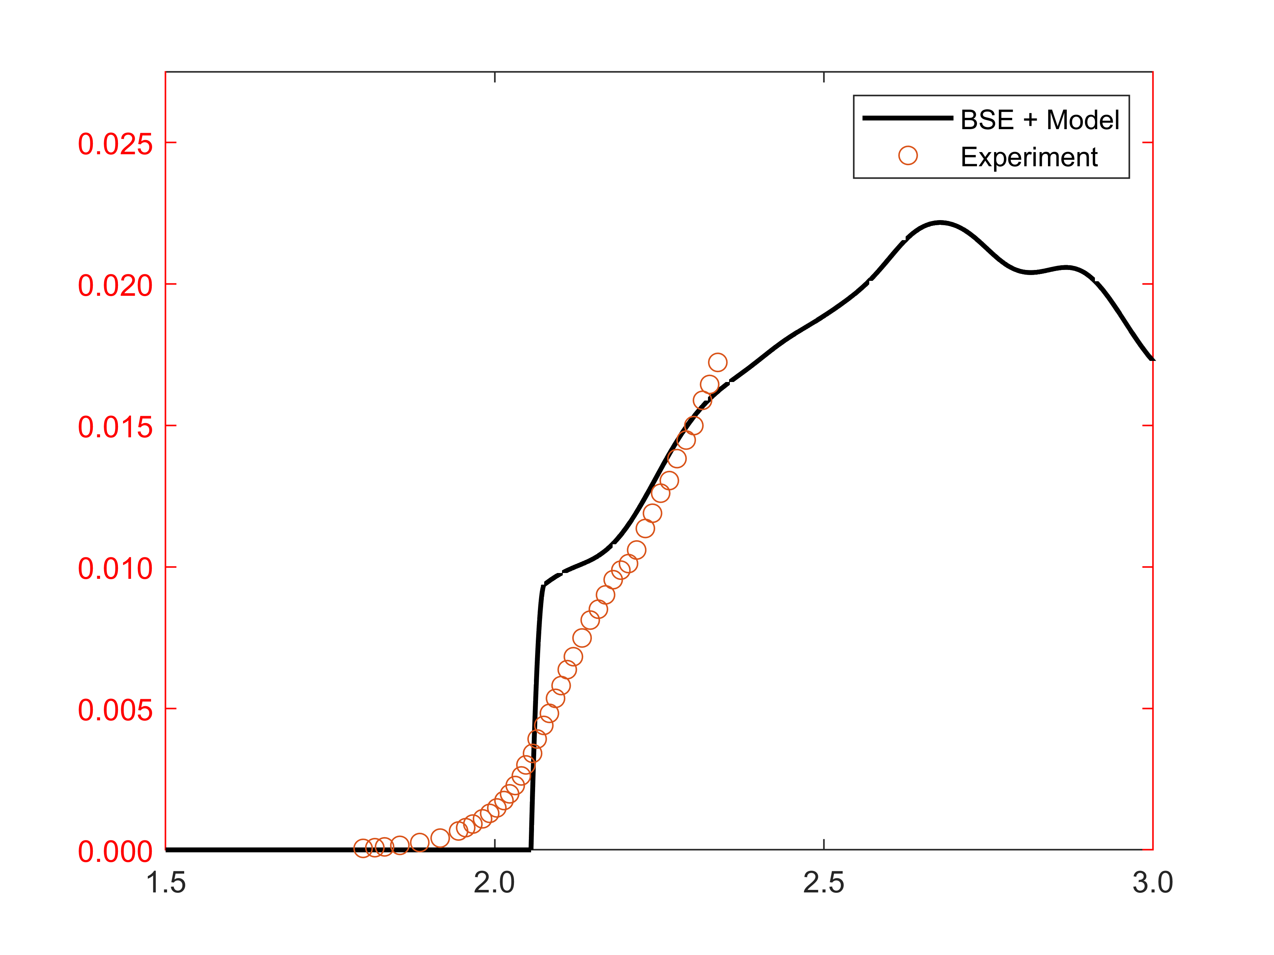
Example 3: Cs₃Sb
Cubic Cs₃Sb
QE
Photon Energy [eV]
Experimental data from P. Saha et al., Appl. Phys. Lett. 120, 194102 (2022)

Slide 16
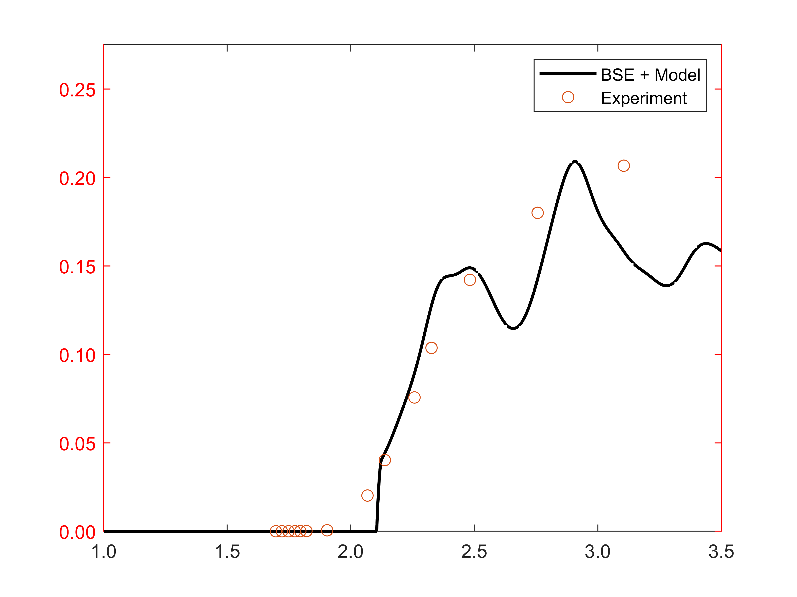
Example 4: CsK₂Sb
Cubic CsK₂Sb
QE
Photon Energy [eV]
Experimental data from L. Guo and M. Katoh, Phys. Rev Accelerators and Beams 22, 033401 (2019)

Slide 17




Summary & Conclusions
We adopted Spicer’s Three-Step-Model to create a description of the photoemission process based on the results from ab initio many-body perturbation-theory.
This goes beyond works based solely on DFT, as we now include electron-electron & electron-hole correlations.
Computational costs are higher than with DFT, but we already have a large set of results from previous works.
Project No. 490940284
Special Thanks to Thorsten Kamps & Team

