Slide 1
Cathodes for high gradient SRF injectors
Ziye Yin Graduate Research Assistant yin@frib.msu.edu
Material for Bright Beams Workshop 2025

Slide 2
Outline
Cathode Requirement for High-Gradient SRF Photoinjectors
Superconducting RF photoinjectors
Cathode requirement and candidates
Cathode Material Candidates
Superconducting photocathodes : Nb, Pb
Normal conducting metal cathodes : Cu, Mg
Semiconductor cathodes : Cs₂Te, K₂CsSb, GaAs
Progress on Cathodes Testing in the LCLS-II HE SRF gun
SRF Cavity test progress
Cathode plug and K₂CsSb cathode preparation
Summary and outlook

Slide 3
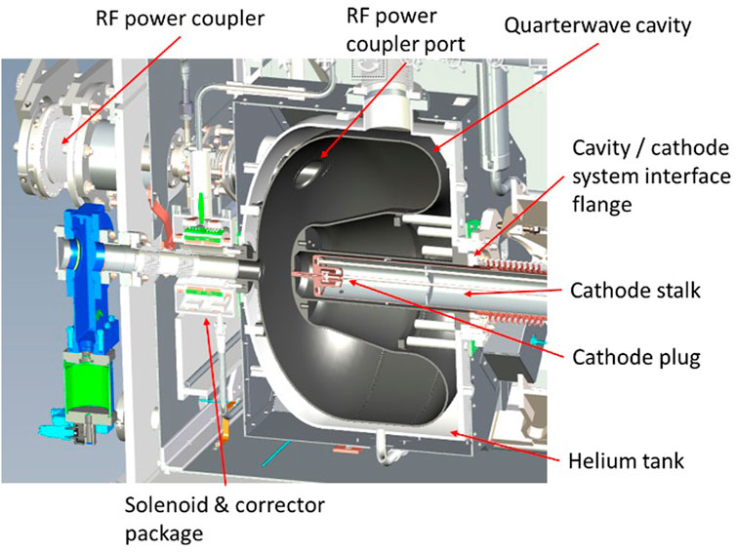
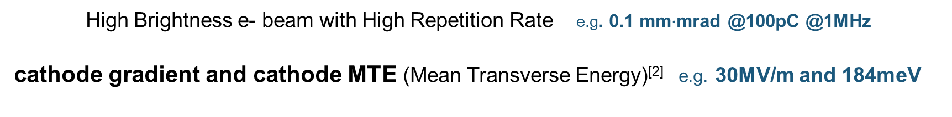
Superconducting RF photo-injector
High Brightness e- beam with High Repetition Rate e.g. 0.1 mm$∙$mrad @100pC @1MHz
cathode gradient and cathode MTE (Mean Transverse Energy)^{[2]} e.g. 30MV/m and 184meV
Key determinants
cryomodule
SC cavity
cathode
E field
solenoid
FPC
Driven laser
SRF photoinjector sketch (elliptical)
LCLS-II-HE SRF Gun^{[1]} (QWR)
[1] Lewellen,J. etc. (2022). Status of the SLAC/MSU SRF Gun Development Project. Proceedings of the 5th North American Particle Accelerator Conference, NAPAC2022
[2] Bazarov, I. etc. (2009). Maximum Achievable Beam Brightness from Photoinjectors. Physical Review Letters, 102(10), 104801

Slide 4
Cathode requirement and candidates
General requirement:
QE (quantum efficiency), thermal emittance, lifetime, response time
Surface roughness^{[1]} → lower MTE and lower dark current
Special requirement for SRF injectors:
Cryogenic temperature: thermal conductivity, thermal expansion, heat load from laser and RF power
Multipacting: low SEY (secondary electron yield)
Avoid Contamination
Material candidates:
Metal: Superconducting / normal conducting → Robust and clean, but low QE
Semiconductor → High QE but fragile
[1] Gevorkyan, G. et al. (2018). Effects of physical and chemical surface roughness on the brightness of electron beams from photocathodes.
[2] Rao, T., & Dowell, D. H. (2013). An engineering guide to photoinjectors.

Slide 5
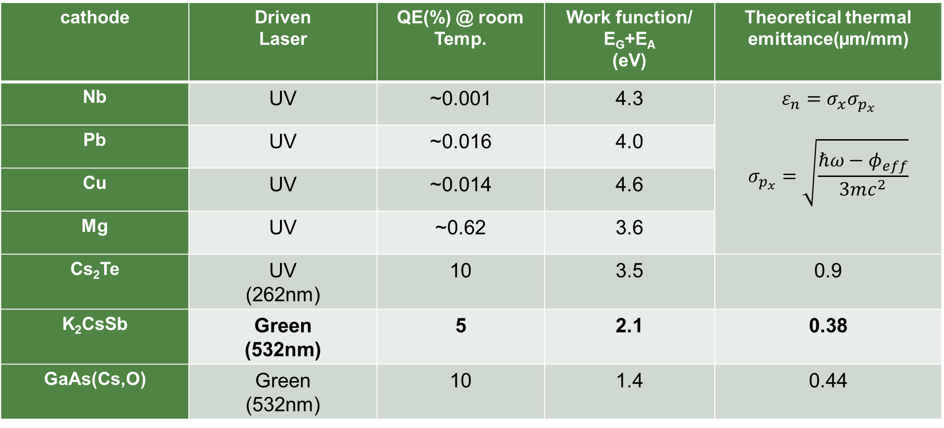
Cathode requirement and candidates
cathode | Driven Laser | QE(%) @ room Temp. | Work function/ E_{G}+E_{A} (eV) | Theoretical thermal emittance(µm/mm)
Nb | UV | ~0.001 | 4.3 | $$ε_{n}=σ_{x}σ_{p_{x}}$$ $$σ_{p_{x}}=\sqrt{\frac{ℏω−φ_{eff}}{3mc^{2}}}$$
Pb | UV | ~0.016 | 4.0
Cu | UV | ~0.014 | 4.6
Mg | UV | ~0.62 | 3.6
Cs₂Te | UV (262nm) | 10 | 3.5 | 0.9
K₂CsSb | Green (532nm) | 5 | 2.1 | 0.38
GaAs(Cs,O) | Green (532nm) | 10 | 1.4 | 0.44
[1] Rao, T., & Dowell, D. H. (2013). An engineering guide to photoinjectors.

Slide 6
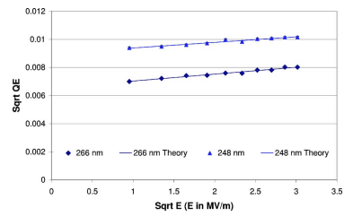
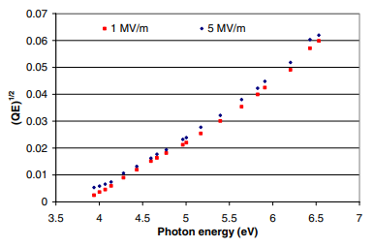

Cathode material candidates – SC metal – Nb/Pb
Directly use back wall of Nb cavity or coat Pb
(QE)^{1/2} vs (field)^{1/2} of Nb^{[1]}
6.5e-5@266nm
1.0e-4@248nm @1MV/m
2.8e-4@193nm
Higher photon energy
→ Higher MTE
$$σ_{p_{x}}=\sqrt{\frac{ℏω−φ_{eff}}{3mc^{2}}}$$
Spectra response of Pb^{[2]}
Max 2.72e-3@213nm, 1MV/m
[1] Smedley, J. etc.(2005). Photoemission studies on niobium for superconducting photoinjectors.
[2] Smedley, J. etc.(2008). Lead photocathodes.

Slide 7
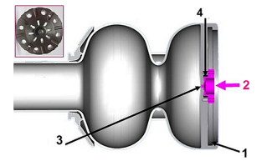
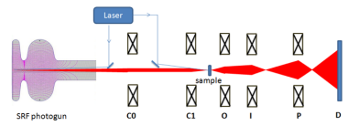
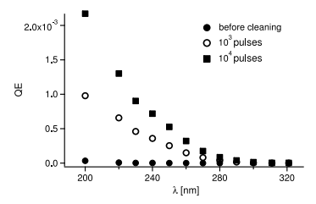
Cathode material candidates – SC metal – Nb/Pb
Nb cathode for UED/UEM application
Charge requirement is low <pC
Pb coated on Nb due to higher QE
Arc deposition gives best results
DESY 1.6cell SRF gun^{[2]}
Max QE 0.2%@200nm
Euclid Techlabs Schematic SRF photogun-based UEM system^{[1]}
cathode QE^{[2]}
[1] Liu, A. etc. (2019). Optimization of an SRF Gun Design for UEM Applications.
[2] Nietubyć, R. etc. (2018). Optimization of cathodic arc deposition and pulsed plasma melting techniques for growing smooth superconducting Pb photoemissive films for SRF injectors.

Slide 8
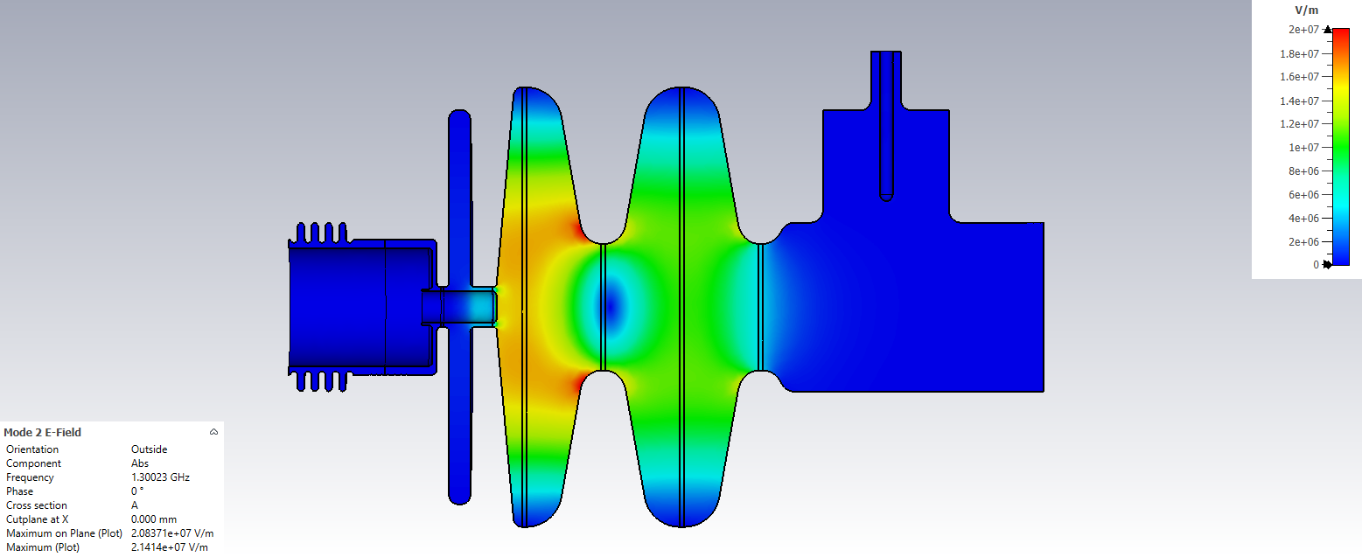
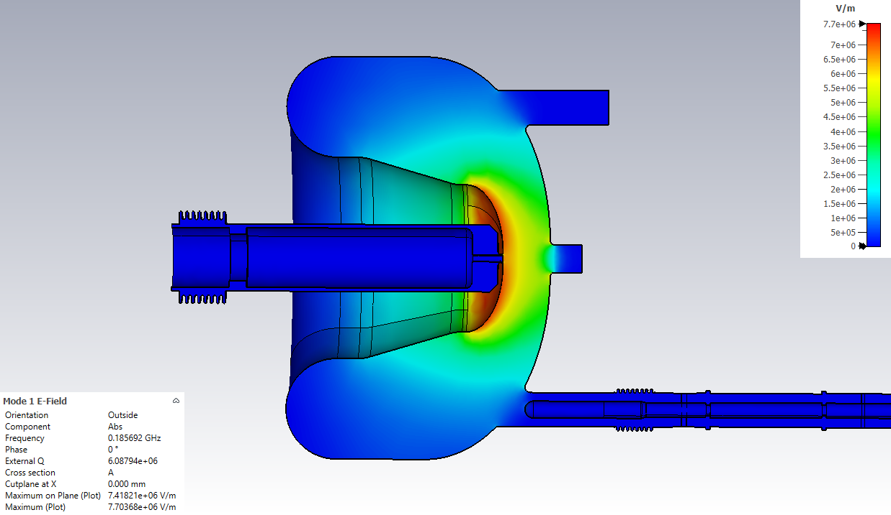
Cathode material candidates – NC metal – Cu/Mg
Robust, good rf properties and thermal conductivity, low dark current and SEY
Thermal isolation from Cavity (same for semiconductor) : choke cavity and cathode stalk
Cu: low QE (<10⁻⁴) but good for initial diagnostic purpose
Mg: high QE up to 0.5%
Cathode plug
Cathode plug
MSU/KEK 1.3GHz 1.5cell SRF gun
LCLS-II HE QWR SRF gun
A challenging mission to transfer cathode without contamination

Slide 9
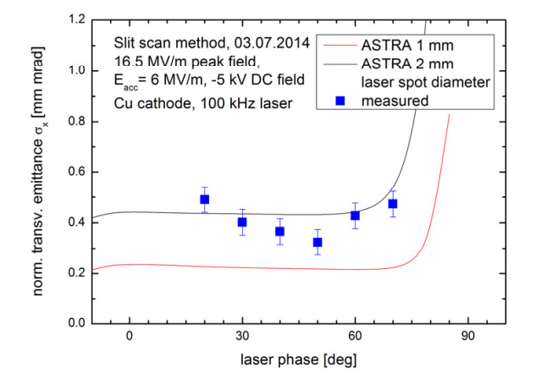
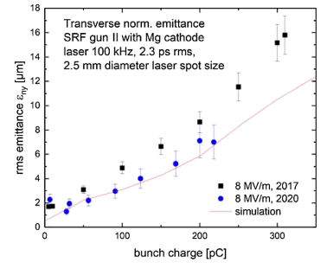
Cathode material candidates – NC metal – Cu/Mg
Performance of cathode in real injector @ HZDR 3.5cell 1.3GHz SRF gun
Cu: ~0.5 mm mrad / mm @ 1pC @6MV/m
Mg: ~3 mm mrad / mm @ 250pC @ 14.5MV/m
*same laser
Cu cathode performance^{[1]}
Mg cathode performance^{[2]}
Over one-year long operation
[1] Teichert, J. et al.(2014) Commissioning of an improved superconducting RF photo injector at ELBE.
[2] Teichert, J. et al. (2021). Successful user operation of a superconducting radio-frequency photoelectron gun with Mg cathodes. Physical Review Accelerators and Beams, 24(3), 033401.

Slide 10
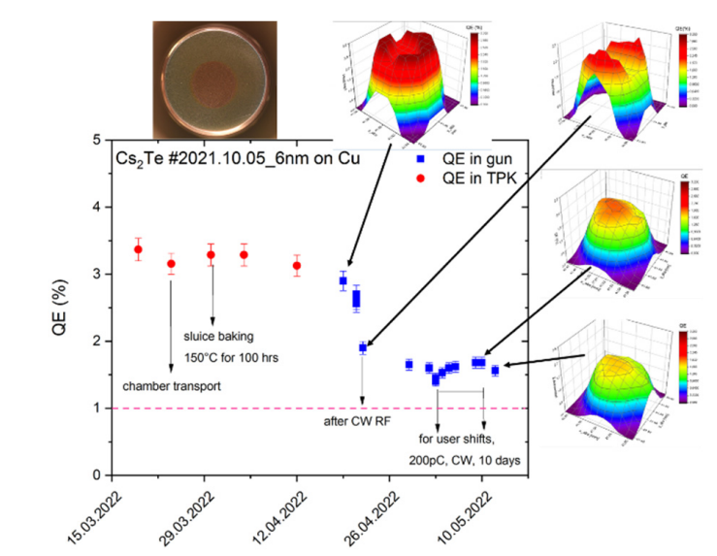
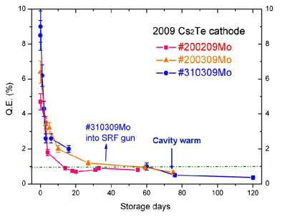
Cathode material candidates – Semiconductor – Cs₂Te
Successful operation @ HZDR 3.5cell 1.3GHz SRF gun
high average current (1 mA) and low emittance (1 mm mrad @ 77 pC)
Cs
evaporators
Te
high QE (1-10%) @ UV
relatively robust
high gradient (100MV/m)
demonstrated in NCRF guns
thermal isolation
Cs contamination
field emission
multipacting
Mo substrate performance^{[1]}
Cu substrate performance^{[2]}
Lifetime > one year
Without cavity warm up
[1] Xiang, R. et al. (2010). Cs₂Te normal conducting photocathodes in the superconducting rf gun. Physical Review Special Topics - Accelerators and Beams, 13(4), 043501.
[2] Xiang, R., & Schaber, J. (2022). Review of Recent Progress on Advanced Photocathodes for Superconducting RF Guns. Micromachines, 13(8), 1241.

Slide 11
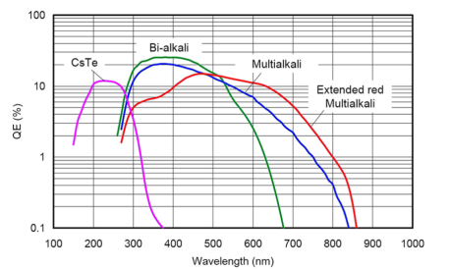
Cathode material candidates – Semiconductor – K₂CsSb
High QE in green wavelength, low thermal emittance
So ideal but unstable and complicated fabrication
Smoother
Sequential deposition to co-deposition[1]
Coating temperature dependence[3]
Substrate dependence[5][6]
Epitaxy growth[7]
Stronger
Sb thickness dependence[2]
Stoichiometry dependence[4]
Graphene/2D protection layer[8][9]
[1] Feng, J. et al. (2017). Near atomically smooth alkali antimonide photocathode thin films. Journal of Applied Physics, 121(4), 044904.
[2] Mamun, M. A. A. et al. (2016). Effect of Sb thickness on the performance of bialkali-antimonide photocathodes.
[3] Mohanty, S. K. et al. (2023). Development and Characterization of Multi-Alkali Antimonide Photocathodes for High-Brightness RF Photoinjectors. Micromachines, 14(6), 1182.
[4] Guo, L. et al. (2025). Improved robustness of sequentially deposited potassium cesium antimonide photocathodes achieved by increasing the potassium content towards theoretical stoichiometry. Scientific Reports, 15(1), 2900.
[5] Guo, L. et al. (2017). Substrate dependence of CsK2Sb photo-cathode performance. Progress of Theoretical and Experimental Physics, 2017(3).
[6] Smedley, J. et al. (2009). K₂CsSb Cathode Development. AIP Conference Proceedings, 1062–1066.
[7] Parzyck, C. T. et al. (2022). Single-Crystal Alkali Antimonide Photocathodes: High Efficiency in the Ultrathin Limit. Physical Review Letters, 128(11), 114801.
[8] Wang, G. et al. (2018). Overcoming the quantum efficiency-lifetime tradeoff of photocathodes by coating with atomically thin two-dimensional nanomaterials. Npj 2D Materials and Applications, 2(1), 17.
[9] Yamaguchi, H. et al. (2017). Active bialkali photocathodes on free-standing graphene substrates. Npj 2D Materials and Applications, 1(1), 12.

Slide 12
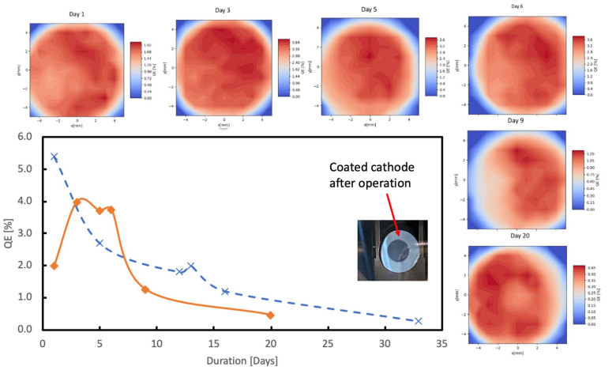
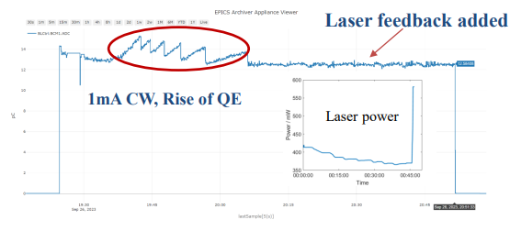
Cathode material candidates – Semiconductor – K₂CsSb
Gradient @ 18MV/m
0.3 um @ 100pC; 0.57 um @ 600pC
one month operation time @ BNL
0.28 um @ 20pC; 0.43 um @ 50pC; 0.58 um @ 100pC
16 hours operation time @ PKU
QE evolution at BNL SRF gun^{[1][2]}
Current evolution at PKU DC-SRF-II gun^{[3]}
[1] Petrushina, I. et al. (2020). High-Brightness Continuous-Wave Electron Beams from Superconducting Radio-Frequency Photoemission Gun. Physical Review Letters, 124(24), 244801.
[2] Wang, E. et al. (2021). Long lifetime of bialkali photocathodes operating in high gradient superconducting radio frequency gun. Scientific Reports, 11(1), 4477.
[3] Huamu, Xie (2023). Successful operation of K2CsSb photocathode in DC-SRF-II gun. Talk at Photocathode Physics for Photoinjectors(P3) Workshop.

Slide 13
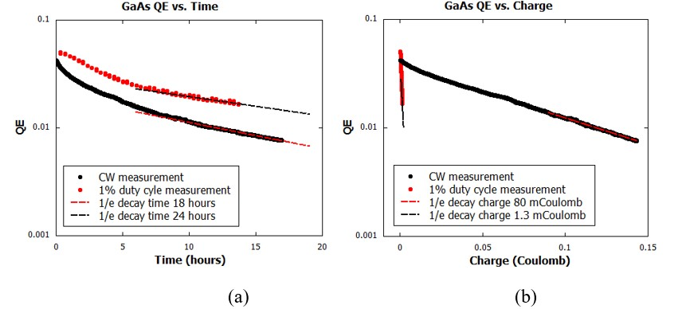
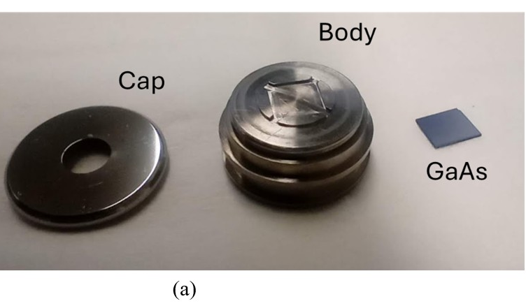
Cathode material candidates – Semiconductor – GaAs
High QE at green wavelength
Polarized beam generation (Cs, O layer)
Successful test in BNL 2025
Super fragile, still long way to go
QE start from 0.05%; lifetime 24hrs; charge lifetime 1.3mC for CW
GaAs cathode assembly^{[1]}
GaAs QE and charge evolution^{[1]}
[1] Litvinenko, V. et al. (2025). Breakthrough in Generation of Polarized Electron Beams: Unveiling the World’s First RF Electron Gun with GaAs Photocathode.

Slide 14
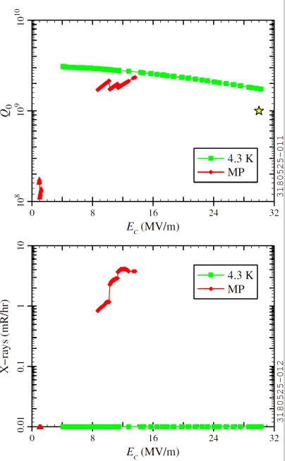




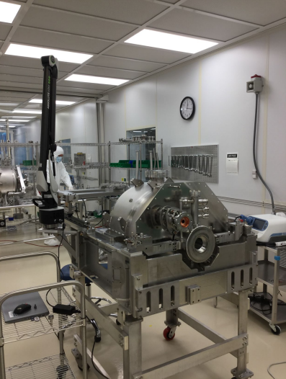
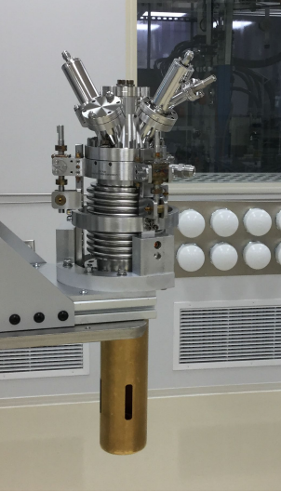
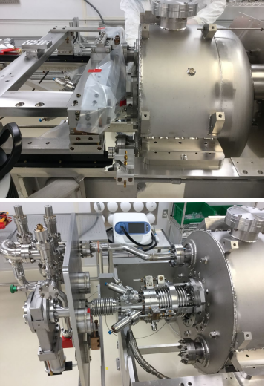
Progress on Cathodes Testing in the LCLS-II HE SRF gun
Successful test of the blank cavity (without cathode port) > 30MV/m
Cold mass
Cathode stalk
Full assembly
Next step is cavity test with cathode stalk in new cryomodule
With Cu plug (dark current could be measured)
Cold test results

Slide 15
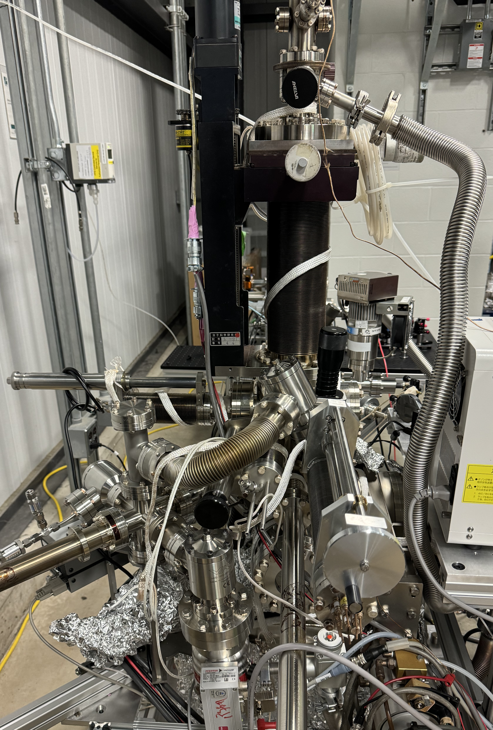
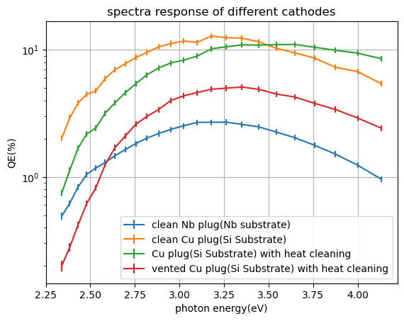
Progress on Cathodes Testing in the LCLS-II HE SRF gun
K₂CsSb has been successfully fabricated at FRIB
Sequential deposition
Si and Nb substrate
Ongoing modification for LCLS-II HE gun suitcase
Co-deposition ability
Mo layer on Cu plug substrate
Fabricated K₂CsSb cathode spectra response^{[1]}
Cathode preparation chamber
[1] Yin,Ziye, et al. (2024). Development of Bi-Alkali antimonide photocathodes for a 1.3 GHz superconducting rf photo-injector.

Slide 16
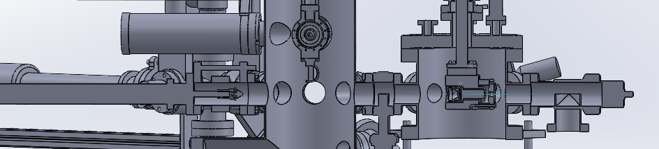
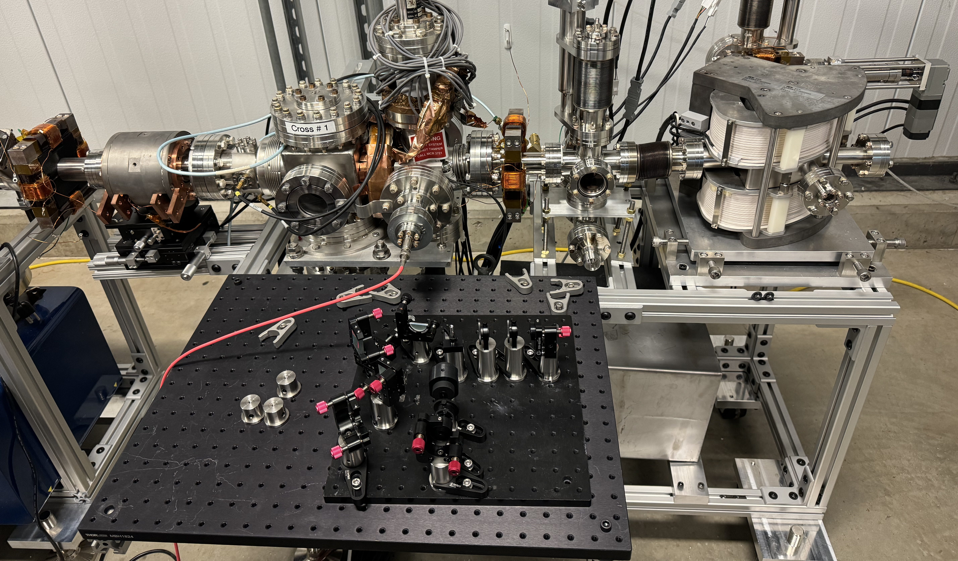
Progress on Cathodes Testing in the LCLS-II HE SRF gun
A diagnostic beam was tested by a 20KeV DC gun
Cathode can be directly transferred to DC gun
Laser system is built by ourselves (ongoing)
515nm, 1ps, 40.625MHz, 0.1mW
electron 100fC/bunch and 1uA average current
Cathode chamber
DC gun chamber
gun
solenoid
mirror chamber
Bending magnet
BPM
faraday cup
& screen
faraday cup
& screen
pulsed laser system
Beamline picture

Slide 17
Summary and Outlook
LCLS-II HE needs 0.1mm *mrad @ 100pC initial electron beam
High gradient SRF photoinjector is being developed, blank cavity is verified
Cathode is one of the key component of it
Metal are clean and robust but not qualified as a cathode
Semiconductor photocathodes especially K₂CsSb have the potential to meet the requirements but still need further effort

Slide 18
Acknowledgement
Thanks for everyone helping with this talk:
John Smedley, SLAC
John Lewellen, LANL
Ting Xu, FRIB
Taro Konomi, FRIB
Rong Xiang, HZDR
Erdong Wang, BNL

Slide 19
Q&A
Thank you for your attention!

Slide 20
Back up slides: cathode test timeline
This summer Cu plug will be tested, and dark current will be measured
Semiconductor test plan is within next two years
Task | Description | Year 1 |  |  |  | Year 2
1 | Beam line and laser system design
2 | Cathode shape optimization
3 | Plasma processing development
4 | Procurements and fabrication
5 | Cathode growth system development
6 | Bunker preparation
7 | Device hazard analysis and review for beam tests in bunker
8 | Cryomodule cool down and Run 1
9 | Cryomodule rework (if needed)
10 | Cryomodule cool down and Run 2
11 | Cryomodule cool down and Run 3

