Slide 1
Charge to the Inaugural Materials for Bright Beams Workshop
Lance Cooley
Magnet Enterprise Director, National High Magnetic Field Laboratory
Florida State University

Slide 2
Why are we here?
Accelerators use special materials to create bright beams
Better accelerators are realized more quickly for lower cost when materials researchers interact with accelerator builders
DOE lab mission pull → “End use inspired” basic research
The grand challenges of accelerators and bright beams, in turn, inspire new materials research
New generations of performance from better materials → opportunities that enable and enhance facilities and devices with particle beams
A 1 TeV linear collider would not be practical without SRF materials

Slide 3
What do we hope to achieve?
This meeting represents a consortia of experts (now and future) who address grand challenges articulated by national panels associated with science, accelerators, and impacts to society
We want to define, and gain support for, an ecosystem where materials research inspires opportunities for producing and accelerating beams, which in turn inspire and motivate funding for new areas of materials research
The main topics of this meeting should be captured in summary notes (not a public-facing white paper) suitable for reading by agency persons
Examples follow on the next slides

Slide 4
The DOE-HEP Conductor development consortia began with university grants c. 1980 and continues today via the annual Low Temperature Superconductor Workshop (LTSW)
New Bi-2212 powder
Steady performance since 2017 → focus is now on magnet development
4.2 K data
1000
750
30 µm + BaZrO₃
LHC Upgrade wire production
Current in 0.5 mm² conductor cross-section, Amperes
38 µm
$1 / kA-m
500
REBCO 20 T (perp.)
(parallel is 6x higher)
Performance is so good that development now focuses on cost reduction and magnet engineering
Ta, APC
IBS
PbMo₆S₈
MgB₂
50 µm
Nb₃Al
250
$16 / kA-m
70 µm
100 µm thick Hastelloy substrate
The first LTSW

Slide 5
Fusion vs HEP: Will there be a shift in magnet conductor innovation ecosystems?

Slide 6
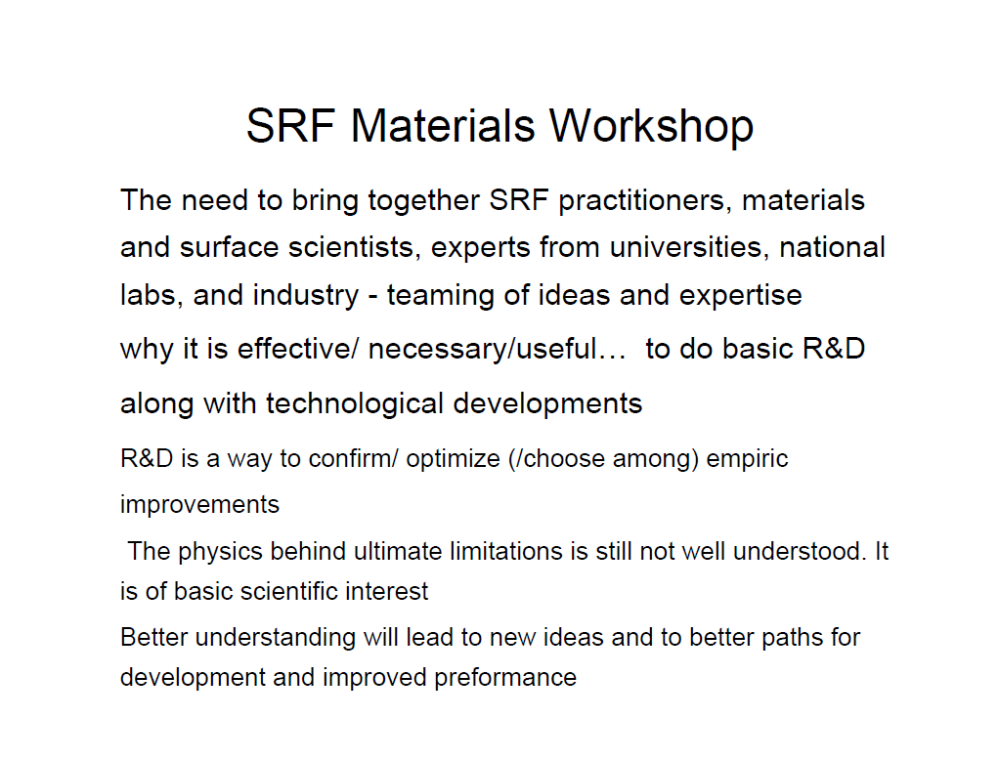
Introductory slide from Helen Edwards for the May 2007 SRF Materials Workshop, organized by Edwards, Claire Antoine, and Lance Cooley
DOE, along with the ILC R&D program, supported a workshop series that formally ran between 2007 and 2012

Slide 7
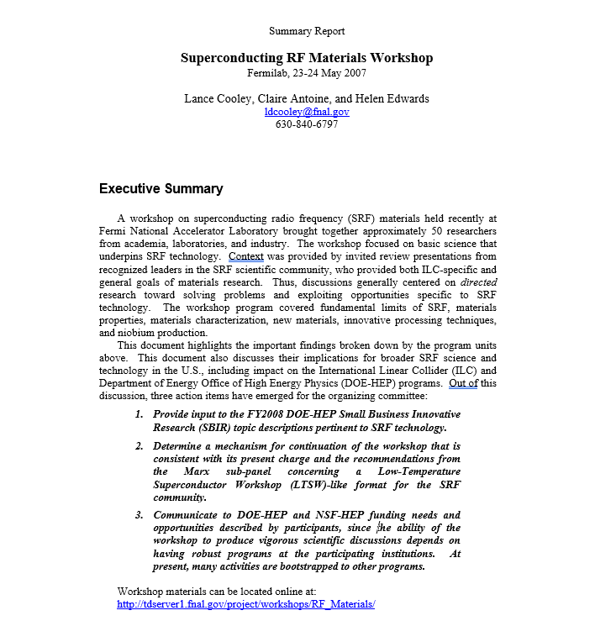
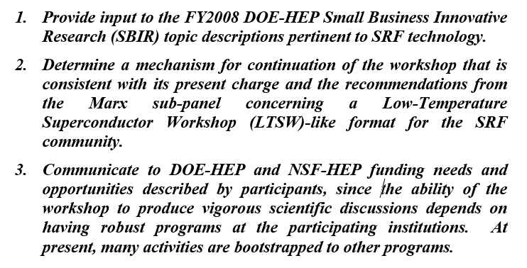
Summary report to DOE, June 2007. This was not a public white paper!
In 2008, the SRF University Collaboration was formed in response, led by Fermilab (Cooley) and Jefferson Lab (Charlie Reece).
Participants: UChicago, IIT, Northwestern, Mich.St., ODU, Wm. & Mary, U Virginia, Cornell, Florida State

Slide 8
Model: the Low Temperature Superconductor Workshop (aka the HEP conductor workshop)
Gordon Conference format: Lots of discussion time
Presentations might show results prior to publication or thesis writing, or might show provocative yet half-baked ideas
Ethics and integrity: Ownership of ideas shall be respected by all attendees (invitation only). There are multiple checks and balances within our small specialized community
For example, university groups review SBIR proposals
For example, national laboratory leaders participate in the comparative grant review

Slide 9
Framework of the LTSW and this meeting
Overview presentations describe the challenges and limitations being encountered in bright beams
Often, the end-use pull from projects and missions
Contributed discussions do not need to spend time on introduction and motivation → get to the details quickly!!
This is not a conference → presenters should allow for lively discussion (and be provocative!)
Moderators are facilitators (“raconteurs”) of lively, free-wheeling, group discussion, especially when groups of presentations have been shown

Slide 10
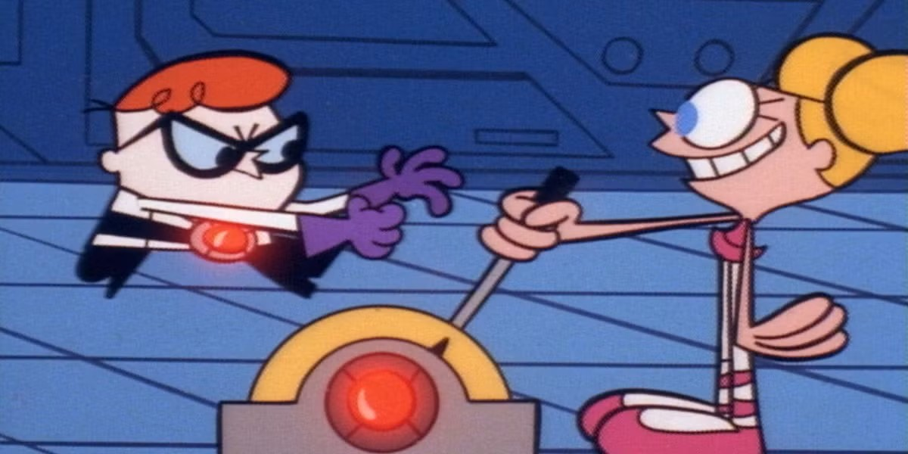
Let’s begin!

