Slide 1
Progress Towards 100pC 100nm Beams at Pegasus

Slide 2
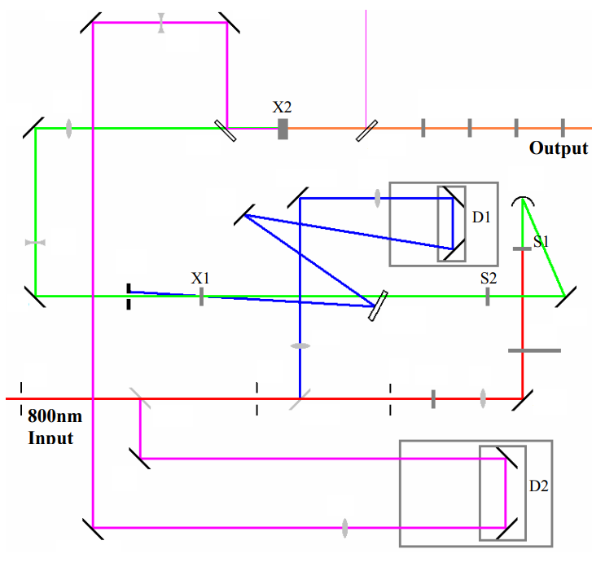
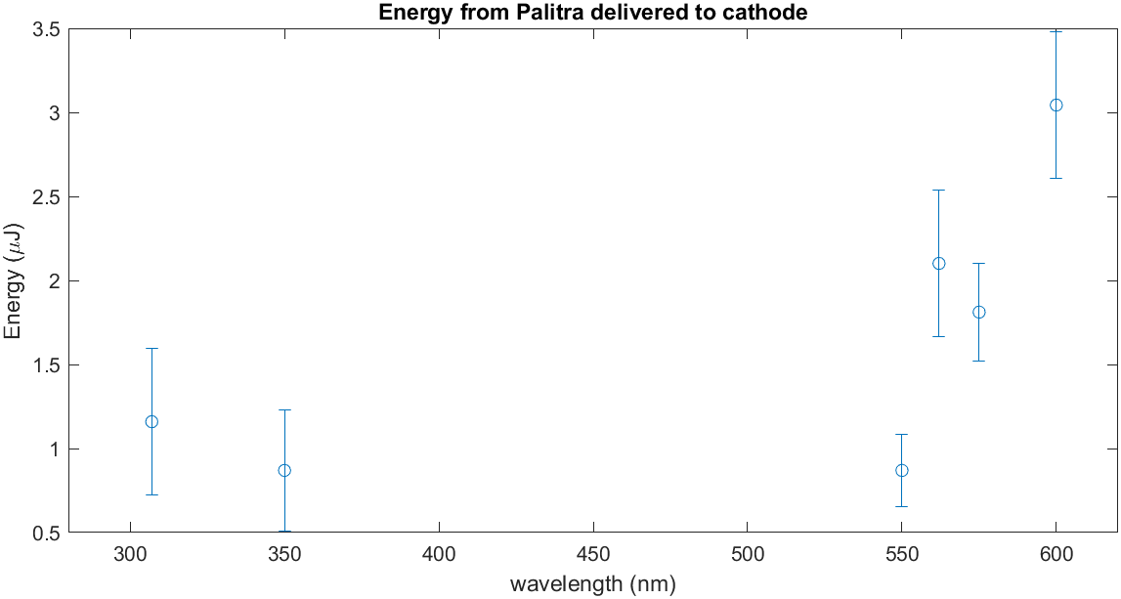
Palitra Optical Parametric Amplifier
Palitra OPA converts input 800nm pulse into a pulse tunable throughout the visible & ultraviolet
To satisfy 100pC & 100nm constraints, we will likely need to be able to tune the excess energy
$${\text{E}}_{\text{ex}}=hν−φ_{\text{eff}}$$
For example, in metals we expect
$\text{QE}∝{\text{E}}_{\text{ex}}^{2}$ & $ε_{n}∝\sqrt{{\text{E}}_{\text{ex}}}$
VIS2
UV2
Schematic of the Palitra OPA

Slide 3
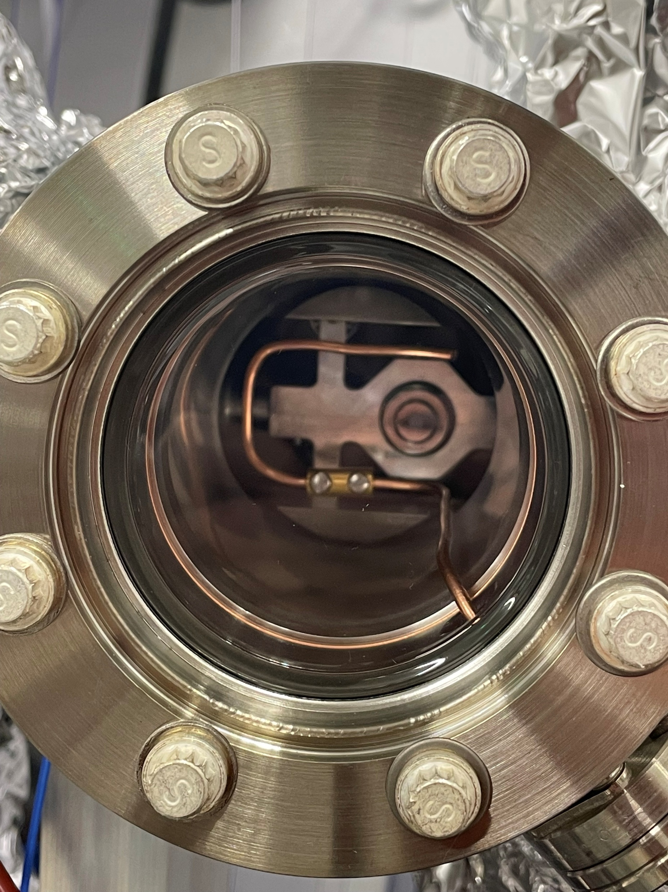
Semiconductor Cathodes
We are receiving 3 cathodes from SLAC early-mid March
2 CsSb & 1 CsTe
Cathodes are being revived next week, QE measured on 2025/02/20
@ 405nm: 1.4e-3
Improvements in transport
Ion pump operational during transport for active pumping
QE monitor to track state of cathode during transport
Suitcase at SLAC with CsSb cathode & collection coil to measure photocurrent

Slide 4
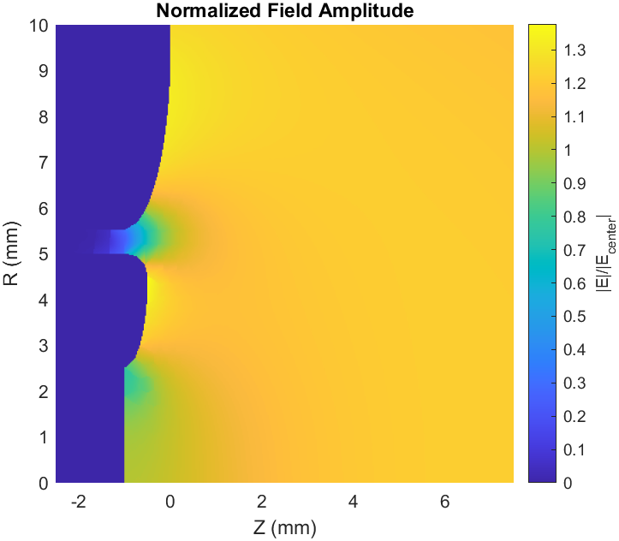
INFN Wafer Compatible Plug
To take advantage of recent developments on growth of single crystal semiconductor cathodes, we modify the INFN plug to accept a wafer of our choice
Post screws into shell to hold a 7mm diameter wafer
Nose designed optimized in Superfish codes to have a 38% larger peak field compared to the cathode center
Notes:
This can just be a stepping stone? In the future we can specialize how to hold a specific wafer to avoid these nose issues
Add lens to the back of the plug for small spots?

