Slide 1
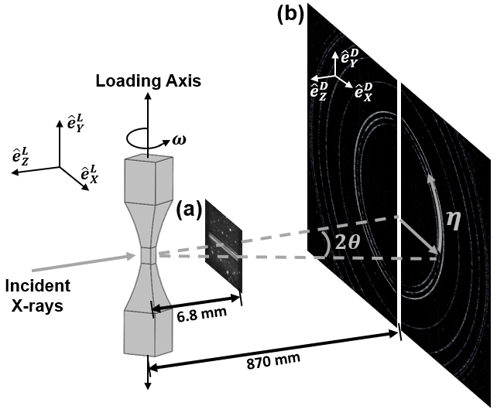
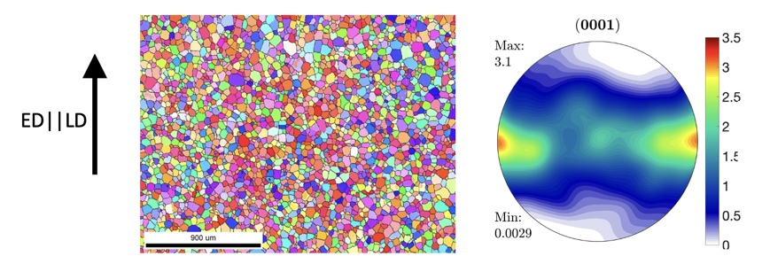
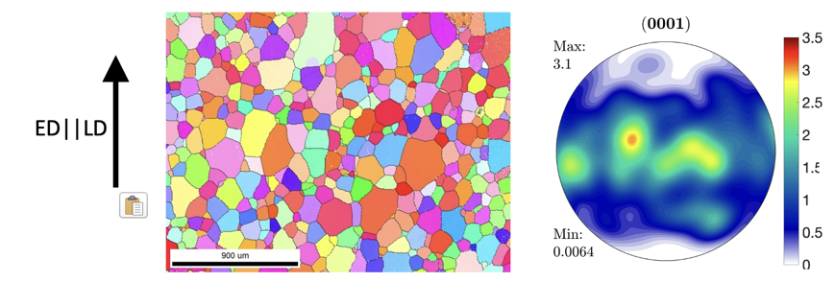
Experimental set-up and motivation
Near-field and far-field HEDM performed at the FAST beamline using the using the Rotational and Axial Motion System (RAMS2) loading frame
Mg-1Y (wt%)
~5-11 mm
Near-Field
Mg-3Zn-0.1Ca (wt%)
~1 m
Far-Field
Goal: understand alloying effect of Y and Zn + Ca on twinning and <c+a> slip
(important deformation mechanisms in the hcp crystal structure)

Slide 2
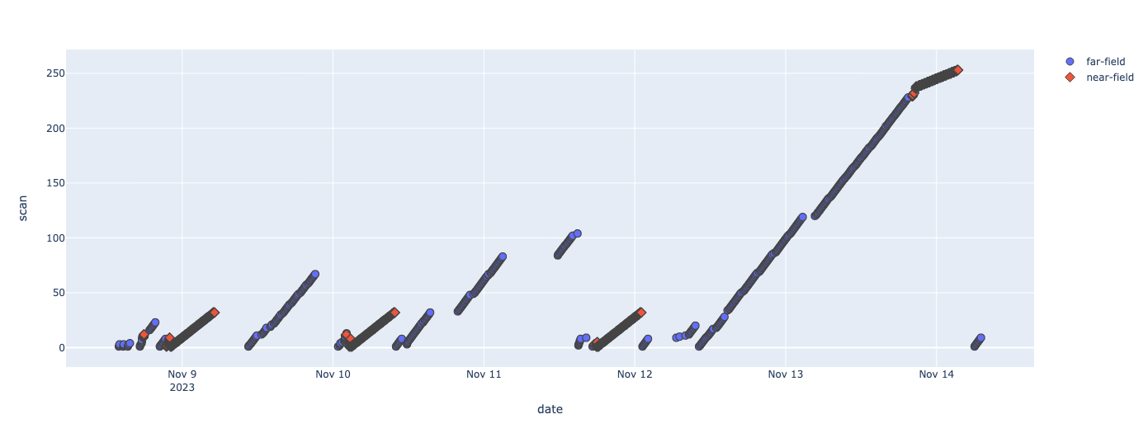
Beam Run Timeline
2nd
Mg-3Zn-0.1Ca
Specimen
(during compressive loading)
Mg-3Zn-0.1Ca
Specimen
(during compressive loading)
Mg-1Y specimen
(during tensile loading)
Mg-1Y specimen
(before loading)
2nd
Mg-3Zn-0.1Ca
Specimen
(after un-loading)
Mg-3Zn-0.1Ca
Specimen
(before loading)
2nd
Mg-3Zn-0.1Ca
Specimen
(before loading)

Slide 3
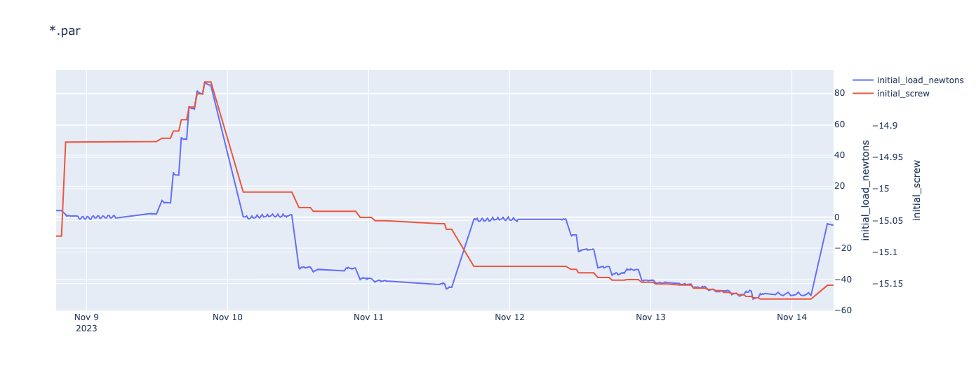
2nd
Mg-3Zn-0.1Ca
Specimen
(during compressive loading)
Mg-3Zn-0.1Ca
Specimen
(during compressive loading)
Mg-1Y specimen
(during tensile loading)
Mg-1Y specimen
(before loading)
2nd
Mg-3Zn-0.1Ca
Specimen
(after un-loading)
Mg-3Zn-0.1Ca
Specimen
(before loading)
2nd
Mg-3Zn-0.1Ca
Specimen
(before loading)

Slide 4
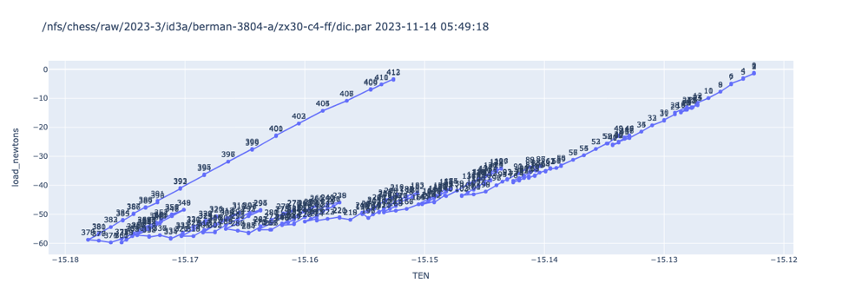
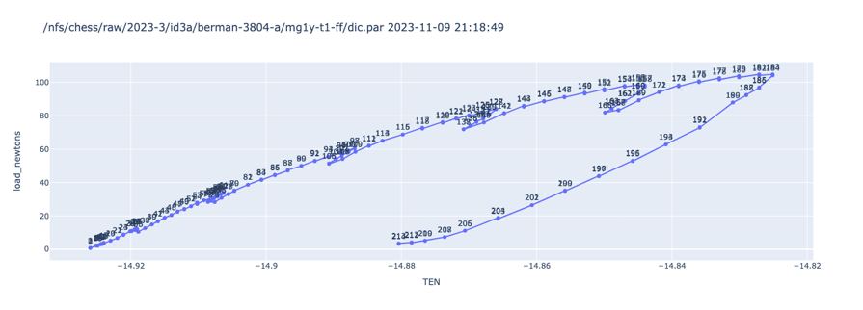
2nd
Mg-3Zn-0.1Ca
Specimen
(during compressive loading)
Mg-3Zn-0.1Ca
Specimen
(during compressive loading)
Mg-1Y specimen
(during tensile loading)
Mg-1Y specimen
(before loading)
2nd
Mg-3Zn-0.1Ca
Specimen
(after un-loading)
Mg-3Zn-0.1Ca
Specimen
(before loading)
2nd
Mg-3Zn-0.1Ca
Specimen
(before loading)
2nd Mg-3Zn-0.1Ca
Specimen
(during compressive loading)
Mg-1Y specimen
(during tensile loading)

Slide 5
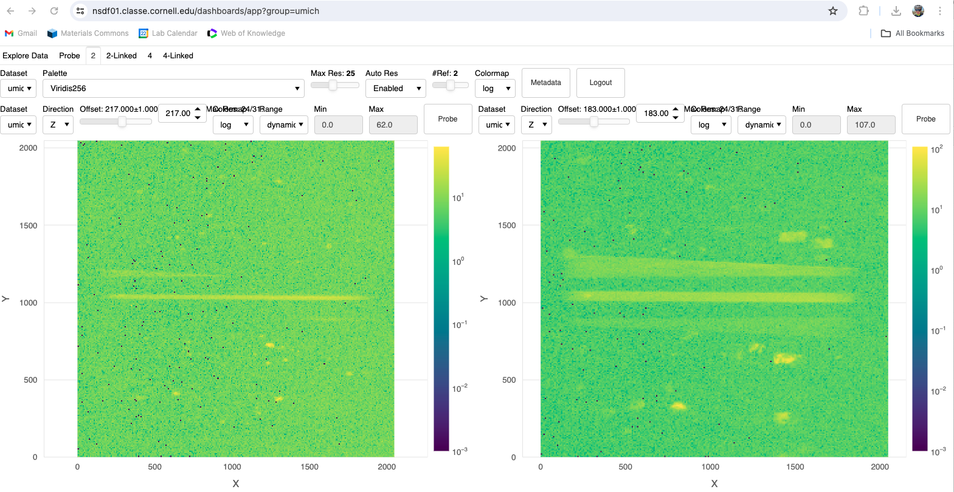
Near Field scans on specimens before loading
Mg-1Y (mg1y-1-nf_#)
(~50 µm diameter)
Mg-3Zn-0.1Ca (zx30-t1-nf_#)
(~150 µm diameter)

Slide 6
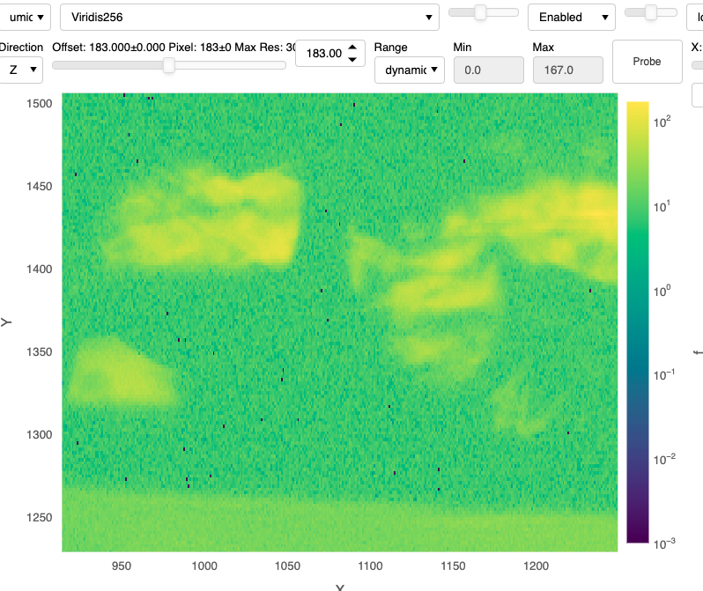
Near Field scans on specimens before loading: Signs of pre-deformation deformation!
Structure within spots suggests material experienced some deformation before the start of our loading experiment (during specimen machining/transport/loading?)
As a remote user in a mixed on-site/remote team, I’d feel more comfortable taking a first look at the NF data on the dashboard than using NoMachine
Zoomed in view zx30-t1-nf_29

