Slide 1
The Bmad-Julia Project
A full-featured ecosystem for modern, differentiable accelerator physics simulations
Matt Signorelli, David Sagan
Cornell ERL/EIC Group
PI: Georg Hoffstaetter de Torquat

Slide 2
Julia? What’s that?
Julia is a relatively new high-level, high performance computing language
Aims to solve the “two-language” problem: as fast as C, but as simple as Python
Adopts multiple dispatch with just-in-time (JIT) compilation as central paradigms
A powerful type system providing universal, ad-hoc, and subtype polymorphisms
Consider the function:
No types specified in function def.
Suppose you call track_drift with
Julia will JIT-compile a function for these specific types
Compiled = fast!!!
function track_drift(z0, L)
zf = similar(z0)
zf[1] = z0[1]+z0[2]*L/(1.0+z0[6])
zf[2] = z0[2]
zf[3] = z0[3]+z0[4]*L/(1.0+z0[6])
zf[4] = z0[4]
zf[5] = z0[5]-L*((z0[2]^2)+(z0[4]^2))/(1.0+z0[6])^2/2.0
zf[6] = z0[6]
return zf
end
z0::Vector{Float64}
L::Float64

Slide 3
Entirely in the Julia Language
Entire ecosystem of optimizers, symplectic integrators, plotting packages, etc. at one’s fingertips with zero extra effort
E.g. suppose you have some tracking function, and you want to find the closed orbit:
We can use any optimizer, written by the experts, immediately. E.g. Optim:
Or NLSolve:
Etc,etc.
The sky is the limit!
function track(ring, z0)
...
return zf
end
using Optim
optimize(z->norm(z-track(z)), [0,0,0,0,0,0])
using NLsolve
nlsolve(z->norm(z-track(z)), [0,0,0,0,0,0])

Slide 4
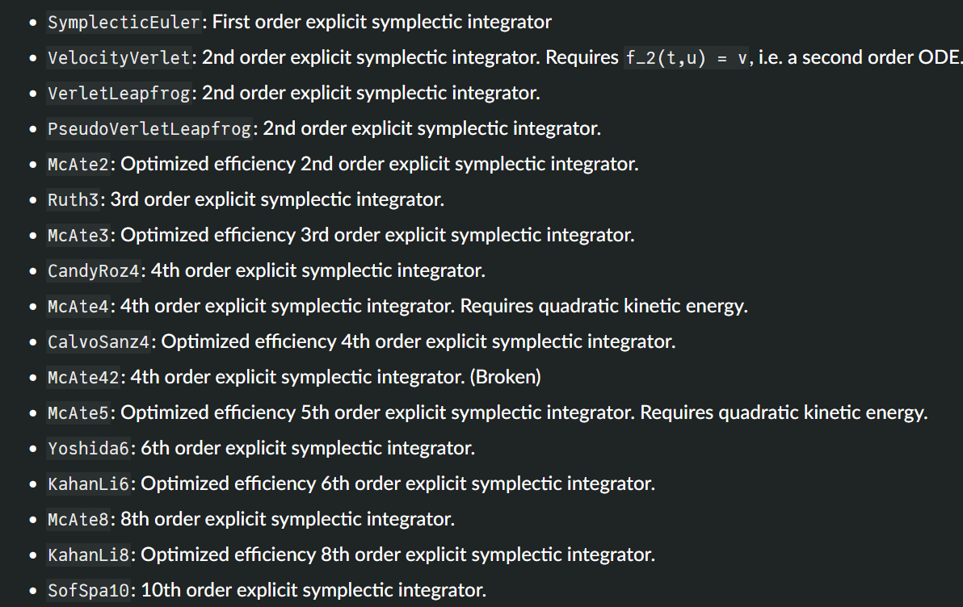
Current Status
Bmad-Julia will provide a set of modular packages for accelerator simulations
AcceleratorLattice.jl: Storing/manipulating the lattice
AtomicAndPhysicalConstants.jl: Physical constants packages for simulations
GTPSA.jl: Full-featured interface to L. Deniau’s GTPSA library (very fast high order AD)
NonlinearNormalForm.jl: Nonlinear parameter-dependent normal form calculations including radiation & spin using Lie algebraic methods. RDT’s, resonance strengths,…
Tracking packages are a work-in-progress
E.g.,
NonlinearNormalForm.jl will work with any TPSA package satisfying a basic interface
AcceleratorLattice.jl can be extended for new elements with ease
The tracking packages will take advantage of Julia’s already-implemented symplectic integrators

Slide 5
Just-In-Time Compilation
Julia is dynamically typed, but remains fast by using JIT compilation (compiled using LLVM toolkit)
Suppose you want to optimize or do machine learning $→$ need to calculate derivatives
Current Bmad: uses finite differencing (step input, see change in output) to calculate derivatives
function track_drift(z0, L)
zf = similar(z0)
zf[1] = z0[1]+z0[2]*L/(1.0+z0[6])
zf[2] = z0[2]
zf[3] = z0[3]+z0[4]*L/(1.0+z0[6])
zf[4] = z0[4]
zf[5] = z0[5]-L*((z0[2]^2)+(z0[4]^2))/(1.0+z0[6])^2/2.0
zf[6] = z0[6]
return zf
end
In Bmad-Julia you can use automatic differentiation (AD), e.g. for L:
Compiled just-in-time for speed
You can give it any type you want or any type that anyone else creates, e.g. symbolic numbers:
z0::Vector{Float64}
L::Dual{Float64}
using Symbolics
@variables z0[1:6] L
z0 isa Vector{Symbolics.Arr{Symbolics.Num, 1}}
L isa Symbolics.Num

Slide 6
What is the “Bmad-Julia” project?
It’s NOT:
× A replacement for current Bmad
× A rewrite of current Bmad in a different programming language
× A Julia interface to current Bmad
Bmad-Julia is a project to create a modern accelerator physics simulations ecosystem written fully in the Julia programming language (including lattice files):
✔ Full features of present Bmad and significantly more
✔ Instantly can use Julia's rich ecosystem of optimizers, symplectic integrators, machine learning toolkits, plotting packages, etc with zero extra effort
✔ Fully-differentiable for advanced optimization methods and machine learning
✔ Easy GPU-parallelized tracking
✔ Can do machine learning through the normal form: RDTs, resonance strengths, etc
✔ Highly modular structure for easy extension/”plug and play”

Slide 7
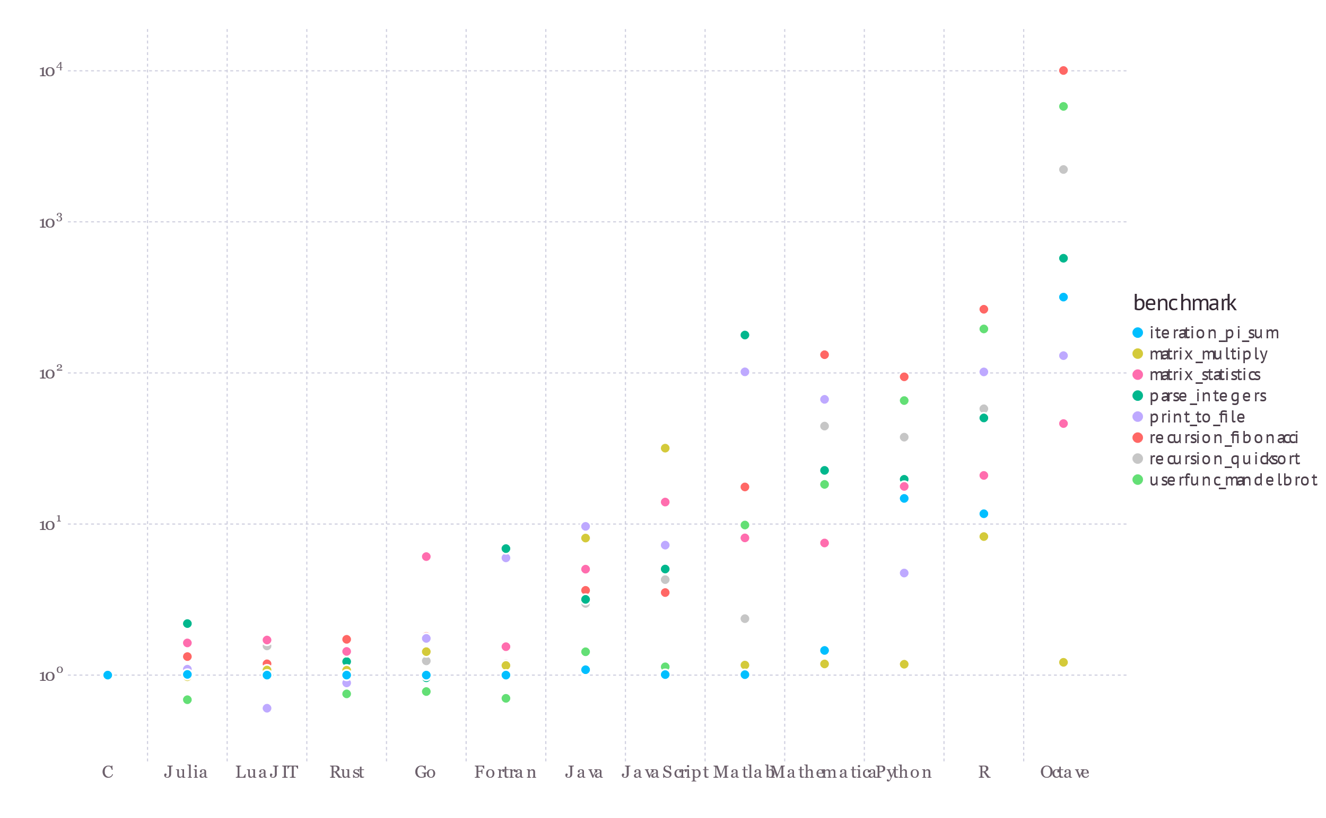
JIT & Multiple Dispatch
In Julia, we can write universally-polymorphic functions for any type, and it will still be fast by compiling that function for the input types it sees just in time
But what is “just-in-time”? And, why not just use templates in C++ for example for universal polymorphism?
Answer: the compiler might not know the types before program execution. Consider…

Slide 8
C++: Single Dispatch
class A { };
class B : public A { };
class C : public A { };
class Foo {
virtual void my_fun(A* arg1, A* arg2) { std::println("A,A"); }
virtual void my_fun(B* arg1, B* arg2) { std::println("B,B"); }
virtual void my_fun(C* arg1, B* arg2) { std::println("C,B"); }
virtual void my_fun(B* arg1, C* arg2) { std::println("B,C"); }
virtual void my_fun(C* arg1, C* arg2) { std::println("C,C"); }
};
void call_my_fun(A* arg1, A* arg2) {
Foo *pFoo = new Foo;
pFoo->my_fun(arg1, arg2); // SINGLE DISPATCH: prints “A,A”
}
int main() {
A* arg1 = new B();
A* arg2 = new C();
call_my_fun(arg1, arg2); // prints “A,A”
return 0;
}
C++ only uses single dispatch, so this will print “A,A” even though both are B,C

Slide 9
Julia: Multiple Dispatch
abstract type A end
struct B <: A end
struct C <: A end
my_fun(arg1::A, arg2::A) = println("A,A")
my_fun(arg1::B, arg2::B) = println("B,B")
my_fun(arg1::C, arg2::B) = println("C,B")
my_fun(arg1::B, arg2::C) = println("B,C")
my_fun(arg1::C, arg2::C) = println("C,C")
function call_my_fun(arg1::A, arg2::A)
return my_fun(arg1, arg2)
end
arg1 = B()
arg2 = C()
call_my_fun(arg1, arg2) # prints B,C
Julia will dynamically-dispatch based on the runtime types
Call to my_fun done by going to method lookup table using runtime types, and JIT-compiling my_fun if not already compiled

Slide 10
Accelerator Physics ML
Other ML softwares (Bmad-X, Cheetah) are limited: few elements, strictly linear beam dynamics, no multipass/control elements, no normal form analysis routines, etc
Bmad-Julia will provide the full features of present Bmad, and be fully-differentiable for ML
Differentiate through any quantity represented by a Number type

Slide 11
Demo
GTPSA, NonlinearNormalForm

Slide 12
Acknowledgements
Development of Bmad-Julia is currently in full-gear, and certainly would not be this far along without the help of:
Dan Abell
Alex Coxe
Oleksii Beznozov
Scott Berg
Etienne Forest
Chris Mayes
Ryan Roussel
Auralee Edelen
Laurent Deniau
Lixing Li
Juan-Pablo Gonzalez
Gavin Hunsche

