Slide 1
Thermal Simulations of TFPX Dee
Shikha

Slide 2
Objective of the Simulation
To track the temperature on the surface of Dee
Check for temperature gradients and track it’s cause while aiming for low temperature
To perform a comparative study of thermal performance from experimental and simulation results
Currently running the simulation test with plaquette

Slide 3
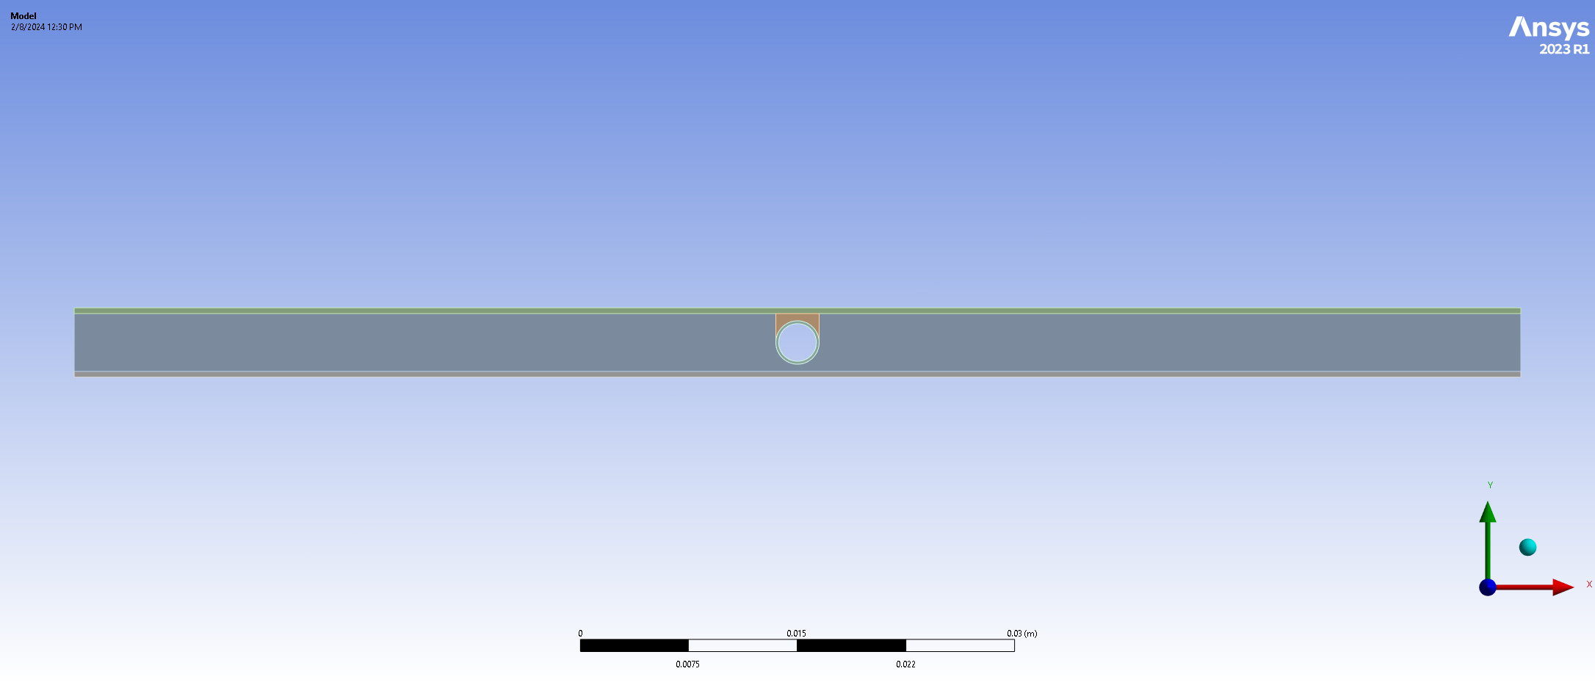
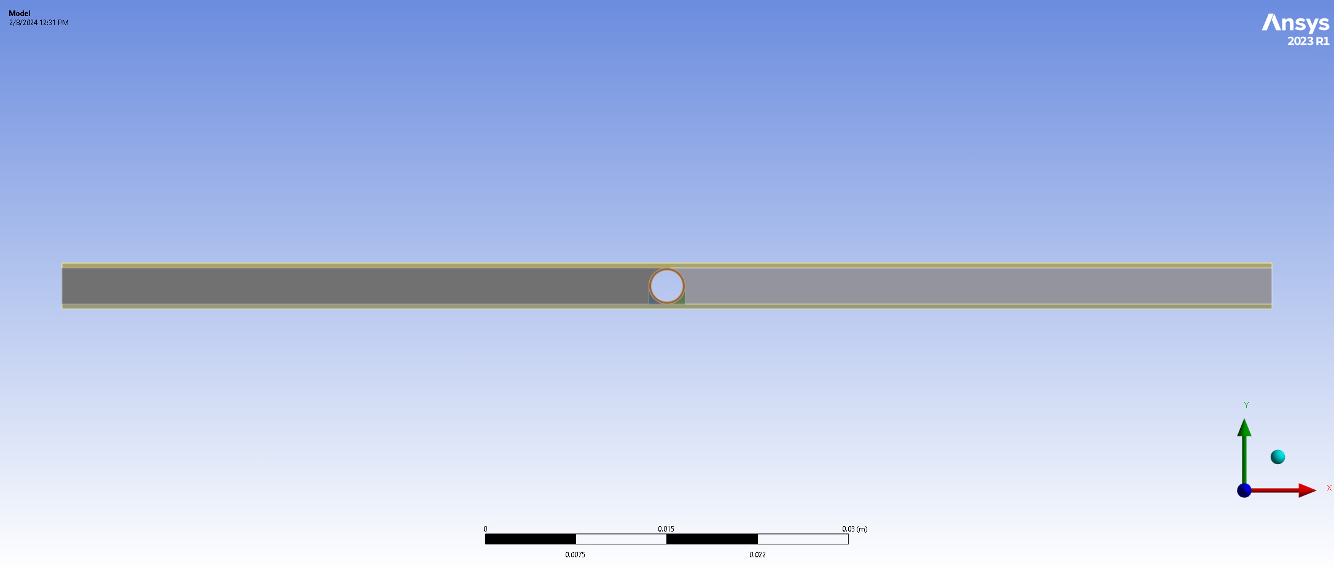
Different Cases for 2-D Simulation in Ansys Steady Thermal
1. Sandwich Model
2. Hot Dog Model
3. Short Hot Dog Model
4. Hot Dog + Toppings Model

Slide 4
Boundary Conditions for 2-D Simulation

Slide 5
2-D Simulation
Ran steady thermal simulation in Ansys for all the 4 cases, with three different values of thermal conductivity of carbon fiber – 20, 2, 0.2 (all in W/mK), and keeping the thermal conductivity of carbon foam 25 W/mK
Temperature trend:
4 < 1< 2 < 3
if we keep the thermal conductivity of carbon fiber and carbon foam same for each trial

Slide 6
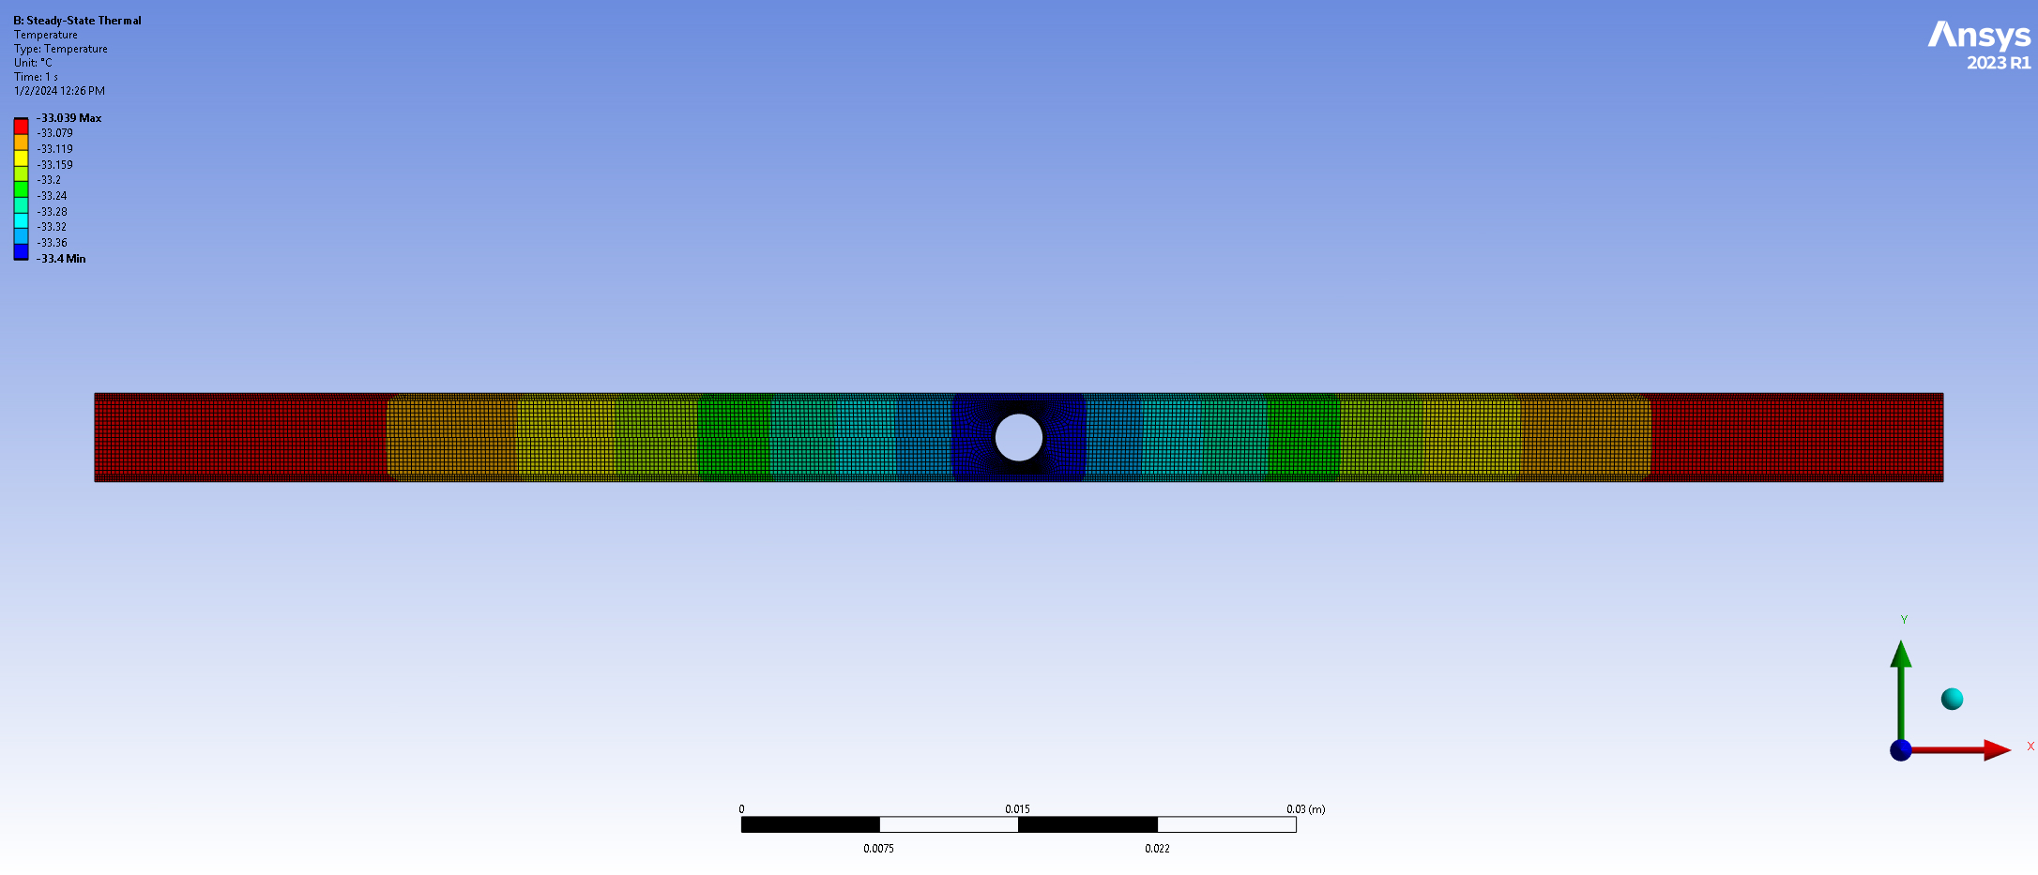
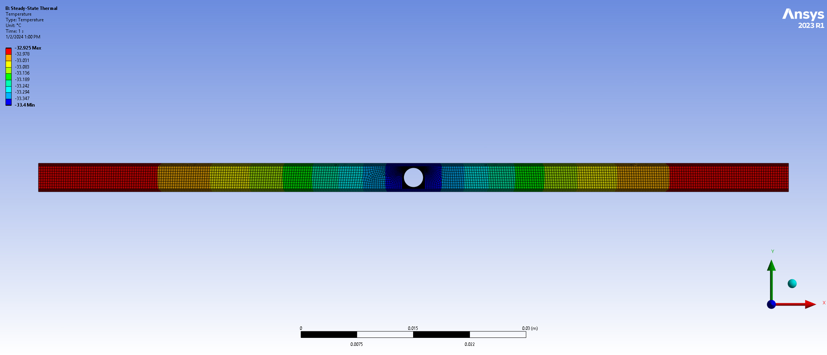
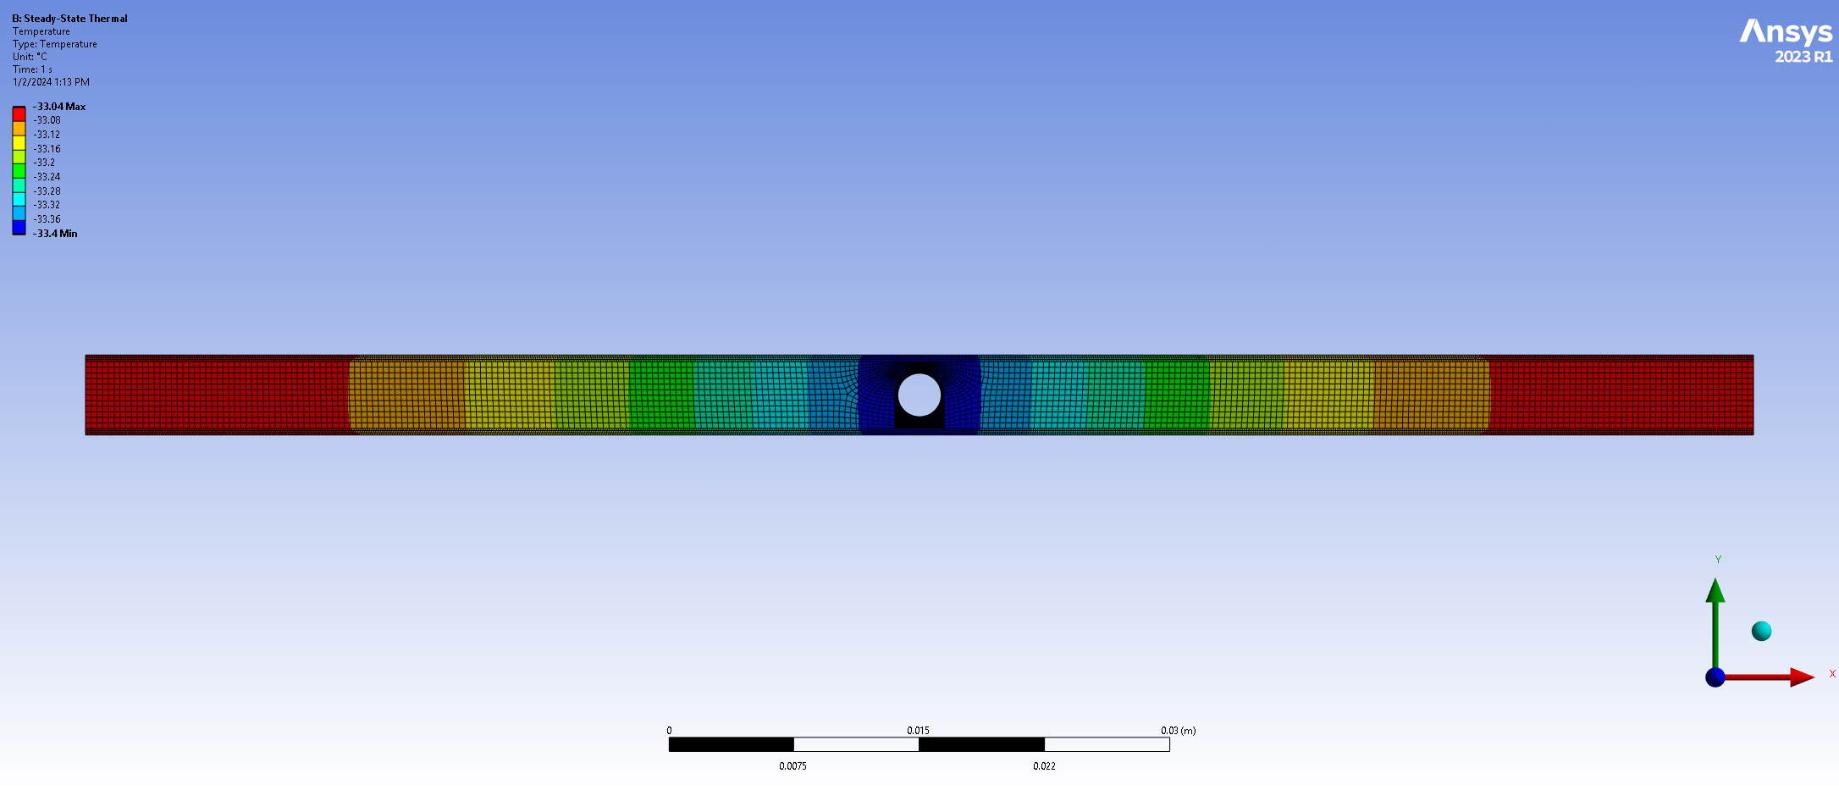
2-D Simulation Results
1. Sandwich Model
2. Hot Dog Model
3. Short Hot Dog Model
4. Hot Dog + Toppings Model

Slide 7
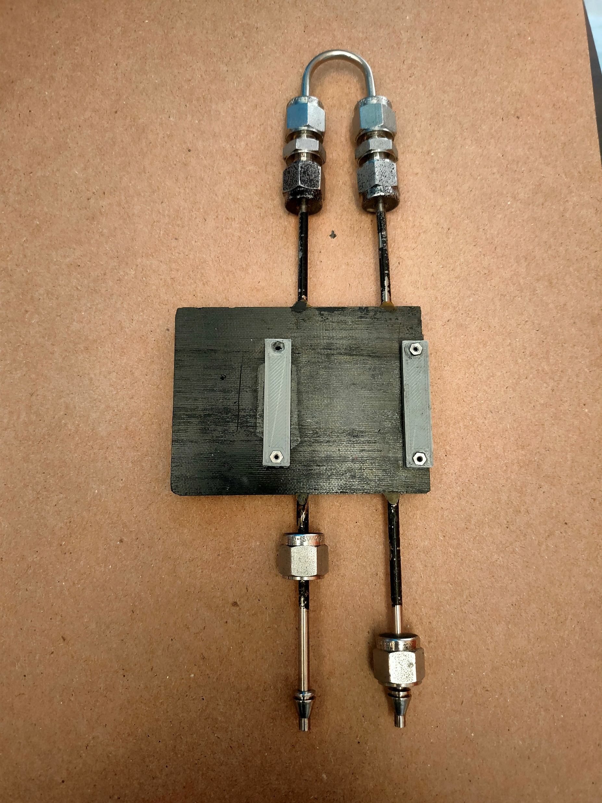
3-D Simulation in Ansys Fluent: Geometry

Slide 8
Boundary Conditions for 3-D Simulation
INLET:
${ CO}_{2}$coolant at Temperature: -29.9 ℃, Pressure: 13.34 bar
OUTLET:
${ CO}_{2}$coolant at Temperature: -33.5 ℃, Pressure: 11.84 bar
AMBIENT is Air at -21.5 ℃ with heat transfer coefficient of 5 W/$m^{2}$K

Slide 9
3-D Simulation Results

Slide 10
Further Plan
Mesh improvement
Grid-independent test
Extracting heat transfer coefficient of the coolant from Ansys Fluent
Transient simulation with ambient temperature changing

