Slide 1
Mechanics basics for CMS TFPX upgrade
J.Monroy
TFPX upgrade mini - workshop
02/08/24

Slide 2
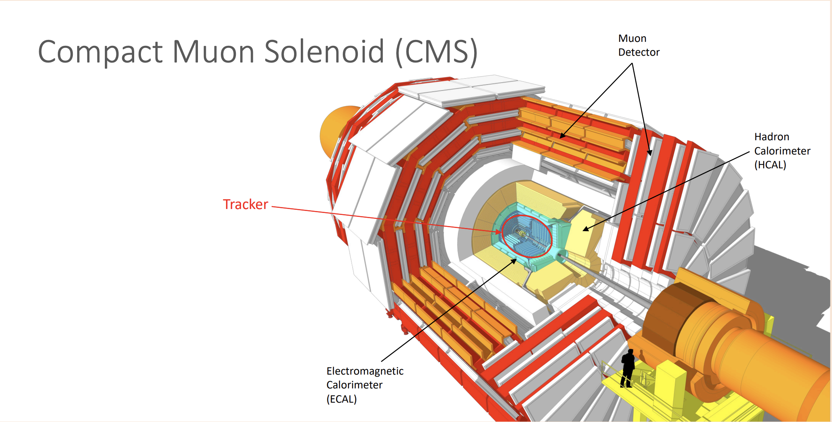
Where is the CMS TFPX detector

Slide 3
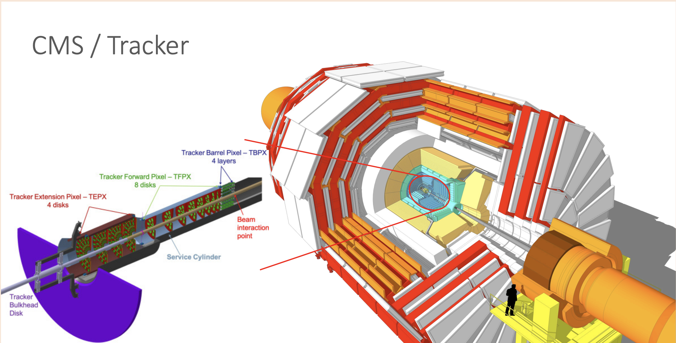
Where is the CMS TFPX detector

Slide 4
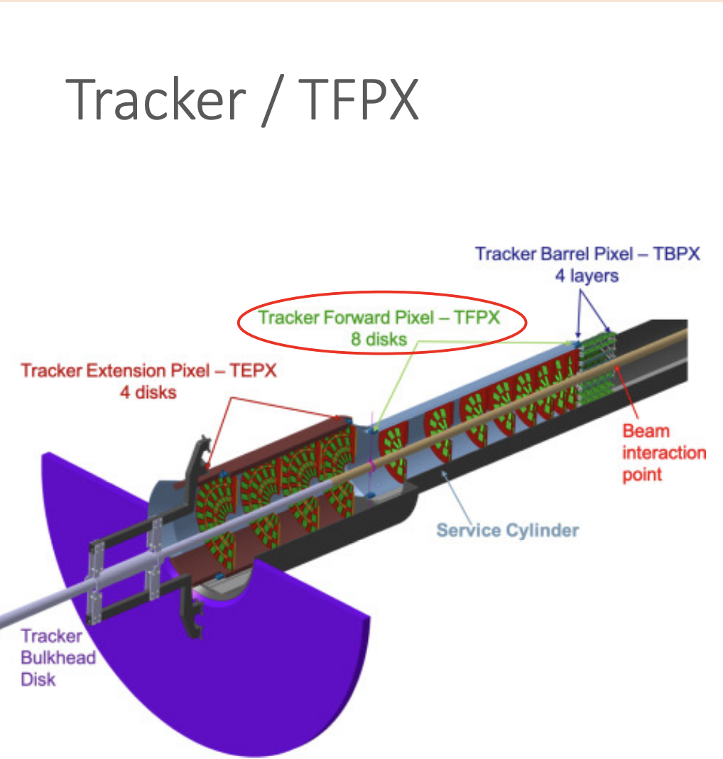
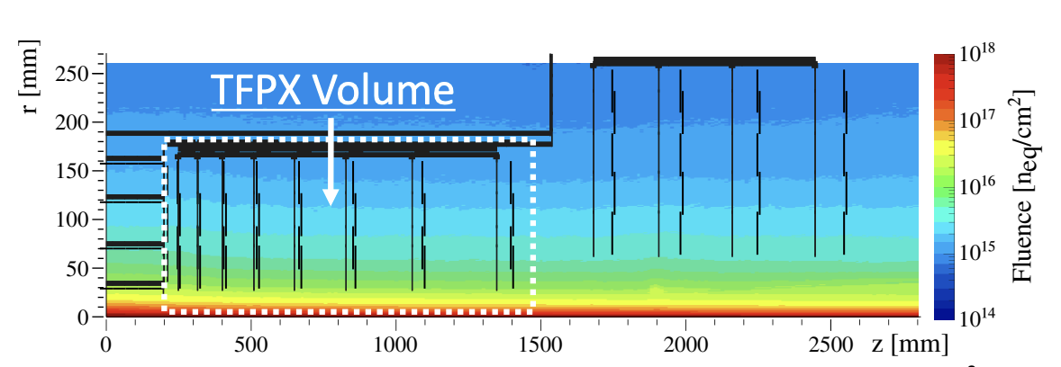
Why to upgrade (physics)
TFPX shall have 25x100 and 50x50 micrometer pixel sizes. Finer granularity
TFPX shall increase the Tracker coverage to |eta|=4.0
TFPX Mass and Density Budget
TFPX shall operate within the CMS detector in the HL-LHC environment for a minimum of 10 years.
The TFPX data readout rate shall be 10 Gbps

Slide 5
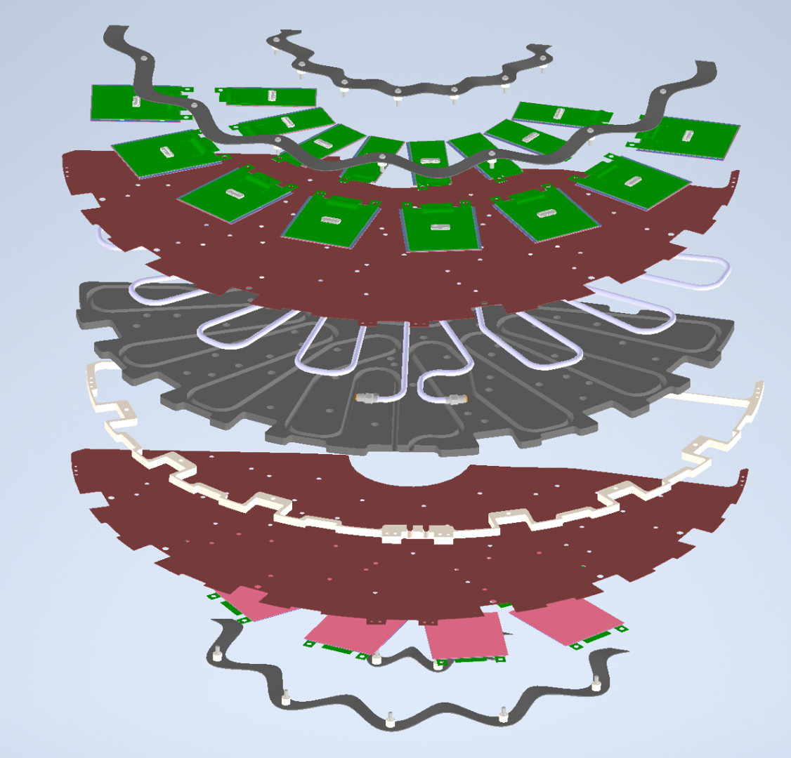
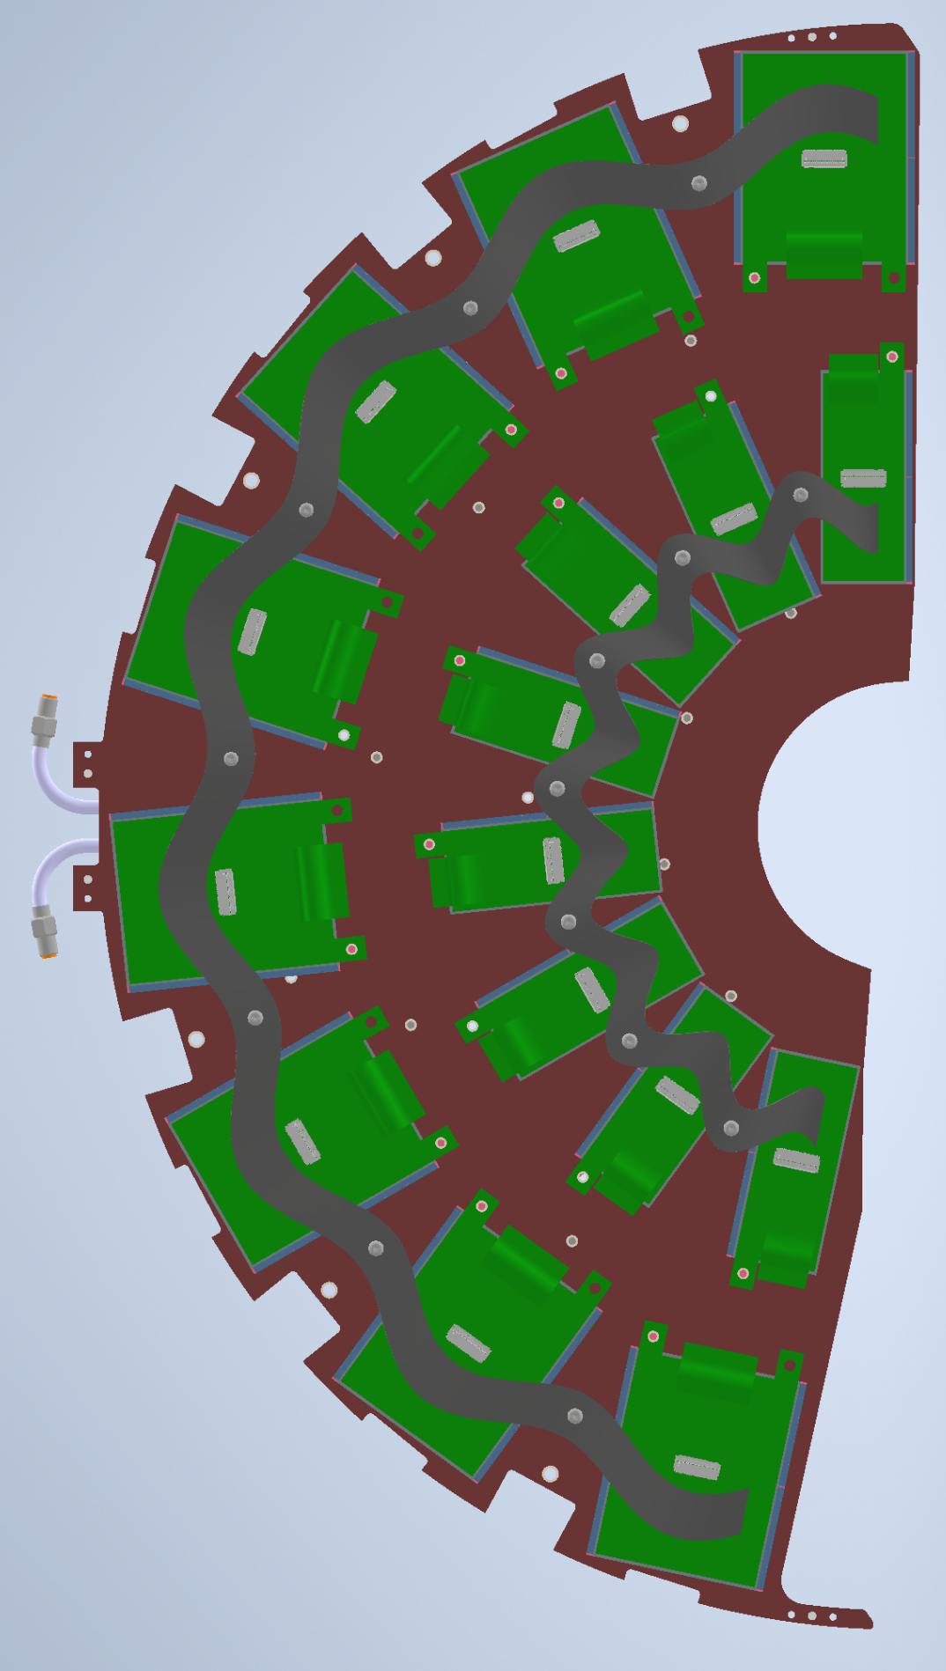
DEE structure
Silicon sensor
Bump bonds
ROC
TIM
Carbon fiber
Carbon foam
SS pipe
CO2
Epoxy

Slide 6
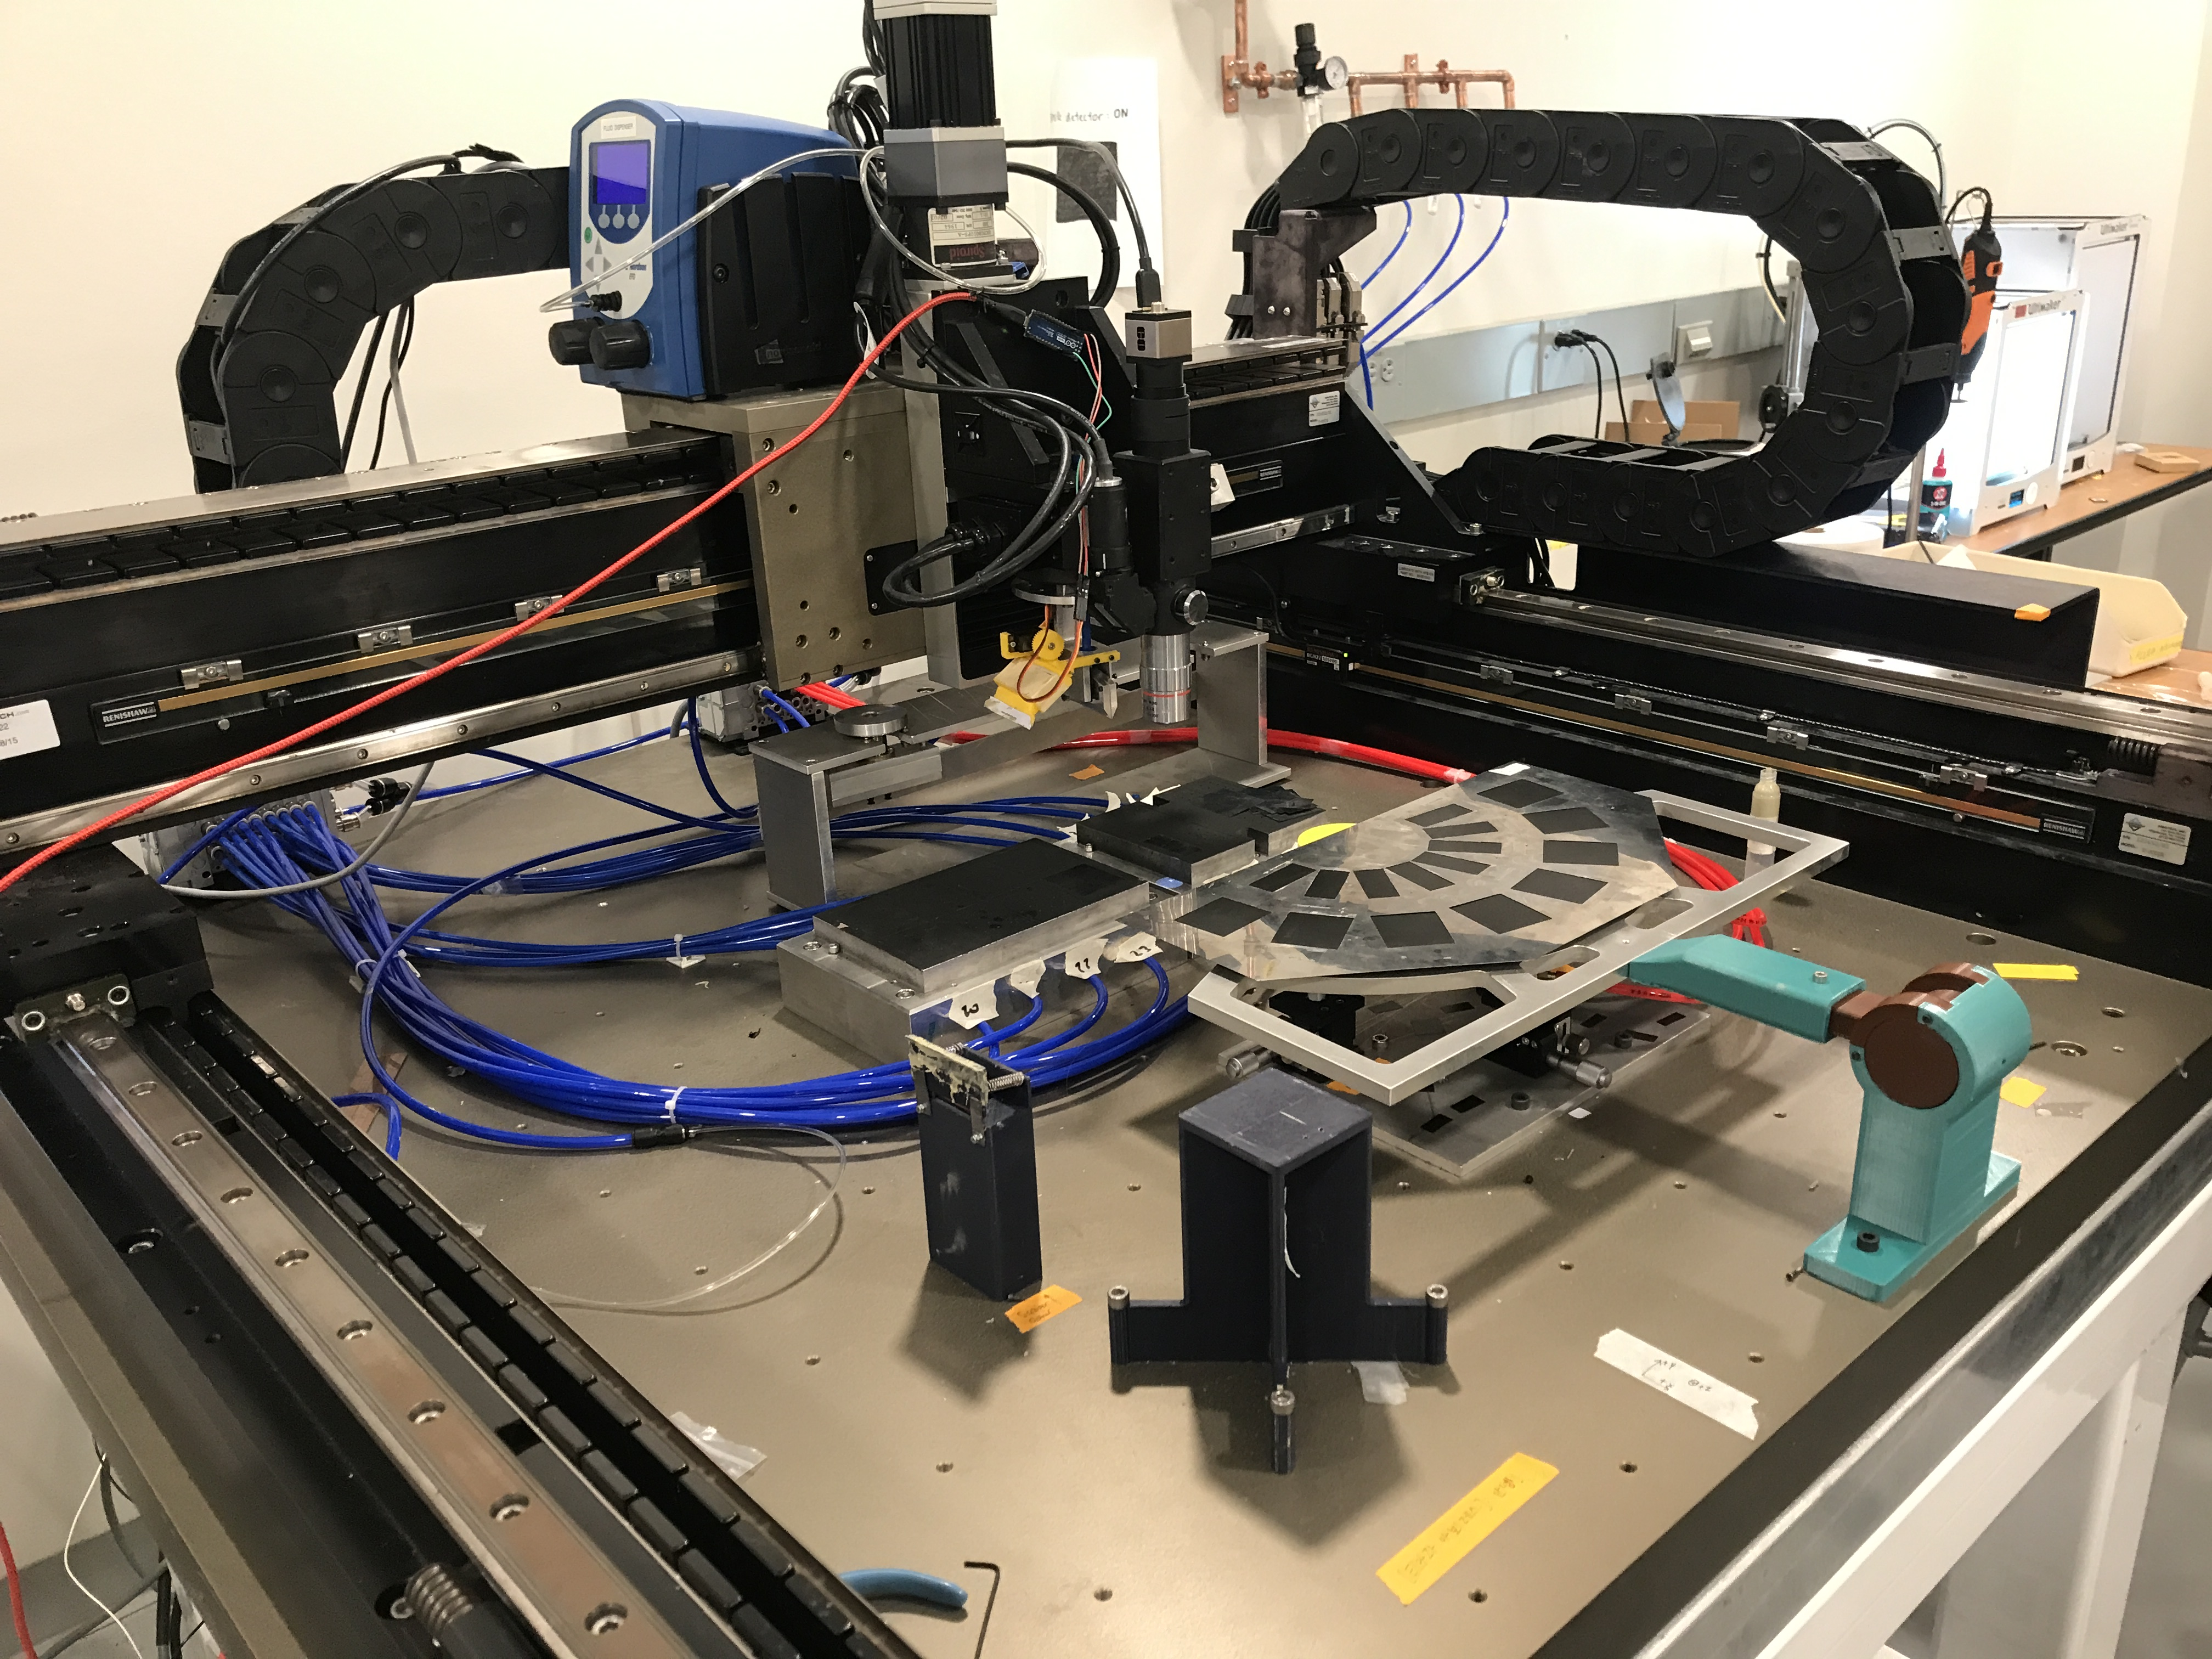
Main tool: Gantry
Dispenser
Robotic gantry-based Setup programed using LabVIEW.
Motion precision ~ 5-10 um
Deposition system
Vision system
DEE structure
Modules Chucks
Stencil
Vacuum lines
DEE stand + handler
Cleaning tower
Calibration tower

Slide 7
How we make the DEE: Timofei’s talk
How we install the modules on the DEE: Sterre’s talk
In parallel, module function and performance is stablished so they cam be mounted: Joseph’s talk
Once the mechanical structure is ready and the modules are mounted and secured, the thermal performance is the focus: Xuan’s and Shikha’s talks

Slide 8
Thanks
Questions?

Slide 9
Backup

