Slide 1
CMS Phase-2 TFPX Antler Support Preliminary Mechanical Design
Dean Reiter, B.S. AEP ‘25
PHYS 4490, Fall 2023
Mentor: Axel Filenius
Supervisor: Prof. Anders Ryd

Slide 2
Introduction
During LS3 (2026-28), CMS experiment at CERN will be upgraded to prepare for the increased luminosity of of the HL-LHC
Phase-2 tracker is almost completely redesigned
Major sections of the Phase-2 inner tracker are TEPX, TFPX, and TBPX
Source: CMS (2017)

Slide 3
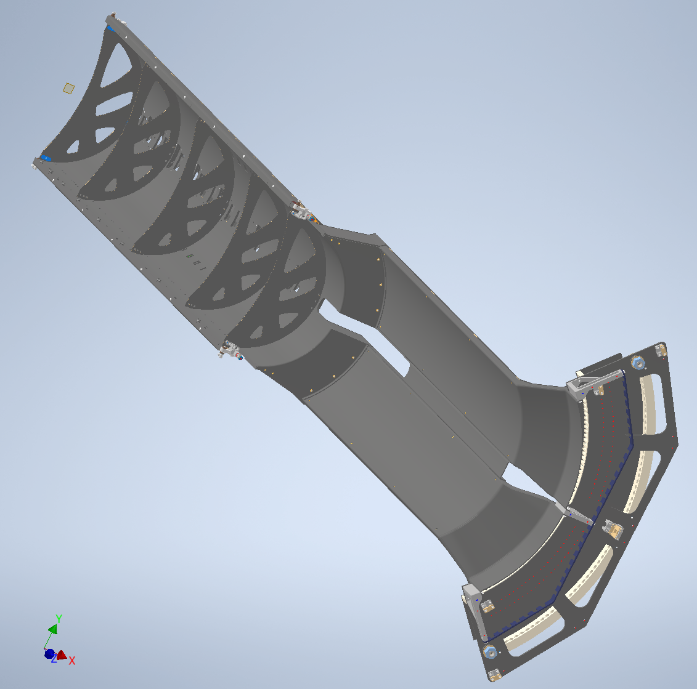
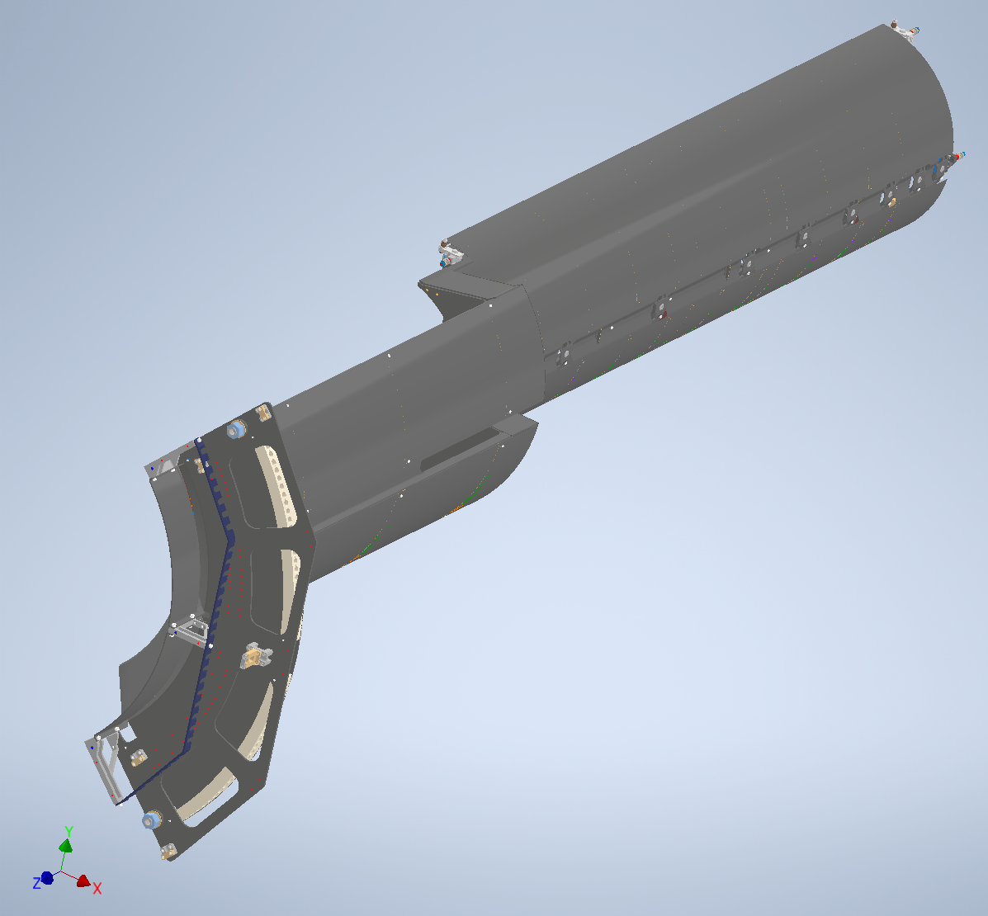
TFPX Assembly
Pixel module “dees” sit in service cylinder structure (one half cylinder pictured)
Service cylinder supports power, thermals, and readout electronics to dees
Each half cylinder is supported by top and bottom rails at three points along main axis
Front
Middle
End-flange or “Antler”
Source: CMS (9/13/2023)

Slide 4
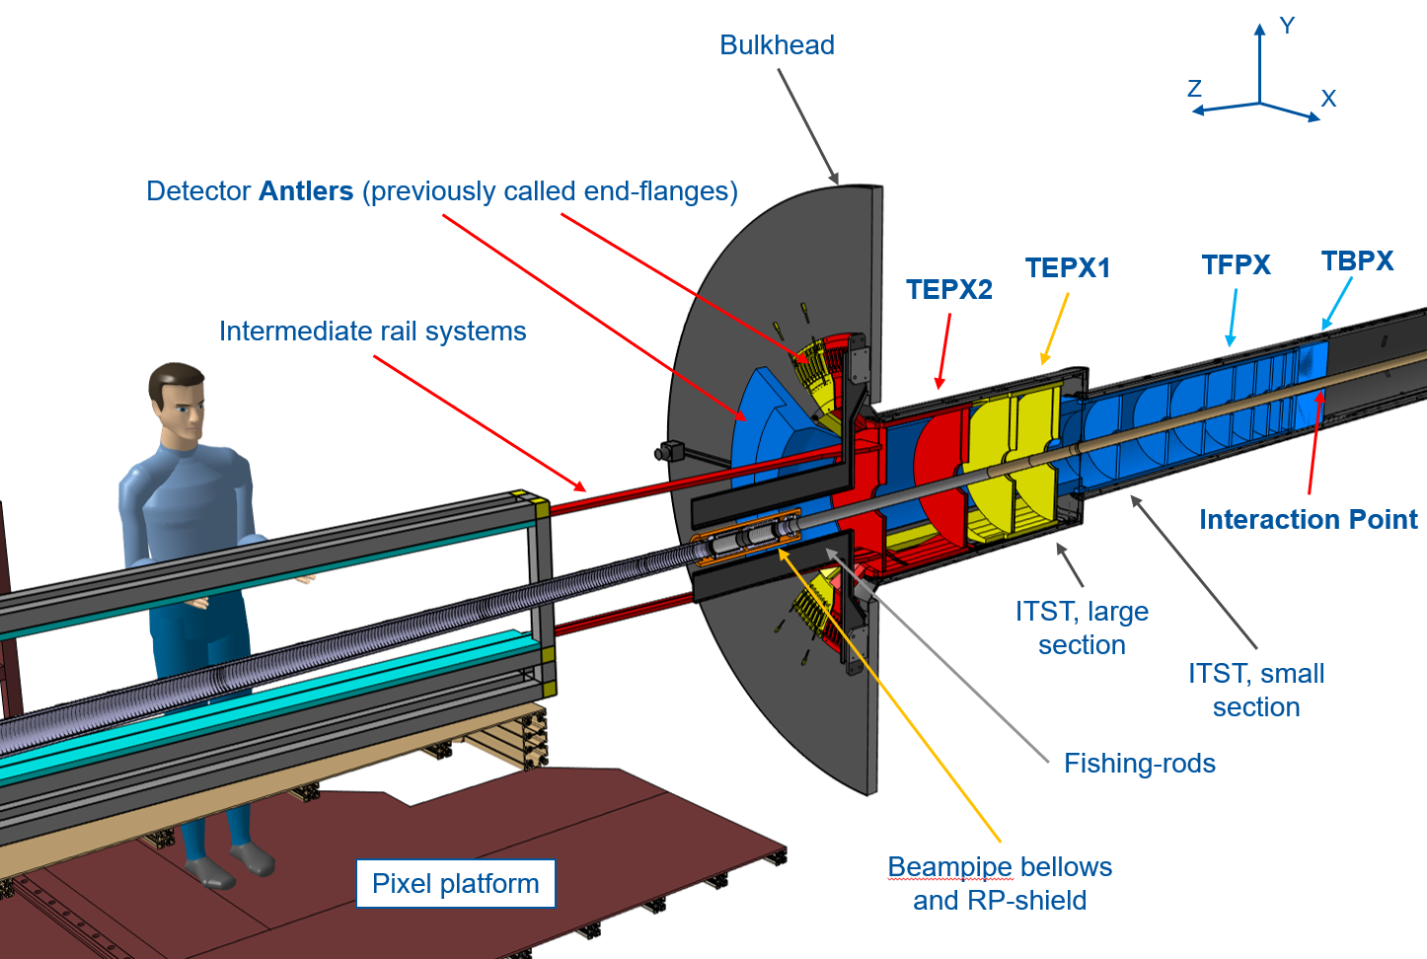
IT Installation System
Source: Axel Filenius (2022)

Slide 5
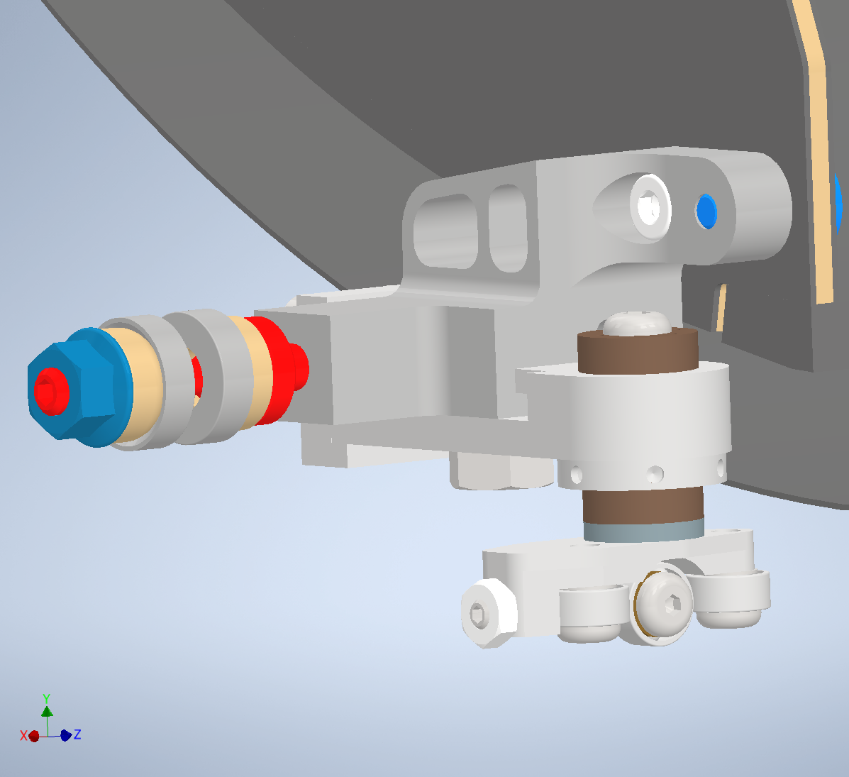
Front Support Wheels

Slide 6
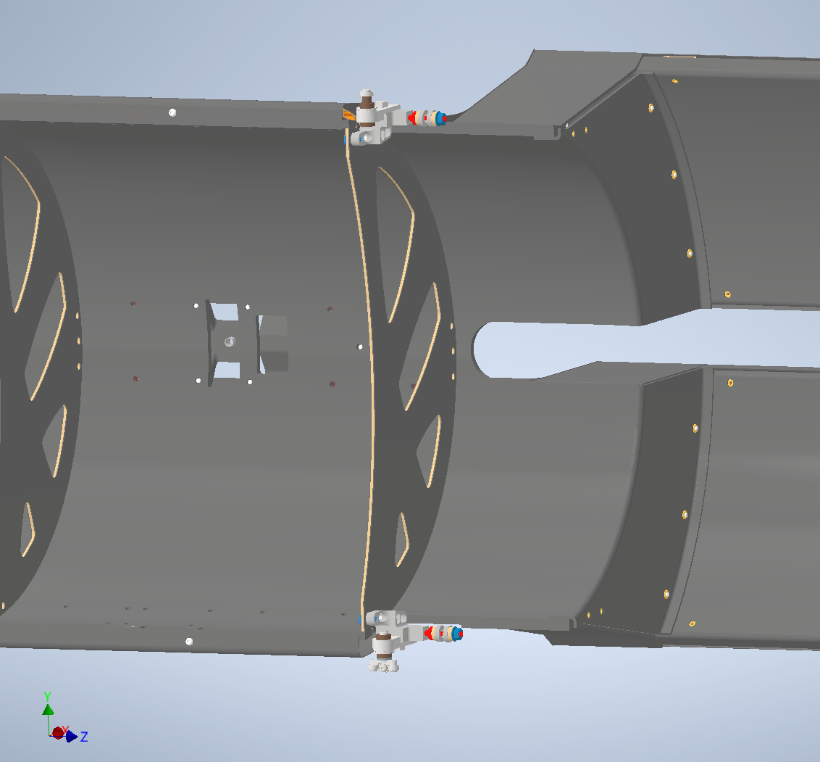
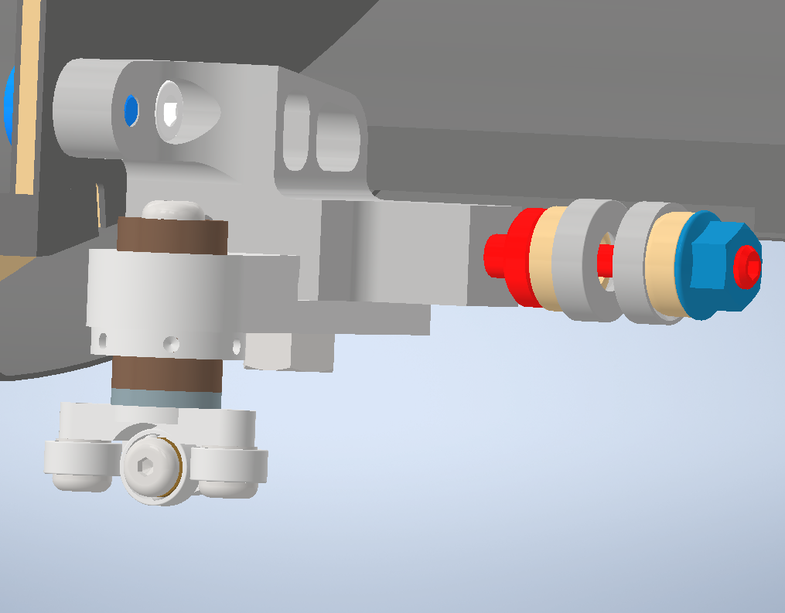
Middle Support Wheels

Slide 7
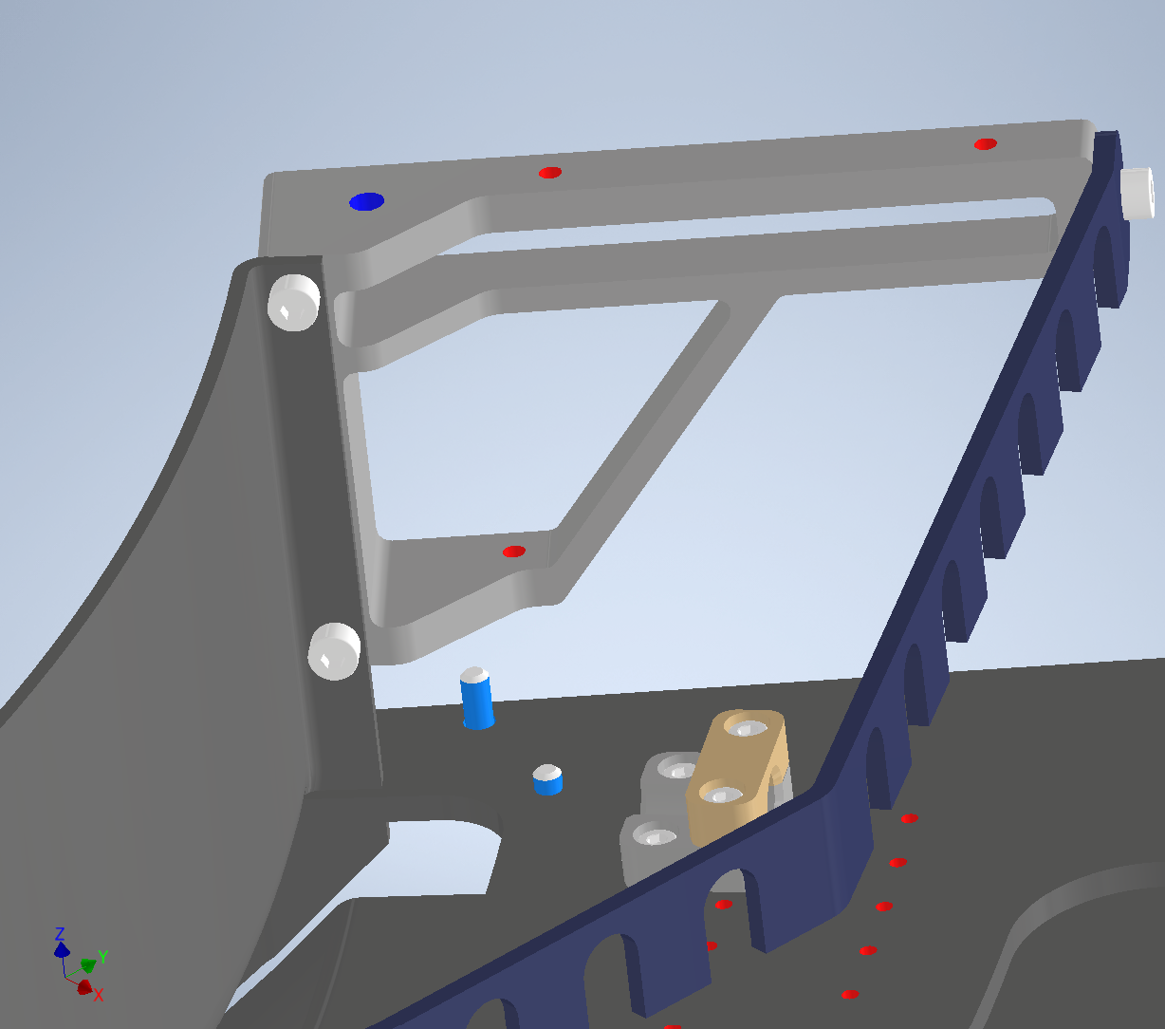
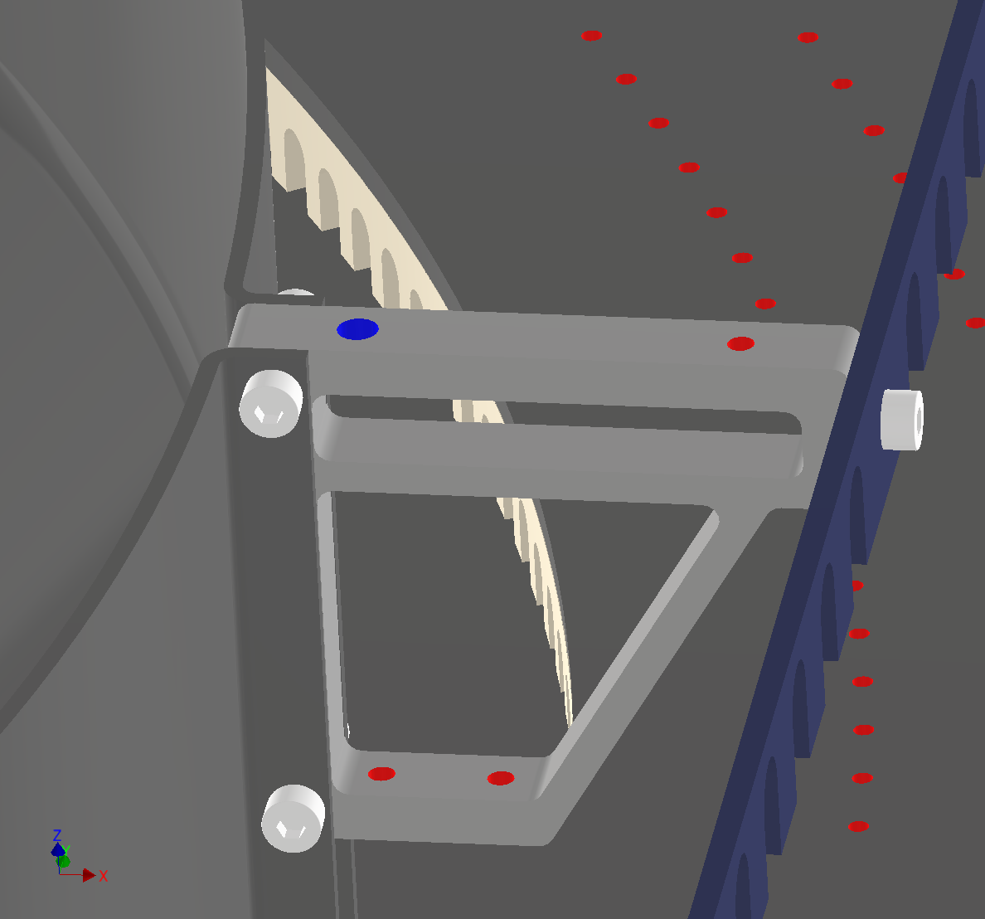
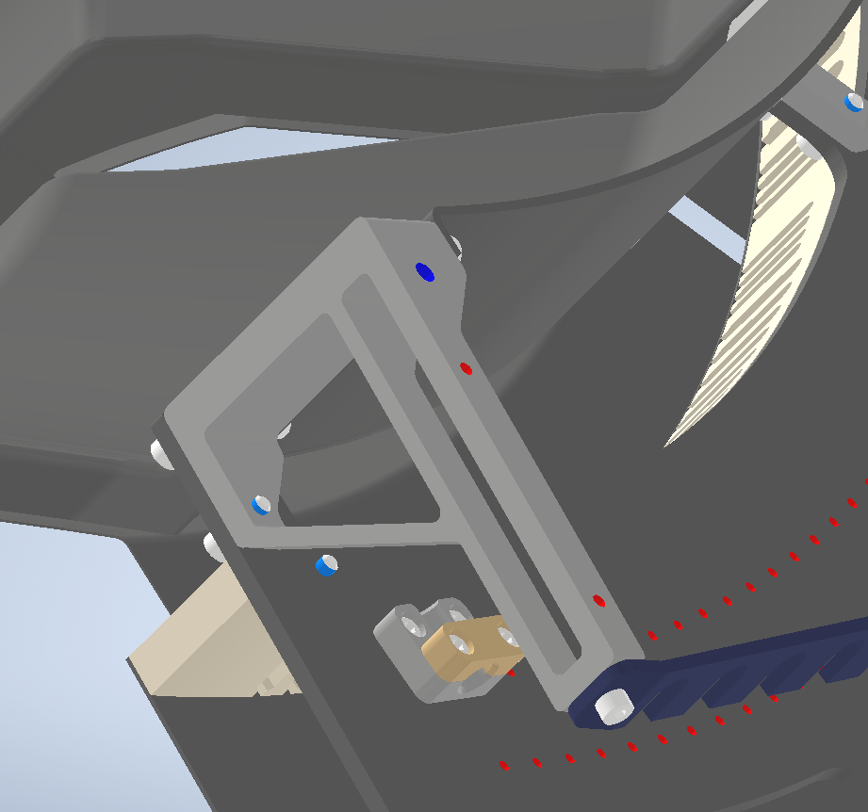
Antler Mounting Points
4.917mm holes for M4 bolts

Slide 8
Antler Support (Concept)
Temporary antler support needed for installation
After installation, antler will be mounted to bulkhead
Slider mechanism needs to allow approx. 250mm movement in the X (radial) direction
VIDEO
Source: Axel Filenius (2022)

Slide 9
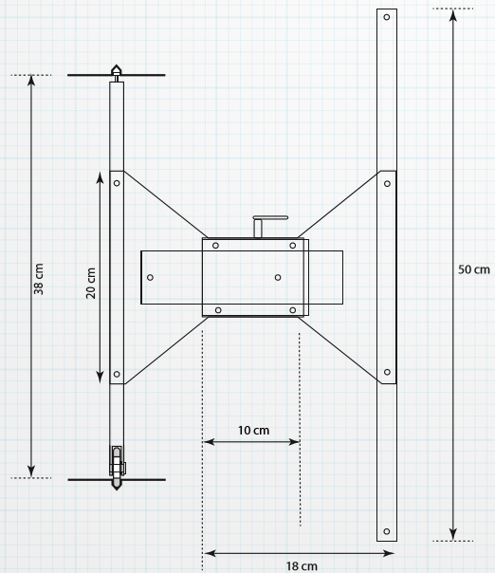
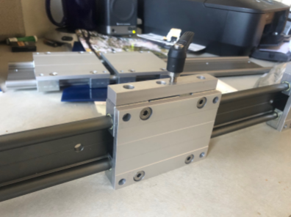
Initial Design Concept
Ideas and images from John Conway
Use off-the-shelf rail and carriage system to accommodate X-direction movement
Assembly must rotate around wheel because installation is not straight

Slide 10
Mechanical Requirements
Allow approx. 250mm sliding movement in X-direction
Sliding mechanism must be able to rotate approx. ± 5 deg to accommodate turns
Support approx. 14.5 kg of detector mass
Vertical position of detector must be adjustable
Support assembly must clear beam pipe, etc.
Structure must be cantilevered because only approx. 45mm clearance behind track in X-direction
Wheel assembly must clear the turns in installation track
Tracks have rectangular grooves: 10mm wide, 7mm deep. 380mm vertical separation

Slide 11
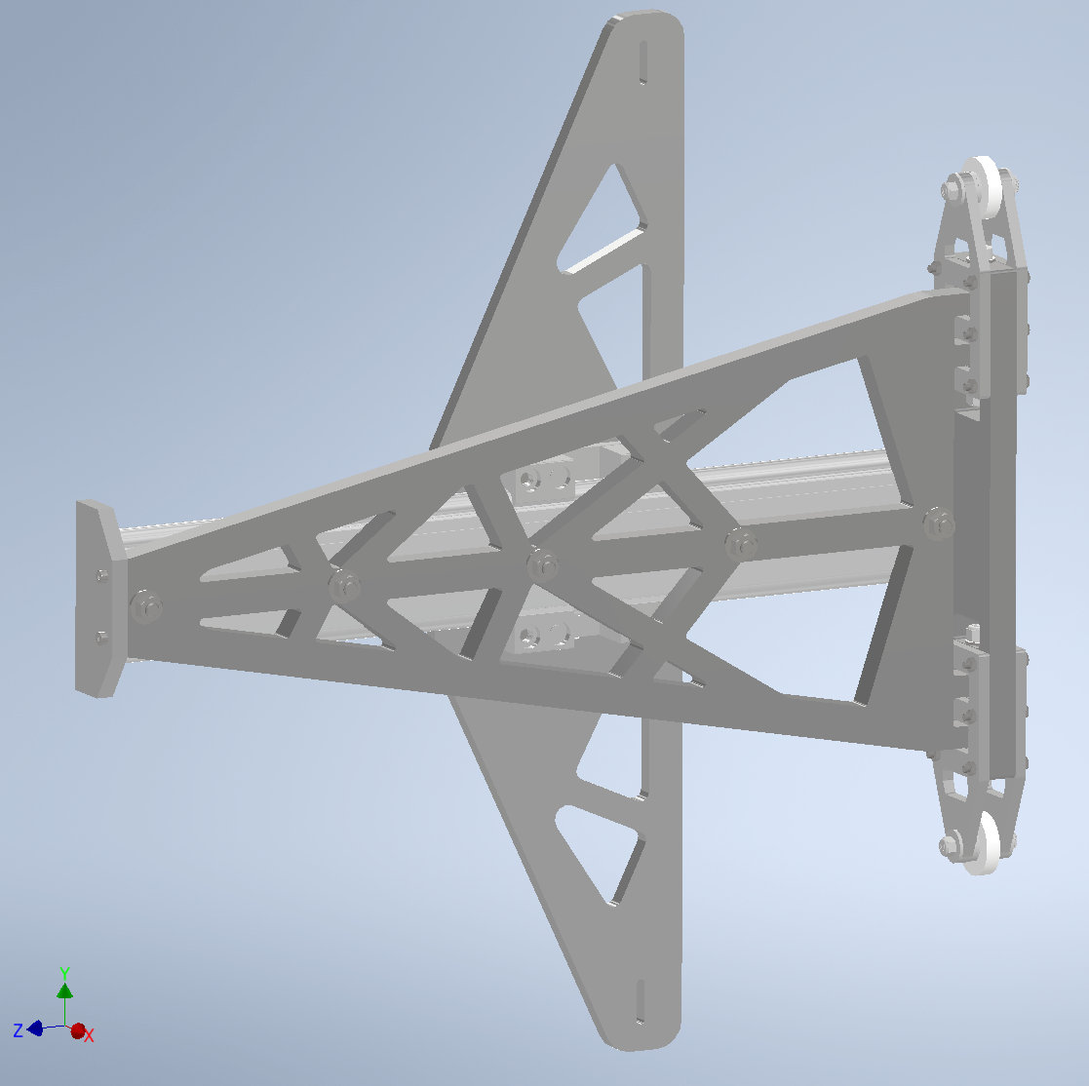
Preliminary Design
Wheel assembly
Hinge
Carriage
End stop
Rail
Antler plate
Rail plate
Total mass: 5.977 kg
Approx. cost: $457.75 each
Easy to manufacture – only off-the-shelf components and aluminum sheets which can be waterjet cut

Slide 12
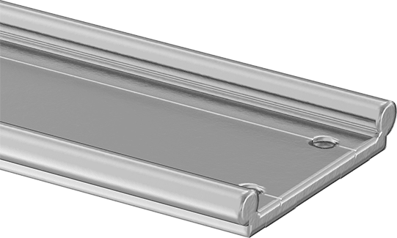
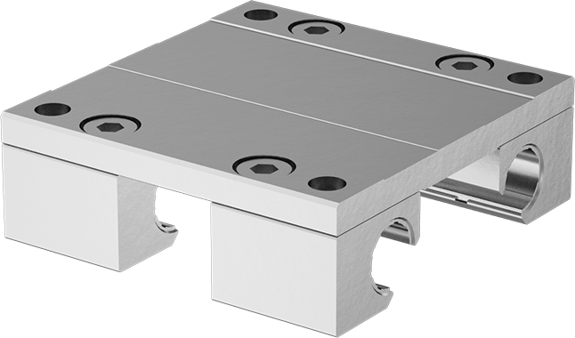
Sliding Mechanism
400mm travel distance
End stop plate at prevents carriage from disconnecting from rail
Note: It must be verified in CAD (for a second time after design changes) that the mechanism allows the full movement
Components:
104mm wide carriage
4x M8 bolts
500mm long rail
5x M8 bolts, nuts
VIDEO
Source: McMaster-Carr

Slide 13
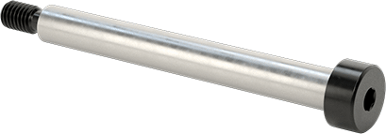
Hinge Mechanism
± 15 degrees of motion
Cutouts in wheel assembly allow clearance for rotation of hinge and for manual access to tighten bolts
Washers help distribute load from rail mount to wheel assembly
Components:
2x M6 shoulder screws, nuts
12x M6 plastic washers
VIDEO
Source: McMaster-Carr

Slide 14
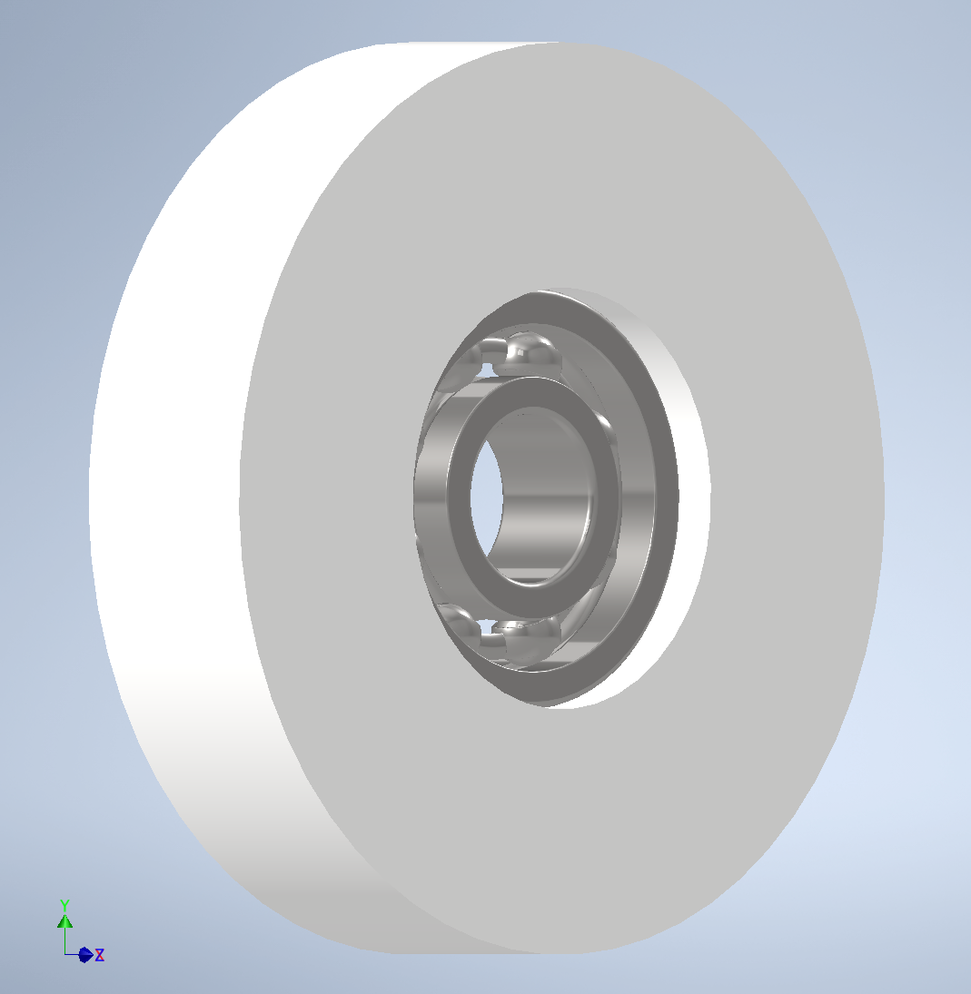
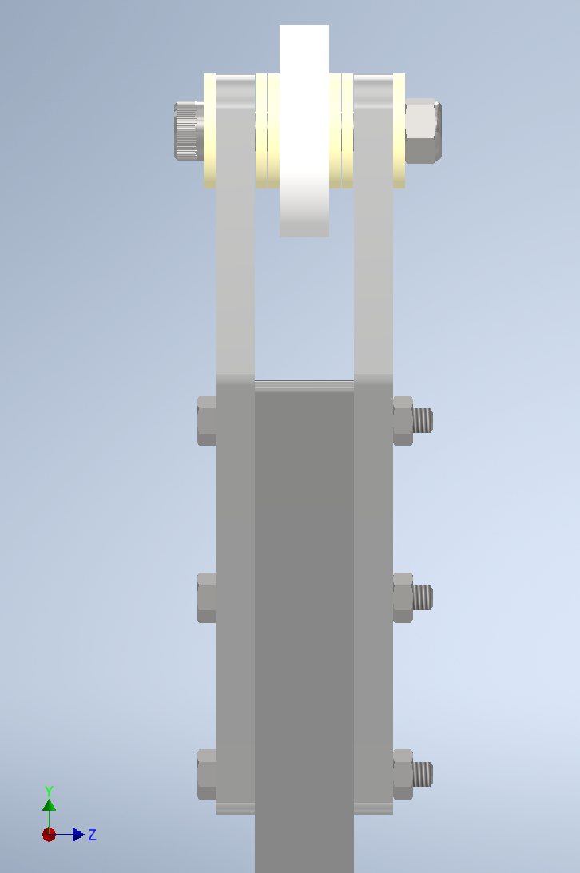
Wheel assembly
Washers
Wheel
Hinge plate
Ball bearing
Wheel plates
Components:
1x 5/8” aluminum hinge plate
4x 1/4” aluminum wheel plates
2x 8mm thick wheels (34mm OD)
12x 1/4” plastic washers
2x 1/4” ball bearings
2x 1/4” shoulder screws
12x M4 35mm bolts, nuts
Approx. mass = 0.87 kg

Slide 15
Wheel Assembly Issues
Mechanical play in wheels
Small gaps between washers could sum to approx. 2mm of play
Could allow for unwanted movement of wheel in X-direction
Could cause antler support to slightly sag or wobble when moving
High stress on wheels (poor load distribution)
Wheels are the only components in contact with track and have very small contact area
Bottom wheel supports entire vertical load
Top and bottom wheels transmit entire moment from wheel assembly (hinge plate to wheel plates to bolt/washers to wheels) to inside of track groove
May lead to deformation depending on material choice
Excess weight
Hinge plate should be 3/8” thick instead of 5/8”
Width of hinge plate can be reduced
Material for wheel has not been chosen
Wheels create additional complexity
Bearings and/or pins might suffice
Modifying the design so there are more points in contact with the track (like middle and front support wheels) will alleviate issues 1, 2
Additional structural analysis and testing is necessary

Slide 16
Rail and Antler Plate Design Process
CAD of rail and antler plates began as solid aluminum pieces
ANSYS Structural Optimization used to remove material
Goal is to reduce mass → minimize vertical loads and moment on wheel assembly → minimize friction and keep detector stable
Results of structural optimization used only as inspiration because ANSYS will not produce structures that are physically possible
All simulations were performed for the case of maximum torque load, where the sliding mechanism is fully extended

Slide 17
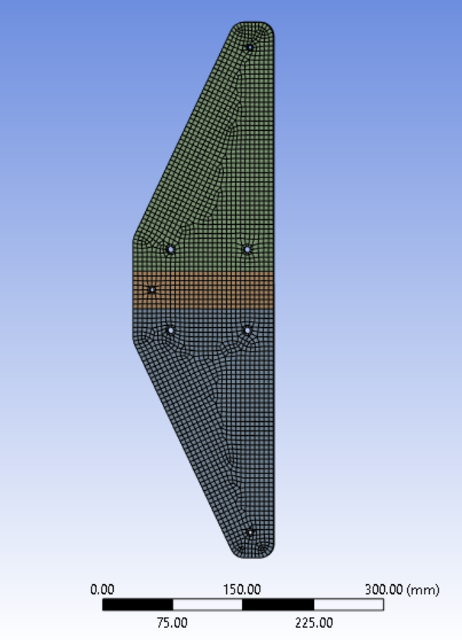
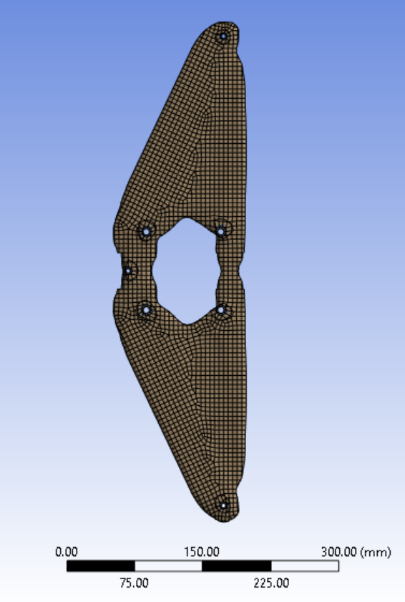
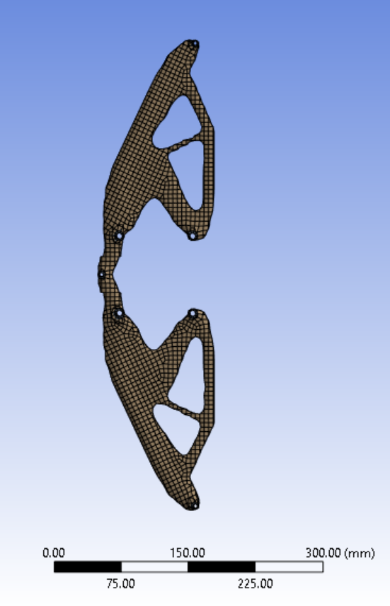
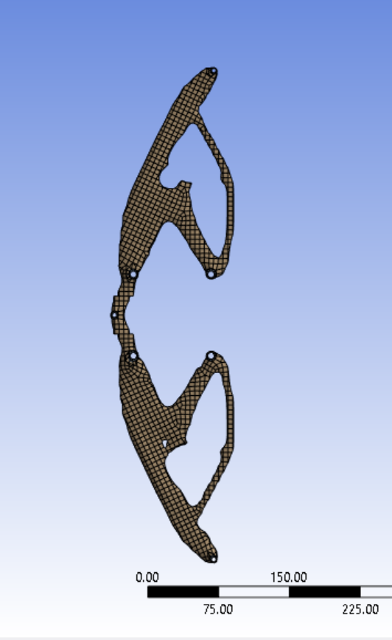
Antler Plate
ANSYS structural optimization
100%
80%
40%
30%
(% mass retained)

Slide 18
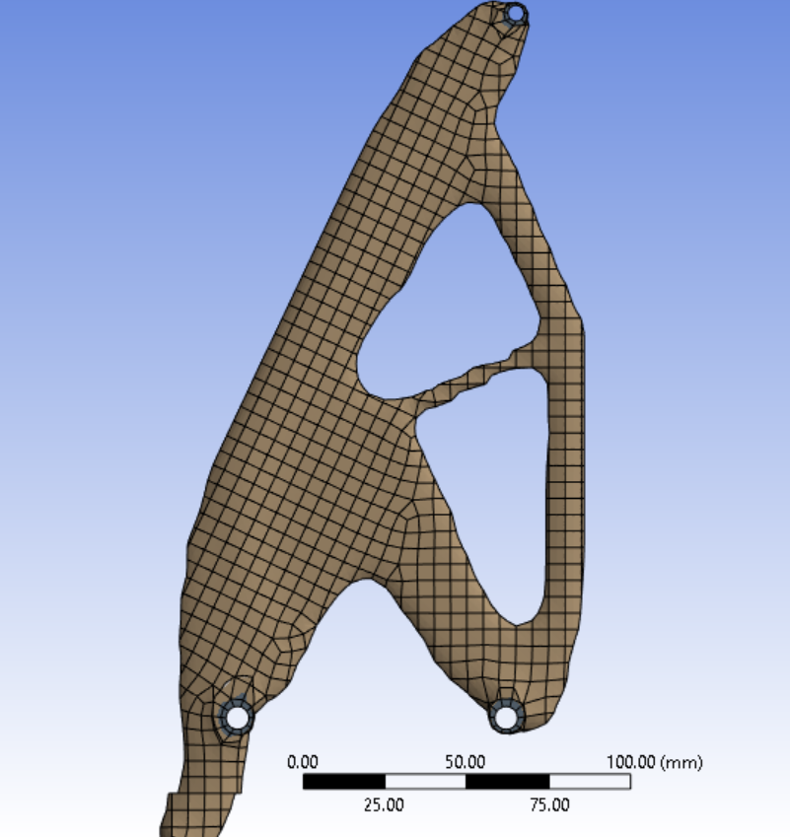
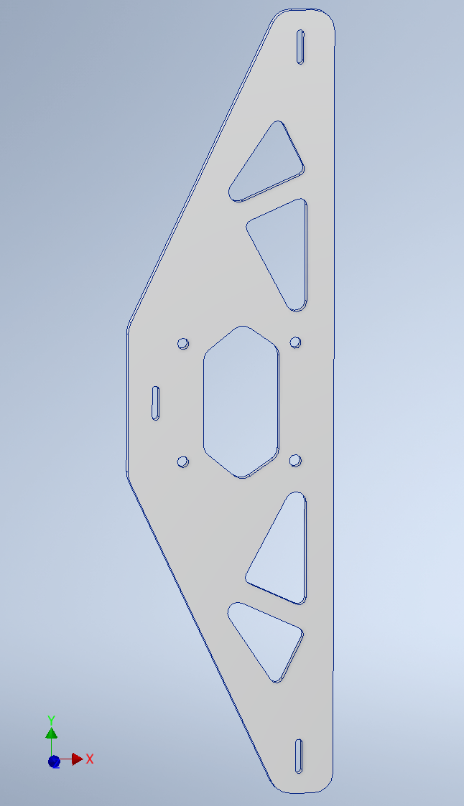
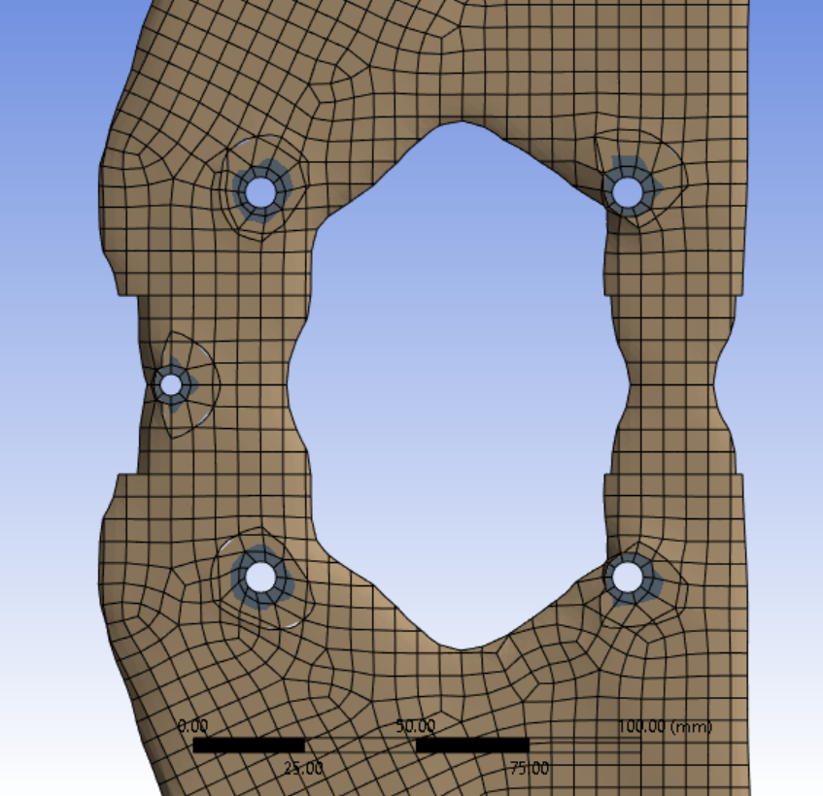
Antler Plate
Elongated mounting holes allow for adjustment of vertical position during installation
Mass before optimization = 1.534 kg
Mass after optimization = 1.194 kg
Mass can be reduced further by using aluminum thinner than 3/8” and removing more material

Slide 19
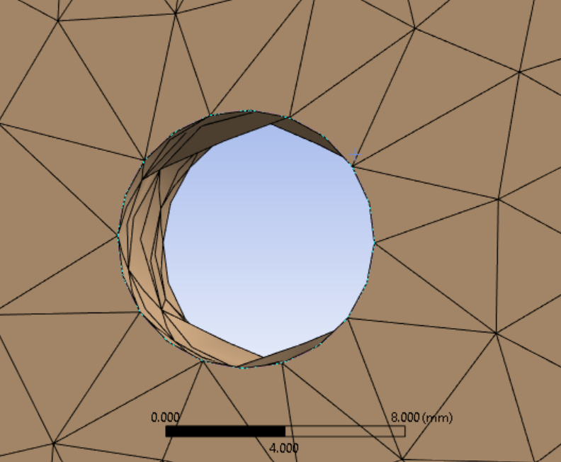
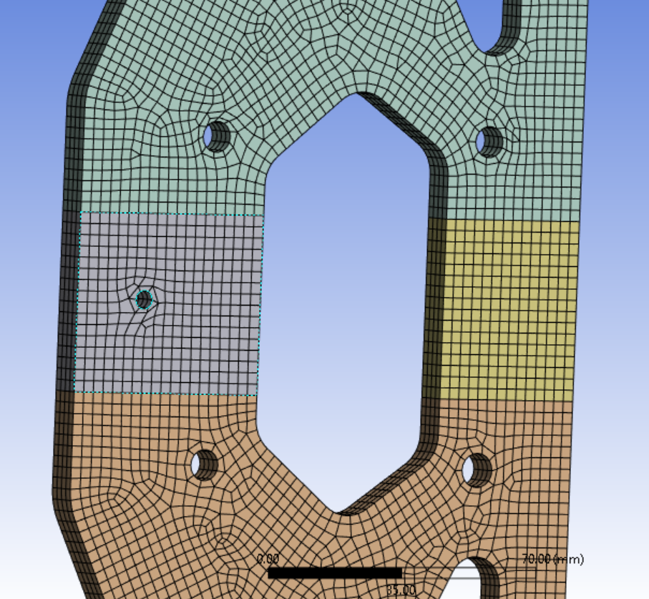
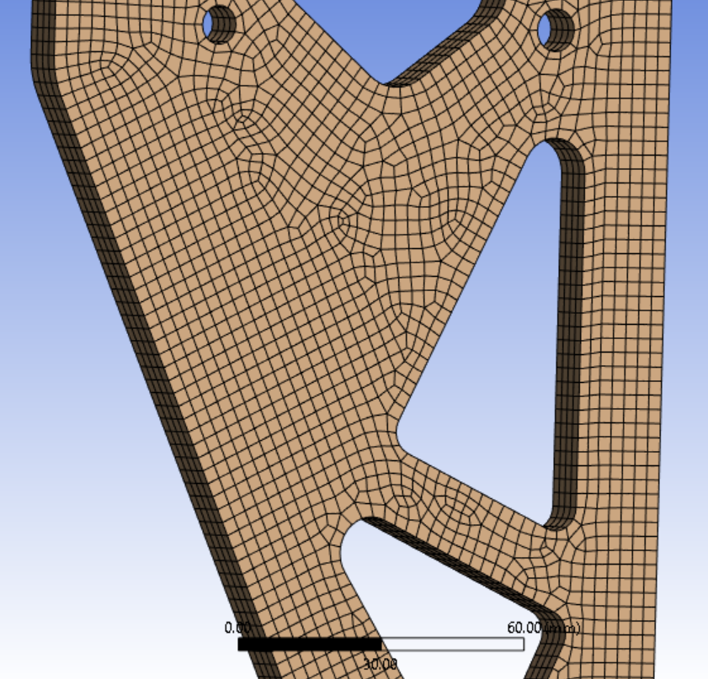
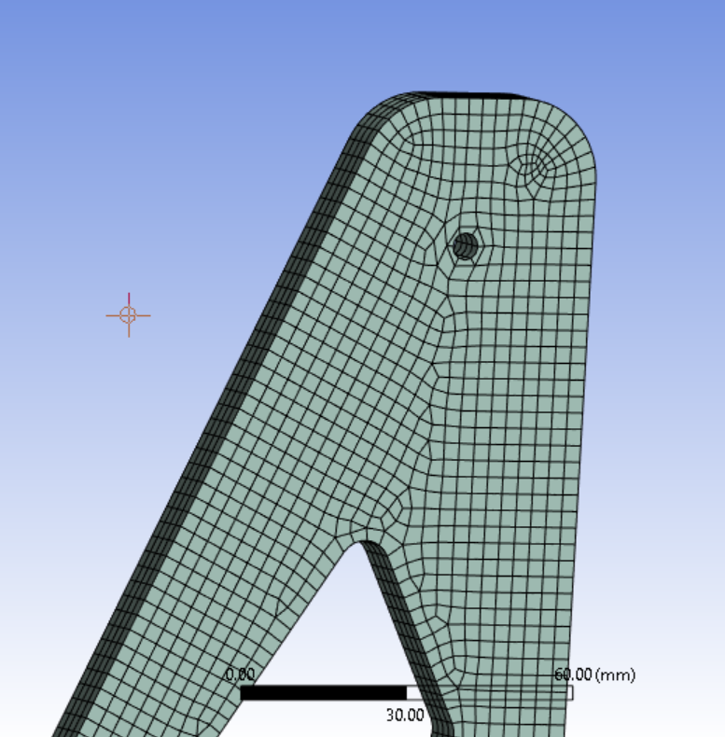
Antler Plate
ANSYS structural analysis
Mesh features

Slide 20
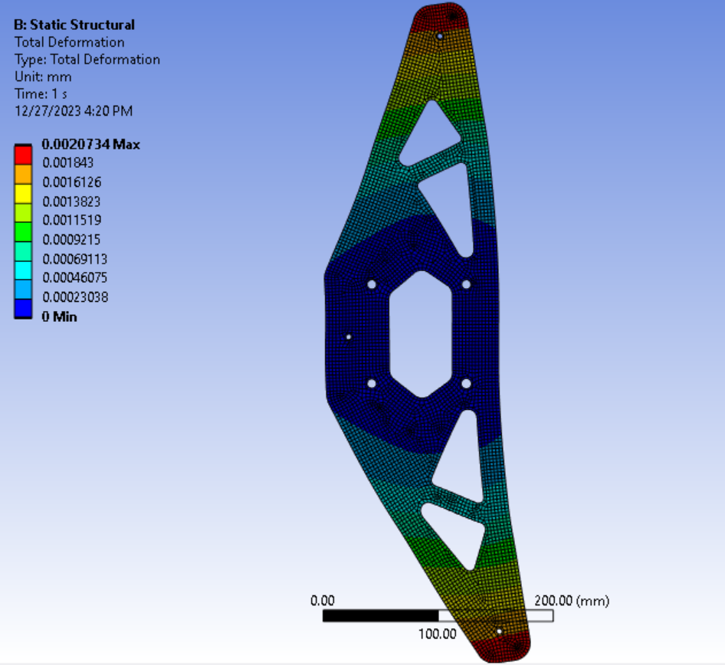
Antler Plate
ANSYS structural analysis
Max deformation: 0.00207mm
Max stress: 1.1963 MPa
Max strain: 1.77467 x 10^-5
Results all well within acceptable limits for Aluminum 6061
Deformation map

Slide 21
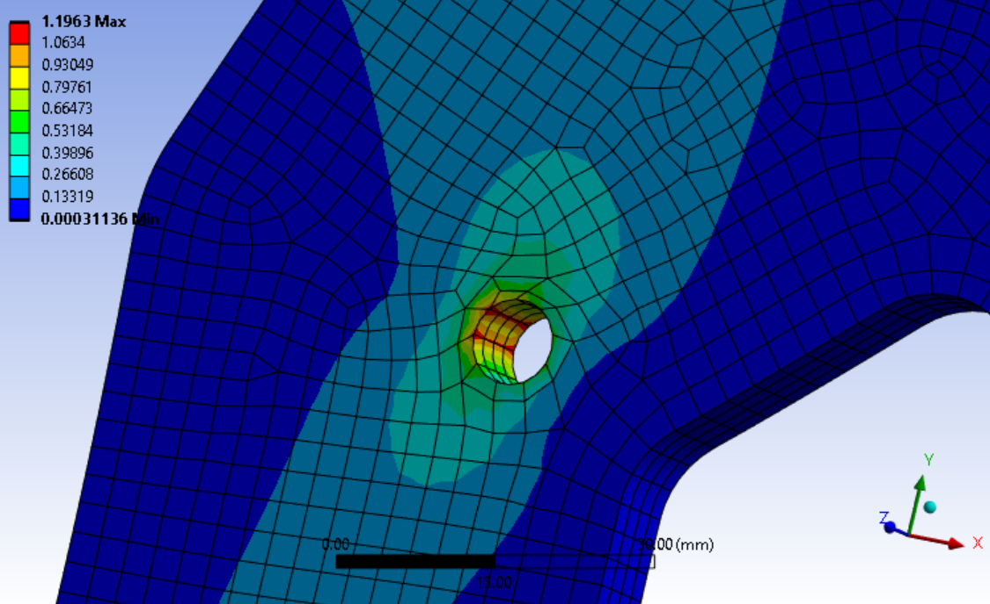
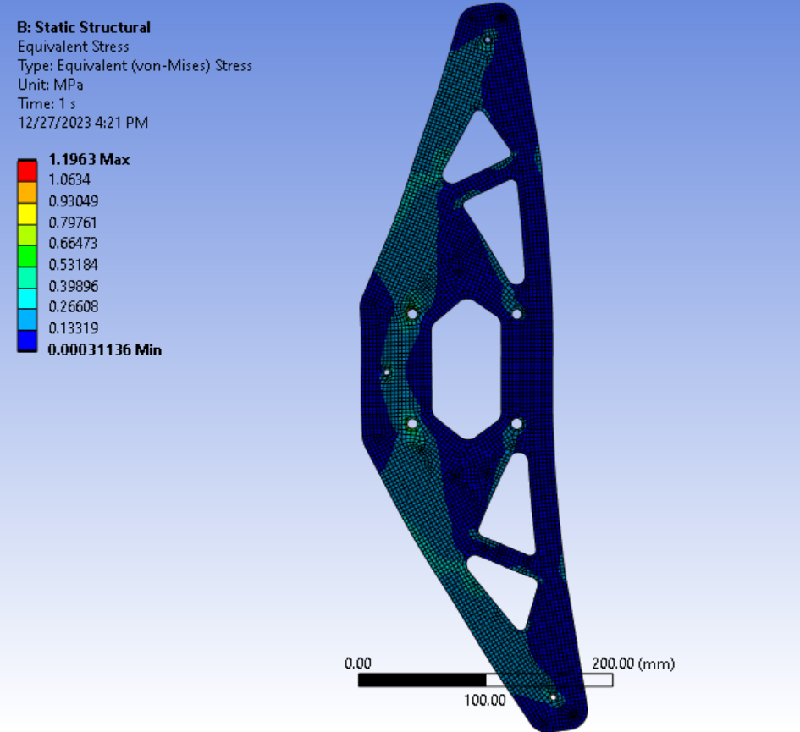
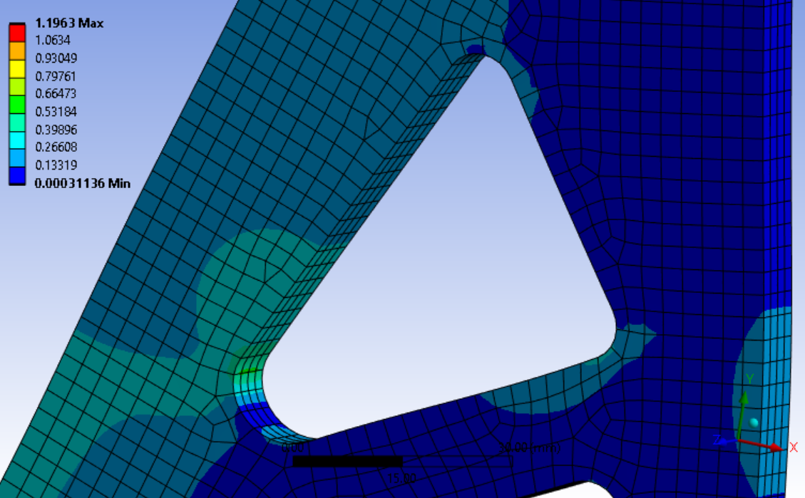
Antler Plate
ANSYS structural analysis
Stress is concentrated around bolt holes, but this could be partially due to bad mesh
Stress map

Slide 22
Rail Plate
ANSYS structural optimization
80%
50%
60%
30%
Note: Structural optimization neglected mass of antler plate and should be redone to see if resulting geometry is significantly different

Slide 23
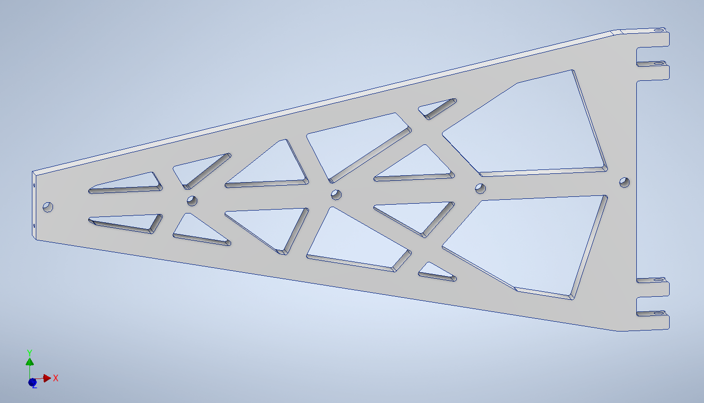
Rail Plate
Mass before optimization = 3.357 kg
Mass after optimization = 2.072 kg
Mass should be reduced further
Aluminum too thick - should be 3/8” or less instead of 5/8”

Slide 24
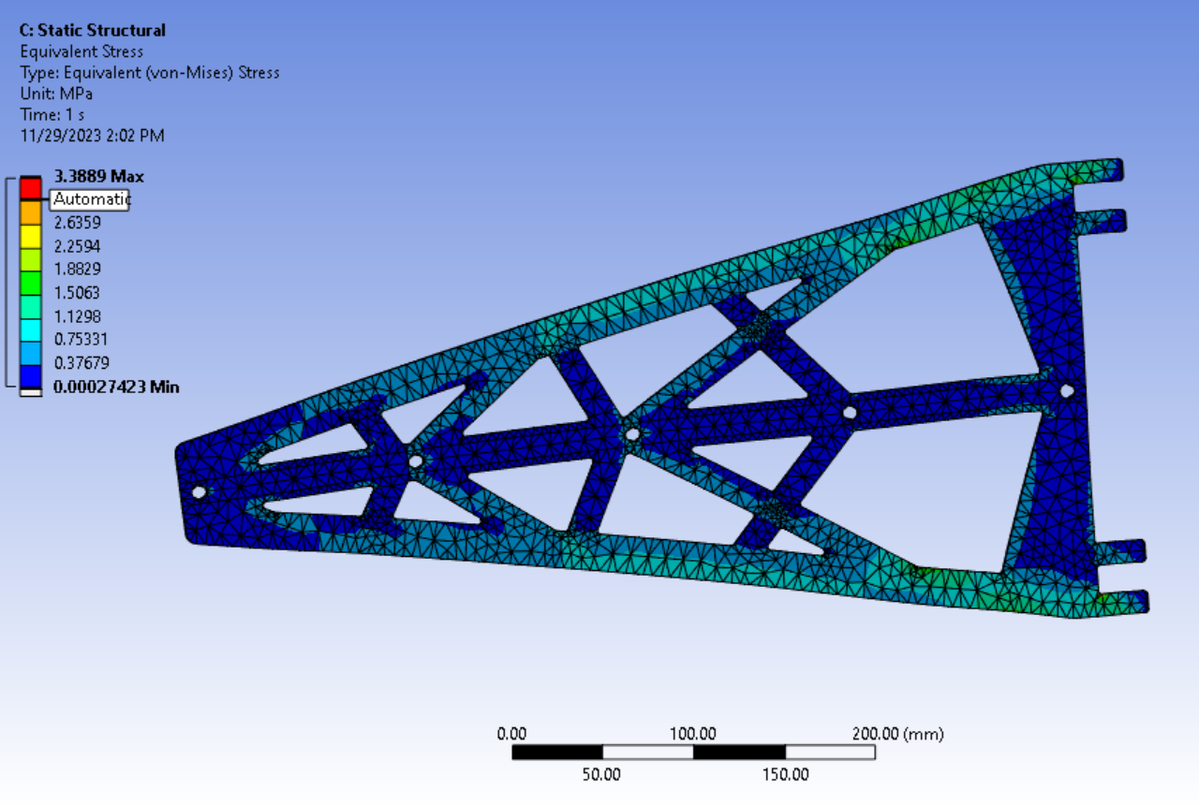
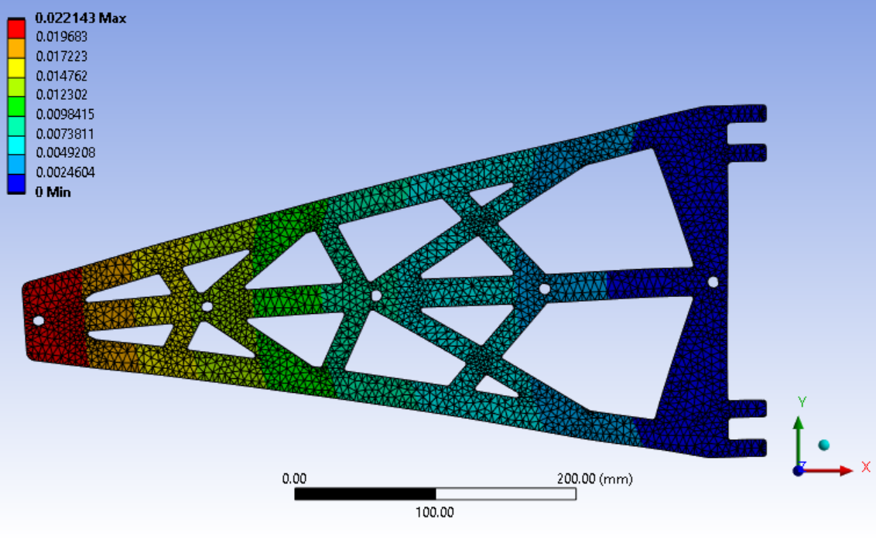
Rail Plate
ANSYS structural analysis
Neglected mass of antler plate (simulation should be redone to see if results are significantly different)
Max deformation: 0.022143mm
Max stress: 3.3889 MPa
Max strain: 5.0991 x10^-5
Results well within acceptable values
Stress map
Deformation map

Slide 25
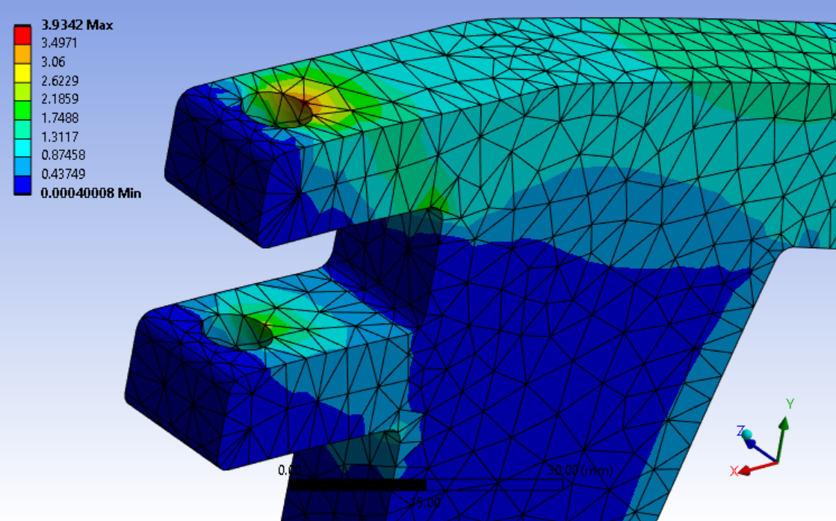
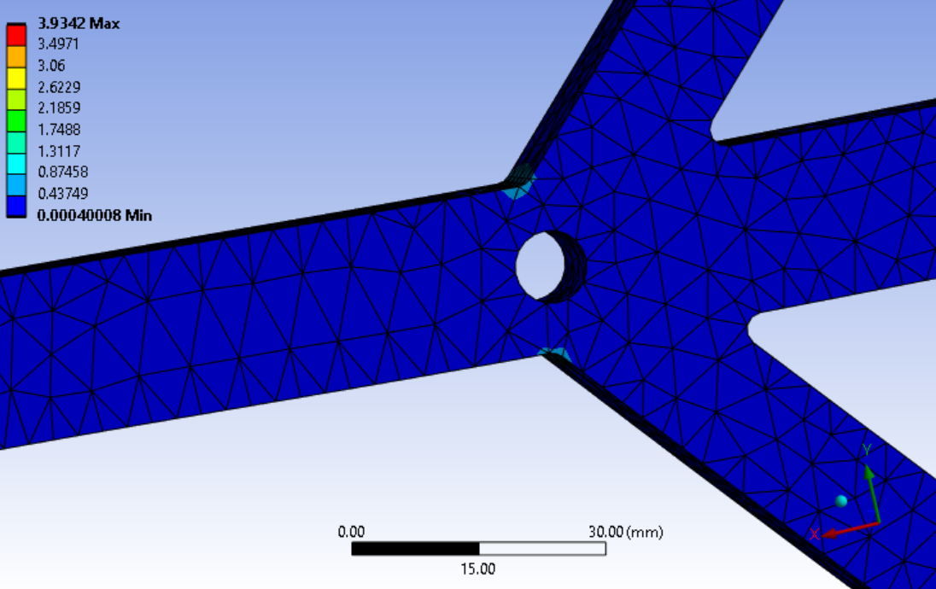
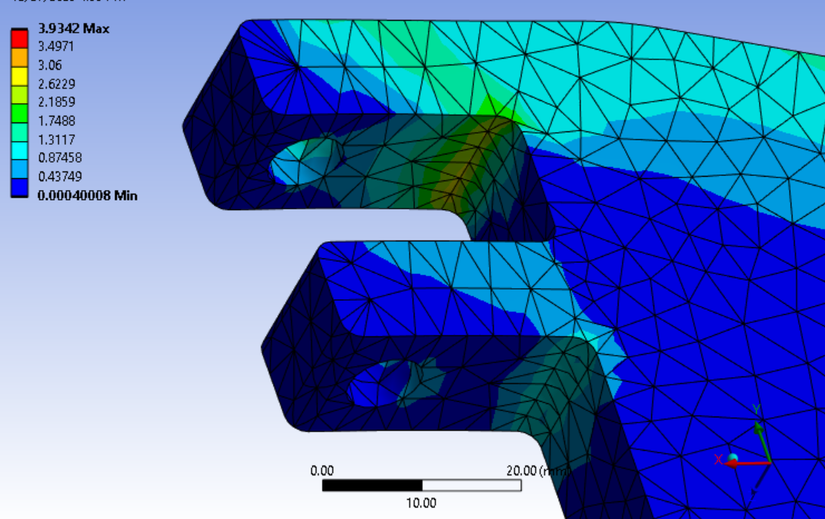
Rail Plate
ANSYS structural analysis
Stress concentrated around hinge
No stress on members connected to second mounting hole
Could indicate poor load distribution in geometry

Slide 26
Action Items
Design reviews and changes
Verify sliding mechanism dimension (slide 12)
Reevaluate design of rail mount plate (slide 23)
Consider redesigning wheel assembly (slide 15)
Perform whole assembly structural simulation
Create mechanical drawings
Prototype and test antler support
Create specialized test stand for antler support or wait until larger scale tests with mock service cylinder
Manufacture 4x antler supports in time for Phase-2 Tracker installation

Slide 27
References
“The Phase-2 Upgrade of the CMS Inner Tracker, Technical Design Report.” CMS Collaboration, CERN, July 1, 2017.
“Installation of Inner Tracker.” Axel Filenius, CERN, Nov. 21, 2022.
https://cernbox.cern.ch/s/IuzEhcnOVJnrVKV
https://drive.google.com/drive/folders/1hsIhDdWPf_LLOO0MlF2ijz6BKTnfdbC4?usp=sharing

