Slide 1
TFPX Mechanics Mini Workshop
Karl Smolenski
Feb. 8, 2024

Slide 2
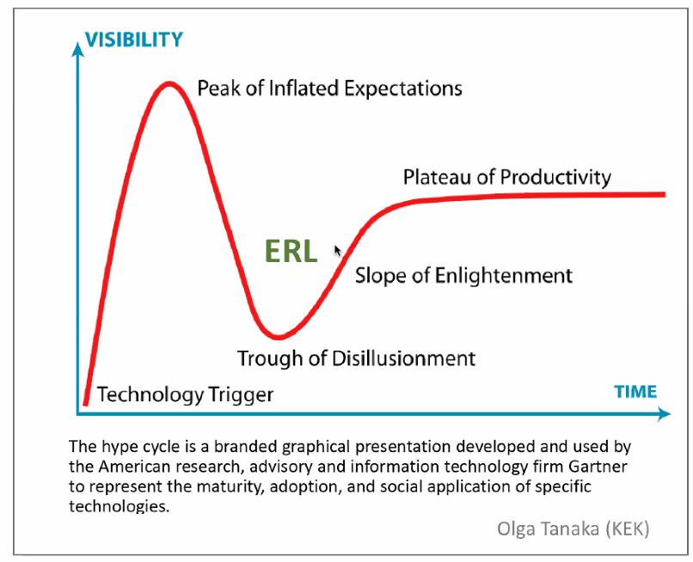
Where are we?
NSF MREFC Review
Production
TFPX
Recent Phase
Year of Covid

Slide 3
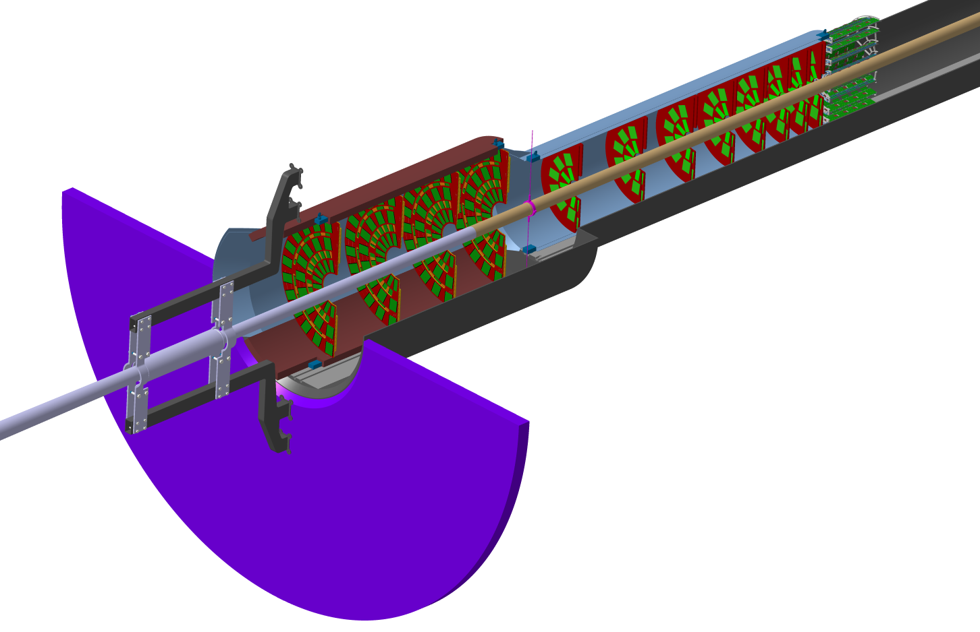
Scope of TFPX Mechanics
Service Cylinder
CMS central beam-pipe
TFPX
TBPX
Dee
Module
TEPX
Beam-pipe support “fishing rods”
Beam interaction point
CMS endcap beam-pipe
Inner Tracker Support Tube (ITST)
ITST design and manufacture, indico: 685933 & 682294
Beam-pipe support collar,
image source:
Antti Onnela
Indico /682359
Beam-pipe connection flanges and bellow
IT installation/support rails in the ITST
Tracker Bulkhead Disk

Slide 4
What do we need to do?
TFPX
IP
Collect 2D “images” of passing particles over a series of 8 planes, in the forward regime on both sides of the interaction point.

Slide 5
Systems architecture
TFPX
Electrical power
CO2 cooling
Particles
Dry air
Track (XYZ)
Time stamp (?)
Fiber optic data link

Slide 6
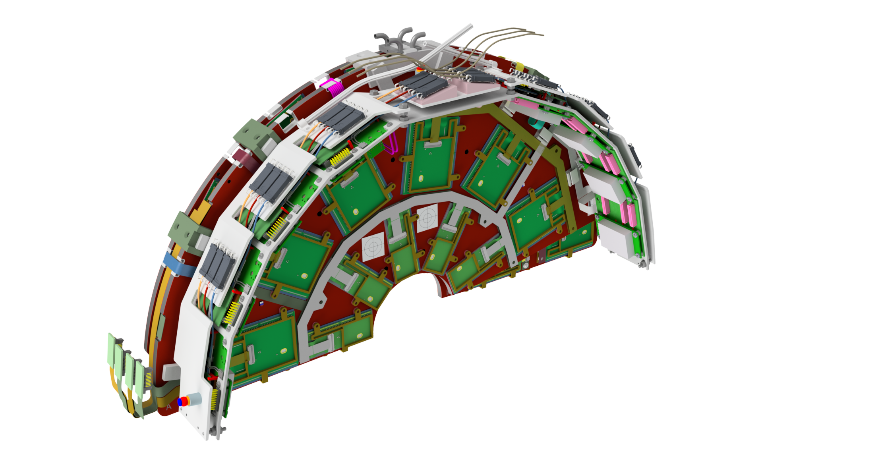
Cartridge layout (sort of)
Cartridge is the core element of TFPX layout
2 dees (sensors support) + local electronics
Final issues being resolved:
thermal pathways
cable routing
kinematic mounts
mechanical attachments
FiberOptics Ring
e-link routing, rear disk
e-link connector
mechanical – dee attachment
e-link routing, front disk
Portcard and DC/DC converter mezzanine
e-link paths
modules
Serial Power (to outside of service cylinder
kinematic mounts

Slide 7
Cartridge layout (sort of)
Currently water jetting PEEK edges to be bonded into layout
Allows for structural and module mounting tapped holes
mechanical – dee attachment
Module Mounting

Slide 8
Key Tasks for Summer
Dee structure (CF / foam / tube / foam / CF)
Slicing of carbon foam
Epoxy vs. Co-curing CF to carbon foam
Machining of perimeter, groove for tube, and recesses for threaded inserts
Application of glue to groove for tube
Glue / install Peek perimeter
Bonding of two halves together
Metrology of final product (flatness, mass, stiffness)

Slide 9
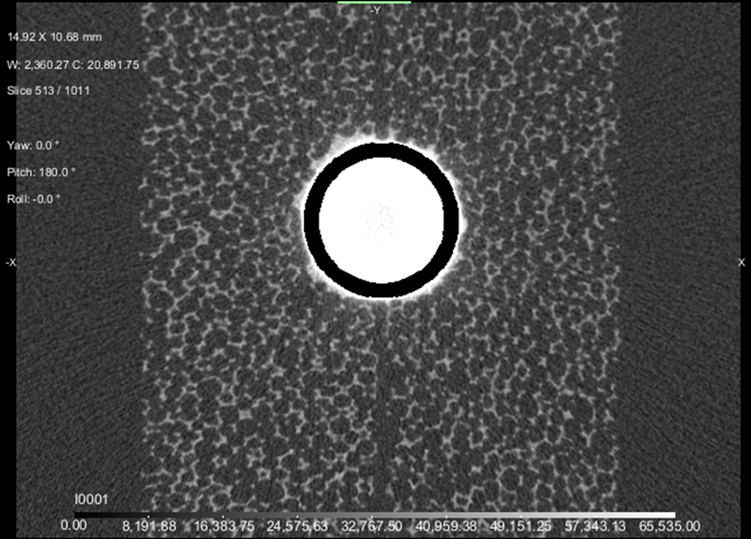
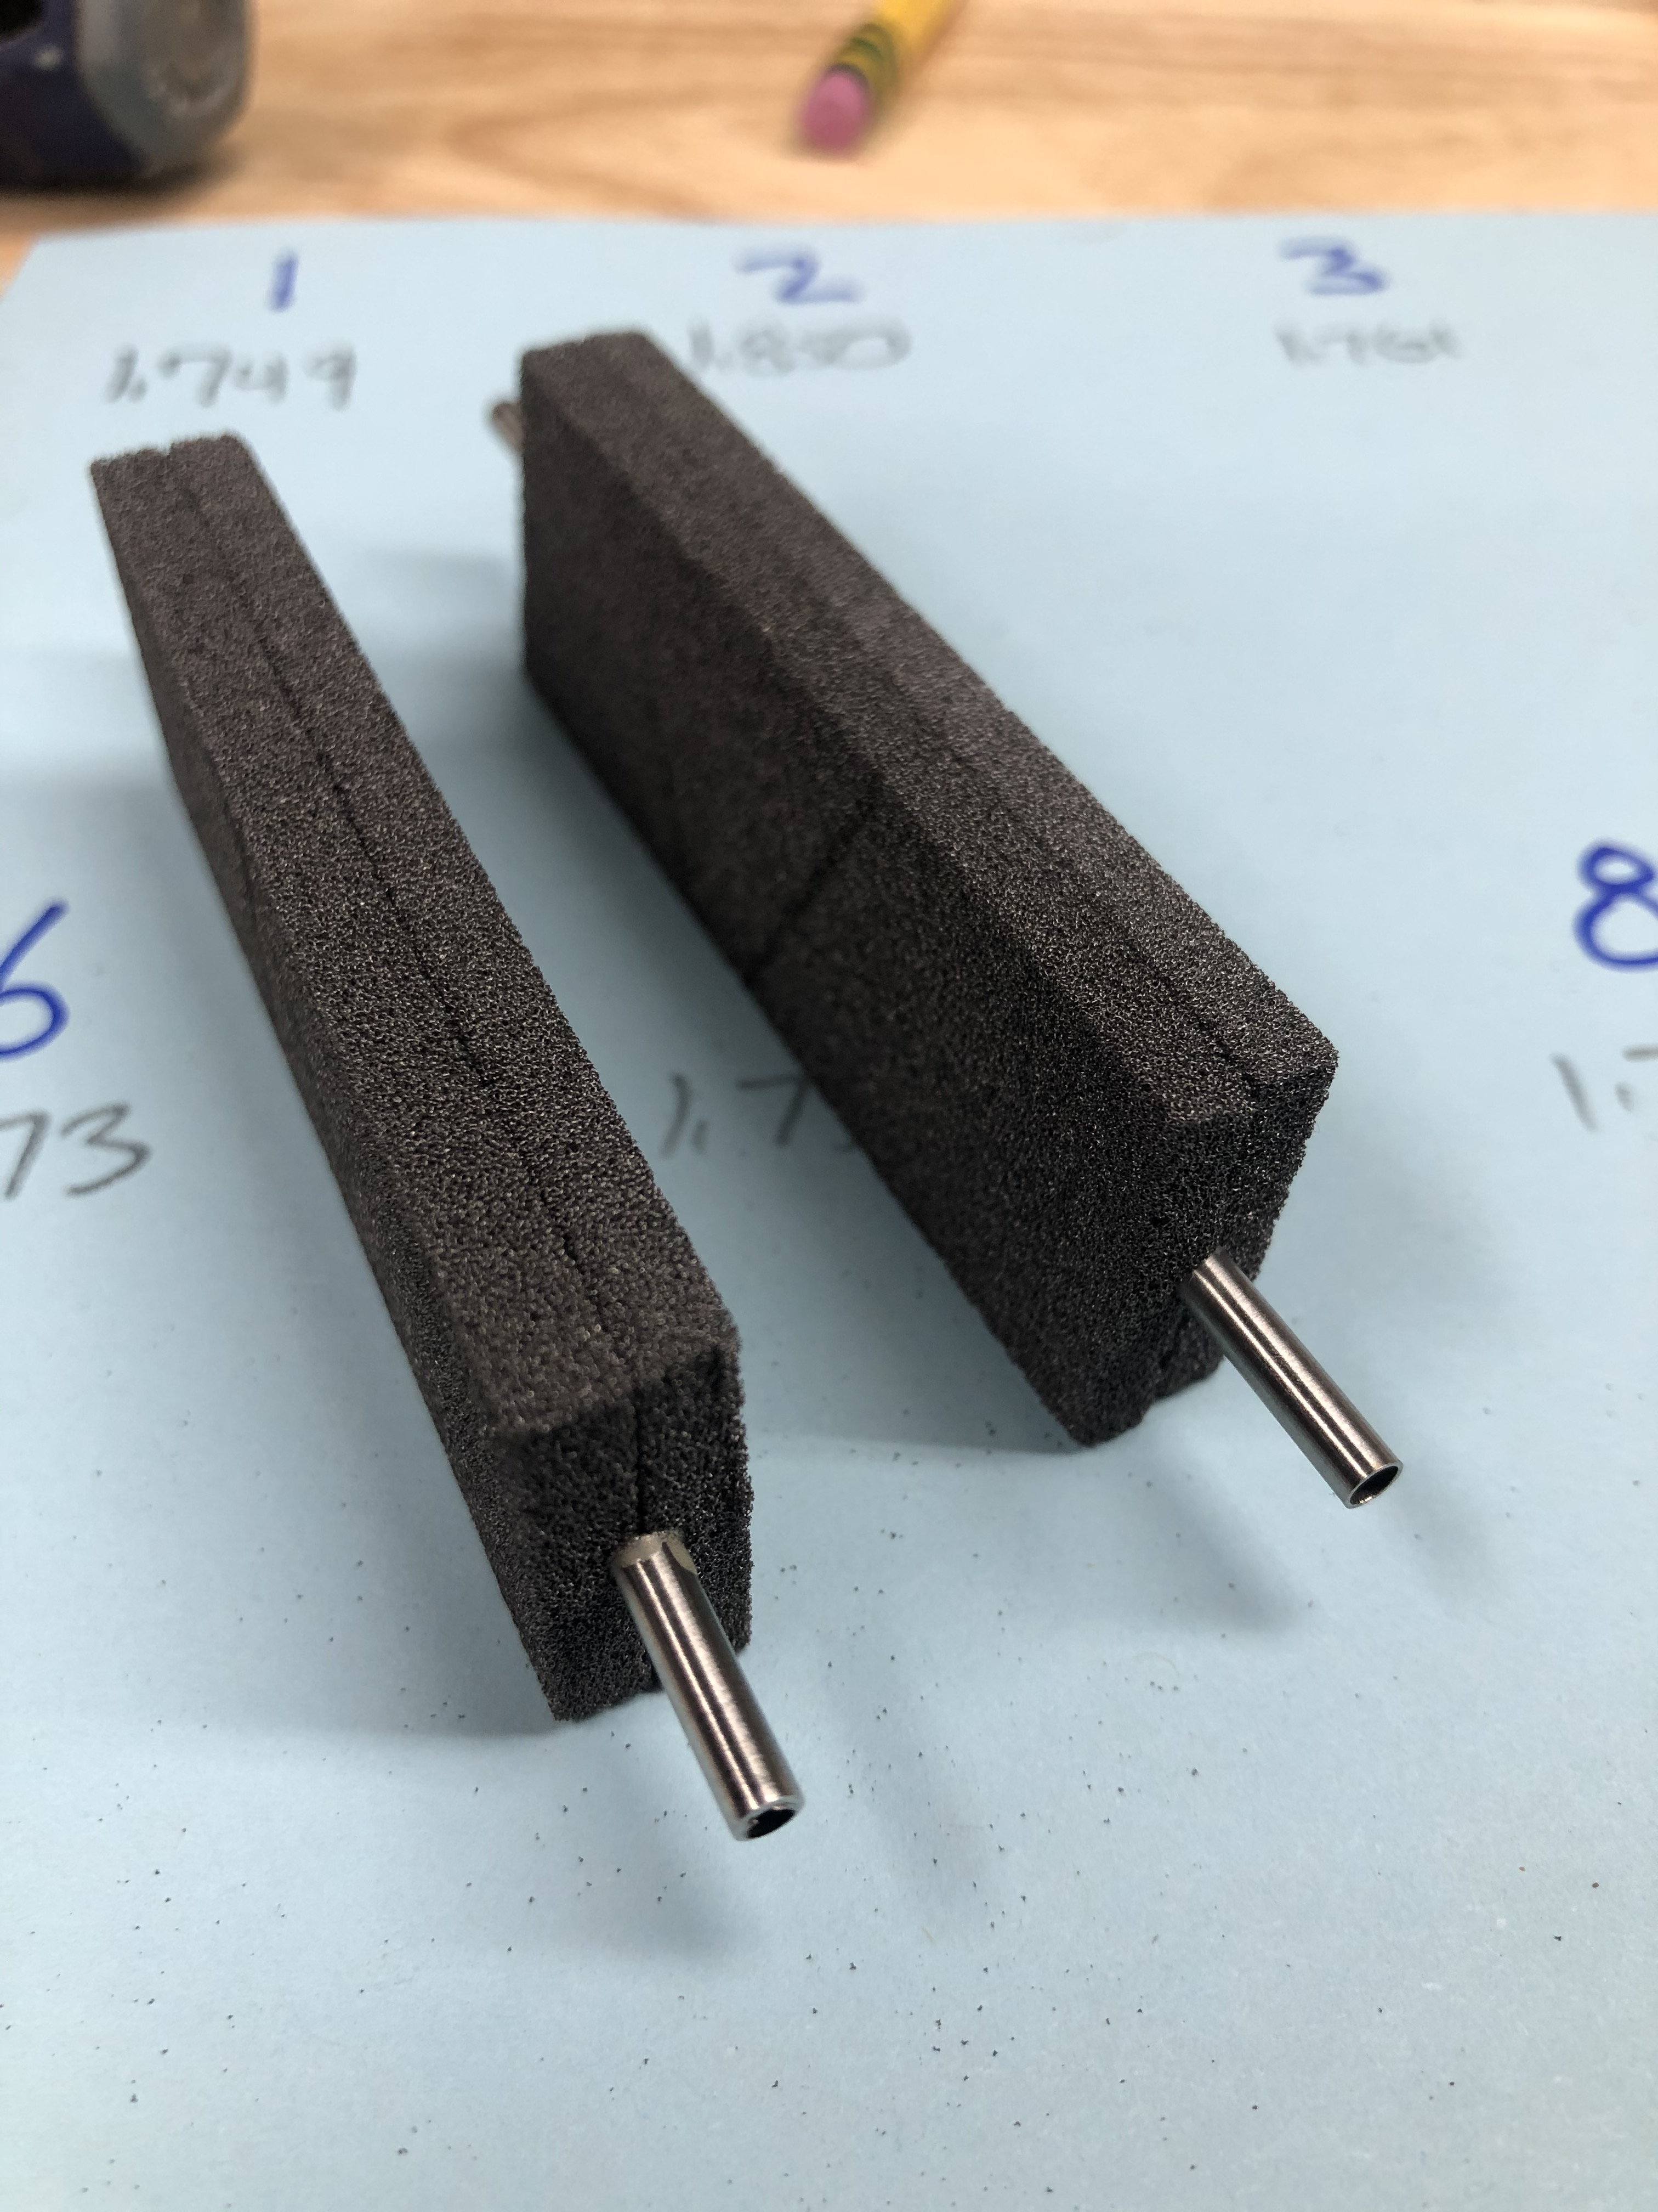
Tube Gluing into Carbon Foam
Cross Section X-ray CT scan shows minimal leakage of epoxy into foam
Loctite / Hysol / Henkel EA9396 Epoxy – as used by TED OT group

Slide 10
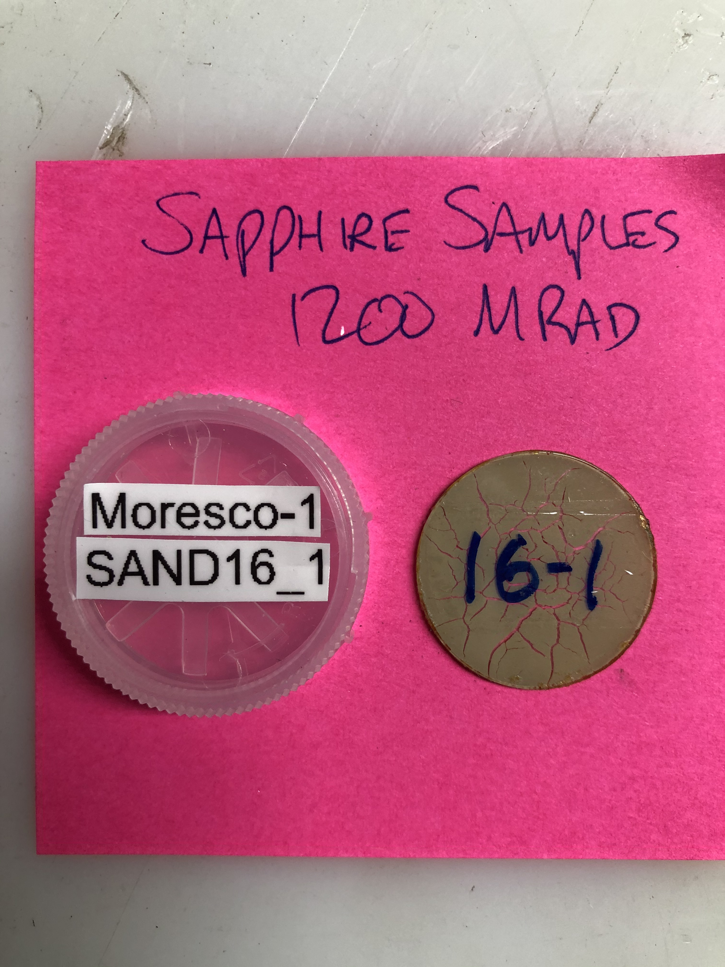
Key Tasks
Module (sensor) Thermal Performance
Thermal Interface Material (TIM) between module and dee
Thermal stack up (tube to foam to CF to TIM to module)
Radiation damage of TIM
How to positively locate module
How to clamp it in place
Gantry operations for assembly / TIM application
Tube routing, optimization, and simulation

Slide 11
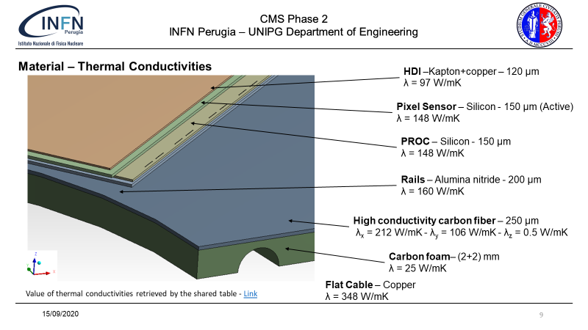
Thermal Modeling
Francesco Bianchi

Slide 12
Thermal Modeling
Francesco Bianchi

Slide 13
Busy !!!
Other topics
E-links
Prototype serial power flex circuits
Thermal mock-up modules
Prototype portcards
Portcard structure
Sapphire cartridge mounting structure

