Slide 1
Why does a physics education researcher belong in a physics department?
Natasha G. Holmes
Ann S. Bowers Associate Professor
Dept of Physics & LASSP
Cornell University

Slide 2
Who am I and what am I doing here?
Great question.
I’m Natasha Holmes – the Ann S. Bowers Associate Professor of Physics. And like many of you, I am here because of Peter. Not only am I here, now, because we’re celebrating Peter, but I am the Ann S. Bowers Associate Professor of Physics at Cornell, in part, because of physics.
When I was a freshly minted PhD, I moved from Vancouver, BC to Stanford, CA to start my post-doc with Carl Wieman. I was introduced to Peter there, who was spending the semester (year?) with Carl on sabbatical after completing his term as Dean of Arts & Sciences. We interacted over my research – he was using Persis Drell’s old office just down the hall from my temporary office – so we often chatted about this or that. One of my fondest memories is when he found a mistake in my intro physics lab assessment where I had miscalculated the uncertainty in the slope of a best fit line. I deeply appreciated that a theorist was paying enough attention to the experimental data to realize that the value for the uncertainty couldn’t possibly make sense.
During this time, Cornell posted a job ad for an experimental condensed matter physicist – my now-husband’s field. I went to Peter’s office to get a sense of whether Cornell would ever consider hiring a physics education researcher. Long story short, they would, and here I am. I was the first discipline-based education research hire at Cornell University – of which there are now five faculty across campus – and, as far we know, the first physics education researcher to be hired for physics education research at an Ivy+ institution.
To make that happen, Peter had for years laid the groundwork for Cornell to be excited about PER. He created the Active Learning Initiative in the College of Arts & Sciences, pitching the idea to Alex Hanson (a generous alumnus who funded it for years). The ALI supported departments to overhaul their courses and implement research-based instructional strategies. Physics was one of the first departments to win an ALI grant. Through this project, the department brought in PER researchers, learned about the field, and eventually overhauled our intro physics for engineers sequence with active learning. So by the time my application crossed their desks, they understand the field, appreciated what it had to offer, and were excited about having an expert contributing to it in house.
One day over coffee, as I talked to Peter about the possibility of Cornell hiring a physics education researcher, Peter asked: “Why should an education researcher be in a physics department?” He knew he was going to need to answer this question from his colleagues back at Cornell. For the rest of this talk, I’m going to give a much updated, and much better prepared, answer to that question.

Slide 3
Why should a Physics Education Researcher be in a physics department?
We study teaching and learning of physics, which requires an understanding of physics and how people do physics.
We apply the tools, ways of thinking, and values for evidence in physics to study the teaching and learning of physics.
We need to work with physicists to do the research and implement the best practices that come out of it.
Notes:
You can’t figure out how to teach quantum mechanics if you don’t understand quantum mechanics.

Slide 4
Why should a Physics Education Researcher be in a physics department?
We study teaching and learning of physics, which requires an understanding of physics and how people do physics.
We apply the tools, ways of thinking, and values for evidence in physics to study the teaching and learning of physics.
We need to work with physicists to do the research and implement the best practices that come out of it.
Notes:
You can’t figure out how to teach quantum mechanics if you don’t understand quantum mechanics.

Slide 5
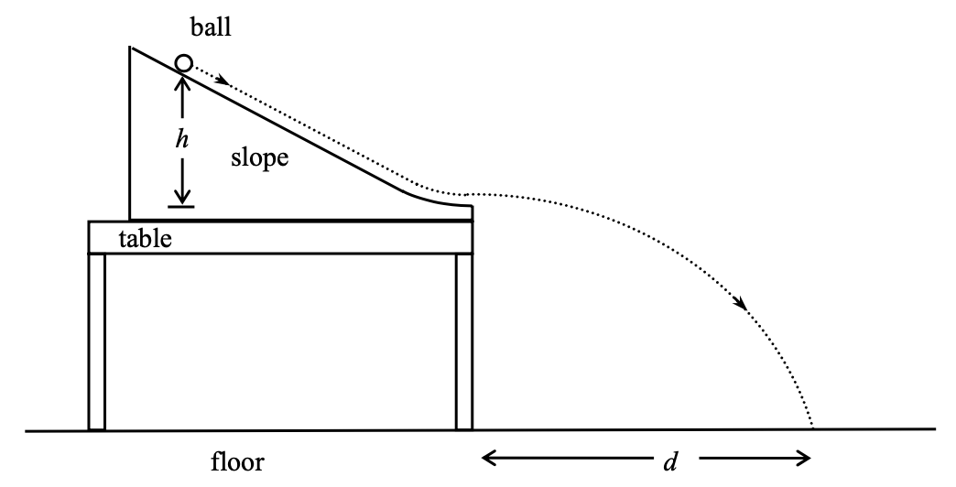
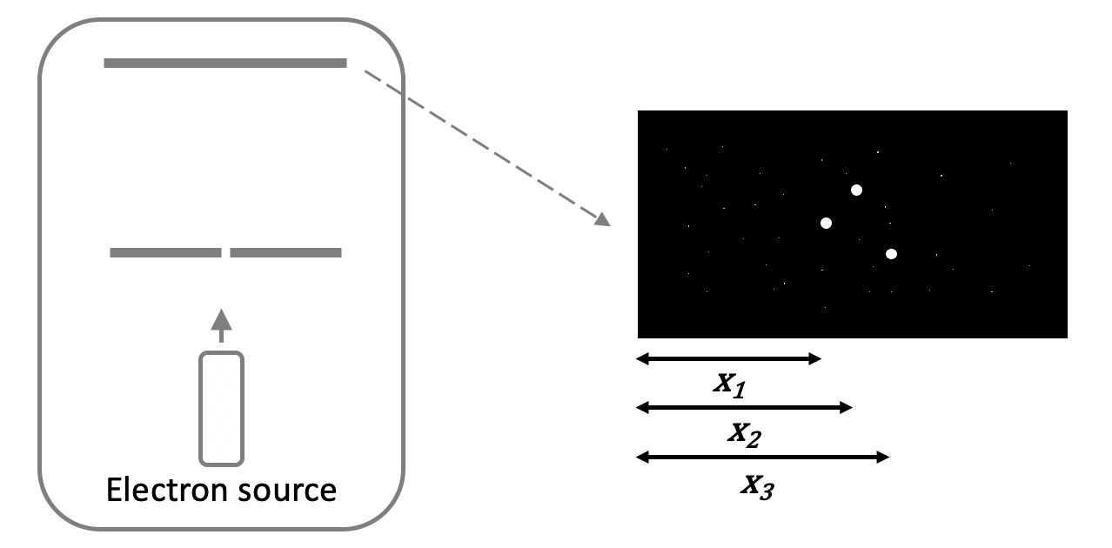




How do students think about measurement and uncertainty in experimental physics?
Classical: Projectile Motion
Quantum: Single-slit
DUE-1809178, DUE-1808945,
and DGE-2139899
Emily Stump Gina Passante Mark Hughes

Slide 6
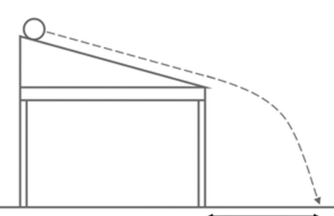
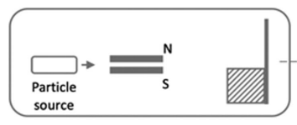
How do students think about measurement and uncertainty in experimental physics?
Projectile motion context
Uncertainty paradigms
Other “advanced” context
Sources
More/Better
Without explicit context
Generic Uncertainty
Two Student
Schang, Dew, Stump, Holmes, Passante (2023); Stump, Dew, Passante, Holmes (2023);
Stump, Hughes, Passante, Holmes (2023); Stump, Hughes, Holmes, Passante (2024) Phys. Rev. PER

Slide 7
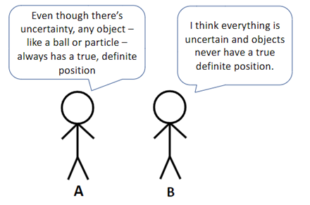
Two students are discussing uncertainty in physics experiments.
Which student do you agree with more?
Please explain your reasoning.
Stump, Hughes, Holmes, Passante (2024) Phys. Rev. PER

Slide 8
Two students are discussing uncertainty in physics experiments.
Which student do you agree with more?
Student A
Student B
Stump, Hughes, Holmes, Passante (2024) Phys. Rev. PER

Slide 9
Two students are discussing uncertainty in physics experiments.
If students think A:
  uncertainty = error = mistake,
  Point of experiment is to find the “true value”
  Results should be evaluated based on closeness to “true value”
  Impacts decisions about experimental design, how they interpret results, and make sense of data.
If students think B:
  Lots of stuff.
Knowing how they’re thinking impacts what our instruction looks like.
Stump, Hughes, Holmes, Passante (2024) Phys. Rev. PER

Slide 10
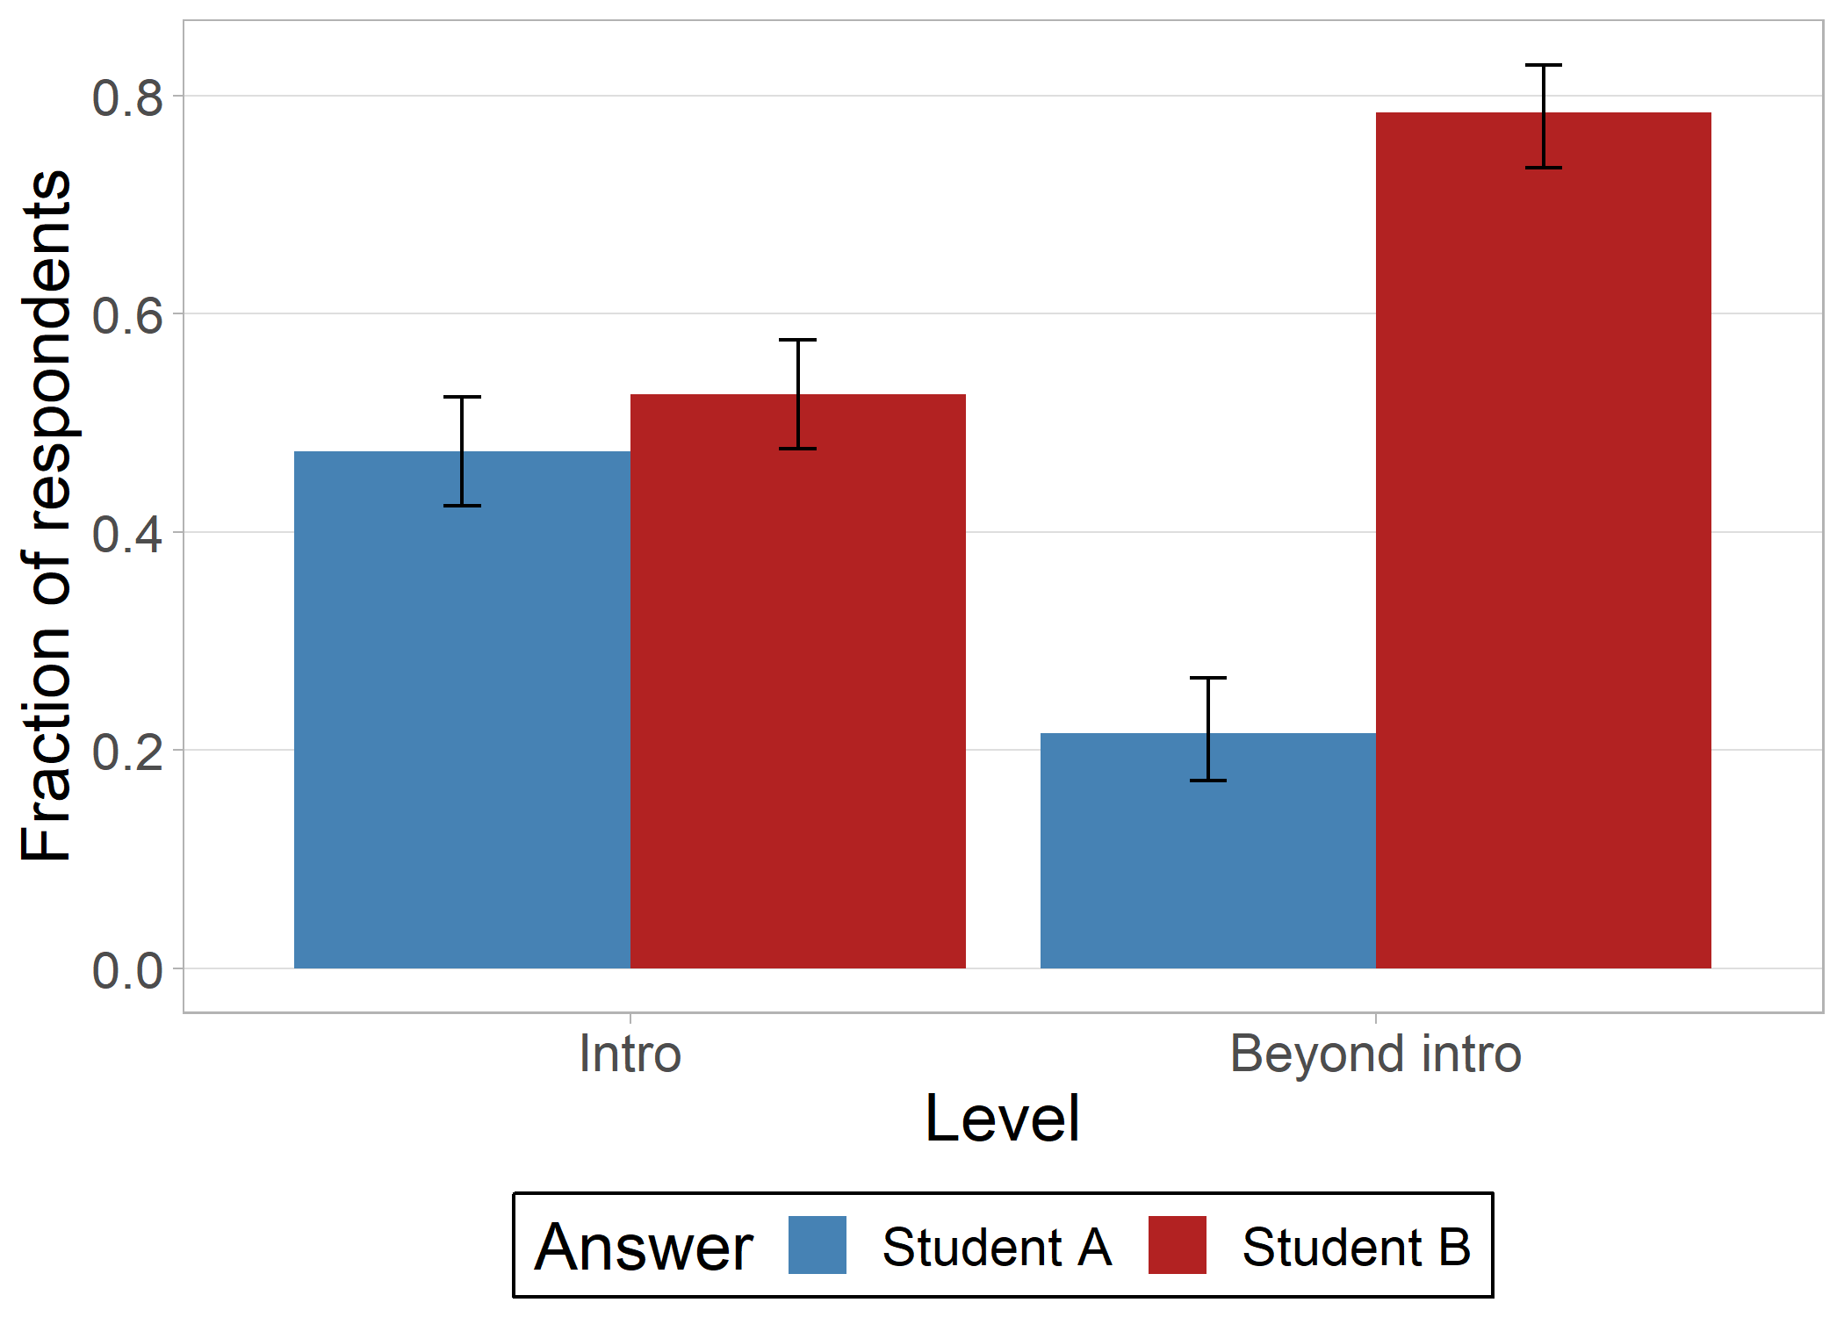
Which student do you agree with more?
Stump, Hughes, Holmes, Passante (2024) Phys. Rev. PER

Slide 11
Which student do you agree with more?
Reasonings
“Measurement uncertainty is not due to objects not having a definite position. It is caused by lack of precision. The marble is not a perfect sphere and each marble is different. Each of the tracks are not going to be exactly the same height. Each of those objects still has a definite position.”
Experimental ideas
Stump, Hughes, Holmes, Passante (2024) Phys. Rev. PER

Slide 12
Which student do you agree with more?
Reasonings
“I believe that no matter how close we get to the object or how precise we are there will always be a percent error of that measurement no matter how small therefore we can never have a definite exact position.”
Experimental ideas
Stump, Hughes, Holmes, Passante (2024) Phys. Rev. PER

Slide 13
Which student do you agree with more?
Reasonings
“The [Heisenberg Uncertainty Principle] is not about an object’s position, but rather our ability to measure it”
Quantum ideas
Stump, Hughes, Holmes, Passante (2024) Phys. Rev. PER

Slide 14
Which student do you agree with more?
Reasonings
“I guess I agree with Student B since the ball is made up of many quantum particles that have a built in uncertainty due to the uncertainty principle.”
Quantum ideas
Stump, Hughes, Holmes, Passante (2024) Phys. Rev. PER

Slide 15
Which student do you agree with more?
Reasonings
Other: object size, or moving objects, or relativity
Stump, Hughes, Holmes, Passante (2024) Phys. Rev. PER

Slide 16
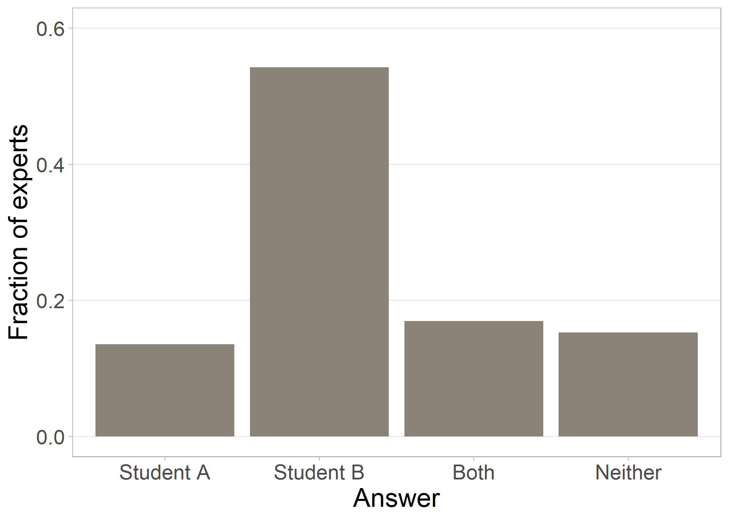
Which student do you agree with more?
Stump, Hughes, Holmes, Passante (2024) Phys. Rev. PER

Slide 17
Example expert responses
I am more inclined to agree with B, for two reasons. (1) If it cannot be measured, it is not clear to me what the philosophical, true position means; (2) knowing quantum mechanics, you simply cannot always have a true, definite position.
Quick question -- good one. I'll side with person B. The uncertainty principle from quantum mechanics places a fundamental limit on the localization of any particle. I don't believe in a deeper realist description of nature beyond quantum mechanics--hidden variable theories-- which would allow things to have definite positions.
In practice, the uncertainty principle places negligibly small restrictions on the uncertainty in position on everyday objects so we can effectively ignore it.
More pedantically, I suppose there is an additional complication of a composite deformable object like a ball -- what exactly do we mean by *the* position? We could define that as the centre of mass for example.
I better not have to return my phd.
The uncertainty is of order hbar. So, if you are thinking of a macroscopic object, the uncertainty is negligible and one can think of it as having a definite position. If you are thinking of a microscopic object, the uncertainty is important.

Slide 18
Example expert responses
I think there's merit in both positions, but I'm more convinced by Person A's response.
My attraction to Person B's response is mostly because my actual answer would be "who cares?". If something like "exact position" really exists, but we cannot, even in principle, access it, then what does it matter what we say about it? It's a question to which the answer is of no consequence. So then, of I'm choosing between these answers, I think Answer B is appealing, since we essentially discard a bit of ontological baggage (I.e. no need to carry around the notion of an exact value).
However, if I give a considered answer, the reason I would ultimately side with Person A is that I think while measurement science itself would say no measurement can ever return an exact value, there's no notion within the idea of uncertainty, or measurement science in general, that limits what precision can actually be achieved to a non-zero value (it can always get lower if you improve your experiment). And if you think there's no principled limit on your precision, just the practical limit of your particular experiment, it seems to me the measured value is approaching a limit as you lower the uncertainty. But that seems to me to mean that this limit is the "exact" value that the measurement estimates, and hence you have to accept that it exists.
I guess one could cite a physical reason why the precision can't get lower at some point (say the uncertainty principle, or something like it) to justify Person B. But that seems to me to be outside the scope of what's being discussed here. That's no longer a discussion of uncertainty or measurement science, that's a discussion about the nature of reality as postulated on some particular physical theory.

Slide 19
Example expert responses
I wish that I could agree with Person A. I think that universe would make more sense that the one we seem to actually inhabit.[*]
But ultimately, based on my understanding of quantum mechanics, I have to agree with Person B. The universe literally *does not contain enough information* to specify the precise position of a particle even in principle.[**] The available information about a (quantum) particle's state needs to be split between specifying its position and specifying its momentum, and it would take *all* of the maximum available information just to specify one or the other. Since any realistic scenario will involve at least some bounds on both of those quantities, the particle’s position will always be incompletely specified.
Or to put all that another way, a particle's state is described by its quantum wavefunction. The wavefunction isn’t just a statement about our knowledge about the particle, it’s the actual encoding of the particle’s true state in the universe. In the form where it can be expressed as a superposition of position states, the wavefunction implies that the particle’s position is a quantum mixture of a whole range of possible values, all of which coexist together. A wavefunction localized to a single point would have infinite energy: an impossibility.
Hopefully something in all that is helpful! If you have any followup questions, I’d be happy to follow up.
[*] I suppose that the Bohm/pilot wave interpretation of quantum mechanics does embrace Person A’s perspective as true (though at a cost that I just can’t accept: as I understand it, that philosophy clings so hard to the claim “objects have a definite position” that they wind up throwing away nearly the entire concept of “objects have momentum”).
[**] In saying this, I am implicitly rejecting the physical reality of delta functions as an actual wavefunction a particle can have (and along with that, rejecting the idea of particles whose position or momentum is delocalized over every possible value out to infinity). Those distributions are mathematically convenient, but I’ve never thought they were physically realistic.

Slide 20
Example expert responses
In a classical world, Person A’s view is essential. Even though there will always be measurement uncertainties in our knowledge about a particle, the underlying description in classical mechanics depends upon the notion that a particle has a definite position and momentum — these concepts are hard-wired into the formalism. Measurement errors are readily modeled in this framework, and, in principle, can be made arbitrarily small, thereby providing an empirical definition of what we mean by the particle’s true position and momentum.
In a non-relativistic quantum world, things are a bit more complicated but it is still possible in principle to locate a particle with arbitrary precision, though with decreasing knowledge of where it is going and how quickly. So even in this case Person B is not quite right to assert that an object never has a true or definite position. In our relativistic world, however, the concept of a particle becomes complicated. Any attempt to localize a particle will result in it turning into three or four different particles (or five or …). So it’s not just the particle’s position that is uncertain but also its existence. Maybe this is what Person B means, but I sort of doubt it.
I am not really happy with either statement because they are both too short and ill defined. For me it is not so much a matter of which statement/position I agree with more. The issue for me is which viewpoint is the most useful for thinking about the properties and behaviors of a particle. Person A’s view is useful in situations where classical physics is a good approximation, and there is a sense in which it is useful in non-relativistic contexts (where there is a position operator whose eigenstates correspond to particles with definite positions). Person B’s view is too vague to be of much practical use.

Slide 21
Example expert responses
The words "always" from student A and "never" from student B are problematic. I think they back them both into corners and, as a result, I think they're both technically "wrong".
First student A. This is a technically incorrect statement, particularly in the context of "particles". The idea that a particle "has" a position evokes ideas of "hidden variables" (in this case the "real position" being some hidden variable that the particle "has" and is only revealed after measurement), which are of course not compatible with the Bell's test experiments (other than some non-local theories or other wild ideas). So this is wrong.
On the other hand, for objects like "balls" or "houses", they have definite positions in the practical sense. You can define a center of mass (or some other coordinate) for these objects, and measure that coordinate with as much precision as you can muster. In all practicality, for macroscopic objects, you will be dominated by your measurement uncertainty. So the idea that there is some "uncertainty" in the position of your house due to quantum mechanics is just being pedantic - yes, it's sort of true in some sense, but it's never relevant.
Student B. I had to do some reading on this one and it's a bit subtle. I think this type of statement comes from a common misunderstanding of the "uncertainty principle". In wave mechanics, it stems from the fact that the momentum and position-space wavefunctions are fourier transforms of each other. You can define a position-space wavefunction as a delta function in coordinate space, with a fourier transform that is a plane wave in momentum, or conversely, a plane wave in coordinate space that is a delta function in momentum. A delta function in coordinate space has a perfectly well-defined position, with no "width". This of course runs into problems when you try to normalize the wavefunctions - plane waves aren't normalizable. You can still work out uncertainty relations for these cases if you do some clever regularization, but I think this line of logic gets a bit obscure. But in any case, we are usually comfortable talking about plane waves of well-defined wavelength, which is something with perfectly-defined momentum. And the analogous "plane wave in momentum space" has a perfectly-defined position. It's sort of a problem of asking what is 0 times infinity (or really, infinity / infinity).
It's a bit clearer if you think about matrix mechanics. Formally, we are happy to write , which is an eigenstate of position. This state has a perfectly well-defined position, by construction! And we are also happy to project arbitrary states into the position basis, to "collapse" them with a measurement. Immediately after, our object has a well-defined position (and will continue to be in that position unless it evolves in time, i.e. if that state isn't an eigenstate of the system's hamiltonian, or if there are external influences).
This is all a bit formal, reducing "measurement" to an operator. Real measurements are more complicated - we don't have "point-like detectors" that collapse wavefunctions into perfect position eigenstates, there is the external "thermal bath", things like entanglement, etc. So in reality you will never get "absolute" measurements of position. But formally, position eigenstates are certainly a thing.
I guess maybe the problem here is that the "fundamental" thing is the commutation relation xp - px = i . This is really a statement about "order of operations", not about uncertainty. "Uncertainty principles" follow as a consequence of the non-commutativity of the conjugate operators, not the other way around. Maybe that's what's confusing.
Or maybe I'm just confused.

Slide 22
Example expert responses
For quantum systems, there’s the uncertainty principle, and even conceptually the electron or photon or whatever doesn’t have an absolutely certain position. In that sense, person B is right, and person A is wrong.
Then there’s measurement uncertainty. Some things you can measure with zero uncertainty, like counting a collection of five, but for even a classical object like a basketball, there’s always uncertainty in measuring a continuous quantity like position. There’s no way to know any “actual” position, because there’s no way to measure it. Person A might say “it really has a position but no one can ever know what it is,” but that’s not terribly practical, and I think most physics professors (certainly me) would say it doesn’t have a definite position.
But I think the question is actually really rich, and you could think of other situations where the answer doesn’t seem so clear cut. For instance, what happens to you if you fall inside a black hole? We can never measure what happens inside the horizon, so in that sense, for those of us who don’t dive to our deaths inside the black hole, it’s the same exact situation as the particle. You can never measure what happens. But if you dived into a black hole, *something* would happen to you, right? If I dived in, I would experience something! So in this situation, I would lean more toward person A: something does happen to a person who dives into a black hole, even though those of us who choose to live can never know (never measure) what.
Or you could take a meta look at the question. What if instead of thinking about the position of a particle, you thought about the laws of physics themselves. Do they have a definite reality, or is it just what we measure, but there’s nothing more to it? This is pretty philosophical. I’m more of a Platoist, in the sense that I believe the laws of physics we have are approximations to the underlying “true” laws. But logical positivists say no, there’s just what we measure, and there isn’t necessary a unique underlying “true” theory. Maybe if my expertise was in quantum physics I’d see this version of the question differently, though.
p.s. I’m curious what you think, and I’d love to chat about this some time!
p.p.s. When I was a grad student, I asked Stephen Hawking the “meta” version of the question in the Q&A at a public lecture (Kip Thorne was MC). Here’s a transcript of the conversation, in case you’re curious:
GL: In your book, The Nature of Space and Time, you and Roger Penrose debated some aspects of cosmology. One thing that came across was your difference in philosophies. You describe yourself as a positivist, so scientific theories are just mathematical models, and asking whether they describe reality is meaningless. Penrose, on the other hand, is a Platonist, so scientific theories do describe an objective reality. How much does a choice in philosophy like this affect your scientific research?
Stephen Hawking: The difference between the positivist and the Platonist view of the world is important in science. It is the cause of Roger Penrose's difficulty with quantum theory, for what is objective reality in quantum theory? Which slit did the electron go through in the two-slit experiment? Is Schrodinger's cat dead or alive? The difference between the two philosophies is clearly seen in the case of M-theory, which is our best candidate for the theory of everything. M-theory isn't a single theory but a collection of very different theories which make the same predictions in the regions where their ranges of validity overlap. They can be regarded as different reflections of the same underlying theory, which we can't formulate as a single set of equations. All of the theories are on equal footing. None can be regarded as more real than the others. In most of the theories, spacetime has 10 dimensions, but in one theory, it has 11. So, what is the real dimension of spacetime? The answer is it is not defined. There is no unique objective reality. All one can do is adopt a positivist approach, finding a theory that makes the right predictions. But it may not be unique.
GL: Thank you.
Kip: So, let me say that in...many occasions of doing lectures like this with Stephen, that's the longest and deepest answer that I have heard to any question that he was asked. This question clearly probed something that is very important to him and I've never before seen him expound on it in quite this way. So, I appreciate very much that response, Stephen.

Slide 23
Example expert responses
That was fun, but I don’t know if my response will be of any use.
Oh, that's fun! So... which one do I agree with more? (Disagree with less?)
Sorry for the waffling.
Sorry for my confusion.
So I think both are discussing metaphysics and I am glad to see they found their happy place, its not mine.

Slide 24
Do students and experts think objects have a true definite position?
Some do. Some don’t. Others say both or neither.
Their reasonings are nuanced and varied and (we postulate) impact their ideas and decisions about measurement in complex ways.
Designing instruction to develop expert-like measurement skills and understandings requires attending to this nuance.
Notes:
So how do we understand or improve student reasoning and decisions about uncertainty?

Slide 25
Why should a Physics Education Researcher be in a physics department?
We study teaching and learning of physics, which requires an understanding of physics and how people do physics.
We apply the tools, ways of thinking, and values for evidence in physics to study the teaching and learning of physics.
We need to work with physicists to do the research and implement the best practices that come out of it.
Notes:
We needed to understand measurement, uncertainty, quantum mechanics, and special relativity to:
Decide this was important,
Design the question,
Analyze the data,
Interpret the results, and
Evaluate implications.

Slide 26
Why should a Physics Education Researcher be in a physics department?
We study teaching and learning of physics, which requires an understanding of physics and how people do physics.
We apply the tools, ways of thinking, and values for evidence in physics to study the teaching and learning of physics.
We need to work with physicists to do the research and implement the best practices that come out of it.

Slide 27
How do you know if an experimental result is trustworthy?
Hu & Zwickl (2018) Phys. Rev. PER

Slide 28
How do you know if an experimental result is trustworthy?
Expected results: The result matches an expected result, such as one predicted by theory or a textbook.
  “A result is acceptable or trustworthy if it is very close to the known value of the parameter (within 5% error of the known value).”
Consistent results: The same result is obtained when looking at more data, either through repeated trials or comparing with other people.
  “An experimental result can be seen as acceptable or trustworthy if it yields the same result after many replications.”
Uncertainty: Measures were taken to reduce or account for uncertainty and/or there is a small calculated uncertainty.
  “If many trials are carried out and there is little uncertainty/error, then I would say a result is trustworthy. ”
Hu & Zwickl (2018) Phys. Rev. PER

Slide 29

How do you know if an experimental result is trustworthy?
E. Smith
 | Lab Course A | Lab Course B
Expected results | 23% | 17%
Consistent results | 53% | 53%
Uncertainty | 19% | 50%
Smith, Stein, Walsh, & Holmes (2020) PRX

Slide 30

How do you know if an experimental result is trustworthy?
Rebeckah Fussell
Machine Learning & Natural Language Processing should be able to mimic human coders.
“Expected Results”
“Consistent Results”
Kappa = measure of how human and computer coder compare
Fussell, Mazrui, Holmes (2022) PERC proceedings

Slide 31
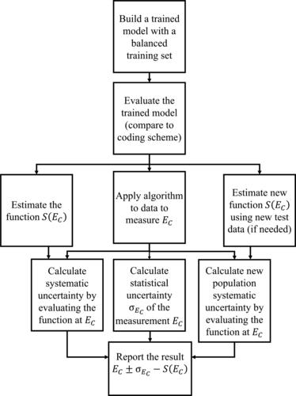
How do you know if an experimental result is trustworthy?
Rebeckah Fussell
How do we know if result from Natural Language Processing coding is trustworthy?
  Calculate statistical uncertainty
  Calculate systematic uncertainty
Fussell, Stump, Holmes (2023) Phys. Rev. PER

Slide 32
How do you know if an experimental result is trustworthy?
Rebeckah Fussell
How do we know if result from Natural Language Processing coding is trustworthy?
  Calculate statistical uncertainty
    If we pull different random samples for training/testing, what is the variability in outcomes?
  Calculate systematic uncertainty
Fussell, Stump, Holmes (2023) Phys. Rev. PER

Slide 33
How do you know if an experimental result is trustworthy?
Rebeckah Fussell
How do we know if result from Natural Language Processing coding is trustworthy?
  Calculate statistical uncertainty
  Calculate systematic uncertainty
    Does the system over/underestimate if we train/test on a sample that over/under samples the code?
    Does the system over/underestimate if we train on a sample that is demographically/instructionally/etc. distinct from the test sample?
Fussell, Stump, Holmes (2023) Phys. Rev. PER

Slide 34
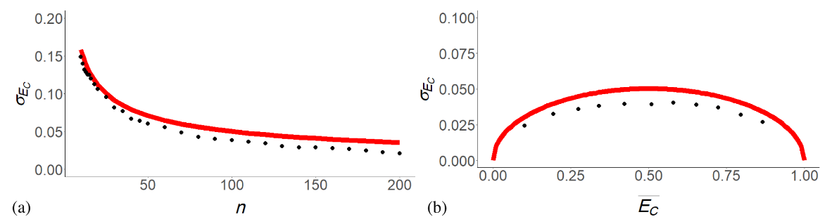
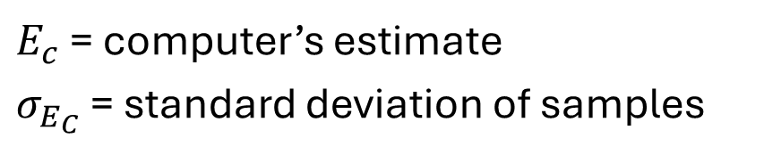
How do you know if an experimental result is trustworthy? Statistical uncertainty
Rebeckah Fussell
Data
Theoretical based on Bernoulli distribution
$E_{c}$ = computer’s estimate
$σ_{E_{C}}$ = standard deviation of samples
Fussell, Stump, Holmes (2023) Phys. Rev. PER

Slide 35
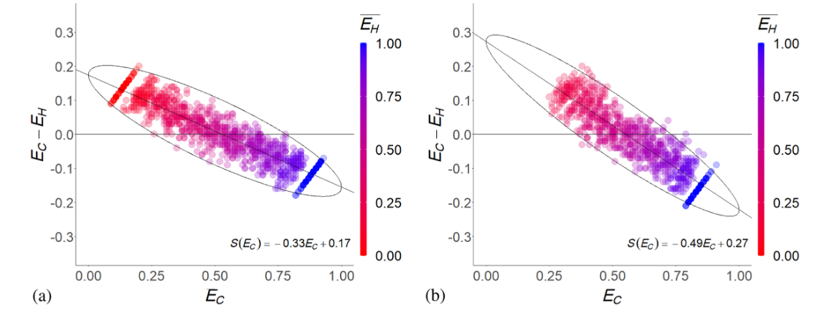
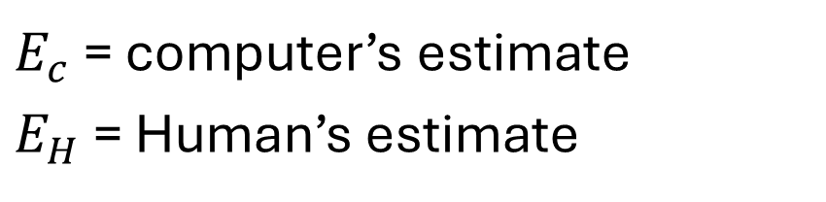

How do you know if an experimental result is trustworthy? Systematic uncertainty
Rebeckah Fussell
Training set = Test set population
Training set $≠$ Test set population
$E_{c}$ = computer’s estimate
$E_{H}$ = Human’s estimate
Computer overestimates lower proportions and underestimates higher proportions
Systematics differ based on population
Fussell, Stump, Holmes (2023) Phys. Rev. PER

Slide 36
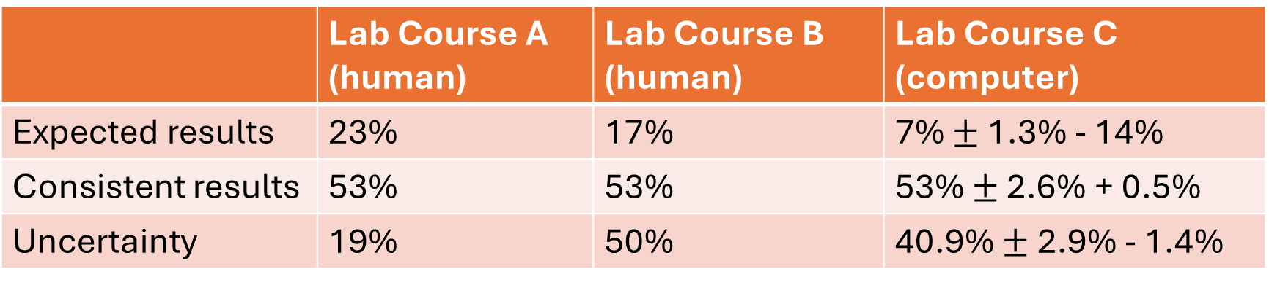
How do you know if an experimental result is trustworthy?
Rebeckah Fussell
 | Lab Course A (human) | Lab Course B (human) | Lab Course C (computer)
Expected results | 23% | 17% | 7% $±$ 1.3% - 14%
Consistent results | 53% | 53% | 53% $±$ 2.6% + 0.5%
Uncertainty | 19% | 50% | 40.9% $±$ 2.9% - 1.4%
Fussell, Stump, Holmes (2023) Phys. Rev. PER

Slide 37

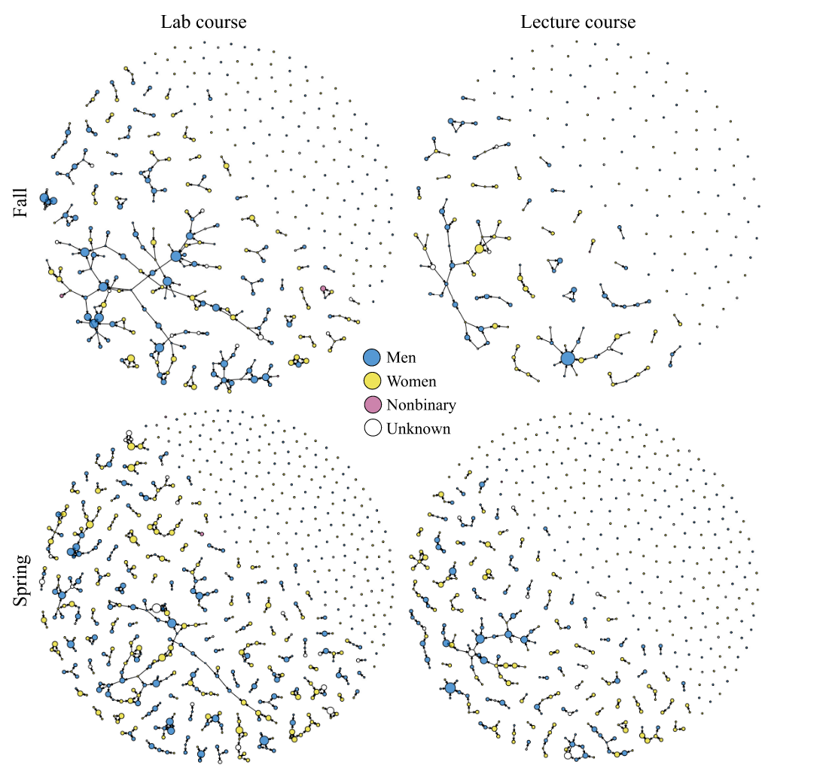
2. We can apply the tools, ways of thinking, and values for evidence in physics to study the teaching and learning of physics.
Meagan Sundstrom
Network Analysis
How are students connected through interactions and recognition?
How do those connections impact student outcomes?
  e.g., Students with more study partners do better? Correlation versus causation?
How do course structures impact those networks and relationships to outcomes?
DGE-2139899
Sundstrom, et al., (2024) Phys. Rev. PER

Slide 38

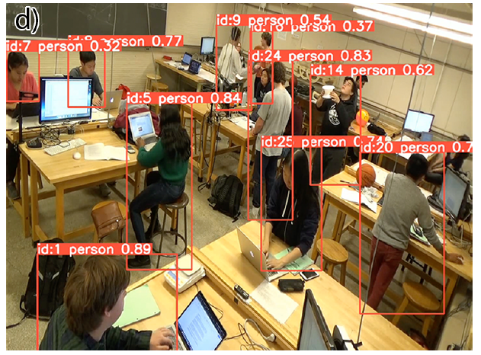
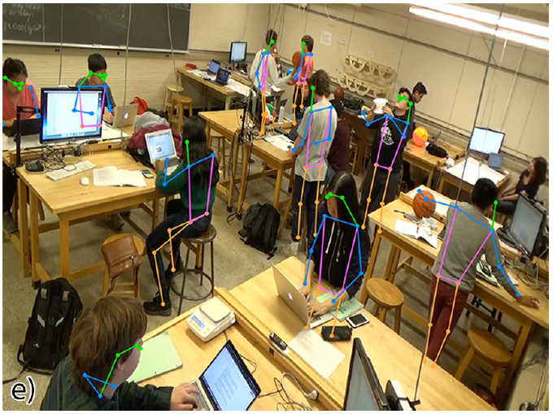
2. We can apply the tools, ways of thinking, and values for evidence in physics to study the teaching and learning of physics.
Matthew Dew
Computer vision
How do men and women participate in hands-on experimentation?
How can instruction more equitably support student participation?
DGE-2139899
e.g., Quinn, et al., (2020) Phys. Rev. PER; Dew, et al., (2024) Phys. Rev. PER

Slide 39
Why should a Physics Education Researcher be in a physics department?
We study teaching and learning of physics, which requires an understanding of physics and how people do physics.
We apply the tools, ways of thinking, and values for evidence in physics to study the teaching and learning of physics.
We need to work with physicists to do the research and implement the best practices that come out of it.

Slide 40


Bidirectional relationship for research and implementation
Physics Education Researchers
Physics Faculty and Instructors
e.g., Dancy, Henderson, and Turpen (2016); Dancy & Henderson (2010); Chasteen, et al., (2011)

Slide 41


Extensive literature indicating that traditional labs are problematic.
Students don’t get to do the things experimental physicists do.
Students follow fixed protocols.
The experiments do not test unanswered questions.
Experiments aim to verify and demonstrate established knowledge.
e.g., Smith & Holmes (2022) Nature Physics; Holmes & Wieman (2017) Physics Today; Holmes, Wieman, & Bonn (2015) PNAS; Etkina, et al., (2001, etc.); Oliver, Werth, & Lewandowski (2023) Phys. Rev. PER; Bartlett & Dunnett (2019)

Slide 42

Developing labs about experimental physics
Interviewed experimental physics faculty and instructors to find out what students should be able to do:
  Collect data and revise an experimental procedure iteratively and reflectively,
  Evaluate the process and outcomes of an experiment quantitatively and qualitatively,
  Extend the scope of an investigation whether or not results come out as expected,
  Communicate the process and outcomes of an experiment, and
  Conduct an experiment collaboratively and ethically.
Holmes & Smith (2019) The Physics Teacher;
Funding from the CAS Active Learning Initiative

Slide 43

Intro Course sequence
Z.Y. Kalender
E. Smith
Lab 1: Periods of a Pendulum
Lab 2: Objects in flight
Lab 3: Stretchy things
Lab 4: Circuits
Lab 5: Electricity! Magnetism! Fun!
Lab 6: Project lab
Increasing agency
Decreasing structure
Smith, Stein, Walsh, & Holmes (2020) PRX; Kalender, Stump, Hubenig, & Holmes (2021) Phys. Rev. PER; Smith & Holmes (2020) Phys. Rev. PER; Funding from the CAS Active Learning Initiative

Slide 44
Other models for non-traditional labs
Biologists developed Course-based Undergraduate Research Experiences (CUREs) as an extension of traditional undergraduate research experiences (UREs).
Have additional benefits when compared to a traditional lab class.
CUREs:
incorporate the use of scientific practices,
engage students in discovery,
explore authentic experiments that are broadly relevant to the field,
include and require opportunities for iteration, and
incorporate collaboration
e.g., Auchincloss, et al., (2014)

Slide 45
Other models for non-traditional labs
Biologists developed Course-based Undergraduate Research Experiences (CUREs) as an extension of traditional undergraduate research experiences (UREs).
Have additional benefits when compared to a traditional lab class.
CUREs:
incorporate the use of scientific practices,
engage students in discovery,
explore authentic experiments that are broadly relevant to the field,
include and require opportunities for iteration, and
incorporate collaboration
Ballen, et al., (2018), Rowland, et al., (2016)

Slide 46
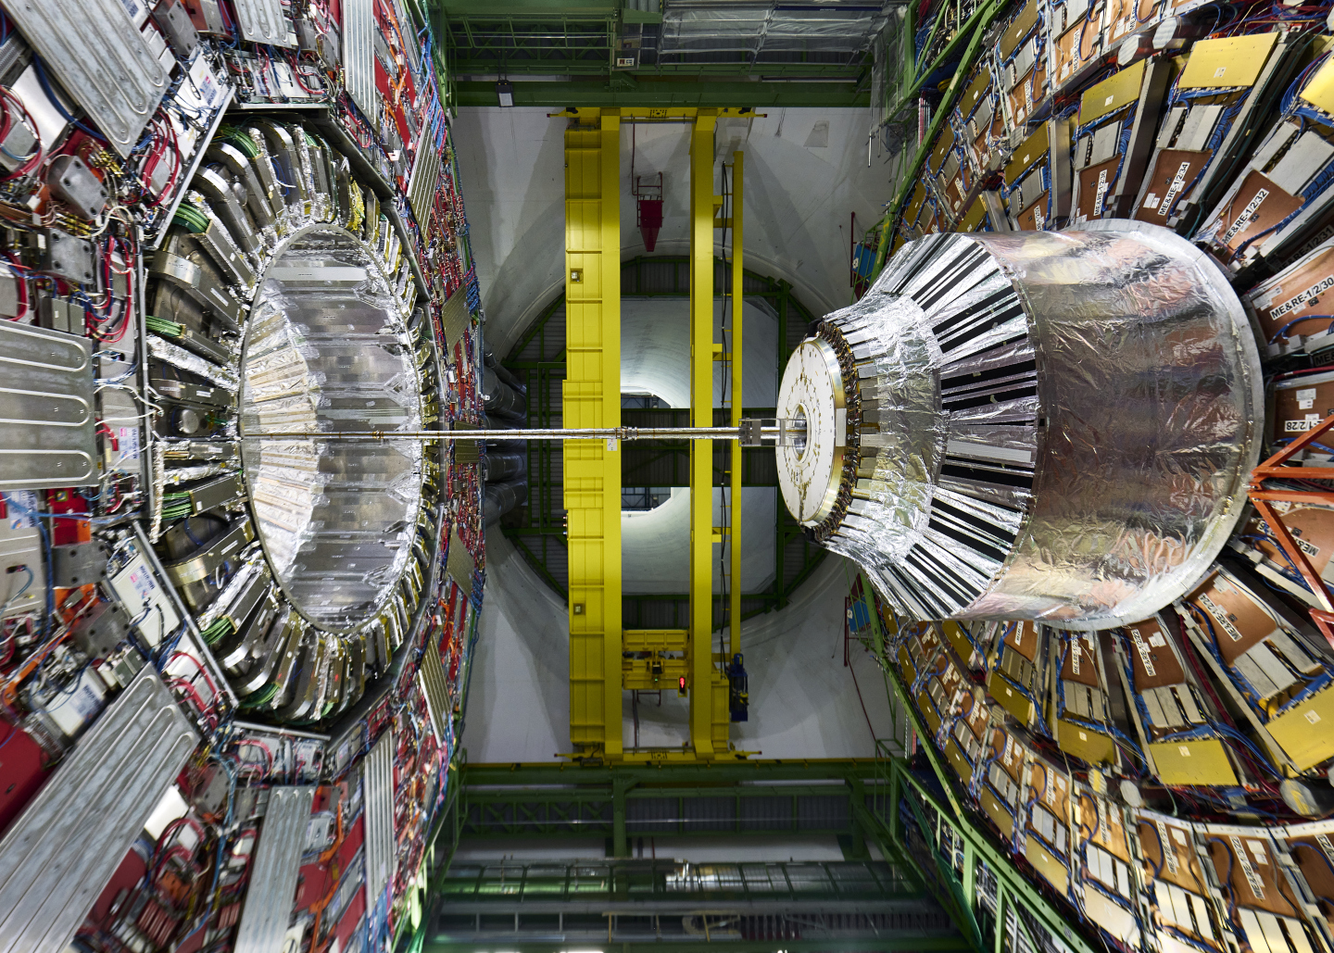
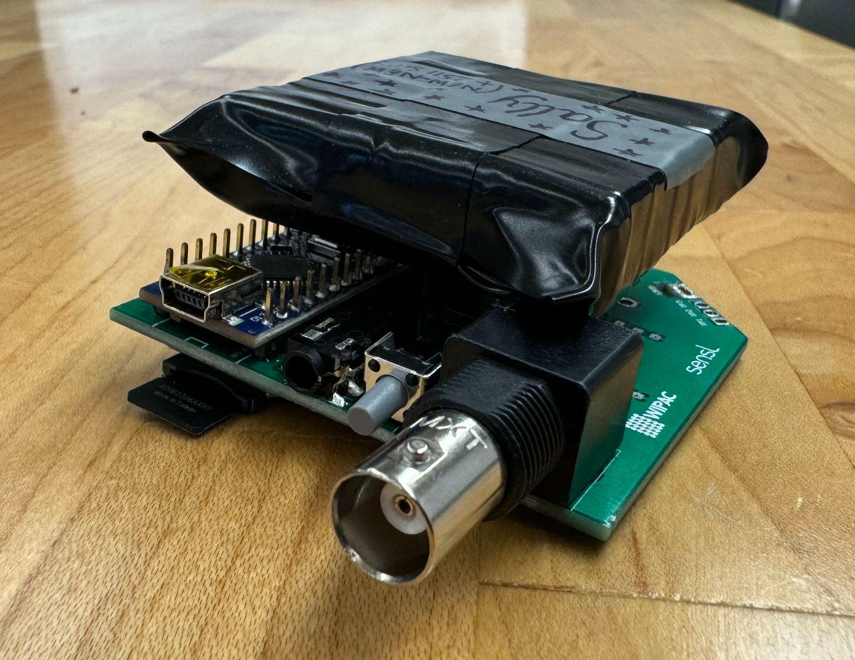
Bringing “authentic physics” to the intro physics lab
The MIT CosmicWatch Tabletop Detector
Developed by Spencer Axani, Katarzyna Frankiewicz, Janet Conrad and Paweł Przewłocki
Compact Muon Solenoid at CERN
PHY-2310035

Slide 47
Bringing “authentic physics” to the intro physics lab
Week 1
Week 2
Week 3
Week 4
Week 5
Week 6
Week 7
Weeks 8 – 15
Configuration experiments
(Trigger threshold, coincidence mode…)
Intro to Particle Physics
Scintillator experiments
Develop RQs
Draft proposal
Carry out project and present

Slide 48






Bringing “authentic physics” to the intro physics lab
Kasia Krzyzanska
Graduate TA
kk829@cornell.edu
Experimental Particle Physics (CMS)
Sofi Padavan
LA
skp64@cornell.edu
Physics Major (‘26)
Xuan Chen
Postdoctoral researcher
xc274@cornell.edu
Experimental Particle Physics (CMS)
Natasha Holmes
Ann S. Bowers Associate Professor
ngholmes@cornell.edu
Physics education researcher
Peter Wittich
Professor
wittich@cornell.edu
Experimental Particle Physics (CMS)
Mark Lory-Moran
Lab Manager
Mark-lory-moran@cornell.edu
PHY-2310035

Slide 49
Bidirectional relationship for research and implementation
Physics Education Researchers
Physics Faculty and Instructors

Slide 50
Bidirectional relationship for research and implementation
Physics Education Researchers
Physics Faculty and Instructors

Slide 51
Understanding how Peer Instruction supports student learning
Individual vote to MC question
Peer discussion
Revote on question
Instructor explanation
Instructor concern: Are students learning or just copying their friend’s answer?
e.g., Crouch & Mazur (2001) AJP

Slide 52
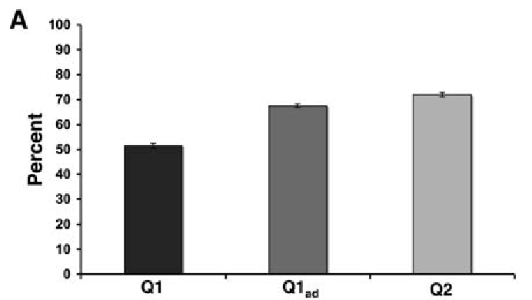
Understanding how Peer Instruction supports student learning
Q1 = individual question
Q1_{ad} = revote after peer discussion
Q2 = “isomorphic” question
Smith, et al., (2009) Science

Slide 53
Bidirectional relationship for research and implementation
Supports:
Asking research questions that faculty and instructors care about
Bringing current physics ideas and thinking to the classroom
Getting best practices sustainably implemented into classrooms
…
Physics Education Researchers
Physics Faculty and Instructors

Slide 54
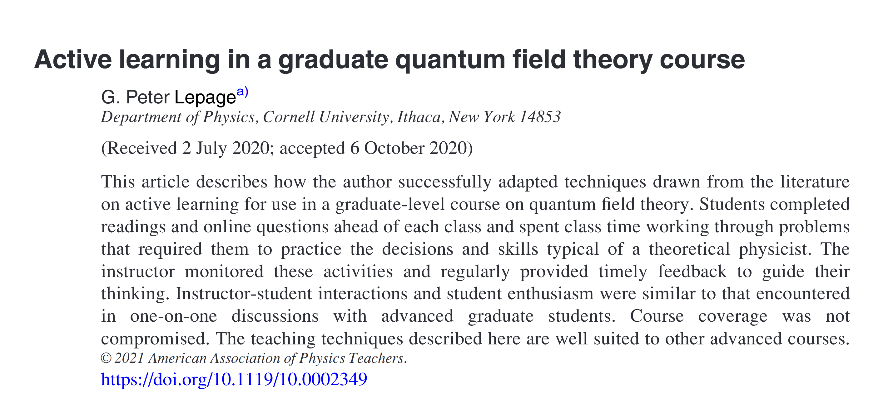

Slide 55
Why should a Physics Education Researcher be in a physics department?
We study teaching and learning of physics, which requires an understanding of physics and how people do physics.
We apply the tools, ways of thinking, and values for evidence in physics to study the teaching and learning of physics.
We need to work with physicists to do the research and implement the best practices that come out of it.
Why should a [materials scientist / biophysicist / astrophysicist / …] be in a physics department?

Slide 56












Cornell Physics Education Research Lab
Physics: Natasha Holmes (PI)
Postdocs: Xuan Chen – Charlotte Zimmerman
Graduate students: Matthew Dew – Rebeckah Fussell Rachel Merrill – Olive Ross
Undergraduate students:
Jacob Feinleib – Sabrina McDowell – Elly Markert – Hissaa Noname – Sofi Padavan – Shaunjae Suarez
Cornell Discipline-based Education Research Community
Bio: Michelle Smith
Econ: Doug McKee – George Orlov
Chem Eng: Allison Godwin – Alexandra Coso-Strong
BioMed Eng: Alexandra Werth
Info Sci: Rene Kizilcec
Math: Tara Holm – Marie MacDonald

