Slide 1


Scientific Communication
March 15, 2024
CBB External Communications, Steven J. Sibener
1

Slide 2
To Establish a Culture of Team Science and Networking with CBB Industrial and National Lab Communities in Accelerator Science and Technology
&
To Empower Our Students and Postdocs to Interact Closely and Freely within CBB and to Introduce them to the Needs of the Accelerator Community
March 15, 2024
CBB External Communications, Steven J. Sibener
2

Slide 3
A Two-way Street
CBB Personnel Interacting with the Community to Hear About their Needs for Next-Gen Accelerators
And
The Community Benefitting from CBB Science, Technology, and Human Resources Going Forward
Visibility from Participation In and Organization of Workshops & Conferences
Accelerator Community
March 15, 2024
CBB External Communications, Steven J. Sibener
3

Slide 4
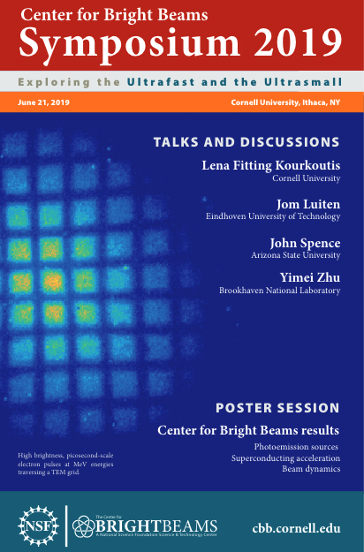
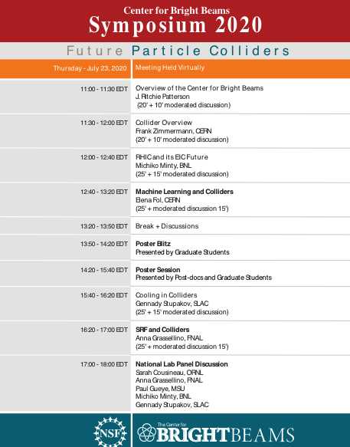
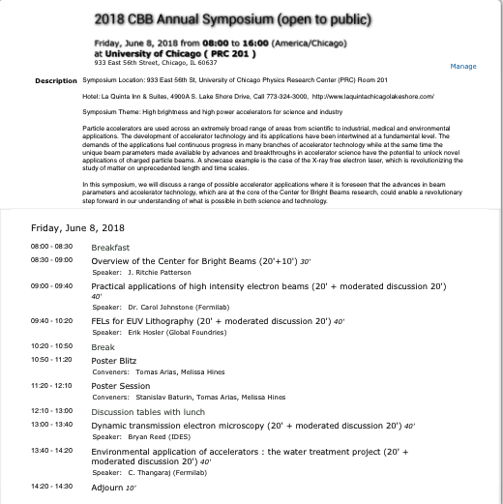
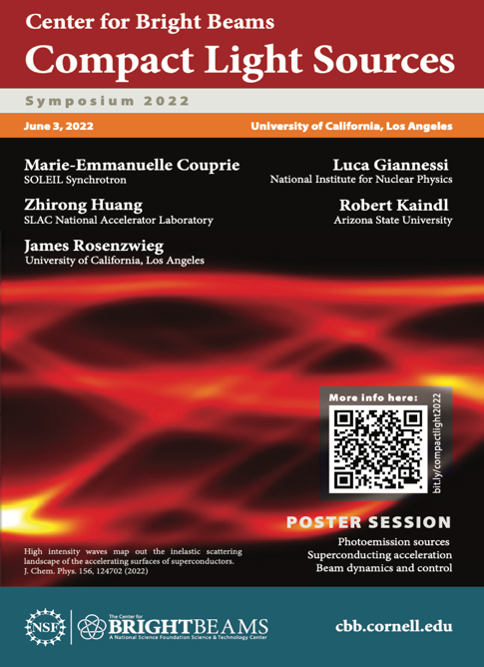
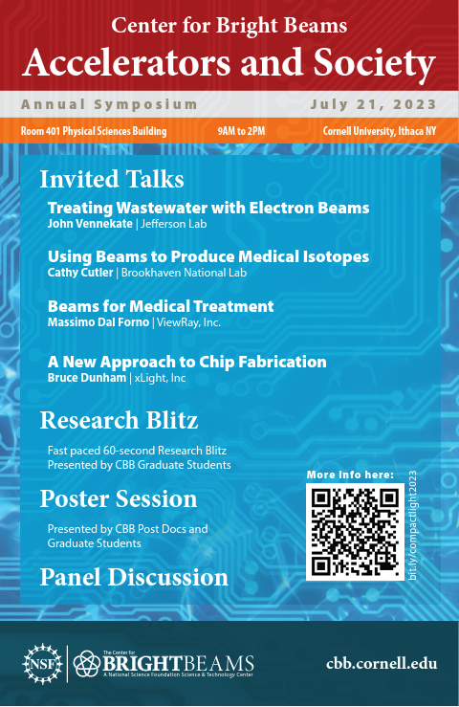
CBB In-Person Symposia
CBB Annual symposia – Leading experts in the field from CERN, SOLEIL Synchrotron, national labs, industry, and universities & Panel discussions with students and postdocs
Accelerators and Society
Compact Light Sources
Future Particle Colliders*
Exploring the Ultrafast and the Ultrasmall
High Brightness and High-Power Accelerators for Science and Industry
Future Accelerators: Overcoming the Challenges
*virtual symposium
March 15, 2024
CBB External Communications, Steven J. Sibener
4
Notes:
Bringing leading experts from around the globe to CBB.
Interacting with students and postdocs in panel discussions, poster sessions, research blitzes

Slide 5
CBB Annual Symposium 2022 @ UCLA
Compact Light Sources
Applications of Compact Light Sources
Robert Kaindl (Arizona State University)
Paths Toward Compact FELs
Zhirong Huang (SLAC)
Laser-based Beam Manipulation
Luca Giannessi (INFN)
X-ray FELs Based on Plasma Accelerators
Marie-Emmanuelle Couprie (SOLEIL)
X-ray FELs Based on High-gradient Conventional Accelerators
Nathan Majernik (UCLA )
March 15, 2024
CBB External Communications, Steven J. Sibener
5
Notes:
Five speakers who then participated in a career discussion with students and postdocs
May want to get rid of this slide since it was presented last year.

Slide 6
CBB Annual Symposium 2023 @ Cornell
Accelerators and Society
Treating Wastewater with Electron Beams
John Vennekate (Jefferson National Lab)
Using Beams to Produce Medical Isotopes
Cathy Cutler (Brookhaven National Lab)
Beams for Medical Treatment
Massimo Dal Forno (ViewRay, Inc.)
A New Approach to Chip Fabrication
Bruce Dunham (xLight, Inc.)
March 15, 2024
CBB External Communications, Steven J. Sibener
6
Notes:
Four speakers who will participate in a career discussion with students and postdocs

Slide 7
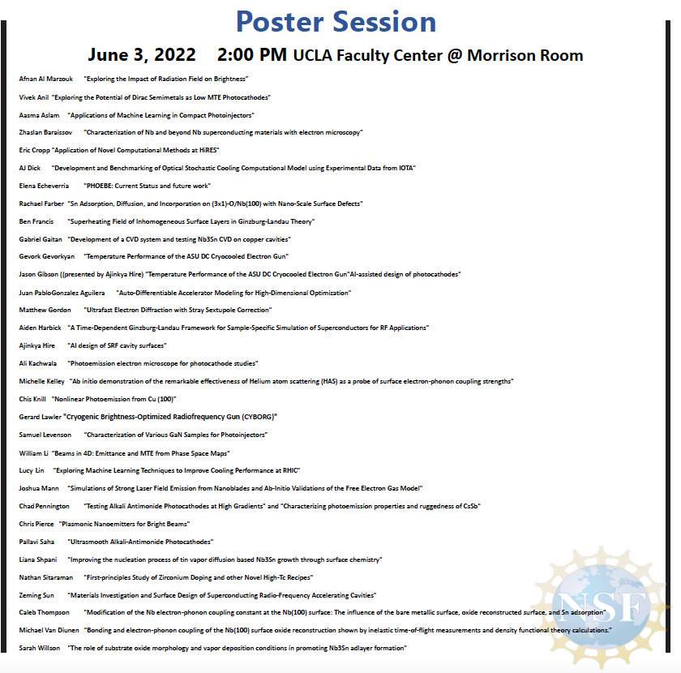
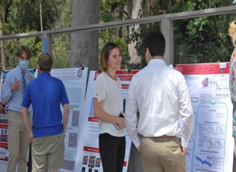
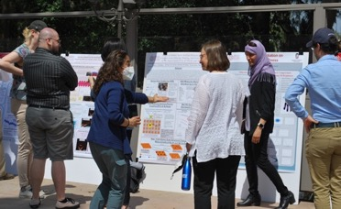
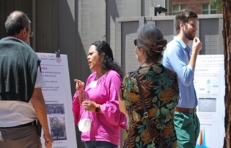
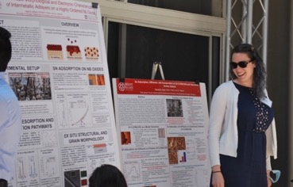
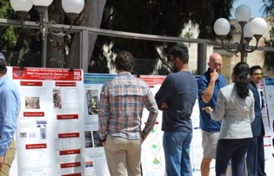
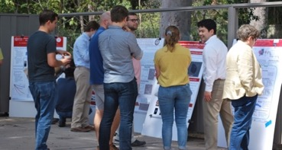
CBB Student Poster Presentations at Symposium
March 15, 2024
CBB External Communications, Steven J. Sibener
7
Notes:
We will host a poster session at lunch today and again during our Symposium on Friday, July 21.

Slide 8
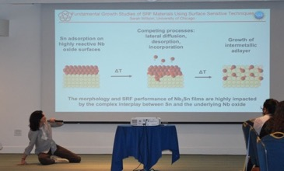
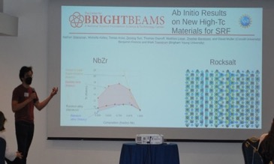
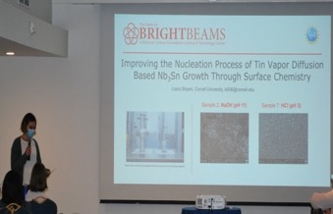
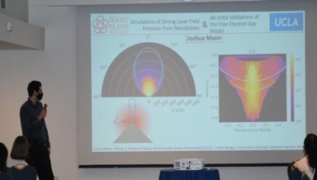
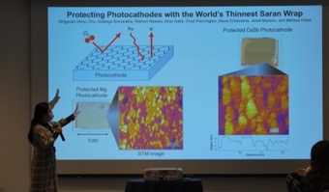
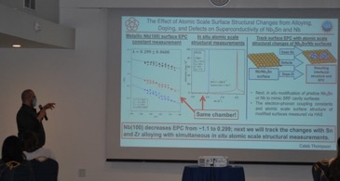
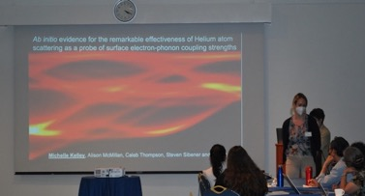
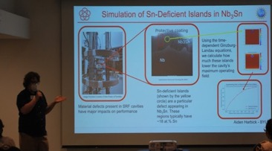
Research Blitz at Symposium
Sarah Willson, U Chicago
Nathan Sitaraman, Cornell
Liana Shpani, Cornell
Joshua Mann, UCLA
Caleb Thompson, U Chicago
Aiden Harbick, Brigham Young U
Amy Zhu, Cornell
Michelle Kelley, Cornell
March 15, 2024
CBB External Communications, Steven J. Sibener
Notes:
Not sure if we include this as the students either will give this or will have just presented to the NSF.

Slide 9
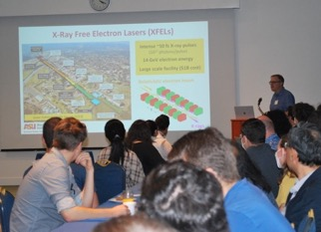
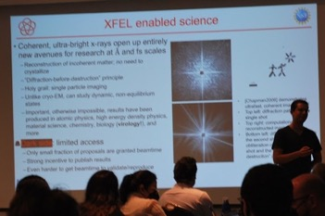
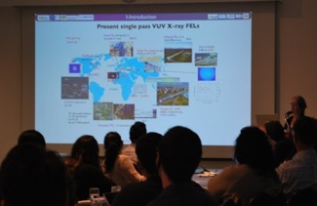
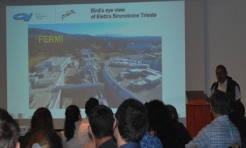
Career Panel Students/PostDocs
2022 Panel Discussion with Leading Experts on Compact Light Sources
Career Development Panels
June 2022
Robert Kaindl – Professor @ Arizona State University
Zhirong Huang - Senior Research Scientist @ SLAC
Luca Giannessi – Senior Research Scientist @ INFN
Marie-Emmanuelle Couprie – Senior Research Scientist @ SOLEIL
July 2023
John Vennekate – Herman Grunder Fellow @
Jefferson National Lab
Cathy Cutler – Director of Medical Isotope Research and Production @ Brookhaven National Lab
Massimo Dal Forno – Electrical Engineer and Scientist @ ViewRay, Inc.)
Bruce Dunham – Vice President of Engineering @ xLight, Inc.
2022 Career Panel Discussion
March 15, 2024
CBB External Communications, Steven J. Sibener
Notes:
On Monday students met with Intellectual property experts:
How to interact with CTL or for outside students/postdocs their tech transfer office
Overview of IP : dig into some of the formalities about patents, copyright, etc.
Careers in IP.
Students and postdocs had one hour to meet with the Symposium speakers to discuss careers beyond academia.
Faculty were excluded from this session so students could talk freely.
2023 will include a 1-hour career panel with symposium speakers (Cathy Cutler, John Vennekate, Massimo Dal Forno, Bruce Dunham

Slide 10
Broad Reach of CBB Seminar Series Webcast
The CBB organizes a seminar series covering recent research in accelerator physics; N.B. organized by postdocs. Unlike a conventional seminar series where the speaker travels to the host institution, the CBB seminar series is presented at the CBB site that is most convenient to the speaker. All seminars are broadcast via Zoom, and some have moved to in-person as well. The slides from these presentations are archived on the CBB Indico site where they can be referenced by all participants. This model has proven to be very popular, and the seminars have attracted high attendance.
Improving the performance of SRF cavities by pairbreaking mechanisms | Alex Gurevich | Old Dominion University
Accelerator Needs for Materials Research: Synergistic Opportunities in Extremes | John L. Sarrao | Los Alamos National Lab
Externally seeded free-electron lasers: opportunities, challenges and prospects | Georgia Paraskaki | Deutsches Elektronen-Synchrotron DESY Research Centre
Phase Space Reconstruction from Accelerator Beam Measurements Using Neural Networks and Differentiable Simulations | Ryan Roussel | SLAC National Accelerator Lab
Single electron emitters, plasmonic bullseyes, and the search for coherent electrons | D. Frank Ogletree | Molecular Foundry, Lawrence Berkeley Lab
The Physics of Transverse Emittance Manipulations | Bruce Carlsten | Los Alamos National Lab
Emerging Computational Workflows for Experiments at Particle Accelerators | Christine Sweeney | Los Alamos National Lab
A New Superconducting Linac: From SRF Cavity Production to Commissioning & Early Operations of LCLS-II at SLAC | Dan Gonnella | SLAC
March 15, 2024
CBB External Communications, Steven J. Sibener
10
Notes:
CBB Postdocs take leadership of this series. They identify speakers and organize the events: Elena Echeverria, Afnan Al Marzouk (NIU).
These seminars are open to everyone within the accelerator community.

Slide 11
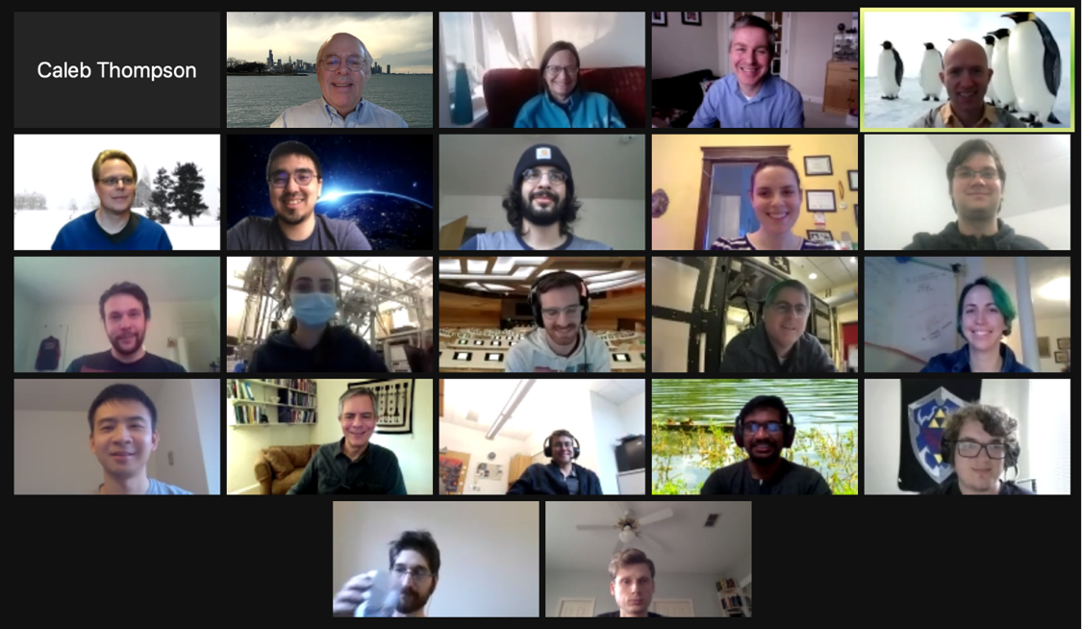
CBB Seminar Series Webcast
CBB Seminars Back to In-Person and Virtual
March 15, 2024
CBB External Communications, Steven J. Sibener
11
Notes:
This is the same one from last year, but I don’t have a new one.

Slide 12


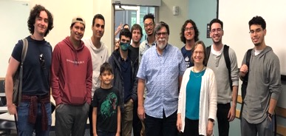
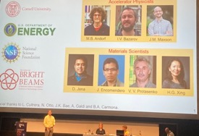
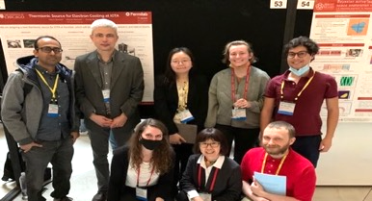
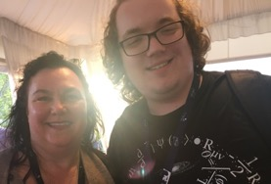
Brighter Ahead! CBB Broad Contributions within the Accelerator Community via Workshops, Meetings and Education
A Sampling of CBB Broad Research Contributions
APS Meetings
DEP
NAPAC ‘22 and ‘23
SRF ‘22
IPAC ‘22 and ‘23
AVS International Symposium
ACS Meeting
CBB faculty serve on the USPAS Curriculum sub-committee and Advisory Council.
CBB faculty will teach Accelerator Physics at an upcoming school.
“Accelerator Physics” taught by Georg Hoffstaetter. Enrollment for this course, and its waiting list, were filled months in advance of the school.
March 15, 2024
CBB External Communications, Steven J. Sibener
12
Notes:
Samuel Levenson (Cornell) presenting (top right)
Sandra Biedron (UNM) and Aiden Harbick (BYU) at IPAC (bottom right)

Slide 13
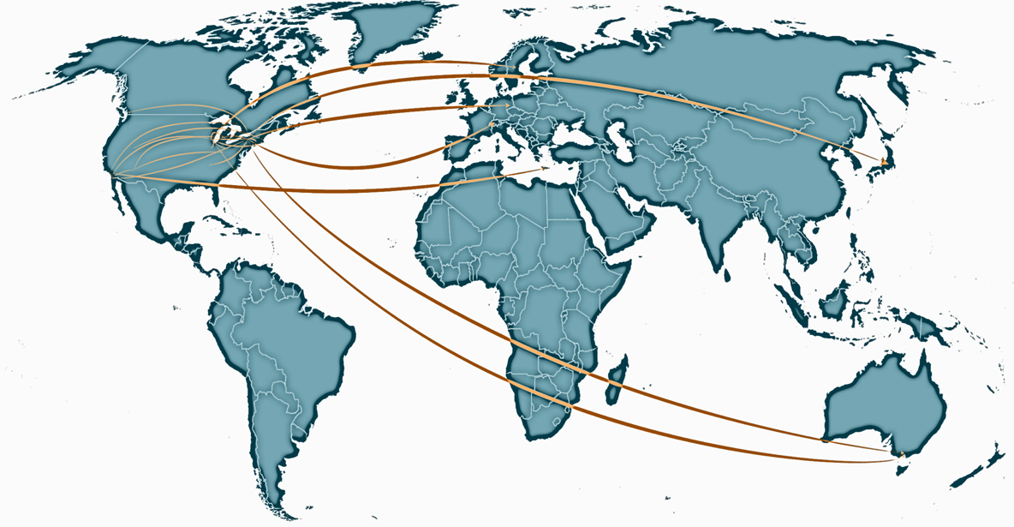
CBB Around the World
CBB had 61 conference presentations and talks during the past year
Broad participation in the accelerator community as well as the broader scientific community
SRF 2022
AVS 68th International Conference
IPAC 2022
NAPAC 2022
APS March Meeting 2023
APS April Meeting 2023
Advanced Accelerator Concepts (AAC) 2022
TESLA Technology Collaboration (TTC) Workshop
Molecular Foundry User’s Meeting
Materials Research Society (MRS) Spring Meeting
PEC 2022 (82nd Physical Electronics Conference)
American Chemical Society (ACS) Fall 2022
10th International MeVArc Workshop 2022
TTC Thin Film Seminar
LINAC 2022
TMS
Energy Recovery Linacs (ERL) 2022
Microscopy and Microanalysis
Sanibel Symposium 2023
3rd ICFA Beam Dynamics Mini Workshop on Machine Learning Applications for Accelerators
2022 Psi-k Conference
International Workshop on Breakdown Science and High Gradient Technology
C^3 Workshop (Cool Copper Collider)
CoDA 2023 Data Analysis Conference
March 15, 2024
CBB External Communications, Steven J. Sibener
13
Notes:
The Beam Team had 61 posters and talks at 25 different conferences. Of those, 12 were accelerator conferences, 11 were materials conferences, 1 quantum, and 1 machine learning. The majority of posters and talks were by students and postdocs.

Slide 14

CBB Knowledge Shared
Accelerator conferences and workshops
Examples: IPAC, NAPAC, LINAC, FEL, …
many presentations by students and postdocs
Materials and condensed matter conferences and workshops
Examples: APS March Meeting, AVS
many presentations by students and postdocs
→ Accelerator Materials is emerging as a new discipline.
Semiconductor manufacturing meetings
Examples: SEMICON West’s Sustainability Summit, SEMI ISS
panel presentation - energy and water nexus partially addressed by accelerators (e.g. water treatment, all-electric lithography, inspection)
CBB Students and Postdocs Research Presentations
27 Students and postdocs presented 36 posters and gave 25 talks at in-person and virtual conferences that included SRF’22, PAVS 68th International Conference, IPAC 2022, NAPAC 2022, APS meetings, ACS Fall 2022, MRS Spring 2022, 2022 Psi-k Conference, AAC 2022, among others.

Slide 15
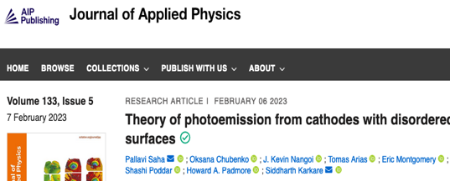
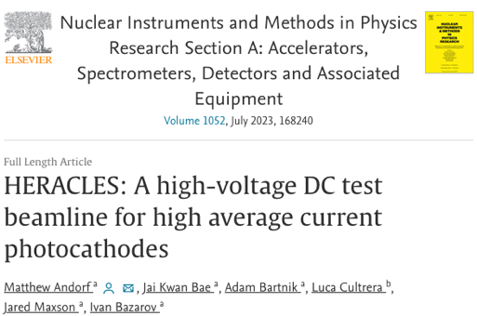
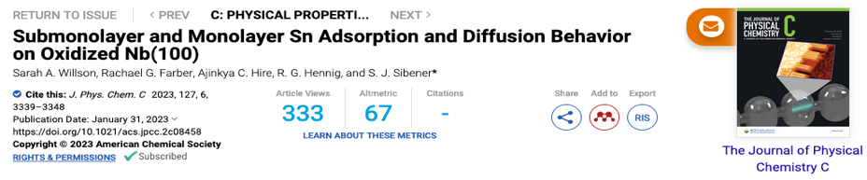
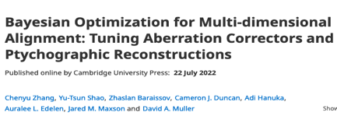
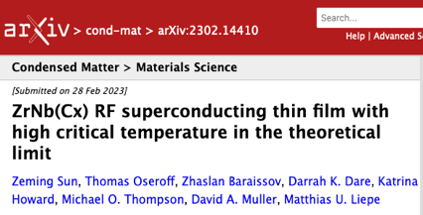
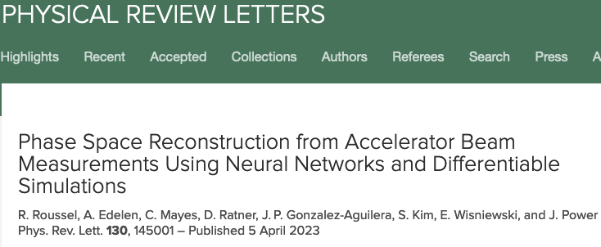
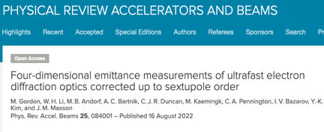
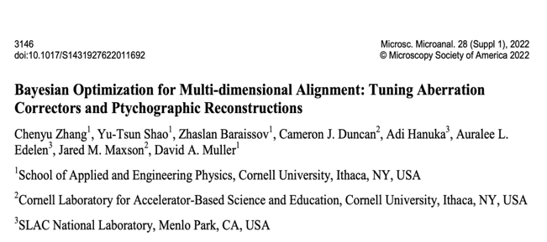
CBB Knowledge Shared – Selected Publications 2022 - 2023
CBB’s multidisciplinary team is essential
*Featured
on cover
See all at: https://cbb.cornell.edu/publications
15
Microsc. Microanal. 28 (S1), 3146 (2022)
Notes:
Collage of new pubs. Ritchie can provide. Should include new one based on SLAC press release.
Look for journals like PRL

Slide 16
Community Engagement
14 CBB faculty served on the organizing committee for 16 conferences and workshops
6 CBB faculty served on 8 advisory and award committees
2 CBB faculty served on 3 review committees
6 CBB faculty served on 4 community planning processes

Slide 17
Professional Activities of CBB Faculty
Advisory Committees
  National Academies Elementary Particle Physics Progress and Promise, Patterson
  BNL Science and Tech Steering Committee, Hines
  IPAC Scientific Advisory Board, Karkare, Musumeci
  Center for Predictive Simulation of Functional Materials, Hennig
  Center for Interfacial Electrochem. Of Energy Matls. (NSF PREM), Hines
  DOE Basic Energy Science, Musumeci
  Advanced Accelerator Concept Steering Comm., Musumeci
  U. Rochester Dean’s Advisory Ctte for A&S, Local Org. Ctte, Physical Electronics Conference, Sibener
  ZEUS EAB Patterson
Review Panels
  Accelerator Physics Subcommittee, DOE/SC Independent Project Review (IPR) for LCLS-II Status, Piot
Review Panels, continued
  Electron-Ion collider review panel (DOE Nuclear Physics), Piot
  NSF, DOE proposal reviewer, Sibener
Community organization and planning
  AAAS, Div. of Physics, Hines
  GARD Accelerator and Beam Physics Roadmap Workshop DOE, Office of Science, Office of HEP 2022, Karkare, Patterson, Piot
  National Academies Elementary Particle Physics Progress and Promise, Patterson and Kim
  APS DPB Education, Outreach and Diversity Committee, Patterson
  Americas Linear Collider Committee, Liepe, Patterson
  ILC Int’l Development Team, Accelerator working group Liepe
March 15, 2024
Notes:
MANY conferences are organized by CBBers. https://cbb.cornell.edu/cbb-professional-activities-2022-2023. Our faculty have reported on 15 conferences they’ve helped organize.

Slide 18
Leadership in the Broader Community
Conference Organization
Physics and Applications of High Beams Brightness Workshop 2023 Rosenzweig (chair), Patterson, Piot
ERL 2022 66th International ICFA Advanced Beam Dynamics Workshop Hoffstaetter (chair), Liepe, Maxson
IPAC 2021 SAB Biedron, Musumeci, Patterson, Piot
IPAC 2022 SPC Biedron, Bazarov, Musumeci, Patterson, Piot
NAPAC 2022 Biedron (SPC Chair), Bazarov, Hoffstaetter, Kim, Liepe, Maxson, Piot, Rosenzweig
Photocathode Physics for Photoinjectors 2021 Karkare, Maxson
Americas Linear Collider Committee Liepe, Patterson
AVS Prairie Chapter 2022 Organizing Committee Sibener

Slide 19
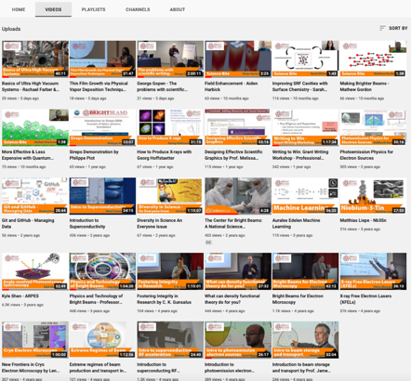
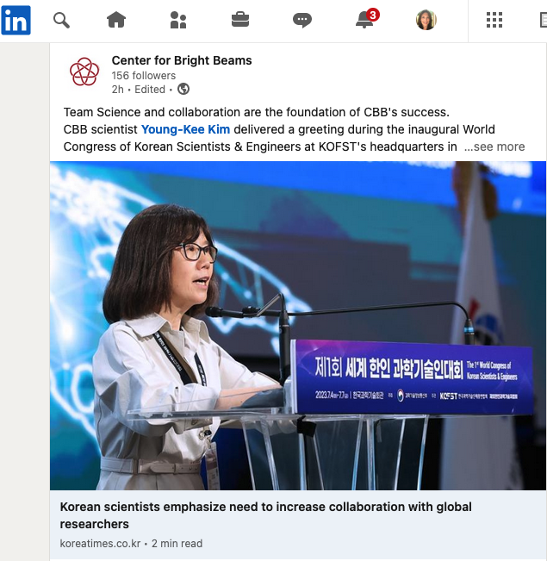
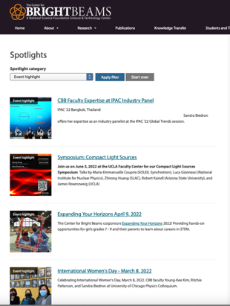
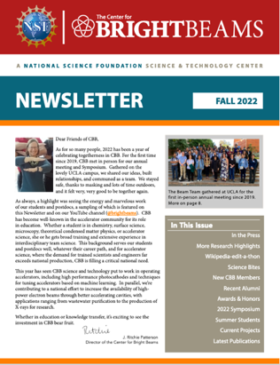
Building Visibility for CBB
CBB’s Social Media and Web Presence
YouTube: 29 videos viewed over 26,000 times
LinkedIn: Building a following and increasing our visibility
Web Spotlights
Sharing News: Newsletters, LinkedIn, Twitter, Facebook
Notes:
CBB has produced 29 YouTube videos on pedagogical topics and these have been viewed more than 19,000 times.
CBB has 155 followers on LinkedIn and posts several times per month
We publish a yearly newsletter
We feature research highlights on our web site and spotlight our people and discoveries

Slide 20








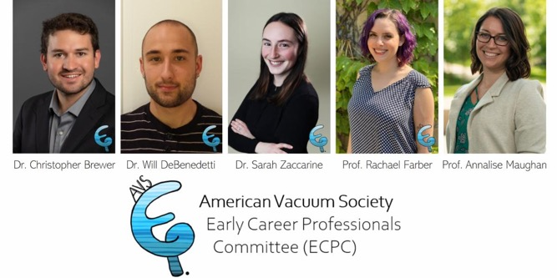







Future Scientists – Broadening Our Impact
51 CBB Participants have gone through the Center
academia (24) national labs (16) industry (11)
Prof. Rachael Farber and Dr. Will DeBenedetti were guest editors of
JVSTB Special Topic Collection:
Celebrating Early Career Professionals
Notes:
Academic faculty positions: Maxson, Karkare,Chubenko, Farber, Galdi,
Other Research Associates who have stayed involved in CBB work
Industry: physicist at Varian Medical Systems, scientist at Microsoft,
Senior Design Engineer at ASML, Intel engineer, Corning Inc.
Oksana - NIU Faculty
Alice – U Salerno Faculty
Lipi – LBNL
Ryan Porter – SLAC
Paul Cueva – Corning
Frank – FDA
Colin Clement – Microsoft
Brianna Harris – physics teacher

Slide 21

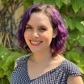
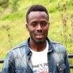
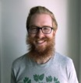





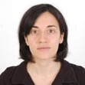
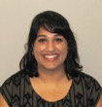
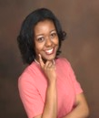
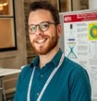



Workforce =on track!
Objective 3. Trained graduate students who transfer these skills to industry and national labs.
Deliverable 3.1: Fifty-five trained PhDs (Fall 2026).
Plan: See Workforce Development Deliverable 2.1.
Training includes student visits to national labs and industry.
See talk by M. Hines
- 51 graduate students and postdocs have gone on
to positions in industry, national labs, and academia.
- 21 undergrads participate in our research annually,
including students from minority serving institutions
12 MSIs to date.

Slide 22




















































Our Output: Highly trained scientists
Academia
National Lab/Gov
Industry
Notes:
Many more in the pipeline

Slide 23



















People of all career levels with academia, industry and labs through a constant pipeline

Slide 24
Summary: Building Visibility for CBB
CBB Culture: Community Interactions
Building Visibility Nationally and Internationally
Summary: We Have Put in Place the Ongoing Culture Needed to Connect the Center to the Outside Community:
National Laboratories, Industry, Academia
Visibility from Participation In and Organization of Workshops & Conferences
Thematic Forum Associated with Annual CBB Meeting
Students and Postdocs Interacting Closely with the Outside Community to Introduce them to the Needs of the Accelerator Community
The Culture of Communication -- A Two-way Street
CBB Science and Personnel Accelerator Community

Slide 25
Example Collaborations with DOE Labs
Lab | Facility | Research | CBB faculty
FNAL | IOTA | Studies of storage ring nonlinearities and optical stochastic cooling | Kim, Piot
ANL | Argonne Wakefield Accelerator (AWA) | Studies of accelerator tuning using ML | Piot, Kim
BNL | Accelerator Test Facility (ATF) | Studies of laser tuning using ML | Biedron
BNL | RHIC and Low Energy RHIC electron Cooling | Studies of accelerator tuning using ML | Hoffstaetter
LANL and SLAC | Advanced Controls | Gradient descent optimization and resonance control of superconducting RF cavities, etc. | Biedron
BNL | NA | Compact MeV photoinjector | Liepe/Maxson

Slide 26

















Industry Connections
External Advisory Board Members from Industry
Partnerships with Industry
Friends of CBB
Erik Hosler
Bryan Reed
Submission of 2 proposals partnering with xLight Inc.
Partnerships in Innovation
Future Manufacturing
CBB should actively seek out new partnerships, explore the academic and industrial landscape to identify potential emerging opportunities. This will allow the Center to be engaged on cutting-edge innovation and be more in control of their legacy.
Notes:
xLight

Slide 27










Industry Collaborations
Modeling tools for photocathodes | Tech-X SBIR-II
Chemical vapor dep. of Nb & Nb₃Sn | Ultramet SBIR-II
High performance SRF cavities | Niowave SBIR-II
MgB₂ films for next generation SRF | Star Cryo SBIR-I
High-brightness cold field emission gun (CFEG) tech. | ThermoFisher
Emittance distortions in aberration correctors | CEOS Gmbh
SRF for light sources and isotope production | Research Instruments
Loadlock for photocathode sharing | Radiabeam
Space charge simulation | Radiasoft
Epitaxial alkali-antimonide cathode growth | Euclid Labs SBIR-I
Advanced controls frameworks | Element Aero SBIR-I
Laser-driven ion accelerators for electronics radiation testing | Element Aero STTR
ML-based auto-alignment of electron microscope | CEOS & Thermo Fisher
High Brightness Source Optimization | Thermo Scientific
Cold-electron gas electron source | RadiaBeam SBIR-I
Compact MeV photo‐injector | Euclid Labs, BNL
Source and beam dynamics dev. (proposed) | xLight, Inc.
Notes:
Phase II SBIR funding is “focused on the development, demonstration and delivery of the innovation.”

Slide 28
















Lab Connections
Strong National Lab Engagement
11 National Lab Affiliates
5 National Lab EAB Members
National Lab EAB Members
National Lab Affiliates
Stuart Henderson (Chair) JNL
Bruce Carlsten LANL
Katherine Harkay ANL
Participating National Labs: SLAC, FNAL, LBNL, and LANL
4 DOE Grad student research awards (SCGSR)
  spent up to 11 months working at national labs
Zhirong Huang SLAC
Yimei Zhu BNL

Slide 29
Patents
Nanoscale Photoemission Based Electron Source for EM | Provisional US Patent 63017798 (2020) ASU, LBNL, Cornell
A Monochromator Device and Methods of Use Thereof | Provisional patent PCT Filing - 9107-03-PC (Applied, 2020) Cornell
Float zone silicon wafer manufacturing system and process | Patent 10811245 (Granted, 2020) UCLA
Localization break down in a high-powered RF network | Publication number: 20200379028 (Applied, 2020) UCLA
Continuous Alkali Gas Cathode | Invention Disclosure, Preliminary Patent (Submitted, 2021) UCLA
Protecting Reactive Materials with Atomically Thin Film | 63/185,407 (Applied, 2021) Cornell
Nanoblade Electrospray Propulsion | 2022-151 (Applied, 2022) UCLA
Improved Multi-leaf Collimator | 2023-062-1 (Applied, 2022) UCLA
Ordered, cubic β-ZrNb alloys for superconducting applications | 63/383,387 (Applied 2022) Cornell

