Slide 1
Knowledge Transfer (KT)
on behalf of the Center for Bright Beams (CBB) team
Notes:
Recommendations from 2022 EAB meeting: (Scatter throughout presentation)
The objectives and deliverables should be updated similarly to how they were for the other sections, with an eye towards incentivizing/recognizing the full spectrum of relevant activity
CBB should actively seek out new partnerships, explore the academic and industrial landscape to identify potential emerging opportunities. This will allow the Center to be engaged on cutting-edge innovation and be more in control of their legacy.
Plan and create a focused effort to transfer beam control, cathode, and injector technology toward microscopy with the same fervor of the accelerator effort.
There needs to be a statement about US competitiveness as well as IP protocol and security. One of the goals of NSF through these STC’s is to enable US competitiveness across STEM fields.

Slide 2
What is Knowledge Transfer (KT)
The NSF has a very specific definition of Knowledge Transfer (KT), and we at CBB adhere to this definition.
  This is from the The State of U.S. Science and Engineering 2022
  Can be found at: https://ncses.nsf.gov/pubs/nsb20224/glossary
  “Knowledge transfer: The process by which technology or knowledge developed in one place or for one purpose is applied and used in another place for the same or a different purpose. This transfer can occur freely or through exchange and be deliberate or unintentional. Technology transfer represents a specific case of knowledge transfer that involves the transfer of knowledge embedded in technology.”

Slide 3
KT in the Strategic Plan
CBB is deepening our understanding of the complex phenomena at play in beams and in the devices that accelerate them.
Transferring this knowledge advances scientific understanding.
Transferring this knowledge, and at times associated technology:
provides more powerful tools for scientific discovery
creates new opportunities for industry as well as several branches of government, thereby increasing U.S. competitiveness, economic security, and national security.
Examples of this KT impact meeting requirements of various sectors….

Slide 4
KT in the Strategic Plan – Impact Example 1
In the microelectronics radiation hardness industry (publicly traded and privately held companies, NASA, DOD - AF, DOD – DARPA, DOD – MDA, DOD – Navy, DOE, FAA, etc.)
https://nepp.nasa.gov/workshops/dhesee2021/presentations.cfm
“Spacecraft depend on electronic components that must perform reliably over missions measured in years and decades. Space radiation is a primary source of degradation, reliability issues, and potentially failure for these electronic components. Although simulation and modeling are valuable for understanding the radiation risk to microelectronics, there is no substitute for testing, and an increased use of commercial-off-the- shelf parts in spacecraft may actually increase requirements for testing, as opposed to simulation and modeling.”
National Academies of Sciences, Engineering, and Medicine. 2018. Testing at the Speed of Light: The State of U.S. Electronic Parts Space Radiation Testing Infrastructure. Washington, DC: The National Academies Press.https://doi.org/10.17226/24993.

Slide 5
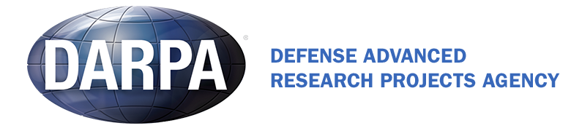
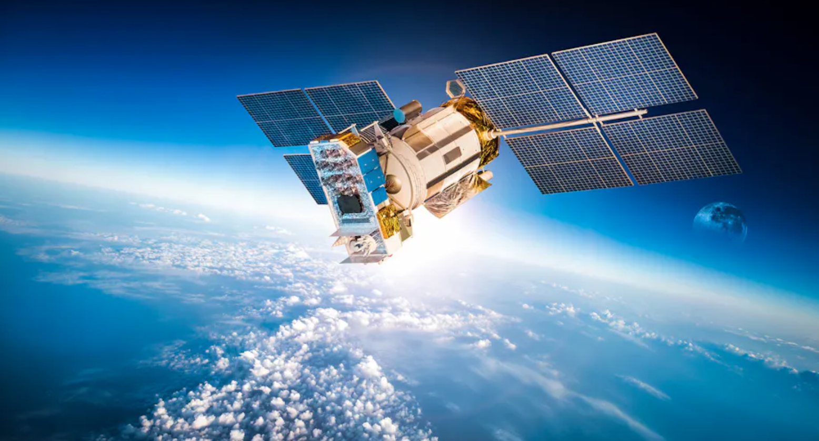
KT in the Strategic Plan – Impact Example 1, cont.
ASSERT seeks to develop SEE testing for radiation-hardened electronics that involves beams that simultaneously achieve long range and high-linear energy transfer in silicon while penetrating packaging and metallization; beam optics to achieve spot diameters that replicate the narrow charge track of a heavy ion while also enabling large-area scanning; sources that predict the heavy-ion response across electronic components; and compact and cost-effective sources that can be incorporated into the development process.
And several other programs

Slide 6

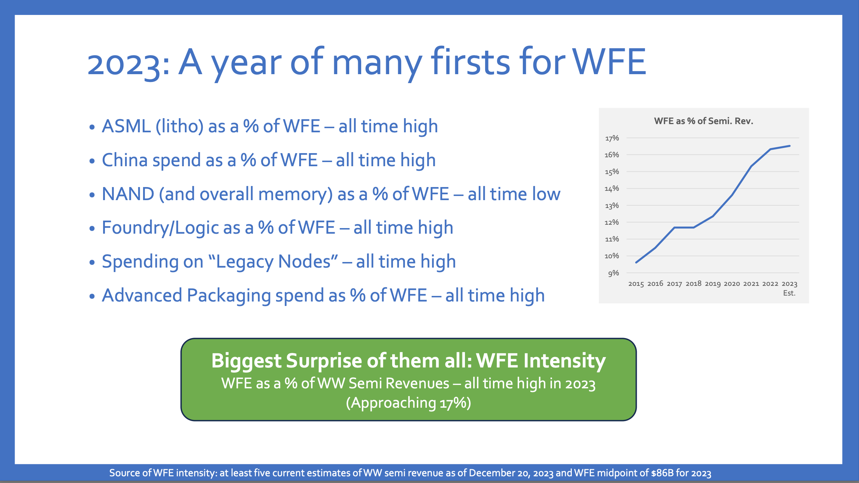
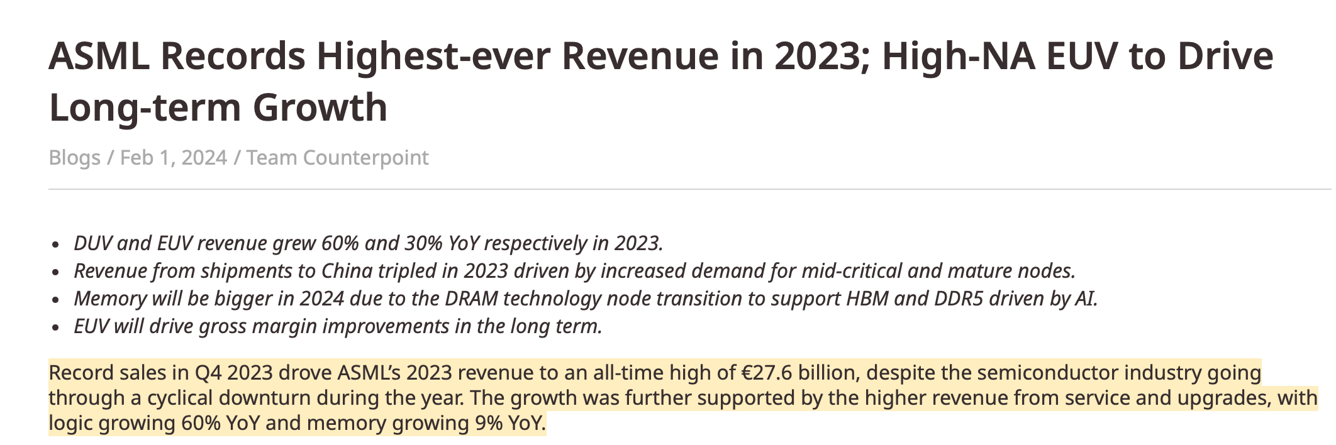
KT in the Strategic Plan – Impact Example 2
An Example – the $1T by 2030 semiconductor market
Example: xLight is harnessing recent accelerator advances for beyond-state-of-the-art chip fabrication
Courtesy xLight from SPIE’s 2024 Advanced Lithography and Patterning Conference, February 2024, San Jose
Courtesy NIST
Looking to the Wafer Fab Equipment Market Only
Wall Street’s WFE Opportunity Through 2030: Claire McAdams, Headgate Partners, SEMI ISS 2024, Half Moon Bay Jan 2024
Courtesy Counterpoint

Slide 7
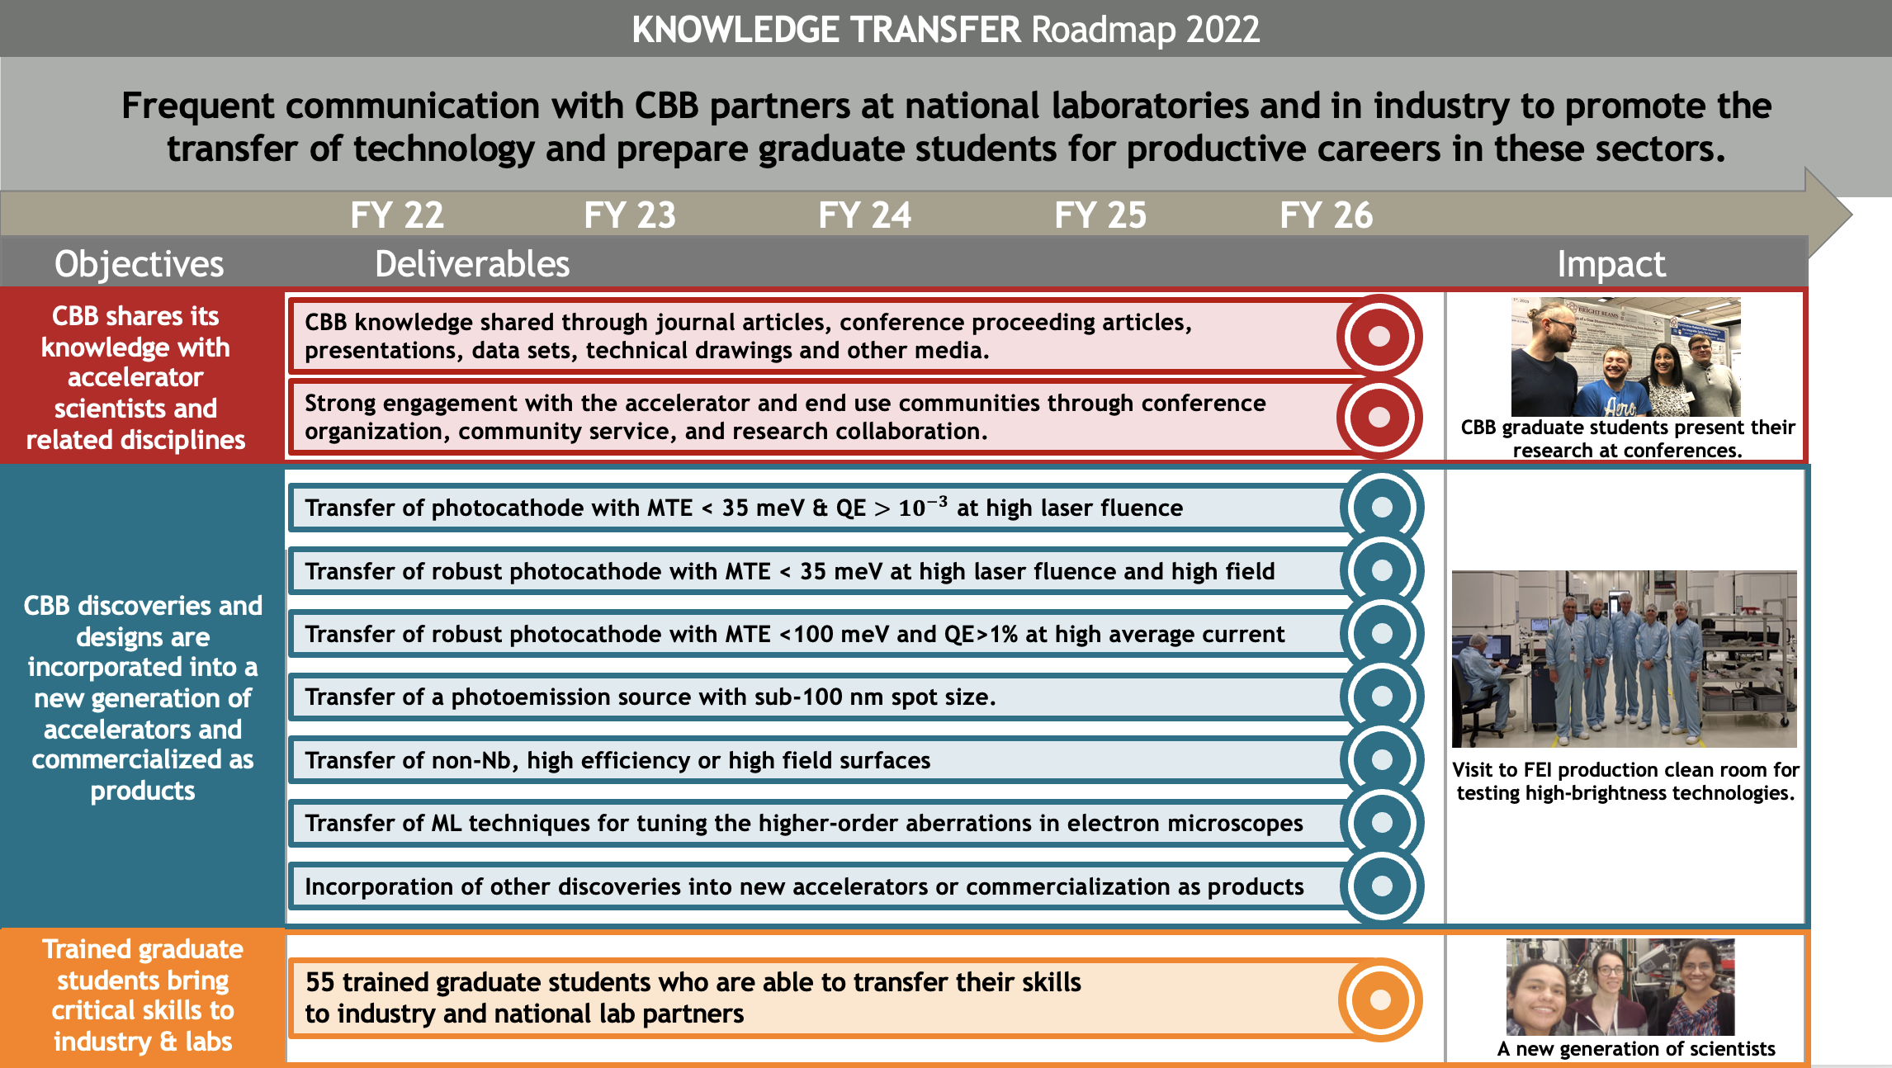
Knowledge Transfer Roadmap

Slide 8
Overview
Optimal Outcome: The transfer of knowledge and technology developed within the Center to other research groups, to national laboratories, and to industry, and to communicate frequently with industry and national lab partners to ensure CBB understands their requirements.
Objective 1: CBB shares its knowledge with accelerator scientists and scientists in related disciplines. (See Sibener’s talk.)
Objective 2: CBB discoveries and designs are incorporated into a new generation of accelerators and commercialized as products. (This talk.)
Objective 3. Trained graduate students are capable of recognizing and transferring these skills to industry and national lab partners. (See Hines’ talk.)
CBB maintains Intellectual Property Agreements (IPAs) with all participating institutions and adheres to its Data Management Plan (DMP).

Slide 9
Objective 2 Deliverables
Objective 2: CBB discoveries and designs are incorporated into a new generation of accelerators and commercialized as products.

Slide 10
Objective 2 Deliverables, cont.
Objective 2: CBB discoveries and designs are incorporated into a new generation of accelerators and commercialized as products.
As mentioned, CBB has developed a transfer plan for every priority deliverable that we presently envision.
Previously, as illustrated earlier, there was a more generalized, singular deliverable.
Let’s step through these new transfer plans for these priority deliverables.

Slide 11
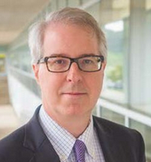
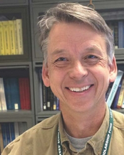
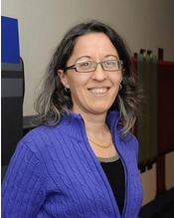
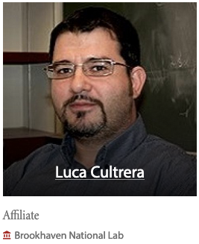
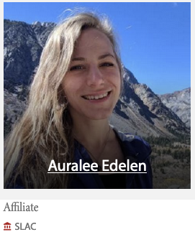
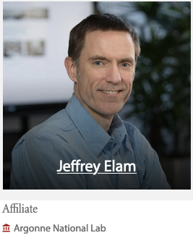
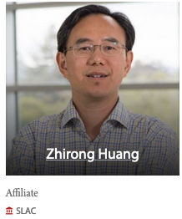
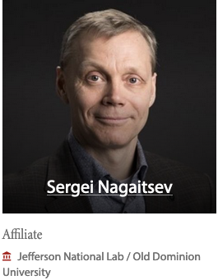
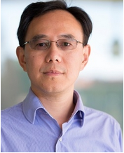
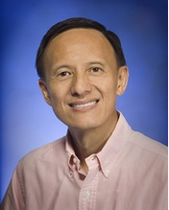
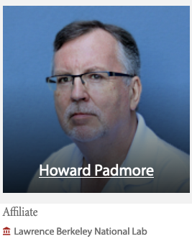
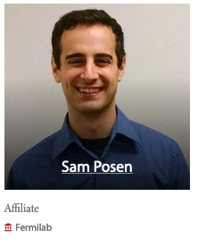
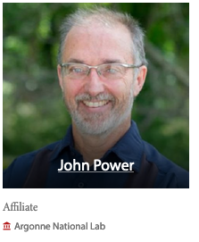
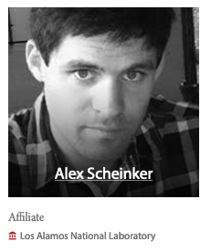
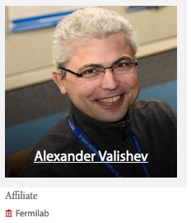
Lab Connections
Strong National Lab Engagement
11 National Lab Affiliates
5 National Lab EAB Members
National Lab EAB Members
National Lab Affiliates
Participating National Labs: SLAC, FNAL, LBNL, and engaging with LANL and BNL
4 DOE Grad student research awards (SCGSR)
  spent up to 11 months working at national labs
Stuart Henderson (Chair) JNL
Bruce Carlsten LANL
Katherine Harkay ANL
Zhirong Huang SLAC
Yimei Zhu BNL

Slide 12
Example Collaborations with DOE Labs
Lab | Facility | Research | CBB faculty
FNAL | IOTA | Studies of storage ring nonlinearities and optical stochastic cooling | Kim, Piot
ANL | Argonne Wakefield Accelerator (AWA) | Studies of accelerator tuning using ML | Piot, Kim
BNL | Accelerator Test Facility (ATF) | Studies of laser tuning using ML | Biedron
BNL | RHIC and Low Energy RHIC electron Cooling | Studies of accelerator tuning using ML | Hoffstaetter de Torquat
LANL and SLAC | Advanced Controls | Gradient descent optimization and resonance control of superconducting RF cavities, etc. | Biedron
BNL | NA | Compact MeV photoinjector | Liepe/Maxson

Slide 13




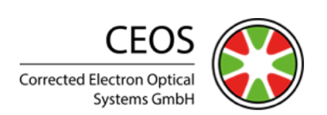
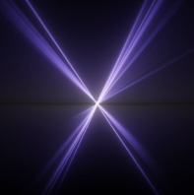


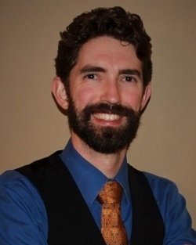
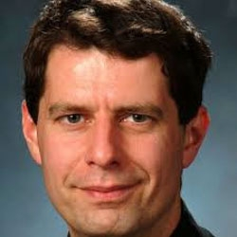












Industry Connections
External Advisory Board Members from Industry
Example Partnership with Industry
Friends of CBB
Erik Hosler
Bryan Reed
Submission of 2 proposals partnering with xLight Inc.
Partnerships in Innovation
Future Manufacturing
CBB should actively seek out new partnerships, explore the academic and industrial landscape to identify potential emerging opportunities. This will allow the Center to be engaged on cutting-edge innovation and be more in control of their legacy.
Notes:
xLight

Slide 14









Industry Collaboration Examples
Modeling tools for photocathodes | Tech-X SBIR-II
Chemical vapor dep. of Nb & Nb₃Sn | Ultramet SBIR-II
High performance SRF cavities | Niowave SBIR-II
MgB₂ films for next generation SRF | Star Cryo SBIR-I
High-brightness cold field emission gun (CFEG) tech. | ThermoFisher
Emittance distortions in aberration correctors | CEOS Gmbh
SRF for light sources and isotope production | Research Instruments
Loadlock for photocathode sharing | Radiabeam
Space charge simulation | Radiasoft
Epitaxial alkali-antimonide cathode growth | Euclid Labs SBIR-I
Advanced controls frameworks | Element Aero SBIR-I
Laser-driven ion accelerators for electronics radiation testing | Element Aero STTR
ML-based auto-alignment of electron microscope | CEOS & Thermo Fisher
High Brightness Source Optimization | Thermo Scientific
Cold-electron gas electron source | RadiaBeam SBIR-I
Compact MeV photo‐injector | Euclid Labs, BNL
Source and beam dynamics dev. (proposed) | xLight, Inc.
Notes:
Phase II SBIR funding is “focused on the development, demonstration and delivery of the innovation.”

Slide 15

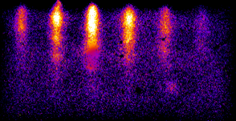
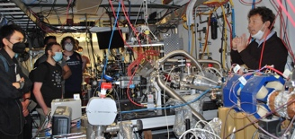

Photocathodes for large X-Ray FEL User Facilities
Deliverable 2.1: The transfer of CBB methods for preparing a photocathode with MTE < 35 meV and QE >10⁻³ at laser fluences in excess of 50 μJ/cm² (PHC Deliverable 1.2).
Simulations, Materials Downselect; Growth and test QA (2022-2023)
Test in Pegasus (UCLA) and APEX (LBNL) Guns (2023-2024)
Testing of a photocathode at <35 meV MTE at low q
Sponsored by DOE and SLAC
✓
LCLS-II Gun
Operational
Requirements
from SLAC
Iterate
Grow and QA
Test
(2024-2025)
Deliver to SLAC
(2025)
e.g. RHEED image of epitaxial Cs3Sb on SiC at PHOEBE
New DOE-BES-funded project of SLAC and CBB is transferring cathode recipes for the LCLCLS-II-HE gun.
Collaboration of Cornell/ASU/UCLA/LBNL/SLAC for testing of CBB recipes for photocathode growth in UCLA and LBNL guns.
CBB trainees regularly participate in collaborative experiments with SLAC (John Smedley) and BNL (Mengjia Gaowei) to transfer epitaxial cathode know-how in growth tests at NSLS-II.
CBB groups leading upcoming beamtime at NSLS-II to complete the transfer to epitaxial growth know-how to BNL and SLAC.
Delivery of high-density bunches relevant for XFEL beam production consistent with < 35 meV MTE
The DOE LCLS-II-HE project at SLAC will increase the energy of the CW-SCRF linac to 8 GeV, enabling the photon energy range to be extended to at least 13 keV 1 MHz
Notes:
Reference 46: https://journals.aps.org/prab/pdf/10.1103/PhysRevAccelBeams.24.121305
The advanced photocathode transfer system for high gradient RF guns that has been developed within the CBB funded Cornell-UCLA collaboration has already proven to be an enabling technology for accelerator and beam physics experiments. Cathodes in S-band guns are typically limited to Cu or Mg in the best case, with QE in the UV of 10^-4 at best. The ability to have %-class QE has allowed the UCLA Pegasus laboratory to carry out and plan for a series of previously un-accessible experiments. The UV laser system energy budget is in fact completely different thanks to the new cathode, making possible aggressive longitudinal and transverse pulse shaping while still emitting high charge beams. This has profound impact on the ongoing research programs in high efficiency THz FEL[46] as well as ultralow emittance generation for dielectric laser accelerators [46].
CBB scientists (Karkare, Maxson, Musumeci) have submitted and received funding for a joint proposal with scientists from SLAC (Smedley, Leweellen, Vecchione) and LBNL (Filipetto) that will enable tests in Pegasus and at LBNL at high field and at low field in guns at Cornell and ASU.

Slide 16

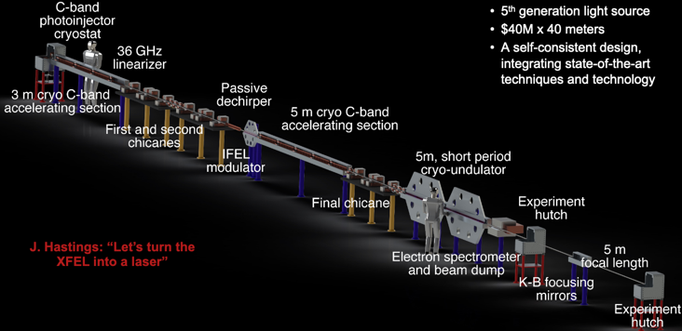
Photocathodes for high peak current for compact FELs
Designs for compact XFELs, place extreme demands on the cathode
Deliverable 2.2. The transfer of CBB methods for a photocathode that can operate for > 1 week with MTE < 35 meV at 50 mJ/cm² laser fluence and high field (> 50 MV/m) for high peak current applications such as compact XFELs (PHC Deliverable 2.1).
✓
Cathode transfer tests to UCLA Pegasus have enabled much larger charge generation and a series of new free electron laser experiments.
A new cryogenic RF photocathode gun tests system is being commissioned at UCLA (CYBORG)
Planned photocathode test at the FAST facility at FNAL and ANL’s AWA in late January 2025
Discovery of the Cs1Sb alkali antimonide as a robust, high QE visible light photoemitter
  10x less oxygen sensitivity
  1% QE at 400 nm
  Higher work function may lead to less dark current at high field.
Delivering methods to to the Pegasus at UCLA (left) system in a THz FEL configuration.
Further system-specific adaptation for insertion into UC-XFEL-like devices.
CBB is part of the UC-XFEL Collaboration that is discussed in this paper: J B Rosenzweig et al 2020 New J. Phys. 22 093067. Four CBB faculty are on this collaboration (Rosenzweig, Maxson, Musumeci, Karkare, and Biedron)

Slide 17


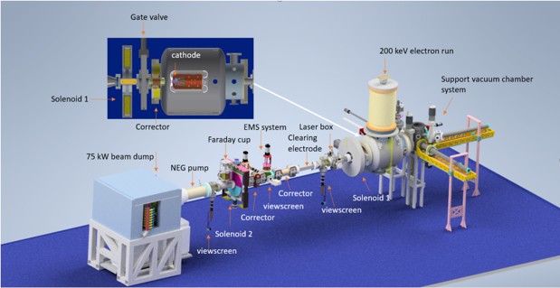
Photocathodes for high average current for NP/HEP Facilities
Deliverable 2.3. The transfer of CBB methods for a photocathode that can operate for > 1 week with MTE < 100 meV and QE > 1% under high average current (> 10 mA) conditions for hadron coolers and colliders (PHC Deliverable 2.2).
These photocathodes can assist e-RHIC and future hadron collider electron-based cooling systems.
Demonstrated single layer graphene protection of arbitrary air-sensitive metallic photocathodes via a new technique for graphene transfer—transferring this procedure to alkali antimonide photocathodes is underway.
Successful high-current testing of GaAs photocathodes activated with Sb-O-Cs, with lifetime up to 50% better compared to Cs alone.
Graduate Student Jai Kwan Bae [PhD, 2022], transferred Sb-O-Cs GaAs activation know-how to JLAB during extended visit (funded by separate DOE Stewardship Track 3 award).
For the testing, CBB has access to the dedicated high current testing facility @ Cornell: HERACLES (see figure), which delivers high power electron beams from a dc gun.
ULTIMATE GOAL: full robustness testing leads to cathode adoption in nuclear/HEP accelerator facilities.

Slide 18

Photocathodes for Microscopes
Deliverable 2.4: The transfer of CBB technology for a photoemission source with sub-100-nm spot size (PHC Deliverable 3.1).
IDES/JEOL (Reed) and CBB (Karkare, Maxson) continue to have informal discussions about the transfer of sub-100-nm-sized cathodes.
CBB has devised two approaches to meeting the requirements of the sub-100-nm spot size and are working through the development steps:
  APPROACH 1: Using plasmonic focusing – New defect free plasmonic spirals fabricated. Demonstration expected summer 2023.
  APPROACH 2: Using nano-scale work-function patterning – Effort to develop impurity-free nanofabrication process. First results expected by spring 2024.
IDES is interested in high QE cathodes (like alkali-antimonides) for Microscopes.
The ASU DC gun will be a test bed for these technologies.
  Gun and emittance measurement system commissioned first measurements with alkali-antimonides underway
Demonstrating and testing these in an electron gun will be essential before the industry will consider integration and test into their products. We are searching for funding for building a relevant gun for the industry as a test bed (in collaboration with IDES/JEOL.
Also will be integrated into HiRES and MEDUSA (LBL), and UED (Cornell)
Insight from Approach 1: defects suspected
Insight from Approach 2:
impurities suspected
2 years for development
Improvements (FY2023-2024)
Validate cathode performance in CBB electron guns (FY2024-2025)
KT to IDES
(FY2025)

Slide 19

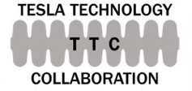




High performance SRF
✓
Deliverable 2.5: Methods for producing non-Nb, high-efficiency surfaces with cooling power
< 1.5 kW/(active meter) or accelerating fields > 25 MV/m (SRF Deliverables 3.1 and 3.2).
CBB Nb₃Sn research updates during monthly meetings with colleagues from TJNAF and FNAL
Patent application - M. Liepe, Z. Sun, “Ordered, cubic β-ZrNb alloys for superconducting applications,” U.S. Patent Application 18/507843, November 13, 2023.
Proposals being submitted, for example, Accelerator Stewardship proposal submitted to DOE (Maxson and Liepe) “Compact MeV photo‐injector for extremely bright electron beams and microscopy”, Euclid Techlabs, BNL
Possible use by industry, such as xLight.
Initiates tech transfer of a conduction cooled Nb3Sn cavity.
For Future Colliders,
Industry or Municipalities
Notes:
Transfer to labs for colliders: Higher critical temperatures of non-Nb surfaces will allow to slash energy consumption (supporting energy sustainability in accelerator driven sciences) and thus cryogenic operating costs and will substantially decrease infrastructure costs for the cryogenic plant. This will be a considerable advantage for high duty factor accelerators, such as FCC-ee. For a linear collider Higgs Factory and future upgrades, high-efficiency SRF technology could enable increasing the RF pulse length as well as the repetition rate of the pulses, thereby greatly increasing luminosity.
Second slide:
Transfer to industry
Non-Nb, high efficiency surfaces will enable robust, turn-key, and compact SRF accelerators. This technology revolution will make SRF accessible to applications in industry (e.g., for EUV lithography; in-line X-ray metrology/wafer inspection; radiation crosslinking; ion implantation), in medicine (e.g., for radionuclide production; sterilization of medical equipment), in environmental conservation (e.g., for radiation processing of polluted water and flue gas emissions), and in national security (e.g., for cargo x-ray imaging).

Slide 20
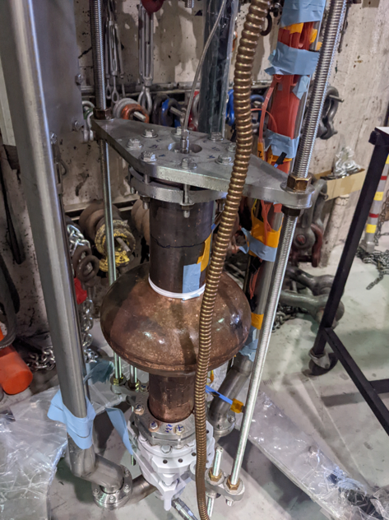
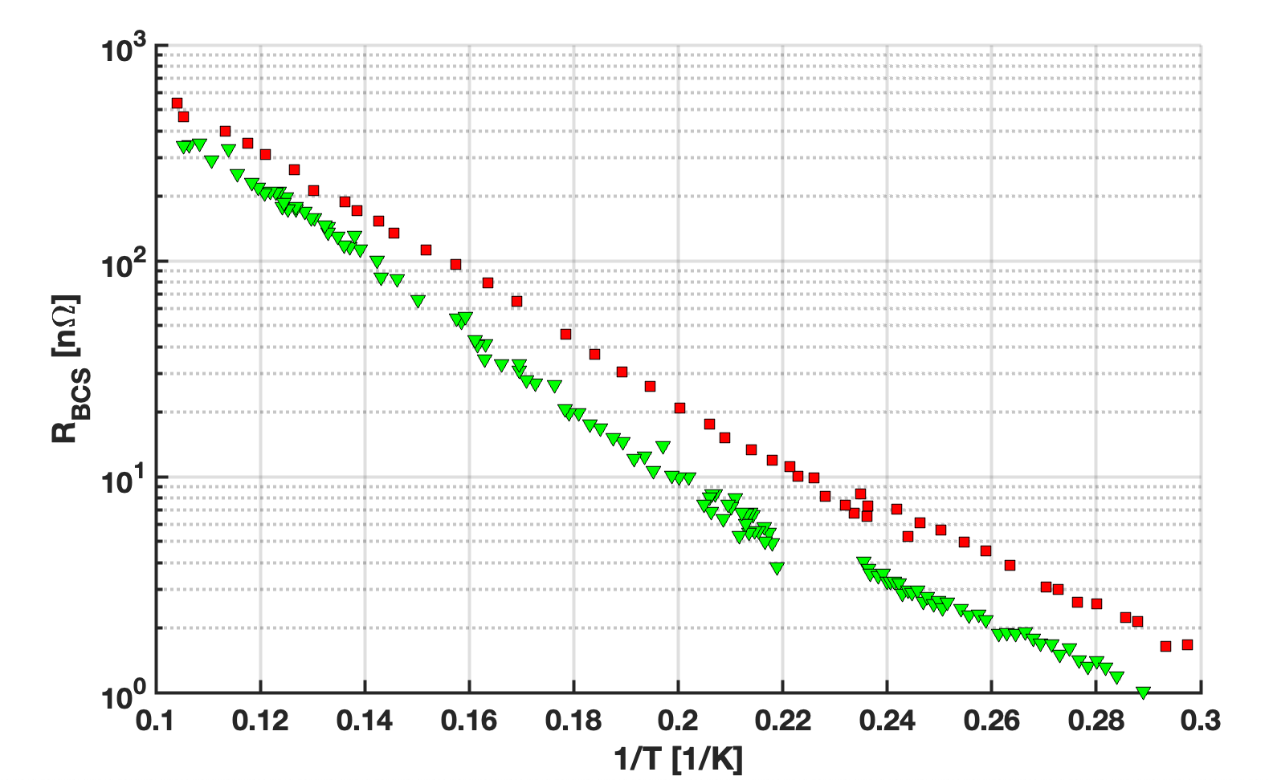
High performance SRF, cont.
✓
Deliverable 2.5: Methods for producing non-Nb, high-efficiency surfaces with cooling power
< 1.5 kW/(active meter) or accelerating fields > 25 MV/m (SRF Deliverables 3.1 and 3.2).
Milestones planned:
  Transfer of CBB method for high efficiency surface to industry or national lab partner (by end of year 9 - 2025).
  Technology transfer/collaboration with industry or national lab partner that employs a CBB high efficiency surface (by end of year 10 - 2026).
Figure: RBCS at 2 MV/m as a function of inverse temperature (1/T ) for electrochemical (green) versus vapor-diffused Nb3Sn (red), measured at 1.3 GHz. Image credit: Liana Sphani. Related publication: Smooth, homogeneous, high-purity Nb3Sn RF superconducting films by seed-free electrochemical synthesis, Z. Sun, Z. Baraissov, L. Shpani, R. D. Porter, Y. Shao, T. Oseroff, M. O. Thompson, D. A. Muller, M. U. Liepe, arXiv:2302.02054 [cond-mat.mtrl-sci] (2023). https://doi.org/10.48550/arXiv.2302.02054
Figure: Ultramet CVD Nb3Sn on copper substrate SRF cavity, ready for cryogenic RF performance testing at Cornell. https://accelconf.web.cern.ch/ipac2022/papers/tupotk035.pdf
Notes:
Transfer to labs for colliders: Higher critical temperatures of non-Nb surfaces will allow to slash energy consumption (supporting energy sustainability in accelerator driven sciences) and thus cryogenic operating costs and will substantially decrease infrastructure costs for the cryogenic plant. This will be a considerable advantage for high duty factor accelerators, such as FCC-ee. For a linear collider Higgs Factory and future upgrades, high-efficiency SRF technology could enable increasing the RF pulse length as well as the repetition rate of the pulses, thereby greatly increasing luminosity.
Second slide:
Transfer to industry
Non-Nb, high efficiency surfaces will enable robust, turn-key, and compact SRF accelerators. This technology revolution will make SRF accessible to applications in industry (e.g., for EUV lithography; in-line X-ray metrology/wafer inspection; radiation crosslinking; ion implantation), in medicine (e.g., for radionuclide production; sterilization of medical equipment), in environmental conservation (e.g., for radiation processing of polluted water and flue gas emissions), and in national security (e.g., for cargo x-ray imaging).

Slide 21
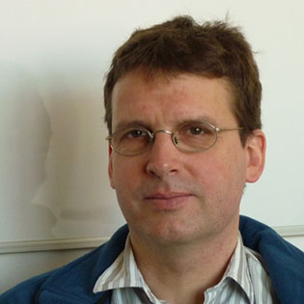
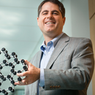
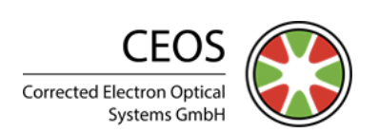
Microscope tuning techniques
✓
Deliverable 2.6: The transfer of CBB ML techniques for tuning the higher-order aberrations in electron microscopes, replacing the regular maintenance interventions by microscope company specialists that are required to keep the conventional alignment software operational (BDC Deliverable 3.2).
Collaboration: David Muller (CBB) with Heiko Muller at Corrected Electron Optical Systems (CEOS) and Dmitri Klenov at Thermo Fisher Scientific (TFS).
Goal: reduce labor-intensive (~3 week-long), costly human tuning required at installation and in routine maintenance.
Successful demonstration of aberration correction by Bayesian Optimization on 3 microscopes (Nion, 2 TFS)
  Emittance proved to be a robust metric
  The tuning was done in two minutes!
  Microsc. Microanal. 28 (S1), 3146 (2022)
Dr. Heiko Muller CEOS
Dr. David Muller
Cornell

Slide 22
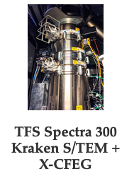
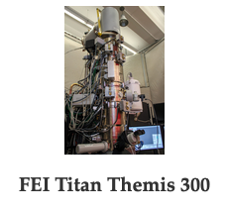

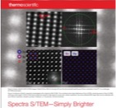
Microscope tuning techniques, cont.
✓
Next steps:
CEOS has shared its proprietary tuning software API with CBB, so that CBB can control the corrector hardware, and TFS has provided a python interface to their microscope’s hardware and detectors.
Software is under development on Cornell Titan and Spectra aberration correctors.
Collaboration with CEOS and Thermo Fisher on machine-learning-based autoalignment of the electron microscope.
Plan: Extend corrections from 2nd order aberration to 5th order, the highest correctable order.
Complete software package expected in 2025
Testing will be at the TFS R&D facility in Aacht (with Klenov).
Productization ~2 years

Slide 23
Microscope tuning techniques, cont.
✓
Knowledge Transfer to Industry:
Thermo Fisher Scientific (TFS) – collaboration on high-brightness cold field emission gun (CFEG) technology.
2nd generation electron microscope pixel array detector licensed to TFS.
TFS funded several of CBB to develop a 2nd generation direct electron detector, which is now completed. It which will take approximately 2 years to bring to market. (Licensing fees from the 1st generation are now over $600k, as an example of level of return.)

Slide 24
Other Knowledge Transfer Activities
Deliverable 2.7: Incorporation of other CBB discoveries into new generations of accelerators or commercialization as products.
✓
(many)
Notes:
CBB’s practice is to identify transferable technologies early and introduce them to client companies with the aim of licensing or joint development, including SBIR/STTR opportunities.

Slide 25
Patents
Title | Status/Number | Inventors
Nanoscale Photoemission Based Electron Source for Electron Microscopy | Provisional US Patent 63017798 (2020) | S. Karkare (faculty, ASU); H.Padmore (faculty, LBNL); and J. Maxson (faculty, Cornell)
A Monochromator Device and Methods of Use Thereof | Provisional patent PCT Filing - 9107-03-PC (Applied, 2020) | C. Duncan (student, Cornell), J. Maxson (faculty, Cornell), D. Muller (faculty, Cornell)
Float zone silicon wafer manufacturing system and related process | Patent 10811245 (Granted, 2020) | J. Rosenzweig (faculty, UCLA)
Localization break down in a high-powered RF network | Publication number: 20200379028 (Granted, 7/19/2022) | J. Rosenzweig (faculty, UCLA); N. Majernik (postdoc, UCLA)
Continuous Alkali Gas Cathode | Invention Disclosure, Preliminary Patent under submission (2021) | V. Yu (undergraduate, UCLA); R. Robles (undergraduate, UCLA); G. Lawler (graduate student, UCLA); C. Hansel (undergraduate, UCLA); N. Majernik (postdoc, UCLA); J. Rosenzweig (faculty, UCLA)
Method for Protecting Reactive Materials with Atomically Thin Film | 63/185,407 (Applied, 2021) | Hines, M.A. (faculty, Cornell), DeBenedetti, W.J.I. (student, Cornell)
Nanoblade Electrospray Propulsion | 2022-151 (Applied, 2022) | Rozenzweig, J. (faculty, UCLA); Majernik, N. (postdoc, UCLA)
Improved Multi-leaf Collimator | 2023-062-1 (Applied, 2022) | Rosenzweig, J. (UCLA); Majernik, N. (postdoc, UCLA)
Ordered, cubic β-ZrNb alloys for superconducting applications | 63/383,387 (Applied 2022) | Liepe, M. (Cornell); Sun, Z. (postdoc, Cornell)

Slide 26
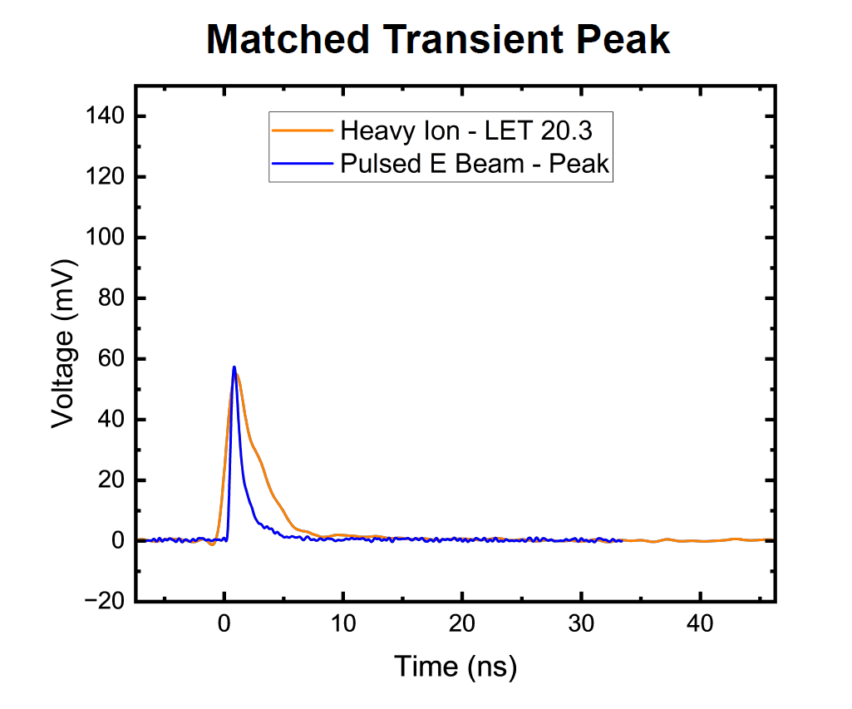



Other Knowledge Transfer Examples Knowledge Transfer – DARPA
Generating ultrasmall beams suitable
for microelectronics alternative testing for SEE
  Develop sub-um single-shot beam diagnostics for dosimetry
  Utilize pinholes to reduce beam emittance to required level to meet 1 um spot size requirement
  Test nanostructured Yttrium cathode to minimize source area.
  Demonstrate electrons as alternative testing method
Preliminary Pegasus data
Goals
The radiation hardness of an electronic component is critical to mission success
Single Event Effects (SEE) are caused by single ions hitting spacecraft
SEE can cause bits to flip, memory losses, or latch-up
Imperative to have adequate testing infrastructure to characterize SEE resistance
Team
  A. Kulkarni
  Collaboration: JPL, Aerospace Corp, RBT, Tau Systems
  Funding from DARPA-ASSERT

Slide 27
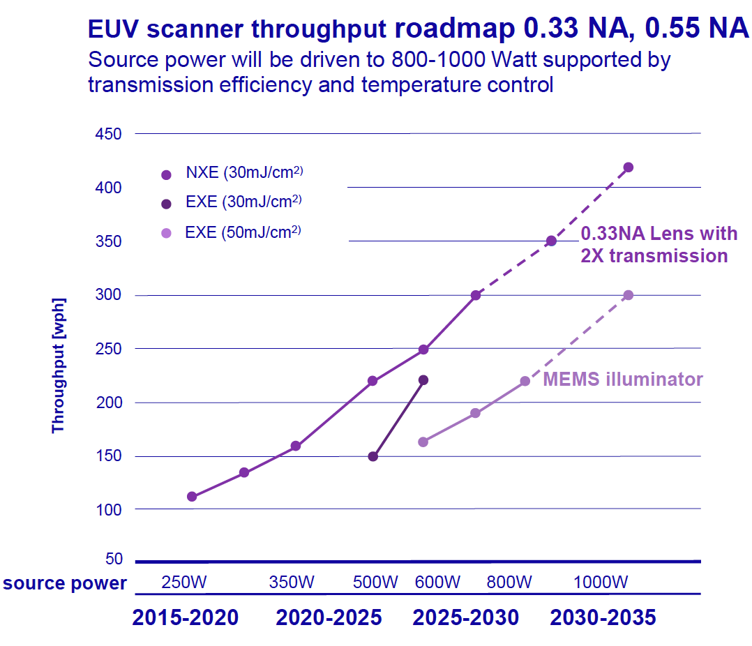
Other Knowledge Transfer Activities, cont. - Xlight
✓
(many)
Xlight is now a friend of CBB
Xlight trying to recruit CBB individuals into various roles
CBB submitting joint proposals with XLight
Working together to bridge university-lab-industry relations, including:
  Providing Xlight knowledge of known system architectures capable of meeting the semiconductor industry requirements.
  Guiding Xlight on known contract instruments on how Xlight can compensate CBB faculty for SRF and injector technologies knowledge transfer.
  Organizing visits to appropriate lab space with CBB lab partners and advising on CRADAs with these entities.
  Organizing visits to Meyer Tool and Ability Engineering yesterday for the peripheral items that will be needed for full injector and system prototypes.
  Giving joint presentations to possible funding agents, such as individuals Department of Defense, e.g. plenary presentation at the Directed Energy Professional Society’s S&T Annual meeting.
  Leveraging participation with SEMI - Coordinating presentation content with the SEMI meetings and SEMI members, e.g. SEMICON West Sustainability Summit and an upcoming presentation at the SEMI Sustainability initiative working group.
*ASML Source Power Roadmap, SEMI ISS 2022

Slide 28
Other Knowledge Transfer Examples - Fermilab
✓
(many)
Knowledge Transfer to Labs:
Optical Stochastic Cooling
CBB-contributed delay system enabled the demonstration of optical stochastic cooling at Fermilab’s IOTA.
CBB also contributed the ELEGANT simulation

Slide 29
Other Knowledge Transfer Activities, cont. - BNL
(many)
Knowledge Transfer to Labs:
ML applied to cooling at RHIC
ML optimization of the hadron cooling rate in LEReC at RHIC
Three Bayesian Optimization algorithms were explored
ADD-GP-UCB is able to optimize cooling rate using high-dimension surrogate model trained from LEReC system simulator data
Both CGP-UCB and PI-GP works well optimizing Gaussian-like test functions
CGP-UCB test on real LEReC machine is successful for tuning 1 corrector
Published: Phys. Rev. Accel. Beams 25, 014601 – Published 7 January 2022
✓

Slide 30
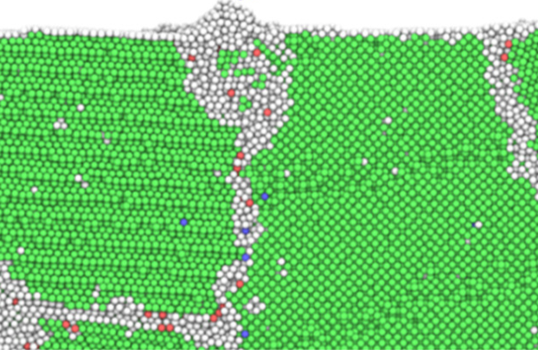
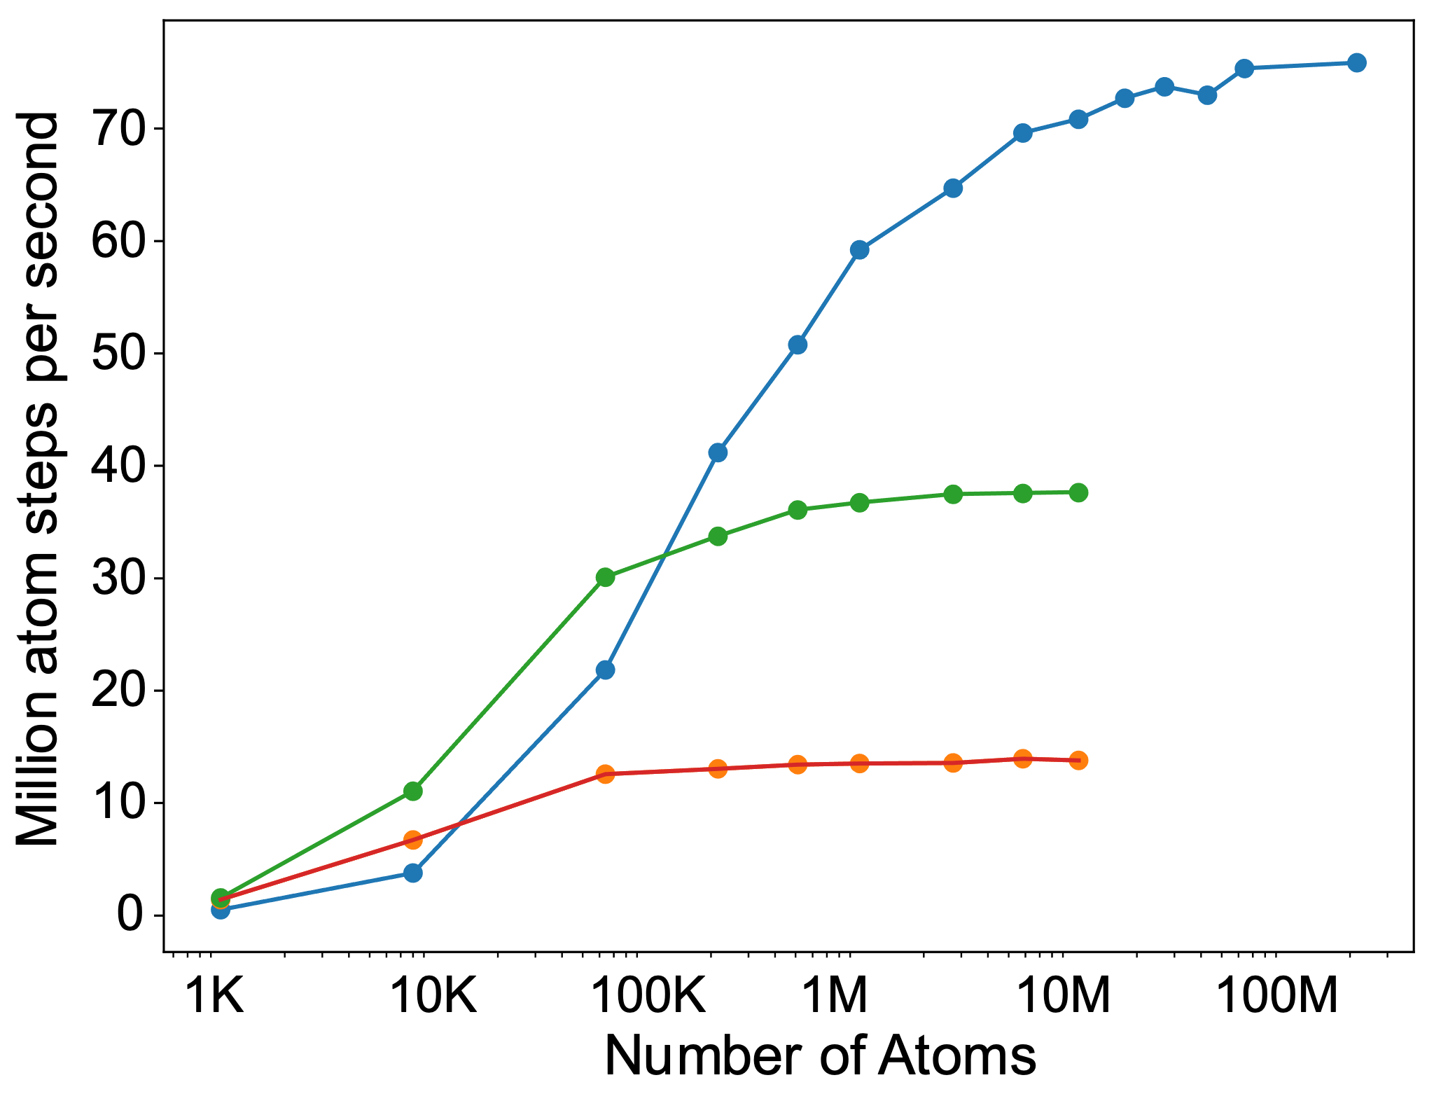
Other Knowledge Transfer Activities, cont. – UF
✓
(many)
Knowledge Transfer to Labs: ML on exascale HPCs for simulating CBB-relevant atomic processes
Need for exascale simulations for bright beams
Fundamental atomic processes during material growth occur over time scales of µs and length scales of many nm
CBB example of materials growth:
  Grain boundary segregation and diffusion of Sn in polycrystalline Nb₃Sn
  Growth of photocathode thin films on substrates
Illustration below shows a grain boundary cell containing about 1 million atoms
Ultra-Fast Force Field (UF³) provide accurate and efficient models (Hennig group)
UF³ method developed at UF is the fastest machine learning potentials with similar accuracy to other ML methods
We provide the UF³ CPU and GPU implementation for the LAMMPS code to Sandia National Labs
Enables accurate long-time simulations of millions of atoms on exascale machines (Permutter, HiPerGator, NVIDIA A100)
216 Million Atoms
✓
Kuppart et al., doi: 10.3390/mi12101178

Slide 31
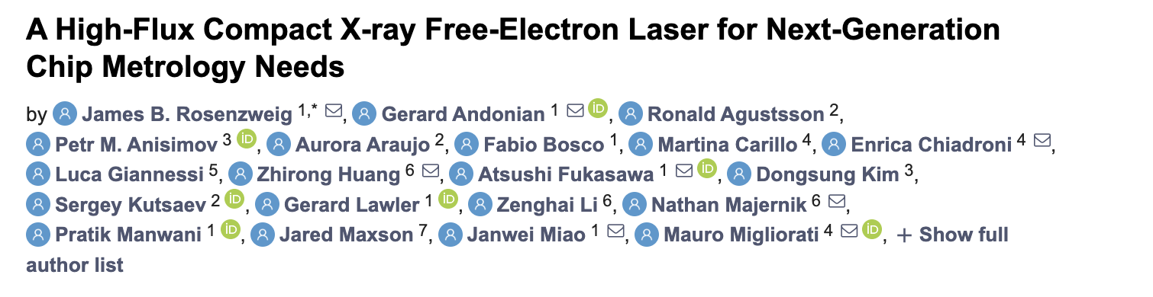
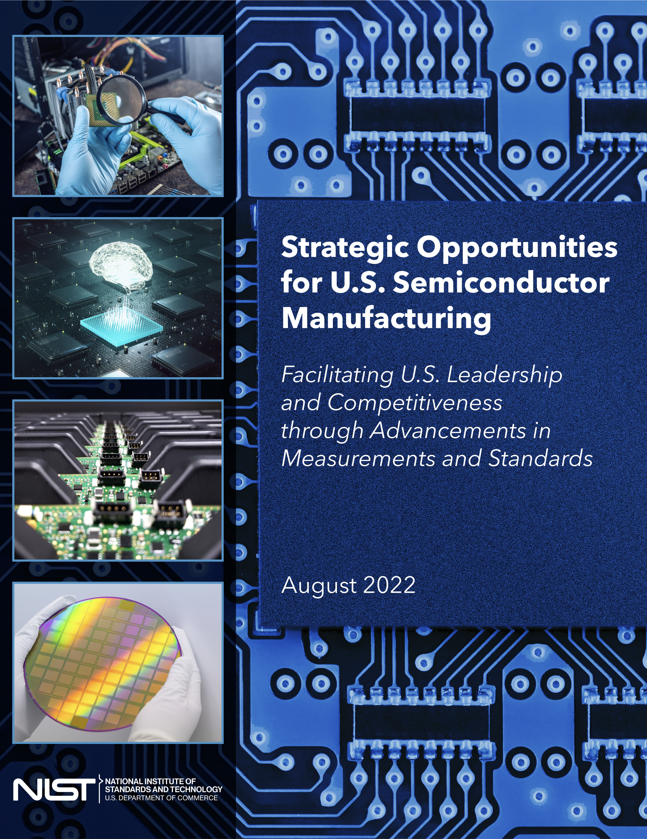
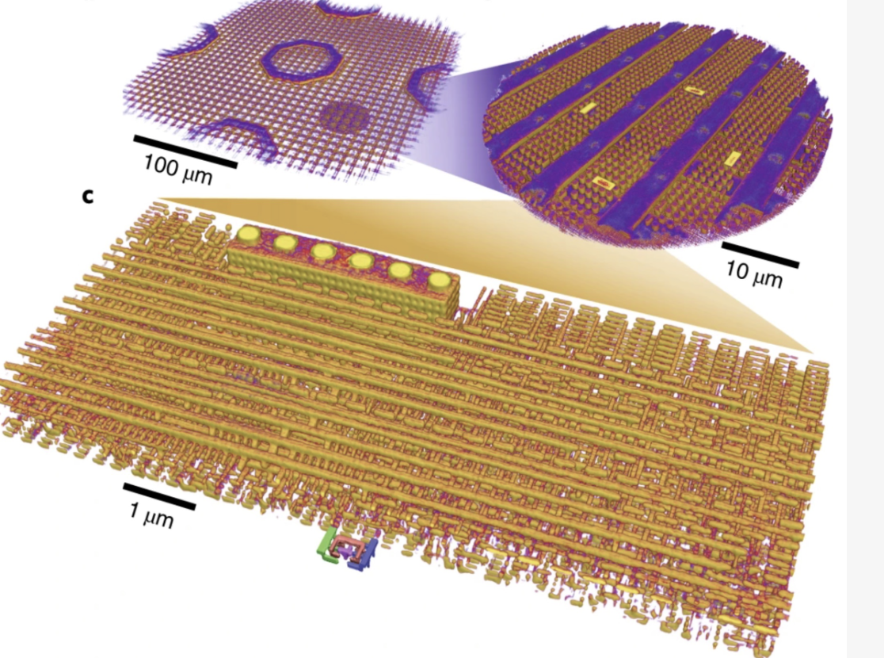
CBB-centered next generation chip inspection initiative (UCLA)
✓
(many)
Compact XFELs uniquely enabled by bright e- beams
  Now high flux, hard x-rays
Improve proof-of-principle light source exp’t flux by 1E5
Gov’t/industry/investor partnership
  UCLA/RadiaBeam NSF STTR proposal; Intel support
  NIST and ARDAP proposals with RadiaBeam
  VC firm engaged (NDA protected)
NIST reports establish
critical need.

Slide 32
To Recap – Knowledge Transfer Roadmap

Slide 33
Summary
Each priority deliverable has a concrete KT plan: The section of the Strategic Plan on Knowledge Transfer has very specific plans with identified end users.
See Sibener’s talk - Close integration with the end-users: We work closely with the end users to understand their requirements and receive feedback throughout the development cycle.
The Knowledge Transfer activities have momentum: For many CBB technologies and methods, there already has been significant KT.
See Hines’ talk - The Knowledge Transfer through 51 alumni:
  11 in industry (21.5%)
  16 into labs (31%)
  22 academia/institutes/teaching (43%)
  2 Unknown (3.9%)
Thanks for your attention.
Questions?

Slide 34
Acronyms
Add-GP-UCD – an algorithm, additive function, Gaussian process upper confidence bound
ANA – Advanced and Novel Accelerators
ANL – Argonne for short but DOE’s Argonne National Laboratory
AI – Artificial Intelligence
AILC – America’s International Linear Collider
AI/ML – Artificial Intelligence/Machine Learning
APS – American Physical Society
ASU – Arizona State University
ATF - Accelerator Test Facility
AVS – American Vacuum Society
AWA – Argonne Wakefield Accelerator
BDC – Beam Dynamics and Control
BES – DOE, SC, Office of Basic Energy Sciences
BNL – DOE’s Brookhaven National Laboratory
BO – Bayesian Optimization
CBB – Center for Bright Beams
CESR - Cornell Electron Storage Ring
CHESS – Cornell High Energy Synchrotron Sources
CEOS - Corrected Electron Optical Systems
CGP-UCB – an algorithm, Contextual Gaussian Process upper confidence bound
CNN – Convolutional Neural Network
CVD – Chemical Vapor Definition
CW – continuous wave or continuous beam in the context of beams
DEPS - Directed Energy Professional Society

Slide 35
Acronyms
DMP – Data Management Plan
DMP – APS, Division of Materials Physics
DOD – Department of Defense
DOE – Department of Energy
DOE GARD – DOE General Accelerator Research and Development
DPF – APS, Division of Particles and Fields
DPB – APS, Division of the Physics of Beams
EAB – External Advisory Board
EAB – Experimental Advisory Board
E&E – Energy and the environment
EIC - Electron-Ion Collider
EM – Electron Microscopy or Electron Microscope
EPP – NAS, Elementary Particle Physics (Progress and Promise)
EPRI – Energy Power Research Institute
FEL – Free-electron laser
FEL – Free-electron laser conference
FNAL – Fermilab for short but DOE’s Fermi National Accelerator Laboratory, named after Fermi by Congress 25 years after the successful first sustained nuclear reaction by Fermi et al.
GP-UCB – an algorithm, Gaussian process upper confidence bound
GP-PI – al algorithm, Gaussian process probability of improvement
Grad or GRAD – graduate student
HERACLES - High ElectRon Average Current for Lifetime ExperimentS
HiRes – High-resolution beamline at LBNL
ICFA – International Committee on Future Accelerators

Slide 36
Acronyms
IDES – Integrated Dynamic Electron Solutions
IEEE – Institute of Electrical and Electronics Engineers
IEEEUSA - Institute of Electrical and Electronics Engineers
I.FAST – Innovation Fostering In Accelerator Science And Technology
ILC – International Linear Collider
IOC – International Organizing Committee
ILS - Ion Linac Systems
IOTA – Integrable Optics Test Accelerator
IPA – Intellectual Property Agreement
IPAC – International Particle Accelerator Conference
JEAC – Japan Atomic Energy Commission
KT – Knowledge Transfer
LBNL – DOE’s Lawrence Berkeley National Laboratory
LANL – DOE’s NNSA Los Alamos National Laboratory
LCLS – Linac Coherent Light Source at the SLAC National Accelerator Facility
LCLS-II – Linac Coherent Light Source II at the SLAC National Accelerator Facility
LCLS-II HE - Linac Coherent Light Source II High Energy at the SLAC National Accelerator Facility
LEReC - Low Energy RHIC electron Cooling
LINAC - Linear Accelerator
LINAC - Linear Accelerator Conference
LLRF – Low-level RF
ML – Machine Learning
MRS – Materials Research Society
MTE – Mean Transverse Energy

Slide 37
Acronyms
MW – MegaWatt or MegaWatt-class
NAPAC – North American Particle Accelerator Conference
NAS – National Academies of Sciences
NNSA – DOE’s National Nuclear Science Administration
NPSS – IEEE’s Nuclear and Plasma Sciences Society
NS – National Security
NSF – National Science Foundation
NSLS-II – DOE’s BNL’s National Synchrotron Light Source -II
OHEP – DOE, SC, Office of High-Energy Physics
PAC – Program Advisory Committee
PAC – Particle Accelerator Conference
PD – post-doctoral researcher
PHC - Beam Production
P3 or P3 - Photocathode Physics for Photoinjectors
REU – Research Experience for Undergraduates
QA – Quality Assurance
QE - Quantum Efficiency
PHOEBE – Photocathode Epitaxy and Beam Experiments Laboratory
RF – Radio-frequency
RHEED - Reflection high energy electron diffraction
RHIC – BNL’s Relativistic Relativistic Heavy Ion Collider (RHIC)
RRR - Residual Resistance Ratio
SAB – Scientific Advisory Board
SAC – Scientific Advisory Committee

Slide 38
Acronyms
SAC – Scientific Advisory Committee
SBIR – Small Business Innovation Research
SC – DOE Office of Science
SCGSR – DOE’s SC’s, Science Graduate Student Research program for US citizens or lawful permanent residents
SEMICON – Semiconductor, but refers to a conference series established by SEMI the global semiconductor trade organization
SLAC – DOE’s SLAC National Accelerator Laboratory
SRF – Superconducting RF
SRF - International Conference On Rf Superconductivity
ST – Science and Technology
STC – Science and Technology Center
STE – Science, Technology and Engineering
TEM – Transmission Electron Microscope (or Microscopy)
TFS – Thermo Fisher Scientific
THz – Terahertz regime electromagnetic emission
UC-XFEL - Ultra-Compact X-Ray Free-Electron Laser
UCLA – University of California, Los Angeles
UED – Ultrafast Electron Diffraction
UNM - University of New Mexico
USPAS – United States Particle Accelerator School
ZEUS - Zettawatt-Equivalent Ultrashort pulse laser System

