Slide 1
Beam Acceleration (SRF) Theme

Slide 2

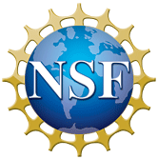


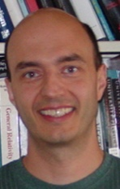
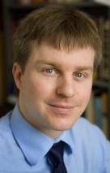
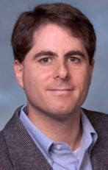

Beam Acceleration (SRF) Theme
Theme Leaders
Faculty
Affiliates
ANL: J. Elam
TRIUMF: B. Laxdal
FNAL: S. Posen
Clark Atlanta: G. Japaridze
X. Wang
Matthias Liepe
Cornell
Steve Sibener
U Chicago
Mark Transtrum
BYU
Tomás Arias
Cornell
Richard Hennig
U Florida
David Muller
Cornell
Jim Sethna Cornell
Optimal Outcome: The advanced methods and surfaces for next-generation SRF cavities that will enable game-changing reduction of cooling power needs (10× lower than traditional bulk Nb cavities), will enable higher temperature operation (well above the 2.17K Lambda point of liquid helium), and will provide higher accelerating fields (2× higher than traditional bulk Nb cavities) for lower cryogenic system costs, energy sustainability, and simpler refrigeration.
3/14/24

Slide 3
Problem Statement
Superconducting RF (SRF) cavities are “gold-standard” for acceleration of high-power, high-brightness beams
  Current generation of SRF cavities has been transformational for accelerator driven sciences
All SRF cavities currently in operation use Niobium as the superconducting material
  But: High cost and complexity of current generation of SRF cavities severely limit use in science and prevent small-scale university and industrial applications
SRF Cryomodule
SRF Linac Cryoplant
3/14/24

Slide 4
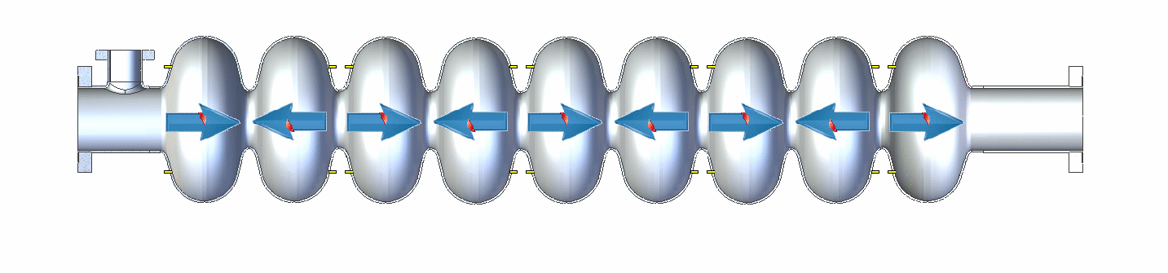
SRF 101
Input RF power at 1.3 GHz
1m
Slowed down by factor of approximately 4x10⁹
Cryoplant efficiency vs. operating temperature
Decrease required cooling power: need smaller surface resistance
Decrease required cooling power: need superconductors with higher critical temperature
Decrease accelerator length: need superconductors with higher fundamental flux-free field limit

Slide 5
Current Progress Towards Ultimate Outcomes
Bulk (undoped) niobium cavity
at 1.3 GHz, operating at 2K
40
300
CBB will open paths for even higher fields
20
100
Future CBB (optimal outcome)
Cryogenic AC cooling power (W/active meter)/(MV/m)²
Energy gain/length (MeV/m)
10
CBB 2023: 1.3 GHz Nb₃Sn cavity, operating at 4K
50
Bulk niobium cavity at 2K
4
Future CBB (optimal outcome)
25
Current Nb3Sn cavity at 4.2K
3/14/24

Slide 6
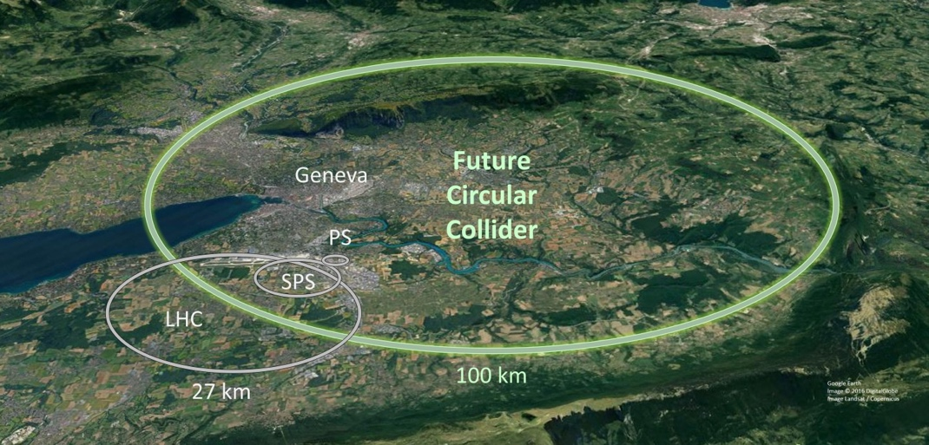
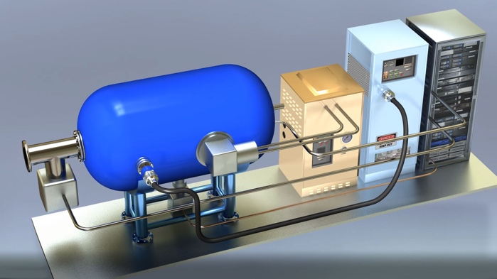

Why this matters: Applications
Overcoming the cost barrier / enabling sustainable science:
Key: Reduced cryo cooling power and higher temp. operation
  Future FELs
  Electron-Ion collider
  Future circular collider (FCC) …
Advancing the energy frontier:
Key: Increased energy gain / length
Enabling new class of compact, turn-key SRF driven accelerators:
Key: Reduced cryogenic cooling power and simplified cryogenics
  Widespread use of SRF
  Small-scale science accelerators
    High-intensity, high-brightness MeV scale beams
  Industrial and medical applications…
Impact on non-accelerator applications:
  S.C. cavities for quantum computing, dark photon detection …
Future Circular Collider
Electron-Ion Collider
CBB Nb₃Sn material advances
FNAL/DOE Compact Accel. Concept
3/14/24
Notes:
Advancing Energy Frontier: ILC-future upgrade
Non-accelerator applications: Emphasize quantum computing

Slide 7
Technical Challenges
Liquid Helium
Niobium
B_{in}
3mm
λ(0) ~ 40 nm
B_{s}=B₀e^{iωt}
Nb₂O₅
1m
Vacuum with RF fields
B_{s}=B₀e^{iωt}
Inner surface layer (few 100 nm “RF penetration layer”) determines RF performance of a cavity.
Transformative advances in RF performance require:
  Utilizing compound superconducting materials with larger energy gaps and higher superheating fields
  Growing complex superconducting films with near-ideal stoichiometry and achieving tight control of defects down to the nanoscale
  Exploring optimized structured surfaces and their robustness to vortex entry
  Understanding and controlling the effects that underlie the RF surface resistance and its field dependence
  ➾ Rich, interdisciplinary CBB research program
3/14/24

Slide 8
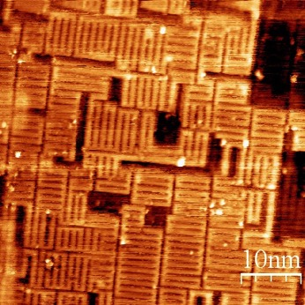
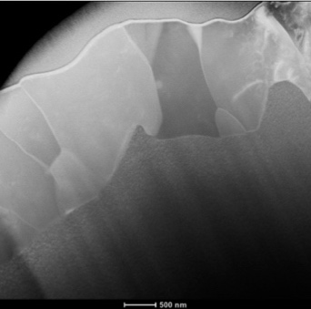
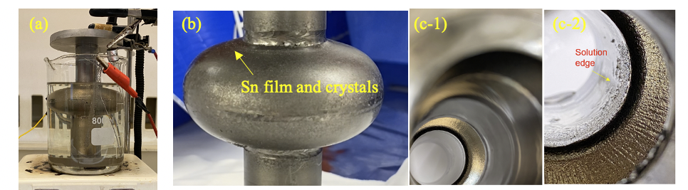
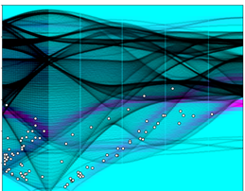
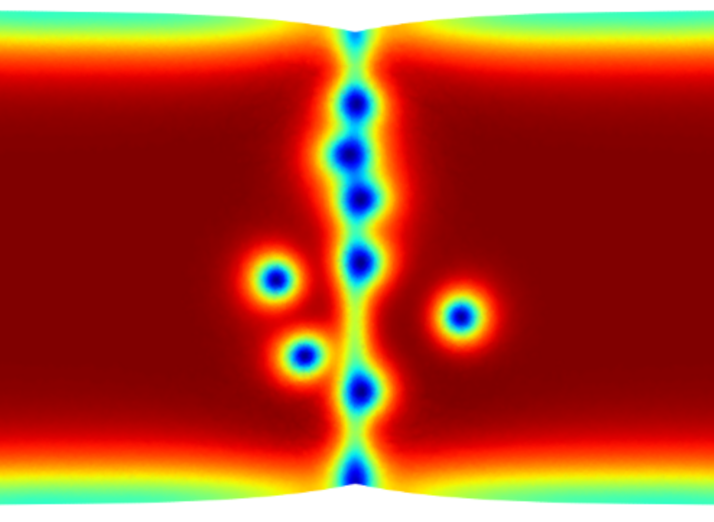
CBB Integration of Complementary Disciplines
Accelerator
Experimentalist
Theorist
Tight knit interdisciplinary community
Multiscale studies: atomic (Å), nano (mm), meso (μm) & macro (mm) dimensions
Examining materials growth, morphology, stoichiometry and critical relations to RF penetration layer across multiple dimensions
Accelerator Science and Technology
Materials Science
Surface Chemistry
Theoretical Condensed Matter Physics
Experimental Condensed Matter Physics
CBB
Sibener, U Chicago
Muller, Cornell
Liepe, Cornell
Arias, Cornell; Sibener U Chicago
Transtrum, BYU
NbO order on (100) Nb
TEM cross section
Nb₃Sn Cavity
Surface(001) phonon structure of Nb
Vortex nucleation at grain boundary
3/14/24

Slide 9


Connections: Research Loop
Synergy: Beam Storage & Transport
e.g. nonlinear continuum descriptions
Synergy: Beam Production
material synthesis
Predict
Electronic structure theorists, condensed matter theorists
Implement
Material scientist, accelerator scientist
Arias
Cornell
Hennig
U Florida
Transtrum
BYU
Sethna Cornell
Posen
FNAL
Liepe
Cornell
Sibener
U Chicago
Elam
ANL
Cavity RF Test
Accelerator scientists
Note: Supported by NSF and DOE accelerator grants.
Characterize
Chemist, condensed matter exp., accelerator scientists
Accelerator
Experimentalist
Theorist
Liepe
Cornell
Posen
FNAL
Sibener
U Chicago
Muller
Cornell
Laxdal
TRIUMF
Liepe
Cornell
Synergy: Beam Production
material characterization
Synergy: Beam Production and Beam Storage & Transport
accel. implementation
CBB enables this unique interdisciplinary research
Paradigm shift in SRF research!
3/14/24

Slide 10
Year 8 Publications
Sun, et al. "Surface oxides, carbides, and impurities on RF superconducting Nb and Nb3Sn: A comprehensive analysis." Superconductor Science and Technology 36.11 (2023): 115030.
Kelley, et al. "Fully Ab Initio Approach to Inelastic Atom-Surface Scattering." Physical Review Letters 132.1 (2024): 016203.
Lee, et al. "Stress-induced structural changes in superconducting Nb thin films." Physical Review Materials 7.6 (2023): L063201.
Sun, et al. "Thermodynamic route of Nb3Sn nucleation: Role of oxygen." APL Materials 11.7 (2023).
Sitaraman, et al. "Enhanced Surface Superconductivity of Niobium by Zirconium Doping." Physical Review Applied 20.1 (2023): 014064.
Sun, et al. "ZrNb (CO) RF superconducting thin film with high critical temperature in the theoretical limit." Advanced Electronic Materials 9.8 (2023): 2300151.
Sun, et al. "Electrochemical polishing of chemical vapor deposited niobium thin films." Thin Solid Films 780 (2023): 139948.
Sun, et al. "Smooth, homogeneous, high-purity Nb3Sn superconducting RF resonant cavity by seed-free electrochemical synthesis." Superconductor Science and Technology 36.11 (2023): 115003.
Lim, et al. "Niobium substitution suppresses the superconducting critical temperature of pressurized MoB 2." Physical Review B 108.9 (2023): 094501.
Oseroff, et al. "Measurements of the amplitude-dependent microwave surface resistance of an Au/Nb bilayer." Superconductor Science and Technology 36.11 (2023): 115009.
Dee., et al. "Diboride compounds doped with transition metals\textemdash a route to superconductivity through structure stabilization as well as defects." arXiv preprint arXiv:2310.03818 (2023).
Sitaraman, et al. "A Comprehensive Picture of Hydride Formation and Dissipation." 21th International Conference on RF Superconductivity (SRF'23), Grand Rapids, MI, USA, 25-30 June 2023. JACOW Publishing, Geneva, Switzerland, 2023.
Sun, et al. "MATERIALS DESIGN FOR SUPERCONDUCTING RF CAVITIES: ELECTROPLATING Sn, Zr, AND Au ONTO Nb AND CHEMICAL VAPOR DEPOSITION." 21st Int. Conf. on Radio-Frequency Superconductivity (SRF’23),(Grand Rapids, MI, USA). 2023.
Howard, et al. "Thermal annealing of DC sputtered Nb3Sn and V3Si thin films for superconducting radio-frequency cavities." Journal of Applied Physics 134.22 (2023).
Kelley, et al. "Fully Ab Initio Approach to Inelastic Atom-Surface Scattering." Physical Review Letters 132.1 (2024): 016203.
Gibson, et al. "Accelerating superconductor discovery through tempered deep learning of the electron-phonon spectral function." arXiv preprint arXiv:2401.16611 (2024).
3/14/24

Slide 11








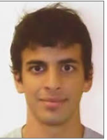




SRF Graduate Students and Postdocs
Zhasla Baraissov
Student
Cornell
Van Do
Student
Chicago
Sam Dong
Student
Florida
Gabriel Gaitan
Student
Cornell
Aiden Harbic
Student
BYU
Ajinkya Hire
Student
Florida
Sadie Seddon-Stettler
Student
Cornell
Liana Shpani
Student
Cornell
Nathan Sitaraman
Postdoc
Cornell
Caleb Thompson
Student
Chicago
Michael VanDuinen
Student
Chicago
Sarah Willson
Student
Chicago
Zeming Sun
Postdoc
Cornell
3/14/24
Notes:
Current Students and Postdocs in SRF
Missing Sadie

Slide 12








Connections: National Labs and Industry
ILC cost
reduction
Nb₃Sn Workshop
Nb₃Sn R&D
New SRF Materials
LCLS-II HE
R&D of N-Doping
High efficiency (2xQ₀)
cavity for NSLS-II
SBIR
National Lab Affiliates:
FNAL: S. Posen
ANL: J. Elam
TRIUMF: B. Laxdal
3/14/24

Slide 13
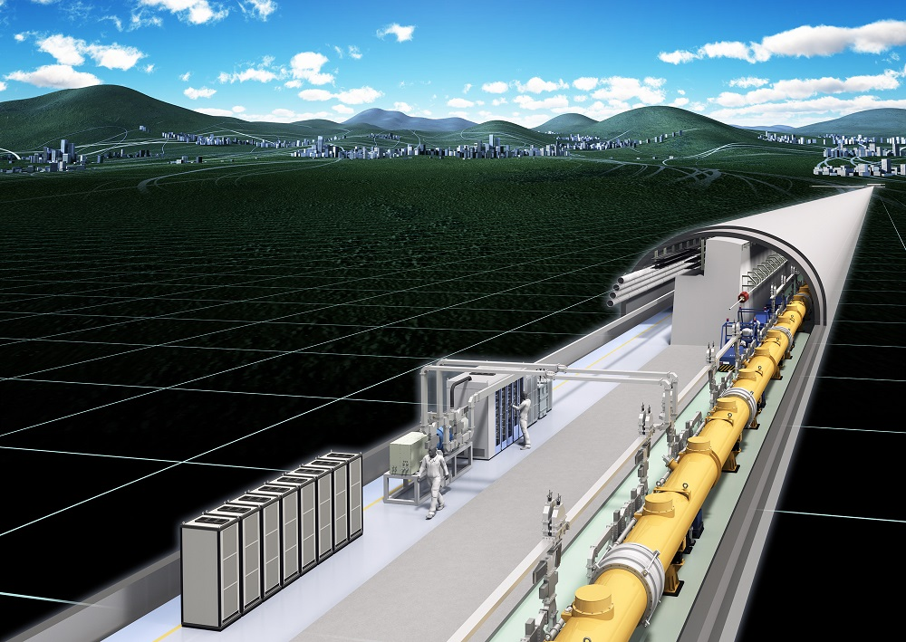
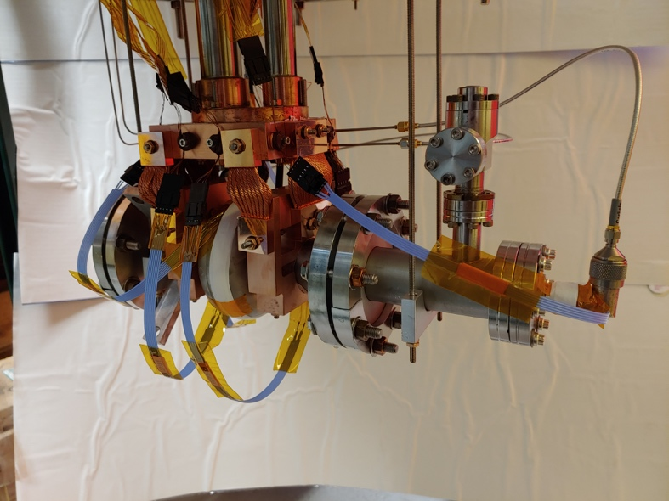
SRF Strategic Plan
The advanced methods and surfaces needed for next-generation SRF cavities that enable game-changing reduction of cooling power, higher temperature operation, and higher accelerating fields for lower cryogenic system costs, energy sustainability, and simpler refrigeration.
FY 22
FY 23
FY 24
FY 25
FY 26
Objectives
Deliverables
Legacy
Advanced SRF materials growth: Develop improved growth methods; understand impact of realistic (non-ideal) surfaces on performance
Methods of growth and their refinement leading to annually enhanced
performance for Nb₃Sn on Nb and Cu substrates
Methods of growth and their refinement leading to annually enhanced
performance for Nb-Zr alloys
﻿
FCC-ee running energy efficient on Nb₃Sn cavities
Determination whether other materials have potential for higher
efficiency and/or higher fields above Nb₃Sn and Nb-Zr limits
Decision point: Continue?
Multi-layers and inhomogeneous layers: Increasing RF performance via surfaces by design
Determination whether inhomogeneous surface layers offer significantly increased
RF performance over homogeneous materials
Decision point: Continue?
Multi-TeV e⁺e– collider enabled by CBB designed surfaces
Higher efficiency and higher fields: Demonstrate higher RF performance in proof-of-principle SRF cavities and study RF superconductivity under extreme conditions
Surfaces from non-Nb with cooling power <4W/(active meter)/(MV/m)²,
corresponding to a 10x reduction in cooling power
Non-Nb, high-efficiency surfaces capable of sustaining
accelerating fields of 25 MV/m
Compact SRF with conduction cooling for turn-key operation
Non-Nb surfaces supporting accelerating fields exceeding 50 MV/m.

Slide 14
SRF Strategic Plan
The advanced methods and surfaces needed for next-generation SRF cavities that enable game-changing reduction of cooling power, higher temperature operation, and higher accelerating fields for lower cryogenic system costs, energy sustainability, and simpler refrigeration.
FY 22
FY 23
FY 24
FY 25
FY 26
Objectives
Deliverables
Legacy
Advanced SRF materials growth: Develop improved growth methods; understand impact of realistic (non-ideal) surfaces on performance
Methods of growth and their refinement leading to annually enhanced
performance for Nb₃Sn on Nb and Cu substrates
Methods of growth and their refinement leading to annually enhanced
performance for Nb-Zr alloys
﻿
FCC-ee running energy efficient on Nb₃Sn cavities
Determination whether other materials have potential for higher
efficiency and/or higher fields above Nb₃Sn and Nb-Zr limits
Decision point: Continue?
Multi-layers and inhomogeneous layers: Increasing RF performance via surfaces by design
Determination whether inhomogeneous surface layers offer significantly increased
RF performance over homogeneous materials
Decision point: Continue?
Multi-TeV e⁺e– collider enabled by CBB designed surfaces
Higher efficiency and higher fields: Demonstrate higher RF performance in proof-of-principle SRF cavities and study RF superconductivity under extreme conditions
Surfaces from non-Nb with cooling power <4W/(active meter)/(MV/m)²,
corresponding to a 10x reduction in cooling power
Non-Nb, high-efficiency surfaces capable of sustaining
accelerating fields of 25 MV/m
Compact SRF with conduction cooling for turn-key operation
Non-Nb surfaces supporting accelerating fields exceeding 50 MV/m.

Slide 15
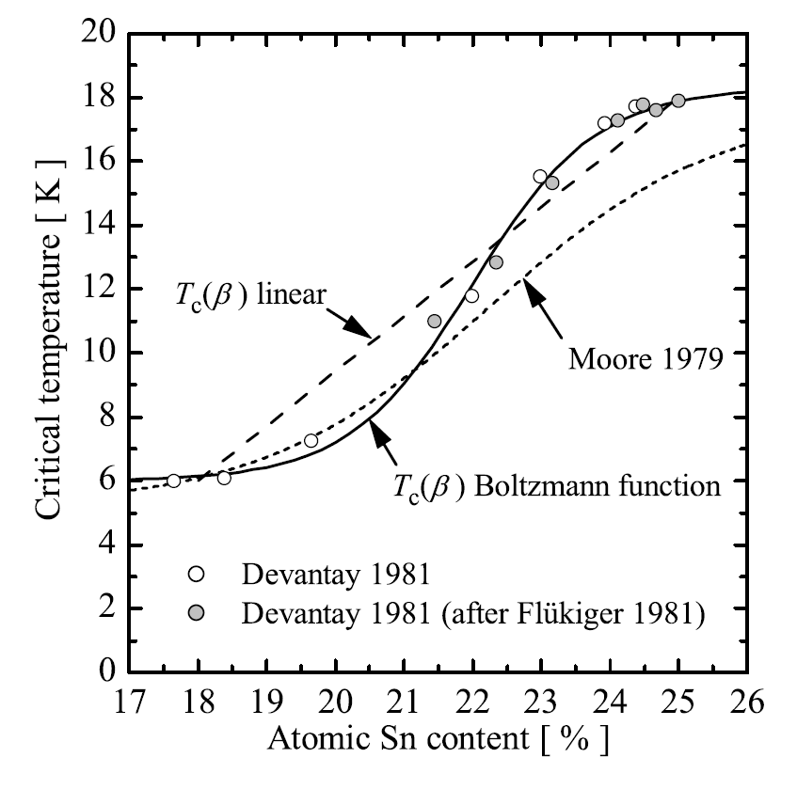
Phase II – Objective 1
Advanced SRF materials growth: Developing improved growth methods and understanding the impact of realistic (non-ideal) surfaces on performance.
Deliverable 1.1: Methods of growth and their refinement leading to annually enhanced performance for Nb₃Sn on Nb and Cu substrates. (Fall 2026)
Why? Nb₃Sn offers a path to increased accelerating fields and lower losses.
 | Niobium | Nb₃Sn
Critical Temperature T_{c} | 9 K | 18 K
Q₀ at 4.2 K | 6 x 10⁸ | 6 x 10¹⁰
Q₀ at 2.0 K | 3 x 10¹⁰ | >10¹¹
 | Niobium | Nb₃Sn
Superheating field | 220 mT | 420 mT
Max. E_{acc} (theoretical limit) | 55 MV/m | 100 MV/m
Challenge? Optimizing Nb₃Sn film growth for ideal 25% Sn concentration (stoichiometry), low roughness, ideal film thickness…
3/14/24

Slide 16
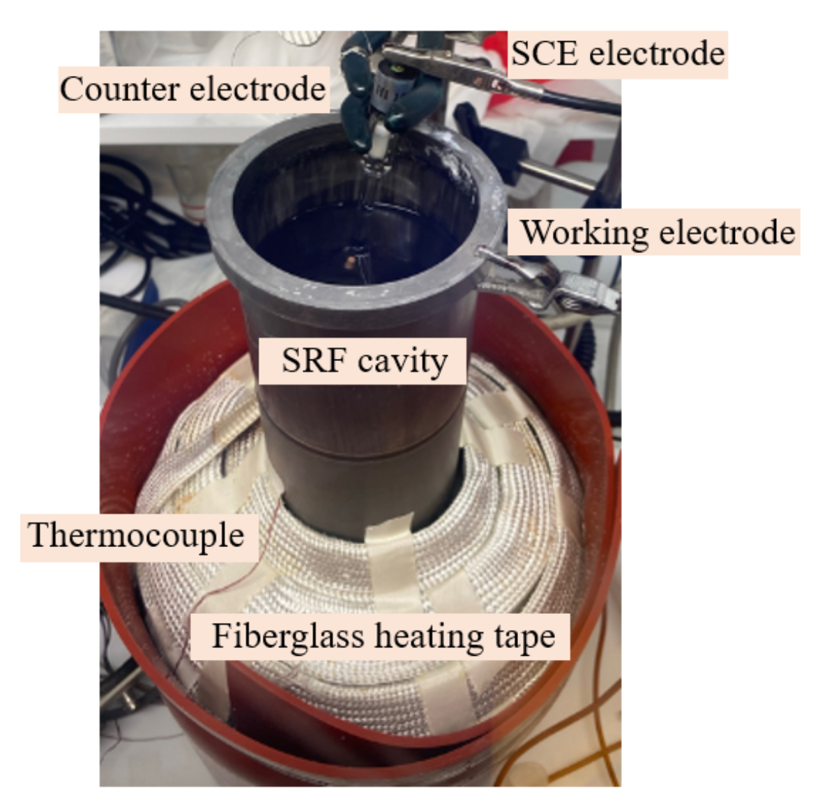
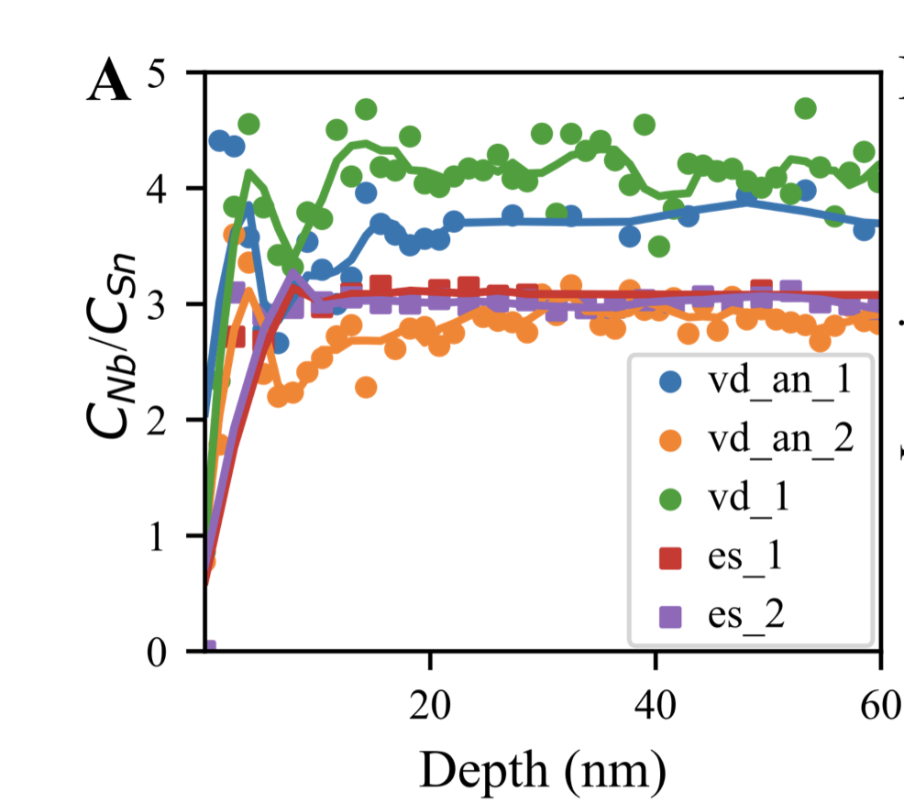
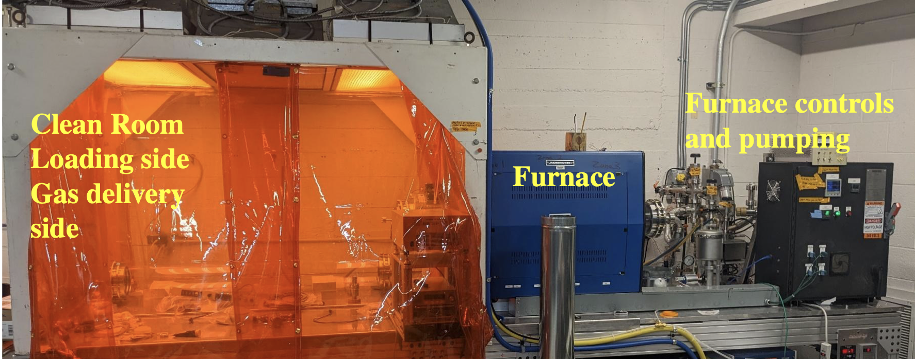
Deliverable 1.1: Methods of growth and their refinement leading to annually enhanced performance for Nb3Sn on Nb and Cu substrates.
Recent important Nb₃Sn growth advances:
  Demonstrated that certain chemical pre-treatments of the Nb substrate oxide improve uniformity of Sn nucleation in vapor diffusion growth ⇒ Important for reduced surface roughness and uniformity of final Nb₃Sn film
  Achieved Nb₃Sn film on 1.3 GHz cavity via CBB’s novel electrochemical Nb₃Sn synthesis ⇒ Smooth, homogeneous, high-purity Nb₃Sn film
  Completed system for Nb₃Sn growth via CVD ⇒ Will allow for improved control of Nb₃Sn film growth
Z. Sun et al., Smooth, homogeneous, high-purity Nb3Sn RF superconducting films by seed-free electrochemical synthesis, arXiv:2302.02054
3/14/24

Slide 17
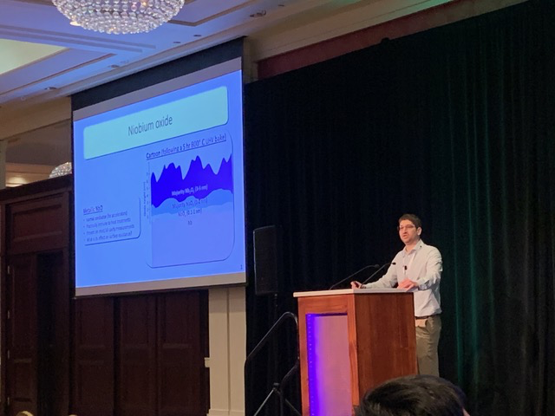
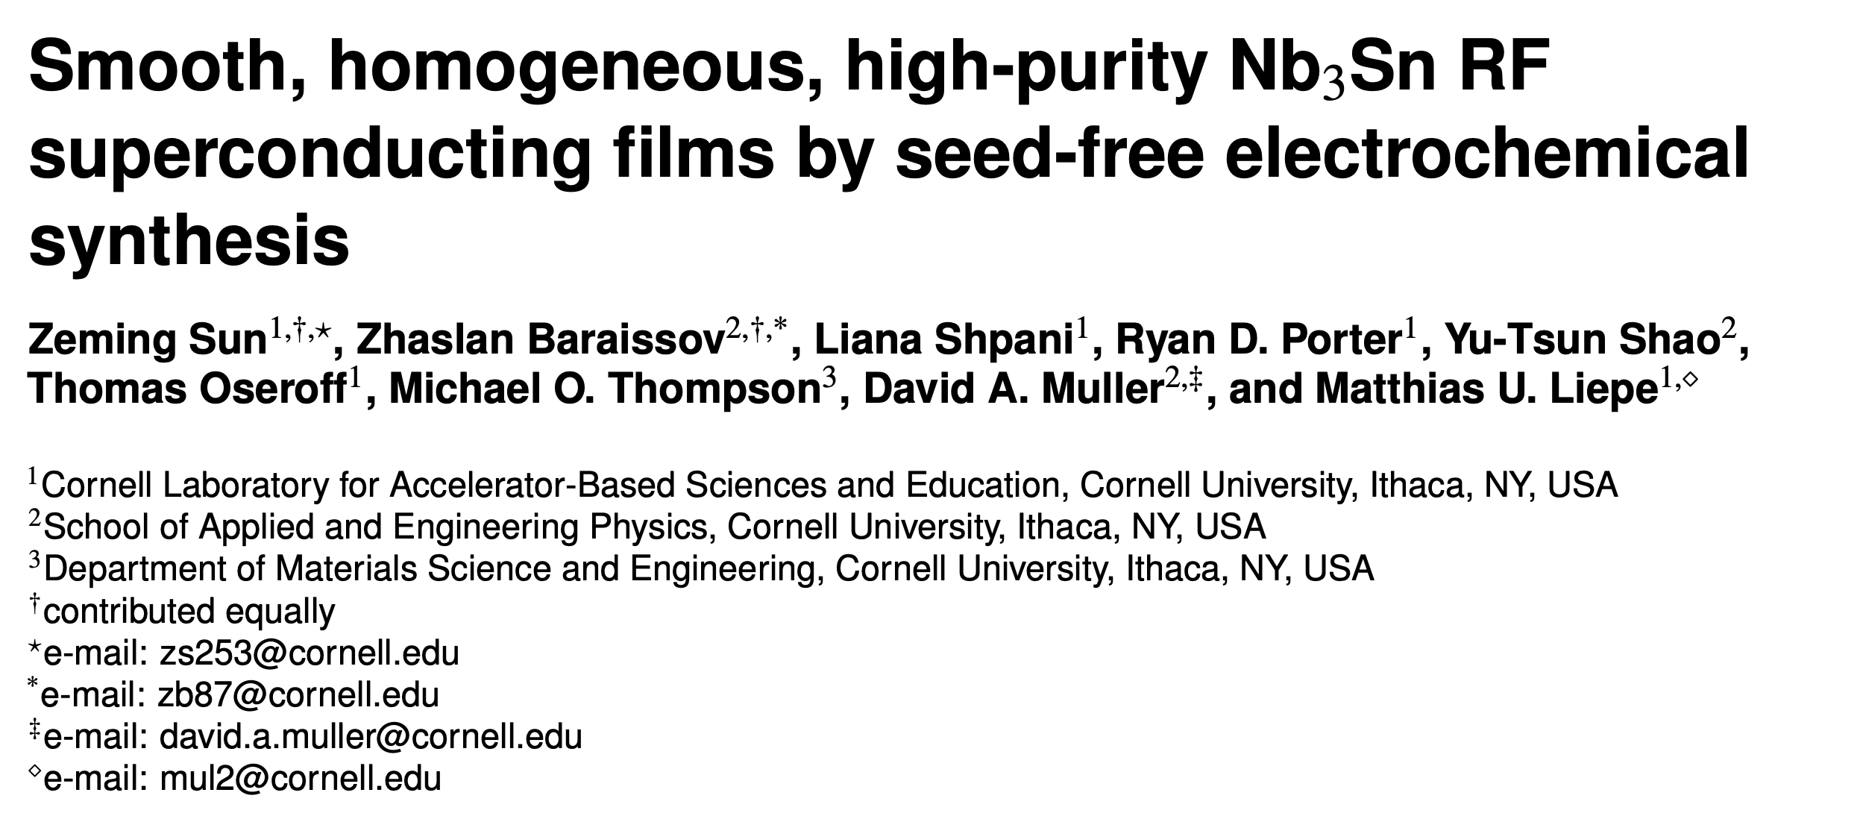
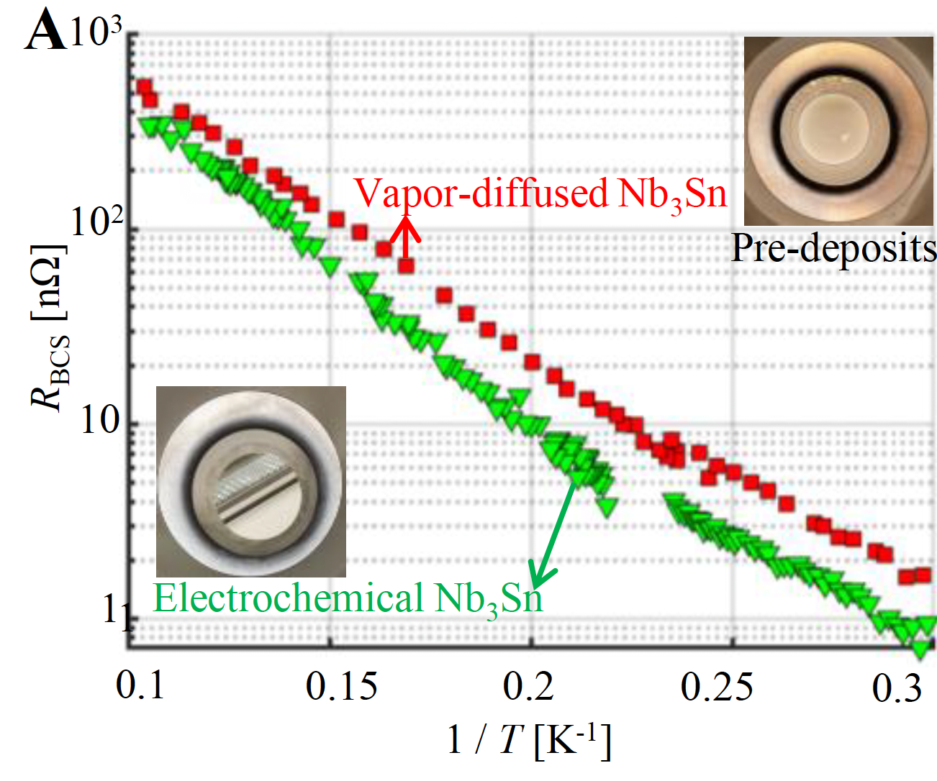
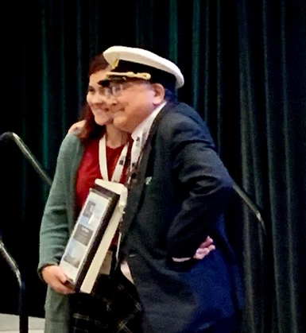
Deliverable 1.1: Methods of growth and their refinement leading to annually enhanced performance for Nb3Sn on Nb and Cu substrates.
Impact of CBB Nb₃Sn growth advances:
  CBB electroplating is the first viable alternative growth method for Nb₃Sn
  Fermilab collaboration
  Multiple invited talks and awards at SRF’23
  First UHV growth using e-beam deposition
3/14/24
Notes:
1. Liana young investigator award for her talk at SRF conference
2. Electroplating is the first alternative Nb3Sn growth method that works.
Fermilab wants to collaborate with us based on these results.

Slide 18
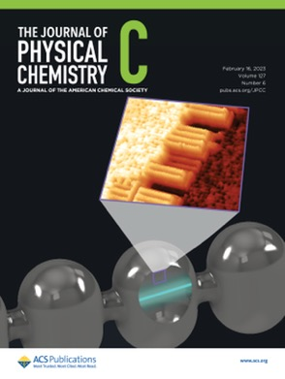
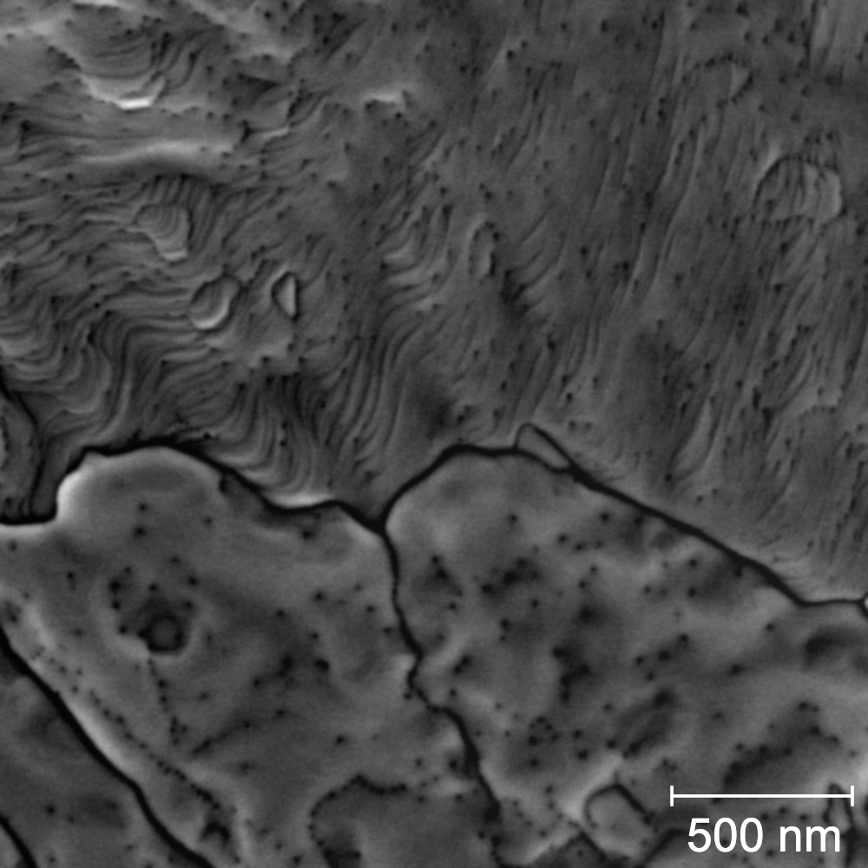
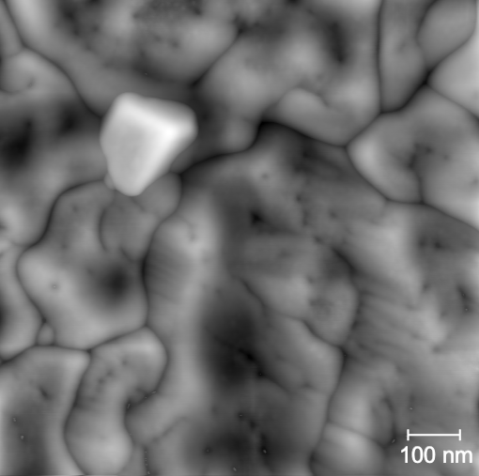
Deliverable 1.1: Methods of growth and their refinement leading to annually enhanced performance for Nb3Sn on Nb and Cu substrates.
Recent important advances in understanding Nb₃Sn formation:
  Identified the chemical and physical properties driving uniform Sn nucleation and wetting behavior on oxidized Nb surfaces during Nb₃Sn growth
  Predictions of core-level shifts to aid interpretation of initial Sn/NbOx chemistries
  ⇒ Guidance for further Nb₃Sn growth optimization
“Sub-Monolayer and Monolayer Sn Adsorption and Diffusion Behavior on Oxidized Nb(100)” Sarah A. Willson, Rachael G. Farber, Ajinkya Hire, Richard Hennig, and S. J. Sibener, J. Phys. Chem. C, 127, 6, 3339-3348 (2023)
Atomically-resolved Sn/NbO interface during initial growth
Surface features impact SRF performance
Nb₃Sn unable to form
Changing Nb surface by 40 ºC during Sn deposition
Nb₃Sn formation promoted
Surface corrugations
Sn islands
Sn atoms
10 nm
10 nm
Sn deficiencies
A fully ab initio approach to inelastic atom–surface scattering, Phys. Rev. Lett., in review
Journal of Chemical Physics 156, 124702 (March 2022), DOI: 10.1063/5.0085653
3/14/24
Notes:
First in situ atomic resolution images of Sn incorporating with Nb.

Slide 19
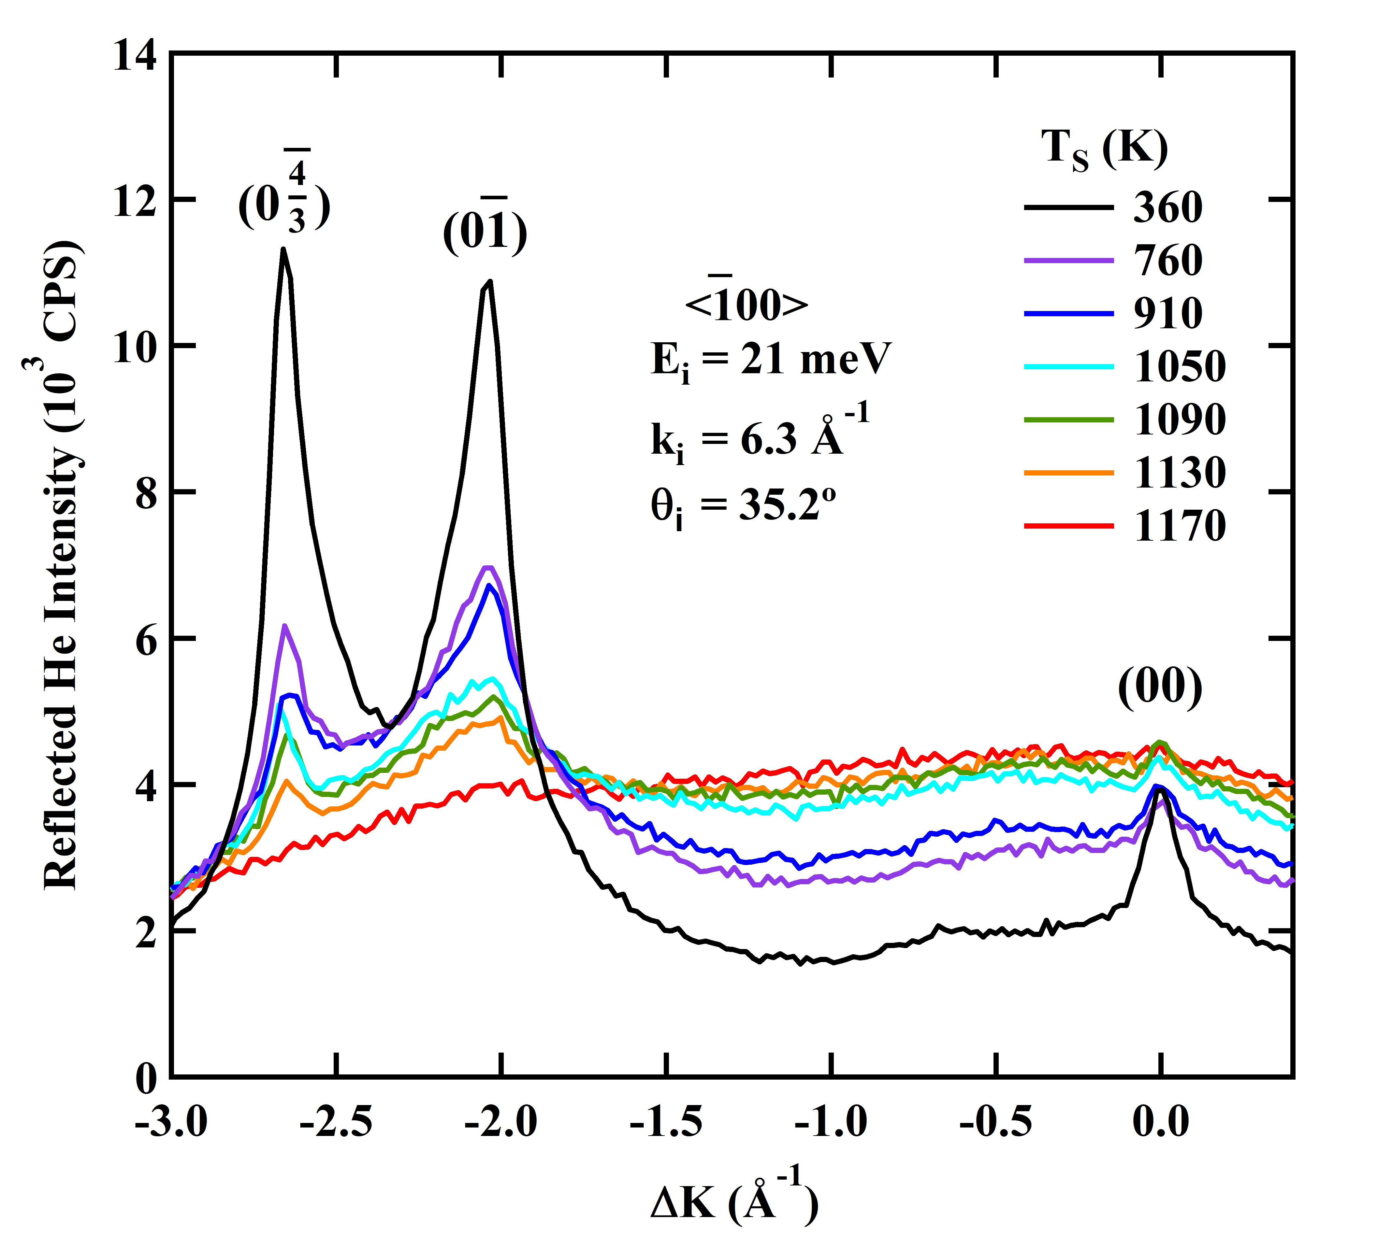
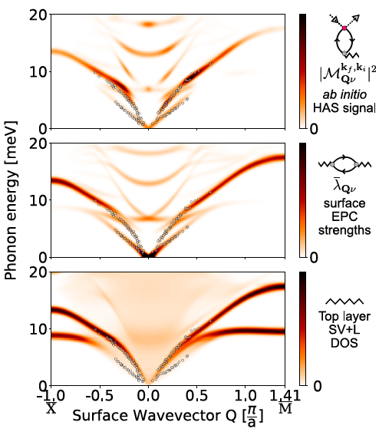
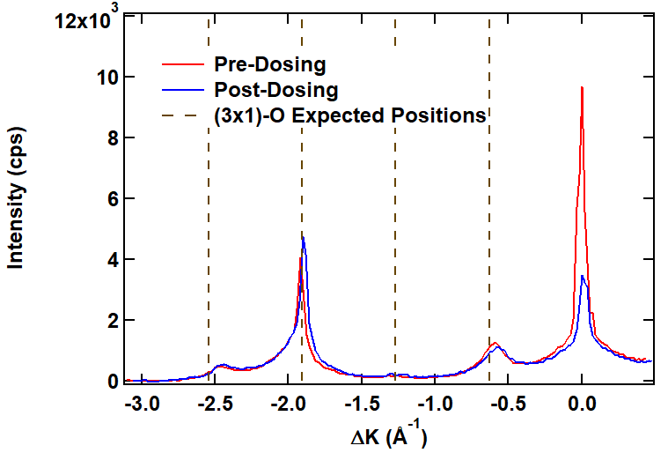
Deliverable 1.1: Methods of growth and their refinement leading to annually enhanced performance for Nb3Sn on Nb and Cu substrates.
Recent important advances in characterizing Nb₃Sn films:
  Helium atom scattering (HAS) measures in situ high-temperature structure and growth dynamics with atomic precision.
  1st fully ab initio theory of inelastic HAS matching experimental intensities from Nb
  ⇒ improvements in next-gen SRF interfaces for cavity applications
High temperature helium diffraction determines surface structure
He scatters from electron density.
Theory in agreement with experiment
Nitrogen dosing affects diffraction peak intensities
E (meV) →
A. A. McMillan, J. D. Graham, S. W. Willson, R. G. Farber, C. J. Thompson, S. J. Sibener Supercond. Sci. Technol. 33, 105012 (2020).
A. A. McMillan, C. J. Thompson, M. M. Kelley, J. D. Graham, T. A. Arias, S. J. Sibener J. Chem. Phys. 156, 124702 (2022).
3/14/24
Notes:
HAS Measurements at the Nb Surface Reveal In Situ Driving Forces for Chemical Reactivity and Physical Behavior

Slide 20
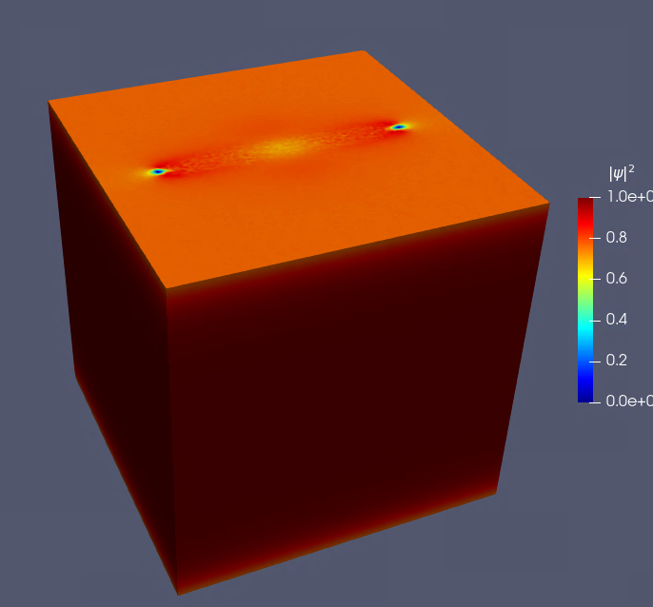
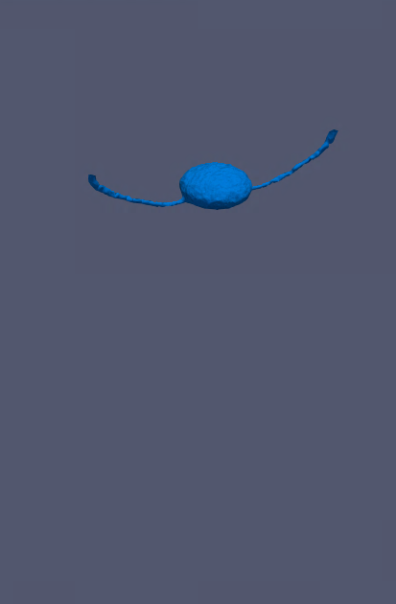
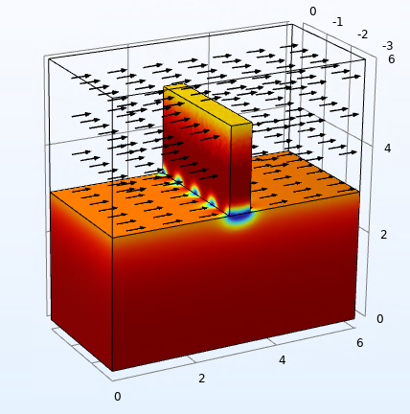
Deliverable 1.1: Methods of growth and their refinement leading to annually enhanced performance for Nb3Sn on Nb and Cu substrates.
Recent important theory advances:
  3D time-dependent Ginzburg-Landau simulations of Sn-depleted regions in Nb₃Sn
    Modeled losses mimic quality factors in real-world cavities.
    ⇒ Simulations reveal which defects are responsible for observed performance issues
  Two-domain TDGL simulations to model rough SC-vacuum interface, including field enhancement
  ⇒ Simulations reveal that geometric and material defects have a complex tradeoff between their ability to nucleate magnetic vortices (reducing efficiency) and pinning vortices (preventing quench)
Arrows indicate field direction
Pinned Vortex
3/14/24

Slide 21
Deliverable 1.1: Methods of growth and their refinement leading to annually enhanced performance for Nb3Sn on Nb and Cu substrates.
Current and future projects for Deliverable 1.1:
Growth
  Optimize growth for uniformity, stoichiometry, oxide structure, low roughness etc.
  Develop and optimize pre- and post-coating processes
  Optimize electroplating + annealing growth process
Characterization
  Determine RF performance of CVD Nb3Sn to guide process optimization
  Prepare optimal Nb₃Sn films via Nb and Sn co-deposition
  Demonstrate the Nb substrate morphologies and Sn deposition conditions that lead to high RF performance Nb alloy surfaces
Theory
  Ab initio study of elastic HAS Debye-Waller factors for e⁻-ph coupling.
  Ab initio study of Nb₃Sn surfaces and interfaces.
  Machine learning modeling of atomic potentials for Nb₃Sn substrates calculations.
  Application of UF3 framework to study the thermodynamics/kinetics of bulk, surfaces, and defects.
  Identify rough geometries that are particularly dangerous for vortex nucleation.
  Calculate frequency dependence of H_{sh} within generalized TDGL.
3/14/24

Slide 22
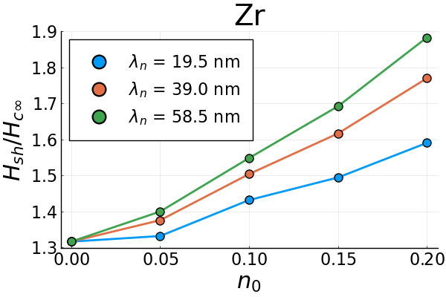
Phase II – Objective 1
Advanced SRF materials growth: Developing improved growth methods and understanding the impact of realistic (non-ideal) surfaces on performance.
Deliverable 1.2: Methods of growth and their refinement leading to annually enhanced performance for Nb-Zr alloys. (Fall 2026) Met Deliverable 1.2 for Y7
Why? CBB recently predicted that Nb-Zr offers Tc and superheating field above Nb. These might be easier to realize than predicted ultimate limits of Nb₃Sn (e.g., due to larger coherence length).
 | Niobium | Nb-Zr
Predicted critical Temperature T_{c} | 9.2 K | 13 - 16 K
Predicted superheating field | 220 mT | >300 mT ?
Challenge? Achieving high-Tc phase. Developing Nb-Zr processes that lead to desired high-quality surfaces without performance impacting impurities.
3/14/24

Slide 23

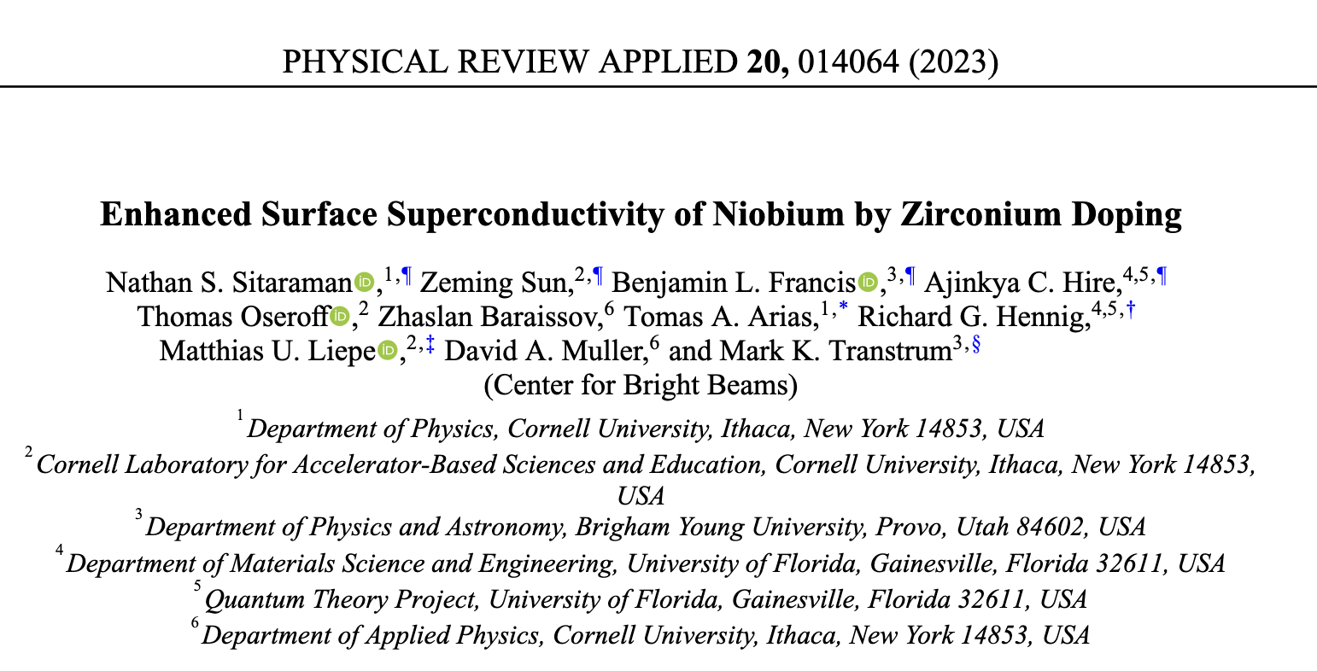
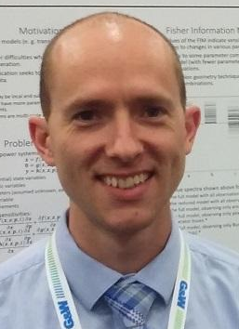
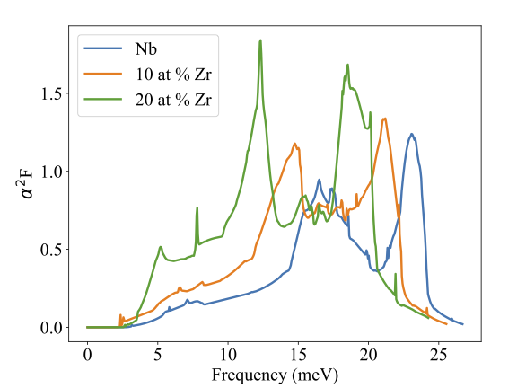
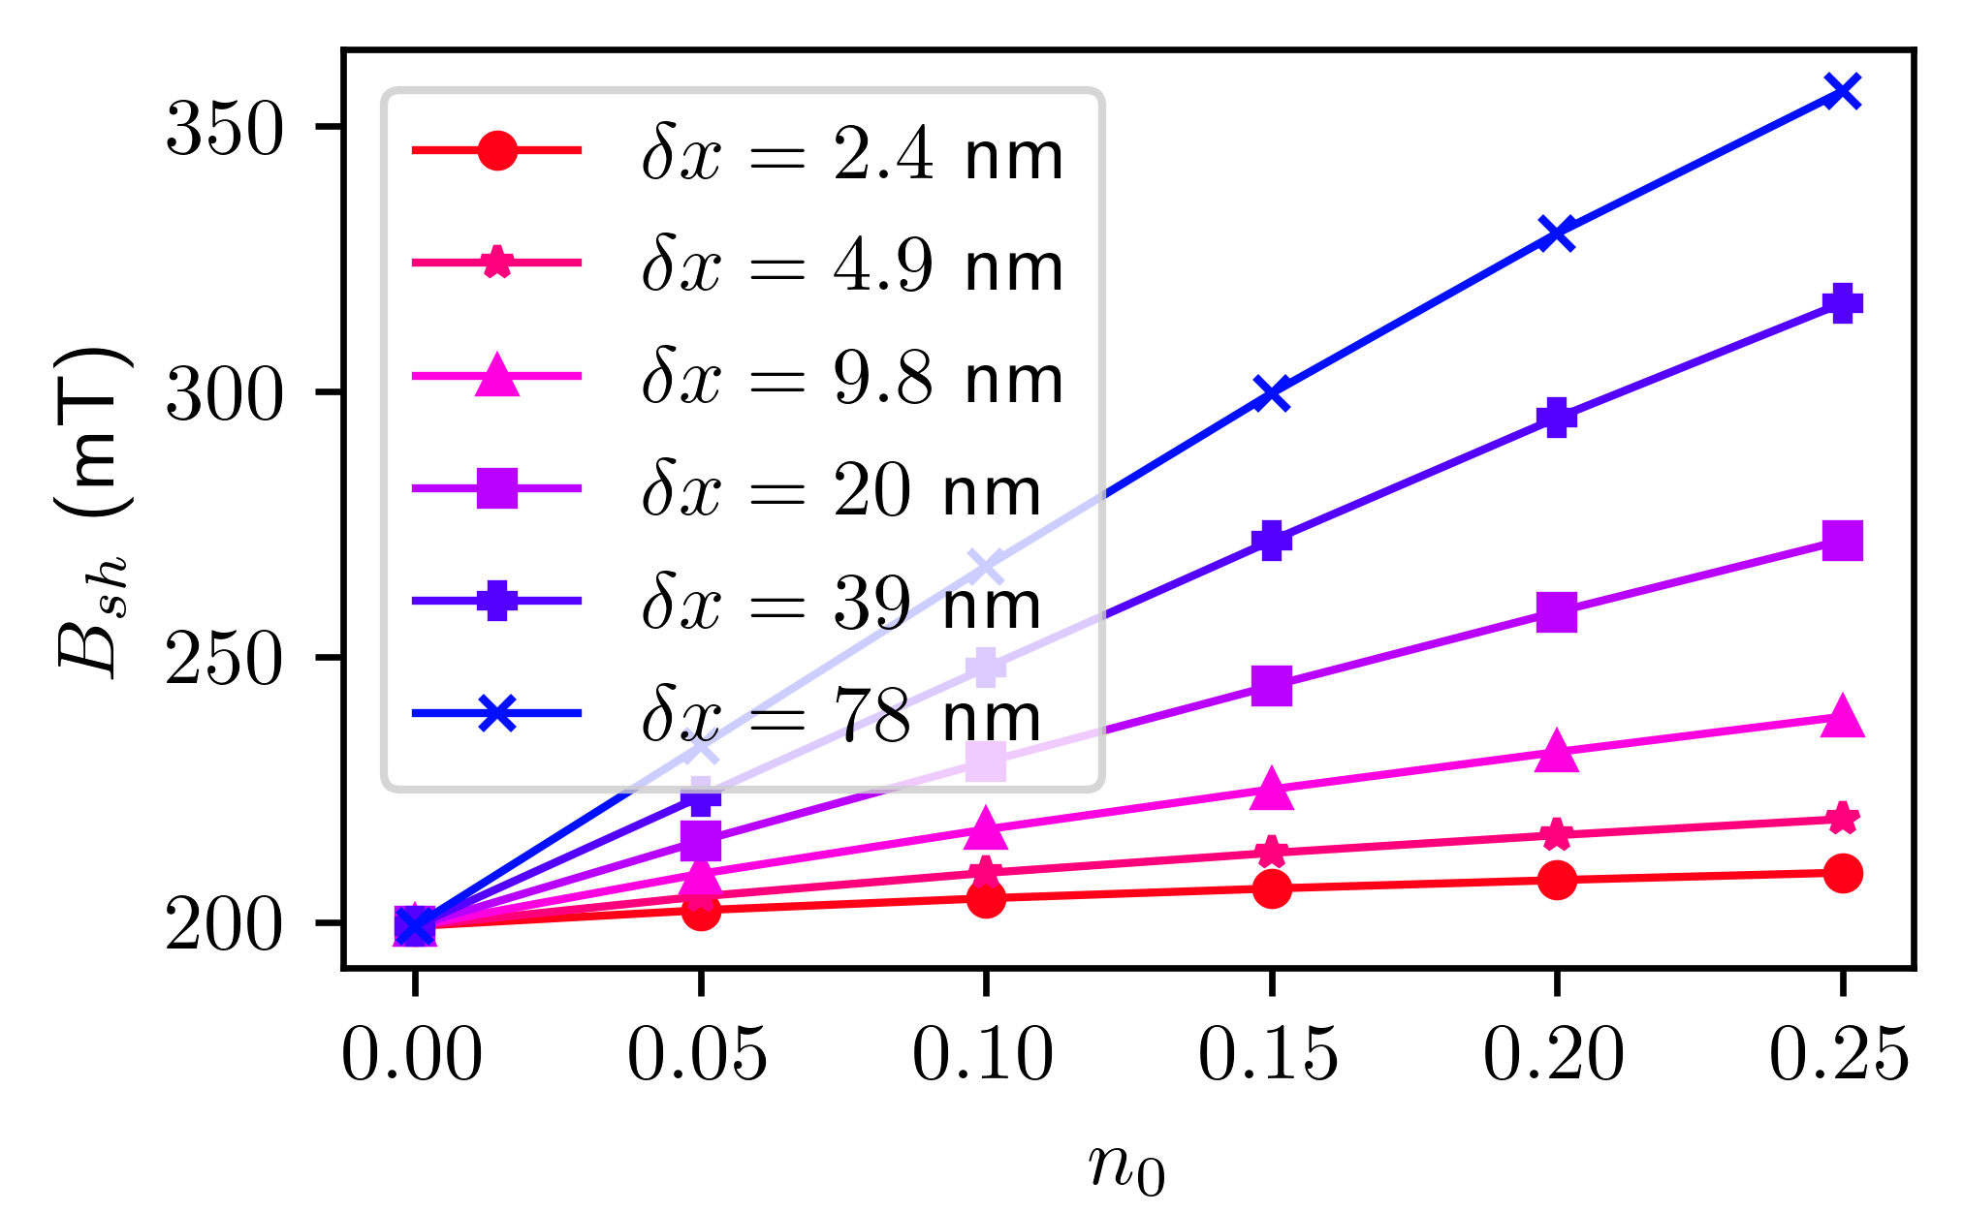
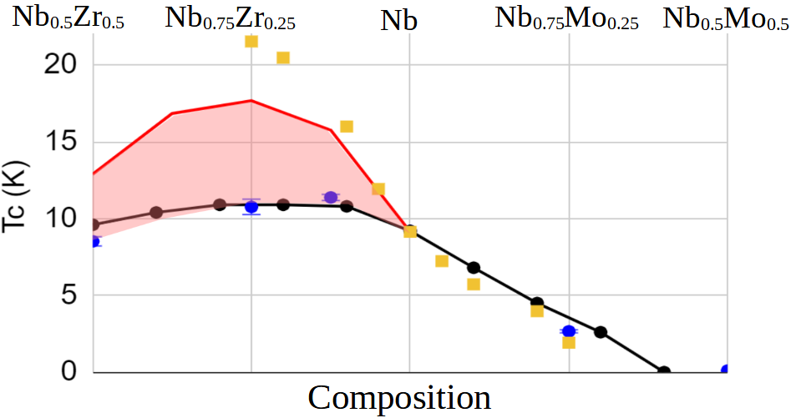
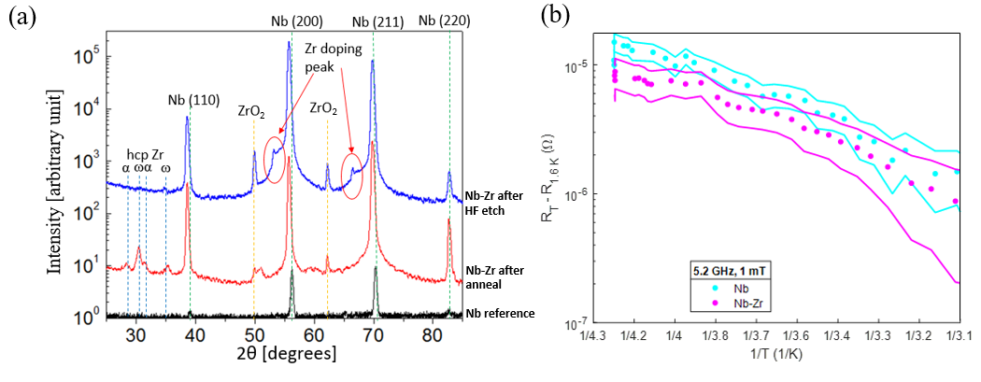


Nb-Zr Alloys: Convergence Research
Hennig
U Florida
Hire
U Florida
Transtrum
BYU
Francis
BYU
Liepe
Cornell
Sun
Cornell
Oseroff
Cornell
Arias
Cornell
Sitaraman
Cornell
Muller
Cornell
Baraissov
Cornell
3/14/24
Notes:
Replace with the published papers (2)

Slide 24
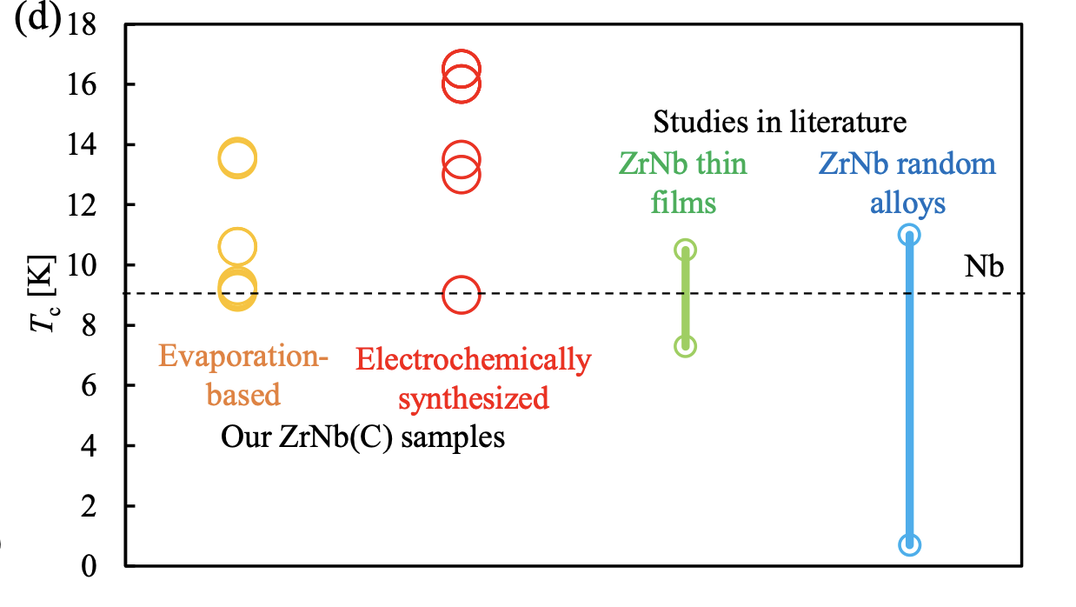
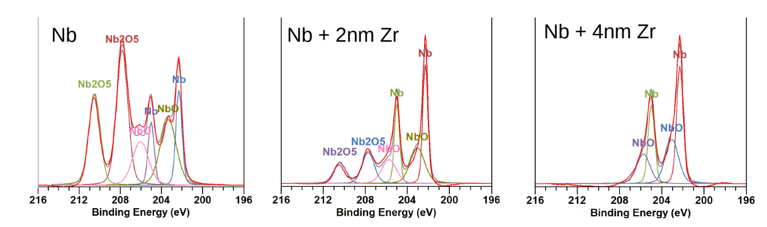
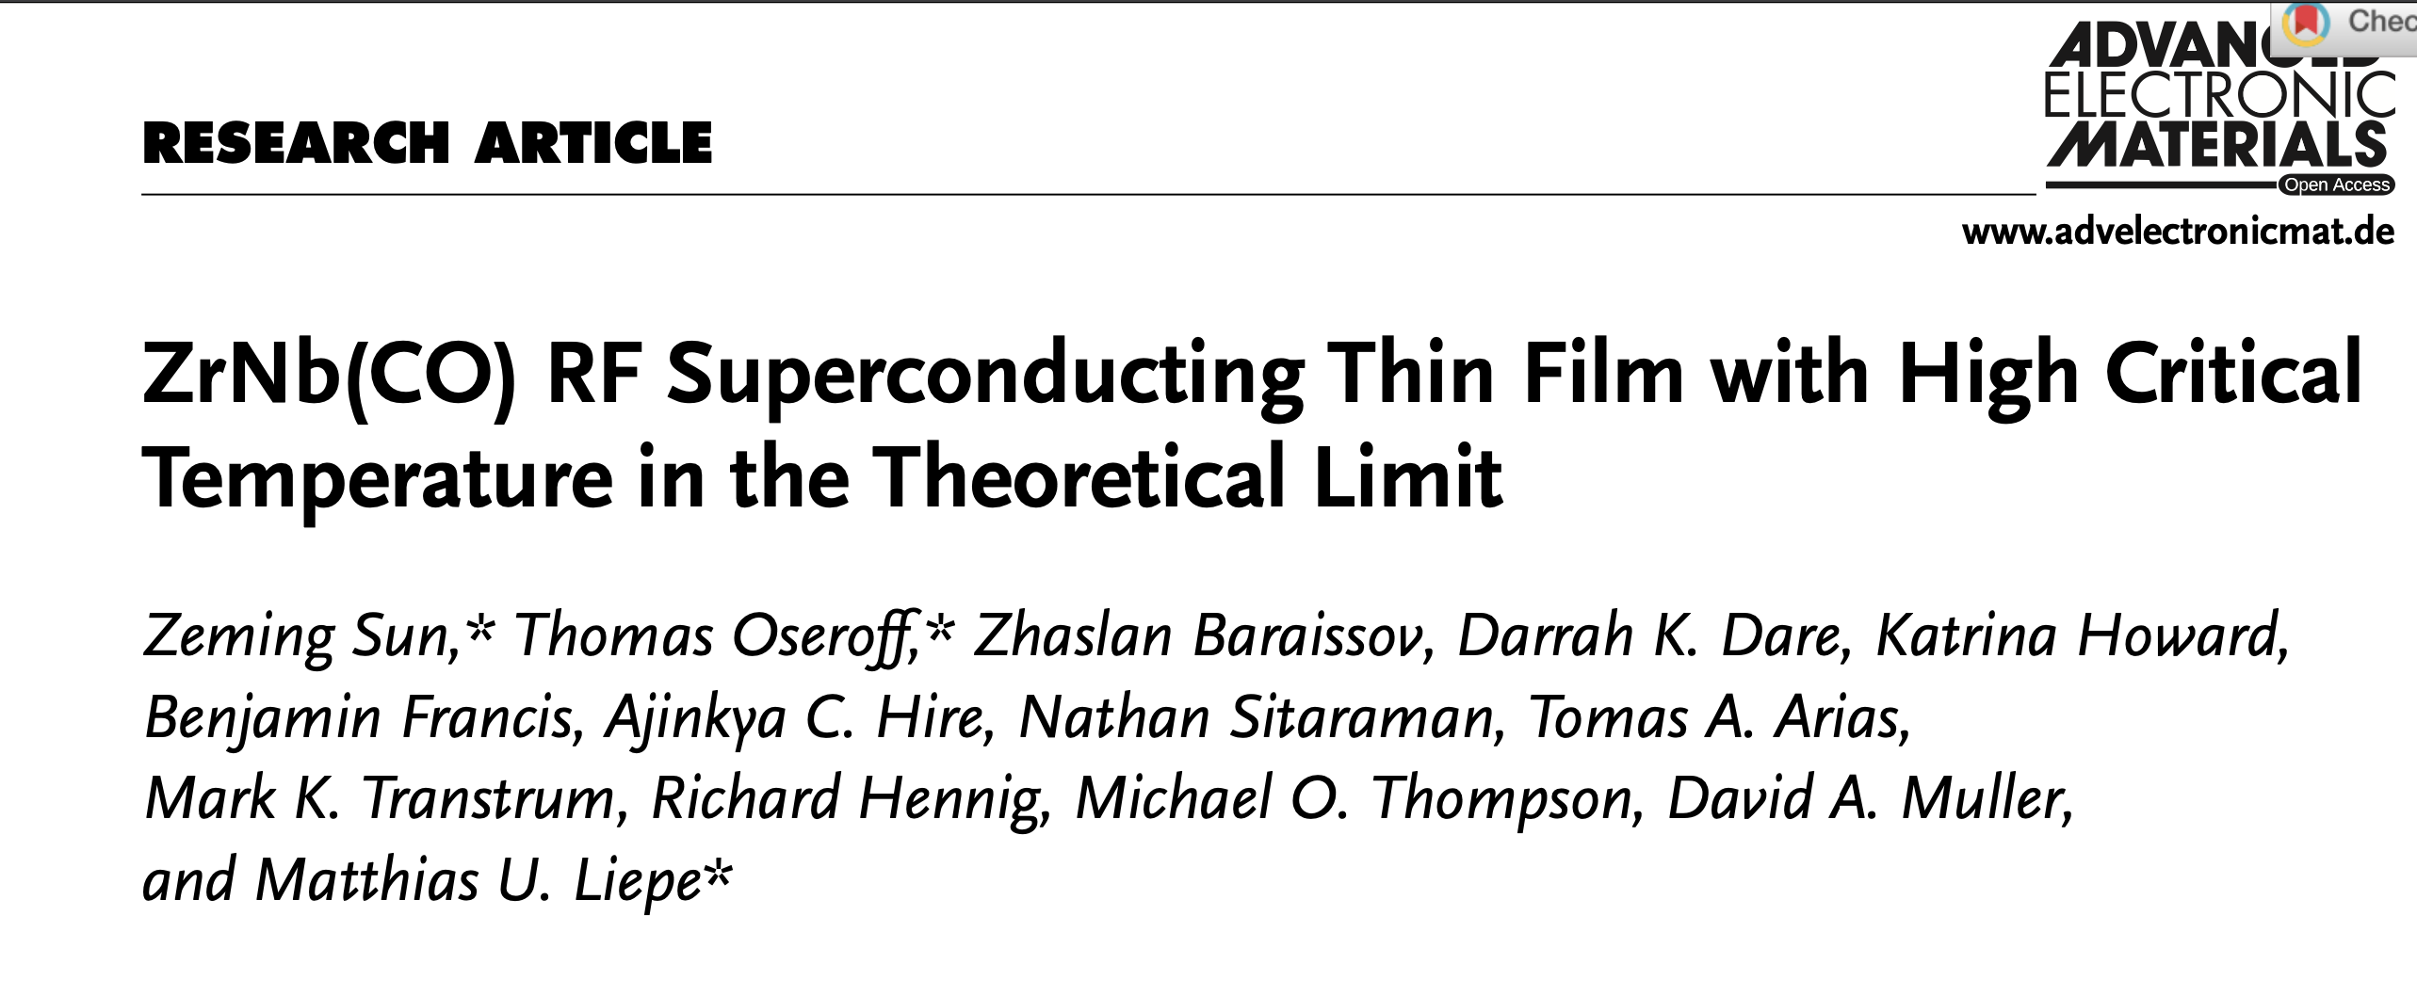
Deliverable 1.2: Methods of growth and their refinement leading to annually enhanced performance for Nb-Zr alloys.
Recent important Nb-Zr growth and performance advances:
  ZrNb(Cx) RF superconducting films with high critical temperatures (13 – 16 K) achieved for the first time under ambient pressure.
  ⇒ Proof-of-concept RF performance of ZrNb(Cx) on an SRF sample shows BCS resistance that trends lower than reference Nb.
  Explored heat treatments and Zr layer thicknesses.
  ⇒ Identified the necessary thickness to drive off the Nb pentoxide
3/14/24

Slide 25

Deliverable 1.2: Methods of growth and their refinement leading to annually enhanced performance for Nb-Zr alloys.
Recent important theoretical advances:
Direct, microscopically detailed ab initio prediction of Nb-Zr performance
  Prediction of Jahn-Teller-Peierls upper bound encompassing observed T_{c}
  Identification of actual potential structure corresponding to observed T_{c}
⇒ Provided insights into interpretation of observed Nb-Zr surface performance and chemistries
Virtual Crystal Theory
CBB Data
CBB
Ordered-Alloy
Theory
Random
Supercell Theory
1961 Data
Sitaraman, et al. "Enhanced Surface Superconductivity of Niobium by Zirconium Doping." Physical Review Applied 20.1 (2023): 014064.
3/14/24

Slide 26
Deliverable 1.2: Methods of growth and their refinement leading to annually enhanced performance for Nb-Zr alloys.
Current and future projects for Deliverable 1.2:
Growth:
  Advancing Nb-Zr growth via evaporation, spattering, and CVD
  Detecting and visualizing alloy growth mechanisms of Zr-Nb that inform optimal growth procedures.
Characterization:
  Nb-Zr layer characterization.
Theory:
  Exploration of T_{c}’s for realizable Nb-Zr structures.
  Exploration of energies and T_{c}’s for rocksalt (Nb,Zr)-(O,N) phases.
  Develop a Nb-Zr-X UF³ potential to study the stability of bulk and surface phases
3/14/24

Slide 27
Phase II – Objective 1
Advanced SRF materials growth: Developing improved growth methods and understanding the impact of realistic (non-ideal) surfaces on performance.
Deliverable 1.3: Determine if other materials have potential for higher efficiency and/or higher fields above Nb₃Sn and Nb-Zr limits.
Why? Other materials might offer an easier path towards exceeding RF performance beyond Nb limitations and/or higher ultimate limits than Nb₃Sn and Nb-Zr.
CBB identified additional materials for further investigation. Examples:
Oxide eliminators | bcc-phase alloys | A15-phase alloys
Nb+Pd and Nb+Au passivating layers | Nb+Hf | Nb+Al
Challenge? Large search space. Can performance predictions be realized on real surfaces?
3/14/24

Slide 28
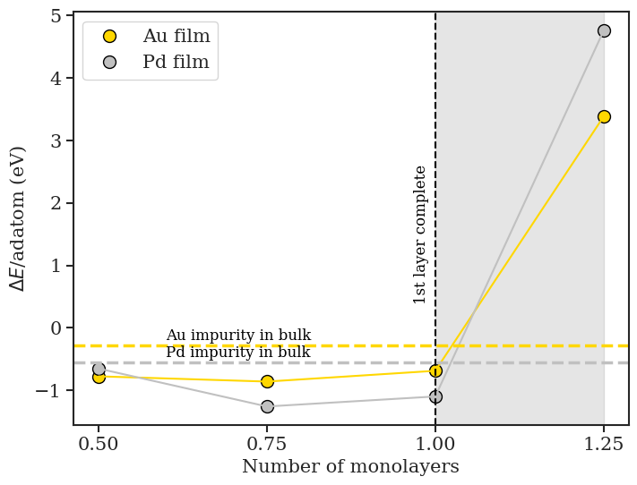
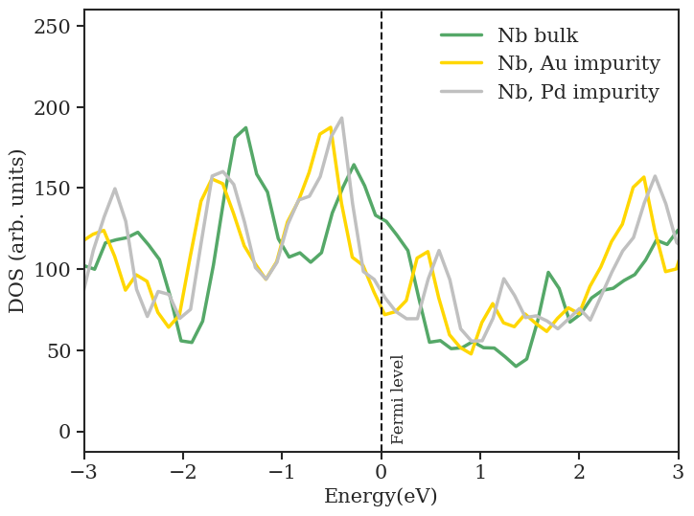
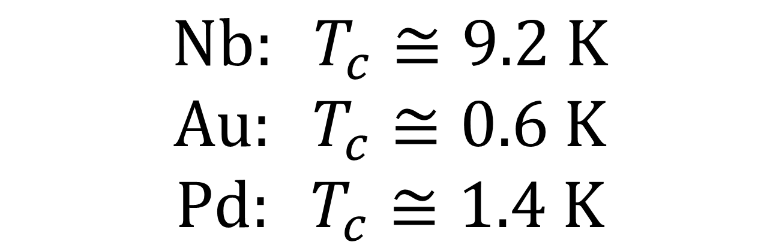
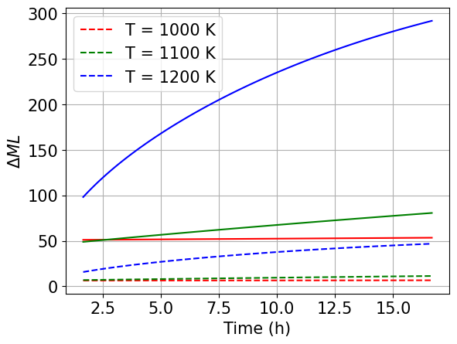
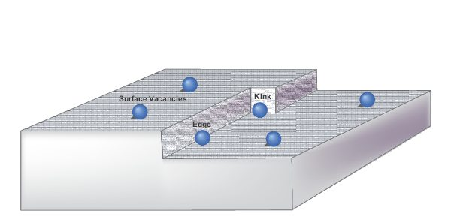
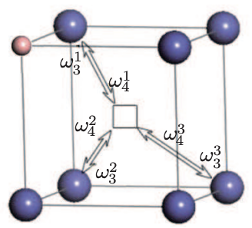
Deliverable 1.3: Determine if other materials have potential for higher efficiency and/or higher fields above Nb3Sn and Nb-Zr limits.
Recent theory-driven advances:
Prediction of surface deposition of Au/Nb and Pd/Nb
Prediction of Nb_{1-x}(Au,Pd)_{x} mixing energies and solubility
Prediction of Nb_{1-x}(Au,Pd)_{x} impact on Tc.
⇒ Provides guidance for down-selection of alternative materials and growth methods for further exploration
Au surface monolayer
stable against solution
Electronic structure analysis of impact on T_{c}
Ab initio recipes for growth including evaporation, diffusion
(Au,Pd)
placement enthalpies
native bulk
Pd_{1-x}M_{x}, x=12.5%
3/14/24

Slide 29
Deliverable 1.3: Determine if other materials have potential for higher efficiency and/or higher fields above Nb3Sn and Nb-Zr limits.
Current and future projects for Deliverable 1.3:
Growth:
  Proof-of-concept growth and RF test of these surface candidates using the Cornell Sample-Host-Cavity.
  Explore potential of Nb3Al on Nb layers
Characterization:
  Connect atomic-scale surface structure to its effects on superconductive properties of other material surfaces prepared in situ.
Theory:
  Predict impact of dissolved Au,Pd in Nb on T_{c}
  Predict superconductivity of Nb surface with and without Au, Pd.
  Predict interfacial contact resistance between Au,Pd layer and Nb.
  Extend study of alternatives to Nb and Nb₃Sn superconductors to focus on multi-component transition metal compounds and alloys, including borides.
3/14/24

Slide 30
SRF Strategic Plan
The advanced methods and surfaces needed for next-generation SRF cavities that enable game-changing reduction of cooling power, higher temperature operation, and higher accelerating fields for lower cryogenic system costs, energy sustainability, and simpler refrigeration.
FY 22
FY 23
FY 24
FY 25
FY 26
Objectives
Deliverables
Legacy
Advanced SRF materials growth: Develop improved growth methods; understand impact of realistic (non-ideal) surfaces on performance
Methods of growth and their refinement leading to annually enhanced
performance for Nb₃Sn on Nb and Cu substrates
Methods of growth and their refinement leading to annually enhanced
performance for Nb-Zr alloys
﻿
FCC-ee running energy efficient on Nb₃Sn cavities
Determination whether other materials have potential for higher
efficiency and/or higher fields above Nb₃Sn and Nb-Zr limits
Decision point: Continue?
Multi-layers and inhomogeneous layers: Increasing RF performance via surfaces by design
Determination whether inhomogeneous surface layers offer significantly increased
RF performance over homogeneous materials
Decision point: Continue?
Multi-TeV e⁺e– collider enabled by CBB designed surfaces
Higher efficiency and higher fields: Demonstrate higher RF performance in proof-of-principle SRF cavities and study RF superconductivity under extreme conditions
Surfaces from non-Nb with cooling power <4W/(active meter)/(MV/m)²,
corresponding to a 10x reduction in cooling power
Non-Nb, high-efficiency surfaces capable of sustaining
accelerating fields of 25 MV/m
Compact SRF with conduction cooling for turn-key operation
Non-Nb surfaces supporting accelerating fields exceeding 50 MV/m.

Slide 31
Phase II – Objective 2
Multi-layers and inhomogeneous layers: Increasing RF performance via surfaces by design
Deliverable 2.1: Determine if inhomogeneous surface layers can offer significantly increased RF performance over homogeneous materials. (Decision point 2024: Continue or drop?).
Why? Inhomogeneous surfaces (e.g., multi-layer laminates S’S, S’IS and nm over-layers might offer additional performance gains over bulk superconductors.
Challenge? Can performance predictions be realized on real surfaces? What is the impact of complex (metallic) oxides layers and other surface features on RF performance and its field dependence?
3/14/24

Slide 32
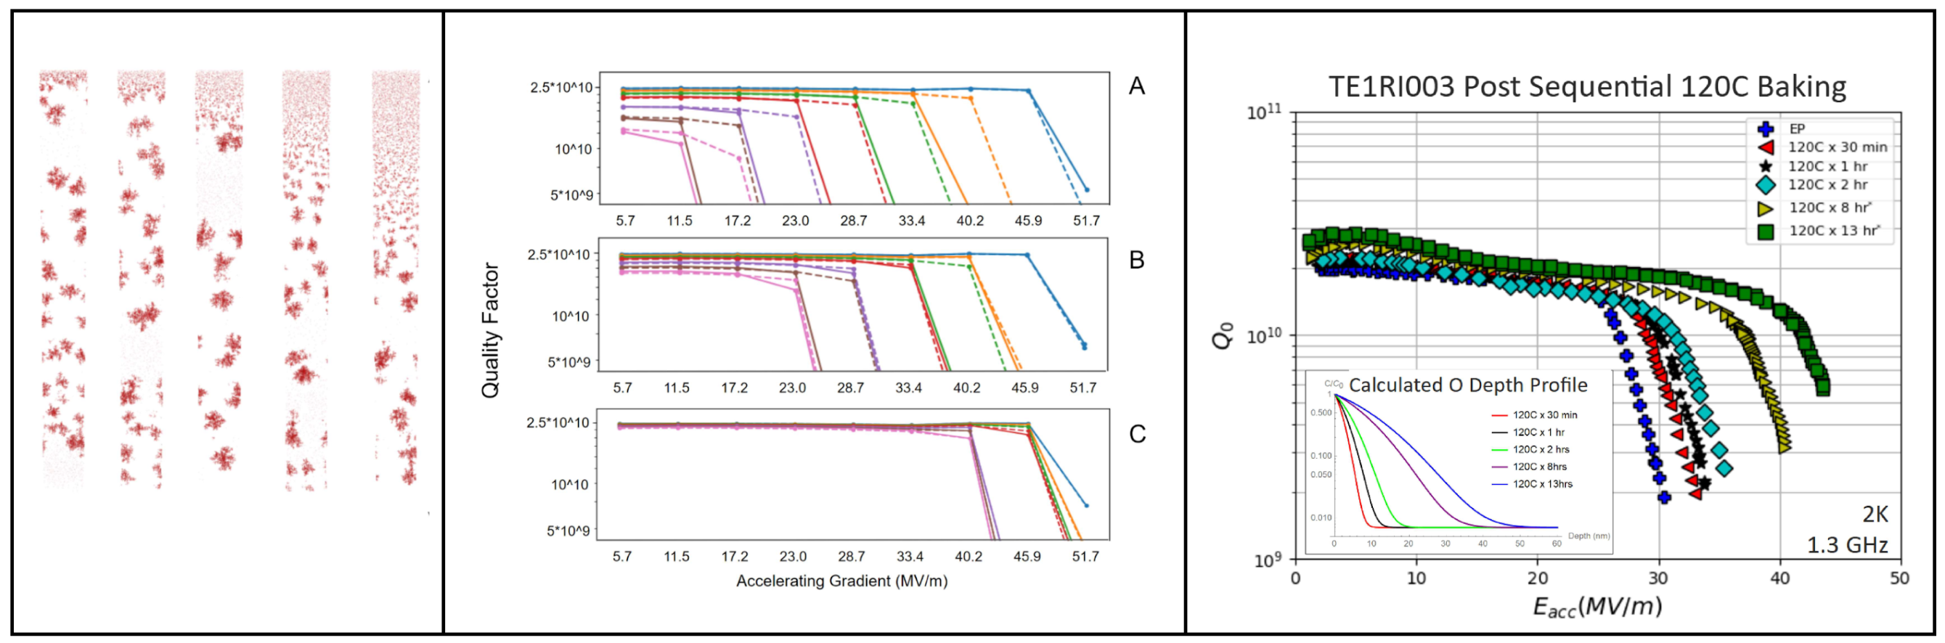
Deliverable 2.1: Determine if inhomogeneous surface layers can offer significantly increased RF performance over homogeneous materials.
Recent important theoretical advances:
  Accelerating fields might be raised up to 30% by increasing the effective mass of electrons over a thin surface layer.
  ⇒ Higher fields via surfaces by design
Development of three-fluid theory of anti-Q slope
Theory for impact of hydrides on maximum fields and RF dissipation
  ⇒ CBB theories explain experimentally observed strong field-dependence of RF surface resistance!
Impact of hydrides on RF performance
Physical Review B 106, 104502 (September 2022), DOI: 10.1103/PhysRevB.106.104502
3/14/24
Notes:
Invited talk at SRF conference (Michelle - anti Q slope)

Slide 33
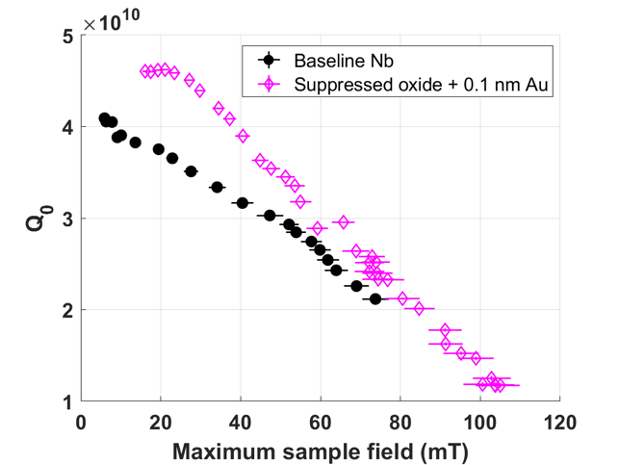
Deliverable 2.1: Determine if inhomogeneous surface layers can offer significantly increased RF performance over homogeneous materials.
Recent important advances on surface oxide:
  Typical SRF treatments significantly alter the type and thickness of Nb surface oxides.
      Demonstrated that carbide formation induced during baking determines subsequent oxide formation upon air exposure.
    ⇒ Surface oxide strongly impacts RF surface resistance and its field dependence.
  Gold-alloyed samples show no detectable peaks at the expected positions for niobium pentoxide.
  ⇒ First high-field demonstration of benefits of passivation layer.
  ⇒ Also of high relevance for low-field SRF applications (e.g., qubits for quantum computing)
Zeming Sun et al., Surface oxides, carbides, and impurities on RF superconducting Nb and Nb3Sn: A comprehensive analysis, arXiv:2305.02467 [cond-mat.mtrl-sci]
T. Oseroff et al, Measurements of the amplitude-dependent microwave surface resistance of a proximity-coupled Au/Nb bilayer arXiv:2305.12035 [cond-mat.supr-cond]
3/14/24
Notes:
Tomas invited talk at SRF conference

Slide 34

Deliverable 2.1: Determine if inhomogeneous surface layers can offer significantly increased RF performance over homogeneous materials.
Current and future projects for Deliverable 2.1:
Characterization:
  Optimize electroplating and evaporation processes of Au on Nb.
  Scale gold electroplating process to proof-of-principle cavity.
  Compare various doping and coating materials (Au, Zr, etc.) on Nb single crystal surfaces.
Theory:
  Refine three-fluid theory for anti-Q slope.
  Employ three-fluid theory to optimize Q via scattering in surface loss layer
  Connect mesoscopic models to candidate dopants by ab initio models.
Ongoing Work
in situ mechanistic studies of optimized SRF surfaces
3/14/24

Slide 35
SRF Strategic Plan
The advanced methods and surfaces needed for next-generation SRF cavities that enable game-changing reduction of cooling power, higher temperature operation, and higher accelerating fields for lower cryogenic system costs, energy sustainability, and simpler refrigeration.
FY 22
FY 23
FY 24
FY 25
FY 26
Objectives
Deliverables
Legacy
x
Advanced SRF materials growth: Develop improved growth methods; understand impact of realistic (non-ideal) surfaces on performance
Methods of growth and their refinement leading to annually enhanced
performance for Nb₃Sn on Nb and Cu substrates
Methods of growth and their refinement leading to annually enhanced
performance for Nb-Zr alloys
﻿
FCC-ee running energy efficient on Nb₃Sn cavities
Determination whether other materials have potential for higher
efficiency and/or higher fields above Nb₃Sn and Nb-Zr limits
Decision point: Continue?
Multi-layers and inhomogeneous layers: Increasing RF performance via surfaces by design
Determination whether inhomogeneous surface layers offer significantly increased
RF performance over homogeneous materials
Decision point: Continue?
Multi-TeV e⁺e– collider enabled by CBB designed surfaces
Higher efficiency and higher fields: Demonstrate higher RF performance in proof-of-principle SRF cavities and study RF superconductivity under extreme conditions
Surfaces from non-Nb with cooling power <4W/(active meter)/(MV/m)²,
corresponding to a 10x reduction in cooling power
Non-Nb, high-efficiency surfaces capable of sustaining
accelerating fields of 25 MV/m
Compact SRF with conduction cooling for turn-key operation
Non-Nb surfaces supporting accelerating fields exceeding 50 MV/m.

Slide 36

Phase II – Objective 3
Higher efficiency and higher fields: Demonstrate higher RF performance in proof-of-principle SRF cavities and study RF superconductivity under extreme conditions
Deliverable 3.1: Surfaces from non-Nb with cooling power <4W/(active meter)/(MV/m)², corresponding to a 10x reduction in cooling power. (Fall 2026)
Recent important advances:
  First Nb₃Sn SRF cavity coated with new electroplating – annealing process shows reduced BCS resistance approximately 50% lower than vapor-diffused cavities.
  ⇒ Promising path to reduce cooling power well below current 10W/(active meter)/(MV/m)² achievement (x4 reduction)
Current and future projects for Deliverable 3.1:
  New and refined growth methods (developed under O1 and O2) applied to samples and proof-of-principle cavities to quantify reduction in RF dissipation.
Z. Sun et al., Smooth, homogeneous, high-purity Nb3Sn RF superconducting films by seed-free electrochemical synthesis, arXiv:2302.02054
3/14/24

Slide 37

Phase II – Objective 3
Higher efficiency and higher fields: Demonstrate higher RF performance in proof-of-principle SRF cavities and study RF superconductivity under extreme conditions
Deliverable 3.2: Non-Nb, high efficiency surfaces capable of sustaining accelerating field of 25 MV/m. (Fall 2023)
Recent important advances:
  Proof-of-principle advanced-shape cavity with reduced surface magnetic field and improved Nb₃Sn coating for high fields ready for RF test.
  ⇒ Best Nb₃Sn surfaces currently capable of reaching 23 MV/m.
Current and future projects for Deliverable 3.2:
  New and refined growth methods (developed under O1 and O2) applied to samples and proof-of-principle cavities to quantify increase in maximum accelerating field.
3/14/24

Slide 38

Phase II – Objective 3
Higher efficiency and higher fields: Demonstrate higher RF performance in proof-of-principle SRF cavities and study RF superconductivity under extreme conditions
Deliverable 3.3: Non-Nb surfaces supporting accelerating fields exceeding 50 MV/m. (Fall 2026)
Recent important advances:
  Novel pulsed RF sample host system to measure maximum fields on material samples commissioned.
  ⇒ Will be used for proof of principle field-limit test of CBB Nb-Zr surfaces.
Current and future projects for Deliverable 3.3:
  New and refined growth methods (developed under O1 and O2) applied to samples and proof-of-principle cavities to quantify reduction in RF dissipation.
3/14/24

Slide 39
SRF Strategic Plan
The advanced methods and surfaces needed for next-generation SRF cavities that enable game-changing reduction of cooling power, higher temperature operation, and higher accelerating fields for lower cryogenic system costs, energy sustainability, and simpler refrigeration.
FY 22
FY 23
FY 24
FY 25
FY 26
Objectives
Deliverables
Legacy
Advanced SRF materials growth: Develop improved growth methods; understand impact of realistic (non-ideal) surfaces on performance
Methods of growth and their refinement leading to annually enhanced
performance for Nb₃Sn on Nb and Cu substrates
Methods of growth and their refinement leading to annually enhanced
performance for Nb-Zr alloys
﻿
FCC-ee running energy efficient on Nb₃Sn cavities
Determination whether other materials have potential for higher
efficiency and/or higher fields above Nb₃Sn and Nb-Zr limits
Decision point: Continue?
Multi-layers and inhomogeneous layers: Increasing RF performance via surfaces by design
Determination whether inhomogeneous surface layers offer significantly increased
RF performance over homogeneous materials
Decision point: Continue?
Multi-TeV e⁺e– collider enabled by CBB designed surfaces
Higher efficiency and higher fields: Demonstrate higher RF performance in proof-of-principle SRF cavities and study RF superconductivity under extreme conditions
Surfaces from non-Nb with cooling power <4W/(active meter)/(MV/m)²,
corresponding to a 10x reduction in cooling power
Non-Nb, high-efficiency surfaces capable of sustaining
accelerating fields of 25 MV/m
Compact SRF with conduction cooling for turn-key operation
Non-Nb surfaces supporting accelerating fields exceeding 50 MV/m.

Slide 40


CBB Legacy (by 2026)
Convergence research: Established new directions and connections between accelerator physics, superconductivity, and materials science. Promoted paradigm shift in SRF research.
Knowledge: Transformative understanding of superconductivity and superconductor growth (~50 journal and conference publications).
Workforce: Young scientists are now entering the workforce in an area of critical need, e.g., SRF experts for DOE national labs, industry, and academia.
Technology: Next gen. of high-performance, sustainable SRF technology
  Technology for first large-scale science accelerator running on high-performance non-Nb SRF cavities (after ~50 years of Nb based SRF!), e.g., Future Circular Collider (FCC-ee) running on very efficient Nb₃Sn cavities
  SRF cavity surfaces enabling a multi-TeV upgrade of the ILC
  Legacy on quantum computing (3D s.c. qubits)
3/14/24

Slide 41



Examples of CBB Impacts on SRF Technology
Nb₃Sn is now a realistic material for next-gen SRF cavities
  New initiatives in Nb₃Sn cavity development worldwide
  CBB hosted first Nb₃Sn SRF workshop with 140 participants from 45 institutions
Higher T_{c} Nb₃Sn is enabling the development of new class of compact, robust SRF driven accelerators for new applications in science and industry (development funded by DOE at FNAL, Cornell, JLAB)
  Medical device sterilization
  Environmental Remediation
  Wastewater treatment
3/14/24

Slide 42



















Our Output: Highly Trained Scientists
Academia
Industry
National Lab/Gov
Nilanjan Banerjee, Postdoc, U Chicago
Mariah Brown, MS, Math Teacher
Rachael Farber, Faculty U Kansas
Michelle Kelley
Postdoc, RPI
Paul Cueva, Scientist, Corning
Benjamin Francis
Chief Scientist, Achilles Heel Tech
Danilo Liarte, Young Investigator São Paulo State U
Srindhi Mula, PhD candidate, TU Delft
Thomas Oseroff
Research Assoc.
Cornell
Jeffrey Sayler, Engineer, LASP, Boulder CO
Daniel Hall, Sr. Design Engineer, ASML
Andy Linschied, Scientist, TomTom
Alison McMillan, Staff Scientist, General Atomics
Jacob Graham, Scientist, NASA
Biswas Rijal, Postdoc, SUNY Buffalo
Nathan Sitaraman
Postdoc, Cornell
Aron Tesfamichael, MS
Darren Veit, Teacher
James Maniscalco, SRF Engineer, SLAC
Alden Pack, Postdoc, Sandia Nat. Lab
Ryan Porter, Staff Engineer, SLAC
Frank Ikponmwen, Scientist, FDA

Slide 43



Summary
Enhanced superconductivity of Nb by Zr doping
Phys. Rev. Applied, accepted
A fully ab initio approach to inelastic atom–surface scattering
Phys. Rev. Lett., in review
Nb-Zr alloy on Nb plate (electroplating + annealing)
“Sub-Monolayer and Monolayer Sn Adsorption and Diffusion Behavior on Oxidized Nb(100)” Willson et al.
J. Phys. Chem. C, 127, 6, 3339-3348 (2023)
Three-fluid model of anti-Q slope
  Computational prediction of Nb-stabilization of MoB₂ superconductor.
TDGL simulations of field enhancement from rough surfaces
3/14/24
Notes:
Multiple expertise Brought tp bear

