Slide 1
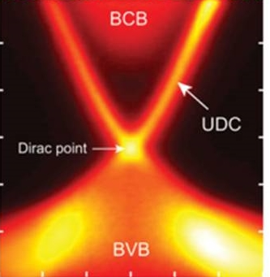
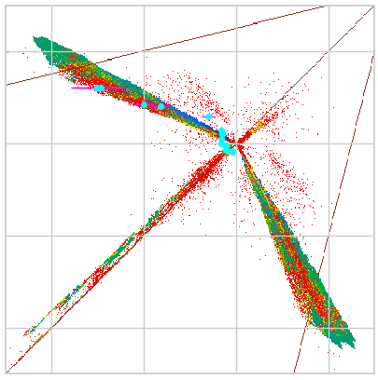
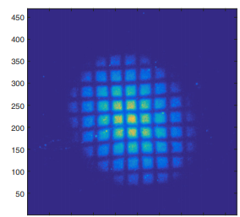
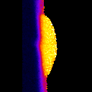
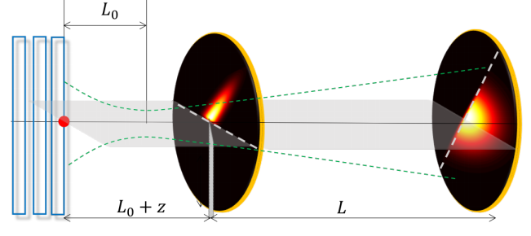
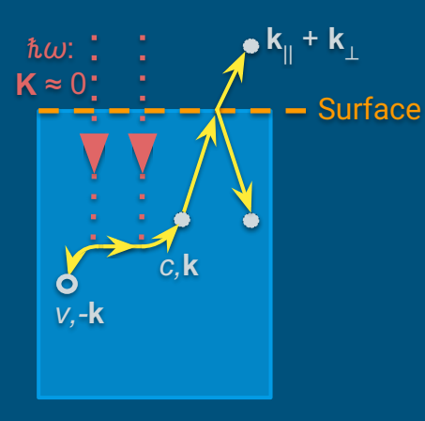
Overview
EAB Meeting 2024
J. Ritchie Patterson
Center Director

Slide 2
EAB Charge
Comment on Strategic Plan revisions, which are aimed at increasing legacy by focusing on deliverables that are achievable in the remaining 2.5 years.
Advise on planning for CBB in the post-STC era
Recommend improvements to presentations
for the NSF Site Visit

Slide 3

Code of Conduct
All participants are expected to conduct themselves professionally and create a welcoming environment free from discrimination, harassment, or retaliation.
Disruptive or harassing behavior of any kind will not be tolerated, including inappropriate language or behavior, unwelcome jokes or comments, unwanted attention or touching, actions or statements based on personal characteristics, offensive images, and photography without permission.
Respect one another.
Report violations the director, managing director, or a theme leader.
Witnesses are empowered to intervene and encouraged to report concerns.
Personal safety and comfort is a top priority.

Slide 4
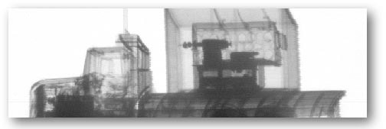
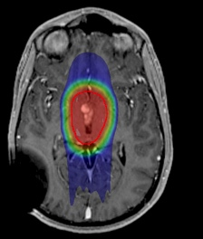
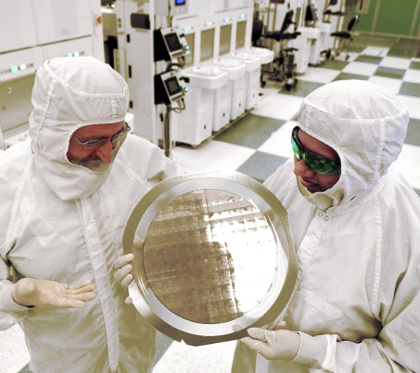
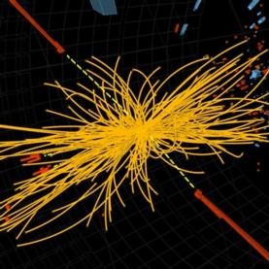
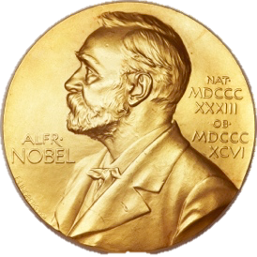
Why accelerators?
Industry
  Food & product safety
  Contraband detection
  Polymer cross-linking, eg tires
  Semiconductor fabrication
Medicine
  Medical isotope production
  Tumor treatment
Research
  X ray sources and colliders for nuclear & particle physics
  Electron microscopes
~30,000 industrial and medical accelerators are in use, with annual sales of $3.5 B and 10% growth per year.
  Since 1943, a Nobel Prize in Physics has been awarded to research benefiting from accelerators every 3 years.
  Since 1997, the same has been true of Chemistry.

Slide 5
Center for Bright Beams - CBB
Center Vision:
Gain the fundamental understanding needed to transform the brightness of beams available to science, medicine and industry.
Center Mission:
What is brightness?
Beam dir.
Low brightness bunch
Increase beam brightness
and reduce accelerator cost and size.
Transfer key technologies
to national labs and US industry.
Prepare a diverse group of students
for leadership.
The annual demand for new
Accelerator Science PhDs
is 2-4x the number produced by US universities.
HEPAP Subcommittee for Review of US Particle Accelerator School (2015).
Beam dir.
High brightness bunch
Notes:
Report of the HEPAP Subcommittee for Review of USPAS (2015), p 13. In 2015, US produced only 40% of need at DOE labs, which is 40 new PhD accelerator scientists per year. US unifversties produce 15-20.

Slide 6
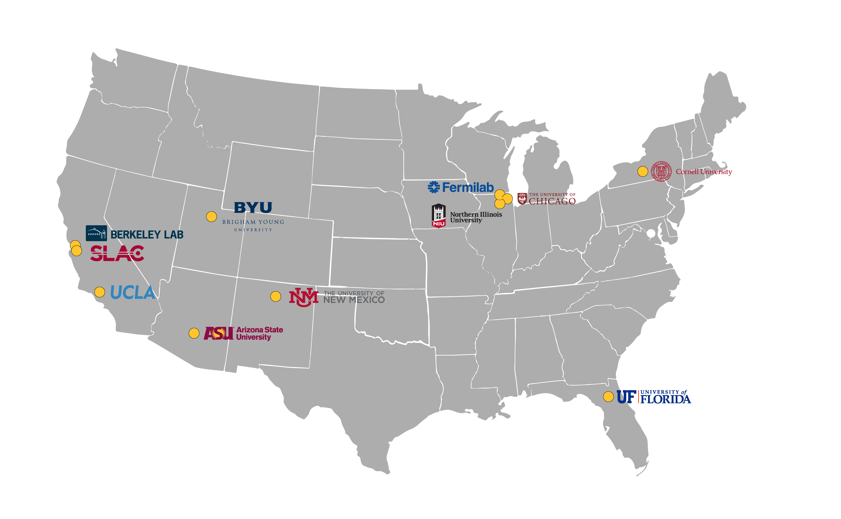







CBB institutions
Cornell
Tomás Arias
Melissa Hines
G. Hoffstaetter
Matthias Liepe
Jared Maxson
David Muller
R. Patterson
Kyle Shen
Northern Illinois U
Oksana Chubenko
Philippe Piot
Brigham Young U.
Mark Transtrum
U. New Mexico-MSI
Sandra Biedron
U. Chicago
Young-Kee Kim
Steve Sibener
UCLA
Pietro Musumeci
Jamie Rosenzweig
Arizona State U.
Siddharth Karkare
U. Florida
Richard Hennig
CBB joins chemists, surface scientists, condensed matter physicists, ab initio physicists, electron microscopists, and accelerator scientists

Slide 7
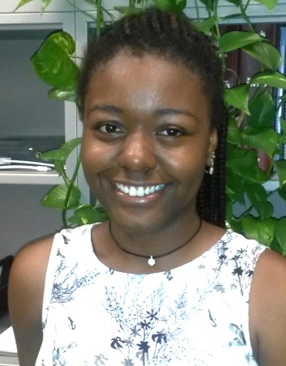
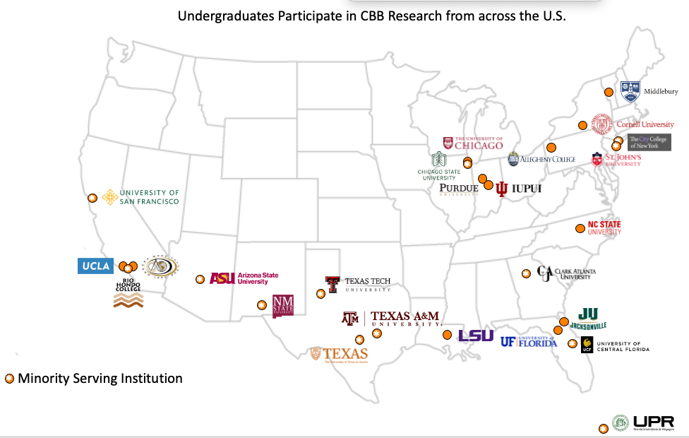


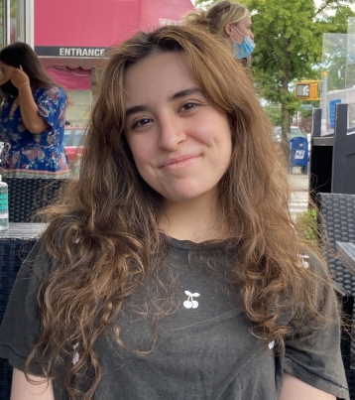






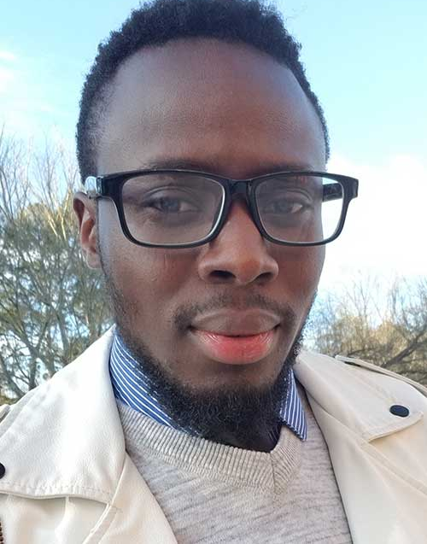
Center for Bright Beams
Institutions of students participating in Center for Bright Beams research
Brianna Harris Davis
MS, Clark Atlanta
Now a HS Physics teacher
*
SLA
*
*
Zeinab Ismail, St Johns U
REU 2021
Partner institution (senior scientists)
Frank Ikponmwen
PhD, Clark Atlanta
Now Analytical Chemist at US FDA
Notes:
CBB universities with REU:
Cornell, Brigham Young, U Chicago, Northern Illinois U.
NSF also supports an accelerator project at an undergrad institution, Cal Poly

Slide 8
Pubs/proceedings 6/22-3/23
Colors show the univ. departments/institutions of the authors.
C. M. Pierce, D. B. Durham, F. Riminucci, S. Dhuey, I. Bazarov, J. Maxson, A. M. Minor, and D. Filippetto, “Experimental Characterization of Photoemission from Plasmonic Nanogroove Arrays,” Phys. Rev. Appl., vol. 19, no. 3, p. 034034, Mar. 2023, doi: 10.1103/PhysRevApplied.19.034034. | Chicago LEPP
A. Kachwala, O. Chubenko, D. Kim, E. I. Simakov, and S. Karkare, “Quantum efficiency, photoemission energy spectra, and mean transverse energy of ultrananocrystalline diamond photocathode,” Journal of Applied Physics, vol. 132, no. 22, p. 224901, Dec. 2022, doi: 10.1063/5.0130114. | ASU Chicago NIU
C. J. Knill, H. Yamaguchi, K. Kawahara, G. Wang, E. Batista, P. Yang, H. Ago, N. Moody, and S. Karkare, “Near-Threshold Photoemission from Graphene-Coated Cu(110),” Phys. Rev. Appl., vol. 19, no. 1, p. 014015, Jan. 2023, doi: 10.1103/PhysRevApplied.19.014015. | ASU
C. J. R. Duncan, M. Kaemingk, W. H. Li, M. B. Andorf, A. C. Bartnik, A. Galdi, M. Gordon, C. A. Pennington, I. V. Bazarov, H. J. Zeng, F. Liu, D. Luo, A. Sood, A. M. Lindenberg, M. W. Tate, D. A. Muller, J. Thom-Levy, S. M. Gruner, and J. M. Maxson, “Multi-scale time-resolved electron diffraction enabled by high repetition rate, high dynamic range direct electron detection.” arXiv, Jun. 16, 2022 | LEPP Chicago AEP
C. M. Pierce, D. B. Durham, F. Riminucci, S. Dhuey, I. Bazarov, J. Maxson, A. M. Minor, and D. Filippetto, “Experimental characterization of photoemission from plasmonic nanogroove arrays.” arXiv, Oct. 10, 2022 | LEPP Chicago AEP BNL
C. Zhang, Y.-T. Shao, Z. Baraissov, C. J. Duncan, A. Hanuka, A. L. Edelen, J. M. Maxson, and D. A. Muller, “Bayesian Optimization for Multi-dimensional Alignment: Tuning Aberration Correctors and Ptychographic Reconstructions,” Microsc Microanal, vol. 28, no. S1, pp. 3146–3148, Aug. 2022, doi: 10.1017/S1431927622011692. | LEPP AEP SLAC
F. Bosco, O. Camacho, M. Carillo, E. Chiadroni, L. Faillace, A. Fukasawa, A. Giribono, L. Giuliano, N. Najernik, A. Mostacci, L. Palumbo, B. Spataro, C. Vaccarezza, J. B. Rosenzweig, and M. Migliorati, “A fast tracking code for evaluating collective effects in linear accelerators.” arXiv, Aug. 12, 2022 | UCLA
F. Cropp, L. Moos, A. Scheinker, A. Gilardi, D. Wang, S. Paiagua, C. Serrano, P. Musumeci, and D. Filippetto, “Virtual-Diagnostic-Based Time Stamping for Ultrafast Electron Diffraction.” arXiv, Feb. 09, 2023 | UCLA LNL BNL
J. Gibson, A. Hire, and R. G. Hennig, “Data-augmentation for graph neural network learning of the relaxed energies of unrelaxed structures,” npj Comput Mater, vol. 8, no. 1, pp. 1–7, Sep. 2022, doi: 10.1038/s41524-022-00891-8. | Florida
J. Jarvis, V. Lebedev, A. Romanov, D. Broemmelsiek, K. Carlson, S. Chattopadhyay, A. Dick, D. Edstrom, I. Lobach, S. Nagaitsev, H. Piekarz, P. Piot, J. Ruan, J. Santucci, G. Stancari, and A. Valishev, “Experimental demonstration of optical stochastic cooling,” Nature, vol. 608, no. 7922, pp. 287–292, Aug. 2022, doi: 10.1038/s41586-022-04969-7. | NIU FNAL
J. Lim, S. Sinha, A. C. Hire, J. S. Kim, P. M. Dee, R. S. Kumar, D. Popov, R. J. Hemley, R. G. Hennig, P. J. Hirschfeld, G. R. Stewart, and J. J. Hamlin, “Suppression of superconductivity in Nb-substituted MoB2 at high pressure.” arXiv, Feb. 27, 2023 | Florida
K. Howard, Z. Sun, and M. U. Liepe, “Thermal annealing of sputtered Nb3Sn and V3Si thin films for superconducting radio-frequency cavities,” 2023, doi: 10.48550/ARXIV.2301.00756. | LEPP
L. Faillace, R. Agustsson, M. Behtouei, F. Bosco, D. Bruhwiler, O. Camacho, M. Carillo, A. Fukasawa, I. Gadjev, A. Giribono, L. Giuliano, S. Kutsaev, N. Majernik, M. Migliorati, A. Mostacci, A. Murokh, L. Palumbo, B. Spataro, S. Tantawi, C. Vaccarezza, O. Williams, and J. B. Rosenzweig, “High field hybrid photoinjector electron source for advanced light source applications,” Phys. Rev. Accel. Beams, vol. 25, no. 6, p. 063401, Jun. 2022, doi: 10.1103/PhysRevAccelBeams.25.063401. | UCLA
M. Gordon, W. H. Li, M. B. Andorf, A. C. Bartnik, C. J. R. Duncan, M. Kaemingk, C. A. Pennington, I. V. Bazarov, Y.-K. Kim, and J. M. Maxson, “Four-dimensional emittance measurements of ultrafast electron diffraction optics corrected up to sextupole order,” Phys. Rev. Accel. Beams, vol. 25, no. 8, p. 084001, Aug. 2022, doi: 10.1103/PhysRevAccelBeams.25.084001. | Chicago LEPP
N. Majernik, G. Andonian, W. Lynn, S. Kim, C. Lorch, R. Roussel, S. Doran, E. Wisniewski, C. Whiteford, P. Piot, J. Power, and J. B. Rosenzweig, “Beam shaping using an ultra-high vacuum multileaf collimator and emittance exchange beamline.” arXiv, Oct. 05, 2022 | UCLA NIU
N. Majernik, G. Andonian, W. Lynn, S. Kim, C. Lorch, R. Roussel, S. Doran, E. Wisniewski, C. Whiteford, P. Piot, J. Power, and J. B. Rosenzweig, “Beam shaping using an ultrahigh vacuum multileaf collimator and emittance exchange beamline,” Phys. Rev. Accel. Beams, vol. 26, no. 2, p. 022801, Feb. 2023, doi: 10.1103/PhysRevAccelBeams.26.022801. | UCLA NIU
N. S. Sitaraman, Z. Sun, B. Francis, A. C. Hire, T. Oseroff, Z. Baraissov, T. A. Arias, R. Hennig, M. U. Liepe, D. A. Muller, and M. K. Transtrum, “Theory of Nb-Zr Alloy Superconductivity and First Experimental Demonstration for Superconducting Radio-Frequency Cavity Applications,” Aug. 2022, doi: 10.48550/arXiv.2208.10678. | LEPP BYU Florida LASSP AEP
P. Saha, O. Chubenko, J. Kevin Nangoi, T. Arias, E. Montgomery, S. Poddar, H. A. Padmore, and S. Karkare, “Theory of photoemission from cathodes with disordered surfaces,” Journal of Applied Physics, vol. 133, no. 5, p. 053102, Feb. 2023, doi: 10.1063/5.0135629. | ASU LASSP BNL
R. Roussel, A. Edelen, C. Mayes, D. Ratner, J. P. Gonzalez-Aguilera, S. Kim, E. Wisniewski, and J. Power, “Phase Space Reconstruction from Accelerator Beam Measurements Using Neural Networks and Differentiable Simulations.” arXiv, Sep. 09, 2022 | SLAC Chicago ANL
S. A. Willson, R. G. Farber, A. C. Hire, R. G. Hennig, and S. J. Sibener, “Submonolayer and Monolayer Sn Adsorption and Diffusion Behavior on Oxidized Nb(100),” J. Phys. Chem. C, Jan. 2023, doi: 10.1021/acs.jpcc.2c08458. | Chicago Florida
T. Paschen, R. Roussel, L. Seiffert, B. Kruse, C. Heide, P. Dienstbier, J. Mann, J. Rosenzweig, T. Fennel, and P. Hommelhoff, “Ultrafast Strong-Field Electron Emission and Collective Effects at a One-Dimensional Nanostructure,” ACS Photonics, Feb. 2023, doi: 10.1021/acsphotonics.2c01551. | UCLA
Z. Sun, M. Ge, J. T. Maniscalco, V. Arrieta, S. R. McNeal, and M. U. Liepe, “Electrochemical Polishing of Chemical Vapor Deposited Niobium Thin Films.” arXiv, Jan. 02, 2023 [Online]. Available: http://arxiv.org/abs/2301.00788 | LEPP
Z. Sun, T. Oseroff, Z. Baraissov, D. K. Dare, K. Howard, M. O. Thompson, D. A. Muller, and M. U. Liepe, “ZrNb(Cx) RF superconducting thin film with high critical temperature in the theoretical limit.” arXiv, Feb. 28, 2023 | LEPP AEP
Z. Sun, Z. Baraissov, L. Shpani, R. D. Porter, Y.-T. Shao, T. Oseroff, M. O. Thompson, D. A. Muller, and M. U. Liepe, “Smooth, homogeneous, high-purity Nb3Sn RF superconducting films by seed-free electrochemical synthesis.” arXiv, Feb. 03, 2023 [Online]. Available: http://arxiv.org/abs/2302.02054 | LEPP AEP
Notes:
Pubs are from 8/22 – March 14, 2023

Slide 9
CBB Diversity
 | Total | %Female & Nonbinary |  | % URM
 |  | Achieved | US Avg.* | Achieved | US Avg.*
Undergraduates | 17 | 53% | 21% | 24% | 12%
Grad. Students | 37 | 30% | 20% | 16% | 3%
Postdocs | 6 | 67% | 20% | 17% | 3%
Senior Scientists | 20 | 20% | 14% | 10% | 5%
*Data from AIP and APS, 2019.
URM includes African American/Black, Hispanic, and Native American/Pacific Islander.
CBB is sharing its best practices for team science and diversity:
Monthly meetings of STC managing directors
Direct mentorship of three new NSF STCs (CROPPS , LEAP, and COMPASS)
and one NIH center (PORTENT)

Slide 10
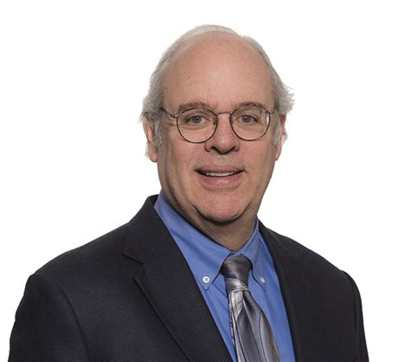
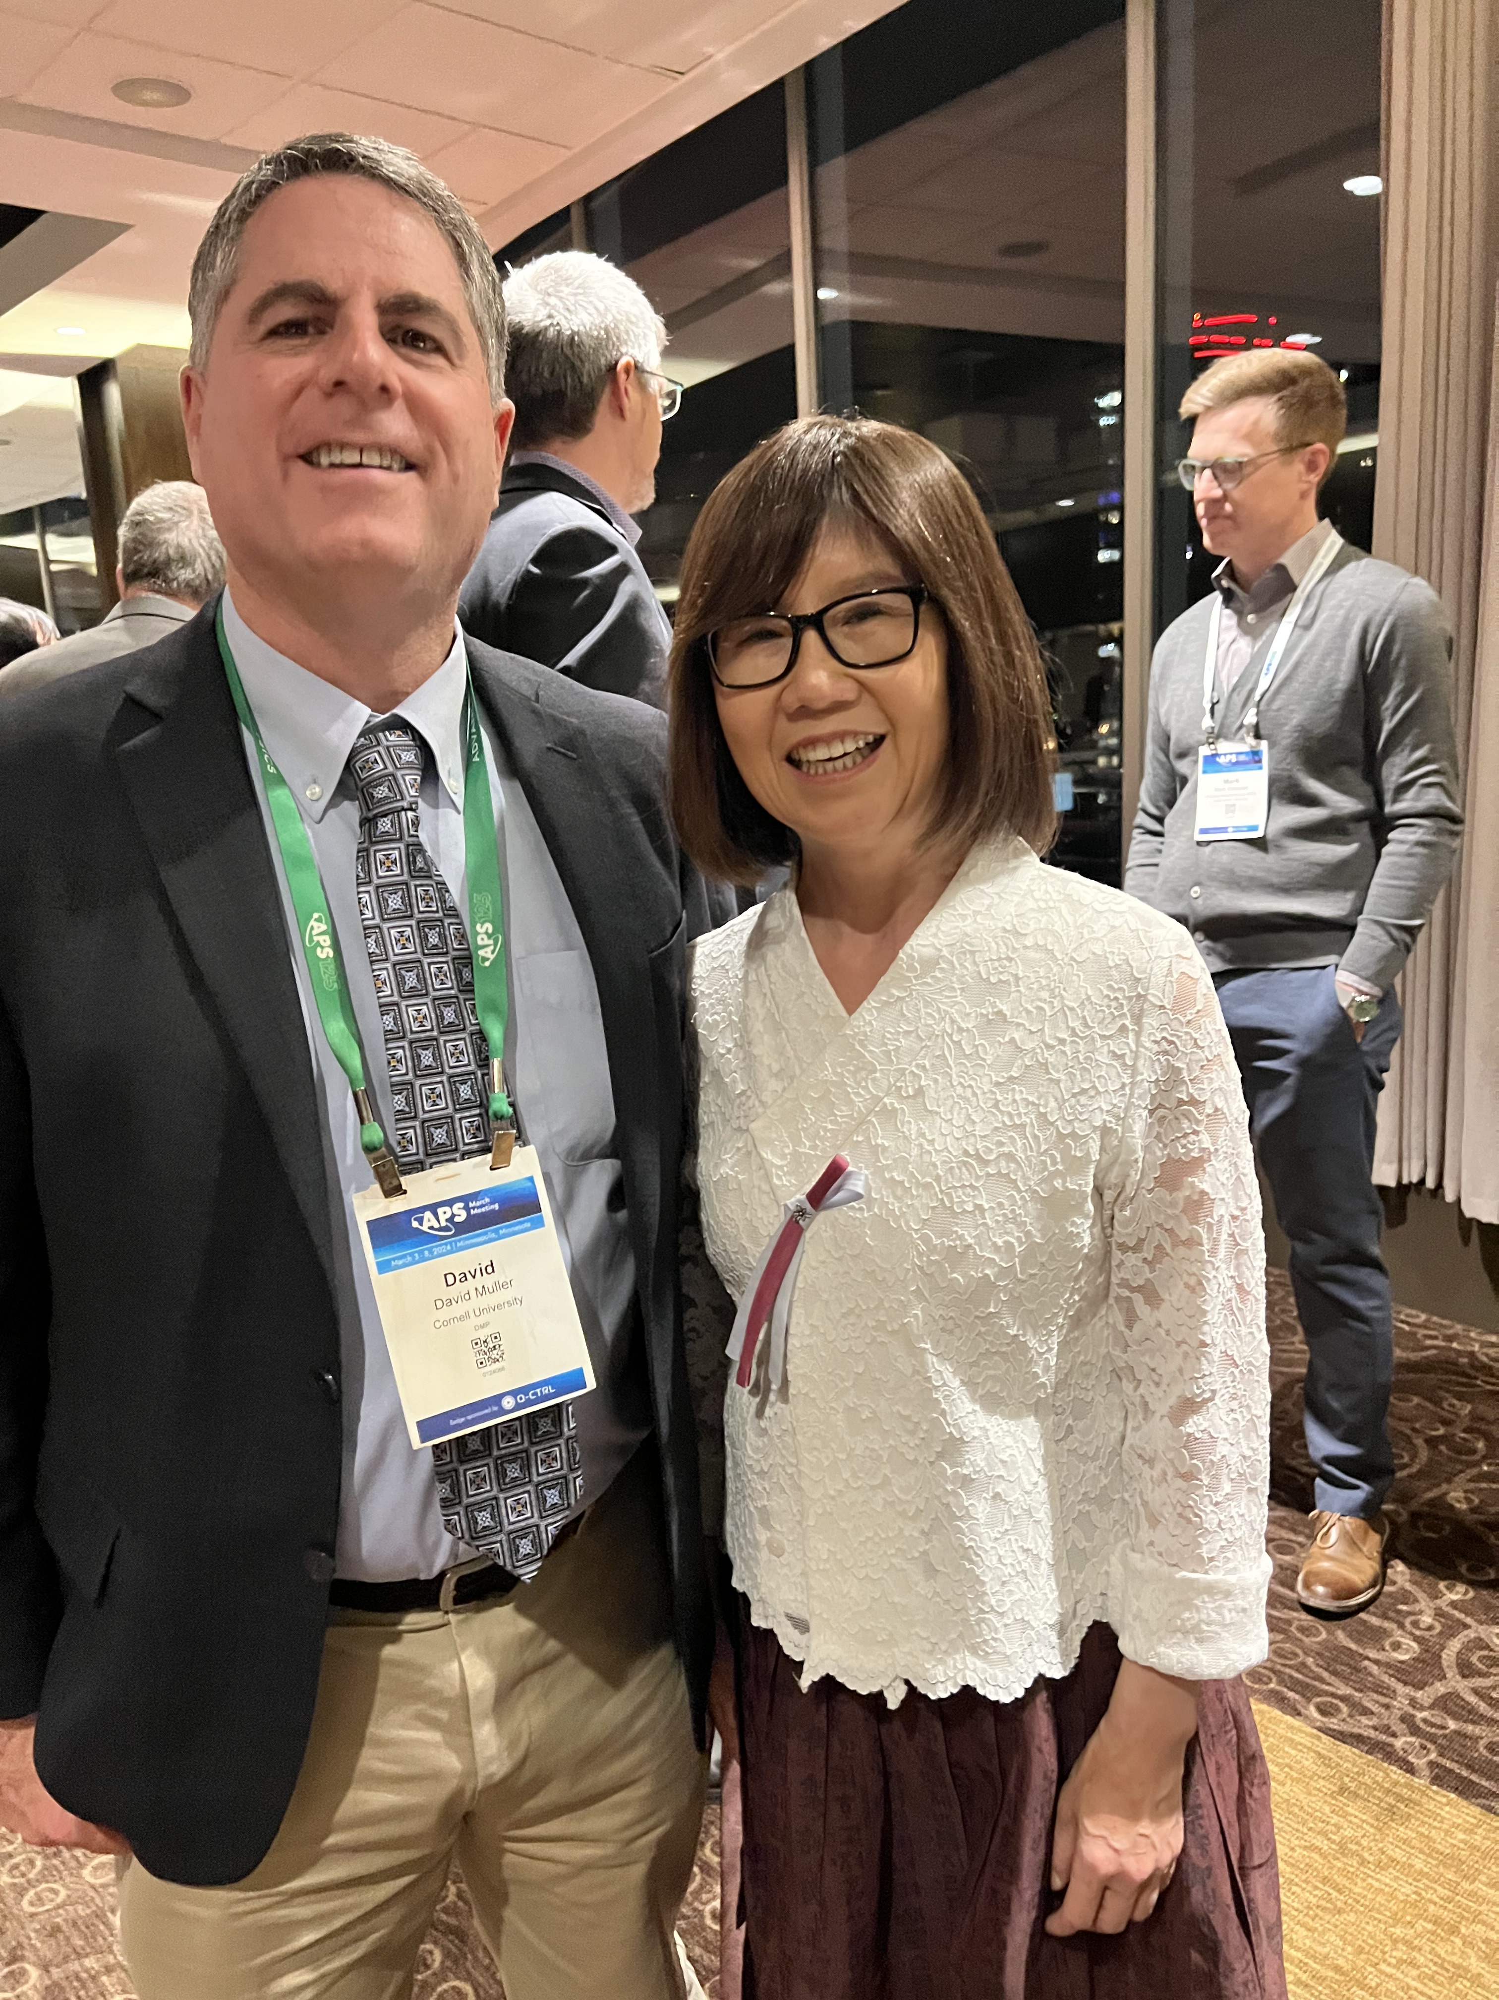
2023 Awards
Steven J. Sibener
2023 Remsen Award
American Chemical Society
James Rosenzweig
2023 Hannes Alfven Prize
in Plasma Physics
European Physical Society
David Muller
2023 John Cowley Medal
Int’l Microscopy Congress
In addition, 11 students and postdocs won a prize, fellowship or award (2022)
Young-Kee Kim
2023 APS Chair

Slide 11
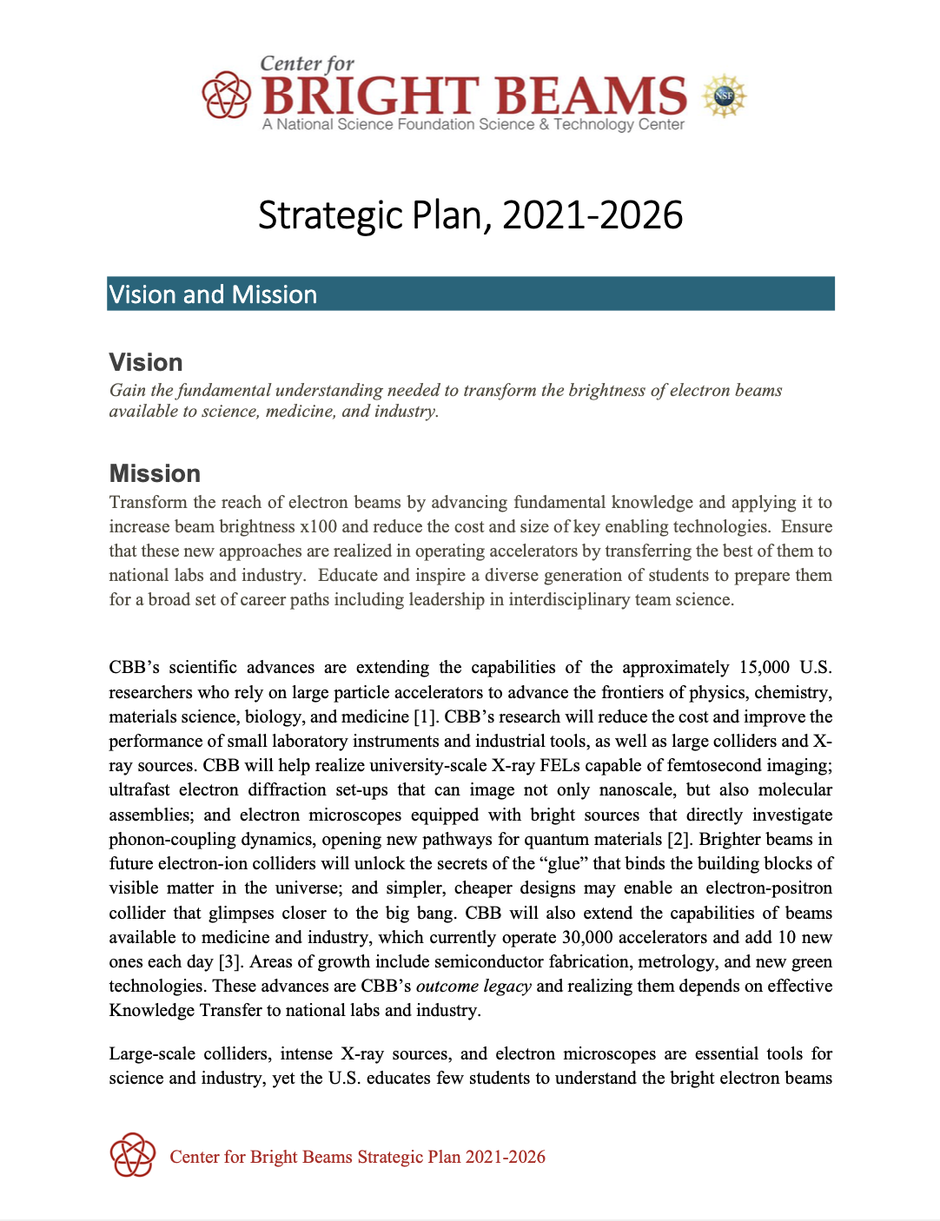
Strategic Plan
Guides CBB activities and budgeting
Evolves to reflect world accelerator
priorities, progress, lessons learned
Seeks to maximize impact and legacy
This year’s changes:
Added Demo of 100pC bunches
with 100nm emittance (BDC 1.3) (priority)
Dropped four deliverables that are out of reach
or make little use of teamwork
    10 meV photocathode PHC 1.4,
    Optical Stochastic Cooling BDC 2.2, 2.3
    Bounds of ML for tuning BDC 3.4
Relaxed two targets
  Robust photocathode will be tested at 10mA rather than 50mA
  Most ambitious single electron photocathode will have
  MTE < 25 meV (and emittance ~10 pm)
  rather than emittance <0.2 pm
  See research talks for details

Slide 12
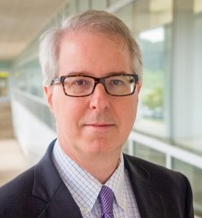
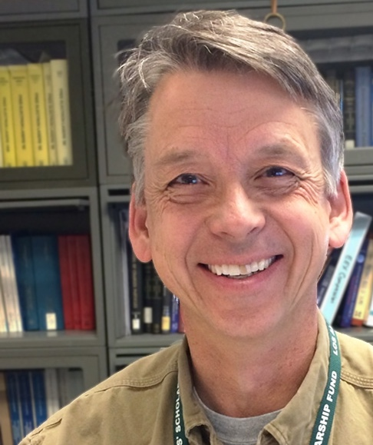
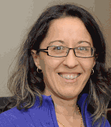
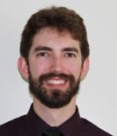
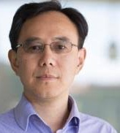
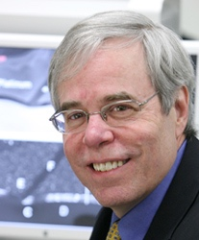
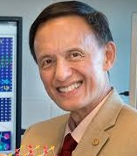
External Advisory Board
Stuart Henderson (ch.) | Jefferson Lab
Bruce Carlsten | Los Alamos Nat’l Lab
Paul Gueye | Michigan State U.
Kathy Harkay | Argonne Nat’l Lab
Erik Hosler | PsiQuantum, Inc.
Zhirong Huang | SLAC
Bryan Reed | Integrated Dynamic Electron Solutions/JEOL
Peter Voorhees | Northwestern U.
Yimei Zhu | Brookhaven Nat’l Lab
One-day in-person meeting, March 15, 2024
Strong lab representation,
consistent with NSF guidance.

Slide 13
CBB budget allocation
Strategic Plan guides budgeting
CBB research consists of a package of projects, which are developed and funded annually.
Each project supports one student or postdoc and addresses a specific deliverable in the Strategic Plan.
Funding is open to anyone and is our mechanism for welcoming new members.
Examples:
Sandra Biedron (UNM) 2020
Oksana Chubenko (NIU) 2022
Project development and selection:
Faculty talk through project ideas for the coming year at a full day meeting.
Faculty then submit brief, written proposals for their project(s)
Given the prior discussion and vetting, the vast majority of projects are aligned with the Strategic Plan and well-planned and are awarded funding.
Yesterday
Upshot
CBB provides stable support for students and postdocs,
while delivering a research program that is coordinated and dynamic.

Slide 14
CBB Budget Allocation Year 8
Grand total $5.5M
(incl. F&A)
Fractions exclude F&A
Shared facilities
CBB manages no shared facilities.

Slide 15
Allocation by Theme
This split is the result of bottoms up planning and the proposal process.
Cornell accounts for about 3/5 of CBB by any metric (leadership, meeting host, students, etc.)
PHC = 35% BDC = 20% SRF = 45%
July 18, 2023

Slide 16





Leveraged Funding Years 1 - 7
Value of awards to CBB PIs

Slide 17
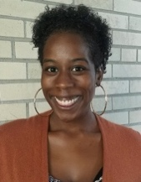
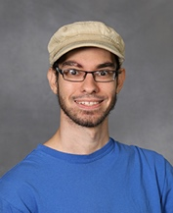
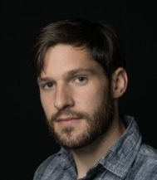

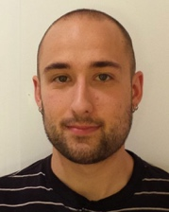
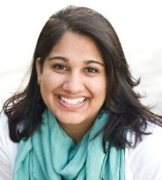

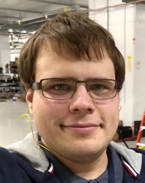
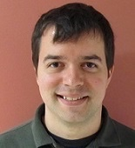
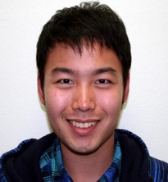
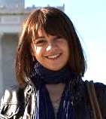
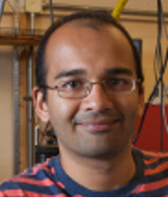
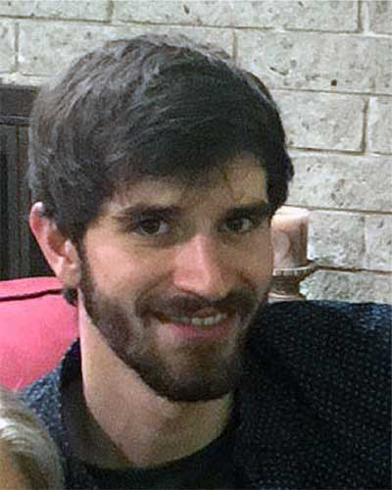
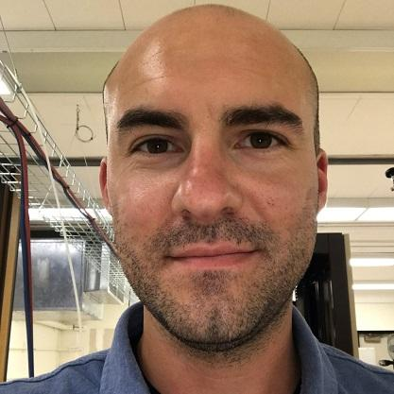
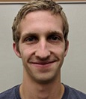
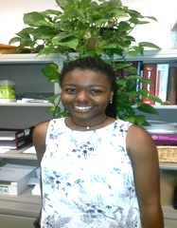
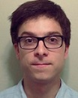
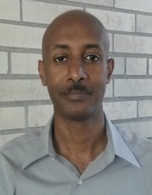
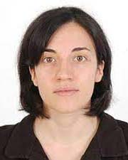
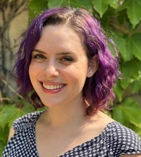
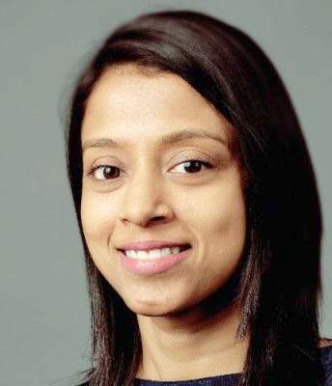
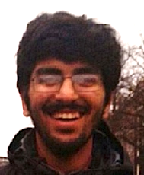
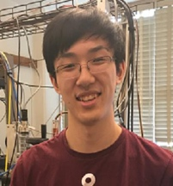
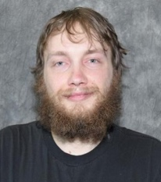
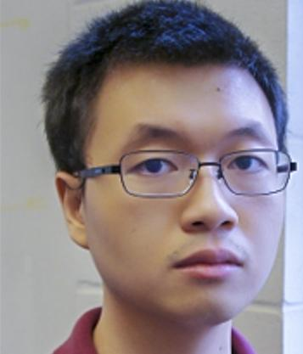
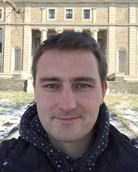











CBB Legacy
54 highly-trained scientists to date with more in the pipeline, trained in
materials in extreme conditions, accelerators, and interdisciplinary team science.
42% academia/education, 33% national lab or govt, 22% industry

Slide 18
CBB Legacy: PHC and SRF
Accelerator expertise, combined with Accelerator Materials,
is transformative
High performance photocathodes
CBB is widely recognized as a world leader – perhaps the world leader
Today most photoinjector designs incorporate an advanced photocathode
Before CBB, copper photocathodes were the norm and in many communities, alkali-antimonide and nano-structured photocathodes were viewed with skepticism.
SRF cavities
First successful Nb₃Sn in 2015 (CBB PI Liepe)
Performance similar to Nb, but at 4K rather than 2K
Nb₃Sn growth methods and understanding of the impact of defects.
Labs and industry use CBB know-how for Nb₃Sn growth.
Alternative Nb₃Sn growth: pioneering chemical vapor deposition
NbZr as the next direction in SRF cavities

Slide 19

Accelerator Materials
Photoemission and Photocathodes
Coherent, three-body electron-phonon-photon scattering
Nangoi, Karkare, Sundararaman, Padmore, and Arias, Phys. Rev. B, 104, 115132 (2021)
Light-induced, non-equilibrium electron distributions
Maxson et al, NIM-A 865, pp. 99–104 (2017)
Multi-photon processes
Maxson et al, NIM-A 865, pp. 99–104 (2017); Nangoi, PhD Thesis, Cornell University (2022); Bae et al, J. Appl. Phys. 124, no. 24, p. 244903 (2018)
Ab initio plane-wave, truncated Green’s function approach to electron scattering states
Wu, in preparation
Superconductivity and SRF cavities
Defect formation and impact on the Fermi-level density of states (related to Tc) Sitaraman et al, Phys. Rev. B 103, 115106 (2021); Kelley, Sitaraman, and Arias, Supercond. Sci. Technol., 34, no. 1, p. 015015 (2021).
Experimentally-validated ab initio theory of Helium Atom Scattering (HAS)
McMillan, Thompson, et al, J. Chem. Phys. 156, no. 12, 124702 (2022); Thompson, Tuinen, Kelley, et al. J. Phys. Chem, in review (2024); Kelley, et al., PRL 132 016203 (2024) (inelastic); Mendez et al, in preparation.
Zr-doped Nb: T_{c} limitation and a solution using ordered alloys
Sitaraman et al., arXiv.2208.10678, PR Appl. (2023); Z. Sun et al., Adv.Electr.Mat. (2023) https://doi.org/10.1002/aelm.202300151
Multi-scale description of SRF materials, combining experiment, ab initio calculations and mesoscopic, continuum modeling
Carlson et al., Phys. Rev. B 103, 024516 (2021); Pack et al., Phys Rev B 101, 144504 (2020)
Notes:
[6] J. K. Nangoi, S. Karkare, R. Sundararaman, H. A. Padmore, and T. A. Arias, “Importance of bulk excitations and coherent electron-photon-phonon scattering in photoemission from PbTe(111): Ab initio theory with experimental comparisons,” Phys. Rev. B, vol. 104, no. 115132, Sep. 2021, doi: 10.1103/physrevb.104.115132. Available: https://arxiv.org/abs/2006.11924
[7] J. Maxson, P. Musumeci, L. Cultrera, S. Karkare, and H. A. Padmore, “Ultrafast laser pulse heating of metallic photocathodes and its contribution to intrinsic emittance,” Nucl. Instrum. Methods Phys. Res. Sect. Accel. Spectrometers Detect. Assoc. Equip., vol. 865, pp. 99–104, Sep. 2017, doi: 10.1016/j.nima.2016.08.032. Available: https://doi.org/10.1016/j.nima.2016.08.032
[8] J. K. Nangoi, “Ab initio study of photoemission processes and photocathode materials for next-generation high-brightness electron emitters,” Ph.D. thesis, Cornell University, Ithaca, NY, 2022.
[9] J. K. Bae, I. Bazarov, P. Musumeci, S. Karkare, H. Padmore, and J. Maxson, “Brightness of femtosecond nonequilibrium photoemission in metallic photocathodes at wavelengths near the photoemission threshold,” J. Appl. Phys., vol. 124, no. 24, p. 244903, Dec. 2018, doi: 10.1063/1.5053082. Available: https://aip.scitation.org/doi/10.1063/1.5053082
[10] N. S. Sitaraman et al., “Effect of the density of states at the Fermi level on defect free energies and superconductivity: A case study of Nb₃Sn,” Phys. Rev. B, vol. 103, no. 11, p. 115106, Mar. 2021, doi: 10.1103/PhysRevB.103.115106. Available: https://link.aps.org/doi/10.1103/PhysRevB.103.115106
[11] M. M. Kelley, N. S. Sitaraman, and T. A. Arias, “Ab Initio Theory of the Impact from Grain Boundaries and Substitutional Defects on Superconducting Nb₃Sn,” Supercond. Sci. Technol., vol. 34, no. 1, p. 015015, Jan. 2021, doi: 10.1088/1361-6668/abc8ce. Available: https://iopscience.iop.org/article/10.1088/1361-6668/abc8ce
[12] A. A. McMillan, C. J. Thompson, M. M. Kelley, J. D. Graham, T. A. Arias, and S. J. Sibener, “A combined helium atom scattering and density-functional theory study of the Nb(100) surface oxide reconstruction: Phonon band structures and vibrational dynamics,” J. Chem. Phys., vol. 156, no. 12, p. 124702, Mar. 2022, doi: 10.1063/5.0085653. Available: https://aip.scitation.org/doi/10.1063/5.0085653
[13] M. M. Kelley, “Effective quantum many-body theories: studies of electronic structure and electron-phonon coupled properties near interfaces in superconductors,” Ph.D. thesis, Cornell University, Ithaca, NY, 2023.
[14] N. S. Sitaraman et al., “Theory of Nb-Zr Alloy Superconductivity and First Experimental Demonstration for Superconducting Radio-Frequency Cavity Applications,” Aug. 2022, doi: 10.48550/arXiv.2208.10678. Available: http://arxiv.org/abs/2208.10678
[15] Z. Sun et al., “ZrNb(Cx) RF superconducting thin film with high critical temperature in the theoretical limit.” arXiv, Feb. 28, 2023. doi: 10.48550/arXiv.2302.14410. Available: http://arxiv.org/abs/2302.14410
[16] J. Carlson et al., “Analysis of Magnetic Vortex Dissipation in Sn-Segregated Boundaries in Nb₃Sn SRF Cavities,” Phys. Rev. B, vol. 103, no. 2, p. 024516, Jan. 2021, doi: 10.1103/PhysRevB.103.024516. Available: https://link.aps.org/doi/10.1103/PhysRevB.103.024516

Slide 20

CBB Legacy: BDC
Very low emittance beams
For a range of applications, showed that low emittance
photocathodes improve the beam at the target.
XFELs, UED, Terahertz lasing, compact XFELs
Machine Learning for Accelerators
At one international accelerator workshop,
every ML talk was given by a CBB participant
or affiliate.
Automated tuning of electron microscopes
For better, cheaper operation
with less reliance on company experts.
Contributions to Optical Stochastic Cooling
Provided the IOTA optical delay line and simulation
Developed a delay line design suitable for a larger-scale demonstration
SLAC Feature
Roussel et al, PRL 130, 145001 (2023)
Over the next 2 1/2 years, this legacy will expand and mature
CBB has much more to come

Slide 21
NSF SV Recommendations 2023
Post 2026 planning
CBB should provide NSF with a milestone identifying the formation of a strategic task force with the explicit purpose of mapping the transition to beyond 2026. The task force should consider future activities which could be conducted under a significantly different award portfolio.
CBB should engage with the program offices who are developing opportunities that overlap with CBB interests, such as DOE Office of Accelerator Research Development and Production.
CBB should ensure that its plans for the future beyond 2026 include education, training and outreach even if, at this stage of planning, they are not explicitly funded.
CBB should identify future opportunities for funding relevant education, training and outreach activities where possible.
CBB should provide NSF with a milestone that defines when they will begin to work in earnest with the SRC to plan for future collaborative activities that will extend CBB thrusts beyond 2026.
CBB should engage with the EAB in strategic discussions regarding the CBB future.
CBB should identify alternative funding avenues now to ensure interdisciplinary, convergent research continues past 2026.
CBB should find ways to continue the training, professional development, and outreach efforts as these are key to continue and support the productive collaborative efforts among institutions developed under the CBB framework.
Research
CBB should keep pushing on the very productive research fronts, being mindful of broader discussions taking place and of literature produced in the broad material science community.
CBB should work more strongly with the knowledge transfer team to ensure that legacies can be preserved to the greatest extent possible.
Workforce Development/Diversity
CBB activities should be advertised broadly within each institution and seek out institutional partners to expand and continue CBB educational and outreach activities.
CBB should tap into each institution's resources further to continue the improvement [in diversity].

Slide 22
NSF Site Visit 2023
Summary recommendations
1. CBB should identify alternative funding avenues now to ensure interdisciplinary, convergent research continues past 2026.
2. CBB should find ways to continue the training, professional development, and outreach efforts as these are key to continue and support the productive collaborative efforts among institutions developed under the CBB framework.

Slide 23

New Award: DOE Traineeship
Tigner Traineeship
Matthias Liepe (PI), Georg Hoffstaetter,
Jared Maxson Cornell
Jamie Rosenzweig, Pietro Musumeci UCLA
Siddharth Karkare Arizona State U.
Young-Kee Kim U. Chicago
The Traineeship program addresses DOE accelerator workforce needs
Program (starts this Fall)
Funds students in Years 2 and 3 of PhD program
14 students per year
Professional development
Weekly seminars
Annual meeting
Inclusive practices
Modeled largely on CBB

Slide 24




New Award: Morgan State U. (HBCU)
Advancing sCientific exCELlence by Empowering Research in Accelerators Through Education
ACCELERATE
Prof. Willie Rockford
Chair of Physics
Morgan State U.
Prof. Paul Gueye
Michigan State University
CBB EAB
Prof. C. Santamaria
Visiting Asst. Prof.
Morgan State U.
Supports 4 Morgan undergrads in CBB related research
Dominic Davis and Joshua Marshall
Dominic Davis

Slide 25


Proposal in review: Morgan St. U.
NSF: Partnerships for Research and Education in Physics
Collaboration between Morgan faculty and CBB
Materials and Photonic Structures (MAPS) for brighter beams
Substrates
for photocathode growth
Photonic crystals as photocathodes
Prof. Michael Spencer
Morgan State U.
Prof. Birol Ozturk
Morgan State U.
Morgan graduate students will prepare materials at Morgan and test them in Jared Maxson’s lab

Slide 26
Training Summary
Tigner Traineeship award
Morgan State U. ACCELERATE award
Morgan State U. MAPS proposal
CBB has made significant progress on expanding and sustaining its training, professional development, and outreach efforts

Slide 27
Research Grants?
CBB faculty plan to self-organize submission of targeted collaborative proposals
What about a new Research Center?
DOE BES Energy Frontier Research Center?
Spoke with program officers in advance of the FOA, but there was no match between CBB research and the call.
NSF Physics Frontier Center?
Requires a shift in NSF practices
NSF Industry University Cooperative Research Centers?
Funding is ~1/10 CBB
NSF Technology Innovation and Partnership Directorate?
2 CBB proposals failed miserably
DOE GARD and ARDAP?
The program officers know CBB and have expressed interest in the center approach.

Slide 28
Maybe: CBB at DOE?
The DOE Office of Science Funding Opportunity allows for collaborative proposals
Funding levels comparable to CBB are allowed (in principle)
3 - 5 year award period
Target program:
Office of High Energy Physics (OHEP) General Accelerator R&D (GARD) “Develops the next generation of particle accelerators and related technologies that are essential for discoveries in HEP.”
Recent High Energy Physics planning process report (P5) recommends GARD budget increases starting in ~2027
Office of Science Accelerator R&D and Production (ARDAP) is also a match, but funding there is very tight.

Slide 29
CBB at DOE?
CBB adaptations to meet GARD program priorities
Continued high impact interdisciplinary research (SRF, PHC)
Greater emphasis on HEP needs: ILC, FCC-ee, Muon collider
  Possible topics: SRF, polarized electron sources, nanobeams, cold copper
Training: scientific leaders with expertise in accelerator science and related fields
  Professional development, USPAS
  Team science
Increased hands-on accelerator training
  Full cavity tests (SRF)
  Beam line experience (BDC)
  MEDUSA (Cornell), PEGASUS (UCLA)
  FAST/IOTA (FNAL), AWA (ANL), RHIC cooler (BNL), etc.
Research projects for
Tigner trainees

Slide 30



Center for Bright Beams Network
Solution if center proposals fail
Network to foster interdisciplinary collaboration and university training for brighter beams
Program elements
Professional development for students
2 online workshops or pedagogical lectures/year
Grad-2-grad meetings for networking
INDICO for meeting agendas and slide archival
Annual poster session (virtual)
Website and Weekly News with
  Publications
  Pointers to resources
  Seminar and meeting listings
  Job or internship opportunities
  REU/SULI program portal
The network will serve as a core
with research grants arrayed around it.

Slide 31
CBB Network
Subscription-based financial model
Membership | Benefits | Impact
University $4k/yr/faculty member or free for MSIs Initially paid by Research Offices and later assumed by grants | Professional development program Networking Science communication DEI best practices and mentoring plans | New collaborative research opportunities, including for center proposals Access to effective professional development, simplifying proposal preparation Contact with faculty at minority-serving institutions
National Lab or Company $20k/year? | Access to students via poster session, advertisements of their jobs and internships, seminar publicity | Support university accelerator science Reach scientists-in-training

Slide 32

Gaining the fundamental understanding needed to transform the brightness of electron beams available to science, medicine and industry.

