Slide 1
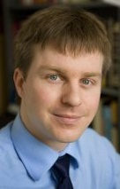
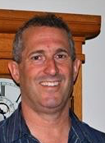
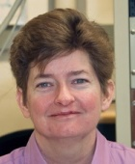
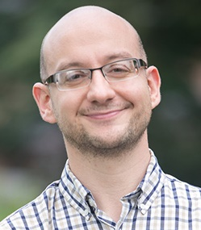

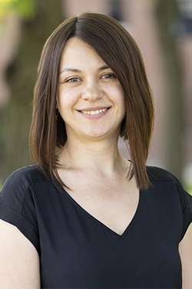
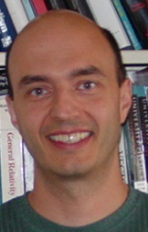
Beam Production
Jared Maxson, Associate Professor, Cornell University
theme leaders
Richard
Hennig
U. Florida
Jamie
Rosenzweig
UCLA
Melissa
Hines
Cornell
Kyle
Shen
Cornell
Pietro
Musumeci
UCLA
Jared
Maxson
Cornell
Siddharth Karkare
ASU
Oksana Chubenko
NIU
Tomas
Arias
Cornell.
Optimal outcome: Methods for x100 brighter electron sources through better photocathodes, enabling better X-ray sources, colliders and electron imaging.

Slide 2
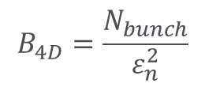



Electron Beam Brightness
Beam Brightness, B = Charge density in phase space
$$B_{4D}=\frac{N_{bunch}}{ε_{n}^{2}}$$
$$x$$
$ε_{n}$ - Emittance
$$p_{x}$$
According to Liouville’s theorem
Peak Brightness remains invariant for Hamiltonian systems (Linacs)
Source determines the maximum possible brightness!

Slide 3
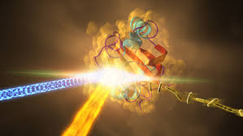
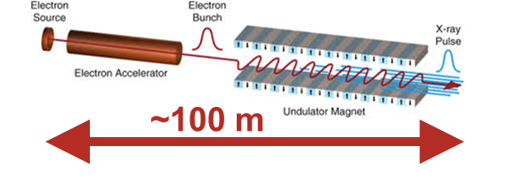
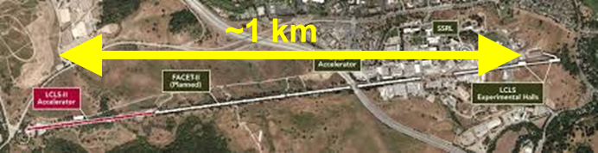
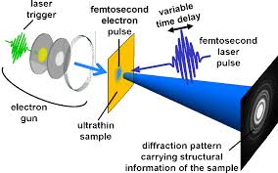
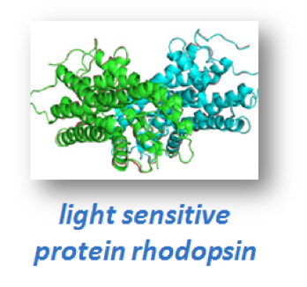
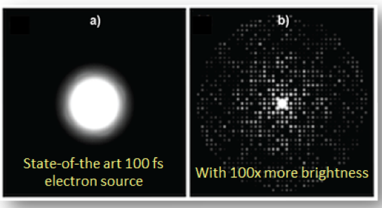
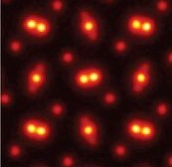

Why Brighter Sources?
Non-collider, high impact applications:
1. Transformed X-Ray Free Electron Lasers
Brighter beams
AND
LCLS @ SLAC
Higher power and photon energy x-rays
Compact XFELS
2. Mesoscale Ultrafast Electron Diffraction
By 2026: Develop electron sources to enable these applications
Today
100XBrighter
3. Time-resolved atomic resolution STEM
Brighter photoemission sources
fs motion

Slide 4


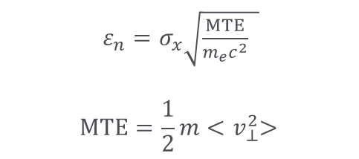

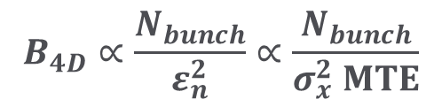
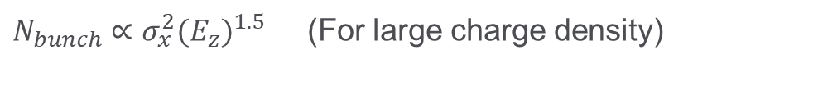
Maximum Beam Brightness
E_{z} (5-100MV/m)
I. Bazarov et al., Phys. Rev. Lett. 102, 104801 (2009)
$$B_{4D}∝\frac{N_{bunch}}{ε_{n}^{2}}∝\frac{N_{bunch}}{σ_{x}^{2} MTE}$$
$ε_{n}=σ_{x}\sqrt{\frac{MTE}{m_{e}c^{2}} }$
$$MTE=\frac{1}{2}m{<v}_{⊥}^{2}>$$
Photocathode
$$σ_{x}$$
MTE → Mean Transverse Energy
Typical MTE used in photoinjectors is ~500 meV
Laser pulse
$σ_{x}^{2}$ → electron emission area
$N_{bunch}∝σ_{x}^{2}{{(E}_{z})}^{1.5}$ (For large charge density)
Low Electron Density Applications: Brightness limited by MTE and source size.
High Charge Density Applications:
Brightness limited by photocathode MTE and field gradient
$$B_{4D}∝\frac{N_{bunch}}{σ_{x}^{2} MTE}$$
$$B_{4D}∝\frac{{{(E}_{z})}^{1.5}}{MTE}$$
Notes:
Space charge only here; include small size too!

Slide 5
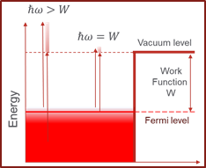
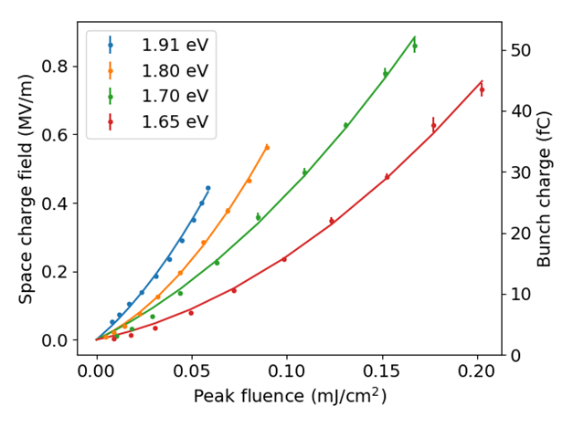
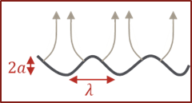
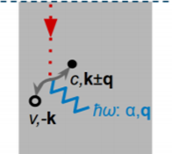
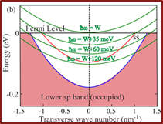
What is MTE limited by?
P. Musumeci et al. Nucl. Instrum. Meth. A, 907, 209 (2018)
Bae et al. Jour. Appl. Phys., 124,. 244903, (2018)
Nangoi et al Phys. Rev. B 104, 115132 (2021)
Excess Energy
Non-linear Photoemission
Surface Non-uniformities
Emit close to threshold and minimize temperature
CBB discovers factors affecting MTE
Need high quantum efficiency
Need atomically smooth surfaces
Many-body Scattering
Band Structure
Need small cross-section of electron-phonon-photon interactions
Need low transverse momentum states
Challenge: Develop materials that satisfy all these criteria
Notes:
Larger energy than necessary—talk to figure.

Slide 6


Interdiscplinary Team
Computational modeling
of electronic structure and emission
Accelerator Testing
Cycle happens on a weekly basis
Demonstrate ‘more than sum of parts’
Materials growth
Materials characterization

Slide 7
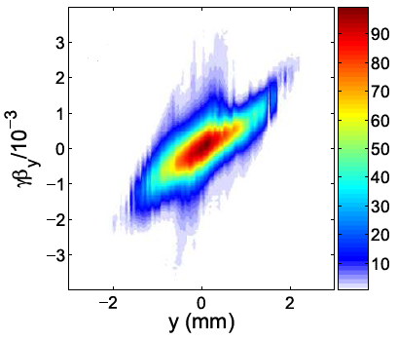


Cross-theme Cohesion
Strong connection to Beam Dynamics and Control:
  Need optimized beam dynamics to conserve low MTE (or emittance)
  In cases with
  significant space charge, or
  aberrations/ field nonlinearities
  Brightness will depend strongly on the beam dynamics!
Several faculty in both themes
Small MTE
Bad
Transport
High density
Low $ε$
Large $ε$

Slide 8
Key Achievements (2016-2023)
1. Demonstration of 5 meV MTE
  – two orders of magnitude higher brightness of low current density applications
Karkare et al Phys. Rev. Lett. 125, 054801(2020) – Editor’s suggestion
2. Effects of non-linear photoemission on MTE
  – limits MTE in for high current density applications
Bae et al. J. Appl. Phys., 124,. 244903, (2018);
Knill et al, Phys. Rev. Accel. Beams 26, 093401 (2023)
  3. Development of ultrasmooth ordered alkali-antimonide films
    – can give low MTE for high current density applications
Parzyck et al, Phys. Rev. Lett. 128, 114801 (2022) – Editor’s suggestion
4. Development of robust coating techniques for vacuum sensitive cathodes
  – essential for protecting vacuum sensitive cathodes in extreme conditions
Patent Pending
5. Sub-nm emittance measurement diagnostics in accelerators
(together with BDC theme)
  – critical for low emittance and high brightness measurements
M. Gordon et al. Phys Rev Accel. Beams, 25, 084001 (2022)
Notes:
These have impacted a lot of research in accelerators and elsewhere

Slide 9
New in 2024 – What I will tell you about today
1. Demonstration of 5 meV MTE
  – two orders of magnitude higher brightness of low current density applications
Karkare et al Phys. Rev. Lett. 125, 054801(2020) – Editor’s suggestion
2. Effects of non-linear photoemission on MTE
  – limits MTE in for high current density applications
Bae et al. J. Appl. Phys., 124,. 244903, (2018);
Knill et al, Phys. Rev. Accel. Beams 26, 093401 (2023)
  3. Development of ultrasmooth ordered alkali-antimonide films
    – can give low MTE for high current density applications
Parzyck et al, Phys. Rev. Lett. 128, 114801 (2022) – Editor’s suggestion
4. Development of robust coating techniques for vacuum sensitive cathodes
  – essential for protecting vacuum sensitive cathodes in extreme conditions
Patent Pending
5. Sub-nm emittance measurement diagnostics in accelerators
(together with BDC theme)
  – critical for low emittance and high brightness measurements
M. Gordon et al. Phys Rev Accel. Beams, 25, 084001 (2022)
NEW: First test of alkali-antimonides in >60 MV/m fields
NEW: Demonstration of sub-100 pm normalized emittance from photocathodes
Notes:
These have impacted a lot of research in accelerators and elsewhere

Slide 10

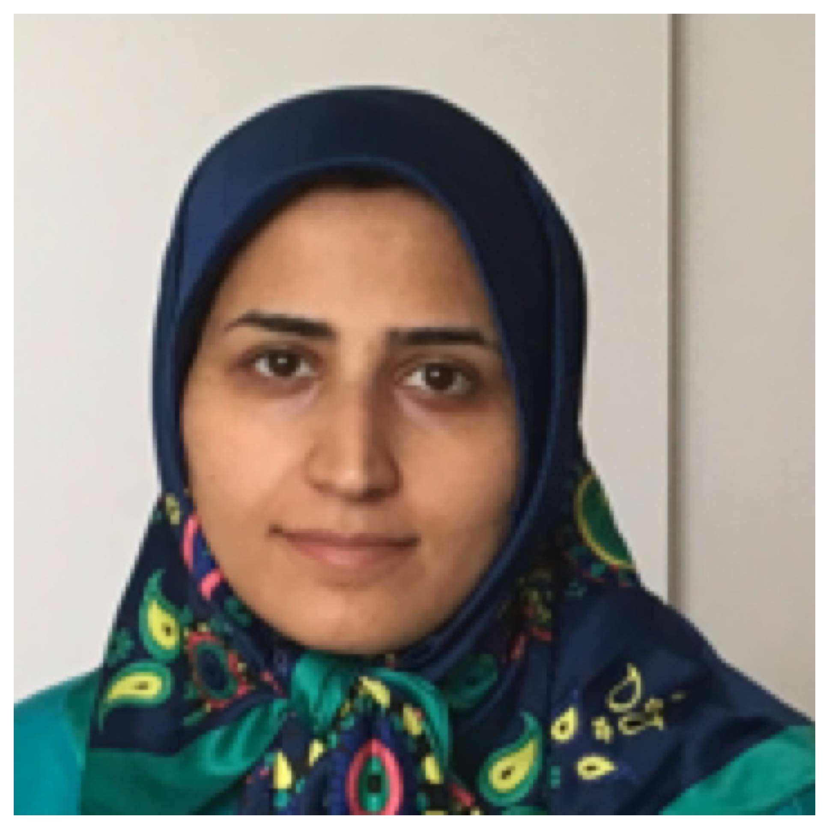








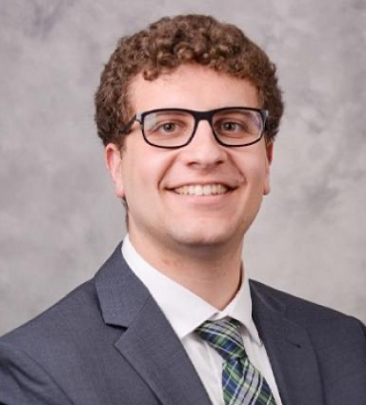
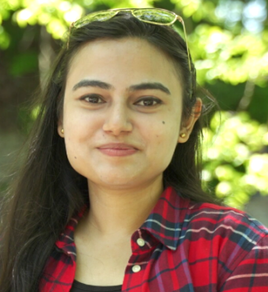
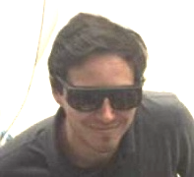
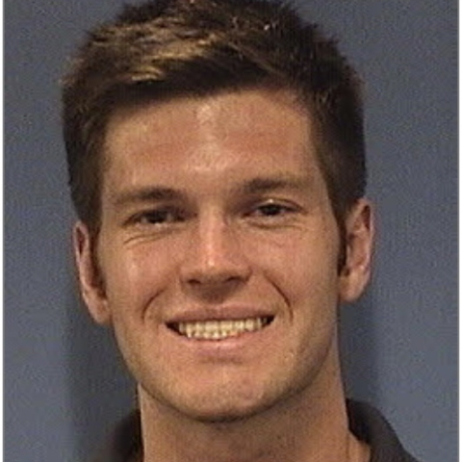



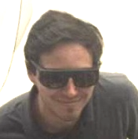
PHC Graduate Students and Postdocs
Vivek Anil,
Cornell
Mansoure Moeini Rizi, ASU
Elena Echeverria, Cornell
Azriel Finsterer, Cornell
Daniel Franklin, NIU
David Garcia, UCLA
Jason Gibson, U Florida
Tariqul Hasan, NIU
Mariam Hasany, Cornell
Ali Kachwala, ASU
Gerard Lawler, UCLA
Sam Levenson, Cornell
Joshua Mann, UCLA
Chad Pennington, Cornell
Annabel Selino, Cornell
Tyler Wu, Cornell
Amy Zhu, Cornell
Notes:
Current Students and Postdocs in PHC

Slide 11









Partnerships
Theme PHC is strongly connected to Beam Dynamics and Control—we hold regular joint meetings, multiple overlap areas.
National Laboratory and industry partners:
Cathode characterization
Photoinjector Physics
Emittance Diagnostics
Nanofabrication
With theme 3: Space charge simulations with low MTE cathodes
Development of robust high-QE GaN based cathodes
Photocathode
simulation
RF gun load-lock development
Cathodes for semiconductor metrology
Photocathode development
xLight:
High power electron sources
Cathodes for electron
microscopes

Slide 12
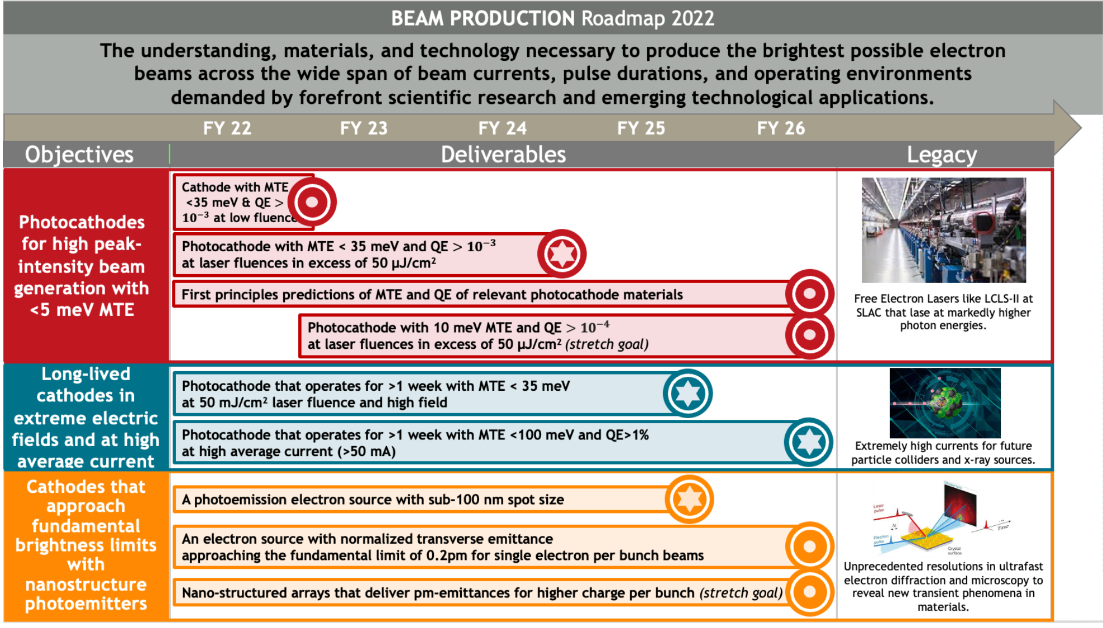
CBB Theme 1 Objectives and Roadmap - old
current
Objective 5 statement (short format)

Slide 13
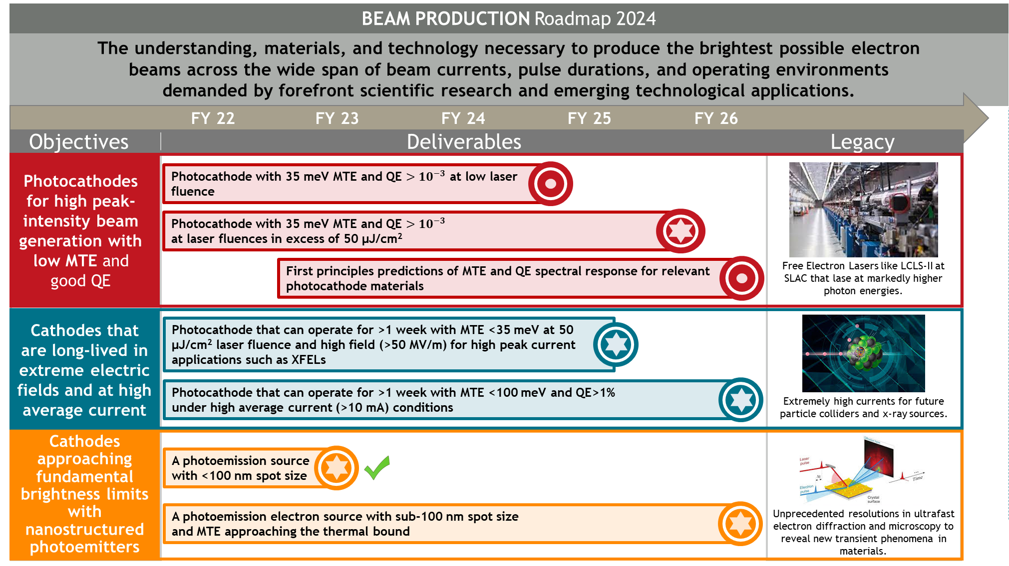
Revised roadmap 2024
current
Objective 5 statement (short format)

Slide 14
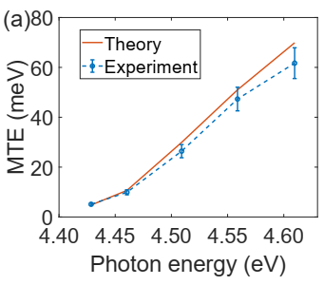
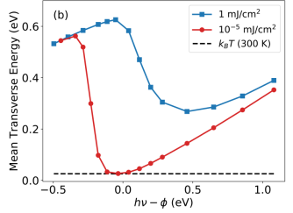
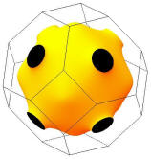
Objective 1
Develop photocathodes low MTE and good QE
Already demonstrated 5 meV MTE for low peak intensity applications
(Key accomplishment 1)
Use high QE (>10⁻³) cathodes to minimize laser fluence and
non-linear photoemission effects
Photoemission at the threshold
Cooled to LHe (30K)
Atomically ordered flat surface
Good band-structure
Experimentally and theoretically demonstrated that MTE at large laser fluences is limited to 100s of meV for metallic cathodes
5 meV MTE measured from Cu(100)
Most photoinjectors use MTE ~500 meV

Slide 15
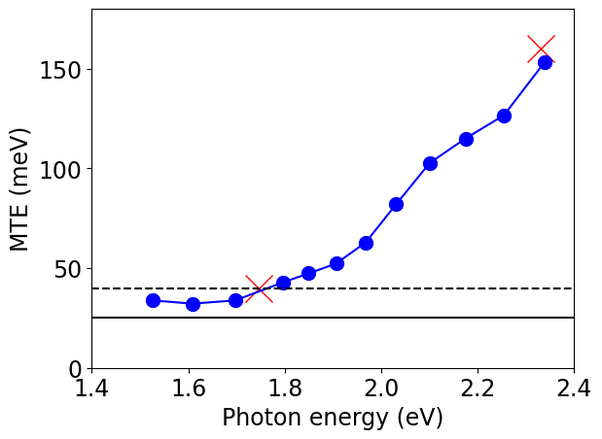
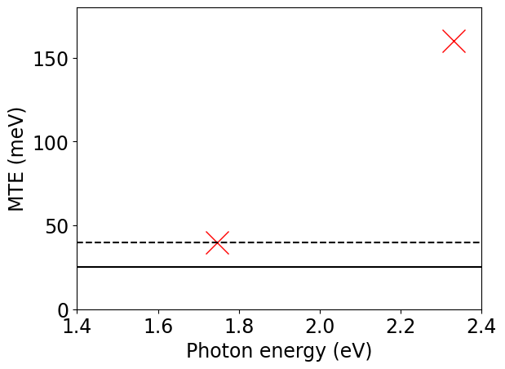
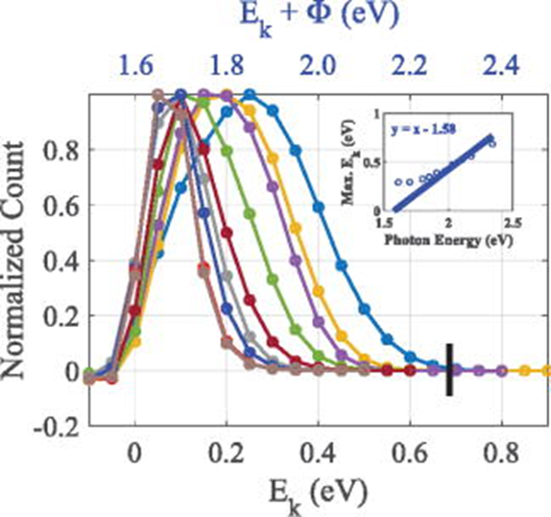
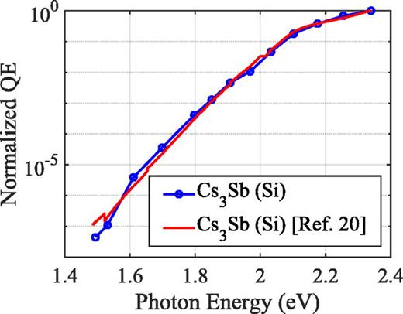
Objective 1
Develop photocathodes low MTE and good QE
Deliverable 1.1: A photocathode with MTE < 35 meV and QE > 10⁻³ at low or moderate laser fluence and at room temperature
Polycrystalline Cs₃Sb
previously presumed work function
previously presumed work function
Actual work function
Actual work function
Best prior to CBB
Thermal limit
Smooth CBB Cs₃Sb
Prior to CBB results
Defect states and structural complexities in polycrystalline Cs3Sb , not surface roughness give >35 meV MTE
A. Kachwala, P. Saha Appl. Phys. Lett. 123, 044106 (2023)

Slide 16
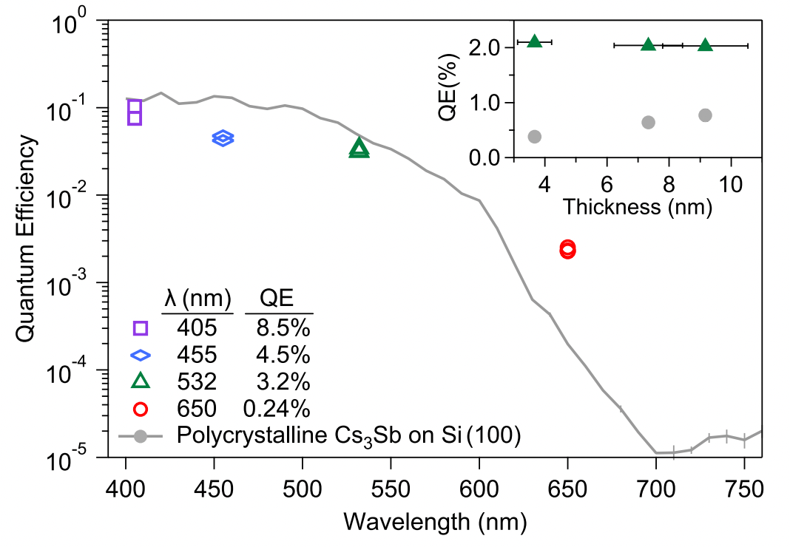
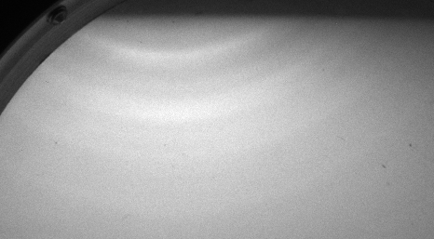
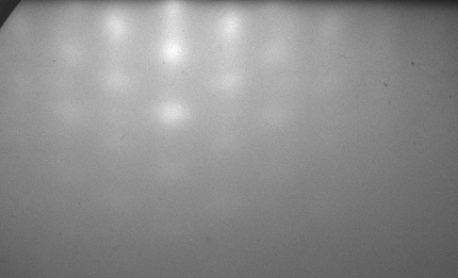
Objective 1
Develop photocathodes low MTE and good QE
Deliverable 1.1: A photocathode with MTE < 35 meV and QE > 10⁻³ at low or moderate laser fluence and at room temperature
Our emphasis now: single crystal photocathodes, and QE engineering.
High red efficiency from single crystal Cs₃Sb
Towards epitaxial K₂CsSb and Na₂KSb cathodes
RHEED: Na-Sb photocathodes on Si
MTE measurements coming soon
E. Echeverria
+ C. Pennington

Slide 17
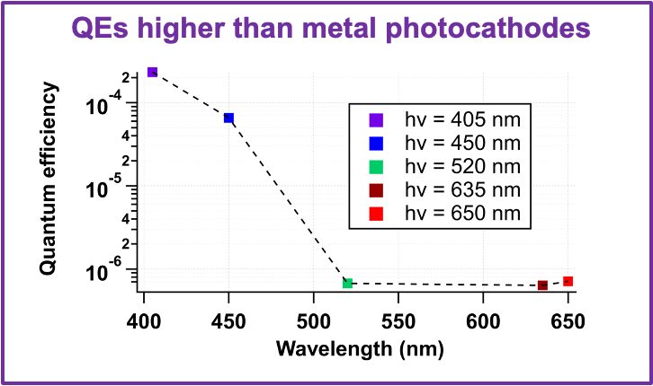
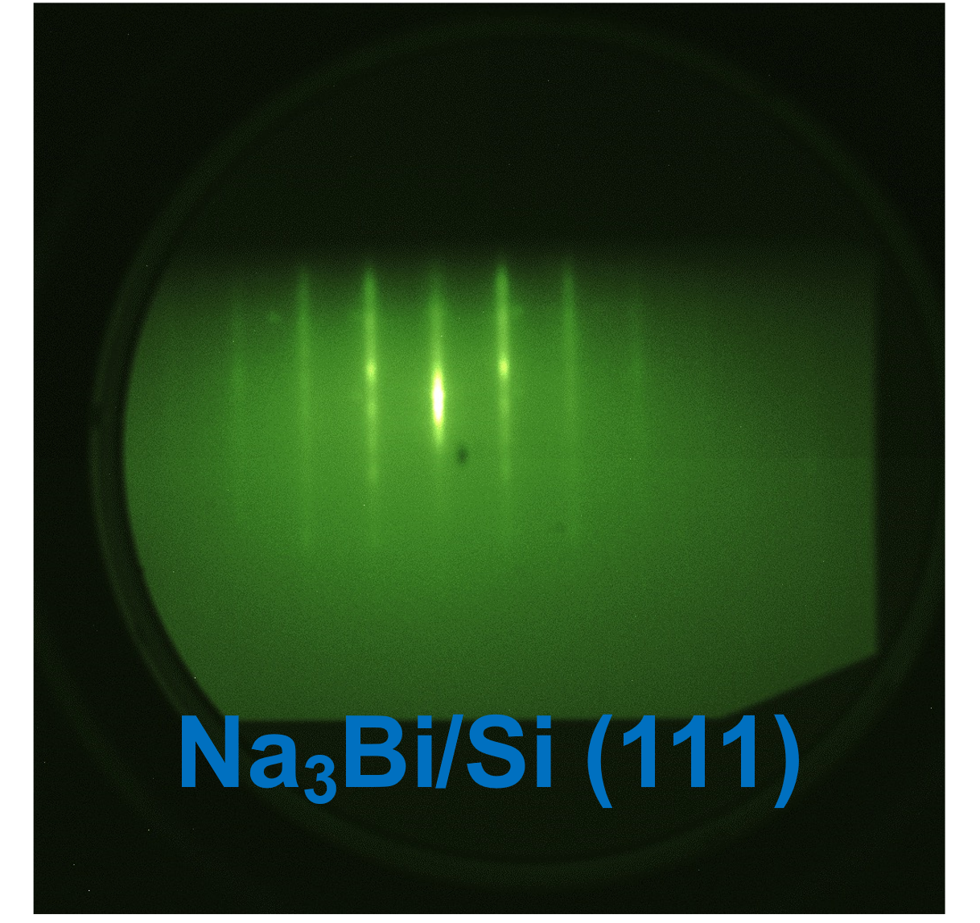
Objective 1
Develop photocathodes low MTE and good QE
Deliverable 1.1: A photocathode with MTE < 35 meV and QE > 10⁻³ at low or moderate laser fluence and at room temperature
Growth and MTE measurements of Topological materials: Na₃Bi, Cd₃As₂
Grown at PARADIM facility at Cornell
Work function of 2.5 eV
V. Anil, E. Echeverria, C. Pennington

Slide 18
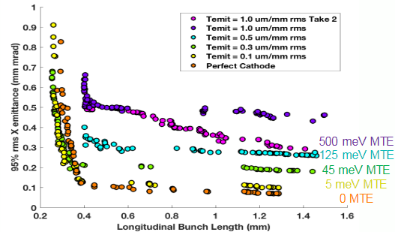
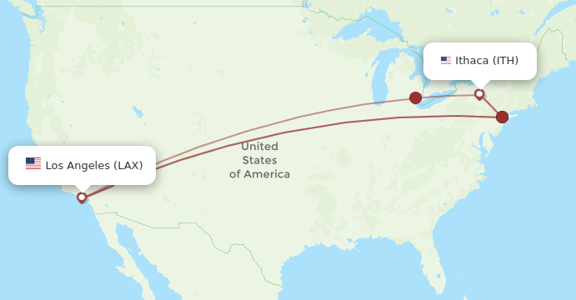
Objective 1
Develop photocathodes low MTE and good QE
Deliverable 1.2 (Priority): A photocathode with MTE < 35 meV and QE > 10⁻³ at laser fluences in excess of 50 µJ/cm2
  Theme 3 CBB Result
➔ Low MTE with large charge density – needs large electric fields
Nearly doubles x-ray photon energy at LCLS-2-HE
Greater FEL output
Smaller new FELs
Optimizations of a potential injector for LCLS-II HE
Partnership:
Ongoing DOE project with SLAC to transfer cathode recipes for use in the LCLS-2-HE SRF gun.
Cathode is robust enough for LCLS-2-HE gun
Measured MTE of Na₂KSb at >60 MV/m in the Pegasus gun at UCLA

Slide 19
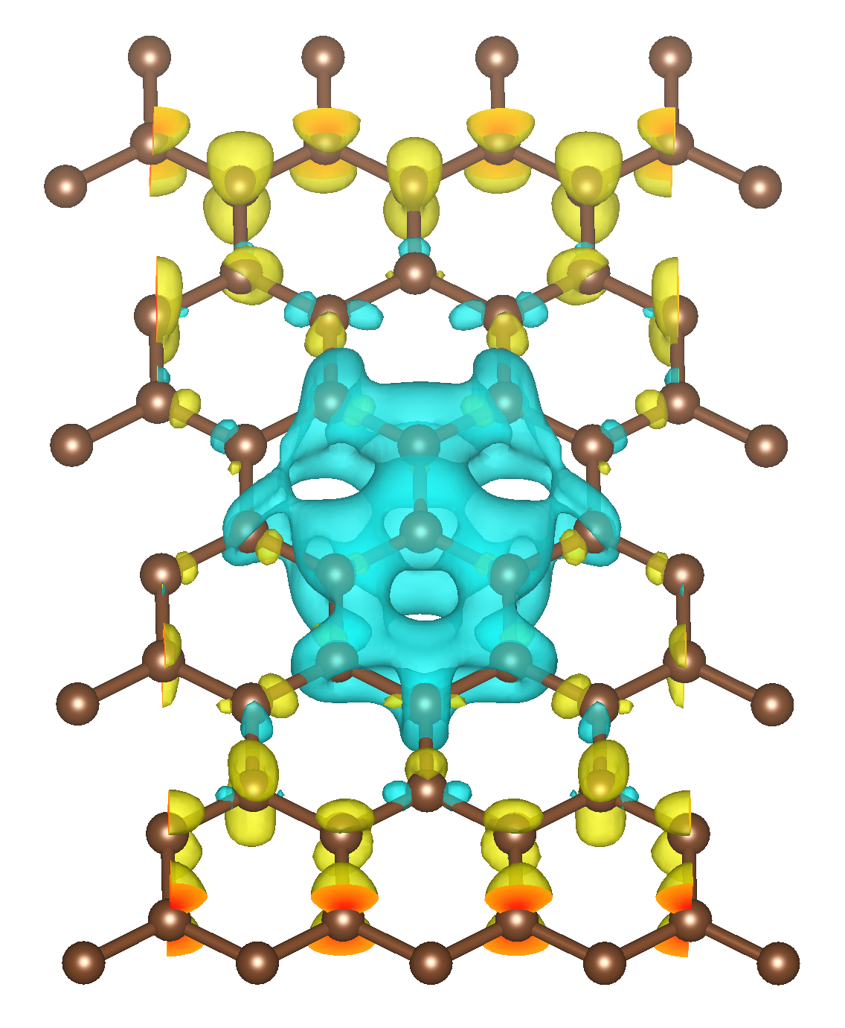
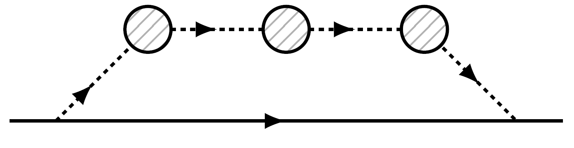
Objective 1
Develop photocathodes low MTE and good QE
Deliverable 1.3: First principles predictions of MTE and QE
Past theory contributions that have shaped our plan
New this year:
Calculation of many-body interactions affecting photoemission
Prediction of low MTE at high QE from alkali-antimonides
Instabilities in Cs₃Sb cubic phase structure
Discovery of new phases of Cs-Sb – also demonstrated experimentally
Developed of Lippmann-Schwinger approach to calculate photoemission properties ab-initio
Modeling emission from and transmission through 2D protective films
Variational Perturbation Theory (VPT) approach to compute dynamic polarization effects (screening) relevant for near-threshold electrons moving slowly away from the sheet/surface
Relevant many-body
screening process
Screened density response of graphene
local potential perturbation using VPT
• + charge response • - charge response

Slide 20
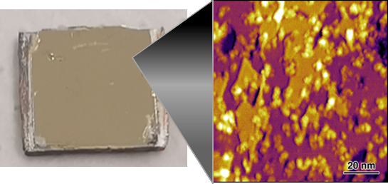
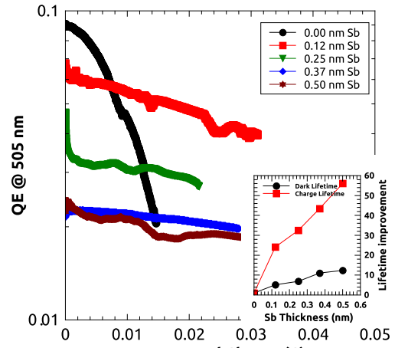
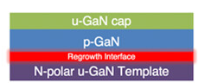
Objective 2
Design materials for long-lived cathodes in extreme electric field and high average current
Protective 2D materials coatings
Robust activation overlayers
Inert high QE cathodes
Cs-free, air stable cathodes based on GaN heterostructures.
Demonstrated QE of 10⁻³, with MTE of 100 meV.
UHV graphene/hBN coating technique to protect an air sensitive thin film of various oxidation-sensitive metals such as Magnesium. Demonstration of protection of an alkali-antimonide film is underway
Cs-Sb and CsI based coatings to activate GaAs to negative electron affinity for robust high QE emission
Patent Pending
Notes:
Mention patent.

Slide 21
Objective 2
Design materials for long-lived cathodes in extreme electric field and high average current
We’ve spent significant effort getting a cathode test “ecosystem” up and running in CBB, both for
High Electric fields (100 MV/m and greater)
High Average Current (10s of mA)

Slide 22


Objective 2
High Field Test Site 1: UCLA Pegasus
NCRF S-band gun capable of up to 100 MV/m. Equipped with load lock for vacuum cathode transfer.
Demonstrated cathode transfer from Cornell. New cathode growth chamber at ASU for easier transfer
Cornell Na-K-Sb cathodes helped access much higher charge for THz FEL experiments.
1/e lifetime of 4.6 days @266 nm
Studies in visible coming this year

Slide 23


Objective 2
High Field Test Sites at Collaborating National Labs
We have ongoing collaborations with FNAL and ANL to test photocathodes in their high gradient guns.
Argonne Wakefield Accelerator Facility
FAST injector at IOTA in Fermilab
AWA cathode test stand
Cathodes to be grown at NIU and Cornell for testing in AWA and FAST

Slide 24




Objective 2
High Field Test Site 2: UCLA CYBORG (in commissioning)
NCRF cryogenic (65 K) c-band (~6 GHz) very high field (>120 MV/m) test station.
Will be upgraded to include vacuum load lock.
YAG or DRZ screen
Dipole
Alignment Laser
Gun
Solenoid
Doublet
UV (250-350nm)
Faraday Cup
Gun Cryostat
G. Lawler

Slide 25

Objective 2
High Average Current Test Site: HERACLES @ Cornell
The only university test-setup for very high average current photocathode tests (multiple 10s of mA)

Slide 26
Objective 3
Approach fundamental brightness limits with nanostructured photoemitters
100 nm spot size with 25 meV MTE gives emittance of ~20 pm – comparable to that obtained from laser-triggered tips
This technology would benefit ultrafast electron microscopes operating in stroboscopic regime and ultrafast EELS systems.
Continuous beam electron microscopy is a stretch goal
Can we obtain the quantum limit of emittance/brightness by manipulating emission area along with low MTE?

Slide 27






Objective 3
Approach fundamental brightness limits with nanostructured photoemitters
Deliverable 3.1 (priority): A photoemission electron source with sub-100 nm spot size
Simulated
Light
Intensity
Simulated
Electron Emission
Measured
Electron Emission – 800 nm laser
Increase due to
e-e repulsion
800 nm laser + Hg Lamp
Impact: 10x improved resolution for stroboscopic UED
End user: JOEL/IDES and HiRES at LBNL

Slide 28

Objective 3
Approach fundamental brightness limits with nanostructured photoemitters
Deliverable 3.2 (priority): A photoemission electron source with sub-100 nm spot size and thermal MTE
Current Status/Plans:
Test performance of immersion lens based focusing – zone plates fabricated on back of transparent substrates with alkali-antimonides.
Plasmonic focusing with alkali-antimonides
Work function nano-patterning
SEM images of fabricated zone-plates
3 um Cu dot on Pt

Slide 29



















Our Output: Highly Trained Scientists (old)
Academia
Industry
National Lab/Gov
Matt Andorf, Research Assoc., Cornell
Jan Balajka, Postdoc, TU Wien
Oksana Chubenko, Faculty, NIU
Jai Kwan Bae, Postdoc SLAC
Alex Bernstein, National Security Agency
Will DeBenedetti, Postdoc, LANL
William Li, Postdoc, BNL
Nathan Majernik, Staff Scientist SLAC
Jorge Giner Navarro, Researcher, CIEMAT
Chris Knill, R&D Scientist Honeywell
Erik Skibinski, PhD
Alice Galdi, Faculty, U Salerno
Brianna Harris, Physics Teacher
Siddharth Karkare, Faculty, ASU
Joshua Paul, Postdoc, Argonne Nat. Lab
Pallavi Saha, Postdoc, BNL
Eylene Pirez, Head Digital Media, Geodesic Pictures
Dulanga Somaratne, PhD
Jared Maxson, Faculty, Cornell
J. Kevin Nangoi, Postdoc, UC Santa Barbara

Slide 30
CBB Legacy
Convergence Science
Photoemission sources: a branch of the new discipline, accelerator materials.
Knowledge
Deeper understanding of fundamental photoemission processes relevant to electron sources
Workforce
Training several graduate students in the field of accelerator physics (electron sources) – an area of critical need for current and future accelerator projects
Technology and applications
By 2026: Develop and deploy transformative electron source technology for:
  Free Electron Lasers
  Particle colliders Macro-molecule single-shot UED
  Atomic scale time-resolved electron microscopy
Growing Convergence Research
NSF Big Idea
Understanding the Rules of Life
NSF Big Idea
Quantum Leap
NSF Big Idea
Notes:
Power of Accelerator Materials…

