Slide 1
Center for
BRIGHT BEAMS
A National Science Foundation Science & Technology Center
Work on the ASU DC Cryogun and Beamline
Owusu Peter Prah
Advisor: Dr. Siddharth Karkare
February 19, 2024

Slide 2
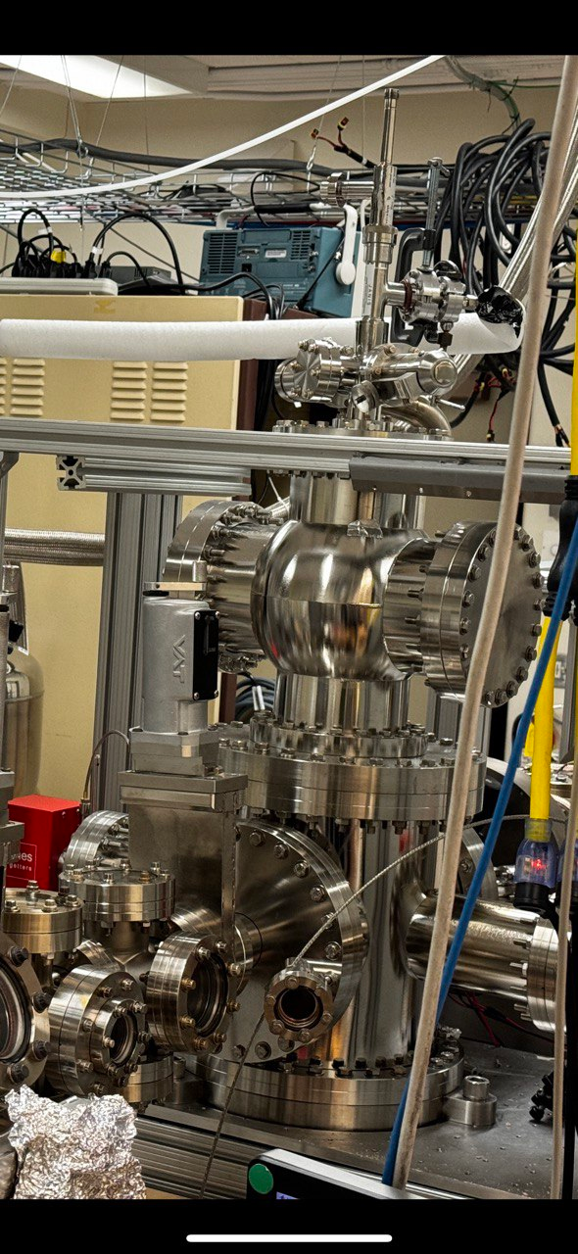
200kV DC Cryogun
Developed for testing various novel photocathode materials at temperatures from 298 K to 35 K.
Key Features
Easy photocathode transfer
High-voltage-high-gradient design.
Flexible configuration for material testing.
Ultralow emittance measurement.

Slide 3
Operational Challenges
Encountered operational difficulties at voltages above 60kV due to arcing in the plug of the power supply and Cathode Field emission.
Sample transfer was more challenging than anticipated.
Pinhole was not well centered in the beamline.
Overbaking resulted in puck dropping in the gun.

Slide 4
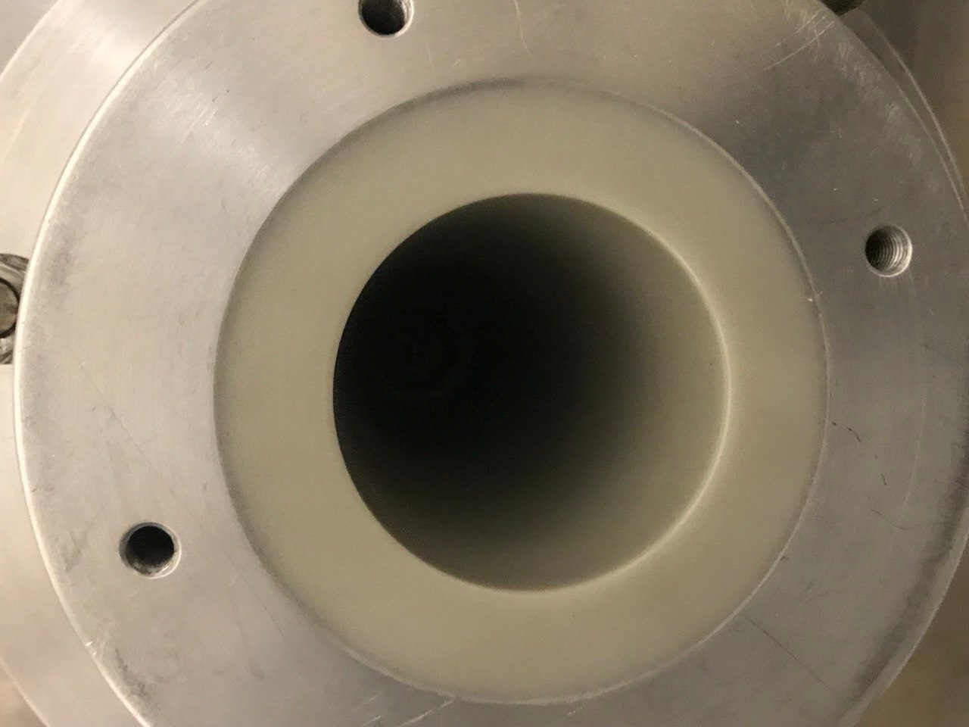
Effective Remedial Actions
(1) Addressing Arc Damage in the DC Gun
Inspected arc damage within the plug .
Conducted plug replacement and SF6 gas replenishment.

Slide 5
RECOMMISSIONING GUN
Gun was first commissioned to 200kV with Si cathode.
After fixing the plug, Increasing to high voltages no longer caused arcing in the power supply.
Field emission from the CS3Sb cathode caused increased radiation.
Cs3Sb annealed off to use the Mo substrate
Higher Field Emission observed.

Slide 6
Next Cathode to be tried was Silicon
Puck dimensions were adjusted to enhance Si cathode durability and prevent future breakage.

Slide 7
Effective Remedial Actions (2) Implementation of a Viewing Mechanism
A mirror-finished aluminum surface.
Mounted on a manipulator and is now in UHV.

Slide 8
Pinhole Scan Technique for Electron Beam Analysis
Utilize a 10-µm pinhole for defining spatial resolution in 4D phase space.
Focus input beam on pinhole and scan across using dipole magnets.
Capture images of transmitted beam at various dipole corrector settings.
Reconstruct the beam's spatial distribution to derive a detailed 4D density distribution.
Significance: Advances precise characterization of electron beams.

Slide 9
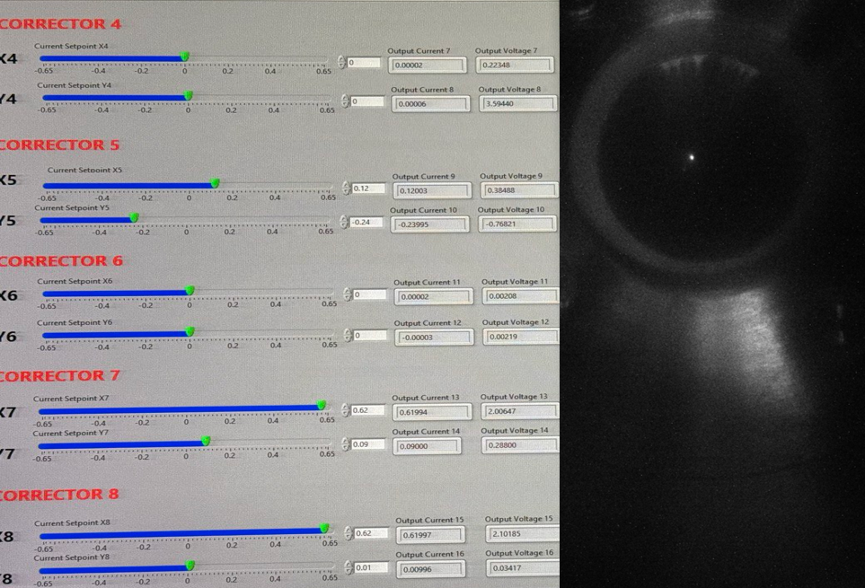
Pinhole Scans
Effective Remedial Actions (3)
The electron beam required steering towards the extreme left of the beamline axis to ensure accurate targeting through the pinhole aperture.

Slide 10
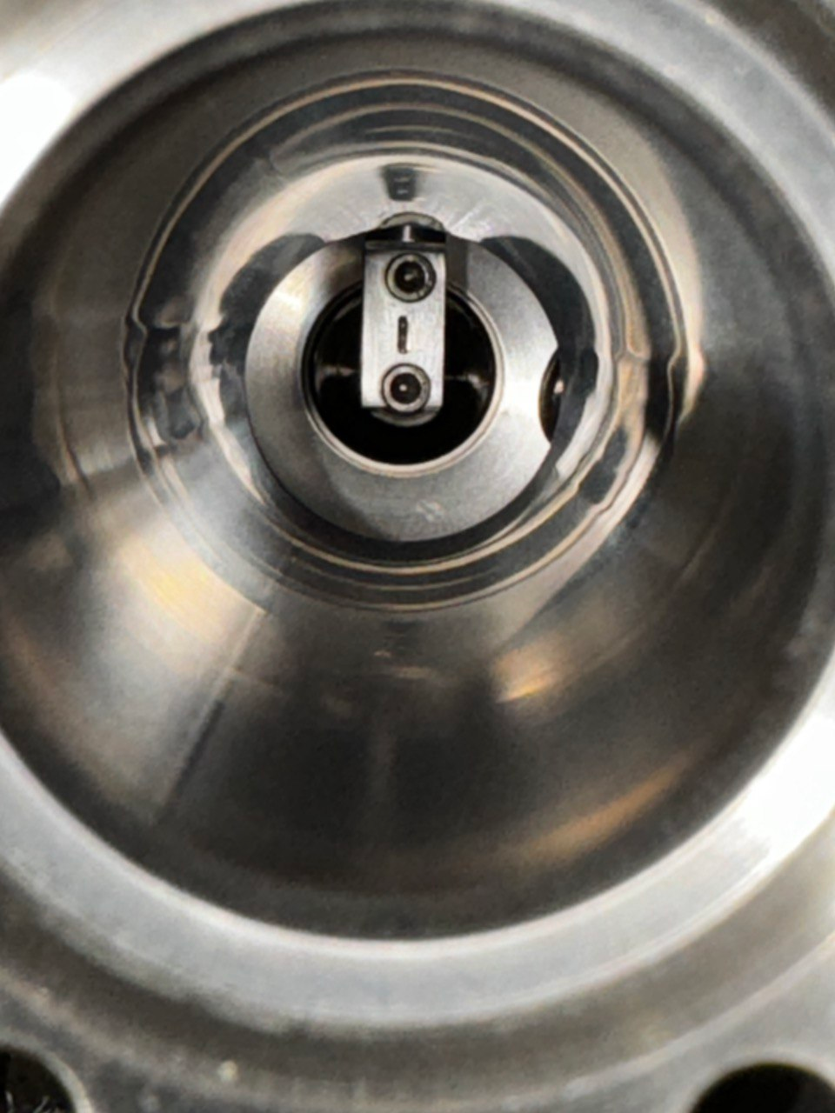
Effective Remedial Actions(3)
Aligning the Pinhole
Successfully realigned the pinhole from a leftward slant to a centered position, ensuring precise beam passage.

Slide 11
Aftermath of Overbaking
Maximum temperatures of parts were exceeded during bakeout.
PEEK polymer component adhered to the transfer arm and subsequently hampering its movement.
Culminated in difficulty during movement.

Slide 12
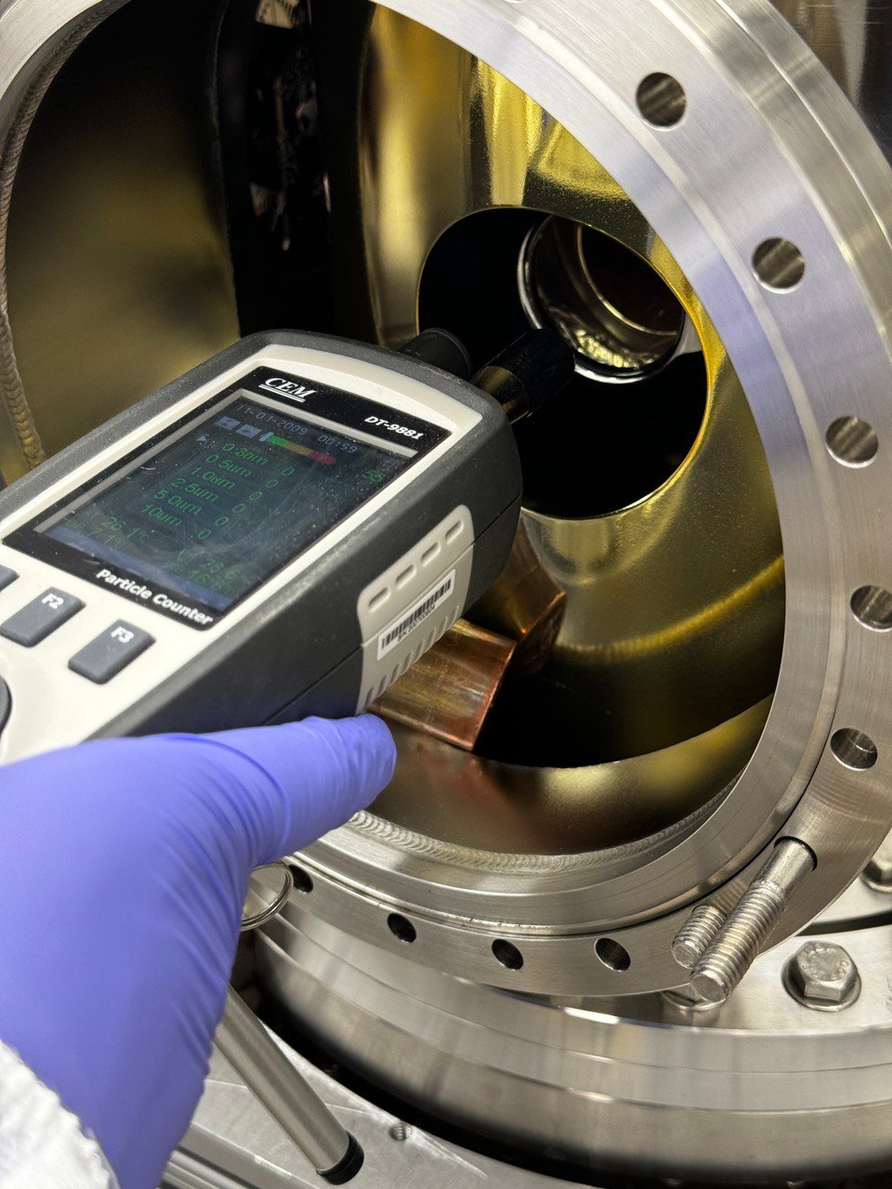
Gun Disassembly
Disassembly of Gun in cleanroom for puck removal and equipment maintenance.

Slide 13
Reassembly and Processing with Silicon Cathode.
Gun was processed steadily without radiation spike until 110kV, where 0.3mR radiation was observed.
Cathode was not well placed on the sample holder exposing the sample holder to high electric fields.

Slide 14
CONCLUSION
Gun and Beamline are fully operational after precise calibrations and minor adjustments.
FUTURE WORK
Process it to the maximum voltage possible
Proceed with 4D Emittance Measurement of Alkali Antimonide at Cryogenic Temperatures.
Develop the system for UED Applications.

