Slide 1






Presenter: Aasma Aslam (Ph. D Student, ECE)
Advisor: Dr. Sandra Biedron
Applications of Machine learning in Compact Photo-injectors.
Research Organizations:
University of New Mexico,
Brookhaven National Laboratory.
ELEMENT AERO
Notes:
The photoinjector produces the electron beam and provides initial acceleration to relativistic energy.
compact photoinjector – a device that spits out electrons when hit by light. X-band microwaves are four times shorter than S-band waves, and can accelerate electrons to higher energy more quickly.
Funding source:
Center for Bright Beams (CBB), support of the National Science Foundation and Technology Center (NSF).

Slide 2
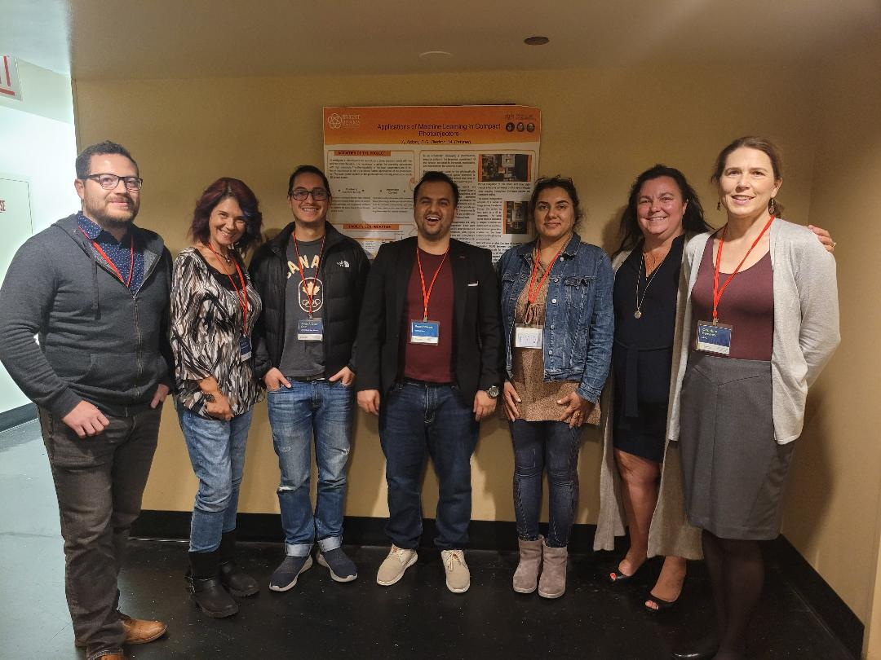
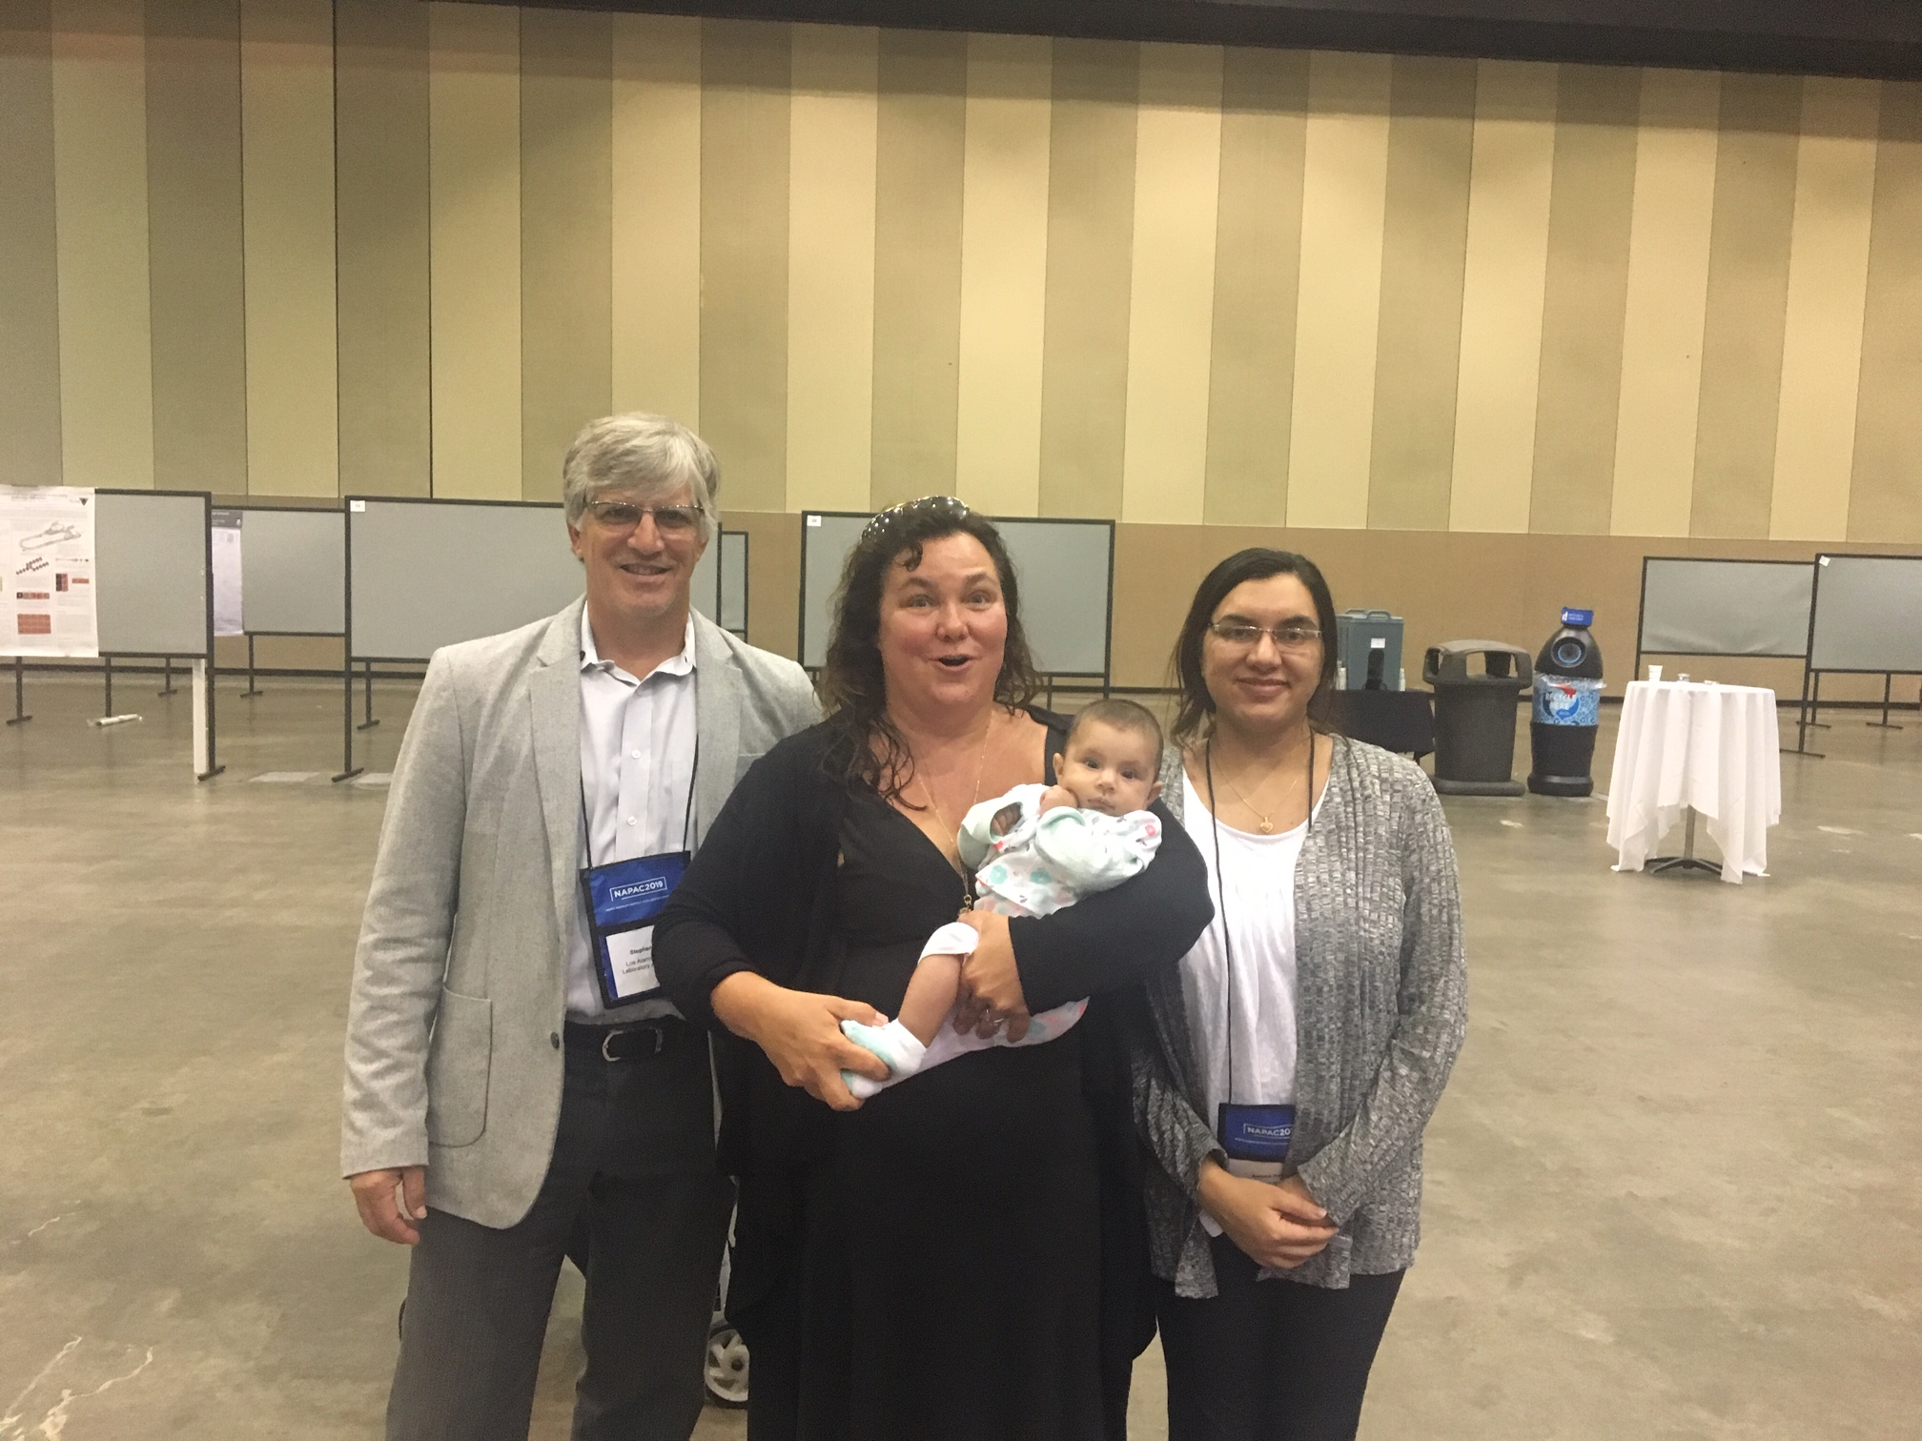
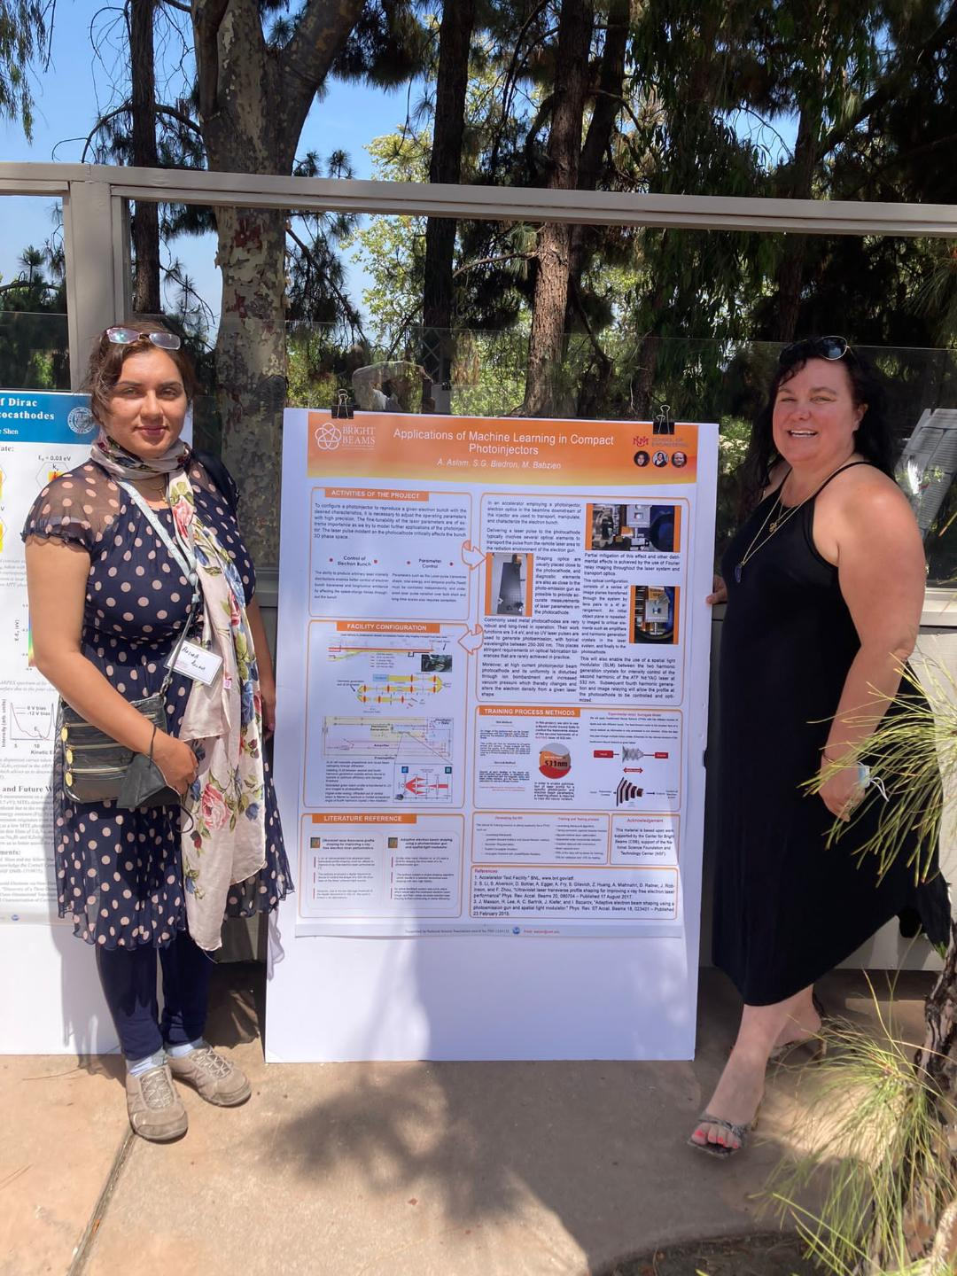
Biography
PhD in Computer Science
Hazara University, Pakistan
June 2014 to June 2023.
Master in Computer Science
Comsats Institute of Information Technology, Pakistan
June 2009 - June 2012
BS in Computer Science
Hazara University, Pakistan
June 2003 - June 2007
BS in Education
Allama Iqbal Open University, Pakistan
June 2014 - June 2015
PhD in Computer Engineering (Dissertation in progress)
University of New Mexico, USA
January 2019 – Present.

Slide 3

Just passed my Comprehensive Exam in December and now full force on my dissertation and completing work at BNL. Details enclosed.

Slide 4
Presentation Contents
Slide 1-8: Title and Introduction (ML)
Slide 9-32: Project Details
Two DOE facilities: ATF and ALCF
Abstract
Research Objectives
Activities of the Project
Experimental Setup
Steps Involved for Virtual Simulation (VSIM)
Application of ML, Developing the Neural Network (NN)
Review, Training and Testing Process
Modelling the Laser
Training Process Methods
Research Resources
Literature Review and Selected Methods
Current Status
Slide 33-36: Future Scope
Slide 37: Own Contribution
Slide 38: Publications/Presentation Status

Slide 5
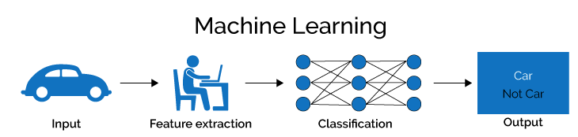
What is Machine Learning
Machine learning is the concept that a computer program can learn and adapt to new data without human intervention.
Notes:
Machine learning is a subfield of artificial intelligence, which is broadly defined as the capability of a machine to imitate intelligent human behavior.

Slide 6
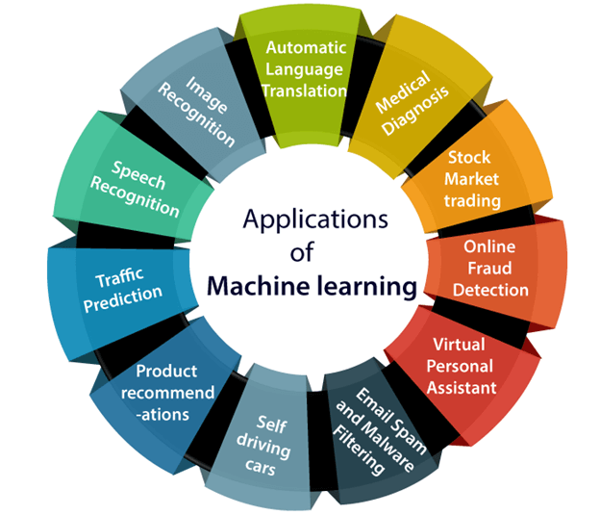
Applications of Machine Learning

Slide 7
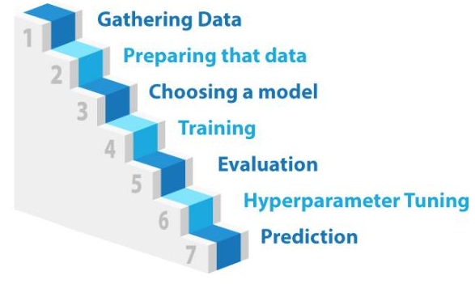
Steps of Machine Learning

Slide 8

AI FOR SCIENCE
“In the Department of Energy (DOE) laboratory community, we use the term “AI for Science” to broadly represent the next generation of methods and scientific opportunities in computing, including the development and application of AI methods (e.g., machine learning, deep learning, statistical methods, data analytics, automated control, and related areas) to build models from data and to use these models alone or in conjunction with simulation and scalable computing to advance scientific research.
The AI for Science town hall discussions focused on capturing the transformational uses of AI that employ HPC and/or data analysis, leveraging data sets from HPC simulations or instruments and user facilities, and addressing scientific challenges unique to DOE user facilities and the agency’s wide-ranging fundamental and applied science enterprise.”
The goal of my research is to use Artificial Intelligence (AI), specifically Machine Learning (ML), to enhance the performance of user facilities/research infrastructures.
https://www.anl.gov/ai-for-science-report.
Notes:
@techreport{Conlin_2020,
author = {L. Conlin and K. Dean and L. Salinas and J. W. Schneider and S. Soroko},
title = {{AI} for Science Report},
institution ={Argonne National Laboratory},
year ={2020},
month = {Feb.},
I would stress here that HPCs enabling AI are a research infrastructure too.

Slide 9
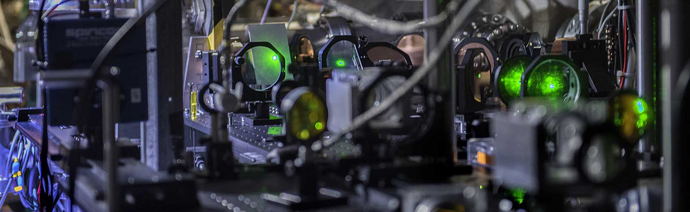
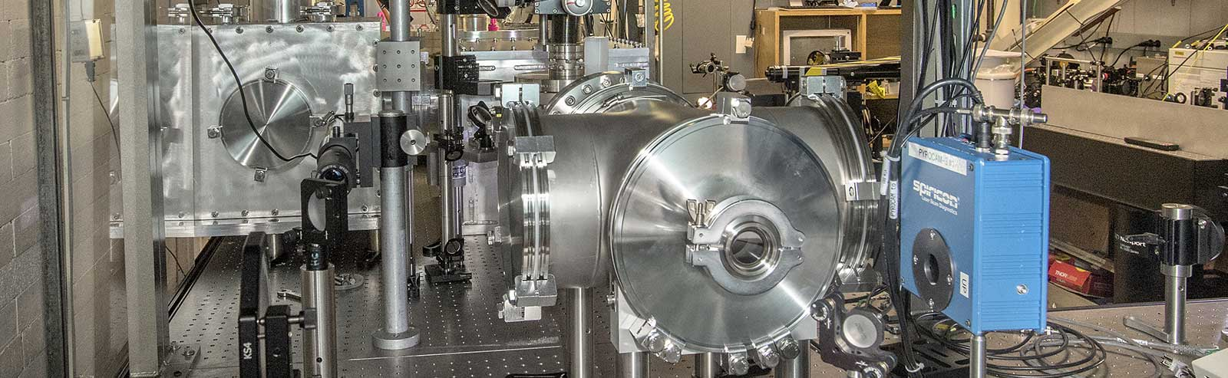
Laboratory Usage
The Accelerator Test Facility (ATF) is the DOE Office of Science User Facility.
It provides users with high brightness electron beams, near-infrared (NIR) and long-wave infrared (LWIR) laser beams, and an ultrafast electron diffraction (UED) facility.
The ATF pioneered the concept of a user facility studying properties of modern accelerators and new techniques of particle acceleration over 25 years ago.
Its role continues to evolve as a valuable resource to the advanced accelerator and laser user community.
ATF Experimental setup

Slide 10
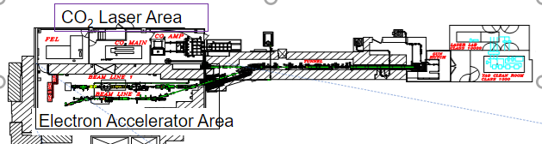
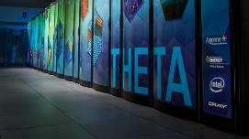

Two DOE facilities are involved: ATF and ALCF
Accelerator Test Facility (ATF)
Argonne Leadership Computing Facility (ALCF)
The combination of machine hardware, advanced computing for simulation, and data science for surrogate modelling, training of neural networks and data analysis is inspired by our past work and our participation on DOE meetings, workshops and reports such as AI for Science (https://www.anl.gov/ai-for-science-report).
Notes:
We expect to collect data from the virtual cathode (images), from the energy meter, from the available downstream electron-beam diagnostics to incorporate into our learned model.

Slide 11
Experimental Time Request
CY2024 Time Request
Capability | Setup Hours | Running Hours
ATF Facility | 30 | 60
Time Estimate for Remaining Years of Experiment (including CY2024)
Capability | Setup Hours | Running Hours
ATF Facility | 30 | 60
We are requesting an extension into this year, which we believe will be approved, as there is an understanding that I needed to pass my comprehensive exam before spending time at BNL.

Slide 12
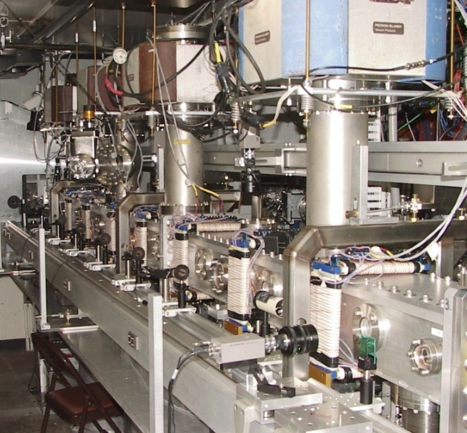
The Accelerator Test Facility at Brookhaven National Laboratory
Our work deals with the initial electron beam generation at the main facility in the RF photocathode electron gun using the Nd:Yag photocathode drive laser.
The ATF at BNL.

Slide 13
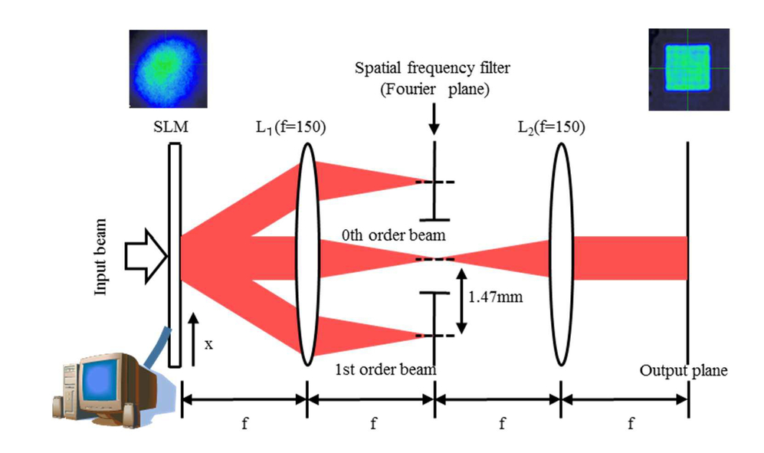
Abstract
“Photocathode drive laser control for an RF electron gun”
In this project, Brookhaven National Lab and the University of New Mexico (UNM) will test control of a laser system. The quality of the laser pulses drives the quality of the electron beam.
The high brightness electron gun is also the ideal test bed for the impact of the laser quality on the electron beam quality.
We will optimize and stabilize the electron beam (length, charge distribution, transverse profile, etc.).
In this research, our goal is to reliably tune a laser and photoinjector system suite to deliver the desired electron bunch.
At the ATF, the fine-tunability of the laser parameters are of extreme importance as we try to model further applications of the photoinjector.
In our program we are implementing a spatial light modulator to manipulate the phase space.
Experimental setup
Notes:
I would add a picture of a photoinjector here (RF gun with a laser striking it) – and note this system will be described later in detail.

Slide 14
The research objectives of the work can be summarized simply by breaking the work into the following steps.
Research Objectives
Designing the Experimental Setup
Demonstrating the Control using ML Algorithms
Data Modeling
Training of the model and loading process
Testing the model.

Slide 15
Research Objectives
Conducting a study of a high brightness photoinjector.
Goal: Configure and analyze parameters for efficient laser shaping for the electron beam generation.
Utilizing machine learning techniques and algorithms for optimization and control.
Simulations using the electromagnetics suite first-principles code VSIM
Using not only the ATF but also using a second research infrastructure - the ALCF (Argonne Leadership Computing Facility)
Applying machine learning techniques to improve the electron beam brightness by reducing its emittance.

Slide 16
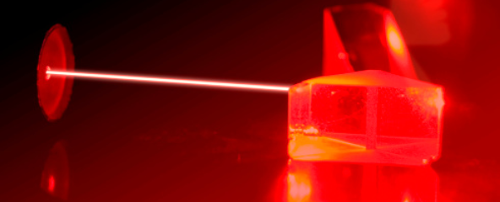
Detailed Scientific Case
In modeling the system, the primary aim is to investigate several model structures and use these to inform the controller design. Instead of building conventional controller, I will build a NN based controller.
The major objectives are
The combination of surrogate model’s inputs
The choice of data training set
The AI System.
Notes:
Particle accelerator systems and subsystems are broadly simulated and optimized. The data from these machines are used to update the offline models and produce an optimal set of parameters under which the predicted optimal output can be generated. However, even with such measures, operators often conduct extensive tuning each time the machine is put into a new operating condition or is turned on after a shutdown. Moreover, this can work well for dynamics that operate on a few human-compatible timescales (i.e., those that are not too long or too short, hundreds of milliseconds to tens of minutes) or that involve only a few parameters. However, the task can become cumbersome as the dynamics become more nonlinear, or as the number of parameters and interrelations increases.

Slide 17
Use of VSIM
I am working on VSIM for the simulations that is installed on ALCF (Argonne leadership computing Facilities).
I am working VSIM to create surrogate datasets that are the outcomes of simulations rather than only collecting or managing experimental data.
These datasets are essential for understanding complex systems and phenomena that are otherwise too difficult or impossible to measure directly, e.g. the relationship between an otherwise typical operational setpoints for the drive laser (e.g. intensity, spot size), RF gun input power etc. and the added SLM on the electron beam parameters “measured” downstream at an emittance diagnostic (or in simulation the 3D phase space).
I am working on VSIM (with elegant) simulations for a variety of SLM settings to create the relationship between the SLM and other photoinjector system setpoints.
Notes:
Simulation Initialization
Launched VSim and created a new simulation. Selected an appropriate simulation type based on experimental requirements (e.g., Electromagnetic or Particle-in-cell simulation).
Laser Oscillator Modeling
Modelling the laser oscillator within the VSim software. Utilizing provided parameters and configurations to set up the laser oscillator.
Nd:YAG Laser Properties
Ensuring accurate definition of Nd:YAG laser properties, including wavelength and intensity.
Spatial Filter Integration
Incorporation of the spatial filter into the simulation setup. Positioning the spatial filter appropriately within the setup.
Vacuum Tube Modeling
Creating a 25m vacuum tube with vacuum-like properties.
Harmonic Generation Setup
Establishing regions for harmonic generation within the tube.
SLM Placement
Positioning the Spatial Light Modulator (SLM) as required.
SLM Property Definition
Defining of SLM properties for effective light modulation.
Object Plane Modeling
Setting up the object plane for Fourier relay imaging reference.
RF Gun Setup
Modelling the RF gun in the simulation.
Preliminary Simulations
Checking setup functionality through preliminary simulations and adjusted parameters.
Dataset Creation
Ran multiple simulations with varying input parameters. Saved relevant output data for dataset creation.
Data Collection and analysis
Compiling all output data to form the dataset and analyze the data to understand the behavior and relationships in the setup.
Documentation
Doing documentation of the parameters, configurations, and results of each simulation run. This will help in future analyses and understanding the dataset.

Slide 18
VSIM Simulation and Device Integration
VSIM Simulation Updates:
  Currently utilizing VSIM for advanced simulation tasks.
  Installed and operational on leadership computing resources.
  Ongoing enhancements to simulation models to increase accuracy and efficiency.
Device Communication and Integration:
  Developing a reliable communication link between the device and computer systems.
  Implementing protocols for data exchange and device management.
  Streamlining device setup process for user-friendly operation.
ATF Control System Integration:
  Integration of the device into the ATF control system is in progress.
  Customizing device interface for compatibility with ATF specifications.
  Conducting rigorous testing to ensure robust performance within the ATF environment.
Next Steps:
  Finalize communication setup and resolve any connectivity issues.
  Complete the integration process with the ATF control system.
  Validate the entire setup through comprehensive testing phases.

Slide 19
Activities of the Project
Configuration of the Photoinjector
To configure a photoinjector to reproduce a given electron bunch with the desired characteristics, it is necessary to adjust the operating parameters with high precision.
The fine-tunability of the laser parameters are of extreme importance as we try to model further applications of the photoinjector.
Notes:
Phase : is the distance between two crest or two trough. Of two waves.
a phase space is a space in which all possible states of a system are represented, with each possible state corresponding to one unique point in the phase space. For mechanical systems, the phase space usually consists of all possible values of position and momentum variables.

Slide 20
Activities of the Project
Parameter
Control
Parameters such as the Laser pulse transverse shape, total energy, and temporal profile (fixed) must be controlled independently, and undesired laser pulse variation over both short and long-time scales also requires correction.
Control of Electron Bunch
.
The ability to produce arbitrary laser intensity distributions enables better control of electron bunch transverse and longitudinal emittance by affecting the space-charge forces throughout the bunch.
Notes:
Transverse waves are always characterized by particle motion being perpendicular to wave motion. A longitudinal wave is a wave in which particles of the medium move in a direction parallel to the direction that the wave moves.
temporal profile(fixed) must be controlled.
Pulse shaping=transerce.\

Slide 21
Experimental Setup
Drive laser optical layout at ATF
Spatial Light Modulator (SLM) will modulate phasefronts and cause beam reshaping through diffraction
Inserting SLM between second and fourth harmonic generation crystals allows device to operate at optimum efficiency and damage threshold
Modulated green beam profile is transferred to UV and imaged to photocathode
Higher-order energy diffracted out of central beam is filtered by aperture or limited acceptance angle of fourth harmonic crystal (~few mradian).
Notes:
A damage threshold is defined as the intensity of a physical effect (e.g., the radiation intensity) below which the damage of a target equipment is unlikely.

Slide 22
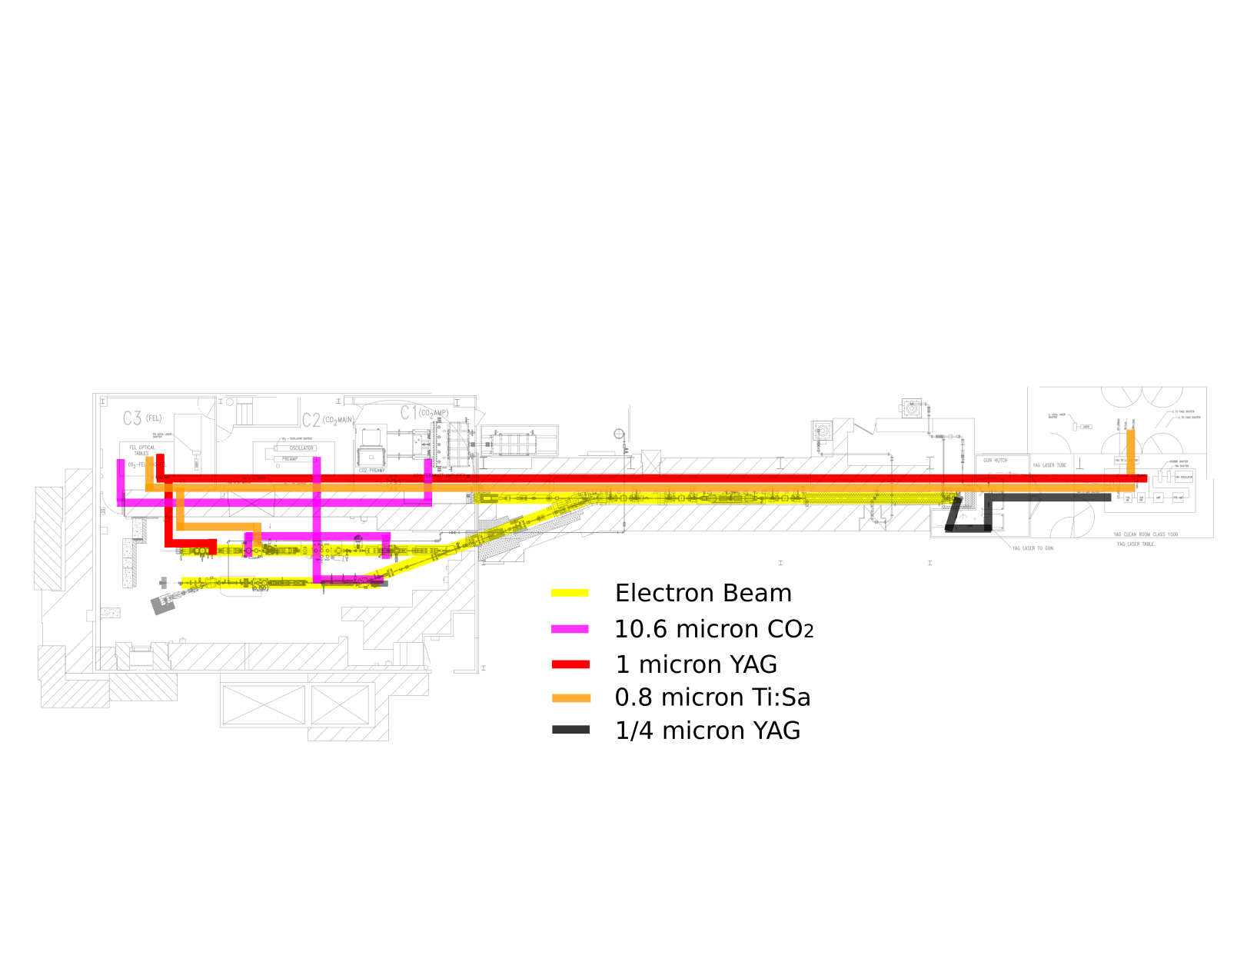
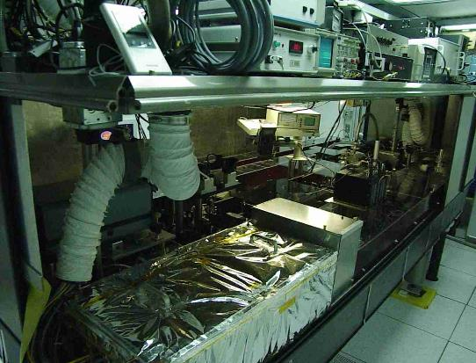
Experimental Setup
Laser delivery to photoinjector already incorporates Fourier relay imaging transport from laser room
YAG Laser Room
Harmonic generation and SLM location
Notes:
F=frequency

Slide 23
Experimental setup: Detail
Subsequent fourth harmonic generation and image relaying will allow the profile at the photocathode to be controlled and optimized.
Shaping optics are usually placed close to the photocathode, and diagnostic elements are also as close to the photo-emission gun as possible to provide accurate measurements of laser parameters on the photocathode.
Commonly used metal photocathodes are very robust and long-lived in operation.
Their work functions are 3-4 eV, and so UV laser pulses are used to generate photoemission, with typical wavelengths between 250-300 nm.
Optical configuration consists of a series of image planes transferred through the system by lens pairs in a 4f arrangement.
An initial object plane is repeatedly imaged to critical elements such as amplifiers and the two harmonic generation crystals in the laser system, and finally to the photocathode.
This imaging enables the use of a spatial light modulator (SLM) between the two harmonic generation crystals for intensity control of the second harmonic of the ATF Nd: YAG laser at 532 nm.
Notes:
The 4f correlator is in essence an optical relay that usually consists of two lenses. The input plane is one focal length in front of Lens 1 while the output plane is located one focal length after Lens 2. In between the two lenses, we have the Fourier plane.
neodymium-doped yttrium aluminium garnet.
In the figure you provided, which appears to be a schematic of a laser system possibly for an electron accelerator, the "RF Gun" is the component where the photocathode would be located. Radio Frequency (RF) guns are types of electron guns that use a photocathode to generate electrons. When the laser light (from the Nd:YAG laser in this case) hits the photocathode within the RF gun, it causes the emission of electrons, which are then accelerated by the radio frequency electric fields.

Slide 24
Training Process Methods
First Method
In this project, we aim to use a liquid crystal based SLMs to control the transverse shape of the second harmonic of a Nd:YAG laser at 532 nm.
  An image of the photocurrent can be formed downstream with the magnetic optics that reproduces the emission profile at the photocathode.
  This profile can then be recorded by phosphor screen and camera. Image analysis will then permit the quality of fit between the ideal and measured emission profiles to be calculated and used as a fitness function to train the neural network.
Nd:YAG laser at
532nm
In order to enable optimization of laser profile for a specific photoinjector and electron beam parameters, a learning phase is required to train the neural network.
Second Method
  Second, at each iteration of the neural network-controlled laser profile, an emittance scan can be performed with the magnetic optics and beam profile monitors, and the beam emittance calculated for use as a fitness function
  .
  These two methods can be compared for efficiency and may prove to be complimentary.
Notes:
Differences:
Focus: Method 1 focuses on the reproduction of the emission profile, which is a measure of the distribution of electrons emitted from the photocathode. Method 2 focuses on the beam emittance, which is a broader measure of beam quality including its spread in position and momentum.
Measurement: Method 1 uses image analysis of a photocurrent profile, whereas Method 2 involves an emittance scan, which is a more direct measure of beam quality.
Outcome: The fitness function in Method 1 is derived from the difference between desired and actual emission profiles. In Method 2, it is derived from the measured beam emittance directly.
Similarity: Both methods involve using a neural network to optimize a parameter of the beam — the emission profile in Method 1 and the emittance in Method 2 — and both could potentially be compared or used together (complementary) to enhance the overall quality and control of the beam.

Slide 25
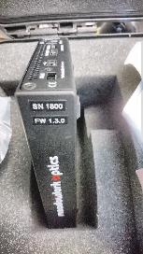
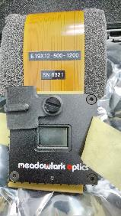
Purchased Hardware
A Spatial Light Modulator (SLM) is an electronic device used to modulate the amplitude or phase of light waves in space and time. An SLM is essentially an optical component that can control various aspects of light, often used in conjunction with lasers or other coherent light sources.
Picture showing Purchased SLM for experimental purpose

Slide 26
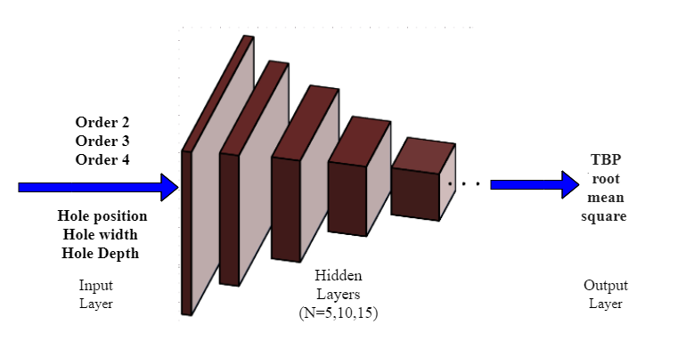
Research Methodology: Surrogate Model
We will apply Feedforward Neural Network (FFNN), Fit Regression NN (FRNN), Support Vector Machine (SVM), Genetic Algorithm (GA), and Random Forest (RF) for regression.
With the different number of layers and Neurons. Schematic for the internal structure of the feedforward Neural Network is given below:
Control of Electron Bunch
Inputs:
Outputs:
Parameter
Control

Slide 27
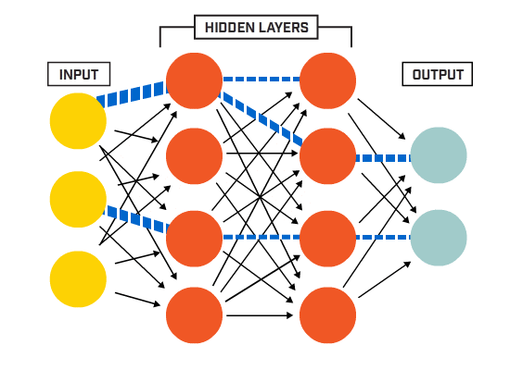
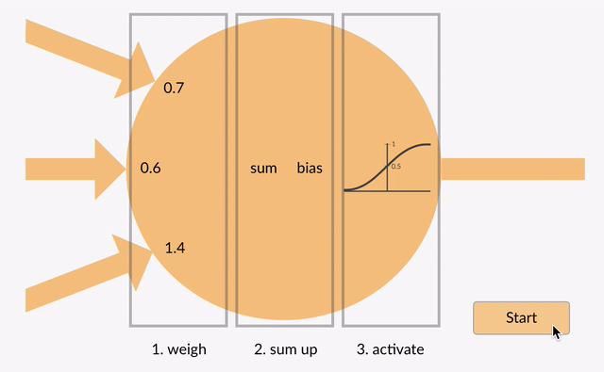
An Artificial Neural Network (ANN) is made up of many interconnected neurons:
How each neuron works?
Each neuron takes in some floating point numbers (e.g. 1.0, 0.5, -1.0) and multiplies them by some other floating point numbers (e.g. 0.7, 0.6, 1.4) known as weights (1.0 * 0.7 = 0.7, 0.5 * 0.6 = 0.3, -1.0 * 1.4 = -1.4). The weights act as a mechanism to focus on, or ignore, certain inputs.
Application of Machine Learning
Notes:
In machine learning, the perceptron is an algorithm for supervised learning of binary classifiers. A binary classifier is a function which can decide whether or not an input, represented by a vector of numbers,

Slide 28
Research Methodology: Developing the
Neural Network
The FFNN contains:
The choice for training function is plenty especially for a FFNN such as:
1.Training set
2. Adaption set
01
      Levenberg-Marquardt.
Gradient descent method and Gauss-Newton method.
02
      Bayesian Regularization.
03
      Scaled Conjugate Gradient.
www.companyname.com
Notes:
WE have selected the first one levenberg Marquardt (with gradient decent and Gauss newton method). Since it is easy and fast.
Bayesian regularization and scale conjugate gradient have higher computational cost.
We used Levenberg–Marquardt algorithm for our FFNN that combines two numerical minimization algorithms: the gradient descent method and the Gauss-Newton method.
The Gauss-Newton method takes the sum of the squared errors, which is reduced by assuming that the least square function is locally quadratic in the parameters. Furthermore, it determines the minima of this quadratic function.
The gradient descent method is utilized when the parameters are far from the optimal value. If the parameter values are closer to the optimal value, the Gauss-Newton method is used.
The FFNN was developed with a total of three hidden layers with 5, 10 and 15 neurons. The first hidden layer has a connection from the network input, whereas the last hidden layer is connected to the network output.

Slide 29
      Levenberg-Marquardt for training.
01
02
Tansig symmetric sigmoid transfer function.
Review: Training and Testing Process
03
Nguyen-widrow layer for optimization.
      Sequential order incremental adoption.
04
05
Gradient descent with momentum.
06
Mean squared error for performance measurement.
07
70% of the data will be taken for training, 15% for validation and 15% for testing.
www.companyname.com
Notes:
Is used for training purpose.
Is used to convert NN’s net inputs into its net output.
Is used for weight and biases
Is used as an adoption function.
Gradient descent with momentum and mean square error are used for performance measuremts.
Nguen pronounce without “g” nuyen.
Yes, both validation and testing involve using unseen data, but the key difference lies in the stage of the model development process at which they are used and the purpose they serve:
Validation Data:
This is a subset of the dataset that is held back from the training phase.
It is used to provide an unbiased evaluation of the model during the training process.
The model sees this data, but it does not learn from it directly. Instead, it is used to tune the model's hyperparameters and to make decisions about which models or model configurations are better.
Validation helps in model selection and in the prevention of overfitting.
Testing Data:
This is another subset of the dataset that is also held back and is not used during the training or validation phases.
It is used after the model has been finalized to provide an unbiased evaluation of the final model's performance.
Testing is like a final exam for the model, after which no more changes are made. It gives an estimate of how well the model is expected to perform on entirely new data.
The test set is crucial for assessing the generalization capability of the model.
In practice, the data is often split into three parts: training, validation, and testing. The training set is used to teach the model, the validation set is used to adjust and fine-tune the learning, and the test set is used to evaluate the final model. The test set acts as a final, unbiased judge of the model's performance before it is deployed into a real-world setting or put into production.

Slide 30
Modelling the Laser
To model this complex system using ML, we will initially use few data points to train the NN.
Later, we will increase the data points to train the NN and for comparison of the small and large dataset results, first we will use 5, 10, and then 15 neurons in three hidden layers. We will use the remaining points to validate the results to find the computed outputs are closer or far from the target values.

Slide 31


Argonne Leadership Computer Facility
Research Resources and Software
  ALCF: The Argonne Leadership Computing Facility is part of the U.S. Department of Energy's (DOE) system of High-Performance Computing (HPC) facilities, supporting large-scale scientific and engineering research.
  THETA Supercomputer: THETA is one of the supercomputing systems available at ALCF. It is designed for complex simulations and computational tasks in various scientific domains, including physics, chemistry, biology, and machine learning.
Our AI for accelerators projects have allocations at the ALCF’s THETA supercomputer.
We currently use THETA for:
  simulations using VSim.
  Deep learning and optimization.
  Surrogate models
  Training of AI-based controllers.
THETA is a 11.69 petaflops system based on the second-generation Intel® Xeon Phi™ processor, 281,088 cores. For more information: https://www.alcf.anl.gov/theta
MATLAB, Jupyter Notebook, MS office, and Overleaf.
Note: The ALCF files and operation is being migrated to Polaris from Theta so there is a transitions time.
Spatial Light Modulator

Slide 32
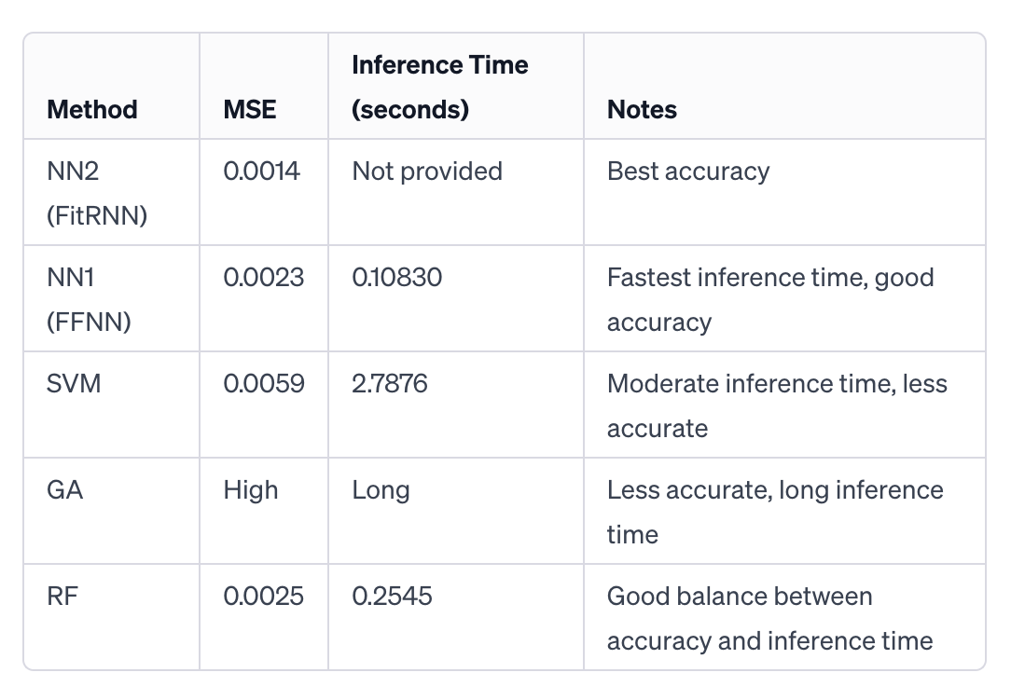
Literature Review and Selected Methods
This table summarizes the performance metrics of each method described in the literature. The Mean Squared Error (MSE) is a measure of accuracy, with lower values indicating higher accuracy. The inference time reflects the computational efficiency of each method.
Notes:
Fitrnet and feedforwardnet, iniferenee time the time it takes to send data to the API of the model, and receive output back.
Add reference
Random forest (RF)

Slide 33
Literature Reference
Ultraviolet laser transverse profile shaping for improving x-ray
free electron laser performance
Adaptive electron beam shaping using a photoemission gun
and spatial light modulator
Li et. al. demonstrated that ultraviolet laser transverse profile shaping could be utilized to improve X-ray free electron laser performance.
On the other hand, Maxson et. al. used a SLM for shaping the drive laser of a dc photoemission gun.
The authors employed a digital micromirror device to control the shape of a 253 nm drive laser at the linear coherent light source.
The authors created a simple shaping algorithm which results in a detailed transverse laser shaping with very high fidelity.
An active feedback system was put in place which would take the unshaped electron beam image, and then create accurate detailed laser shaping further contributing to better efficiency.
However, due to the low damage threshold of the digital micromirror in the UV, the work is limited in its applications
Notes:
Li et al. found a way to shape the profile (which is basically the cross-sectional 'outline') of an ultraviolet (UV) laser beam.
By shaping this UV laser beam in a controlled manner, they were able to enhance the performance of an XFEL. XFELs are advanced scientific instruments that produce very intense X-rays, which are used for a variety of research applications, including studying the atomic structure of materials.
How They Did It:
To control the UV laser beam shape, the researchers used a device called a digital micromirror device (DMD). This is a piece of technology that has lots of tiny mirrors that can be individually adjusted to reflect light in different ways.
By using this device, they could manipulate the 253 nanometer (nm) drive laser at the Linear Coherent Light Source (LCLS), which is a type of XFEL.
The Limitation:
The problem they encountered was that the digital micromirror device is not very resistant to damage from UV light, especially at the UV wavelength they were using (253 nm).
Because of this low damage threshold (the point at which the device starts to get damaged), they couldn't use the technique as broadly as they might like, since doing so could damage the DMD.
In essence, they've developed a promising technique for improving XFELs with UV lasers, but they need to be careful with it because the equipment they're using to control the laser shape can be easily damaged by the very light it's supposed to manipulate.
2nd paper
Maxson and colleagues used a special device called a spatial light modulator (SLM) to shape the laser that's used in a direct current (dc) photoemission gun. A photoemission gun is a device that produces electrons when light hits a material, and these electrons can then be used in various scientific applications.
How They Did It:
They developed a straightforward algorithm to control the SLM. An algorithm is like a recipe for a computer to follow, and in this case, it tells the SLM exactly how to shape the laser beam.
This shaping was done with high fidelity, meaning the final shaped beam very closely matched the desired shape they programmed into their algorithm.
The Active Feedback System:
An active feedback system is a loop system that continuously makes adjustments to get the desired outcome. In this context, it works by first taking an image of the electron beam produced by the unshaped (original) laser.
Then, using this image, the system adjusts the SLM to reshape the laser in a way that makes the electron beam more efficient or better in quality.
The Result:
By creating accurate and detailed shapes for the laser, they were able to enhance the performance of the photoemission gun, likely producing electron beams with desirable characteristics for their specific scientific needs.
In essence, the research developed a method to precisely control the shape of a laser beam, which in turn improved the quality and efficiency of the electrons produced by the photoemission gun. This kind of control is crucial for experiments and applications that need very precise electron beams.

Slide 34
Current Status
Surveyed Available SLM Hardware and Designed Integration
Approach
Worked with Vendors to Identify Top Candidate Devices.
Vendor and Model Selection
SLM ordered and delivered
Negotiated Damage Testing Protocol and Timeline
Discussion of ATF Running Schedule
Development of Remote Access Capability
Renewal of BNL User Guest Account
Experiment Readiness Achievement
Surveyed Machine Learning Algorithms
VSIM simulations and simulated Data Generation (In Progress)
Utilizing ALCF (Theta) for Large Data Set Analysis (We are
transitioning from Theta to Polaris)
Research Article Writing
Dissertation Writing
Notes:
AVR optics, NY.
Surveyed Available SLM Hardware and Designed Integration Approach
Conducted an extensive survey of the available SLM (Spatial Light Modulator) hardware options.
Strategically designed the optimal approach for seamlessly integrating SLM functionality with the ATF (Advanced Targeting Laser) drive laser.
Collaborated with Vendors to Identify Top Candidate Devices
Collaborated closely with various vendors to assess and identify the most suitable candidate devices from their product offerings.
Vendor and Model Selection
Successfully narrowed down our selection to a specific vendor and model based on comprehensive evaluation criteria and project requirements.
Vendor Collaboration for Issue Resolution
Engaged in productive collaboration with the selected vendor to identify and address any potential issues that may arise during the integration process.
Optical Damage Testing Strategy for Risk Mitigation
Developed a comprehensive strategy for testing the SLM to determine its optical damage limits, mitigating potential risks associated with the integration.
Negotiated Damage Testing Protocol and Timeline
Negotiated and established a clear protocol and timeline with the vendor for conducting optical damage testing.
Discussion of ATF Running Schedule and Facility Location
Engaged in discussions to determine the most suitable ATF running schedule and the optimal location within the ATF facility for implementing the SLM.
SLM Procurement Completed
Successfully completed the procurement process for the selected SLM hardware.
Experiment Readiness Achievement
Reached a stage of readiness to conduct experiments with the integrated SLM within the ATF drive laser system.
Funding for Travel to BNL (Brookhaven National Laboratory)
Actively working on securing funds for travel to BNL, an important aspect of the project.
Development of Remote Access Capability
In the process of developing remote access capabilities to facilitate experimentation and system control, enhancing project efficiency and flexibility.
Renewal of BNL User Guest Account
Successfully renewed the user guest account at BNL (Brookhaven National Laboratory) to maintain essential access privileges.
Surveyed Machine Learning Algorithms
Conducted a comprehensive survey of the latest machine learning algorithms to stay current with developments in the field.
VSIM Installation and Data Generation (In Progress)
Currently in the process of installing VSIM (Virtual Simulation) software and actively generating data.
Maintaining ongoing communication with ATF team for collaboration and updates on this task.
Utilizing ALCF (Theta) for Large Data Set Analysis
Leveraging the computational power of ALCF (Argonne Leadership Computing Facility), specifically the Theta supercomputer, for analyzing extensive datasets.
Research Article Writing
Engaged in research activities aimed at writing and publishing research articles from dissertation material.
Dissertation Writing
Actively working on the dissertation, a significant academic project.

Slide 35
Future Scope
The future scope of this work includes investigating all NN, SVM, GA and on the number of layers, number of neurons, type of NN and many other parameters to evaluate the performance of our NN and its variants.
We will automate method for optimizing the number of layers, number of nodes, choice of NN.
We are also planning to test this approach experimentally at University of Michigan and to obtain data sets to refine our model to reliably modeling the complex system.
As large amounts of labeled experimental data are generally needed, it is a challenge to collect data and label suitable data in the case of NN. Additionally, in the future we can use a variation in the feedforward network.
Notes:
which is the cascade forward network that has additional connections from the input to every layer and from each layer to all subsequent layers.

Slide 36
Future Scope
  Working with Advisor: Collaborating with the advisor to secure additional funds for the control system.
  Implementing at BNL: Planning to implement the purchased device and developed model at Brookhaven National Laboratory (BNL).
Financial Collaboration:
  Advisor Partnership: Exploring opportunities to work closely with the advisor for financial support.
  Additional Funds: Seeking additional funds to enhance the control system's capabilities.
Implementation at BNL:
  Strategic Partnership: Establishing a strategic partnership with BNL for seamless implementation.
  Facility Integration: Ensuring the smooth integration of the device within the BNL infrastructure.
Transition to ATF:
  Graduation Goal: Aspiring to transition to the Advanced Test Facility (ATF) post-graduation.
  Milestones: Outlining key milestones to achieve a successful transition to ATF.
Notes:
which is the cascade forward network that has additional connections from the input to every layer and from each layer to all subsequent layers.

Slide 37
Own Contributions
Neural Network-Based Control: Develop a system to enhance electron beam dynamics.
Laser System Enhancement: Integrate a Spatial Light Modulator (SLM) with the ATF drive laser for superior beam shaping.
Optimization & Analysis: Configure and analyze laser shaping parameters using VSIM and ALCF resources.
Machine Learning Application: Employ machine learning to reduce emittance, using FFNN, FRNN, SVM, GA, and RF techniques.
Research Dissemination: Writing of papers to journals and conferences.
Technique Advancement: Application of advanced machine learning to refine and improve upon genetic algorithm methods.
Performance Objectives: Aim for greater prediction accuracy and computational efficiency.

Slide 38
Publications/Presentations Status
Submission of recent work and presentation at DEPS2023 + Poster Presentation
Submission of recent work at IPAC23 + Poster Presentation
Submission of recent work at NAPAC23 + Poster Presentation
Submission of recent work at CODA23 + Poster Presentation
Attended BNL annual meeting 2023.
Published Research article for the Journal named “ Nuclear Instruments and Methods in Physics Research Section A: Accelerators, Spectrometers, Detectors and Associated Equipment”.
Abstract submission for IPAC2024.
Registration done for APS.
Outcomes

Slide 39


