Slide 1
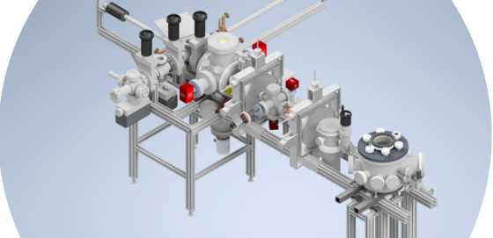
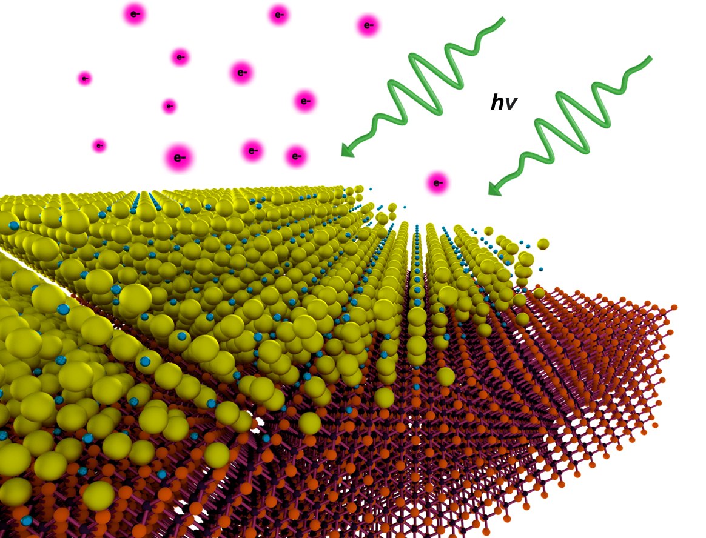
Electron Source Development
High Current Testing: HERACLES
Ultrafast Electron Diffraction: MEDUSA
PI Leads: Bazarov, Maxson
Characterization including:
QE
Intrinsic emittance
Lifetime
Polarization
~ 7 grad students + Postdocs
2 Staff Scientists
Photocathode Characterization

Slide 2
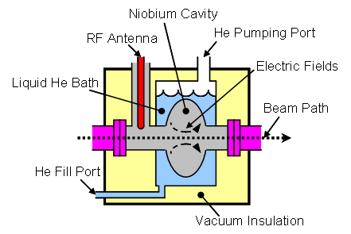
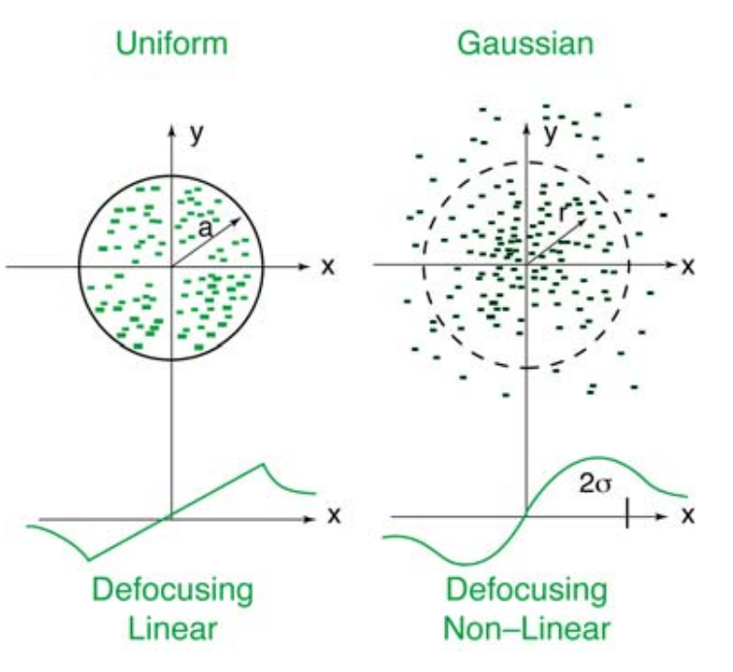
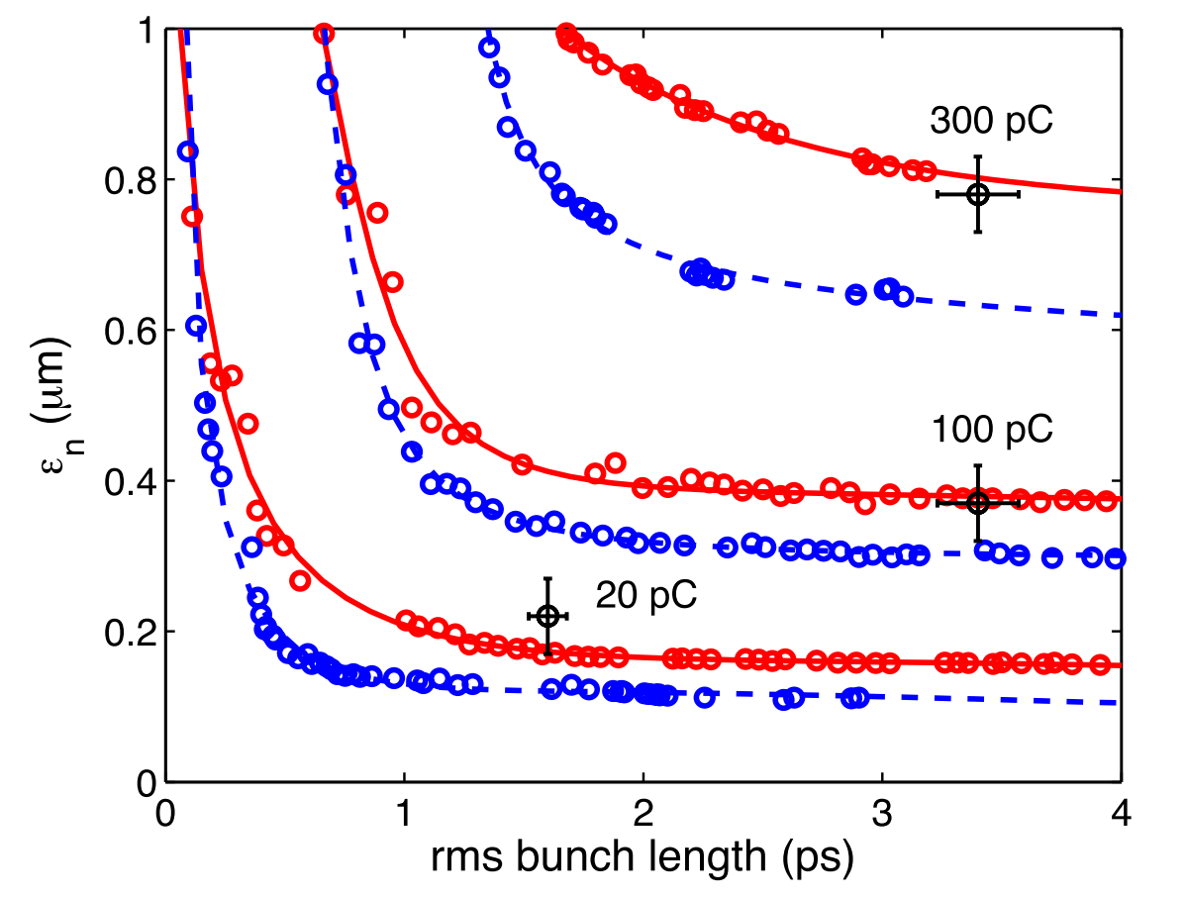
The bigger picture
Source Development
SRF
Dynamics/Modeling
Example: the Cornell DC/SRF Photoinjector (1.3 GHz)
Tech Transfer: BNL, RI

Slide 3
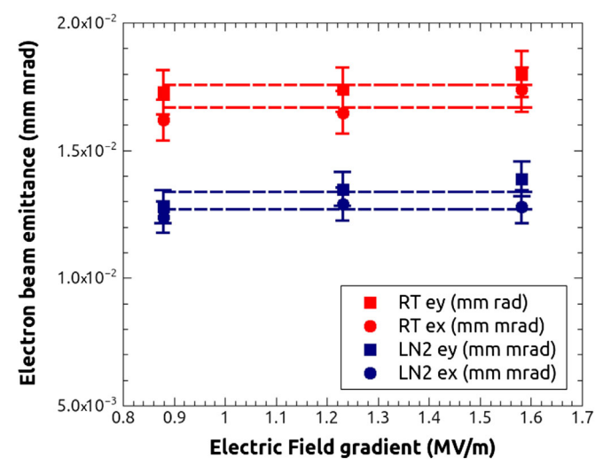
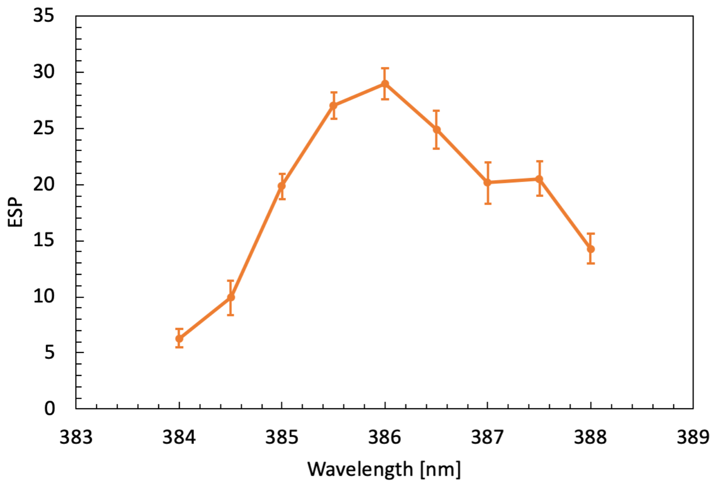
Photocathode Highlights --HEP
The first single-crystal alkali antimonide
Robust coatings for GaAs polarized
cathodes
~10x less sensitive to chemical poisoning, preserving spin.
Journal of Applied Physics 127, 124901 (2020)
Up to 10x higher QE and 10x thinner.
PRL 128, 114801
(2022)
Extremely Low emittance from cryo-cathodes
New Discovery (DOE HEP): Cubic GaN is a spin polarized emitter like GaAs
Cryocooling reduces cathode energy spread down to 19 meV
PRAB 18, 113401 (2015)
But may be more robust than GaAs!

Slide 4
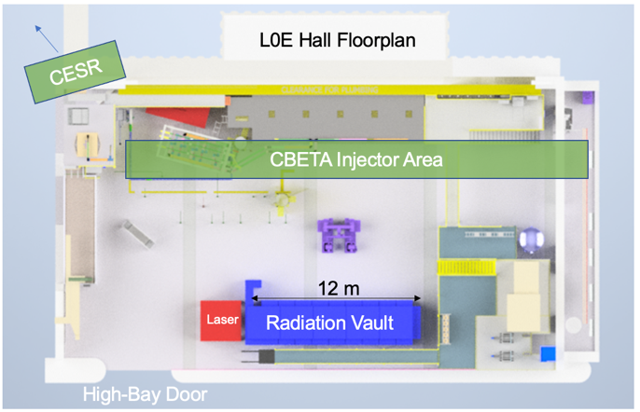
Vision for a C3 Demonstrator @ Cornell
We envision a multi-GeV cold copper linac at Cornell
Fundamental High Gradient Studies
C³ Demonstrator (3 GeV)
Ultimately, 6 GeV linac could revolutionize CHESS
Direct energy injection
Faster filling, stabler current
Options for compact XFEL, short x-ray pulses
Our Plan’s First step: 150 MeV Testbed facility

Slide 5
Vision for a C3 Demonstrator @ Cornell
We envision a multi-GeV cold copper linac at Cornell
Fundamental High Gradient Studies
C³ Demonstrator (3 GeV)
Ultimately, 6 GeV linac could revolutionize CHESS
Direct energy injection
Faster filling, stabler current
Options for compact XFEL, short x-ray pulses
Our Plan’s First step: 150 MeV Testbed facility
Inside the bunker:
2 meter-long
structures
Dump
User Expts
Gun
Laser
Partners: SLAC, UCLA, LANL, MSU

